Slide 1
Measuring Human Contributions to Safety
A NASA System Wide Safety Project Initiative
July 18, 2023
Jon Holbrook, PhD

Slide 2
Human Contributions to Safety (HC2S) Initiative
System Wide Safety (SWS) Project focus:
Transformational changes in aviation to make flight more efficient and accessible will require new technologies, policies, and procedures. Enabling these changes to be done safely at every step is the goal of the SWS project.
Human Contributions to Safety (HC2S) Initiative focus:
People represent the primary source of safety in aviation, through their capability to anticipate, monitor for, respond to, and learn from expected and unexpected change. Understanding and measuring this capability so that it can be integrated into the design of technologies, policies, and procedures is the goal of the HC2S initiative.

Slide 3
How to “Change the Narrative…”
… that people are the safety problem
PROBLEM DESCRIPTION
Human error is implicated in 80% of aviation accidents, so…
“To fast forward to the safest possible operational state … network operators will be interested in the path that realizes full machine autonomy as quickly as possible.” (Uber, 2016)
Recent analysis based on accident and LOSA data estimates that pilots intervene to keep flights safe from aircraft malfunctions ~157,000 times for every time that human error contributes to an accident.

Slide 4
Pilots Produce Safety Far More Often than They Reduce It
Human error has been implicated in up to 80% of accidents in civil and military aviation¹

Slide 5
Pilots Produce Safety Far More Often than They Reduce It
Human error has been implicated in up to 80% of accidents in civil and military aviation¹
Outcome
Not Accident
Accident
No
?
20%
?
Attributed to
Human Intervention
Yes
?
80%
?
?
?
?

Slide 6
Pilots Produce Safety Far More Often than They Reduce It
Human error has been implicated in up to 80% of accidents in civil and military aviation¹
Pilots intervene to manage aircraft malfunctions on 20% of normal flights²
Outcome
Not Accident
Accident
No
80%
20%
?
Attributed to
Human Intervention
Yes
20%
80%
?
?
?
?

Slide 7
Pilots Produce Safety Far More Often than They Reduce It
Human error has been implicated in up to 80% of accidents in civil and military aviation¹
Pilots intervene to manage aircraft malfunctions on 20% of normal flights²
World-wide jet data from 2007-2016³
  244 million departures
  388 accidents
Outcome
Not Accident
Accident
No
80%
20%
?
Attributed to
Human Intervention
Yes
20%
80%
?
243,999,612
388
244,000,000

Slide 8
Pilots Produce Safety Far More Often than They Reduce It
Human error has been implicated in up to 80% of accidents in civil and military aviation¹
Pilots intervene to manage aircraft malfunctions on 20% of normal flights²
World-wide jet data from 2007-2016³
  244 million departures
  388 accidents
Outcome
Not Accident
Accident
No
195,199,690
78
195,199,768
Attributed to
Human Intervention
Yes
48,799,922
310
48,800,232
243,999,612
388
244,000,000

Slide 9
Pilots Produce Safety Far More Often than They Reduce It
Human error has been implicated in up to 80% of accidents in civil and military aviation¹
Pilots intervene to manage aircraft malfunctions on 20% of normal flights²
World-wide jet data from 2007-2016³
  244 million departures
  388 accidents
Outcome
Frequently Studied
Not Accident
Accident
No
195,199,690
78
195,199,768
Attributed to
Human Intervention
Yes
48,799,922
310
48,800,232
Rarely Recognized
243,999,612
388
244,000,000
Learn more: Holbrook, J. (2021). Exploring methods to collect and analyze data on human contributions to aviation safety. In Proceedings of the 2021 International Symposium on Aviation Psychology. https://aviation-psychology.org/wp-content/uploads/2021/05/ISAP_2021_Proceedings_FINAL.pdf
(1) Weigmann & Shappell, 2003; (2) PARC/CAST, 2013; (3) Boeing, 2017

Slide 10
How to “Change the Narrative…”
… that people are the safety problem
IMPLICATIONS
Designs intended to “protect” the system from “error-prone” humans can design-out the capability for the human to effectively intervene / adapt, which is a far more common behavior
Designs intended to replace humans often fail to acknowledge or understand the capabilities that humans routinely contribute to safety, and therefore fail (or don’t have the data/knowledge) to design that into the system
Designs that leverage a “safety pilot” who will only intervene to “save the day” in rare failure events fail to consider how our cognitive systems work and how they evolved to work. Such designs are setting up the safety pilot to fail.

Slide 11
How to “Change the Narrative…”
… that people are the safety problem
PROPOSED SOLUTION
In today’s aerospace industry, data talks
When the only data that are available are about human failure, then data-driven designs only consider that humans fail
To change the narrative, we need new data and new ways to examine data
  Specifically, data on how (and the processes by which) humans contribute to safety
IMPACTS
Safer system designs
Increased organizational awareness
Improved operational learning/training
System safety that is robust to future changes

Slide 12
Human Contributions to Safety (HC2S) Initiative
Expand the range of safety-relevant events to include not just rare safety failures but frequent safety successes
Create a data testbed to enable exploration of methods and metrics for pilot contributions to safety and mission success
Develop methods and metrics for learning from what happens
  Structured observation
  Self reports
  System data
Learn from simulations and operations

Slide 13
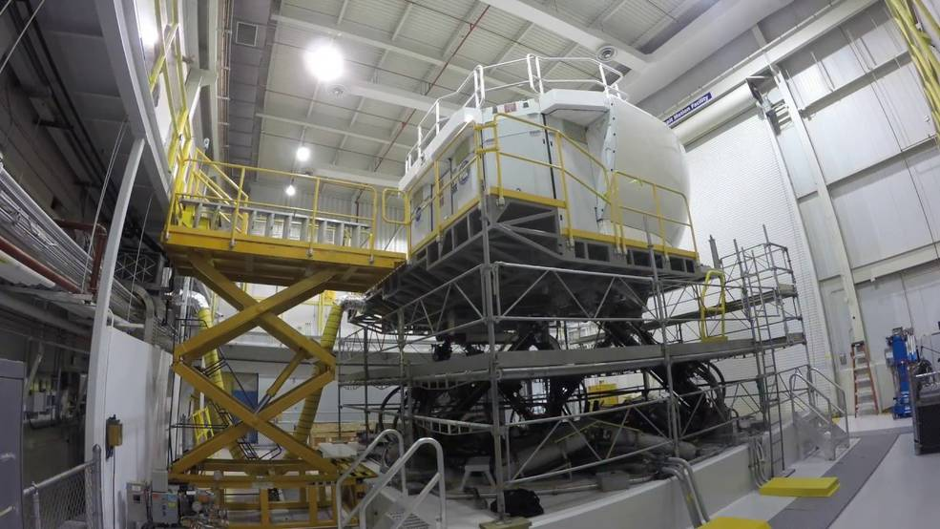
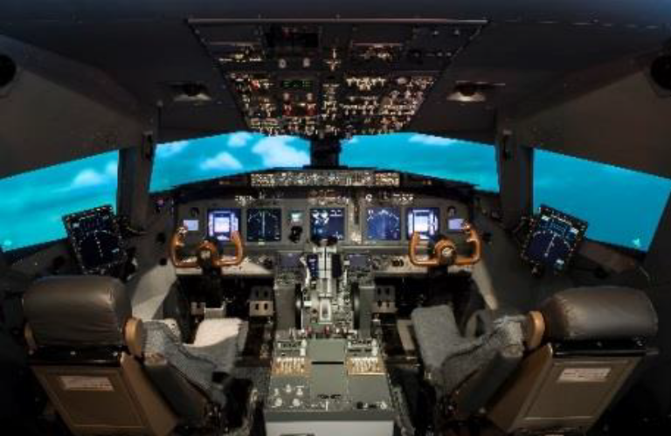
HC2S Testbed Operational Concept
How do pilots respond to expected and unexpected disturbances during arrivals?
Using NASA Langley’s Integrated Flight Deck (IFD) simulator, 12 crews of Boeing 737-rated pilots from a US air carrier performed multiple arrivals into Charlotte Douglas International Airport (KCLT)
Created an environment realistic enough to leverage expertise and flexible enough to enable a range of possible behaviors
Included a range of challenging but manageable pressures
Our interest was in the processes by which crews adapted to manage those pressures (not just outcomes)
Image Credit: NASA
Image Credit: NASA

Slide 14
What is in the HC2S Data Testbed?
Observer-based data
  “Over the shoulder” video recordings to enable post-hoc expert observation
Self-report data
  Demographics survey
  System resilience potential
  Subjective workload
  Subjective situation awareness
System-based data
  (Simulated) flight data
  Psychophysiological measures
    Eye/gaze tracking
    Electroencephalography (EEG)
    Electrocardiography (ECG)
    Heart rate variability
  Resilient performance self-assessment
  Resilient performance surveys
  Event narratives
  Cued retrospective think-aloud
    Galvanic skin response
    Skin temperature
    Accelerometry

Slide 15
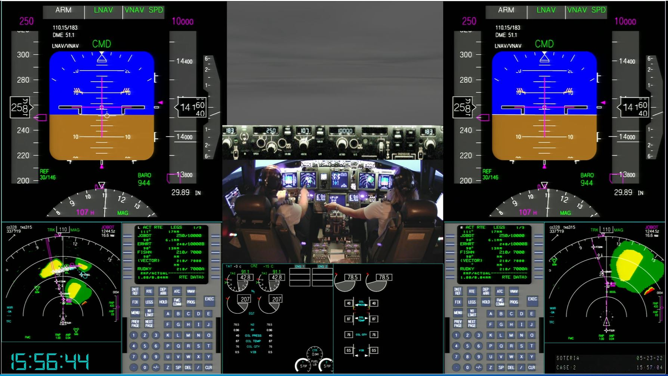
Video Data for Structured Observation
Understand how different knowledge frameworks impact insights
Identify methods/strategies for refining what behaviors to observe (i.e., which behaviors provide the most impactful insights, etc.)
Can observers identify what crews (reported they) were thinking?
Provide a resource for training observers
Image Credit: NASA

Slide 16
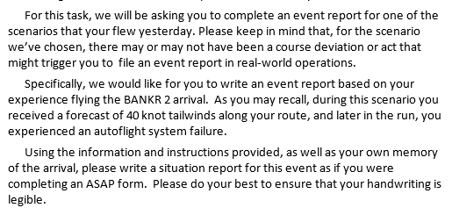

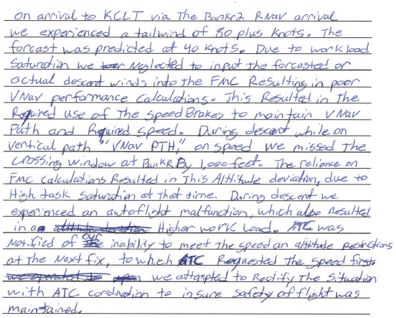
Event Report Narrative Data
From the Data Testbed
From Operational Data
Approach #1: Leverage the vastness of report narratives (over 1.8 million in the ASRS database) to explore trends and patterns; detect anomalies and workarounds; etc.
Approach #2: Leverage the richness of a small set of narratives to enable/enrich the ability of individuals to learn from others’ experiences.
Image Credit: NASA

Slide 17
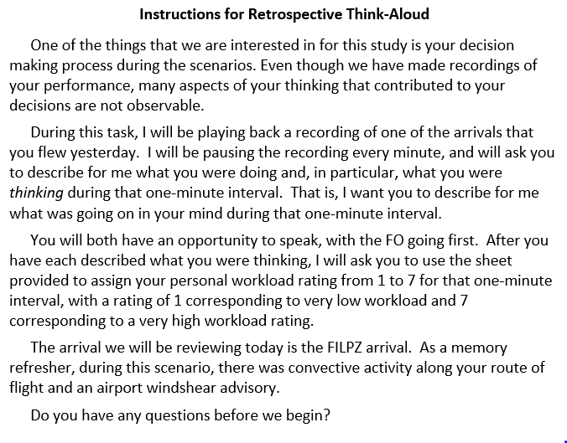
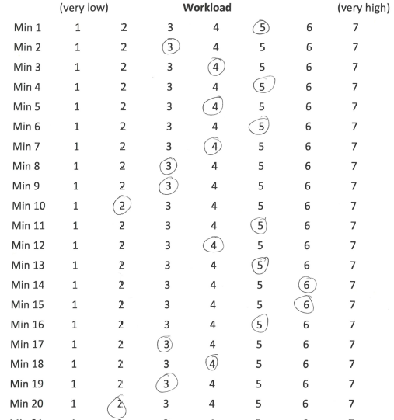
Cued Retrospective Think-Aloud Data
FO/PF (blue) | CA/PM (red)

Slide 18
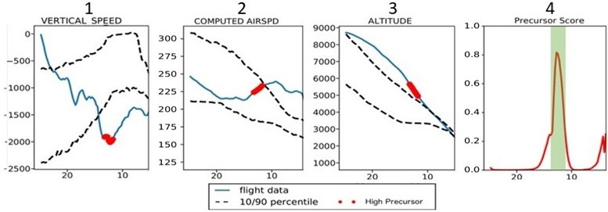
Simulated Flight Data
Roll Angle
Latitude
Longitude
Altitude
Corrected AOA
Pitch Angle
APPR SPD TARGET
COMPUTED AIRSPD
N1 ACTUAL (LOW ROTOR SPD)
N2 ACTUAL (HGH ROTOR SPD)
PFD SELECTD SPEED
DRIFT ANGLE
YAW
WIND SPD
A/P HEADING MODE
A/P NAV MODE
A/P RUNWAY MODE
A/P LOC MODE
A/P TRACK
A/P APROACH
A/P ALT MODE
A/P VERT SPD MODE
A/P GS MODE
A/P CLIMB
A/P DECEND
AP1 ENGAGD
AP2 ENGAGD
FD1 ENGAGD
FD2 ENGAGD
ATS ENGAGD
ATS ACTIVE
GEAR LEVER POS
FLAPS
SPD BRAKES

Slide 19
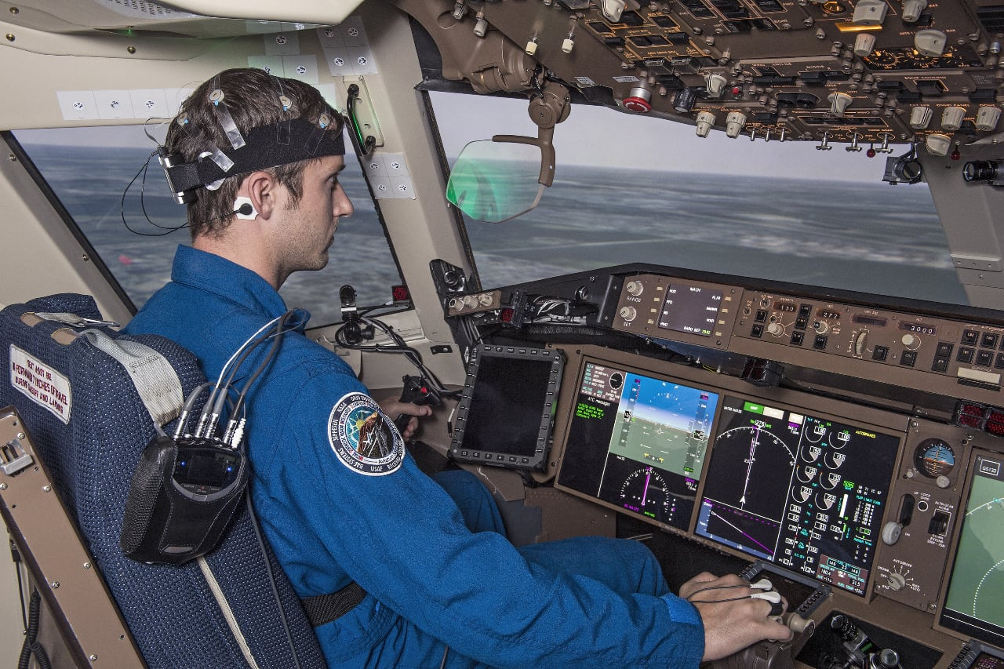
Psychophysiological Data
B-ALERT X10
Electroencephalography (EEG)
Electrocardiography (ECG)
https://www.advancedbrainmonitoring.com/products/b-alert-x10
SmartEye Pro
Head and Eye Tracking with a 5-camera system
https://smarteye.se/smart-eye-pro/
Empatica E4 Wristband
Photoplethysmogram (PPG)
Galvanic Skin Response (GSR)
Peripheral Skin Temperature
3-axis Accelerometry for actigraphy measures
https://www.empatica.com/research/e4/
eyesDX MAPPS
All psychophysiological data were synchronized and saved with the simulator flight data, cockpit voice recording, a scene camera video recording, and 6 simulated avionics displays
https://www.eyesdx.com/products/mapps/
Image Credit: NASA

Slide 20
HC2S Outreach & Awards
Over 35 publications and presentations
Partnerships and collaborations with
  Aviation industry
  Other government organizations
  Academia
Mentions/features in mainstream media
  Forbes.com | November 14, 2019 | Kristy Kiernan
  In Focusing On What Pilots Do Wrong, We May Be Missing
  Valuable Lessons From What They Quietly Do Right
  Aviation Week & Space Technologies | June 22, 2020 | Thierry Dubois
  New Research and Technologies Fuel Single-Pilot Operations Debate
2022 NASA Honor Award: Group Achievement

Slide 21
Summary
People represent the primary source of safety in aviation, through their capability to anticipate, monitor for, respond to, and learn from expected and unexpected change.
Created a data testbed to enable exploration of methods and metrics for pilot contributions to safety and mission success
  Structured observation
  Self reports
  System data
Understanding and measuring this capability is needed so that it can be integrated into the design of technologies, policies, and procedures

Slide 22



System-Wide Safety
Thank you!
Measuring Human Contributions to Safety
Jon Holbrook, PhD
jon.holbrook@nasa.gov

Slide 23
Back Up Charts

Slide 24
Data Collection Procedure
Day 1
Day 2
S0
S1
S2
S3
S4
S5
Cued event report
Cued retrospective think-aloud
Cued minute-by-minute workload rating
Pre-Study
During-Run
Post-Run
Post-Study
Demographics
System Resilience Potential Assessment
Resilient Perf. Survey 1
Sim data
Eye-tracking
EEG
Heart rate
OTS video
TLX
SART
Resilient Performance Self Assessment
Resilient Perf. Survey 2

Slide 25
Cued Retrospective Think-Aloud
Insights included…
Pilots used informal body language cues and gestures to communicate.
Pilots generalized application of formally learned techniques to other situations.
Pilots described instances in which they were trying to ascertain the “right time” or a “good time” to perform a task.
Pilots used tactile cues to maintain situational awareness.
Pilots adapted how they communicated to support shared situational awareness.
Pilots gauged the competency of their copilots, and this determination impacted their decision making.
Captains thought about their role as “mentor” to their First Officer.
Paired statements by the First Officer and Captain do not always reflect paired thinking.
Automating a procedure does not necessarily reduce crew workload.

