Slide 1
PPAP
Tutorial
Carlton Faller, NASA JSC
carlton.s.faller@nasa.gov

Slide 2
About this “tutorial”
This is not a tutorial
The subject material is not sufficiently consistent
“Automotive” depends on who you are and who your supplier is.
What’s included in a PPAP depends on who you are and who your supplier is.
The rules for “automotive” and “PPAP” are defined by the interested parties.
Ask questions as they come to you.
  Don’t bother going to a microphone. I’ll repeat the question for the audience.

Slide 3
What’s a PPAP?
Production Part Approval Process
Defined by the AIAG (Automotive Industry Action Group) aiag.org along with APQP
PPAP is not EEE-specific. PPAP also applies to nuts, bolts, windshield wipers, tires, brake pads, plastic clips, and mud flaps.
As such, some of the elements of a PPAP don’t make sense for EEE parts
PPAP is not the end-all magic document that retires all risk

Slide 4
18 Elements make up a PPAP
PPAP elements and whether they are included in Level 2 and Level 3 PPAP
Level 1 is Part Submission Warrant only
2,3 | Design Record |  | 2,3 | Records of Material / Performance Test Results
2,3 | Authorized Engineering Change documents |  | 3 | Initial Process Studies
3 | Customer Engineering Approval |  | 2,3 | Qualified Laboratory Documentation
3 | Design Failure Mode and Effects Analysis (Design FMEA) |  | NA | Appearance Approval Report (AAR)
3 | Process Flow Diagram(s) |  | NA | Sample Production Parts
3 | Process Failure Mode and Effects Analysis (Process FMEA) |  | NA | Master Sample
3 | Control Plan |  | NA | Checking Aids
3 | Measurement System Analysis Studies |  | NA | Customer-Specific Requirements
2,3 | Dimensional Results |  | All | Part Submission Warrant (PSW)

Slide 5
Will a manufacturer give me a PPAP?
Depends on your relationship with the manufacturer
Some will provide what appears to be pre-canned PPAPs
Some will provide a Level 2 PPAP without resistance
Some will provide a Level 3 PPAP. This requires nontrivial effort by the manufacturer.

Slide 6
PPAP Elements
Just the facts
1. Design Record
  Datasheet – Big deal
  CDCQ – Certificate of Design Construction and Qualification
    BIG DEAL!!! Specified by AEC-Q100,101,200
    http://www.aecouncil.com/Documents/AEC_Q100_CDC_Rev_H.doc
2. Authorized Engineering Change documents
  Any PCNs that aren’t captured by the current datasheet
3. Customer Engineering Approval
  If applicable.

Slide 7
PPAP Elements – cont
The page turners
4. Design Failure Mode and Effects Analysis (Design FMEA)
  Mature parts typically don’t have this
  Many parts leave this out as proprietary (available for review on site)
5. Process Flow Diagram(s)
  Are resistors singulated first or terminations applied?
  How many times is resistance value checked?
6. Process Failure Mode and Effects Analysis (Process FMEA)
  Have seen 400 pages, with ~5 rows/page for FAB
  Risk Priority Number (RPN) = How well is this failure mode controlled?
    calculated by multiplying Severity (S), Occurrence (O) and Probability (P)
7. Control Plan
  All process steps with methods, measurements, machines, etc used to monitor or control the process

Slide 8
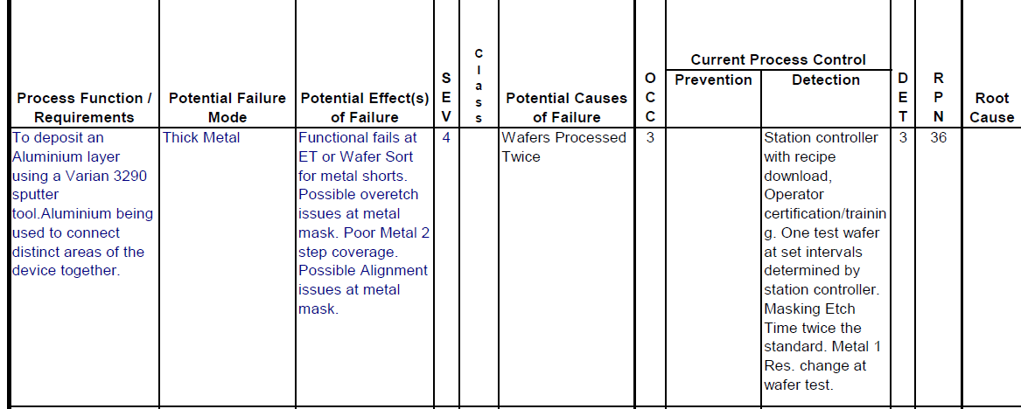
PFMEA example
This FAB PFMEA goes on for 630 pages
Has 190 rows for Aluminum deposition
Potential Failure Modes include: Thick metal, thin metal, no metal, wrong metal, non-uniform metal, low reflectance, high reflectance, non-uniform reflectance, mobile ion contamination, particle contamination, wafer breakage, wafer lost in chamber…..
SEV x OCC x DET = RPN
RPN>100? TAKE ACTION

Slide 9
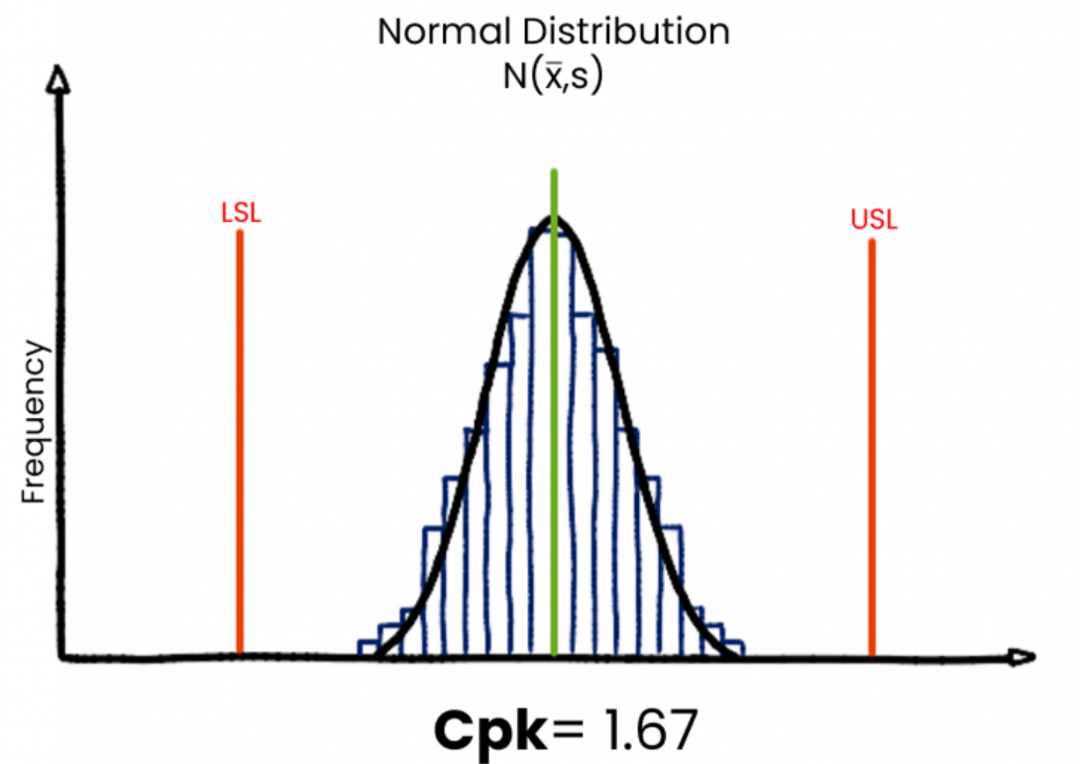
PPAP elements - cont
8. Measurement System Analysis Studies
  Are my instruments capable of distinguishing between good and bad units?
    determine the total observed variability due to the instrument
    isolate the components of variability in the system
    assess if the instrument is suitable or capable for the intended application.
9. Dimensional Results
  Dimensional measurement of representative parts
10. Records of Material / Performance Test Results
  Qualification results
  Often significantly QBS
11. Initial Process Studies
  Cpk, Ppk for critical processes
  How many Std Dev is my mean from my nearest
  spec limit? Divide by 3.
  Cpk=1.67 means we’re 5 σ from nearest limit
    1 defect / million

Slide 10
Significant Production Run
The data for items 9, 10, 11 must be must be taken from a “Significant Production Run.”
The PPAP manual states that the run must be at the production site, using the production tooling, at the production rate, using the production process, materials, and operators.
The production run must be at least 300 parts …. unless otherwise specified by the customer representative.

Slide 11
PPAP Elements – cont
The boring or non-existent ones
Qualified Laboratory Documentation
  Important, but boring
The rest are usually not applicable for catalog EEE parts
  13. Appearance Approval Report (AAR)
  14. Sample Production Parts
  15. Master Sample
  16. Checking Aids
  17. Customer-specific Requirements

Slide 12
PPAP Elements - cont
18. Part Submission Warrant (PSW)
  This is the form, signed by the part manufacturer, that attests that all requirements have been met.
  Of key interest is that the manufacturer states that the parts that were used to create the PPAP were produced at normal production rate (no special runs)
  It also includes the Engineering revision and change information
  It must be signed by the manufacturer representative responsible for the parts/process.
  It includes a statement that production parts are made using the same process as those represented in the PPAP
  Optionally, it allows for signing by the customer.

Slide 13
What the PPAP is
It’s a piece of paper
It’s a peek into SOME of the key mechanisms used by the part maker
It MIGHT be an agreement between the customer and the manufacturer
It MIGHT require customer notification if the manufacturer changes anything.

Slide 14
What a PPAP isn’t
It’s not a replacement for an audit
It usually doesn’t describe the part maker’s practices for ongoing reliability monitoring
It usually doesn’t describe details about defective part elimination or anomalous lot detection
Usually doesn’t describe dominant wear-out mechanisms or acceleration factors
Doesn’t talk about process qualification
Doesn’t describe how wafer probe is performed
What about good die in a bad neighborhood?

Slide 15
PPAP and other Automotive resources
The PPAP Manual and many other automotive resources (not EEE) are available at www.aiag.org
Automotive Electronics Council www.aecouncil.com
  Lots of documents/best practices
IATF 16949:2016 www.iatfglobaloversight.org
  Supplement to ISO9001 for automotive
JEDEC
  AEC specs call out many JEDEC

