Slide 1

Utilizing Gaps and Performance Measures to Inform NASA Environmental Control and Life Support Systems and Crew Health and Performance Technology Decisions ICES Paper 2023-368 17 July 2023
James L. Broyan, NASA Headquarters
Andrew Abercromby, NASA Johnson Space Center
Alexander Burg, Bryce Space & Technology

Slide 2

Outline
ECLSS-CHP capability alignments to NASA M2M ADD
Capability gap definitions
ECLSS-CHP capability areas
Technology Validation Maturation Objectives (VMOs)
Rationale and overview
VMO rubric overview
VMO examples
Concluding remarks
ECLSS = Environmental Control and Life Support Systems
CHP = Crew Health and Performance
SCLT = System Capability Leadership Team
52nd International Conference on Environmental Systems July 16-20, 2023

Slide 3
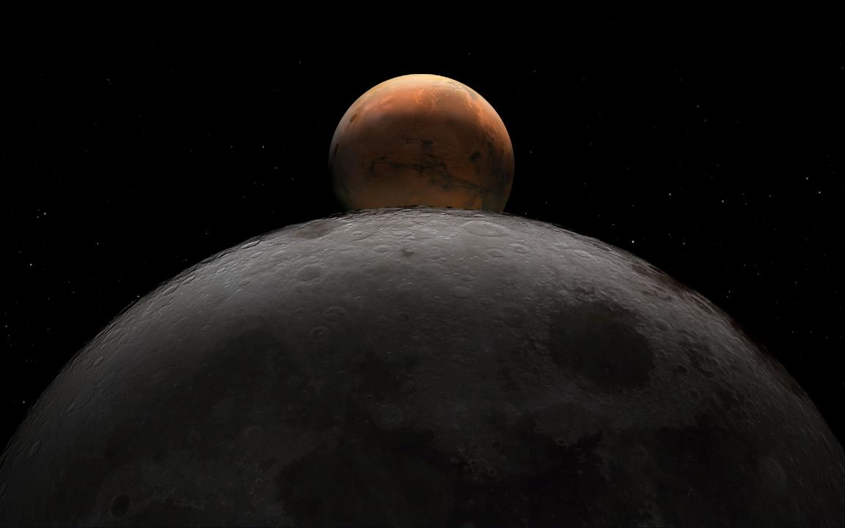
Capabilities Alignment to NASA’s M2M ADD (1/2)
NASA released 63 blueprint objectives in May 2022 (Transportation-Habitation, Lunar and Mars Infrastructure, Operations, and Science)
NASA released the initial Moon to Mars (M2M) Architecture Definition Document (ADD) in April 2023
Foster transparency in the evolutionary approach to exploration architecture to meet NASA’s objectives
Define a systems engineering approach to address the large architecture questions
Why, Who, What, Where, When, and How
M2MADD_ESDMD-001(TP-20230002706).pdf (nasa.gov)
ECLSS-CHP technology development has been capability focused for several years
Approaching technology development using capability needs and gaps is robust way supporting higher level NASA goals
Tech development is most strongly aligned with the ‘How’ question
But need to answer the other questions first
52nd International Conference on Environmental Systems July 16-20, 2023

Slide 4
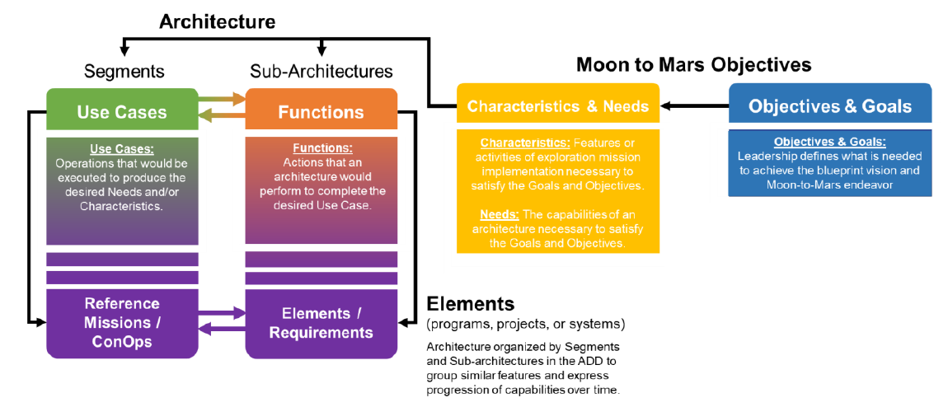
Capabilities Alignment to NASA’s M2M ADD (2/2)
The ADD NASA Objectives are decomposed to ‘Characteristics & Needs’ and ‘Architecture’
Architecting from the right long-term goals
Executing from the left
Establishing a set of elements with requirements
Functional gaps for elements and reference missions most strongly align with previous ECLSS-CHP capability gap nomenclature
The M2M ADD will be updated annually and continue to add detail to architecture/segments/ and elements
Initial release focused on Human Lunar Return Segment
52nd International Conference on Environmental Systems July 16-20, 2023

Slide 5
Capabilities Gap Closure Evolves and Matures Over a Range Of Programs and TRLs
Program-specific implementation of technologies / countermeasures
Programmatic Infusion
Technology gaps, habitation & CHP systems
Programs
Low TRL, industry & academia
Space Technology Mission Directorate - Early Stage
Technology / Countermeasure Dev & Maturation
Exploration
Capabilities
ECLSS-CHP SCLT: Strategic Planning & Integration
Human Research Program
Informing New / Updated Standards
Science Mission Directorate – Biological and Physical Sciences
Knowledge gaps, physiological / psychological research, medical technology, human standards & requirements, grants, academia
Applied Research
Basic
Research
Knowledge gaps, mechanistic research, organism level, cells or plants
ECLSS-CHP SCLT: Strategic Planning & Integration
TRL 1
Technology / Countermeasure Readiness Level
TRL 9
52nd International Conference on Environmental Systems July 16-20, 2023

Slide 6






Capability Gaps Definition
CAPABILITY
The ability to meet an exploration objective through Architecture, Engineering, Development, Technology, Operations or Research for a given set of constraints and level of risk.
Current Capabilities (state of the art)
THE DIFFERENCE IS THE
Envisioned Future (Future Needed Capabilities)
Capabilities we have today, supporting or available for human or robotic missions….
Anticipated future capabilities based)on future mission architectures and
agency strategic planning
GAP
GAP CLOSURE APPROACH
TEST / Demo
LOCATION
GAP CLOSURE MILESTONE
OUTCOMES
Mars
Lunar
Gateway/Cislunar
ISS/LEO
Ground Activity
Updated Standards
Enable Architecture
Updated Procedures
Crew Health Countermeasures
TRL Advancement
Technology Infusion
Policy Decisions
Operational Concepts
Architecture Changes
Scientific Research (Knowledge)
Technology
Development
Engineering
Modeling and Analysis
Ground Simulation
In-Space Demo
Long-term Testing
52nd International Conference on Environmental Systems July 16-20, 2023
Reliable Exploration ECLSS-CHP

Slide 7
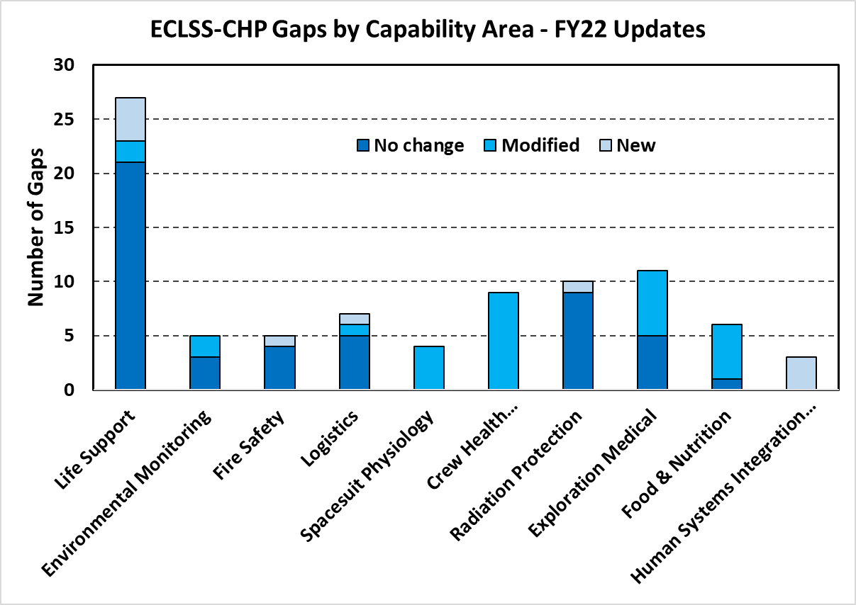

ECLSS-CHP Capability Areas (gaps defined below capability areas)
Close alignment with TX.06 on NASA Technology Taxonomy
6
New: EARTH INDEPENDENT HUMAN OPERATIONS TECHNOLOGIES
Decision Support & Situation Awareness Tools
Human-Hardware Maintenance Interfaces and Tools
Procedure Execution Support Tools
Asynchronous Distributed Operations Management Systems
Integrated Earth-Independent Human Systems Simulation Technologies
52nd International Conference on Environmental Systems July 16-20, 2023

Slide 8
Technology Validation Maturation Rubric - Rationale
Mass reduction (or Equivalent System Mass) is often the primary parameter compared in selecting technologies for a mission
Other ‘parameters’ are less defined but critical for crew safety and mission sucess
The SCLT initiated effort to for systematic comparison and prioritization of ECLSS-CHP technologies
The Technology Validation MaRubric is not an official NASA metric or requirement, it is an informational tool
This information can be used to:
Communicate what functions/features must be future validated before crew depart to Mars (or sustained lunar) to reduce future risks to the crew and mission
Identify what activities are useful to be added to future project plans
Help prioritize payloads for future vehicles and/or where ground testing may require increased fidelity
This is NOT to replace key performance parameters (KPPs) used in comparing technologies or in measuring progress during development
This is NOT to replace technology readiness levels (TRLs) to show technology maturity across a wide range of ideation to flight
This IS intended to characterize how well we have robustly validated a technology/system in the relevant mission environment
52nd International Conference on Environmental Systems July 16-20, 2023
8
8

Slide 9
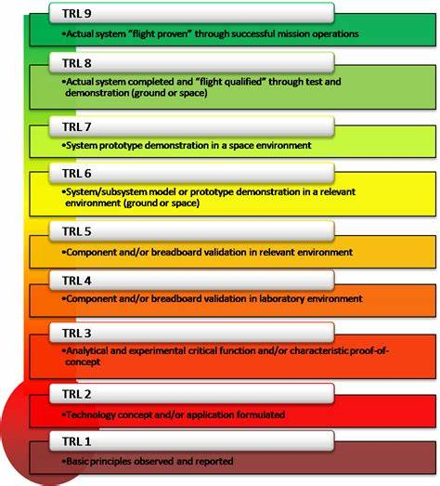
Technology Validation Maturation Rubric – Alignment to TRLs
Technology may have been demonstrated and even qualified for initial elements
Supports executed from the left
But additional maturity is needed for long-term mission
Support architecting from the right
NASA Technology Readiness Levels (TRLs)
Approximate TRL alignment of gaps and rubric
~ SCLT – Technology Maturation Validation Rubric
~ Engineering gaps
~ Development gaps
~ Technology gaps
~ Knowledge & Architecture gaps
52nd International Conference on Environmental Systems July 16-20, 2023
9

Slide 10
Technology Validation Maturation Rubric – Objectives Overview
Rubric Objectives
Integrated testing in relevant environment with realistic contaminant loading and duty cycle
Test verified reliability sufficient to reduce MTH spares mass and improve crew survivability
Demonstrated dormancy recovery or tolerance (after operation)
Demonstrated crew time and equipment for operations and maintenance
Test verified spare mission-length shelf-life storage time and ability to provide nominal operational life
Demo in-mission human system integration troubleshooting with limited time delay ground assist
For CHP systems also identify the R/Y/G of HSRB risks that systems support
For each object there are criteria to determine R/O/Y/G/B
Green is the ‘requirement’
Blue is the ‘goal’
52nd International Conference on Environmental Systems July 16-20, 2023
10
Covered in presentation

Slide 11
Technology Validation Rubric – Summary Table
Covered in presentation
11
11

Slide 12
Technology Validation Maturation Rubric – Integrated System Operation
Objective: System integrated with interfacing systems in relevant environmental environment with human interactions (HILT=human in the loop testing)
Validate all functions of system met
Validate no performance deterioration from sys interactions, spacecraft environment, or humans
Cabin air off gassing likely different from ISS – may impact catalysts, adsorbers, coatings, and detection capabilities
Rationale: Reduce the risk of adverse performance during integrated operation
Mars Transit (MT) Objective (green)
>5 yrs of ISS TD or >9 years of full-scale integrated ground testing
5 yrs ~2x MT mission
Representative environmental inputs of major/minor and if appropriate HILT
Assume ~2x ground = ug test (not substantiated by data)
If not ug or features sensitive to contaminants, then 1.2x ground = ug test (not substantiated by data)
Lunar Objective (green) – Relevant testing must include reduced pressure and elevated O2 and if applicable dust tolerance/filtering
Reduce duration to >12-month ug or ground testing (system dependent)
52nd International Conference on Environmental Systems July 16-20, 2023
12

Slide 13
Technology Validation Maturation Rubric – Integrated System Operation
Changes for Long Duration Lunar Surface Missions Validation Objectives (e.g. Surface Habitat)
REQUIREMENT: - Relevant environment testing must include reduced pressure and elevated oxygen (8.2psia, 34% O2). Air systems must characterize dust impacts (filtering and/or tolerance) - Durations reduced to 12 months ground or ug testing
52nd International Conference on Environmental Systems July 16-20, 2023
13

Slide 14
Technology Validation Maturation Rubric – Dormancy
Objective: Ensure systems maintain functionality after repeated crewed and uncrewed periods
Rationale: MTH outfitting/shakedown will require uncrewed periods (9-11 months) while attached to GW. Lunar surface missions are short with long (11-23 months) uncrewed periods
Microbial activity, corrosion, seal stiction, gas permeability, and uncirculating fluids can be detrimental
Mars Transit Objective (green)
Must expose system to representative microbial and chemical loading before entering dormancy
>60 days (may be tailored to represent shorter mission lengths)
Micro-g fluid distribution must be considered in determining if ground or ug is best demo
Must be dormant long to allow microbes to perfoliate in challenging against challenging dormancy countermeasures
>270 days is long enough for fungi or biofilms to have replicated after adapting to countermeasures
Must operate nominally afterward long enough for problems to reveal themselves
>30 days would allow microbes or precipitates time to detach and accumulate
Lunar Objective (green) – Same as Mars Transit
52nd International Conference on Environmental Systems July 16-20, 2023
14

Slide 15
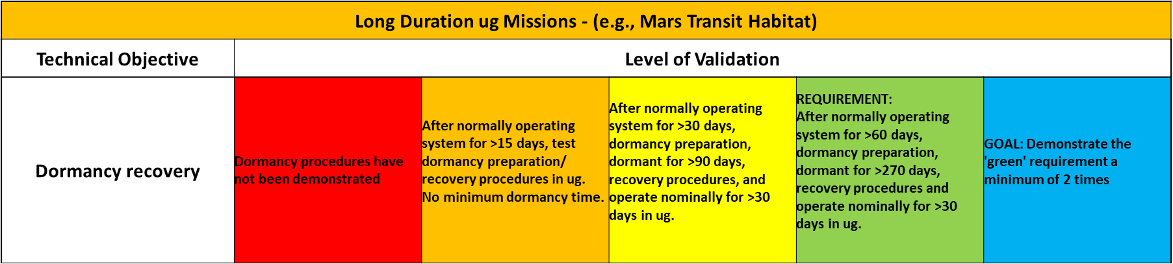
Technology Validation Maturation Rubric – Dormancy
52nd International Conference on Environmental Systems July 16-20, 2023
15

Slide 16
Summary
The NASA M2M ADD will continue to decompose the high-level objectives and add details to functions, sub-architectures, and elements
Capability gaps and tech dev will be adapted to support the M2M ADD
While a single technology measure, like TRL, is convenient, additional measures are useful to communicate development level (KPPs) and validation (maturation objective rubric)
Long-term architecture functions are important in setting requirements and goals for technology systems beyond initial operational requirements
Validation Maturation Objectives rubric help project and strategic planning across elements
Should the commercial LEO be targeted as a payload rather than a system?
How can higher fidelity ground testing be improved to help meet validation goals?
How can the early cis-lunar Mars transit vehicle missions be sequentially outfitted to validate dormancy durations and allow time for modifications if needed?
16

Slide 17
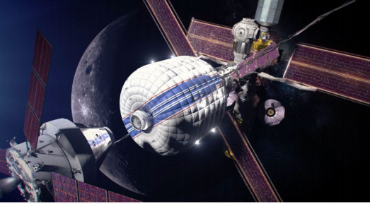
Questions?
52nd International Conference on Environmental Systems July 16-20, 2023
17

Slide 18









(Mission need)
L = Lunar surface
T = Transit to Mars
M = Mars surface
ECLSS-CHP Envisioned Future Decomposition by Capability Area
(only a subset of the 77 gaps listed)
LIFE SUPPORT
ENVIRONMENTAL
MONITORING
FIRE SAFETY
LOGISTICS
Reliable long-duration life support with Earth independent diagnostics and repair (L,T,M)
>20% reduction in spares and installed mass (T)
Enable single missions >800 days w/o resupply (T)
Repeated missions with >9 months dormancy (L,T,M)
>75% oxygen recovery at 2 mm-Hg CO₂ (T)
High pressure oxygen recharge for EVA (L,M)
>98% water recovery (L,T,M)
Remove respirable lunar and Mars dust (L,M)
Planetary protection compatible ECLSS venting (M)
Identify and quantify chemical (>12 water, >33 air) and microbial species in-flight with out sample return (L,T,M)
Ability to detect unknown constituents (T,M)
Distinguish between fire, habitat dust, and surface dust particles (L,M)
Support forward and backward planetary protection detection (both microbial and non-DNA techniques) (M)
Test-verified partial gravity flammability characteristics and countermeasures (L,M)
ECLSS compatible fire suppression (L,T,M)
Reduce post fire clean-up time (L,T,M)
Common fire safety strategy across element architectures (L,T,M)
Jettison >90% of trash mass during Mars transit (T)
Mars trash disposal compatible with planetary protection (M)
In-flight autonomous logistics (L,T,M)
Reducing clothing and wipes mass by >50% (L,T,M)
Clothing flammability (and other non-metallics) >36% O2 (L,M)
SPACESUIT PHYSIOLOGY
COUNTER-MEASURES
RADIATION PROTECTION
EXPLORATION MEDICAL
FOOD & NUTRITION
100% of tasks within human performance (L,T,M)
Predict and mitigate decompression sickness (L,M)
Predict and mitigate of suit or EVA injury (L,M)
6 Major physiological informatics parameters provided in-suit to enable real time self assessment or loss of communication areas (L,M)
Reduce mass and volume (L,T,M)
Maintain/monitor fitness in-flight to enable unassisted landing egress & EVA (L,T,M)
Validated lunar and Mars fitness standards (L,M)
24-hr prediction of solar storm duration and intensity to >90% (L,T,M)
High energy neutron detectors (L,T,M)
Earth independent monitoring/forecasting (T,M)
GCR shielding (T,M)
In-flight diagnostics and treatment for 100 of 120 medical risk conditions (L,T,M)
Autonomous medical skill and & decision support systems (T, M)
100% of nutrient stability >5-year shelf life (T,M)
Food acceptability >90% (L,T,M)
<30% launched water content (T,M)
Exploration counter-measure in-flight nutrition intake monitoring (L,T,M)
52nd International Conference on Environmental Systems July 16-20, 2023
18

Slide 19
ECLSS-CHP State-of-the-Art by Capability Area
LIFE SUPPORT
ENVIRONMENTAL
MONITORING
FIRE SAFETY
LOGISTICS
ISS life support demonstrations have identified required system reliability issues – fixes in work
~21,700 kg spares + food, 4 crew x 860days x Probability of Sufficiency (POS)=0.99
Resupply every 2-6 months
Nearly uninterrupted use of wetted systems
~47% oxygen recovery at 2 mm-Hg CO₂
No in-flight EVA oxygen recharge capability
~93% water recovery
HEPA filters require frequent manual cleaning
Detailed gas/water chemical, microbial identification, and particle analysis only with samples returned to ground
Major air constituents & limited targeted trace gases in flight
Water analysis limited to total organic carbon
Culture based microbial sample return; DNA sequencing limited to surface microbes
Limited particle measurement capability demonstrated
Mass intensive passive acoustic adsorption/damping
Partial understanding of large ug fire propagation and properties
Very limited knowledge of partial gravity fire properties
Obsolete monitoring
Cleanup by depress/repress
Limited mask emergency response
CO₂ based fire extinguishers
Manual trash compaction, short storage time, module level jettison only
No planetary protection compliance for waste disposal
Manual & limited In-flight autonomous logistics tracking
Disposable & flammable clothing, towels, & wipes
SPACESUIT PHYSIOLOGY
COUNTER-MEASURES
RADIATION PROTECTION
EXPLORATION MEDICAL
FOOD & NUTRITION
Physiological inputs/outputs adequately known for ISS EVA only
Only limited ground communicated informatics provided to EVA crew
Ground, ISS, and Apollo suit injuries occur (27 injury mechanisms identified)
Prebreath for 14.7 and 10.2 psia only
3+ large devices, large mass
Returning crew egress from landing vehicle requires ground team assistance
Exercise planning and monitoring via ground
Limited sensorimotor countermeasures
Mature shielding design tools
Reconfigurable SPE shielding & limited GCR shielding
Crew radiation monitoring
Short term space weather using earth centric assets
Evacuate <8 hrs
Resupply 2-3 months
Limited in-flight diagnostic, treatment
Ground medical data & decision support systems
~1.5 year shelf life, fresh food resupply every 2-3 months
Only ~215 standard food items, μg plant experiments
~47% launched water content
In-flight nutrient intake monitoring in development
52nd International Conference on Environmental Systems July 16-20, 2023
19

Slide 20
Technology Validation Rubric – Reliability
Objective: Reliability testing to verify operation times to reduce mass for improved crew survivability
Systems are with combination of ground and ISS units with representative major consistent loading
Rationale: Test verified spares mass allows us to take the best mix of spare parts within a given MT spares mass allocation.
This improves crew survivability
MT Objective (green)
Test time depends on system mass (smaller systems have less mass savings potential)
System over 300 kg, >12 yrs combined testing
System 50-300 kg, > 9 yrs combined testing
System <50 kg, >4 yrs combined testing
12 yrs ~5x MT mission
Representative environmental major inputs
Assume ground = ug test (not substantiated by data)
If intermittent usage, combined testing can be reduced by the duty cycle
Lunar Objective (green) – Relevant testing and loading (system specific tailoring)
Reduce duration to >30m, >20m, >10m (assume six years of 30-day missions x5)
52nd International Conference on Environmental Systems July 16-20, 2023
20-

Slide 21
Technology Validation Rubric – Reliability
Changes for Long Duration Lunar Surface Missions Validation Objectives (e.g. Surface Habitat)
REQUIREMENT: - Durations reduced to ~>30 months, >20 months, >10 months
52nd International Conference on Environmental Systems July 16-20, 2023
21

Slide 22
Technology Validation Rubric – Crew Time for Ops and Maintenance
Objective: Demonstrate full set of maintenance operations in flight
Rationale:
Reduce risk of unexpected need for additional maintenance steps or hardware damage.
Reduce risk of overscheduling crew or inadequate release/contingency supplies
MT Objective (green) Demonstration of lower level (components) maintenance operations in flight
~For simple, non-fluid, non-particle containing equipment, or portable equipment ground validation may be sufficient
What components are recommended for lower maintenance is system specific
Lunar Objective (green) – Same as MT
52nd International Conference on Environmental Systems July 16-20, 2023
22

Slide 23
Technology Validation Rubric – Crew Time for Ops and Maintenance
52nd International Conference on Environmental Systems July 16-20, 2023
23

Slide 24
Technology Validation Rubric – Consumables/Spares Shelf-life
Objective: Demonstrate spares can be stored for expected mission duration and still function
Rationale:
Reduce risk that spares are not able to perform function after storage from ground prep, MTH outfitting, through MT round trip mission
This risk has been experienced on ISS some ECLSS spares have not operated when needed
MT Objective (green) >5-year storage & run nominal time
5 yrs = 0.5 yr pre-launch + 2-yrs of MTH spares build-up at GW + 2.5 yr MT roundtrip
Lunar Objective (green) – > 3-year storage & run nominal time
3 yrs = 0.5 yr pre-launch + 1-yrs of skip mission + 1.5 yr on surface (allows support of 2 surface missions)
52nd International Conference on Environmental Systems July 16-20, 2023
24

Slide 25
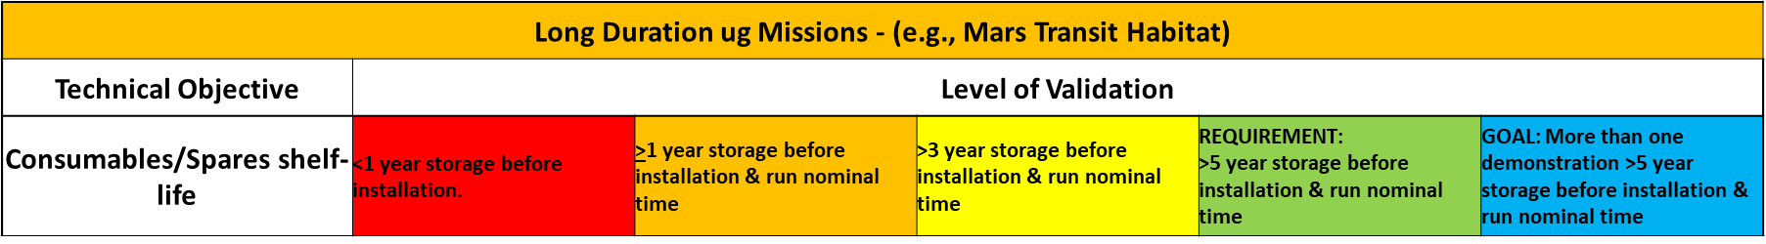
Technology Validation Rubric – Consumables/Spares Shelf-life
52nd International Conference on Environmental Systems July 16-20, 2023
25

Slide 26
Technology Validation Rubric – Human System Integration (HSI)
Objective: Ensure the crew can sufficiently operate and maintain the vehicle with time delay and communication drop out periods
This is a notational objective – this capability area will formulate its scope in FY23
Rationale:
Reduce risk hardware has sufficient features/sensors and crew has sufficient proficiency for key operations independent or with limited time delay ground assistance
MT Objective (green):
Independent in-mission HSI troubleshooting, with limited time delay ground assist. Demonstrated in a relevant environment
Not all operations require earth independent operation or autonomy
Need to determine what types of operations will be targeted
Lunar Objective (green) – Same as MT
52nd International Conference on Environmental Systems July 16-20, 2023
26

Slide 27
Technology Validation Rubric – Human System Integration (HSI)
52nd International Conference on Environmental Systems July 16-20, 2023
27

Slide 28
Exploration ECLSS on ISS
Getting to 98% water & >75% oxygen recovery requires integration and verification of many systems
Air String
Water String
Humidity Condensate (H₂O (l))
to WW Bus
Water Processor Assembly
Cabin air
Siloxane + Heavy VOC Removal
CHX
Water Sep
Potable water
Particle Filter
Trace contaminants to cabin
Air out to cabin
Potable Water Dispenser
(Combined HEPA/Charcoal Filter)
Distillate
Low humidity, Low temp
Air
Trace contaminants to cabin
H₂O to crew and science
Cabin air
Light VOC Removal
Urine Processor Assembly
Microbial Monitor
ARFTA
Urine/air
Air out to cabin
CO₂ free air + H₂O (g)
CO₂ Removal
Humidity & trace contaminants to cabin
Brine
Air Particle Monitor
Pre-treated
Urine (PTU)
CO₂
Toilet #1 (UWMS)
Major & Trace Air Monitor
CO₂ to vent
(when needed)
BPA
Urine Transfer System
PTU
CO₂ Accumulator
O₂ to cabin
PTU
Toilet #2 (WHC)
Fire Extinguisher
Humidity
Hi Pressure CO₂
Concentrated brine to trash
Emergency Response Equipment
Upgraded OGA
H₂
Sabatier
H₂O (l) to WW Bus
Air out to cabin
Compressed air
PTU
Urine/air
PTU
Crew Consumables
H₂
CH₄
CH₄ to vent (when needed)
Trace contaminants to cabin
Methane Reduction
Device
Back-up urine storage
Russian urine
Spacecraft Water Impurity Monitor
Trash Processing
EDV
EDV
Total Organic Water Analyzer
Logistics Management
H₂ to vent
(when needed)
C₂H₂ + trace gases to vent
Potable water
28

Slide 29
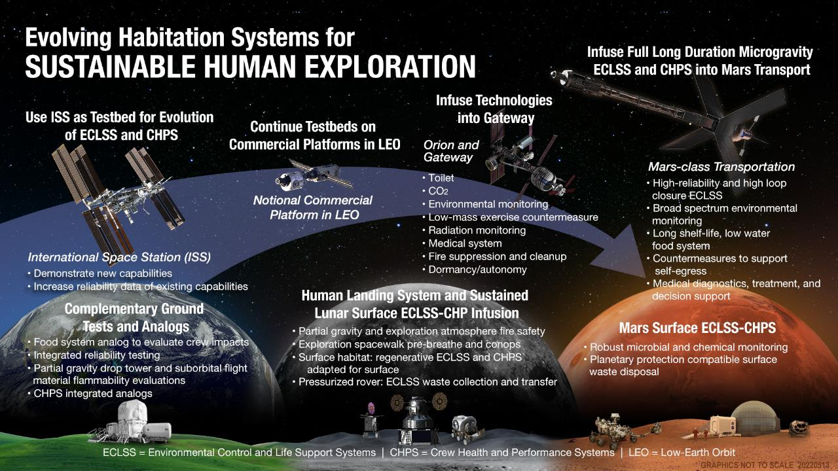
29

Slide 30
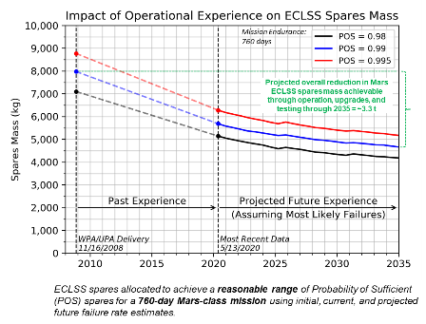
Long-term Test Verified ECLSS is Critical for Mars Reduces Mass and Improves Crew Safety
Failure rates cannot be measured directly
Must be statistically estimated from test & operational data
ISS experience shows that initial failure rate estimates are often incorrect, sometimes by >4x
ISS flight experience has been extremely valuable, providing data to refine failure rate estimates
30% reduction in spares mass
Improved crew safety via identification and mitigation of hidden risk from underestimated failure rates (too low a spares mass allocation or taking the wrong complement of spares)
Open loop ECLSS for 4 Crew on round trip Mars mission (860 days) requires:
~16,500 kg water
~3,300 kg oxygen
~ 6,000 kg food (@25% hydration)
Does not include tankage, packaging and structure
52nd International Conference on Environmental Systems July 16-20, 2023
30

