Slide 1
USORT Team Status
Lee Feinberg/GSFC, Laura Coyle/Ball Aerospace
Contributors: Dave Redding/JPL, Mike Menzel/GSFC, Sang Park/SAO, Marcel Bluth/GSFC, Julie Van Campen/GSFC
7/11/23

Slide 2
Scope of Effort
This effort chartered by COR under the NASA Astrophysics Division is intended to develop roadmaps and technical guidance that provide input to the Science, Technology, Architecture Review Team (START) and TAG activities
The team includes broad representation from industry, NASA centers, Academia
At the 20,000 feet level, what is the holistic roadmap to get to technologies to TRL5 and to mature related topics like architectures, verification?
Effort is primarily volunteer and uses best current existing knowledge/expertise/lessons –part of effort is to identify future work to further refine capabilities
Approach uses guidance from the Decadal and the NASA Astrophysics Director’s “HWO Big Picture” in terms of what is roadmapped
  Ultrastable (eg, 10 picometer RMS over temporal bandpass over IWA/OWA spatial frequencies)
  Segmented Off-axis Primary Mirror with roughly 6m (ID)
  Need margin (technical, scientific)
  Assume large rocket fairings are available
  Serviceable
Observatory aspects that effect stability (ranging from dynamics to thermal, verification, facilities) are all within the scope
Team is not doing trades or downselecting technologies, only developing roadmaps and associated support information like block diagrams

Slide 3
Ultrastable Observatory Roadmap Team (USORT)
Team is divided into 5 subgroups
  Observatory/System/Attitude Control System
  Sensing and Control
  Mirrors/Thermal/Coatings
  Backplane/Structure/Deployments
  Verification/Facilities/Demos
Goal is to identify gaps to get to TRL5/6 and to identify critical near term analyses and technology areas

Slide 4
Team Members

Slide 5
Ultra-stable Observatory Roadmap Process
Fill in the Metrics/
Capabilities
Define WBS Item Metrics/Capabilities
Feedback from High Contrast Workshop
8/10-8/12
Evaluate SOA for each technology
Example:
Areal Density <25Kg/M2
Example: Areal Density, PMSA thermal stability
Define WBS for Each Group:
Based on Investment Areas
USORT Workshop
TBD
Define Top Level Launch and Mass Assumptions
Identify Gaps
Choose Driving Cases
Choose Segmentation Assumptions
Review Error Budget(s)
Input to START, TAG teams
Update/Iterate
Blue=Process steps
Yellow=External Interface
Interface with Coronagraph Technology Error Budgets/Assumptions
Future Technology Investments

Slide 6
USORT External Engagement
Science with Habitable Worlds Observatory and Beyond: July 10-15, 2023
  First external presentation sharing current status – looking for feedback
High Contrast Workshop, August 8-10 (exact dates still TBD), Pasadena
  Will provide more detailed status including capability needs
USORT workshop in the Fall
  ITAR
  Hope to coordinate timing with a START team meeting so they can attend part of it
Will feed efforts into the START and TAG
Other opportunities for external engagement? Please let us know!

Slide 7
Definition of Metrics
Team is currently defining metrics across the telescope architecture and gathering relevant information to identify gaps
Metrics |  |  | Current State |  |  | Required for HWO | Tech Gap?
Level 0 (Science) | Level 1 (Observatory) | Level 2 (System) | Upper Limit | Mid-Point | Lower Limit
0.1 Exo Earth Yield |  |  |  |  |  | 25
 | 1.1 Contrast/IQ @ waveband |  |  |  |  | <1e-10 for 450-550 nm band
 |  | Static Low SF WFE Residual |  |  |  | 20 nm RMS
 |  | Static Mid SF WFE Residual |  |  |  | 15 nm RMS
 |  | Optical Throughput
 |  | Stray Light
 |  | Surface Metrology Metrics
 | 1.2 Constrast Stability @ waveband |  |  |  |  | <1e-10/hour
 |  | OTE WFE Residual - Low SF WF and amplitude drift |  |  |  | <1 pm/hour
 |  | OTE WFE Residual - Mid SF WF and amplitude drift |  |  |  | <1 pm/hour
 |  | OTE WFE Residual - High SF WF and amplitude drift |  |  |  | <1 pm/hour
 |  | OTE WFE Residual - Low SF Wavefront Jitter |  |  |  | <10 pm
 |  | OTE WFE Residual - Mid SF WF Jitter |  |  |  | <5 pm
 |  | OTE WFE Residual - High SF WF Jitter |  |  |  | <1 pm
 |  | OTE WFE Residual - Metrology Interfaces
 |  | CG WFE Residual
 |  | LOS Stability - Drift |  |  |  | <1 nanoradian/hr
 |  | LOS Stability - Jitter
 |  | Roll Stability
 |  | Post Processing
 |  | Deformable Mirror Metrics
 |  | Metrology Metrics
 | 1.3 Spectral Resolution @ waveband |  |  |  |  | TBR
 |  | Spectral Resolving power
 |  | Distortion (Keystone/Smile)
 |  | Spectral Registration
 | 1.4 Mission Design
 |  | System Optical Design
 |  | Operating Temperature
 |  | Stable Mirror Architecture
 |  | Outer Barrel Assembly
 |  | Observing Efficiency
 |  | Attitude Control Subsystem
 |  | Vibration Isolation
 |  | Structural Systems
 |  | Lifetime and Reliability
 | 1.5 Observatory Resources
 |  | Mass
 |  | Thermal
 |  | Power Subsystem
 |  | Communications Subsystem
 |  | Data Volume
 |  | Flight Dynamics
 |  | Propulsion
 |  | Ground Station Availability
 | 1.6 Verification and Facilities
 |  | Integrated Modeling Tools
 |  | Hardware Testbeds
 |  | Facilities
WBS Flowdown from Science Goals > Observatory > Telescope system > Telescope subsystems > Components
Try to keep metrics architecture agnostic, especially at the higher levels. At lower levels, include options for approaches/components for comprehensive evaluation, with attention paid to bounding cases.
Gap analysis will inform roadmap creation and will be flowed to START and TAG team.
Color coding:
Observatory/System/ACS
Sensing and Control
Mirrors/Thermal/Coatings
Backplane/Structures/Deployments
Verification/Facilities/Demo
Other Inputs

Slide 8
Definition of Metrics
Metrics |  |  | Current State |  |  | Required for HWO | Tech Gap?
Level 0 (Science) | Level 1 (Observatory) | Level 2 (System) | Upper Limit | Mid-Point | Lower Limit
0.1 Exo Earth Yield |  |  |  |  |  | 25
 | 1.1 Contrast/IQ @ waveband |  |  |  |  | <1e-10 for 450-550 nm band
 |  | Static Low SF WFE Residual |  |  |  | 20 nm RMS
 |  | Static Mid SF WFE Residual |  |  |  | 15 nm RMS
 |  | Optical Throughput
 |  | Stray Light
 |  | Surface Metrology Metrics
 | 1.2 Constrast Stability @ waveband |  |  |  |  | <1e-10/hour
 |  | OTE WFE Residual - Low SF WF and amplitude drift |  |  |  | <1 pm/hour
 |  | OTE WFE Residual - Mid SF WF and amplitude drift |  |  |  | <1 pm/hour
 |  | OTE WFE Residual - High SF WF and amplitude drift |  |  |  | <1 pm/hour
 |  | OTE WFE Residual - Low SF Wavefront Jitter |  |  |  | <10 pm
 |  | OTE WFE Residual - Mid SF WF Jitter |  |  |  | <5 pm
 |  | OTE WFE Residual - High SF WF Jitter |  |  |  | <1 pm
 |  | OTE WFE Residual - Metrology Interfaces
 |  | CG WFE Residual
 |  | LOS Stability - Drift |  |  |  | <1 nanoradian/hr
 |  | LOS Stability - Jitter
 |  | Roll Stability
 |  | Post Processing
 |  | Deformable Mirror Metrics
 |  | Metrology Metrics
 | 1.3 Spectral Resolution @ waveband |  |  |  |  | TBR
 |  | Spectral Resolving power
 |  | Distortion (Keystone/Smile)
 |  | Spectral Registration
 | 1.4 Mission Design
 |  | System Optical Design
 |  | Operating Temperature
 |  | Stable Mirror Architecture
 |  | Outer Barrel Assembly
 |  | Observing Efficiency
 |  | Attitude Control Subsystem
 |  | Vibration Isolation
 |  | Structural Systems
 |  | Lifetime and Reliability
 | 1.5 Observatory Resources
 |  | Mass
 |  | Thermal
 |  | Power Subsystem
 |  | Communications Subsystem
 |  | Data Volume
 |  | Flight Dynamics
 |  | Propulsion
 |  | Ground Station Availability
 | 1.6 Verification and Facilities
 |  | Integrated Modeling Tools
 |  | Hardware Testbeds
 |  | Facilities
Metrics
Level 0 (Science) | Level 1 (Observatory) | Level 2 (System) | Level 3 | Level 4
0.1 Exo Earth Yield
 | 1.1 Contrast/IQ @ waveband
 |  | Static Low SF WFE Residual
 |  |  | OTA WFE - PM Figure
 |  |  |  | Mirror Substrate
 |  |  |  | Mirror Mounting
 |  |  |  | PM Support Structure
 |  |  | OTA WFE - PM Alignment Residual
 |  |  | OTA WFE - SM Figure
 |  |  |  | Mirror Substrate
 |  |  |  | Mirror Mounting
 |  |  |  | SM Support Structure
 |  |  | OTA WFE - SM Alignment Residual
 |  |  | OTA WFE - TM Figure
 |  |  | OTA WFE - FSM Figure
 |  |  | CG WFE
 |  |  | DM Shape Residual
Detail view of a Telescope System Metric
Level 4’s will capture information like “what is the current surface figure error capability for stable glass mirrors?”
Color coding:
Observatory/System/ACS
Sensing and Control
Mirrors/Thermal/Coatings
Backplane/Structures/Deployments
Verification/Facilities/Demo
Other Inputs

Slide 9
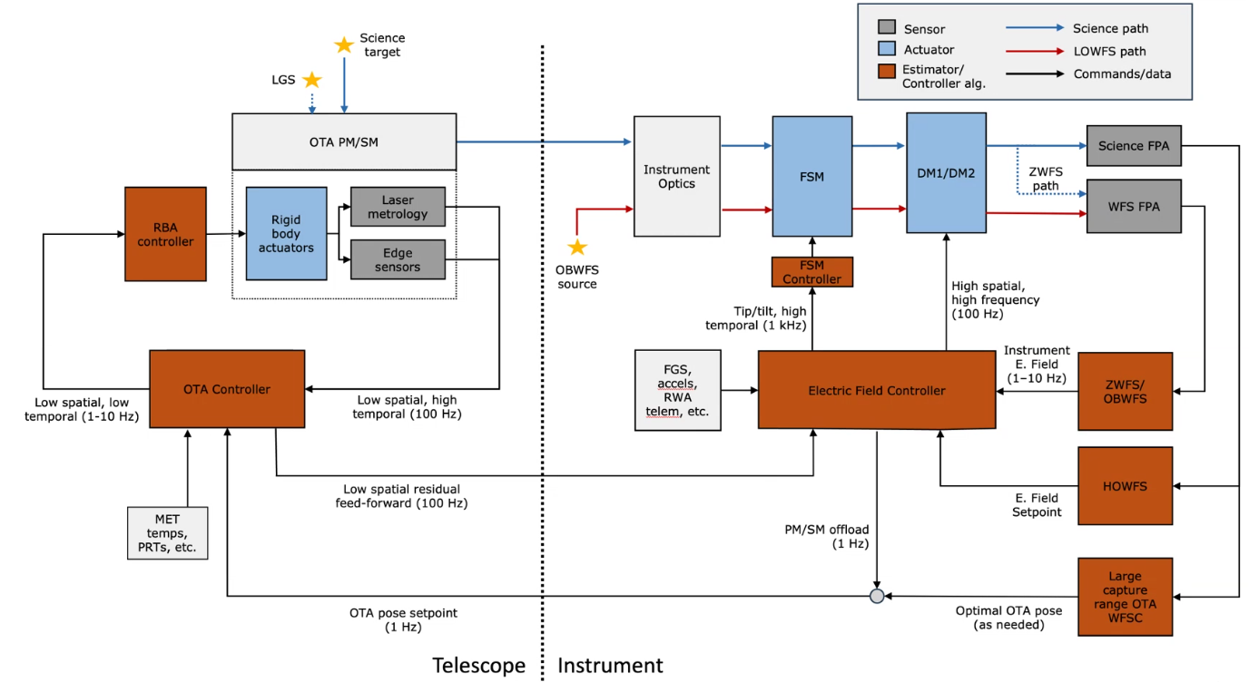
Draft Integrated Control Block Diagram
OTA Controller uses MET to estimate segment and SM poses and control them to a target pose set by WFSC – and the Electric Field Controller
Coronagraph Electric Field Controller uses HDWFS/EFC to dig dark holes – and set an Electric Field target for maintenance
Dark hole contrast is maintained by OBWFS (+LOWFS) measuring EF and driving the DMs – and the OTA poses
A bright OBWFS source enables continuous high BW, high spatial frequency EF measurement
Potential additional S&C elements not shown here include:
  A second WF sensor to maintain the OTA WF using stars elsewhere in the field
  A third, segmented DM to provide high-speed compensation for OTA jitter
  FSM off-load to the space vehicle ACS
J. Tesch/D. Redding

Slide 10
Control matrix assesses gaps between instabilities and sensing and controls
Temporal frequency at which the instability could occur
B. Sitarski
Sensing & control systems/technologies for HWO
Spatial frequency of error that the instability could impart
Likely contributors to instability in the system
Green boxes = how technologies address instabilities

Slide 11
Key findings from the team (p.1):
Detailed mission technology roadmaps are architecture-dependent, which is not yet defined for HWO. Roadmapping activities at this early stage consider bounding performance needs and potential approaches/technologies based on current best understanding.
Need to be holistic in our approach. It’s not just about TRL, but also about Concept Maturity Level (CML) and Manufacturing Readiness Level (MRL).
Need to think in terms of system engineering starting with Level 0/1 requirements like rocket options we want to support and science drivers
The biggest priority we need to refine technology roadmaps is architecture work derived from modeling and simulation to develop error budgets and specs that we believe in. This needs to be a real priority next year.
Baffle complexity is turning out to be an important consideration in the overall architecture
  Desire for it to be long enough to protect against micrometeoroids and for servicing protection and for starshade compatibility
  Likely requires a scarf
  Total length could be 22 meters for an off-axis telescope!
Decision on rocket compatibility can drive mass allocations, deployment needs
  Both height and diameter depend on which size options we want compatibility
  Long versions of rockets seems optimistic at this early time
Use or disclosure of data contained on this page is subject to the restriction(s) on the title page of this document.

Slide 12
Key findings from the team (p.2):
Lowest mode of the structure sets the highest segment rigid body control BW
If higher frequency measurements are made, feed-forward to the DMs can potentially extend the overall control bandwidth – provided the DMs can be operated in servo mode
For disturbances within the S&C bandwidths, contrast stability will be set by S&C performance, not by the underlying structures and thermal subsystems
Disturbances beyond the S&C bandwidths will need to be eliminated, damped and/or isolated from the optical train
A common error budget framework across the coronagraph + telescope, and their disturbance-reducing control systems, is required. Need to factor in SNR and calibration methods.
Testbeds are key, to validate models, and to help characterize control loop interactions and overall performance a tiered sensing and control system operating at various spatial and temporal bandwidths
Use or disclosure of data contained on this page is subject to the restriction(s) on the title page of this document.

Slide 13
Next Steps
Capabilities, capabilities, capabilities. These are the numbers that go with the metrics. Use optimistic, pessimistic, mid cases if needed.
Would like these complete by our next meeting in late July.
Systems starting to think about other aspects of the system like detector capabilities and system implications.
Next meeting will be July 27th 1-3PM. In time to review capabilities for August workshop presentation.
After we define capabilities, we will start filling in state of the art and gaps…
Use or disclosure of data contained on this page is subject to the restriction(s) on the title page of this document.

