Slide 1


NASA Crew Health & Performance Capability Development for Exploration: 2022 to 2023 Overview
ICES Paper 2023-255
18 July 2023
Andrew F.J. Abercromby, Ph.D., Grace L. Douglas, Ph.D., Kent L. Kalogera, Karina Marshall-Goebel, Jeffrey Somers,
Rahul Suresh, M.D., M.P.H., Moriah S. Thompson, M.D., M.P.H., Scott J. Wood, Ph.D.
NASA Johnson Space Center, Houston, TX 77058
Ralph Fritsche
NASA Kennedy Space Center, Merritt Island, FL 32815
Emma Y. Hwang, Ph.D.
KBR, Houston, TX 77058
Justin D. Yang
Aegis Aerospace, Houston, TX 77058
and
James L. Broyan
NASA Headquarters, Washington, D.C. 20546

Slide 2
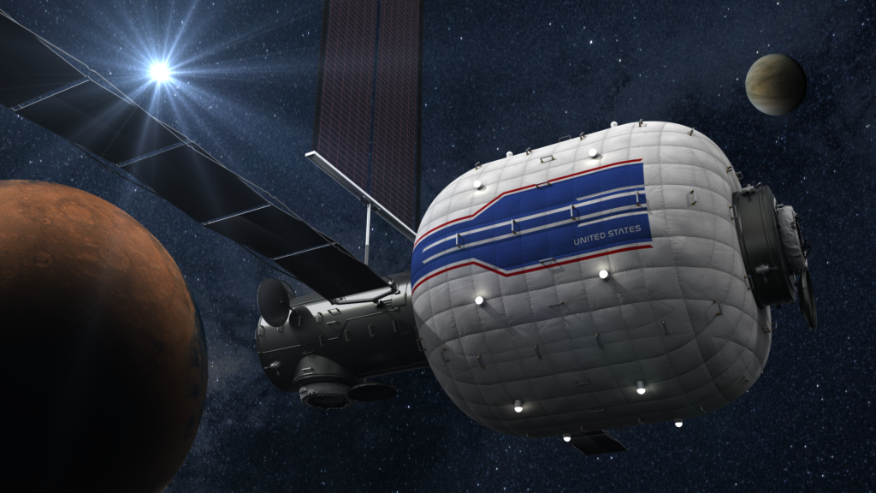
Overview
ECLSS-Crew Health & Performance System Capability Leadership Team
Human System Capability Gap Updates
Crew Health & Performance Capability Areas:
  Spacesuit Physiology & Performance
  Crew Health Countermeasures
  Exploration Medical
  Food Systems
Conclusions
52nd International Conference on Environmental Systems
July 16-20, 2023

Slide 3
What is an SCLT?
System Capability Leadership Team
Cross-agency, program-independent
Responsibilities:
Identify capability gaps & develop strategies for closure
Make recommendations on technology development and support architecture studies
Establish key performance parameters and monitor progress
Analyze assets required to execute capability advancement and recommend acquisition strategies
Maintain cognizance of state of ECLSS & CHP capabilities
Coordinate with commercial and international partners to identify opportunities
52nd International Conference on Environmental Systems
July 16-20, 2023

Slide 4


Capability Gaps
The ability to meet an exploration objective through Architecture, Engineering, Development, Technology, Operations or Research for a given set of constraints and level of risk.
CAPABILITY
Current Capabilities (state of the art)
THE DIFFERENCE IS THE
Future Needed Capabilities (Envisioned Future)
Capabilities we have today, supporting or available for human or robotic missions….
Anticipated future capabilities based on future mission architectures and
agency strategic planning
GAP
52nd International Conference on Environmental Systems
July 16-20, 2023

Slide 5
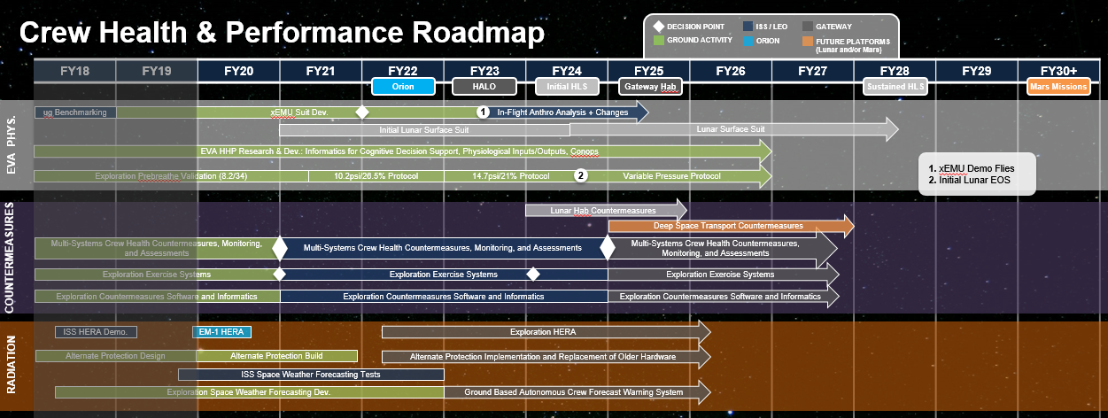
Importance of Capability Gaps
SCLT Roadmaps aim to include:
  All work that is ongoing across the agency – regardless of funding source – that is relevant to Capability Gap closure
  Future work – with identified capability products and schedule – considered necessary to close each Capability Gap
SPACESUIT
PHYSIOLOGY
Example

Slide 6

ECLSS-CHP SCLT Capability Areas
6
New: EARTH INDEPENDENT HUMAN OPERATIONS TECHNOLOGIES
    Decision Support & Situation Awareness Tools
    Human-Hardware Maintenance Interfaces and Tools
    Procedure Execution Support Tools
    Asynchronous Distributed Operations Management Systems
    Integrated Earth-Independent Human Systems Simulation Technologies
  Close alignment with TX.06 on NASA Technology Taxonomy

Slide 7
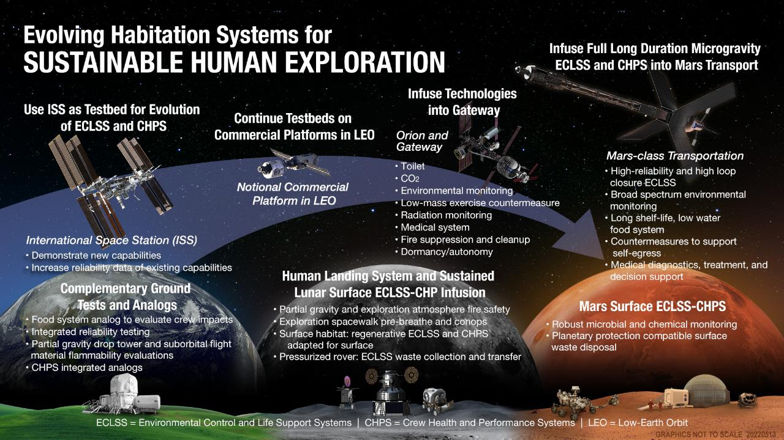

Slide 8
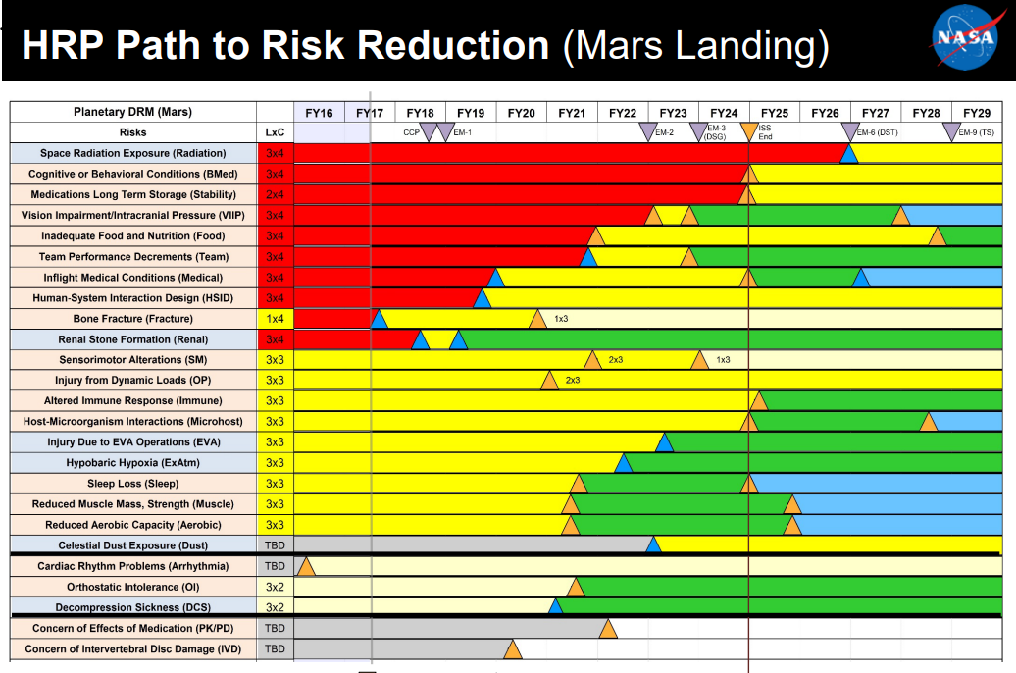
Human System Risks
NASA uses Human System Risks to aid in identifying and prioritizing human research needs
But… no linkage between Human System Risks (research) and Capability Gaps (tech dev)
52nd International Conference on Environmental Systems
July 16-20, 2023

Slide 9
Human System Capability Gaps
What?
  Integrated set of capability gaps
  Mapped to Human System Risks
  Utilized by CHP community
  Configuration managed by HSRB
Why?
  Facilitate fully integrated roadmaps
  Demonstrate alignment of agency investments with Human System Risks
  Improve ability to communicate Human System Risk implications of agency investment decisions
52nd International Conference on Environmental Systems
July 16-20, 2023

Slide 10
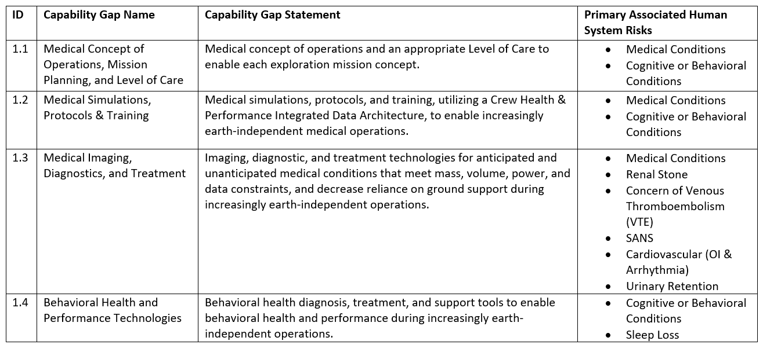
Example of Human System Capability Gaps
52nd International Conference on Environmental Systems
July 16-20, 2023

Slide 11
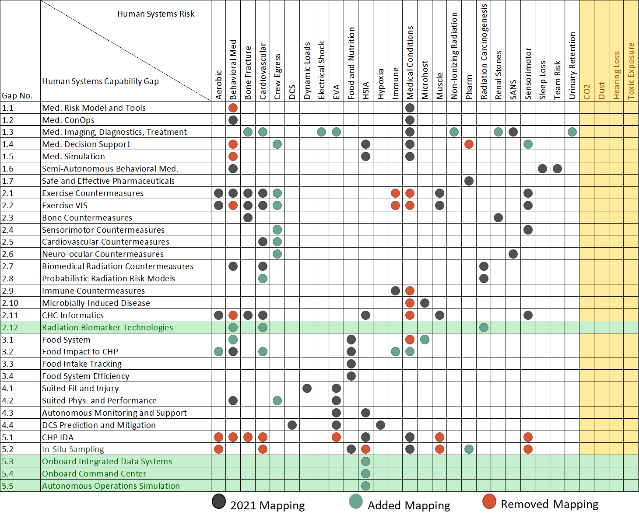
2022 Human System Capability Gaps
10

Slide 12
CHP Capability Area Updates
52nd International Conference on Environmental Systems
July 16-20, 2023

Slide 13

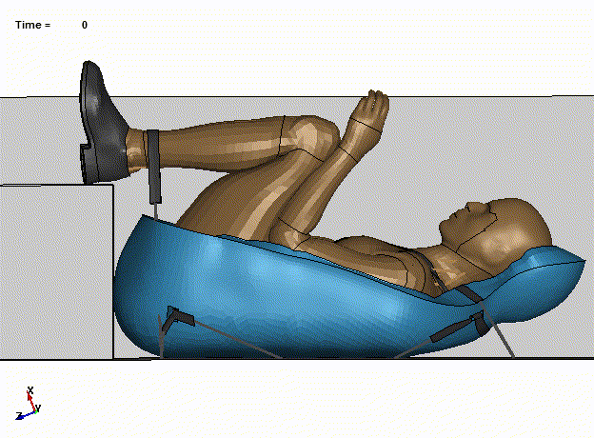
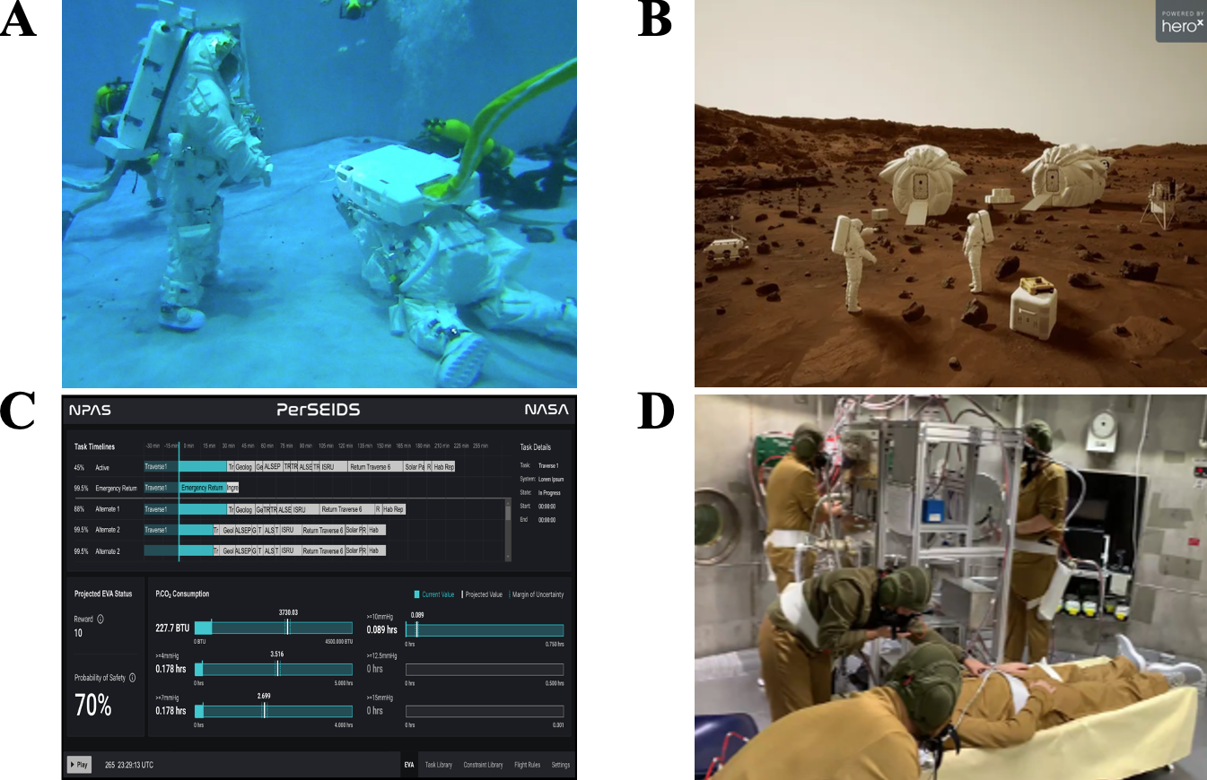
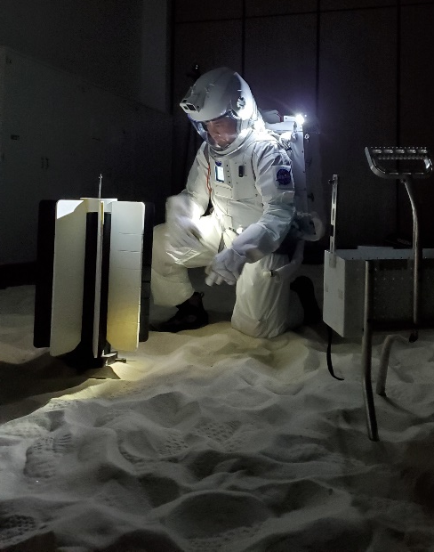
SPACESUIT PHYSIOLOGY
& PERFORMANCE
Protecting crew health and performance during suited testing, training and operations
Decompression sickness risk quantified and efficiently mitigated for exploration destinations
Suited injury risk quantified and mitigated for all anthropometries
Physiological & cognitive capabilities & constraints understood for all tasks
Physiological & cognitive monitoring and decision support solutions identified for operations with delayed or interrupted space-ground comm
Suited Fit & Injury Technologies
Prebreathe protocols only valid for microgravity EVAs & specific atmospheres
Ground, ISS, and Apollo suit injuries documented; 27 potential injury mechanisms identified
Crew capabilities & constraints adequately known for ISS EVA only
Limited crew state monitoring (metabolic & heart rate); fully ground-based decision support
Current Capabilities (ISS)
PersEIDS Testing in APACHE
Capability Gap | Gaps | Priority | Projects
Spacesuit Fit & Injury | 2938 | Mid-term Enabling | Spacesuit Fit & Injury Technologies (S-FIT)
Suited Physiology & Performance | 2937 | Mid-term Enabling | Crew State & Risk Model (CSRM)
Suited Autonomous Health Monitoring & Decision Support | 2941 | Near-term Enabling | Personalized EVA Informatics & Decision Support (PersEIDS)
Decompression Stress Prediction & Mitigation | 2943 | Mid-term Enabling | Aerospace Estimation Tool for Hypobaric Exposure Risk (AETHER)

Slide 14
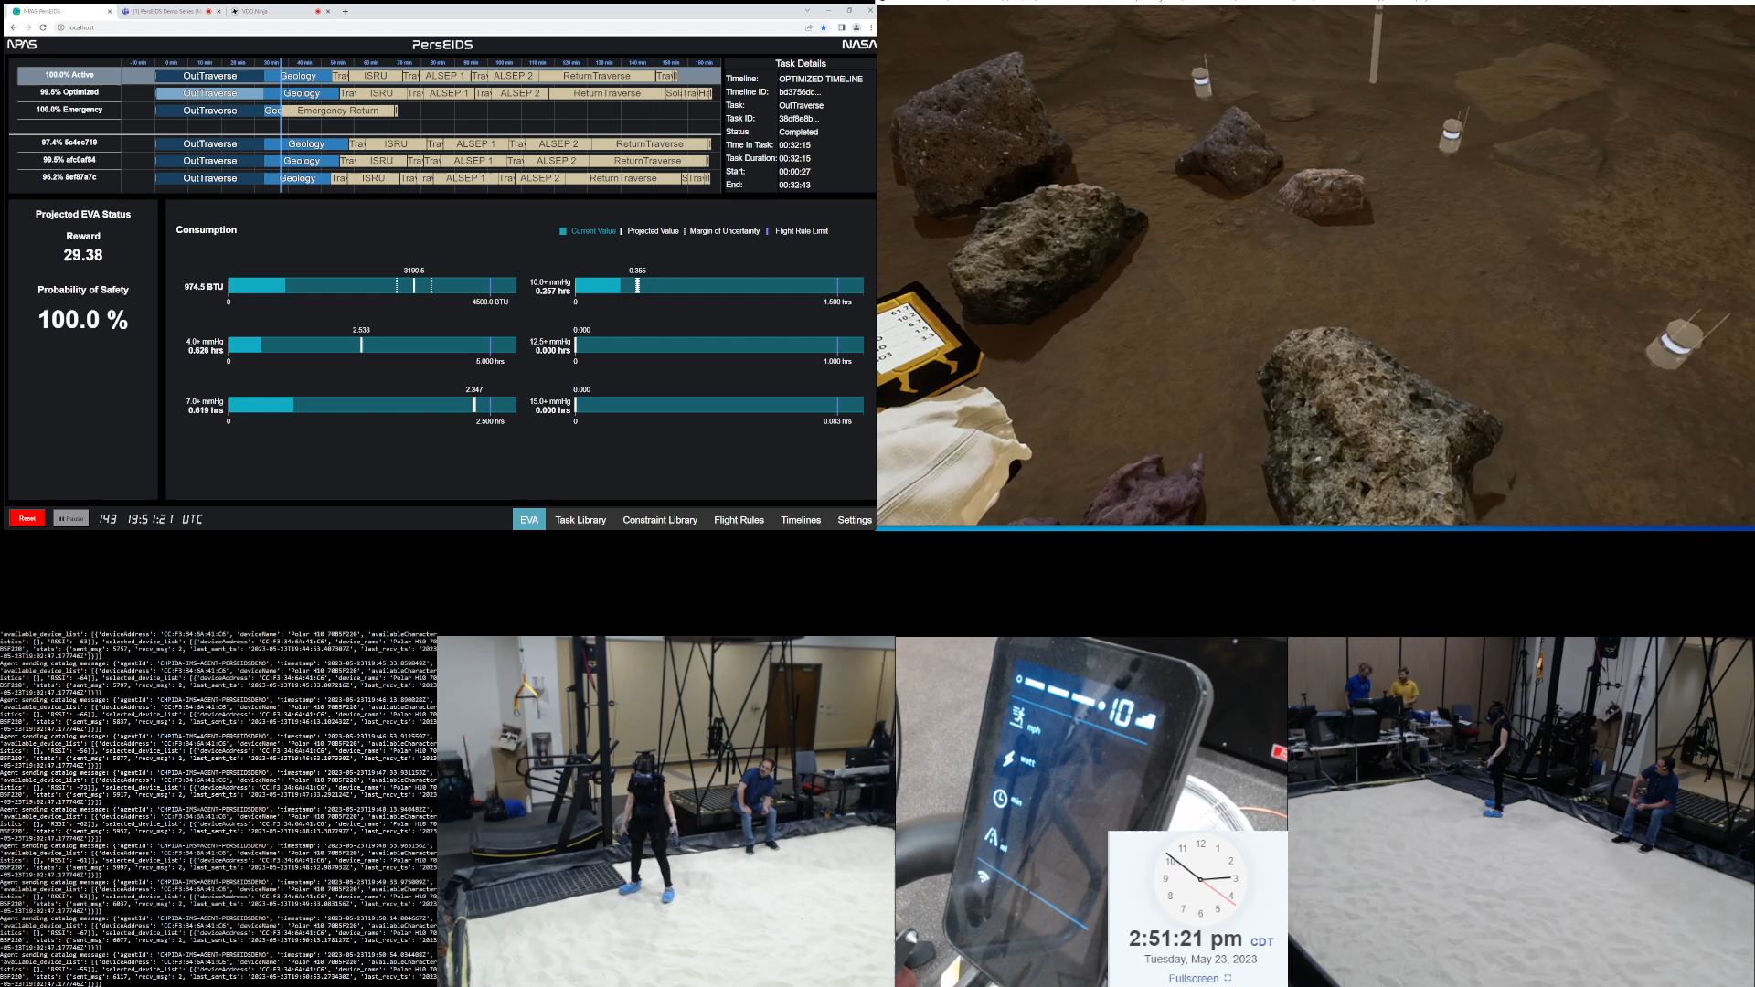
Personalized EVA Informatics & Decision Support (PersEIDS)
Emergency return timeline projection/ simulation
APACHE Test Environment

Slide 15

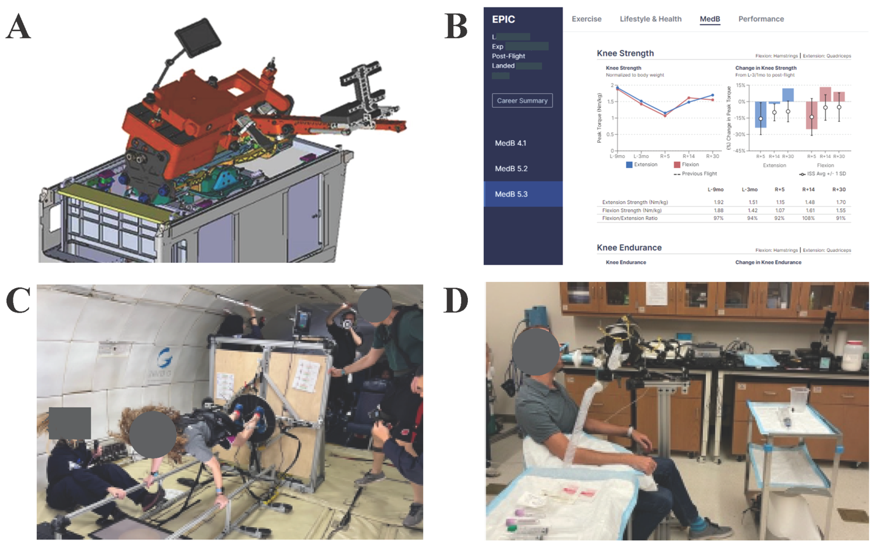
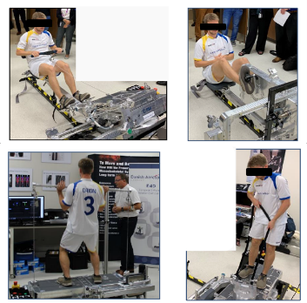
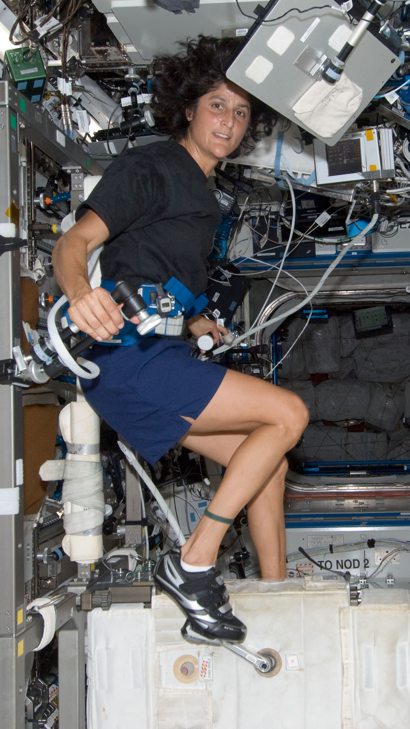
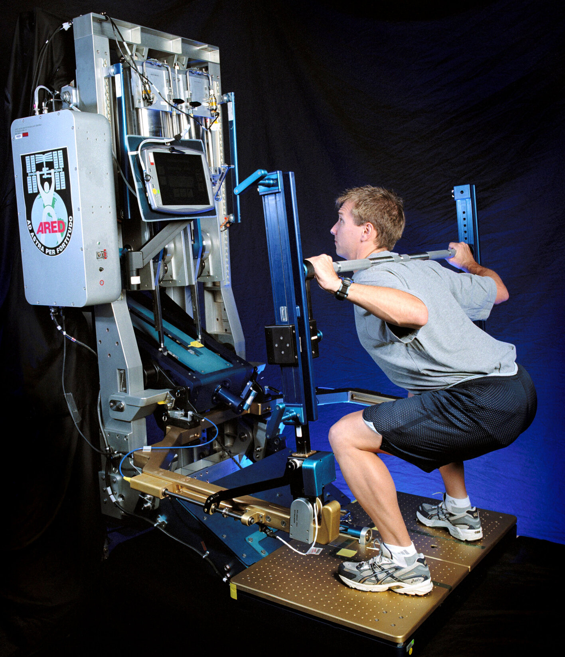
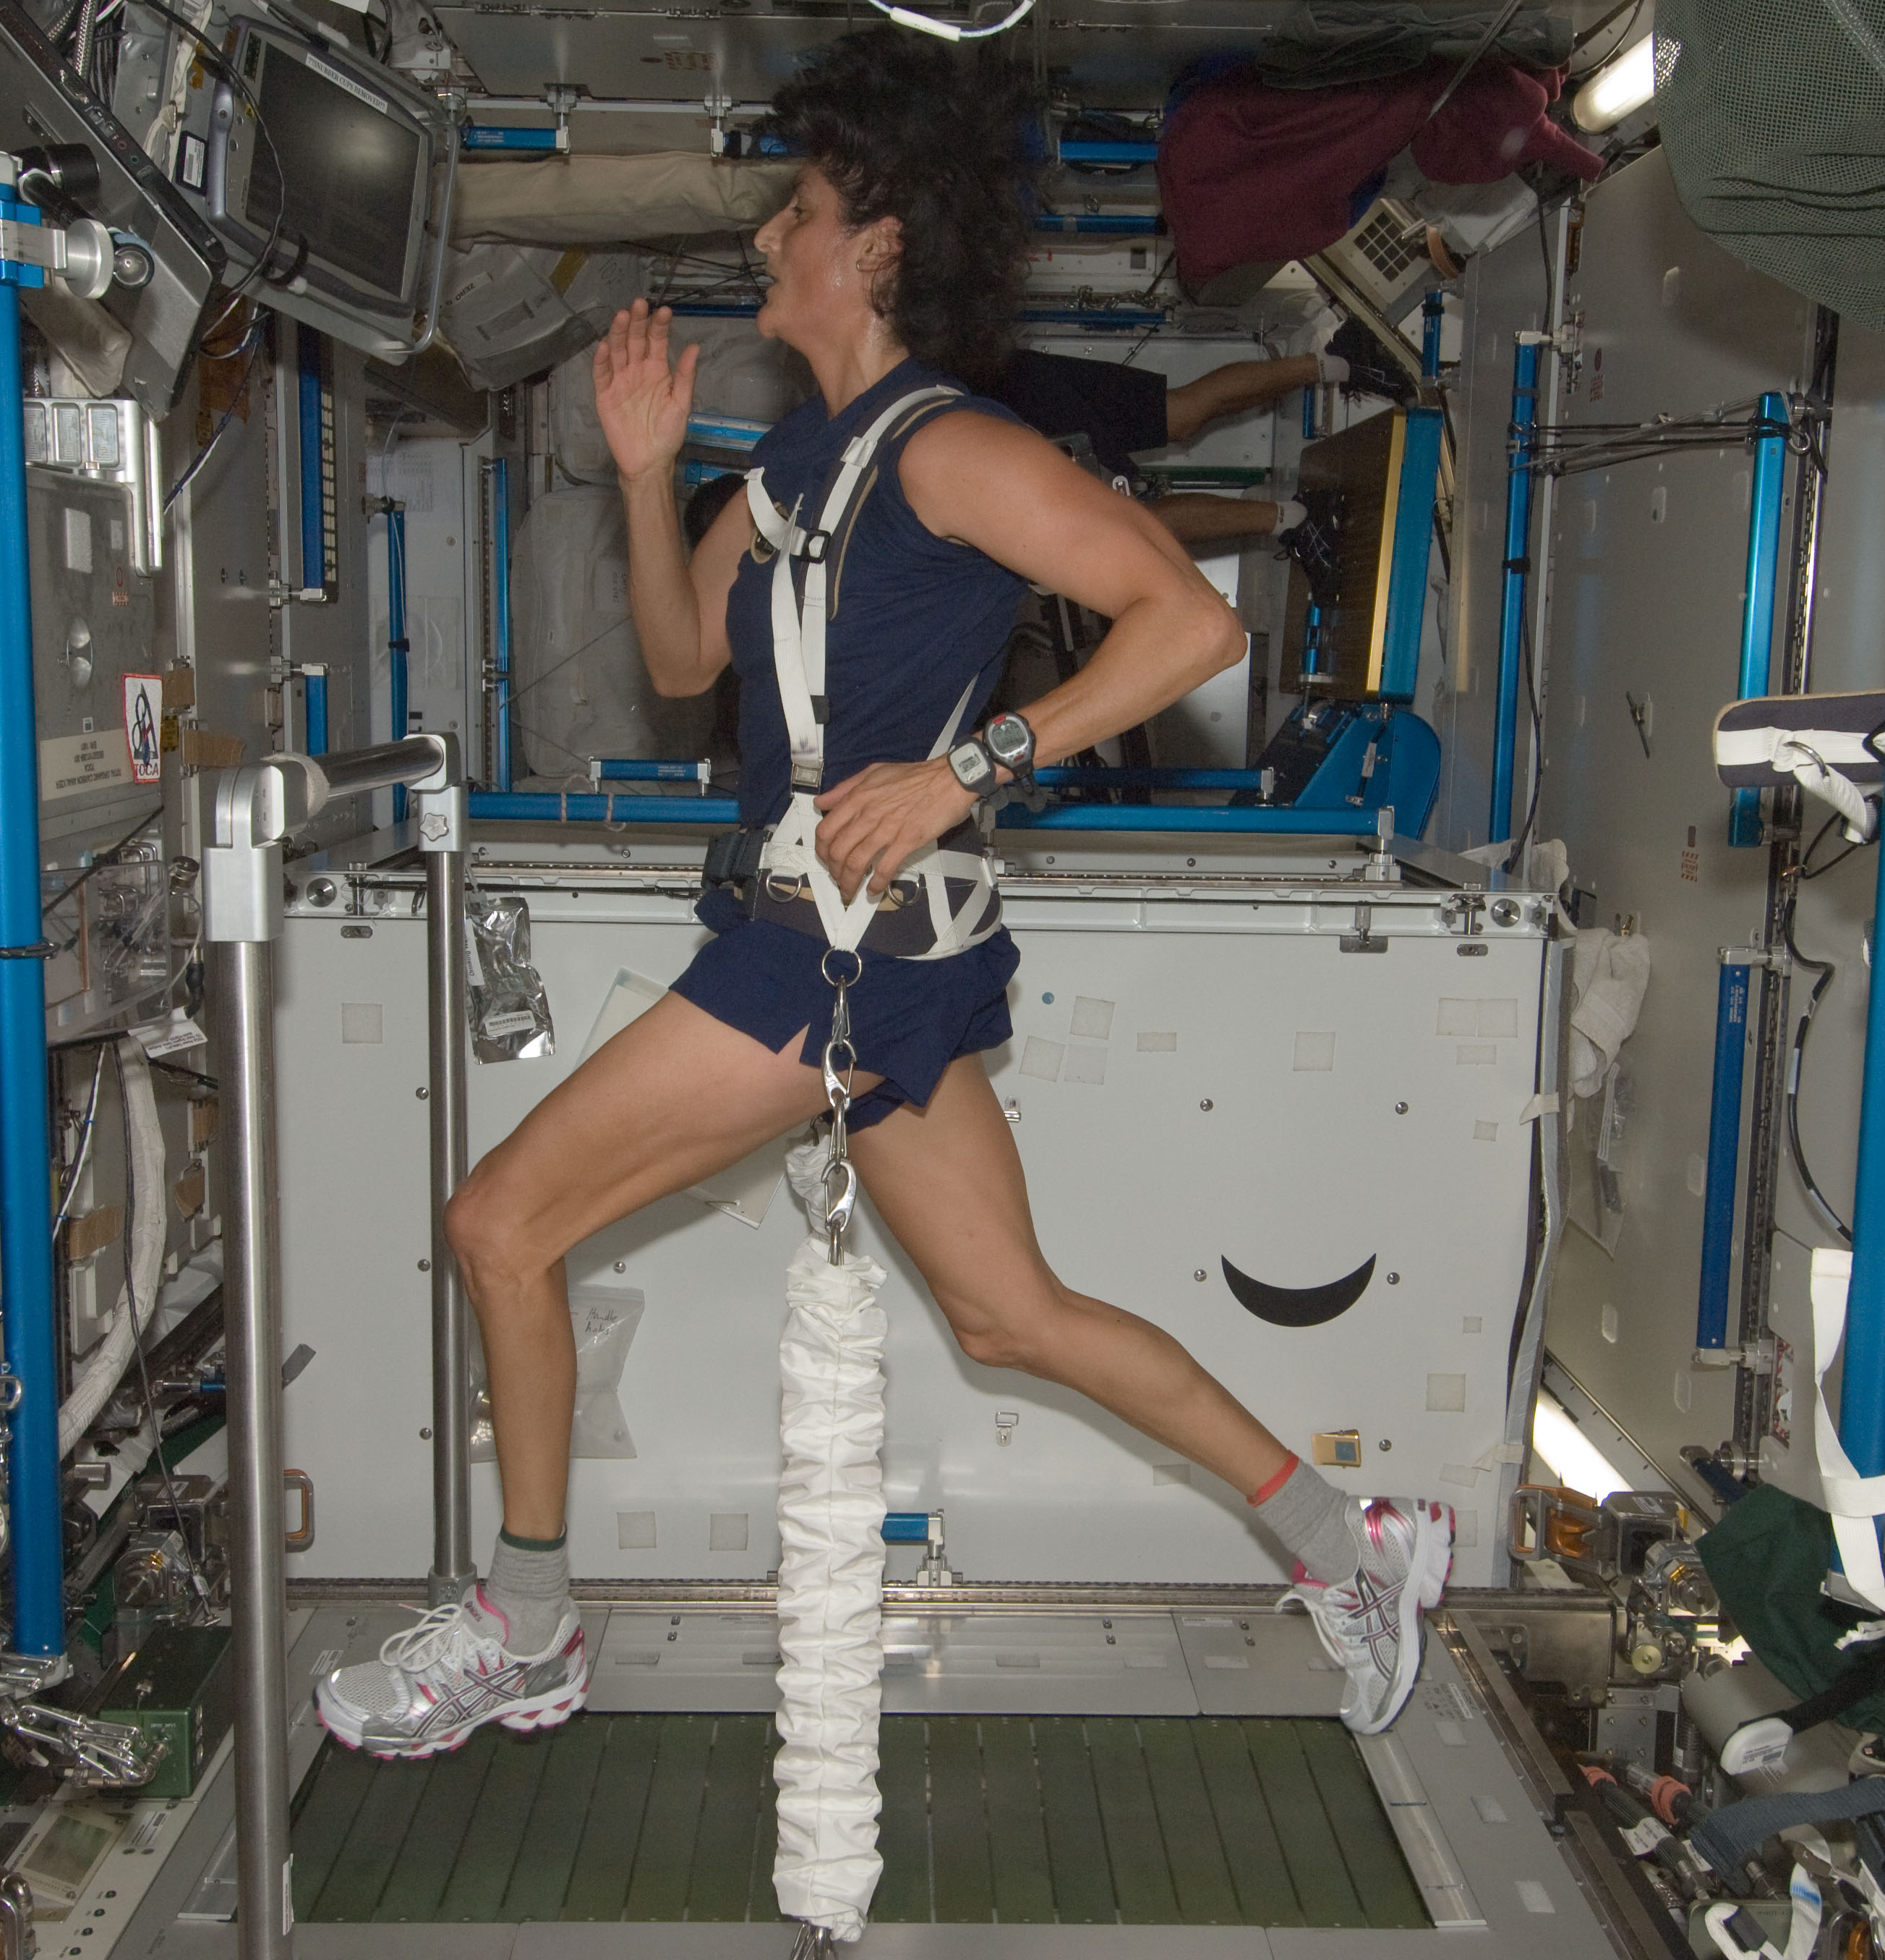
CREW HEALTH COUNTER-MEASURES
Exercise devices and other technologies to mitigate the effects of spaceflight on crew health & performance
Reduced mass and volume; increased reliability
Maintain/monitor fitness in-flight to enable unassisted landing egress & EVA
Validated lunar & Mars fitness standards (incl. sensorimotor)
Current Capabilities (ISS)
Advanced Resistive Exercise Device
COLBERT (treadmill)
CEVIS (cycle ergometer)
Mass: ~4300 lbs *
Volume: ~19 m³
Power: ~2100 Watts
EPIC / HERMES Informatics
Sensorimotor Balance Board
ESA’s E4D Exercise Device Prototype
Capability Gap | Gaps | Priority | Projects
CHC and Performance Informatics | 2954 | Near-term Enabling | EPIC / HERMES
Expl. Exercise System | 2952; 2947 | Near-term Enabling | E4D (ESA) | Ex VIS | Zero-T2 Study
Expl. Sensorimotor Countermeasures (CM) | 3492 | Near-term Enabling | Balance Board
Expl. Cardiovascular CM | 3514 | Mid-term Enhancing | Fluid Loading Protocol | Orthostatic Intolerance Garment
Expl. Behavioral Health & Performance CM | New | TBD | BHP Roadmap in definition

Slide 16

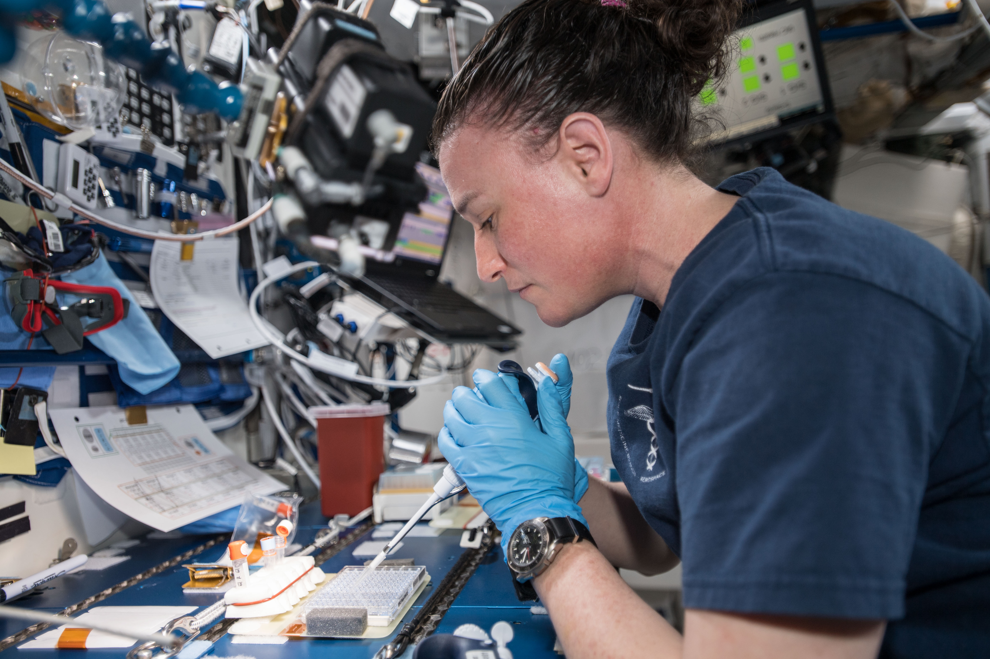
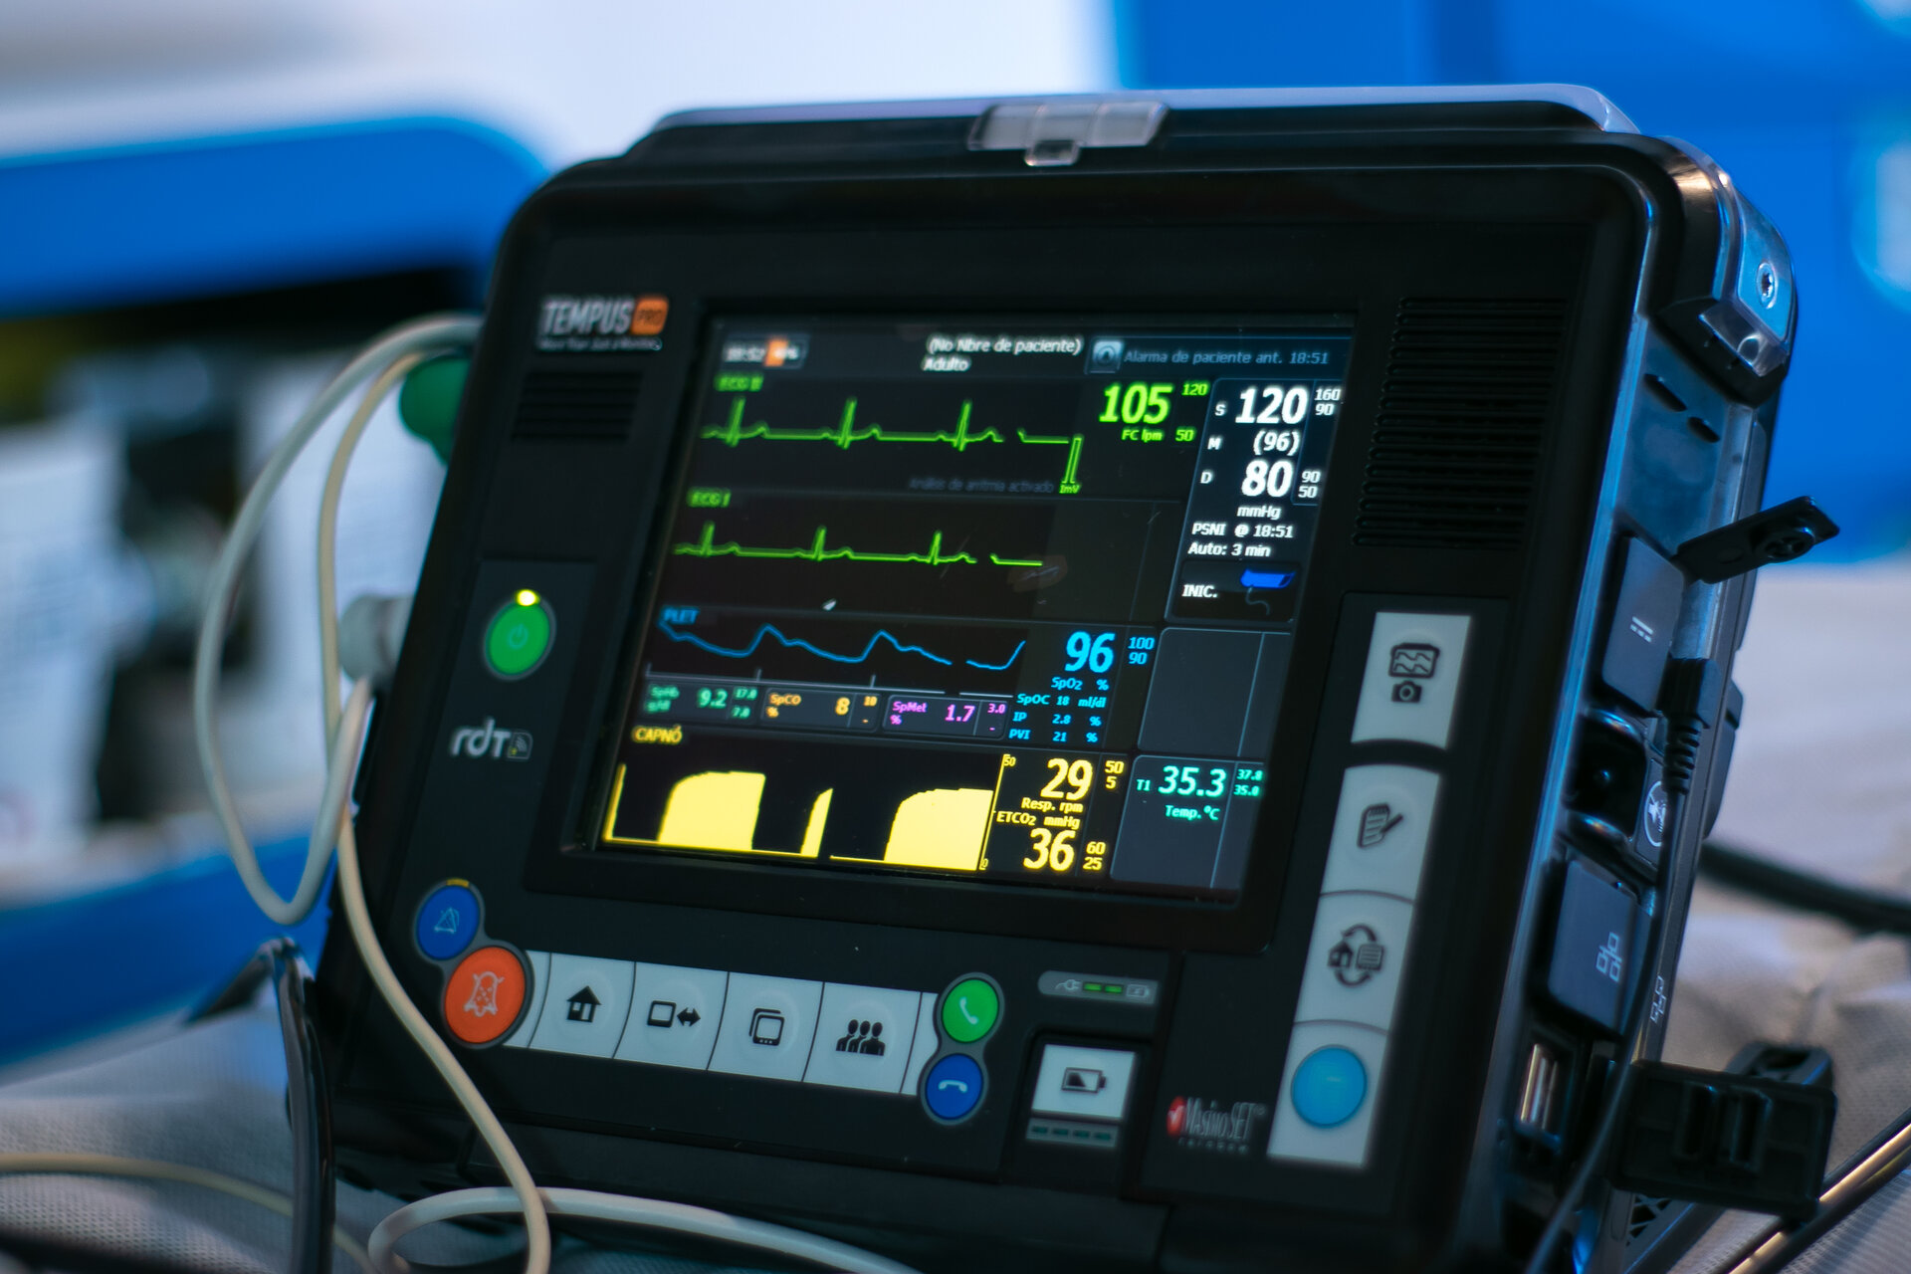
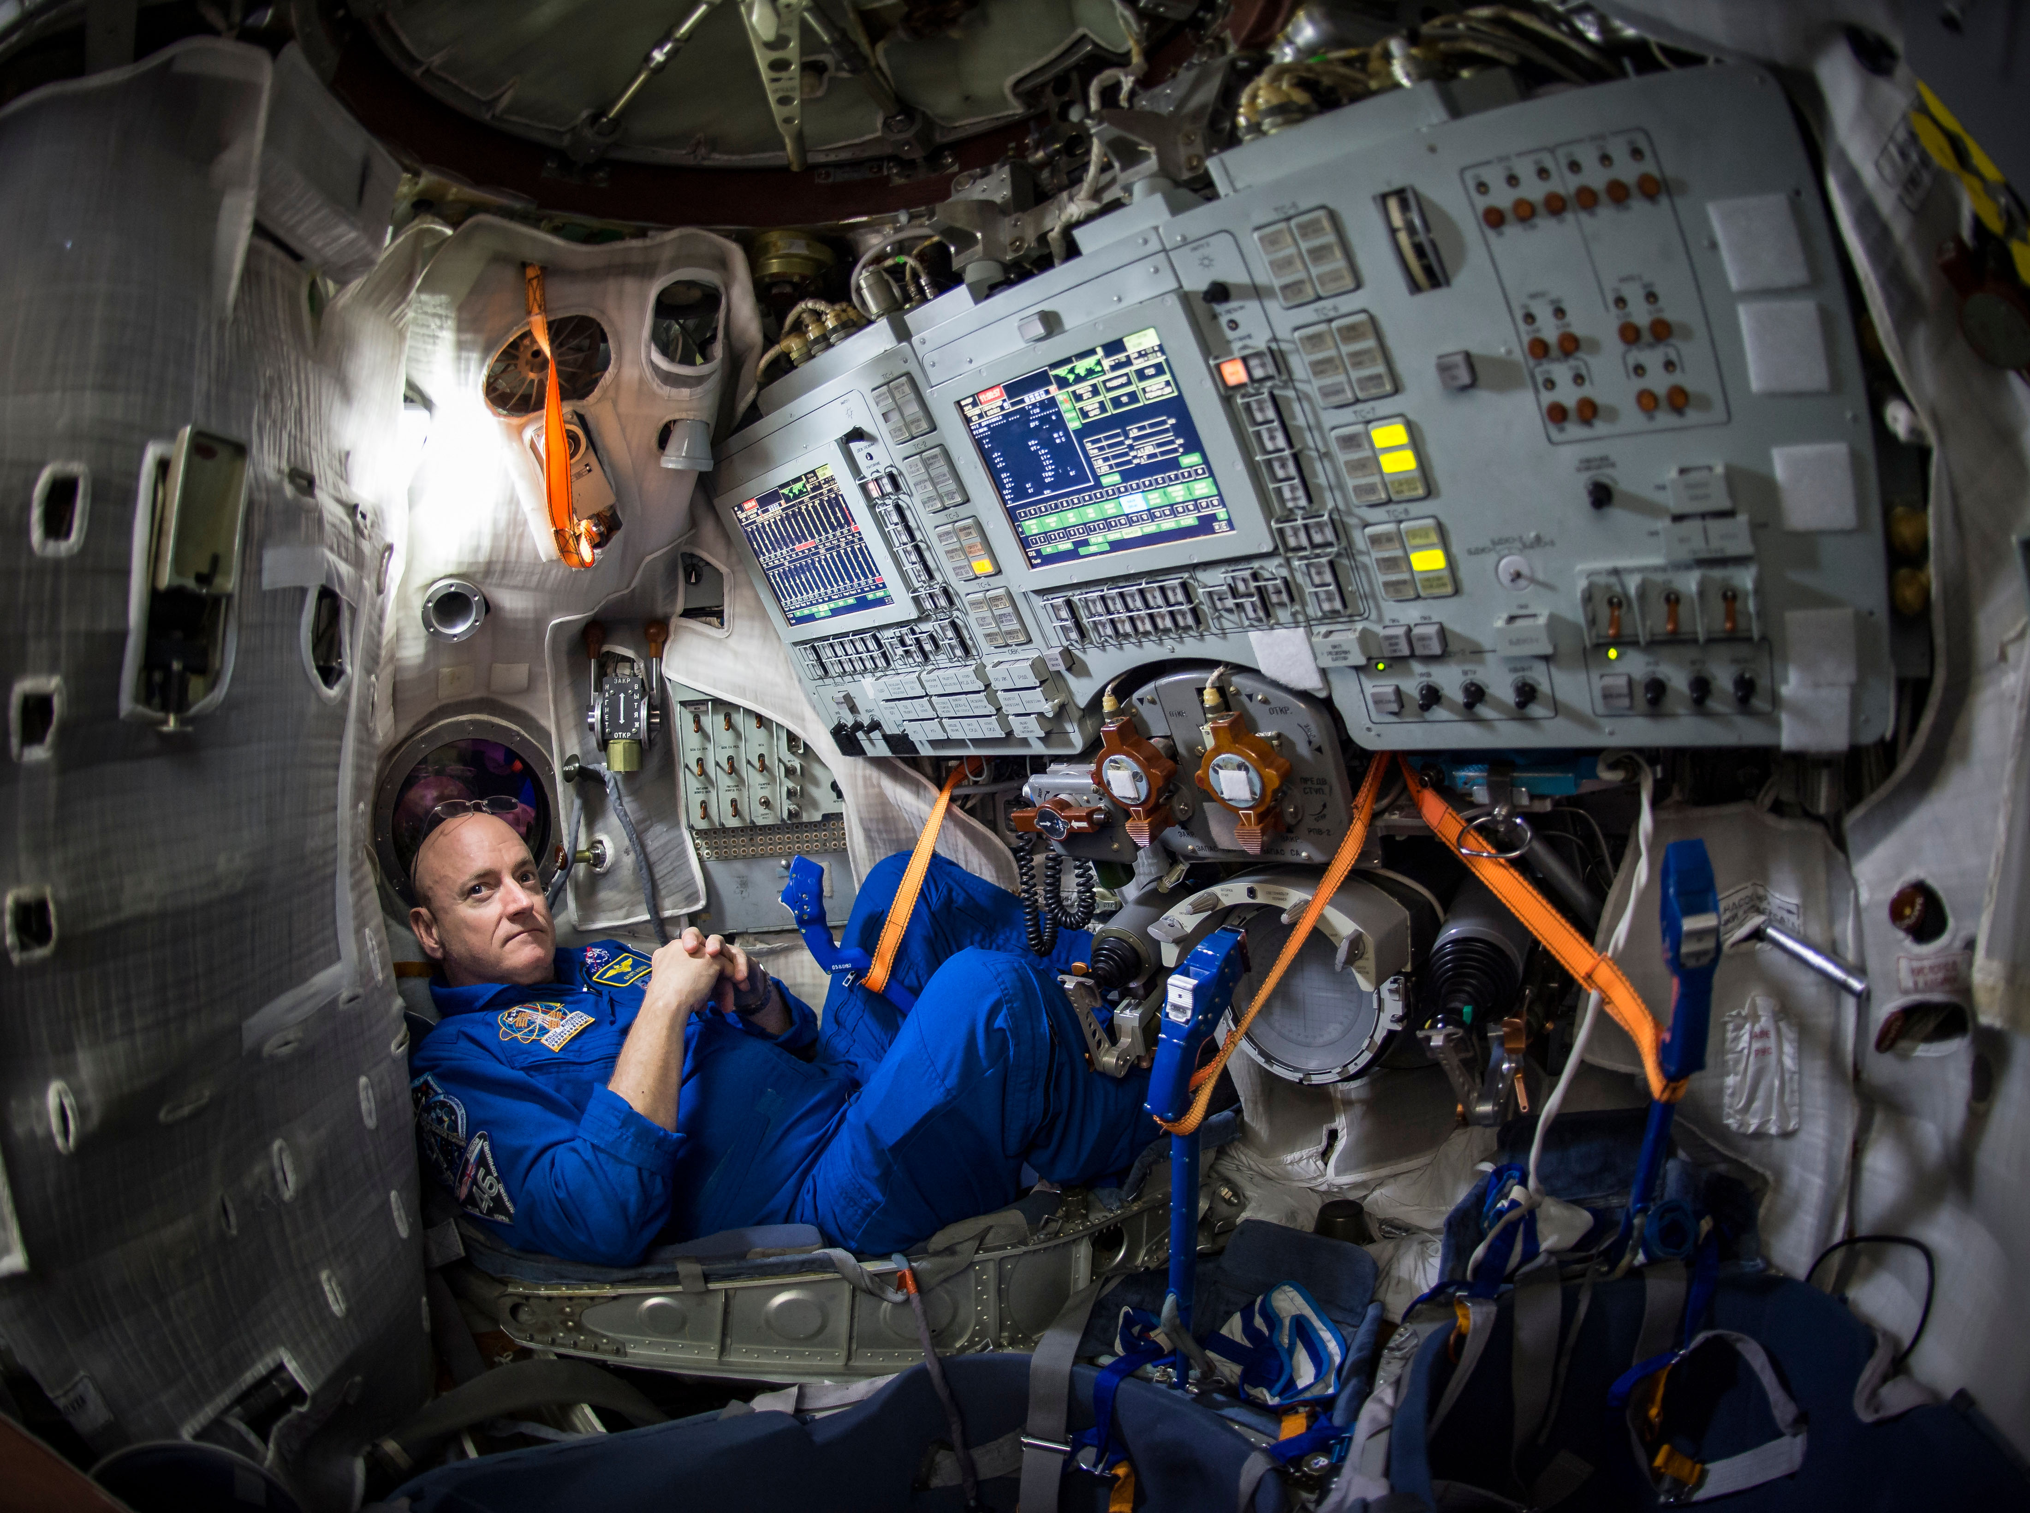
EXPLORATION MEDICAL
Protocols, technology, and supplies to address in-mission medical conditions
In-flight diagnostics and treatment for 100 of 120 medical risk conditions
Autonomous medical skill and & decision support systems
Long-Duration Pharma
Conventional medical capabilities with real-time supervision & support always available from ground
Regular resupply of consumables and replacement of equipment as needed
Current Capabilities (ISS)
Multi-functional Medical Devices
BHP Diagnostics & Treatment Aides
Capability Gap | Gaps | Priority | Projects
Imaging, Diagnostics & Treatment | 2950 | Near-term Enabling | Regenerable IV Fluid Device Development (Mini IVGEN); Multifunctional Integrated Medical Device; SANS Diagnostic Devices; Mini X-ray;
Medical Ops Decision Support & Informatics | 2904; 2905 | Near-term Enabling | Automated Medical Inventory System (AMIS); Ex. Electronic Heath Record; Hololens Tech Demo; CHP Integrated Data Architecture
Long-Duration Pharmaceuticals | 3508 | Mid-term Enabling | Medications Vacuum Testing; Exploration Formulary
Behavioral Health and Performance Medical Technologies | 2911 | Near-term Enabling | Autonomous BHP Diagnostic/Treatment Aides

Slide 17

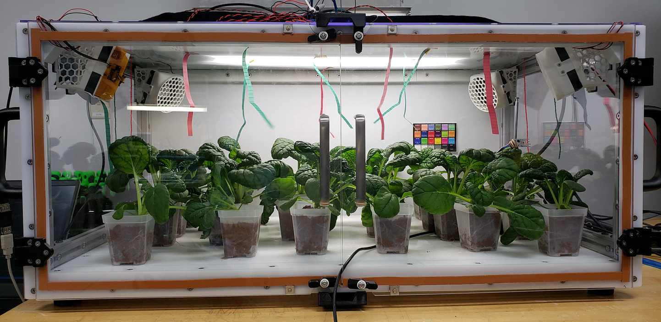
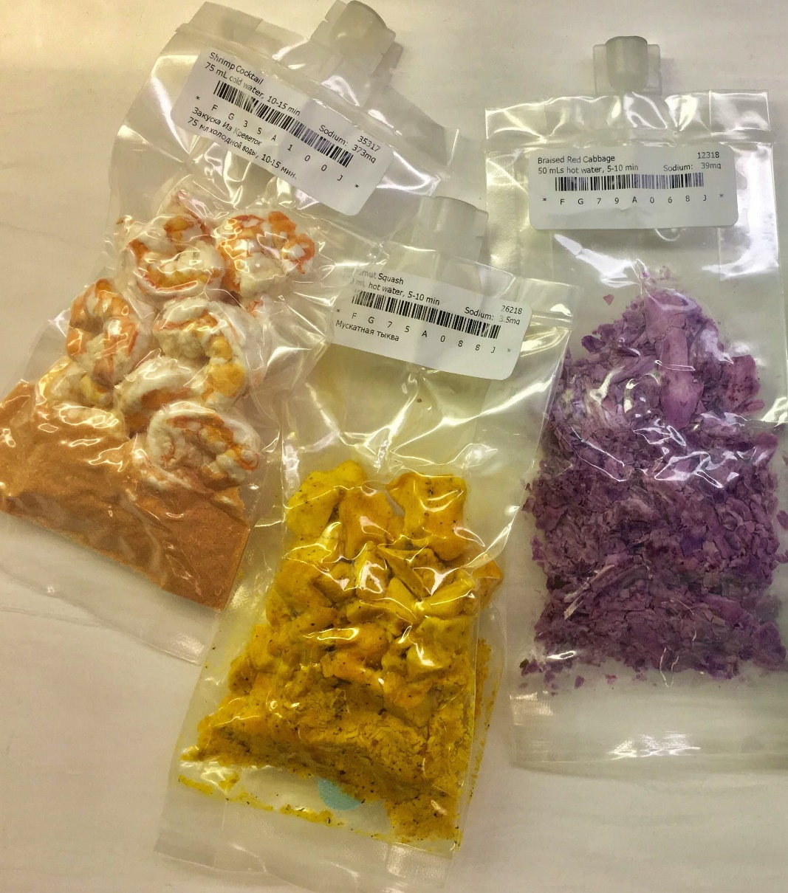
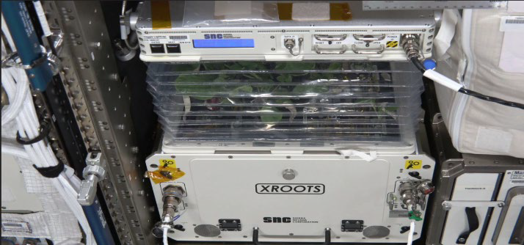

FOOD & NUTRITION
Safe, acceptable, nutritious & resource-efficient foods for exploration missions
100% of nutrient stability >5-year shelf life
Food acceptability >90%
< 30% launched water content
Exploration in-flight nutrition intake monitoring
1.5 year shelf life, fresh food resupply every 2-3 months
~215 standard food items, μg plant experiments
~47% launched water content
In-flight nutrient intake monitoring in development
Current Capabilities (ISS)
Airflow test in Ohalo growth chamber prototype
Reduced Water Content Food
Aero/hydroponic crop experiment
CHAPEA: 1 year Food Study
Capability Gap | Gaps | Priority | Examples
Long Duration Food System | 2944 | Near-term Enabling | Crop systems (VEGGIE, APH; OHALO III, XROOTS); Alternative nutrition sources (bacterial, algae, fungi); Synthetic biology approaches (CUBES)
Food System Efficiency | 2945 | Near-term Enabling | Prepackaged food water content reduction
Food Impacts to Health and Performance | 2946 | Near-term Enabling | Crew Health and Performance Exploration Analog (CHAPEA)

Slide 18
Conclusions
Human System Capability gaps facilitate an integrated approach to NASA’s human-centered research and technology development
Human research at NASA is led by the Human Research Program; details on HRP projects can be found at humanresearchroadmap.nasa.gov
This paper summarizes NASA’s current technology development efforts associated with four different CHP capability areas: Spacesuit Physiology & Performance; Crew Health Countermeasures; Food; and Exploration Medical Systems
Roadmaps for each capability area aim to ensure at least one technological solution is available to address each identified Capability Gap
Gap closure does not in itself assure the health and performance of crewmembers in future spaceflight missions; definition of an integrated CHP System is a priority for NASA’s human-centered research and technology development integration
52nd International Conference on Environmental Systems
July 16-20, 2023

Slide 19
Questions?
52nd International Conference on Environmental Systems
July 16-20, 2023

