Slide 1
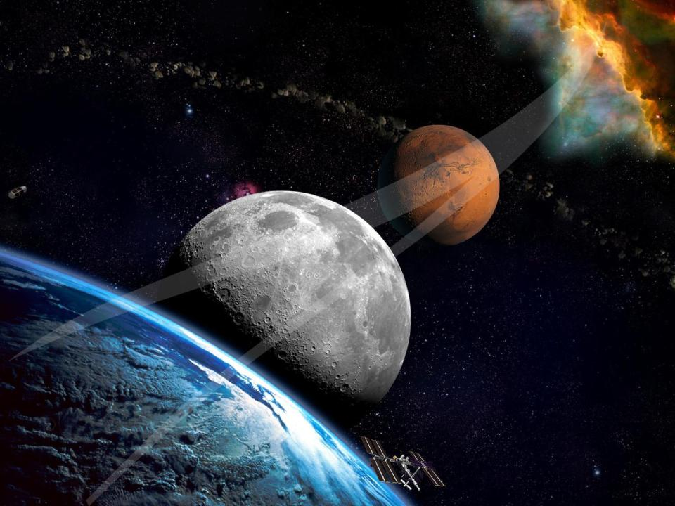

Parametric Analysis of the Charge-Hold-Vent Method for Cryogenic Propellant Tank Chilldown
Mariano Mercado
Jason Hartwig
NASA Glenn Research Center
Presented at:
The 2023 Cryogenic Engineering Conference
July 11th, 2023

Slide 2
Outline
Introduction
CHV Model Description
MATLAB Implementation
Parametric Analysis Base Case
Initial Parametric Results
CHV Parametric Trends
Model Validation
CHV Cycles vs Mass to Volume Ratio
Conclusion and Trend Summary
References

Slide 3
Introduction
The transfer of cryogenic propellants from a supply tank to a receiver tank in the microgravity of space can be broken down into five stages: (1) pressurization of the supply tank, (2) acquisition of single-phase liquid via propellant management devices, (3) transfer line chilldown, (4) chilldown of the receiver tank, and (5) fill of the receiver tank.
Regardless of the architecture, in the absence of internal or external heat exchangers, if the receiver tank is warm at the start of propellant transfer, some pre-cooling and thus venting will need to occur to ensure the high final fill fraction.
The Charge-Hold-Vent (CHV) method is a technique for thermodynamically chilling a tank before an on-orbit fill of a cryogenic propellant.
The method follows a cyclic “charge-hold-vent” process to remove the thermal energy stored in the tank mass.
This approach maximizes the cooling potential of the injected liquid cryogen by allowing the resultant vapor to superheat to near the tank wall temperature. The superheated vapor is then vented overboard, and a new cycle begins.

Slide 4
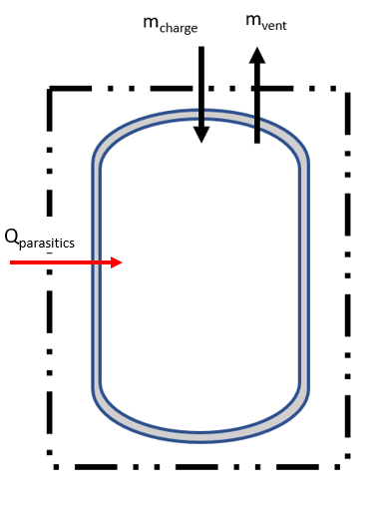
CHV Model Description
A time independent analytical CHV model was developed from first principles to quantify the number of cycles and propellant mass consumed
The thermodynamic equilibrium model used here is adopted and updated from [1]. The model uses conservation of mass and energy on the control volume shown in Figure 1.
Charge and Hold Phase:
  Mass is injected into the tank at a user specified state
  The model assumes the entirety of the charge fluid evaporates and reaches 95% of the wall temperature when the pressure at the end of the hold is equal to the tanks maximum expected operating pressure (MEOP)
  The temperature at the end of the hold is solved numerically and the mass injected during charge is calculated form the conservation of energy equation
Vent Phase:
  Each vent cycle is modeled by two processes which are repeated until the tank is evacuated to the desired pressure and ready for the next chilldown cycle to begin
  The first process is an adiabatic reversible venting of the vapor to an intermediate lower pressure
  The second process is the energy balance between the tank and this now colder vapor mass
Figure 1: CHV Control Volume

Slide 5
MATLAB Implementation
The model is coded up as a simple to use and quick MATLAB function with the following inputs:
The function outputs are the total (1) number of cycles, (2) total mass injected, and (3) a summary table of the state of the tank after each charge and intermediate step as shown in an example below for a chilldown test which starts at 247K and has a goal tank temperature of 53K
Property | Units
Tank MEOP | psi
Charge Pressure | psi
Charge Temperature | K
Intermediate Pressure Drop | Psi
Tank Initial/Evacuated Pressure | Psi
Initial Tank Temperature | K
Goal Tank Temperature | K
Tank Volume | m³
Tank Mass | kg
Fluid | -
Tank Material | -
 | Charge 1 | Charge 2 | Charge 3 | Charge 4 | Charge 5 | Charge 6
Initial Temperature for Cycle (K) | 247 | 216.3 | 184.8 | 151.84 | 115.27 | 54.59
Tank Temperature After Charge (K) | 222 | 190.8 | 158.31 | 122.61 | 67.73 | 53
Tank Temperature After Venting (K) | 216.3 | 184.8 | 151.84 | 115.27 | 54.59 | 52.7
Mass Injected per Cycle (kg) | 1.5 | 1.74 | 2.11 | 2.73 | 5.05 | 0.08

Slide 6
Parametric Analysis Base Case
To evaluate the effect of each input on the overall number of cycles (N) and propellant mass consumed (m), a parametric study was conducted
The base case inputs are shown in the table below. Each property was then varied while holding all the other properties constant
Property | Value
Tank MEOP (psi) | 100
Charge Pressure (psi) | 40
Charge Temperature (K) | 78
Intermediate Pressure Drop (psi) | 5
Tank Initial/Evacuated Pressure (psi) | 2
Initial Tank Temperature (K) | 305
Goal Tank Temperature (K) | 120
Tank Volume (m³) | 0.424
Tank Mass (kg) | 183.2
Fluid | Nitrogen
Tank Material | 5086 Aluminum

Slide 7
Initial Parametric Results
Results indicates that tank MEOP, tank volume, tank mass, and target temperature are the primary parameters that impact N and m and will be explored subsequently.
The tank material does impact propellant consumed, but it is accounted for in the tank mass and MEOP. In general, lighter weight and higher-pressure capable metals will always lead to reduced # of cycles and consumed mass.
The initial/evacuated receiver tank pressure can reduce the number of cycles but its effect on the mass consumed is more pronounced. Lower evacuation pressures reduce the mass consumed during the chill and NVF testing has shown that the initial tank pressure at the start of fill significantly impacts the probability of successful fill as well as the total allowable final fill fraction [2].
The inlet liquid temperature has a secondary impact on N and m; colder injected fluid per charge equates to more tank wall cooling potential per charge. Meanwhile, the inlet liquid pressure has little-to-no impact on N or m, due to weak relationship between enthalpy and pressure.
 | N Cycles | Mass Consumed [kg]
Base Case | 18 | 92.5
Receiver Tank Volume Variation [0.424 m³ Base]
0.212 m³ | 36 | 91.1
0.848 m³ | 9 | 94.7
1.696 m³ | 5 | 96.5
Receiver Tank Mass Variation [183.5 kg Base]
91.5 kg | 9 | 47.3
366 kg | 36 | 182.1
Receiver Tank Material Variation [5086 Al Base]
316 SS | 22 | 109.2
6A1-4V Ti | 12 | 59.8
Tank MEOP Variation [689.5 kPa Base]
344.7 kPa | 38 | 91.3
1034.2 kPa | 12 | 93.5
Receiver Tank Initial Pressure Variation [13.8 kPa Base]
48.3 kPa | 19 | 92.9
103.4 kPa | 21 | 91.8
Inlet Liquid Pressure Variation [275.8 kPa Base]
413.7 kPa | 18 | 92.4
689.5 kPa | 18 | 92.4
Inlet Liquid Temperature Variation [78K Base]
86K | 19 | 97.4
73K | 18 | 88.7
Target Temperature Variation [120 K Base]
110 K | 19 | 96.8
160 K | 16 | 70.5

Slide 8
CHV Parametric Trends
Figure 2a) plots the # of CHV cycles and propellant mass consumed as a function of the MEOP for all other parameters fixed.
Figure 2b) plots the effect of varying tank volume, for all other parameters fixed.
Figure 2c) plots the effect of varying tank mass for all other parameters fixed.
Figure 2d) plots the effect of target temperature for all other parameters fixed.
a)
b)
c)
d)
Figure 2: CHV Parametric Trends

Slide 9
Model Validation
The CHV model was validated against the only publicly available datasets in literature.
Case 1 is from Chato and Sanabria [3] for a single CHV test using LH2 on a 116 kg, 4.94 m³ inner volume, 2219 Aluminum tank.
  The tank chilled down to the target temperature in 6 CHV cycles, consuming 14.5 kgs
  The model predicts 6 CHV cycles and 13.2 kgs
Case 2 is from Hartwig et al. [2] for a single CHV test using LN2 on a 12.3 kg, 0.22 m³ inner volume, 6-4 Titanium tank
  The tank reached the target temperature in 2 cycles, consuming 6.4 kgs
  The model predicts 2 cycles and 4.3 kgs
The model has perfect agreement on the number of CHV cycles for both cases but underpredicts the amount of mass consumed.
The reason for the discrepancy is because the model is a thermodynamic equilibrium model that does not factor in time. In other words, the hold phase runs to near-perfect equilibrium.
In the experiments, the hold phase lasted for a shorter, finite time, and not to full thermal equilibrium. The easiest way to address this in the model is to simply change the assumed final temperature difference between the fluid and wall from 95% to some lower percentage.

Slide 10
CHV Cycles vs Mass-to-Volume Ratio
Figure 3 plots smooth lines for each cryogen (hydrogen, nitrogen, oxygen, and methane) for all parameters fixed except the mass-to-volume-ratio.
As shown, there is a linear correlation between the # of CHV cycles and the mass-to-volume ratio.
While not immediately apparent, each fluid seems to have a corresponding x intercept, or a mass to volume ratio minimum for which more than 1 cycle is required.
Figure 3: CHV Cycles vs Tank Mass to Volume Ratio

Slide 11
Conclusion and Trend Summary
Key takeaway points from the CHV Parametric study are as follows:
The required number of CHV cycles is linearly proportional to the mass to volume ratio of the tank and is the primary parameter that impacts performance.
Tank mass is the main driver of propellant mass consumed. Mass consumed scales linearly with tank mass.
Maintaining the mass to volume ratio keeps the number of cycles constant but the propellant mass consumed is still directly proportional to the tank mass.
Increasing the tank MEOP decreases the number of cycles without changing the amount of propellant mass consumed but it is capped by the tank maximum allowable working pressure.
The tank material has a noticeable impact on performance but is primarily captured in the tank mass and MEOP.
Increasing the target temperature decreases the required number of CHV cycles and the propellant mass.
Inlet liquid temperature and pressure have a minor impact on # of cycles and mass.
The model agrees well with historical CHV data, and to make the model more conservative, a lower equilibrium temperature difference between the fluid and wall at the end of the hold phase can be chosen.
The model runs quickly and can easily be used for early-stage design, sizing, and analysis of current and future cryogenic propellant transfer systems.

Slide 12
References
[1] DeFelice, D.M. and Aydelott, A.C. “Thermodynamic Analysis and Subscale Modeling of Space-Based Orbit Transfer Vehicle Cryogenic Propellant Resupply” NASA-TM-87-1764, July, 1987.
[2] Hartwig, J.W., Stevens, J., Rhys, N. Clark, J., LeClair, A., and Majumdar, A. “Test Data Analysis of the CRYOTE-2 TVS Augmented Top Spray Injector Liquid Nitrogen Transfer Experiments” International Journal of Heat and Mass Transfer 194, 122986. 2022.
[3] Chato, D.J., and Sanabria, R. “Review and Test of Chilldown Methods for Space-Based Cryogenic Tanks” NASA-TM-104458 June, 1991.

Slide 13
Thank you!

