Slide 1
Attentional Limits and Advanced Air Mobility Ecosystem: A Model of Attention Allocation, Trust, and System Performance
Yusuke Yamani¹, Tetsuya Sato¹, Jessica Inman¹, Michael S. Politowicz^{1,2}, & Eric T. Chancey²
¹Old Dominion University
²NASA Langley Research Center
Notes:
Limit it to 10-12 slides

Slide 2
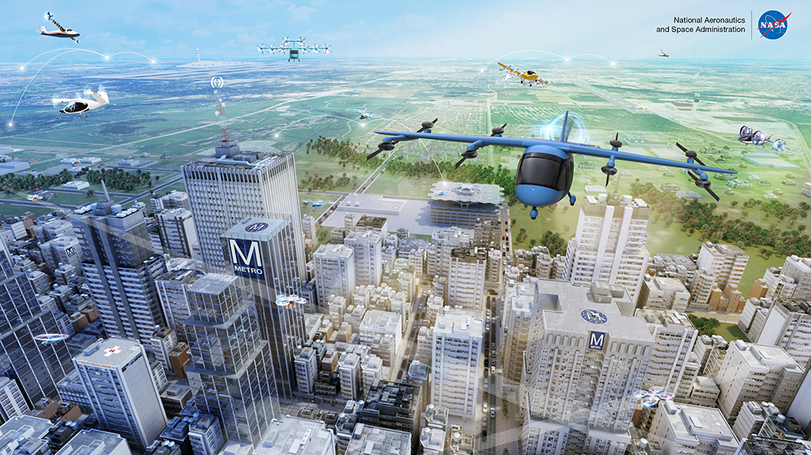
Advanced Air Mobility (AAM)
AAM applications encompass aerial transportation of goods and passengers across rural and urban environments (National Academies of Sciences, Engineering, and Medicine, 2020)
Mature AAM operations will be enabled by increasingly autonomous systems (Wing et al., 2020)
Shift from an active pilot-in-command to assisting/managing numerous increasingly autonomous aircraft (Sato et al., 2022)

Slide 3
Issue 1: Limited Tracking/Monitoring Capacity
Human operators can track/monitor limited number of objects in space
  Maximum tracking capacity of 8 objects (Alvarez & Franconeri, 2007)
  Supervisory control capacity ranges from 8-12 autonomous vehicles (Cummings & Guerlain, 2007)
  Human operators have limited attentional capacity to track/monitor multiple objects requiring them to selectively allocate attentional resources to certain objects (Wickens et al., 2021)

Slide 4
Issue 2: Automation Disuse, Automation Misuse, and Trust
Human operators can use automation in a counterproductive manner (Parasuraman & Riley, 1997)
  Automation misuse: human operators overly depend on unreliable automation
  Automation disuse: human operators under depend on reliable automation
Trust in automation can influence how human operators use automation (Lee & See, 2004; Parasuraman and Riley, 1997)
  Over trust → automation misuse
  Under trust → automation disuse

Slide 5
Objective
Provide a literature review on potential constructs that account for the issues in multi-vehicle management operations, including trust in automation and attention allocation
Propose a theoretical model describing the attentional resource allocation of human-technology interaction in multi-vehicle management operations

Slide 6
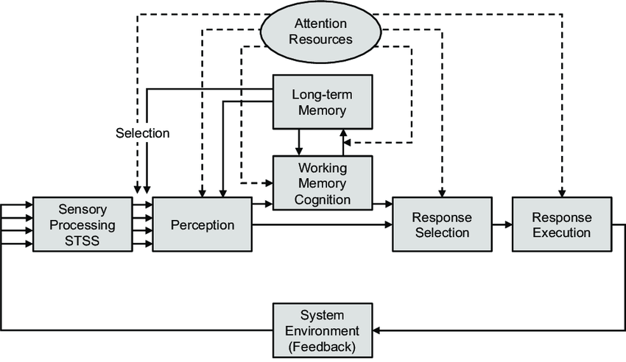
Human Information Processing Model (Wickens et al., 2021)
Information is processed through different stages of human-information processing (HIP)
Attentional resources are distributed across different HIP stages
Multiple tasks will compete for limited attentional resources
Wickens et al. (2021)

Slide 7
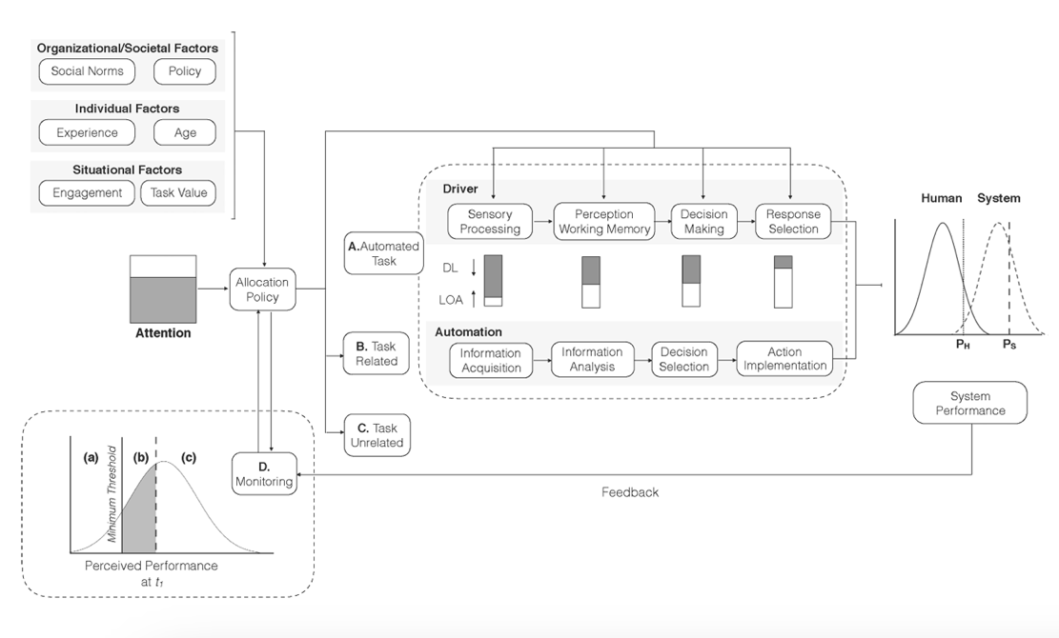
Yamani & Horrey (2018) Model
The human is expected to allocate attentional resources across three concurrent tasks:
  Task assisted by automation (i.e., automated task)
  Task related to the automated task (i.e., task related)
  Task unrelated to the automated task (i.e., task unrelated)
Yamani & Horrey (2018)

Slide 8
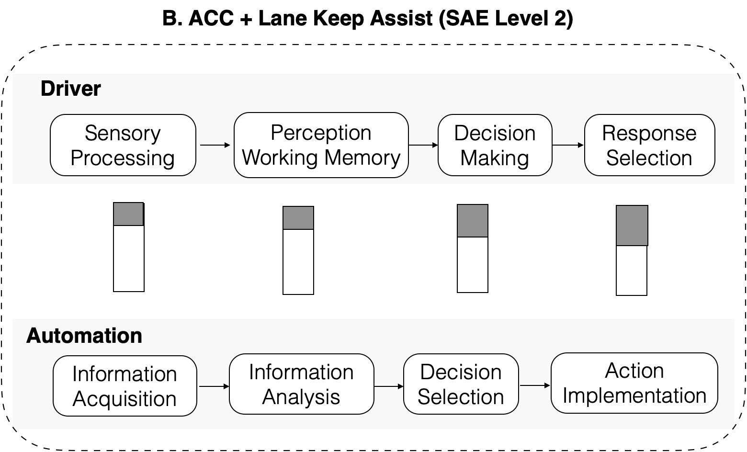
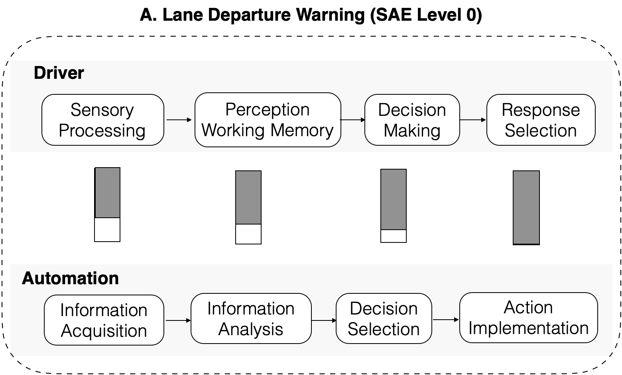
Yamani & Horrey (2018) Model
Implementing automation supports specific stages of HIP at varying levels, remobilizing attentional resources to tasks unsupported by automation or tasks that require more human input
Yamani & Horrey (2018)

Slide 9
Trust in Human-Automation Interaction
Trust is defined as “an attitude that an agent will help achieve an individual’s goals in a situation characterized by uncertainty and vulnerability” (Lee & See, 2004, pp. 51)
Basis of trust in automation (Lee & See, 2004)
  Performance
  Process
  Purpose

Slide 10
Trust in Human-Autonomy Teaming (HAT)
HAT: A distinguishable set of two or more agents (human operator, increasingly autonomous system) that interact dynamically, interdependently, and adaptively toward a common goal/objective/mission (adapted from Salas et al., 1992)
An autonomous agent/system possesses three qualities (Kaber, 2018)
  Viability
  Independence
  Self-governance
Sato et al.’s (2023a) survey study showed that public trust in drone operations was highest in a scenario describing drones that were not independent (i.e., the operations required human oversight), when compared to drones that were not able to self-govern or be viable in the operational environment
Notes:
Main point is that our proposed model will primarily integrate trust aspect from human-automation interaction literature.

Slide 11
Yamani & Horrey (2018)
Notes:
Show this figure again and state that our proposed model by adapting Yamani and Horrey’s (2018) model.

Slide 12
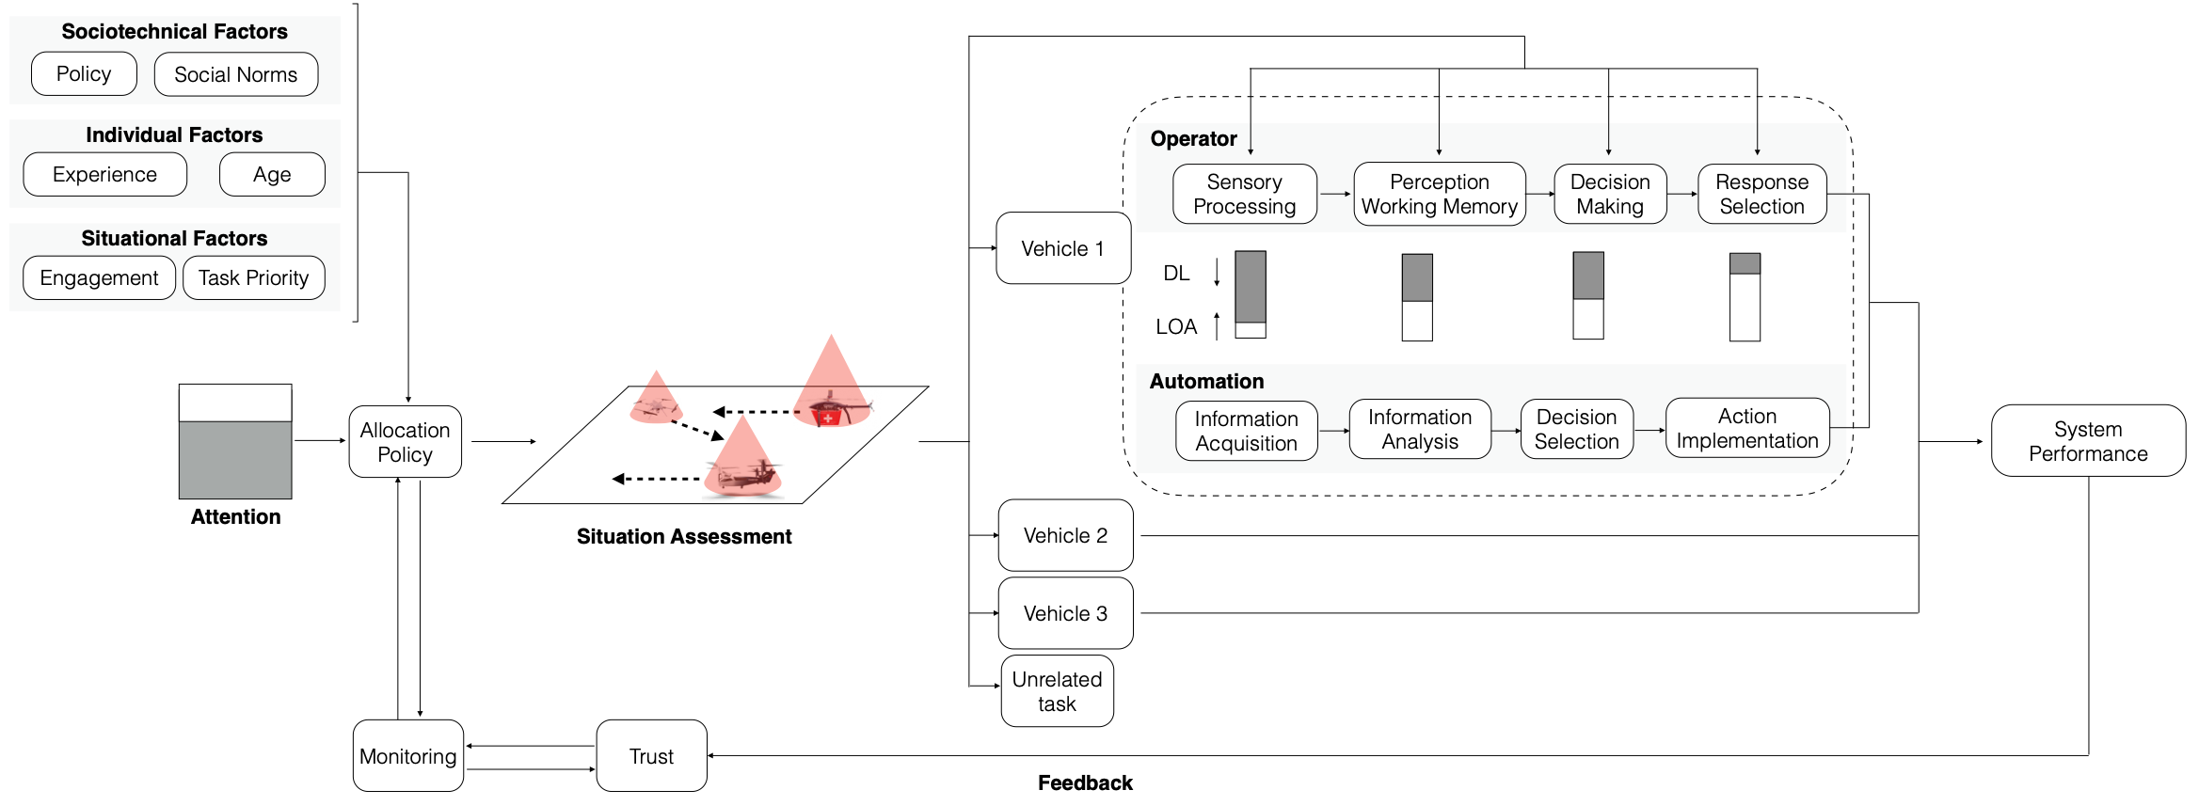
Human-Technology Interaction in AAM
Assumptions:
  Human is a capacity-limited information processor
  Human is ultimately responsible for the consequences of multiple air vehicles in an airspace
  Human operator is in the loop

Slide 13
Human-Technology Interaction in AAM
Notes:
Show this figure. State that an obvious difference between previous model and this model is the number of vehicles that human operators are tracking/monitoring.

Slide 14
Human-Technology Interaction in AAM
Notes:
Also, state that the levels and degrees of automation may vary across vehicles. Furthermore, it can fluctuate over time.

Slide 15
Human-Technology Interaction in AAM
Notes:
Show this figure and emphasize that situation assessment phase is integrated in the proposed model.

Slide 16
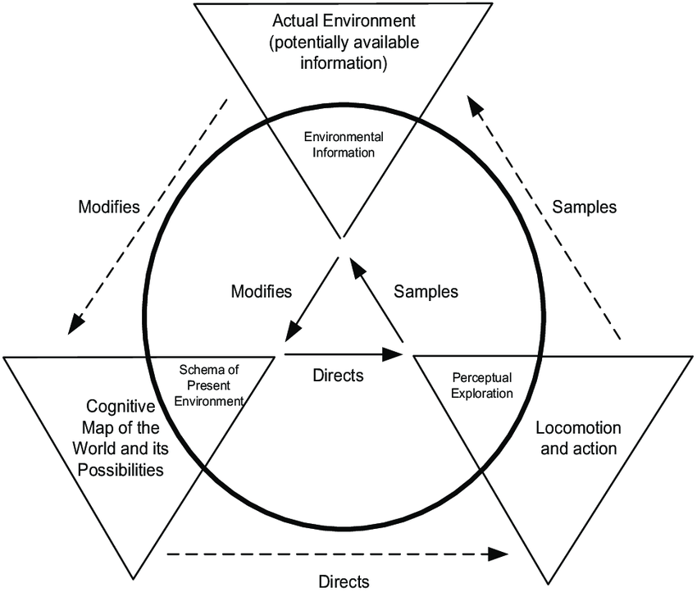
Situation Assessment
In multi-vehicle management operations, operators enter situation assessment phase where they sample objects in an environment to readjust their allocation of attentional resources
Attentional resources will be allocated to vehicles that…
  Behave abnormally
  Report malfunctions or functional failures
  Issue alarms
Neisser (1978)
Notes:
Situation assessment could possibly influence monitoring capacity limit such that they will expand their monitoring capacity by anticipating patterns of air vehicles to track. Consequently, they can effectively allocate resources to vehicles with less certainty. Alternatively, they can chunk individual vehicles as one group of vehicles, counting as one object, which expands their monitoring capacity.

Slide 17
Human-Technology Interaction in AAM
Notes:
Show this figure again and state that we added trust aspect into this proposed model.

Slide 18
Trust in Automation
Sato et al.’s (2023b) meta-analytic study showed a negative correlation between performance-based trust toward automation and visual percent dwell time toward a task assisted by automation across three human-in-the-loop experiments (Sato et al., 2020; Sato et al., 2023c; Sato & Yamani, 2023)
System-wide trust theory (Keller & Rice, 2009)
  Predicts that operators treat possibly independent automated aids as part of a larger integrated system and calibrate their trust toward the overall system rather than individual automated aids (i.e., operators can demonstrate a “contagion effect”)

Slide 19
Model Summary
Human operators will eventually be responsible for managing and assisting multiple vehicles in mature AAM operations
The outcome of situation assessment will influence the allocation of attentional resources to different air vehicles
Trust in automation or autonomous systems is a critical construct that influences attention allocation policy

Slide 20
Contact Info
Dr. Yusuke Yamani: yyamani@odu.edu
Tetsuya Sato: tsato003@odu.edu
Jessica Inman: jinman@odu.edu
Michael S. Politowicz: michael.s.politowicz@nasa.gov
Dr. Eric T. Chancey: eric.t.chancey@nasa.gov

Slide 21
References
Alvarez, G. A., & Franconeri, S. L. (2007). How many objects can you track?: Evidence for a resource-limited attentive tracking mechanism. Journal of vision, 7(13), 14-14.
Cummings, M. L., & Guerlain, S. (2007). Developing operator capacity estimates for supervisory control of autonomous vehicles. Human Factors, 49, 1-15.
Kaber, D. B. (2018). A conceptual framework of autonomous and automated agents. Theoretical Issues in Ergonomics Science, 19, 406-430.
Keller, D., & Rice, S. (2009). System-wide versus component-specific trust using multiple aids. The Journal of General Psychology: Experimental, Psychological, and Comparative Psychology, 137, 114-128.
Lee, J. D., & See, K. A. (2004). Trust in automation: Designing for appropriate reliance. Human Factors, 46, 50-80.
National Academies of Sciences, Engineering, and Medicine. (2020). Advancing aerial mobility: A national blueprint. National Academies Press.
Neisser, U. (1978). Perceiving, anticipating, and imagining. Minnesota Studies in the Philosophy of Science, 9, 89-105.
Salas, E., Dickinson, T. L., Converse, S. A., & Tannenbauem, S. I. (1992). Toward an understanding of team performance and training. In R. W. Swezey and E. Salas (Eds.), Teams: Their training and performance (pp.3-29). Norwood, NJ: Ablex.
Sato, T., Politowicz, M. S., Islam, S., Chancey, E. T., & Yamani, Y. (2022). Attentional considerations in advanced air mobility operations: control, manage, or assist? Proceedings of the Human Factors and Ergonomics Society Annual Meeting, 66, 28-32.
Sato, T., Yamani, Y., Liechty, M., & Chancey, E. T. (2020). Automation trust increases under high-workload multitasking scenarios involving risk. Cognition, Technology & Work, 22, 399-407.
Sato, T., Inman, J., Politowicz, M., Chancey, E. T., & Yamani, Y. (2023a). The Influence of Viability, Independence, and Self-Governance on Trust and Public Acceptance of Uncrewed Air Vehicle Operations. Proceedings of the Human Factors and Ergonomics Society 2023 Annual Meeting.
Sato, T., Inman, J., Politowicz, M. S., & Yamani, Y. (2023b). A meta-analytic approach to investigating the relationship between trust and attention allocation. Proceedings of the Human Factors and Ergonomics Society 2023 Annual Meeting.
Sato, T., Islam, S., Still, J. D., Scerbo, M. W., & Yamani, Y. (2023c). Task priority reduces an adverse effect of task load on automation trust in a dynamic multitasking environment. Cognition, Technology & Work, 25, 1-13.
Sato, T., & Yamani, Y. (2023). Interruption frequency influences response time in multitasking flight simulated environment, but not human- automation trust [Manuscript submitted for publication]. Department of Psychology, Old Dominion University.
Wickens, C. D., Hollands, J. G., Banbury, S., & Parasuraman, R. (2021). Engineering psychology and human performance (5th ed.). Boston, MA: Pearson.
Wing, D. J., Chancey, E. T., Politowicz, M. S., & Ballin, M. G. (2020). Achieving resilient in- flight performance for advanced air mobility through simplified vehicle operations. In AIAA Aviation 2020 Forum (p. 2915).
Yamani, Y., & Horrey, W. J. (2018). A theoretical model of human-automation interaction grounded in resource allocation policy during automated driving. International Journal of Human Factors and Ergonomics, 5, 225-239.

