Slide 1
A Liquefaction Model for a Cryogenically Refrigerated Ellipsoidal Tank
Paper No.: C3Or2A-03
A. Hedayat, A.R. Koch, A.C. Leclair, A. K. Majumdar
Propulsion Department, Marshall Space Flight Center, Huntsville, AL 35812, United States
S.M. Ghiaasiaan
Georgia Institute of Technology, Atlanta, GA, United States
CEC/ICMC, July 12, 2023, Honolulu, HI

Slide 2
Outline
Introduction
Modeling Approach
Film Condensation Model
Modeling of Liquefaction Process within Tank
GFSSP Model
GN2 CryoFILL Test
Model Predictions Vs. Test Data
Summary
References

Slide 3
Introduction
ISRU technology is critical for NASA’s future human spaceflight efforts [1,2].
NASA is developing technology to produce cryogenic propellants on the Lunar and Martian surfaces.
ISRU (in-situ resources utilization) techniques collect resources in gaseous form, and they must be purified and condensed to be used as propellant.
Liquefaction is a combination of convection and condensation processes. Both processes must be modeled in detail.
Objectives:
  1) to develop a model for the liquefaction process of gaseous propellant inside a cryogenically refrigerated elliptical tank;
  2) to enhance capabilities of engineers for design, analysis, and evaluation of technology advancements for ISRU propellant and liquefaction processes.

Slide 4
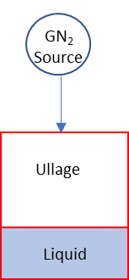
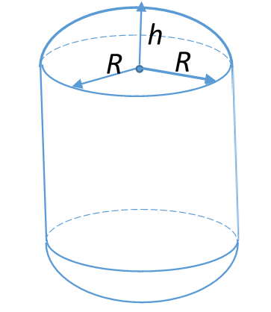
Modeling Approach
Condensation is modeled using commonly-applied method of considering liquid and gas side thermal resistances as described in Ghiaasiaan[3]
Cylindrical tank with ellipsoidal top and bottom sections.
Assumptions:
  Constant mass inflow rate of pure GN2 at constant pressure and temperature.
  Ullage gas is pure GN2.
  Tank walls are refrigerated uniformly at a constant temperature below saturation of the ullage gas.
  Condensed liquid is collected at the bottom of tank.
  Earth gravity environment.
  Specified ellipsoidal caps for top and bottom segments.
  Filmwise condensation is the only mode of condensation on the tank surfaces.
Top
+
U
L
+
Bottom

Slide 5
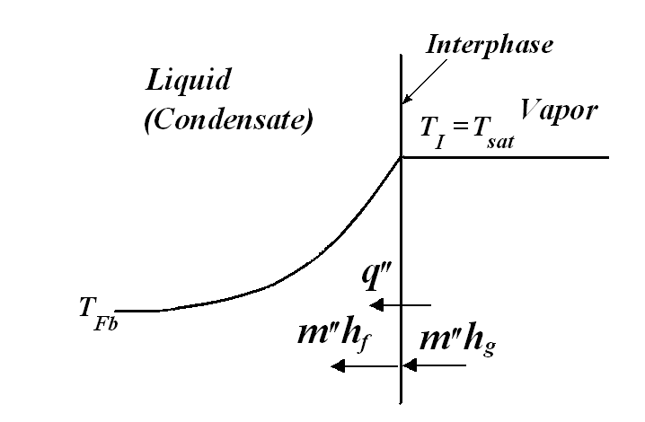
Condensation Model
Condensation on vertical surfaces
  General (superheated Ullage)
  When Ullage is pure and saturated vapor
    Liquid – side thermal resistance dominates the condensation process
T_{G} = Vapor Bulk Temp
T_{I} = Liquid-Vapor interphase Temp
T_{W} = Wall Temp

Slide 6
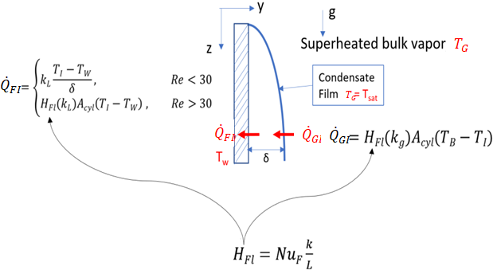

Heat Transfer Correlations
Vertical surfaces
Liquid side heat transfer coefficient for calculating $q_{FI}^{"}$
Gas side heat transfer coefficient for calculating $q_{GI}^{"}$

Slide 7
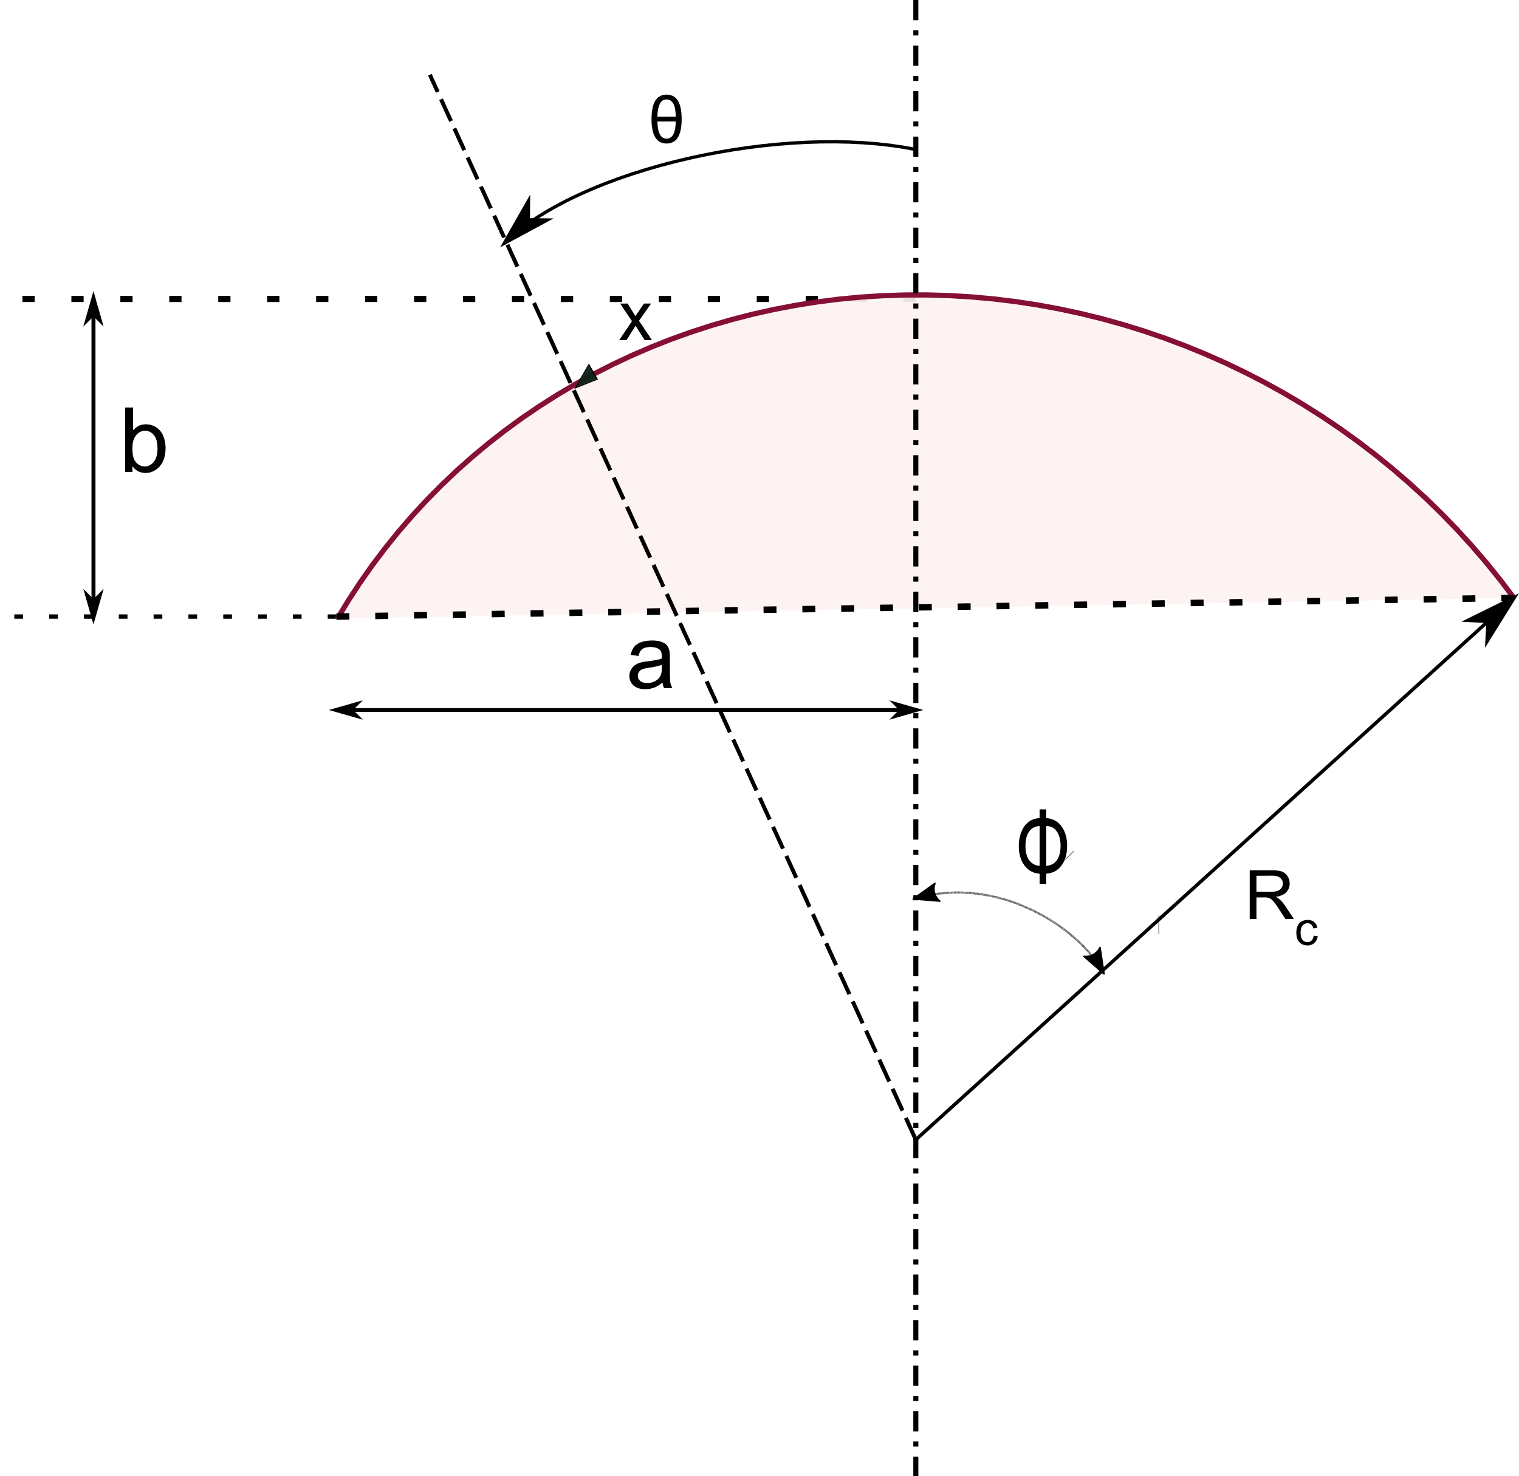

Heat Transfer Correlations
Tank Bottom
Liquid side heat transfer coefficient for calculating $q_{FI}^{"}$[4]
Gas side (free convection) heat transfer coefficient for calculating $q_{GI}^{"}$[4]
Tank Top
Assume that laminar and smooth condensate film forms on the downward-facing axi-symmetric ceiling
Modify and extend a model developed by Lienhard & Dhir [7]

Slide 8
GFSSP User’s Subroutine Code
GFSSP [8] has been developed at NASA-MSFC as a general fluid flow system solver
Developed a transient model
  Mass and energy balance
  Wall-gas mass and heat transfer
  Liquid-gas mass and heat transfer
  Total condensate mass
Model assumes that all condensate liquid is collected at bottom of the tank.
GFSSP model:
  Node 1 - GN2 supply source, supplies mass flow rate of GN2 through valve 12 to the refrigerated tank with specified temperature, pressure, and mass flowrate
  Node 2 - ullage portion of the tank
Custom Fortran Code
Condensed Liquid
  Mass balance
  Energy balance
Heat Transfer Rates
  Gas-to-condensate film
  Condensate Film-to-wall
Condensation Rates
  Mass sink from node 2
  Energy sink from node 2
Source Gas Boundary Node
Control Valve
Ullage Volume

Slide 9
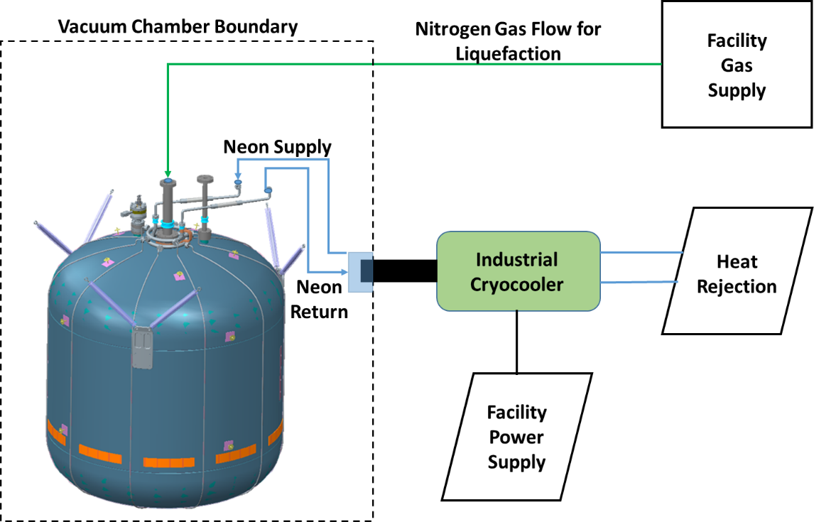
LN2 CryoFILL Test
Funded by NASA’s Advanced Exploration Systems and managed under the Advanced Cis-Lunar Space Capability Project, the Cryogenic Fluid In-Situ Liquefaction for Landers (CryoFILL) [9].
  Multi center team was formed to develop a liquefaction and storage system that is efficient, reliable and scalable.
A series of GN2 liquefaction testing was conducted at Marshall Space Center in 2018-2019.
Propellant Tank
  Stainless Steel
  48.5 ft³ total volume
  Tube-On-Tank Heat Exchanger
  Outfitted with 80 layers of MLI

Slide 10
Model Predictions Vs. Test Data
Low Fill Level
*
Test # | LN2 Fill Level % | GN2 Inlet Temp. K | GN2 Inlet Press kPa | GN2 flow rate kg/hr | Tank Wall Temp. K
1 | 0.43 - 6.76 | 269.35 | 124.8 | 0.4545 | 68.52
Model
Test
After 400,000 s (~4.5 days)
Condensate Liquid Mass:
Test: 45.41 kg
Model: 58.66 Kg
Overprediction: 22.6%
63.3 kg
50.05 kg
* Ref. 10 and 11
4.64kg

Slide 11
Model Predictions and LN2 CryoFILL Test Data
Comparison for Mid Fill Level
*
Test # | LN2 Fill Level % | GN2 Inlet Temp. K | GN2 Inlet Press kPa | GN2 flow rate kg/hr | Tank Wall Temp. K
2 | 49.64 – 54.25 | 293.98 | 105.8 | 0.4545 | 73.75
Model
Test
After 400,000 s (~4.5 days)
Condensate Liquid Mass:
Test: 49.59 kg
Model: 54.89 Kg
Overprediction: 9.8%
587.1 kg
581.7 kg
* Ref. 10 and 11
532.21 kg

Slide 12
Model Predictions and LN2 CryoFILL Test Data Comparison for High Fill Level
*
Test # | LN2 Fill Level % | GN2 Inlet Temp. K | GN2 Inlet Press kPa | GN2 flow rate kg/hr | Tank Wall Temp. K
2 | 89.64 – 94.07 | 271.16 | 101.3 | 0.4545 | 76.20
Model
Test
After 400,000 s (~4.5 days)
Condensate Liquid Mass:
Test: 47.45 kg
Model: 50.95 Kg
Overprediction: 6.9%
1012 kg
1008.5 kg
961.05 kg
* Ref. 10 and 11

Slide 13
Summary
The model predictions were compared with the data from LN2 CryoFILL test data for low, mid, and high fill level cases.
Liquefaction model increases in accuracy with higher fill levels.
This model can be highly useful scoping calculations and predicting liquefaction rates for a variety of tank geometries and operating conditions.
Recommended future follow-up activity
  Experimental study of condensation underneath ellipsoidal/spherical caps
Test | Error (%)
Low Fill Level (~0%) | 22.6
Mid Fill Level (~50%) | 9.8
High Fill Level (~90%) | 6.9

Slide 14
Acknowledgments
This work was funded by NASA’s Marshall Space Flight Center Tech Excellent program.
The authors wish to extend appreciation to Mr. Juan Valenzuela and Mr. Jonathan Stephens for providing LN2 CryoFILL test data and related documents.
Special thanks goes to the NASA’s CFM Portfolio Project Office for their support in preparation and presentation of this paper.

Slide 15
Thank You
Questions ?

Slide 16
References
https://www.nasa.gov/isru/overview
https://www.sciencedirect.com/topics/earth-and-planetary-sciences/in-situ-resource-utilization
Ghiaasiaan, S. M., Two-Phase Flow, Boiling, and Condensation, 2nd ed., Cambridge University Press, 2017.
Ghiaasiaan, S. M., Convective Heat and Mass Transfer, 2nd ed., CRC Press, 2018.
Chen, S. L., Gerner, F. M., and Tien, C. L., “General Film Condensation Correlations”. Exp. Heat Transfer, Vol. 1, pp. 93-107, 1987.
Churchill, S. W. and Chu, H. H. S., “Correlating Equations for Laminar and Turbulent Free Convection from a Vertical Plate”. Int. J. Heat Mass transfer, Vol. 18, pp. 1323-1329, 1975.
Dhir, V., and Lienhard, J., “Laminar Film Condensation on Plane and Axisymmetric Bodies in Nonuniform Gravity”, J. Heat Transfer. Feb 1971, 93(1): pp. 97-100.
Majumdar, A. and Leclair, A. GFSSP, “Generalized Fluid System Simulation Program,” Ver. 1.1.0, NASA Marshall Space Flight Center, Huntsville, AL, 2020.
Valenzuela, J. G., “Cryogenic In-Situ Liquefaction for Landers “Brassboard” Liquefaction Testing Series,” NASA/TM—20210010564, February 2021.
Stephens, J. P., ER64-MSFC, Personal Communications, 11/28/2022.
Valenzuela, J. G., ER64-MSFC, Personal Communications, 2/7/2023.

