Slide 1


Ka-Band GaN-on-SiC MMIC Balanced
High Power Amplifier for
NASA’s Lunar Missions
Rainee.N. Simons, Ph.D., Life Fellow, IEEE
Joseph A. Downey, Marie T. Piasecki, and Bryan L. Schoenholz
NASA Glenn Research Center, MS 54-1
21000 Brookpark Road, Cleveland, OH 44135 e-mail: Rainee.N.Simons@nasa.gov
2023 IEEE International Symposium on Antennas & Propagation and USNC-URSI Radio Science Meeting
Portland, OR, July 23-28, 2023
Session WE-UB.1P: Microwave & Optical Devices, C120-122 (OCC), Wed, July 26, 2023,
Paper # WE-UB.1P.7, presentation at 15:40-16:00 PDT

Slide 2
Abstract
The feasibility of Ka-band GaN-on-SiC MMIC based balanced high power amplifier (HPA) for science data downlinks from NASA’s Lunar mission assets in space is investigated.
The HPA combines the RF output power from two PAs using a rectangular waveguide based 3-dB hybrid coupler.
The investigation includes characterizing the HPA for the overall RF output power, Gain, PAE, RMS EVM for offset-QPSK, 8PSK, 16APSK, and 32APSK waveforms, Spectrum, 3rd order IMD products, noise figure, phase noise, & group delay.
The HPA has high P_{out} and good linearity and can support high data rate downlinks from the surface and vicinity of the Moon to Earth.

Slide 3
Outline
Introduction
HPA Architecture & Specifications
Benefits of Balanced HPA
HPA Performance Validation
  Output Power & Power Added Efficiency (PAE) vs. Input Drive Power
  Error Vector Magnitude (EVM) for OQPSK, 8PSK, 16APSK, & 32APSK Waveforms
  Output Spectrum & Spectral Regrowth
  Third-Order Intermodulation Distortion Products
  Noise Figure
  Phase Noise
  Group Delay
Conclusions & Discussions

Slide 4
Introduction
NASA’s Artemis program plans to build systems for sustainable human presence on the Moon and use Moon as a steppingstone for missions to Mars & beyond
Additionally, to support the Artemis program NASA plans to establish terrestrial as a well as non-terrestrial network of communication, navigation, timing, & tracking systems consisting of large diameter antennas
Furthermore, to ensure availability of adequate bandwidth to support the high data rate down links, the Agency plans to use Ka-band as much as practical for telecommunication services

Slide 5
Introduction (continued)
This paper builds on our prior development efforts in gallium nitride (GaN) MMIC based microwave power modules (MPMs) and single-ended power amplifiers (PAs)
In this paper, we extend the above effort to the demonstration of a Ka-band GaN MMIC based balanced HPA

Slide 6
GaN for Microwave High Power Amplifiers —Advantages
Gallium nitride (GaN) has large bandgap, high electron saturation velocity, excellent thermal properties, & good chemical stability
Consequently, high electron mobility transistors (HEMTs) fabricated on epitaxially grown GaN-on-SiC wafers can
  Operate at high frequencies
  Deliver high RF output power
  Offer good linearity
  Bestow high power added efficiency
  Perform at elevated temperatures
  Radiation hard

Slide 7
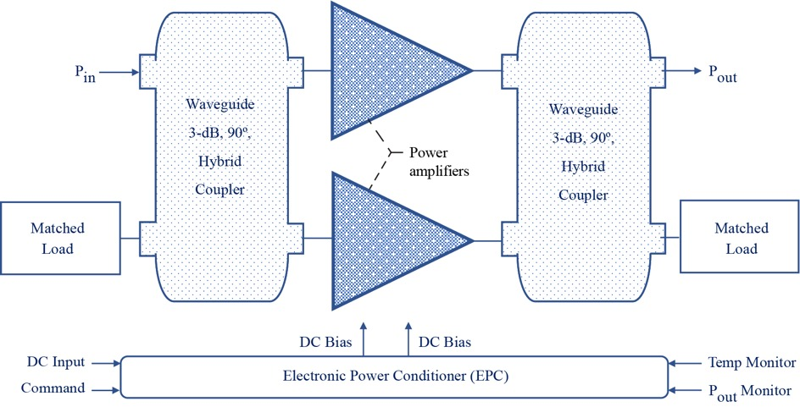
  Simplified Balanced HPA Architecture

Slide 8
  Brief Set of Specifications
Saturated output power (P_{sat}): 10 to 15 W (CW)
Bandwidth: 25.25 to 31.0 GHz
PAE: 18 to 22 percent
Small signal gain: 28 to 32 dB
Input/output return loss: < –10.0 dB
Gain flatness over full bandwidth: ± 1 dB

Slide 9
  Advantages of Balanced HPA over Single-Ended HPA
Better stability across the coupler bandwidth because of the good isolation between the two amplification paths or PAs.
Provides excellent input/output return loss characteristics because any reflected power is absorbed by the matched loads connected to the isolated ports. This feature provides a constant load impedance to the driver amplifier, which improves gain flatness & phase stability.
HPA gain can be controlled by changing the drain & gate bias voltages without impacting the input/output impedance match or return loss.
Since the input drive power is divided between two PAs, a given amount of gain compression & intermodulation distortion is reached at a 3-dB higher signal drive level than a single-ended amplifier with identical PAs.
If one of the PAs were to fail, the HPA output power would drop by 6 dB, thus avoiding a catastrophic failure & providing graceful degradation reliability.
The disadvantages include greater number of components & consequently higher cost.

Slide 10
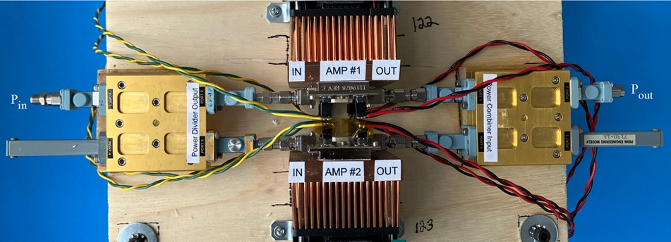
  Proof-of-Concept HPA Demonstration Model

Slide 11
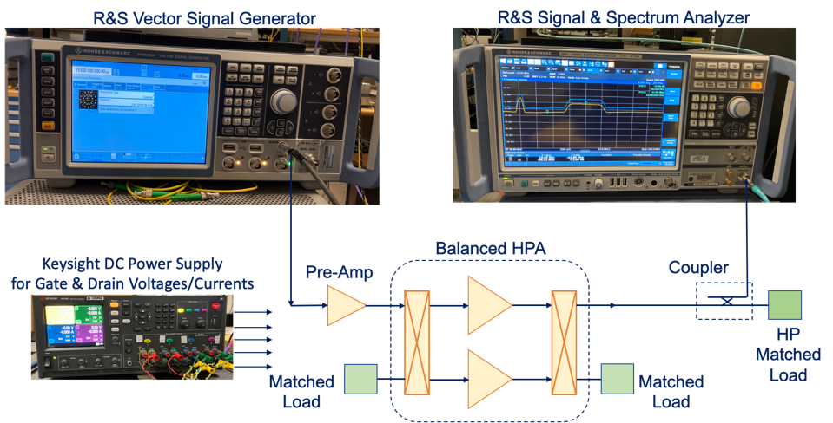
  Test Set for HPA Characterization

Slide 12
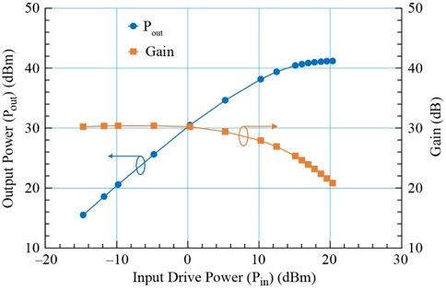
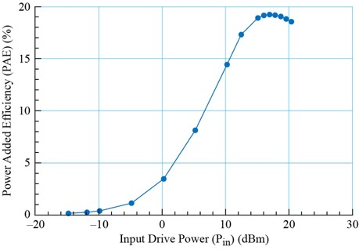
  Measured P_{out} , Gain, & PAE vs. P_{in}
  (f₀ = 27.5 GHz. V_{d1} = V_{d2} = 20 V, V_{g1} = –2.2 V,
  V_{g2} = –2.15 V, T = 25 °C)
The high P_{out} (13.2 watts), Gain (> 30 dB), & wide bandwidth can be exploited by cognitive radios to enable tunability & seamless interoperability across legacy space networks that operate over different frequency bands within the Ka-band spectrum
High PAE reduces power dissipation & improves thermal reliability, thereby enabling smaller size, weight, & power (SWaP) cognitive radios

Slide 13
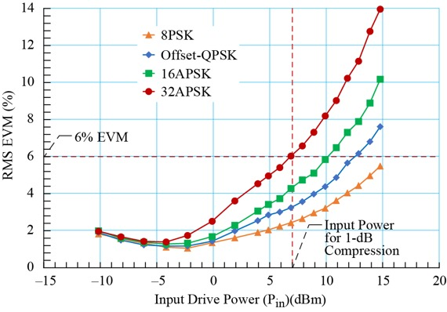

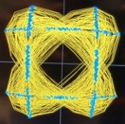
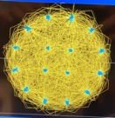
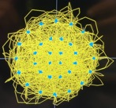
  Measured RMS EVM vs. P_{in}
  (F₀ = 27.5 GHz, Symbol rate is 100 Msymbols per second & Square Root Raised Cosine (SRRC) filter is set to 0.35)
Waveforms & Constellations
8PSK
Offset-
QPSK
16APSK
32APSK
Low RMS EVM (≤ 6%) up to the 1-dB compression point demonstrates high linearity, which enables amplifying higher-order modulation waveforms, such as 8PSK, 16APSK, & 32APSK. This feature enables cognitive radios to support CCSDS compliant waveforms used in many NASA missions, as well as DVB-S2 waveforms typically used by commercial service providers

Slide 14
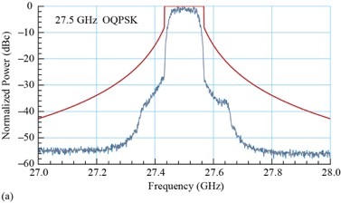
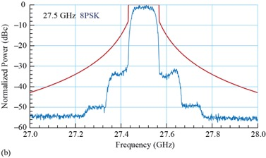
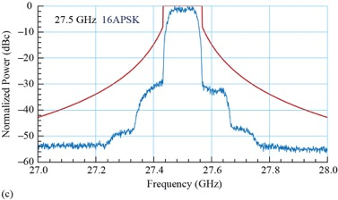
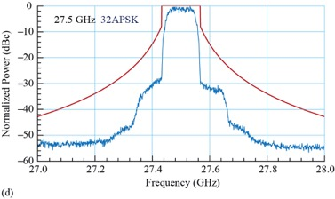
  Measured Spectrum
  (F₀ = 27.5 GHz, Symbol rate: 100 Msymbols per second, SRRC filter: 0.35, & Channel bandwidth: 135 MHz)
  (Red solid line is the NTIA mask)
For a fixed bandwidth the spectral efficiency improves from 2bits/s/Hz (OQPSK) to 5bits/s/Hz (32APSK) & can be exploited by cognitive radios to enhance throughput
The spectrum is compliant with the NTIA mask requirements

Slide 15
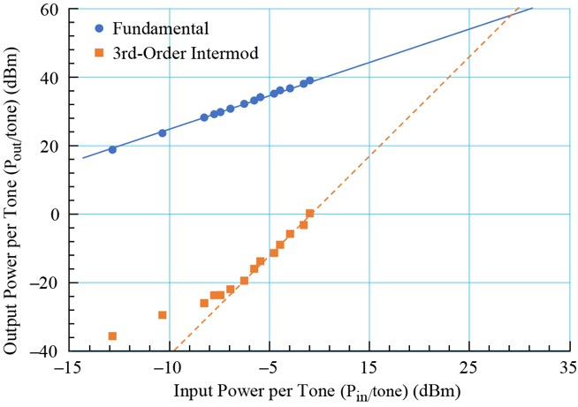
  Measured 3rd-Order Intermodulation Distortion (IMD) vs. P_{in} per Tone
  (Tone Frequencies: f₀=27.5 GHz ± 2.5 MHz & Tone Spacing: 5 MHz )
The high OIP3 of 56 dBm demonstrated that the 3rd-order IMD products generated is small. Hence, interference signals generated within the cognitive radio channel bandwidth due to HPA nonlinearity is also small

Slide 16
  Out-Of-Band Spectral Regrowth
The out of band spectral regrowth is measured at 1-symbol rate (100 MHz) away from the center frequency or carrier frequency (27.5 GHz) for all four waveforms and the results are summarized below
Waveform | Spectral Regrowth (dBc) (@27.6 GHz)
Offset-QPSK | -35.1
8PSK | -34.1
16APSK | -32.8
32APSK | -31.5
The data indicate that the spectral regrowth is less than –30 dBc, which demonstrates low adjacent channel interference or adjacent channel power ratio (ACPR). A cognitive radio with this capability enables roaming & interoperability

Slide 17
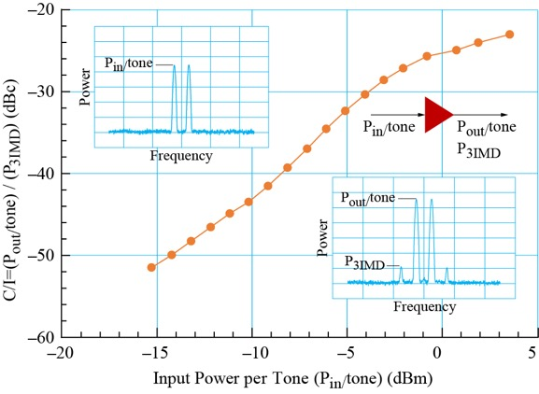
  Measured C/I vs. P_{in} per Tone
  (Tone Frequencies: f₀=27.5 GHz ± 2.5 MHz & Tone Spacing: 5 MHz )
The C/I is less than –50.0 dBc initially & gradually increases to about –20.0 dBc as the HPA is driven from small signal to the 1-dB compression point & beyond. This feature enables roaming without needing complex lookup tables to prevent adjacent band interference

Slide 18
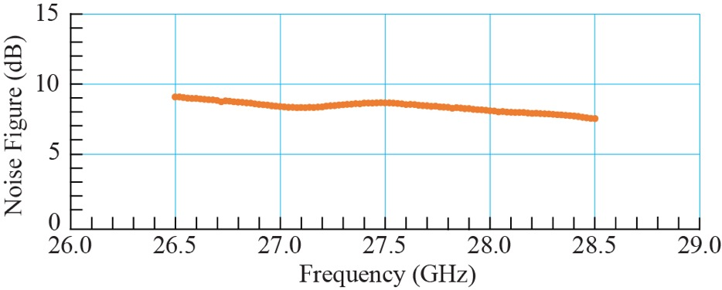
  Measured Noise Figure vs. Frequency
In a cognitive radio while transmitting a HPA with low noise figure (≤9.0 dB) implies less S/N ratio degradation of the adjacent channels & while receiving less deviation of the constellation points from their desired locations

Slide 19
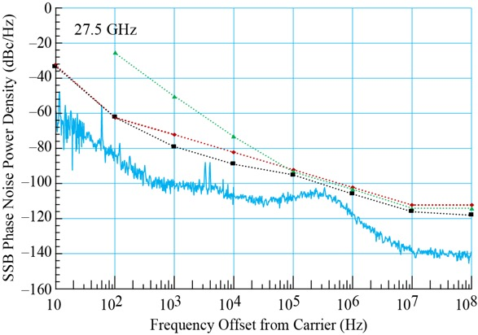
  Measured SSB Phase Noise Spectral Power Density vs. Frequency Offset from F₀ = 27.5 GHz
The red, green, and black dotted lines are the MIL-STD-188-164C & DVB-S2X aggregate Phase Noise & Professional Services Masks, respectively
The HPA phase noise spectrum is compliant with the standards
Low HPA phase noise implies less rotation of the waveform constellation points which improves BER performance of the cognitive radio

Slide 20
  Test Result Summary
Parameter | Measured Value
Frequency Range (GHz) | 27.5±1.0
Output Power (P_{sat}) (dBm) | 40.8±0.4 (12±1.2 W)
Small Signal Gain (dB) | 30.0±0.75
Peak PAE (%) | 17.6±1.7
Gain at peak PAE (dB) | 23.5±1.1
Return Loss (dB) | < –10.0
RMS EVM Offset-QPSK, 8PSK, 16APSK, and 32APSK (Drive at 1-dB compression point and carrier frequency of 27.5 GHz) | ≤ 6%
Out-of-Band Spectral Regrowth (dBc), @ 27.6 GHz | < –30.0 dBc
OIP3 (dBm) at carrier frequency of 27.5 GHz | 56
Noise Figure (dB) across the above frequency range | < 9.0
SSB Phase Noise Power Density (dBc/Hz) (Drive at 1-dB compression point) | Compliant with the MIL-STD Mask
Group Delay (ns) (Over 320 MHz band centered at 27.5 GHz) | 2.0±0.33

Slide 21
  Summary of Power Amplifier Performance Characteristics vs. Benefits to Cognitive Radio Platforms
Performance Characteristics | Benefits to Cognitive Radio Platforms
Wide bandwidth | Enables tunability & seamless interoperability across legacy space networks
High P_{sat} , Gain, and PAE | Improves communication distance or range, smaller size & mass, and reduces power dissipation which improves thermal reliability
Amplifies higher-order waveforms with low EVM | Good linearity & improves spectral efficiency which enhances throughput. Enables supporting CCSDS compliant waveforms used by NASA & DVB-S2 waveforms used by commercial service providers
Low out-of-band spectral regrowth | Low adjacent channel interference. Compliance with NTIA mask requirements. Enables roaming & interoperability.
High 3rd-order intercept point | Interference signals generated within the radio’s bandwidth due to amplifier nonlinearity is small. Enables roaming
Low noise figure | While transmitting, less S/N degradation of adjacent channels
Low phase noise | Low rotation of waveform constellation point which improves BER. Compliance with standards
Low group delay | Low phase distortion which improves BER

Slide 22
  Potential Use Cases for Cognitive Radio Platforms with Wideband HPA
Wide Tunable Bandwidth
  Enables interoperability between several space network service providers especially in the near-Earth domain
    This flexibility can be leveraged by an intelligent agent that resides onboard to optimize the selection of a provider by trading several factors, such as cost, latency, & peak data rates, & considering real-time & learned performance, such as weather, availability, & interference
Higher-Order Modulation Waveform Amplification
  Capable of amplifying higher-order modulation waveforms with low EVM of ≤6%
    This is significant because it allows standards such as DVB-S2 to allow frame-by-frame selection of modulation from QPSK to 32APSK, allowing the onboard intelligent agent to trade reliability vs. throughput & spectral efficiency
Low Intermodulation Distortion Interference
  Output OIP3 is on the order of 56 dBm & C/I is ≤-50 dBc initially & gradually increases to -20 dBc when driven from small signal to the 1-dB compression point
    This characteristic is important for a lunar relay satellite that is transmitting data to several user assets on the lunar surface using FDMA technique. An intelligent agent on the relay satellite could determine which of the several users are within the wide service area that needs to be contacted at any given time

Slide 23
Conclusions & Discussions
The design, architecture & advantages of a Ka-band GaN HEMT MMIC based balanced HPA are presented
The architecture is validated by characterizing the HPA. The measured output power, gain, PAE, RMS EVM for Offset-QPSK, 8PSK, 16APSK, and 32APSK waveforms, spectral efficiency, 3rd-order IMD products, spectrum, spectral regrowth, NF, phase noise, group delay are presented
The measured performance characteristics indicates that the HPA meets NTIA, military, and commercial spectral mask requirements & hence enables user terminals that can interoperate and roam.

Slide 24
Conclusions & Discussions (Continued)
In addition, the benefits of the above performance characteristics toward the design & implementation of cognitive radio platforms is also discussed
Lastly, as examples, three potential use cases that exploit AI and ML techniques for cognitive radios with an integrated wideband balanced HPA are discussed

Slide 25
Acknowledgements
The authors would also like to thank Nicholas Varaljay for installing the DC bias harness on the HPAs.

Slide 26
Extra Material

Slide 27
Relevant Material Properties — Wide Bandgap Semiconductors
Literature search indicates that wide bandgap semiconductors such as SiC and GaN
have unique material properties which enable them to operate in harsh
environments
Material | Mobility, μ_{n}, cm²/V.s | Bandgap, E_{g}, eV | Relative Dielectric Constant, 𝛆_{r} | Breakdown Voltage, E_{b}, 10⁶ V/cm | Saturation Drift Velocity, V_{sat}, 10⁶ cm/s | Thermal Conductivity, 𝜥, W/cm K
Si | 1350 | 1.1 | 11.8 | 0.3 | 10 | 1.5
GaAs | 8500 | 1.42 | 13.1 | 0.4 | 10 | 0.43
4H-SiC | 700 | 3.26 | 10 | 3.0 | 20 | 3.3 – 4.5
GaN | 1200 (Bulk) 2000 (2DEG) | 3.39 | 9.0 | 3.3 | 25 | 1.3
2 𝜇m
0.2 𝜇m
G = Gate Schottky Contact
Source Ohmic Contact
G
Drain Ohmic Contact
AlGaN/GaN Epilayer
100-mm High Purity Semi-insulating 4H-SiC Wafer
Cu-Mo Carrier plate as a heat spreader

