Slide 1
OPeNDAP and the
Data Access Protocol (DAP)
ESIP Summer 2023
James Gallagher
NASA EED-3 / OPeNDAP jgallagher@opendap.org
David Fulker
OPeNDAP
dfulker@opendap.org
This work was supported by NASA/GSFC under Raytheon Technologies contract number 80GSFC21CA001.
This document does not contain technology or Technical Data controlled under either the U.S. International Traffic in Arms Regulations or the U.S. Export Administration Regulations.

Slide 2
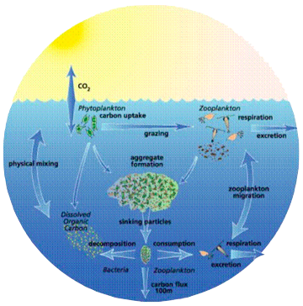
OPeNDAP Origins
Scientists studying ocean fluxes & temps (1993) envisaged using HTTP* for remote data access
  This led to the Distributed Ocean Data System (DODS)
  DODS later was renamed the Open-source Project for a Data Access Protocol (OPeNDAP)
Image credit: U.S. Joint Global Ocean Flux Study (JGOFS)*
*HTTP: HyperText Transport Protocol
Notes:
*https://www.nsf.gov/news/mmg/media/images/dmsp3_h.jpg

Slide 3
OPeNDAP Now Is:
A not-for-profit corp. that develops & supports
  “DAPx” — a web-service protocol for data access
    Deployed by hundreds of data providers internationally
    Employed in many analysis packages (MATLAB, e.g.)
    NASA has designated DAP2 “Community Standard”
  Server & client software implementing the DAP
A name used to indicate any server that includes DAP
  Servers that “include OPeNDAP”: ERDDAP*, TDS*, PyDAP*, …
*ERDDAP: Environmental Research Division Data Access Program; *TDS: THREDDS Data Server; PyDAP: Python Data Access protocol implementation

Slide 4
Concept:
Clients Get Just the Data They Need, as They Need them
Accessing data via URL*s (i.e., URL = dataset)
  Appending query strings to invoke server functions
Getting responses of 2 (general) types:
  Metadata - dataset descriptions & catalogs (textual)
  Content - values and metadata (binary or textual)
Using responses in diverse ways, e.g.
  MATLAB maps responses to its internal math types
  netCDF library allows apps to work as though reading a local file
*URL: Universal Resource Locator

Slide 5
Some of the OPeNDAP Community’s
Distinguishing Traits
Data often depict (scientific) phenomena, where
  Geospatial maps are one of several useful view types
  Coordinates are 3-, 4- & 5-dimensional
    These may include (time-dependent) coordinate-proxies
Servers (publishing files or DB*s via DAP) often
  Aggregate datasets, correct or enrich metadata...
  Perform data translations (more on this later)
*DB: Database

Slide 6
OPeNDAP Data-Type Philosophy
The data model has few data types
  For simplified programming & lowered risk of errors
Types are deliberately domain-neutral
  For better trans-domain utility & programmer uptake
  But they allow for both syntactic & semantic metadata
The Types do in fact support domain needs
  NetCDF*-like (can represent functions on 4- or 5-D domains, e.g.)
  Sequences & selections match DBMS* sensibilities
*NetCDF: network Common Data Format; DBMS: Database Management Systems

Slide 7
DAP Data Model¹ (simplified)
(unadorned) URL = dataset = a collection of variables
each variable comprises
a name | a type (incl. shape) | a value² | optional attributes³
Our use of Data Model seems roughly equivalent to Abstract Specification in OGC parlance.
Depending on its type (i.e., syntax) the value of a variable may comprise (vast) quantities of numbers...
Attributes are much like variables, but their purpose is semantic, i.e., to make a variable more meaningful. For example, variables often have a “units” attribute of type string. Variables of type 2-D grid often have “Lat” and “Lon” attributes whose types are real arrays.

Slide 8
DAP Data Types
the type of a DAP variable falls into one of few categories
(indivisible) | (compound, often recursively)
atoms, as in C or Java | constructors, as in C or Java | constructors with more complex semantics
integer float string ... | structure array (n-dim) (incl. arrays of structures, …) | coverage (has coordinate maps → measured values) sequence (with relation-like traits, i.e., tabular)

Slide 9
DAP Operations (invoked as query strings)
3 kinds of constraint expressions (i.e., query strings) yield subsets or invoke (server-side) processing
projection (define a subset) | selection (define a subset) | function (optional)
spec the included variables (by name) & spec the indices of included array elements | limit the elements of a sequence to those whose values satisfy a relational-style predicate | invoke a (server-specific) function to calculate a return (e.g., a subset by lat-lon limits)

Slide 10
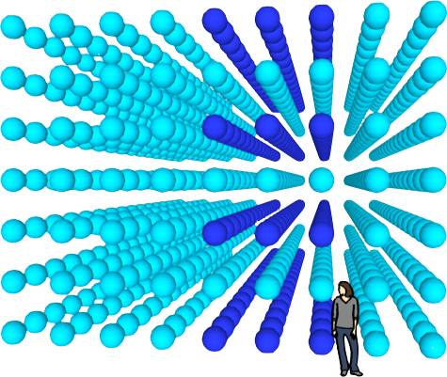
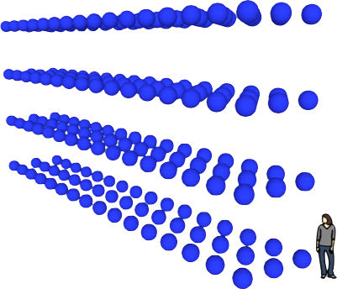
OPeNDAP Projection Operators
Like netCDF, Python, but as a Web service, users may
Skip indices
Limit index ranges
Reduce dimensionality
Image credit: Dave Fulker / OPeNDAP

Slide 11
More on Data Translation
Note: this function is not part of the DAP protocol per se
Many DAP-based servers (from Unidata & OPeNDAP, e.g.)
  Accept multiple types of data as inputs
  Present multiple views of them over the web
    Native DAP web services: for DAP-enabled clients
    Source format (lossless): CSV*, netCDF or geoTIFF* files
    Alternative web services: html (browser views), WCS*, etc.
Such servers are, in essence, data-format brokers
*CSV: Comma Separated Values; geoTIFF: geospatial Tagged Image File Format; WCS: Web Coverage Service

Slide 12
This work was supported by NASA/GSFC under Raytheon Technologies contract number 80GSFC21CA001.

