Slide 1
Thermal Vacuum and Vibration Testing of the Differential Thermal Expansion Thermal Switch
Stephanie Mauro
NASA MSFC ES22

Slide 2
Outline
The Differential Thermal Expansion Thermal Switch
Test Campaign to Raise TRL
Thermal Vacuum Test Set Up
Test Challenges
Vibration Test
Pre- and Post- Vibration Thermal Vacuum Cycle
  Data Overview
  Comparison
Long Duration Thermal Vacuum Cycle
  Data Overview
  Data Observations
  Comparison to Pre- and Post-Vibration
Performance Calculations
  MLI Assumptions
  Long Duration Thermal Vacuum Cycle Calculations
Summary
Acknowledgements

Slide 3
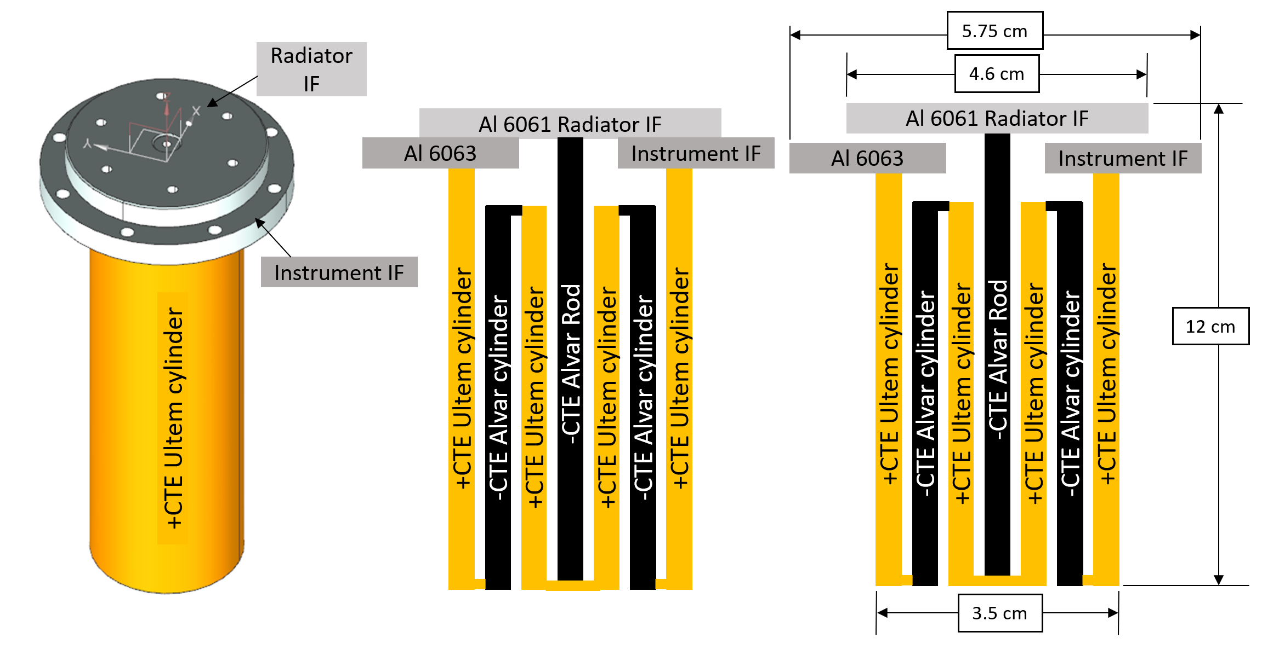
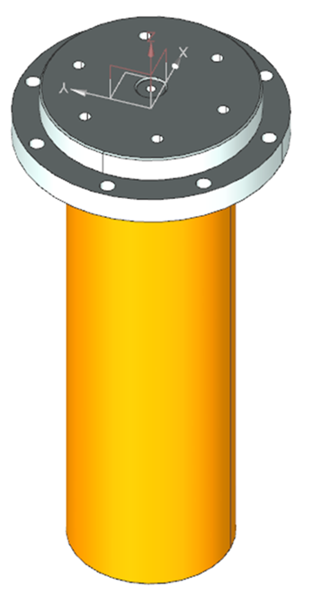
The Differential Thermal Expansion Thermal Switch
Development
  Design, build, and preliminary testing of thermal switch (TS) funded through JPL Center Innovation Fund (CIF)
    PI: Dave Bugby, Co-I: Jose Rivera
  Testing to raise TRL to 6 funded through MSFC Technology Investment Program (TIP)
    PI: Stephanie Mauro, Co-I: Jeff Farmer
  Purpose: to develop a high turndown ratio variable control technology to be used in both near-vacuum and low-atmosphere applications experiencing extreme variable environments
Key Features
  Reverse operation differential thermal expansion thermal switch
    ON when closed: high thermal contact
    OFF when open: low thermal contact
  Utilizes materials with both positive and negative coefficients of thermal expansion (CTE)
  Extended stroke: a larger gap (~1mm) forms when thermal switch is off and fully open
  Small size:
    Total height = 12 cm in total height
    Diameter at widest point (instrument IF) = 5.75 cm
    Main body diameter = 3.5 cm
  Passively operates, no power required
Model of thermal switch
Thermal switch ON – gap is closed, high thermal contact
Thermal switch OFF – gap is open, low thermal contact
When integrated into a thermal control system:
The radiator interface (IF) is thermally coupled to a heat sink / radiator.
The instrument IF is thermally coupled to the instrument or system being thermally controlled.
When the temperature increases, the TS is ON, the gap is closed, and a high thermal contact is created between the two IF disks to dissipate heat from the instrument to the heat sink.
When the temperature decreases, the TS is OFF, the gap is open, and a low thermal contact is created between the two IF disks to conserve the component heat.
Heat sink / radiator
Instrument being thermally controlled with thermal switch

Slide 4
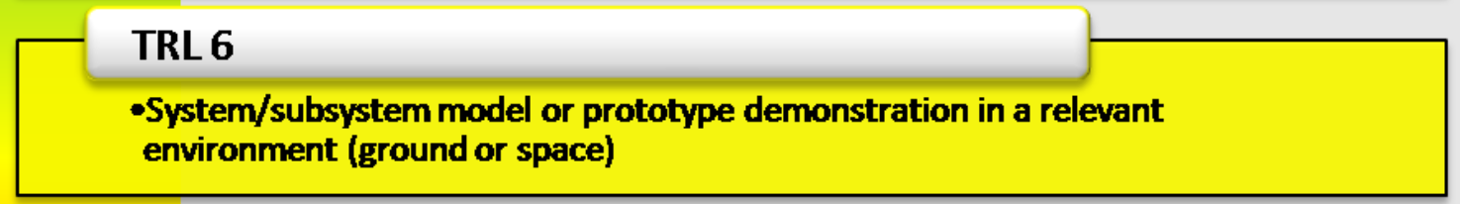
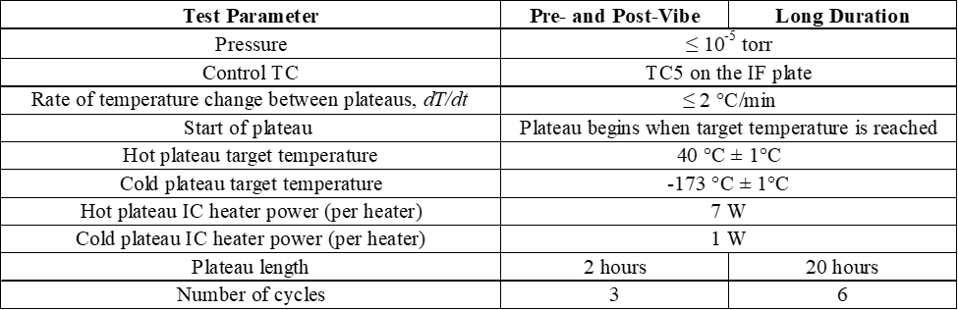
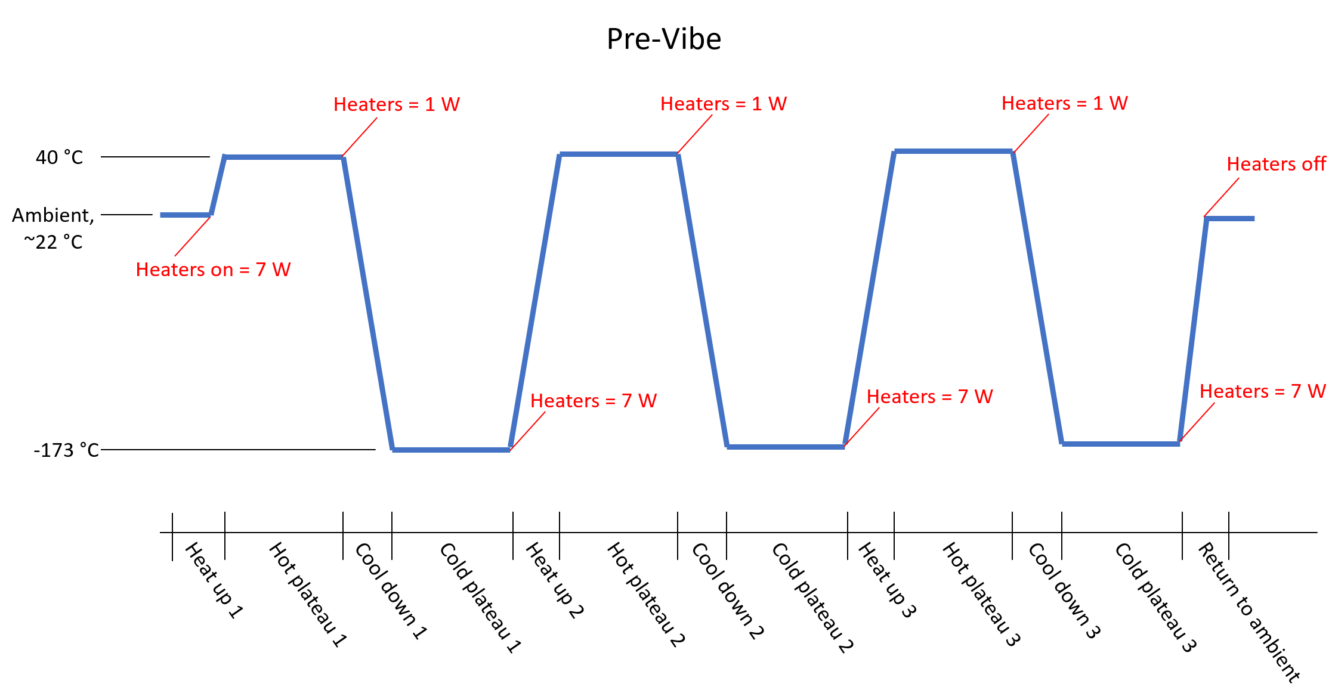
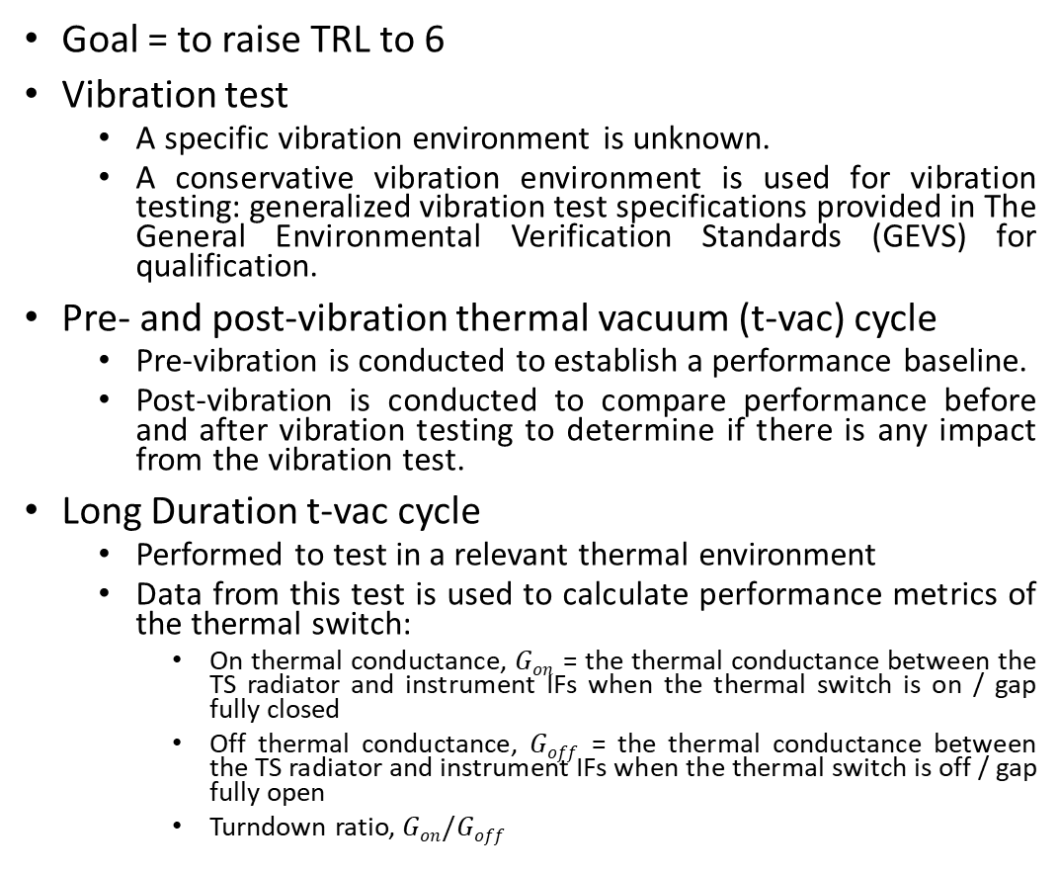
Test Campaign to Raise TRL
Goal = to raise TRL to 6
Vibration test
  A specific vibration environment is unknown.
  A conservative vibration environment is used for vibration testing: generalized vibration test specifications provided in The General Environmental Verification Standards (GEVS) for qualification.
Pre- and post-vibration thermal vacuum (t-vac) cycle
  Pre-vibration is conducted to establish a performance baseline.
  Post-vibration is conducted to compare performance before and after vibration testing to determine if there is any impact from the vibration test.
Long Duration t-vac cycle
  Performed to test in a relevant thermal environment
  Data from this test is used to calculate performance metrics of the thermal switch:
    On thermal conductance, $Gon$ = the thermal conductance between the TS radiator and instrument IFs when the thermal switch is on / gap fully closed
    Off thermal conductance, $Goff$ = the thermal conductance between the TS radiator and instrument IFs when the thermal switch is off / gap fully open
    Turndown ratio, $Gon/Goff$
Summary diagram of pre-vibe test phases.

Slide 5
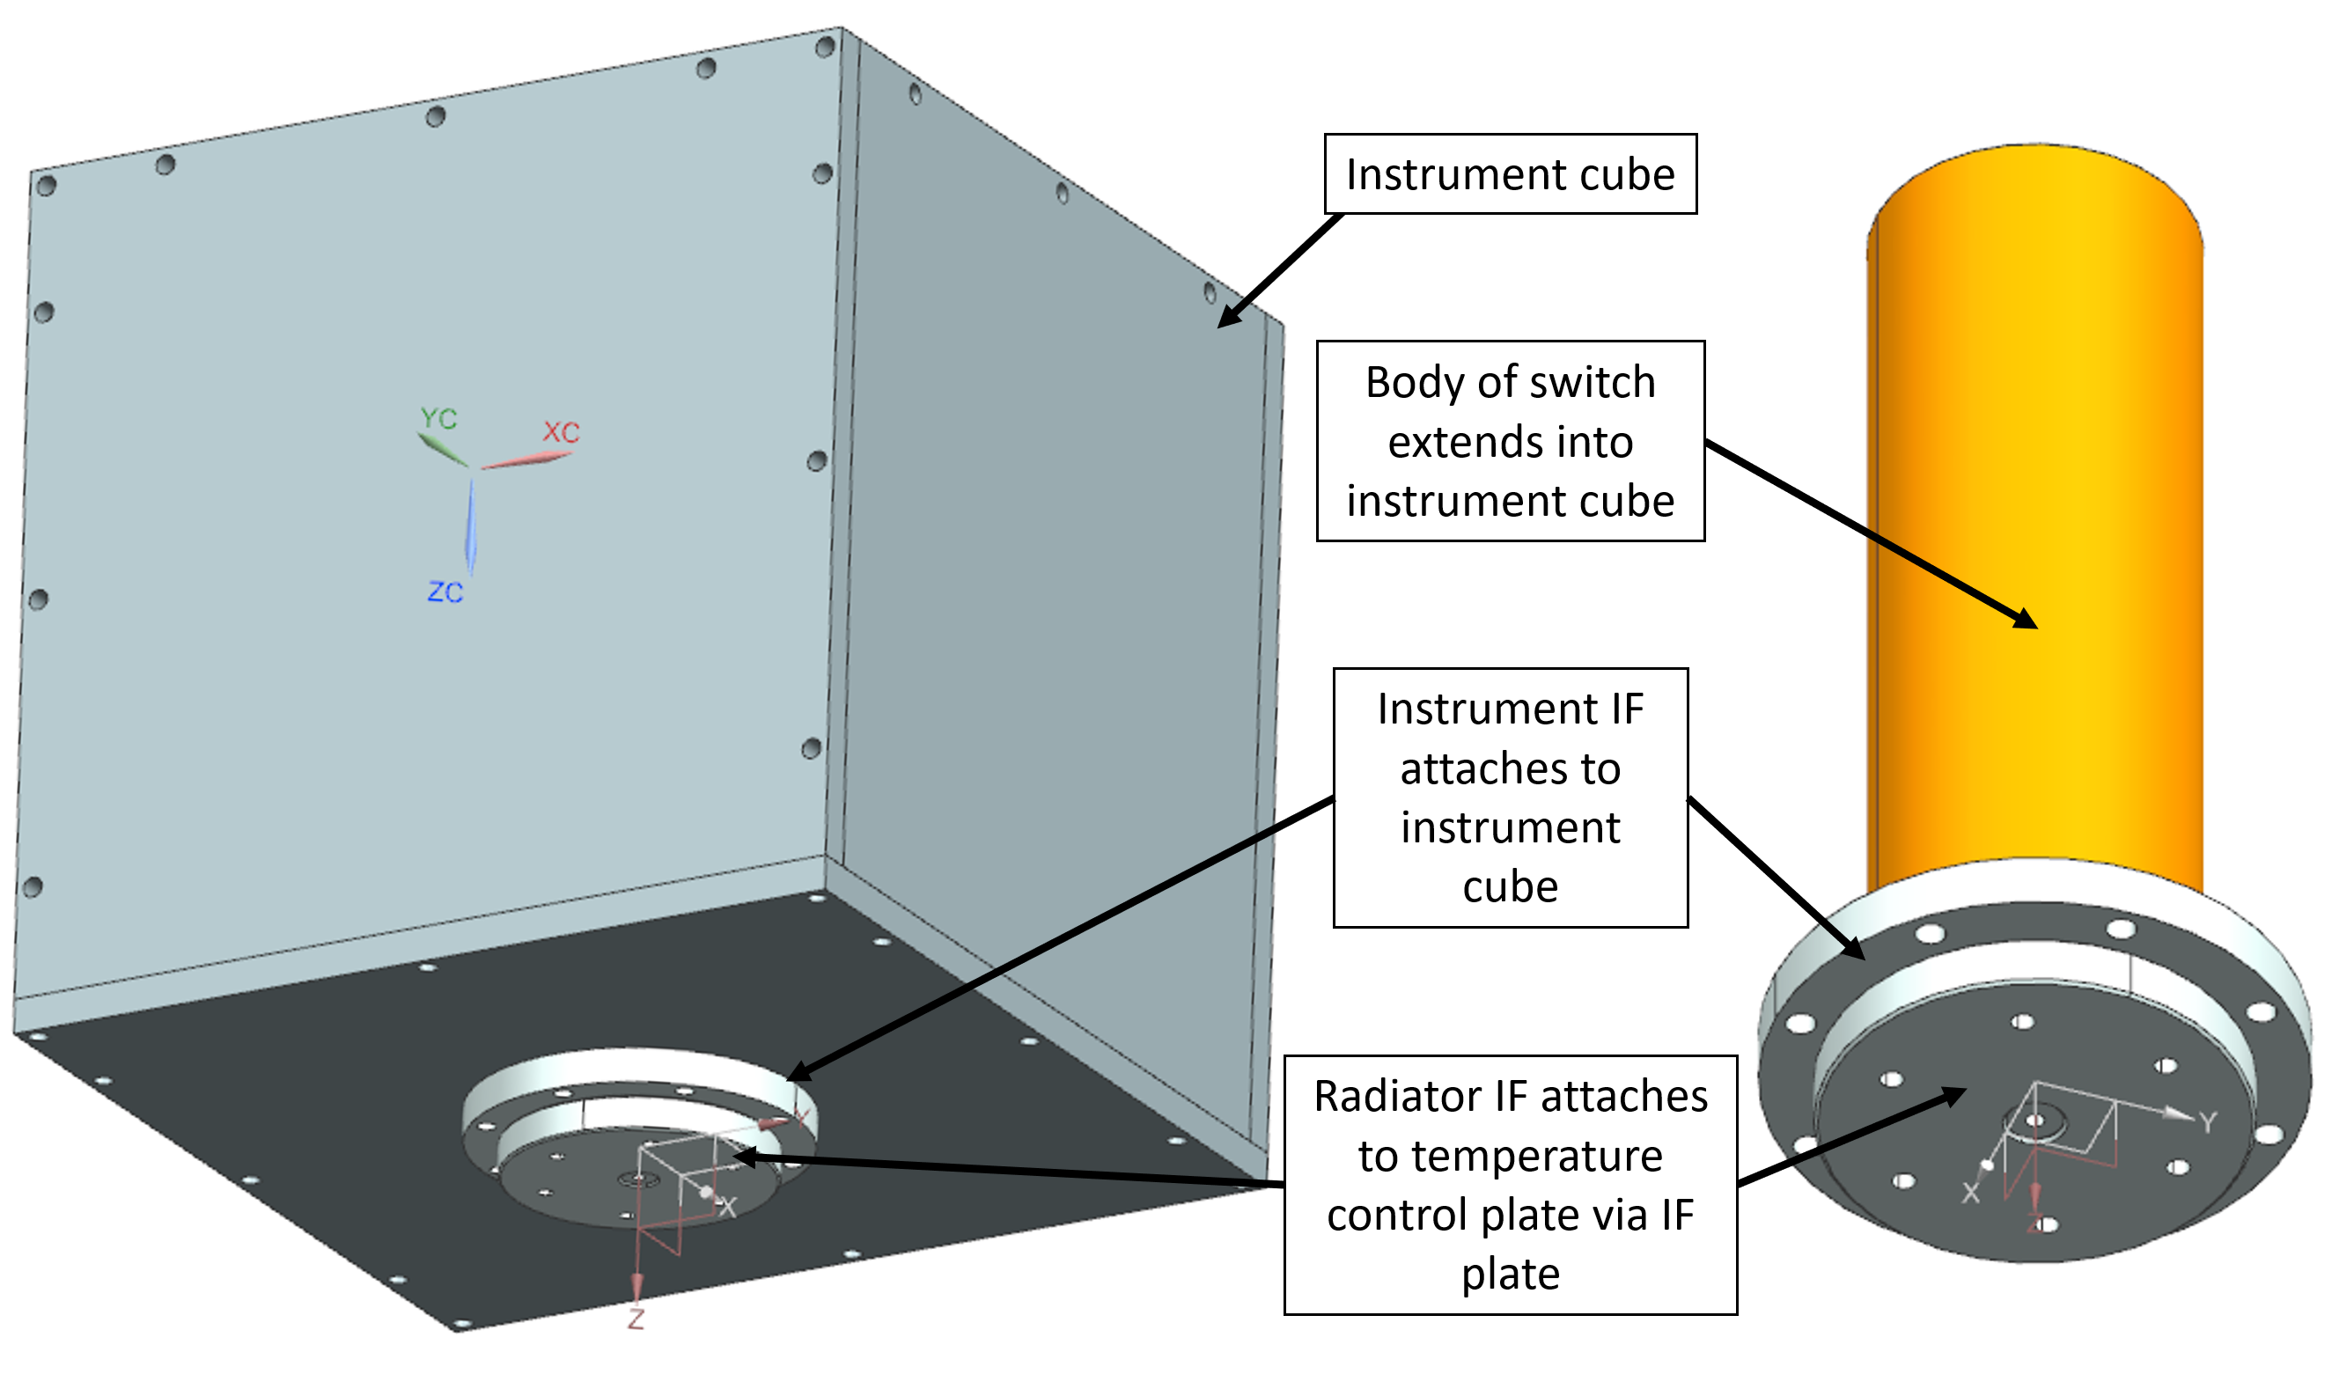
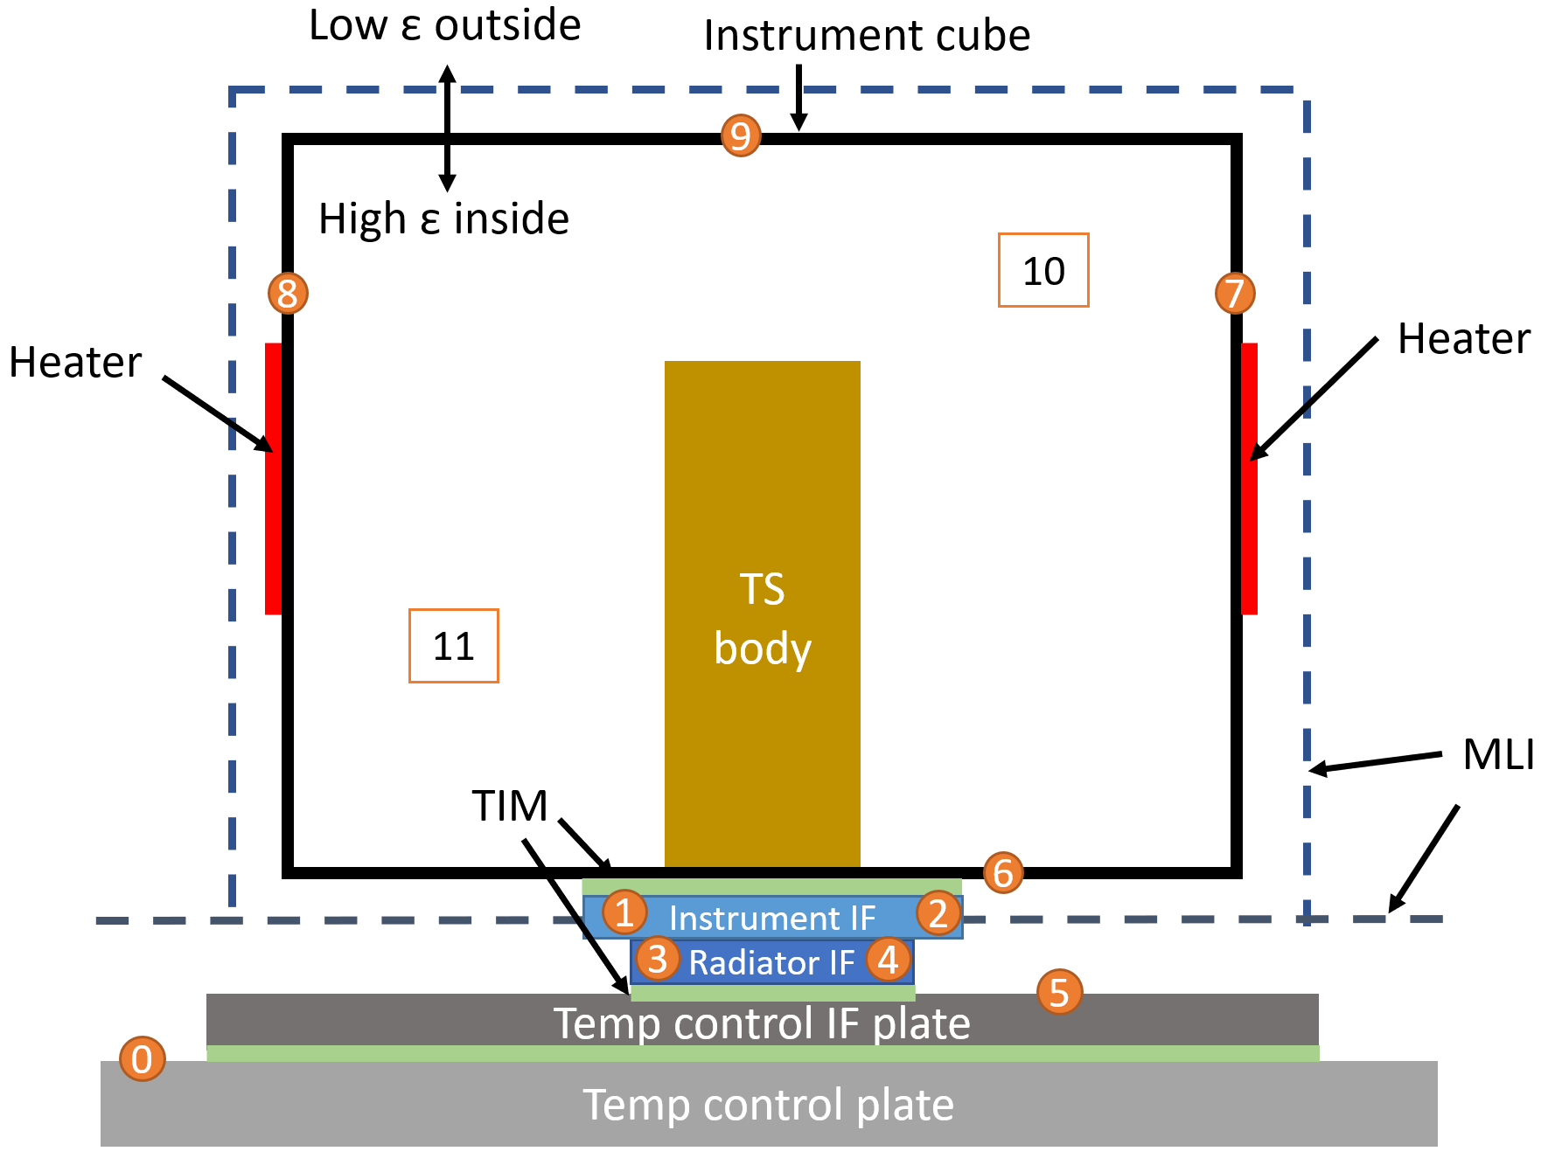
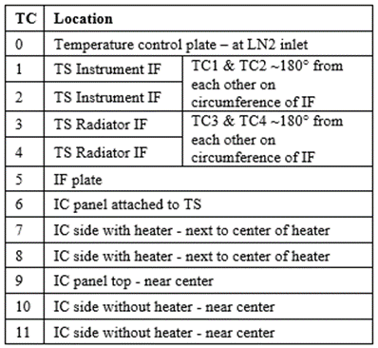
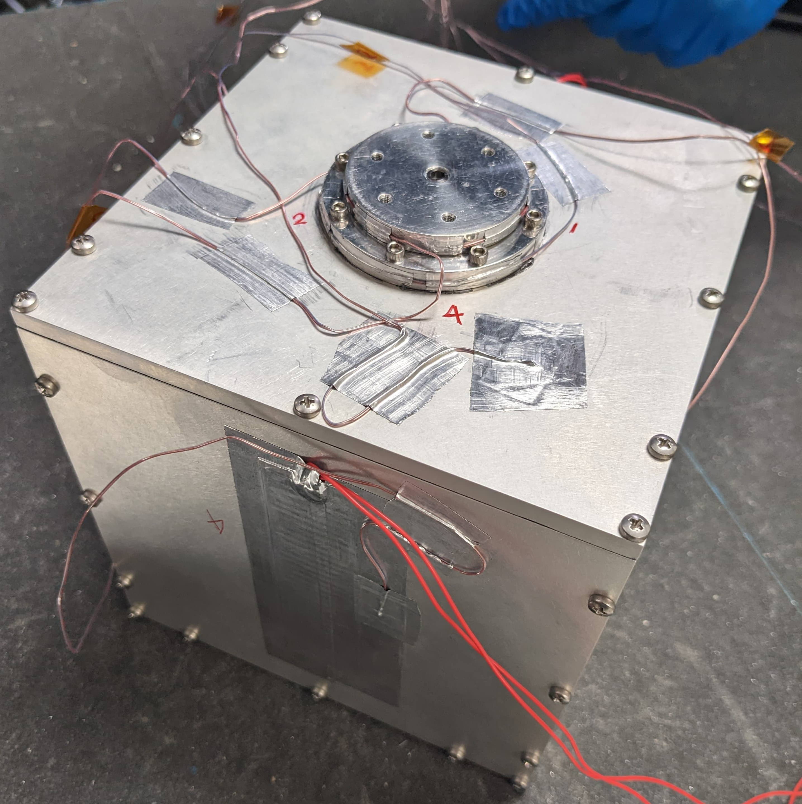
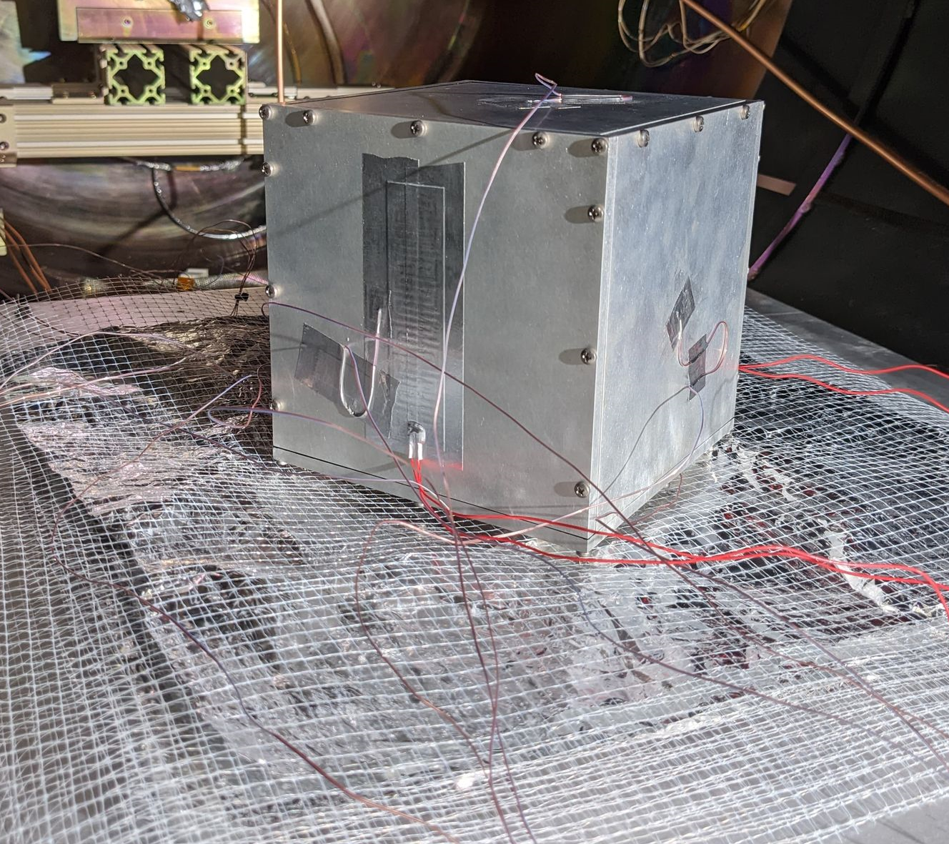
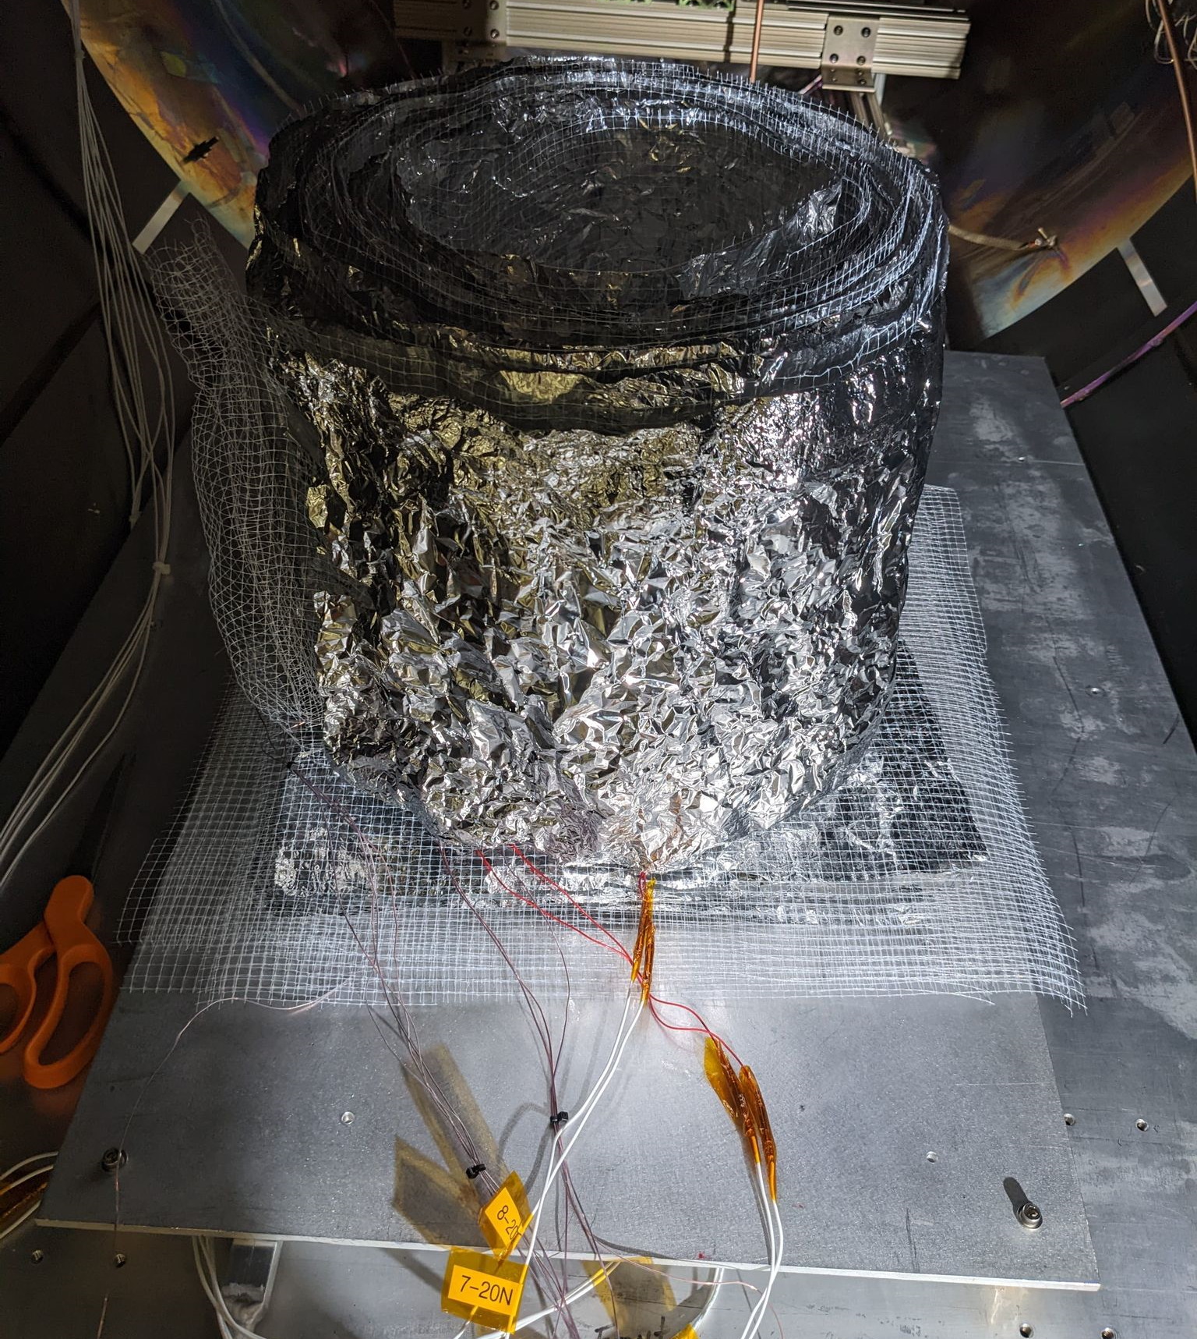
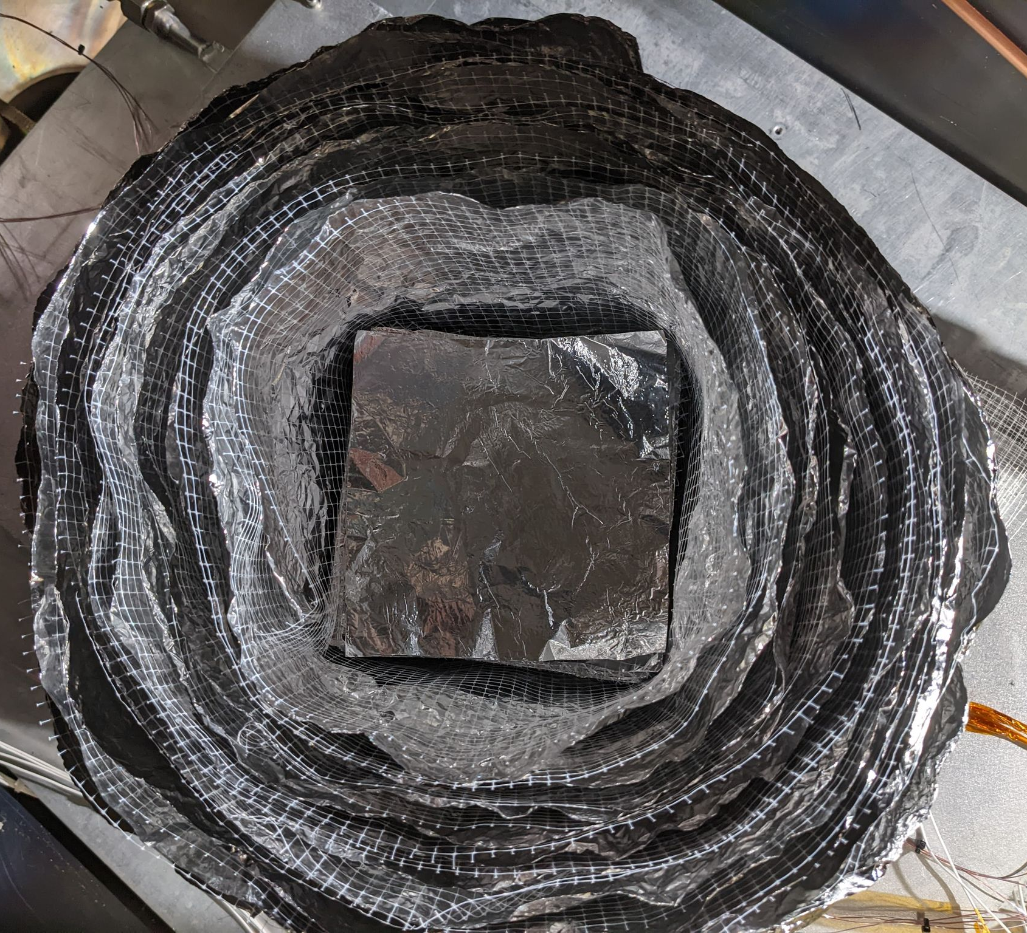
Thermal Vacuum Test Set Up
T-vac test set up
  The TS is mounted in an instrument cube (IC) through the instrument IF to represent an instrument to be thermally controlled.
  There are 2 heaters on opposite sides of the IC to represent an instrument heat dissipation.
  The radiator IF is mounted to a temperature control IF plate. The temperature control plate temperature is controlled through LN2 flow and heaters mounted on the same plate.
Transition to vibration testing
  The test set up must be partially disassembled to transition to/from vibration testing, including:
    MLI removal
    Detachment of temp control IF plate (and test set up above the plate) from temp control plate
    Detachment of temp control IF plate from TS
    Removal of IC side to which TS is mounted
    Removal of TS from IC plate
    Removal of thermocouples (TCs) from TS instrument and radiator IFs
TS mounted in instrument cube.
Thermocouple location diagram and summary.

Slide 6
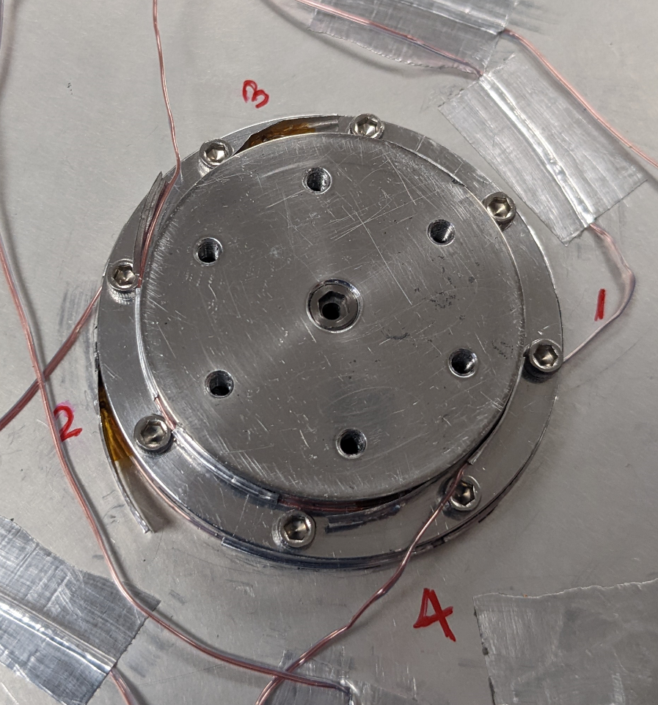
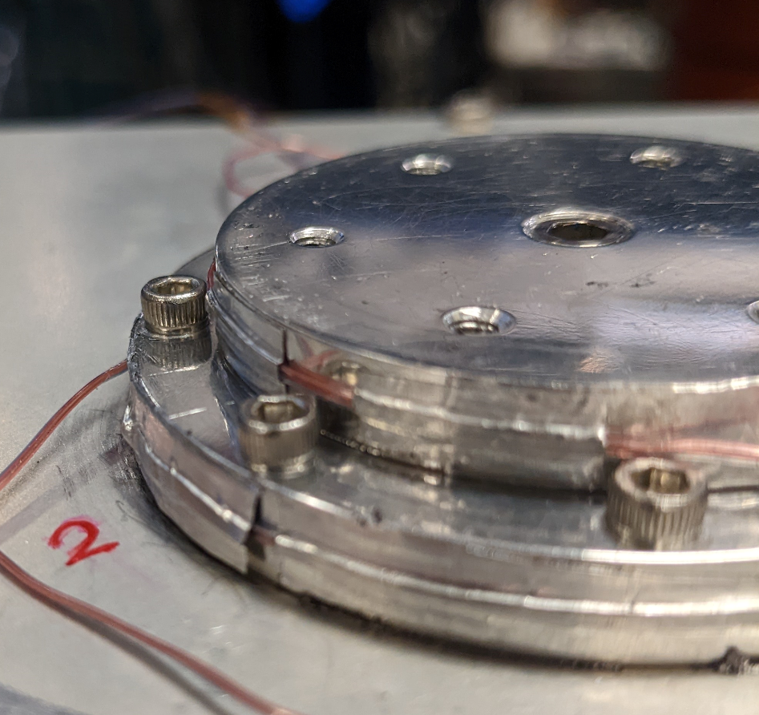
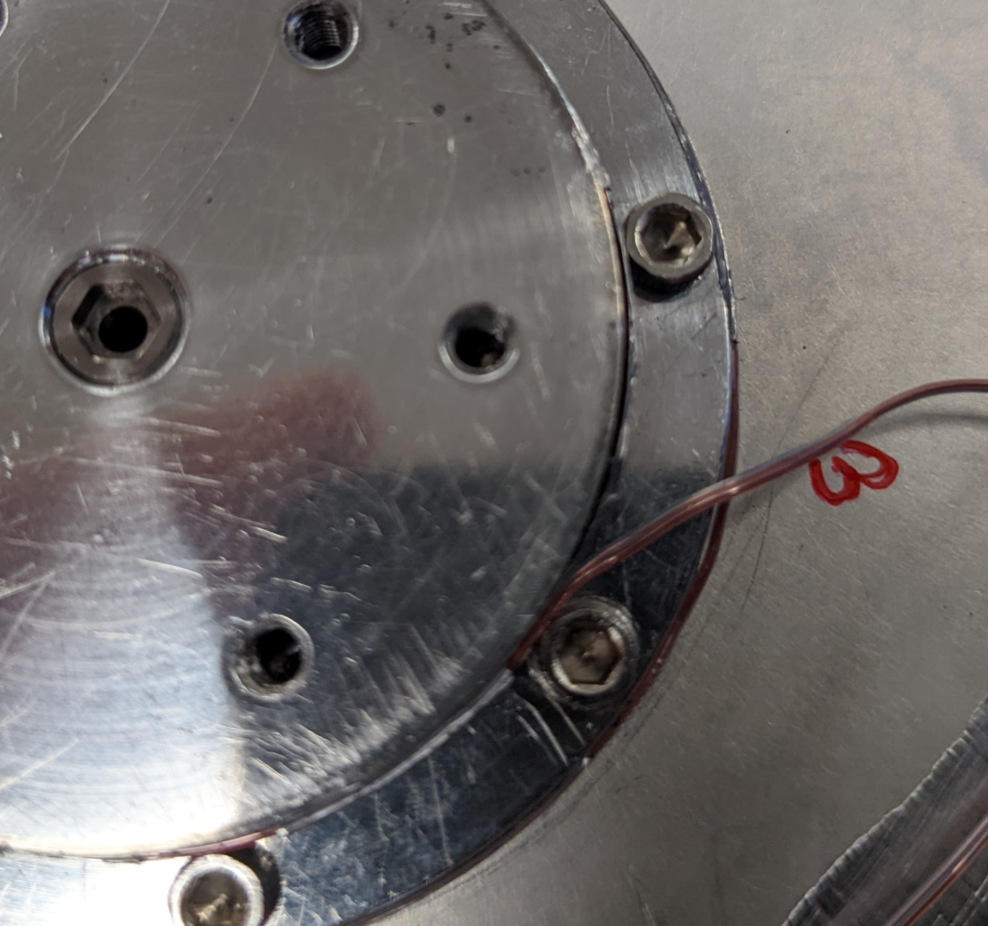
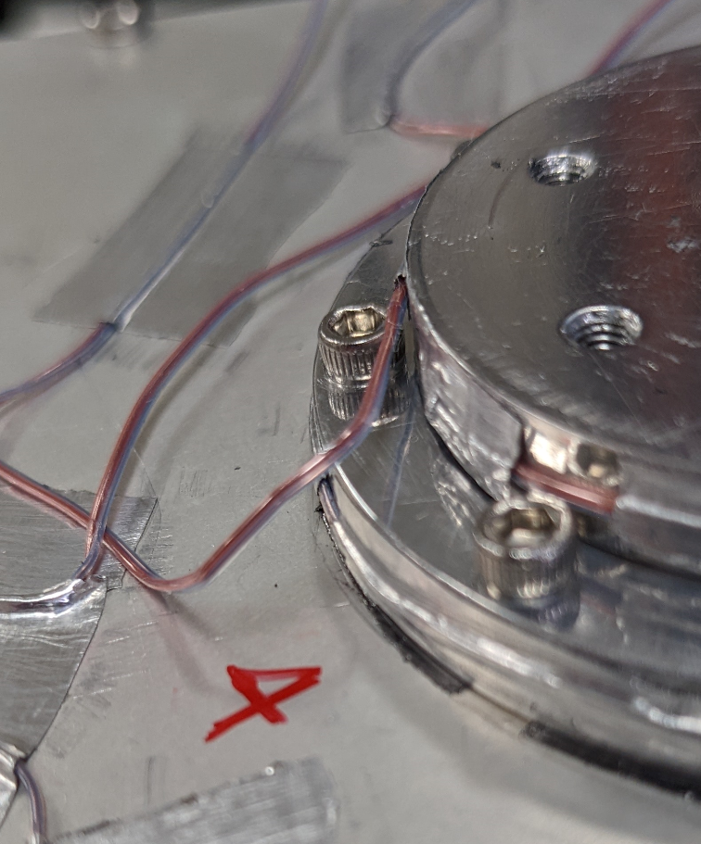
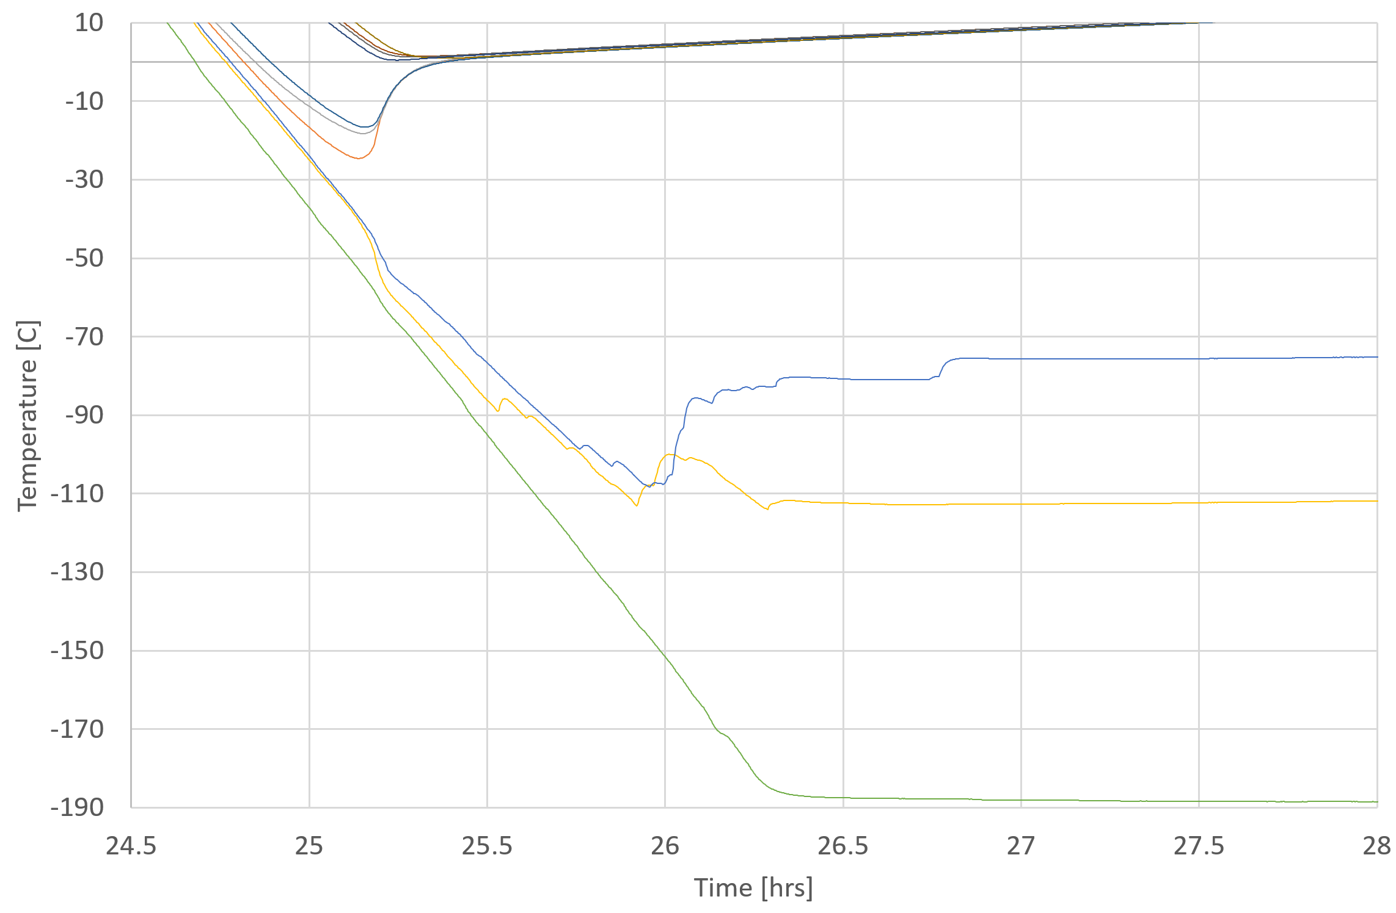
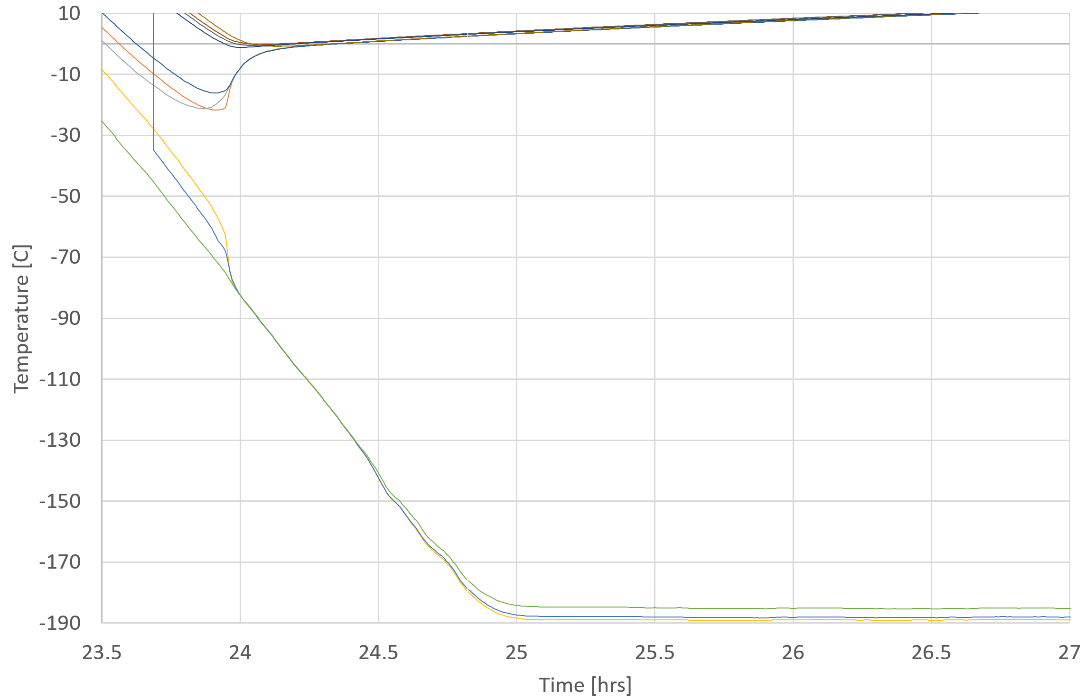
Test Challenges
Thermocouple attachment
  Challenge: The TCs attached to the TS IFs became uncoupled from the IF surfaces during pre- and post-vibe t-vac cycle tests.
    The tape is partially peeled away from the surfaces during post test inspection.
      TC detachment was observed only on the TS IFs due to the small, curved, application surface
    Initial attachment method: Kapton “sandwich” around TC and covered with Aluminum tape
      Placed Kapton tape on TS surface, then TC bead, then additional piece of Kapton tape, then covered with aluminum tape
  Solution: attach TCs on TS IFs with only aluminum tape (no Kapton)
    The solution was implemented prior to the long duration test, but after pre- and post-vibration t-vac cycle tests.
  Impact:
    During the pre- and post-vibration t-vac cycle test cool down phases the radiator IF TCs periodically jump in temperature and do not provide accurate temperatures of the TS radiator IF.
    Long duration t-vac cycle data shows that after the TS is open during a cool down phase the radiator IF temperature is very close to the temperature control IF plate temperature.
    For pre- and post-vibe comparison, the temperature control IF plate temperature is used to represent the TS radiator IF temperature.
Pre-vibe TC detachment.
Post-vibe TC detachment.
TC4
TC3
TC5
TC3
TC4
TC5
Post-vibe cool down and cold plateau 2 with TC3 and TC4 detached.
Long duration cool down and cold plateau 1 with TC3 and TC4 remaining attached.

Slide 7
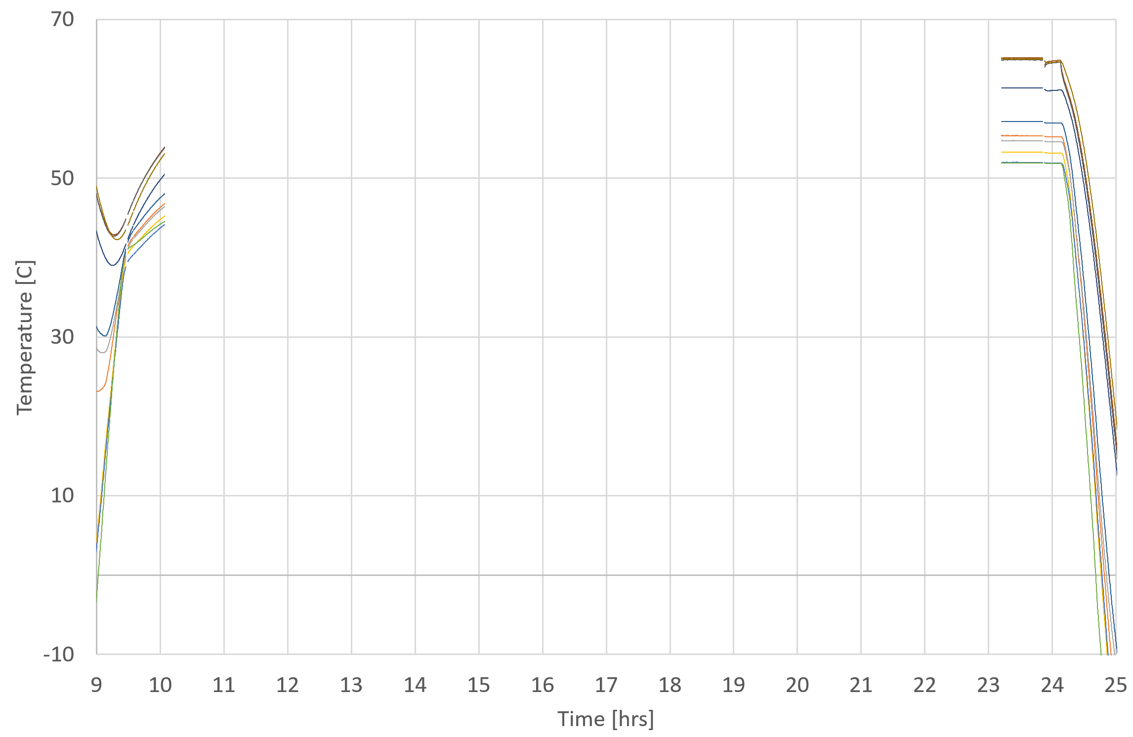
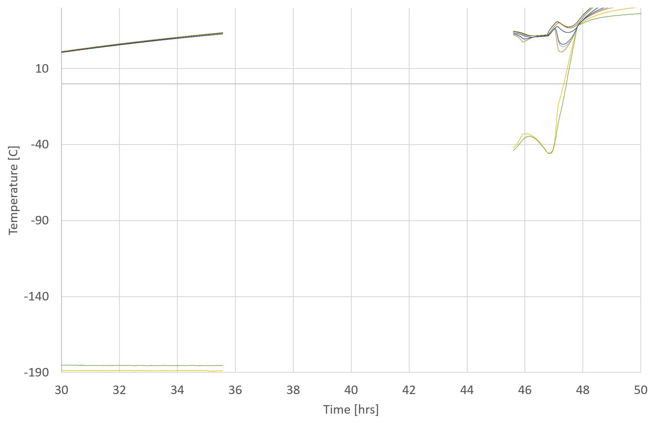
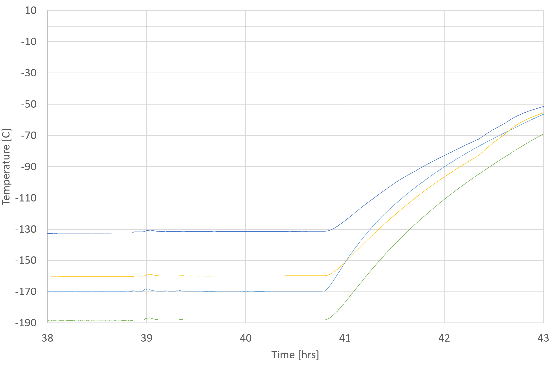
Test Challenges
Data collection errors
  Challenge: Unpredictable Labview error
  Solution: Disconnected the test computer from network
  Impact: No data collection when error occurs until program is restarted
    During hot plateau – data is not collected, but heaters remain on, and test continues
    During cold plateau – data is not collected, and flow of LN₂ is turned off, halting test
LN₂ dewar sizing
  Challenge: LN₂ dewar needed to be swapped during testing to provide needed LN₂ continuously
  Solution: Developed plan to swap LN₂ dewars before long hold periods
  Impact: LN₂ ran out before the planned end of usage and prematurely ended the cold plateau during post-vibe cold plateau 2 and long duration cold plateau 2
Program is restarted
Data collection stops, heating continues, cooling is lost
Data collection stops, but heating continues
Program is restarted
Example of data loss: post-vibe hot plateau 2
Example of data loss: long duration cold plateau 1
Gradual increase in temperature due to loss of LN₂
Example of LN2 loss: post-vibe cold plateau 2

Slide 8
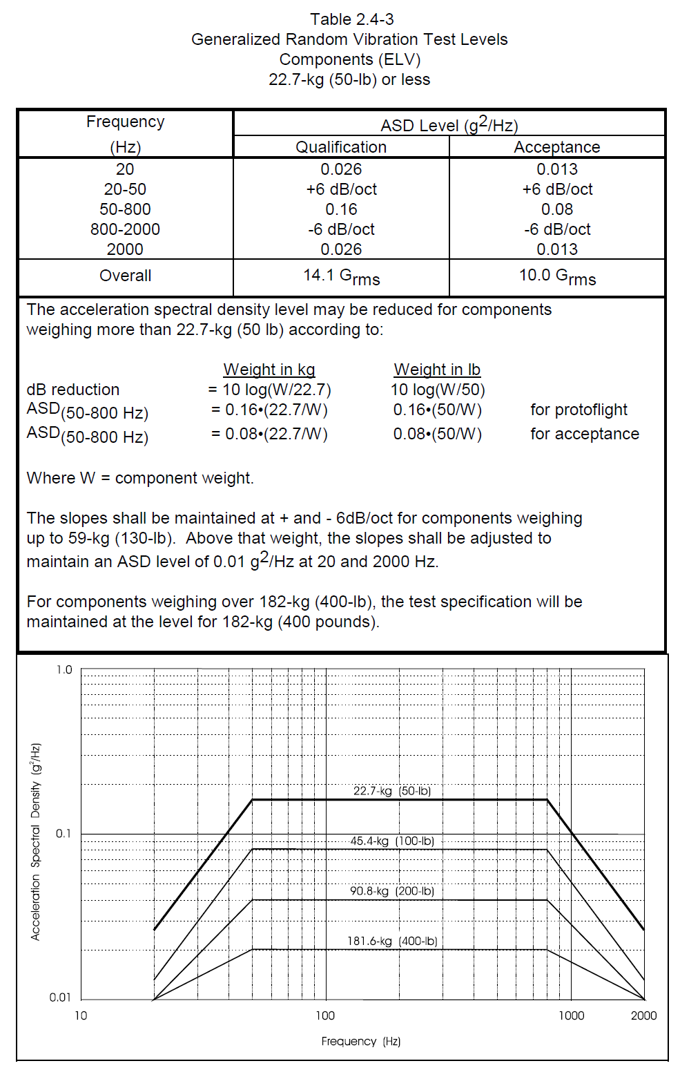
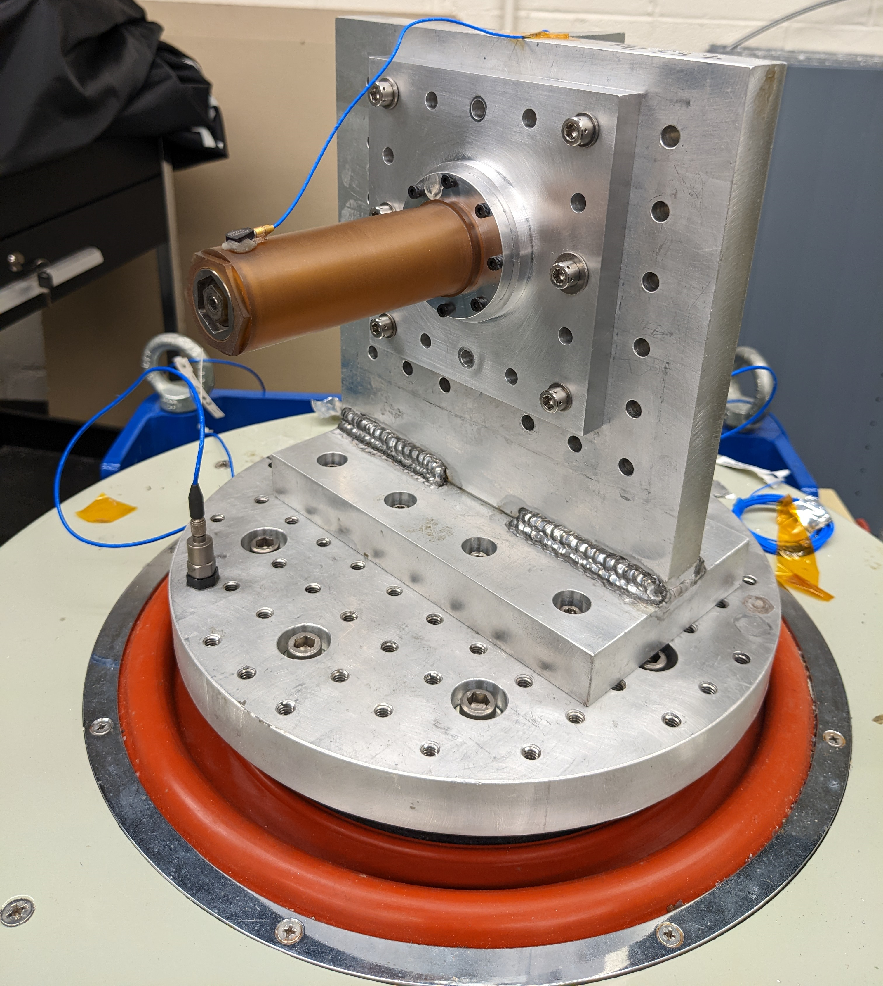
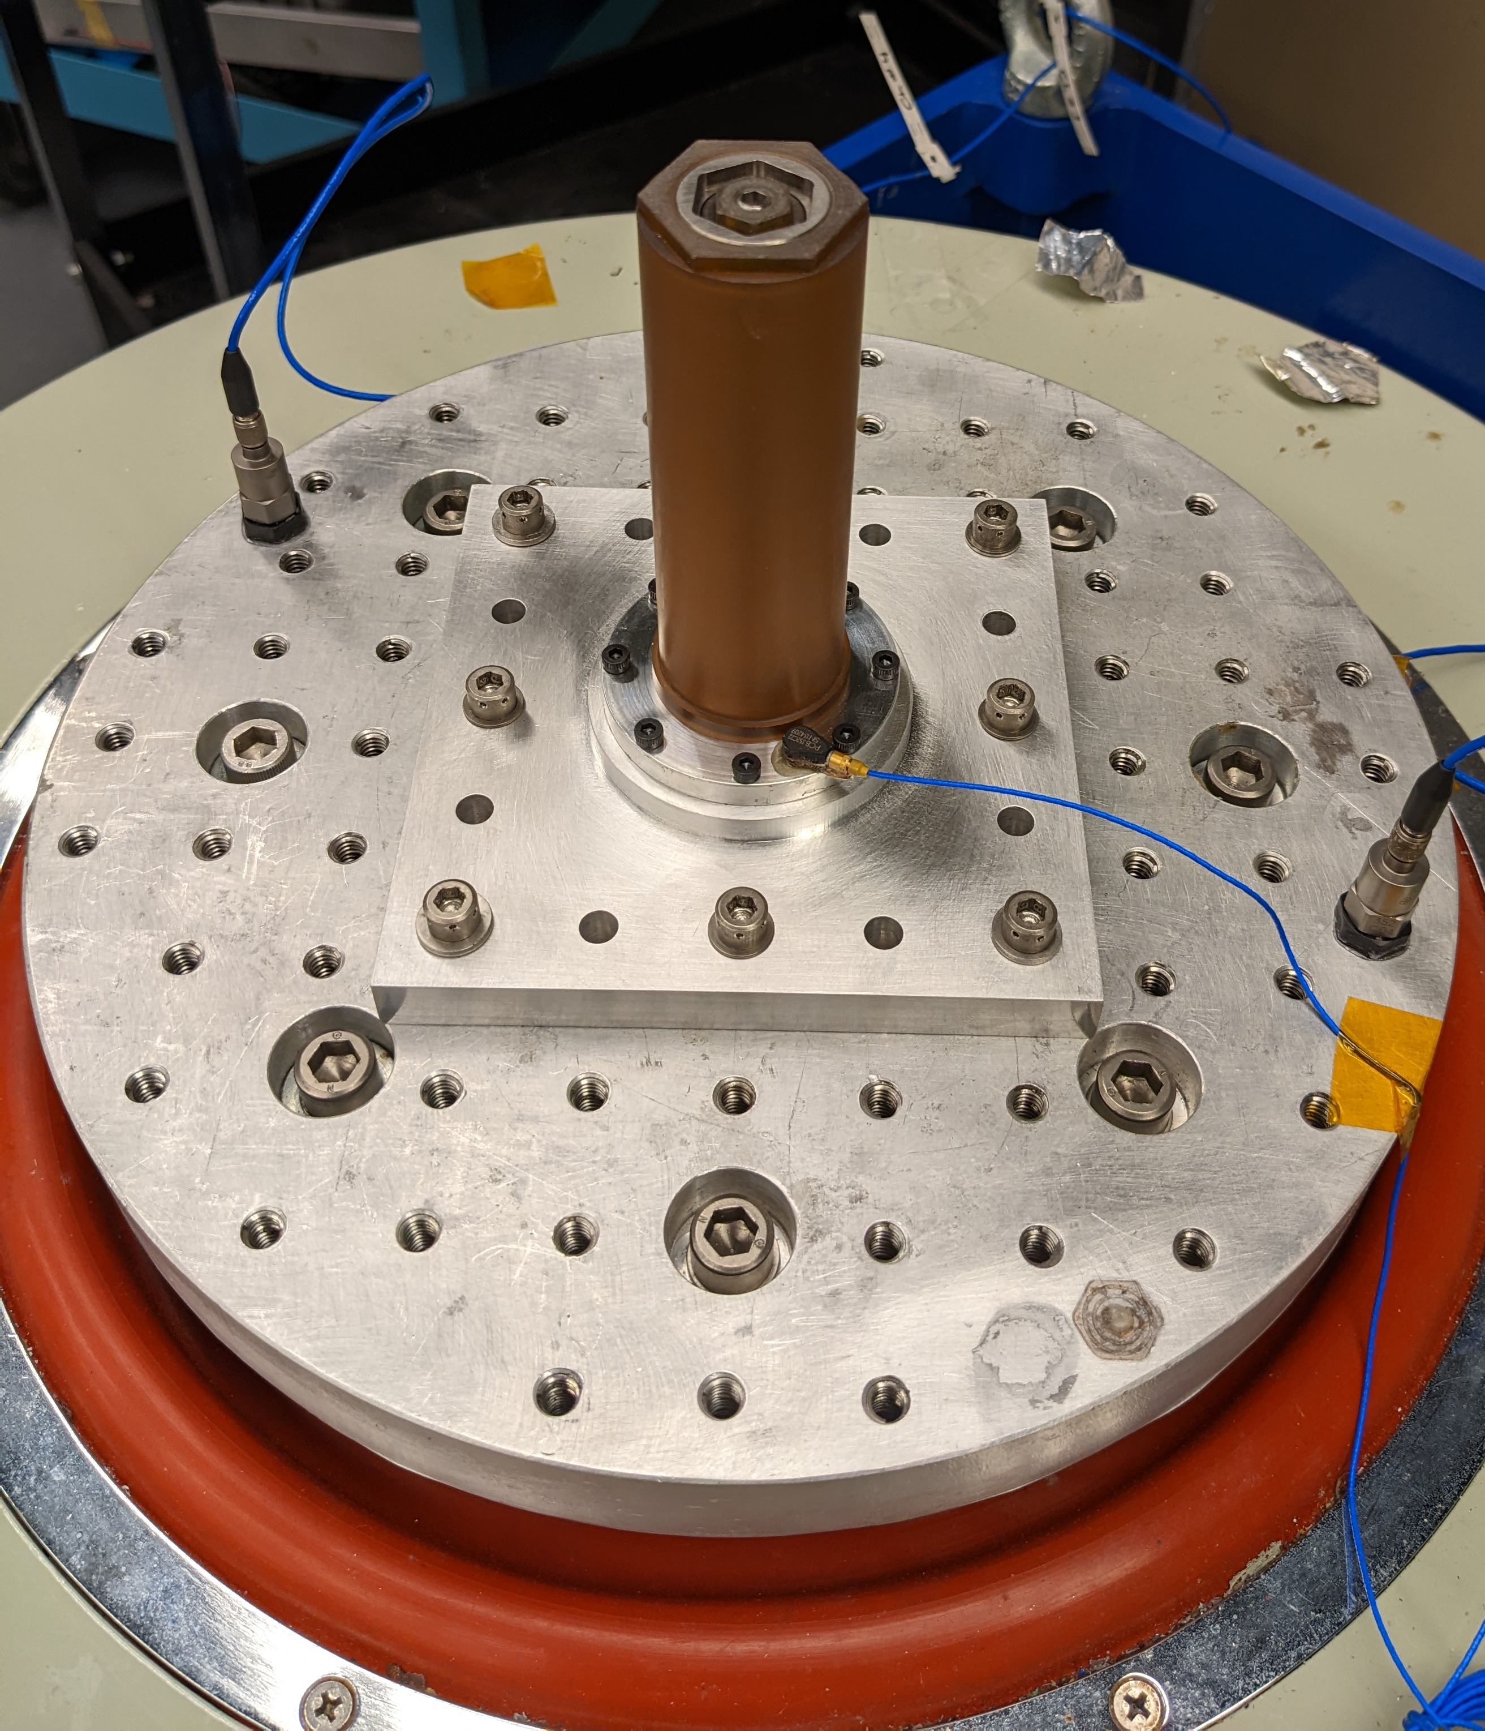
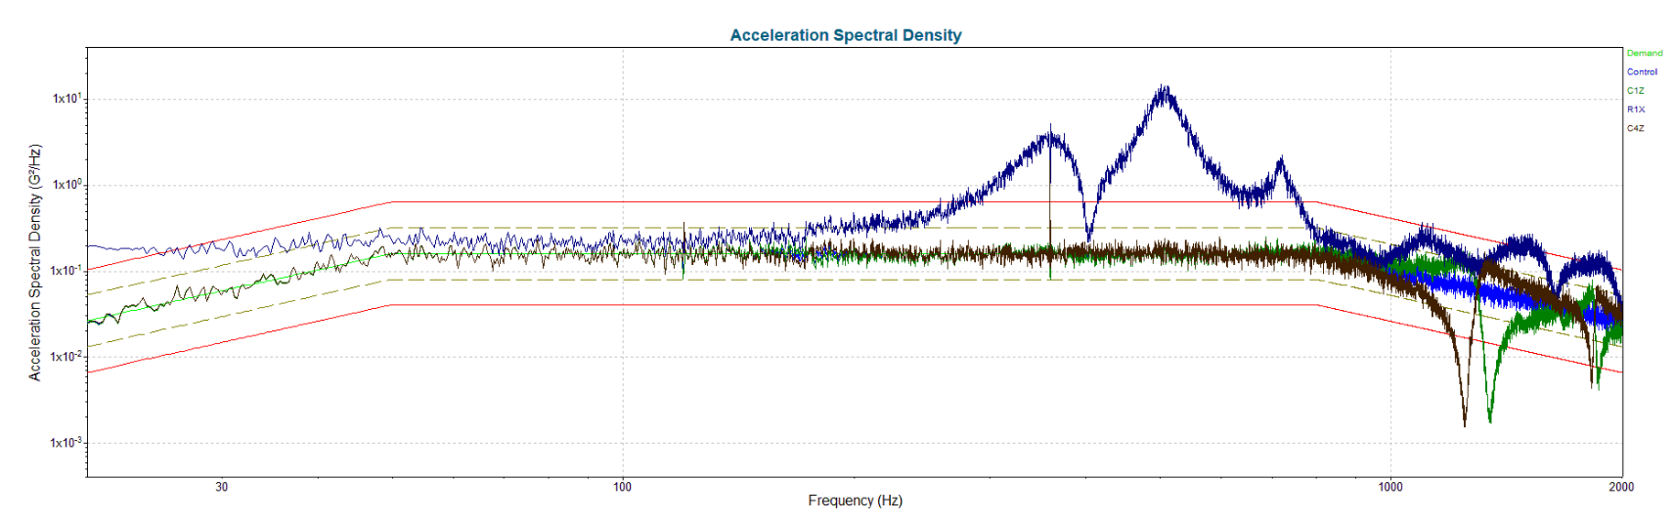
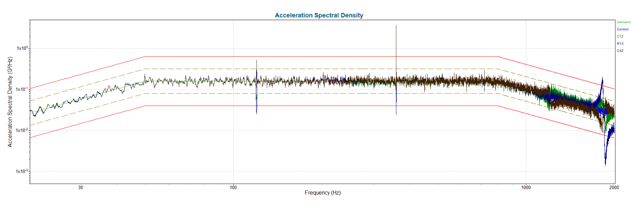
Vibration Test
The General Environmental Verification Standard (GEVS) was used as a reference to determine a conservative vibration environment.
  Future flight vibration environment unknown
  Used the generalized random vibration test levels for qualification hardware
The thermal switch was mounted in an interface plate and attached to the shaker table horizontal mount for z-axis testing, and vertical mount for x- and y-axis testing.
  Because the cylindrical TS is symmetrical, one test was performed for both the x- and y- axis test (labeled as xy-axis).
Observed results
  Chatter was audible during the xy-axis test from the TS internal concentric tubes making contact.
  No chatter was audible during the z-axis test.
  No physical changes or damage were observed after either test, but the thermal switch was not disassembled for internal examination.
xy-axis test set up.
z-axis test set up.
Generalized Random Vibration Test Levels from GEVS.
xy-axis data.
z-axis data.

Slide 9
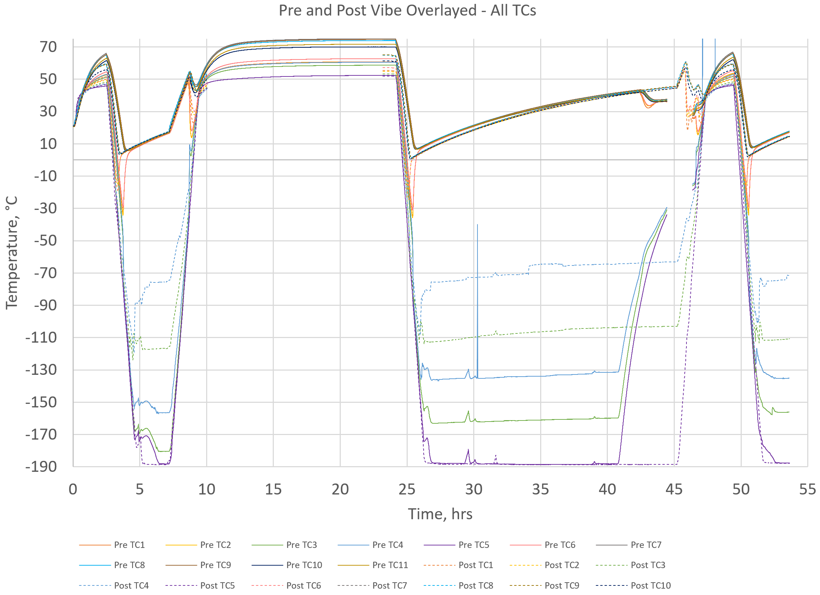
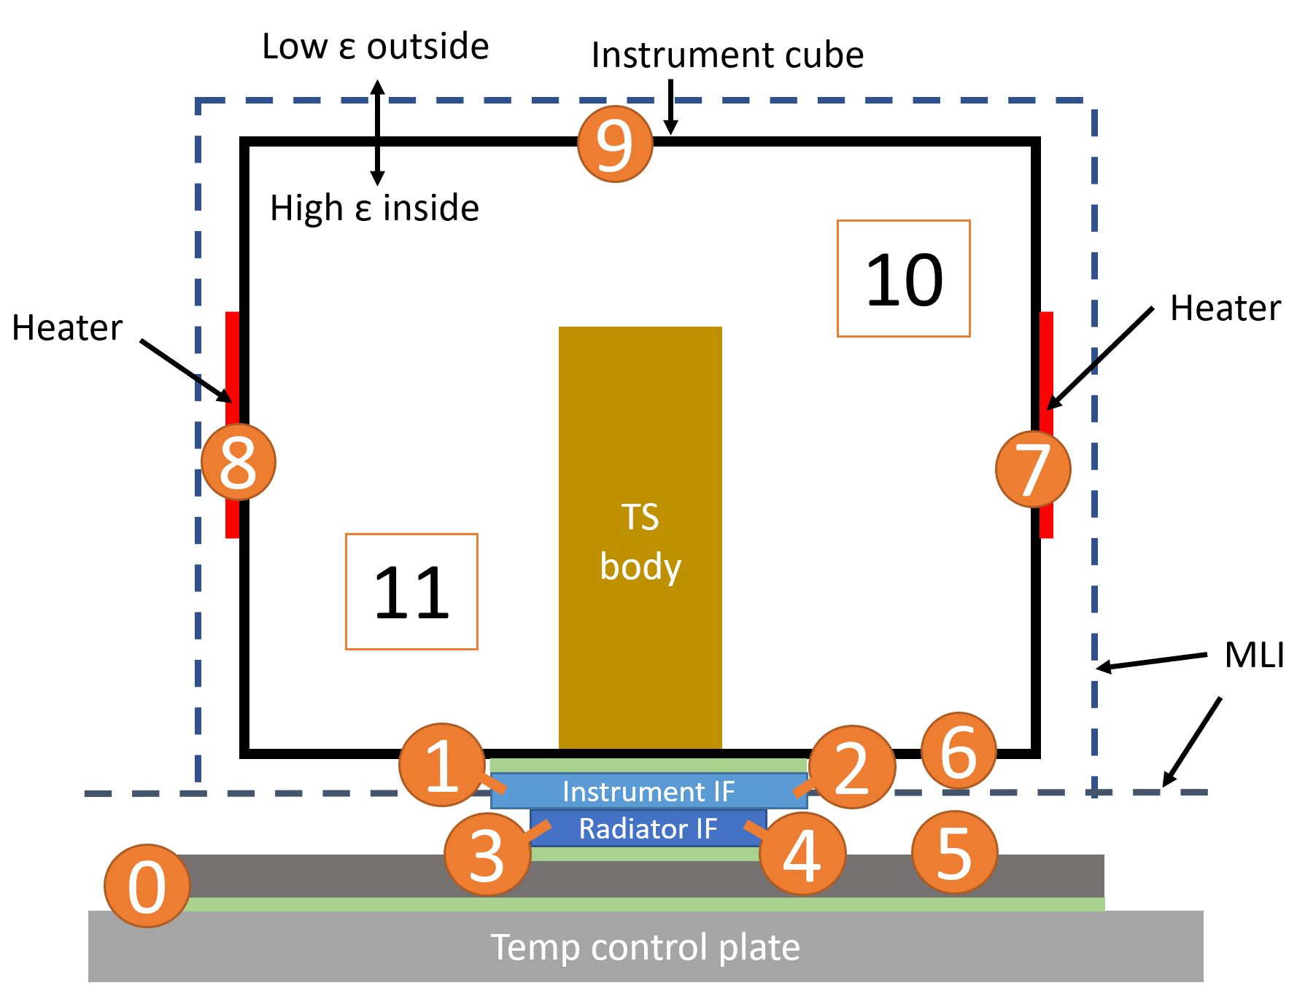
Pre- and Post- Vibration Thermal Vacuum Cycle Data Overview
Post-vibe test phases were timed to match the pre-vibe test for easier data comparison.
Minimum plateau hold time goal = 2 hrs
Rate of change goal = +/- 2 °C/min
Long holds were performed for hot plateau 2 and cold plateau 2 to collect nearer steady-state-like data and convenience of avoiding 24/7 test support.
Challenges evident in data:
  TC3 and TC4 detachment
  Data loss during post-vibe hot plateau 2
  LN₂ loss during pre-vibe cold plateau 2
Thermocouple locations

Slide 10
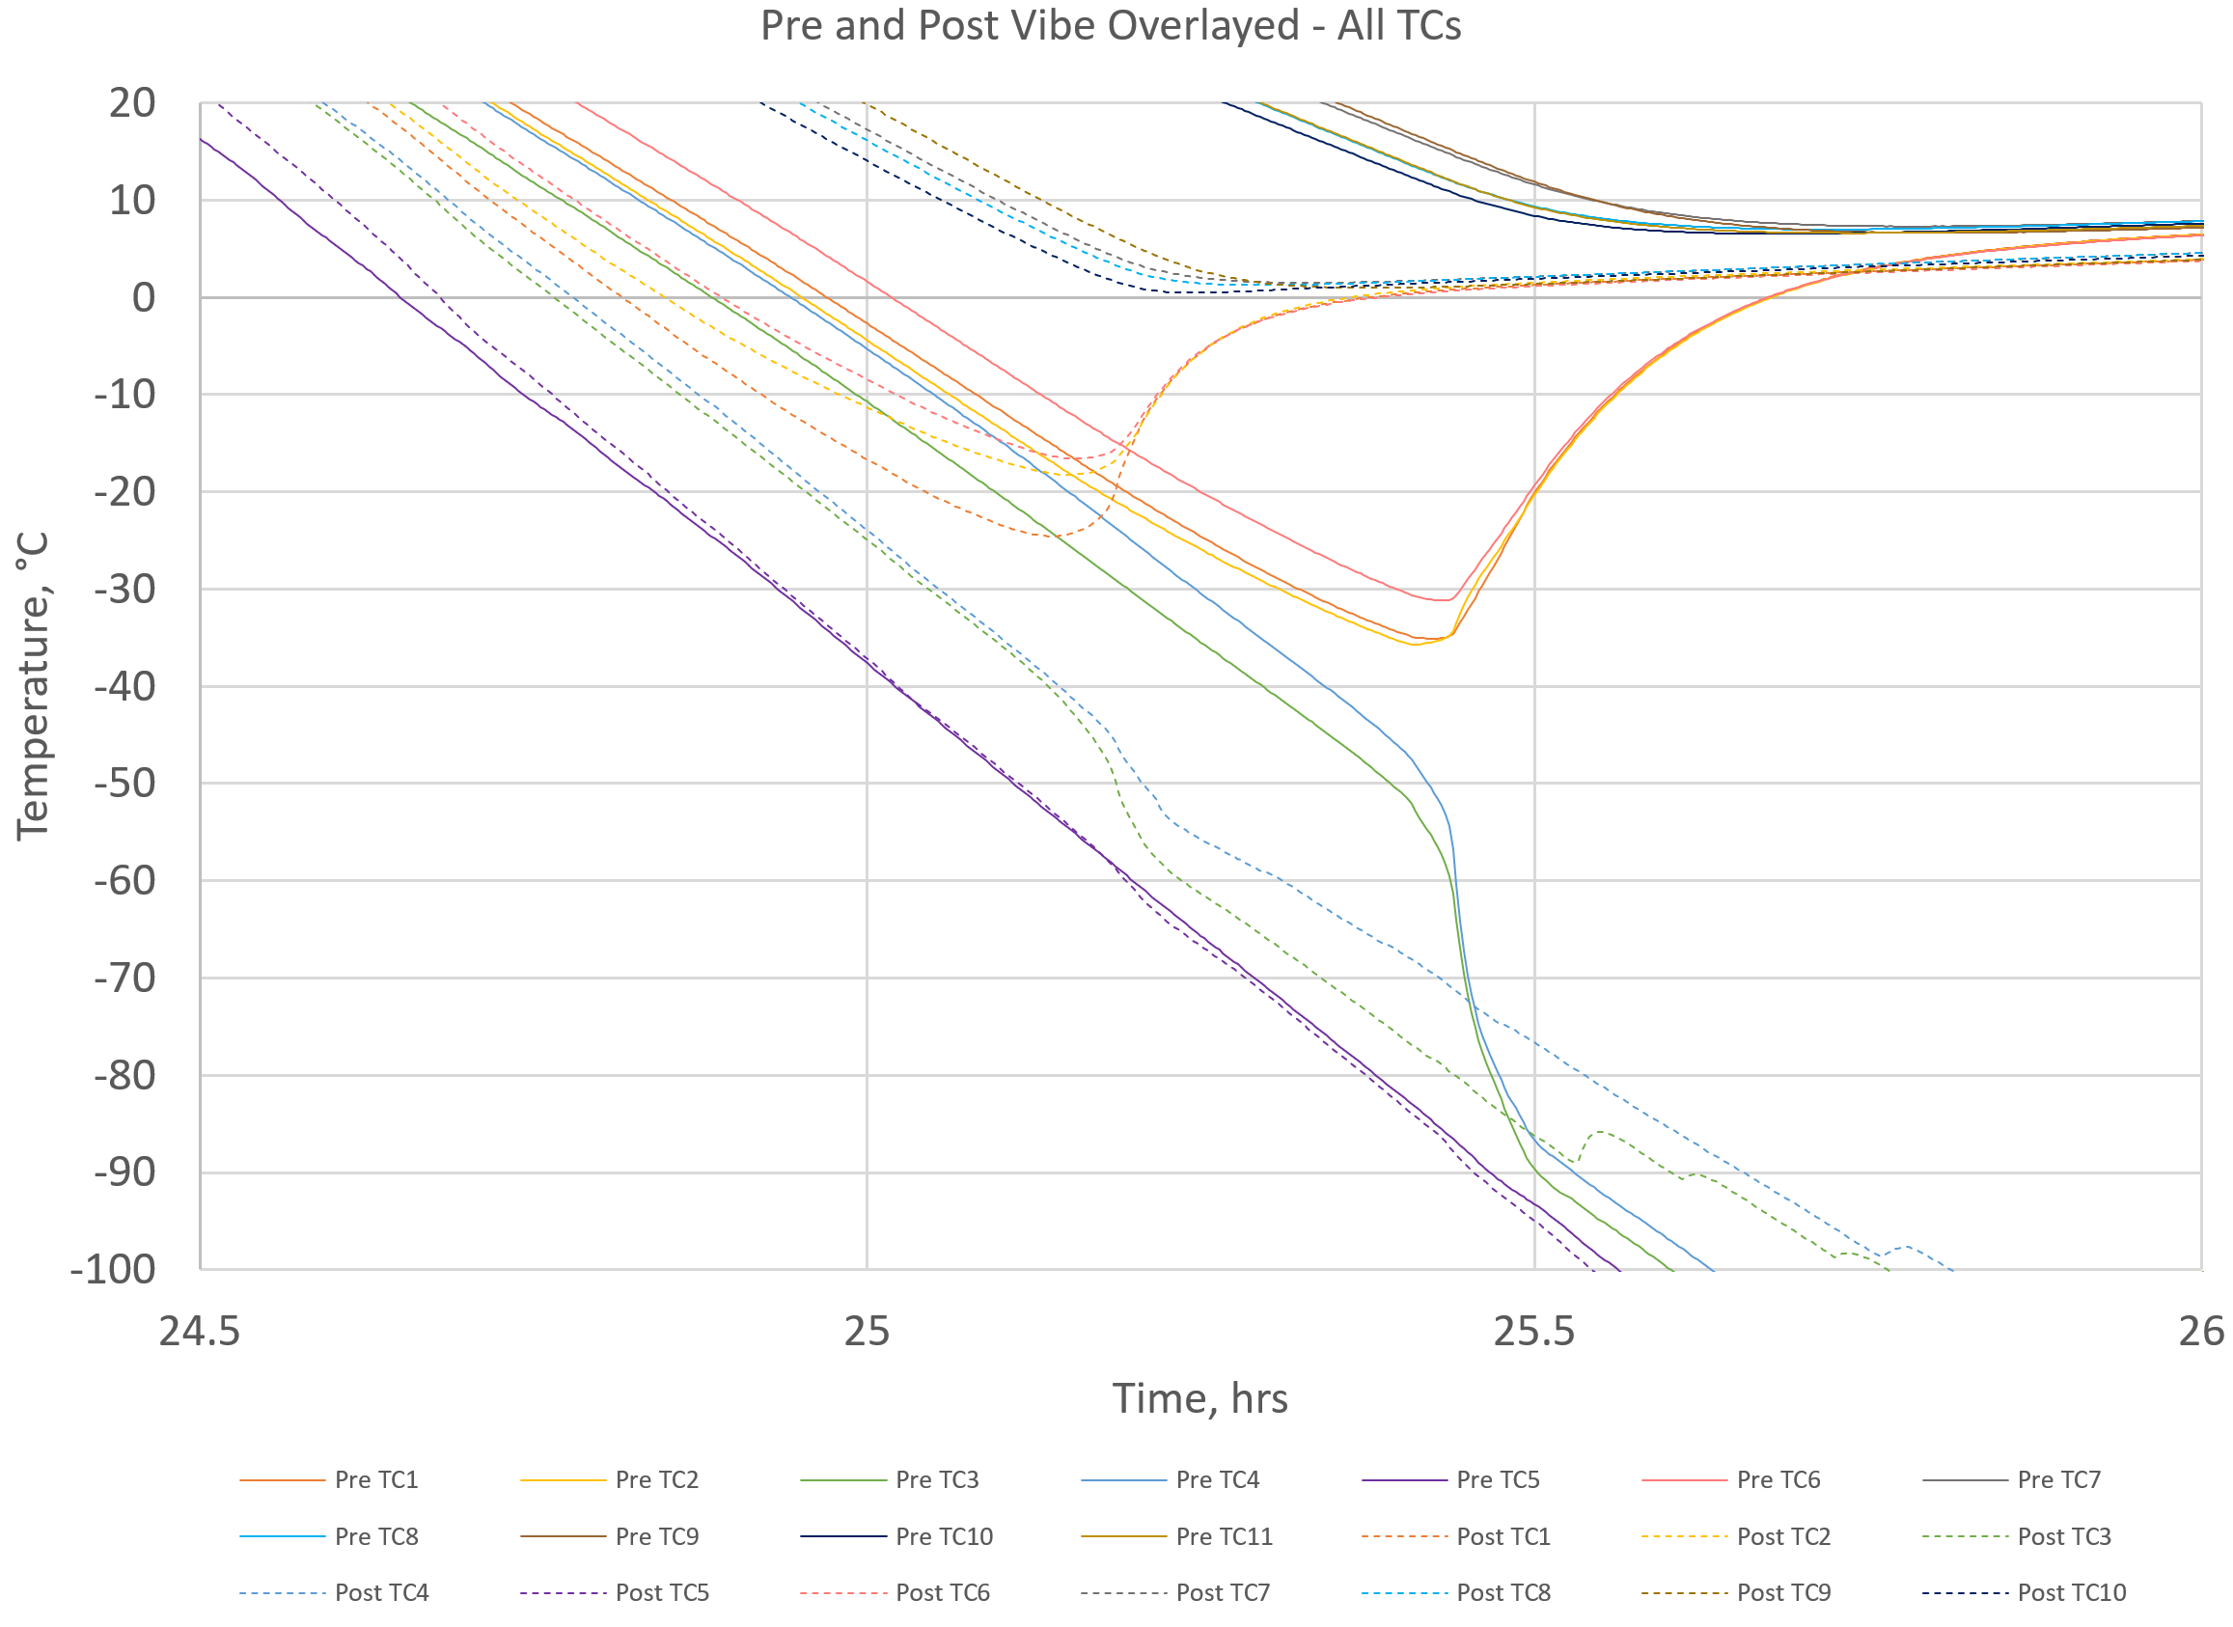
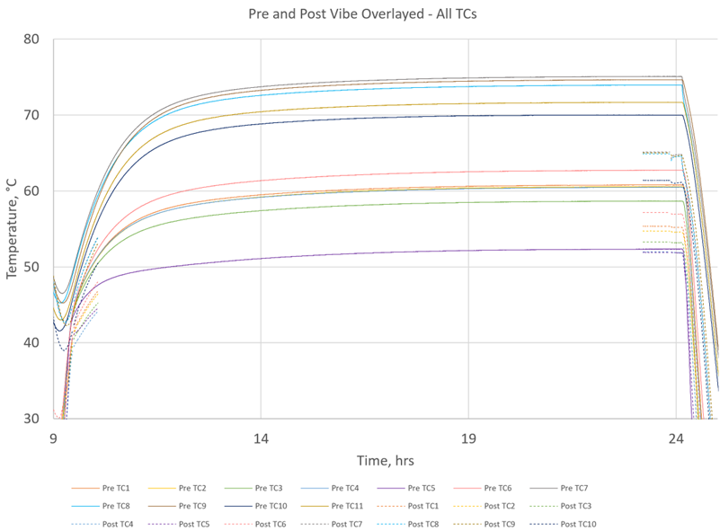
Pre- and Post- Vibration Thermal Vacuum Cycle Comparison
Hot plateau
  The TS instrument IF and instrument cube temperatures are greater during pre-vibe than post-vibe.
    The pre-vibe IC max temperature reaches ~ 10 °C hotter than the post vibe IC max temperature during hot plateau 2.
    Because the temperature control plate is colder than the instrument cube, the thermal contact between the IC and the temperature control plate is greater when the IC is lower in temperature, so the contact is greater during post-vibe.
  The difference between TS IF disks is greater during pre-vibe than post-vibe.
    Closer temperatures indicate a greater thermal contact between IFs during post-vibe.
Cool down / TS opening
  The instrument cube reaches lower temperatures before the TS opens during post-vibe than pre-vibe.
    During pre-vibe the IC temperatures reach ~7 °C before the TS opens and the IC cube temperatures begin to increase. During post-vibe this value is ~ 0 °C.
  The TS begins to open at a higher temperature during post-vibe than pre-vibe
    During pre-vibe the average TS IF temperature is ~-57 °C when it begins to fully open
    During post-vibe the average TS IF temperature is ~-45 °C when it begins to fully open
IC cube lowest temperatures before TS opening
Cool down 2
Hot plateau 2
The pre-vibe IC max temperature reached is greater during pre-vibe than post-vibe
Pre-vibe TS opening
Post-vibe TS opening
Thermocouple locations

Slide 11
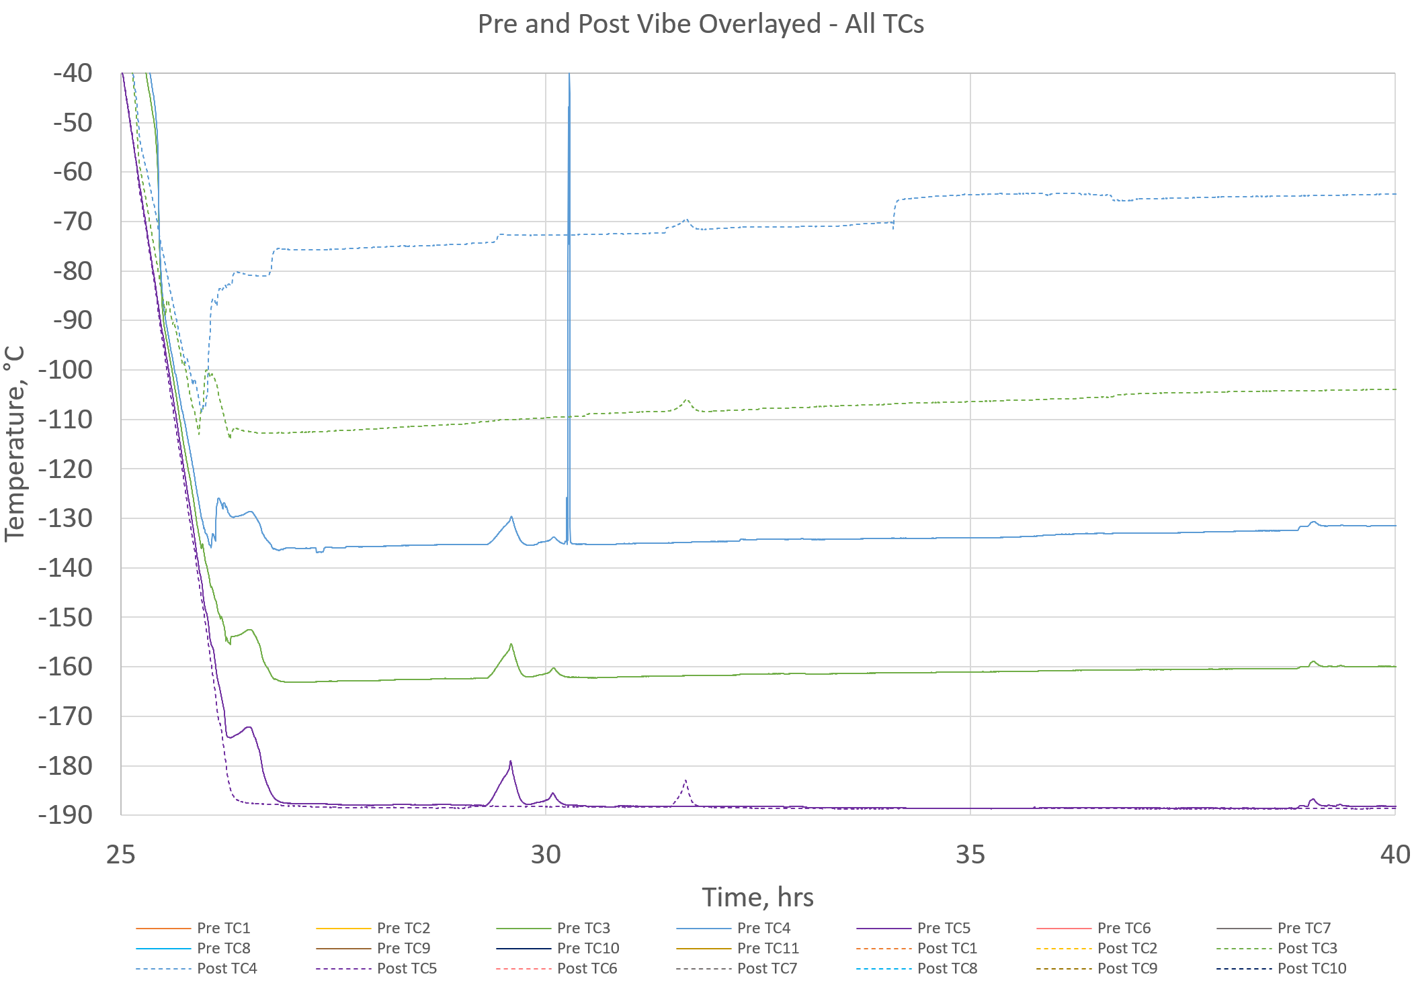
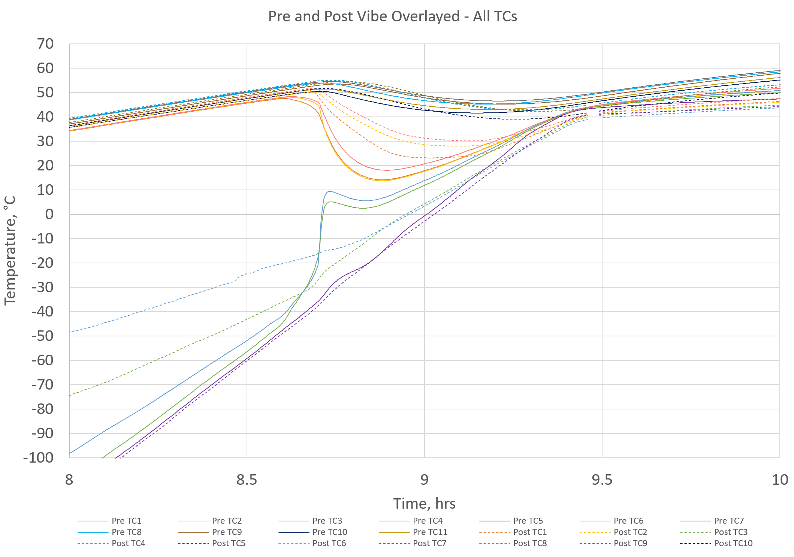
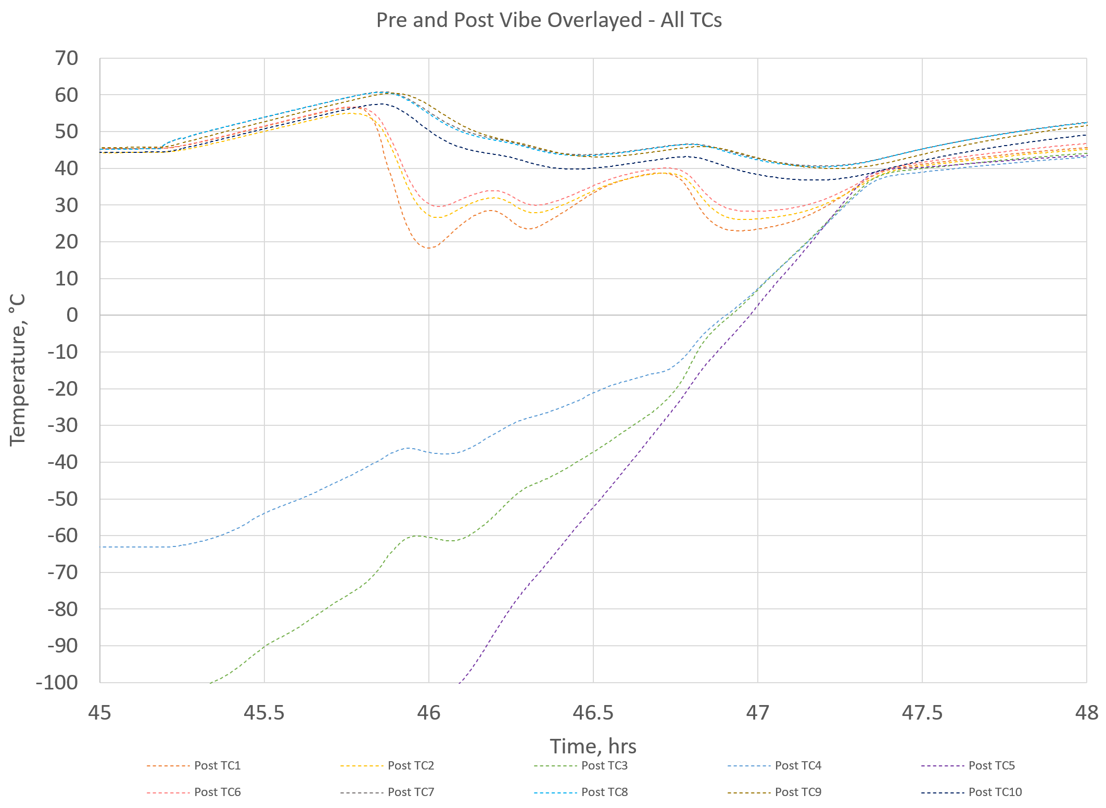
Pre- and Post- Vibration Thermal Vacuum Cycle Comparison
Cold plateau
  The TS radiator IF thermocouples are less thermally coupled to the surface during post-vibe than in pre-vibe.
    Consistent with post-test observations
Heat up / TS closing
  The TS IF temperatures converge more gradually during post-vibe than in pre-vibe.
    Likely due to TC detachment
  “False closing” observed during post-vibe heat up 3 during which TC would appear to close and temperature trends of the TS IFs then reversed before the TS actually closed. This was also observed during the long duration test.
Thermocouple locations
Cold plateau 2
Heat up 2
Heat up 3
False closing
LN2 Dewar Swap

Slide 12
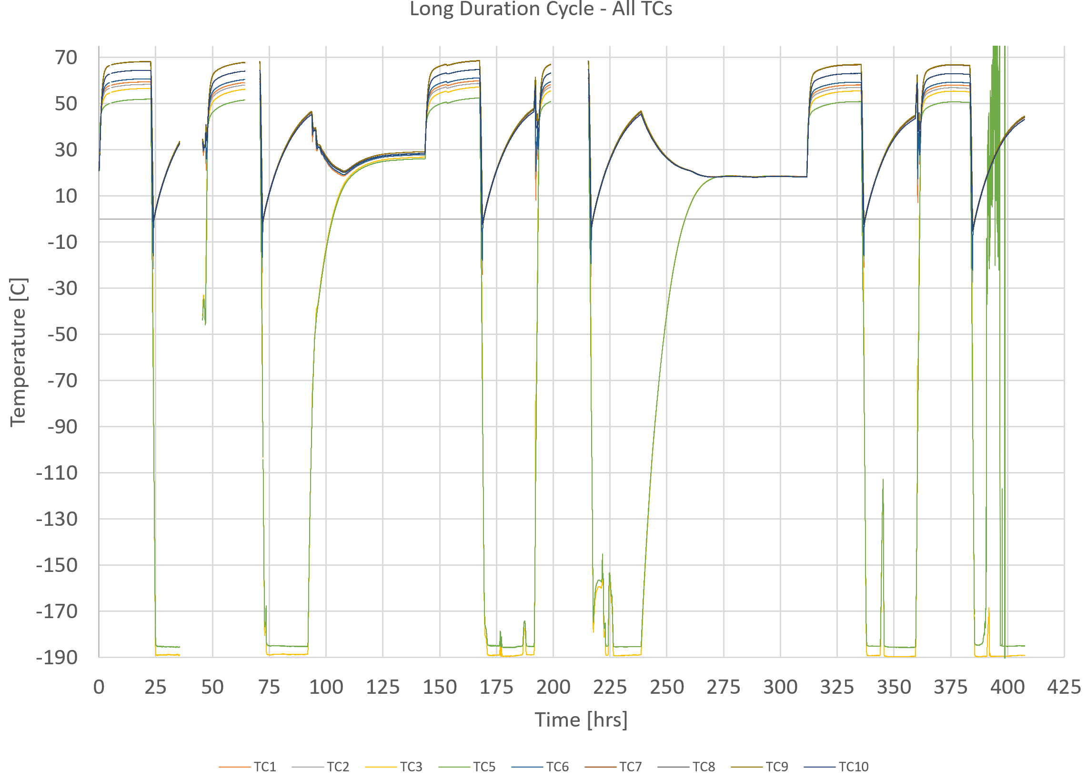
Long Duration Thermal Vacuum Cycle Data Overview
Long duration total time of testing = 407.5 hrs (~ 17 days)
Minimum plateau length goal = 20 hrs
Rate of change goal = +/- 2 °C/min
Heat up 3 and Heat up 5 include a test pause throughout the weekend during which the test set up was allowed to reach ambient temperatures before restarting heat up phase.
TC4 is hidden in plot on this slide due to erratic readings.
Challenges evident in data:
  TC3 nearly aligned with TC5. No detachment confirmed by post-test inspection)
  Loss of data during hot plateau 2 and 4
  Loss of data and cooling during cold plateau 1
  LN2 loss during cold plateau 2 (at ~19 hours into plateau)
Thermocouple locations

Slide 13
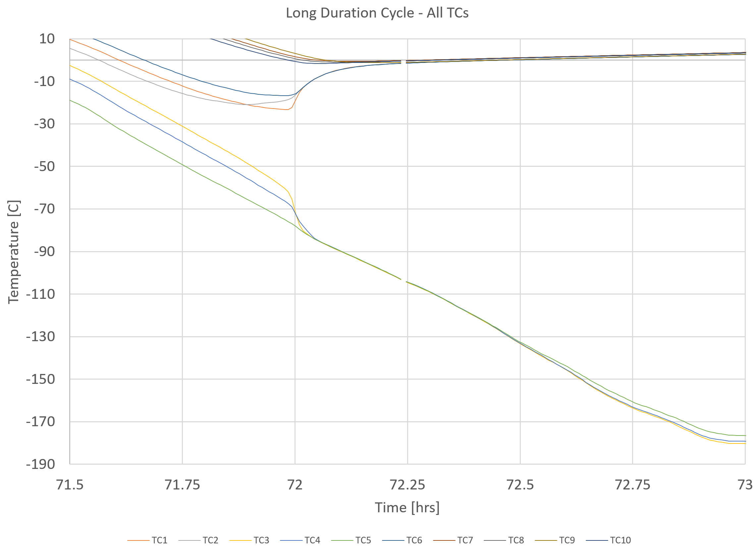
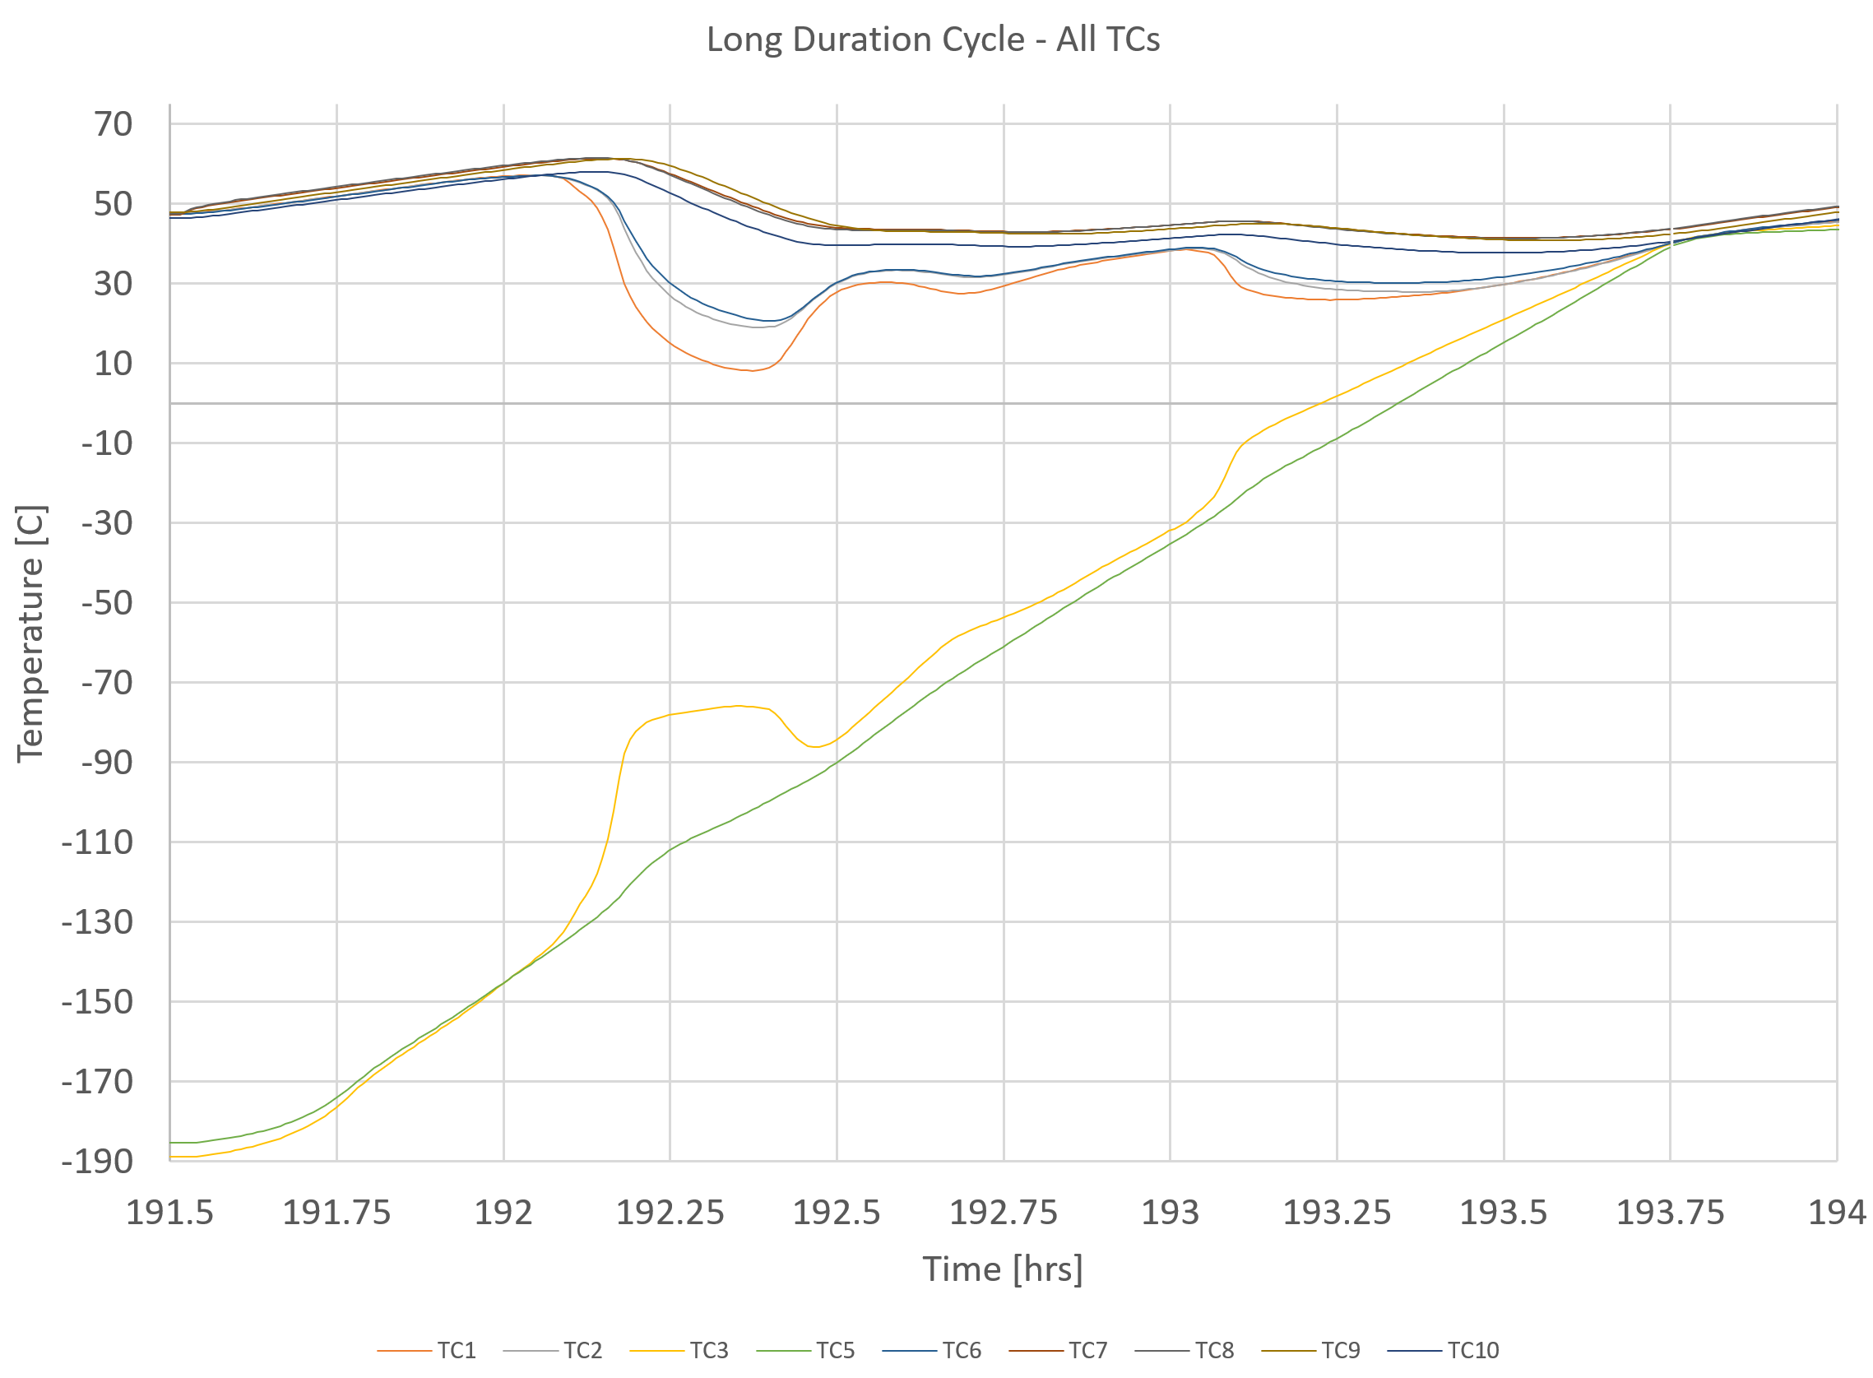
Long Duration Thermal Vacuum Cycle Data Observations
TCs remained attached. TC3 and TC4 (TS radiator IF) are much closer to TC5 (temperature control IF plate) during the cool down and cold plateaus once TS is open.
False closing was observed during which the TS appears to begin to close, temperature trends reverse, and then TS closes.
Cool down 2
Heat up 4
TS instrument IF
IC
TS opening
TS closing
TC3 and TC4 closely follow TC5 after TS opening
False closing
TC3 and TC4 are colder than TC5 once cold plateau is reached
TS radiator IF

Slide 14
Long Duration Comparison to Pre- and Post- Vibe Thermal Vacuum Cycle
Compared at 14.5 hrs into each plateau
  In general, the long duration temperatures recorded at each point are between the pre- and post-vibration temperatures, and slightly closer to the post-vibration values.
  TC2, TC3 and TC4 became detached from surfaces during pre- and post-vibration thermal cycle tests.
During cool down phases / TS opening
  Long duration temperatures are more like the post-vibe data than the pre-vibe data collected.
During heat up phases / TS closing
  Less data was collected during TS closing because heat up 1 for each test started from room temperature with the TS already closed and heat up 3 and 5 during the long duration test was a gradual warming to ambient temp without using the temperature control plate heaters.

Slide 15
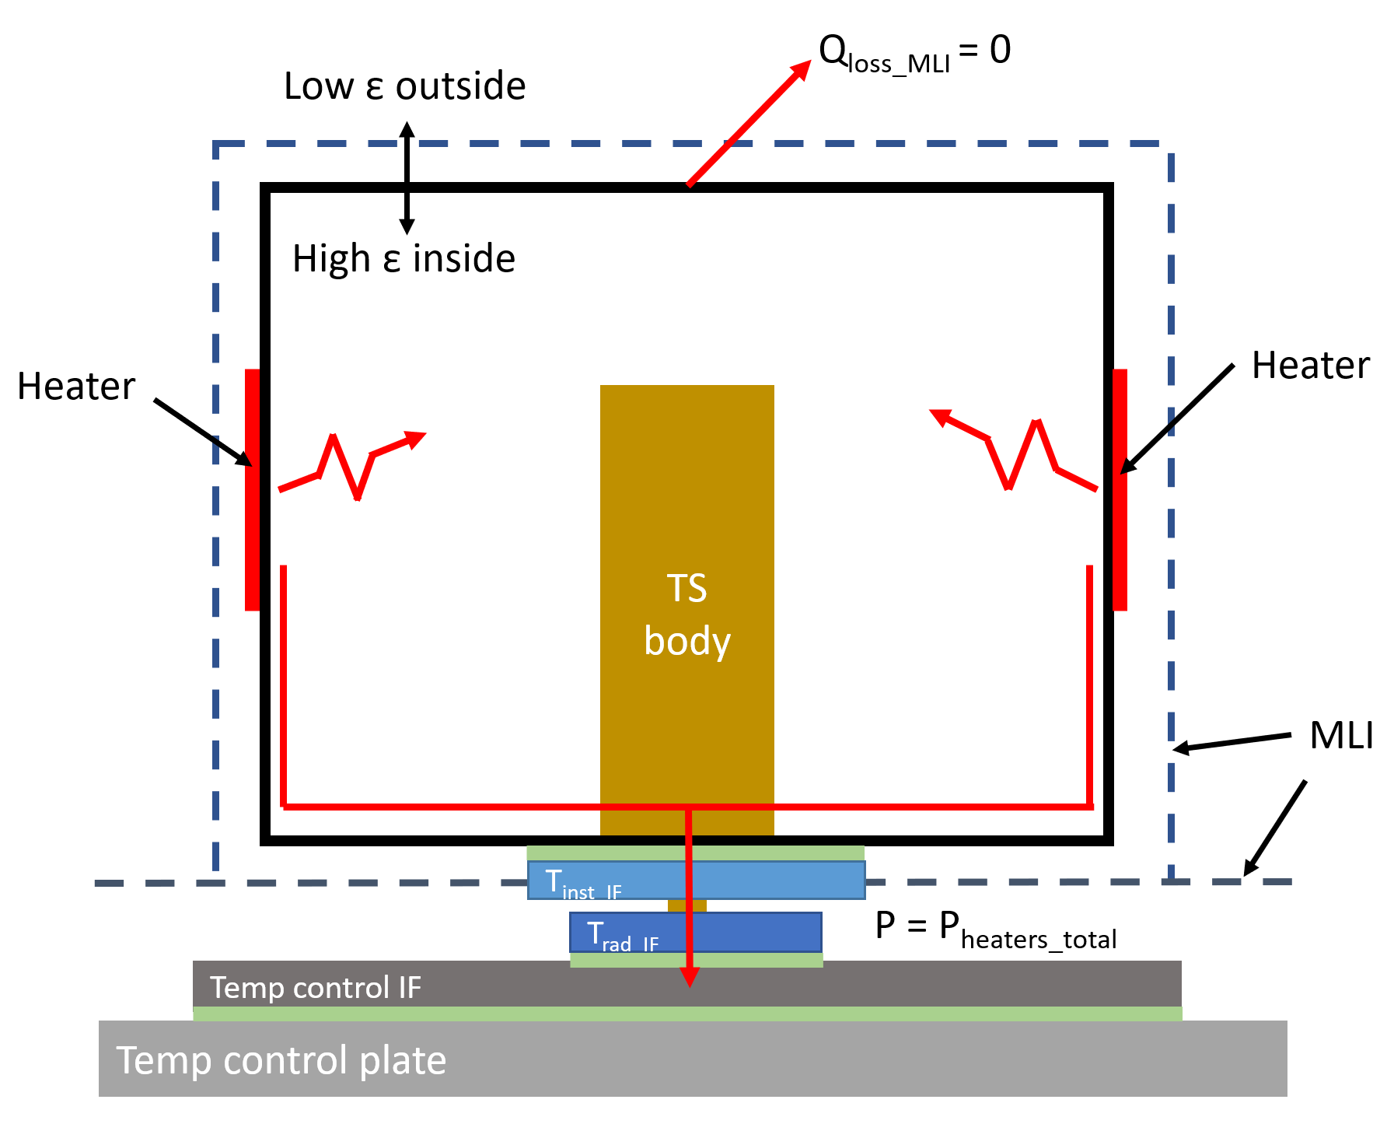

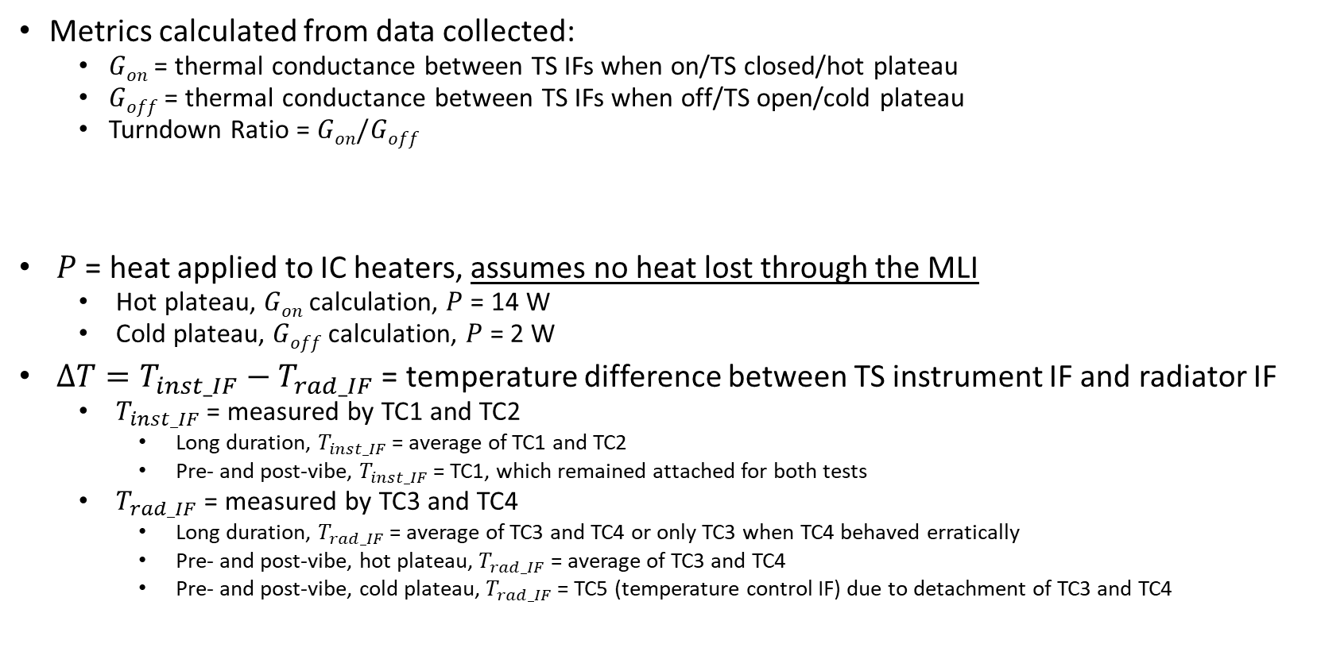
Performance Calculations
Metrics calculated from data collected:
  $Gon$ = thermal conductance between TS IFs when on/TS closed/hot plateau
  $Goff$ = thermal conductance between TS IFs when off/TS open/cold plateau
  Turndown Ratio = $Gon/Goff$
$P$ = heat applied to IC heaters, assumes no heat lost through the MLI
  Hot plateau, $Gon$ calculation, $P$ = 14 W
  Cold plateau, $Goff$ calculation, $P$ = 2 W
$∆T=T_{inst_IF}−T_{rad_IF}$ = temperature difference between TS instrument IF and radiator IF
  $T_{inst_IF}$= measured by TC1 and TC2
    Long duration, $T_{inst_IF}$ = average of TC1 and TC2
    Pre- and post-vibe, $T_{inst_IF}$ = TC1, which remained attached for both tests
  $T_{rad_IF}$ = measured by TC3 and TC4
    Long duration, $T_{rad_IF}$ = average of TC3 and TC4 or only TC3 when TC4 behaved erratically
    Pre- and post-vibe, hot plateau, $T_{rad_IF}$ = average of TC3 and TC4
    Pre- and post-vibe, cold plateau, $T_{rad_IF}$ = TC5 (temperature control IF) due to detachment of TC3 and TC4
$$G=\frac{P}{∆T}$$
Diagram assuming Q_{loss_MLI}=0

Slide 16
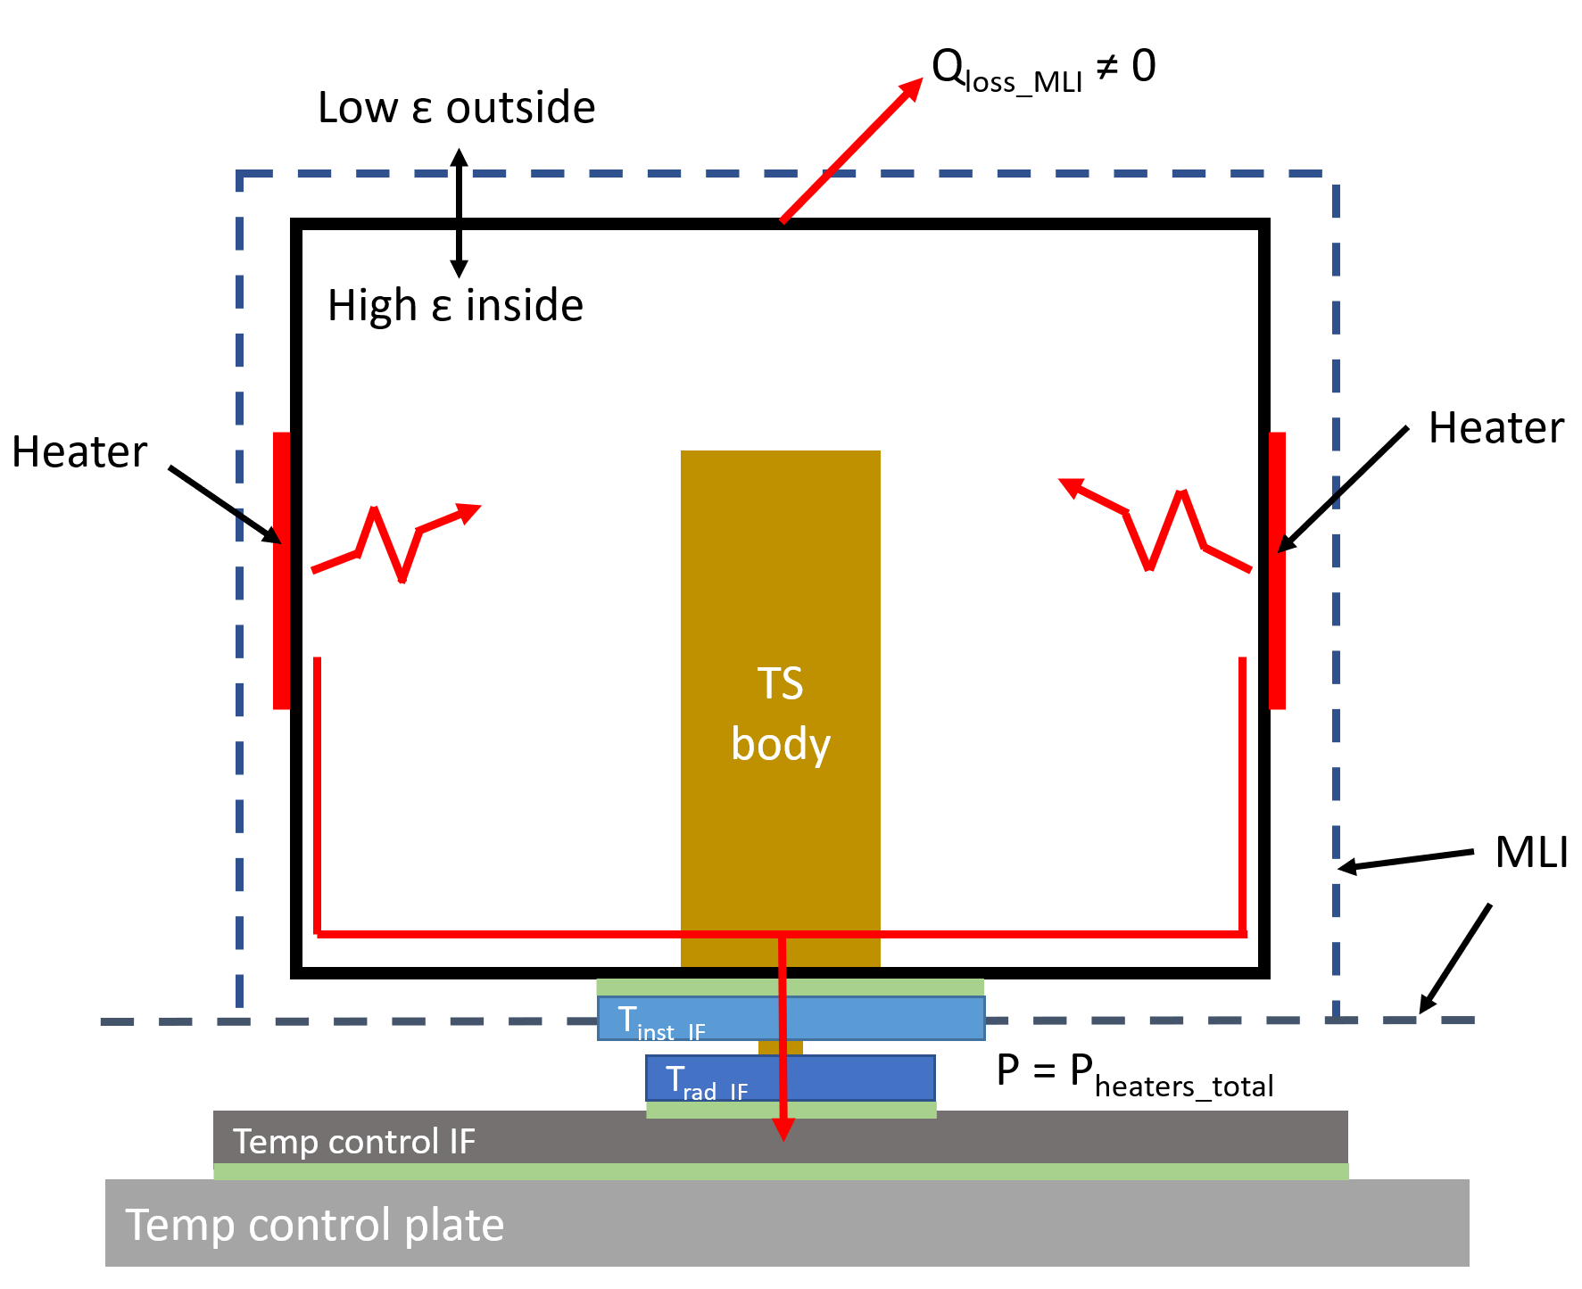
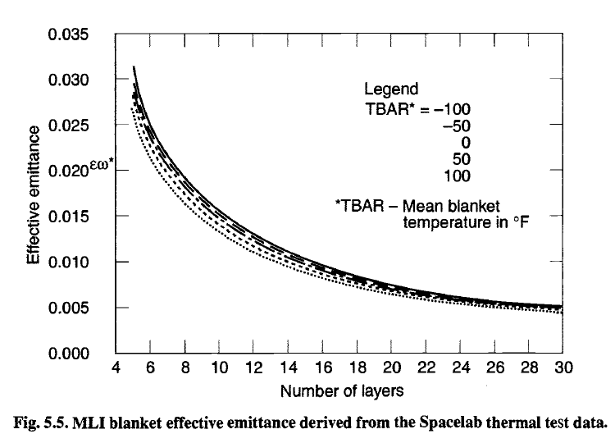
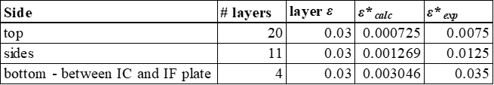

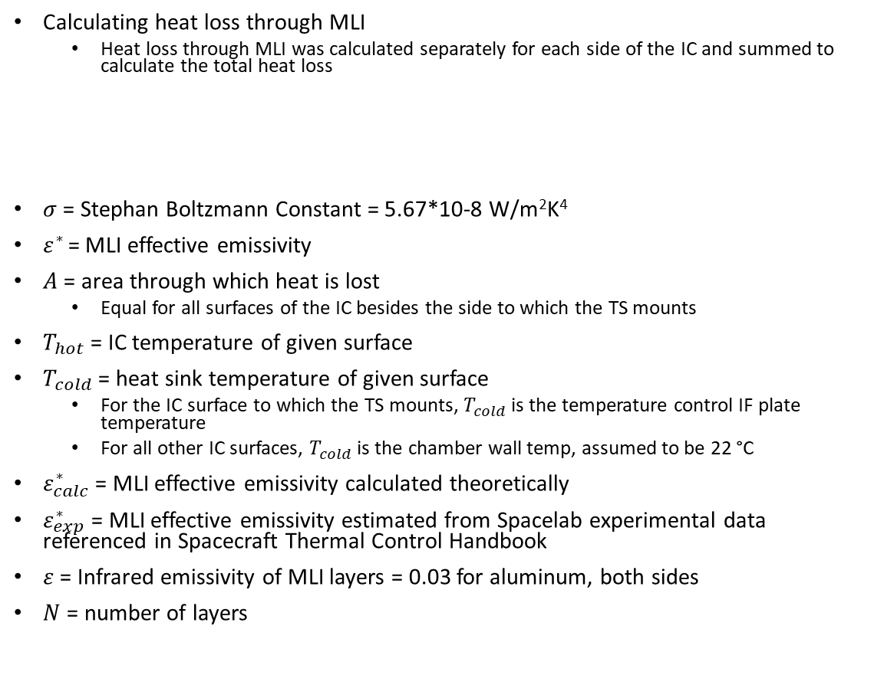
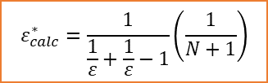


MLI Assumptions
Calculating heat loss through MLI
  Heat loss through MLI was calculated separately for each side of the IC and summed to calculate the total heat loss
$σ$ = Stephan Boltzmann Constant = 5.67*10-8 W/m²K⁴
$ε^{∗}$ = MLI effective emissivity
$A$ = area through which heat is lost
  Equal for all surfaces of the IC besides the side to which the TS mounts
$T_{hot}$ = IC temperature of given surface
$T_{cold}$ = heat sink temperature of given surface
  For the IC surface to which the TS mounts, $T_{cold}$ is the temperature control IF plate temperature
  For all other IC surfaces, $T_{cold}$ is the chamber wall temp, assumed to be 22 °C
$ε_{calc}^{∗}$ = MLI effective emissivity calculated theoretically
$ε_{exp}^{∗}$ = MLI effective emissivity estimated from Spacelab experimental data referenced in Spacecraft Thermal Control Handbook
$ε$ = Infrared emissivity of MLI layers = 0.03 for aluminum, both sides
$N$ = number of layers
$$ε_{calc}^{∗}=\frac{1}{\frac{1}{ε}+\frac{1}{ε}−1}\left(\frac{1}{N+1}\right)$$
$$Q_{loss_MLI}=σε^{∗}A\left({T_{hot}}^{4}−{T_{cold}}^{4}\right)$$
$$ε_{exp}^{∗}=estimated from plot$$
Gilmore, D. G. (2002). Spacecraft Thermal Control Handbook Volume I: Fundamental Technologies. El Segundo, California: The Aerospace Press.
Diagram assuming Q_{loss_MLI ≠} 0
Effective emissivity summary
$ε_{exp}^{∗}$ is about 10x greater than $ε_{calc}^{∗}$

Slide 17
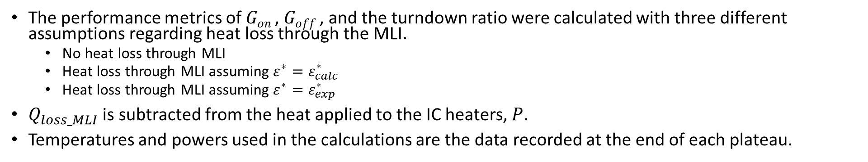
Long Duration Thermal Vacuum Cycle Calculations
The performance metrics of $Gon$, $Goff$, and the turndown ratio were calculated with three different assumptions regarding heat loss through the MLI.
  No heat loss through MLI
  Heat loss through MLI assuming $ε^{∗}=ε_{calc}^{∗}$
  Heat loss through MLI assuming $ε^{∗}=ε_{exp}^{∗}$
$Q_{loss_MLI}$ is subtracted from the heat applied to the IC heaters, $P$.
Temperatures and powers used in the calculations are the data recorded at the end of each plateau.

Slide 18
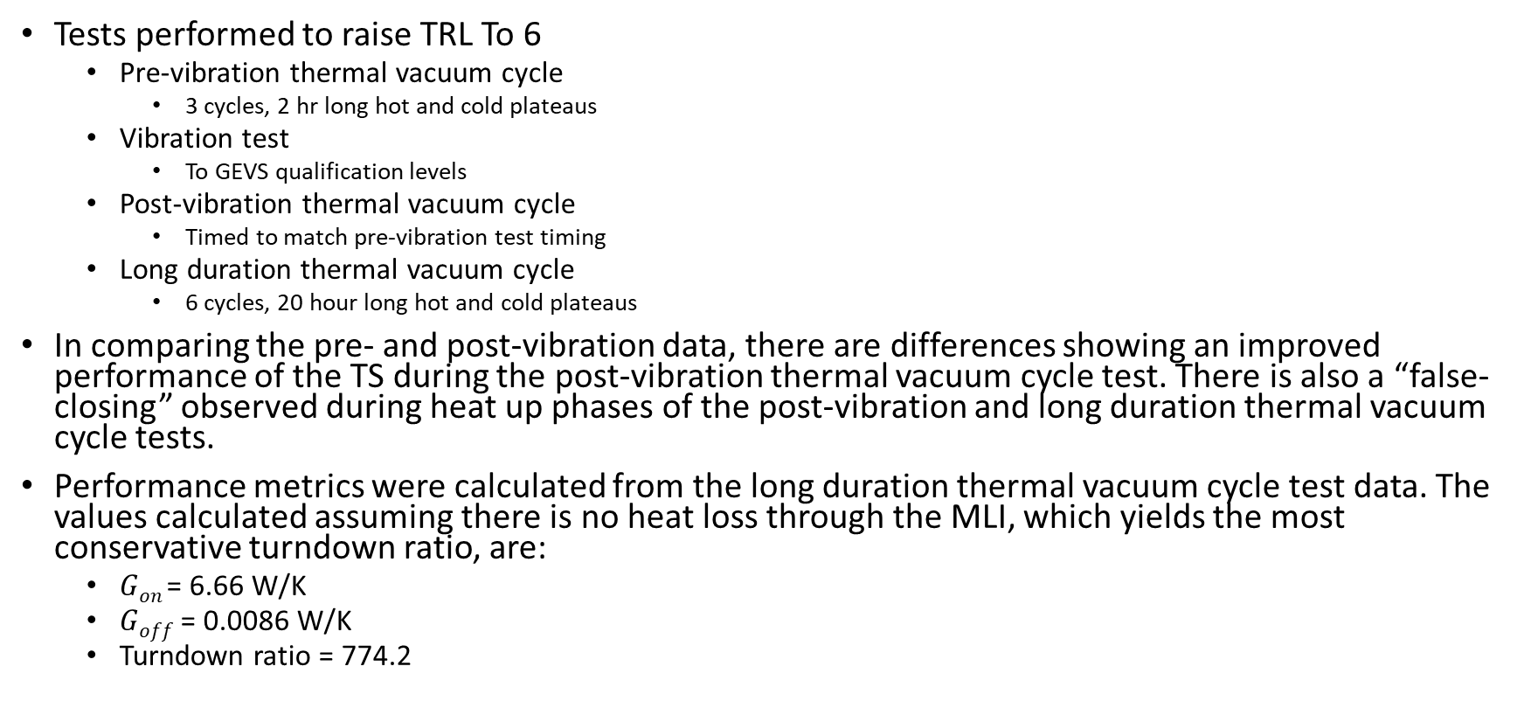
Summary
Tests performed to raise TRL To 6
  Pre-vibration thermal vacuum cycle
    3 cycles, 2 hr long hot and cold plateaus
  Vibration test
    To GEVS qualification levels
  Post-vibration thermal vacuum cycle
    Timed to match pre-vibration test timing
  Long duration thermal vacuum cycle
    6 cycles, 20 hour long hot and cold plateaus
In comparing the pre- and post-vibration data, there are differences showing an improved performance of the TS during the post-vibration thermal vacuum cycle test. There is also a “false-closing” observed during heat up phases of the post-vibration and long duration thermal vacuum cycle tests.
Performance metrics were calculated from the long duration thermal vacuum cycle test data. The values calculated assuming there is no heat loss through the MLI, which yields the most conservative turndown ratio, are:
  $Gon$= 6.66 W/K
  $Goff$ = 0.0086 W/K
  Turndown ratio = 774.2

Slide 19
Acknowledgements
I would like to acknowledge the following people for making this work possible:
CIF and TIP selection committees for funding the projects to design, build and test this technology
Dave Bugby and Jose Rivera for acting as the PI and Co-I of the CIF at JPL to design and develop the thermal switch
Jeff Farmer for his thermal expertise provided throughout the project
Erin Hayward, Jason Vaughn, and Todd Schneider for their test assistance in both using the EM vacuum chamber and test materials and with conducting the test
Savanna Lyles for testing help and effort correlating the thermal switch test model to the test data

Slide 20
Thank you!
Contact information:
Stephanie Mauro
Stephanie.L.Mauro@nasa.gov

