Slide 1


Observing Earth radiation budget
Seiji Kato, Norman G. Loeb, and the CERES science team
NASA Langley Research Center

Slide 2
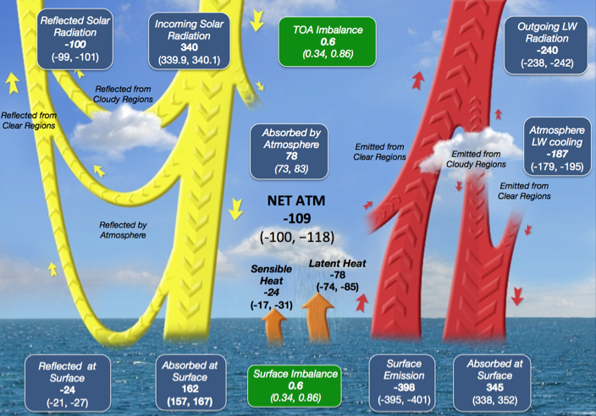
Energy diagram of Earth’s climate system
CERES project provides most of the fluxes and is observing radiative flux changes in the last 23 years
CERES is the only project that can provide observationally constrained radiative fluxes at a global scale

Slide 3
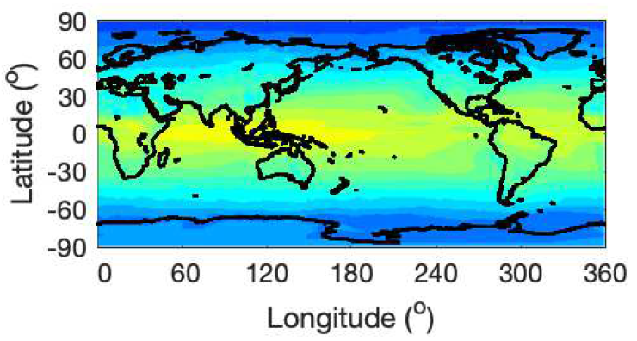
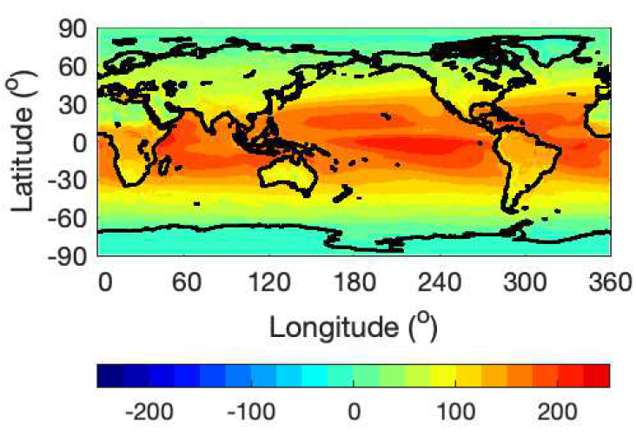
NET TOA and surface radiative fluxes
July 2005 to June 2015 mean
Top-of-atmosphere
Shortwave + longwave net
Larger radiative flux at the surface over the tropics.
Energy is transported toward polar regions by the atmosphere and ocean.
Surface
Shortwave + longwave net

Slide 4
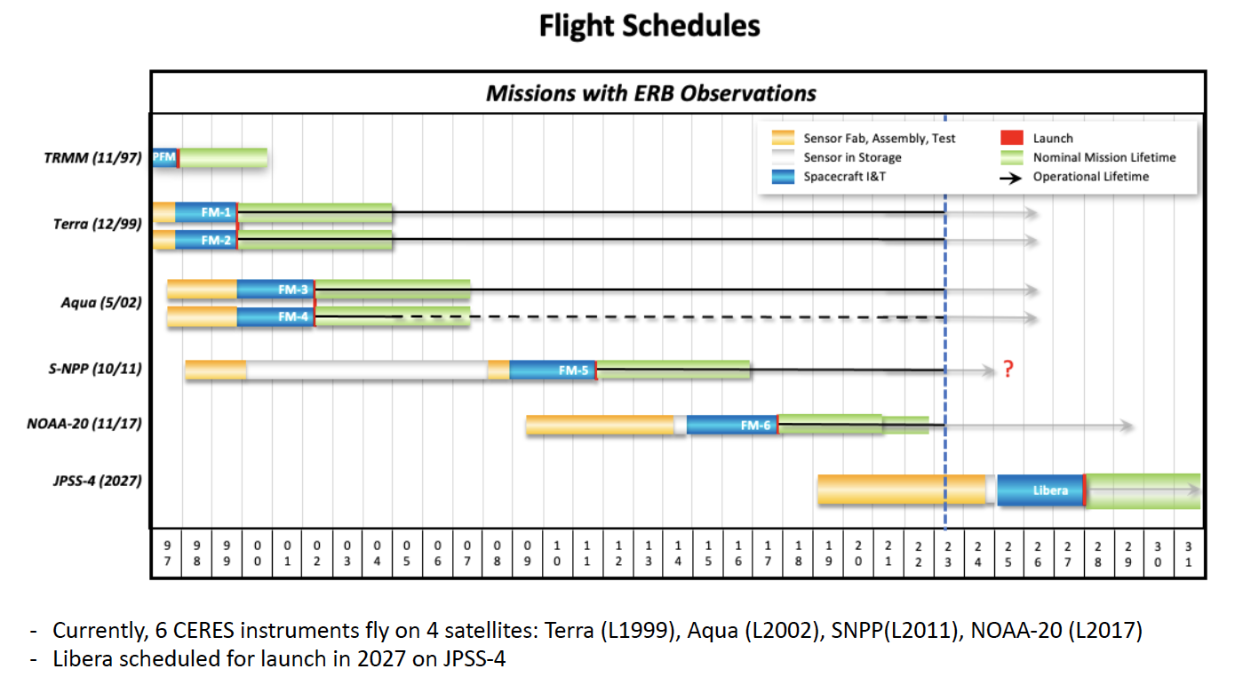
Earth energy budget observations by CERES (Clouds and the Earth’s Radiant Energy System) instruments

Slide 5
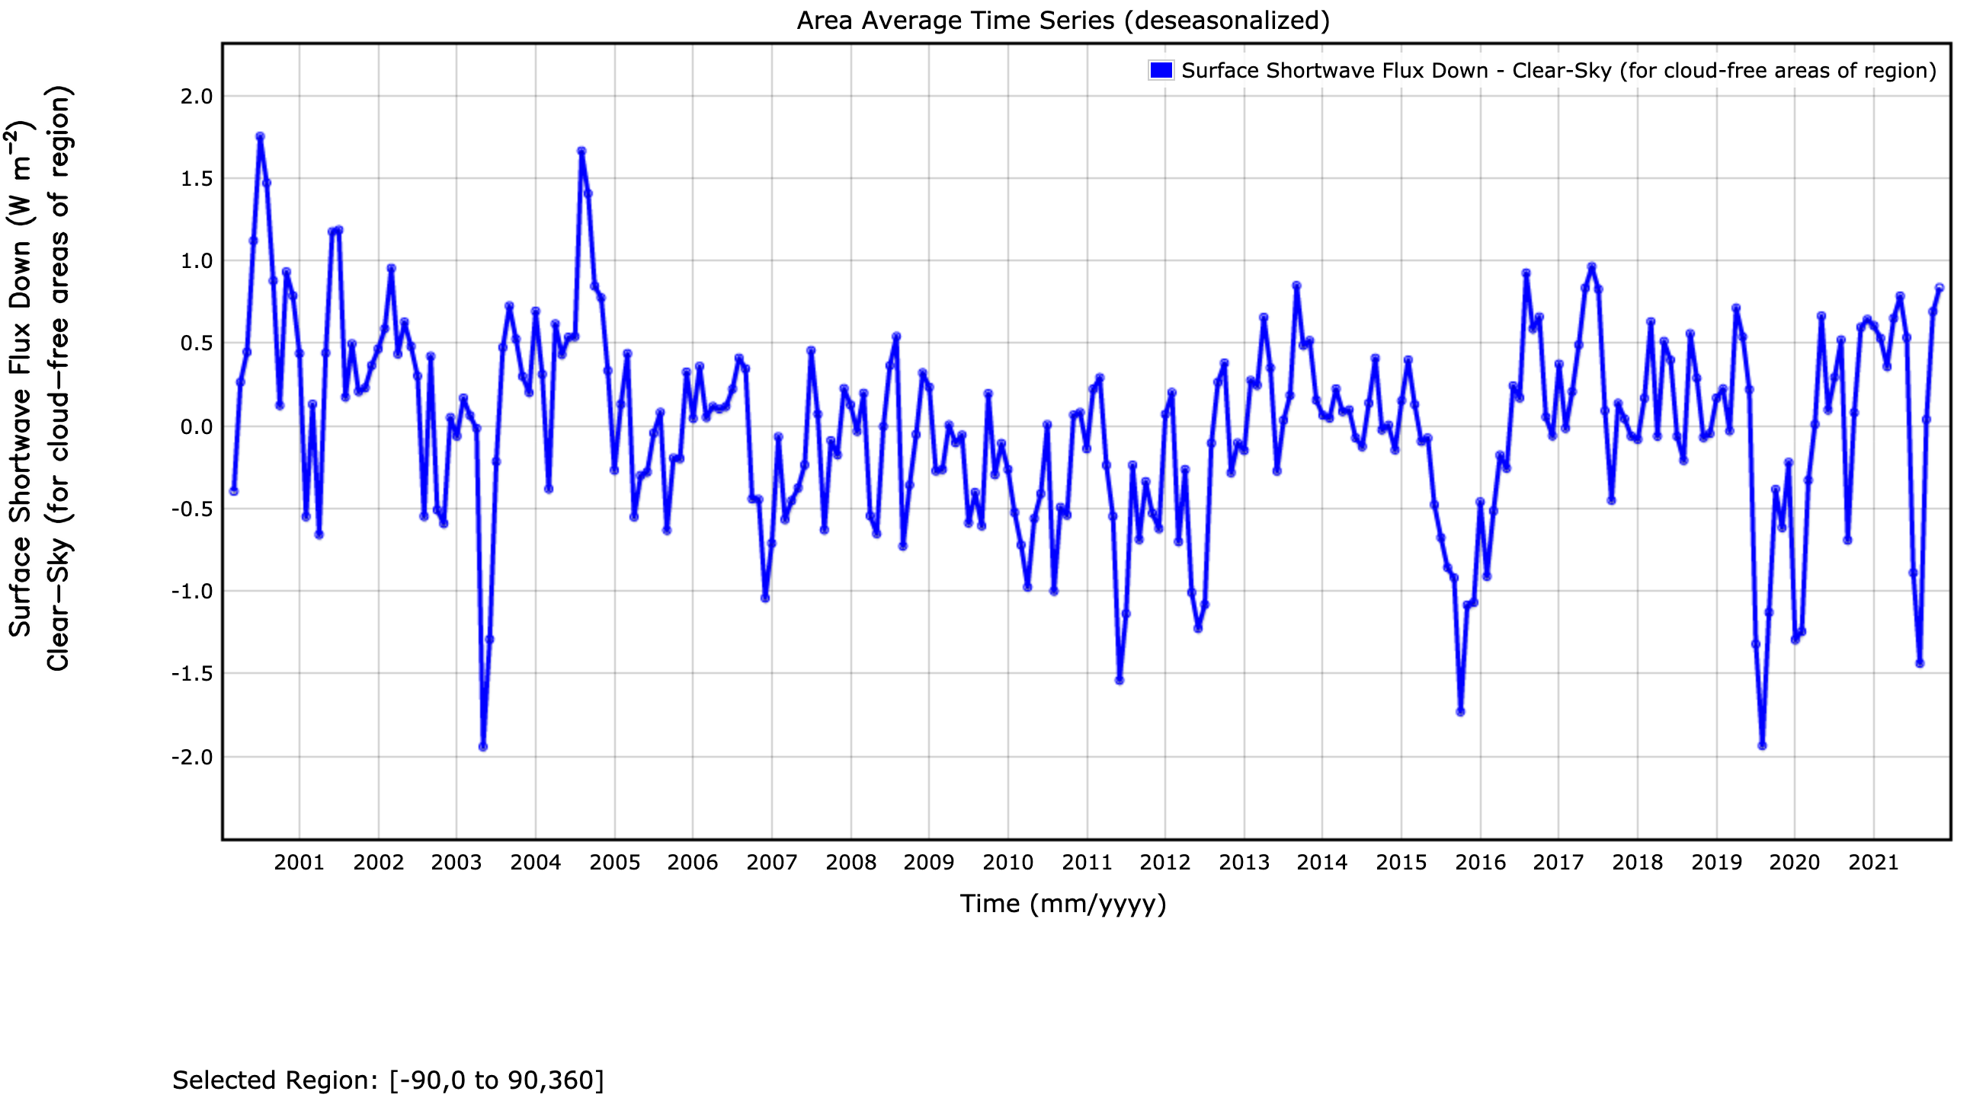
Global monthly surface clear-sky downward shortwave anomalies
August 2000
missing Terra data
May 2003
Siberian forest fire??
August 2019
Siberian wildfire
January 2020
Australian fire
August 2021
Siberian wildfire
June 2011
Canadian smoke
October 2015
Indonesian smoke
Standard deviation = 0.59 Wm⁻²
Number of month > 2𝝈: 14 (out of 261)
8 occurred after 2010
5 occurred after 2019
Notes:
Over arctic, we need a good model.
Instrument, satellites consistency, no AERONET assimilation. Use AERONET as an independent validation. Adjust fine/coarse modes independently
TOA clear-sky EBAF anomalies

Slide 6
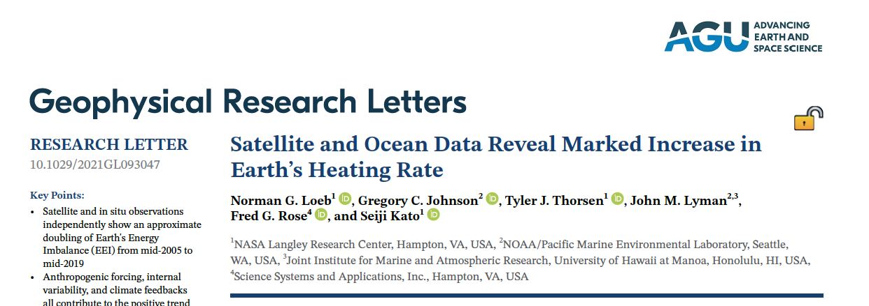
Earth’s energy imbalance at the top-of-atmosphere is energy input to Earth’s climate system.
Both satellite and in situ observations show doubling of Earth’s energy imbalance from 2005 to 2019.
Marked decreases in cloud cover and sea ice extent and increases in trace gas concentrations and water vapor amount contribute the increase Earth’s energy imbalance

Slide 7
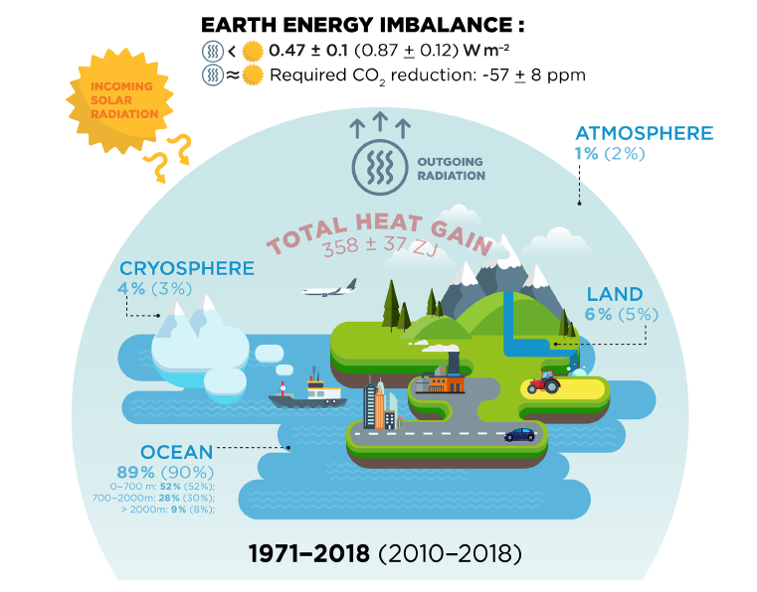
Inventory of absorbed energy by Earth
Annual global mean top-of-atmosphere net radiative flux is sum of all energy absorbed by Earth
Von Schuckmann et al. 2020

Slide 8
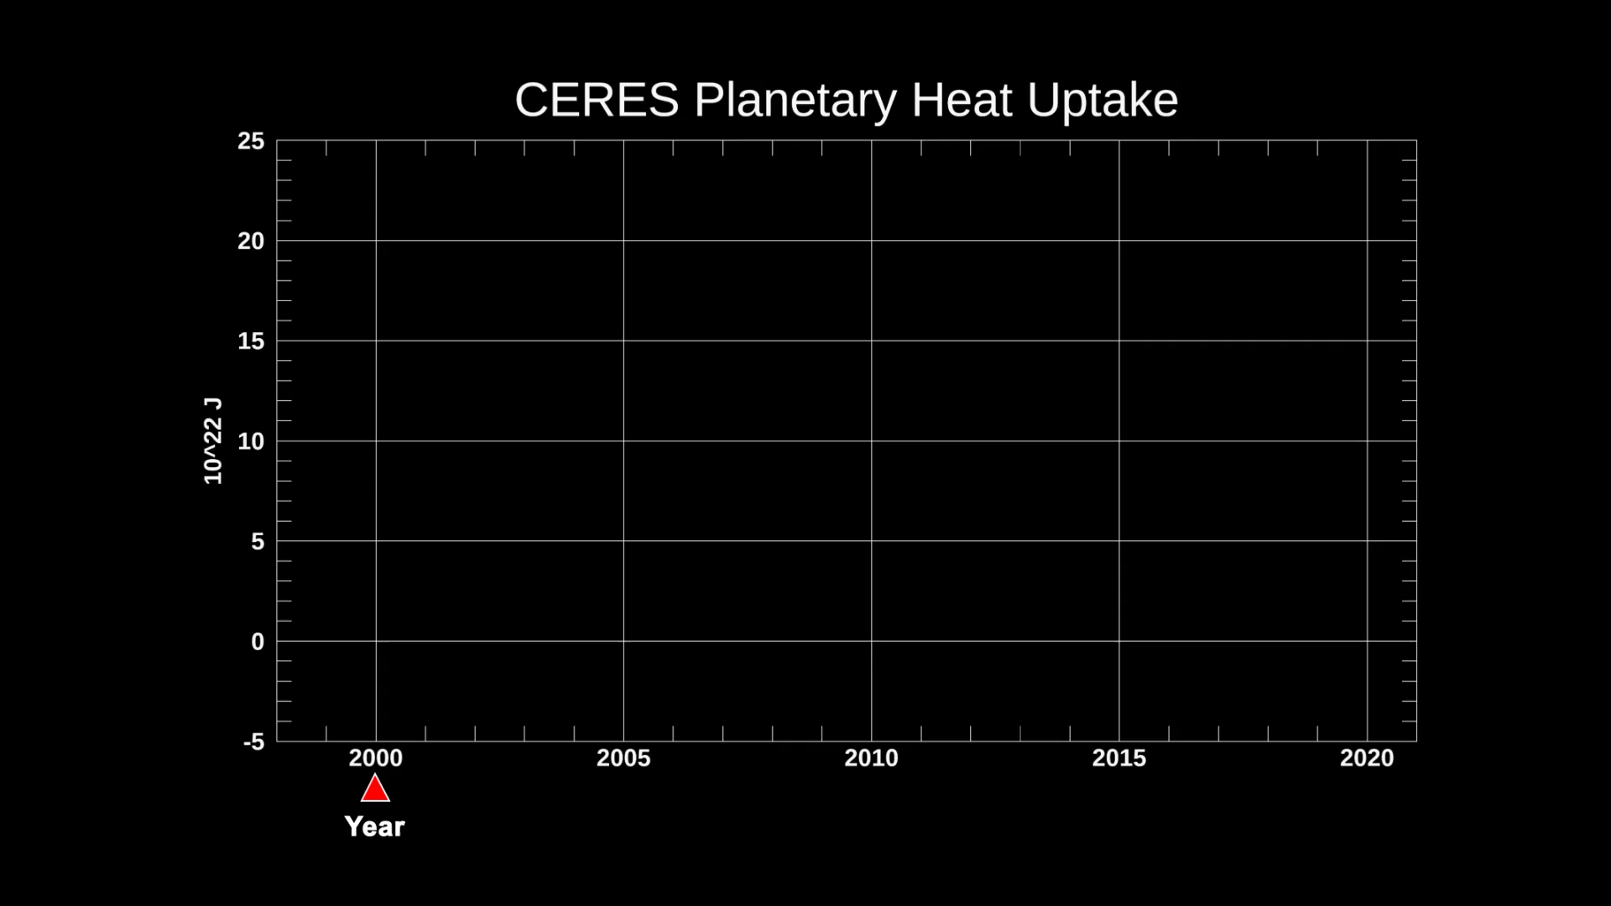
Ocean heat content estimated from CERES measurements
Ocean heat content is an integration of net top-of-atmosphere radiative flux with time.
The trend of Earth energy imbalance is the second derivative of ocean heat content.
https://agupubs.onlinelibrary.wiley.com/doi/full/10.1029/2019GL086705
“Earth’s Energy Imbalance: Confirmation and Implications” and available from
https://science.sciencemag.org/content/308/5727/1431
Notes:
Launched in December 2017, the CERES Flight Model 6 scanned Earth for the first time, joining 5 other operational CERES instruments to extend a critical climate data record begun in 1997. CERES FM6 supports NASA’s continuing goal to understand and measure the solar energy reflected by Earth, the heat the planet emits, and the role of clouds in that process. The first data products were released to the public for the CERES Flight Model 6 (FM6) instrument on JPSS/NOAA-20 on June 13, 2018. A year later the instrument on-orbit performance is excellent – functioning as designed.
Zonal changes in climate - LEADERSHIP

Slide 9
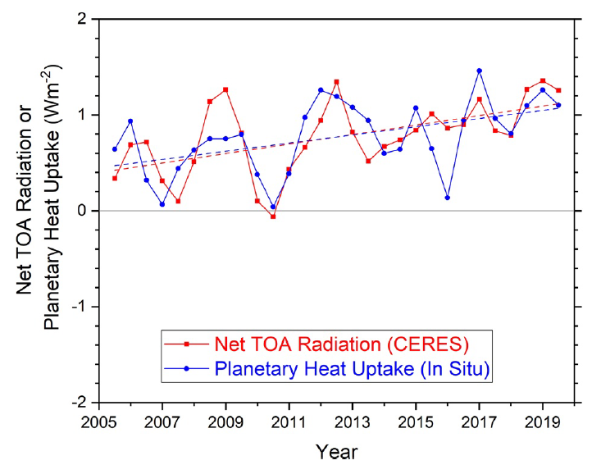
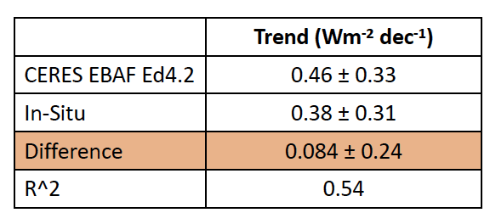
Time series of annual global mean net top-of-atmosphere radiative flux (red)
Inter annual variability and trend derived from CERES observations and in situ ocean temperature, sea ice, etc. measurements are independent.
Annual variabilities derived from two different methods agree very well.
Net top of atmosphere radiative flux is changing at the rate of 0.5±0.3 Wm⁻² decade⁻¹
If the rate continues, energy imbalance will be twice as large as the current value in 20 years.

Slide 10
Conclusions
NASA is observing earth radiation budget by CERES instruments since March 2000.
CERES instruments capture changes that influence radiation.
Frequency of large forest fire that influence clear-sky downward shortwave irradiance at a global scale is increasing.
Earth’s energy imbalance at the top-of-atmosphere is energy input to Earth’s climate system.
Both satellite and in situ observations show doubling of Earth’s energy imbalance from 2005 to 2019.

Slide 11
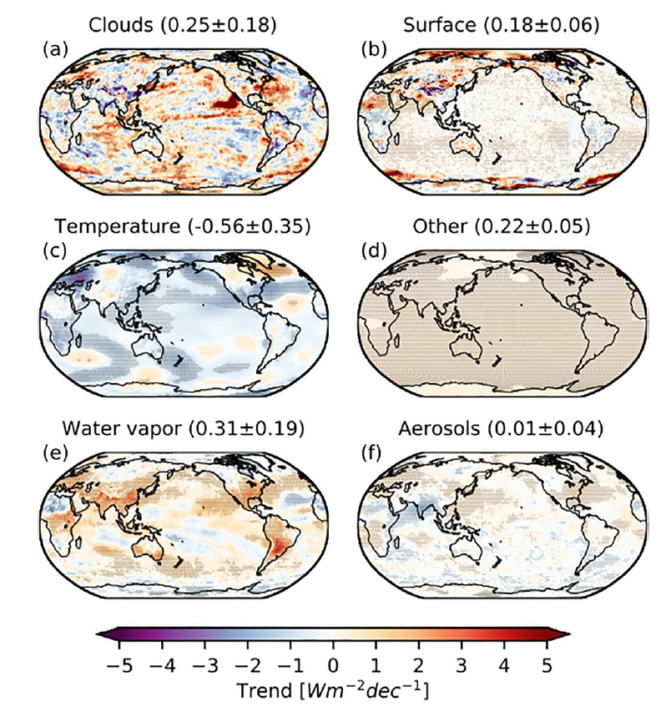
Contribution to Earth Energy Imbalance trend
The contribution depends on region
Cloud cover: e.g. low-level clouds are influenced by sea surface temperature increases
Surface: Sea ice extent and snow over land
Temperature: Increasing temperature reduces the imbalance
Other: e.g. increasing CO2 concentration reduces longwave emission to space.
Water vapor: increasing water vapor amount associated with a temperature increase increases absorption of solar radiation and reduces longwave emission to space.
Aerosols: decreasing aerosol loading increases absorption of solar radiation

