Slide 1
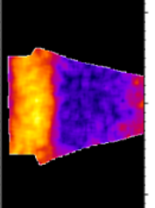
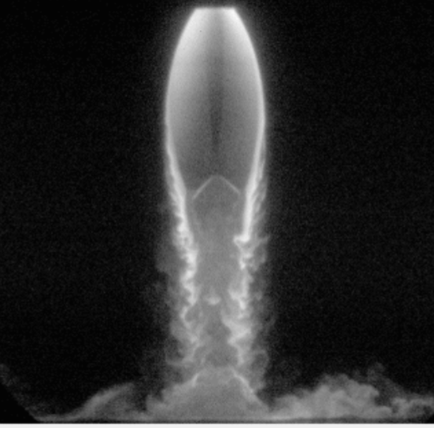
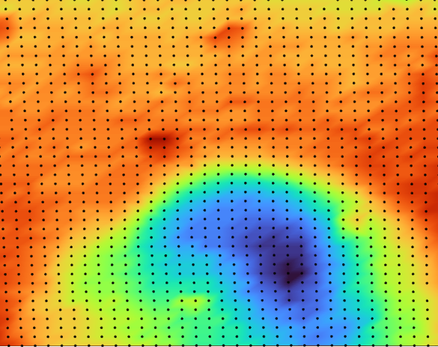
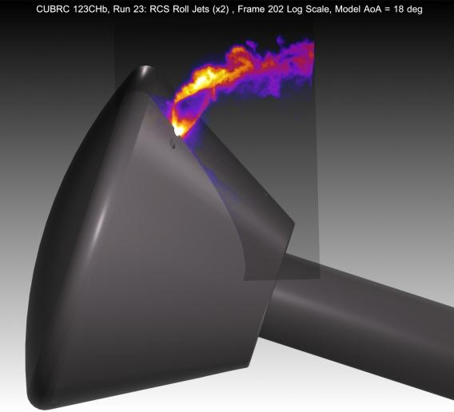
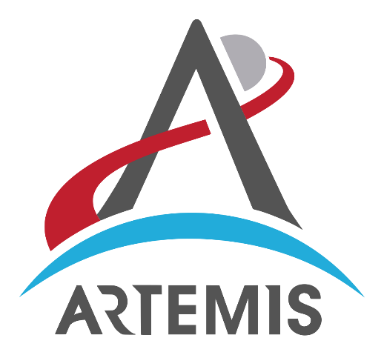

Challenges and Opportunities in Applying Laser Diagnostics to Support NASA’s Artemis Program
Paul M. Danehy
Senior Technologist for Adv. Meas. Systems
Advanced Meas. and Data Systems Branch
NASA Langley Research Center
Hampton, Virginia, USA
Gordon Research Symposium (GRS) on Laser Diagnostics in Energy and Combustion Science July 8, 2023

Slide 2
List of key collaborators and abstract
Work presented herein:
  Brett Bathel, Josh Weisberger, Jennifer Inman, Neil Rodrigues, Ashley Korzun, Steven Jones, Holt Ripley (NASA Langley)
  Ross Burns, Jon Retter, Olivia Tyrrell (NIA, Hampton VA)
  Manish Mehta (NASA Marshall)
  Chris Combs (UTA/UTSA)
  Ron Parker and co-workers (CUBRC)
  Craig Johansen (Calgary)
  Chris Ivey (Stanford)
  Walt Lempert (Ohio State, d. 2015)
  Naibo Jiang, Sukesh Roy (Spectral Energies)
  Many others…
Abstract: NASA and their partners are on the cusp of embarking on a series of space missions to the moon and beyond, collectively known as the Artemis Program. The Artemis I mission occurred Nov 16, 2022 – Dec 11, 2022. This talk briefly summarizes the upcoming Artemis missions and describes laser and optical measurement technique development and application to ground and flight tests related to, or inspired by, the Artemis program. In particular, development and application of three different measurement techniques (planar laser-induced fluorescence [PLIF], femtosecond laser electronic excitation tagging [FLEET] and photogrammetry) are described. These techniques have been applied to study vehicle launch, lunar landing, and earth entry. Such optical and laser-based instrumentation can provide unique qualitative and quantitative information to inform the underlying physics of space flight while also providing benchmark data for validating ever advancing predictive codes.

Slide 3
Outline
Introduction
  Artemis Program: Vehicles, Timeline, Challenges
  Utility of optical and laser-based measurements
Launch: SLS
  Flow visualization
  Quantitative Thermometry
Earth Entry: Orion
  Orion RCS Jets
    Flowfield structure
    Comparison with CFD (computational flow imaging)
  Laminar to Turbulent Transition: velocimetry
Descent:
  Orion transonic/subsonic descent
Landing on the moon
  PSI PLIF
Opportunities for the Future
Planar laser induced Fluorescence (PLIF)
Femtosecond Laser Electronic Excitation Tagging (FLEET)
PLIF
Disclaimer: The present talk focuses on my research group’s work related to Artemis. Other important optical and laser measurement work has occurred at the agency. Also, I don’t want to overstate our team’s contributions to the Artemis program. Meaningful contributions were made in a few cases but many of these were basic research inspired by the space program and/or are recent activities and have not had significant impact (yet).

Slide 4
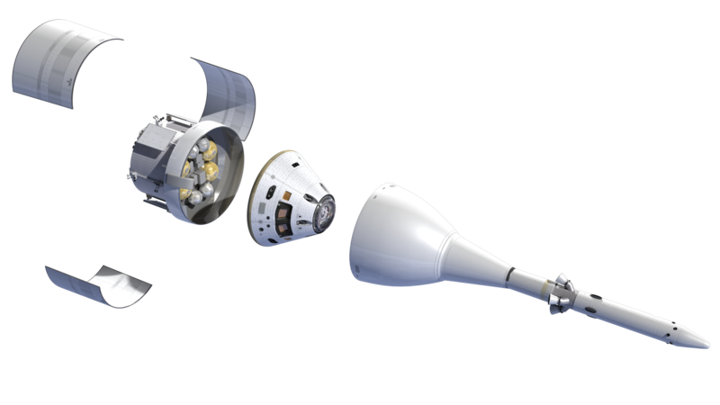
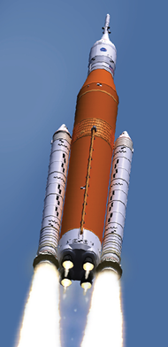
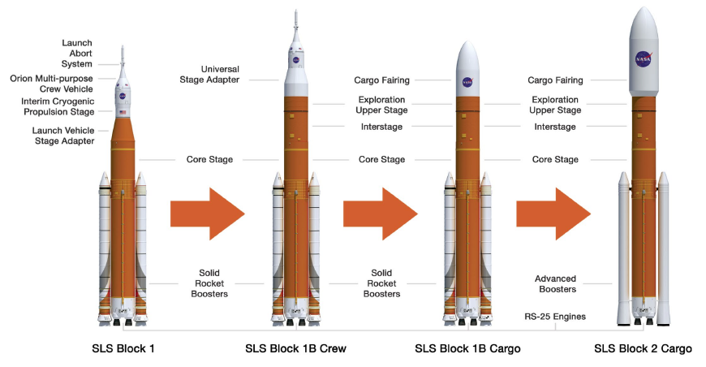
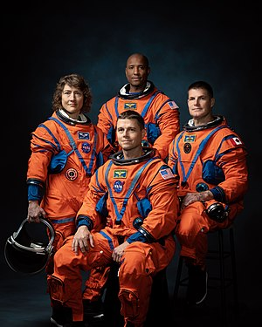
Artemis Program: Vehicles and Timeline
Orion MPCV
ESA Service Module
Launch Abort System
First flight | Artemis I (Nov. 16 2022, 25.5 days)
First crewed flight | Artemis II (NET Nov. 2024)
First Lunar Landing | Artemis III (NET Dec. 2025)
2nd Lunar Landing | Artemis IV (2028)
3rd Lunar Landing | Artemis V (2029)
Core stage
Space Launch System
Notes:
NET = Not Earlier Than
To develop a human landing system for the agency’s Artemis V mission to the Moon, NASA has selected Blue Origin of Kent, Washington. Through Artemis, NASA will explore more of the Moon than ever before, uncovering more scientific discoveries, and preparing for future astronaut missions to Mars.
Blue Origin will design, develop, test, and verify its Blue Moon lander to meet NASA’s human landing system requirements for recurring astronaut expeditions to the lunar surface, including docking with Gateway, a space station where crew transfer in lunar orbit. In addition to design and development work, the contract includes one uncrewed demonstration mission to the lunar surface before a crewed demo on the Artemis V mission in 2029. The total award value of the firm-fixed price contract is $3.4 billion.
“Today we are excited to announce Blue Origin will build a human landing system as NASA’s second provider to deliver Artemis astronauts to the lunar surface,” said NASA Administrator Bill Nelson. “We are in a golden age of human spaceflight, which is made possible by NASA’s commercial and international partnerships. Together, we are making an investment in the infrastructure that will pave the way to land the first astronauts on Mars.”
For the Artemis V mission, NASA’s SLS (Space Launch System) rocket will launch four astronauts to lunar orbit aboard the Orion spacecraft. Once Orion docks with Gateway, two astronauts will transfer to Blue Origin’s human landing system for about a weeklong trip to the Moon’s South Pole region where they will conduct science and exploration activities. Artemis V is at the intersection of demonstrating NASA’s initial lunar exploration capabilities and establishing the foundational systems to support recurring complex missions in lunar orbit and on the surface as part of the agency’s Moon to Mars exploration approach.
Adding another human landing system partner to NASA’s Artemis program will increase competition, reduce costs to taxpayers, support a regular cadence of lunar landings, further invest in the lunar economy, and help NASA achieve its goals on and around the Moon in preparation for future astronaut missions to Mars.
The agency previously contracted SpaceX to demonstrate an initial human landing system for the Artemis III mission. Under that contract, the agency also directed SpaceX to evolve its design to meet the agency’s requirements for sustainable exploration and to demonstrate the lander on Artemis IV. As a result of the contract with Blue Origin to demonstrate on Artemis V a lander that meets these same sustainable lander requirements, including capabilities for increased crew size, longer mission duration, and delivery of more mass to the Moon, multiple providers will be available to compete for future opportunities to fulfill NASA’s lunar surface access needs for Artemis missions.
By supporting industry’s development of innovative human landing system concepts and designs, NASA will help increase access to space for the benefit of all.
“Having two distinct lunar lander designs, with different approaches to how they meet NASA's mission needs, provides more robustness and ensures a regular cadence of Moon landings,” said Lisa Watson-Morgan, manager, Human Landing System Program at NASA’s Marshall Space Flight Center in Huntsville, Alabama. “This competitive approach drives innovation, brings down costs, and invests in commercial capabilities to grow the business opportunities that can serve other customers and foster a lunar economy.”
NASA issued the solicitation, known as Appendix P, of its second Next Space Technologies for Exploration Partnerships Broad Agency Announcement (Next-STEP2 BAA), in September 2022 as part of the ongoing development of advanced space exploration technologies, capabilities, and concepts.
Through Artemis, NASA will send astronauts – including the first woman and first person of color – to explore the Moon for scientific discovery, economic benefits, and to build the foundation for crewed missions to Mars. Together, the SLS rocket, Orion, Gateway, advanced spacesuits, and human landing systems are NASA’s foundation for deep space exploration.

Slide 5
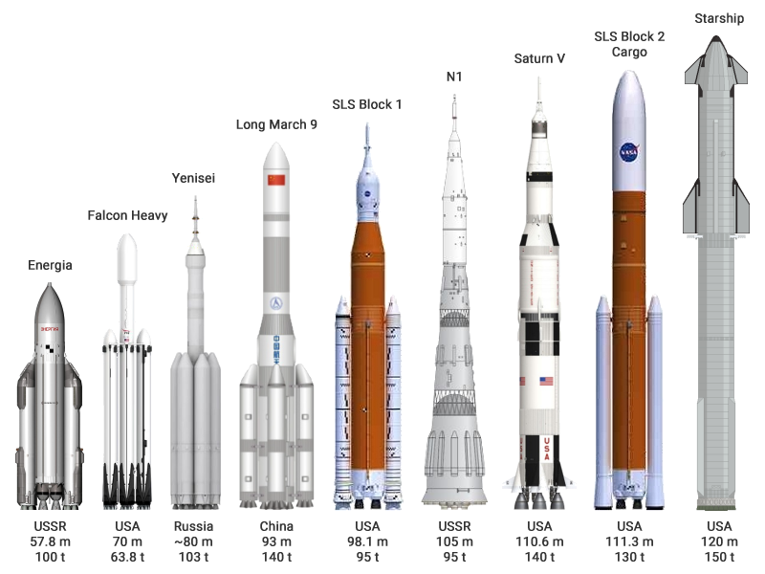
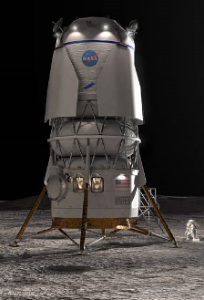
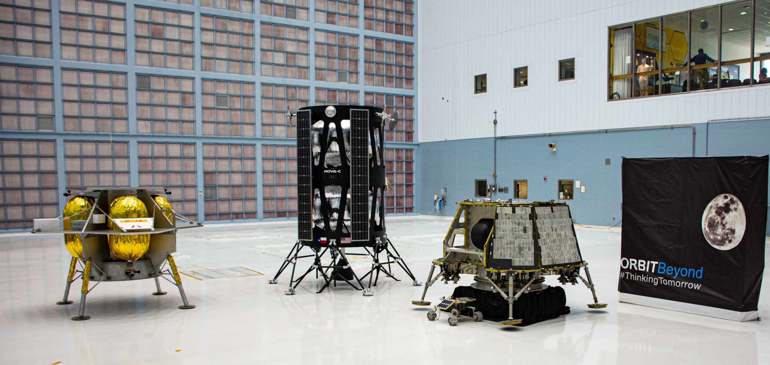
Artemis Program: Vehicles and Timeline
Space-X
Starship
Orion MPCV
ESA Service Module
Launch Abort System
First flight | Artemis I (Nov. 16 2022, 25.5 days)
First crewed flight | Artemis II (NET Nov. 2024)
First Lunar Landing | Artemis III (NET Dec. 2025)
2nd Lunar Landing | Artemis IV (2028)
3rd Lunar Landing | Artemis V (2029)
Core stage
Artemis III & IV
Space Launch System
Blue Origin
Blue Moon
Artemis V, 2029
CLPS Robotic Landers
https://commons.wikimedia.org/wiki/File:NASA_Selects_First_Commercial_Moon_Landing_Services_for_Artemis_Program_(47974915261).jpg
Notes:
NET = Not Earlier Than
To develop a human landing system for the agency’s Artemis V mission to the Moon, NASA has selected Blue Origin of Kent, Washington. Through Artemis, NASA will explore more of the Moon than ever before, uncovering more scientific discoveries, and preparing for future astronaut missions to Mars.
Blue Origin will design, develop, test, and verify its Blue Moon lander to meet NASA’s human landing system requirements for recurring astronaut expeditions to the lunar surface, including docking with Gateway, a space station where crew transfer in lunar orbit. In addition to design and development work, the contract includes one uncrewed demonstration mission to the lunar surface before a crewed demo on the Artemis V mission in 2029. The total award value of the firm-fixed price contract is $3.4 billion.
“Today we are excited to announce Blue Origin will build a human landing system as NASA’s second provider to deliver Artemis astronauts to the lunar surface,” said NASA Administrator Bill Nelson. “We are in a golden age of human spaceflight, which is made possible by NASA’s commercial and international partnerships. Together, we are making an investment in the infrastructure that will pave the way to land the first astronauts on Mars.”
For the Artemis V mission, NASA’s SLS (Space Launch System) rocket will launch four astronauts to lunar orbit aboard the Orion spacecraft. Once Orion docks with Gateway, two astronauts will transfer to Blue Origin’s human landing system for about a weeklong trip to the Moon’s South Pole region where they will conduct science and exploration activities. Artemis V is at the intersection of demonstrating NASA’s initial lunar exploration capabilities and establishing the foundational systems to support recurring complex missions in lunar orbit and on the surface as part of the agency’s Moon to Mars exploration approach.
Adding another human landing system partner to NASA’s Artemis program will increase competition, reduce costs to taxpayers, support a regular cadence of lunar landings, further invest in the lunar economy, and help NASA achieve its goals on and around the Moon in preparation for future astronaut missions to Mars.
The agency previously contracted SpaceX to demonstrate an initial human landing system for the Artemis III mission. Under that contract, the agency also directed SpaceX to evolve its design to meet the agency’s requirements for sustainable exploration and to demonstrate the lander on Artemis IV. As a result of the contract with Blue Origin to demonstrate on Artemis V a lander that meets these same sustainable lander requirements, including capabilities for increased crew size, longer mission duration, and delivery of more mass to the Moon, multiple providers will be available to compete for future opportunities to fulfill NASA’s lunar surface access needs for Artemis missions.
By supporting industry’s development of innovative human landing system concepts and designs, NASA will help increase access to space for the benefit of all.
“Having two distinct lunar lander designs, with different approaches to how they meet NASA's mission needs, provides more robustness and ensures a regular cadence of Moon landings,” said Lisa Watson-Morgan, manager, Human Landing System Program at NASA’s Marshall Space Flight Center in Huntsville, Alabama. “This competitive approach drives innovation, brings down costs, and invests in commercial capabilities to grow the business opportunities that can serve other customers and foster a lunar economy.”
NASA issued the solicitation, known as Appendix P, of its second Next Space Technologies for Exploration Partnerships Broad Agency Announcement (Next-STEP2 BAA), in September 2022 as part of the ongoing development of advanced space exploration technologies, capabilities, and concepts.
Through Artemis, NASA will send astronauts – including the first woman and first person of color – to explore the Moon for scientific discovery, economic benefits, and to build the foundation for crewed missions to Mars. Together, the SLS rocket, Orion, Gateway, advanced spacesuits, and human landing systems are NASA’s foundation for deep space exploration.

Slide 6
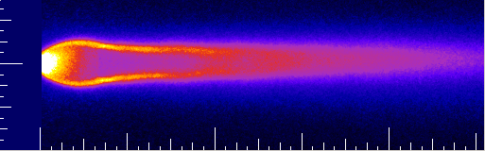
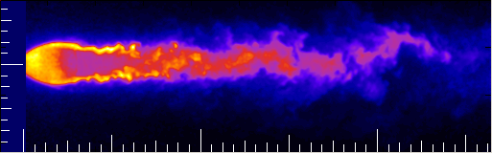
The utility of optical and laser measurements
Laser and optical measurements to study flow in ground test and flight
- nonintrusive, spatially and temporally resolved, quantified accuracy.
Walter Lempert (d. 2015): “It’s amazing what you see… if you look”
Dick Whitcomb (1922-2009) [Area rule, winglets, supercritical wing]:
“My 3 biggest innovations came from studying schlieren images”
Understand flow physics
  Why does the vehicle (e.g. lift/drag) behave that way?
  Identify flow features (shock/expansion, laminar/turbulent, attached/separated).
  Ideation of new vehicle or control concepts.
Understand facility operation
  Inflow conditions → scale to flight
  Boundary conditions (wall boundary layers)
Benchmark Data for Code Validation
  Measurements of parameters like T, P, ρ, V, etc. → eval/develop models?
    NASA efforts: simulate the vehicle and the wind tunnel facility
    Interest in non-equilibrium effects for entry flows (T_{rot}, T_{vib})
  Trend: workhorse time-averaged RANS CFD → unsteady (LES, etc.)
    Pushes measurement techniques towards higher speeds: kHz-MHz
1 mm, 1000 m/s
→ 1 μs, 1 MHz

Slide 7
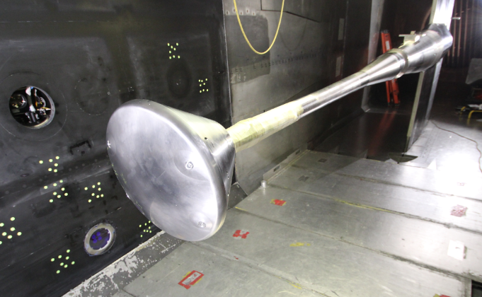
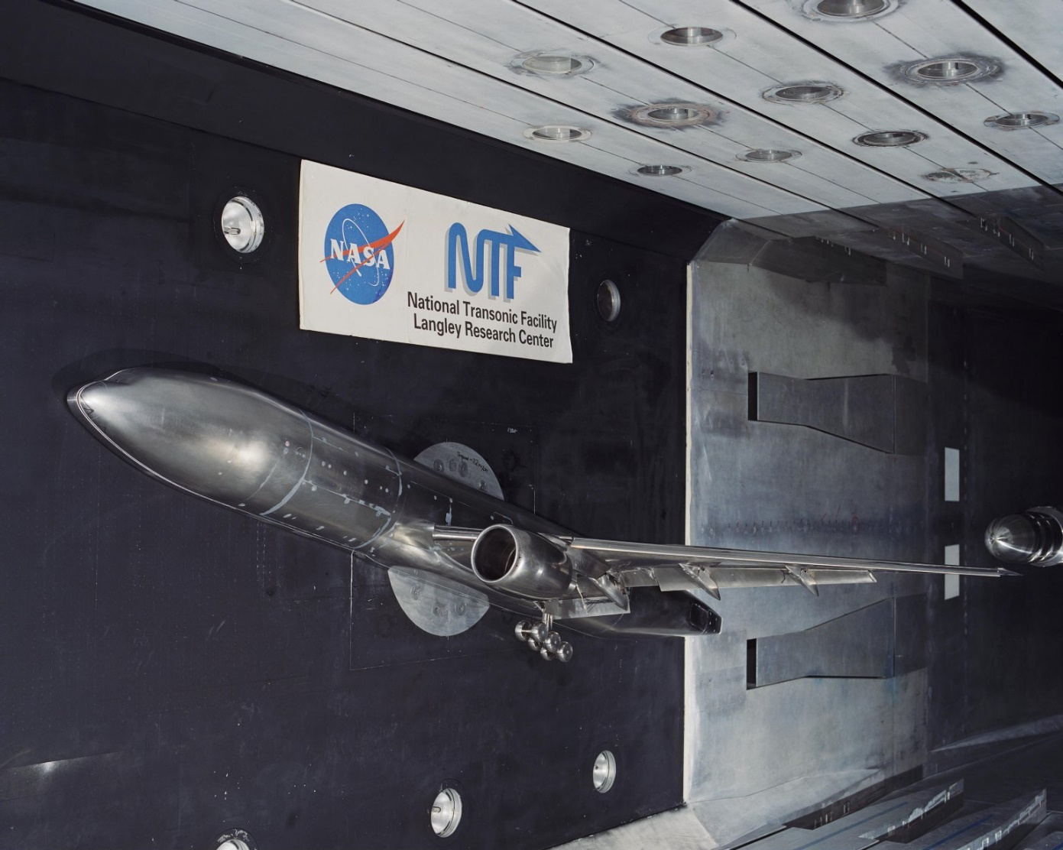
Measurement Challenges 1: NTF FLEET
Subsonic-Transonic Wind Tunnel
National Transonic Facility (NTF)
High Reynolds Number Testing
  Large scale (8 foot =2.4 m)
  High pressure (10 atm) plenum
  Low temperature cryogenic gaseous N₂ (100 K): frost
  High density: refraction
  No external optical access; limited internal access
  Remote operation required
  Expensive operation and expensive models
  No H₂O or particle seeds

Slide 8
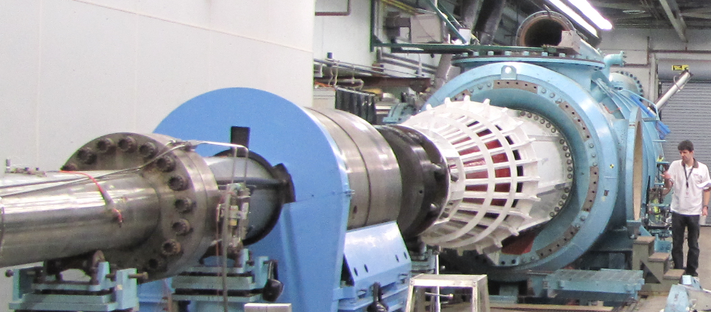
Measurement Challenges 2: CUBRC PLIF
Hypersonic Shock Tunnel
Image Credit: NASA
CUBRC LENS Shock Tunnel LENS 1, Buffalo, New York
  Mach 6-20, scramjet, entry vehicle, launch vehicle, hypersonic testing
  Remote location, large scale, short run duration (10’s of ms), 1 or 2 runs per day, tunnel moves, remote operation

Slide 9
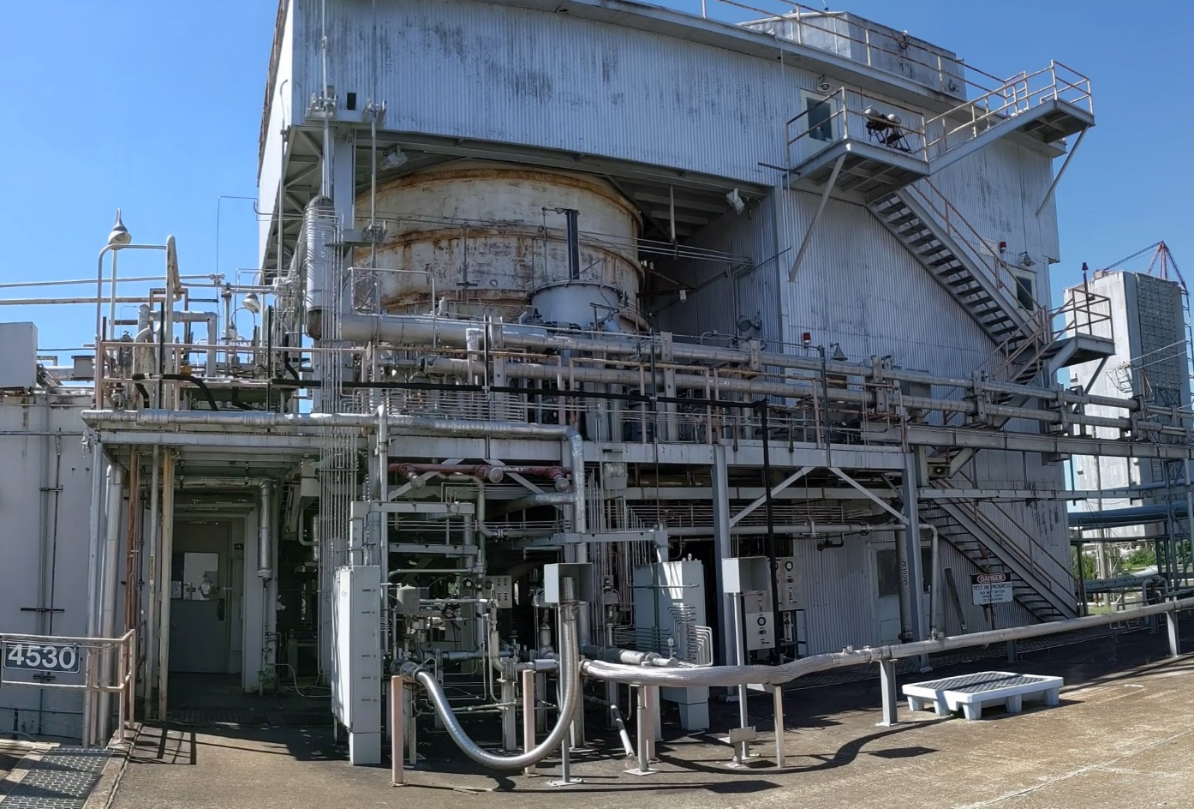
Measurement Challenges 3: NASA Marshall PLIF
Huntsville, Alabama
  20-ft Vac. Chamber
Plume-Surface Interaction (PSI) Study
  Lunar Landing
  Mach 5.3
  N₂ seeded with NO
20’ Chamber
Lasers
Cameras in atmospheric pressure enclosures within vacuum chamber
Laser transmits to chamber
Hot, poor AC, thunder & lightning
Remote operation

Slide 10
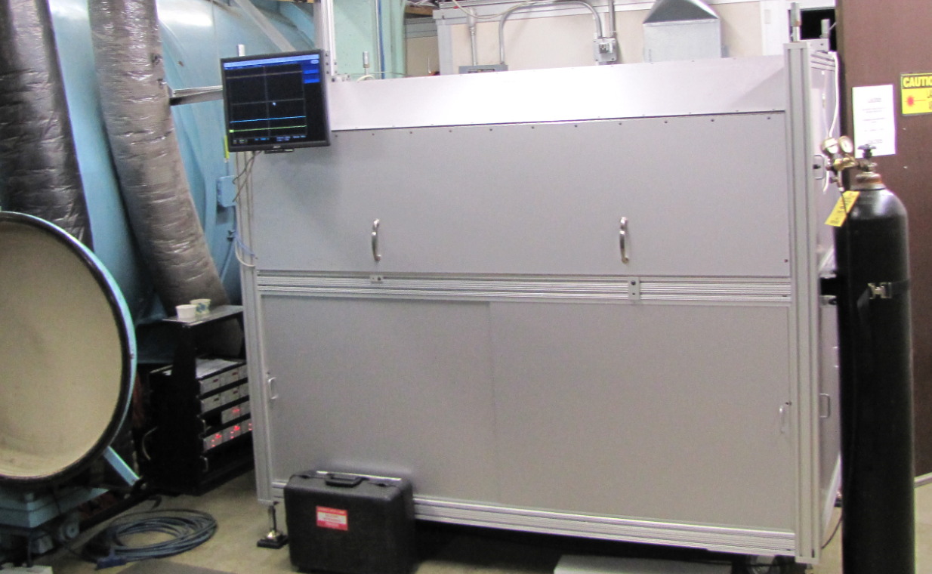
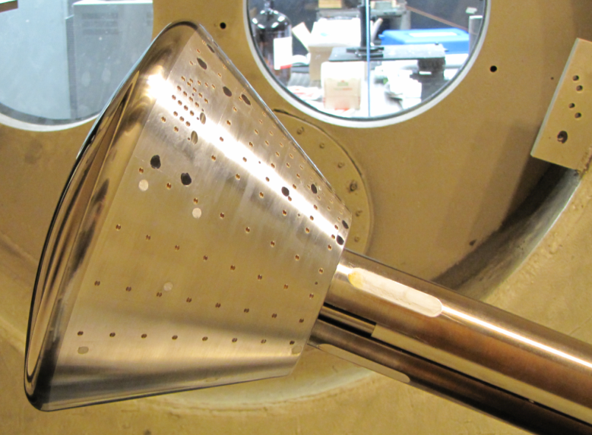
Measurement Strategy
Mobile measurement systems
  Test in lab;
  Get set up quick & get out
  A few weeks to test
Automated operation
  Acquire thousands of measurements if possible
  Remote operation
Hardened hardware
  Cooled / Heated, SSD, Robust construction
Prefer simple methods
  Fewer lasers the better
  Fewer laser beams the better
Setup for Orion Testing in CUBRC, Buffalo NY

Slide 11
Launch – Entry – Descent - Landing

Slide 12
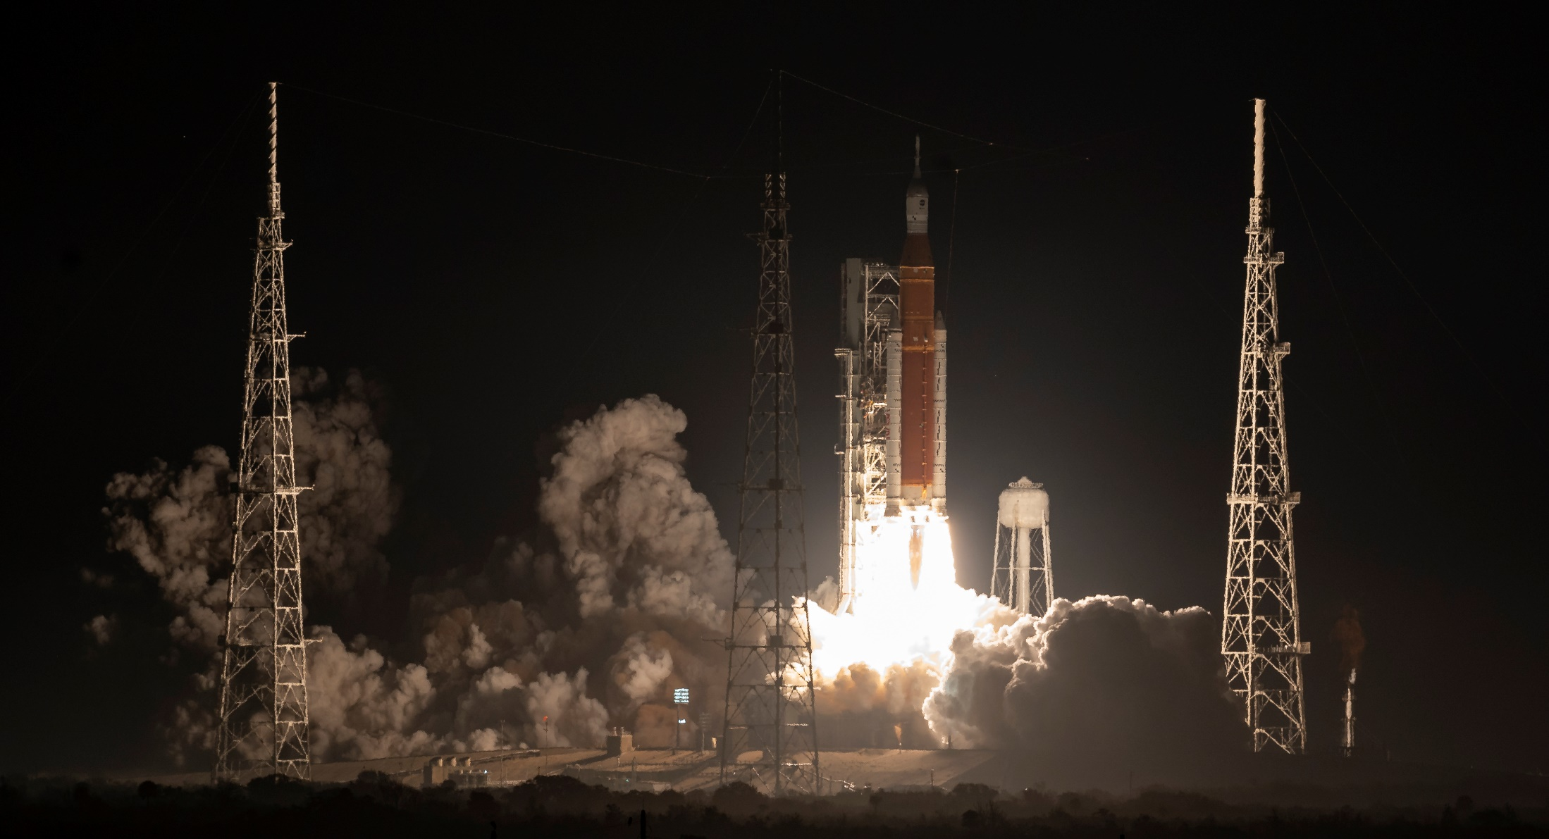
Launch of Artemis I: November 16, 2022, 1:47 a.m. EST
Launch Complex 39B at NASA’s Kennedy Space Center in Florida
https://www.nasa.gov/press-release/liftoff-nasa-s-artemis-i-mega-rocket-launches-orion-to-moon

Slide 13
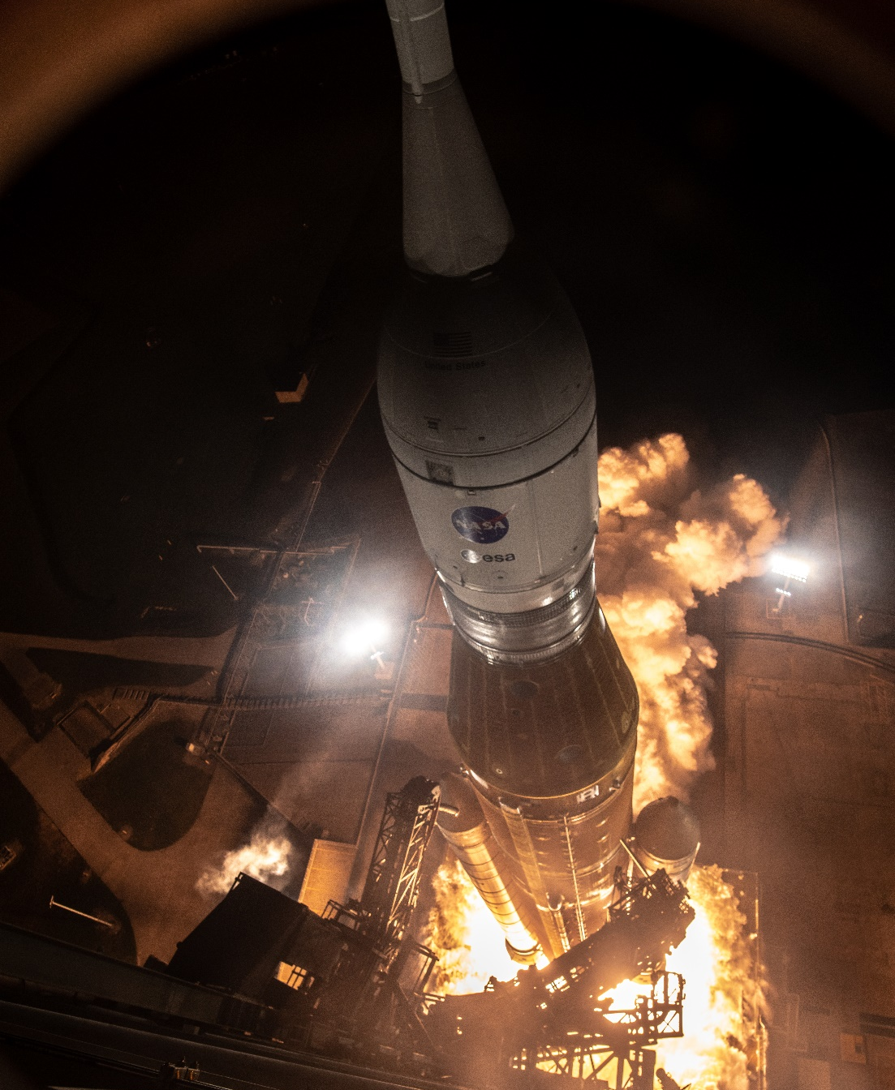
Launch
Aeroscience Phenomena
SRB/Core-stage buffet
SRB Stage separation
Plume-induced base heating
https://www.nasa.gov/sites/default/files/thumbnails/image/artemis_i_launch_top_birds_eye.jpg

Slide 14
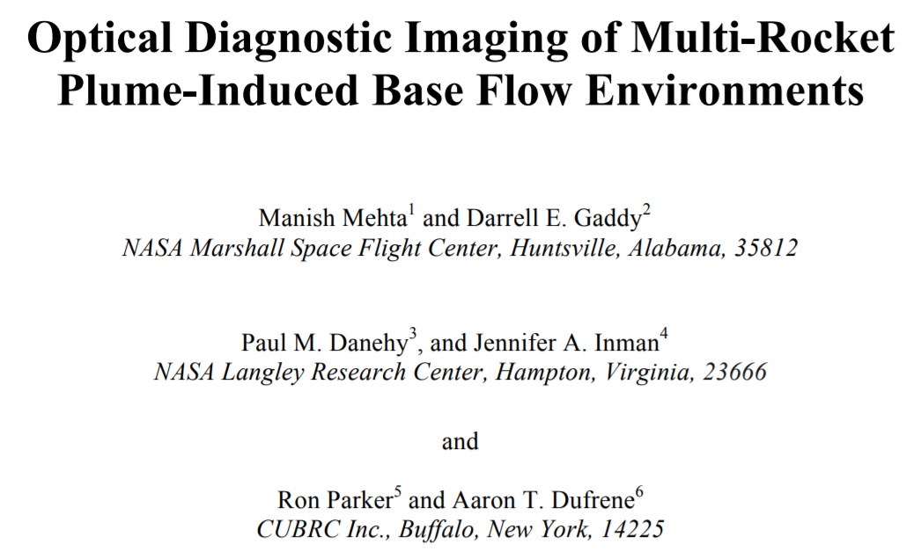
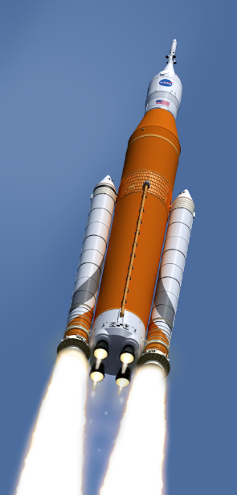

OH PLIF Visualization and Thermometry for NASA Space Launch System (SLS) Base Flow Heating
Measurements at CUBRC in Buffalo
Using NASA Mobile PLIF system
JANNAF Conference, Newport News, Dec 2018

Slide 15
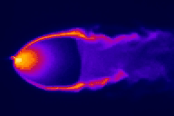
What is Planar Laser-Induced Fluorescence (PLIF)?
Tunable Laser
Laser sheet
excites molecules
Excited molecules fluoresce
Excited state
Gas flow
CCD camera detects
Ground state
LIF ~ n_{NO (or OH)}
Hanson, McDaniel and many others… 1980s
Notes:
Changed PLIF image to an animated gif

Slide 16
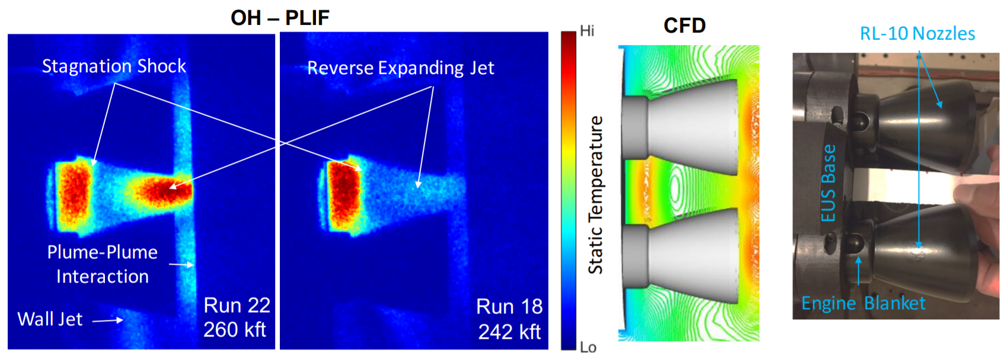
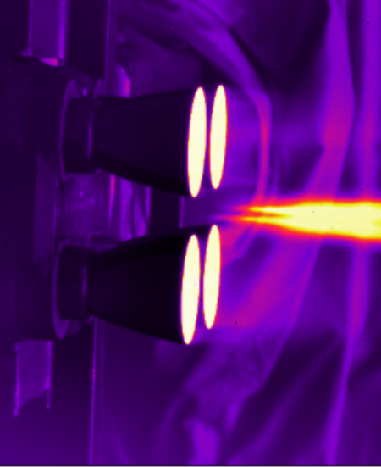
OH PLIF Visualization and Thermometry for NASA Space Launch System (SLS) Plume Induced Base Heating
At high altitudes, flow leaving engines impinges on base
Prior to PLIF: no direct experimental evidence of shock formation
Wind tunnel tests: Use OH Planar Laser-Induced Fluorescence (PLIF)
  Naturally-occurring OH present in plume and plume-induced base flow
OH PLIF flow visualization clearly showed stagnation shock.
  Neither Schlieren nor IR showed base flow structures
Position of shock agreed with CFD, increasing confidence in CFD.
Mid-IR OH PLIF

Slide 17
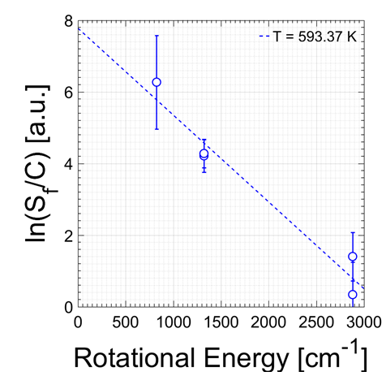
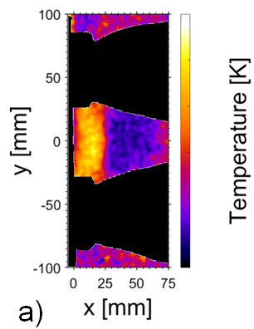
OH PLIF Thermometry of SLS Base Flow
Probe different ground state transitions: measure rotational temperature
“Recovery temperature” measurement is needed to determine flight-scaled convective heat transfer coefficient
Quantity critical in determining flight-scaled heat transfer rates
  Previously used a few thermocouples protruding into flow: 50-80% uncertainty
  Using PLIF, measured with uncertainty of 10-30% with only 5 images
Used to design base thermal protection system (TPS) thickness
High
Low
QUANTITATIVE, MULTI-LINE, OH-PLIF THERMOMETRY TO EXAMINE BASE HEATING IN THE SPACE LAUNCH SYSTEM CORE AND EUS STAGES
Ross A Burns et al, JANNAF 2017

Slide 18
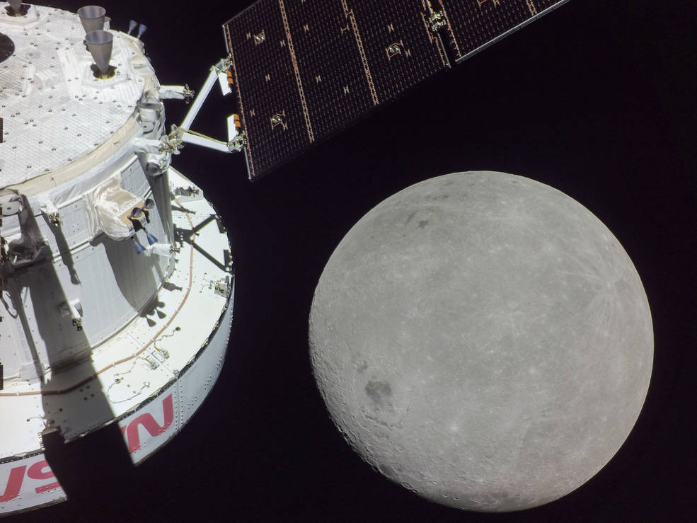
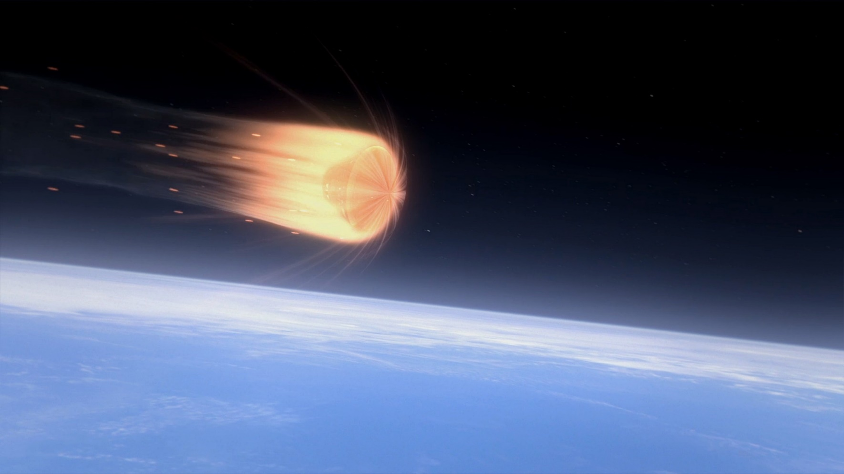
Lunar Flyby and Entry
Orion and the far side of the Moon. Image taken on the sixth day of the Artemis I mission.
Aero/Aeroheating: RCS Jets, Transition

Slide 19
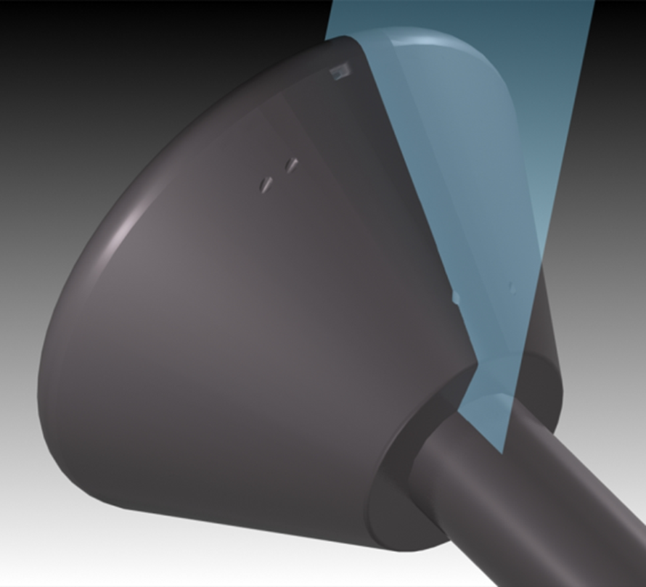
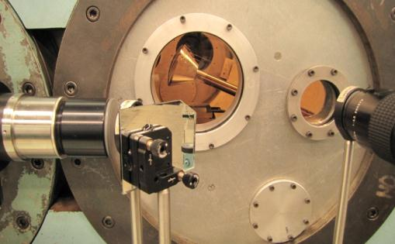
Typical setup: PLIF Imaging in CUBRC Lens-1 Facility
Optics direct laser sheet directed into flow
Imaged by cameras

Slide 20
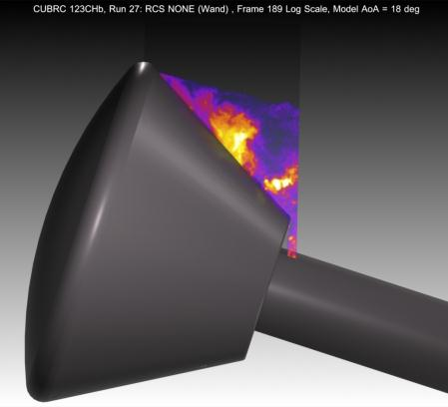
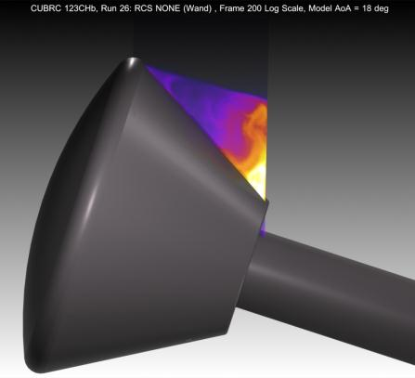

Orion MPCV - Testing at CUBRC
Short duration shock tunnel testing (LENS-1) at Mach 8
Primary goal: Determine backshell heating environment with gauges
Visualize shear layer, Reaction Control System (RCS) Jets with 1% NO
No Jets
No Jets, Re_{D} x7 higher
Roll RCS
Schlieren didn’t show jets
Combs et al. J. of Spacecraft and Rockets (2015): Vol.52: 243-252

Slide 21
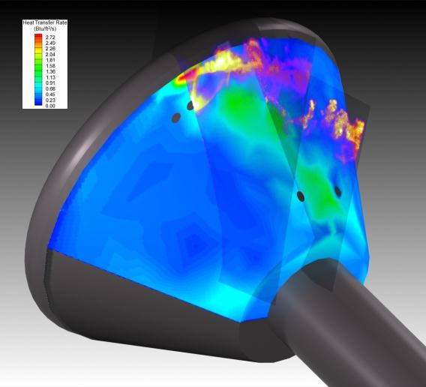
PLIF imagery helps interpret conventional data
Composite of two PLIF images taken at different image planes plus heating map generated by discrete gauges
Clear that roll jet fluid is not heating the model
Possibly a horseshoe vortex wrapping around roll jet structure is heating surface
Separation shock may be cause of high heating near capsule lip

Slide 22
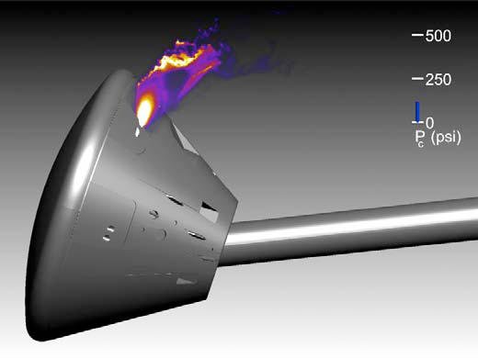
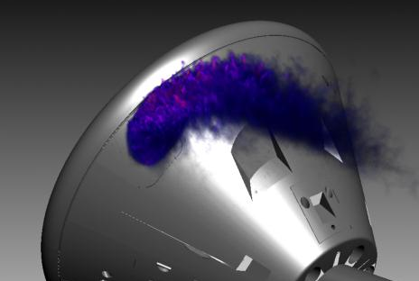
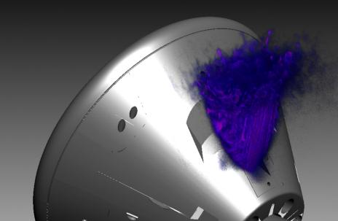
Volumetric Imaging at Mach 10: Orion
Pair of Roll RCS Jets
P_{jet} = 132 psi
Pitch Jet
P_{jet} = 132 psi
1 minute runs in NASA Langley’s 31” Mach 10 facility
Single shot images of NO-seeded RCS jet fluid; scan laser sheet
Multiple images displayed simultaneously to show 3D trajectory of jet: quasi-volumetric imaging
J. A. Inman, P. M. Danehy, et al. AIAA Journal Vol. 47, No. 4, April (2009)

Slide 23
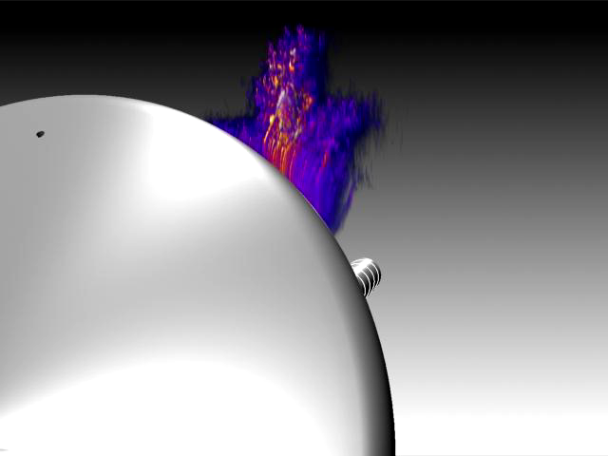
Visualization of 3D flow structures: Roll Jets

Slide 24
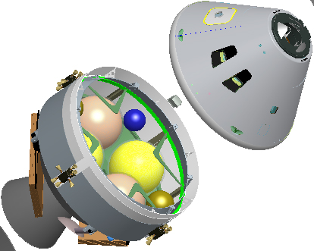
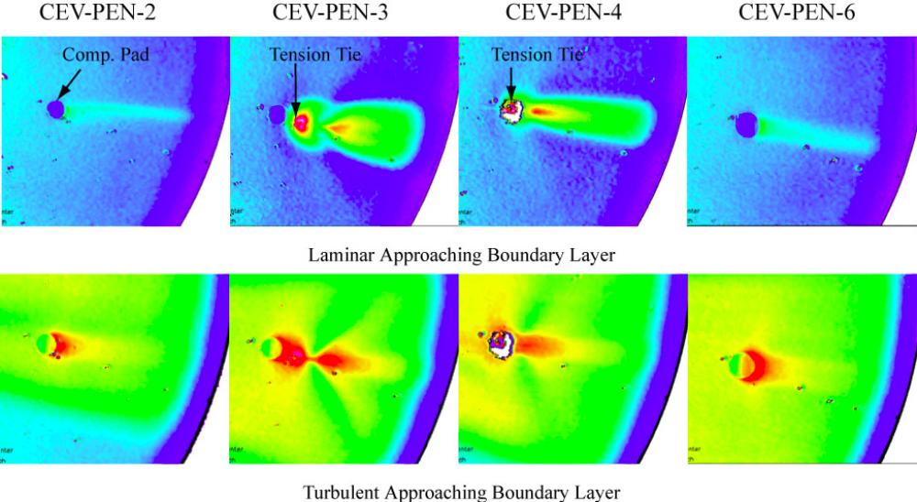

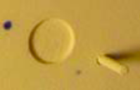
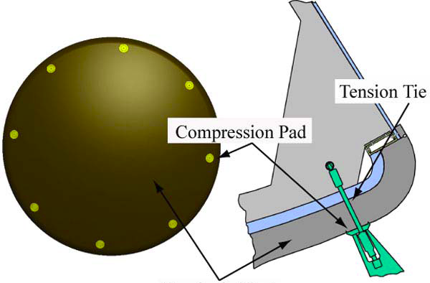
Motivation for M=10 flow over discrete roughness study
Orion MPCV Compression Pads / Tension Ties
Crew
Module
Service
Module
Liechty
AIAA-2008-1240
3x higher heating downstream of tension tie:
Why?
Understand the laminar-to-turbulent transition process induced by a discrete protuberance
Many other researchers using cylinders for fundamental trip studies (Schneider, Choudhari, Goldstein)
Freestream
Turbulent BL
Transitional BL
Forebody Heat Shield
Laminar BL
Flow Visualization: 10 Hz and MHz
Velocimetry

Slide 25
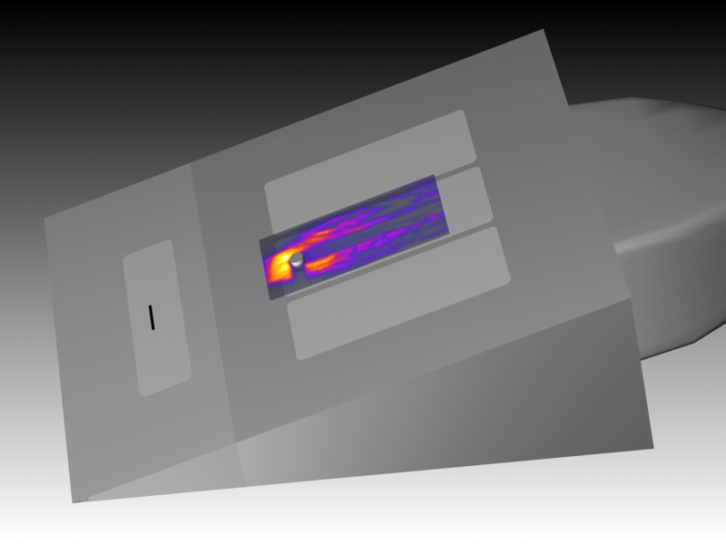
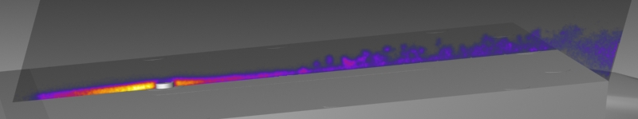
Flow over discrete roughness: Flow Vis
Flow visualization can provide information about BL behavior
Tripped, transitional flow
NO seeded from 11-mm wide spanwise slot
Laminar flow
Cylinder Trip (and shadow)
Sting
Sharp leading edge
Camera FOV
Length Scale
(1/4” increments)
Freestream
Turbulent BL
Transitional BL
Laminar BL
M_{e} ≈ 4.2
Re_{kk} ≈ 5,000
k/δ = 1.4

Slide 26
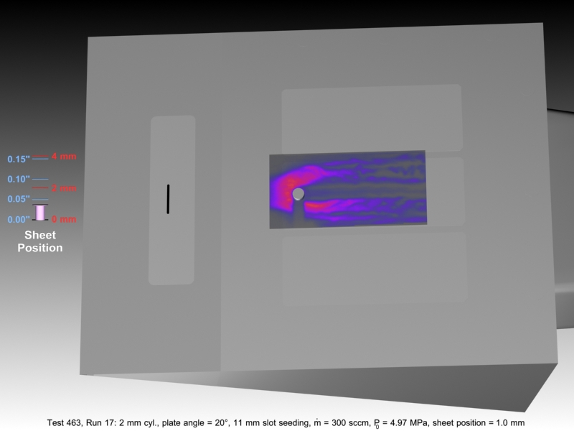
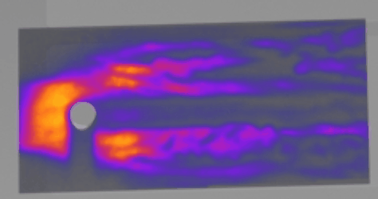
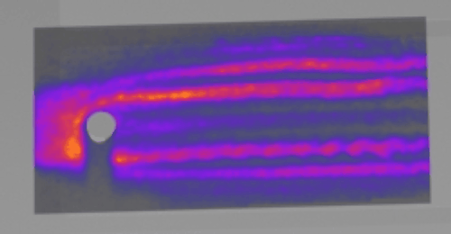
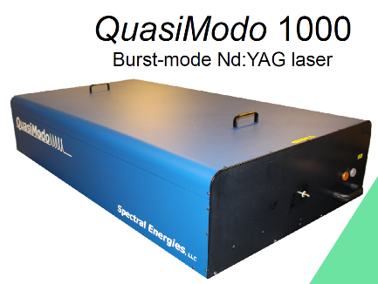
1 MHz NO PLIF System
See also N. Jiang talk at GRC
Jiang et al, Applied Optics Vol. 50, Issue 4, pp. A20-A28 (2011)
1 million FPS – time resolve these flows, compare with time resolved CFD
More coming soon: NASA just procured a similar system through SBIR program (Spectral Energies, Dayton OH)
26

Slide 27




Single-laser Molecular Tagging Velocimetry (MTV)
Excited state
Tunable Laser
Gas flow
Sheet-forming lenses
Ground state
Lens array
LIF ~ n_{NO}
Flow Direction
Laser excites lines of molecules
Molecules move, fluoresce
Camera captures image
27
BF Bathel, et al, AIAA journal 49 (9), 1883-1896, 2011

Slide 28







Applications: Single-laser MTV
0.41 cm
0.00 cm
Trip
No Trip
cm
cm
cm
M_{e} ≈ 8.1
Velocity Measurement
  Single-component
  Developed thorough uncertainty analysis methodology
  Data used in subsequent CFD study by Iyer et al. of Univ. of Minnesota (AIAA 2011-566)
BF Bathel, et al, AIAA journal 49 (9), 1883-1896, 2011

Slide 29


Descent
Between Entry and Landing is a Transonic/Subsonic Descent Phase will have an ablated heatshield: Understand Aero performance

Slide 30



Femtosecond Laser Electronic Excitation Tagging (FLEET)
Molecular Tagging Velocimetry in Transonic Cryogenic Tunnels
(Performed series of measurements in the NASA Langley 0.3 m TCT, validated method with accuracy and precision 1% of measured velocity)
Orion in the National Transonic Facility
30

Slide 31

What is FLEET?
Femtosecond Laser Electronic Excitation Tagging
70 fs laser focused down excites N₂ which fluoresces for 10’s of μs
  Acquire image pairs or sequences and determine velocity from displacement (Δt = 1 μs, 5 μs, … 50 μs)
  Can perform precise velocity measurements in air and N₂ flows
(Princeton)
Laser (1 kHz)
-1 ms = 1000 usec
between pulses
Camera (200 kHz)
-5 usec between images
FLEET Raw Data obtained in 0.3 m transonic cryogenic tunnel at NASA Langley
(use slideshow mode)
Single, robust laser
Single camera, 200 kHz
800 nm laser, 1 kHz
Visible fluorescence
Multi-exposure
No seeded gas
V = Δx/Δt

Slide 32

Implement FLEET in NTF: NASA Orion Spacecraft
National Transonic Facility
  High pressure cryo facility
  Unique national asset
  High Reynolds number testing
Built a beam transmitting system
  Evacuated beam path
  Articulating mirrors
  Remote operation
Camera acquisition System
  Intensified high speed camera
Orion test:
  Vary Mach, Reynolds #, AoA

Slide 33



FLEET Measurement Arrangement
Sweep Pattern
Simulated Velocity Planes
To avoid damage to model, measurements were obtained at +/- 90 degree roll.

Slide 34



Orion Results: Mach and Reynolds Number Dependence
Full Vertical Bin
Shear layer moves further from vehicle for higher Mach, further distance downstream
Data was delivered to Orion program for code validation, 2022.
Data set was made available to wider community (Retter et al, SciTech 2023)

Slide 35



Lunar Landing: Plume Surface Interaction
Barrel shock
Wall jet
PSI leads to surface erosion (vehicle tilt), plumes of dust (reduced visibility), ejecta (damage nearby installations) and other issues
What are the plume physics at lunar conditions?
When is crater onset? How deep, how large will the craters be? Can we measure them as they erode?

Slide 36

PSI Test at MSFC within 20-ft Vacuum Chamber
Performed 10 Hz NO PLIF within large-scale facility in July 2022
Objective: obtain plume structure measurements in rarefied (lunar-relevant) and continuum (Martian relevant) environments
  Mach 5 plume of heated N₂ seeded with NO impinging normal a flat instrumented plate
Even at very rarefied conditions, PLIF shows flow features of interest
  Concave surface shock vs. triangular surface shock
  Large-scale structures within wall jet
  Rarefied jet vs. jet boundary
  Shear layers
Rodrigues et al (In preparation)
Lunar-relevant, lower lander altitude
Lunar-relevant, higher lander altitude
Martian-relevant, higher lander altitude

Slide 37
Conclusions
Launch, Entry, Descent, Landing
Optical and Laser based measurements are making contributions
  Insight into flow physics for potential problem areas of Artemis Program
  Sometimes explain why/how…
  Code validation / confirmation (e.g. base heating on SLS)
  NASA has developed detailed understanding, predictive capability for challenging aeroscience phenomena; work with / advise partners
Two measurement techniques described here
  PLIF (OH and NO)
  FLEET
Our research team is doing more…
  Similar series of studies towards Mars /subsonic aircraft / Scramjet.
    LOFTID, COBRA, Propulsive Descent, etc – Mars entry concepts
      See Fahringer talk Tuesday AM
      See Jiang talk Tuesday AM
      See Rodrigues poster

Slide 38
Where can we go from here?
New measurement tools --- Opportunities
Laser technologies
  More compact 10 Hz lasers (single box laser + OPO + UV + IR)
  Femtosecond, white light
  Pulse burst lasers with ever improving capabilities including OPO
New camera technologies
  High-speed cameras (10 Mfps, 256 frames; 76k fps 1 Mpix, continuous)
  sCMOS, isCMOS, qCMOS cameras (low noise, high pixel density) to ~1 kHz
    s = scientific, i = intensified q = quantitative (vs emCCD is ~0.1 kHz full frame)
  Event-based imaging cameras [Willert, DLR]
Software Developments
  Commercialized, standardized data processing would be advantagous
    Currently available: PIV
    Potentially forthcoming (?): MTV, CARS, PLIF thermometry, etc.
  Improved tomography algorithms for 3D measurement
    Shake-the-box PIV
    Volume data such as PLIF, Background oriented schlieren (BOS), others…
  AI / Neural-network based analysis?
New measurement ideas and applications!
  See GRC session: Advances in Measurements for High-Speed Flows. Tu 9 am
Notes:
Traditional camera systems use a frame-based approach, wherein a lot of the captured data is the same from frame to frame with typically only a few clusters of pixels changing values. This means that the sensor is constantly integrating the full field of view and sending the data from every pixel within it, even when it is the same data as the previous frame. When the camera is looking at a stationary scene, much of this pixel data is the same from frame to frame thus consuming unneeded bandwidth and processing resources.
Event-based Vision Sensors (EVS) help alleviate this issue by only sending data from pixels that have detected a change in intensity. This allows them to minimize the volume of data that is transmitted over the sensor’s data bus while minimizing the processing resources need to analyze the image. On top of this, individual pixel autonomously responds to illuminance changes allowing the sensor to detect small and/or high-frequency changes with lower bandwidth requirements.

Slide 39
Thanks for your attention!

Slide 40
Backup

Slide 41
Aeroscience Challenges for the Artemis Program
Launch:
  Core stage plume-induced base heating on SLS
  Buffet between core stage and SRB in SLS
  Supersonic Stage Separation (non-contact)
Entry:
  Orion Reaction Control System (RCS) Jets
    Aero performance
    Backshell heating
  Transition/heat shield performance
Descent:
  Orion heat shield roughness aero performance
  Earth: Parachute deployment
Earth Landing: Splashdown
Lunar Landing: Plume-surface interaction (PSI)
Many, many other challenges…
NASA has developed detailed understanding, predictive capability for these phenomena; work with / advise partners
(Mars entry has a separate list of problems! It has a thin atmosphere.)

Slide 42

EFT-1 Dec 5, 2014
http://www.nasa.gov/pdf/631631main_12-03_HEOC.pdf

Slide 43


Slide 44

NASA Artemis III mission with SpaceX: 2025+
https://en.wikipedia.org/wiki/Starship_HLS#/media/File:Artemis_III_CONOPS.svg
Notes:
Starship HLS, or Starship Human Landing System, is a lunar lander variant of the Starship spacecraft that will transfer astronauts from a lunar orbit to the surface of the Moon and back. It is being designed and built by SpaceX under contract to NASA as a critical element of NASA's Artemis program to land a crew on the Moon in the 2020s.
The mission plan calls for a Super Heavy booster to launch a Starship HLS into an Earth orbit, where it will be refueled by multiple Starship tanker spacecraft before boosting itself into a lunar near-rectilinear halo orbit (NRHO). There, it will rendezvous with a crewed Orion spacecraft that will be launched from Earth by a NASA Space Launch System (SLS) launcher. A crew will transfer from Orion to HLS, which will descend to the lunar surface for a stay of several days which is to include five or more EVAs. It will then return the crew to Orion in NRHO.
In the third phase of its HLS procurement process NASA awarded SpaceX a contract in April 2021 to develop, produce, and demonstrate Starship HLS. A crewed flight will occur as part of the Artemis 3 mission, no earlier than April 2025, after an earlier uncrewed test flight successfully lands on the Moon and returns to NRHO.
On 23 March 2022, NASA announced its intention to procure a second crewed Starship HLS demonstration mission to the Moon, with the HLS design updated to meet new sustainability requirements. NASA intends to negotiate a sole-source award to SpaceX by exercising an option under the 2021 HLS contract. The updated Starship HLS would be used for the Artemis V mission and would compete with landers to be procured from other vendors for later landings.

Slide 45
SLS Configurations
www.nasa.gov/sls
Notes:
Which ones tested?

Slide 46

https://commons.wikimedia.org/wiki/File:NASA_Selects_First_Commercial_Moon_Landing_Services_for_Artemis_Program_(47974915261).jpg

Slide 47
https://commons.wikimedia.org/wiki/File:Super_heavy-lift_launch_vehicles.png

Slide 48


Current Flow Measurement in TCTs
What are they doing now in TCTs?
  Physical probes (hotwire; pitot-static)
    bulky, slow, perturb the flow.
    Typically mount on main sting or model.
    Not always available in National Transonic Fac. (NTF)
Current flow measurement approach in NTF uses rakes attached to model:
PIV
Milholen, Jones, et al, 2013

Slide 49
Laser Setup in the NTF: Details
Please consult for more information
AIAA 2019-3380
Reese et al., Exp Fluids 62, 99 (2021).

Slide 50


The National Transonic Facility at NASA Langley RC
The NTF is NASA Langley’s largest, most expensive facility.
Minimal off-body measurement capability
Contributions to civilian aero, aerospace, DOD missions
Could be used for high Reynolds number code validation experiments

Slide 51


Transonic Cryogenic Wind Tunnel
Flow Facility – NASA Langley 0.3-m Transonic Cryogenic Tunnel (0.3-m TCT)
Continuous, closed-circuit wind tunnel operating with air or N₂
Mach number range: 0.2 to 0.9
Total pressure range: 100 kPa to 500 kPa
Total temperature range: 95 K to 320 K
Reynolds number range: 4$×$10⁶ 1/m to 300$×$10⁶ 1/m

Slide 52



Transonic Cryogenic Wind Tunnel
Flow Facility – NASA Langley 0.3-m Transonic Cryogenic Tunnel (0.3-m TCT)
Continuous, closed-circuit wind tunnel operating with air or N₂
Mach number range: 0.2 to 0.9
Total pressure range: 100 kPa to 500 kPa
Total temperature range: 95 K to 320 K
Reynolds number range: 4$×$10⁶ 1/m to 300$×$10⁶ 1/m
Double-shelled construction
Pressure shell
Inner ‘D’-window
Flow direction
Plenum
Inner rectangular window

Slide 53

Transonic Cryogenic Wind Tunnel
Flow Facility – NASA Langley 0.3-m Transonic Cryogenic Tunnel (0.3-m TCT)
Continuous, closed-circuit wind tunnel operating with air or N₂
Mach number range: 0.2 to 0.9
Total pressure range: 100 kPa to 500 kPa
Total temperature range: 95 K to 320 K
Reynolds number range: 4$×$10⁶ 1/m to 300$×$10⁶ 1/m
Double-shelled construction
Optical access: outer pressure shell window + two windows in turntable
Pressure shell
Inner test section
Flow direction
Outer window
Plenum

Slide 54


Optical Setup
Within plenum, laser passed through an evacuated conduit/periscope to alleviate wavefront distortion caused by density fluctuations
Beam focused at center of test section with $f$ = + 200 mm PCX lens
High-speed intensifier lens-coupled to CMOS camera
Quasi-boresight imaging perspective
Acquisition rate: 200 kHz in bursts of 15 frames (100 bursts/s)

Slide 55

Characterization of FLEET velocimetry
Data Sample
FLEET signal takes on a nearly-circular intensity distribution due to boresight imaging
Burst imaging allows the simultaneous measurement of signal position and intensity as a function of time
  Immunity to vibration-based errors in velocity calculations
  Signal intensity- /lifetime-based measurements
Raw data
Scaled data
Centroid data
(processed)

Slide 56


Characterization of FLEET velocimetry
Measurement Accuracy
Accuracy assessed by comparing FLEET velocity measurements to those calculated by the 0.3-m TCT data acquisition system (DAS)
Standard error found to lie between 0.5% and 1.5% of measured velocity
Measurement Precision
Standard deviation of velocity measurements compared to wind-off values
  Measurement precision consistently less than 1% of measured velocities
Burns, Danehy, Halls, Jiang, “Application of FLEET Velocimetry in the NASA Langley 0.3-m Transonic Cryogenic Tunnel,” Aviation 2015, AIAA-2015-2566.
Burns, Danehy, Halls, Jiang, “Femtosecond Laser Electronic Excitation Tagging Velocimetry in a Transonic, Cryogenic Wind Tunnel,” AIAA Journal, 2016.

Slide 57







Computational Flow Imaging (CFI)
Compute PLIF Images based on CFD and spectroscopic data (broadening, shift, quenching)
  More direct comparison between PLIF and CFD
T
Y_{NO}
P
λ, Δλ
v
J. A. Wilkes, C. Glass, P. M. Danehy and R. J. Nowak, “Fluorescence Imaging of Underexpanded Jets and Comparison with CFD” AIAA Paper 2006-910, Jan. 9-12, 2006.
CFI
Y_{O2}
Originally in support of Space Shuttle Return to Flight (RTF) after Columbia accident.
Recent improvements in support of Mars missions. (Rodrigues, SciTech 2022)
PLIF
Overlap Integral, G
Laser, Doppler, Pressure Broadening, Shift

Slide 58

CFI comparison for Orion tested at Mach 10
(Ivey et al, AIAA Conference, 2011-713)

