Slide 1
Technical Challenge 1
In-Time Terminal-Area
Risk Management
SPM: Dr. Nikunj Oza
Chad Stephens

Slide 2
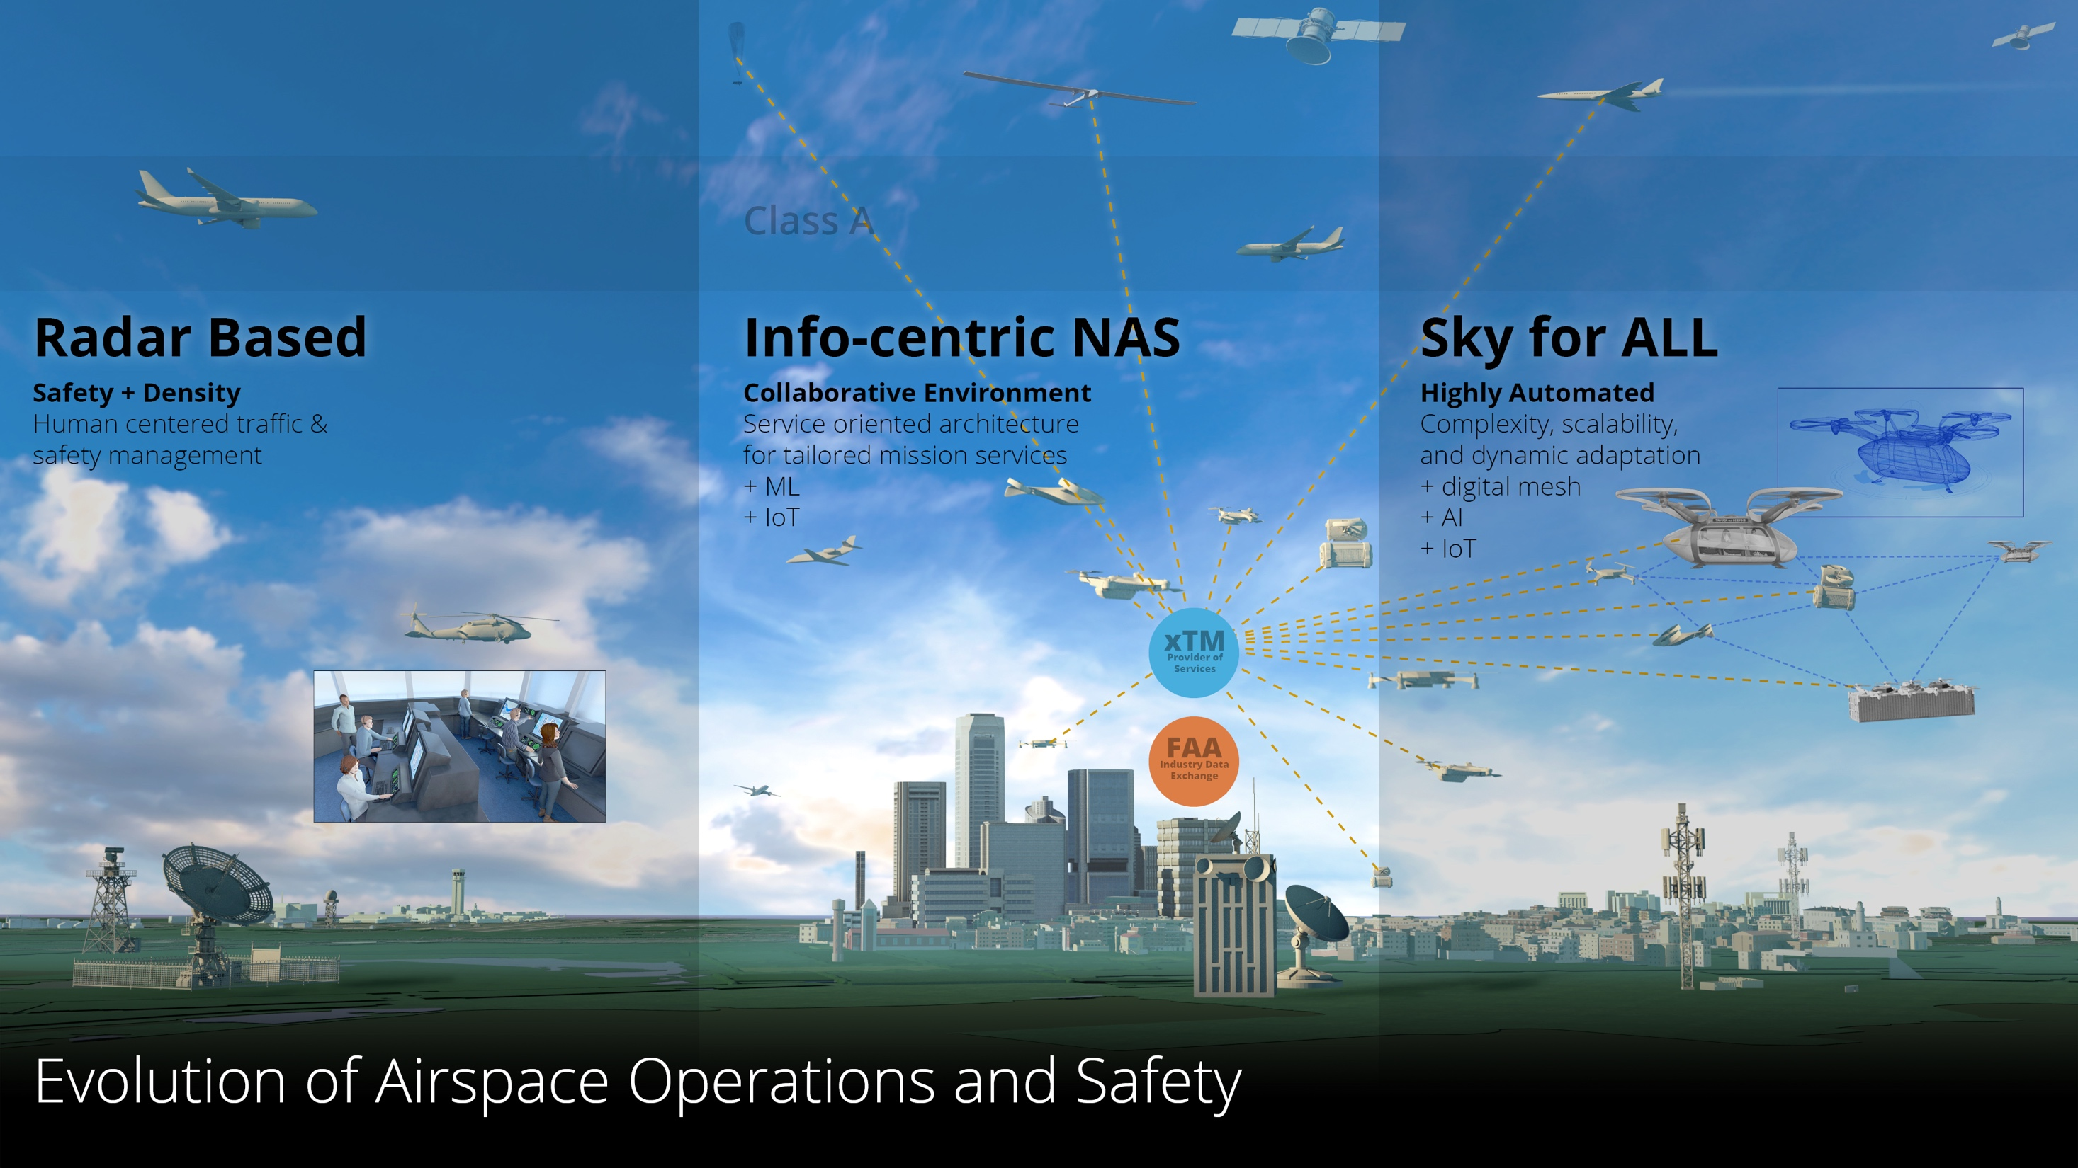
Innovating the Future of Aviation Safety
Today
2035
2045
Credit: NASA

Slide 3


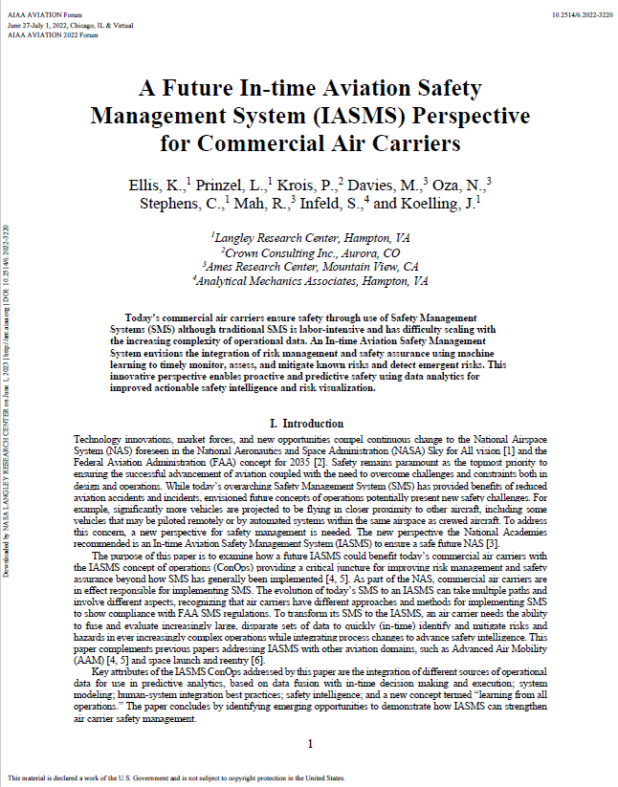
In-time Safety Needs and Impact
Need: Novel types of aircraft having different performance capabilities and wide complexity of operations necessitates the development of tools and processes to quickly (in-time) mitigate risks and hazards effectively and economically.
Objective: Develop innovative ways for humans to interact with safety data and manage information to rapidly evaluate existing and discover new patterns in data that lead to negative outcomes before the next safety event occurs.
Impact: Improved speed and characterization of system-wide risk identification to augment existing SMS processes supporting risk management and safety assurance.
3

Slide 4
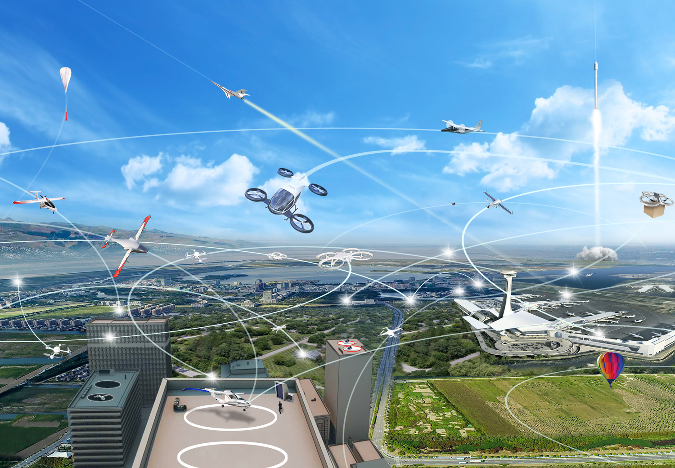
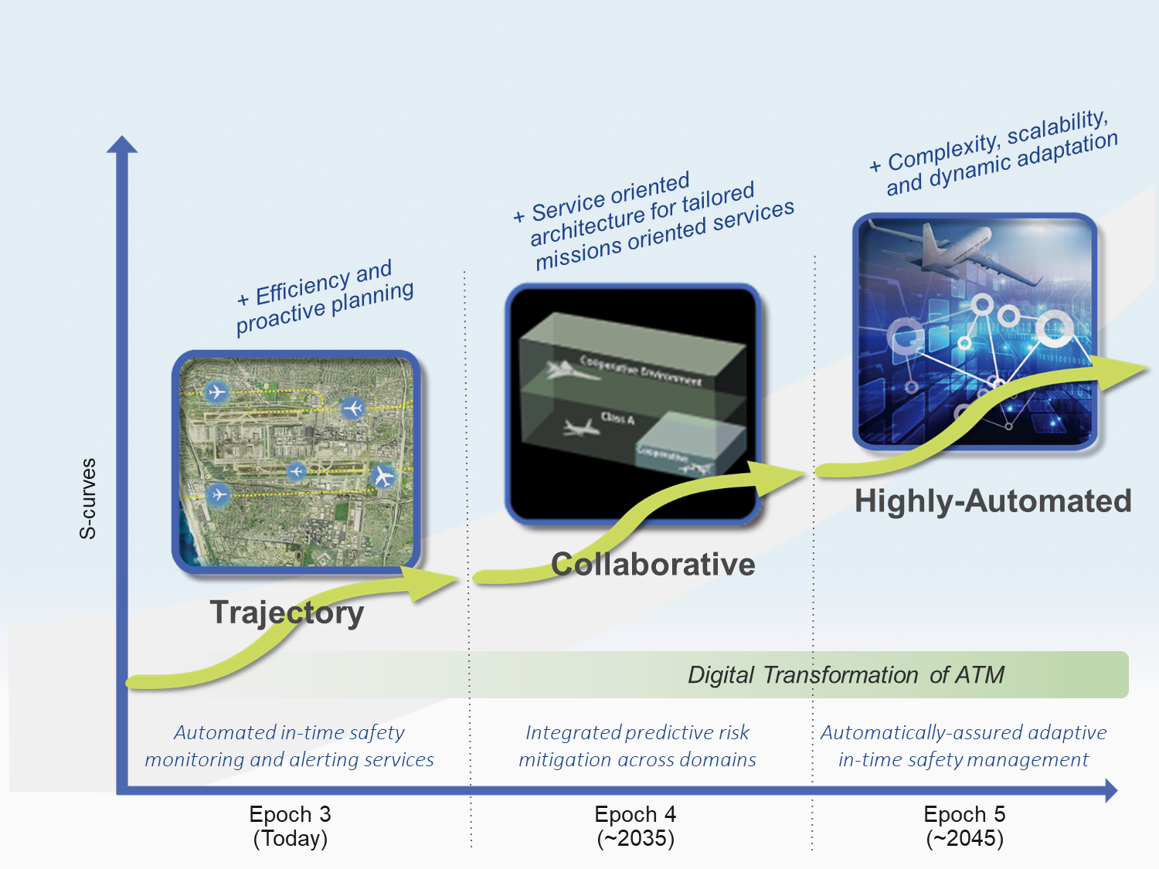
In-time Safety Needs and Impact
NASA System-Wide Safety Project
To explore, discover, and understand the impact on safety of growing complexity introduced by modernization aimed at improving the efficiency of flight, the access to airspace, and/or the expansion of services provided by air vehicles.
Credit: NASA
To develop and demonstrate innovative solutions that enable this modernization and the aviation transformation envisioned for global airspace system through proactive mitigation of risks in accordance with target levels of safety.
Credit: NASA
4

Slide 5
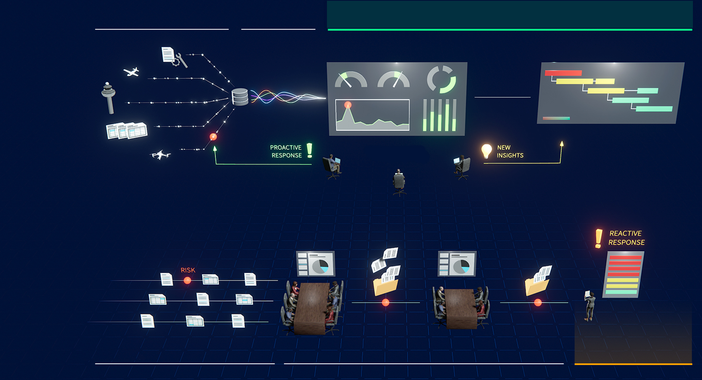
SWS Modernization of Airline SMS to IASMS
DATA COLLECTION &
AGGREGATION
FUSION OF BIG
DATA SETS
RISK MITIGATION
IASMS
INTERPRETATION &
UNDERSTANDING
Monitor Assess Mitigate
SMS
DATA COLLECTION
DISTILLATION & REVIEW
RISK MITIGATION
Credit: NASA

Slide 6

Current SWS Project Research Portfolio
Operational Safety (Thrust 5)
TC-2: IASMS SFC Development for Emerging Operations
TC-1: Predictive Terminal Area Risk Assessment
TC-5: Safety Demonstrator Series for Operational IASMS
Transformed
NAS
Current Day
Near Future
TC-3: V&V for Commercial Operations
TC-4: Complex Autonomous Systems
Assurance
Design Safety (Thrust 6)
6

Slide 7


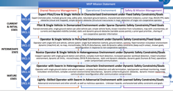

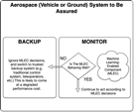
TC-1 in the System-Wide Safety Project Context
Integrated Terminal Area Risk
Develop and implement a prototype Thrust 5 ISSA capability for terminal area operations.
Operational Safety (Thrust 5)
Data Issues
Predictive Safety
TC: Integrated Terminal Area Risk
Distributed Safety
TC: In-Flight Safety Predictions for Emerging Operations
Evolutionary Path
Current Day
Near Future
Transformed NAS
TC-5,
New eTCs
Scale, Diversity
Time to Certification
TC: Validation and Verification for Commercial Ops
TC: Complex Autonomous Systems
Assurance
Assurance of Autonomy
Design Safety (Thrust 6)

Slide 8



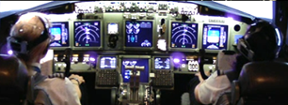

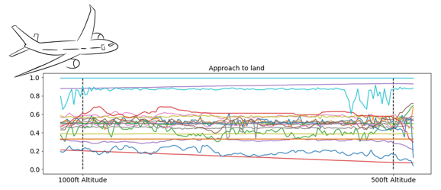
Technical Challenge 1 Research Areas
Human
Contributions
to Safety
Human Performance
Fatigue Risk
Management
ML-Enabled Data Analytics

Slide 9
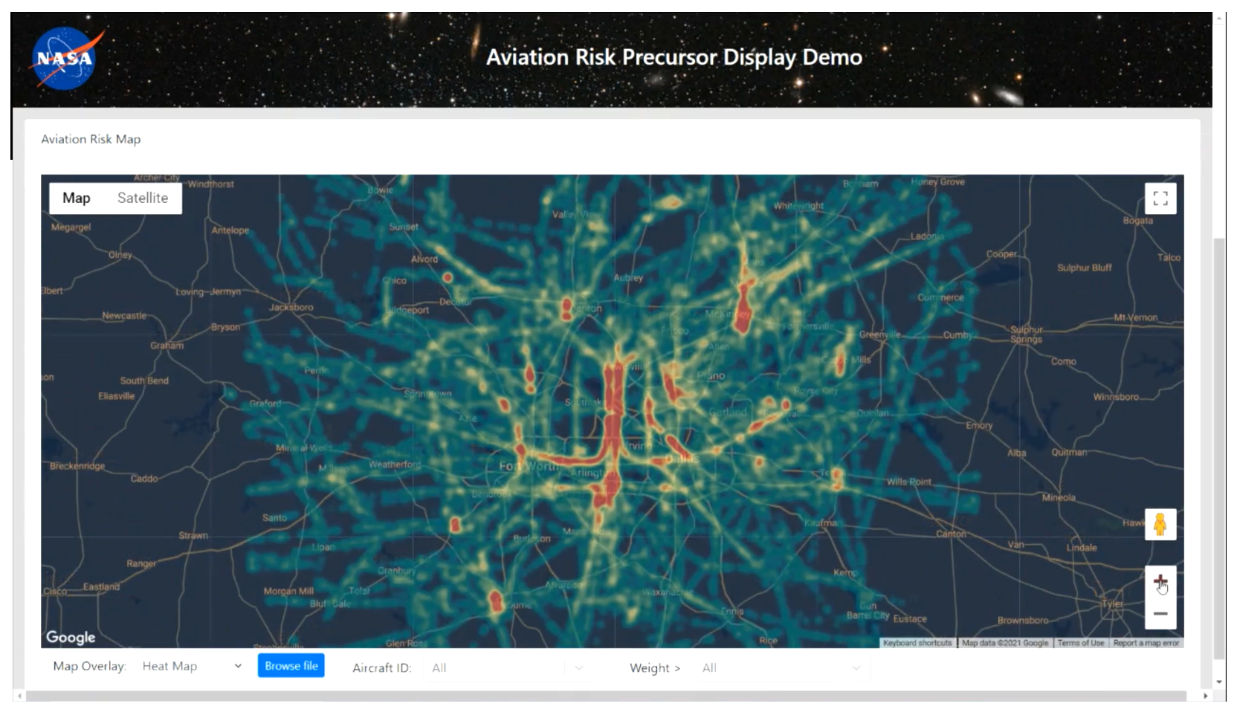
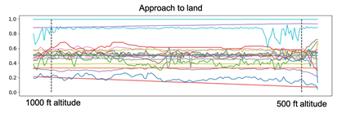
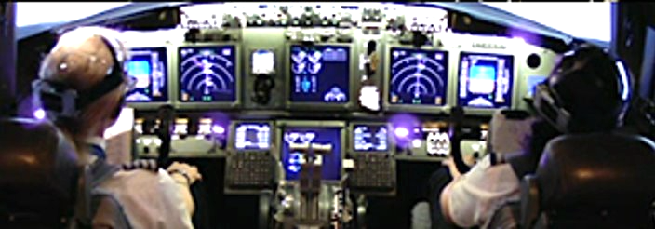
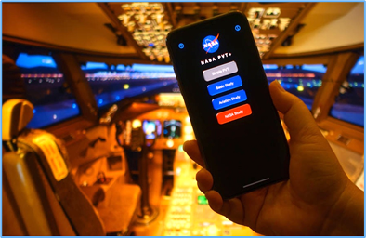
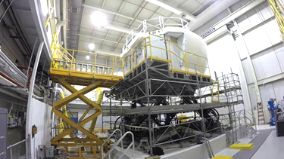










NASA SWS Research on Terminal Area Risk Analysis
Improves air carrier safety management systems using ML and previously-unused data sources to allow airlines to predict and mitigate safety threats in time to prevent them. Airlines also gain new insights on safety they didn’t have before.
ML Enabled Data Analytics: Semi-supervised ML algorithm for detection of safety events at a major airline partner using FOQA data to detect unstable approaches, crossing deviations, and previously-
unknown safety issues with
more efficiency than tradi-
tional analytics methods.
Non-Traditional Safety Data Monitoring and Analysis:
Deployment of NASA PVT+ app supports research on strategies to mitigate fatigue and increase pilot alertness and performance. Airline carrier partners benefit through improvements to their SMS Fatigue
Risk Management programs.
HC2S SOTERIA STUDY: Partners can identify productive safety behaviors in addition to effective threat and error manage-ment behaviors. This approach enables training and procedures to be more effective and help train crews to be more resilient.
Aviation Risk Precursor Identification (ARPI) technology prototype:
Implementation of machine learning methods to anticipate and resolve potential safety issues, predict the health and robustness of aviation systems, and analyze integrated risk in terminal area operations and ground operations.
Directly aligns with ARMD’s Strategic Thrust 5 to provide In-Time System-Wide Safety Assurance. In addition, the impact supports strategic industry partnerships, a key ARMD priority. Our partners include:

Slide 10
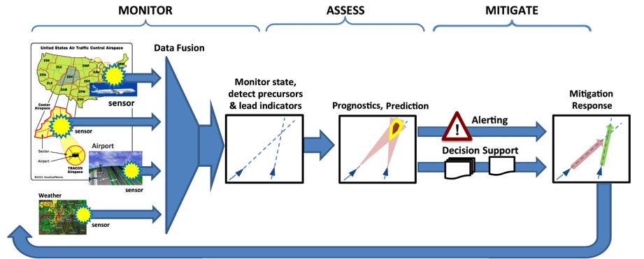
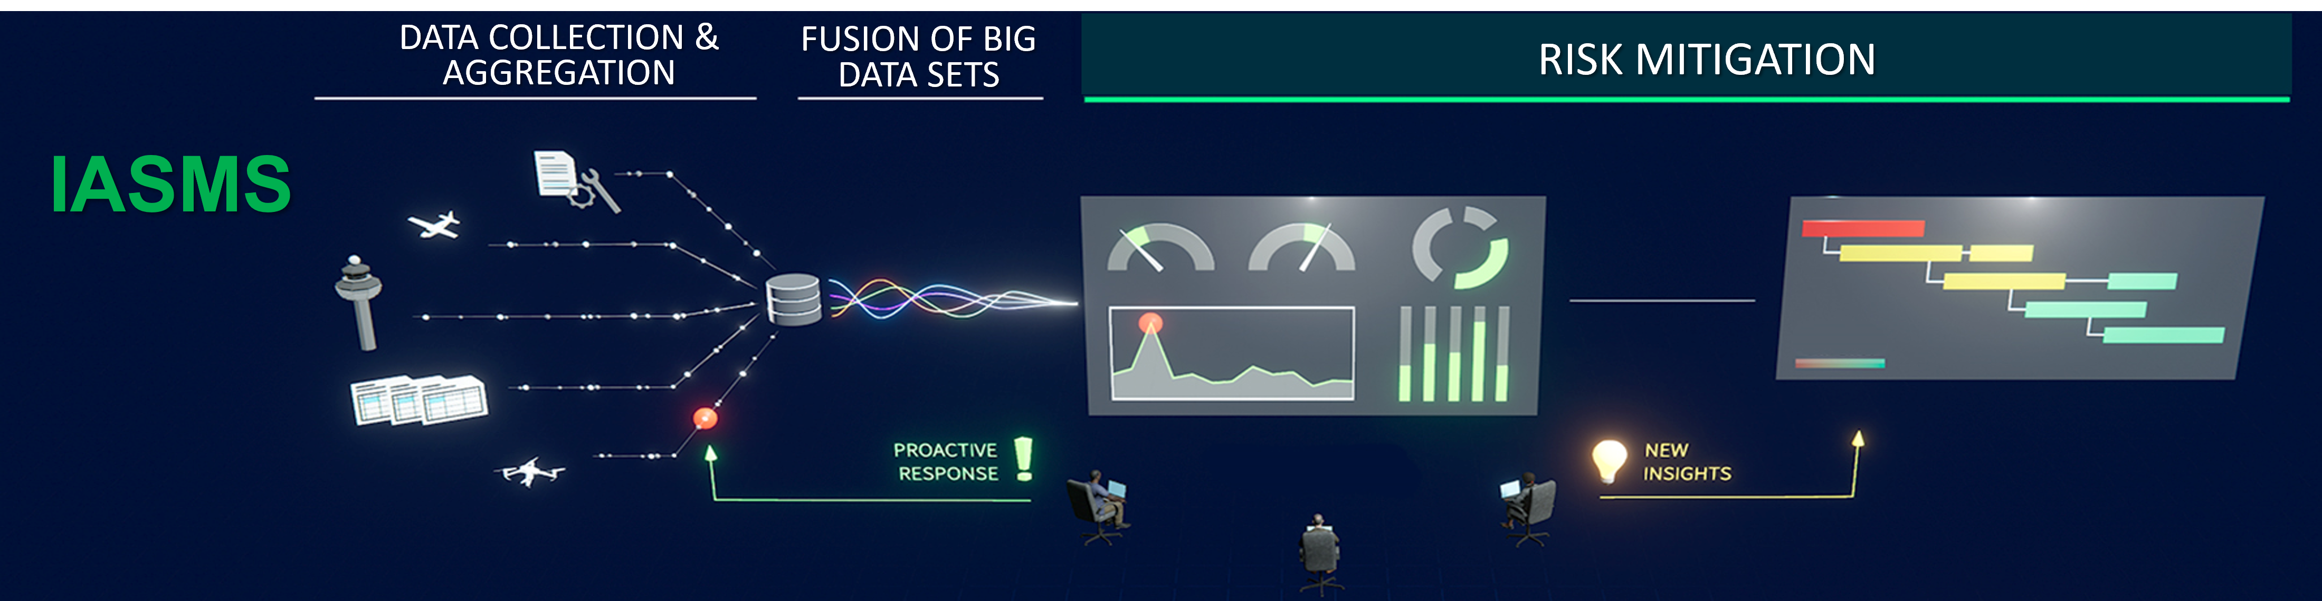
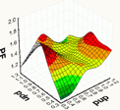


What We Are Developing to Enable IASMS
Develop fundamental In-time System-Wide Safety Assurance (ISSA) data analysis techniques required for the transformed NAS by demonstrating and validating a capability for an Airline Operation Center that determines integrated risk based on available data
T-2 hours
(takeoff)
T+5 Hours
(approach & landing)
Pre-flight
Pre-flight/in-flight

Slide 11




Data Challenges: The Four V’s
Volume:
  Radar Tracks: 47 facilities (1 year) ~423 GB (Compressed), ~3.2 TB (CSV)
  Weather and Forecast (Entire NAS): CIWS ~2.8 TB
Veracity
  Data dropouts
  Duplicate tracks
  Track ending in mid air
  Reused flight identifiers
Velocity
  Radar Tracks: 47 Facilities
    ~35 GB/month (compressed).
    ~268 GB/month (uncompressed)
  Weather and Forecast (Entire NAS): CIWS ~233 GB/month
Variety
  Numerical (continuous/binary)
  Weather (forecast/actual)
  Radar/Airport meta data
  ATC Voice
  ASRS text reports (Pilot/Controller)
Amazing Algorithm
Intuitive
Reports

Slide 12
Data-Driven Methods
DISCOVER anomalies by
  learning statistical properties of the data
  finding which data points do not fit (e.g., far away, low probability)
Complementary to existing methods
  Lower false negative (missed detection) rate
  Higher false positive rate (identified points/flights unusual, but not always operationally significant)
Data-driven methods -> insights -> modification of exceedance detection
Operationally Normal
Statistically Normal
False Alarms
Statistically Anomalous
Unknown Problems
Operationally Anomalous
Known Problems

Slide 13

Active Learning Approach
✅ Operationally Significant
❌ Non-Operationally Significant
❌
✅❌
✅
❌
❌
✅
❌
✅
Select Bootstrap Sample
Re-rank
✅
❌
❌
✅
Review Flights
Learn Classifier
❌
Re-rank
✅
Review Flight
Update
Classifier
✅
❌
❌
Annotator
Interface

Slide 14
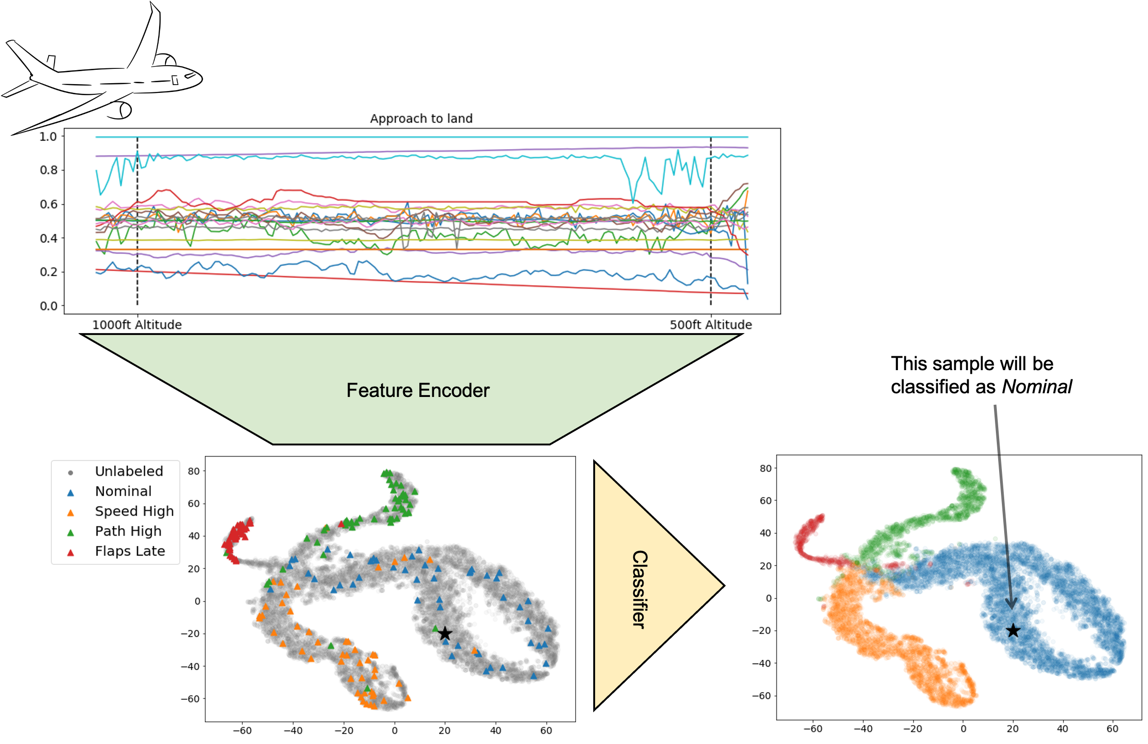
Semi-Supervised Learning
Semi-supervised Active Learning for Anomaly Detection (SALAD)
Memarzadeh, M., Matthews, B., Templin, T., Multi-Class Anomaly Detection in Flight Data Using Semi-Supervised Explainable Deep Learning Model. AIAA SciTech 2021.
  2021 Intelligent Systems Best Paper Award
Memarzadeh, M., Matthews, B., Templin, T., Rohani, A.S., Weckler, D., Semi-Supervised Active Learning for Anomaly Detection in Aviation with Experts in the Loop. AIAA SciTech 2022.
14

Slide 15
Precursors
S₄
S₅
S₆
S₇
Hazard
S₁
S₂
S₃
Corrective actions
S₄
S₅
S₆
S₇
Safe
t₁
t₂
t₃
t₄
t₅
t₆
t₇
t_{end}

Slide 16
Some ML Results
Anomaly Detection
  Multiple Kernel Anomaly Detection (MKAD) on Threaded Track data, identified operationally significant safety events at 35 airports over 6 months
  MKAD plus active learning with annotator GUI: MITRE evaluated in ASIAS sandbox environment on FOQA data
    MKAD’s top 46: 11 safety events, 35 false alarms
    Adding active learning: 15 safety events, 31 false alarms
  Convolutional Variational AutoEncoders (CVAE): to be presented
  Robust and Explainable Semi-supervised Anomaly Detection (RESAD): to be presented
  RNAV Adherence Data Integration (RADI): decision trees applied to Sherlock USA merged trajectories, Rapid Refresh wind data, CIWS, and CIFP
    Predicted 60-72% of RNAV waypoint deviations representing 2.7% of waypoint encounters.
Precursor Identification
  Deep Temporal Multiple Instance Learning (DT-MIL) open sourced, demonstrated

Slide 17
ML Analysis of FOQA Data
Examined about 6000 flights between domestic southeast and northeast city pair, 9400 flights between domestic midwest and west coast city pair, including multiple aircraft types (A320 and 737)
Testing two anomaly detection algorithms (CVAE, SALAD)
  Found several safety issues
  Airline knew about them through other data sources
Testing precursor identification algorithm (ADOPT)
  Looking for precursors to unstable approach
  Found indications related to unstable approach on wrong runway landing

Slide 18
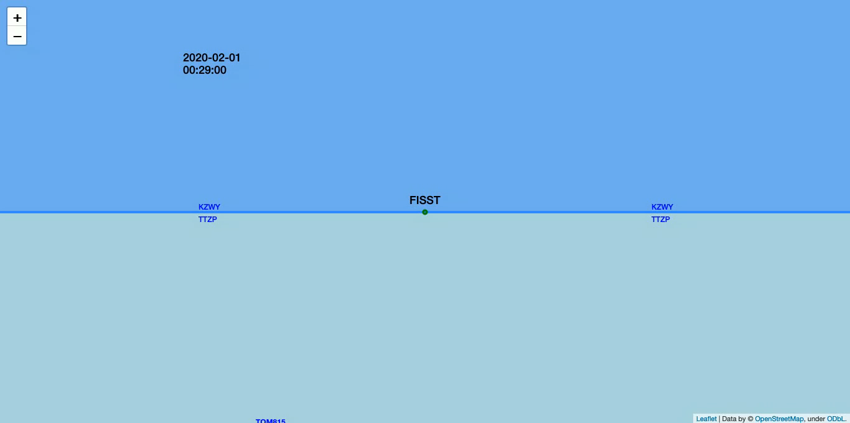
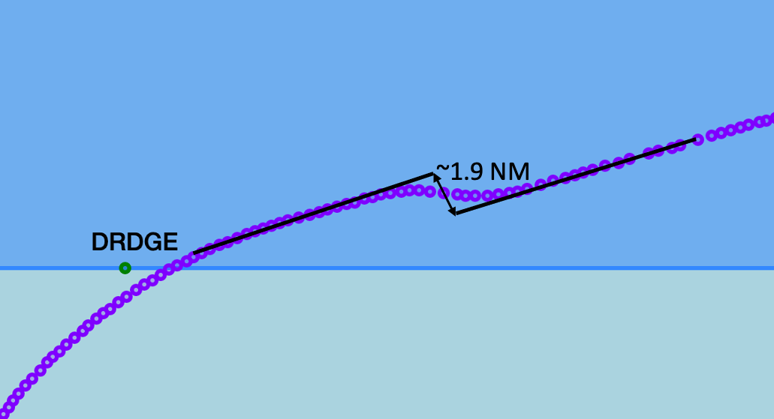
Detecting Oceanic Deviations Using Space-Based ADS-B
Motivation and Objectives
Example Result
FAA is evaluating Space-Based ADS-B to decide if it can enable use of new separation standards in 2025+
North Atlantic Oceanic Area Control Centers (OACCs) divided into five Flight Information Regions (FIRs)
Manual reporting of separation violations, believed underreporting
Want automatic detection
Approach
Holding pattern before entering KZWY airspace
Resulted in a temporarily loss of separation (<50NM in trail) with following aircraft before new altitudes were issued and vertical separation was achieved.
Start with domain knowledge of oceanic flight behavior
Allow for Strategic Lateral Offset Procedure (SLOP)–approved to fly on parallel track, in-trail separation technique to reduce wake encounters
Filter out whitelisted turn locations (grids and fixes)
Next steps
Apply same method in Pacific region
Apply machine learning-based anomaly detection algorithms
Cluster similar potential deviations together and better identify the outliers.
Request ATOP data to determine if anomalies were approved and filed in amended flight plans
Oza, N., Aviation Safety InfoShare. Apr 2022, St. Louis, MO.​

Slide 19
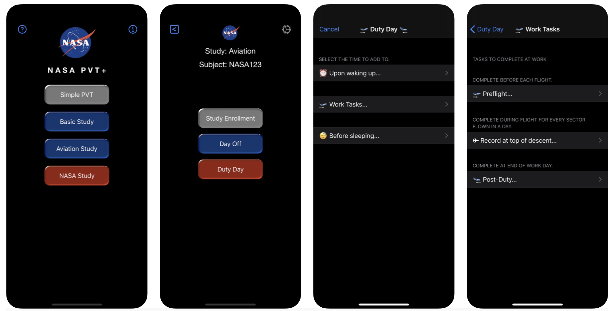
Human Performance Work
NASA Psychomotor Vigilance Test (PVT+) iOS app (5000+ downloads, 2nd most downloaded NASA app after NASA TV).
  Being used by American, Delta, United, Southwest, others
  Currently being used by researchers at Oxford, Harvard, JHU, UCL, OHSU.
Data modeling project with Jeppesen (Boeing) via our agreements with SWISS, Delta, and easyJet; to evaluate how scheduling optimizations influence pilot fatigue.
Survey describing how pilot fatigue has been affected by the pandemic (1).
Study showing how early starts influence pilot performance (2).
Completed a focus group to identify what short-haul operations are most fatiguing (paper under review).
(1) Hilditch, C.J. and Flynn-Evans, E.E., 2022. Fatigue, Schedules, Sleep, and Sleepiness in US Commercial Pilots During COVID-19. Aerospace Medicine and Human Performance, 93(5), pp.433-441.
(2) Arsintescu, L., Pradhan, S., Chachad, R.G., Gregory, K.B., Mulligan, J.B. and Flynn‐Evans, E.E., 2022. Early starts and late finishes both reduce alertness and performance among short‐haul airline pilots. Journal of sleep research, 31(3), p.e13521.

Slide 20
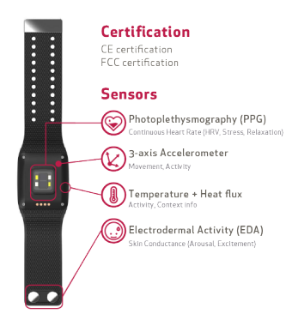
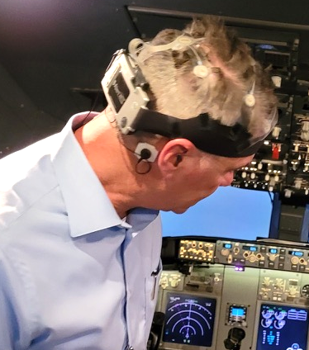
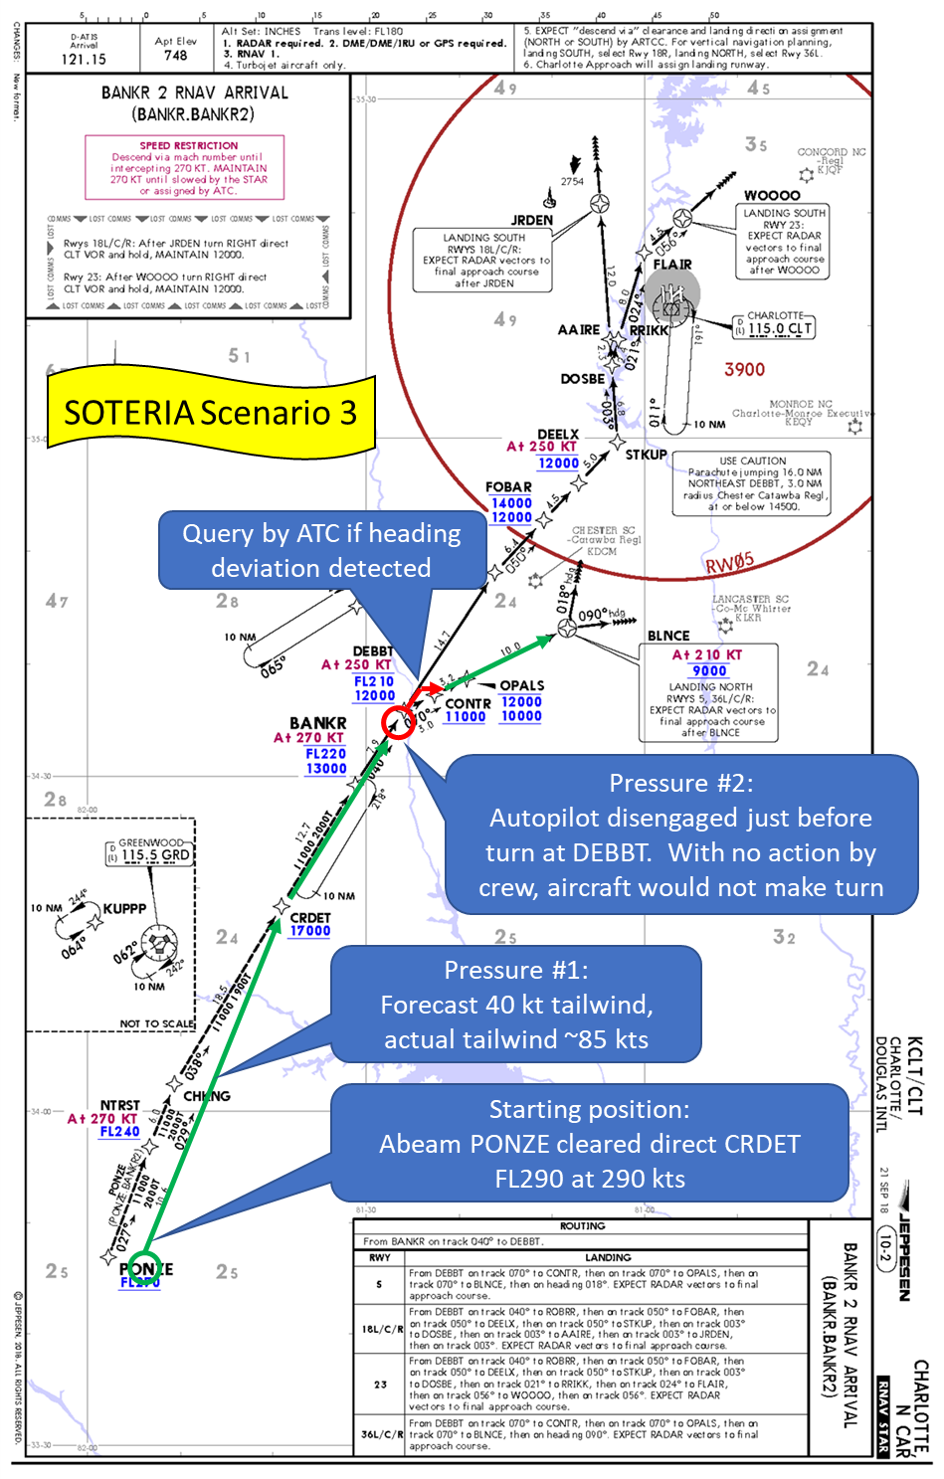
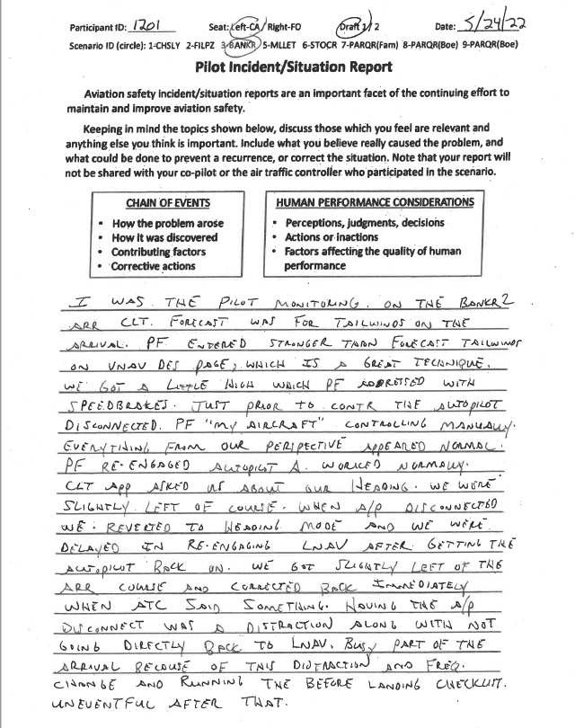
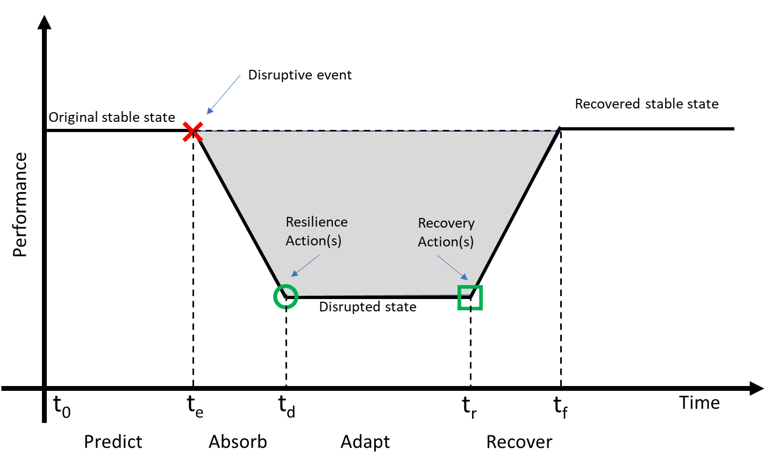
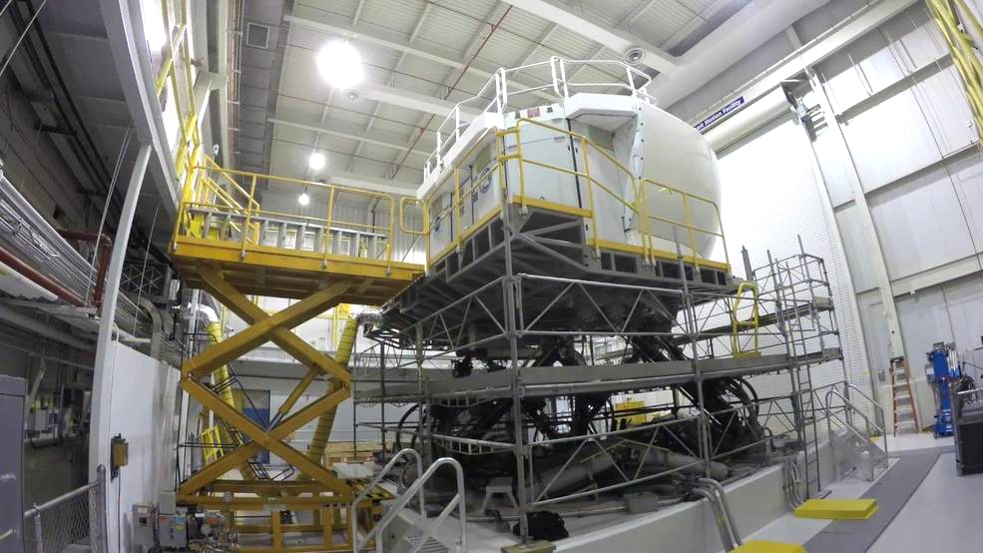

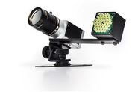
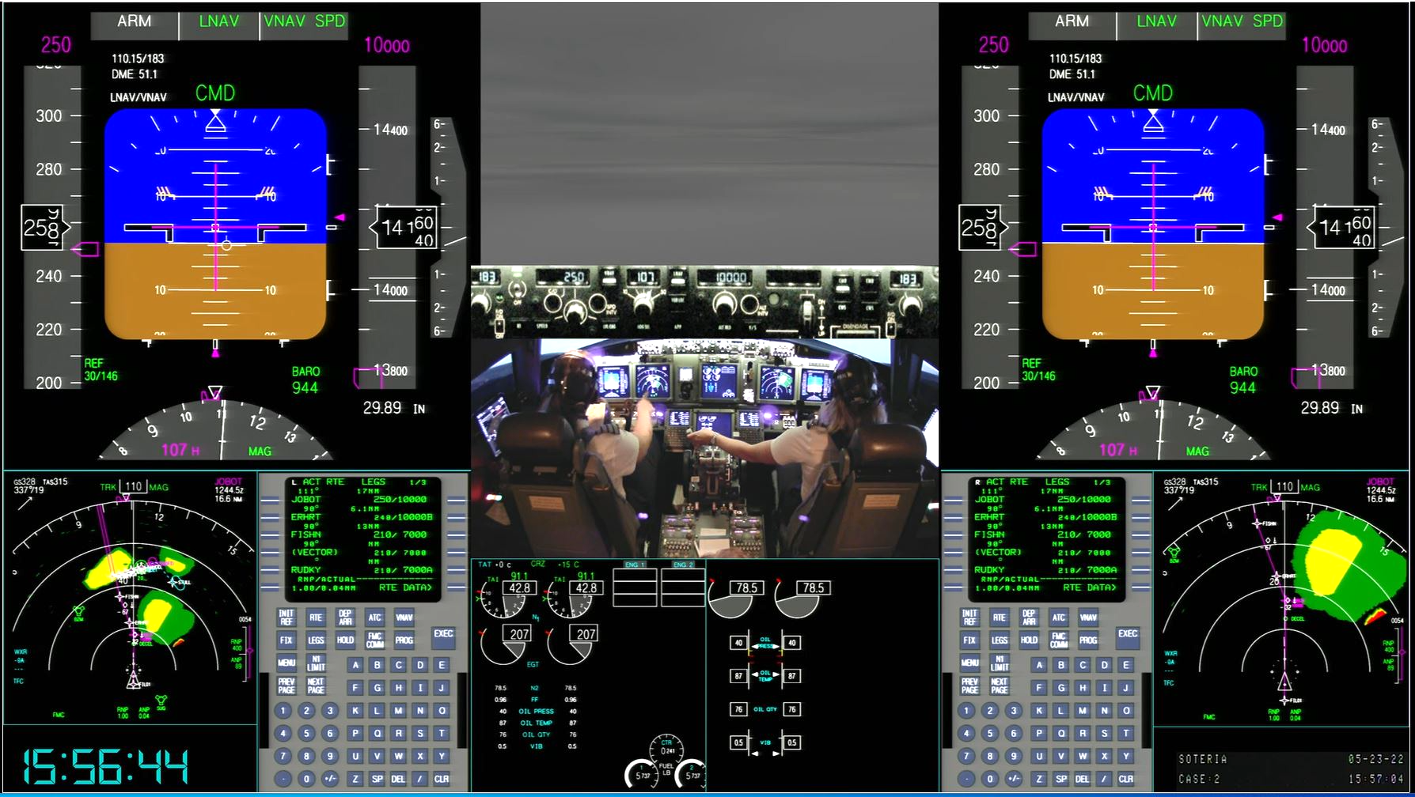
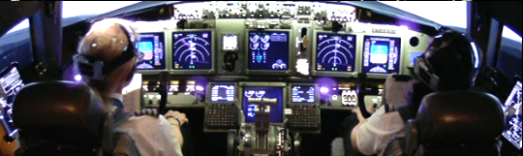
Human Contributions to Safety: SOTERIA Study
Motivation and Objectives
Progress, Status, and Highlights
Address often-unrecognized gap in data collected about operator performance
  The majority of currently collected data focuses on rare safety failures, rather than frequent safety successes
  Can lead to “data driven” policy & design risks due to sampling bias; rare failures are not representative of human performance
Created a data testbed for identifying approaches for measuring the actions and strategies that operators use to successfully anticipate, monitor for, respond to, and learn from events in their environment
Status: Cleaning, transforming, and transcribing data into analyzable and sharable formats
Approach
13 B737 flight crews took part in a 1.5-day study at Langley’s Integration Flight Deck (IFD), using a high-fidelity B737 motion-base simulator
Participating flight crews flew a series of eight 25-minute scenarios based on arrivals into Charlotte Airport. Each scenario was designed to contain at least two manageable “threats” for crews to experience and manage
Impact
Enable assessment of methods for learning from what happens, not just from what fails
Potential to massively expand the pool of safety-relevant data available to IASMS, which will enhance the ability to be “in time” and reduce risk of sampling bias

Slide 21

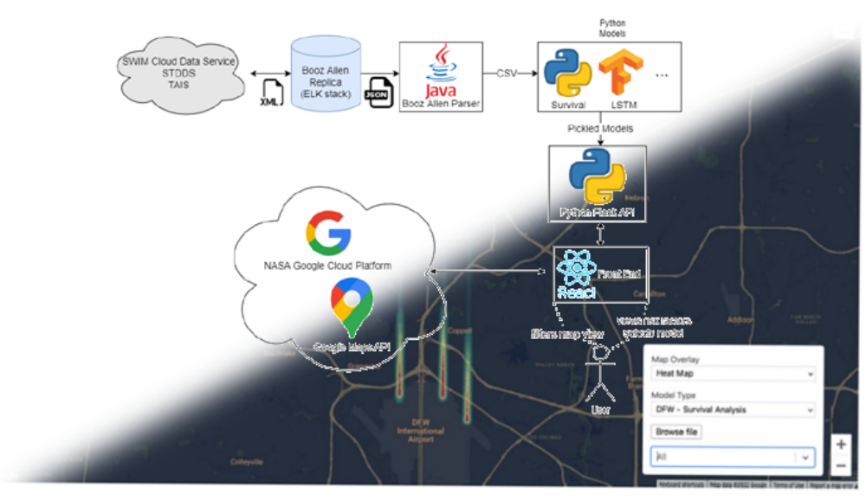
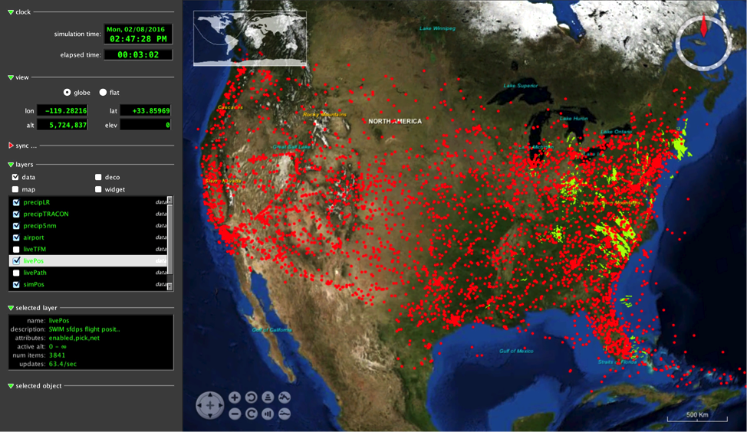
Booze Allen Hamilton (BAH)
Machine Learning for Advancing Risk Precursor Identification Tools Assessment
BAH evaluated three machine learning models to identify flights that are at risk for an unstable vertical approach to a commercial airline terminal with initial, narrow SWIM data sets
Recommended the Long Short-Term Memory (LSTM) neural network autoencoder that learns time dependence and encodes and decodes temporal relationships. Determines if the flight should be flagged for review and had an accuracy 36% better than a naïve predictor
Laid foundation for Risk Precursor Identification Tools future integration with NASA’s RACE
Risk Precursor Identification Tool Architecture
Runtime for Airspace
Concept Evaluation (RACE)
Integration
as Actor

Slide 22
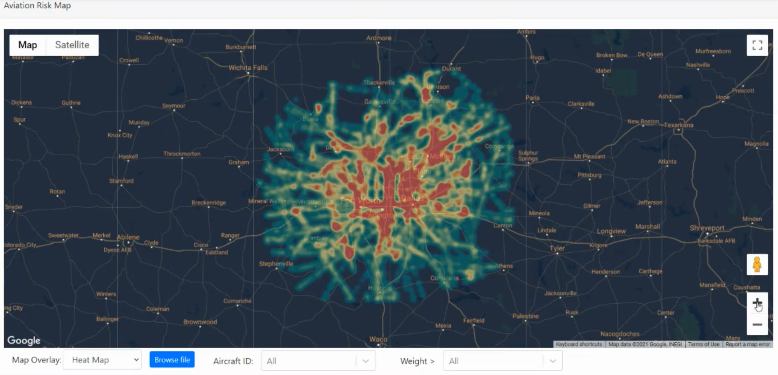
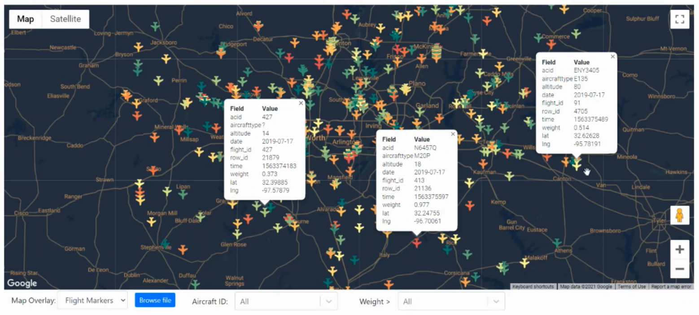

Booze Allen Hamilton (BAH)
Machine Learning for Advancing Risk Precursor Identification Tools in Commercial Airline
Terminal Area Operations
Recommended commercial terminal area aviation failure modes in addition to unstable vertical approaches. Evaluated failure modes for machine learning feasibility and incorporate the most promising solutions into the suite of prototype models
  Refined SWIM-derived dataset to only include fully tracked, landed flights
  Trained existing Long Short-Term Memory (LSTM) and Categorical Boosting (CatBoost) models on a subset of new dataset
Incorporated the additional terminal area aviation failure modes into the prototype UI
  Adapted ARC-TI developed models (CVAE) to Discovery in Aeronautics Systems Health (DASHLink) data
  Assess adapting ARC-TI developed models (CVAE, SALAD, ADOPT) to SWIM data
  Assess adapting existing BAH developed models to DASHLink data
Supported SWS Project booth at AirVenture Oshkosh 2022
Provisional patent application: Risk Precursor Identification in Commercial Aviation Terminal Area Operations Case Number: LAR-20356-1
https://c3.ndc.nasa.gov/dashlink/projects/85/

Slide 23

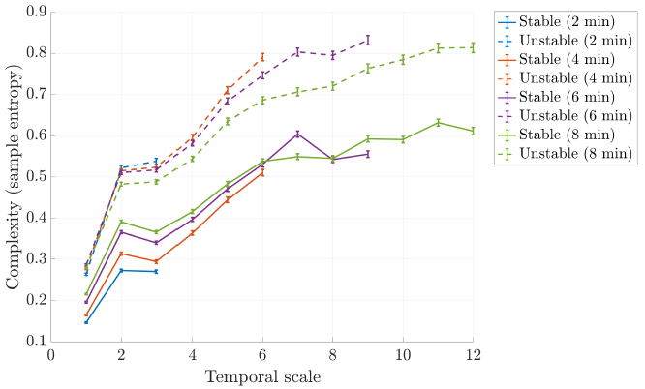
University of Florida NIA Activity
Garcia, E.J., Stephens, C.L., & Napoli N.J. (2022) Detecting Risk and Anomalies in Airplane Dynamics Through Entropic Analysis of Time Series Data. Presented at the AIAA Aviation 2022 Conference
Research Question: How do the entropy dynamics vary between stable and unstable approaches at different time instances before landing?
  The glideslope deviation complexity for an unstable approach is significantly different than that of a stable approach. This difference is observable at multiple temporal scales.
Multiscale entropy for glideslope deviation (mean± std. error)
and overlapping time windows
https://c3.ndc.nasa.gov/dashlink/projects/85/

Slide 24
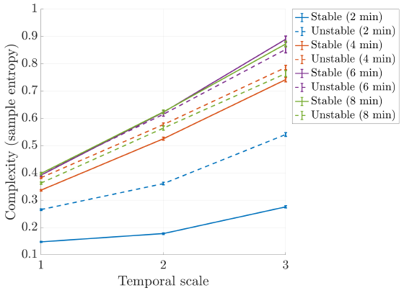
University of Florida NIA Activity
Garcia, E.J., Stephens, C.L., & Napoli N.J. (2022) Detecting Risk and Anomalies in Airplane Dynamics Through Entropic Analysis of Time Series Data. Presented at the AIAA Aviation 2022 Conference
Research Question: How do the entropy dynamics vary between stable and unstable approaches at different time instances before landing?
Multiscale entropy for glideslope deviation
(mean ± std. error) and non‑overlapping time windows
  Significantly different complexity distributions are evident minutes before a plane crosses the 1,000 ft threshold (i.e., before an approach is deemed stable or unstable). The significance is more evident at larger temporal scales.
https://c3.ndc.nasa.gov/dashlink/projects/85/

Slide 25
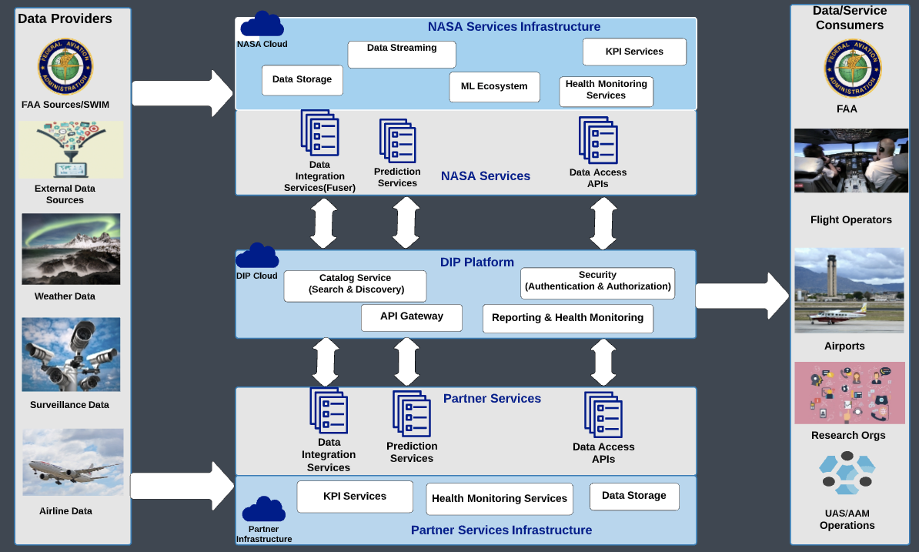
Potential SWS TC-1 Contributions to
ATM-X Digital Information Platform

Slide 26
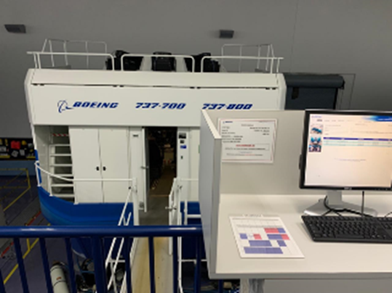
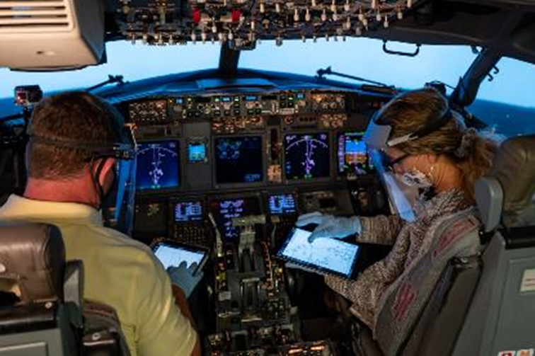
SWS TC-1 Partnerships
Extending technical challenge data analytics efforts through examination of non-traditional and under-explored data types for indicators, precursors, anomalies, and resilience metrics for critical commitment of IASMS for Part 121 and eTCy
  Established working groups in collaboration with major airline partners to evaluate and analyze data from commercial airline off-nominal operations and return-to-service response
  Established partnerships with industry and international safety organizations for innovative system safety approaches and IASMS data analytic methods, including knowledge transfer to medical field
  SOTERIA Study on IASMS data types and analytic methods utilizing high-realism line operational simulation, extending success of NASA/Boeing study (November 2020) conducted in the Boeing MIA 737-800 training facility (NASA-Boeing Space Act Agreement)
  NASA patented technology developed under SWS, “System and Method for Training of State-Classifiers” (LaRC Case Number: LAR-18996-1) licensed by AdvancingX, inc. and Optymyzd Inc.

Slide 27
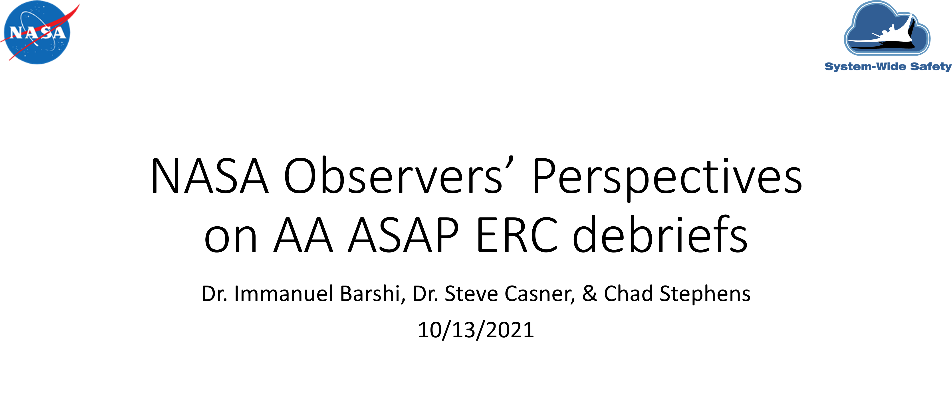
SWS TC-1 Partnerships
Extending technical challenge data analytics efforts through examination of non-traditional and under-explored data types for indicators, precursors, anomalies, and resilience metrics for critical commitment of IASMS for Part 121 and eTCy
  Established working groups in collaboration with major airline partners to evaluate and analyze data from commercial airline off-nominal operations and return-to-service response
    Data Science Working Group: FOQA data for operational disruption for novel in-time predictive indicators of flight data type
    Human Performance Working Group: FRMS data for safety assured scheduled line operations and in-time emergent risk mitigation data type
    Human Factors & Training Working Group: ASAP data for detection and mitigation of identified in-time safety events for operator reported data type

Slide 28
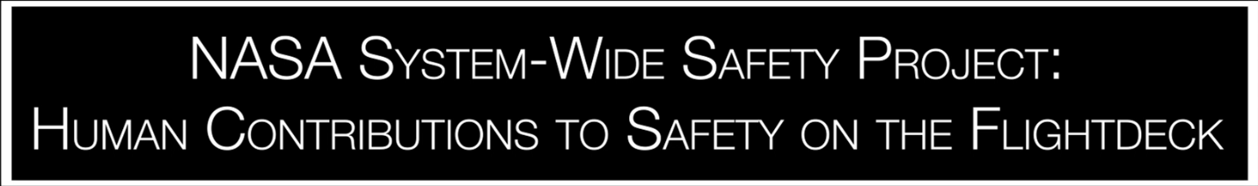

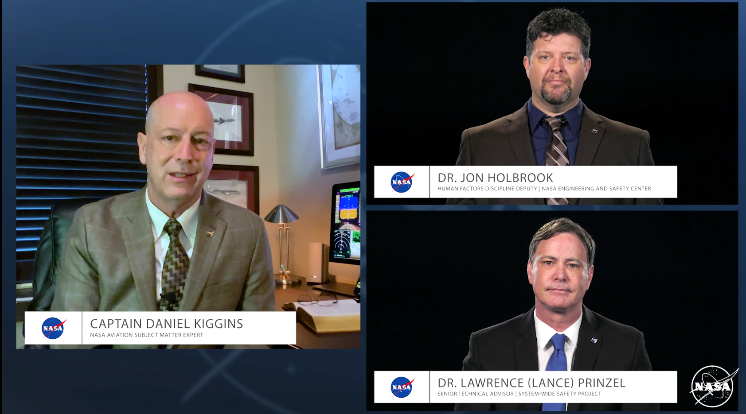
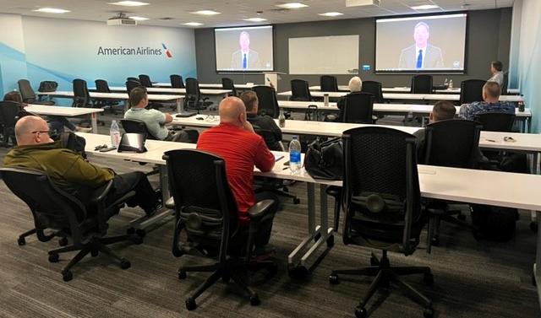
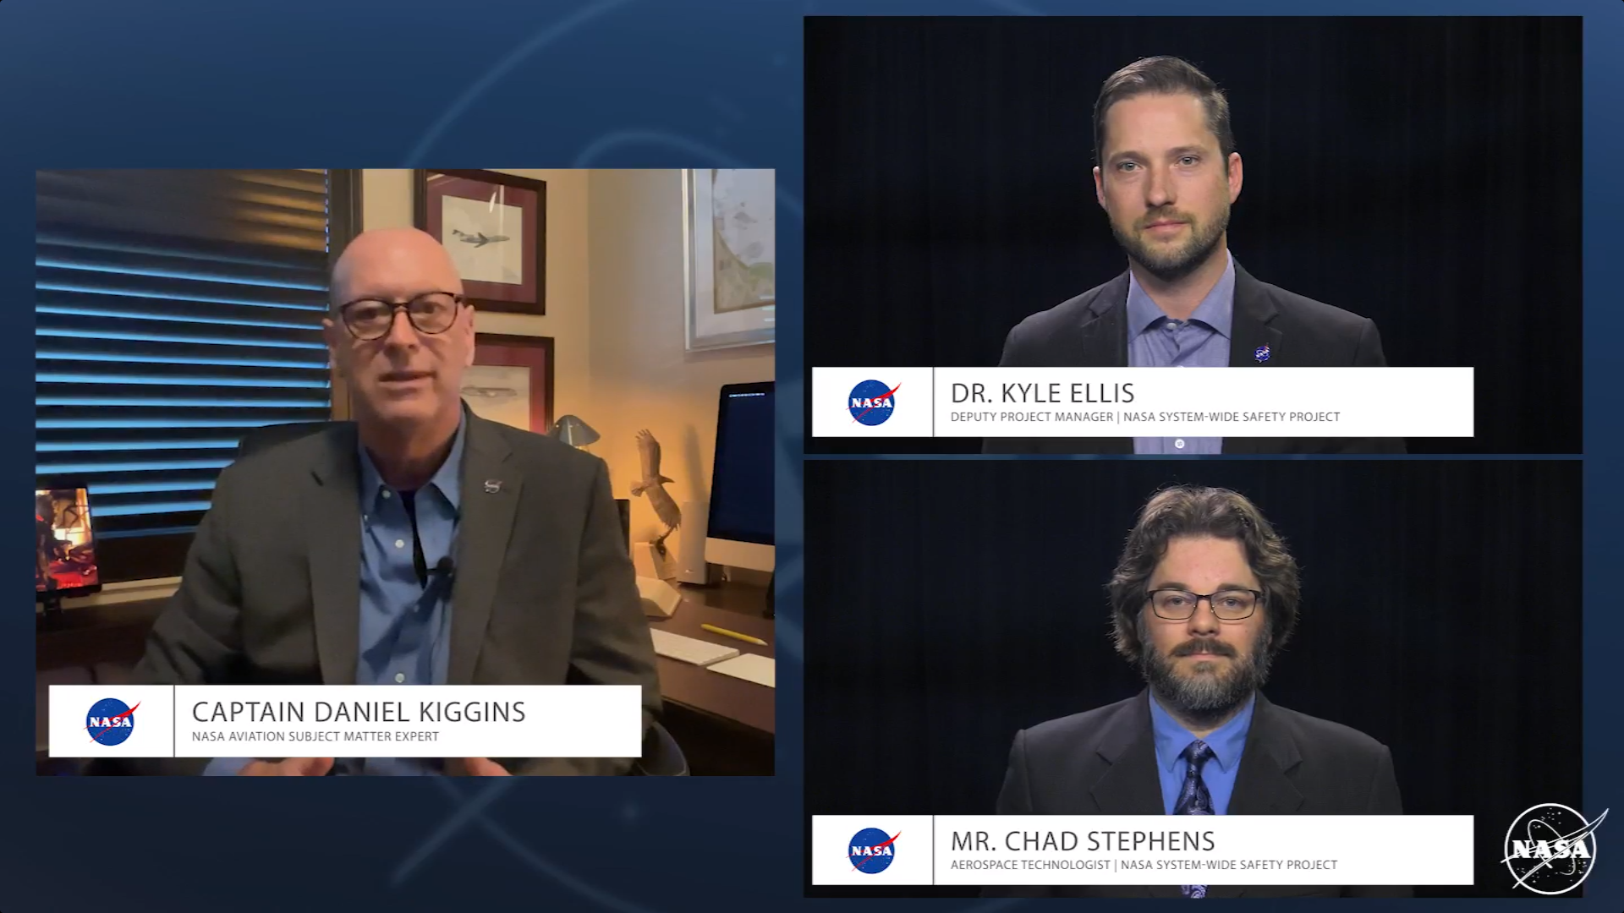
SWS TC-1 Partnerships
Extending technical challenge data analytics efforts through examination of non-traditional and under-explored data types for indicators, precursors, anomalies, and resilience metrics for critical commitment of IASMS for Part 121 and eTCy.
  Established working groups in collaboration with major airline partners to evaluate and analyze data from commercial airline off-nominal operations and return-to-service response
    Human Factors & Training Working Group: SWS HC2S Video shown to all 15,000+ pilots in annual recurrent training in 2022; has also been shown to all 1200+ new pilot hires since April 2022 and will continue to be shown to all incoming new hire pilots at airline

Slide 29
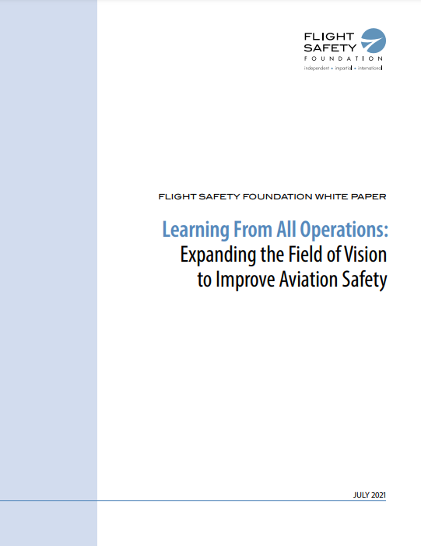
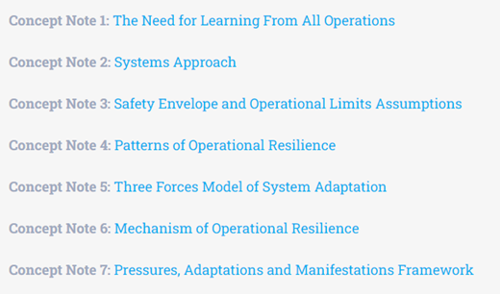
SWS TC-1 Partnerships
Extending technical challenge data analytics efforts through examination of non-traditional and under-explored data types for indicators, precursors, anomalies, and resilience metrics for critical commitment of IASMS for Part 121 and eTCy
  Established partnerships with industry and international safety organizations for innovative system safety approaches and IASMS data analytic methods, including knowledge transfer to medical field
  Flight Safety Foundation (FSF) collaborative research agreement Task 2 accomplishments; “Learning From All Operations” Working Group
    White papers and concept notes at https://flightsafety.org/toolkits-resources/learning-from-all-operations/

Slide 30









Partnerships
Human Performance
SWS Operations and Technologies for Enabling Resilient In-Time Assurance (SOTERIA) Study
Machine Learning
Human Performance
Human Factors
Resilience/Safety-II
Machine Learning
Human Performance
Human Performance*
Human Performance
Machine Learning*
Resilience/Safety-II
IASMS
Data Mining & Prediction RTT
Human Factors RTT
Machine Learning*
* informal

Slide 31
TC-1 in the System-Wide Safety Project Context
Integrated Terminal Area Risk
Develop and implement a prototype Thrust 5 ISSA capability for terminal area operations.
Operational Safety (Thrust 5)
Data Issues
Predictive Safety
TC: Integrated Terminal Area Risk
Distributed Safety
TC: In-Flight Safety Predictions for Emerging Operations
Evolutionary Path
Transformed NAS
Current Day
Near Future
TC-5,
New eTCs
Scale, Diversity
Time to Certification
TC: Validation and Verification for Commercial Ops
TC: Complex Autonomous Systems
Assurance
Assurance of Autonomy
Design Safety (Thrust 6)

Slide 32

Proposed SWS Project Research Portfolio
Operational Safety (Thrust 5)
TC-2: IASMS SFC Development for Emerging Operations
TC-1: Predictive Terminal Area Risk Assessment
Emerging TC: IASMS for Traditional Commercial Air Operations
TC-5: Safety Demonstrator Series for Operational IASMS
Current Day
Near Future
TC-3: V&V for Commercial Operations
TC-4: Complex Autonomous Systems
Assurance
Transformed NAS
with IASMS
Design Safety (Thrust 6)
32

Slide 33
The TC-1 Team
    Lucia Arsinescu
    Ata Akbari Asanjan
    Ilya Avrekh
    Nick Bathurst
    Nathan Feick
    Erin Flynn-Evans
    Kevin Gregory
    Bita Hasheminezhad
    Cassie Hilditch
    Jon Holbrook
    Vincent Houston
David Iverson
Daniel Kiggins
Crystal Kirkley
Paul Krois
Bryan Matthews
Milad Memarzadeh
Nikunj Oza
Sean Pradhan
Lance Prinzel
Chad Stephens
Thomas Templin
Hamed Valizadegan
Daniel Weckler

Slide 34
Papers and Presentations
Ellis, K., Prinzel, L.J., Davies, M.D., Krois, P.A., Mah, R.W., Oza, N.C., Stephens, C.L., Vincent, M.J., Ackerson, J.R., Infeld, S.I., The In-time Aviation Safety Management Concept for Part 135 Operators, 41st Digital Avionics Systems Conference, Sep 2022.
Garcia, E.J., Stephens, C.L., & Napoli N.J. (2022) Detecting Risk and Anomalies in Airplane Dynamics Through Entropic Analysis of Time Series Data. AIAA Aviation 2022 Conference.
Ellis, K., Krois, P., Koelling, J., Prinzel, L., Davies, M., Mah, R. and Infeld, S., Defining services, functions, and capabilities for an Advanced Air Mobility (AAM) In-Time Aviation Safety Management System, AIAA Aviation 2022.
Ellis, K., Prinzel, L., Krois, P., Davies, M., Mah, R., Koelling, J., and Infeld, S., A Future In-time Aviation Safety Management System (IASMS) Perspective for Commercial Air Carriers, AIAA Aviation 2022.
Prinzel, L.J., Krois, P., Ellis, K.K., Oza, N.C., Mah, R.W., Stephens, C.L., Davies, M.D., Infeld, S.I., Human Interfaces and Management of Information (HIMI) Challenges for "In-time" Aviation Safety Management Systems (IASMS), Human Computer Interaction International Conference, 2022.
Oza, N., Detecting Oceanic Deviations Using Space-Based ADS-B, Presentation at Aviation Safety InfoShare. Apr 2022, St. Louis, MO.
Hilditch, C. and Baumgartner, H., Short-Haul Fatigue: Research Plan and Results of a Focus Group Study, Presentation at Aviation Safety InfoShare. Apr 2022, St. Louis, MO.
Keller, M., NASA ASRS: Maintenance-Related Reports, Presentation at Aviation Safety InfoShare. Apr 2022, St. Louis, MO.
Keller, M., NASA ASRS Cabin Crew Reports: COVID-Related Issues, Presentation at Aviation Safety InfoShare. Apr 2022, St. Louis, MO.
Keller, M., NASA ASRS: Contributions to Rotorcraft Safety, Presentation at Aviation Safety InfoShare. Apr 2022, St. Louis, MO.
Keller, M., NASA ASRS: Turbulence Events, Presentation at Aviation Safety InfoShare. Apr 2022, St. Louis, MO.
Keller, M., NASA ASRS: Contributions to Business and General Aviation Safety, Presentation at Aviation Safety InfoShare. Apr 2022, St. Louis, MO.
Memarzadeh, M., Matthews, B., and Templin, T., Multi-Class Anomaly Detection in Flight Data Using Semi-Supervised Explainable Deep Learning Model, Journal of Aerospace Information Systems, 19:2, pp. 83-97, Feb. 2022.
Memarzadeh, M., Matthews, B., Templin, T., Rohani, A.S., Weckler, D., Semi-Supervised Active Learning for Anomaly Detection in Aviation with Experts in the Loop, AIAA SciTech Forum, Jan 2022.
Holbrook, J. B., (2022, January) Autonomy and the Intangible Value of the Pilot. Panel Presentation: AIAA SciTech Forum.

Slide 35
Papers and Presentations
Ellis, K., Prinzel, L., Koelling, J., Davies, M., Mah, R., Krois, P., and Infeld, S.I., An Ontological Approach to Integrate Commercial Space Operations with an In-time Aviation Safety Management System (IASMS), ASCEND 2021.
Holbrook, J. B. & Null, C. H. (2021, November). Expanding our understanding of what constitutes a safety-relevant occurrence. Presentation at the International Conference on Systems Engineering’s Human-Systems Integration Conference, Virtual Event.
Holbrook, J., (2021, November) Learning from all operations: Expanding the field of vision to improve aviation safety. Presentation at Aviation Safety InfoShare. Pittsburgh, PA.
Gonter, K. and Hooey, B., NASA Aviation Safety Reporting System, Dispatcher ETOPS Issues, Presentation at Aviation Safety InfoShare. Nov 2021, Pittsburgh, PA.
Gonter, K. and Hooey, B., NASA Aviation Safety Reporting System, HAZMAT-Related Safety Reports, Presentation at Aviation Safety InfoShare. Nov 2021, Pittsburgh, PA.
Gonter, K. and Hooey, B., NASA Aviation Safety Reporting System, Maintenance, Presentation at Aviation Safety InfoShare. Nov 2021, Pittsburgh, PA.
Hilditch, C., The Impact of COVID-19 on Fatigue in U.S. Commercial pilots: A Survey, Presentation at Aviation Safety InfoShare. Nov 2021, Pittsburgh, PA.
Holbrook, J. (2021, October). Creating a culture of continuous learning. Presentation at the Children’s Hospitals’ Solutions for Patient Safety National Learning Session, Virtual Event.
Ellis, K., Krois, P., Mah, R., Koelling, J., Prinzel, J., Davies, M., Infeld, S.I., An Approach for Identifying IASMS Services, Functions, and Capabilities from Data Sources, 40th Digital Avionics Systems Conference, Oct. 2021.

Slide 36
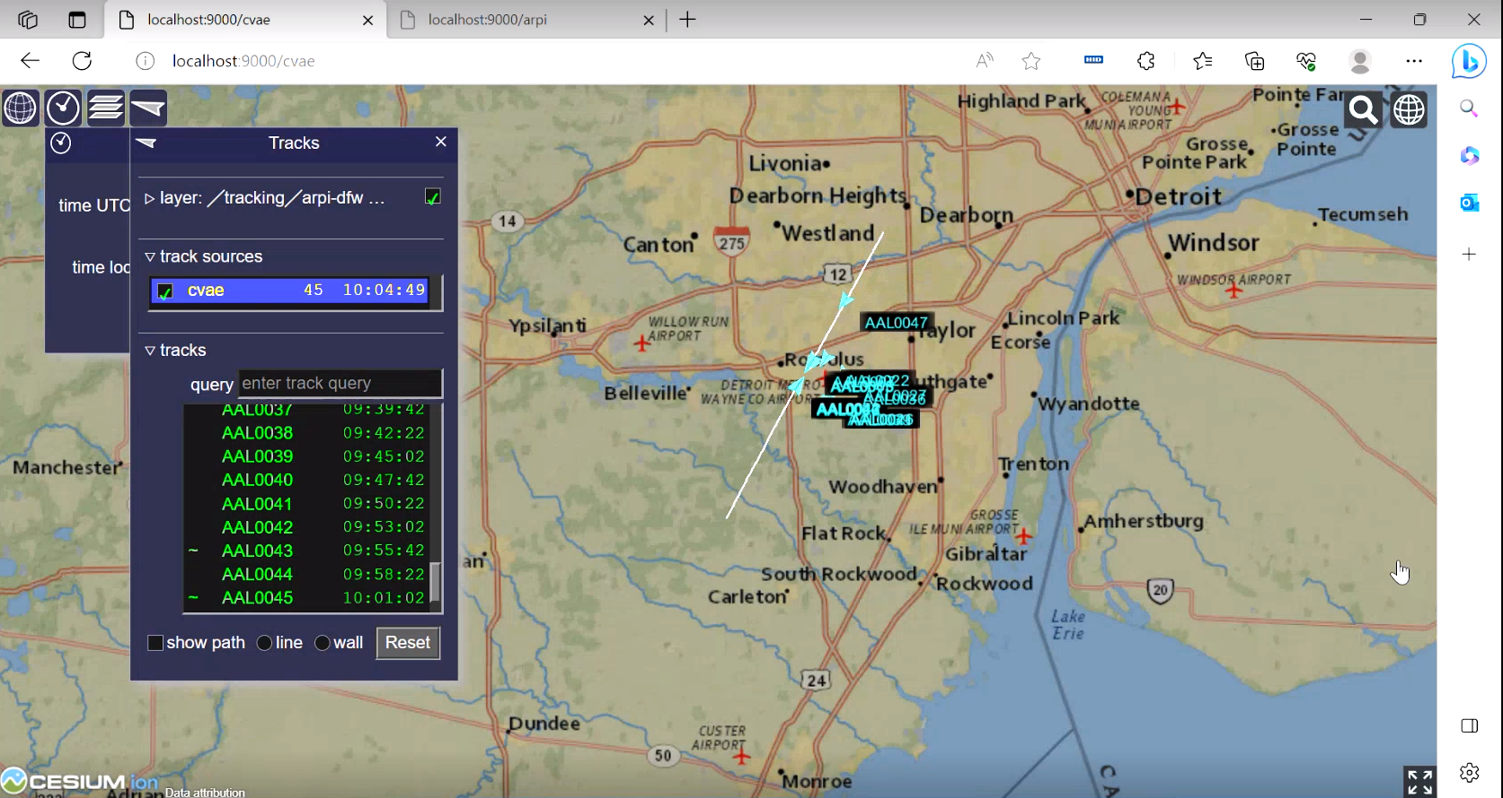
BAH Team Prototype Demo up next…
Context for the use of the prototype
Note that prototype is a Minimum Viable Product
  Potential end users: Airline Dispatcher or SMS personnel

Slide 37
Backup Slides

Slide 38
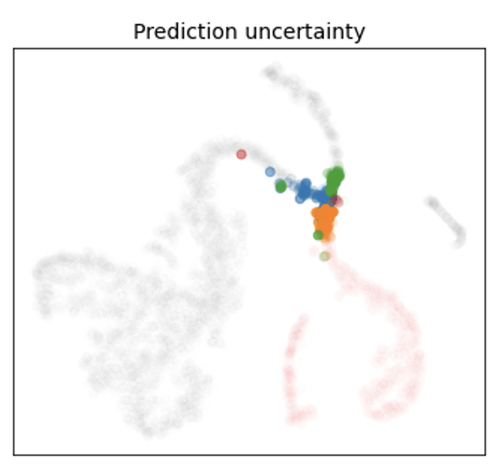
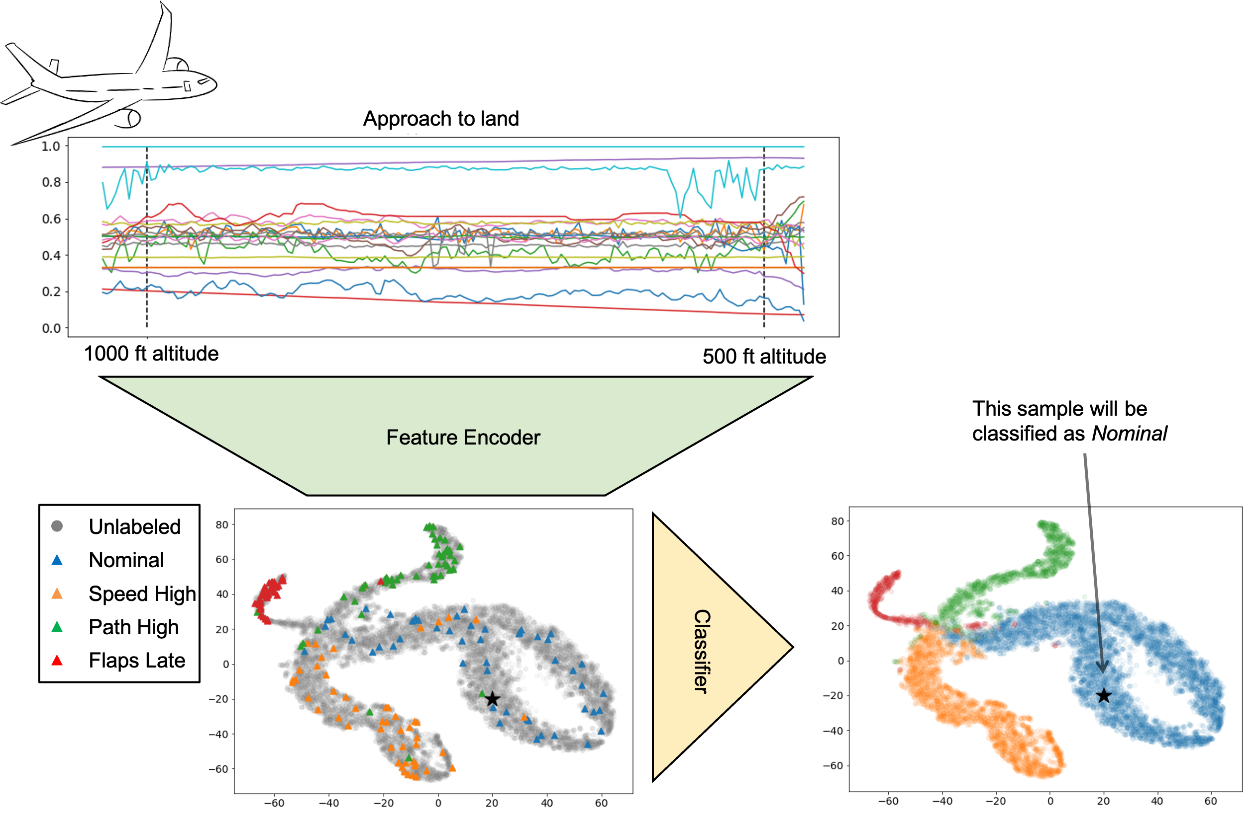
Semi-supervised Active Learning for Anomaly Detection (SALAD)—Tech Presentation
Developed new algorithm for anomaly detection—can use labeled and unlabeled data and enables active learning. Paper at AIAA SciTech 2022.
  Can use any available labeled data (normal, various anomaly types) and all available unlabeled data
  Outperforms supervised methods (can only use labeled data) and unsupervised methods (cannot use available labeled data)
  Can choose examples for domain expert labelling that give biggest “bang-for-the buck.”
  Can be used to visualize data clearly of different types, level of uncertainty

Slide 39
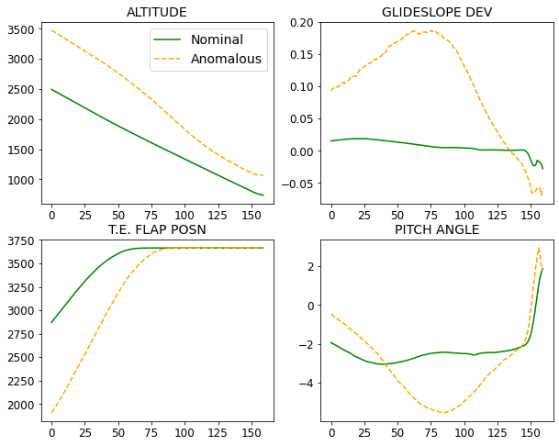
Aviation Anomaly Detection Literature
Example of unstable approach to landing
Exceedance detection:
Compares against pre-defined thresholds, which are identified by subject-matter experts.
Cons:
Complete reliance on
domain knowledge.
Requires extensive
reviews of entire data.
Can only identify
known anomalies.

Slide 40

Aviation Anomaly Detection Literature
Supervised learning:
Produces inference using only labeled data.
Pros:
It demonstrates amazing performance when a
sufficient number of labeled data is available.
Cons:
Can only identify known anomalies.
Creating labels for data requires huge
effort from subject-matter experts and
is very expensive and largely impractical.
Jankiraman (2018), KDD.

Slide 41

Aviation Anomaly Detection Literature
Unsupervised learning:
Uses a data-driven mechanism to identify off-nominal patterns in the data.
Pros:
Does not require labels to make inference.
Cons:
Low precision, which means a high number of
false positives and low reliability.
It is not easy to extend to multi-class
anomaly detection.
deep learning-based
methods
Classic methods
Memarzadeh et al. (2020), Aerospace, 7(8), 115.

Slide 42
Anomaly Detection Case Study Based on Real Flight Data
Each data instance is 160-s recording of 20 variables during approach of a commercial aircraft to landing. Attributes cover a variety of systems, including the state and orientation of the aircraft, positions and inputs of the control surfaces, engine parameters, and auto pilot modes and corresponding states.
Data from: https://c3.nasa.gov/dashlink/projects/85/

Slide 43
Multi-class Anomaly Detection During Approach to Landing
Training data consists of 18,313 samples falling into four classes:
  Nominal (66.7%): no anomalies identified.
  Speed Anomaly (22.9%): speed of the aircraft is higher from the nominal pattern.
  Path Anomaly (7.2%): path of descent is higher from the nominal pattern.
  Control Anomaly (3.2%): flaps are deployed late or off-nominal during approach.
Separate test data of 6105 samples is used for evaluating the models.

Slide 44


Learning Module: Semi-supervised Learning
The data, $X$ is divided into:
  Labeled set, $\left(X_{L}, y_{L}\right)$
  Unlabeled set, $X_{U}$
  $\left|X_{U}\right|≫\left|X_{L}\right|$
Unsupervised learning ignores $y_{L}$,
while supervised learning ignores $X_{U}$.
Semi-supervised learning takes both
data sources into account.

Slide 45

SALAD – Semi-supervised Active Learning for Anomaly Detection
learning module
data-selection module

Slide 46


Closed-set Recognition
Experiment: We start with a set of 40 labeled samples (uniformly selected across classes), and review/label $M=$ 40 data points in each round, for 20 rounds total.
Overall, the clustering and
BALD strategies perform better.

Slide 47


Detection of Unknown
Experiment: We start with a set of 10 labeled samples (only from the classes Nominal and Speed Anomaly), and review/label $M=$ 10 data in each round, for 80 rounds total. The Path and Control anomaly classes are unknown to the model.
Overall, BALD and entropy strategies perform better
towards the beginning, while the clustering strategy
outperforms after 40 rounds of labeling.
The random strategy really struggles to compete with
the other methods.

