Slide 1
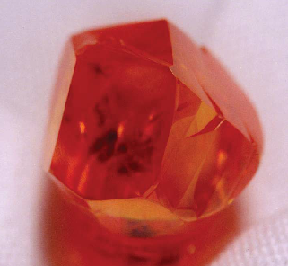
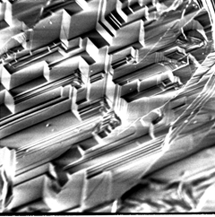
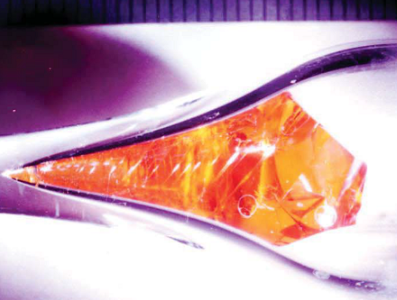
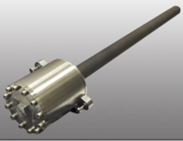
Vapor Growth of ZnSe-based Compound Semiconductors in Low Gravity environment on International Space Station
A physical science low-gravity experiment conducting in Low Gradient Furnace (LGF), Materials Science Research Rack (MSRR), on ISS
Principal Investigator: Dr. Ching-Hua Su, NASA/MSFC
Project Scientist: Dr. Martin Volz, NASA/MSFC

Slide 2
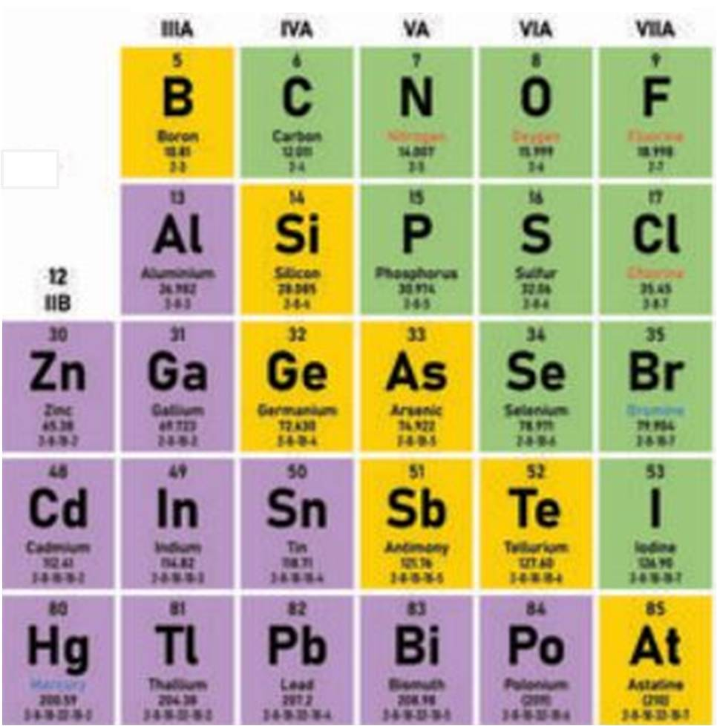
Crystal growths of zinc selenide (ZnSe)–based ternary compound semiconductors by physical vapor transport
A list of II-VI compound semiconductors grown by PVT at MSFC
Compounds | CdTe | ZnTe | CdS | ZnSe | ZnS
Melting point (ºC) | 1092 | 1292 | 1397 | 1526 | 1718
PVT growth temperature | 850 | 1000 | 985 | 1120 | 1150
Physical Vapor Transport (PVT) process consists of three steps:
(1) vapor species sublime from the source material at higher temperature,
(2) vapor species transport (diffusion/convection) through vapor phase to crystal site at lower temperature,
(3) condensation of vapor species on the crystal surface for its growth.
Main disadvantage of PVT process: Growth rates are low and inconsistent.

Slide 3
Scientific objectives
To establish the effects of gravity-driven fluid flows to (1) crystalline structural quality, (2) the non-uniform incorporation of dopants, impurities and defects and (3) the compositional segregation in the ternary compounds grown by PVT – caused by the buoyancy-driven convection and irregular fluid-flows on Earth.
To assess self-induced strain effects developed during processing at elevated temperatures caused by the weight of the crystals.
To conduct theoretical simulation of heat transfer, mass transport and growth kinetics to obtain quantitative comparisons between the experimental and calculated results and, consequently, understand and simplify the complexity of the coupled mass transport and growth kinetics problem.

Slide 4
Earth benefits/spin-off applications
Routine production of high-quality single crystals of high melting point semiconducting compounds requires a fundamental and in-depth understanding of the overall vapor growth processes.
Cr-doped ZnSe as efficient, tunable, diode-pumpable, mid-IR lasers operating at room temperature in the 2000-3000 nm range.
The growth of thick ZnSe film on GaAs substrate as quasi-phase matching media for the frequency converters of lasers.
Optical bistable characteristics of ZnSe for digital optical computer with bandgap tunability of ternary alloys of ZnSeTe and ZnSeS.

Slide 5
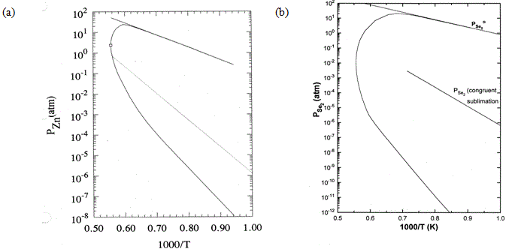
Partial pressures along the three-phase curve for ZnSe
At 1150ºC, P_{Zn} varies from 8.4 to 1.3x10⁻⁴ atm, P_{Se2} varies from 20 to 5x10⁻⁹ atm
and α = P_{Zn}/ P_{Se2} varies from 1.7 x10⁹ to 6.5x10⁻⁶
Zn sat.
Se sat.
Zn sat.

Slide 6
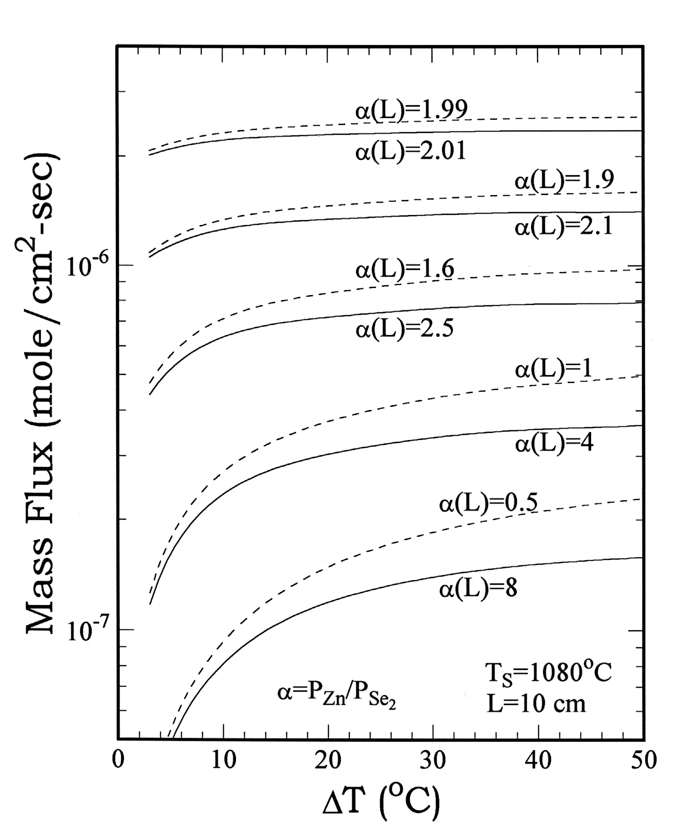
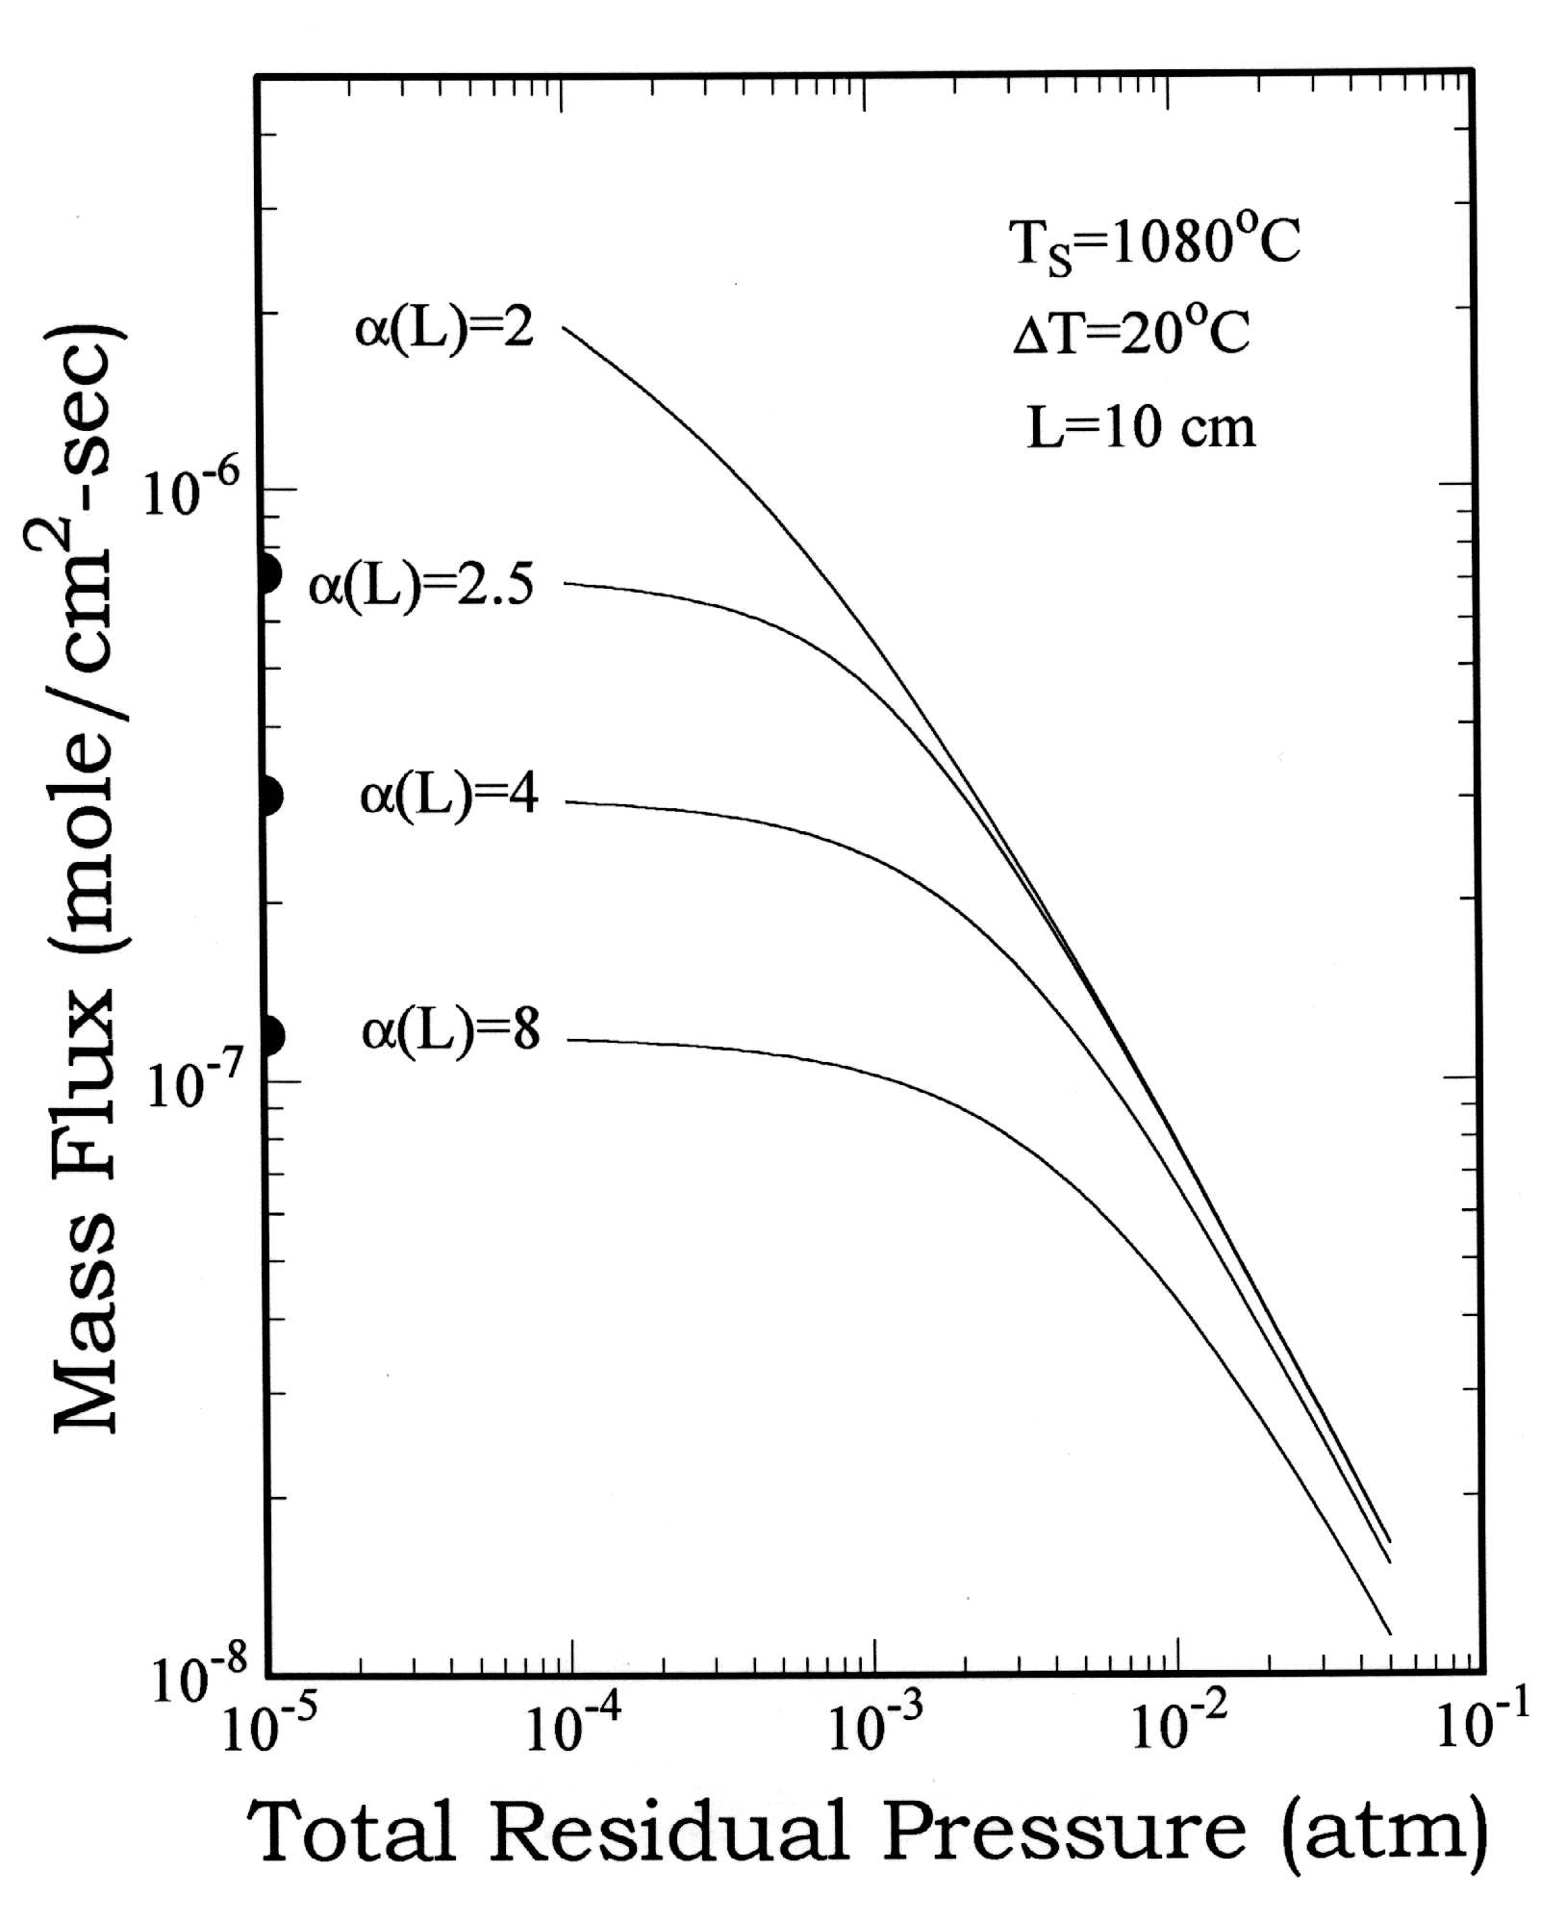
Analytical: one-dimensional diffusion on mass flux of A_{II}B_{VI}
Four parameters determine mass flux : source temperature, crystal temperature, α, the pressure ratio of A and B₂ and pressures of residual gases, such as CO, CO₂ H₂, …
Mass flux of ZnSe as a function of ΔT for source temperature at 1080 ºC and different values of α
Mass flux of ZnSe as a function of P_{Z} and different values of α(L)

Slide 7
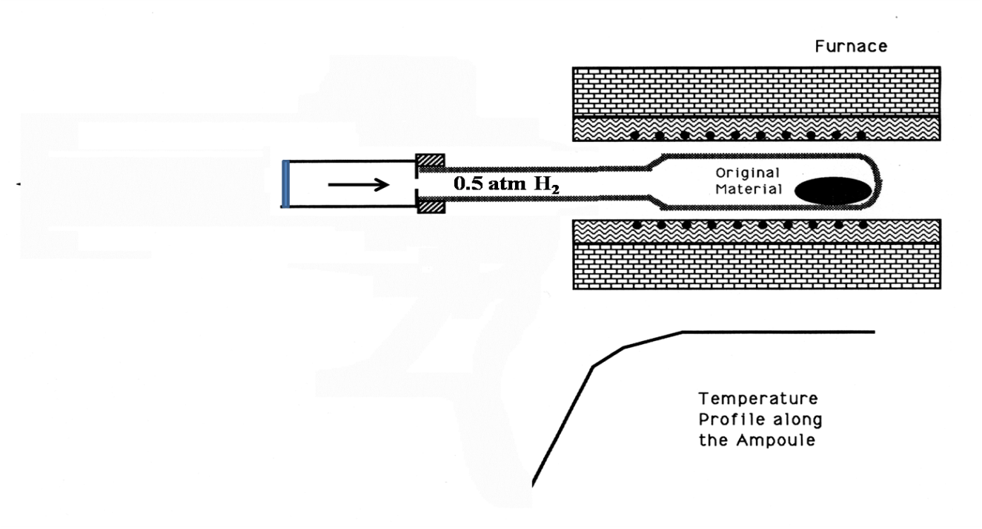
Maximizing transport rate by reducing residual gas and adjusting the stoichiometry
A. H₂ reduction to reduce residual gases
B. baking under vacuum to adjust α ∼ 2.0

Slide 8
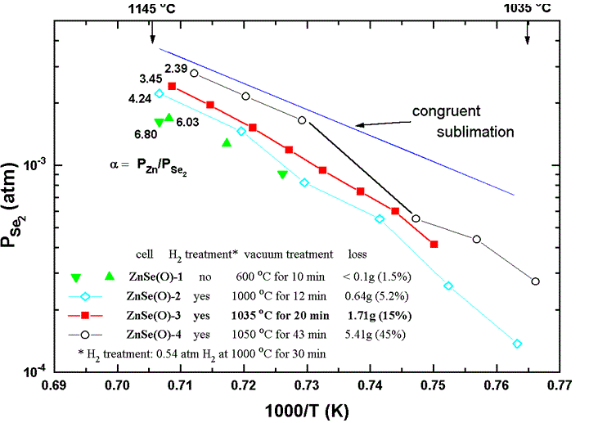
Heat treatment by baking under vacuum

Slide 9
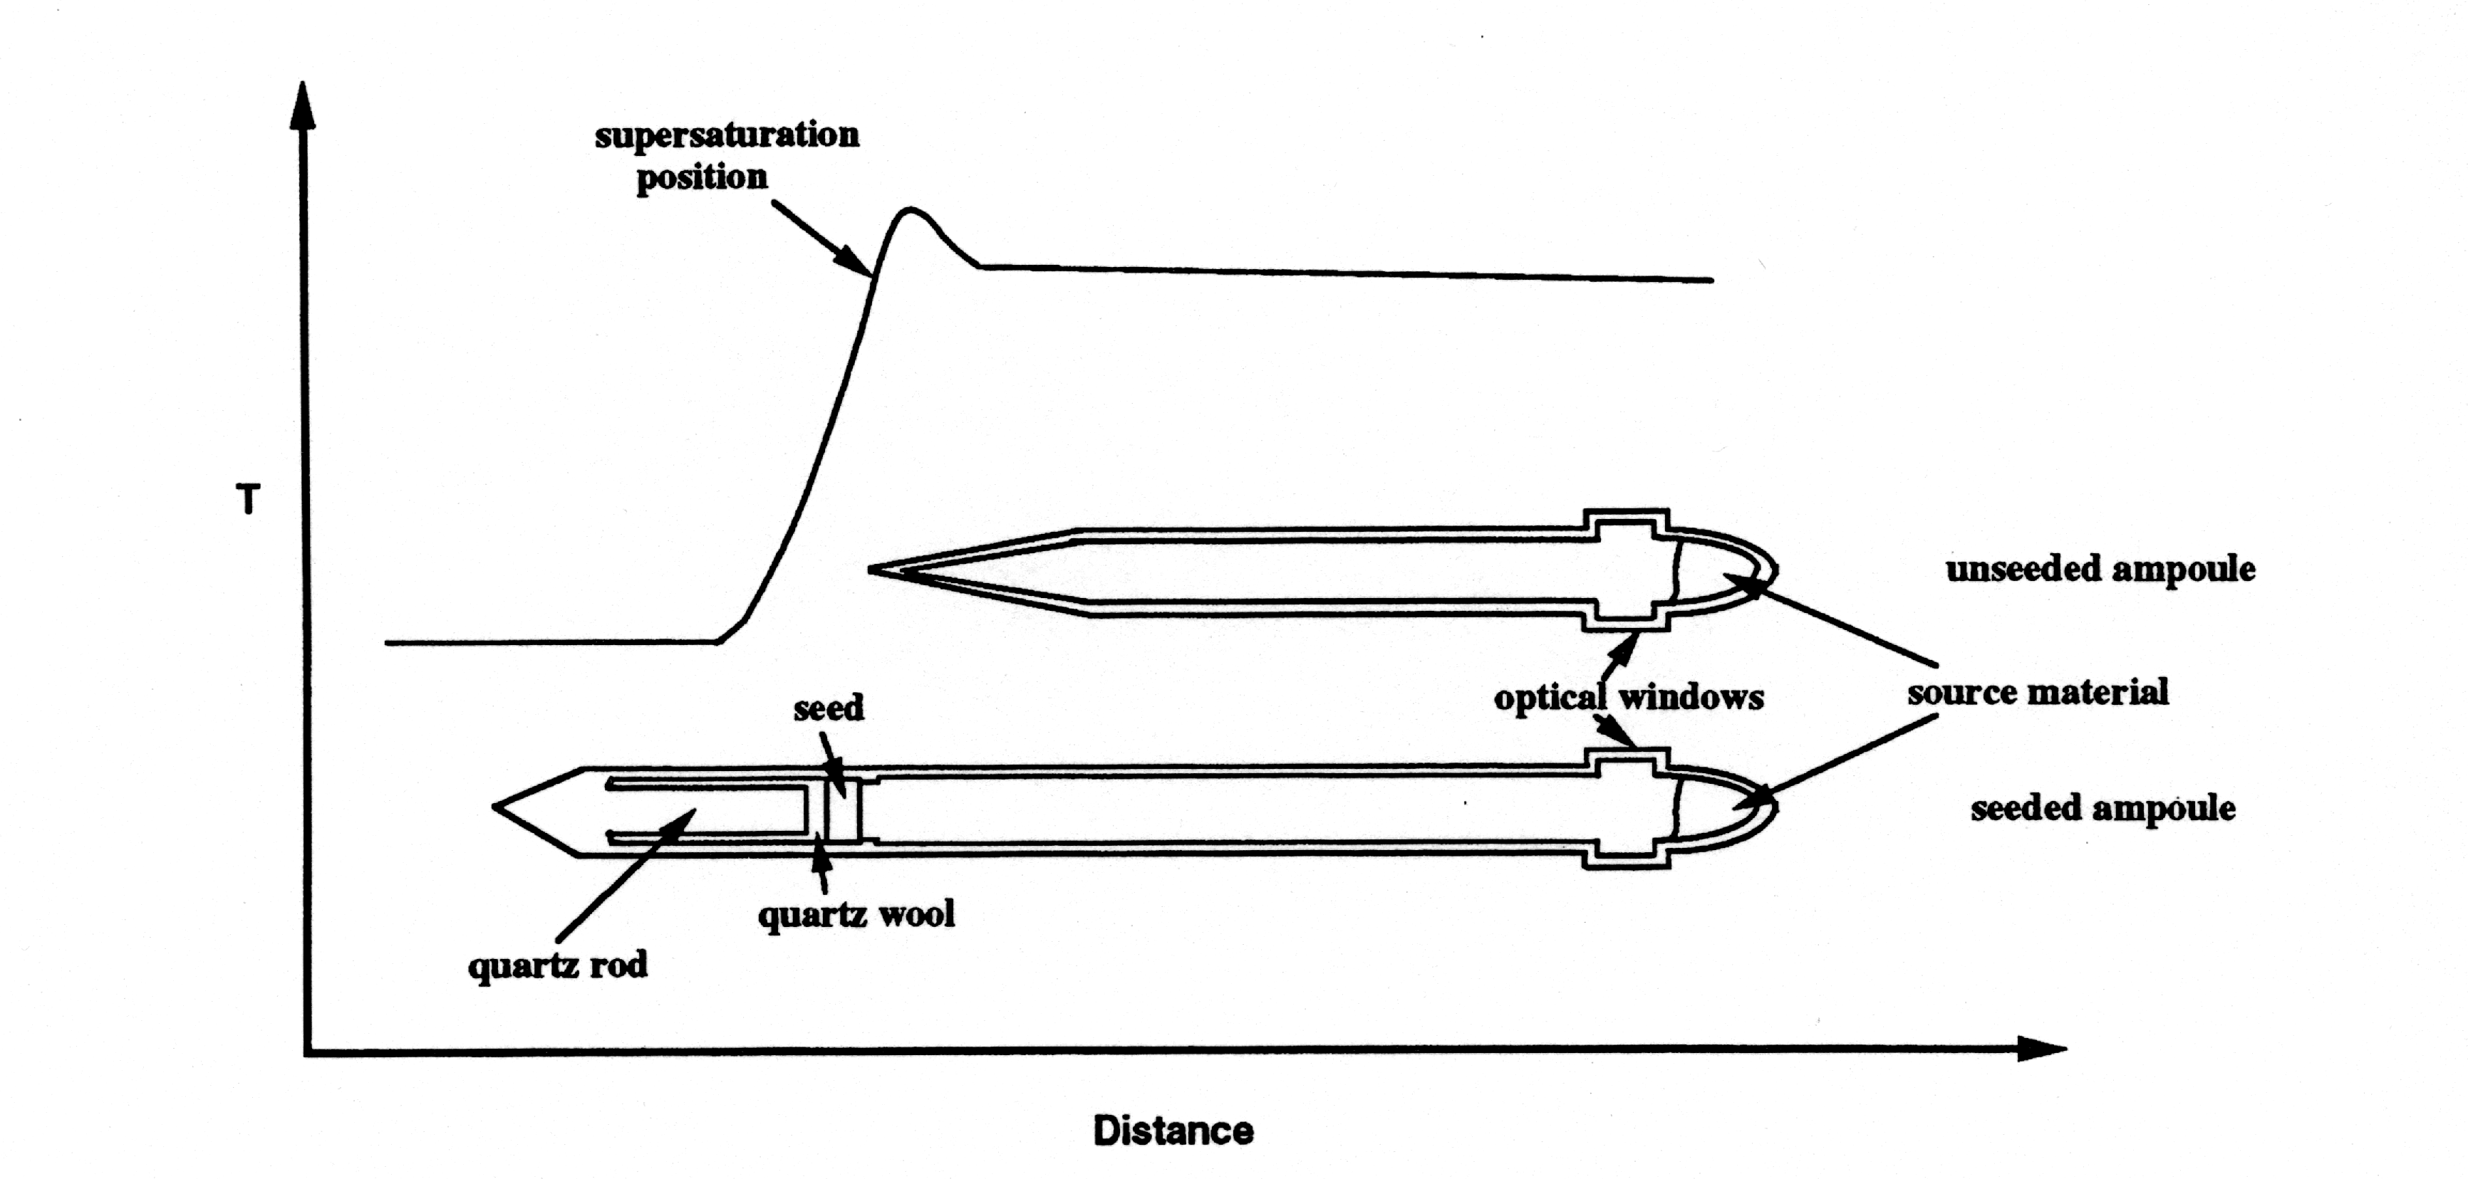
Crystal growth, thermal profile and initial ampoule positions
Growth was initiated by translating furnace to the right.
The peak with high temperature gradient confines the supersaturation position to a narrow region.
The peak reduces secondary nucleation by subliming any deposited material just ahead of growth interface.
Gravity
direction
horizontal
vertical
destabilized
vertical
stabilized

Slide 10
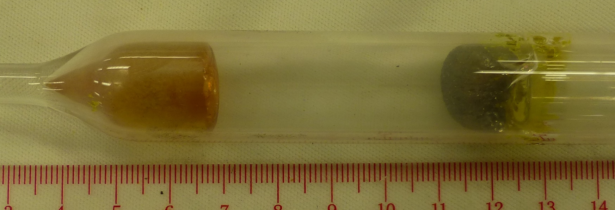
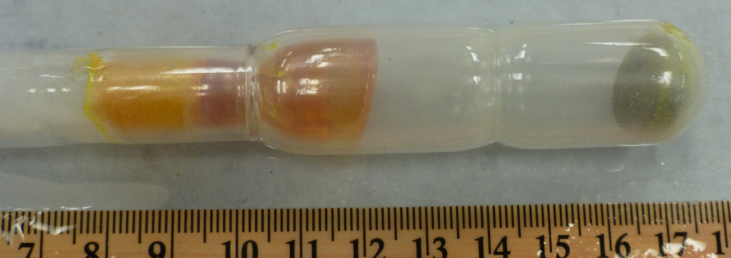
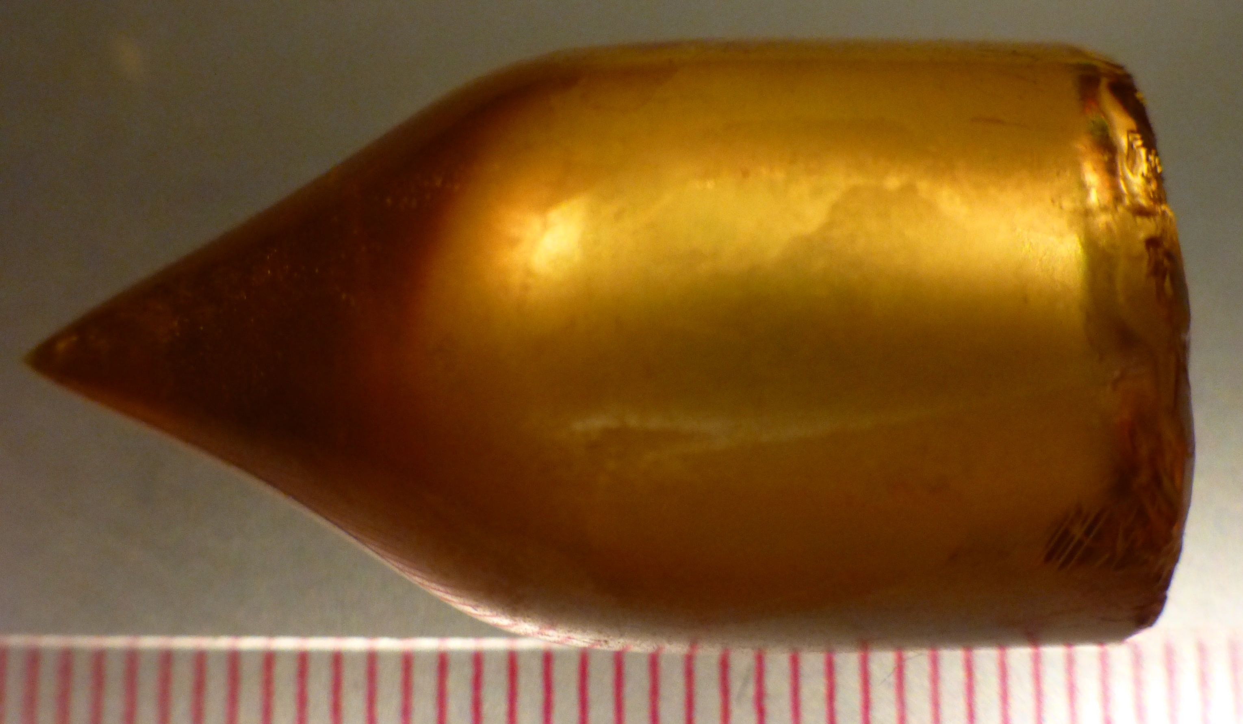
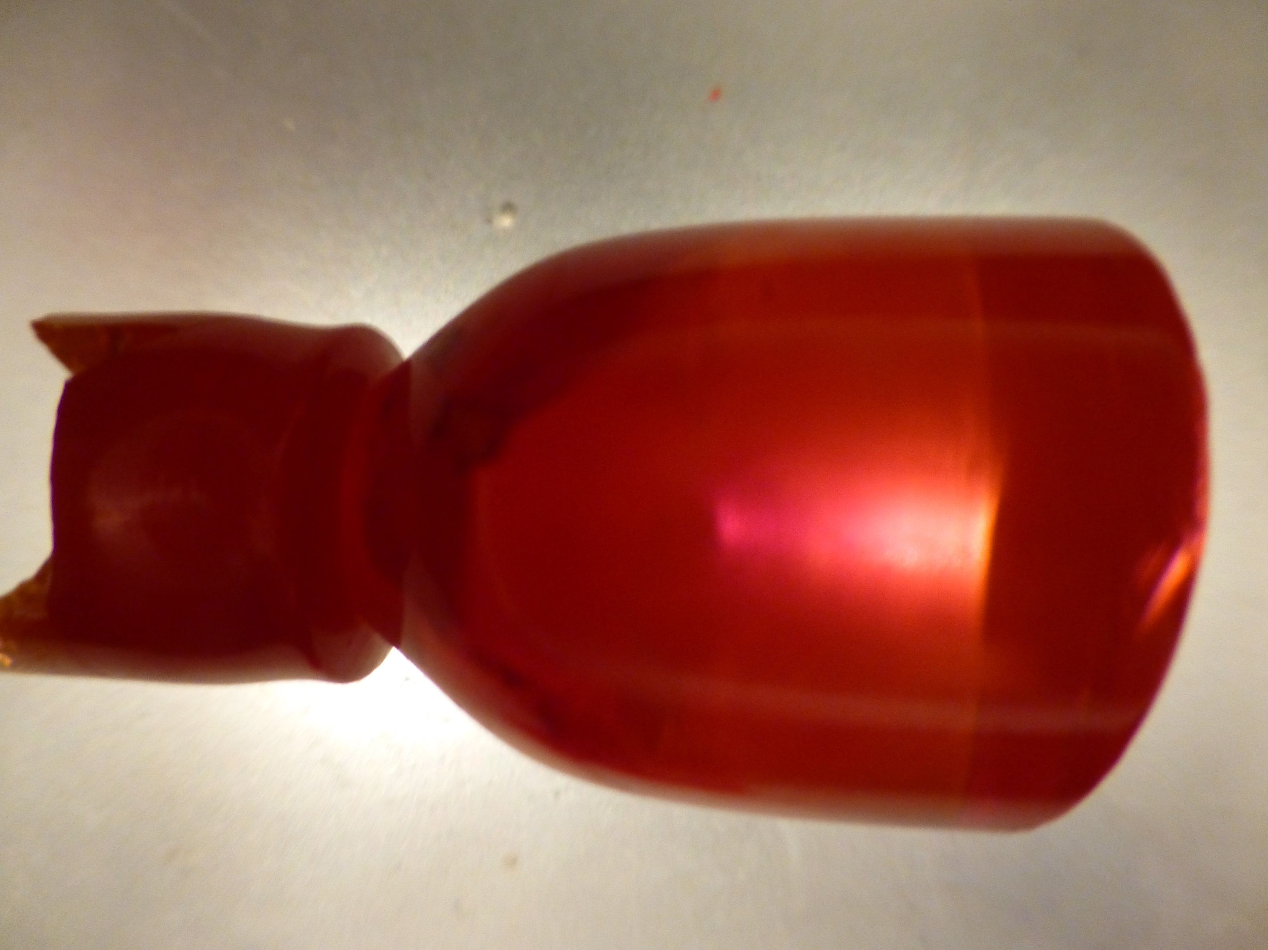
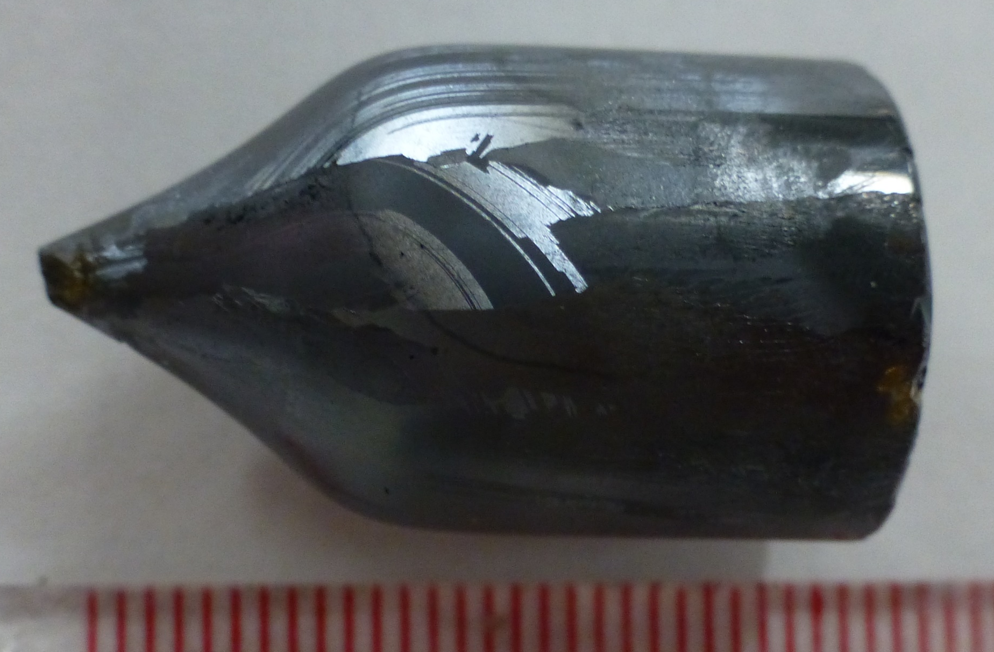
Unseeded growth
Seeded growth
ZnSe
ZnSe grown on (110) seeded
Cr-ZnSe
Seeded grown ZnSe crystal on light table

Slide 11
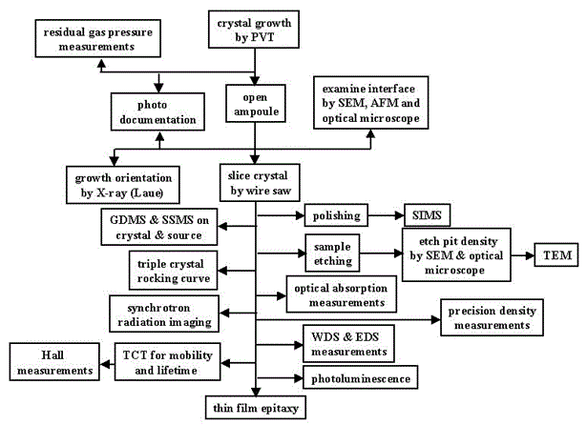
Flow chart of post-growth sample characterization plan

Slide 12
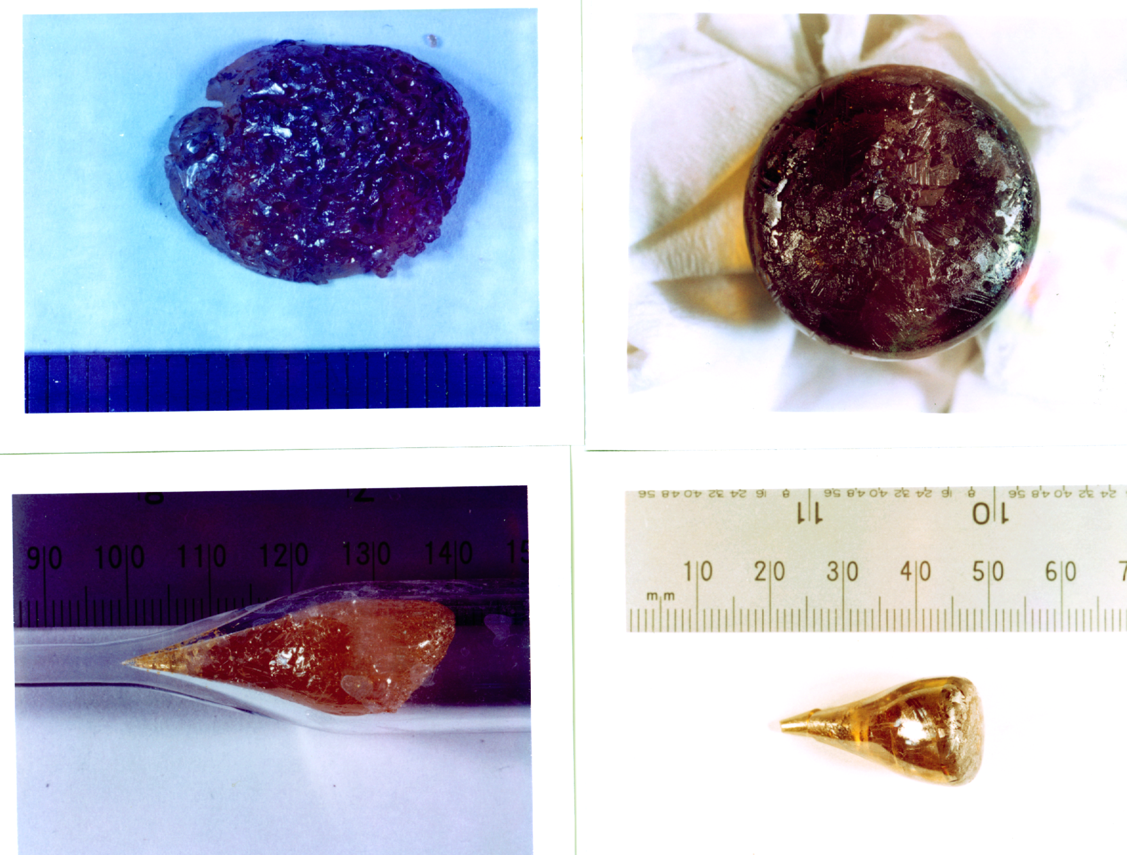
Morphologies of grown ZnSe crystals
Vertical unseeded growth
g
g
x
x
g
g

Slide 13
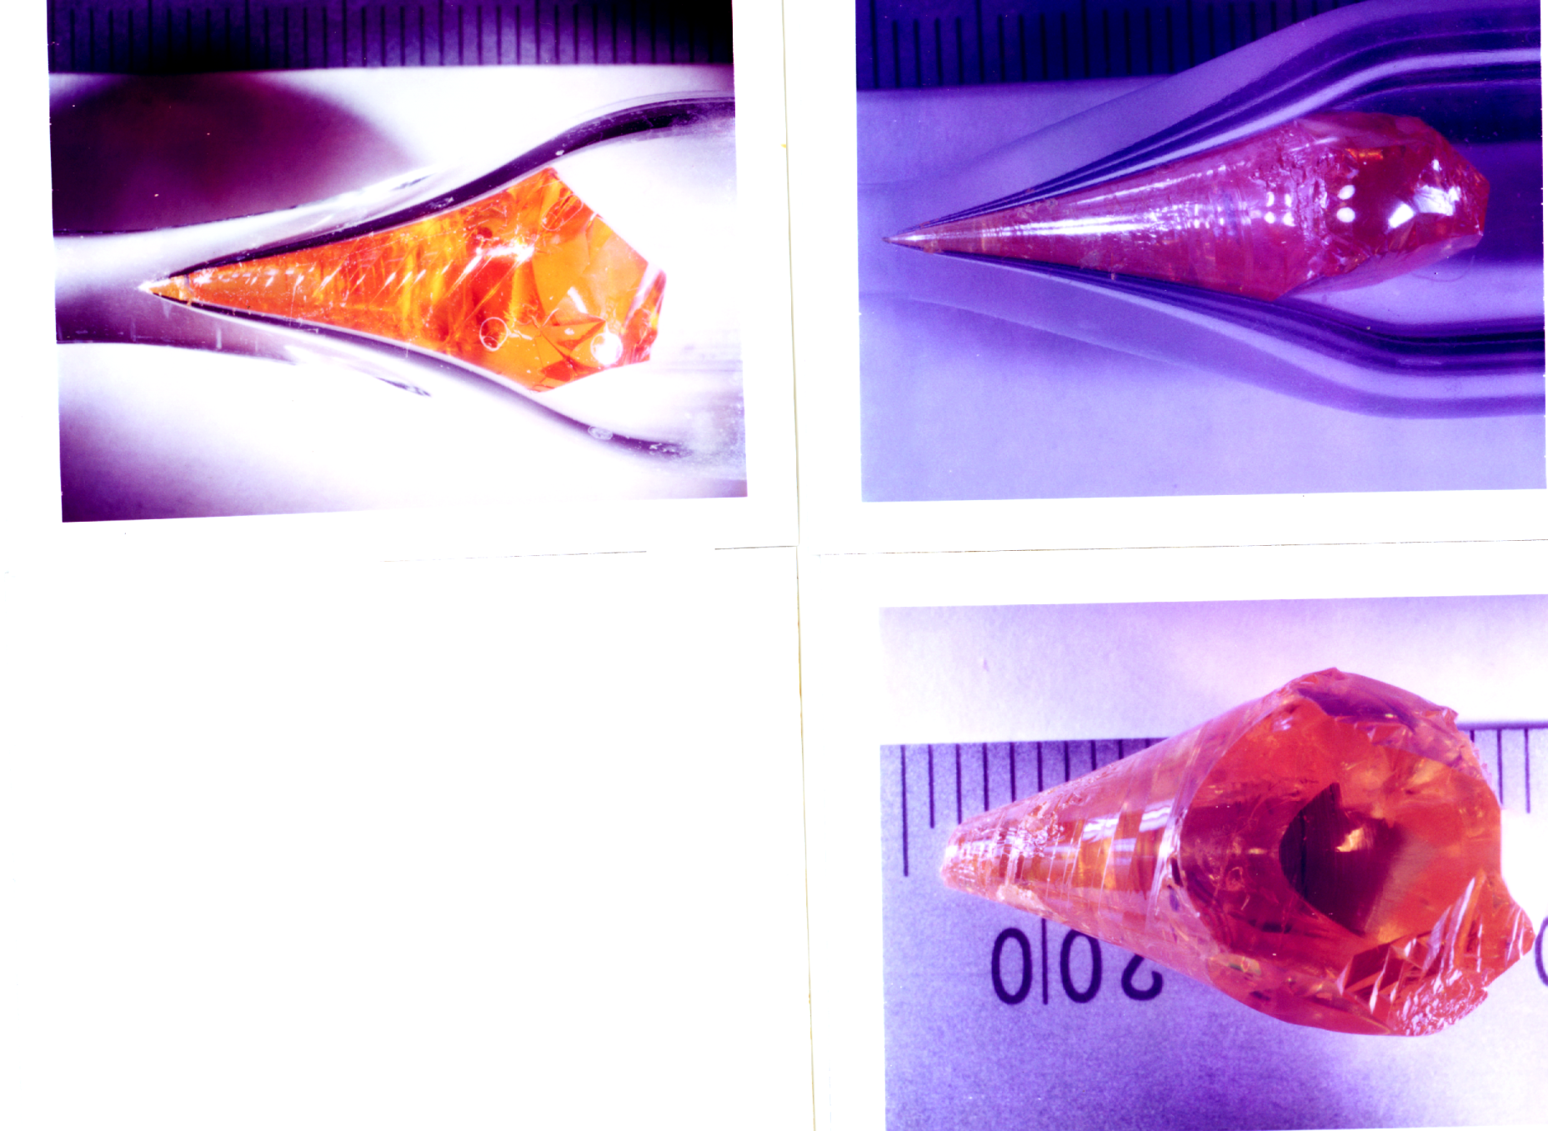
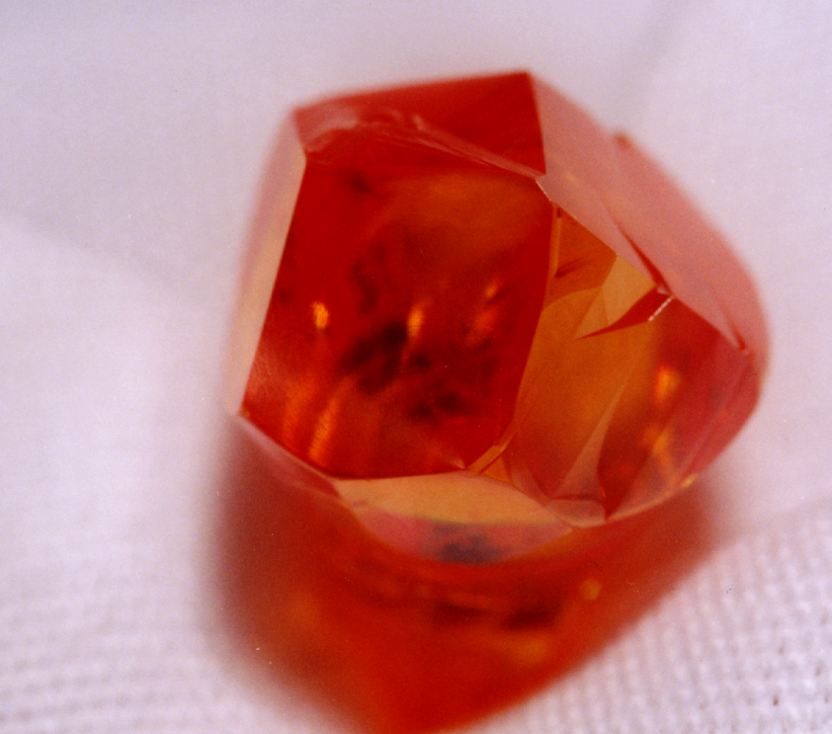
Horizontal unseeded growth
ZnSe-44
ZnSe-43
.
g
g
x
g

Slide 14
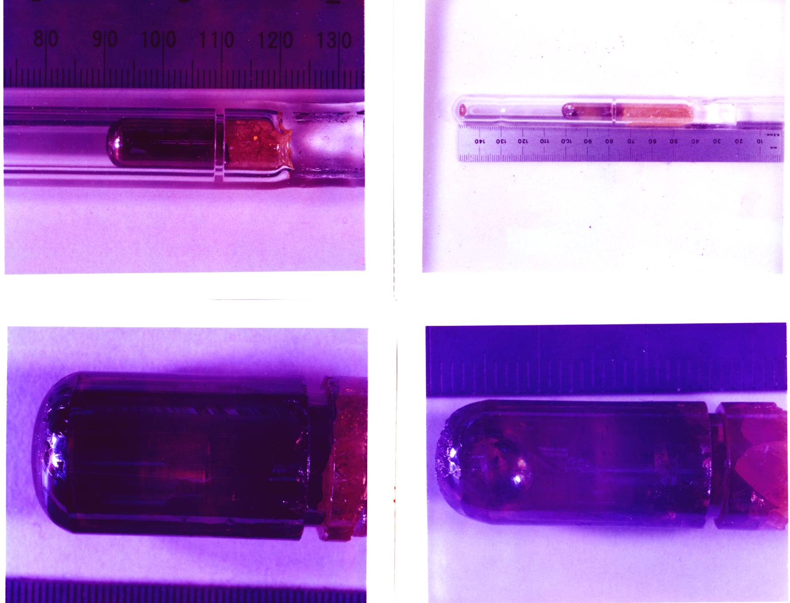
Morphologies of the seeded grown ZnSe crystals
Vertical growth
g
ZnSe(S)-9V
ZnSe(S)-12V

Slide 15
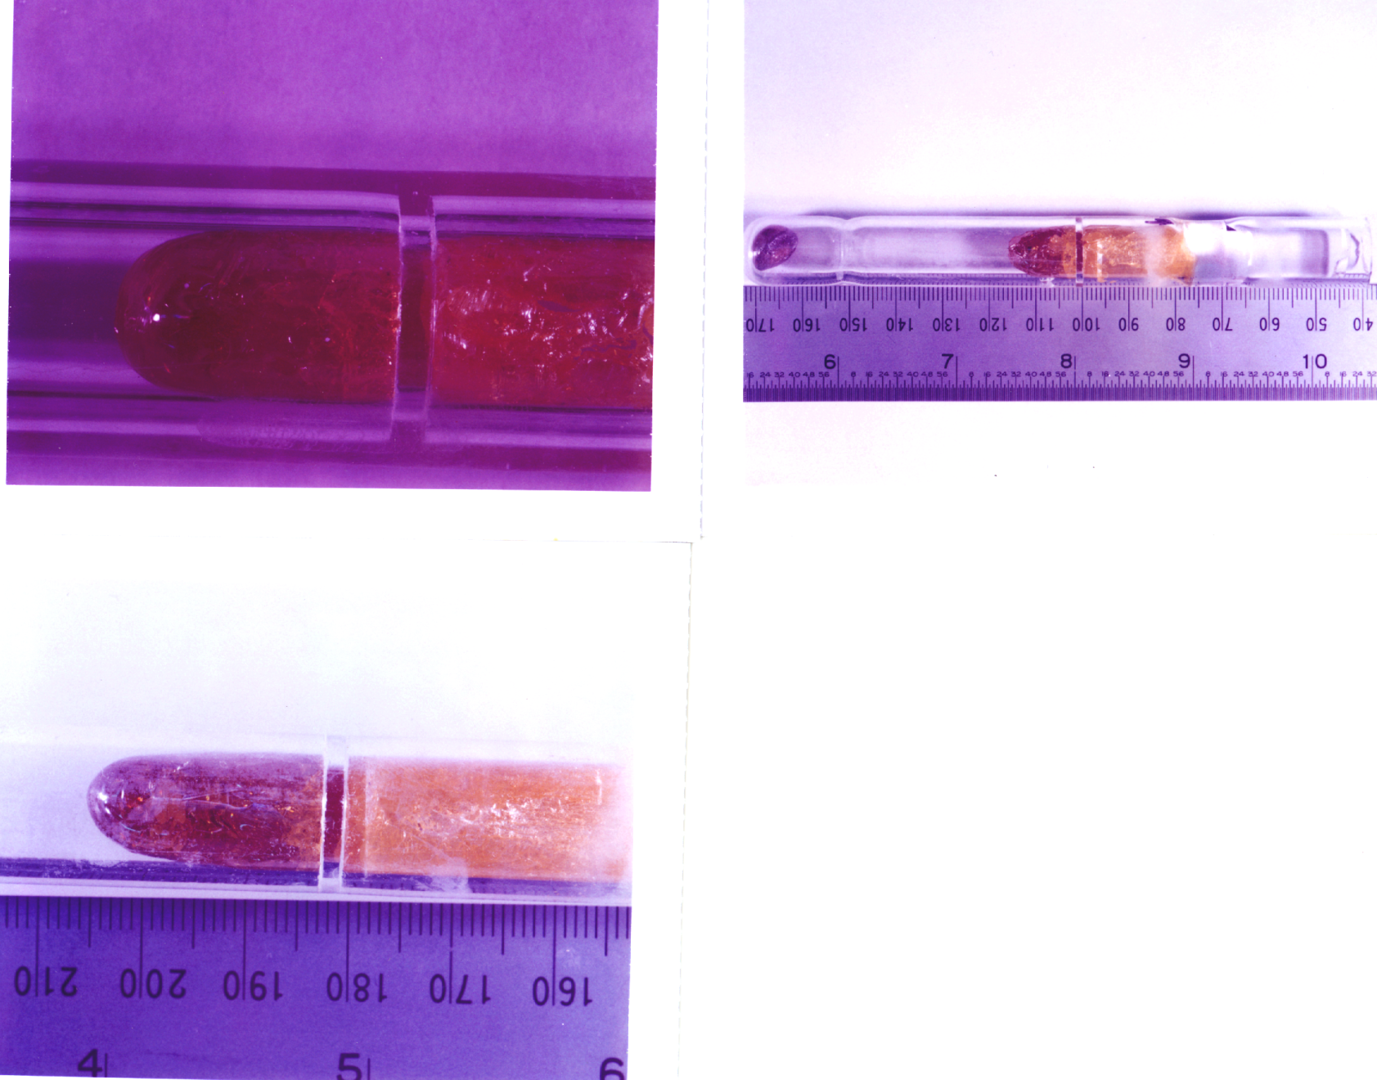
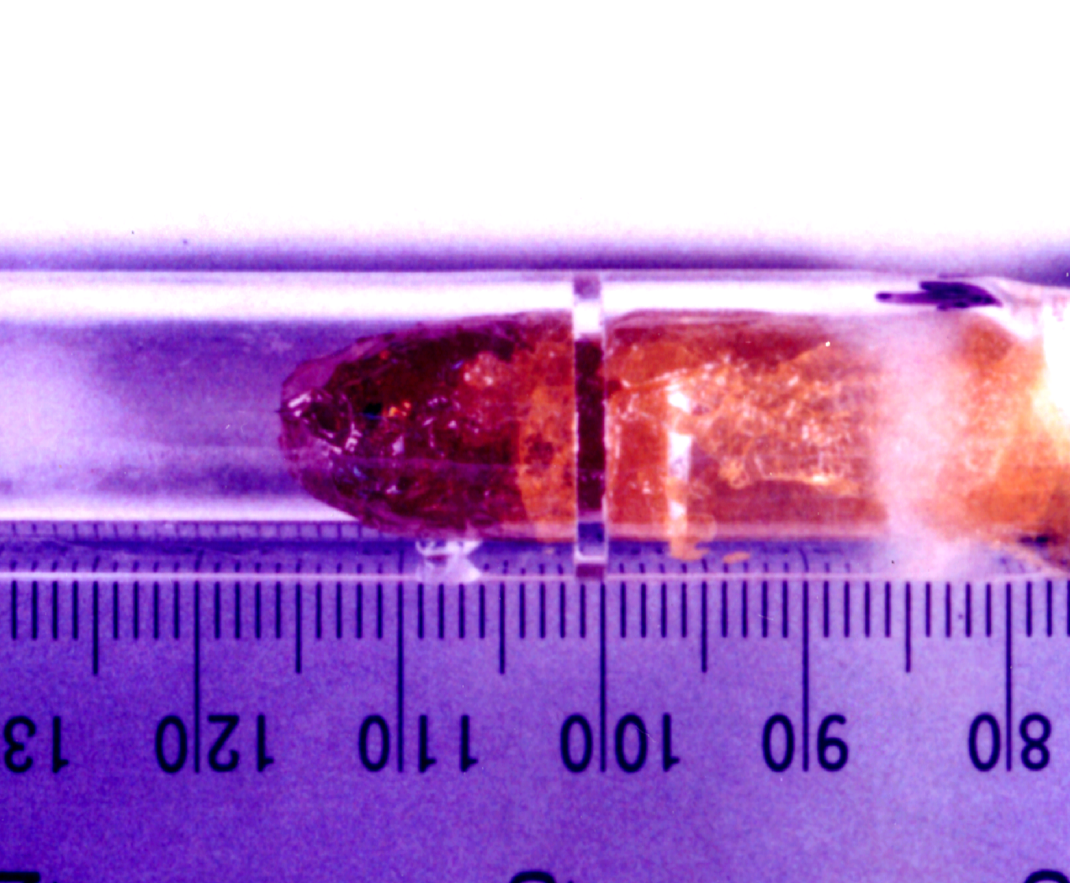
Horizontal seeded growth
ZnSe(S)-11H
g
x
g
ZnSe(S)-8H
ZnSe(S)-13H
g

Slide 16
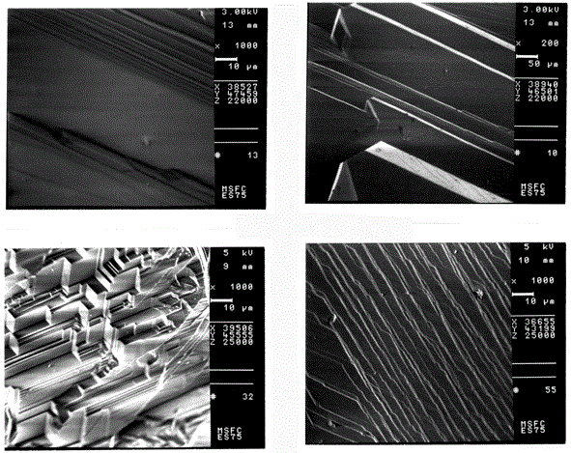
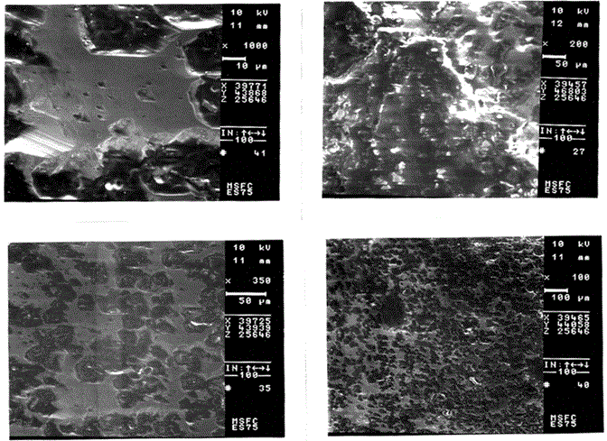
SEM micrograph of the as-grown surface
horizontal growth
vertical growth
Step growth:
Shear convective vapor flow parallel to growing surface
Island growth:
Individual nucleus forming on growing surface

Slide 17
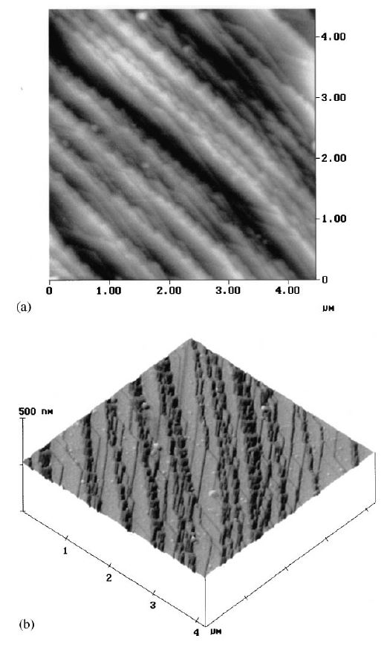
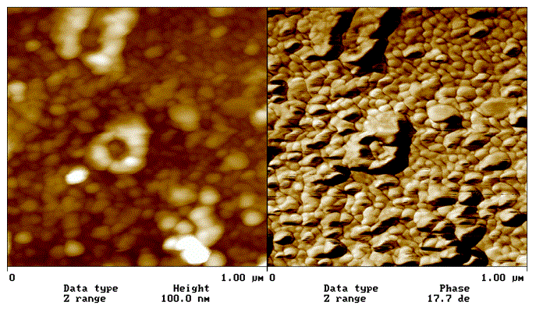
Atomic force microscopy (AFM) on growth surface
Horizontal growth
Vertical growth
Growth mechanism of island mode with nucleation of islands in the order of 10 nm in height and 10 μm in diameter.
Step mode mechanism consists of (110) terraces of 10 μm with numerous steps of 10 nm height between the terraces.

Slide 18
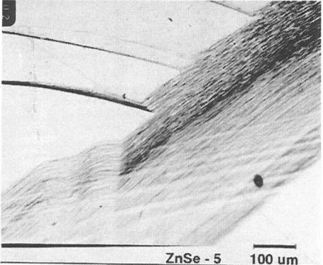
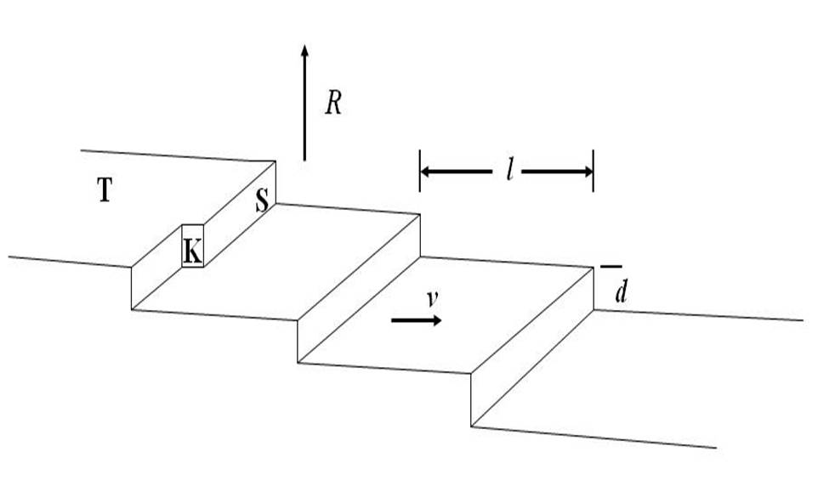
Kinetics of step growth
A growing surface contains the structures of terraces (T), steps (S) and kinks (K).
Zn and Se₂ species reach surface to form adsorbed atoms (adatoms) which migrate on the surface.
A kink, K, makes an energy favorable site for the formation and attachment of adatom.
As kink filled to the edge of the surface, one step, S, is grown and the terrace extends one step to the right.
When the terrace, T, fills up the whole growing surface, the crystal grows upward by the step height.
Growth velocity R = dv/l where d: step height; l: distance between steps; v: growth velocity of the step.
From typical experimental values: R: 3-5 mm/day, d = 10 nm, l = 10 mm, v is estimated to be 50 μm/s.
SEM micrograph of as-grown surface
Schematics of the step growth mechanism on a growing surface with terrace (T), kink (K) and step (S).

Slide 19
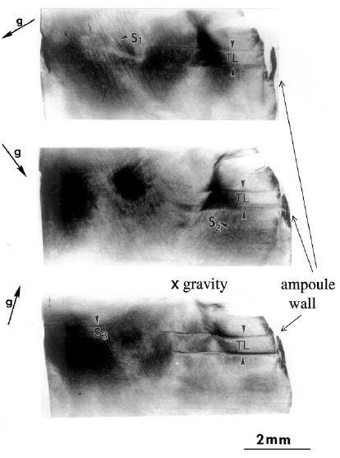
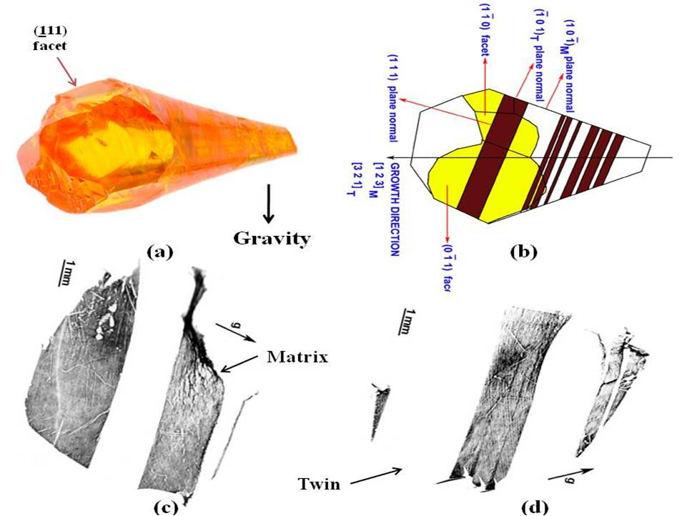
SWBXT on ZnSe crystals
Transmission images show twin lamellae and distortion caused by wall-wetting
Surface reflection images of 43H show alternate (111) twins

Slide 20
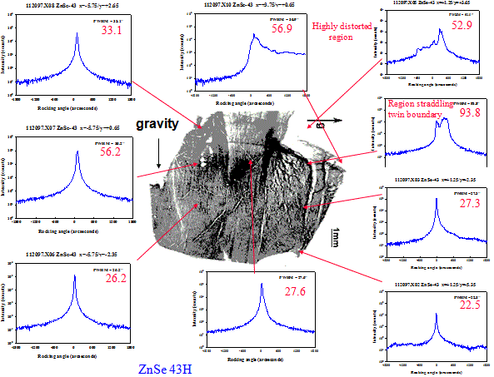
Correlation between SWBXT and x-ray diffraction rocking curves

Slide 21
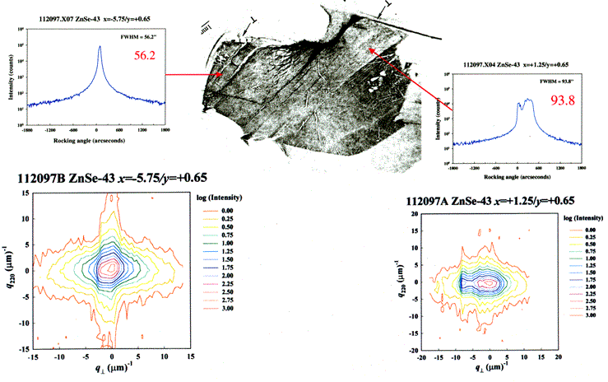
Correlation between SWBXT, rocking curve and reciprocal space map
RSM differentiates mosaicity from strain
Double broaden
streaks: strain

Slide 22
SWBXT on ZnSe crystals
Transmission images show twin lamellae and distortion caused by wall-wetting
Surface reflection images of 43H show alternate (111) twins

Slide 23
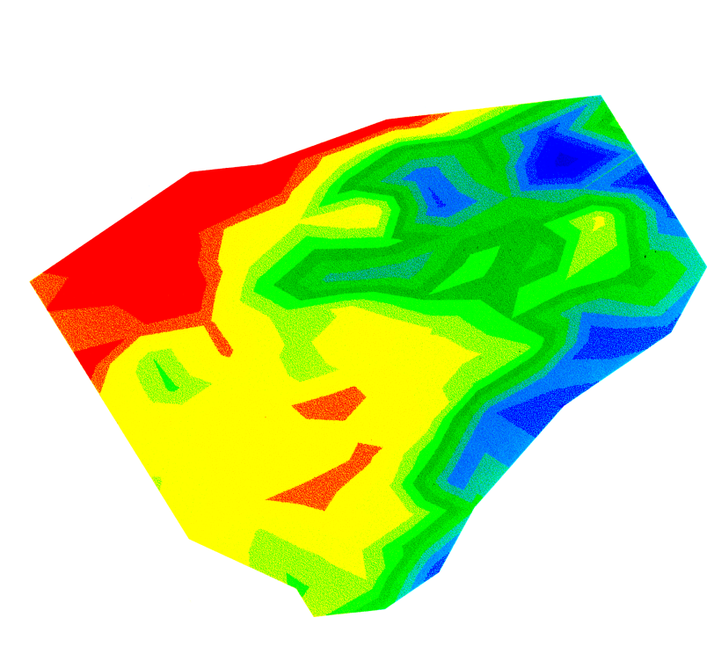
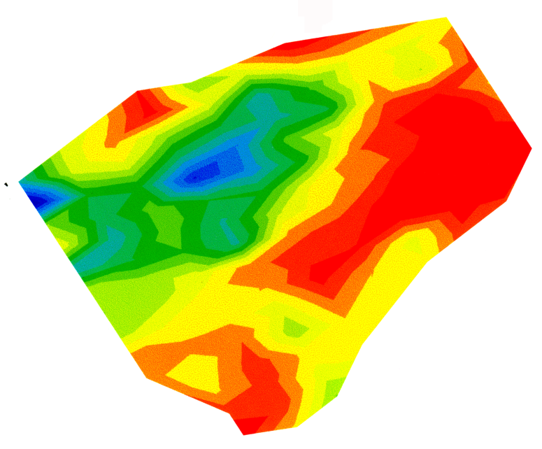
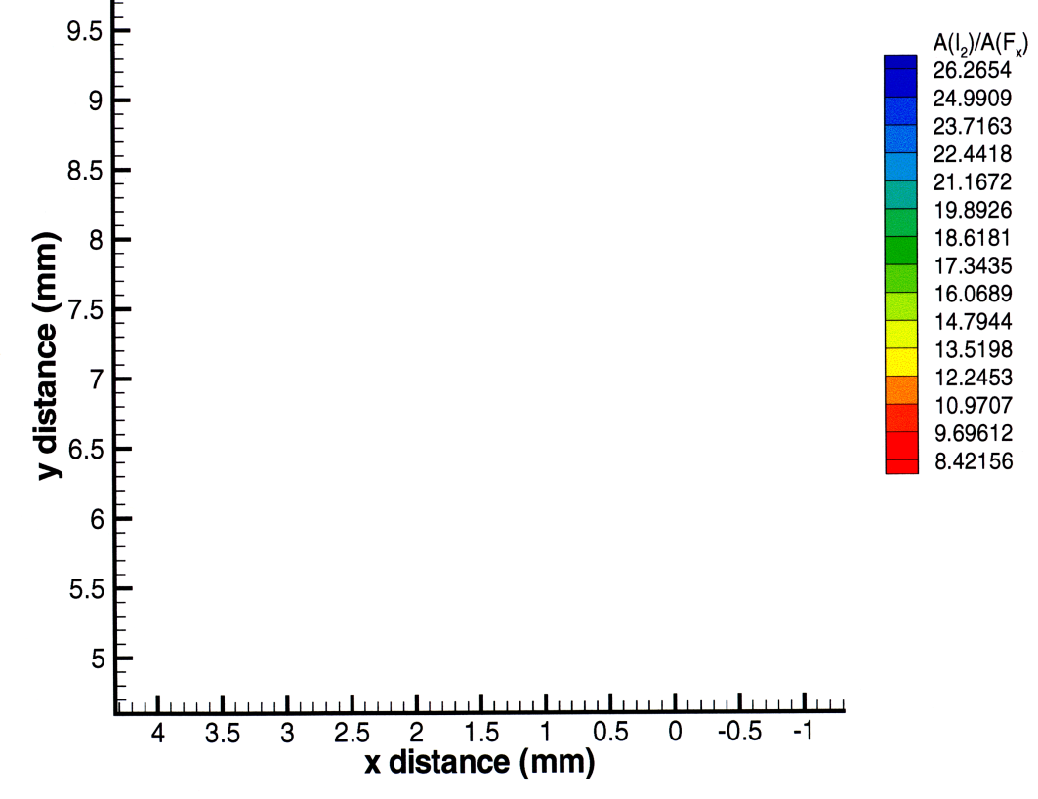
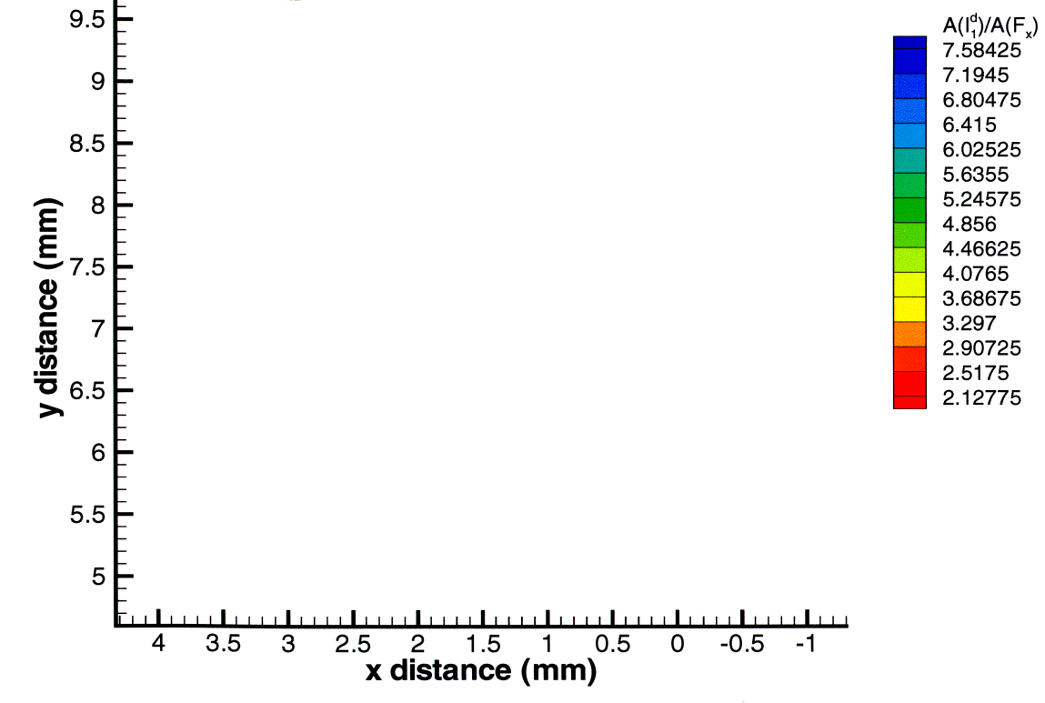
Effects of gravity on the grown crystals
Distribution of [V_{Zn}] and [Al] in ZnSe (horizontal)
[V_{Zn}]
[Al]
growth
direction
gravity

Slide 24
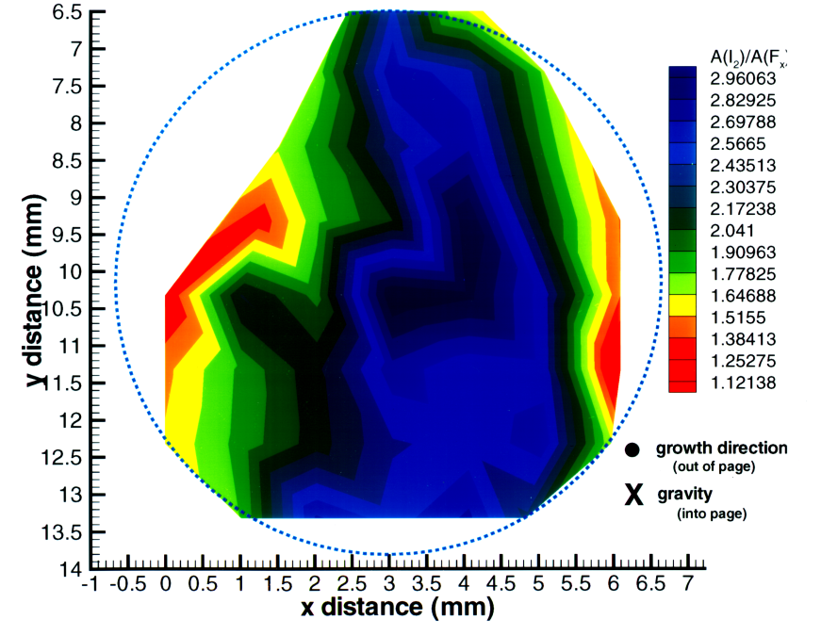
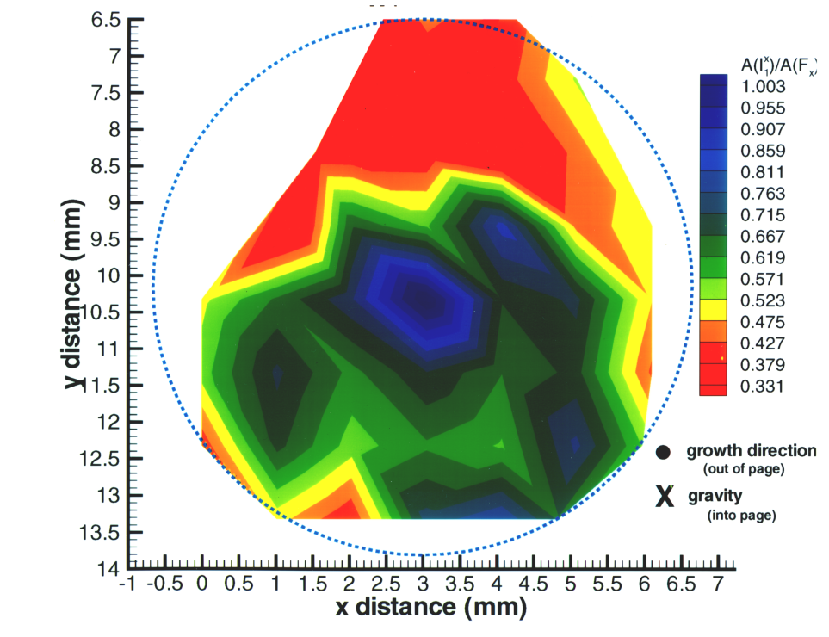
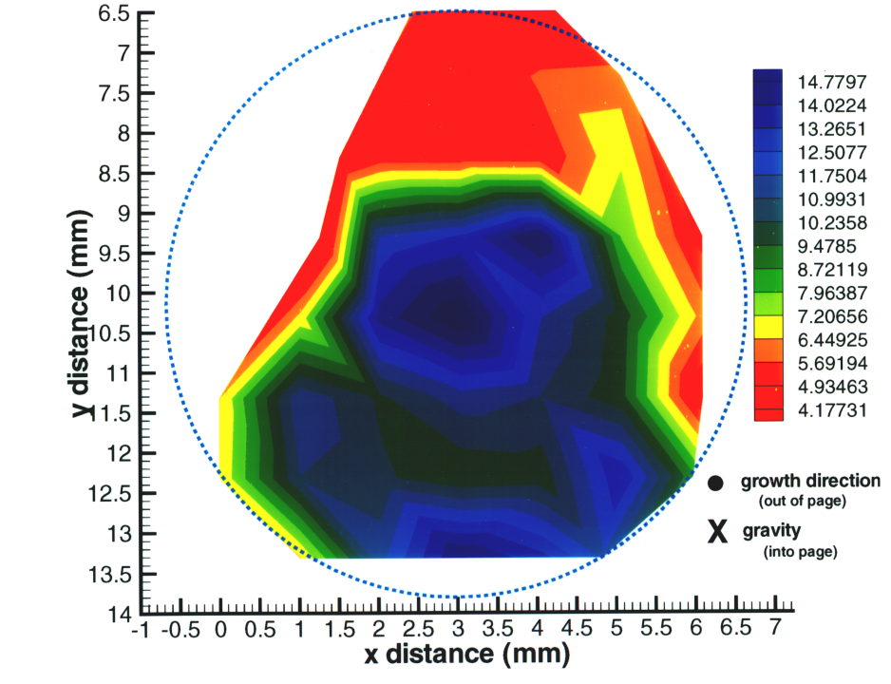
Distribution of [Al], [Na] and [V_{Zn}] in ZnSe (vertically stabilized)
g
[Al]
x
A(I₁^{d})/A(F_{x})
[Na]
[V_{Zn}]

Slide 25
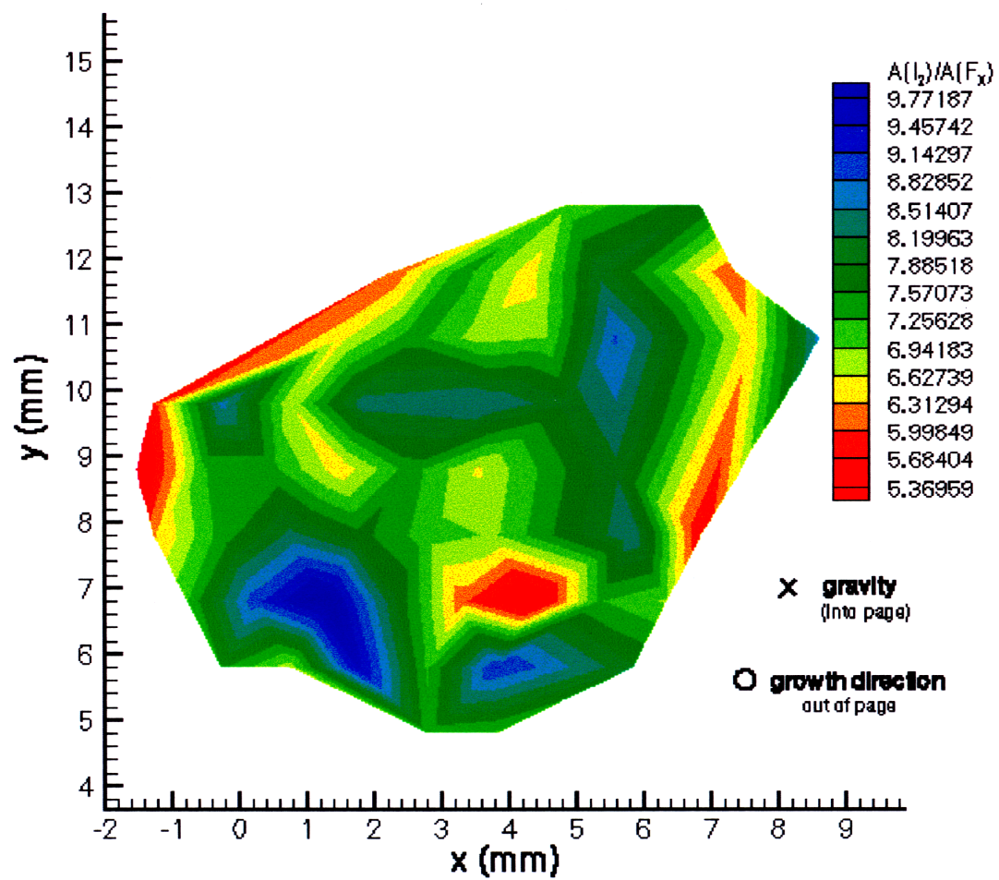
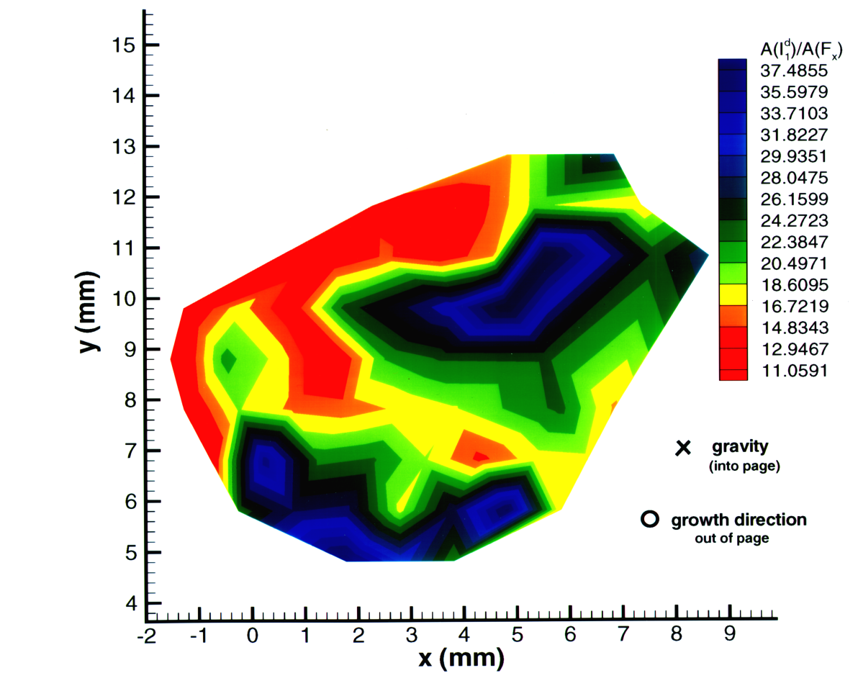
Distribution of [V_{Zn}] and [Al] in ZnSe (vertically destabilized)
g
x
[Al]
[V_{Zn}]

Slide 26
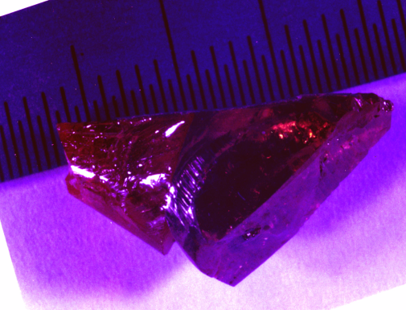
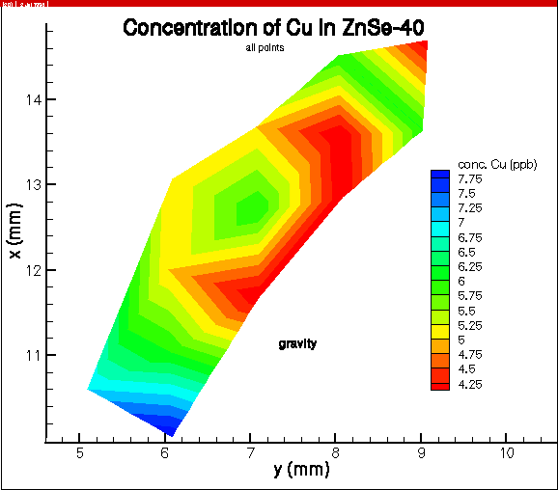
Impurities Distribution by secondary ion mass spectroscopy (SIMS)
(horizontally grown)
growth direction
[Si]
gravity
[Fe]
[Cu]

Slide 27
Impurities Distribution by secondary ion mass spectroscopy (SIMS)
(vertically grown)
x
gravity and
growth direction
[Si]
[Fe]
[Cu]

Slide 28
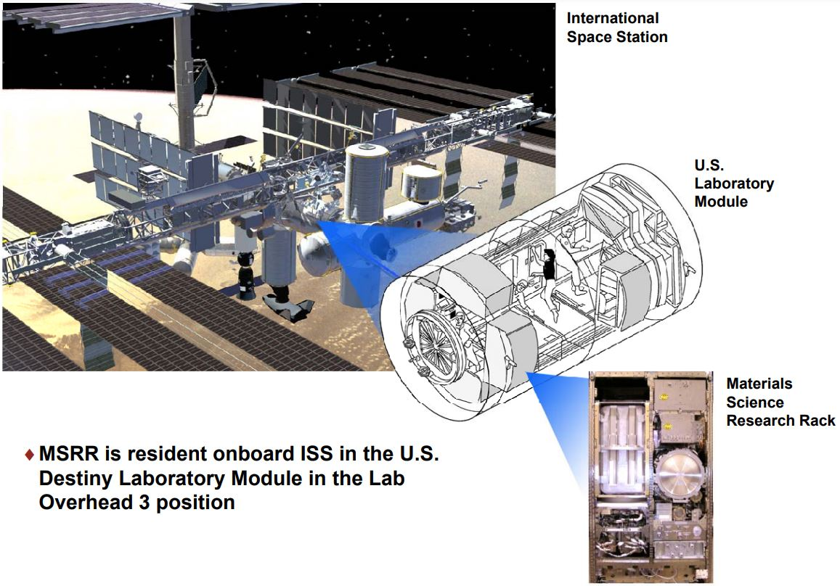
Low Gradient Furnace, Materials Science Research Rack, U.S. Lab Module on ISS

Slide 29
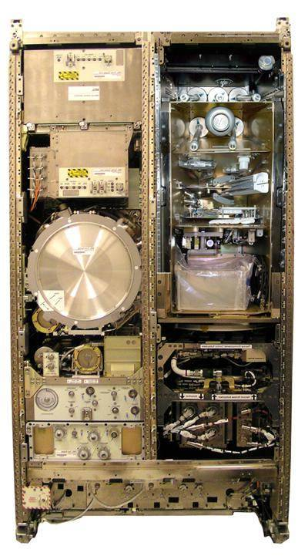
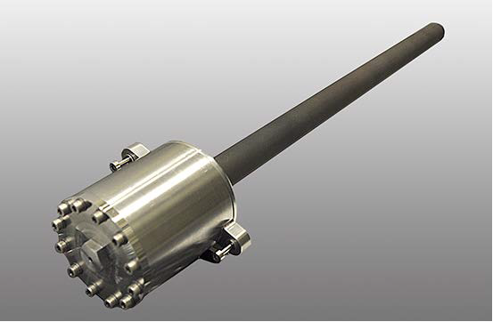
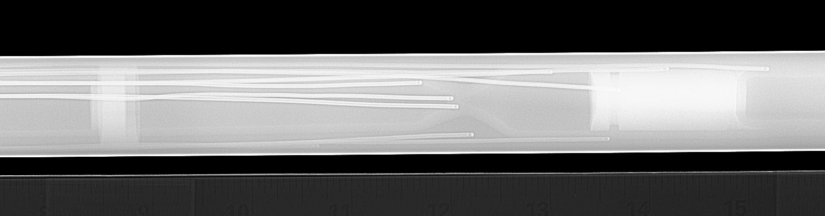
Material Science Research Rack (MSRR)
Sample Cartridge Assembly (SCA)
seed
Thermocouple
positions
source
Low Gradient Furnace (LGF) built by ESA (European Space Agency)
SCA X-ray image

Slide 30
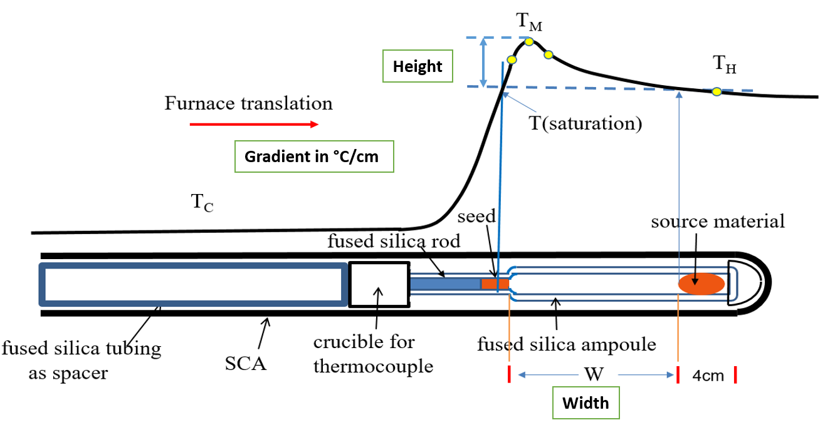
Schematics of Sample Cartridge Assembly (SCA) and thermal profile during growth

Slide 31
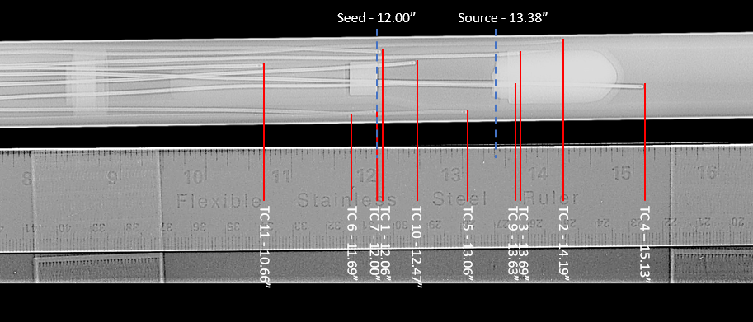
Transmission X-ray to locate relative positions of seed, source and thermocouples

Slide 32


Six flight samples, 3 unseeded and 3 seeded, processing on ISS
GTCS-C3 (unseeded Cr-doped ZnSe)
Processed on 3/3/23 after two failed attempts on 8/1/22 and 10/10/22
GTCS-C1 (unseeded ZnSe)
Process started on 3/21/23 and ended 11 hours before the planned 6 days growth
GTCS-C2 (seeded with ZnSe (110) crystal)
Process started on 4/25/23 and was disrupted during program cool-down after 5 days growth
GTCS-C4 (seeded with ZnSe (100) crystal)
Process planned on 8/7 -8/18/2023
GTCS-C5 (seeded with ZnSe (111) crystal)
Process planned on 9/11 -9/22/2023
GTCS-C6 (unseeded ZnSeTe)
Process planned on 11/20 -12/1/2023
unseeded growth ampoule
Seeded growth ampoule

Slide 33

Measured thermal profile every 12 hours through the furnace translation for C2
saturation
temperature

Slide 34
Acknowledgments
To my colleagues for their contributions to the project:
Drs. R. F. Brebrick, A. Burger, M. Dudley, S. Feth, M. A. George, D. G. Gillies, S. L. Lehoczky, R. Matyi, K. Mazuruk, W. Palosz, Balaji Raghothamachar, N. Ramachandran, Yi-Gao Sha, N. G. Singh, F. R. Szofran, M. P. Volz and Ling Jun Wang.
Technical supports: Curtis Bahr and Jeff Quick

