Slide 1
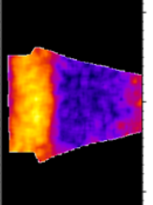
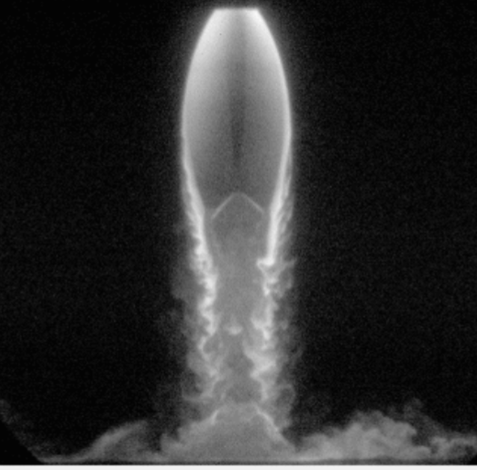
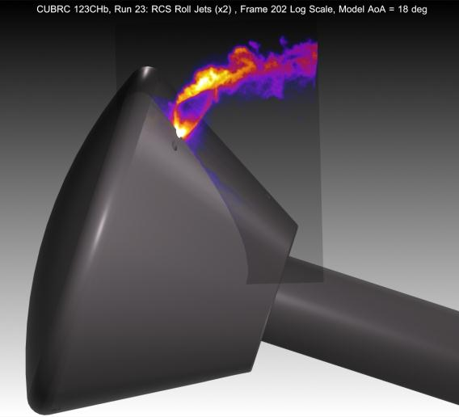

Advances in Measurements for
High-Speed Flows
Paul M. Danehy
Senior Technologist for Advanced Measurement Systems
Advanced Measurement and Data Systems Branch
NASA Langley Research Center
Hampton, Virginia, USA
Gordon Research Conference (GRC) on Laser Diagnostics in Energy and Combustion Science July 11, 2023

Slide 2
Advances in Measurements for High-Speed Flows
9:00 am - 9:15 am | Introduction by Paul Danehy (NASA Langley Research Center, USA)
9:15 am - 9:55 am | Naibo Jiang (Spectral Energies LLC, United States) "High-speed Laser Diagnostics in Hypersonic Flows"
9:55 am - 10:10 am | Discussion
10:10 am - 10:40 am | Coffee Break
10:40 am - 11:20 am | Ellen Yi Mazumdar (Georgia Institute of Technology, USA) "Holographic and Interferometric Diagnostics for High- Speed Flow Applications"
11:20 am - 11:35 am | Discussion
11:35 am - 12:15 pm | Timothy Fahringer (NASA Langley Research Center, USA) "Revealing High-Speed Aerospace Flow using Pulse-Burst Lasers with Dynamic Wavelength Adjustment"
12:15 pm - 12:30 pm | Discussion

Slide 3
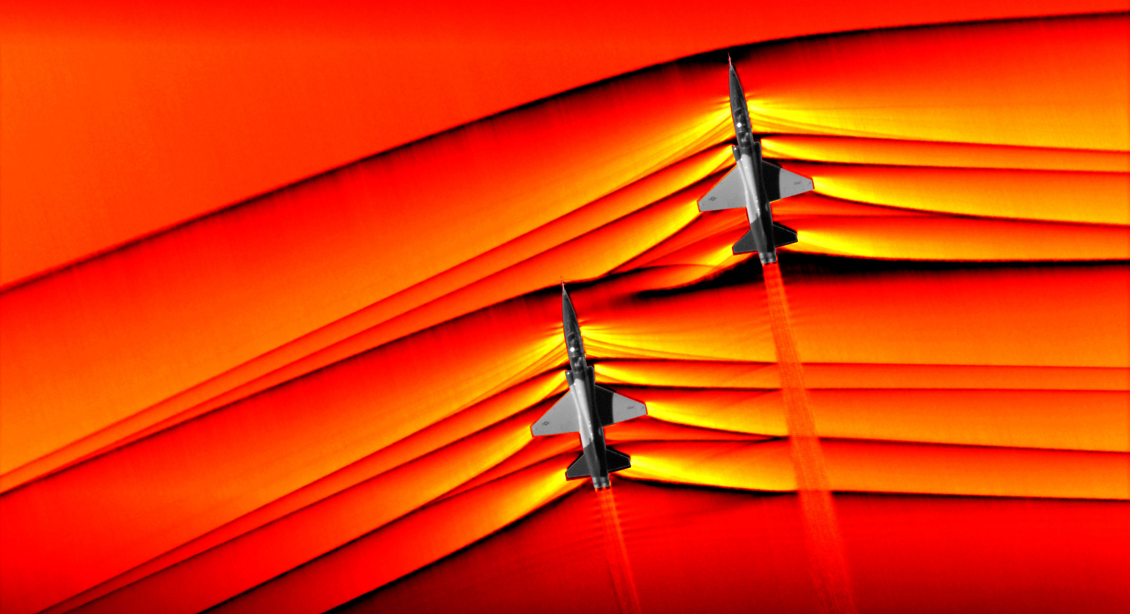
Example High-Speed Flows @ NASA
Transonic/Supersonic Flows: large and sudden changes in P, T, ρ, u, v, w
T-38s
https://www.nasa.gov/centers/armstrong/features/supersonic-shockwave-interaction.html
AirBOS from J.T. Heineck of NASA’s Ames Research Center

Slide 4
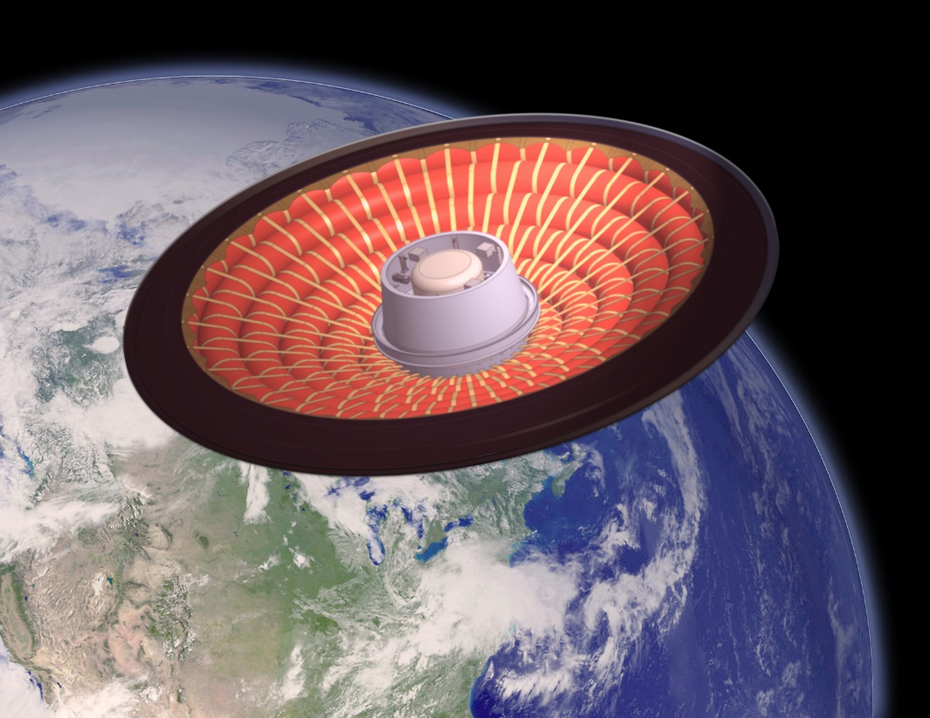
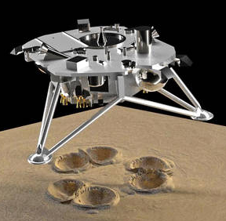
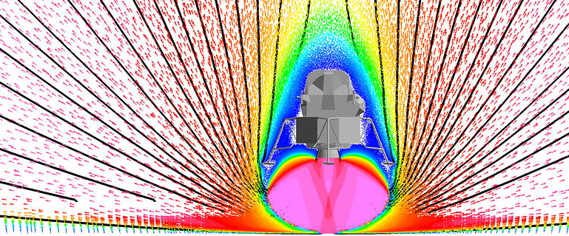
Example High-Speed Flows @ NASA
Transonic/Supersonic Flows: large and sudden changes in P, T, ρ, u, v, w
Hypersonic Flows: same parameters as supersonic plus thermal nonequilibrium: T_{rot}, T_{vib}, T_{elec} or chemical nonequilibrium: n_{NO}, n_{N}, n_{O.} n_{N2}, n_{O2}
Supersonic and hypersonic flows often involve combustion or plasma: χ_{i}, n_{elec}
https://www.nasa.gov/centers/armstrong/features/supersonic-shockwave-interaction.html
AirBOS from J.T. Heineck of NASA’s Ames Research Center
https://www.nasa.gov/directorates/spacetech/game_changing_development/projects/PSI
Particulate size, locations, velocities needed; difficult to predict multiphase flow.
Laser-based measurement techniques are well suited to measure these parameters with suitable accuracy… and suitable time resolution?
https://blogs.nasa.gov/jpss-2/2022/11/10/nasas-loftid-a-new-kind-of-heat-shield/
NASA’s Low-Earth Orbit Flight Test of an Inflatable Decelerator (LOFTID)
A Hypersonic Inflatable Aerodynamic Decelerator (HIAD); Flew 11/2022

Slide 5

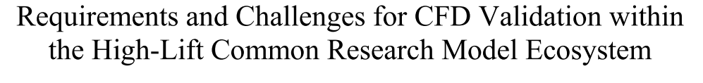
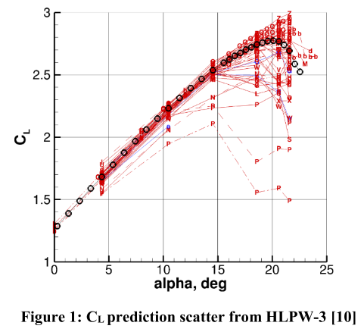
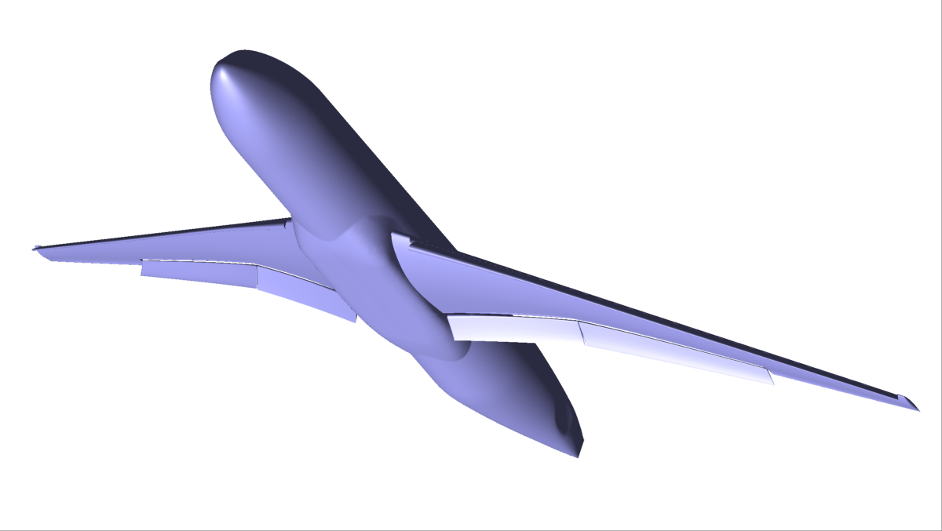
Challenges in Predicting High Speed Flows:
Computational methods are actively used to design aircraft and space vehicles but they have limitations and higher-than-desired uncertainties:
  Smooth-body flow separation
    Commercial aircraft at high lift
    Supersonic/Hypersonic vehicles
  Fluid-Structure interaction (flutter)
  Buffet
Flow separation
stall
Ma ~ 0.2
High lift wing
Clark et al., AIAA 2020-2772
HiLiftPW-4

Slide 6

Challenges in Predicting High Speed Flows:
Computational methods are actively used to design aircraft and space vehicles but they have limitations and higher-than-desired uncertainties:
  Smooth-body flow separation
    Commercial aircraft at high lift
    Supersonic/Hypersonic vehicles
  Fluid-Structure interaction (flutter)
  Buffet
  Transition from laminar to turbulent flow in boundary and shear layers
  Stage separation
  Plume flows
    Rocket engines
https://www.nasa.gov/audience/forstudents/5-8/features/nasa-knows/what-is-heavy-lift-launch-vehicle-58.html

Slide 7
Challenges in Predicting High Speed Flows:
Computational methods are actively used to design aircraft and space vehicles but they have limitations and higher-than-desired uncertainties:
  Smooth-body flow separation
    Commercial aircraft at high lift
    Supersonic/Hypersonic vehicles
  Fluid-Structure interaction (flutter)
  Buffet
  Transition from laminar to turbulent flow in boundary and shear layers
  Stage separation
  Plume flows
    Rocket engines
    Plume-surface interaction
    Reaction Control Systems
PSI at Martian conditions by Rodrigues et al, unpublished (GRC poster)
These are high-speed, unsteady flows. Need unsteady predictive capability. (RANS is not sufficient.) Need for quantitative unsteady experimental data to validate these codes*
Combs et al. J. of Spacecraft and Rockets (2015): Vol.52: 243-252
*Slotnick, Jeffrey P., et al. CFD vision 2030 study: a path to revolutionary computational aerosciences. No. NF1676L-18332. 2014.

Slide 8
Advances in Measurements for High-Speed Flows
9:00 am - 9:15 am | Introduction by Paul Danehy (NASA Langley Research Center, USA)
9:15 am - 9:55 am | Naibo Jiang (Spectral Energies LLC, United States) "High-speed Laser Diagnostics in Hypersonic Flows"
9:55 am - 10:10 am | Discussion
10:10 am - 10:40 am | Coffee Break
10:40 am - 11:20 am | Ellen Yi Mazumdar (Georgia Institute of Technology, USA) "Holographic and Interferometric Diagnostics for High- Speed Flow Applications"
11:20 am - 11:35 am | Discussion
11:35 am - 12:15 pm | Timothy Fahringer (NASA Langley Research Center, USA) "Revealing High-Speed Aerospace Flow using Pulse-Burst Lasers with Dynamic Wavelength Adjustment"
12:15 pm - 12:30 pm | Discussion
This morning’s presentations:
High-speed measurements for
High-speed flows!

Slide 9

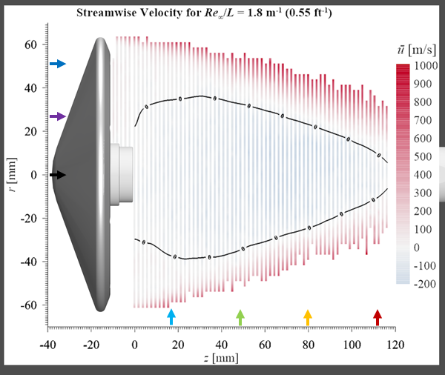
But how fast do these measurements need to be?
(Example from Neil Rodrigues, NASA Langley)
For details see Neil’s GRC poster on Wednesday
LOFTID Entry Vehicle concept
  Unsteady wake flow observed at all Reynolds #s tested
  Inherently unsteady flowfield
  Velocity measurements performed
How fast does measurement system need to be to resolve flow?
1/10th of a flow structure movement (1 mm) → 10 usec → 100 kHz.
But in shear layer, 10x faster: 1 MHz. Small BL structures: 10 MHz!
NO PLIF Flow visualization
~1000 m/s
10 mm
~100 m/s

Slide 10

Dr. Naibo Jiang
Senior Research Scientist
Spectral Energies, Dayton, Ohio
M.S. (2002), and Ph.D. (2006) from the Ohio State University
Joined Spectral Energies and AFRL as a contractor in 2011
High-speed Laser Diagnostics in Hypersonic Flows

Slide 11

Dr. Ellen Yi Chen Mazumdar
Assistant Professor
Woodruff School of Mechanical Engineering
Courtesy Appointment in Guggenheim School of Aerospace Engineering
Georgia Institute of Technology
B.S. (2008), M.S. (2010), and Ph.D. (2015) from Massachusetts Institute of Technology
Post-doctoral studies at Sandia National Laboratories, Albuquerque NM
Holographic and
Interferometric Diagnostics for
High Speed Flow Applications

Slide 12

Dr. Timothy Fahringer
Lead Research Engineer
Advanced Measurements and Data Systems Branch
NASA Langley Research Center
Hampton, Virginia
BAE (2011), PhD (2018) from Auburn University
Revealing High-Speed Aerospace Flow using Pulse-Burst Lasers with Dynamic Wavelength Adjustment

Slide 13
Advances in Measurements for High-Speed Flows
9:00 am - 9:15 am | Introduction by Paul Danehy (NASA Langley Research Center, USA)
9:15 am - 9:55 am | Naibo Jiang (Spectral Energies LLC, United States) "High-speed Laser Diagnostics in Hypersonic Flows"
9:55 am - 10:10 am | Discussion
10:10 am - 10:40 am | Coffee Break
10:40 am - 11:20 am | Ellen Yi Mazumdar (Georgia Institute of Technology, USA) "Holographic and Interferometric Diagnostics for High- Speed Flow Applications"
11:20 am - 11:35 am | Discussion
11:35 am - 12:15 pm | Timothy Fahringer (NASA Langley Research Center, USA) "Revealing High-Speed Aerospace Flow using Pulse-Burst Lasers with Dynamic Wavelength Adjustment"
12:15 pm - 12:30 pm | Discussion

