Slide 1
UPWT Check Standard Model Vortex Characterization

Slide 2
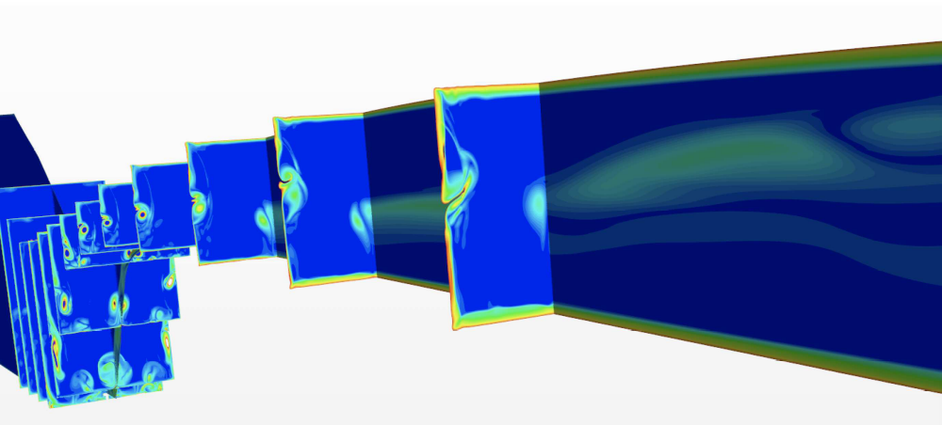
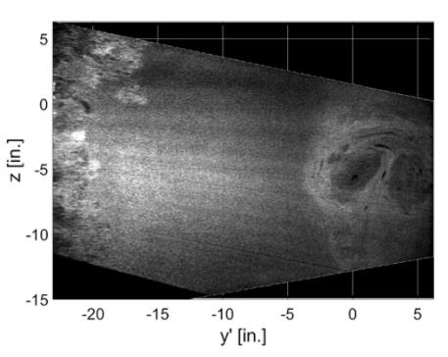
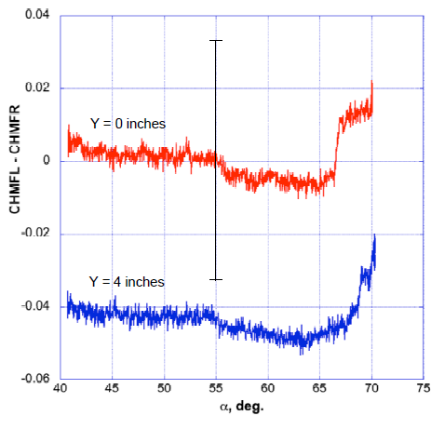
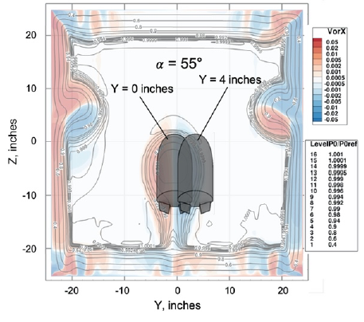
Background
Centerline vortex caused by presence of nozzle block T-rail discovered during CFD studies of UPWT in 2019
Asymmetric flap loading occurred during CobraMRV Control Surface Effectiveness test in 2020 while model was at 0° beta with symmetric flap deflection angles
  Asymmetric loading was believed to be caused by presence of vortex following additional CFD and flap check loads
Would an internal balance be able to detect the presence of the vortex as well?

Slide 3
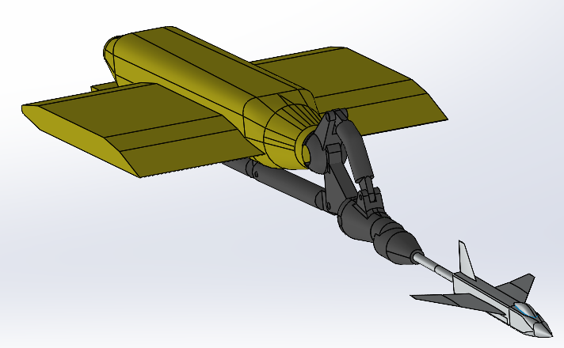
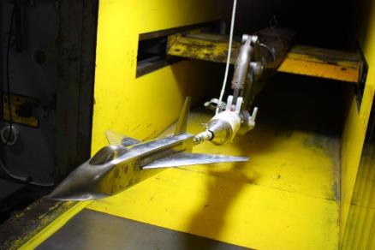
Objective
Devised an experiment using the UPWT Check Standard Model (CSM) to characterize centerline vortex using an internal balance
Move model to different locations within the test section to see changes in balance force and moment coefficients as model passes into and out of vortex
Compare changes in balance loads to force/moment coefficient uncertainty from previous CSM tests
Test usual CSM flow conditions along with flow conditions from CFD study

Slide 4
Test Matrix
Sweep | Alpha | Beta | Roll | Model Nose
1 | sweep from -3° to 6° | 0° | 0° | centered in test section
*2 | sweep from -3° to 6° | +2°, +4° | 0° | centered in test section
3 | sweep from -3° to 6° | 0° | 0° | ±6 in.
4 | 0° | -3° to +3° | 90°, 270° | centered in test section
5 | 0° | -3° to +3° | 90°, 270° | off center
6 | 0° | 0° | 90°, 270° | -10 in. to +10 in.
*CFD comparison sweeps
Primarily focused on sweeps 1-3, 6
Notes:
Sweeps 4-5 did not show much at time of testing, had to remove from matrix

Slide 5
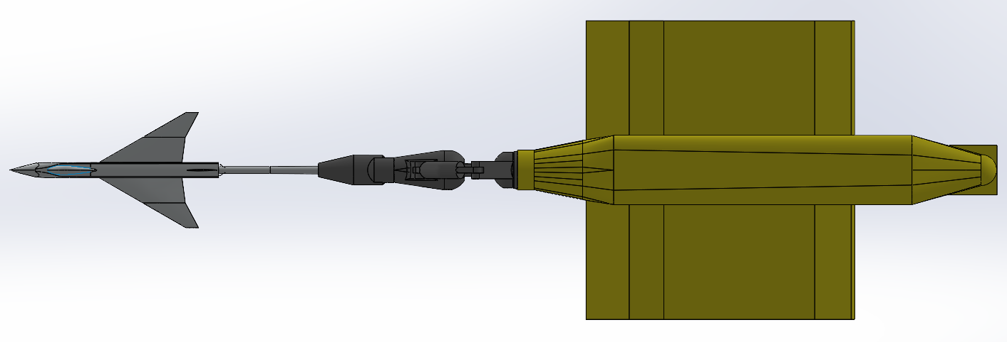
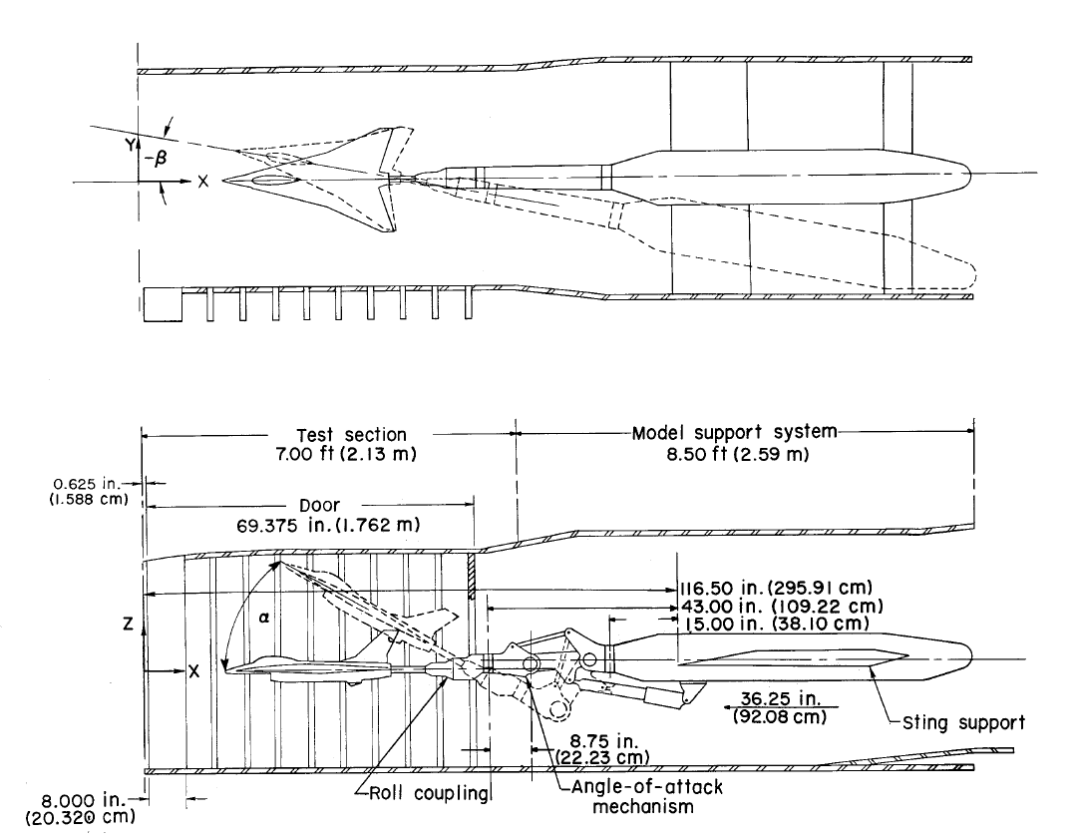

Support System Motion for Model Attitude

Slide 6
Test Conditions
Condition | Mach | Ho (psf) | To (°F) | Re (1x10⁶) | Q (psf) | P∞ (psf) | Dewpt (°F)
1 | 2.60 | 1686 | 125 | 2.00 | 399.7 | 84.48 | -24.9
2 | 3.40 | 2737 | 150 | 2.00 | 335.0 | 41.39 | -16.4
3 | 4.30 | 4261 | 150 | 2.00 | 245.4 | 18.96 | -7.5
4 | 2.60 | 3371 | 125 | 4.00 | 799.5 | 169 | -12.2
5 | 3.40 | 5474 | 150 | 4.00 | 669.9 | 82.8 | -2.4
6 | 4.30 | 8521 | 150 | 4.00 | 490.7 | 37.9 | 6.2
7 | 2.399 | 2280.5 | 125 | 3.00 | 629.20 | 156.13 | -18.7
Conditions 1-6 are the usual CSM conditions
Condition 7 is one of the conditions from the previous CFD studies
Focusing on conditions 1–3 for presentation
Notes:
Focusing on Conditions 1-3 for presentation

Slide 7
Instrumentation
UT59A internal balance
7 x 5-psia Druck transducers
  4 base pressure measurements
  2 cavity pressure measurements
  1 tunnel static pressure measurement
Pitch mechanism Q-flex accelerometer
Component | Load | Sensitivity
Normal | 400 lbs. | 310.9537 (lb./mv/V)
Axial | 40 lbs. | 36.9301 (lb./mv/V)
Pitch | 1200 in-lbs. | 721.9365 (in-lb./mv/V)
Roll | 200 in-lbs. | 191.502 (in-lb./mv/V)
Yaw | 300 in-lbs. | 204.0489 (in-lb./mv/V)
Side | 100 lbs. | 102.2324 (lb./mv/V)

Slide 8
Pitch Sweep Results

Slide 9
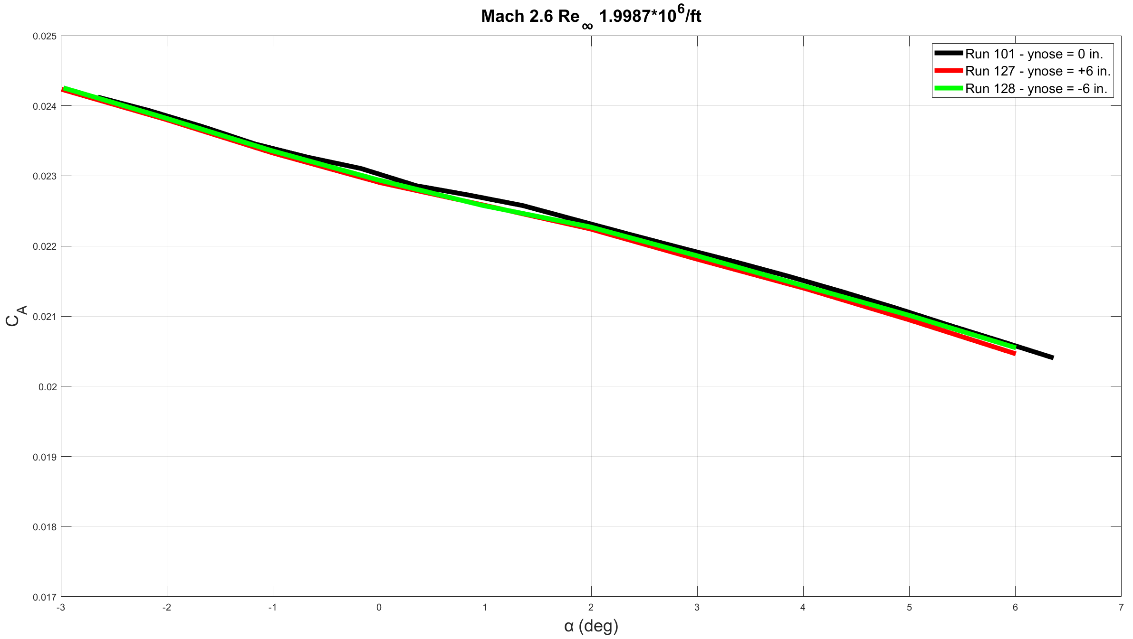
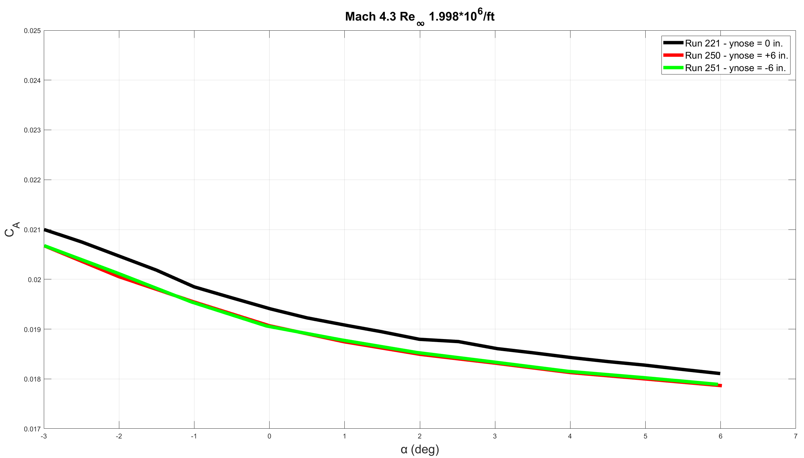
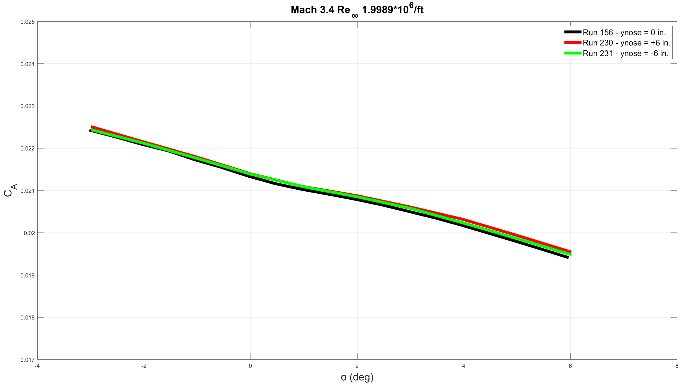
AF Coefficient
Notes:
Not a large difference in axial force trends, though Mach 4.3 shows a downward shift when off tunnel centerline

Slide 10
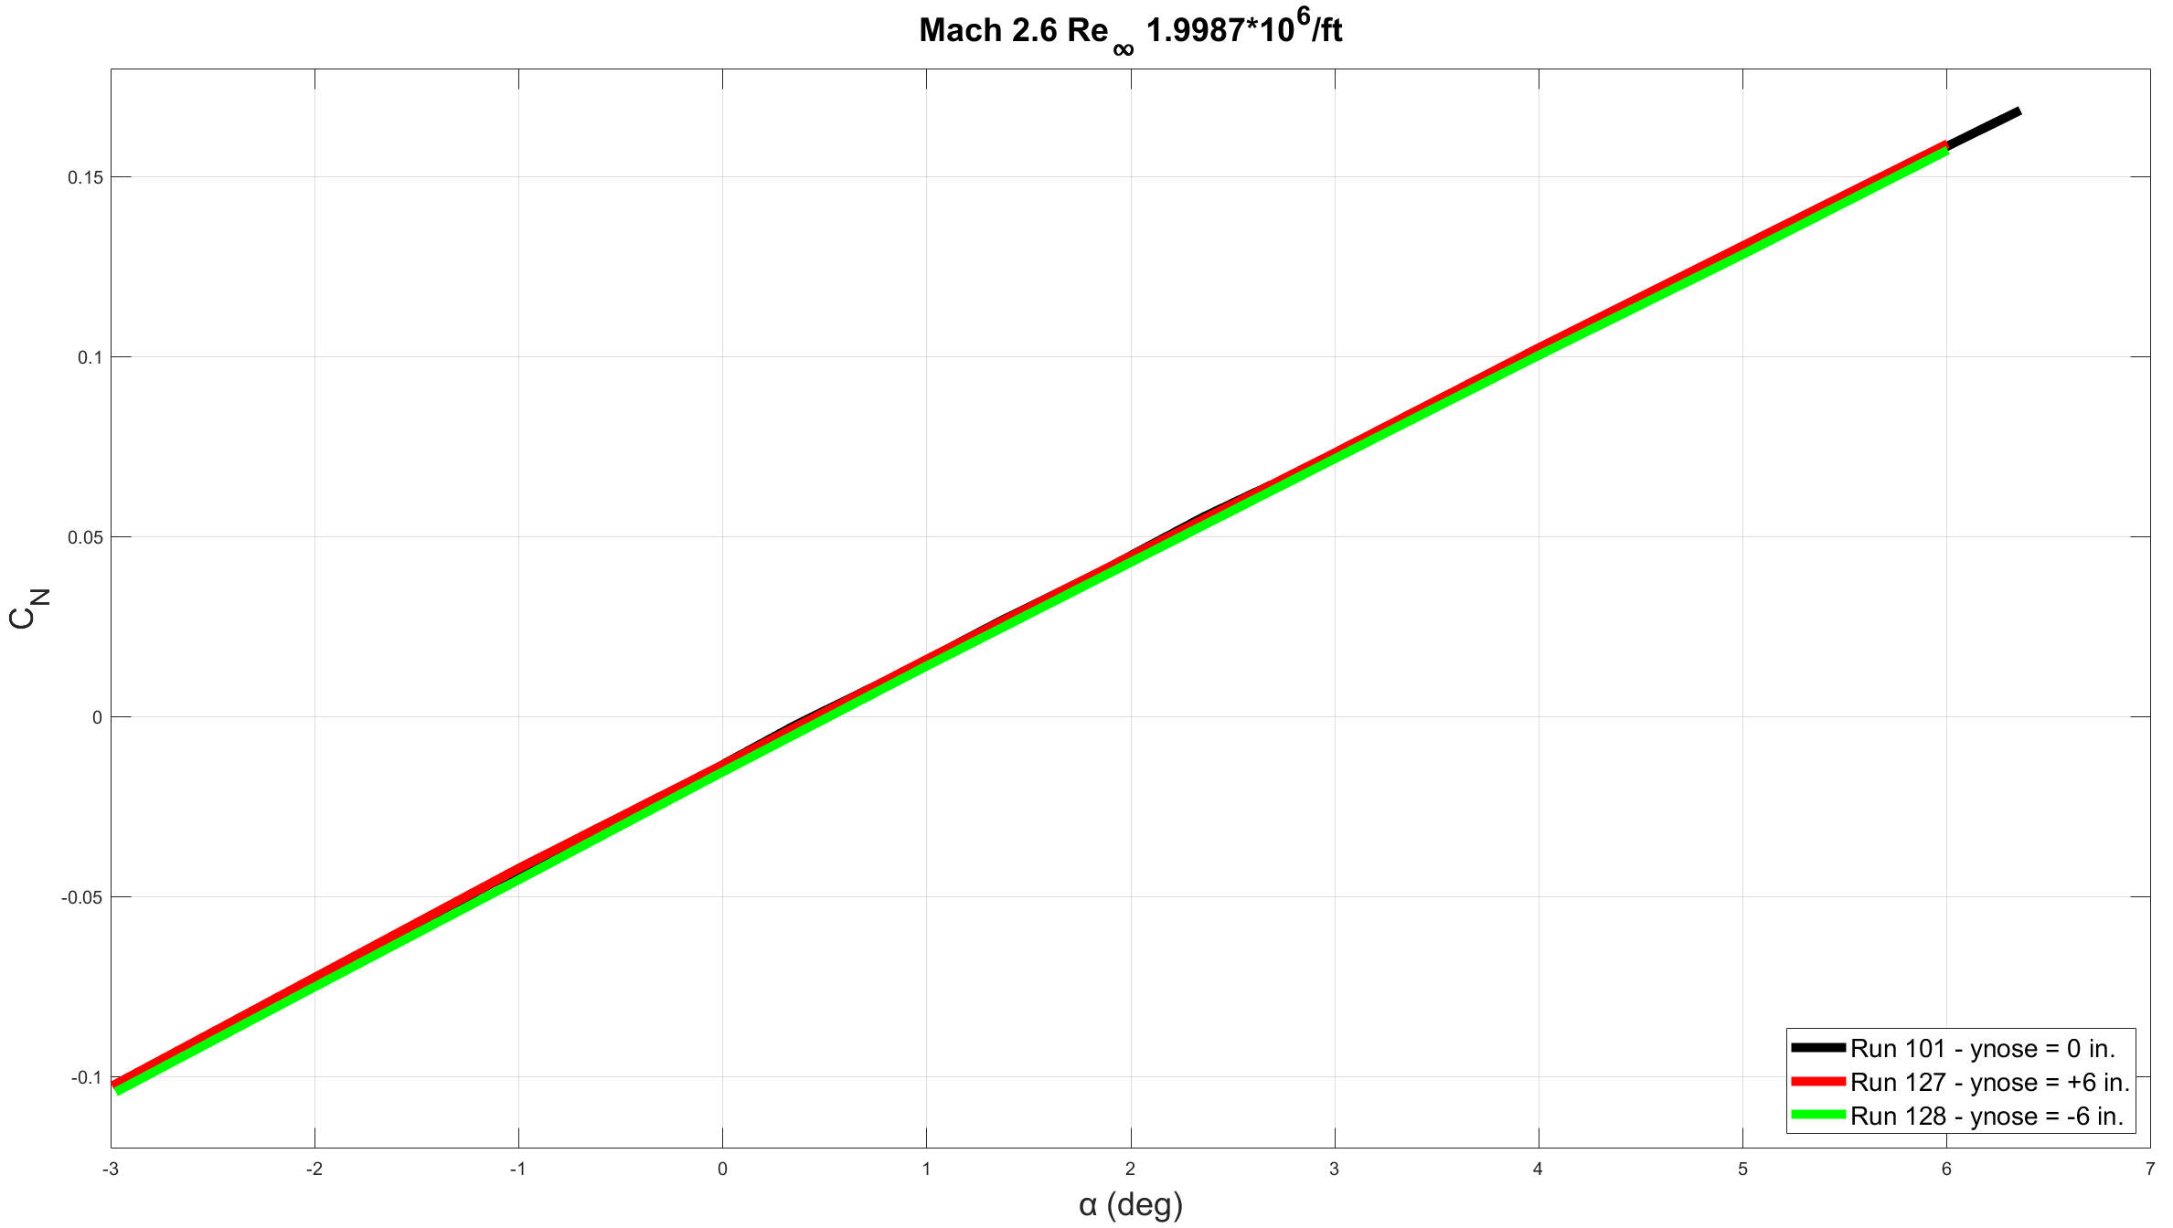
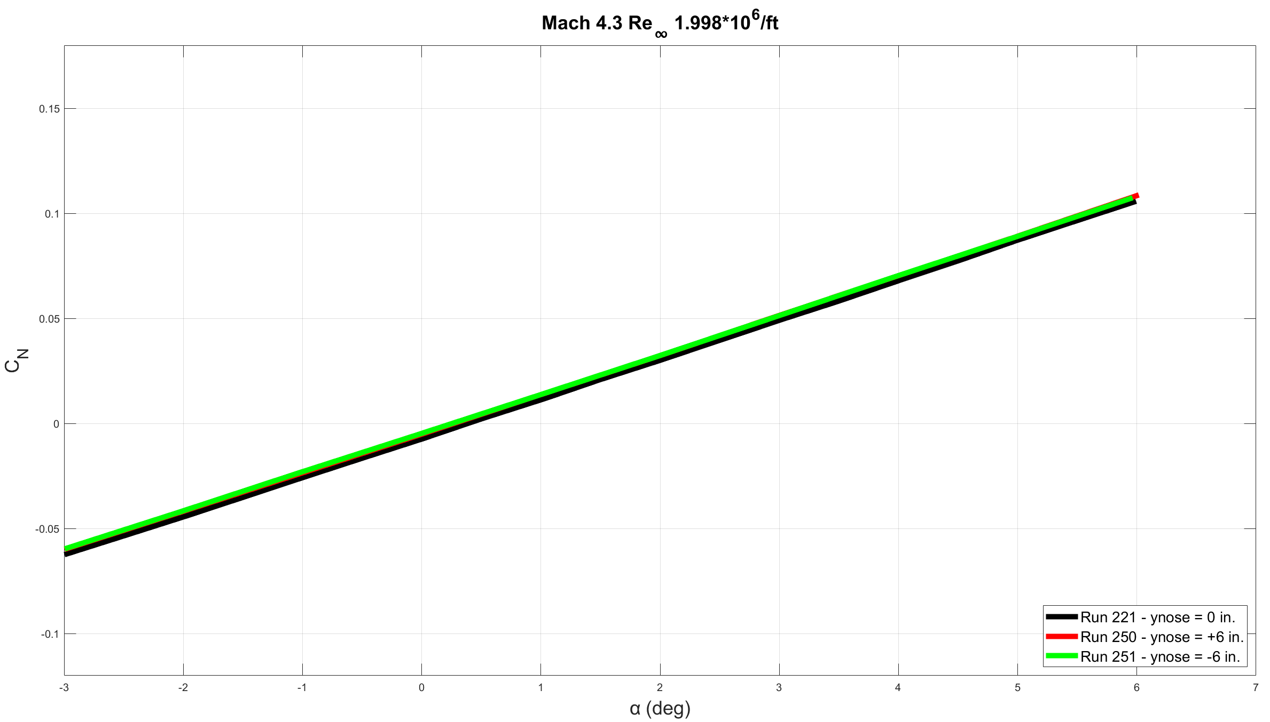
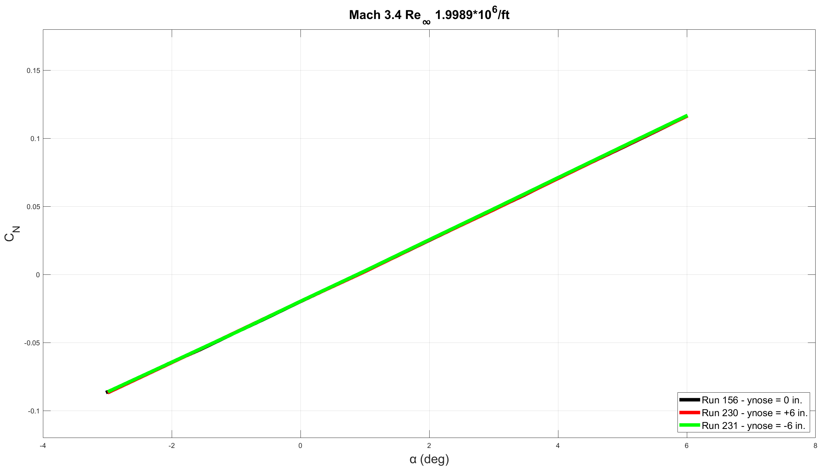
NF Coefficient
Notes:
NF tracks well

Slide 11
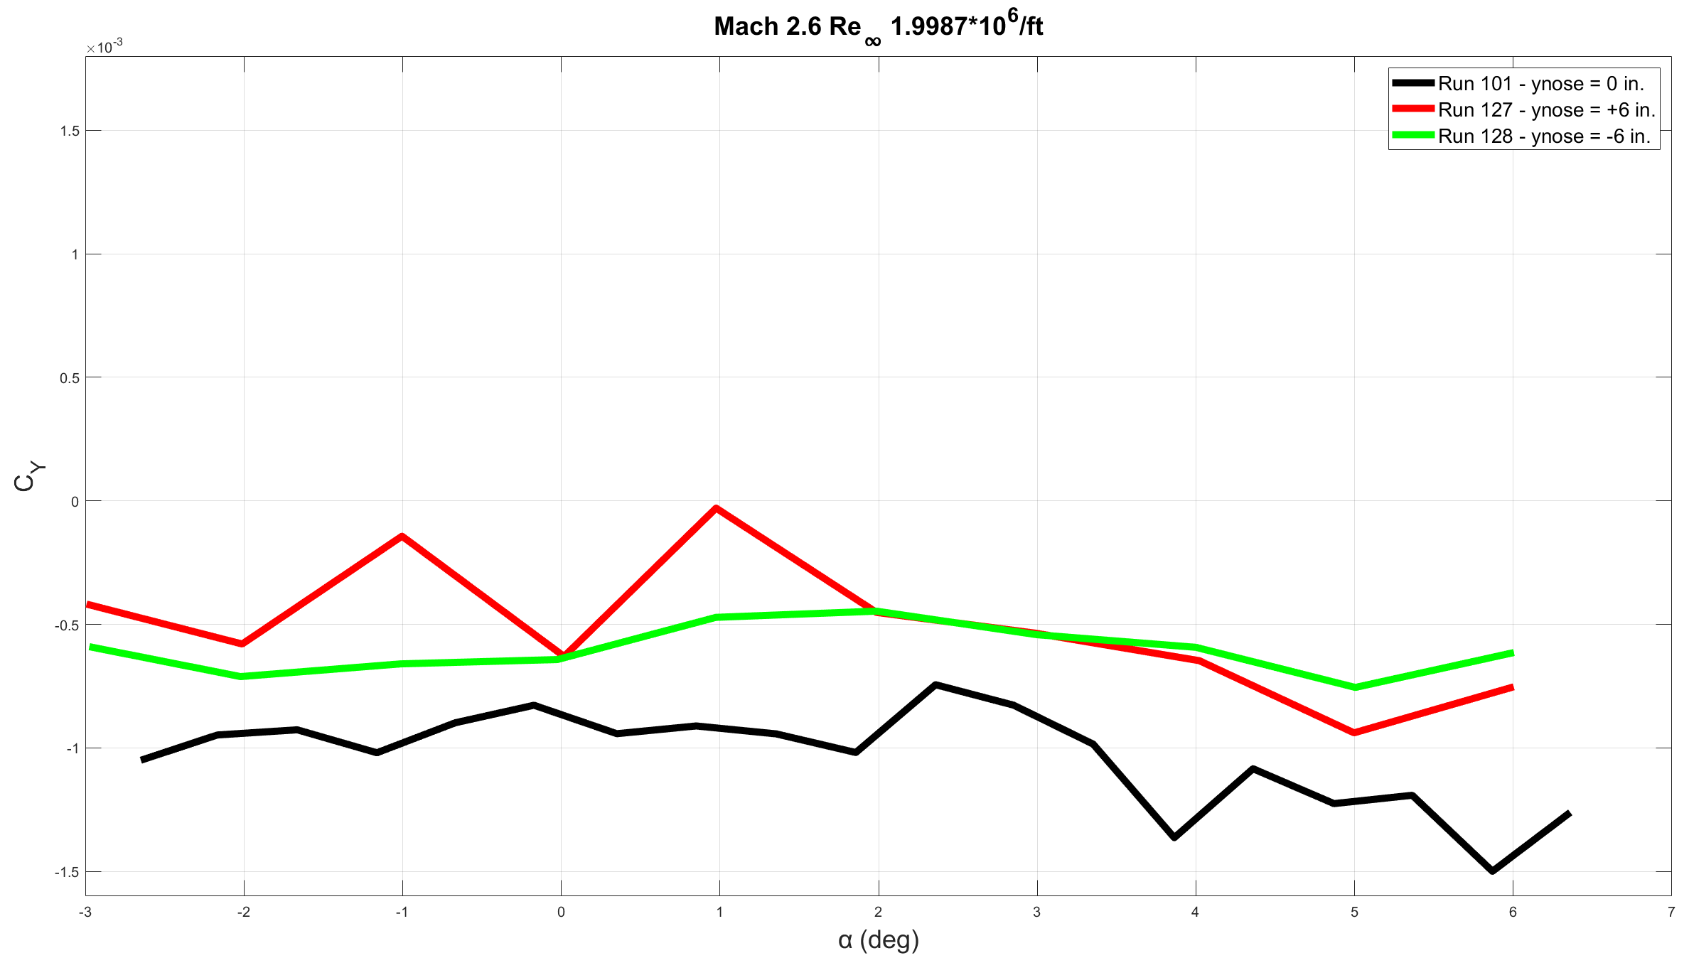
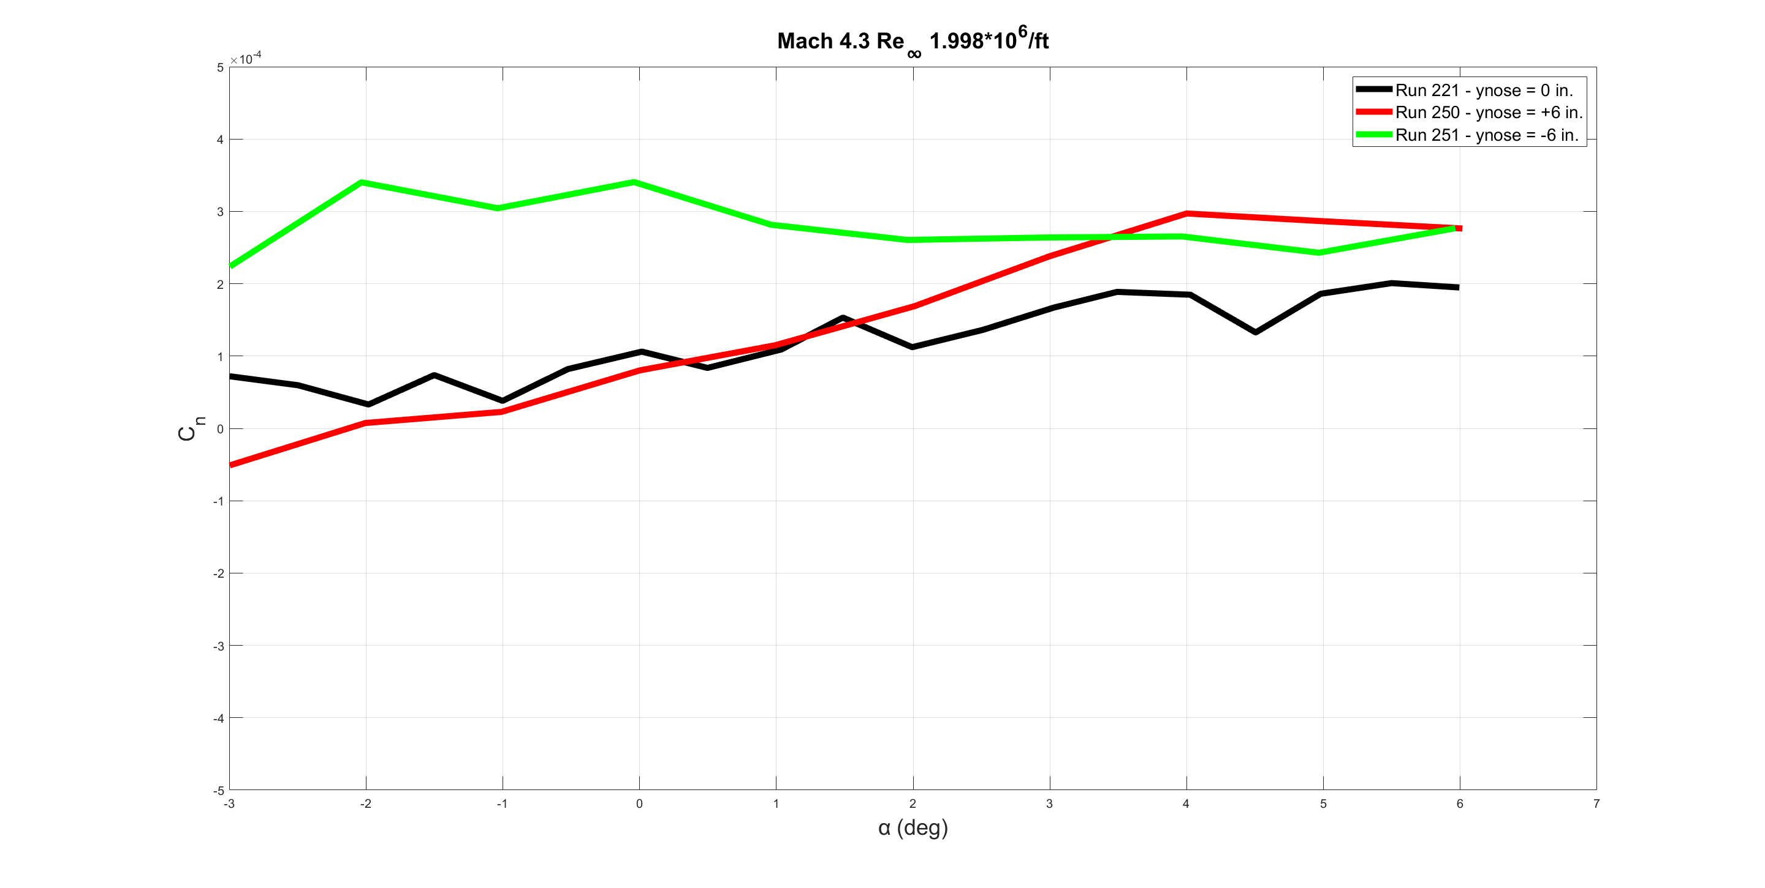
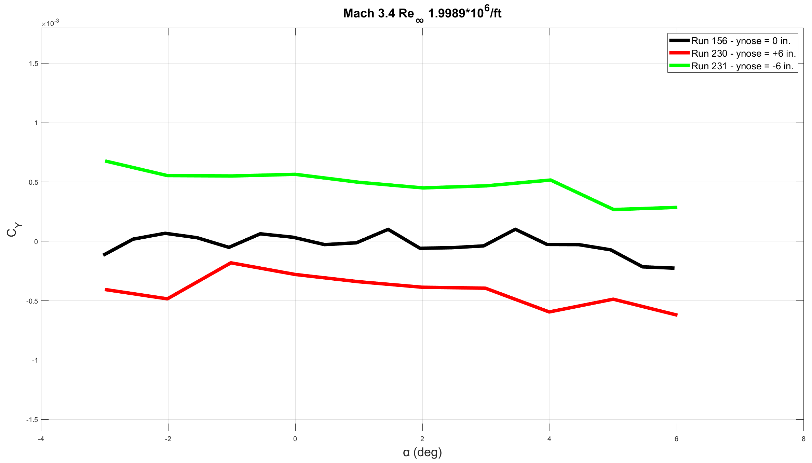
SF Coefficient
Notes:
SF coefficient at centerline increases more rapidly as Mach number increases, hard to tell if caused by vortex or not

Slide 12
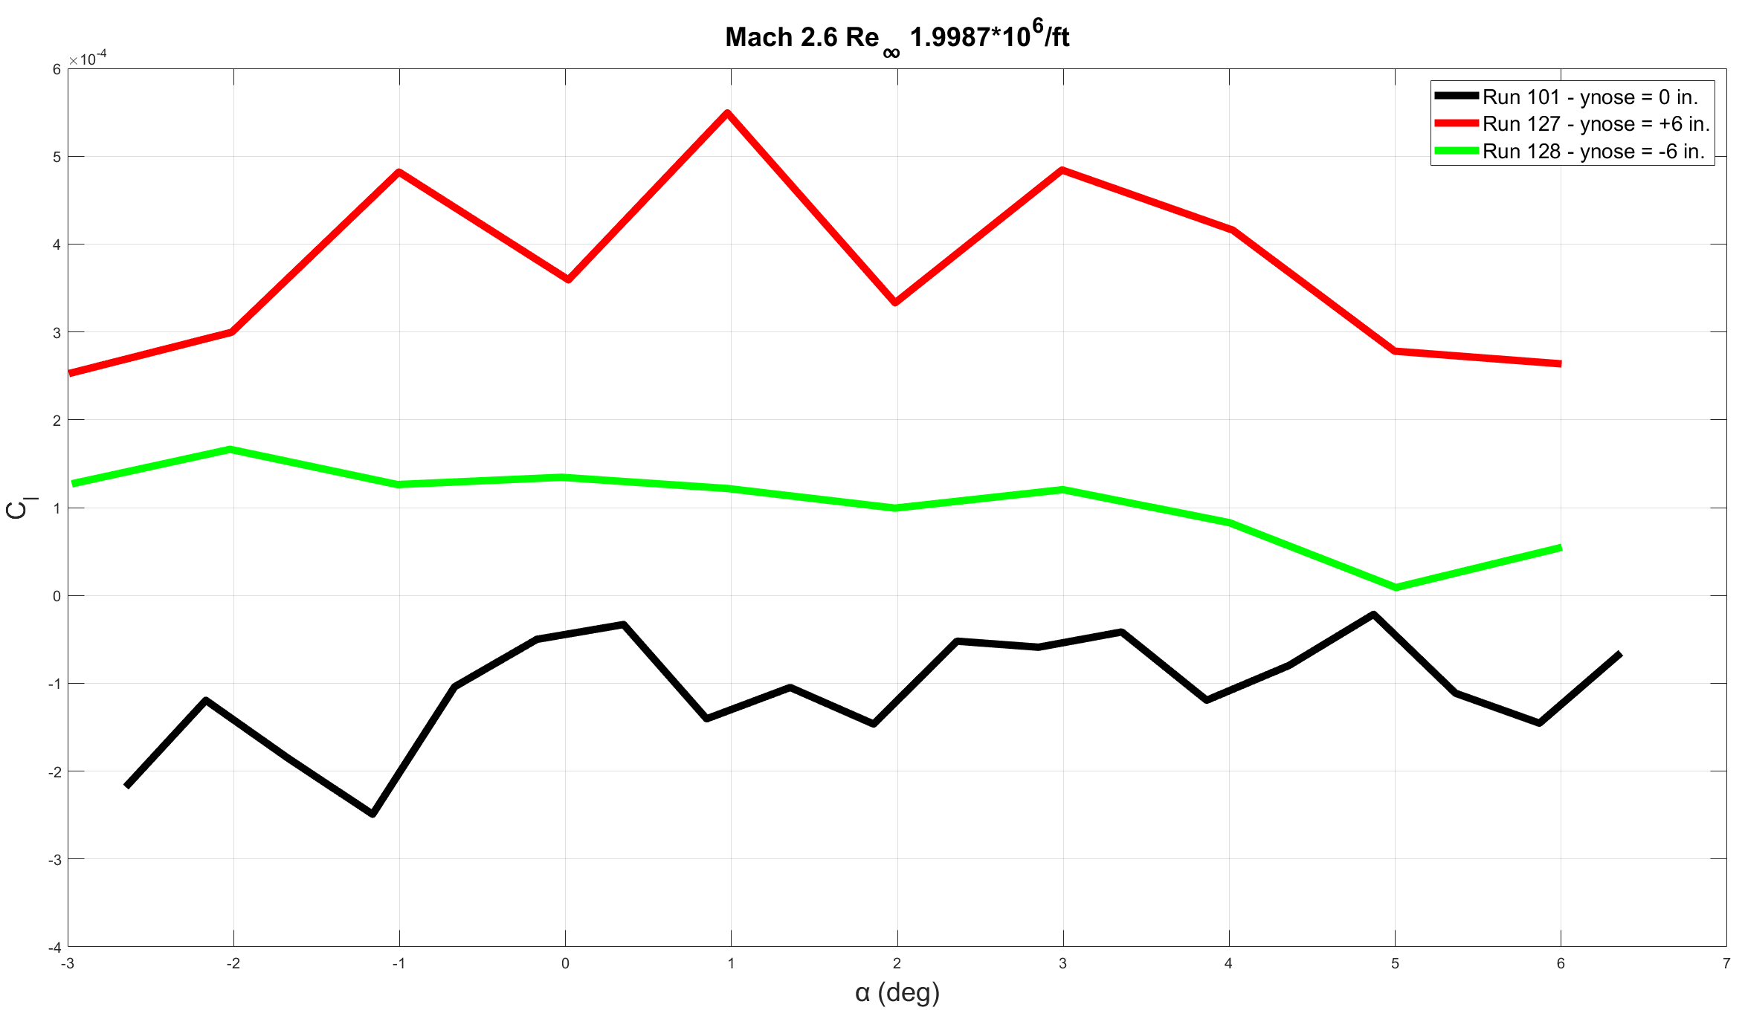
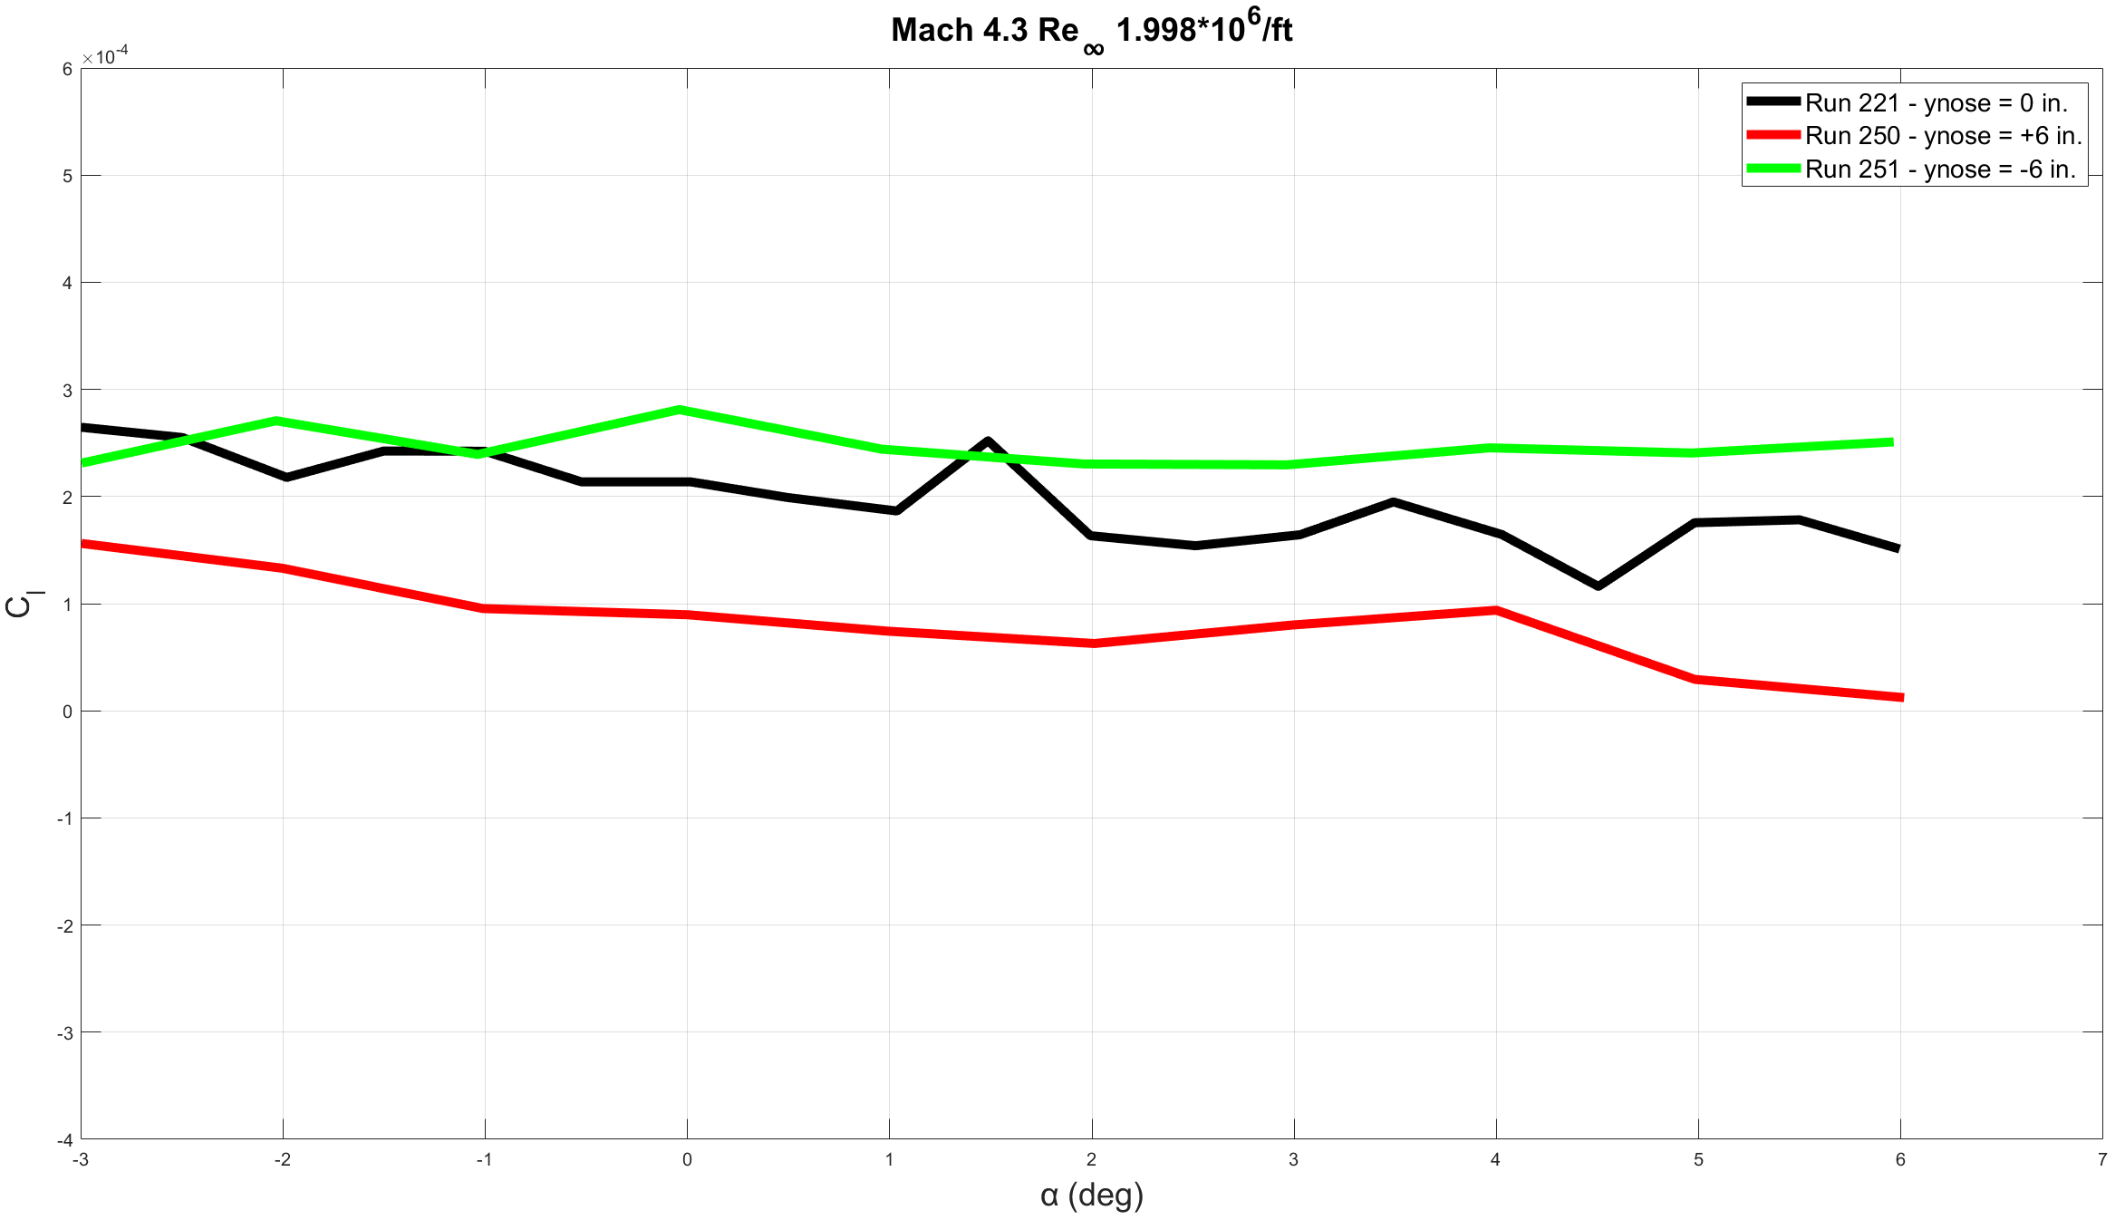
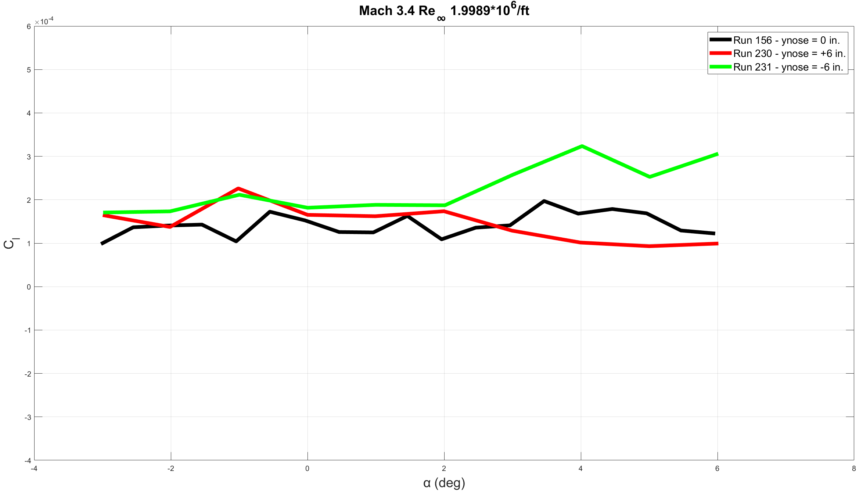
RM Coefficient
Notes:
At lower Mach, RM coefficient is than when negative when on-centerline. More dispersion of data at lower Mach number. For higher Mach numbers, centerline data tracks off-center data well

Slide 13
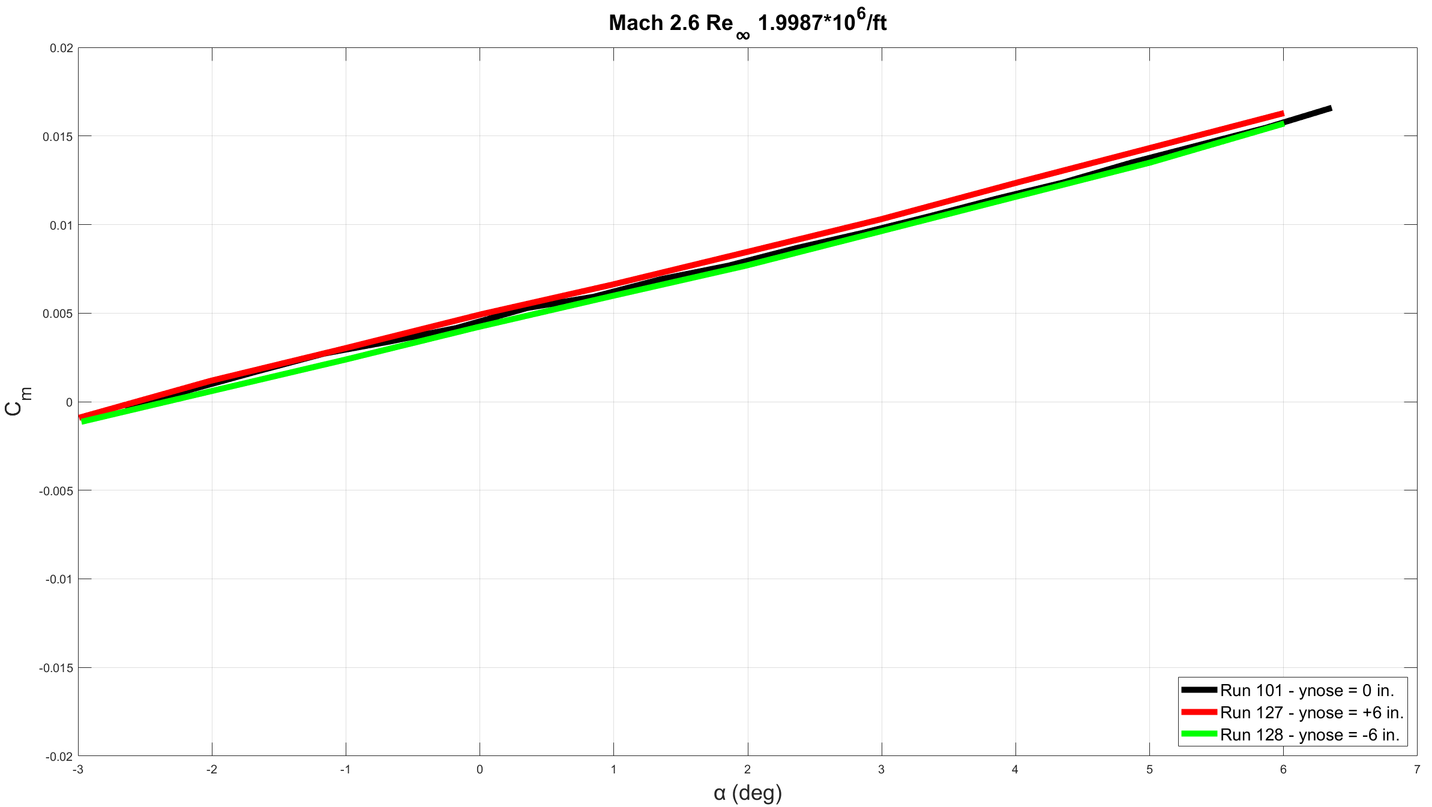
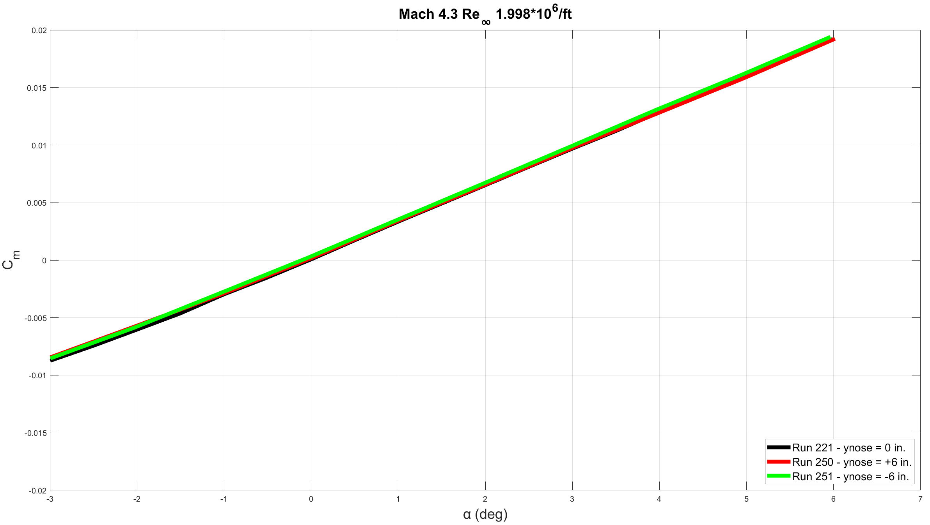
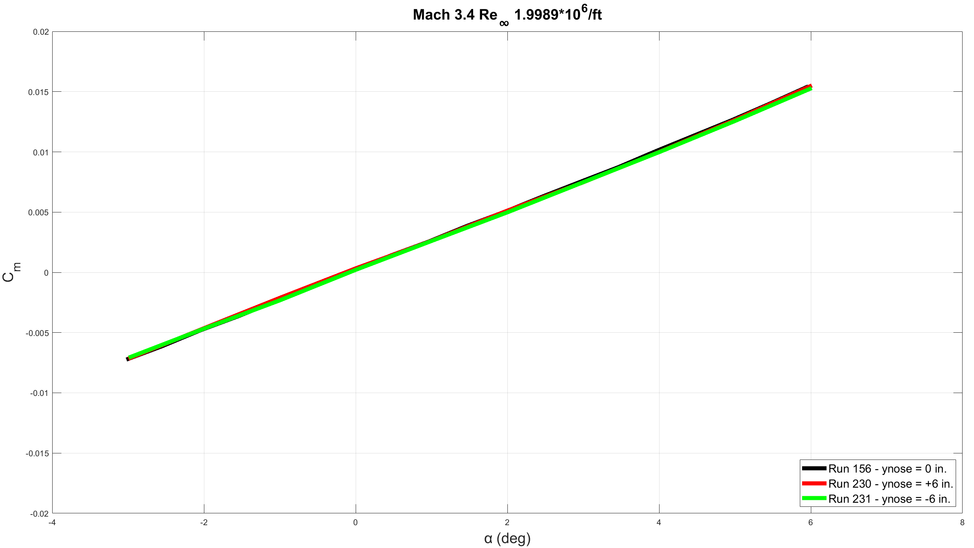
PM Coefficient
Notes:
PM coefficient data appears to track well

Slide 14
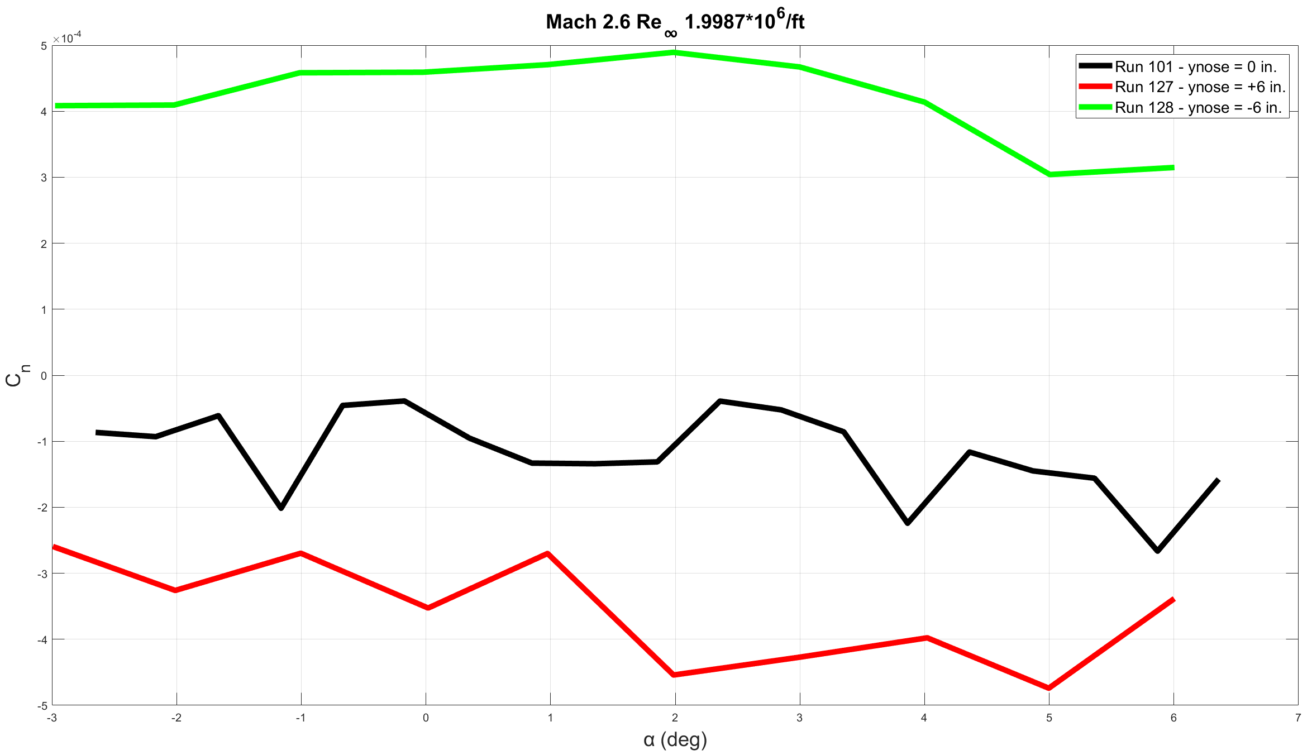
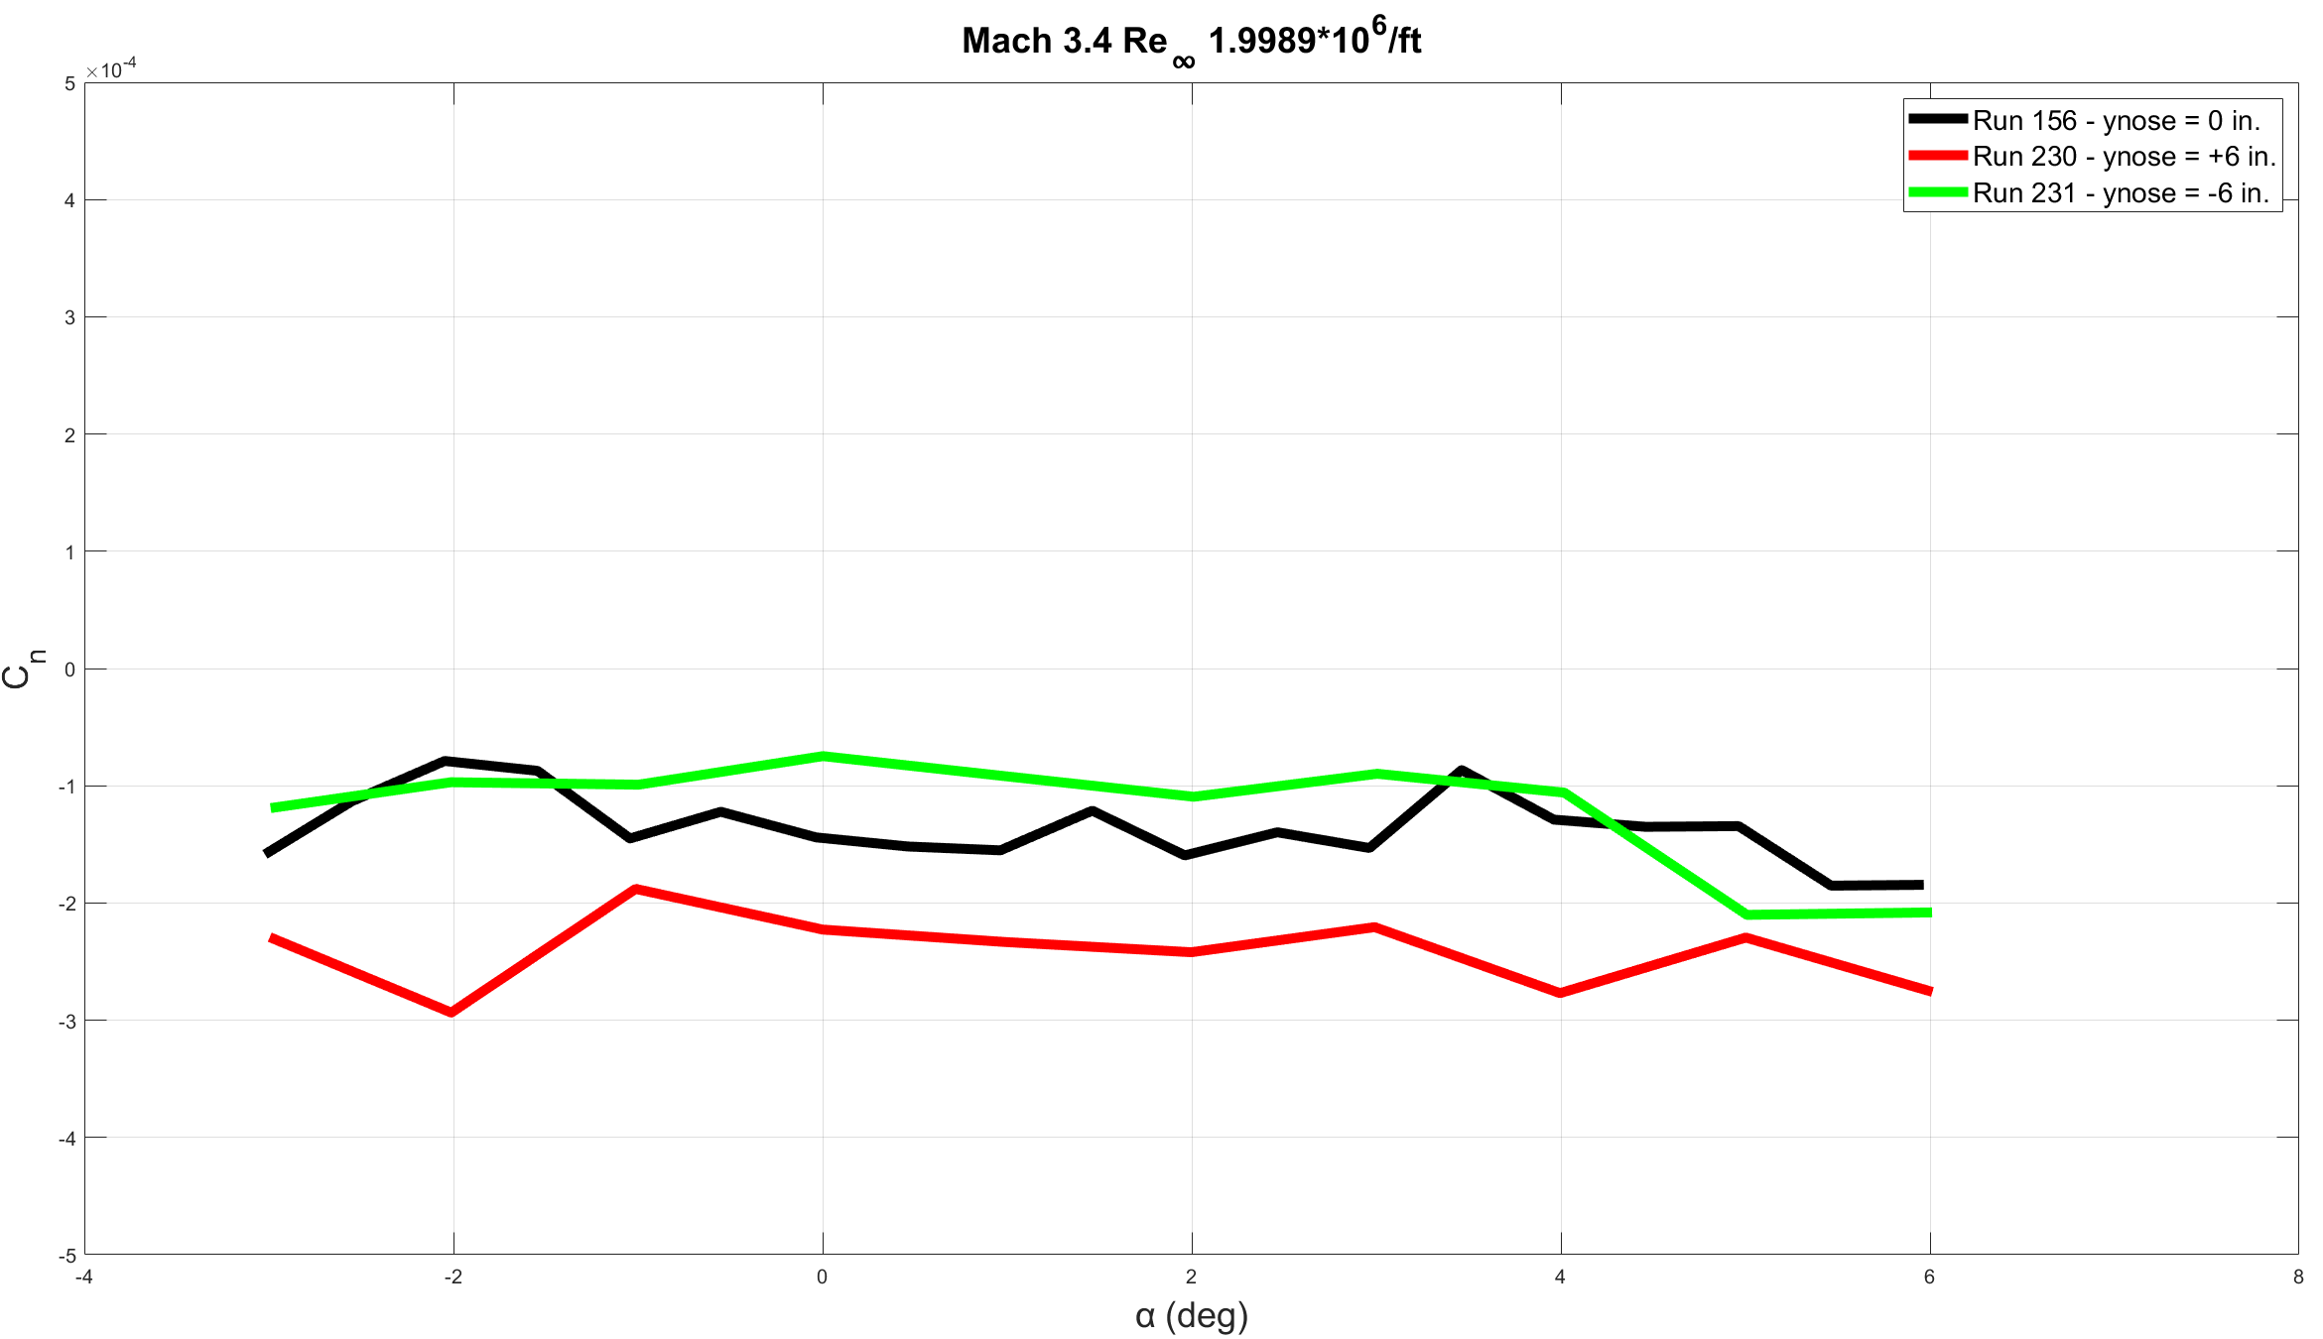
YM Coefficient
Notes:
At lower Mach number, YM coefficient data appears to be more spread apart, but tightens up as Mach number increases

Slide 15
Lateral Sweep Results

Slide 16
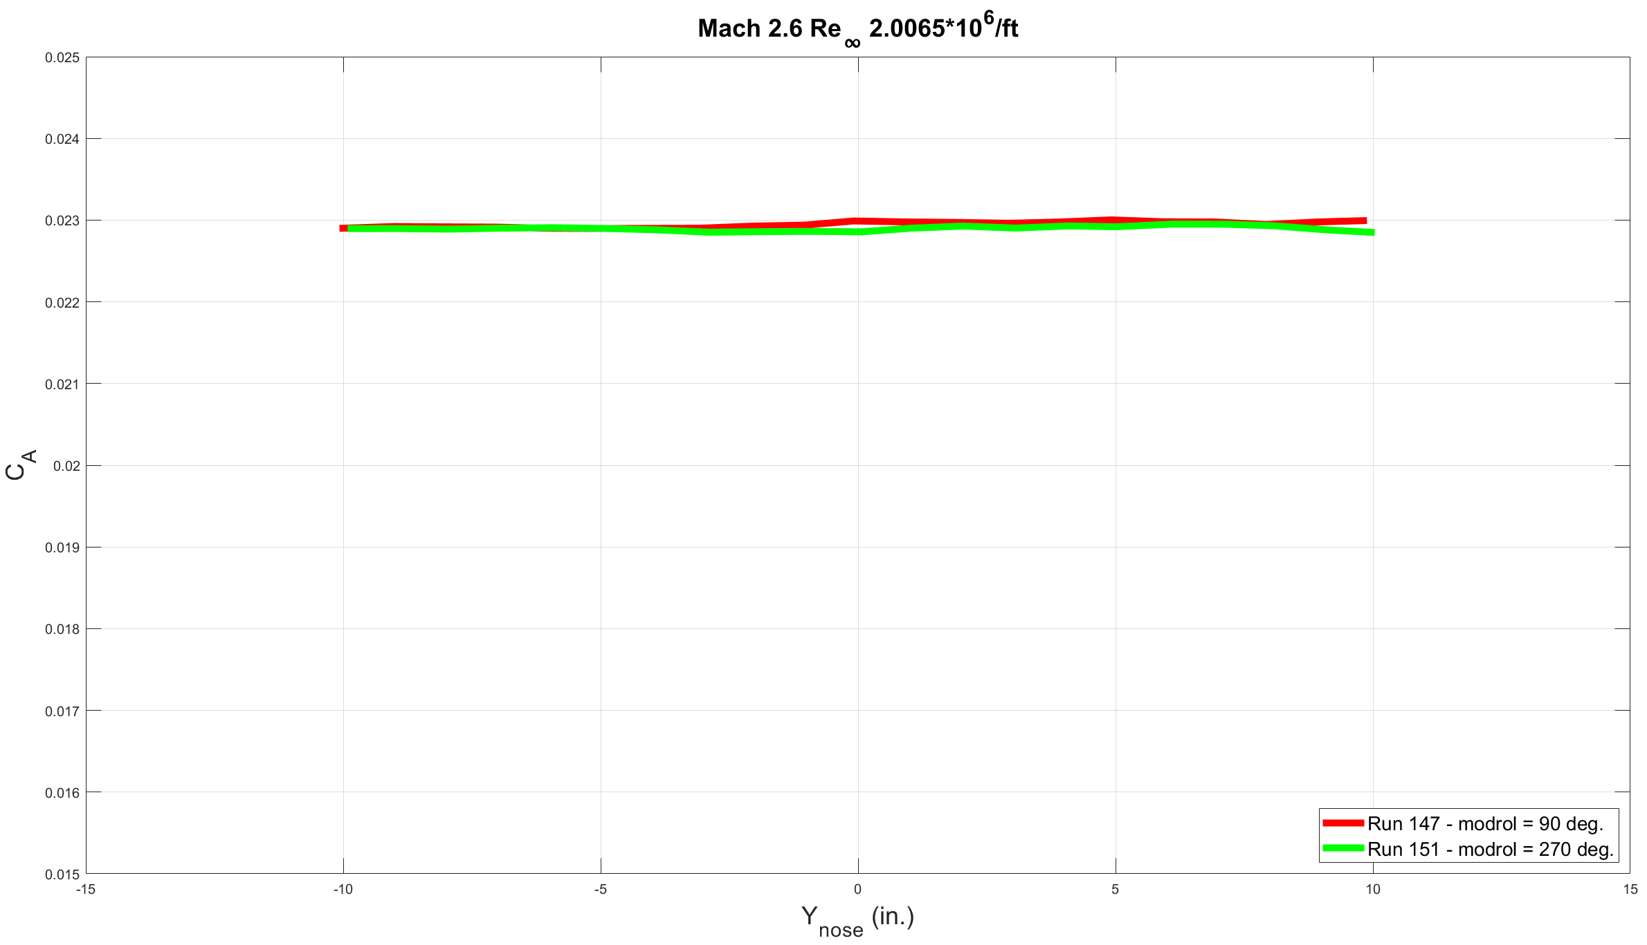
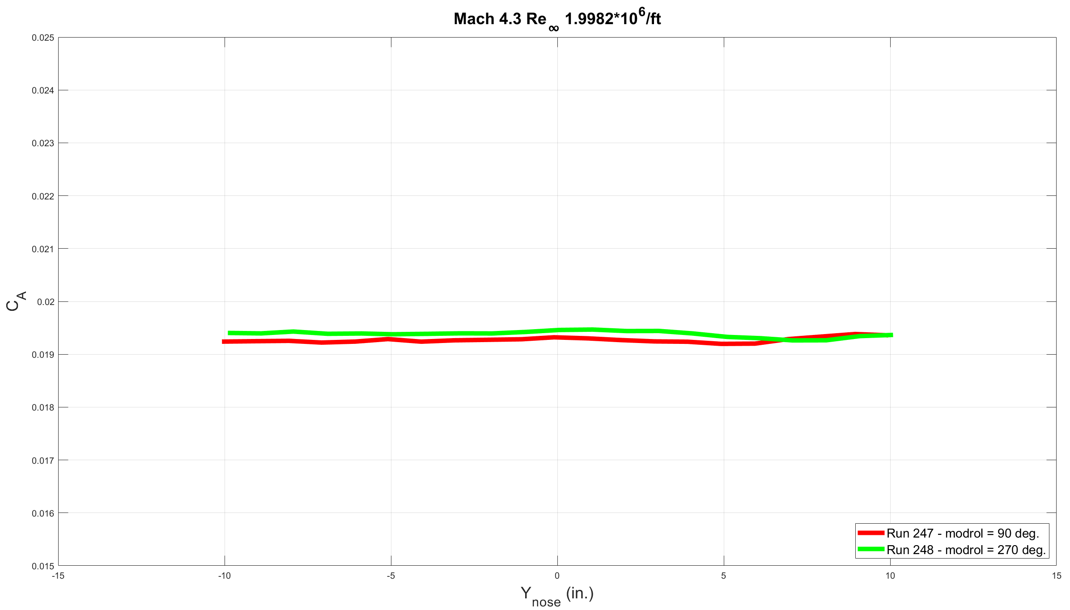
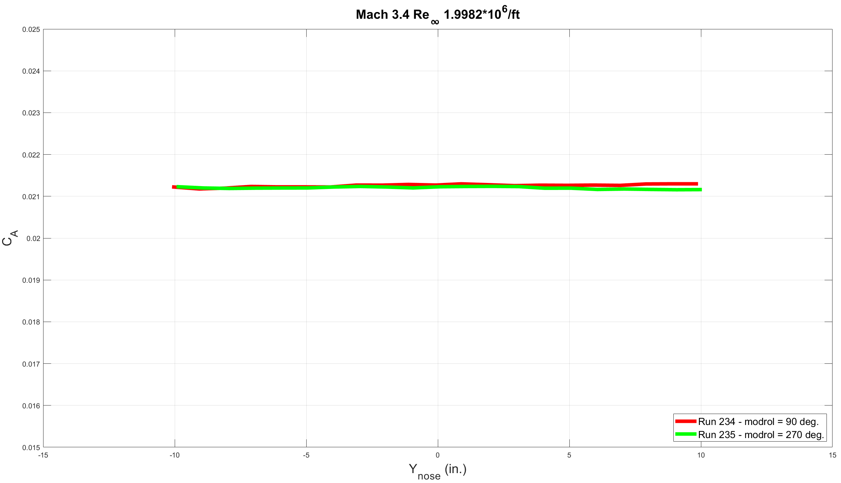
AF Coefficient
Notes:
AF coefficient data tracks well

Slide 17
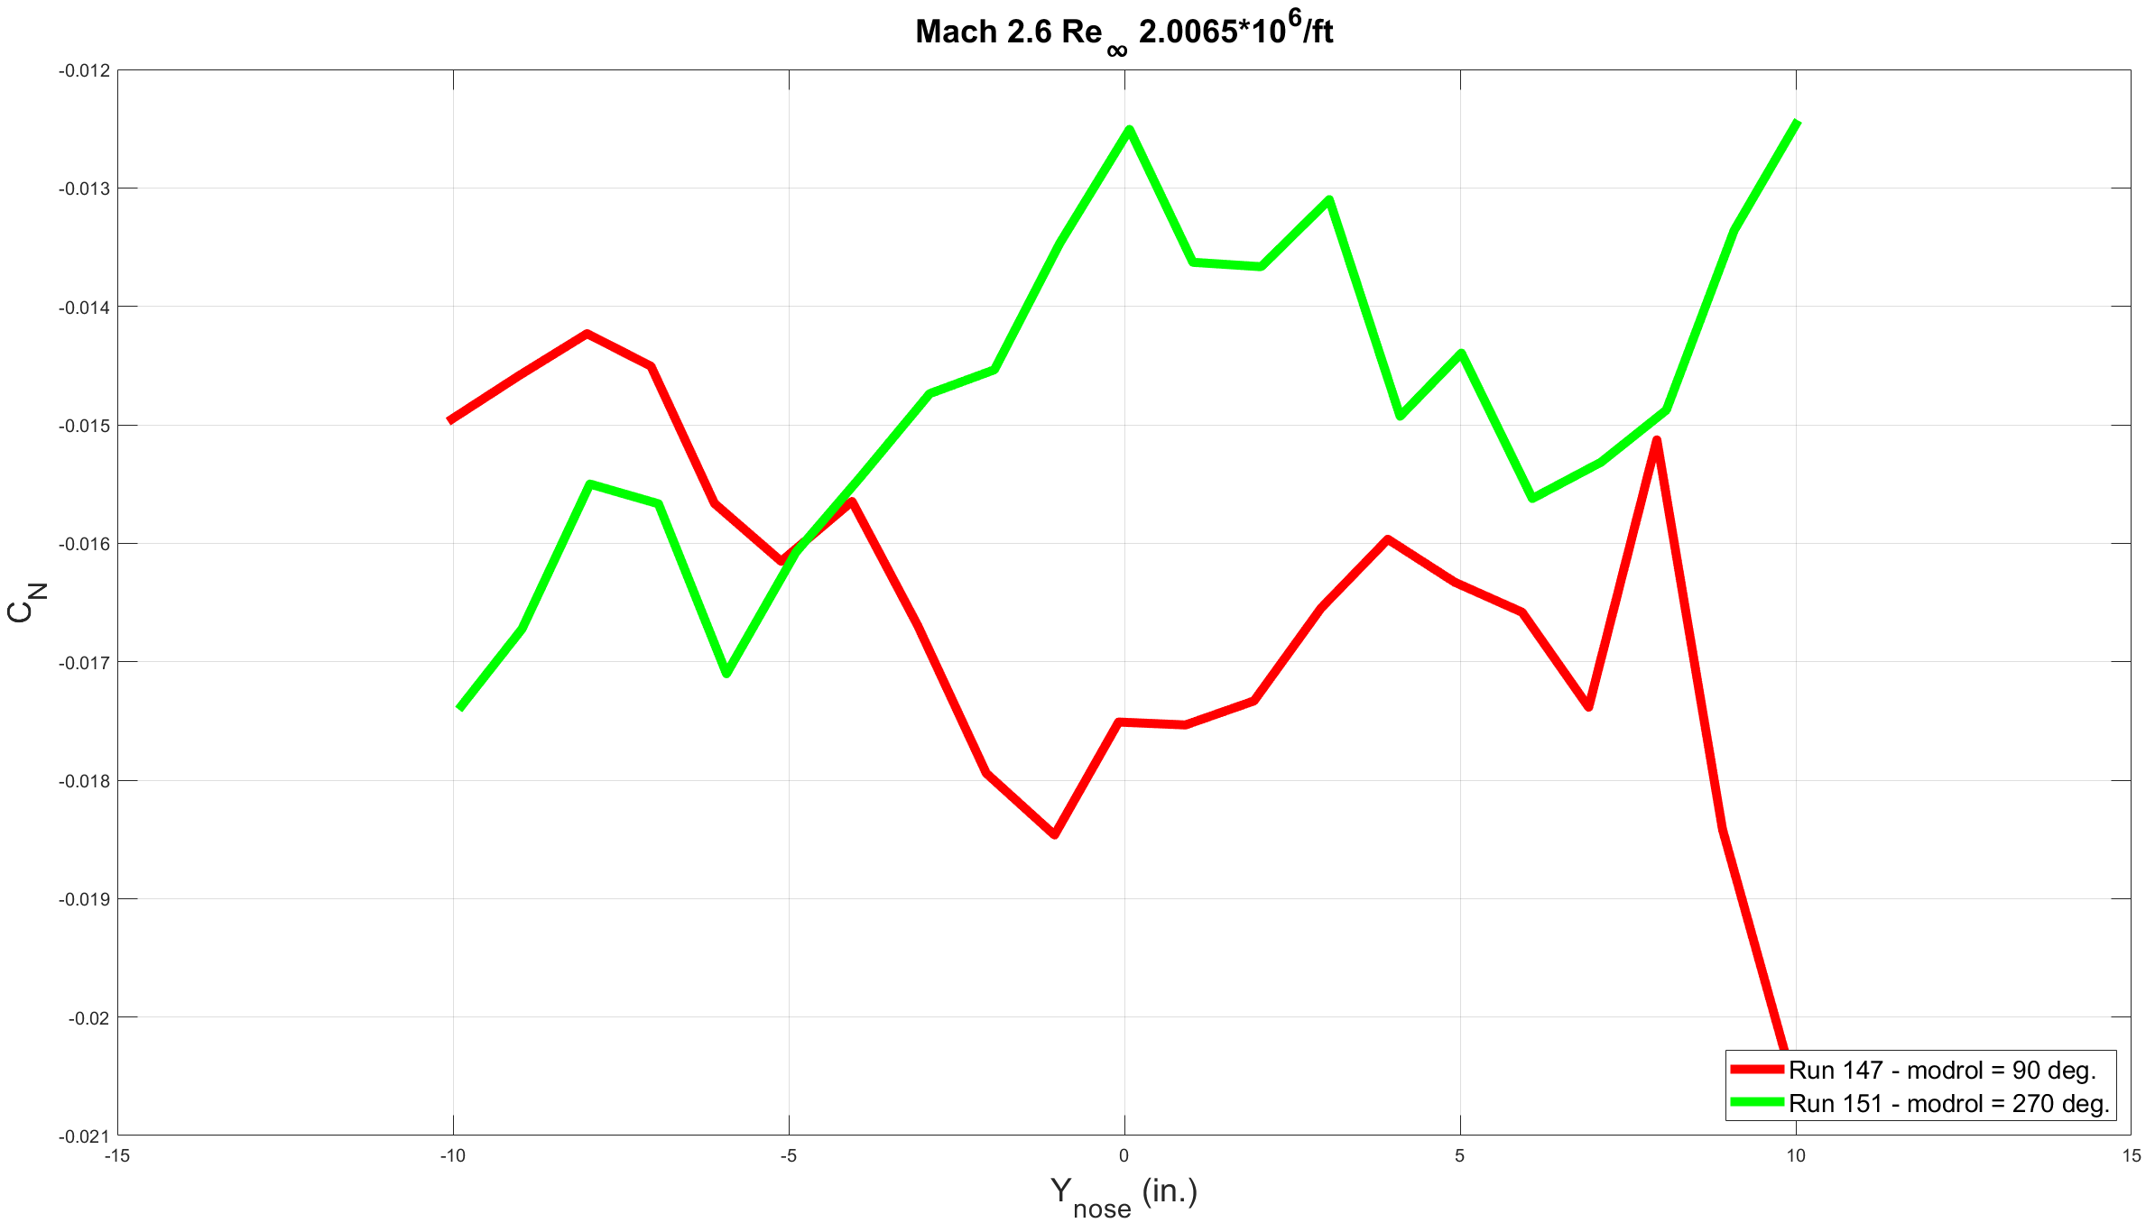
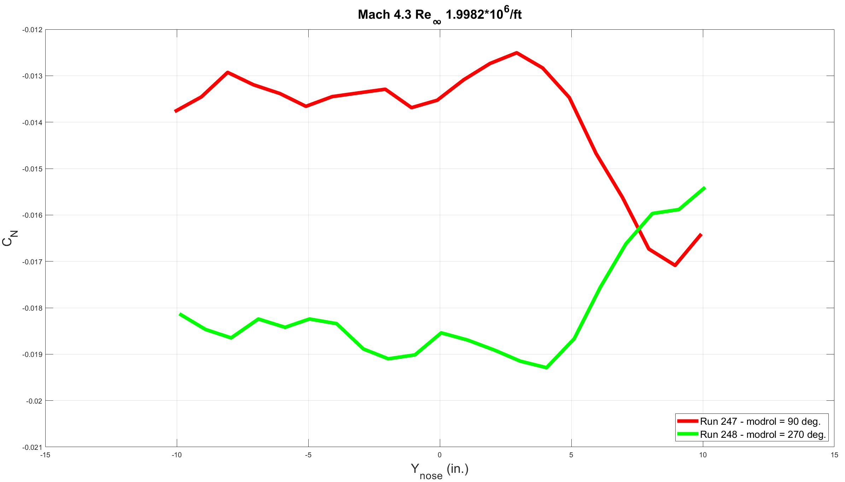
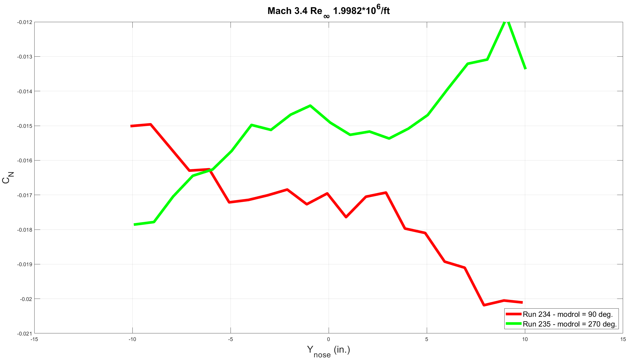
NF Coefficient
Notes:
Trends in NF coefficient appear to be mirrored as model moves laterally across test section, with a bump in the center at Mach 2.6. Weird things happening at sides around +10 in. Maybe vertical tail is catching sidewall vortex? NF trends are closer together at Mach 2.4, bubble at centerline appears to flatten as Mach number increases

Slide 18
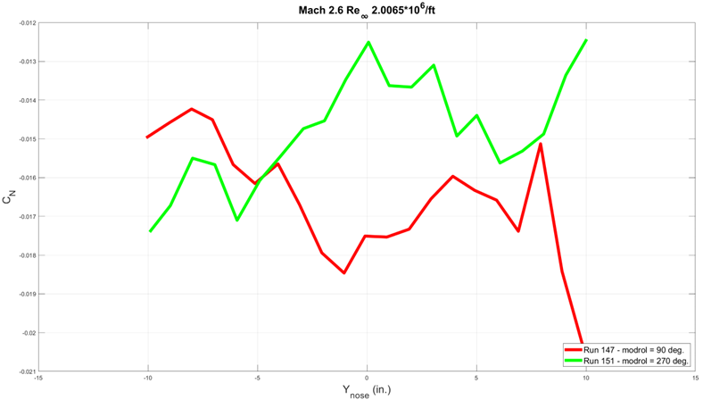
Vortex Overlay - NF
Notes:
Trends in NF coefficient appear to be mirrored as model moves laterally across test section, with a bump in the center at Mach 2.6. Weird things happening at sides around +10 in. Maybe vertical tail is catching sidewall vortex? NF trends are closer together at Mach 2.4, bubble at centerline appears to flatten as Mach number increases

Slide 19
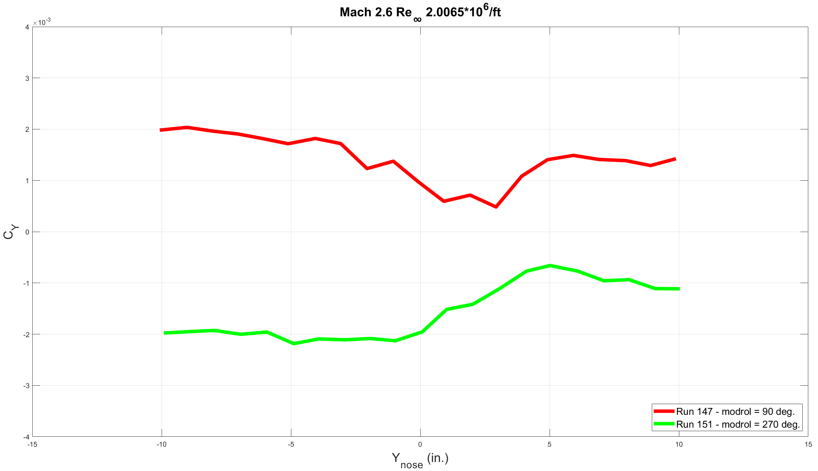
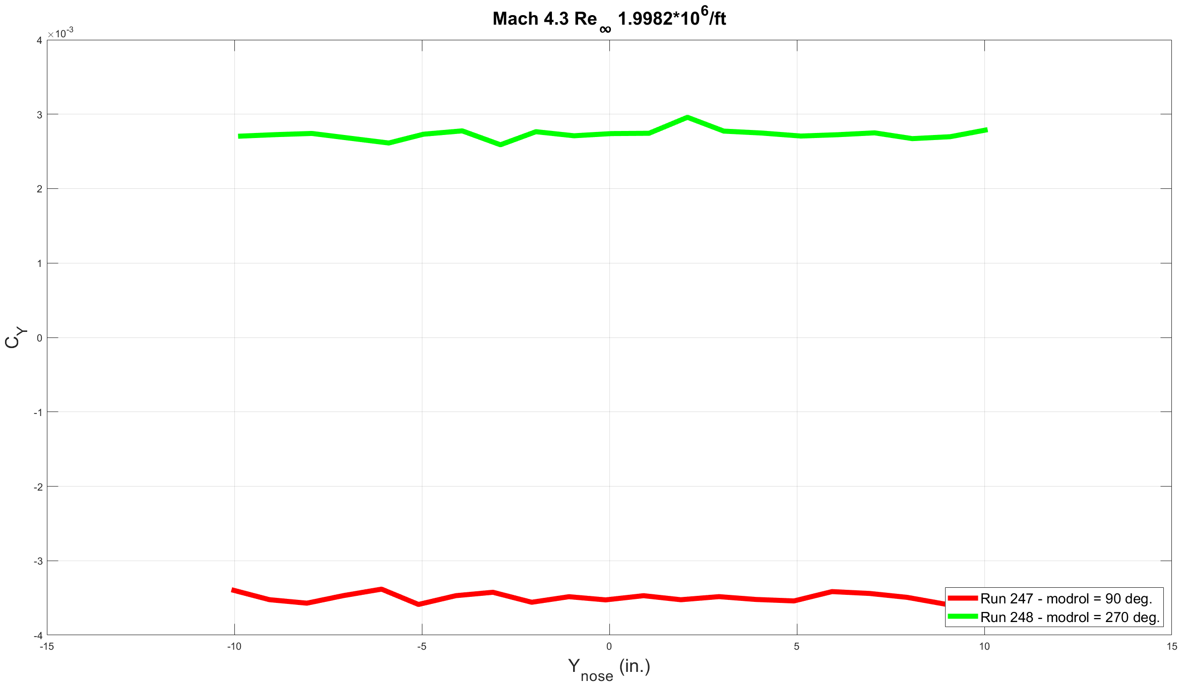
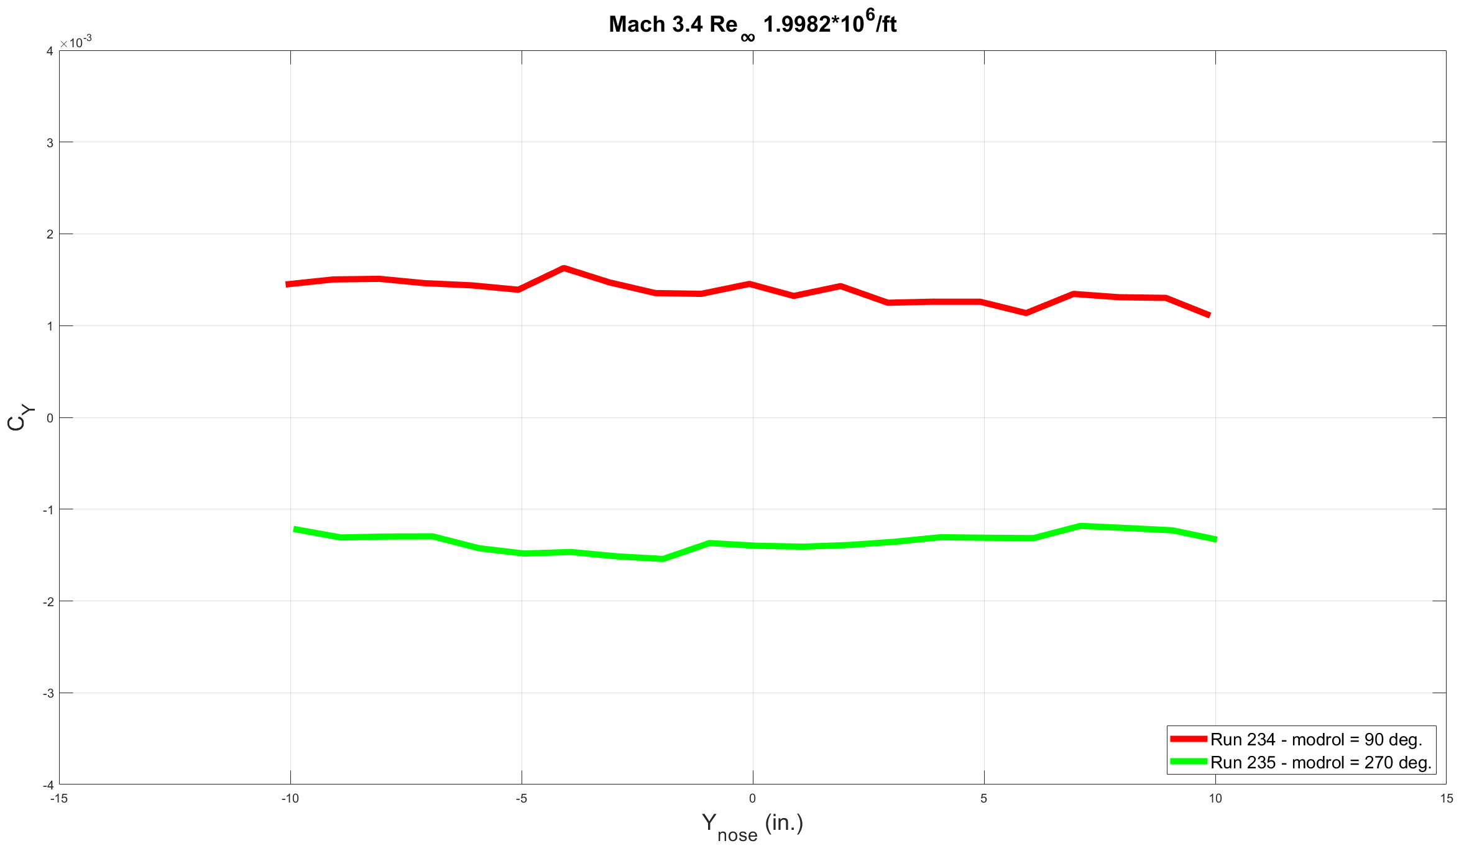
SF Coefficient
Notes:
Bubble roughly at centerline forms in data at Mach 2.4, but dissipates as Mach number increases

Slide 20
Vortex Overlay - SF
Notes:
Bubble roughly at centerline forms in data at Mach 2.4, but dissipates as Mach number increases

Slide 21
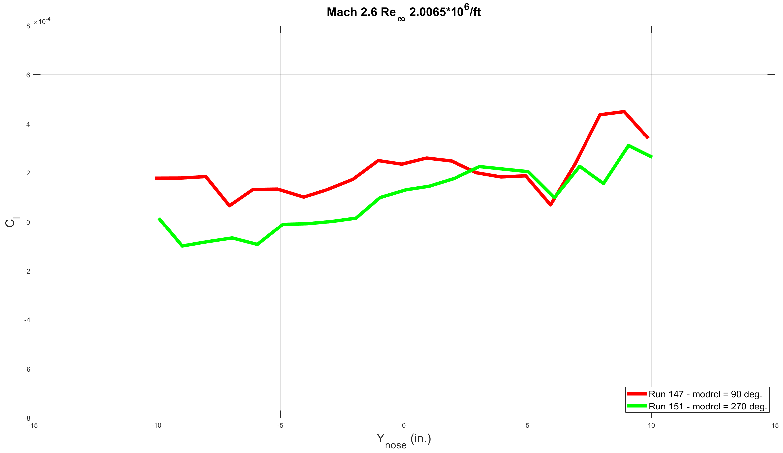
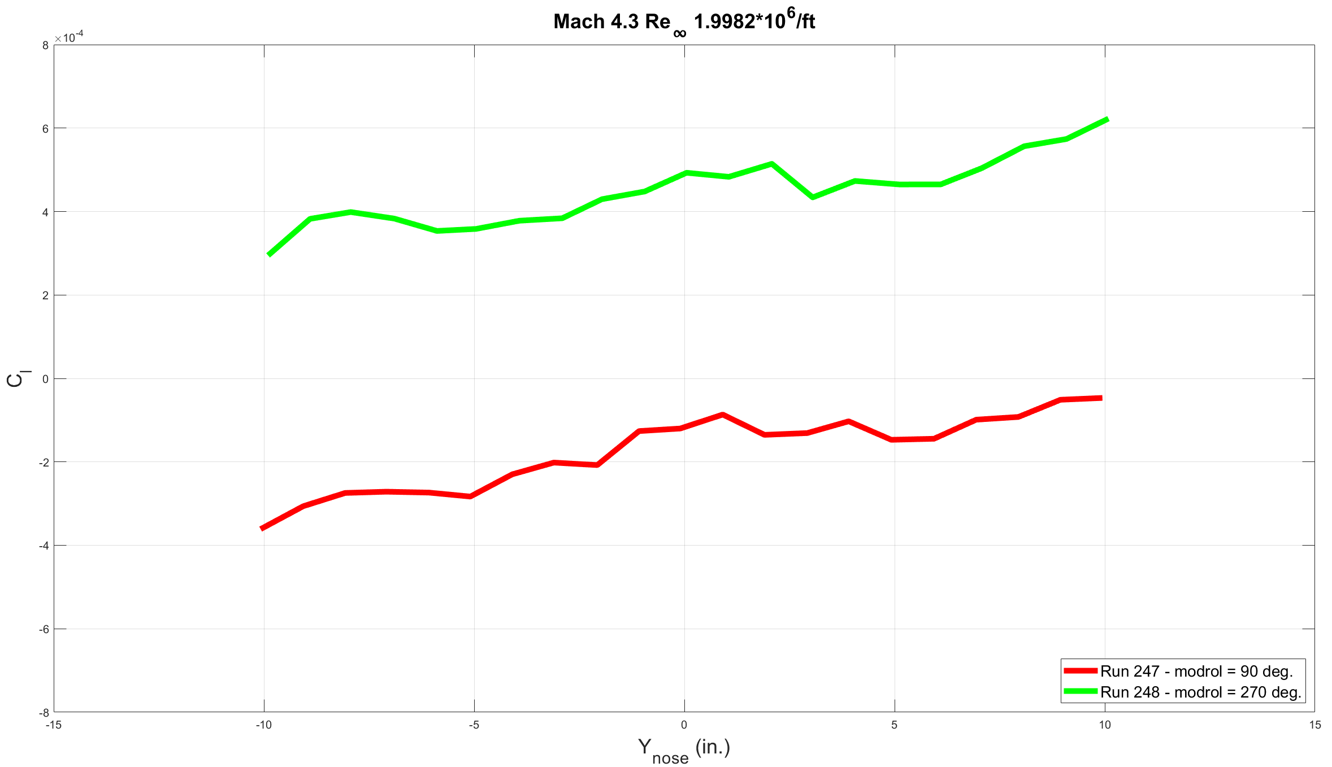
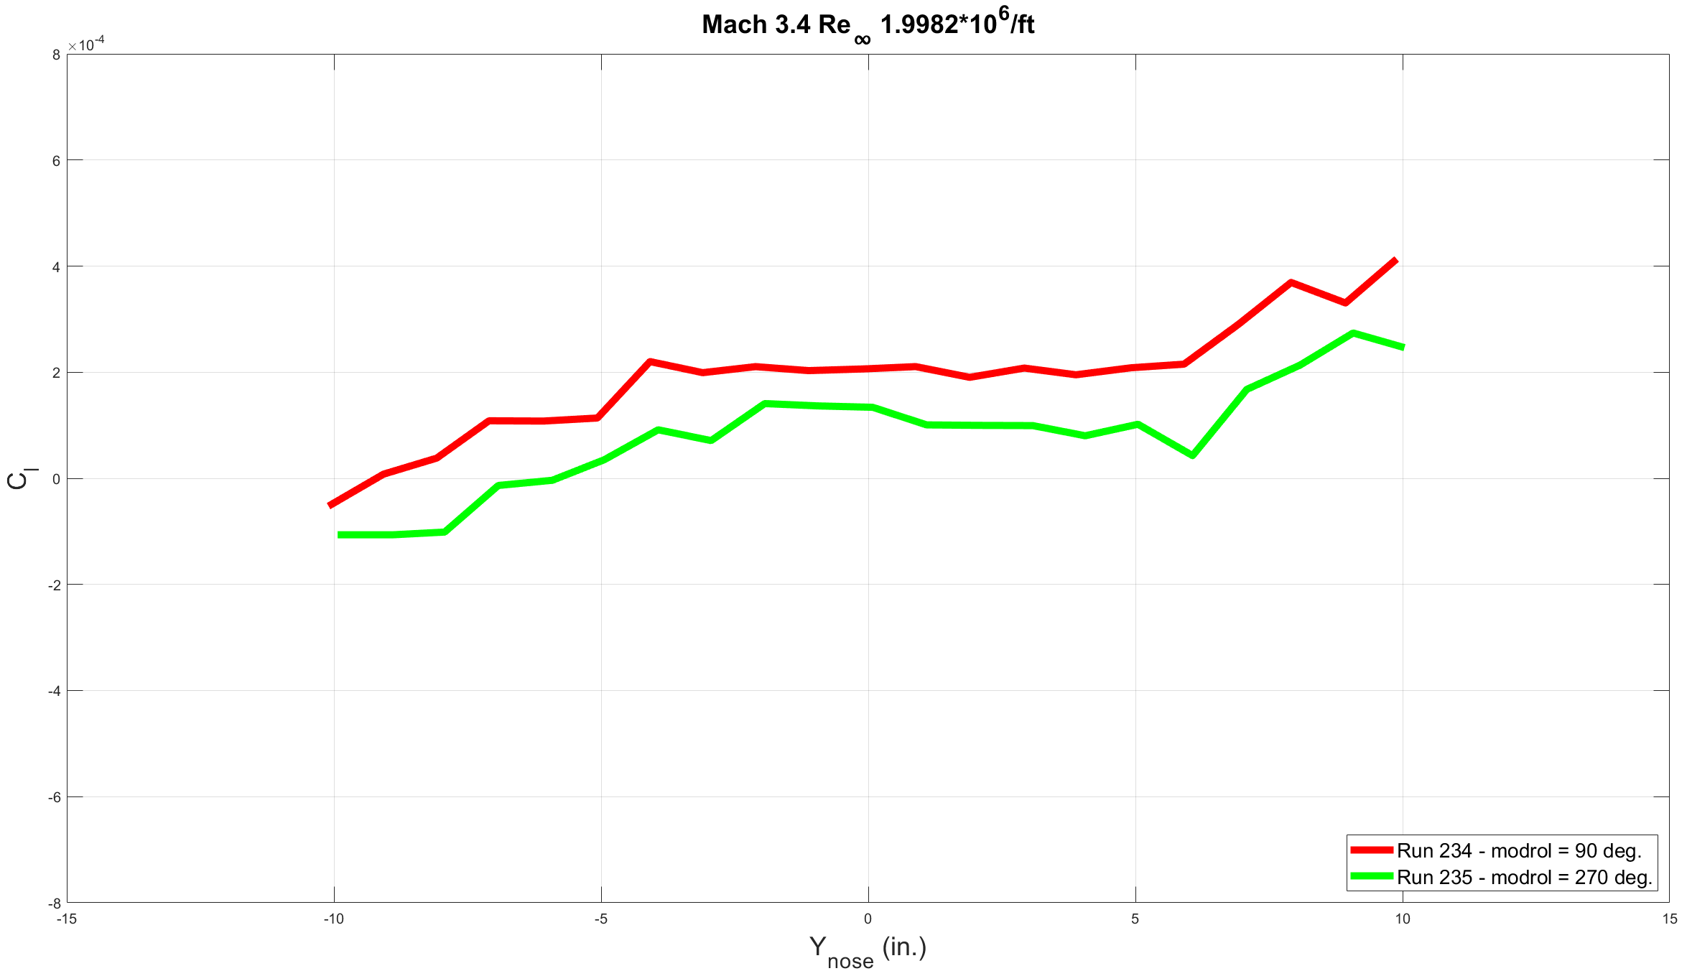
RM Coefficient
Notes:
RM coefficient trends track each other well. Data crosses at Mach 2.4 near centerline and not at other Mach numbers. Hard to tell if caused by presence of vortex

Slide 22
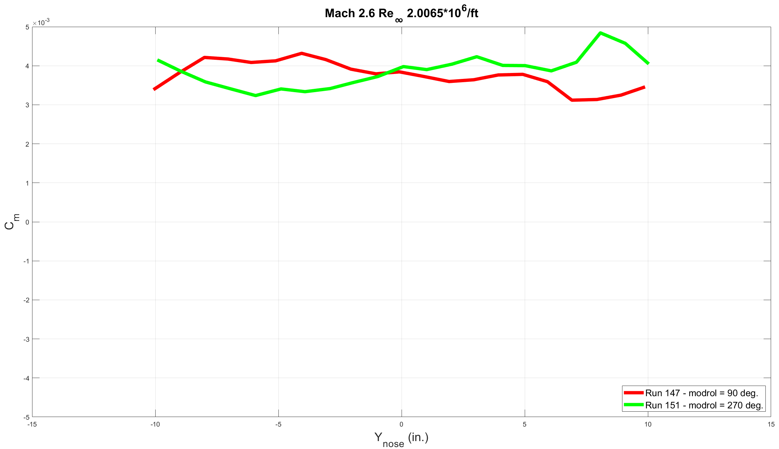
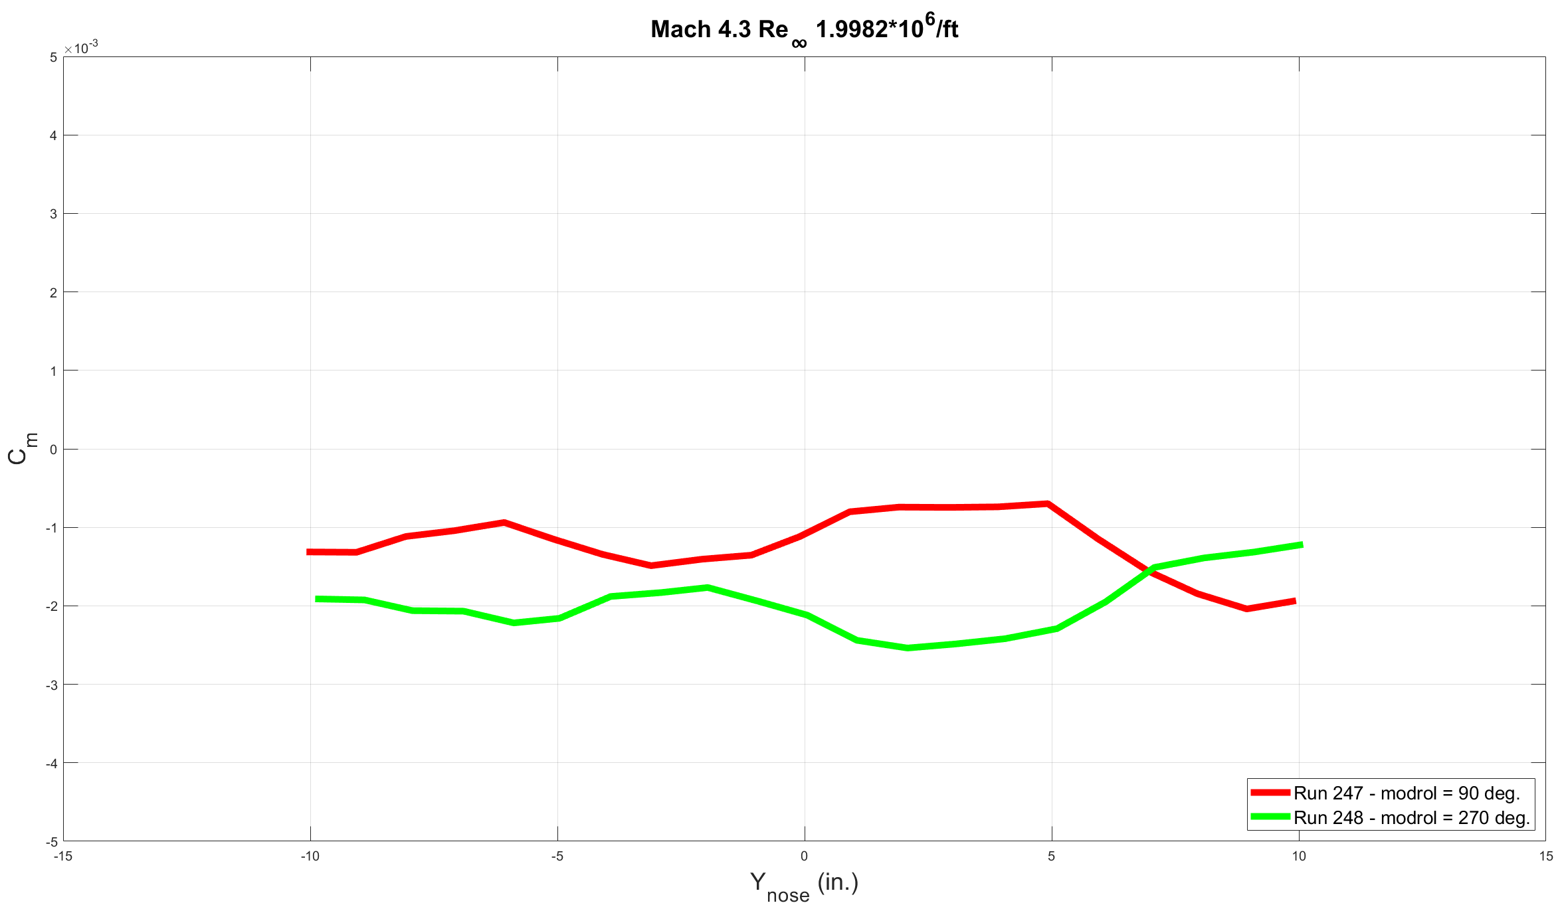
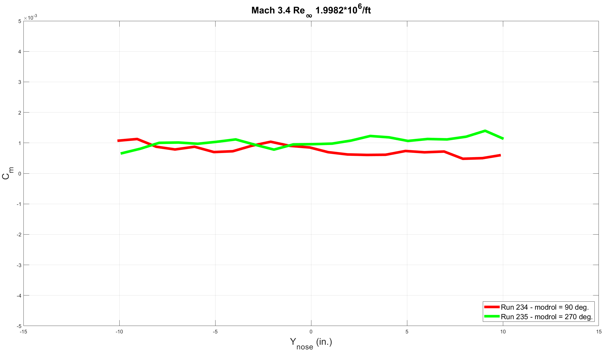
PM Coefficient
Notes:
PM coefficient tracks well at all Mach numbers. Some symmetry present as model moves across test section. Not seeing much influence from vortex

Slide 23
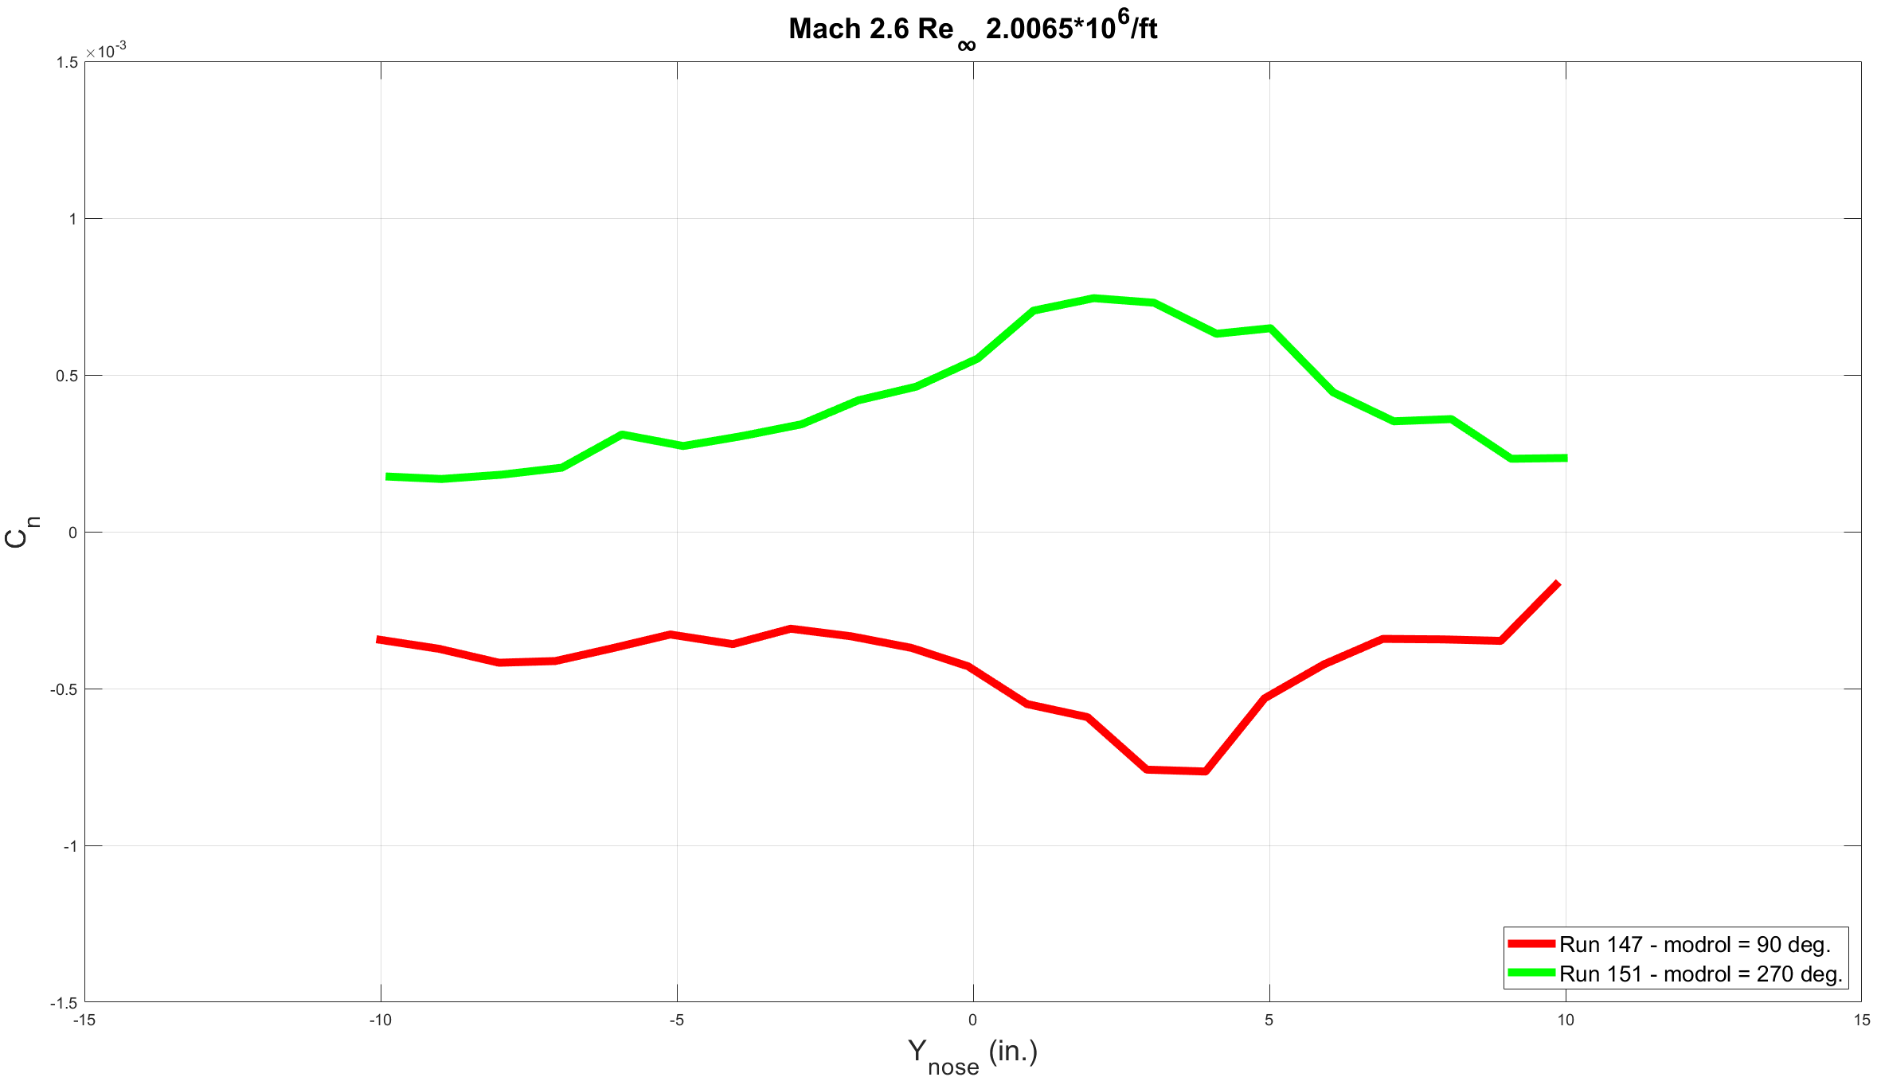
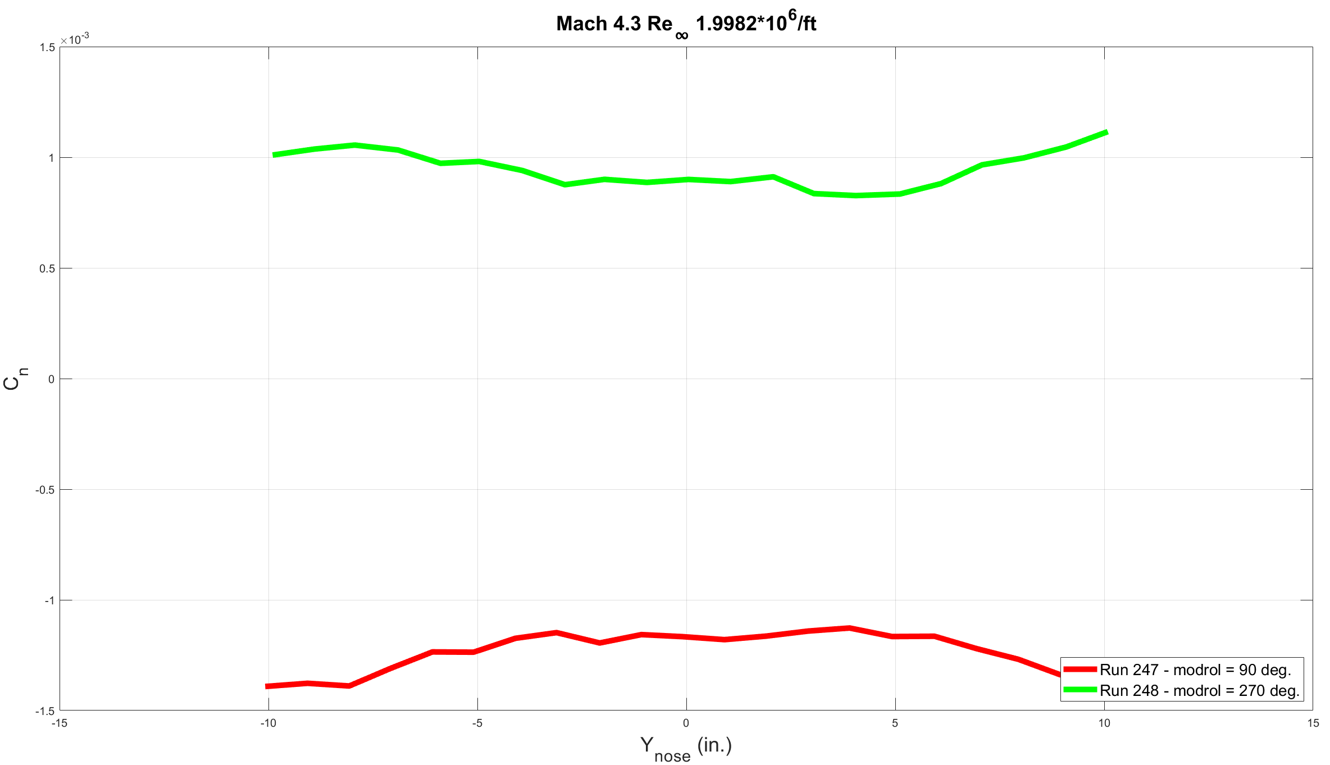
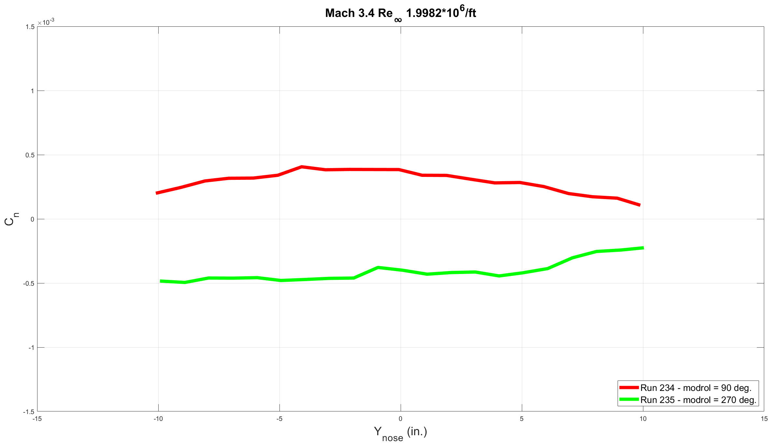
YM Coefficient
Notes:
Large bubble in data at Mach 2.4, right near centerline. Bubble dissipates as Mach number increases

Slide 24
Vortex Overlay – YM
Notes:
Large bubble in data at Mach 2.4, right near centerline. Bubble dissipates as Mach number increases

Slide 25
Uncertainty: Off-Centerline Pitch Sweep Comparisons

Slide 26
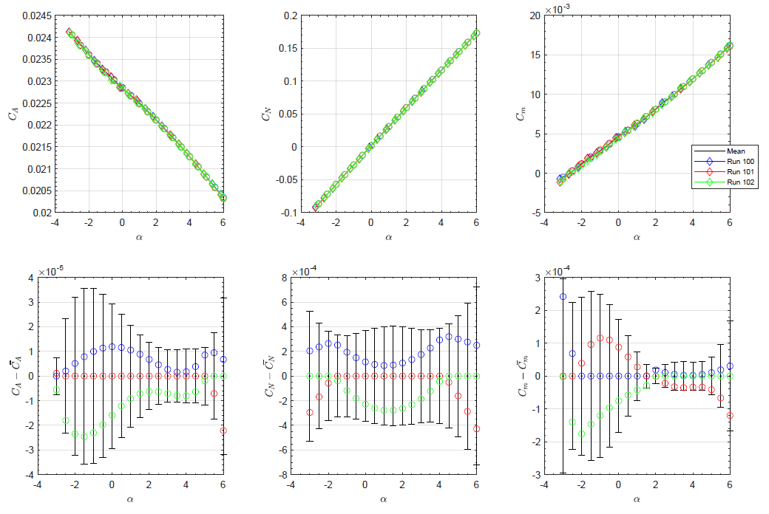
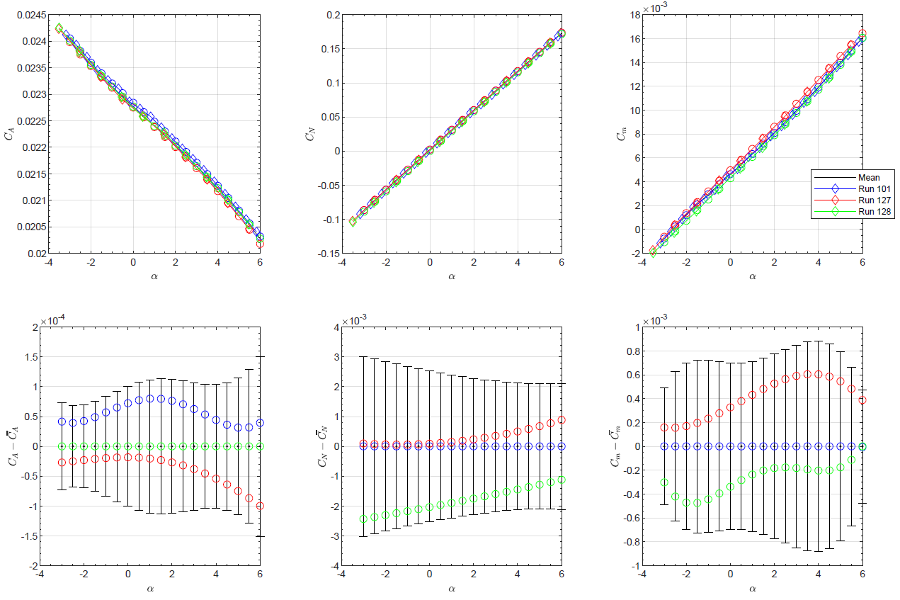
Mach 2.6 Re∞ 2.0 Million/ft
α (deg)
α (deg)
α (deg)
α (deg)
α (deg)
α (deg)
α (deg)
α (deg)
α (deg)
α (deg)
α (deg)
α (deg)
3 repeated pitch sweeps at tunnel centerline
0, +6, -6 in. pitch sweeps
Notes:
Uncertainty increases for normal force and pitching moment coefficients as model moves off centerline, but data is still within bounds

Slide 27
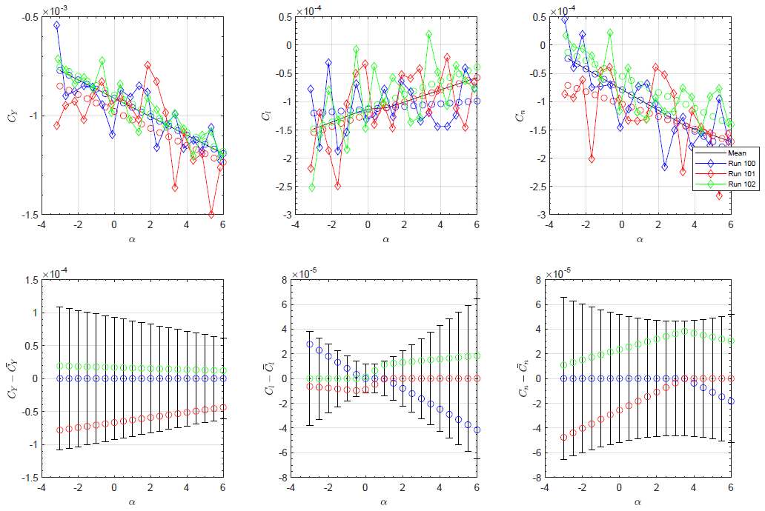
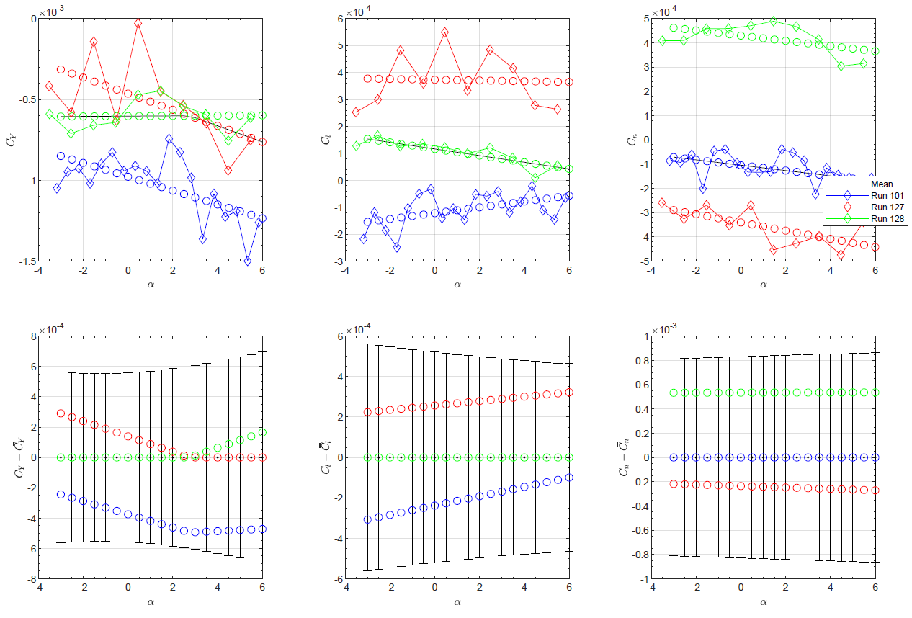
Mach 2.6 Re∞ 2.0 Million/ft
α (deg)
α (deg)
α (deg)
α (deg)
α (deg)
α (deg)
α (deg)
α (deg)
α (deg)
α (deg)
α (deg)
α (deg)
3 repeated pitch sweeps at tunnel centerline
0, +6, -6 in. pitch sweeps
Notes:
Side force, rolling moment, and yawing moment coefficient uncertainty all increase when off centerline

Slide 28
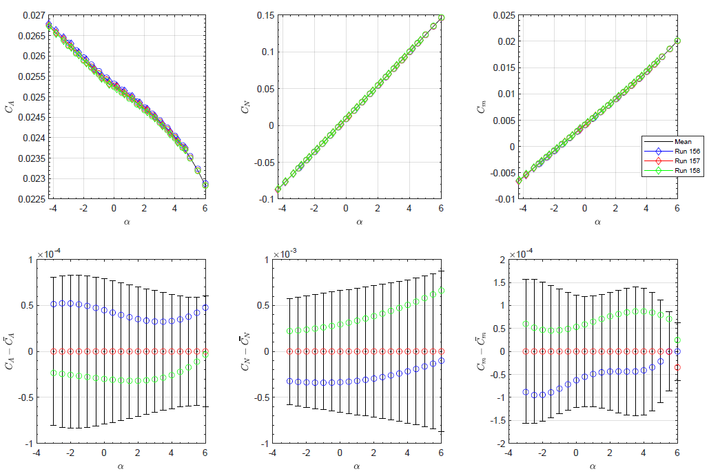
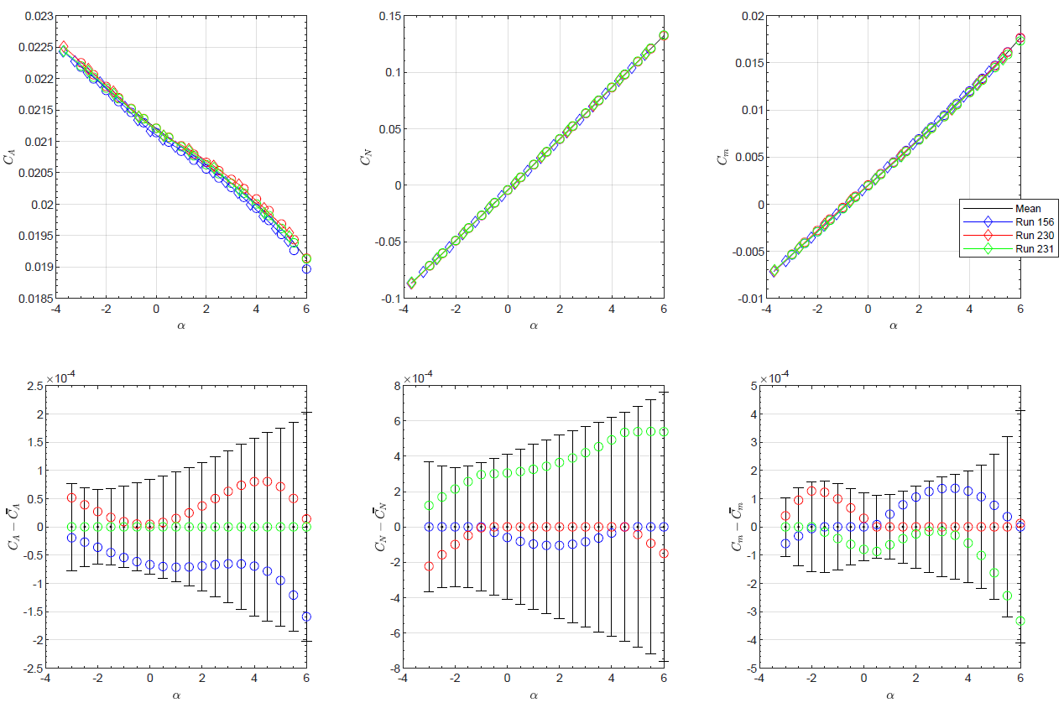
Mach 3.4 Re∞ 2.0 Million/ft
α (deg)
α (deg)
α (deg)
α (deg)
α (deg)
α (deg)
α (deg)
α (deg)
α (deg)
α (deg)
α (deg)
α (deg)
3 repeated pitch sweeps at tunnel centerline
0, +6, -6 in. pitch sweeps
Notes:
Increase in uncertainty appears to be less compared to Mach 2.6 cases

Slide 29


Mach 3.4 Re∞ 2.0 Million/ft
α (deg)
α (deg)
α (deg)
α (deg)
α (deg)
α (deg)
α (deg)
α (deg)
α (deg)
α (deg)
α (deg)
α (deg)
3 repeated pitch sweeps at tunnel centerline
0, +6, -6 in. pitch sweeps
Notes:
Larger increase for side force, rolling moment, and yawing moment coefficients than for other coefficients

Slide 30
Results and Discussion
AF Coefficient
  Pitch sweeps
    No large differences at each Mach number, though slight drop in axial force when off-centerline at Mach 4.3
  Lateral sweeps
    No large change between sweeps
NF Coefficient
  Pitch sweeps
    No large change between sweeps
  Lateral sweeps
    Trends appear to be mirrored as model moves laterally across test section, with a “bump” occurring near centerline at Mach 2.6
    Bump likely caused by presence of vortex at centerline of test section
    Bump near tunnel centerline flattens as the Mach number increases
    As Mach number increases, the nozzle block moves forward exposing less of the T-rail. This causes the vortex pair to diminish in size and strength
SF Coefficient
  Pitch sweeps
    SF increases more rapidly at centerline as Mach number increases
    Possible indication of vortex effecting increase in SF, but tricky to identify cause
  Lateral sweeps
    Bump occurs at centerline for SF data as well which flattens as Mach number increases, indicating reduction in size and strength of vortex

Slide 31
Results and Discussion
RM Coefficient
  Pitch sweeps
    More dispersion of data at lower Mach numbers
    For higher Mach numbers, centerline data tracks off-center data well
  Lateral sweeps
    Likely no influence of vortex
PM Coefficient
  Pitch sweeps
    No large change between sweeps
  Lateral sweeps
    No large change between sweeps
YM Coefficient
  Pitch sweeps
    Data appears to be more spread apart, but tightens up as Mach number increases
  Lateral sweeps
    Bump occurs at centerline for SF data as well which flattens as Mach number increases, indicating reduction in size and strength of vortex
Uncertainty
  Higher uncertainty in data as model moves off centerline

Slide 32
Future Work
Analyze beta (CFD) sweeps
Continue uncertainty analysis for pitch sweeps at Mach 4.3
Analyze uncertainty for lateral sweeps at all Mach numbers
Plan to add similar sweeps to next check standard test for additional data supporting facility modifications

Slide 33
Acknowledgements
Bryan Falman
Jim Ross
Jose Mondragon

Slide 34

Questions?

