Slide 1
Advancing understanding of the formation and evolution of the solar system with the Habitable Worlds Observatory
Kathleen E. Mandt^{1*}, D. Z. Seligman², J. Noonan³, O. Mousis⁴, S. E. Anderson⁴, M. Womack^{5,6}, D. Bodewits³, M. D. Hofstadter⁷, A. Luspay-Kuti⁸, A. Simon¹
¹NASA Goddard Space Flight Center, *Kathleen.Mandt@nasa.gov, ²Cornell University, ³Auburn University, ⁴Aix Marseille Université, CNRS, LAM, ⁵National Science Foundation, ⁶University of Central Florida, ⁷Jet Propulsion Laboratory, ⁸Johns Hopkins Applied Physics Laboratory.

Slide 2
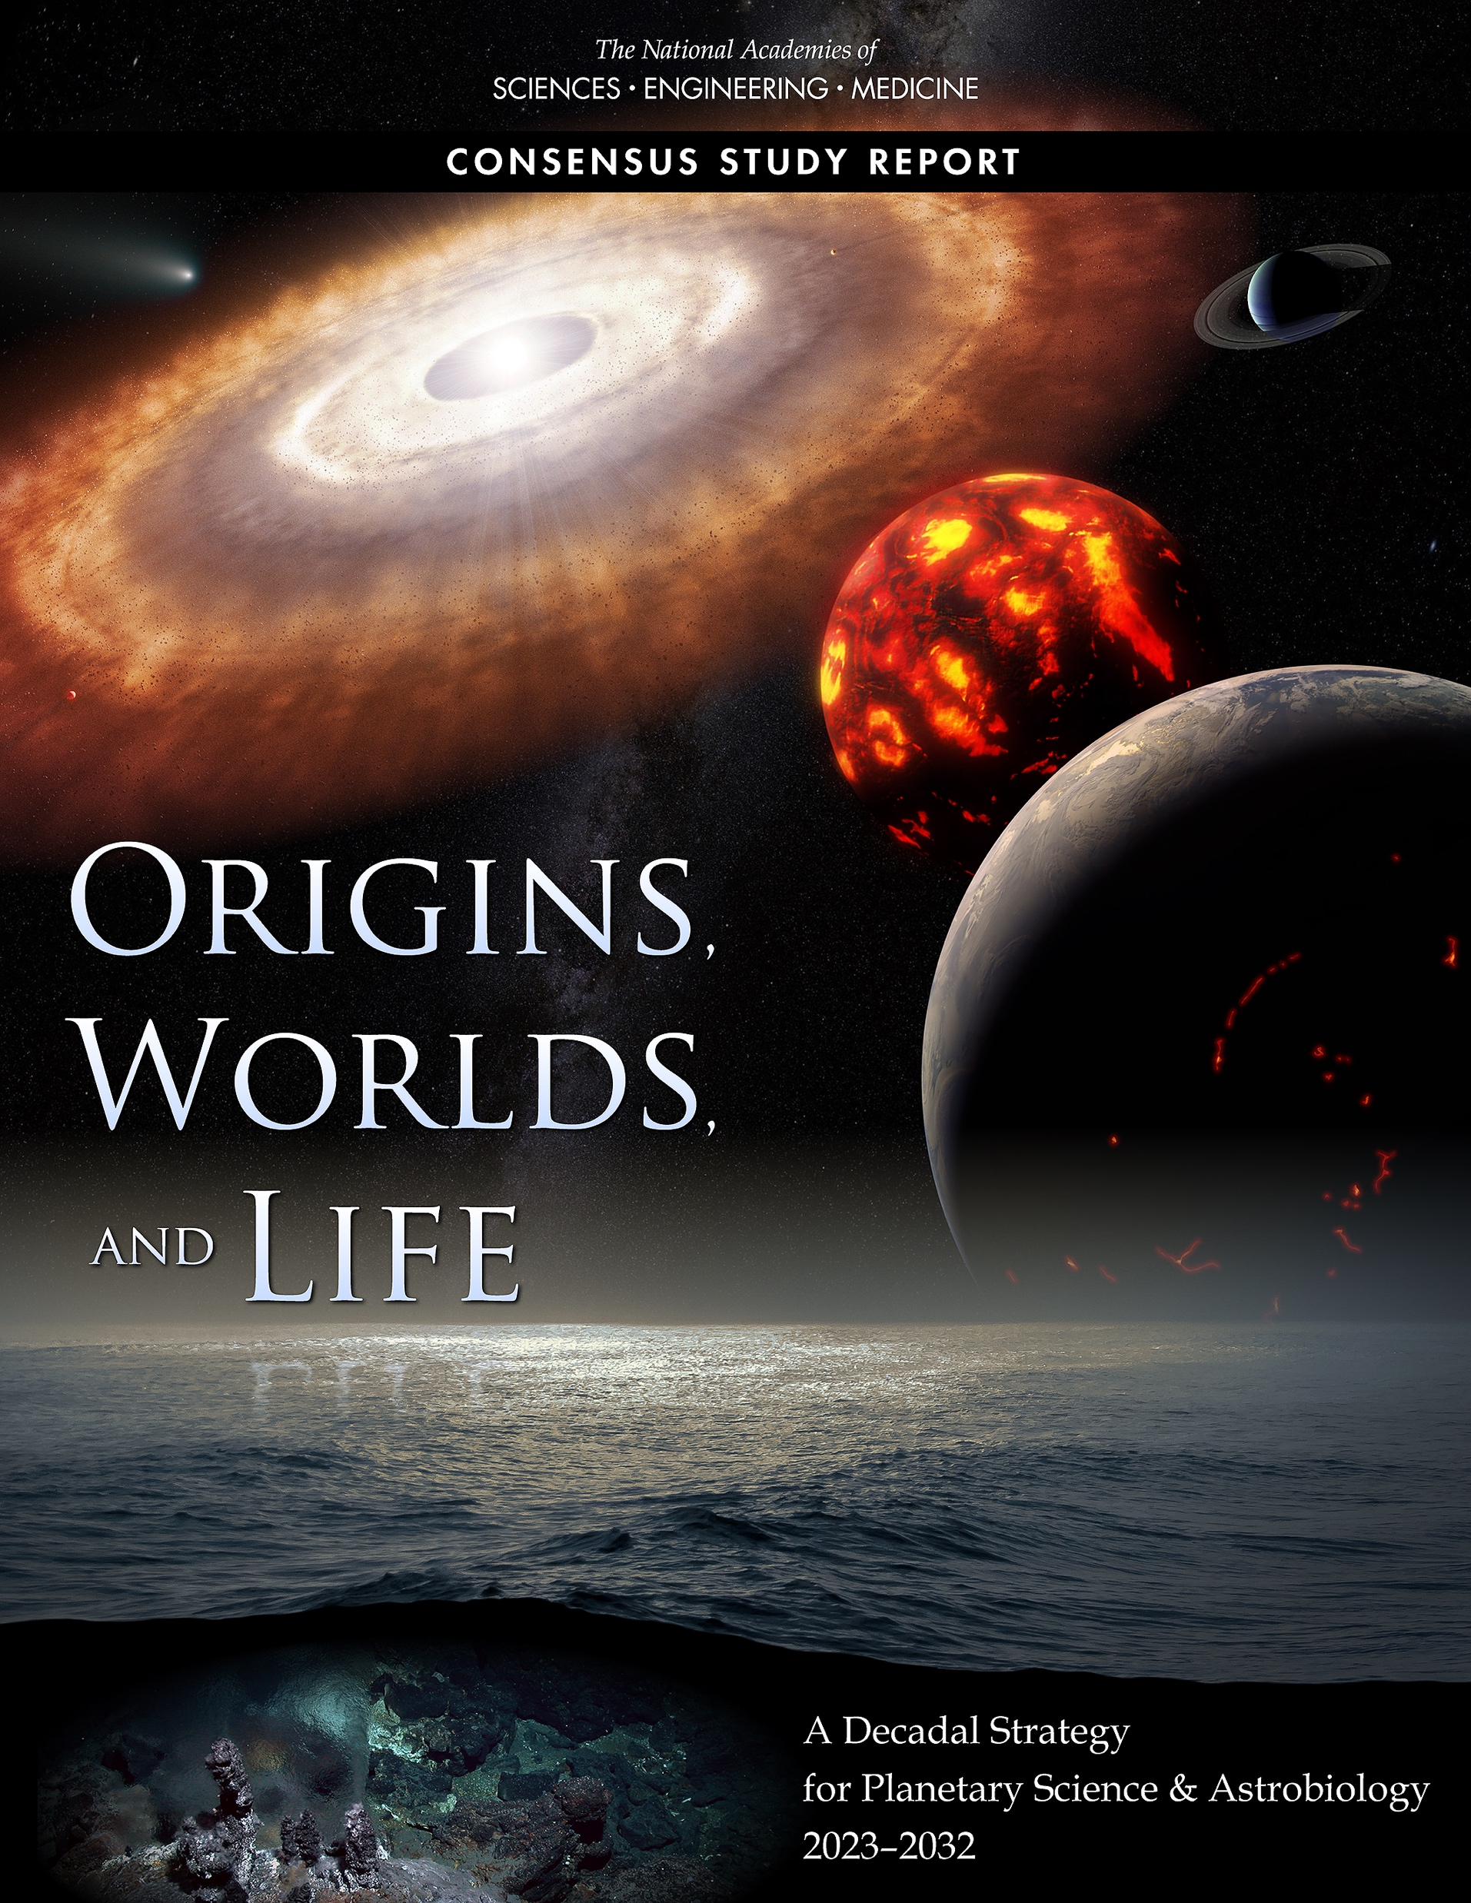
Planetary Science Decadal Survey for 2023-2032: Origins, Worlds, and Life (OWL)
The formation and evolution of the Solar System played a prominent role in OWL
Q1: Initial conditions, building block formation and materials
Q2: Giant planet and satellite systems formation and migration
Q3: Delivery of water to the inner planets
Q4: Giant planet migration and solar system ”architecture”
Q12: What the formation of our solar system tells us about exoplanet systems

Slide 3
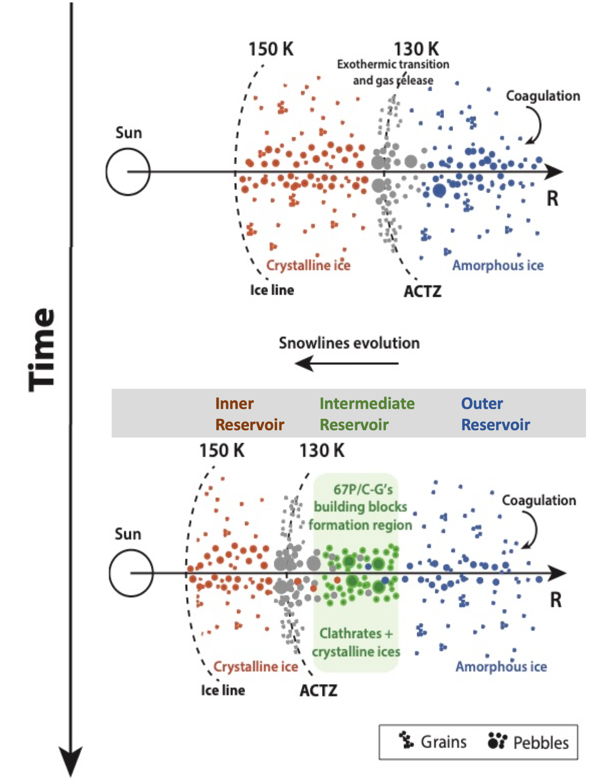
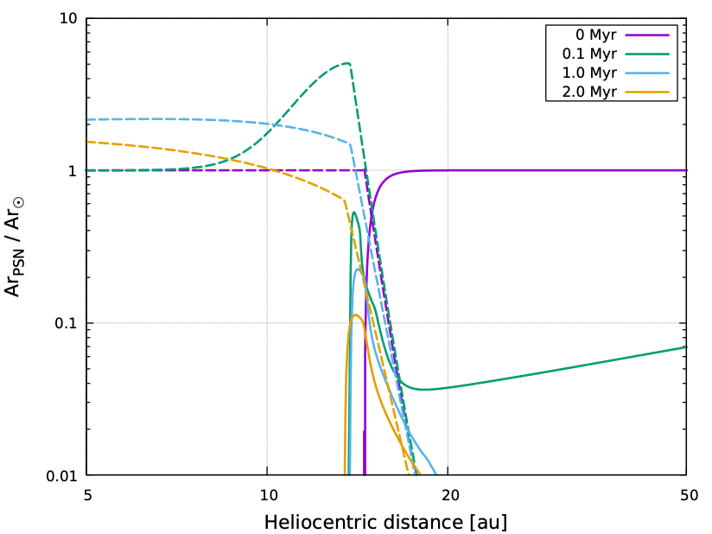
Key decadal question (Q1) Initial conditions, planetary building block production, nature and evolution of materials
Three reservoirs of icy building blocks
Protosolar Nebula (PSN) gas that varies spatially
Mandt et al. 2020b
Comets and giant planet atmospheres serve as ”time capsules” of material from the PSN
Mandt et al. 2020b

Slide 4
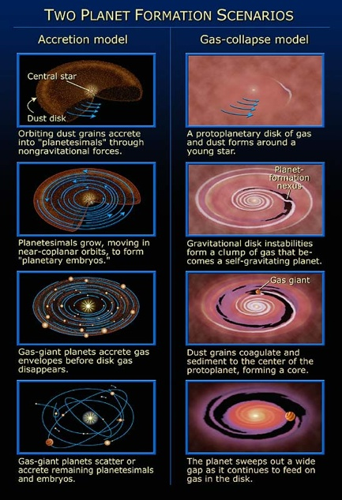
Key decadal question (Q2a) Giant planets and satellite system formation and migration
Did the giant planets form through accretion or gas collapse?
What was the composition of the solid building blocks for the giant planets?
How did the Protosolar Nebula (PSN) gas composition vary with distance from the Sun?
The composition of comets and the four giant planets’ atmospheres is key to understanding giant planet formation
Image credit: NASA/STScI

Slide 5
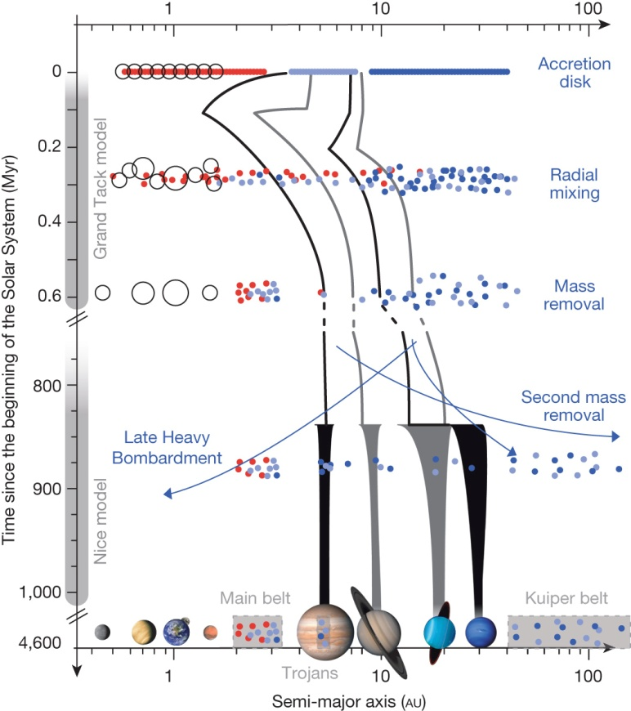
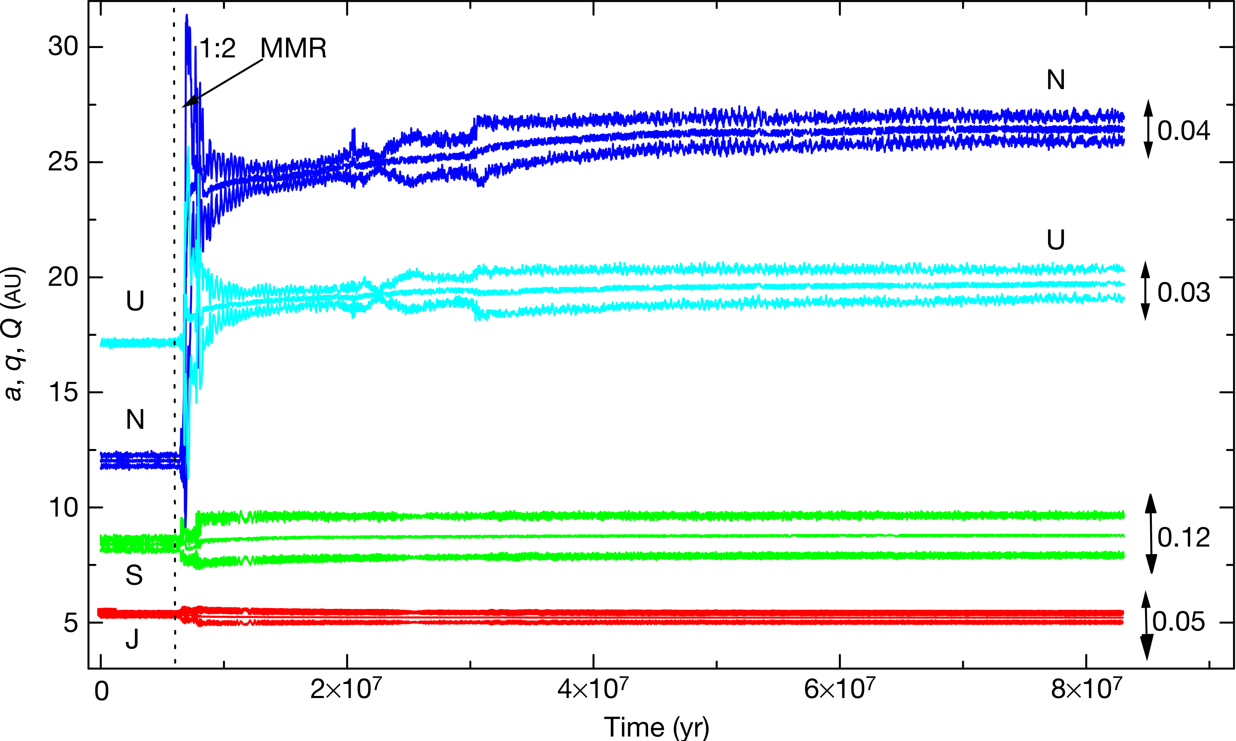
Key decadal question (Q2b) Giant planet migration and impact on solar system “architecture”
Tsiganis, K. et al. 2005
The composition of comets and all four giant planets’ atmospheres is key to understanding giant planet migration
DeMeo & Carry 2014

Slide 6
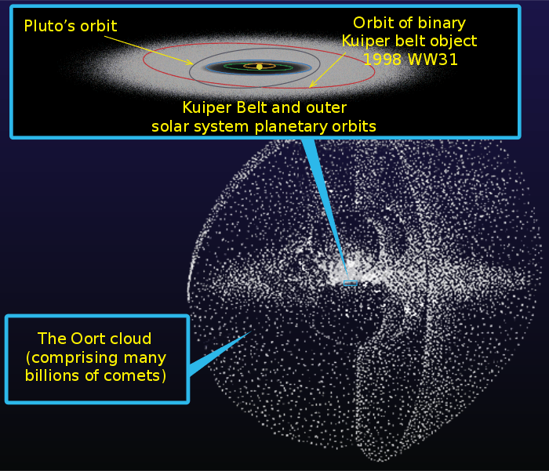
Key decadal questions (Q3) Water delivery to the inner planets; and (Q4) small body distribution
DeMeo & Carry 2014
Source: NASA
Constraining giant planet migration has implications for understanding water delivery to Earth, Venus, and Mars; and for explaining the distribution of small bodies

Slide 7
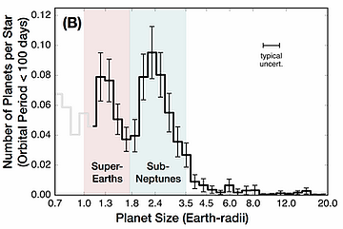
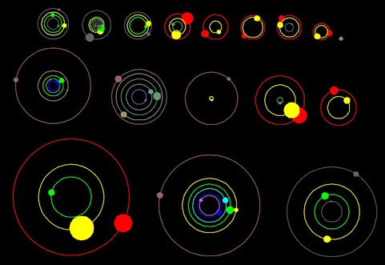
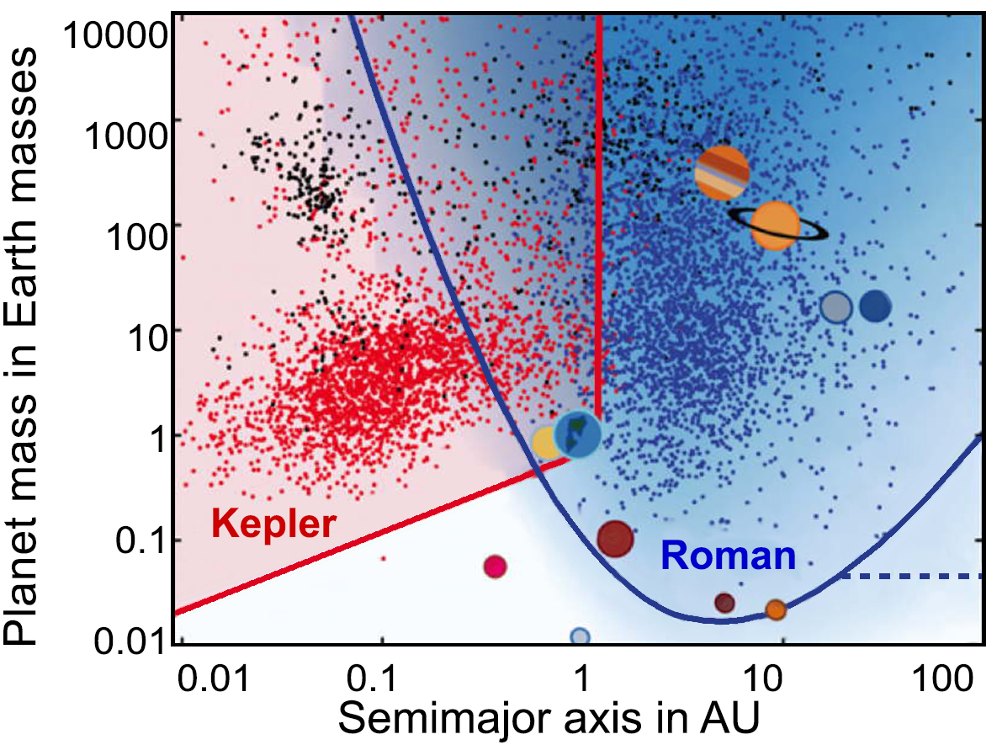
Key decadal questions (Q12) Relevance to exoplanet systems
Fulton et al. 2017
Illustration of Kepler discovery of 11 new planetary systems. Source: https://exoplanets.nasa.gov/resources/79/nasas-kepler-announces-11-new-planetary-systems/
source: https://roman.gsfc.nasa.gov/exoplanets_microlensing.html
Everything we learn about the origin and evolution of our solar system provides critical information needed to understand exoplanets and their systems

Slide 8
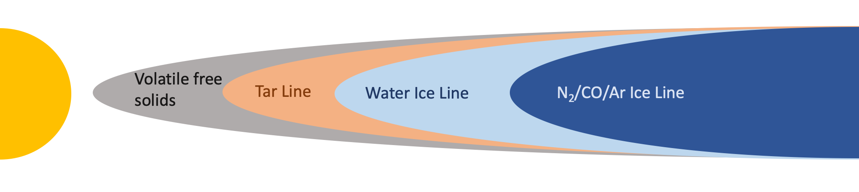
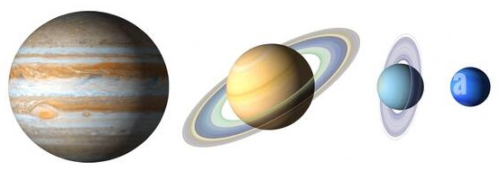
Where do we stand in finding answers?
Composition is key to understanding solar system formation

Slide 9
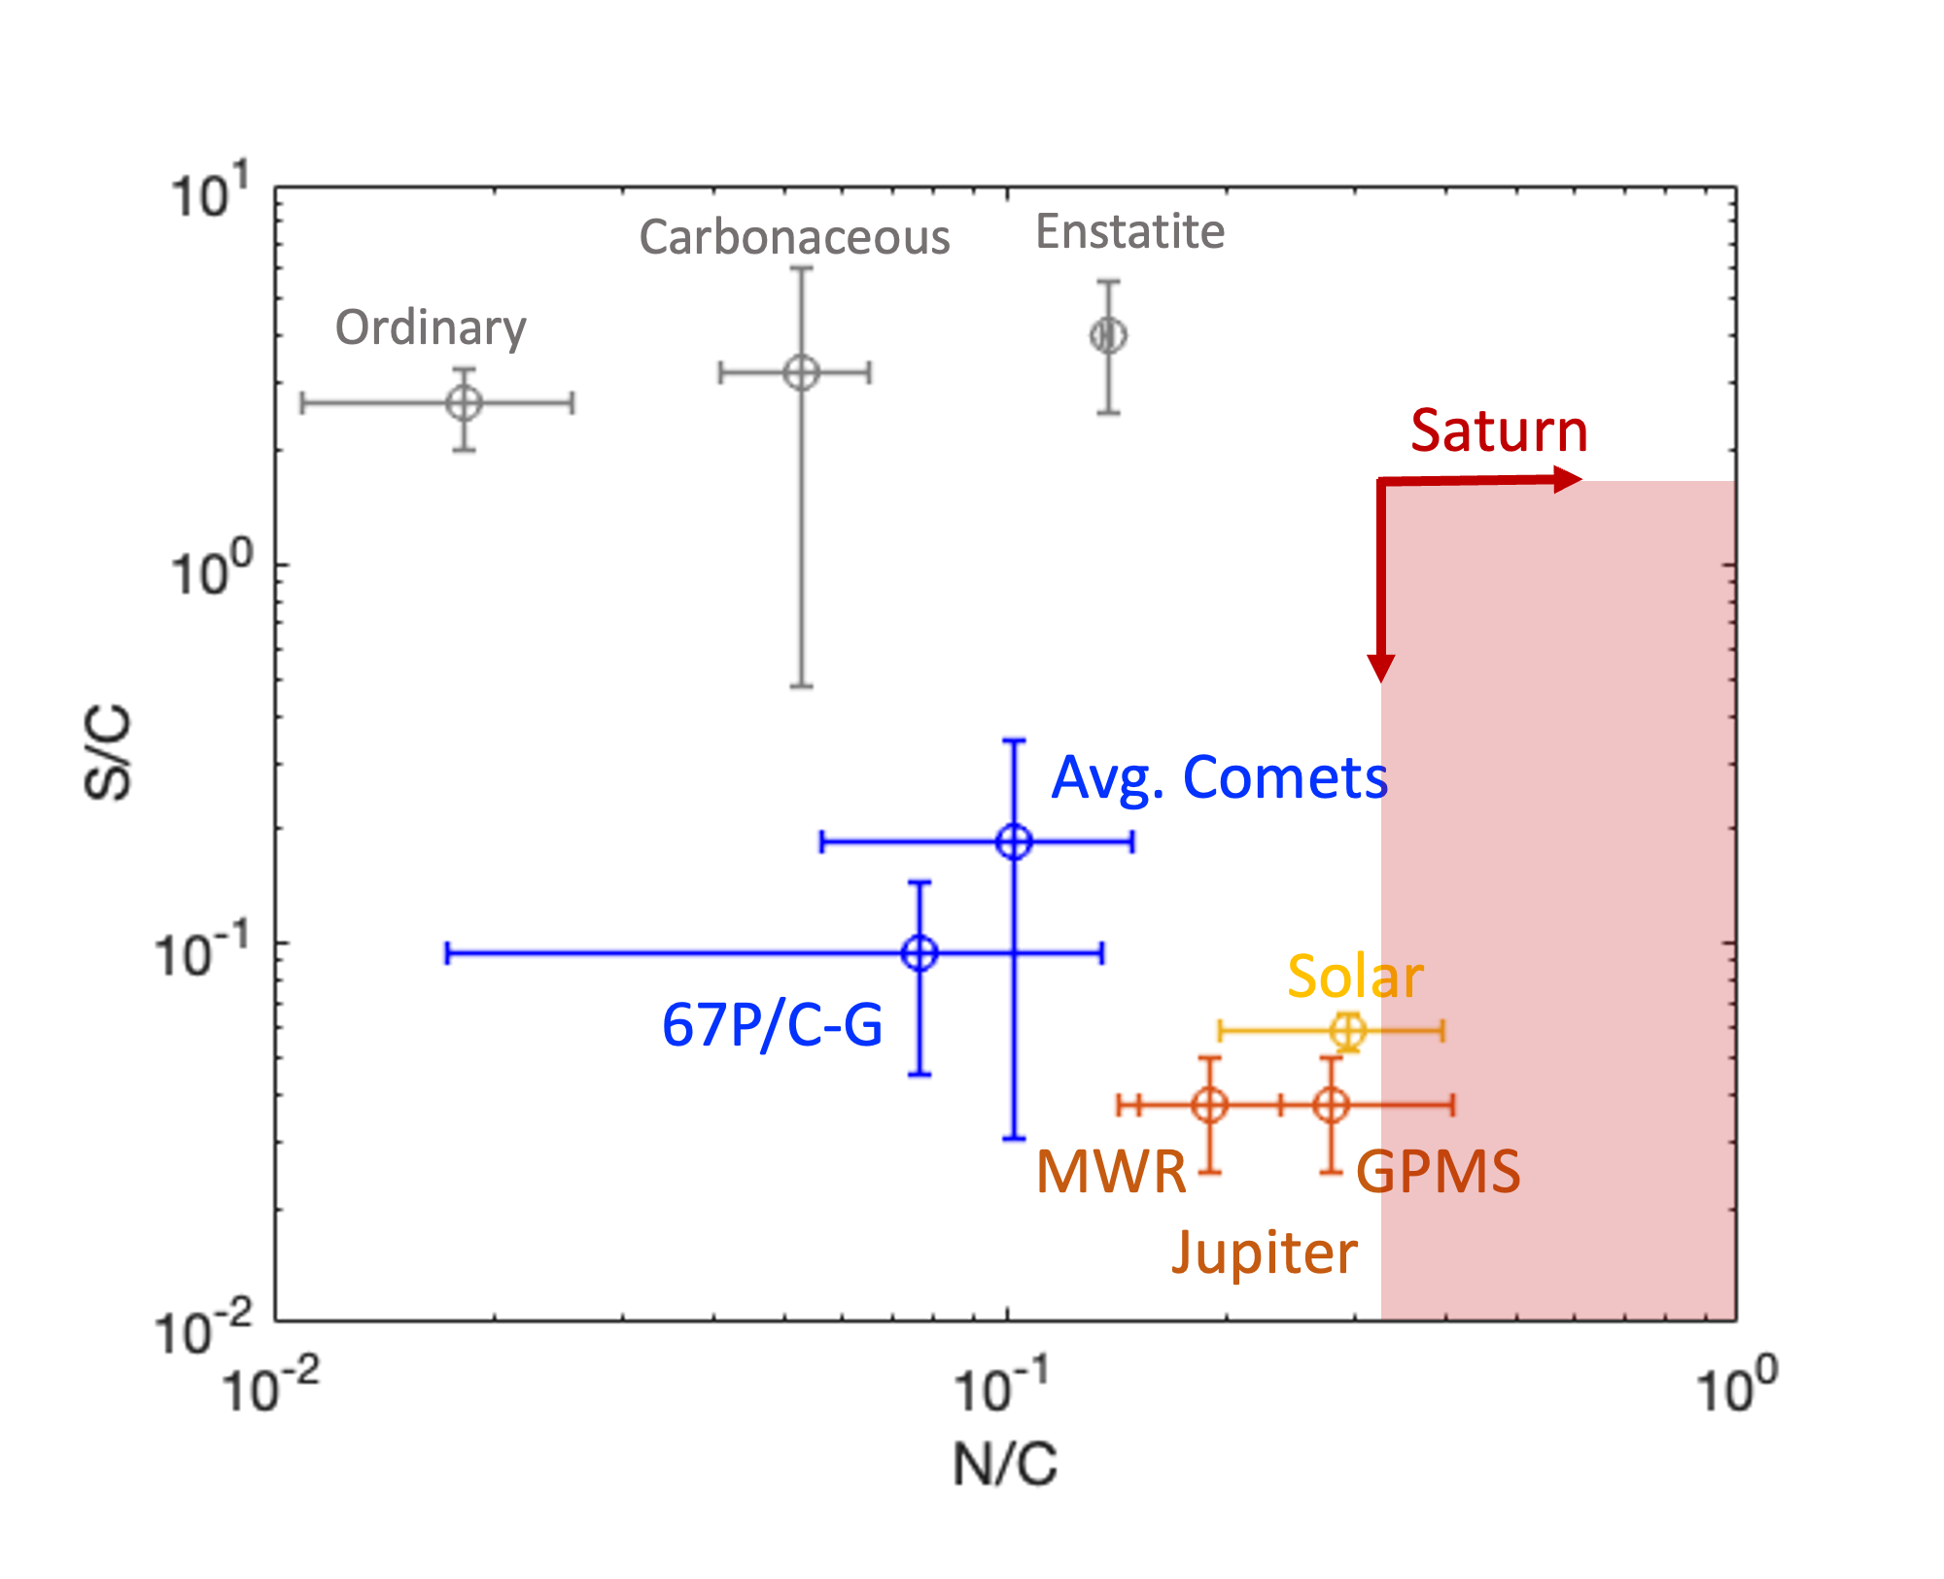
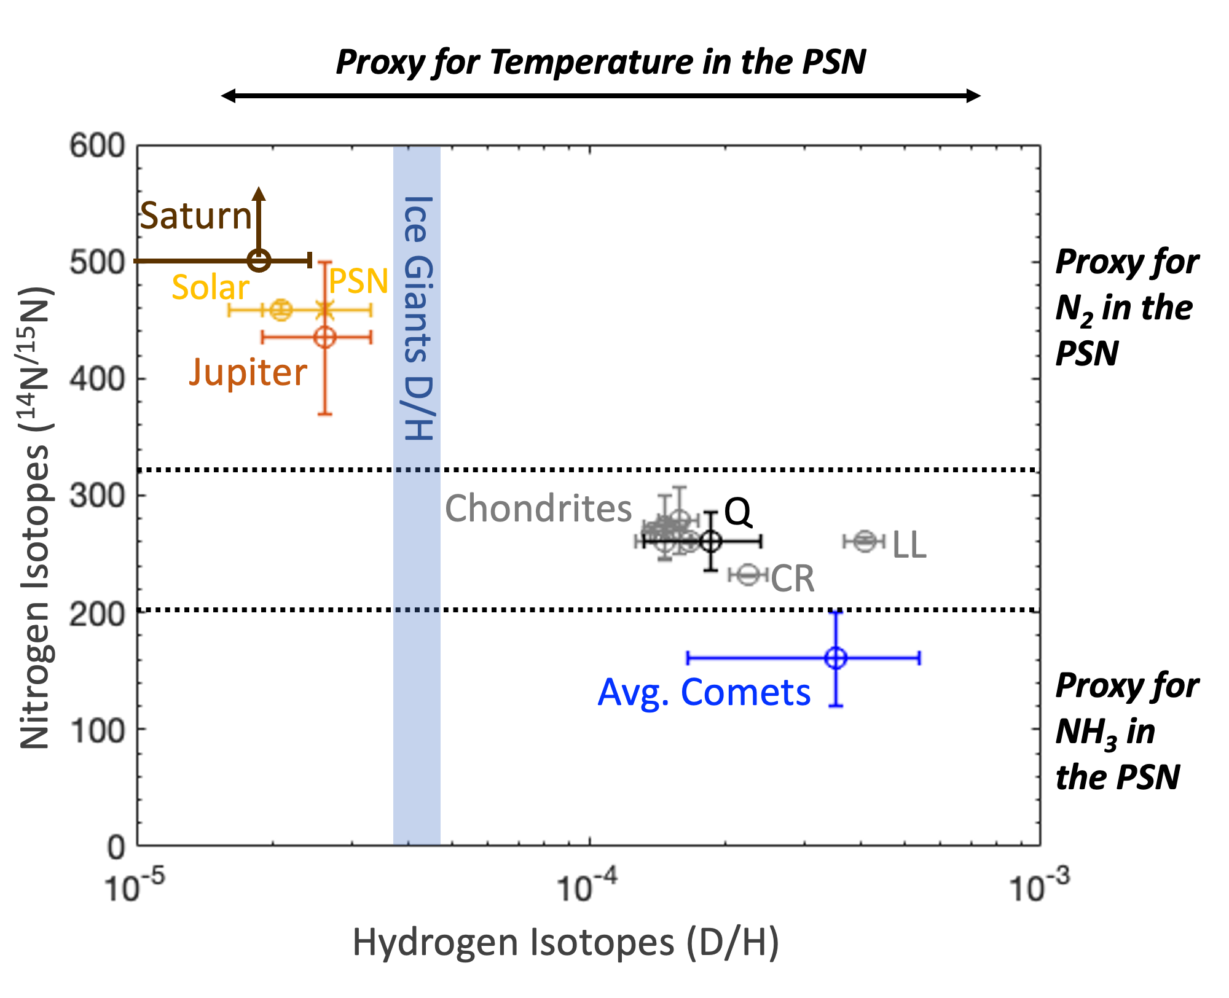
Elemental ratios and Stable isotopes
Refractory & Ice <-> Gas
Refractory <-> Ice <-> Gas
Proxy for source of N
These measurements connect atmospheres to building blocks and tell us when and where planets formed
Figures from Mandt et al. (in prep)

Slide 10
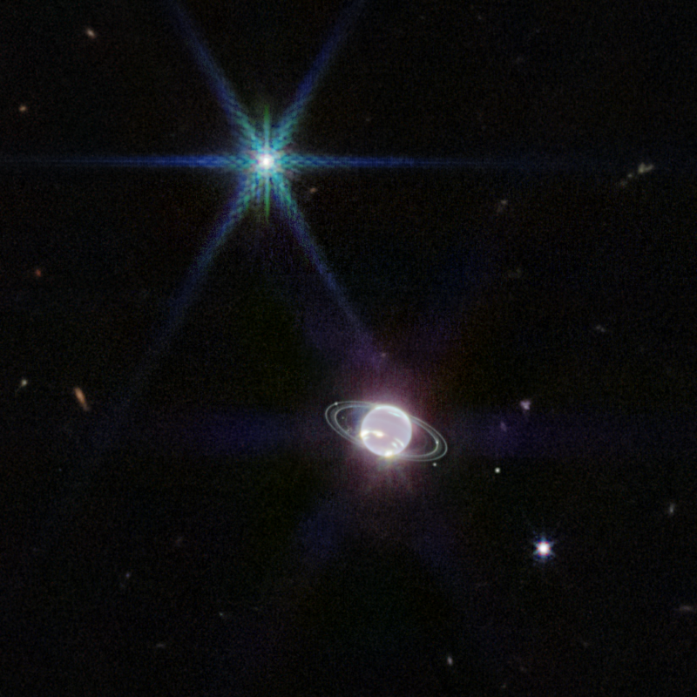
Top Measurement Goals for HWO to advance solar system origin understanding
Giant planet atmosphere composition
  Nitrogen and oxygen isotopes (IR)
Small body composition – comets, Centaurs, active asteroids
  Nitrogen abundances (N₂, NH₃, HCN) and isotopes (IR/UV)
  Sulfur abundances and isotopes (UV)
  D/H in water (IR)
  Oxygen isotopes (IR)
Pluto, Triton, KBO atmospheres
  Nitrogen isotopes in N₂ and HCN (IR/UV)
  Methane abundance and D/H (IR)
  CO abundance and isotopes (IR)
JWST image of Neptune and Triton (Source: NASA/STScI)

Slide 11
Backup
Follow Us Everywhere Under the Sun

Slide 12


