Slide 1
Fundamental Science Achievable with a Single Atmospheric Probe
Kathleen E. Mandt^{1*}, O. Mousis², D. Atkinson³, M. D. Hofstadter³, A. Simon¹
¹NASA Goddard Space Flight Center, *Kathleen.Mandt@nasa.gov, ²Aix Marseille Université, CNRS, LAM, ³Jet Propulsion Laboratory.

Slide 2
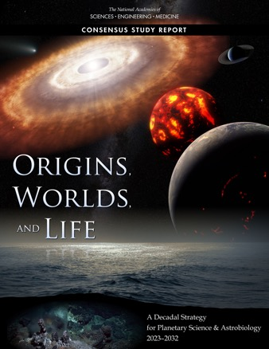
Planetary Science Decadal Survey for 2023-2032: Origins, Worlds, and Life (OWL)
UOP in situ measurements can answer key decadal questions about Solar System Origin and Evolution
Q1: Initial conditions, building block formation and materials
Q2: Giant planet and satellite systems formation and migration
Q3: Delivery of water to the inner planets
Q4: Giant planet migration and solar system ”architecture”
Q12: What the formation of our solar system tells us about exoplanet systems

Slide 3
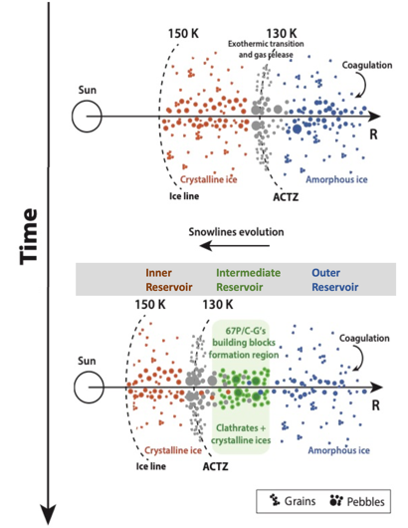
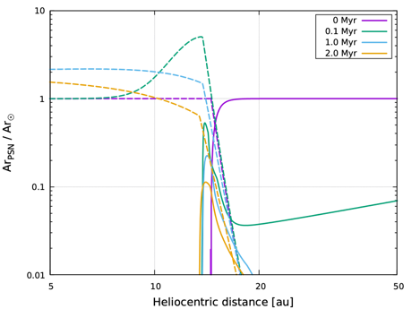
Key decadal question (Q1) Initial conditions, planetary building block production, nature and evolution of materials
Three reservoirs of icy building blocks
Protosolar Nebula (PSN) gas that varies spatially
Mandt et al. 2020b
Giant planet atmospheres serve as ”time capsules” of material from the PSN
Mandt et al. 2020b

Slide 4
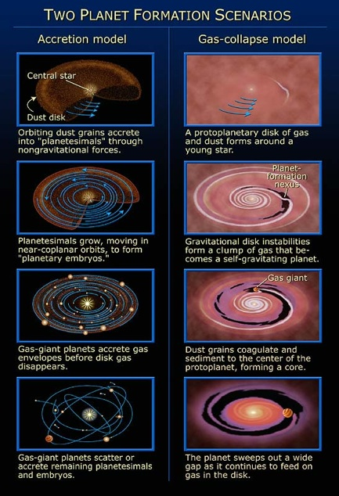
Key decadal question (Q2a) Giant planets and satellite system formation and migration
Did the giant planets form through accretion or gas collapse?
What was the composition of the solid building blocks for the giant planets?
How did the Protosolar Nebula (PSN) gas composition vary with distance from the Sun?
The composition of the four giant planets’ atmospheres is key to understanding giant planet formation
Image credit: NASA/STScI

Slide 5
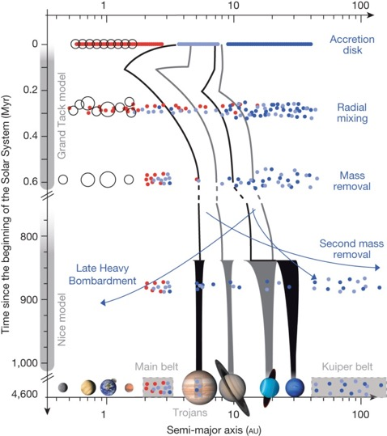
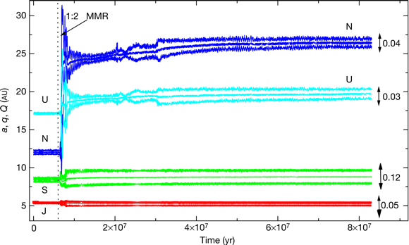
Key decadal question (Q2b) Giant planet migration and impact on solar system “architecture”
Tsiganis, K. et al. 2005
The composition of comets and all four giant planets’ atmospheres is key to understanding giant planet migration
DeMeo & Carry 2014

Slide 6

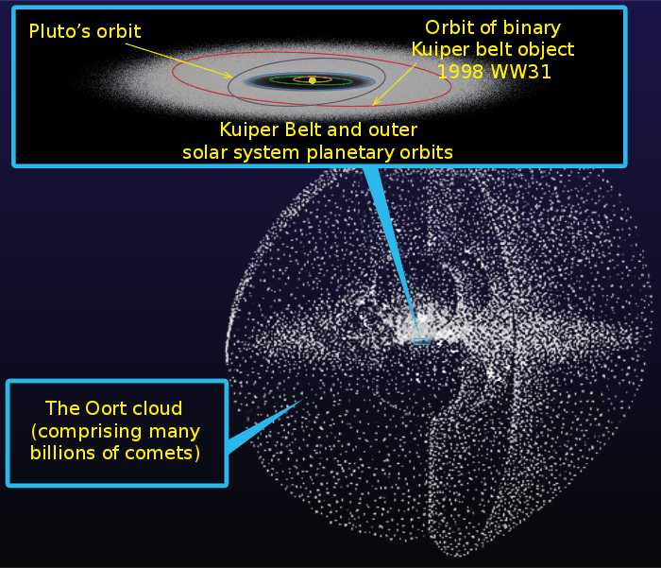
Key decadal questions (Q3) Water delivery to the inner planets; and (Q4) small body distribution
DeMeo & Carry 2014
Source: NASA
Constraining giant planet migration has implications for understanding water delivery to Earth, Venus, and Mars; and for explaining the distribution of small bodies

Slide 7
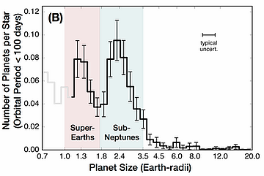
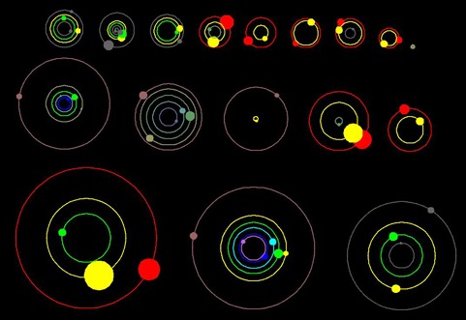
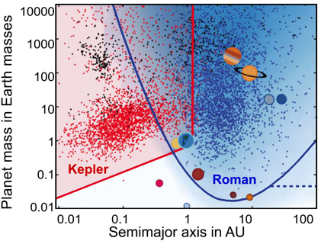
Key decadal question (Q12) Relevance to exoplanet systems
Fulton et al. 2017
Illustration of Kepler discovery of 11 new planetary systems. Source: https://exoplanets.nasa.gov/resources/79/nasas-kepler-announces-11-new-planetary-systems/
source: https://roman.gsfc.nasa.gov/exoplanets_microlensing.html
Everything we learn about the origin and evolution of our solar system provides critical information needed to understand exoplanets and their systems

Slide 8
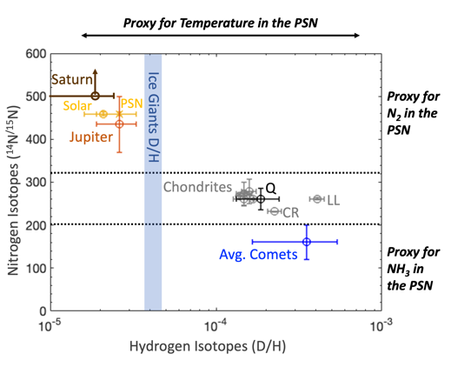
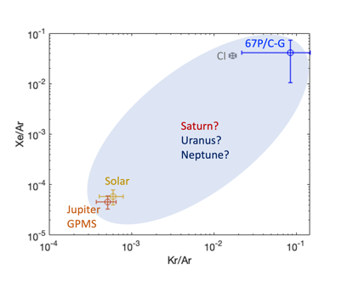
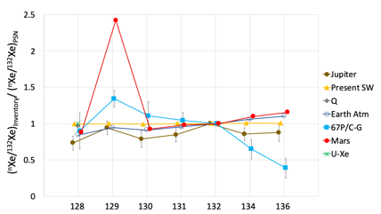
Measurement Needs: Noble gas abundances and isotope ratios provide constraints for solid building blocks
Jupiter is the only giant planet with sufficient information to study its origin and evolution

Slide 9

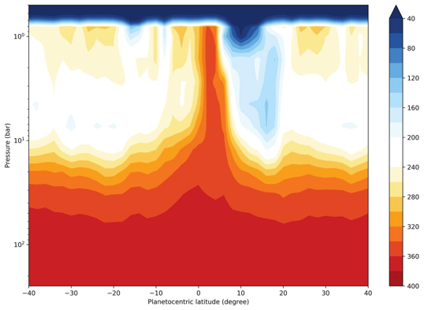
Can we achieve the science with a single probe?
Juno MWR-derived NH₃ ppm
Li et al. 2017

Slide 10
Two proposed theories to explain NH₃ depletion: Does either affect the required measurements?
Fletcher et al. 2021
Notes:
Fletcher et al. (2020) Ice Giant Circulations Patterns: Implications for Atmospheric Probes – “Measurements of noble gases and their isotopes, which are critical to testing planetary formation models, can be made at any latitude without regard to atmospheric patterns and weather due to the non-reactive nature of those species.”
Private comm with Leigh: The implied vertical motions would affect any species that isn’t well mixed – so volatiles like NH3, H2S, H2O for example, and potentially other disequilibrium species like CO, GeH4, AsH3 and PH3 which vary with altitude due to thermochemistry/photochemistry/mixing. But any species that is well mixed should be unaffected by these motions (e.g., CH4, halides, noble gases)… However, if there’s a chance that the species undergo some strange combination chemistry (e.g., get trapped into aerosols or ‘mushballs’), then they might not be well mixed, and therefore their abundances would depend on dynamic motions.
Atreya et al. 2022: He, Ne, Ar, Kr and Xe are chemically inert, hence unaffected by meteorology or dynamics

Slide 11
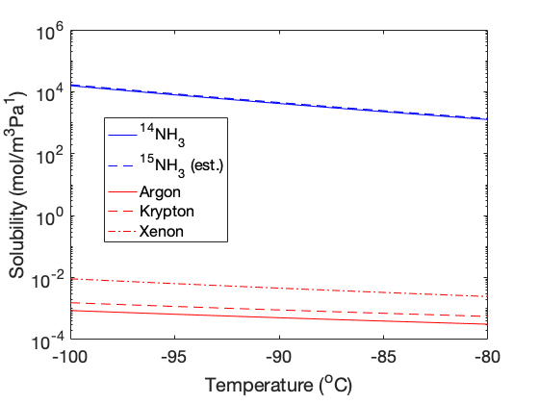
Solubility comparisons for ammonia and the heavy noble gases
It is unlikely that noble gases would be adsorbed into ”mushballs” or that the isotopes of ammonia would fractionate

Slide 12

We should be careful to distinguish between observations for origins from observations for “weather”
In situ measurements are needed to understand origin and evolution of the solar system
Microwave demonstrates that condensibles are a challenge
Noble gases and isotope measurements are not affected
Single point measurements of noble gases and isotope ratios are valid and essential
Giant planet formation, migration, and evolution can be solved with single point measurements in each planet’s envelope

Slide 13
Backup
Follow Us Everywhere Under the Sun

Slide 15


