Slide 1
Machine Learning Methods for Advancing Risk Precursor Identification Tools in Commercial Airline Terminal Area Operations
Mr. Fasil Alemante, Booz Allen Hamilton
SWS In-Time Terminal Area Risk Management
Technical Challenge: Close-Out
NASA Ames Research Center
July 18, 2023

Slide 2
Introduction and Background

Slide 3
Vision and Background
The Crew Systems and Aviation Operations Branch (CSAOB), under the Research Directorate at NASA Langley Research Center (LaRC) is investigating ways to integrate emerging urban air mobility (UAM) vehicle operations into the National Airspace System (NAS)
Machine Learning for Advancing Risk Precursor dentification Tools in Commercial Airline Terminal Area Operations
  Under Task Order (TO) 004 of Strategic Professional Engineering Assessment Contract (SPEAC) II (80JSC023AA001)
  Results of this TO are intended to:
    Improve machine learning methods to anticipate and resolve potential safety issues
    Predict the health and robustness of aviation systems
    Analyze integrated risk in terminal area operations in support of the SWS Project in the Airspace Operations and Safety Program (AOSP) under the Aeronautics Research Mission Directorate (ARMD)

Slide 4
Background
The goal is to characterize the risk of an unstable approach for a flight at the earliest possible time step to aid dispatchers
  An unstable approach (vertical) is defined as a descent (negative vertical velocity) of greater than 1000 ft per minute
The objective is to find a relation that can be included and evolved into a display capability
  Interpretability of results is a relatively high importance feature
  Prototype display capability: Aviation Risk Precursor Identification (ARPI)
Analyses performed thus far are meant to take advantage of initial, limited data sets

Slide 5
Background
This demonstration is intended to showcase
  Back end and user interface proof of concept to display aviation risk precursor detection in a terminal area from System Wide Information Management (SWIM) data
  Integration of the ARPI prototype with ARC-TI’s Runtime for Airspace Concept Evaluation (RACE) as a use case
  Integration of ARC-TI’s Convolutional Variational Autoencoder (CVAE) into the ARPI-RACE prototype
This work supports the ARMD Strategic Implementation Plan, 2019:
  Strategic Thrust 1: Safe, Efficient Growth in Global Operations
  Strategic Thrust 5: In-Time System-Wide Safety Assurance
  Strategic Thrust 6: Assured Autonomy for Aviation Transformation
This work supports SWS Technical Challenge-1
  Milestone TC1-02-02, “Demo proof of concept showing integration of NASA & AOC capabilities”

Slide 6
Booz Allen Hamilton Team Members
Name | Role
Mr. Shannon Walker | Task Manager
Mr. Fasil Alemante | Data Scientist
Mr. Rami Houssami | Data Scientist
Mr. Farley Reynolds | Software Developer

Slide 7
Aviation Risk Precursor Identification (ARPI) Architecture

Slide 8
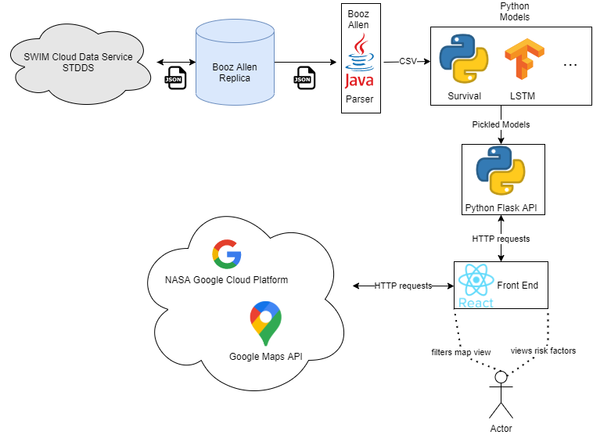
High-Level Architecture Diagram – ARPI
Neither the U.S. Government nor NASA endorse or recommend any commercial products, processes, or services. Reference to or appearance of any specific commercial products, processes, or services by trade name, trademark, manufacturer, or otherwise, in NASA materials does not constitute or imply its endorsement, recommendation, or favoring by the U.S. Government or NASA.

Slide 9
Architecture Description
Back End
  STDDS – SWIM Terminal Data Distribution System
  Replica – Booz Allen replica of STDDS that was used in building the proof of concept. It has historical data going back several years and is conveniently indexed
  Java Parser – a Java applet that converts data from SWIM's native hierarchical JavaScript Object Notation (JSON) to a data science friendly long comma-separated variable (CSV) format
  Python – the models used for prediction and analysis are written in Python, specifically due to the great availability of data science libraries. Libraries used include pandas, numpy, statsmodels, and Tensorflow (Keras)
Front End
  Python Flask application programming interface (API) – web API framework that connects the front end to the Python models
  React.js – JavaScript library that powers data visualization and graphical interface
  Google Maps – provides map tiles and flight path overlay

Slide 10
SWIM Data Description

Slide 11



System Wide Information Management (SWIM)
SWIM is a Federal Aviation Administration (FAA) information-sharing platform designed to increase the sharing of data through the SWIM Cloud Distribution Service (SCDS) which contains key data sources, such as the SWIM Terminal Data Distribution System (STDDS) data outlet
SWIM makes data available from over 200 airports, and over 400 individual systems
Credit: FAA - https://www.faa.gov/air_traffic/technology/swim

Slide 12
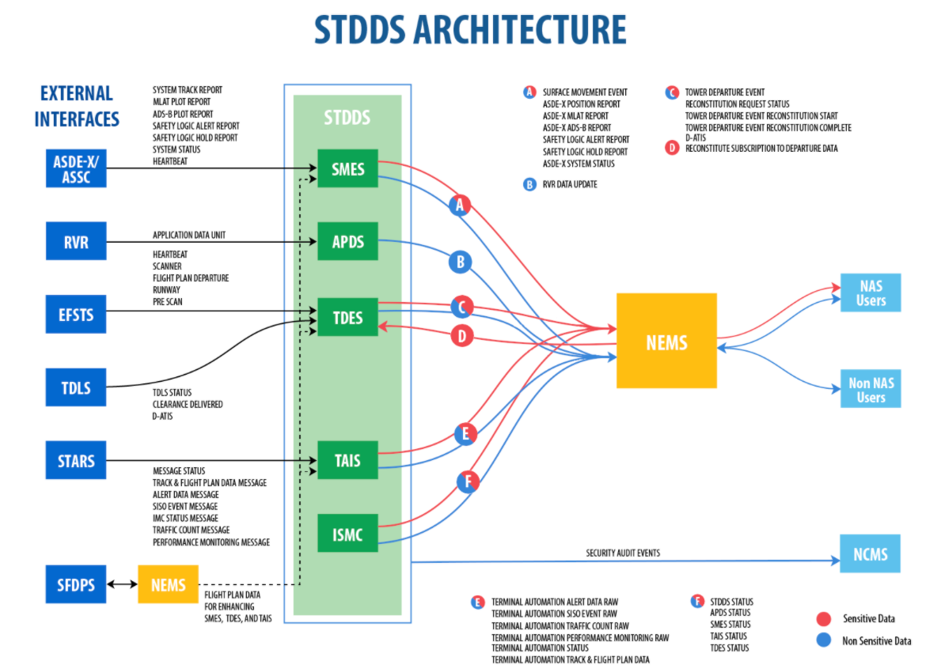
System Wide Information Management (SWIM)
STDDS interfaces with six FAA airport and terminal systems, and publishes data from them through the following services:
  SMES – Surface Movement Event Service
  ADPS – Airport Data Service
  TDES – Tower Departure Event Service
  TAIS – Terminal Automation Information Service
  ISMC – Infrastructure, System Monitor and Control Service
Source & description of data in STDDS is available at https://www.faa.gov/air_traffic/technology/swim/stdds/

Slide 13
Characterizing SWIM Data
Data Retrieval
  The SWIM data originates from STDDS
  The data is obtained from STDDS, stored, and run through a Java parser which converts the data from a JSON (hierarchical) to CSV (flat) format
In order to use the SWIM data, a few transformations are necessary:
  Resolution for velocity is rounded to the nearest 100 ft/s. Because of this it is necessary to smooth the velocity by averaging the past two time-steps’ velocities (𝑣_{𝑡−1} + 𝑣_{𝑡−2}). Otherwise, there will be a very high number of unstable approaches.
  Velocity is provided as ft/s, so a simple conversion to ft/min is required
  SWIM provides altitude data in a fashion similar to GPS (i.e., feet above mean sea level (MSL)). Thus, to determine altitude above ground level (AGL), it is necessary to know subtract the runway’s MSL elevation from SWIM’s altitude.
  SWIM’s aggregation of data from many systems offers access to a wide range of data and features that can provide a highly dimensional record of flight instances to be evaluated for predictive value.

Slide 14
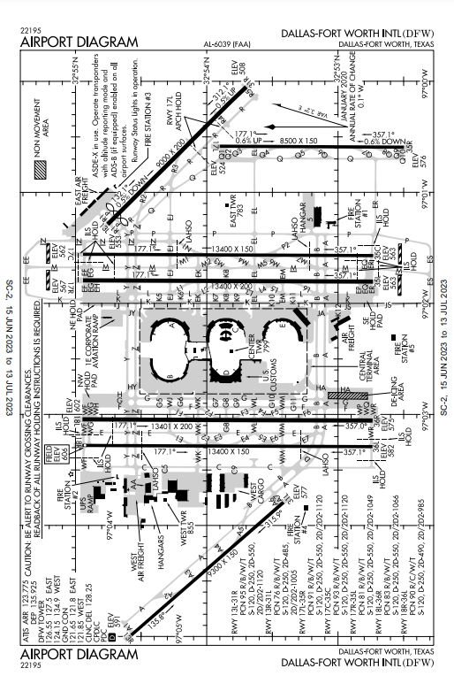
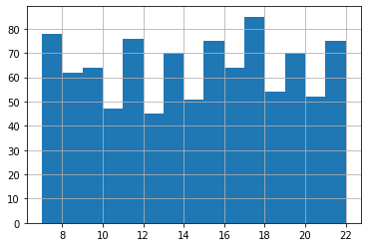
Characterizing a Day at Dallas-fort Worth (DFW)
Data for the demonstration is a full day from the DFW runways on July 17, 2019, starting at 7 AM local time (Central Daylight Time: -5 from GMT) and ending at about 10:30 PM
Weather: 15-20 mph winds, clear sky, low of 79°F at 9 AM to high of 94°F at 3 PM
A total of 968 flights landed on the runways
Average of 46 flights landing per hour with a peak between 5 to 6 pm with over 80 aircraft landing in that hour
No. of flights landed
FAA DFW Airport Diagram
https://aeronav.faa.gov/d-tpp/2306/06039ad.pdf#nameddest=(DFW)
Hour

Slide 15
Models

Slide 16
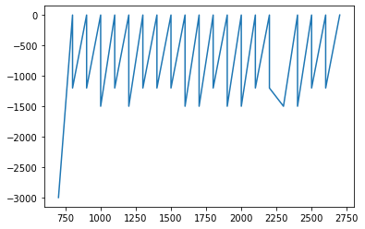
Time Series Based Analysis
Considering the problem statement, the base requirement for interpretability is a prediction at a given time step. Naturally, this type of problem lends itself to time series analysis
Concept: flights have a descent trend
  By separating the trend component from any stochastic component, the altitude at future time steps can be predicted.
Autoregressive, Integrated, and Moving Averages (ARIMA, Box-Jenkins approach) are very useful methods to capture common time variant components. It allows for the use of exogenous variables as well
Future pivot: great for short run but degrades quickly
  Does not model the actual thought process; it is only a forecasting method
Pros: very quick to calculate and forecast, would scale well in a production environment
Velocity (ft/s)
Altitude (ft)
Figure: plot showing descent velocity as a time series over altitude.

Slide 17
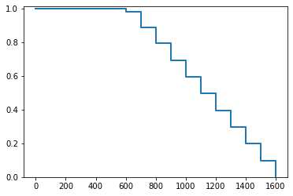
Survival Analysis
Reconsidering the problem statement as “what is the likelihood of a failure state (mean time to failure), given the current conditions?”
Answers the following question: Given what is known about previous flights up to this point (i.e., time step, altitude, and descent velocity), what is the likelihood of this flight ending with an unstable approach? Stated differently, the empirical cumulative distribution function (CDF) (Kaplan-Meier estimator) is used to determine likelihood of a future failure state.
Since the modelling is based on initial conditions, updates can be made for more and more specific scenarios
Pros: Very easy to interpret and visualizes extremely well. Also scales very well and can increase in accuracy with more data. Well suited to the problem space.
PR (future event)
Altitude (ft)
Figure: plot showing survival curve for flights. Dropoff represents the risk at that point.

Slide 18
Long Short-Term Memory (LSTM)
Long Short-term Memory – a type of sequence-to-sequence neural network that, like survival analysis, is well suited to the problem space. It incorporates learning long order (time) dependence. Works like an autoencoder that encodes/decodes temporal relationships.
Train on off and on nominal sample. Given the past x time steps, the model then predicts y future time steps. Based on the predictions, the model determines if the flight should be flagged for review.
Pros: Very easy to interpret for dispatchers, as it boils down to a Boolean condition
Cons: No answer given as to “why” the flight was flagged, which is a “black box”
Velocity (100 ft/s)
Time
Figure: Vertical bar represents start of predicted results for this correctly predicted on nominal flight

Slide 19
Visualization

Slide 20

Visualization Back End: Python Flask API
Flask is a micro web framework written in Python
  Fairly lightweight
  No unnecessary functionality
Allows for quick responses (given the proper hardware) even with large datasets and computation
Due to the extensible nature of an API the backend can support multiple models
  Has different API calls for each model and can be extended or changed as needed for the application
The back end currently supports two models
  Survival Analysis
  LSTM
Simply send one of the API calls the appropriate data and it will return the outcome from one of the models to whatever service is calling it
  Can be used by different services
    User interface (UI)
    Provide data or analytic capabilities to another service
Neither the U.S. Government nor NASA endorse or recommend any commercial products, processes, or services. Reference to or appearance of any specific commercial products, processes, or services by trade name, trademark, manufacturer, or otherwise, in NASA materials does not constitute or imply its endorsement, recommendation, or favoring by the U.S. Government or NASA.

Slide 21

Visualization Front End: React.JS
A JavaScript library for building UIs
Efficiently updates and renders components when data changes
  Can handle complex UIs with low overhead
    Ensures faster rendering
Technology stack independent
  Does not rely on a particular back end
  If the data supplied to it matches what the UI expects then it should work
Can use client side (user’s browser) to offload tasks from any potential back end
  Limits back-end resource usage for only important tasks
  Allows for higher user counts
Can be employed on different platforms
  Desktop
  Mobile
Neither the U.S. Government nor NASA endorse or recommend any commercial products, processes, or services. Reference to or appearance of any specific commercial products, processes, or services by trade name, trademark, manufacturer, or otherwise, in NASA materials does not constitute or imply its endorsement, recommendation, or favoring by the U.S. Government or NASA.

Slide 22

Visualization Front End: Google Maps API
Contained in LaRC’s Google Cloud Platform (GCP) instance
Employs three main features of the Google Maps API
  Heat Map Layer
    Two ways to interpret based on what a model returns
      Model returns weight or risk score: Greater intensity around points that have a higher weight or risk score and areas with higher flight density
      Model returns a classification: Greater intensity only around areas with higher flight density
  Polyline Layer (Flight Paths)
    Given the coordinates of a flight path it can visualize where a flight has been
    Paired with coloring, can show the outcome of a model when given a data point
    Coloring can be used for other uses as well
  Markers (Flight Icon/Current Location)
    Shows where in the data the flight terminated
    In a near real time scenario this will show the flight’s current location
    A user can click on a flight and see any information that is available for the flight
    Paired with coloring, can show the outcome of a model at the marker’s point
Neither the U.S. Government nor NASA endorse or recommend any commercial products, processes, or services. Reference to or appearance of any specific commercial products, processes, or services by trade name, trademark, manufacturer, or otherwise, in NASA materials does not constitute or imply its endorsement, recommendation, or favoring by the U.S. Government or NASA.

Slide 23
RACE Integration

Slide 24

RACE Integration
Runtime for Airspace Concept Evaluation (RACE) is an actor-based framework intended for simulation
Actors
  Every object, update, etc., constitutes an actor
  Actors are defined in Scala files which are called upon by configuration files which tell RACE which actors to run and how
  “Ingest actors” ingest the data; these ingest SWIM data well
  “Archive actors” read archived data (as opposed to live, real-time data)
  “Route actors” visualize the tracks
Cesium is a powerful tool for visualization
  An open platform for software applications for 3D data
  A supported application with libraries
For the current demo
  Repurposed a replay actor that was built around ADS-B CSV files to work with the SWIM data
  SWIM ingest actors already exist for backend level access to SWIM
  Used a route actor to display in Cesium
Possible future avenues
  Opportunities to write functionality to display things differently
  Write an actor that interacts with the ARPI algorithm via an API
Neither the U.S. Government nor NASA endorse or recommend any commercial products, processes, or services. Reference to or appearance of any specific commercial products, processes, or services by trade name, trademark, manufacturer, or otherwise, in NASA materials does not constitute or imply its endorsement, recommendation, or favoring by the U.S. Government or NASA.

Slide 25
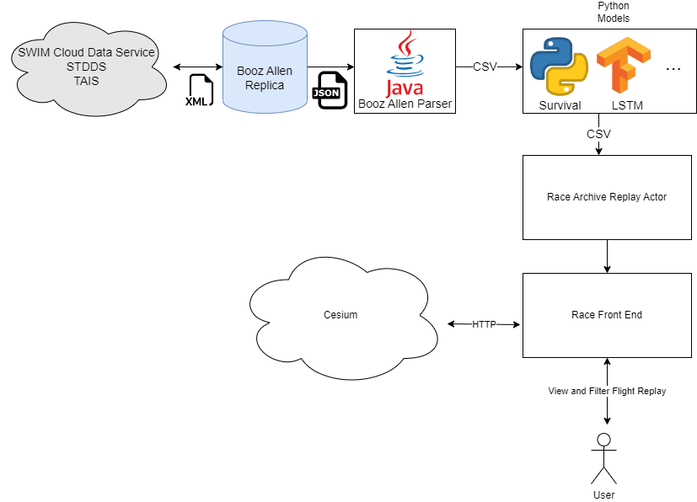
High-Level Architecture Diagram – ARPI & RACE
ARPI
RACE
Neither the U.S. Government nor NASA endorse or recommend any commercial products, processes, or services. Reference to or appearance of any specific commercial products, processes, or services by trade name, trademark, manufacturer, or otherwise, in NASA materials does not constitute or imply its endorsement, recommendation, or favoring by the U.S. Government or NASA.

Slide 26
CVAE Integration

Slide 27
Convolutional Variational Autoencoder (CVAE) Algorithm
A neural network based autoencoder, unsupervised learning technique for anomaly detection in high-dimensional heterogeneous time series
  Does not use the expert labels for training, but does use the information for hyperparameter tuning
Two main components
  An encoder, which maps the the original data by sampling from the low-dimensional latent space into a compressed low-dimensional latent space
  A decoder, which reconstructs the original data by sampling from the low-dimensional latent spaceCVAE uses a 160 second window (160 data points)
    The ARPI window size for SWIM data is 15 steps, which is about 45-60 seconds (3 to 5 seconds between observations)
CVAE generates a nominal or off-nominal prediction label with about 70% accuracy within the window
Memarzadeh, M., Matthews, B., and Avrekh, I. "Unsupervised Anomaly Detection in Flight Data Using Convolutional Variational Auto-Encoder," Aerospace 2020, 7, 15, 8 Aug 2020, DOI: 10.3390/aerospace7080115

Slide 28
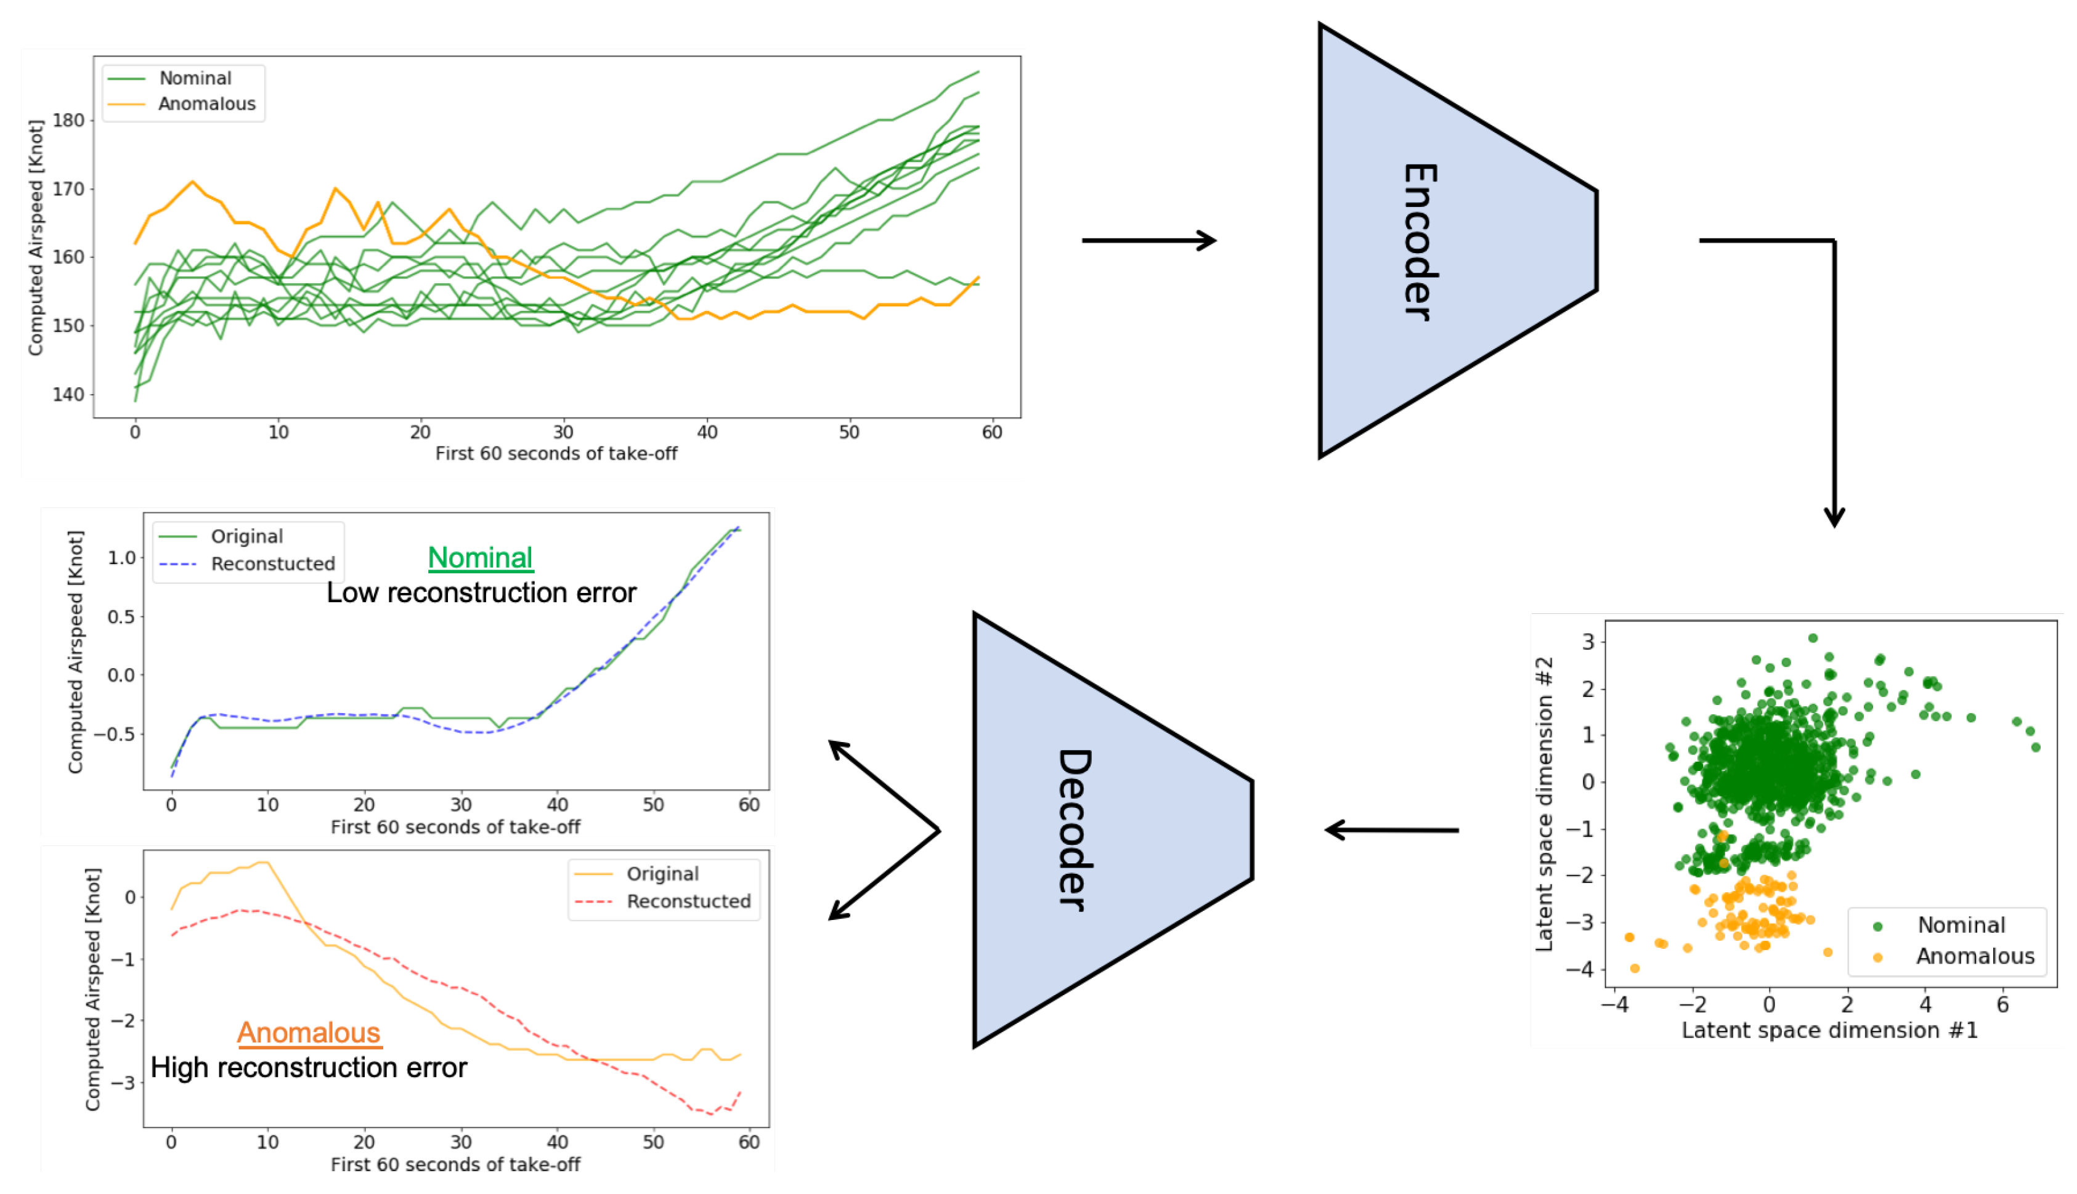
CVAE Algorithm
Goal is to predict labels accurately from available variables
Results on the test set:
  Precision = 61.24%
  Recall = 58.92%
  F1-score = 60.06%
Memarzadeh, M., Matthews, B., and Avrekh, I. Unsupervised Anomaly Detection in Flight Data Using Convolutional Variational Auto-Encoder. Aerospace 2020, 7, 15, 8 Aug 2020, DOI: 10.3390/aerospace7080115

Slide 29
Data Set
Data Mining and System Health (DASHlink) anonymized flight level Flight Operations Quality Assurance (FOQA) data from defunct airlines
  Date/time is stripped from the flight data as part of the anonymizing process. Arbitrary start times are simulated for the purpose of visualization here.
21 aircraft characteristics in addition to latitude and longitude
  Left and right aileron positions, left elevator position, trailing edge flap position, rudder position, average core speed average
  Corrected angle of attack, glideslope deviation, pitch angle, roll angle
  Selected heading, localizer deviation, selected course, drift angle, true heading
  Barometric correct altitude, total pressure
  Computed airspeed, vertical acceleration, wind speed, selected airspeed
1 Hz sampling frequency
Includes data for 30,523 flights, but for the demo we limit to 6,250 flights due to system memory constraints
Because it lacks date and time info, weather information is not available

Slide 30
Demonstration

Slide 31
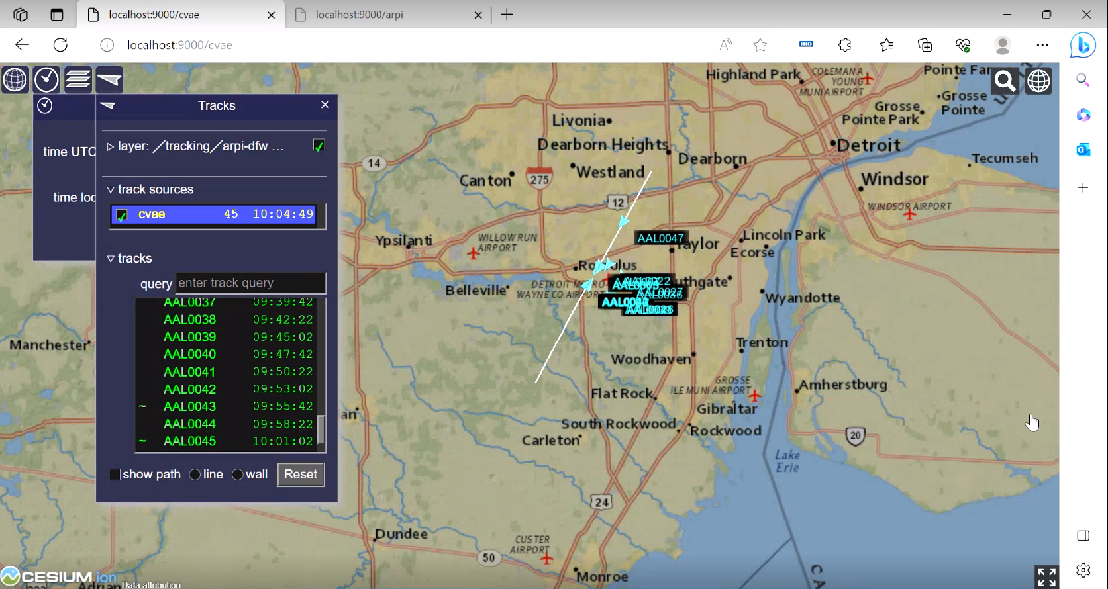
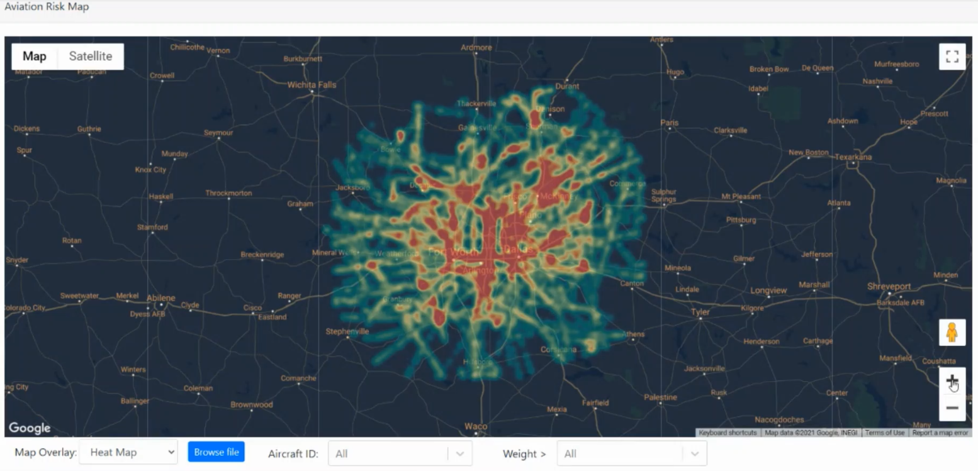
Demonstration
Demo 1 SWIM data
Demo 2 FOQA data

Slide 32

Questions

Slide 33
Backup Slides

Slide 34
Demonstration Videos
Embedded videos of the Demo 1 and Demo 2

