Slide 1
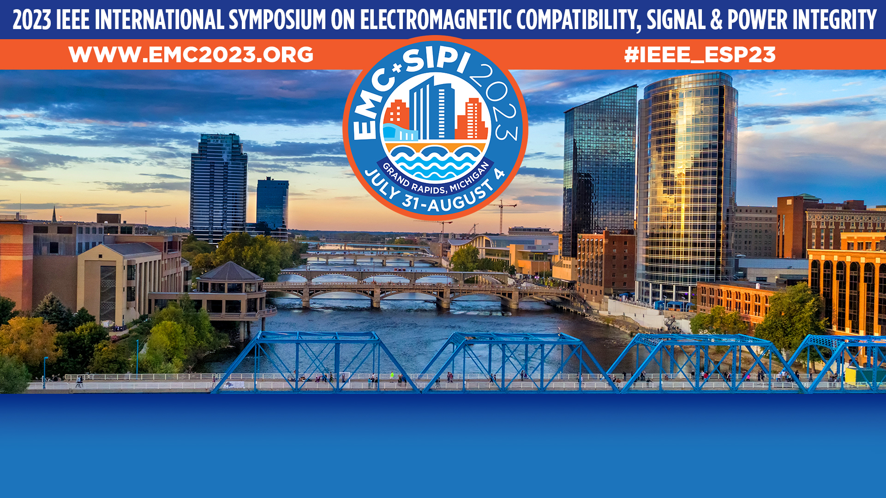
Roman Space Telescope EMC Testing
Nick Davis, Electrical Systems Engineer, RST
MERC Aerospace, NASA Goddard

Slide 2
Today’s Workshop
Roman Space Telescope: About the mission and the observatory
EMC Testing Approach
Lessons Learned
  Importance of being active part of ongoing projects
  Cables, shielding, and terminations
  Perils of EGSE

Slide 3
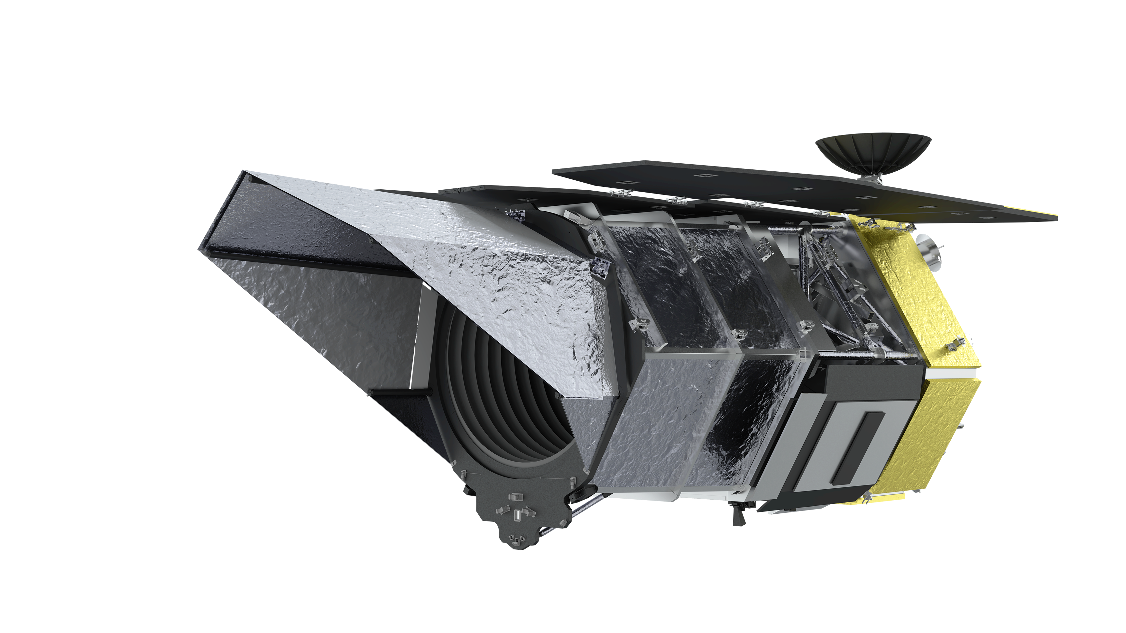
The Nancy Grace Roman Space Telescope
Designed as a “cousin” to Hubble and JWST, the Roman Space Telescope (RST) will study dark energy, exoplanets, and astrophysics.
Image: roman.gsfc.nasa.gov

Slide 4
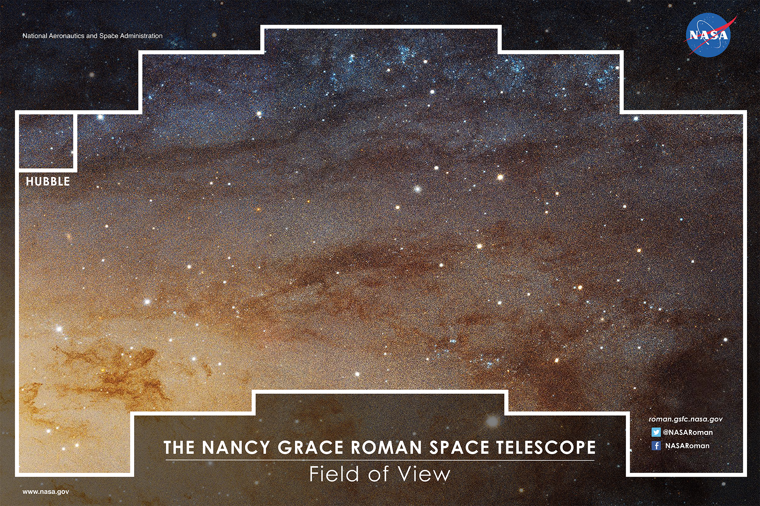
RST vs Hubble
RST’s exceptionally wide field-of-view allows it to see vast expanses of space at one time, at the same resolution as Hubble.
This larger field of view allows for much more science data to be taken in a given amount of time.
Image: roman.gsfc.nasa.gov

Slide 5
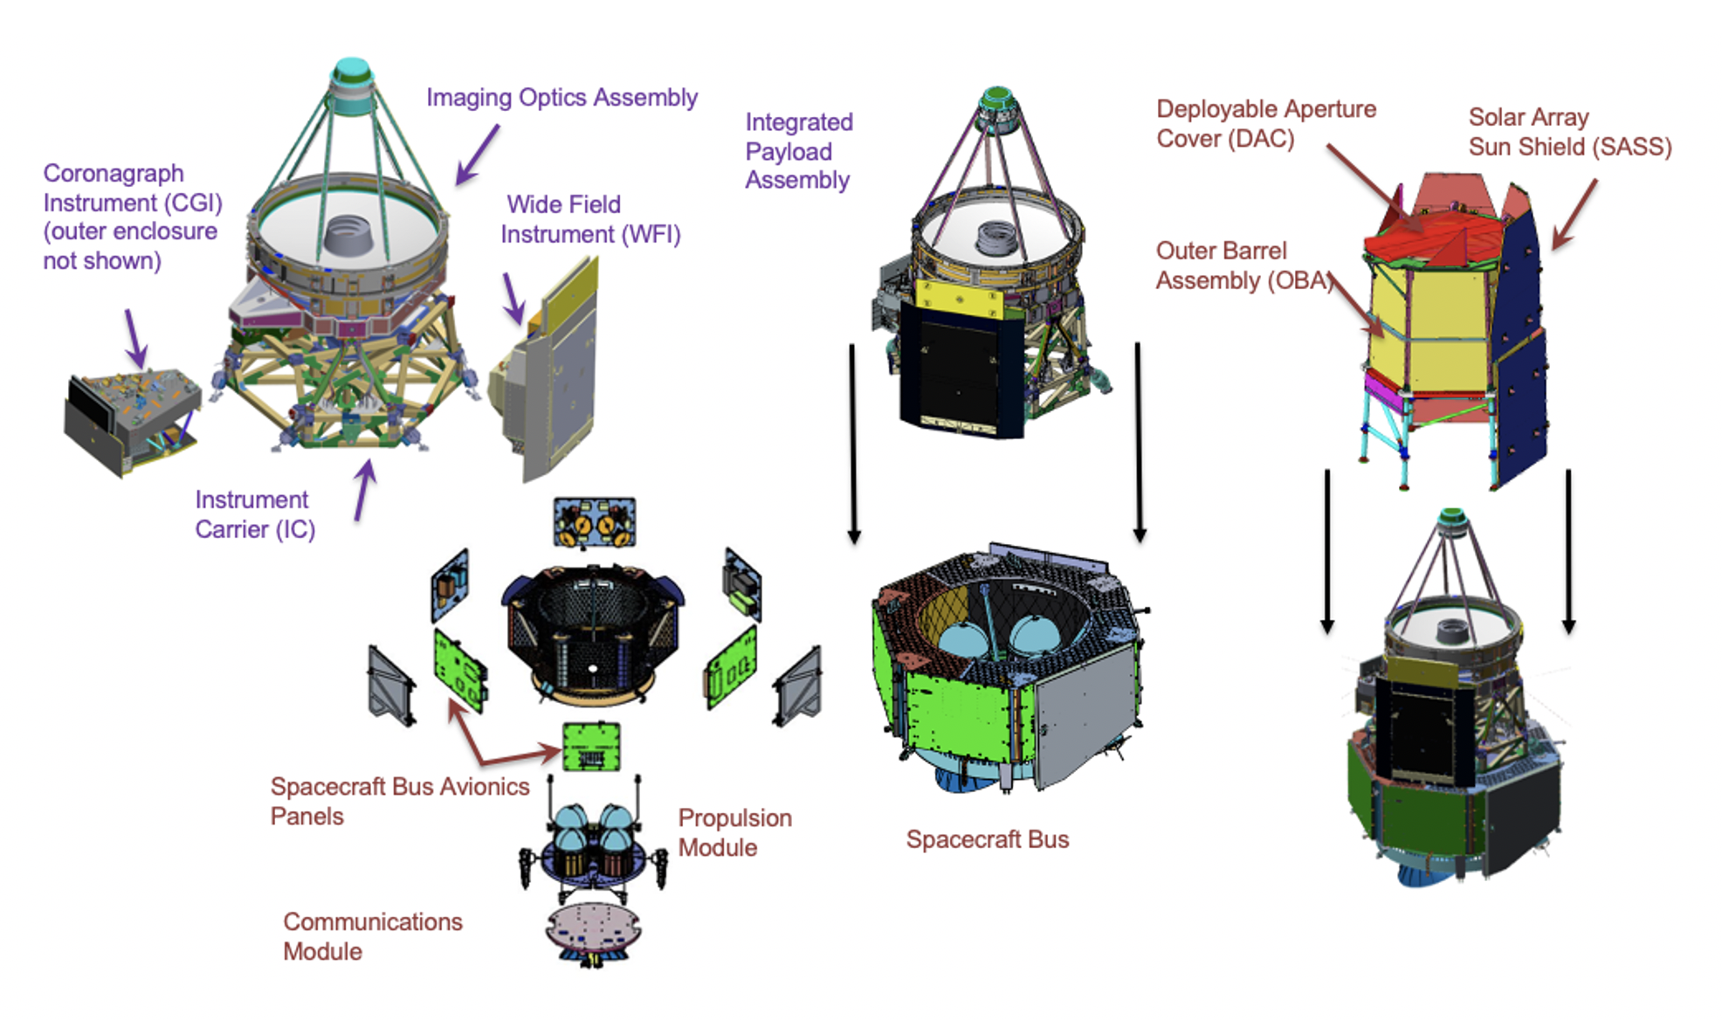
RST Architecture
Image: roman.gsfc.nasa.gov

Slide 6
RST’s EMC Testing Approach
As with most large, complex missions, RST EMI testing is performed at multiple levels with verifications performed in a piecewise manner
Tests performed at unit/avionics box level, instrument level, spacecraft, spacecraft and payload assembly (SCIPA) level, and observatory level
  Flowchart on next slide

Slide 7
RST EMI Testing Flowchart
Spacecraft Avionics Boxes
Spacecraft Testing
Spacecraft + Integrated Payload Assembly (SCIPA) Testing
Observatory Testing
Instrument Electronics
Instrument Testing
Note: instrument electronics split between SC and instrument

Slide 8
Differences and Lessons from JWST
We are able to test at much higher levels of integration (including full observatory) due to less complex deployments and simpler sunshield design
  Radiated emissions/susceptibility testing at SC+Payload level (was not feasible on JWST OTIS)

Slide 9
Lessons Learned and Reinforced
Effectivity of embedding EMI/EMC engineers into project staff
Importance of cable “audits”
Connector savers – not as scary as they used to be

Slide 10
EMI/EMC Engineers as Project Staff
Embedding EMI/EMC engineers (as electrical and/or systems engineers), along with oversight with upper-level EMI/EMC engineers/chiefs in a project brings significant benefits such as
  Early requirements management
  Access to box/board designers early
  Access to top-level engineers and management for addressing concerns early

Slide 11
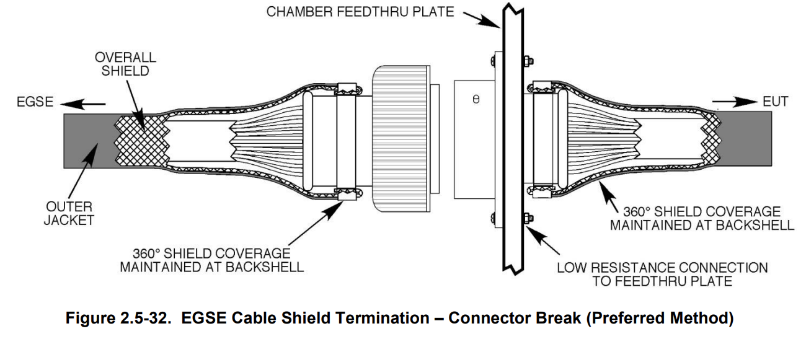
Test Cable Perils
EMI is just one of the many tests performed on NASA spacecraft. Commonly, the Electrical Ground Support Equipment (EGSE) cables are used for other testing.
Cables are re-used as part of Thermal Vacuum testing.
  Thermal Vacuum (TVAC): equipment is placed in a chamber where pressure and temperature can be adjusted to simulate a space-like environment.
  Feedthrough/penetration plate common to both EMI and TVAC testing (as both take place in a specialized chamber).
Typical EGSE cabling uses overall shield braid in construction

Slide 12
RST Harnessing – And a Concern
Many cables on RST use aluminized tape alone as an outer shield due to concerns with space charging, mass (braid is heavier, harness mass is significant), and thermal isolation (important on a cryogenic observatory)
Aluminized tape is substantially less effective than a braid
  Data on next page
Major Concern: an item will pass with more effective GSE braid but present issues in flight with the less-effective flight shielding – a “false pass”.

Slide 13
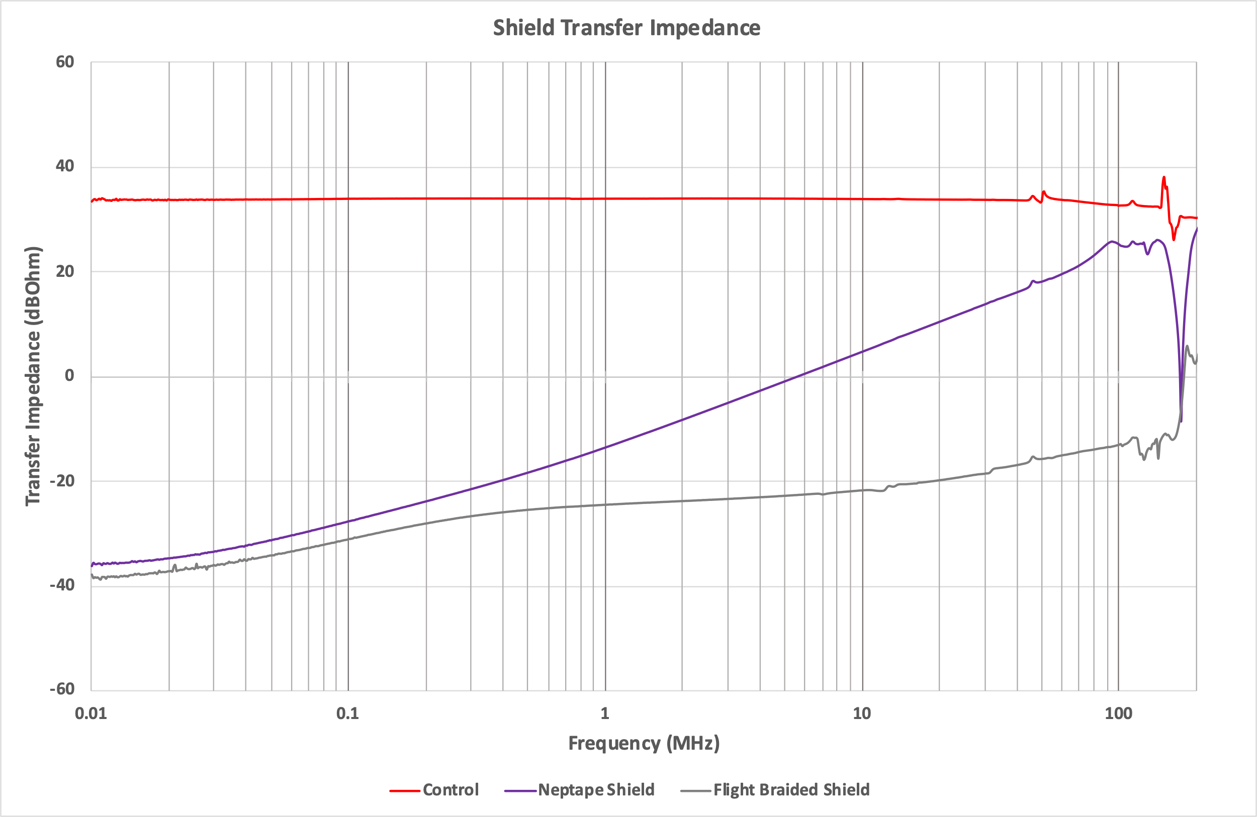
Neptape vs Braid on Cable Sample
Significantly higher transfer impedance at higher frequencies for Neptape. This means that more potential will couple to signal-carrying conductors for a given shield current.

Slide 14
Test Cables – What Can be Done?
If early, cables resembling flight can be added to build orders on needed interfaces
  Scope can be reduced to interfaces expected to produce problematic emissions (high-speed digital) or likely to be susceptible (low-level analog)
  Characterize shield effectiveness (transfer impedance) of representative cables as early as possible.
If later in the program, resolutions still exist:
  Disconnecting the backshell on one or both sides of the cable to unterminate the shields
  Adapter cables without shields
  Breakout boxes (not ideal; especially at high frequencies – many BOBs compromise signal integrity)

Slide 15
Connector Savers
Connector savers are commonly used to reduce the number of physical mates/demates on sensitive (flight) hardware.
Previous guidance – remove all connector savers
  Required QA support for any configuration change on flight hardware, slowing down testing
  Brought a (small) risk of damage when mating or demating connectors to flight hardware
Connector savers in use today at GSFC pass through shields and are well-built. Previously, connector savers were removed due to concerns over quality of the connection, especially to the shield.
Compared savers on/off through multiple tests; there were no differences.
Regardless, any connector savers should be inspected – if they pass the shield through as a “true shield” (and not a wire), the savers can stay on for the test.

Slide 16
Summary
Roman Space Telescope is an evolution in space telescope design that will allow much more data to be taken in a given amount of time.
Similar to previous flagships, this presents a need to do EMI testing at multiple levels.
Lessons learned:
  Embed EMI/EMC-trained personnel in the electrical teams as early and as much as possible.
  Harnessing differences between ground testing and flight are a significant concern more now than ever – they should be accounted for in all testing.
  Connector savers, if of sufficient quality, need not be removed. This saves time and protects hardware.

