Slide 1
Comparison of liquefaction testing with liquid nitrogen and liquid oxygen
Presentation ID: C4Or1B-02
R.J. Grotenrath¹, R. Balasubramaniam^{1,2}, J.W. Smith³,
P.A. Giddens³, and W.L. Johnson¹
¹Glenn Research Center, Cleveland, OH, 44135 USA
²Case Western Reserve University, Cleveland, OH, 44106 USA
³Marshall Space Flight Center, Huntsville, AL 35812 USA
2023 Cryogenic Engineering Conference

Slide 2
Introduction
A sustainable human presence on Lunar & Martian surfaces heavily depends on the ability to utilize local resources from their respective environments.
In-situ Resource Utilization (ISRU) technologies are in development to harvest resources from ice pockets and local regolith.
Liquefying the locally processed commodities is the last step for propellant production.
A NASA trade suggests an oxygen liquefaction tank with an ISRU system can reduce Martian mission mass requirements by over 50% [1].
Nitrogen liquefaction was demonstrated at NASA Marshall Space Flight Center (MSFC) under Brassboard testing in 2019 [2].
The Brassboard nitrogen testing matured the CryoFILL test plan for oxygen.
Oxygen liquefaction was demonstrated at NASA Glenn Research Center (GRC) in 2022 through the Cryogenic Fluid In-situ Liquefaction for Landers (CryoFILL) project.
CryoFILL is a NASA internal technology demonstration of liquefaction operations.
The CryoFILL hardware was tested with nitrogen before the oxygen.

Slide 3
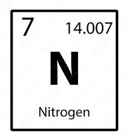
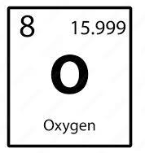
Nitrogen and Oxygen Summary
Nitrogen
Homonuclear Diatomic
N₂ Molecular Mass: 28 g/mol
Inert
Makes up ~78% of air
Normal Boiling Point (NBP): 77.36 K
Density at Stand Temperature & Pressure (STP): 1.25 kg/m³
Saturated liquid density at 1 atm: 806.08 kg/m³
Gaseous Nitrogen: GN2
Liquid Nitrogen: LN2
Oxygen
Homonuclear Diatomic
O₂ Molecular Mass: 32 g/mol
Oxidizing agent
Makes up ~21% of air
Normal Boiling Point (NBP): 90.19 K
Density at Stand Temperature & Pressure (STP): 1.43 kg/m³
Saturated liquid density at 1 atm: 1141.2 kg/m³
Gaseous Oxygen: GOX
Liquid Oxygen: LOX

Slide 4
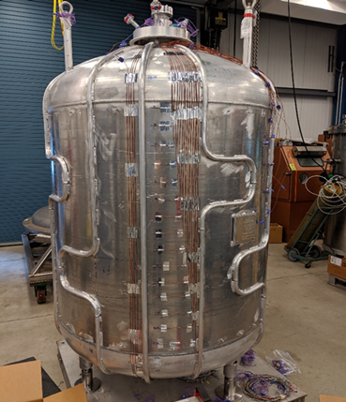
Cryogenic Fluid In-situ Liquefaction for Landers (CryoFILL) Description
CryoFILL will demonstrate cryogenic liquefaction capabilities for Lunar & Martian landers in conjunction with ISRU technologies at a relevant scale and in a relevant environment.
Brassboard nitrogen liquefaction testing was the precursor to Prototype oxygen liquefaction testing using NASA’s stainless steel zero boil-off (ZBO) tank.
The aluminum Prototype tank was designed to be
½ scale of the surface area required for a prototypical Mars
Ascent Vehicle (MAV)[3].
CryoFILL oxygen liquefaction testing demonstrated
constant (nominally 1.1 kg/hr) and transient
liquefaction operations
Advanced TRL of “Oxygen Liquefaction Operations” from TRL 4 to TRL 5
Prototype Tank without MLI

Slide 5
CryoFILL LN2 and LOX Testing Timeline and Test Descriptions
Test Timeline
Test Types Considered
Boil-off:
Venting of evaporated liquid cryogen from environmental parasitic heat loads imposed on the tank. No mass flow into the tank.
Autogenous Pressurization:
Increasing the tank pressure by constantly introducing gas into the system. No venting occurred during pressurization.
Cryocooler Initiation:
Chill down of the neon loop.
Cryocooler Operation:
Operating at a constant fan speed/neon mass flow rate.
Fluid | Date | Test
Nitrogen | 06/30/22 | Autogenous Pressurization
Nitrogen | 07/01/22 | Boil-off
Nitrogen | 07/08/22 | Cryocooler Initiation
Nitrogen | 07/08/22 | Cryocooler Operations
Oxygen | 07/24/22 | Boil-off
Oxygen | 07/25/22 | Autogenous Pressurization
Oxygen | 08/01/22 | Cryocooler Initiation
Oxygen | 08/02/22 | Cryocooler Operations

Slide 6
Similar LN2 and LOX Testing
Fluid | Boil-off | Autogenous Pressurization | Cryocooler Initiation | Cryocooler Operation
Nitrogen | Tank Pressure: 206.84 kPa Saturation Temp: 84.23 K Fill Level: 49% Vent Mass Flow Rate: 0.58 kg/hr No external surface heaters | Initial Tank Pressure: 137.75 kPa Initial Saturation Temp: 93.24 K Final Tank Pressure: 207.15 kPa Final Saturation Temp: 84.23 K Fill Level: 37% Vent Mass Flow Rate: 0 kg/hr GN2 Mass Flow Rate: 2.25 kg/hr | Tank Pressure: 234.42 kPa Saturation Temp: 85.25 K Fill Level: 48% Vent Mass Flow Rate: 0 kg/hr GN2 Mass Flow Rate: 0 kg/hr Cryofan Speed: 25 kRPM | Tank Pressure: 234.42 kPa Saturation Temp: 85.25 K Fill Level: 48% Vent Mass Flow Rate: 0 kg/hr GN2 Mass Flow Rate: 1.01 kg/hr Cryofan Speed: 25 kRPM Lift: 226.4 W
Oxygen | Tank Pressure: 206.84 kPa Saturation Temp: 97.61 K Fill Level: 58% Vent Mass Flow Rate: 0.61 kg/hr No external surface heaters | Initial Tank Pressure: 206.89 kPa Initial Saturation Temp: 97.61 K Final Tank Pressure: 275.47 kPa Final Saturation Temp: 100.99 K Fill Level: 50% Vent Mass Flow Rate: 0 kg/hr GOX Mass Flow Rate: 1.24 kg/hr | Tank Pressure: 206.85 kPa Saturation Temp: 97.61 K Fill Level: 48% Vent Mass Flow Rate: 0 kg/hr GOX Mass Flow Rate: 0 kg/hr Cryofan Speed: 20 kRPM | Tank Pressure: 206.85 kPa Saturation Temp: 97.61 K Fill Level: 48% Vent Mass Flow Rate: 0 kg/hr GOX Mass Flow Rate: 1.07 kg/hr Cryofan Speed: 20 kRPM Lift: 216.52
* All measurements are averaged over their respective test periods
* Initial and final pressures are an averaged measurement at the start and end of each test

Slide 7
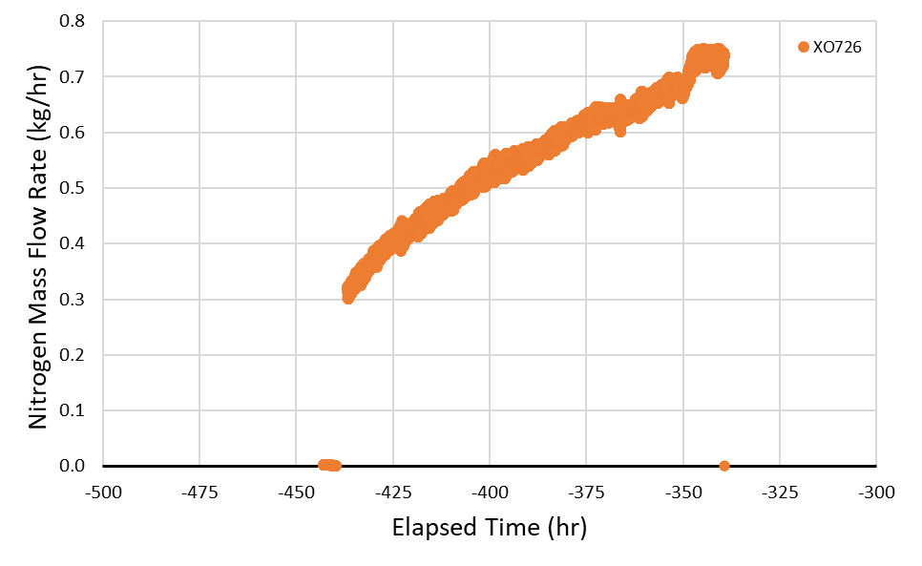
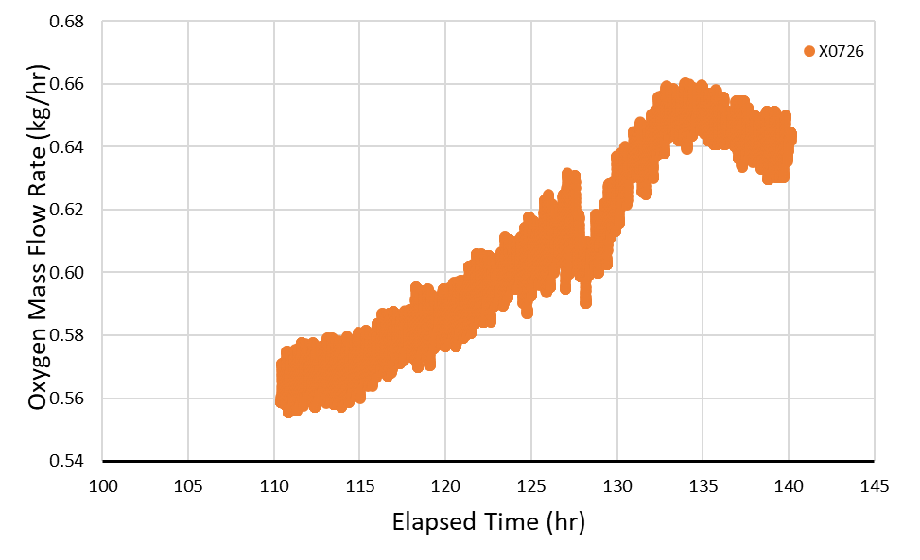
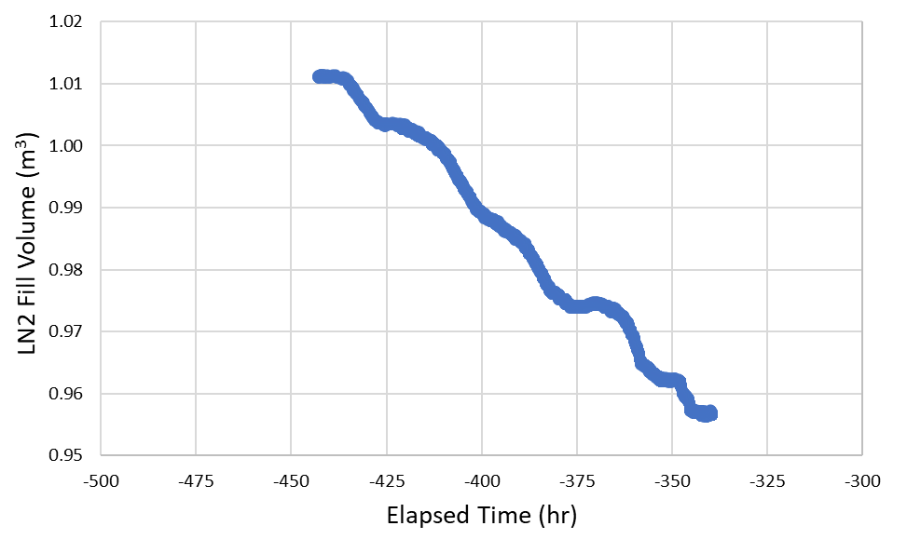
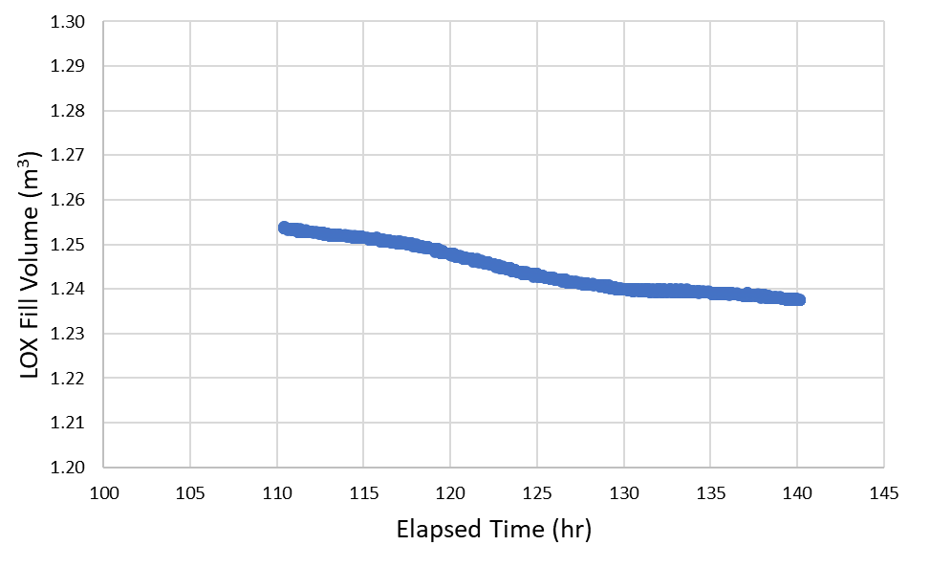
Cryogenic Boil-off
No gas input. Venting occurred during boil-off to maintain a near constant tank pressure of 206.84 kPa
Reduction in liquid volume during boil off
Steady state boil off achieved during oxygen test
Nitrogen
Both test’s boil-off rates were within 5% of one another
Oxygen

Slide 8
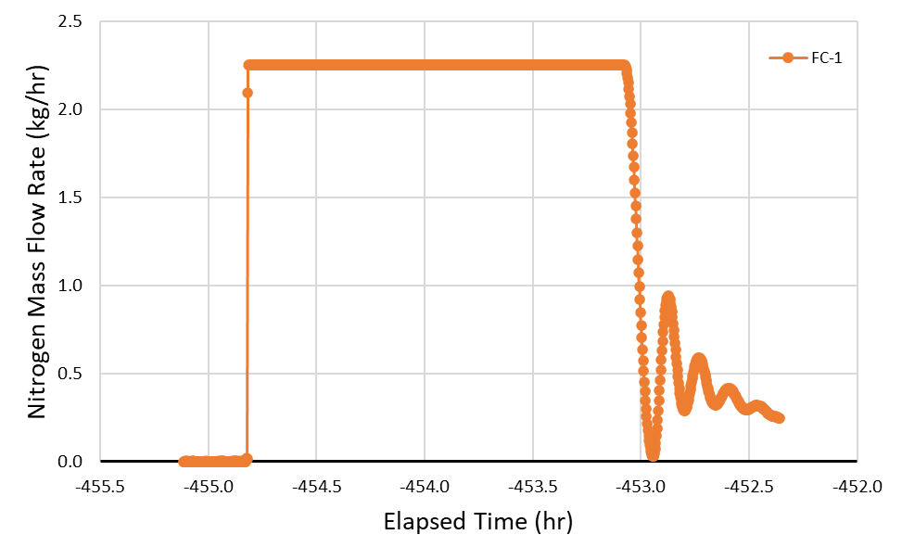
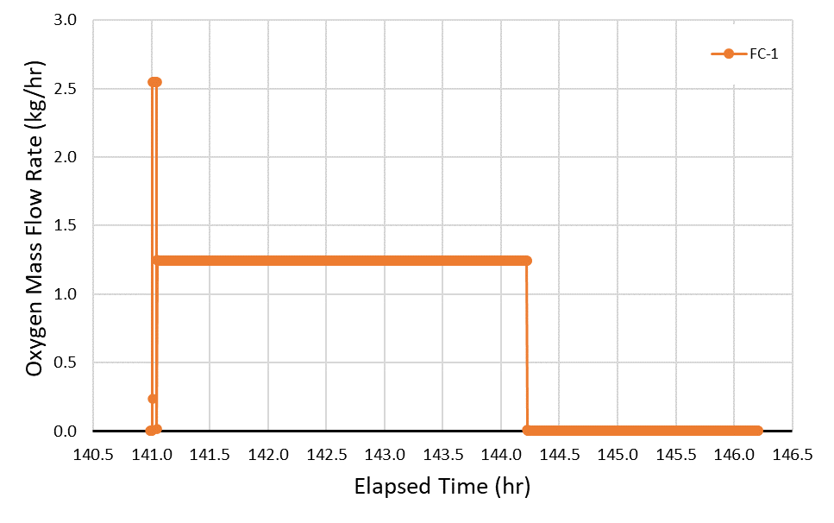
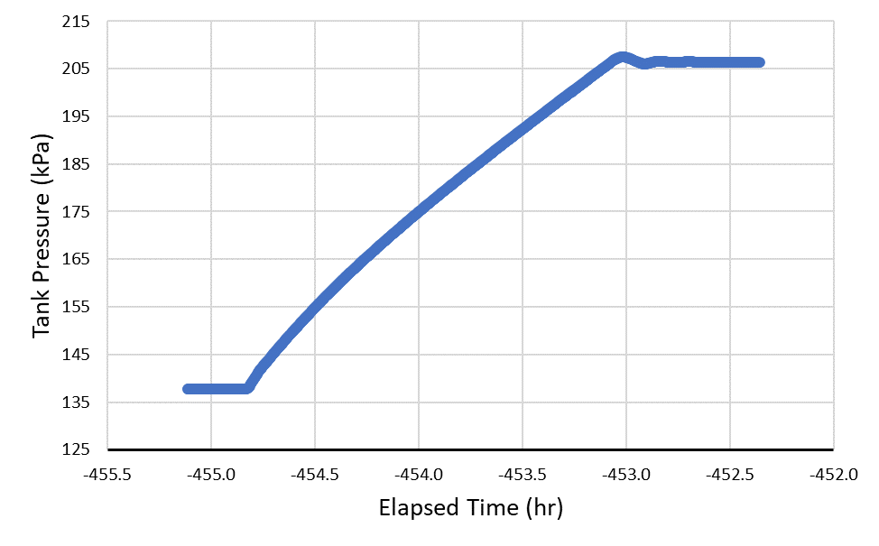
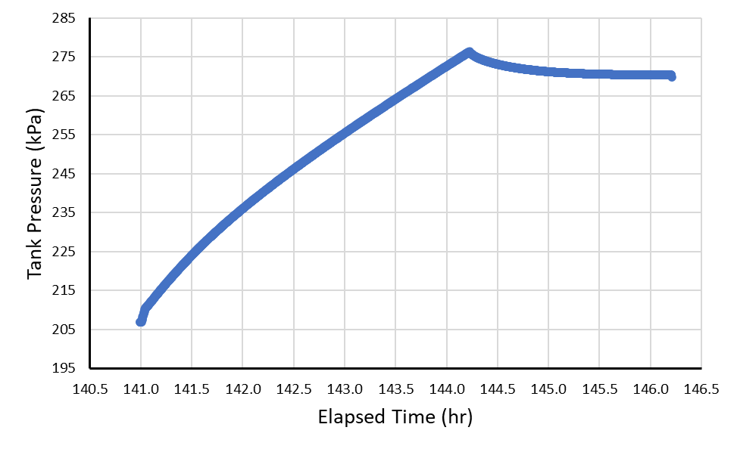
Autogenous Tank Pressurization
Nitrogen test was close to wide open flow on the gas flow controller. Flow was adjusted for the oxygen pressurization test
Nitrogen gas flow was about double that of the oxygen test.
No venting, heaters, or active cooling
Tank pressure dipped a bit when cutting of gas flow into the tank
Nitrogen
Oxygen

Slide 9
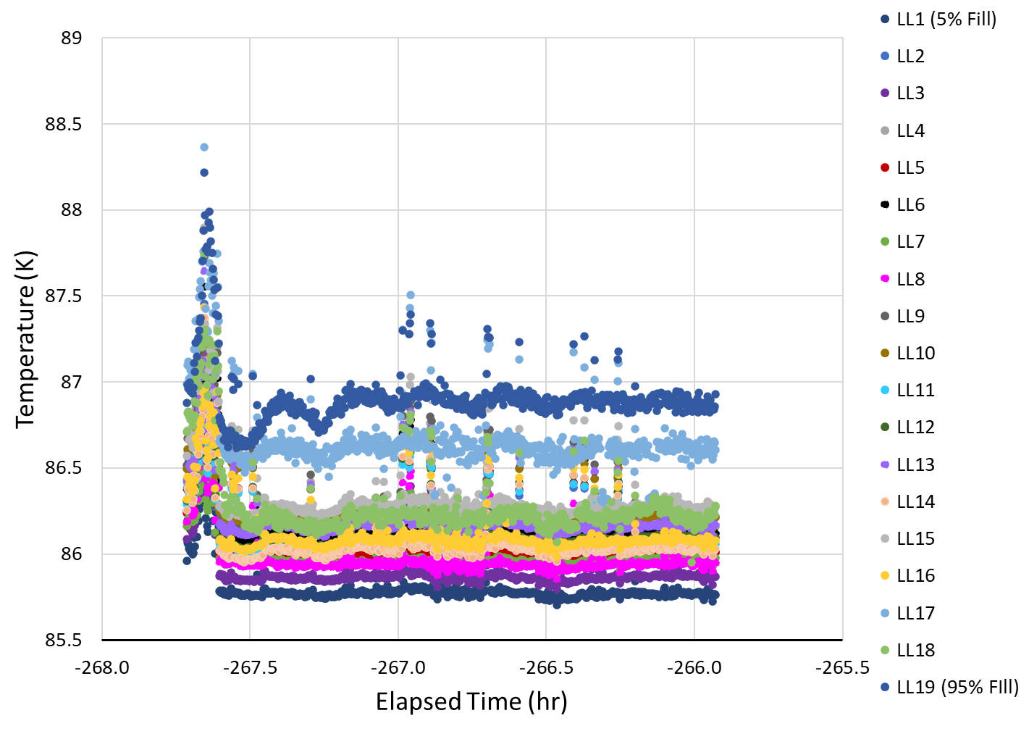
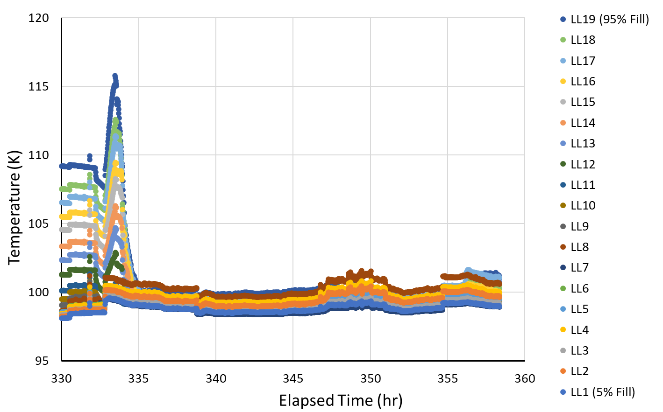
Cryocooler Initiation
Nitrogen
Oxygen
Noise from diodes on the temperature rake
Fluid chill down due to activation of the cryocooler

Slide 10
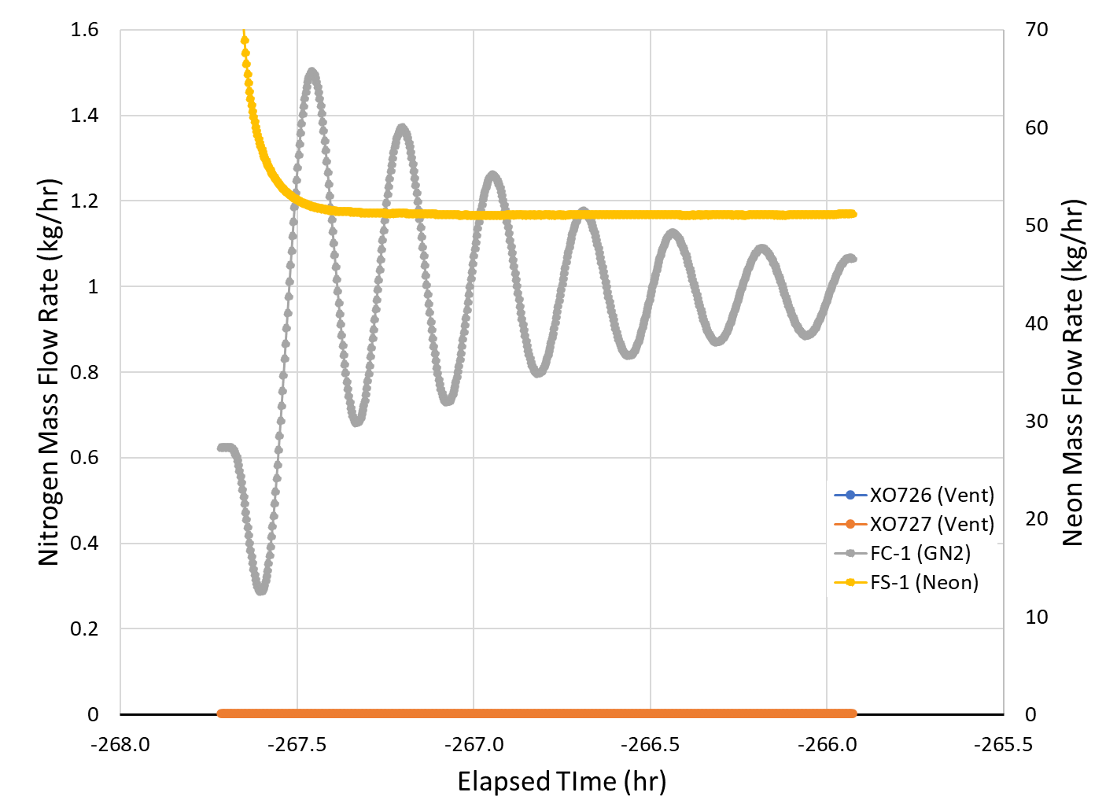
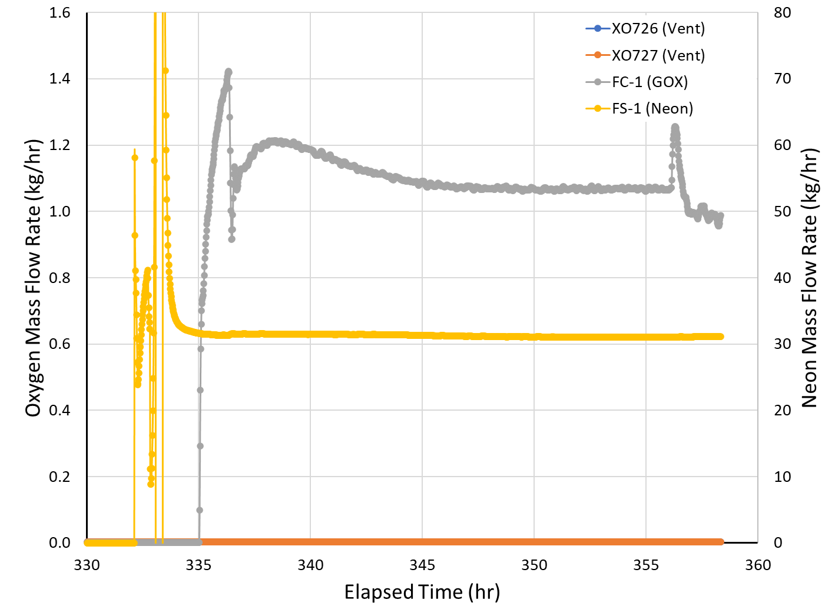
Cryocooler Operation
The oxygen test gas flow control is smoother than the oxygen due to the addition of heat from tank wall and cryocooler loop heaters
Nitrogen
Oxygen
No external surface heaters to thermally balance the system
Cryocooler is running at a constant fan speed for each test and the gas input/liquefaction rate is allowed to float to maintain tank pressure

Slide 11
CryoFILL LN2 and LOX Comparison Summary
Fluid | Boil-off | Autogenous Pressurization | Cryocooler Initiation | Cryocooler Operation
Nitrogen | Tank Pressure: 206.84 kPa Boil-off Heat Load: 47.9 W No external surface heaters | Vent Mass Flow Rate: 0 kg/hr GN2 Mass Flow Rate: 2.25 kg/hr Pressurization Rate: 38.13 kPa/hr GN2 Heat Load: 26.65 W | Tank Pressure: 234.42 kPa Saturation Temp: 85.25 K Cryofan Speed: 25 kRPM Neon Mass Flow Rate: 51.1 kg/hr | Lift: 226.4 W Liquefaction Rate: 1.01 kg/hr Cryofan Speed: 25 kRPM Neon Mass Flow Rate: 51.1 kg/hr No external surface heaters
Oxygen | Tank Pressure: 206.84 kPa Boil-off Heat Load: 36.5 W No external surface heaters | Vent Mass Flow Rate: 0 kg/hr GOX Mass Flow Rate: 1.24 kg/hr Pressurization Rate: 21.10 kPa/hr GOX Heat Load: 13.33 W | Tank Pressure: 206.85 kPa Saturation Temp: 97.61 K Cryofan Speed: 20 kRPM Neon Mass Flow Rate: 31.41 kg/hr | Lift: 216.52 Liquefaction Rate: 1.07 kg/hr Cryofan Speed: 20 kRPM Neon Mass Flow Rate: 31.41 kg/hr Heaters: Tank: 20 W | Neon Loop: 27 W
Comparison | Boil-off Heat Load Variance ~24% | GN2 mass flow was roughly double that of the GOX Gas Flow Heat Load Variance ~50% | Higher neon mass flow rate with increased fan speed Reduced stratification with active cooling | Addition of external surfaces heaters smoothed the tank pressure control with respect to gas input Lift Variance ~5%
* All measurements are averaged over their respective test periods

Slide 12
Takeaways/Conclusions:
The CryoFILL nitrogen check out tests guided the test operations with oxygen
Future liquefaction testing with the CryoFILL Prototype hardware can tailor the nitrogen check out tests and oxygen tests for a more direct comparison with respect to test conditions.
Nitrogen and oxygen boil-off rates were within 5% of one another for similar test conditions. This resulted in a 24% variance in the associated boil off heat load which is tied to the similarity in fluid properties.
The mass flow of GN2 was double that of the GOX introduced during the autogenous pressurization tests. The heat load imposed by the gaseous flow matched the variation of mass flow while accounting for thermal effects indicates a lower GN2 mass flow autogenous pressurization test could be representative of what was observed with the original GOX test.
Based on the similarities observed in the nitrogen and oxygen boil-off and autogenous pressurization tests, nitrogen could be considered as a surrogate fluid when developing cryogenic tests with oxygen.
Nitrogen is inert on its own and could reduce potential project risk related to oxygen safety hazards
Nitrogen should be considered for benchtop or brassboard testing [2]

Slide 13
Thank you for your time!

Slide 14
References
Johnson WJ, Hauser DM, Plachta DW, Wang XYJ, Banker BF, Desai PS, Stephens JR and Swanger AM 2018 Comparison of oxygen liquefaction methods for use on the Martian surface Cryogenics 90 p 60-61
Valenzuela JG 2021 Cryogenic in-situ liquefaction for landers “brassboard” liquefaction testing series NASA/TM-20210010564 http://ntrs.nasa.gov
Polsgrove T, Thomas H D, Stephens W and Rucker M A, "Mars Ascent Vehicle Design for Human Exploration," in AIAA-2015-4416, 2015.

