Slide 1
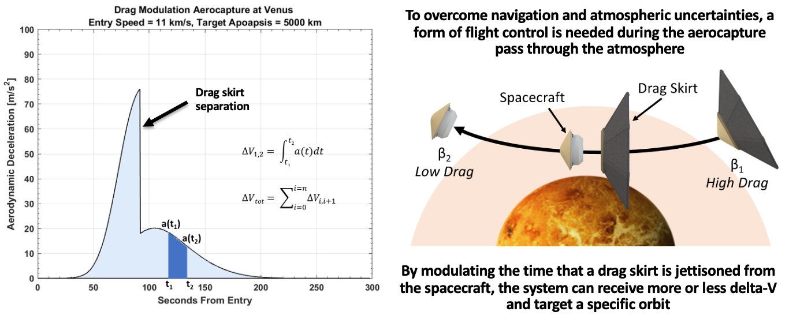
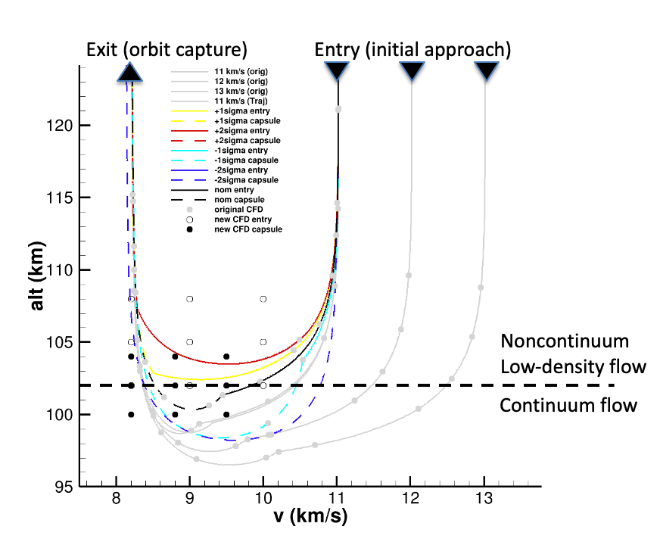
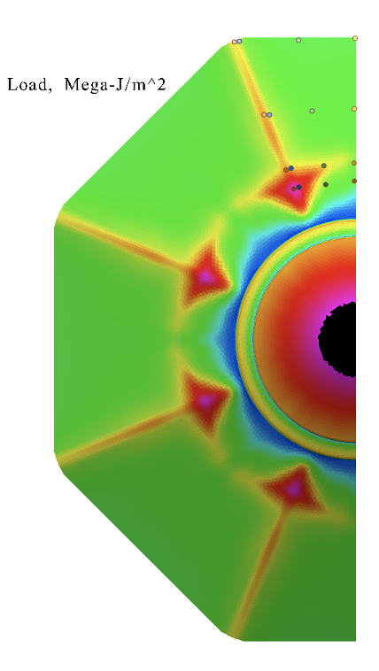
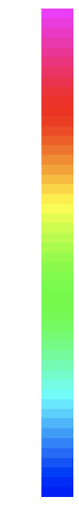
Computational Aerothermal Modeling and Simulation of Hypersonic, Low-density Flows for the ADEPT Drag Modulated Aerocapture Mission
ADEPT Drag Modulated Flight Control
Project Lead: Paul Wercinski (ARC-TSS) paul.wercinski@nasa.gov
Key Contributors:
    CFD: Ryan McDaniel (TSA), Yehia Rizk (TSA),
    Prakash Shrestha (TSA/AMA)
CBAero: Dave Kinney (AA)
TPSizer: Kathy McGuire (AA), Frank Milos (TSM/AMA)
Need
Drag Modulated Aerocapture (DMA) for Venus orbiter missions relies on the deployable aeroshell ADEPT to perform orbit insertion Delta-V
Novel entry technology coupled with challenging mission application requires fast, robust analysis tools to assess feasibile configurations
IRAD Objectives
Develop high-fidelity computational analysis tools to predict surface heat flux, temperature, shear, pressure.
Apply design tools for the ADEPT drag skirt (e.g. a CFD-anchored CBAERO model) that enables rapid estimation of aerothermal environments for a range of candidate DMA trajectories.
Solution and Results
Aerothermal Database spans wide range of possible DMA trajectories
CBAero and TPSizer generate trajectory base environments to size TPS thickness (11 km/s entry at 59sec separation shown)
Heat Load
(kJ/cm²
10
7.5
5
2.5
0
TPSizer analysis showing feasible TPS thicknesses for CPICA rigid nose and ADEPT carbon fabric on DMA aeroshell
Tool capability demonstrated and results presented to JPL DMA partners
Ready for future design studies and trades!

