Slide 1
14x22 Wall and Floor Tape Impact Study
Sam Zauber
Wind Tunnel Characterization Working Group (WTCWG)
2023 Face-to-Face Meeting
July 25-27, 2023

Slide 2
Agenda
Overview
Test Objectives
Facility Description
Check Standard Probe Overview
Check Standard Probe Results
Wall Rake Results
WICS Results
Conclusions

Slide 3
Overview
Study goals:
  Do wall and floor gaps impact the tunnel calibration?
  Can we discontinue taping the gaps during testing (and therefore improve operational efficiency)?
  Are there special test configuration considerations impacting the recommendation?
Presentation goals:
  Provide context of test performed to capture data for the study
  Report on results from three data sources
  Provide recommendations for future testing

Slide 4
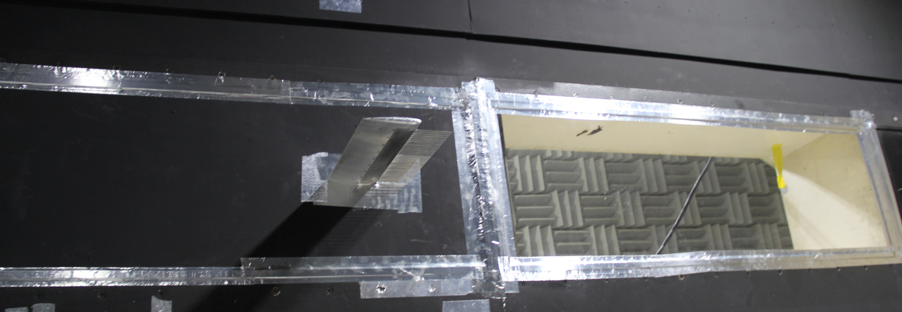
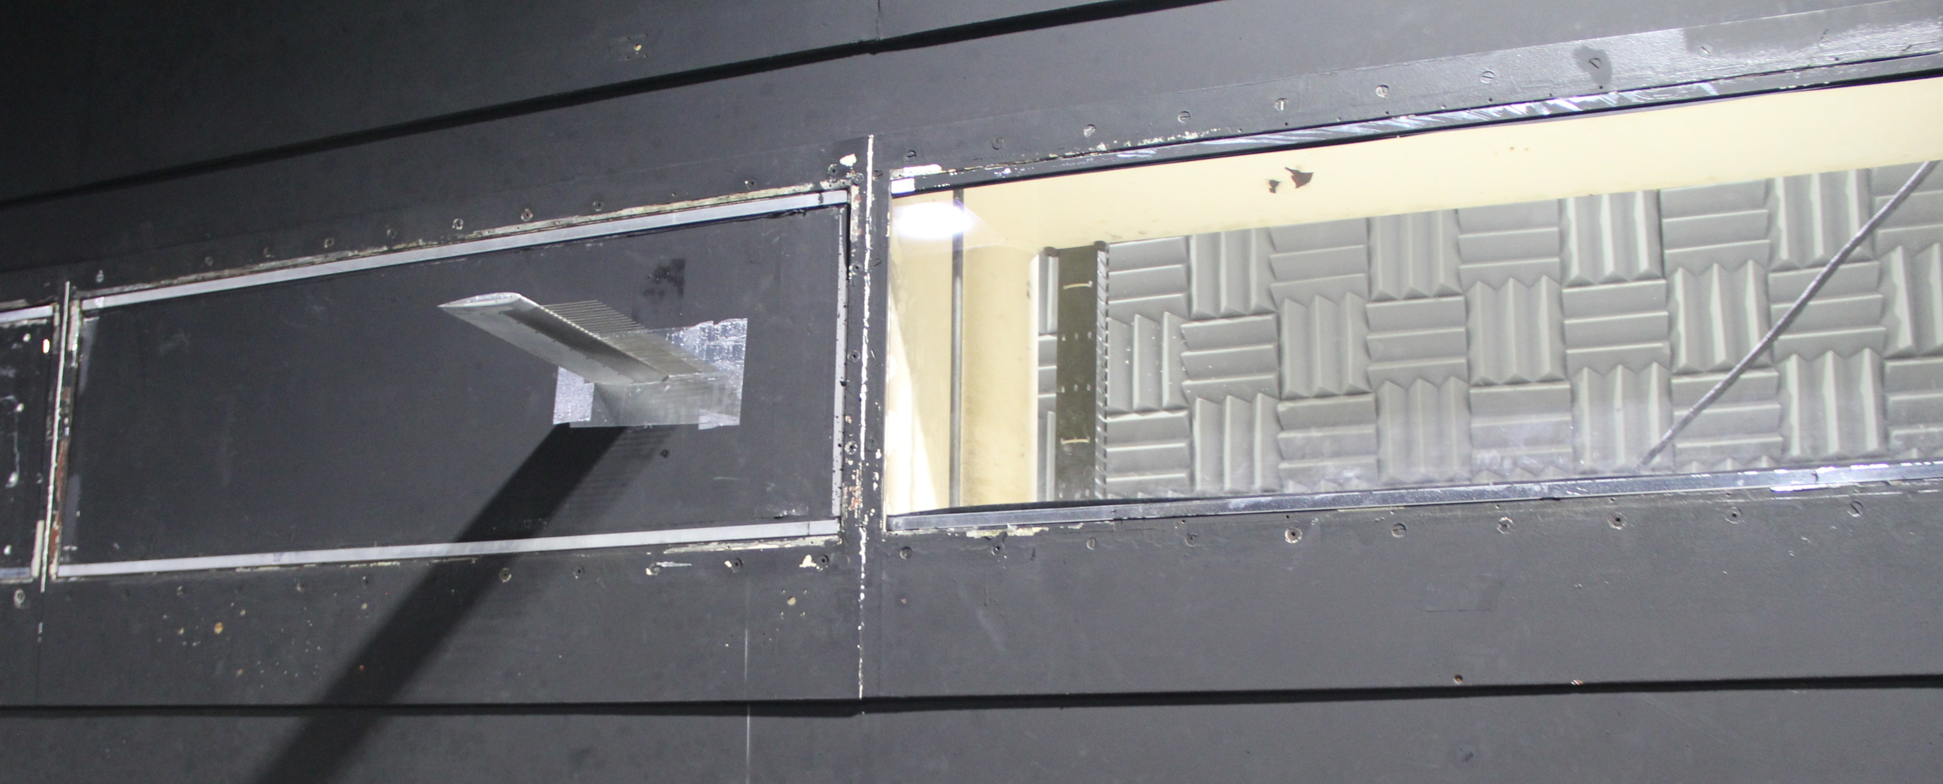
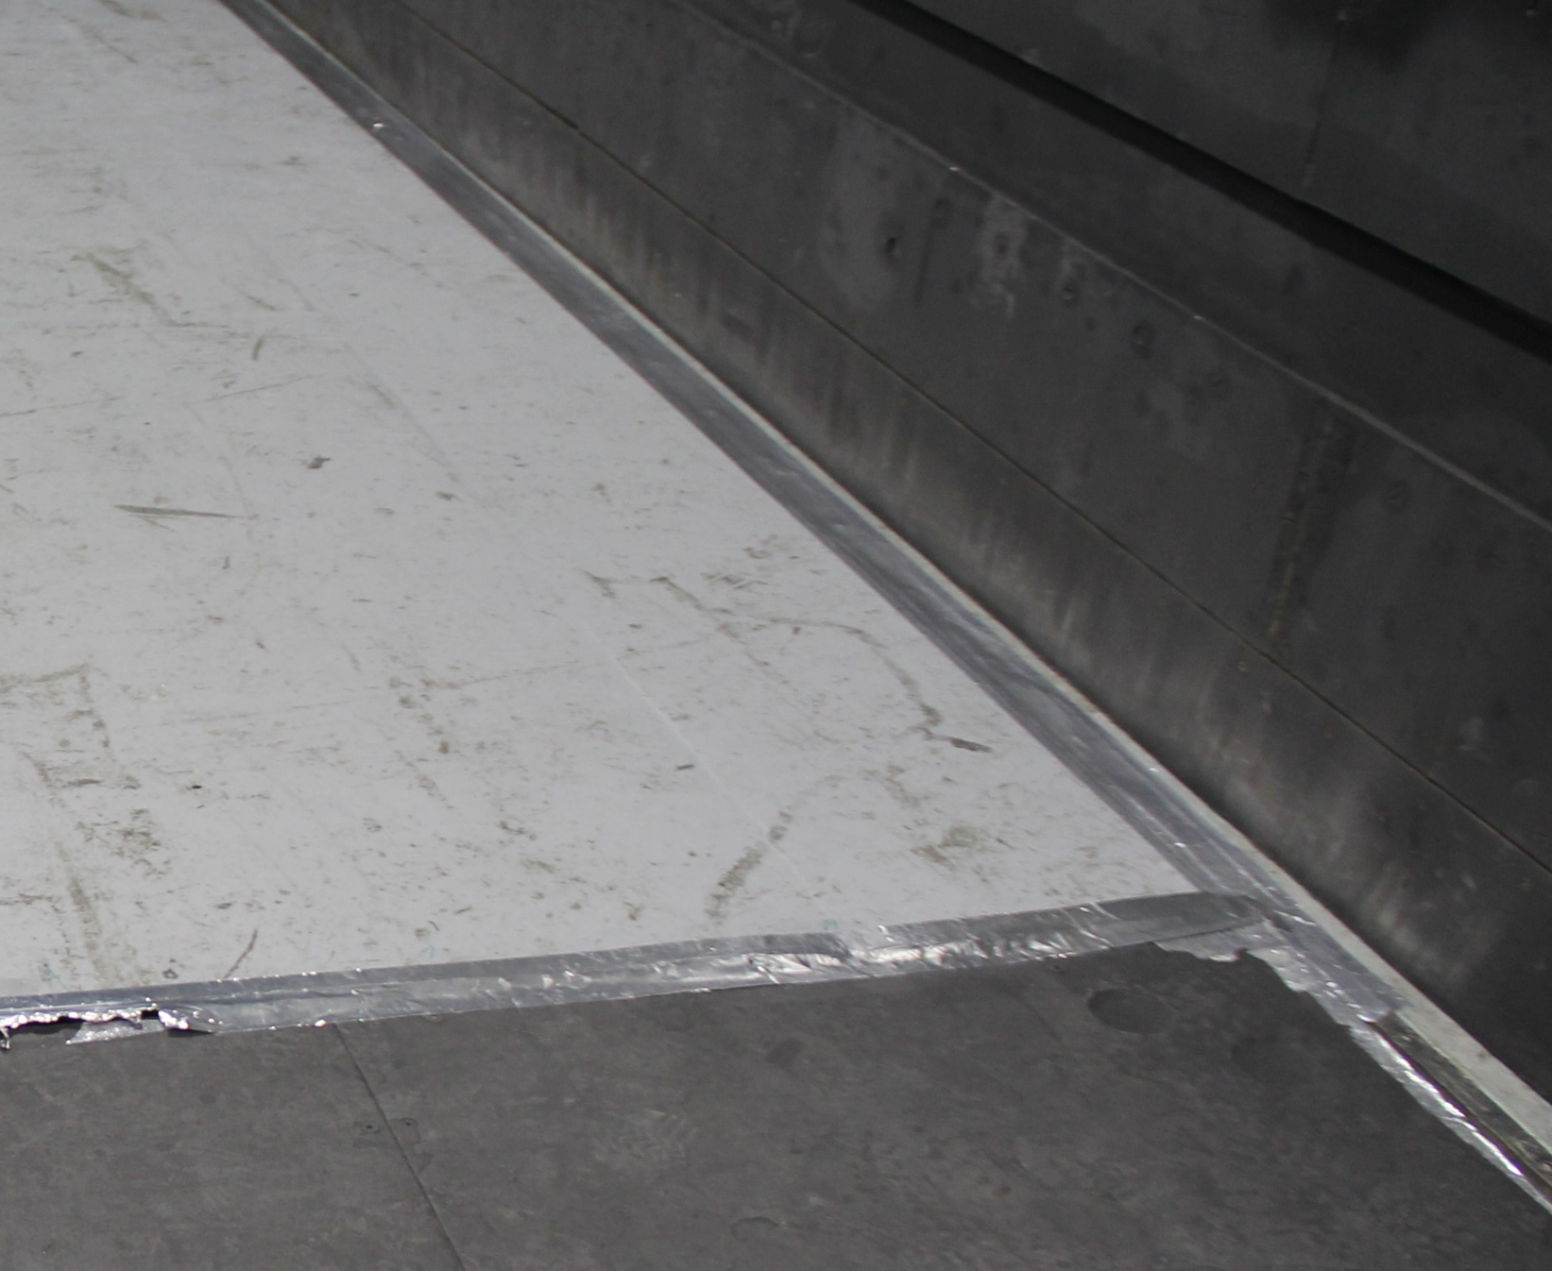
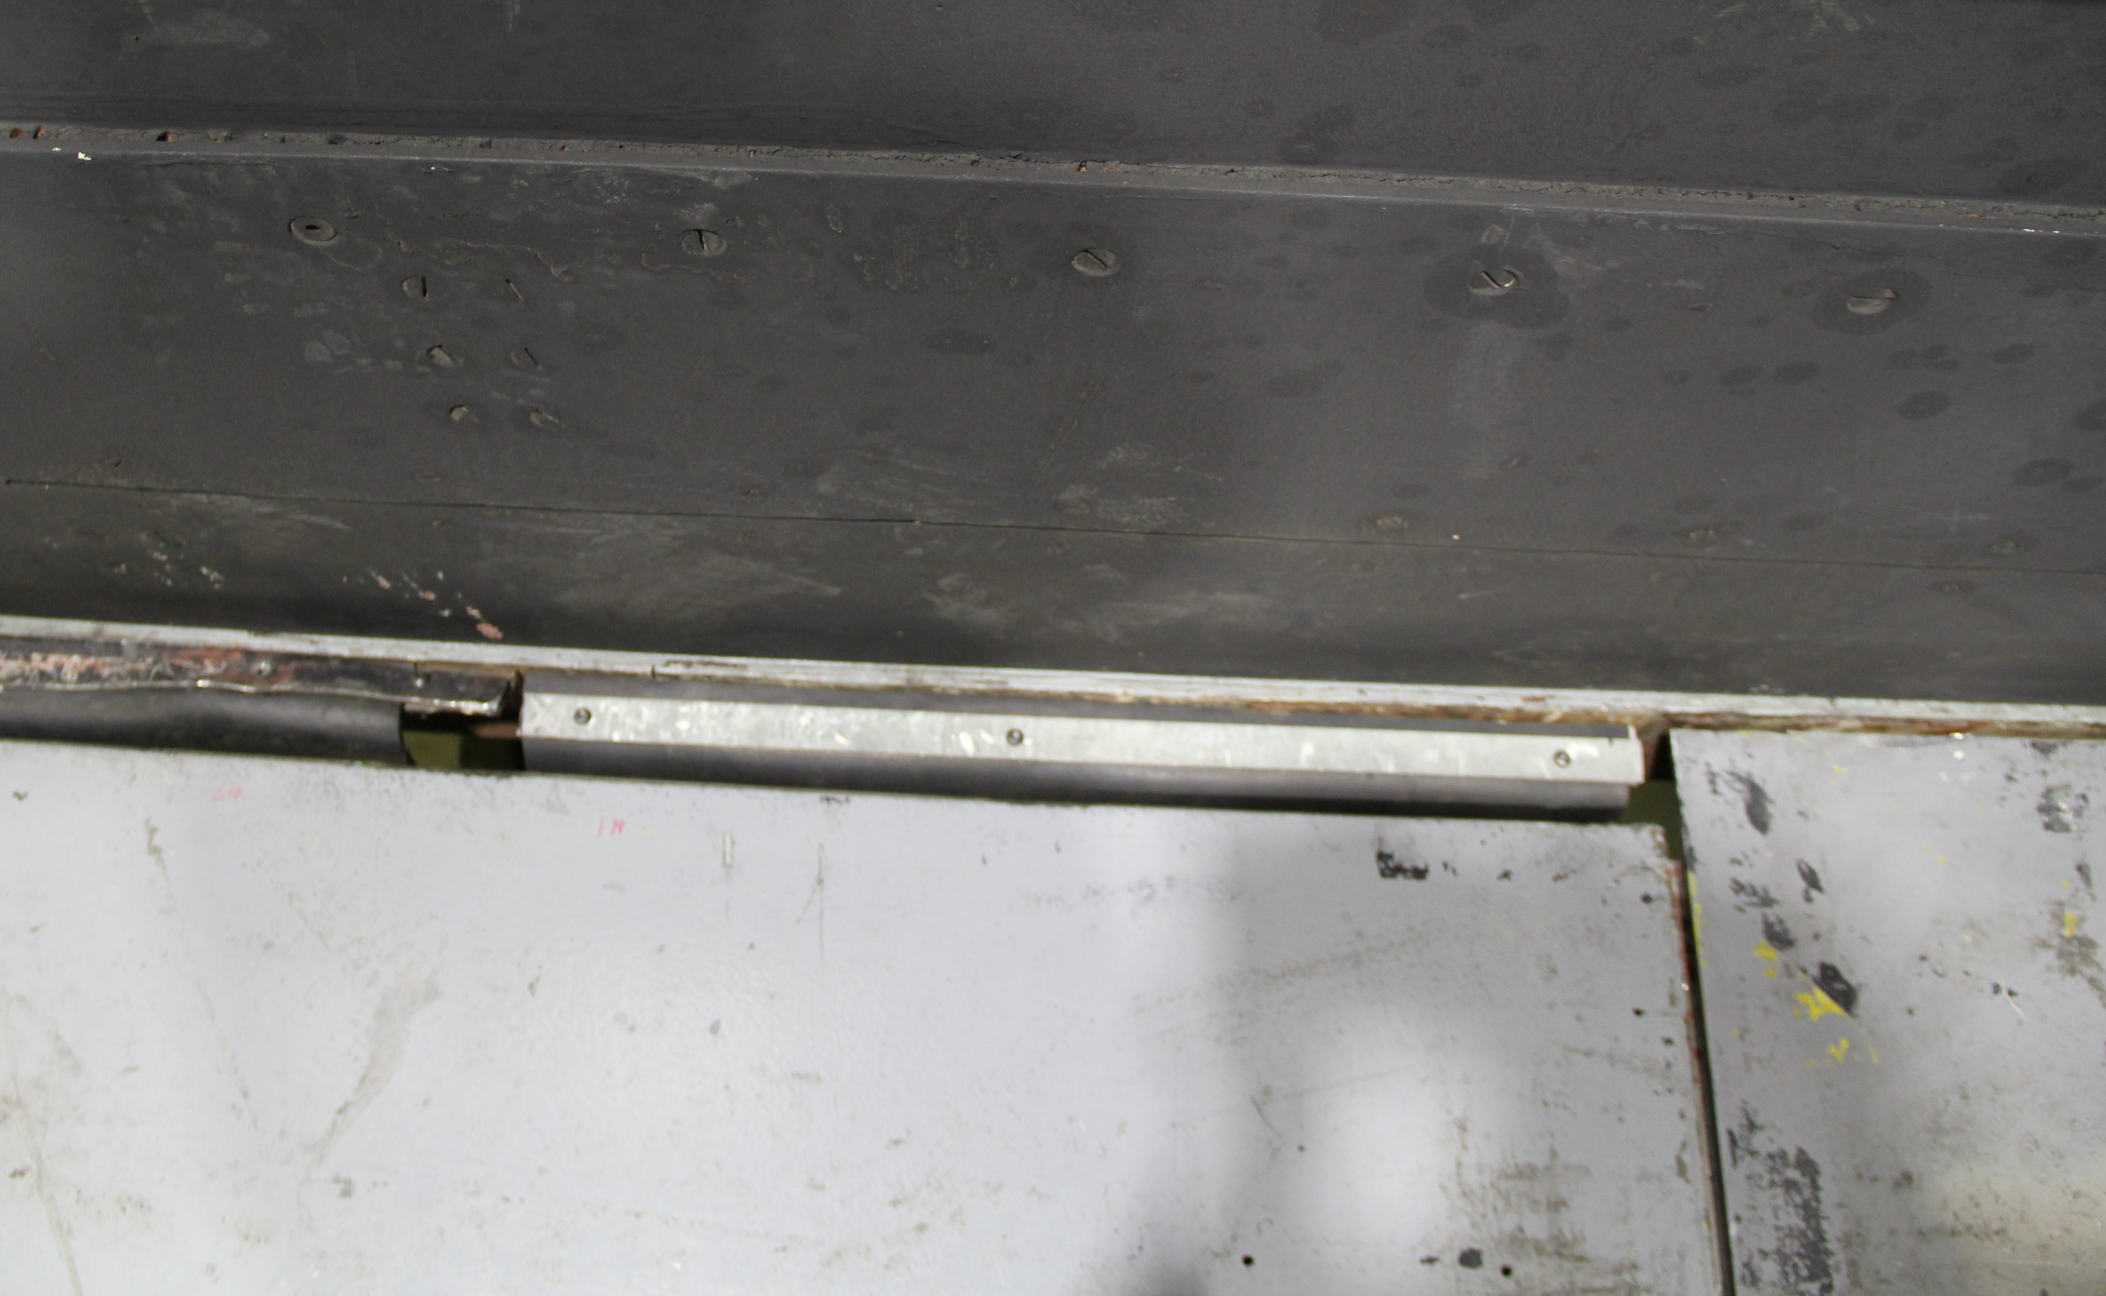
Test 673 Objectives
Primary Objective: Assess need for taping wall and floor gaps
  QCODE 2 & 3 with Standard Tape
  QCODE 2 & 3 with floor and wall tape removed
Secondary Objective: Compare dynamic pressure calibration against past test results
Additional Objective: Capture representative data for alternative configurations
  Single run of data capture
  QCODE 2 & 3 Taped and Un-Taped with Flaps Open
  QCODE 2 Taped with Entrance Cone Flaps Open
Taped
Taped
Un-Taped
Un-Taped
Notes:
- One run performed with “partial tape”, which had tape removed from the floor, but still in place on the walls around the windows

Slide 5
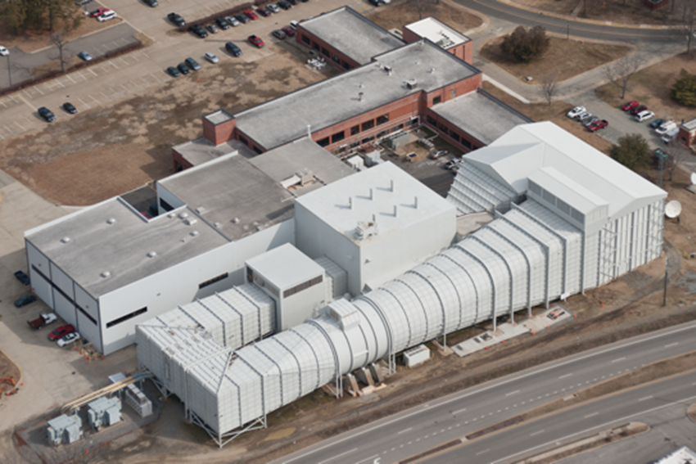
14x22 Facility Description
Test Section Size
  14.5 ft x 21.75 ft x 50 ft
  4.4 m x 6.6 m x 15.2 m
Closed Jet
  Max Speed: 348 ft/sec
  (106 m/sec)
  Max unit Reynolds Number:
  2.2x10⁶/ft (7.2x10⁶/m)
Open Jet
  Max Speed: 275 ft/sec
  (84 m/sec)
  Max unit Reynolds Number:
  1.7x10⁶/ft (5.6x10⁶/m)
Usage
  Aircraft, Spacecraft, Rotorcraft
  Ground Effect, Free-Flight, Acoustic

Slide 6
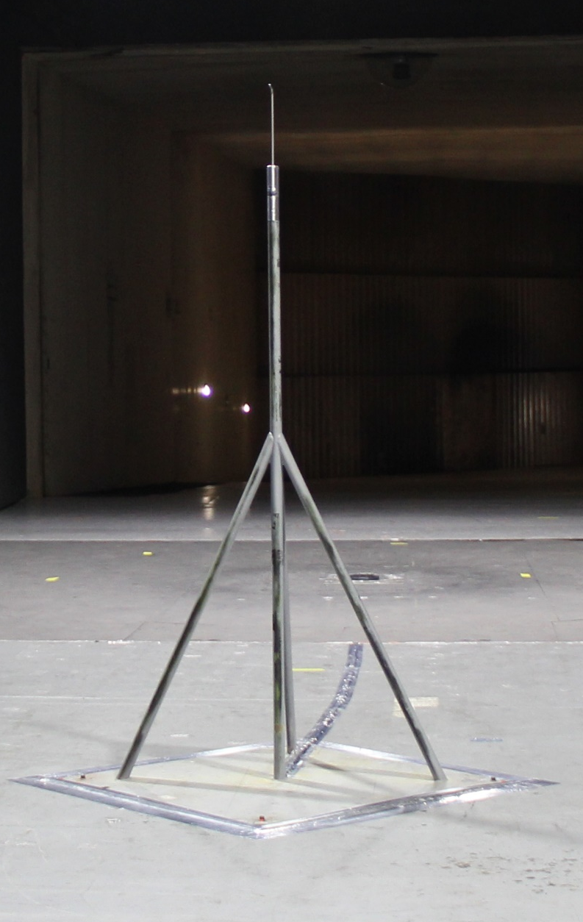
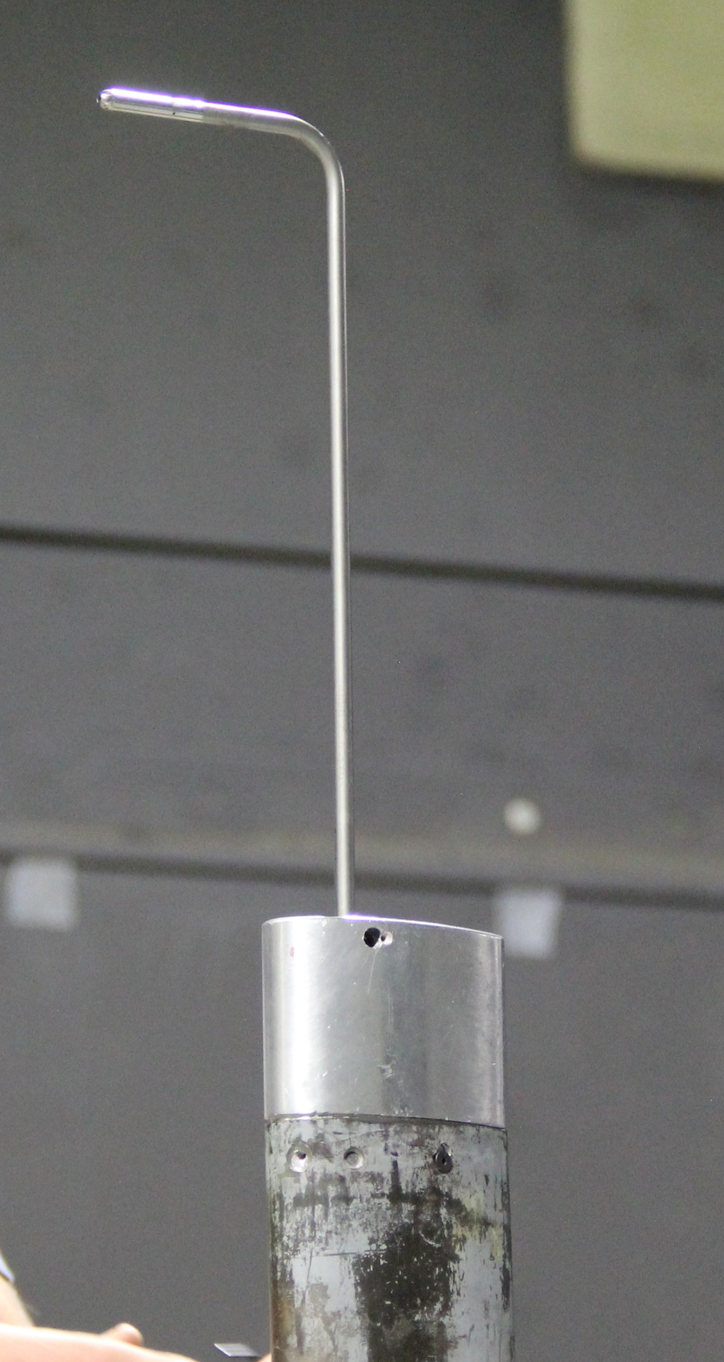
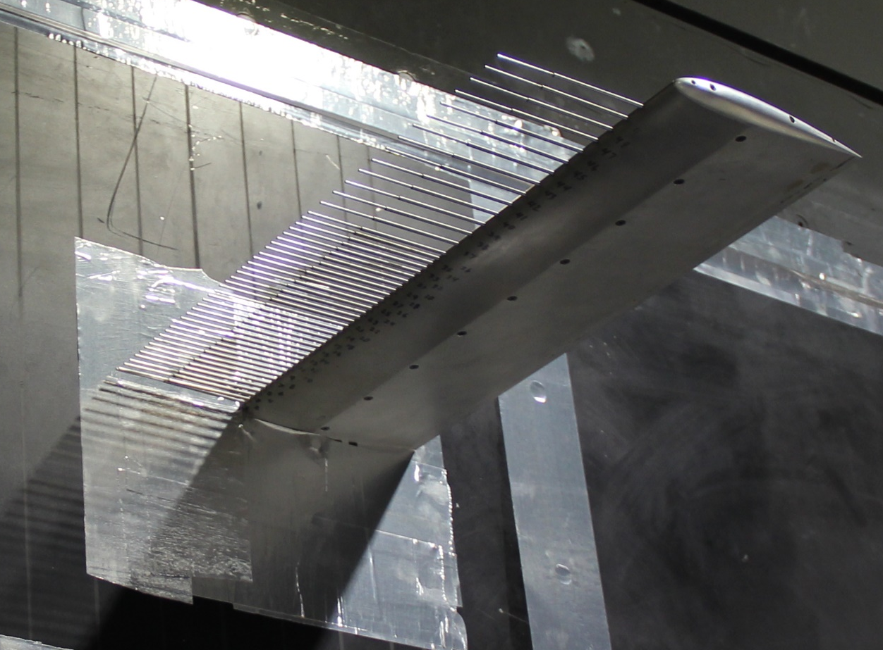
Check Standard Probe Overview
Model
  Single pitot-static probe at Tunnel Station 17.75’ (5.41m) (standard model position) and 87” height (2.21m) (Tunnel centerline)
  Optional wall/ceiling boundary layer rakes at entrance or model station
4 Tunnel Configurations
  QCODE 2: Closed Test Section, Boundary Layer Removal System (BLRS) off
  QCODE 3: Closed Test Section, BLRS on
  QCODE 4: Open Test Section, BLRS off
  QCODE 5: Open Test Section, BLRS on
Test Execution
  17 Test Section Dynamic Pressures (DPIHS): 1.5 to 120psf (23.9 to 5,745.6Pa)
  2-3 Consecutive DPIHS Sweeps: 1 Group
  Full database: 3 Groups
Primary comparison parameter
  Dynamic Pressure Calibration (CPRIME) = Probe Differential Pressure (DPCHS)
  Tunnel Differential Pressure (DPIHS)

Slide 7
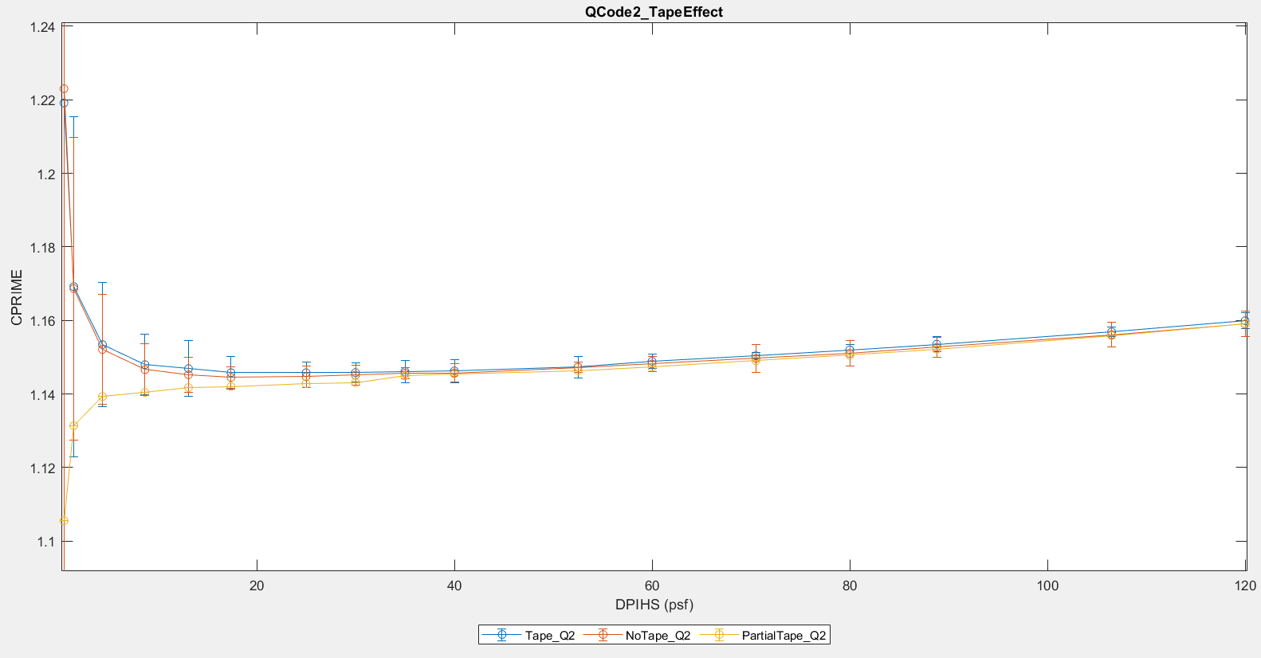
Check Standard Probe Results – QCODE 2
Within group repeatability
Partial tape joins trend at 35psf
Taped Back-up
No Tape Back-up
Notes:
Error bars reflect group repeatability of measured data
No error bars on Partial Tape since only one data set was captured
Data table expresses CPRIME average of the data captured in that configuration at the DPIHS indicated in the first row. “Data Set Range” expresses the range (max-min) across the configurations

Slide 8
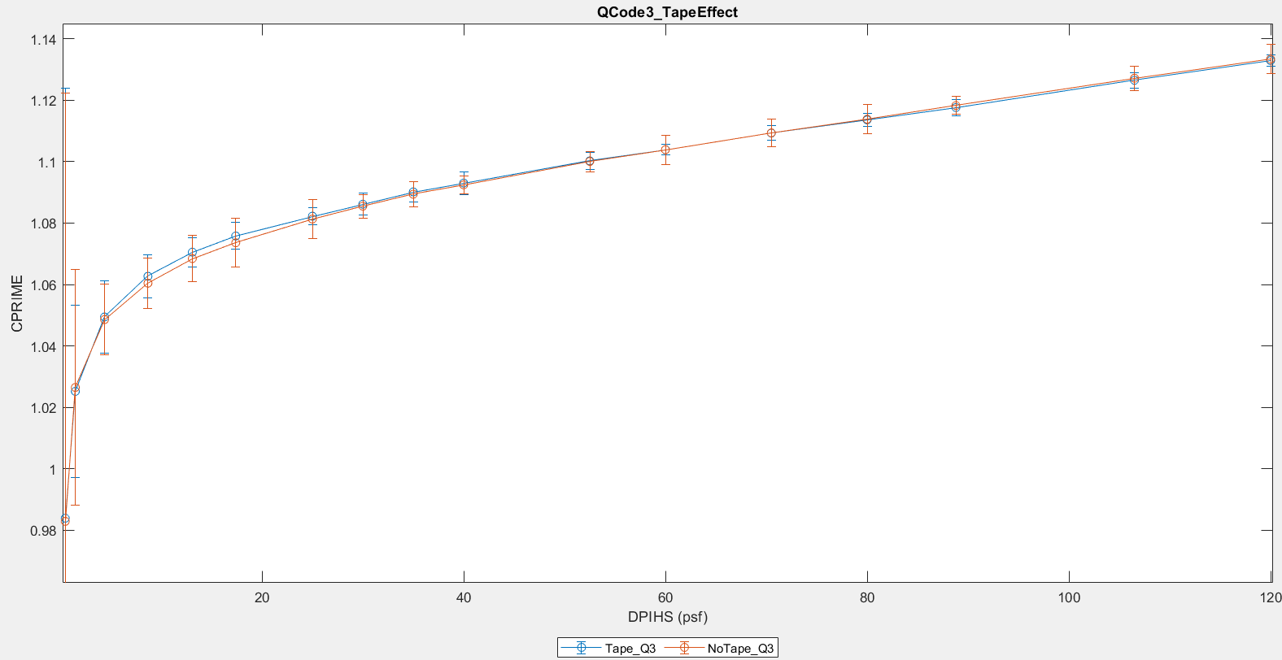
Check Standard Probe Results – QCODE 3
Within group repeatability
Curves rotated about approx. 65psf
Taped Back-up
No Tape Back-up
Notes:
Error bars reflect group repeatability of measured data
Data table expresses CPRIME average of the data captured in that configuration at that DPIHS. “Data Set Range” expresses the range (max-min) across the configurations

Slide 9
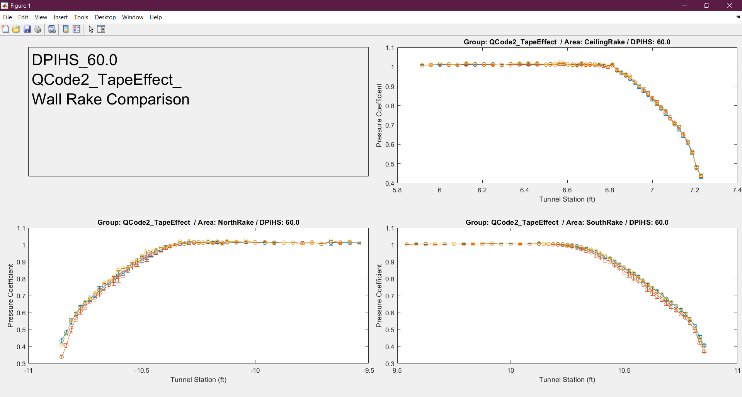
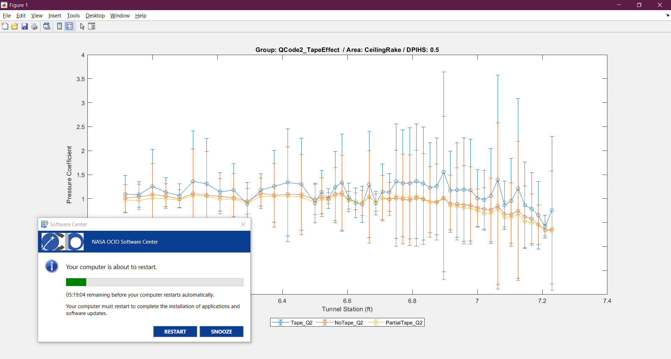
Wall Rake Results – QCODE 2
Back-up
Within group repeatability outside boundary layer
Boundary layer profile impacted on walls
Boundary layer height not impacted
No change on ceiling
Similar across all speeds
Notes:
Error bars reflect group repeatability of measured data
No error bars on Partial Tape since only one data set was captured

Slide 10
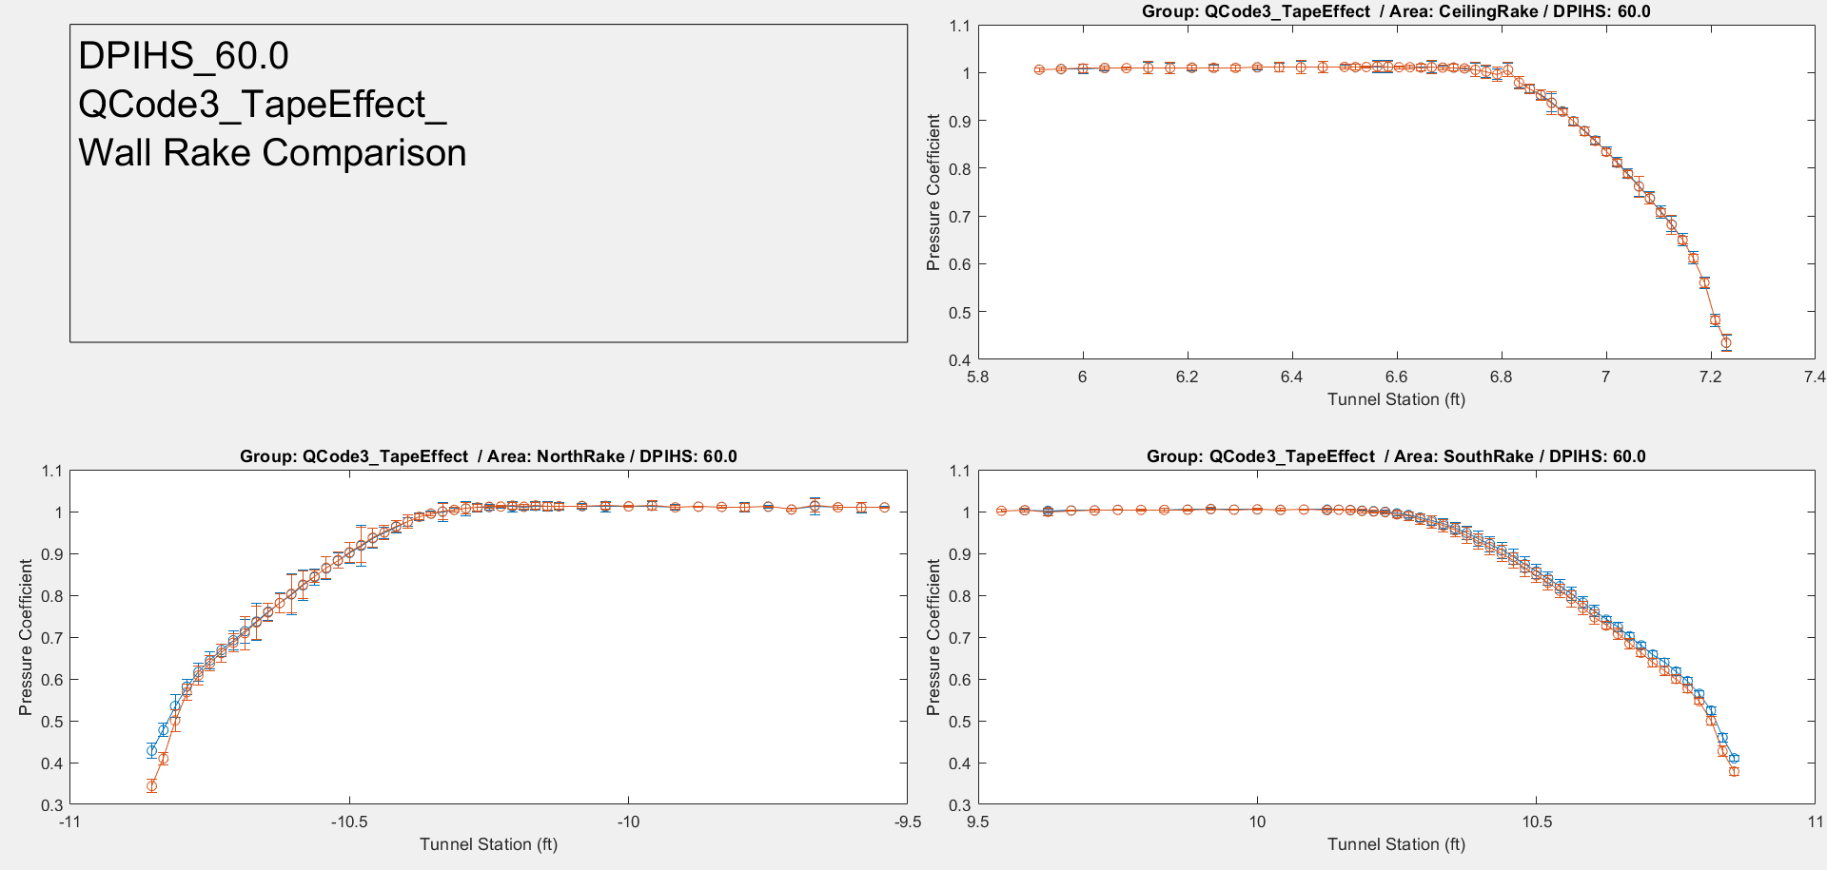
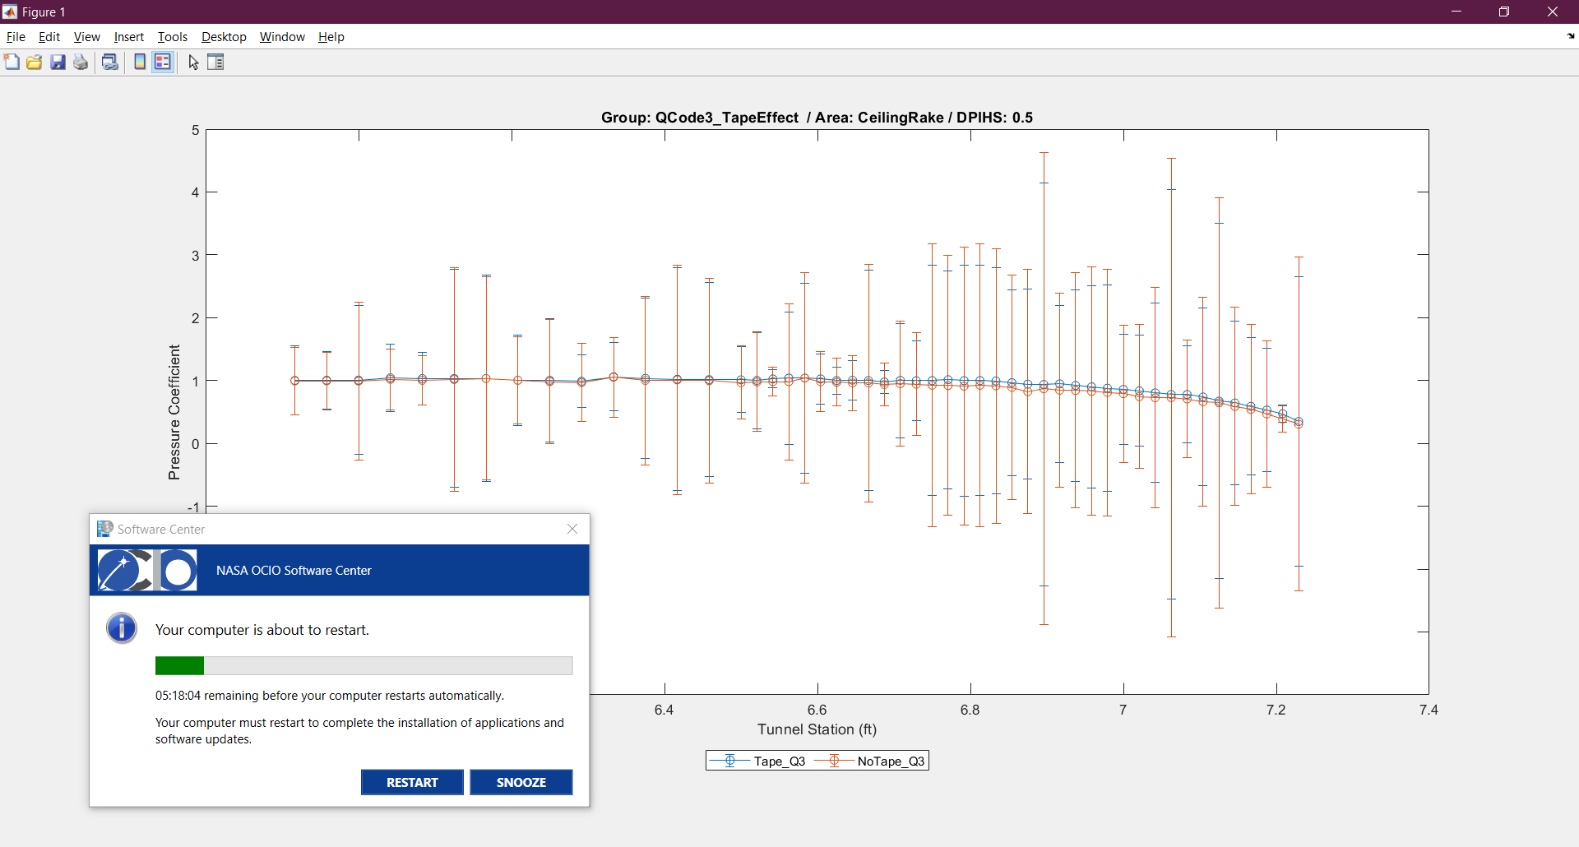
Wall Rake Results – QCODE 3
Back-up
Within group repeatability outside boundary layer
Boundary layer profile impacted on walls
Boundary layer height not impacted
No change on ceiling
Similar across all speeds
Notes:
- Error bars reflect group repeatability of measured data

Slide 11
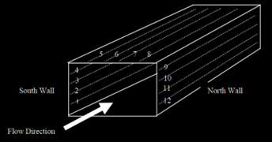
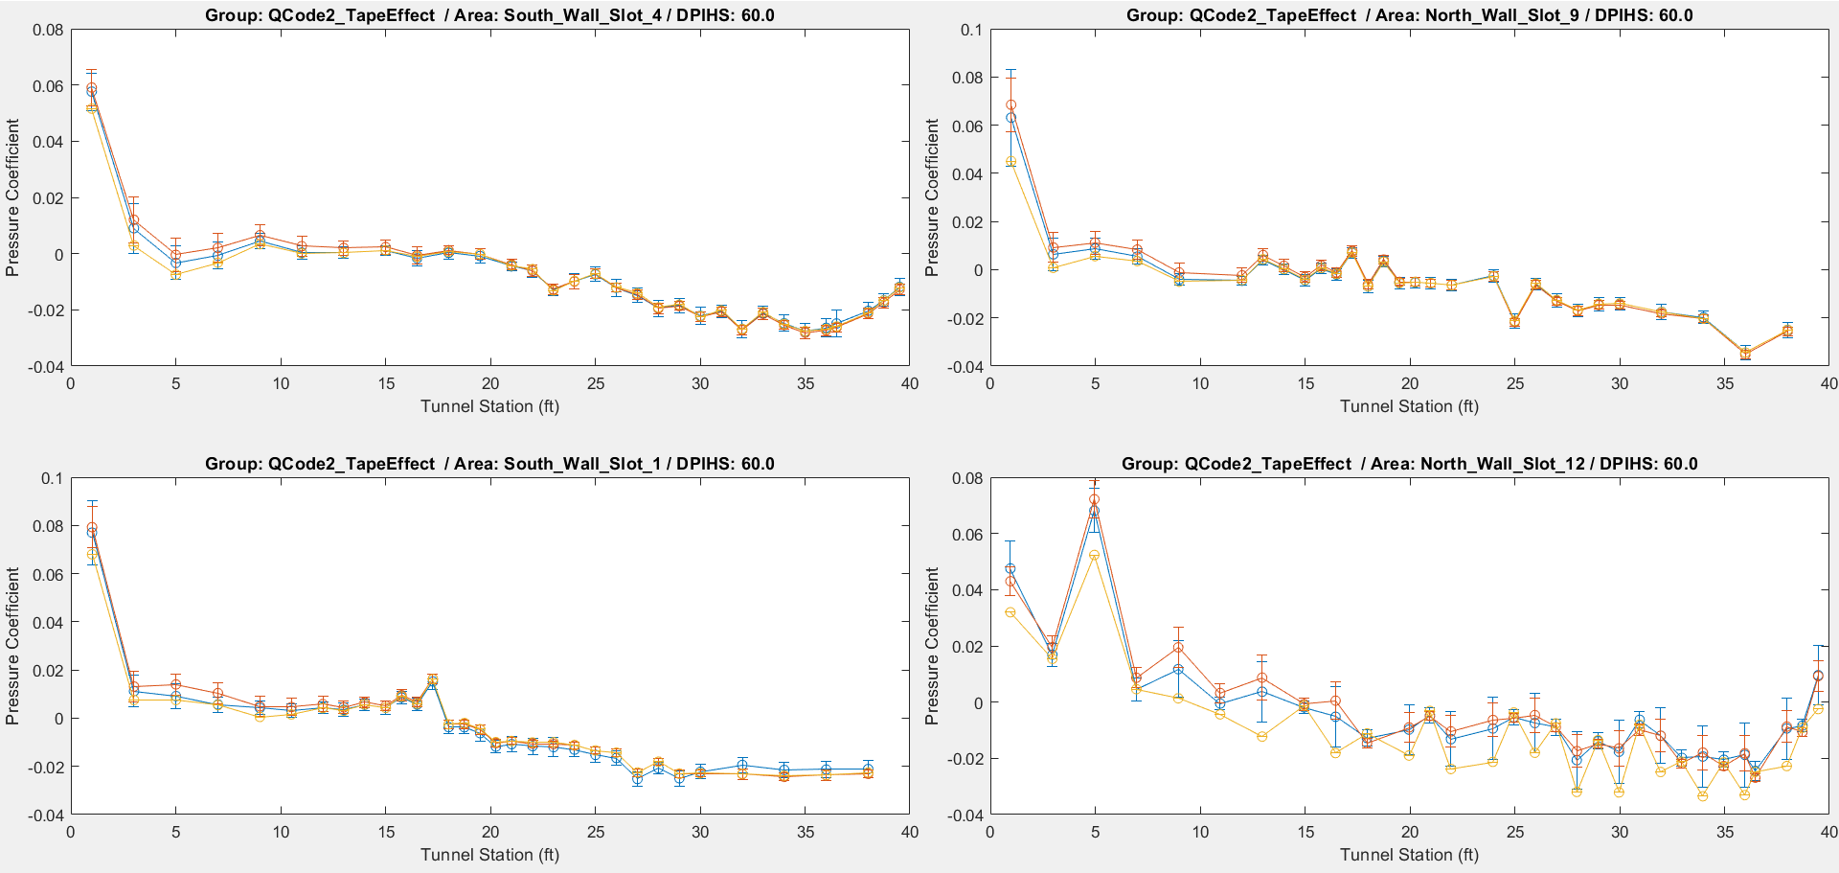
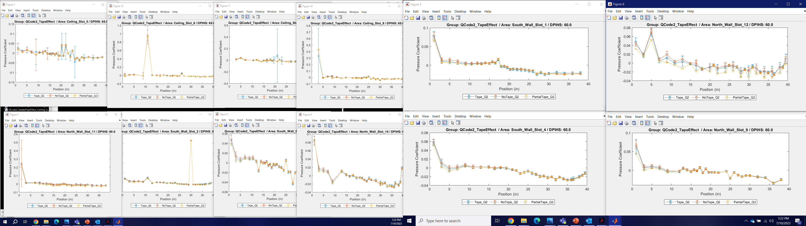
WICS Results – QCODE 2
Within group repeatability
Separation forward of Tunnel Station 17.75’
Back-up
Notes:
Error bars reflect group repeatability of measured data
No error bars on Partial Tape since only one data set was captured
Separation is similar to that seen when comparing empty tunnel runs performed in different years, which indicates that while something is going on with the flow there it may not be related to the tape vs. no-tape configuration change. Additional investigation is required.
Jumps in curve may potentially be due to measurement bias of different modules. WICS port mapping places every other port on different modules with 2-4 modules supporting one slot.

Slide 12
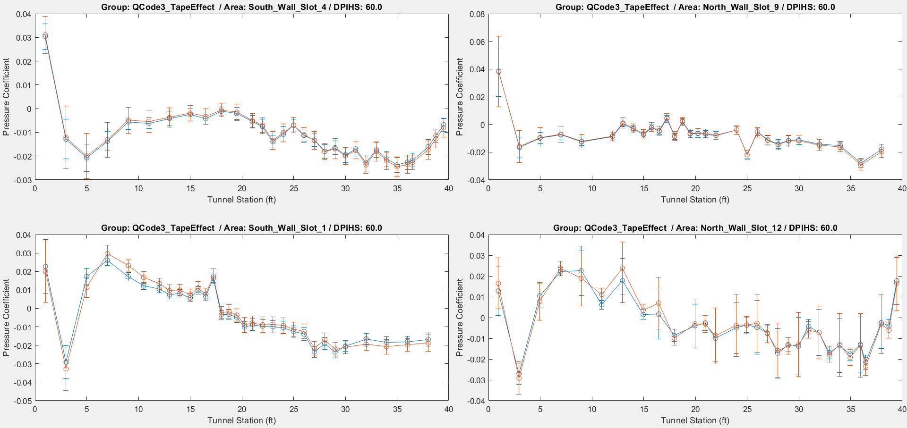
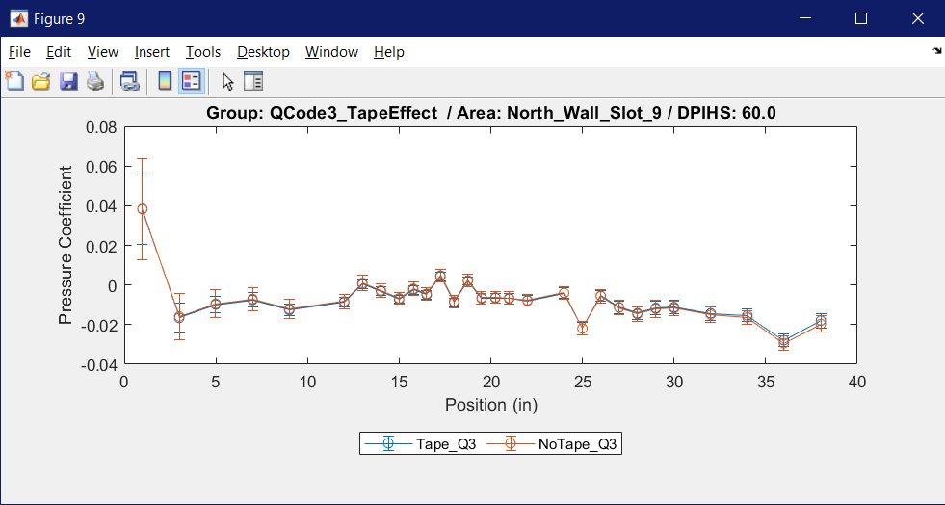
WICS Results – QCODE 3
Within group repeatability
Separation forward of Tunnel Station 17.75’
Back-up
Notes:
Error bars reflect group repeatability of measured data
Separation is similar to that seen when comparing empty tunnel runs performed in different years, which indicates that while something is going on with the flow there it may not be related to the tape vs. no-tape configuration change. Additional investigation is required.
Jumps in curve may potentially be due to measurement bias of different modules. WICS port mapping places every other port on different modules with 2-4 modules supporting one slot.

Slide 13
Conclusions
Tunnel calibration at tunnel station 17.75’ was not impacted by tape
Wall boundary layer height unaffected, but profile shape impacted
WICS trends impacted forward of tunnel station 17.75’, but within group repeatability
Recommended follow-up:
  Further study on WICS repeatability
  Floor boundary layer rakes testing
  Intake flap positioning effect analysis
  Entrance flap effect analysis
Notes:
Future tests:
Consider no tape for tests that do not use WICS corrections
Those that do use WICS corrections, but have not tested in the tunnel before, consider no tape
Those that do use WICS corrections and have tested in the tunnel before, recommend keeping the tape consistent with previous entries until WICS repeatability is investigated further

Slide 14
Questions/Comments?

Slide 15
Check Standard Probe Back-up Slides
QCODE 2, No Tape Group Comparison
Back

Slide 16
Check Standard Probe Back-up Slides
QCODE 2, Taped Group Comparison
Back

Slide 17
Check Standard Probe Back-up Slides
QCODE 3, No Tape Group Comparison
Back

Slide 18
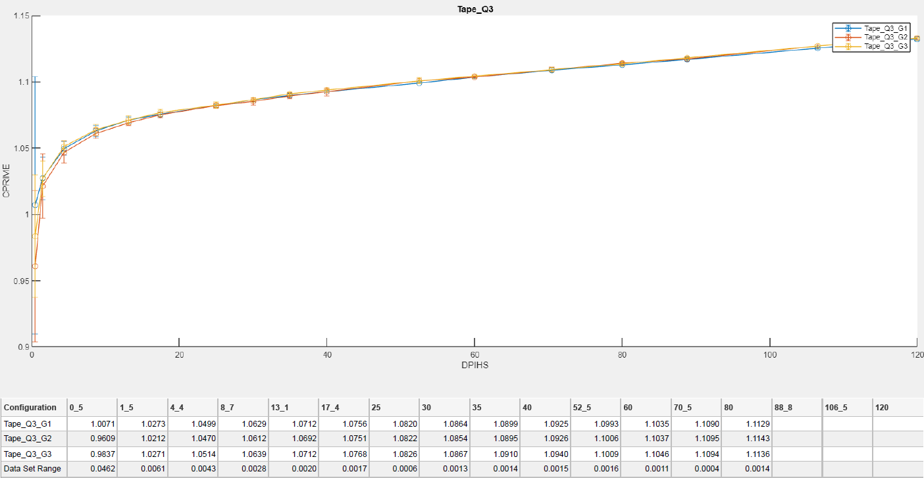
Check Standard Probe Back-up Slides
QCODE 3, Taped Group Comparison
Back

Slide 19
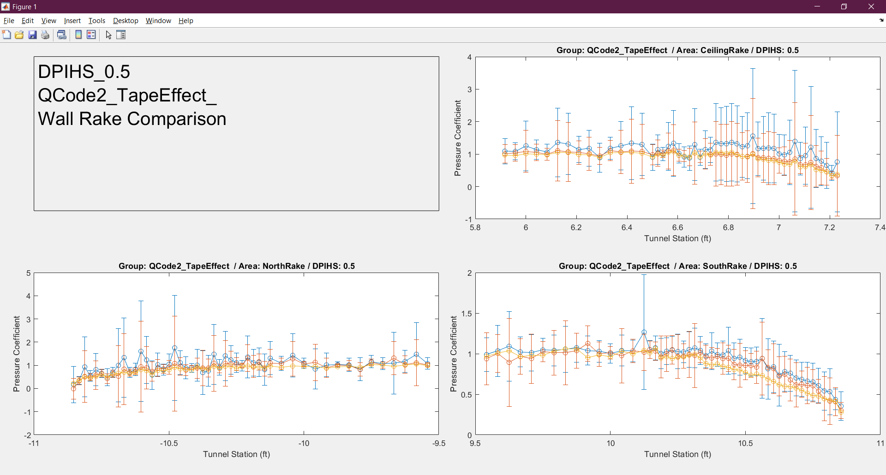
Wall Rake Back-up Slides – QCODE 2
Back

Slide 20
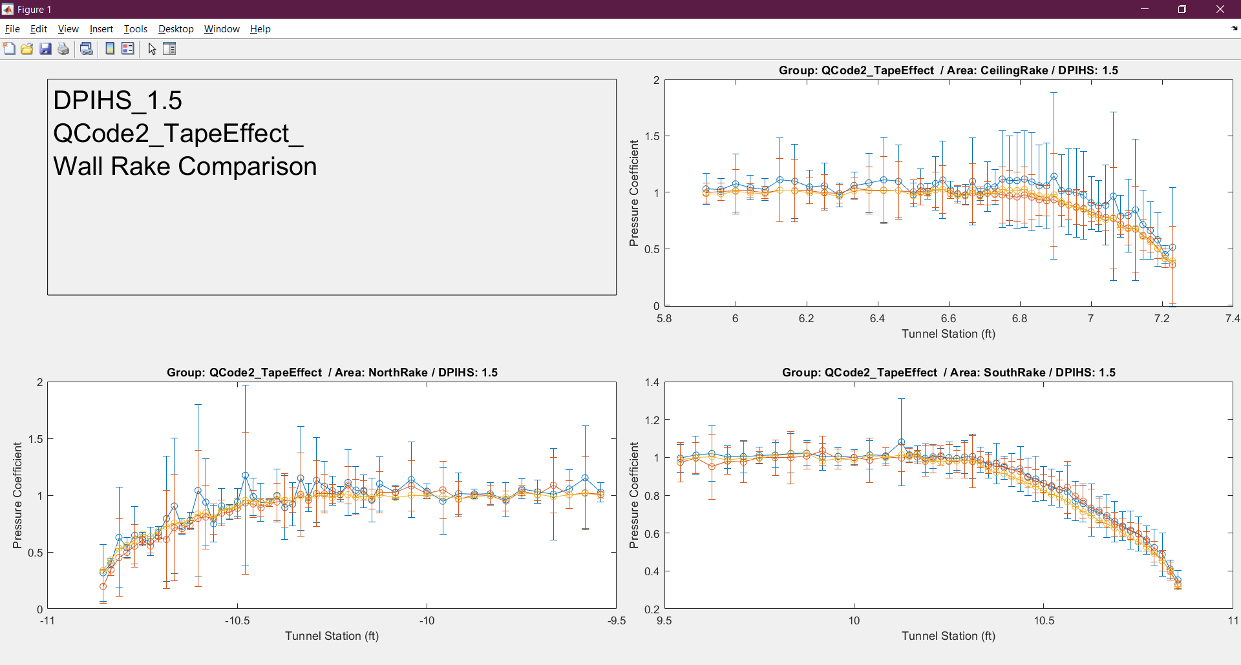
Wall Rake Back-up Slides – QCODE 2
Back

Slide 21
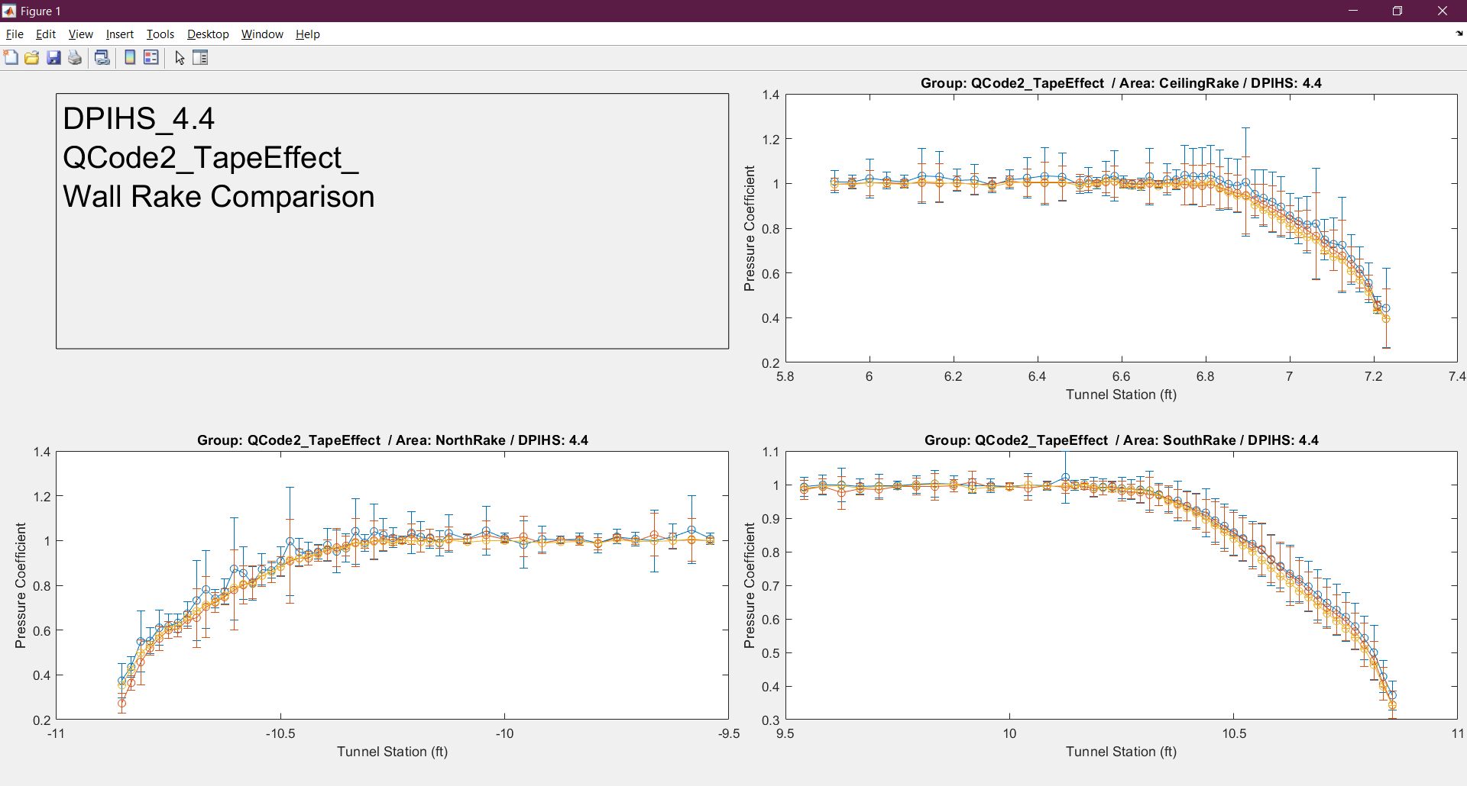
Wall Rake Back-up Slides – QCODE 2
Back

Slide 22
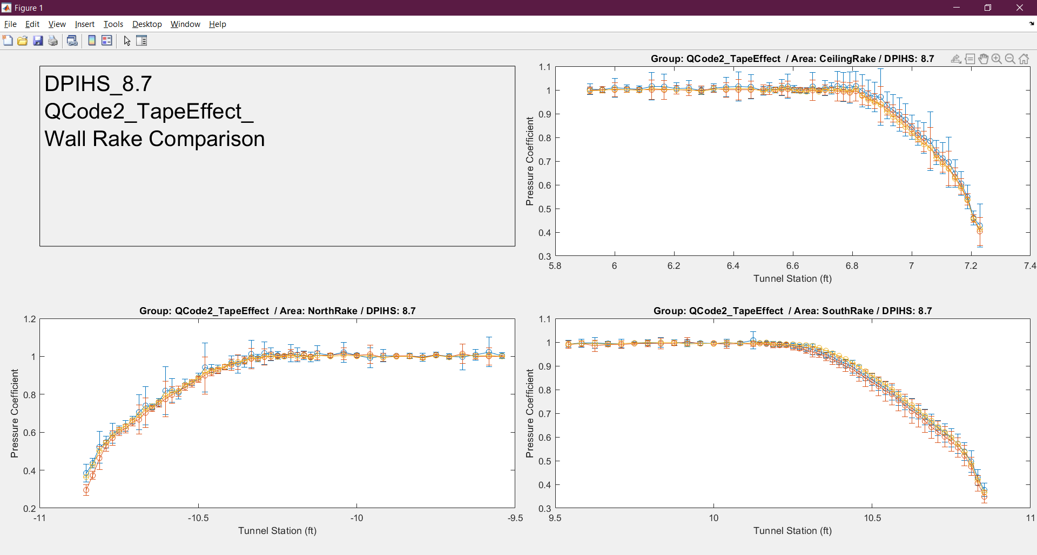
Wall Rake Back-up Slides – QCODE 2
Back

Slide 23
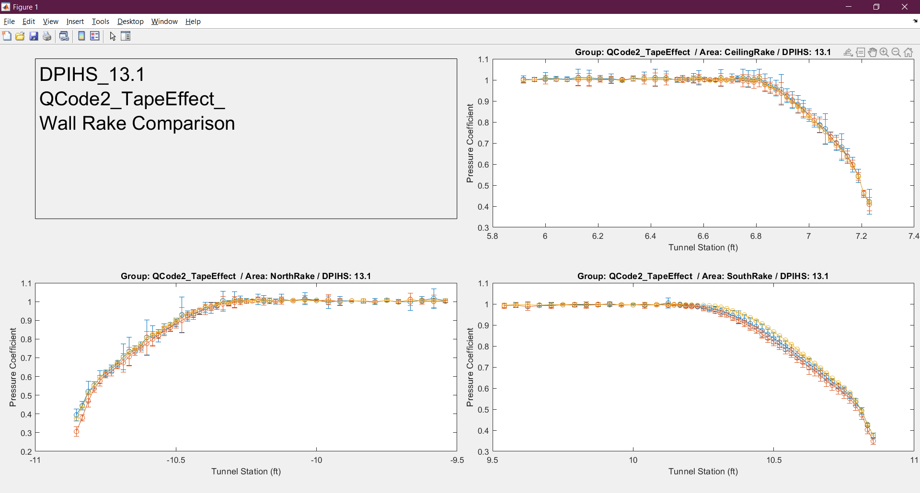
Wall Rake Back-up Slides – QCODE 2
Back

Slide 24

Wall Rake Back-up Slides – QCODE 2
Back

Slide 25
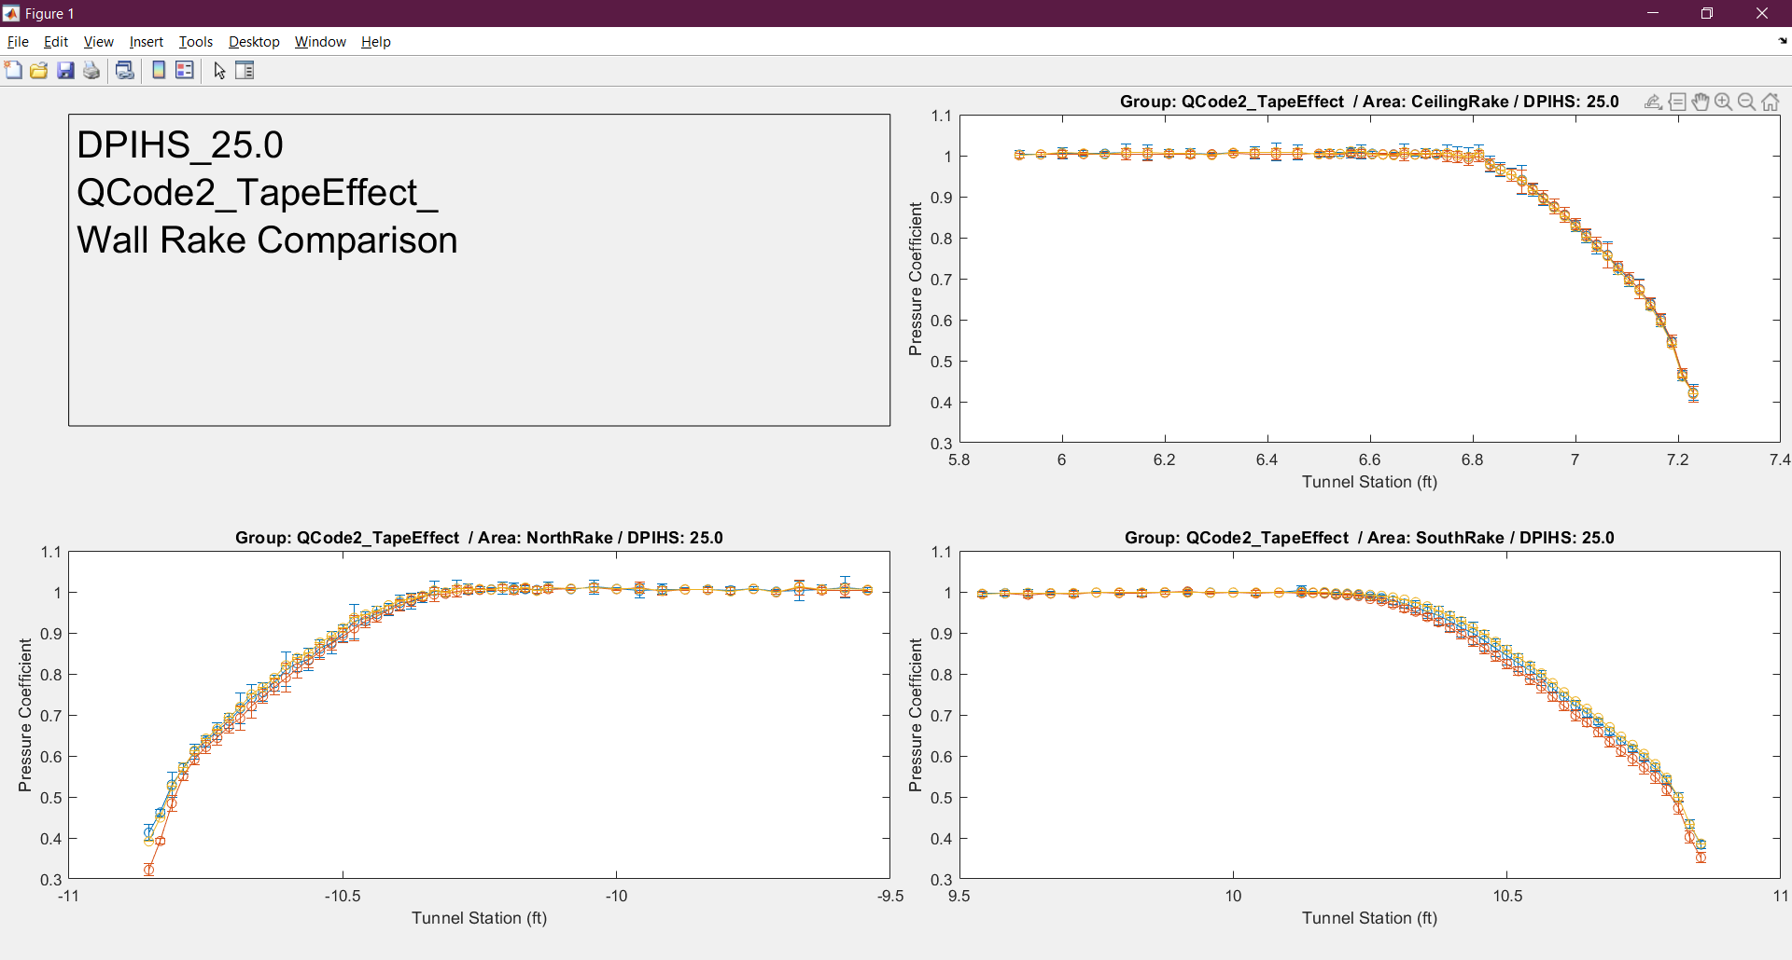
Wall Rake Back-up Slides – QCODE 2
Back

Slide 26
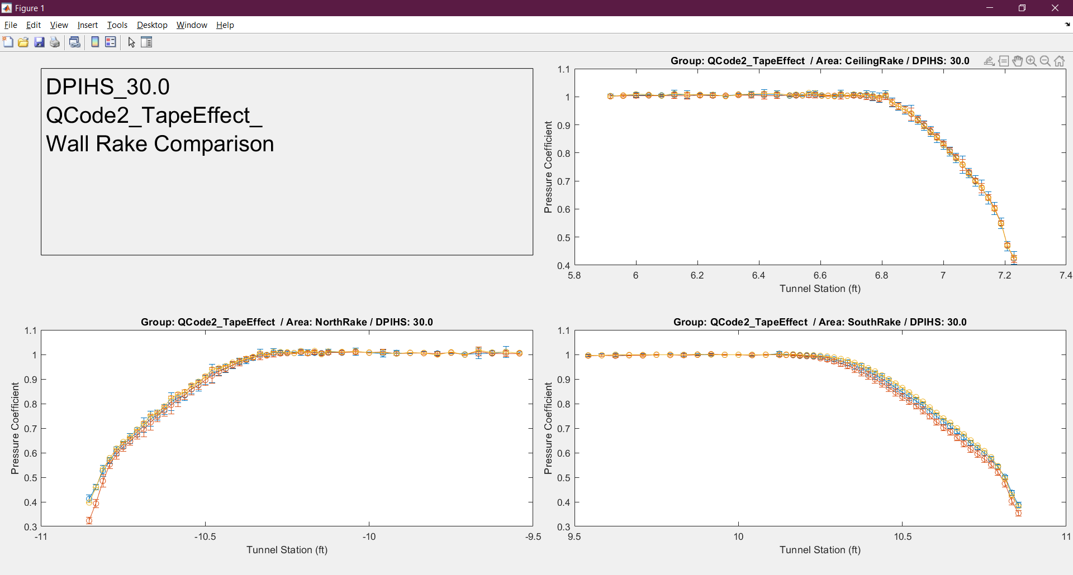
Wall Rake Back-up Slides – QCODE 2
Back

Slide 27

Wall Rake Back-up Slides – QCODE 2
Back

Slide 28
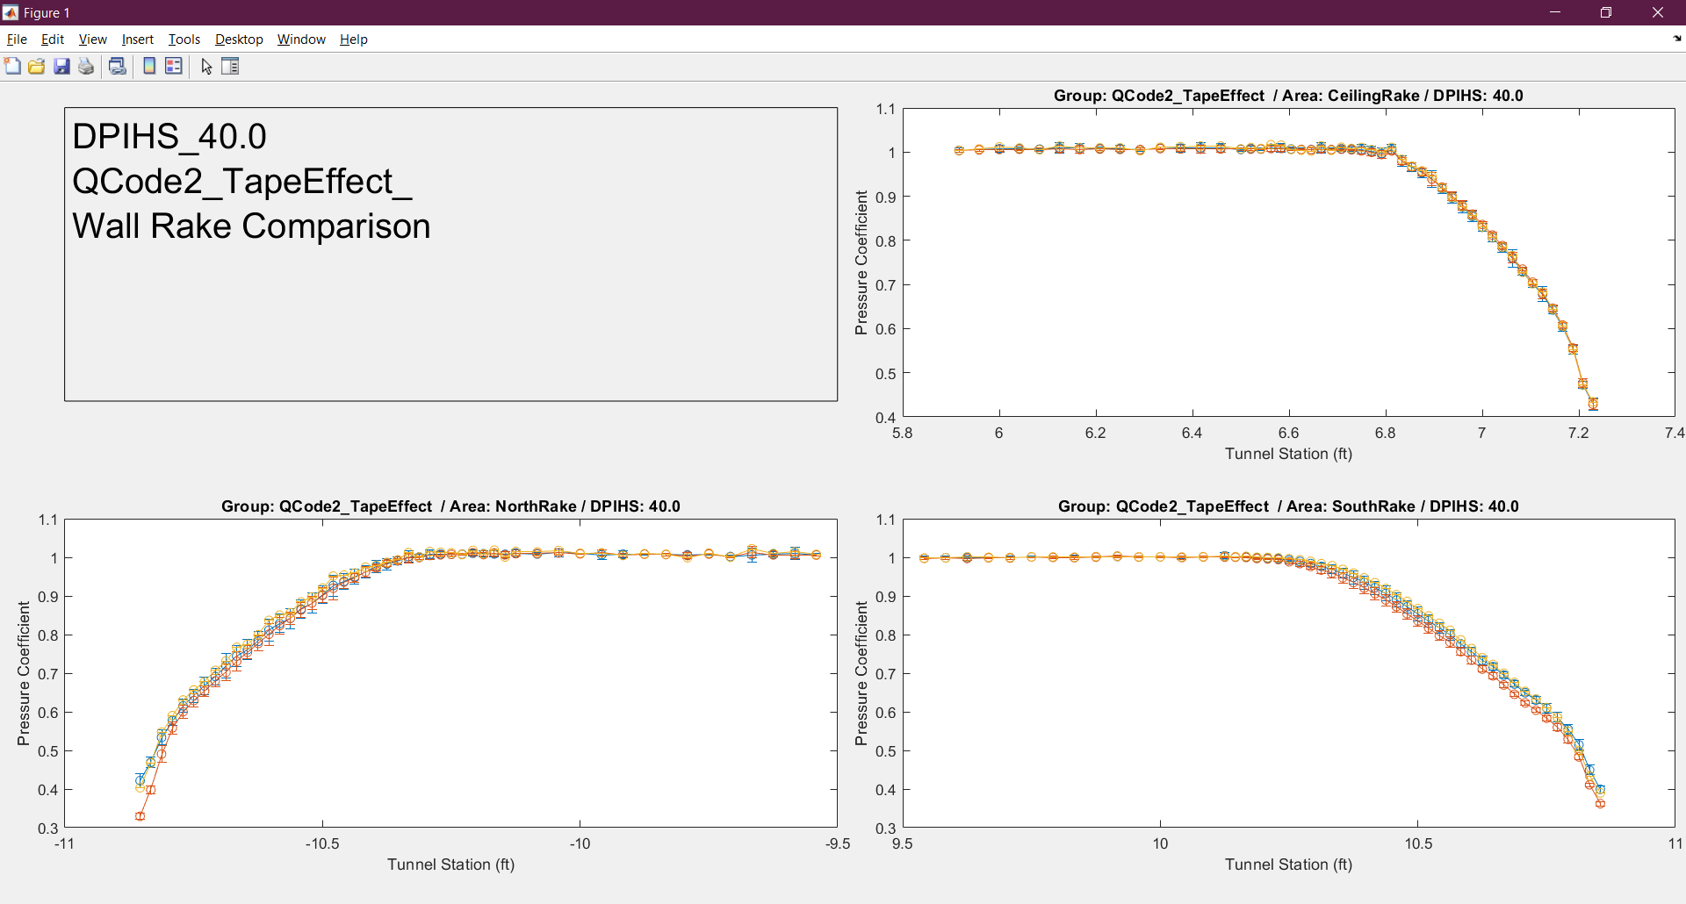
Wall Rake Back-up Slides – QCODE 2
Back

Slide 29

Wall Rake Back-up Slides – QCODE 2
Back

Slide 30
Wall Rake Back-up Slides – QCODE 2
Back

Slide 31

Wall Rake Back-up Slides – QCODE 2
Back

Slide 32
Wall Rake Back-up Slides – QCODE 2
Back

Slide 33

Wall Rake Back-up Slides – QCODE 2
Back

Slide 34

Wall Rake Back-up Slides – QCODE 2
Back

Slide 35
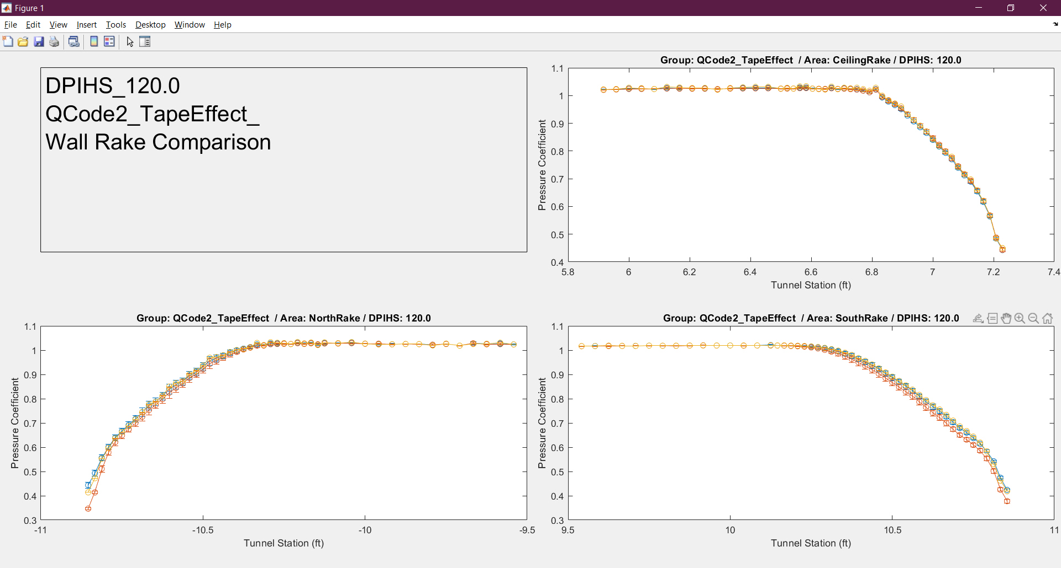
Wall Rake Back-up Slides – QCODE 2
Back

Slide 36
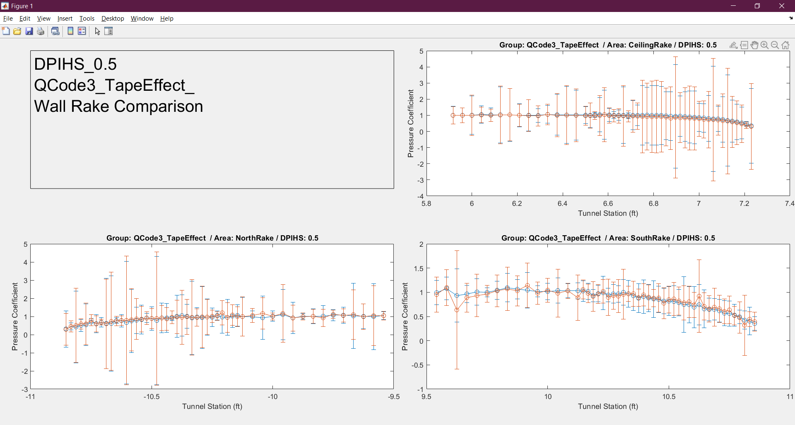
Wall Rake Back-up Slides – QCODE 3
Back

Slide 37
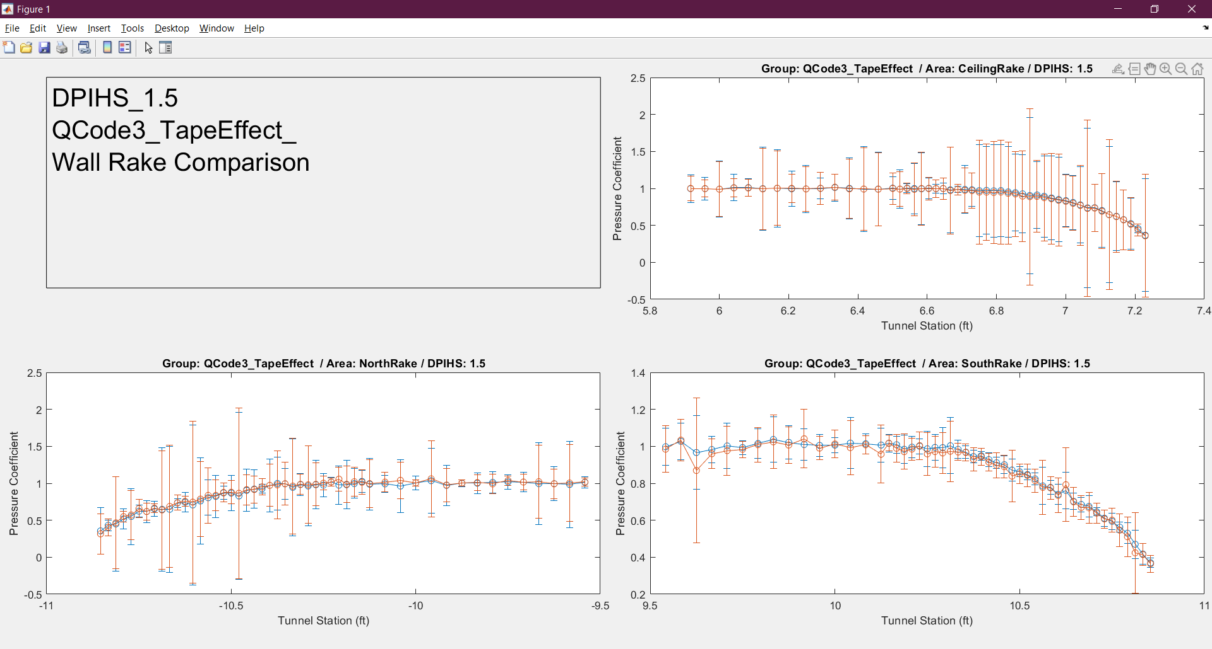
Wall Rake Back-up Slides – QCODE 3
Back

Slide 38
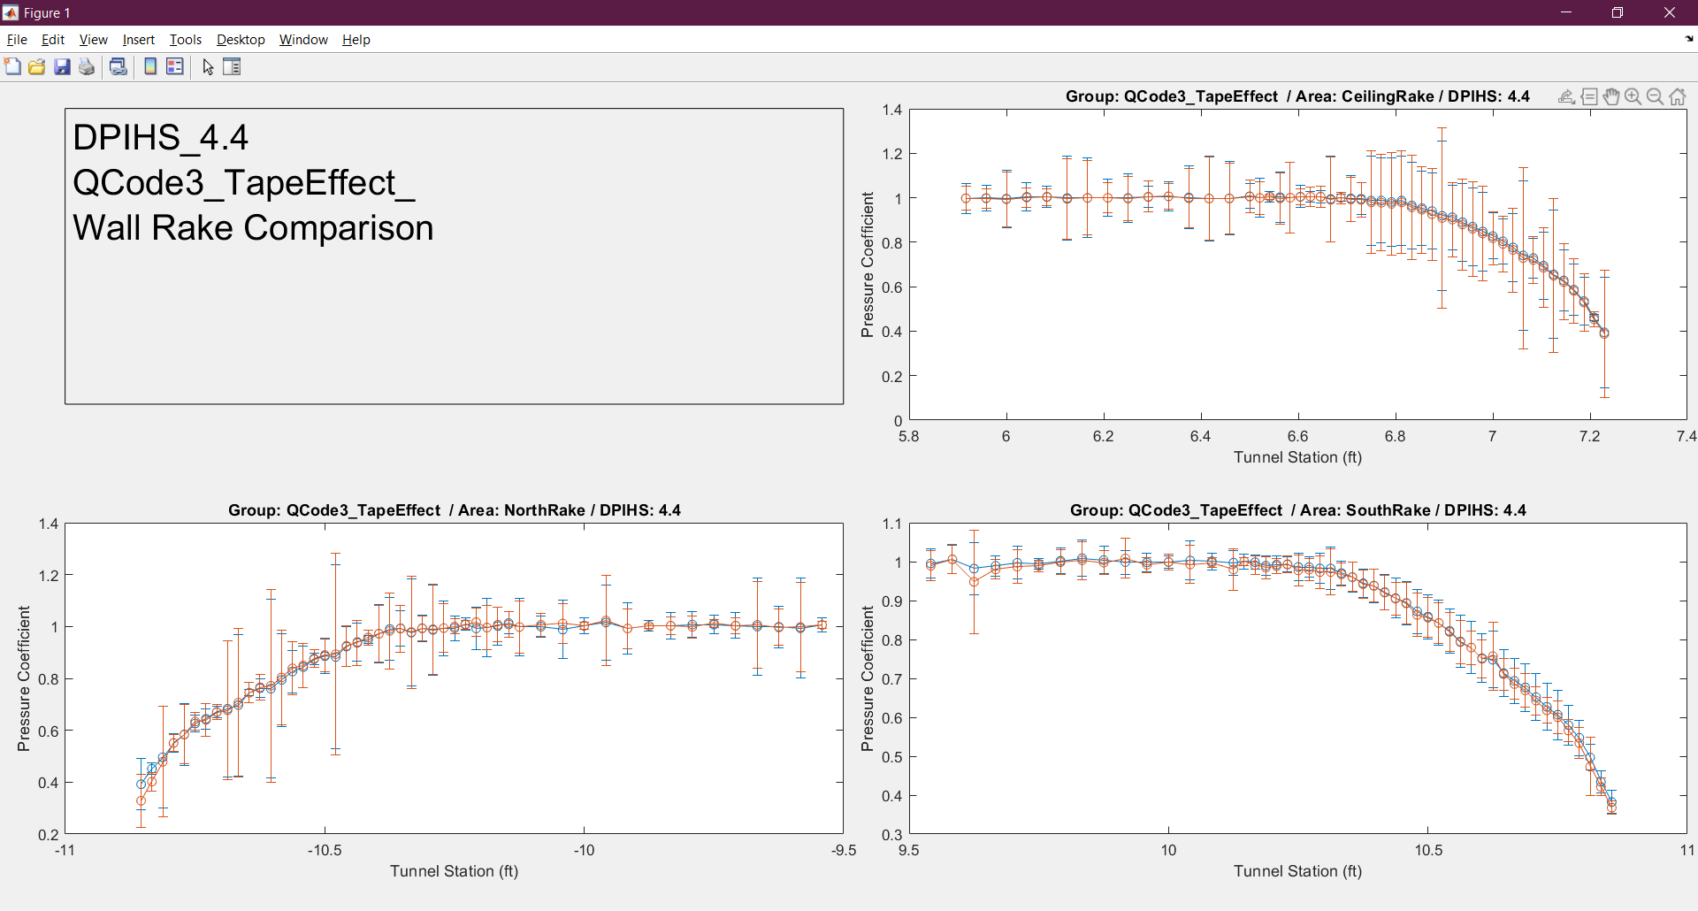
Wall Rake Back-up Slides – QCODE 3
Back

Slide 39
Wall Rake Back-up Slides – QCODE 3
Back

Slide 40
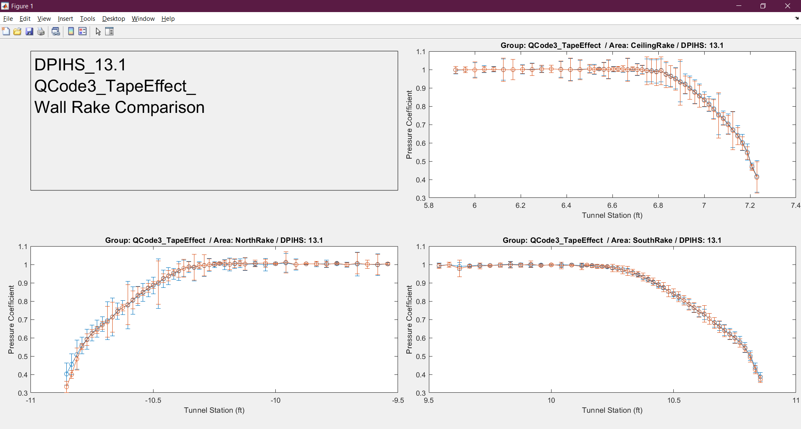
Wall Rake Back-up Slides – QCODE 3
Back

Slide 41
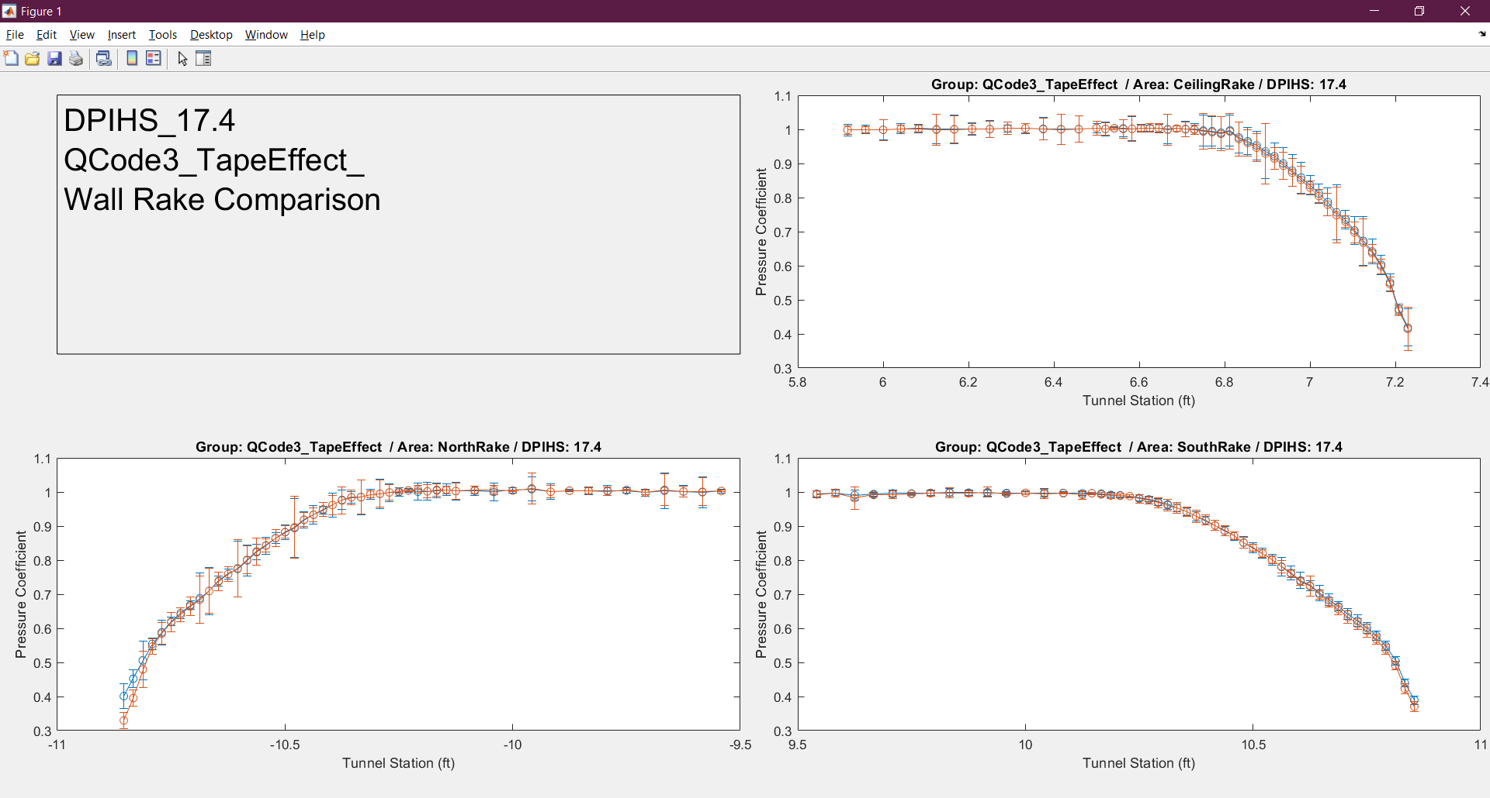
Wall Rake Back-up Slides – QCODE 3
Back

Slide 42
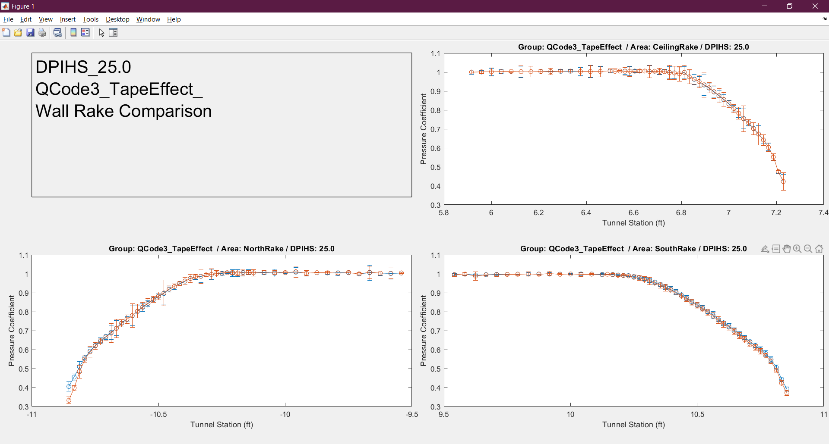
Wall Rake Back-up Slides – QCODE 3
Back

Slide 43
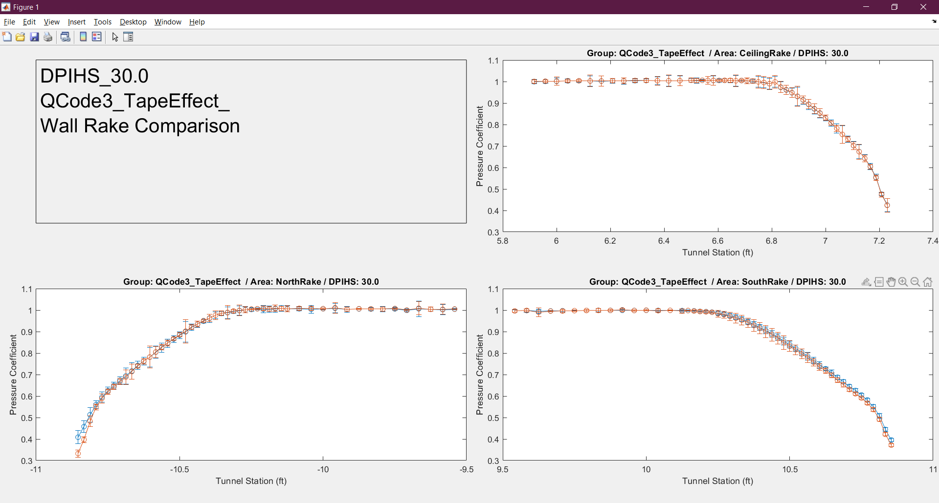
Wall Rake Back-up Slides – QCODE 3
Back

Slide 44
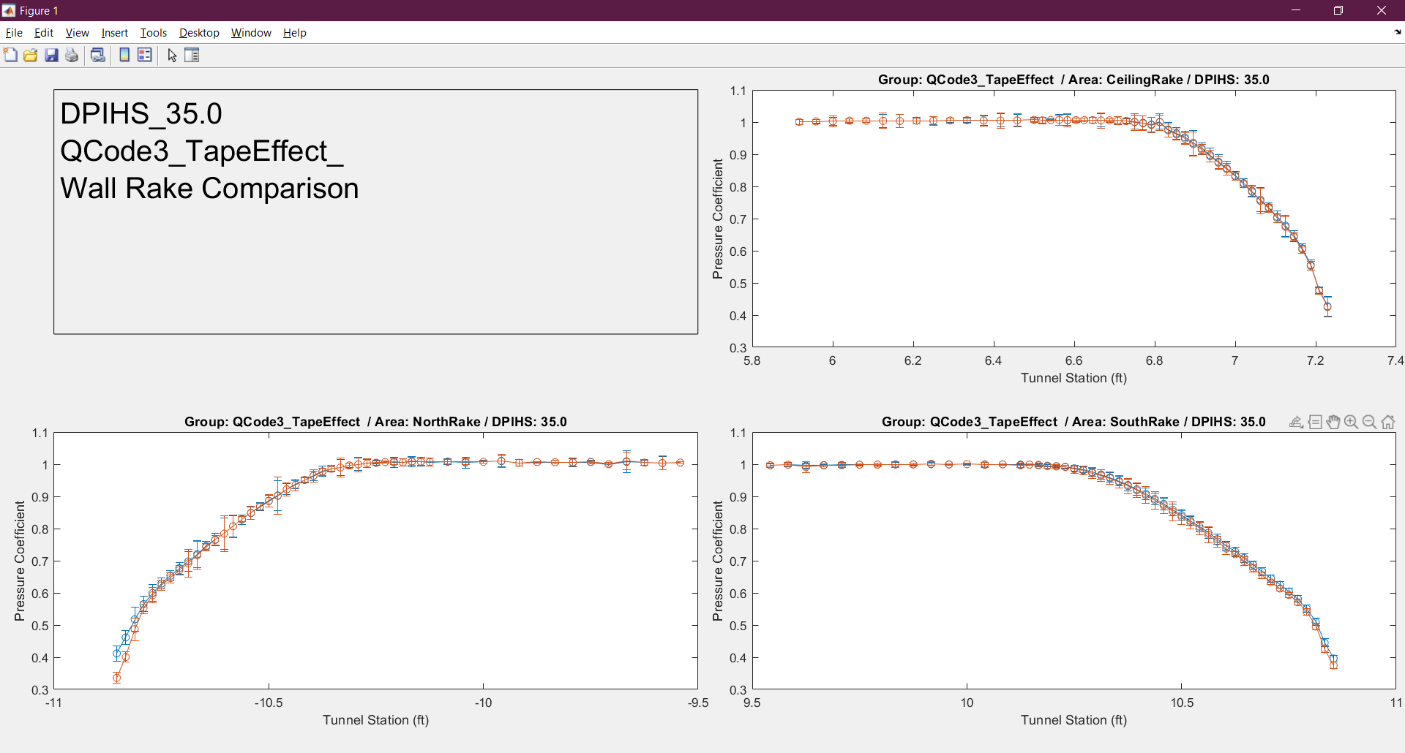
Wall Rake Back-up Slides – QCODE 3
Back

Slide 45

Wall Rake Back-up Slides – QCODE 3
Back

Slide 46

Wall Rake Back-up Slides – QCODE 3
Back

Slide 47

Wall Rake Back-up Slides – QCODE 3
Back

Slide 48

Wall Rake Back-up Slides – QCODE 3
Back

Slide 49
Wall Rake Back-up Slides – QCODE 3
Back

Slide 50
Wall Rake Back-up Slides – QCODE 3
Back

Slide 51
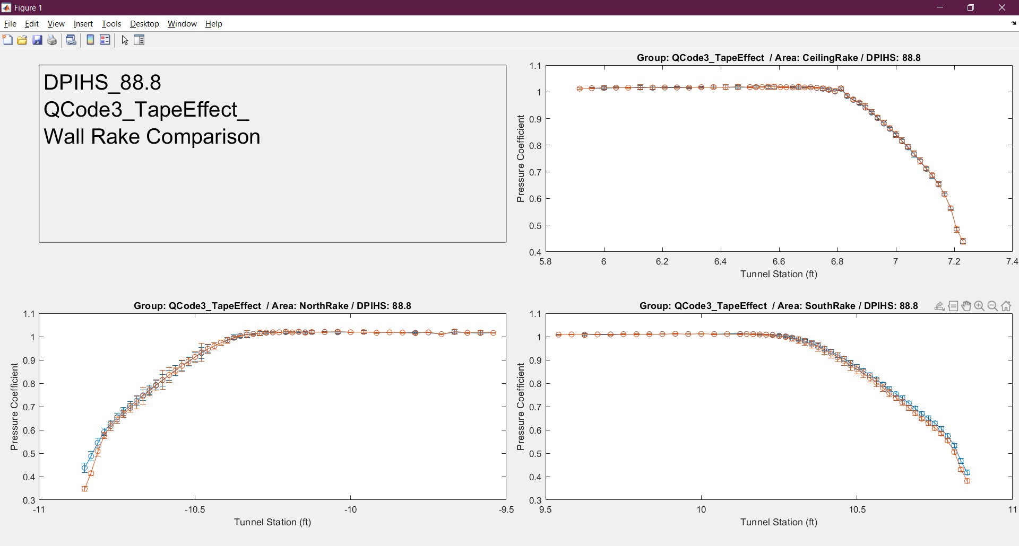
Wall Rake Back-up Slides – QCODE 3
Back

Slide 52

Wall Rake Back-up Slides – QCODE 3
Back

Slide 53

Wall Rake Back-up Slides – QCODE 3
Back

Slide 54
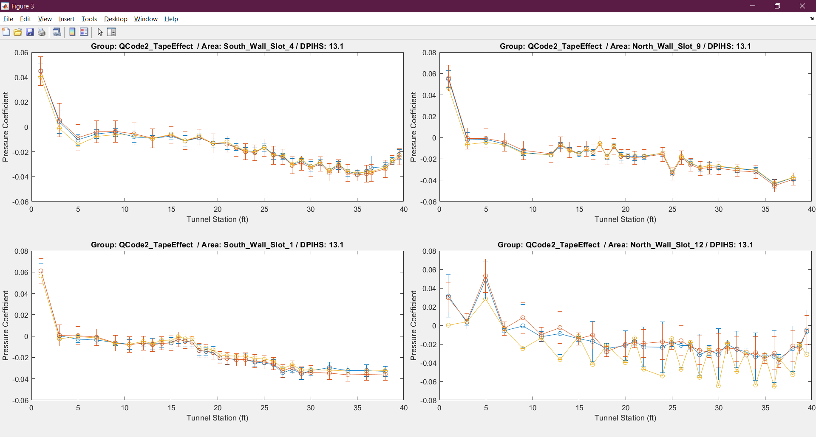
WICS Back-up Slides – QCODE 2
Back

Slide 55
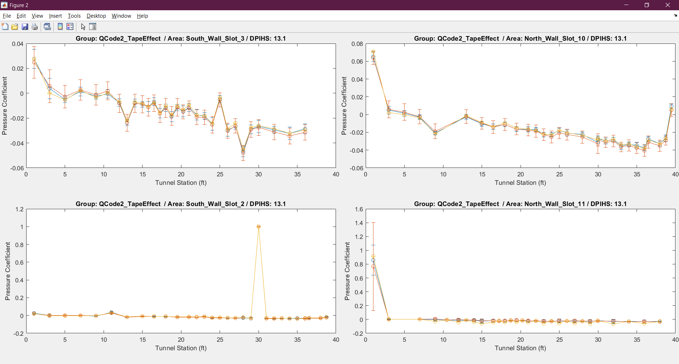
WICS Back-up Slides – QCODE 2
Back

Slide 56
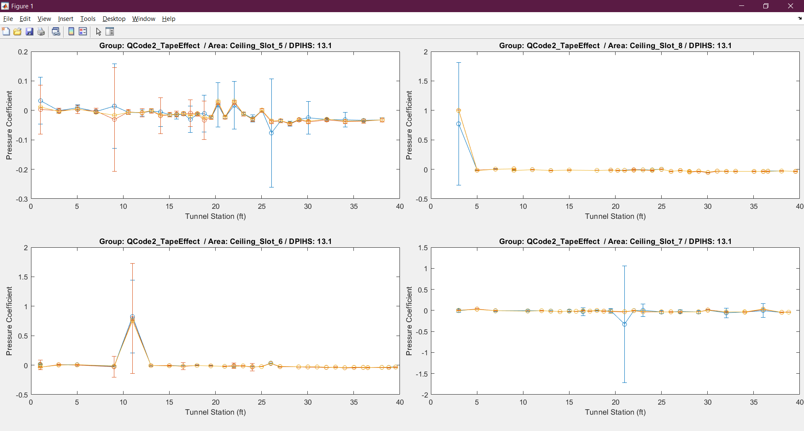
WICS Back-up Slides – QCODE 2
Back

Slide 57
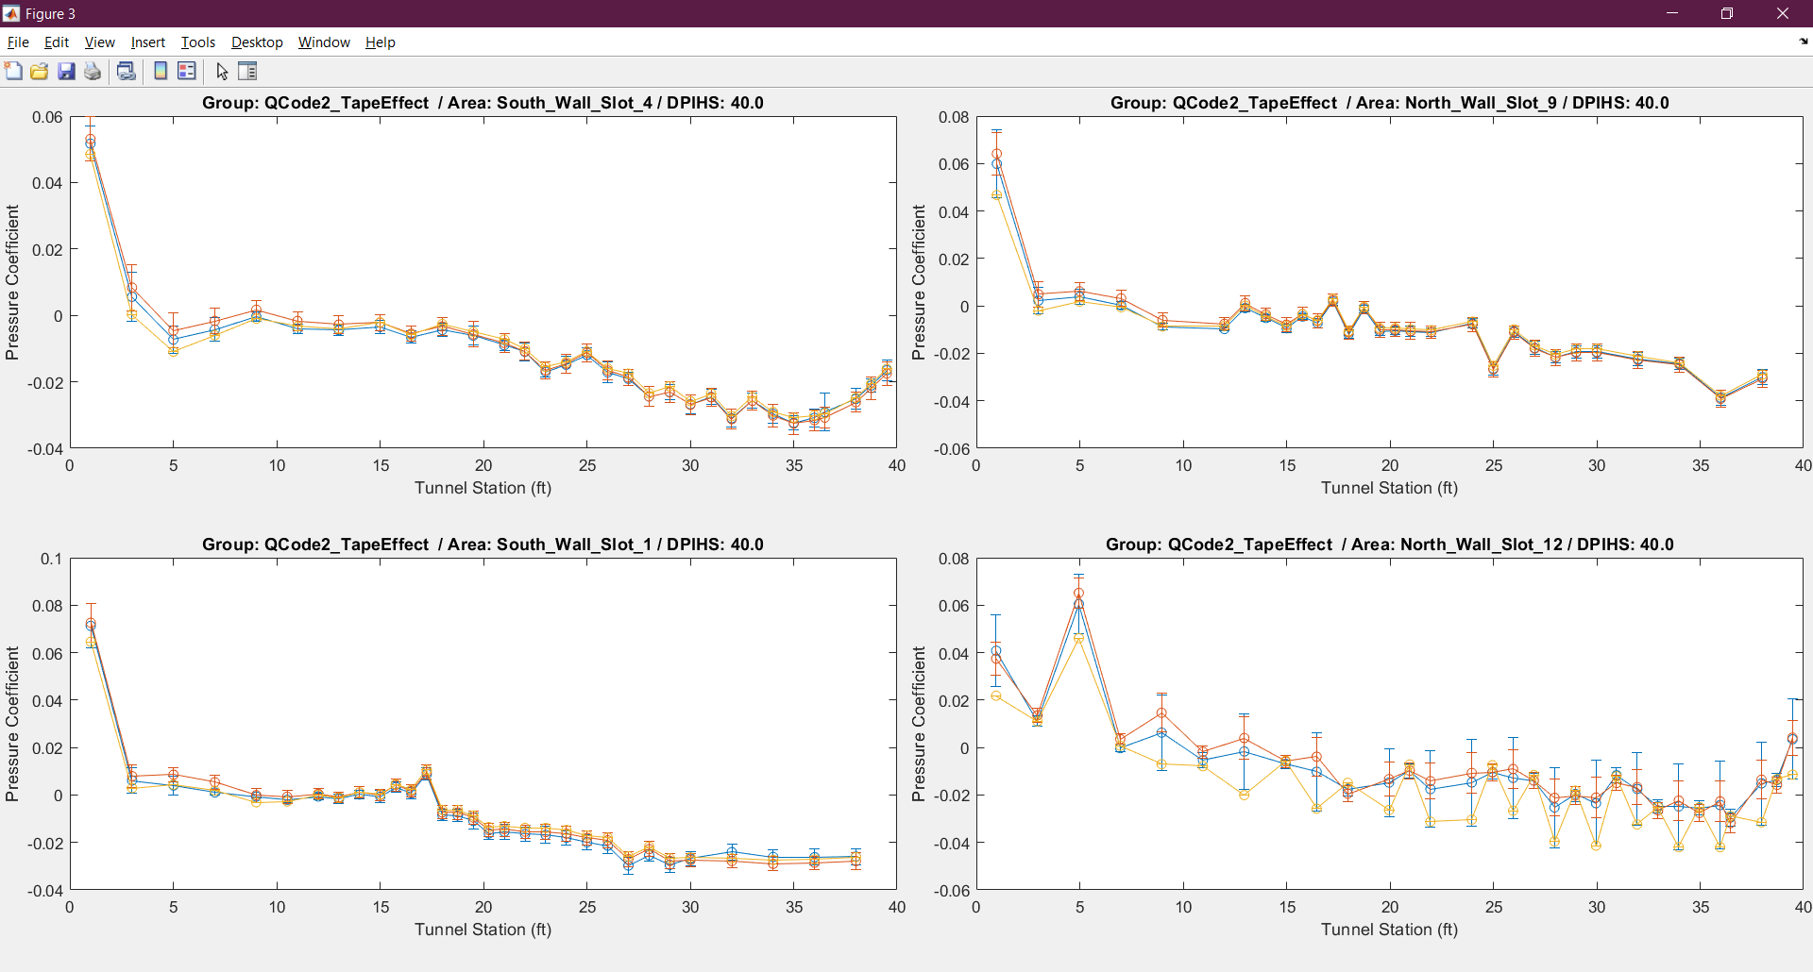
WICS Back-up Slides – QCODE 2
Back

Slide 58
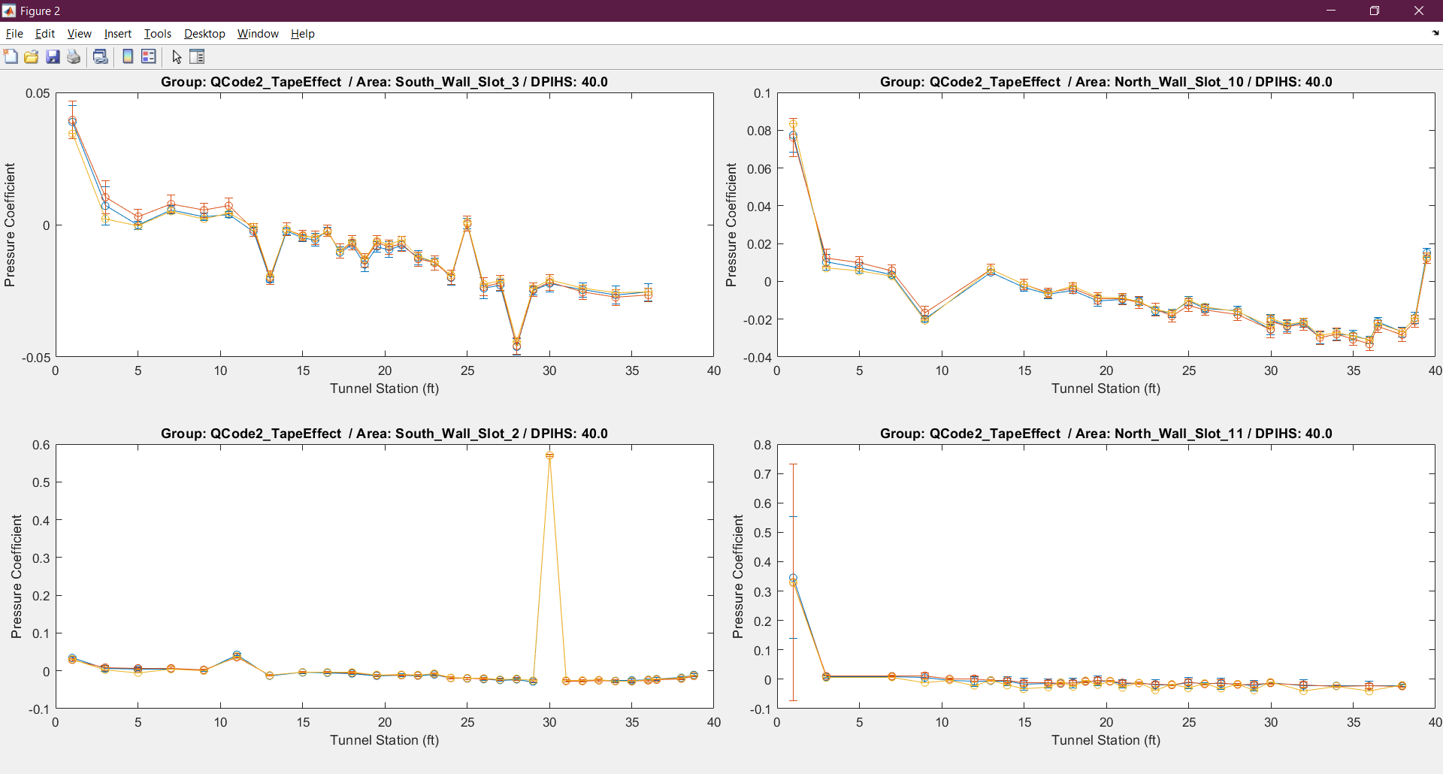
WICS Back-up Slides – QCODE 2
Back

Slide 59
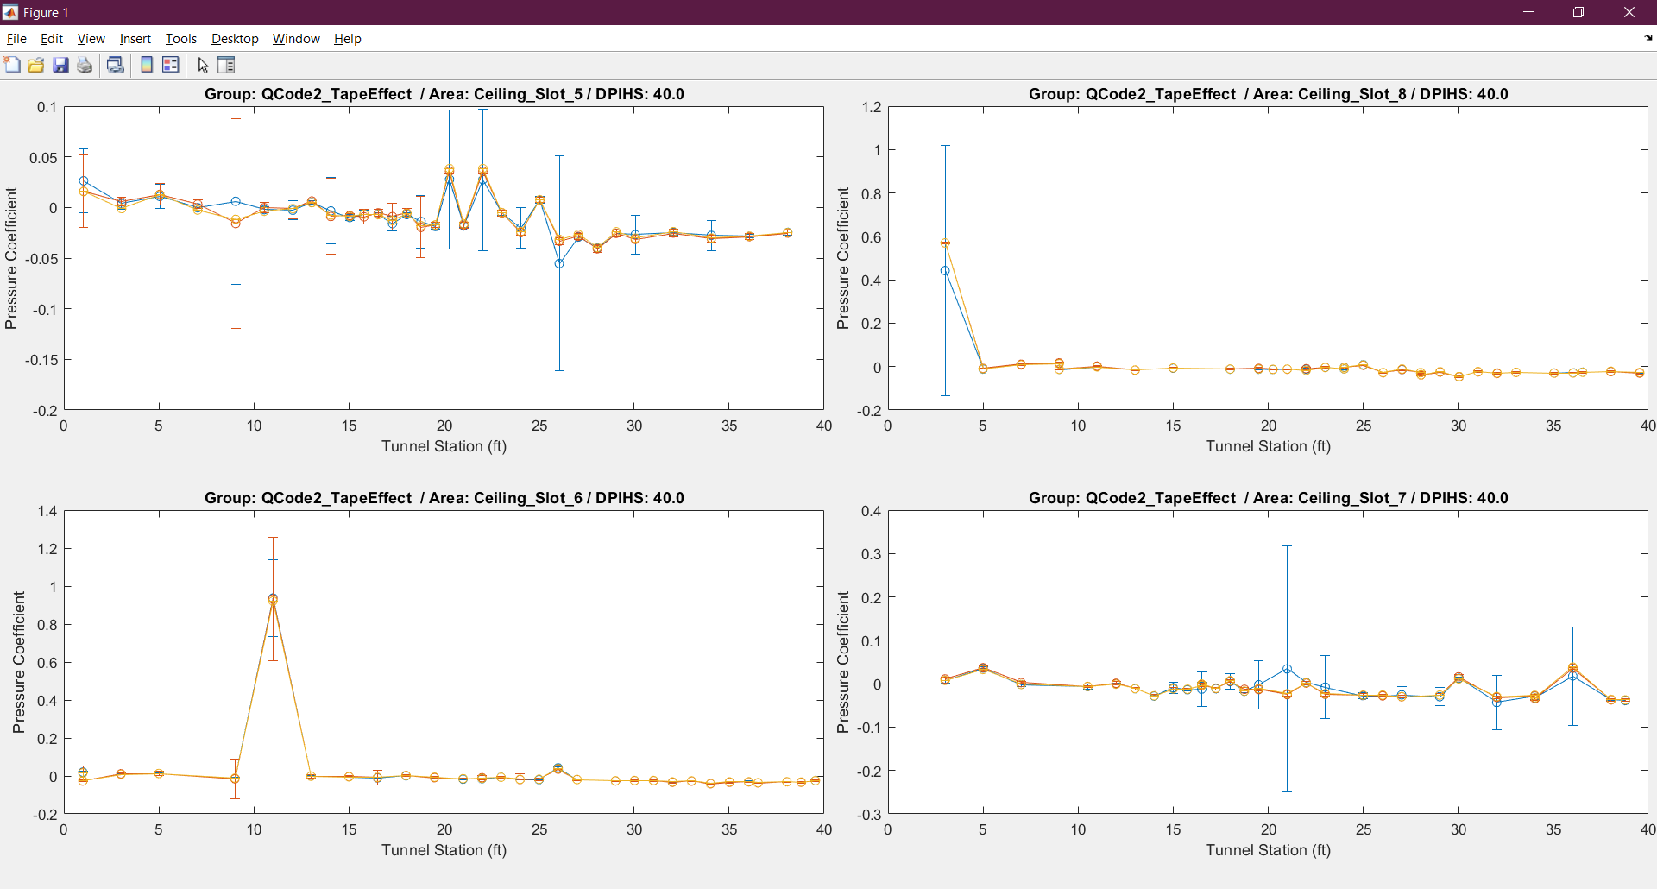
WICS Back-up Slides – QCODE 2
Back

Slide 60
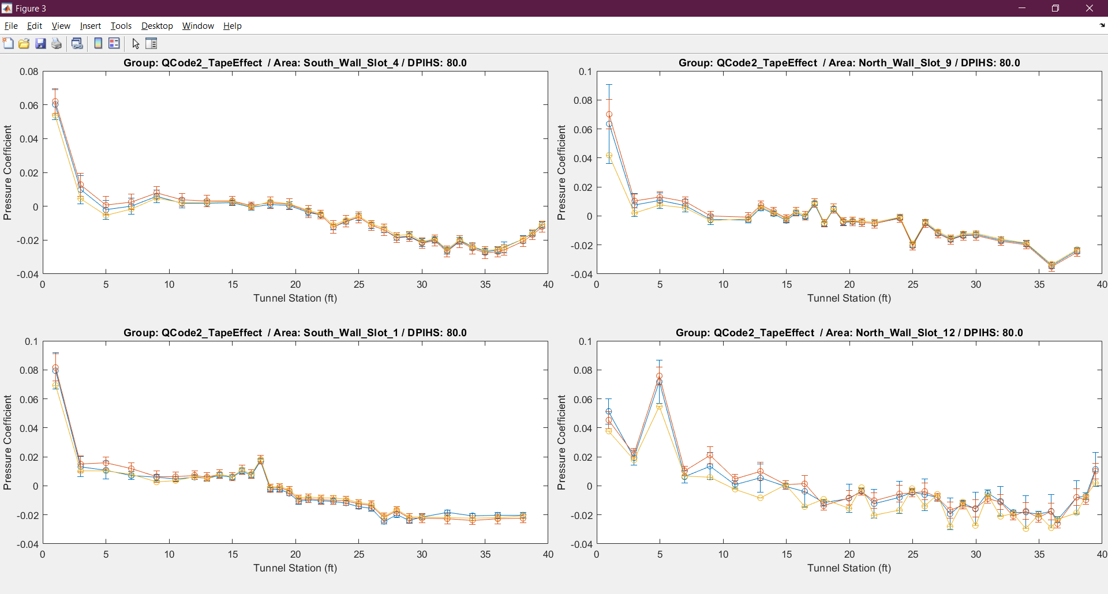
WICS Back-up Slides – QCODE 2
Back

Slide 61
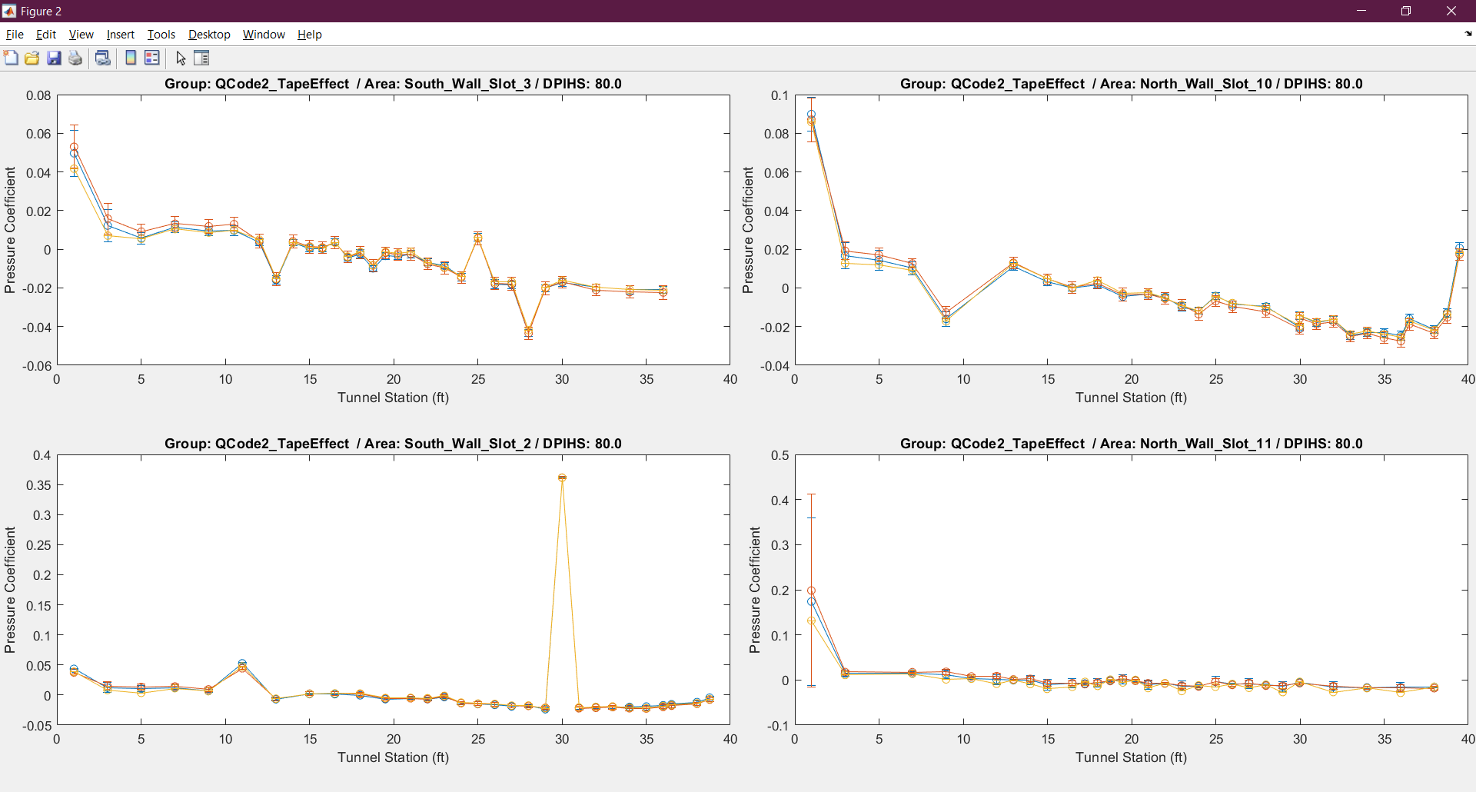
WICS Back-up Slides – QCODE 2
Back

Slide 62
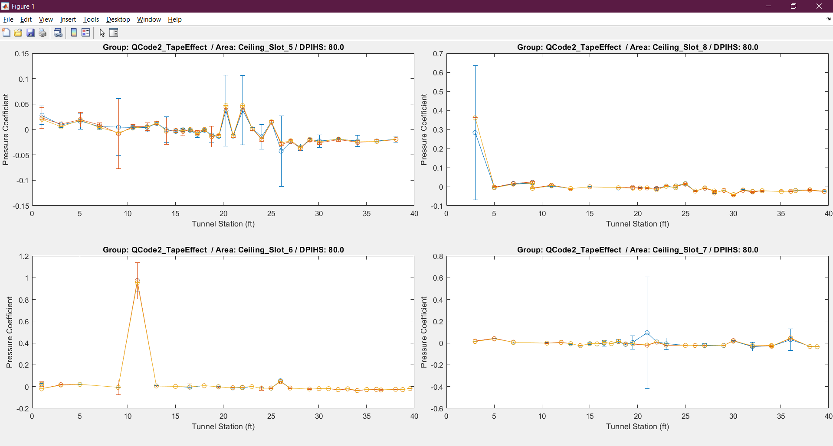
WICS Back-up Slides – QCODE 2
Back

Slide 63
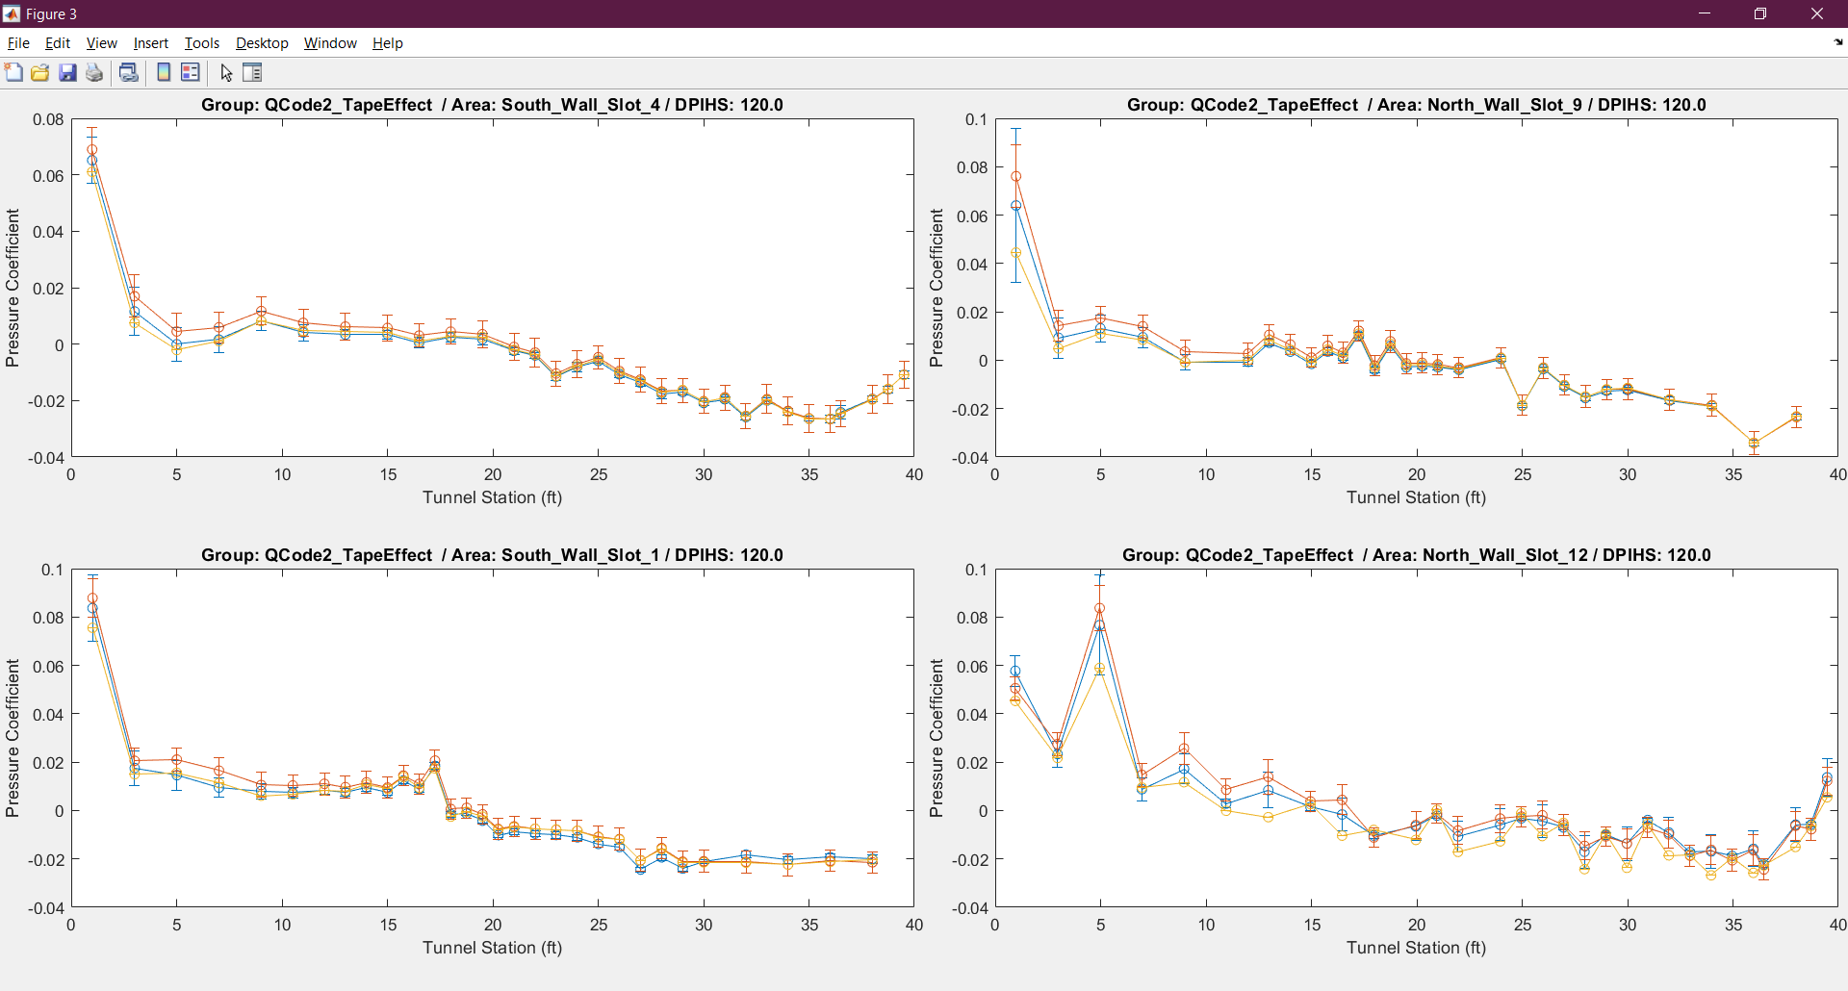
WICS Back-up Slides – QCODE 2
Back

Slide 64
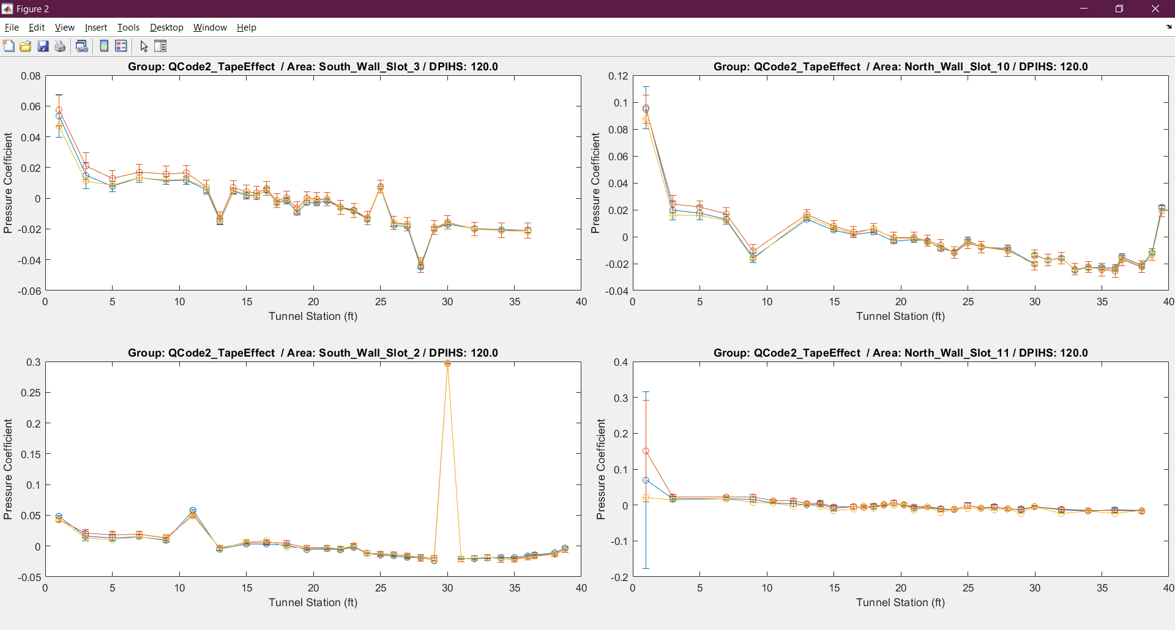
WICS Back-up Slides – QCODE 2
Back

Slide 65
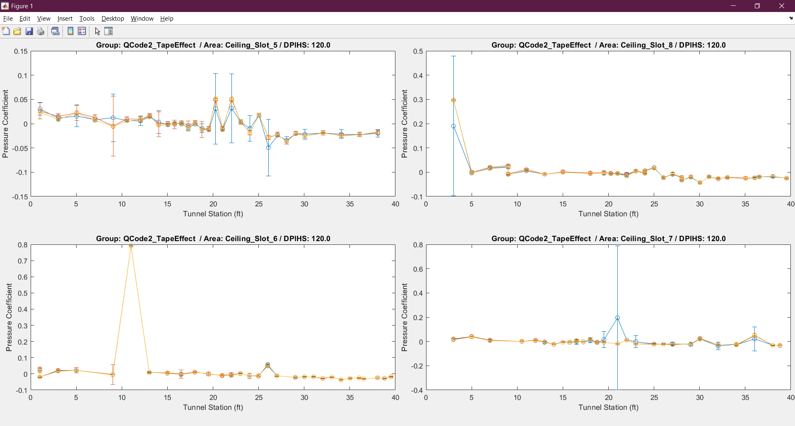
WICS Back-up Slides – QCODE 2
Back

Slide 66

WICS Back-up Slides – QCODE 3
Back

Slide 67

WICS Back-up Slides – QCODE 3
Back

Slide 68

WICS Back-up Slides – QCODE 3
Back

Slide 69

WICS Back-up Slides – QCODE 3
Back

Slide 70

WICS Back-up Slides – QCODE 3
Back

Slide 71

WICS Back-up Slides – QCODE 3
Back

Slide 72

WICS Back-up Slides – QCODE 3
Back

Slide 73

WICS Back-up Slides – QCODE 3
Back

Slide 74

WICS Back-up Slides – QCODE 3
Back

Slide 75

WICS Back-up Slides – QCODE 3
Back

Slide 76

WICS Back-up Slides – QCODE 3
Back

Slide 77

WICS Back-up Slides – QCODE 3
Back

