Slide 1
Onboard Phase-Retrieval for Habitable Worlds Observatory
Alden Jurling
Kaitlyn Summey
Matthew Bergkoetter
NASA GSFC, Optics Branch
Not Subject To Export Control

Slide 2
Goal
Control telescope mirrors
How?
  Using phase retrieval
  Using out-of-field stars
  Or alternately: out-of-band stars
Why
  Direct optical measurement
  Relax stability requirements
Topics
  What is phase retrieval?
  Does it work
    JWST on-sky sub-nm example
  How well can we do for HWO?
    Photon limited parametric performance studies
    Target coverage
    Predicted frame rates

Slide 3
Onboard WFS Architectures
Out of Field
Out of Band
Telescope
Telescope
SM
SM
PM
PM
WFS
BS1
CG1
BS1
CG1
BS2
CG2
BS2
CG2
Less interference with coronagraph
Large FoV
Packaging impact
WFS
Requires dichroic bandpass selector mechanism
No light lost to occulter

Slide 4
Phase Retrieval Introduction
Goals
  Measure optical performance and aberrations of integrated / finished optical systems (after integration, in flight, etc.)
  Minimize specialized hardware (mass/volume constraints)
  Measure performance at science focal planes, not else where
Challenges
  Full description of an optical beam requires phase information
  Normal cameras only measure intensity, not phase
  Installed focal planes prevent access for double pass interferometer
  Many wavefront/field sensing technologies require significant dedicated hardware and/or separate optical paths (Shack Hartmann wavefront sensor, Zernike wavefront sensor, shearing interferometer, etc.)
  Slope-only methods like SHWFS do not work with segmented telescopes
Modern phase retrieval approach
  Observe (defocused) stars using flight (imaging) cameras
  Create numerical model of the imaging
  Solve inverse problem to recover system features

Slide 5
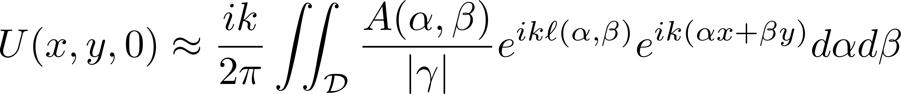
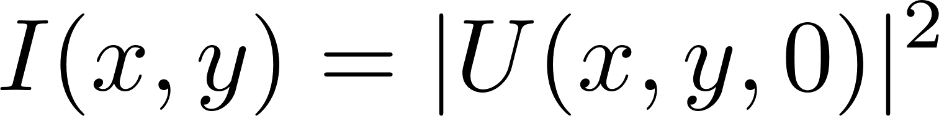
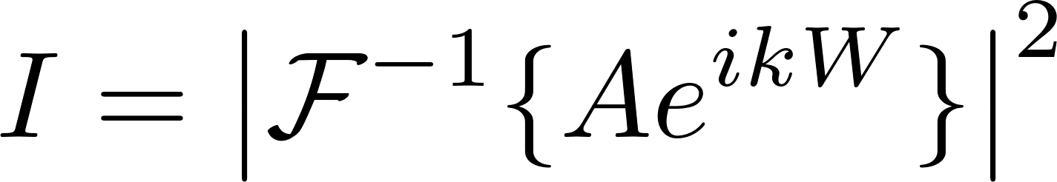
Phase Retrieval Fourier Imaging Model
Pupil Illumination
Basically W
Image Field
Image intensity
Nearly constant
Fourier Kernel
Simple conceptual form
Basic phase retrieval problem statement:
Given (measurements of) I, find W
Sometimes also find A or part of A

Slide 6
Commentary
This is an inverse problem
  Similar problems arise in other areas, X-ray crystallography
No known direct solution in general
Inverse problems are well studied but difficult
Two major approaches
  Iterative Transform / Gerchberg-Saxton algorithm
    Used in most early work, including JWST WAS, GSFC ISIM analysis
    Transform back and forth between image and pupil domains enforcing constraints
    Simplest form is easy to implement, state-of-the-art form is hard to implement
    Particular to this problem
    Not going to discuss further
  Nonlinear optimization
    Used in RST WFSC, JWST PRMS
    Construct a data consistency cost function and minimize it
    Simplest form is harder to implement, more advanced features easier to add
    General approach based on optimization theory

Slide 7
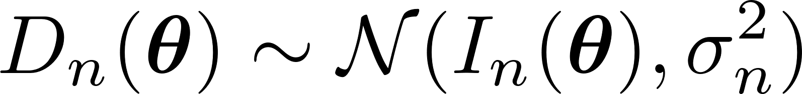
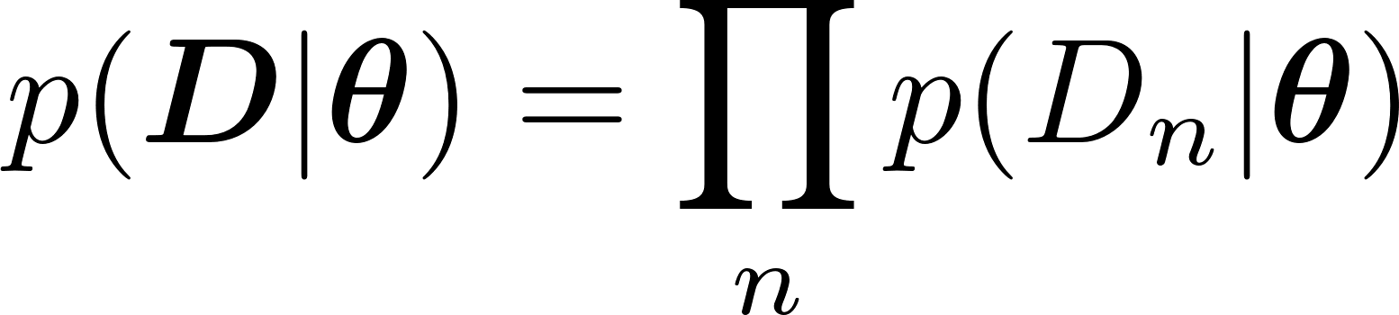
Maximum Likelihood Estimation
When prior probabilities are not known, MLE is a standard approach
Essentially, find a value of the unknown where the measured data is a likely to be observed. Observed noise is not too improbable
Assume each pixel is a normally distributed random variable
Compute total probability given the vector of unknowns θ
Use natural logarithm to turn product into sum and drop constants
Weighted linear least squares estimation
n is pixel index

Slide 8
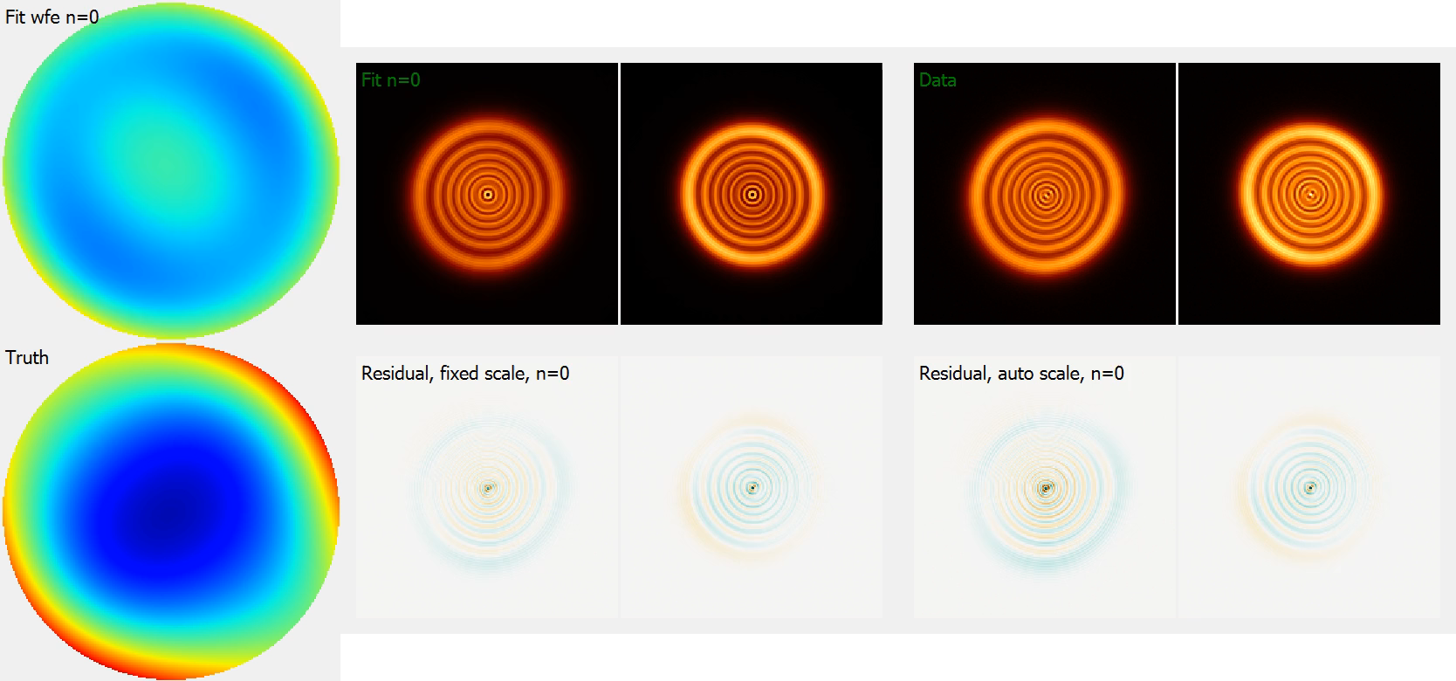
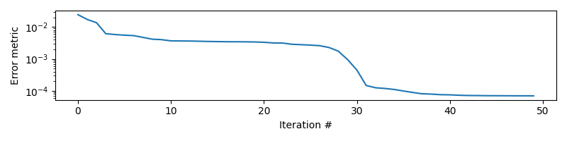
Simulation example

Slide 9
HWO Application Concept
Idea
  Dedicated instrument for phase retrieval
  Perform phase retrieval on board
  Control primary mirror segments and/or secondary mirror alignment in closed loop
Why phase retrieval?
  Wide field of view system could capture many stars and analyze in parallel
  No need to control absolute pointing
    contrast with Zernike or pyramid sensor
  Sensitive to segment pistons
    Contrast to SHWFS
  Reduced non-common path optics
    No need for pupil imaging optics
    In some configurations no need for relay optics
  Trades hardware complexity for software complexity

Slide 10
Does this Work?
Used in Hubble characterization
Used extensively in JWST and RST ground testing
Used extensively in JWST commissioning
Particular example: JWST IEC characterization
  Single image time series
  Sub-nm wavefront sensitivity
  NIRCam weak lens observations

Slide 11
JWST IEC Results

Slide 12
JWST IEC Phase Retrieval
JWST collected NIRCam time series data (APT program 1602)
  1800 s continuous monitor every 8.5 second in each in the +8 and -8 NIRCam weak lenses
Analyzed adjacent +8 and -8 wave pair with conventional two image FDPR
Analyzed single images using baseline starting guess
High sensitivity differential measurement.
We identified the dominant aberration content and analyzed it over time
  Average magnitude 0.8 nm RMS
  Noise sensitivity level clearly much less than this
Correlated the phase retrieval results with the temperature sensor data
  Predicted most of the variation in the observed phase retrieval signal.
  Predicated much of the variation in the second time series using only sensor data

Slide 13
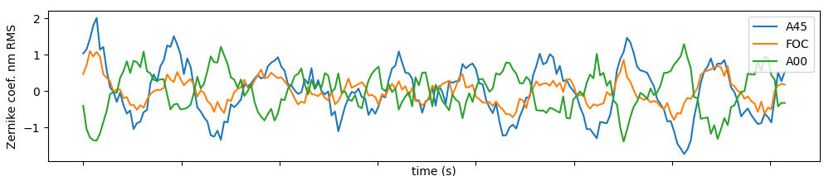
Phase Retrieval Process Review
Analyze adjacent -8 and +8 wave weak lens data
  Includes high order wavefront and amplitude
  Establishes base line
Construct single image PR model for weak lens set
  Refit (low order only) the -8 or +8 image used in the reference set in single PR model
  Accounts for any weak lens bias
  Produces starting guess
For each image in -8 or +8 set
  Using starting guess above, re-optimize
  Segment piston-tip-tilt, and low order global Zernikes
For wavefront time series, subtract average wavefront over each time series
A
B

Slide 14
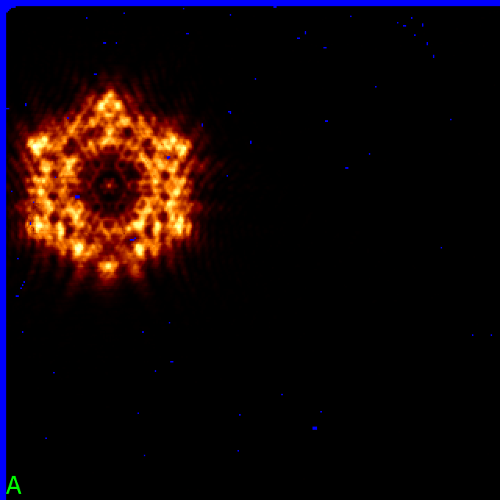
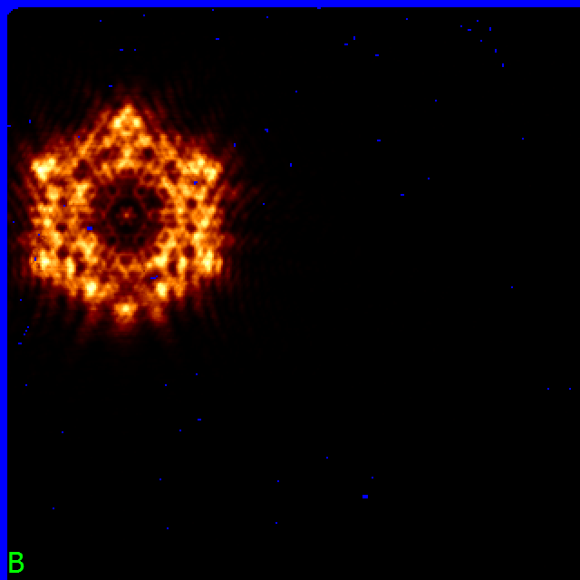

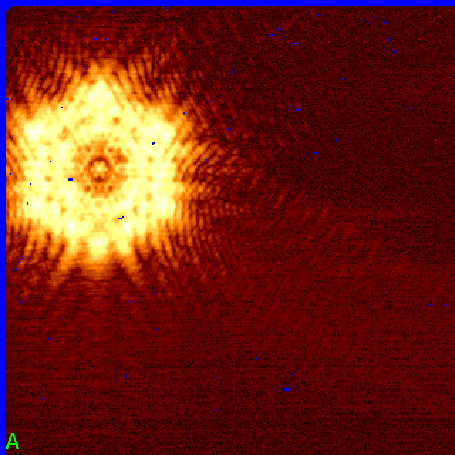
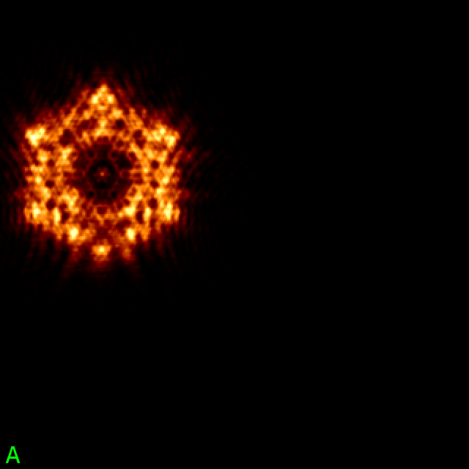
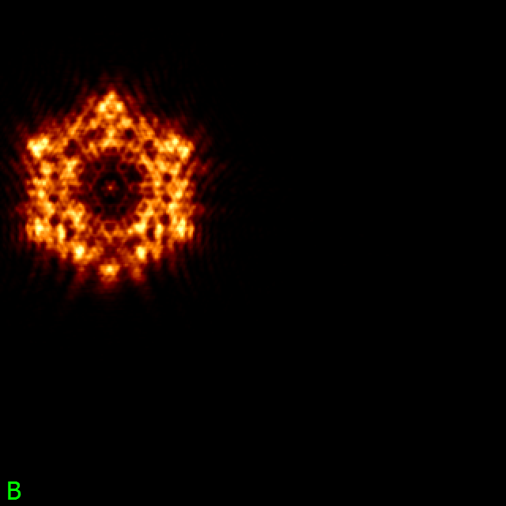

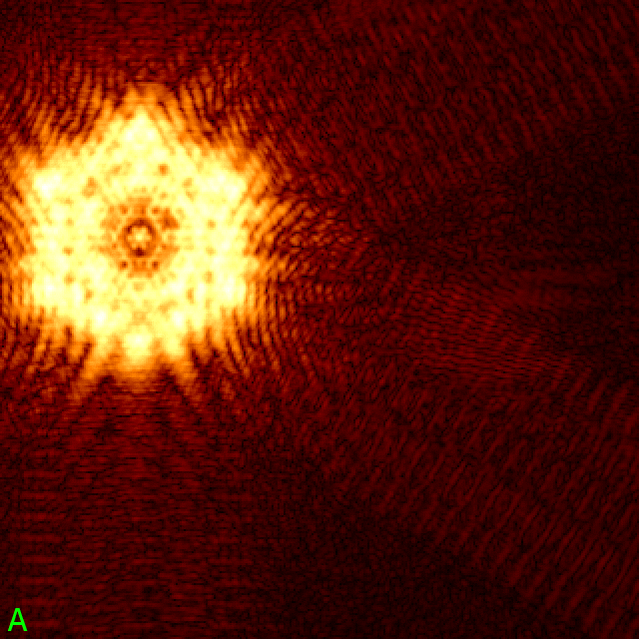
PSF Comparison (1)
A/B flicker
quarter power
A
B
A/B flicker
Data
PR
Fit

Slide 15
PSF Comparison (2)
Excellent agreement
No sign of major artifacts or systematic issues
Indistinguishable on linear scale
Case B is similar
A: Comparison (linear)
A: Comparison (quarter power)

Slide 16
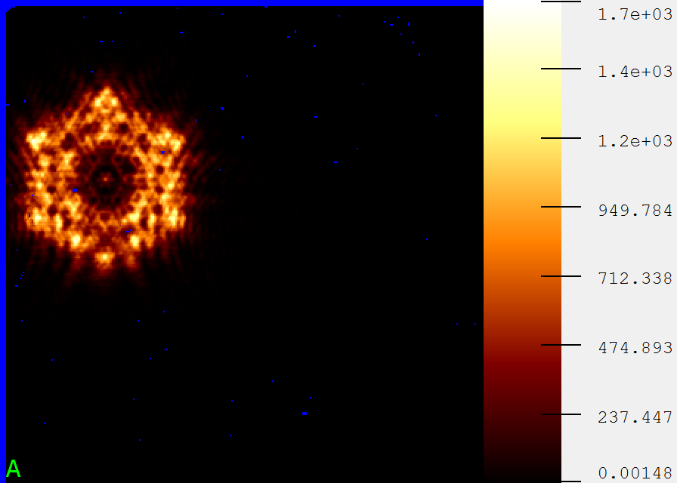
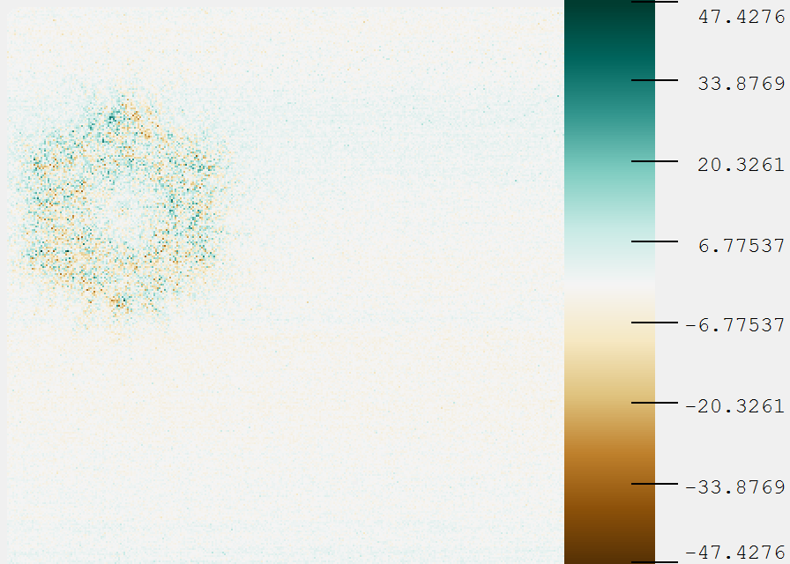
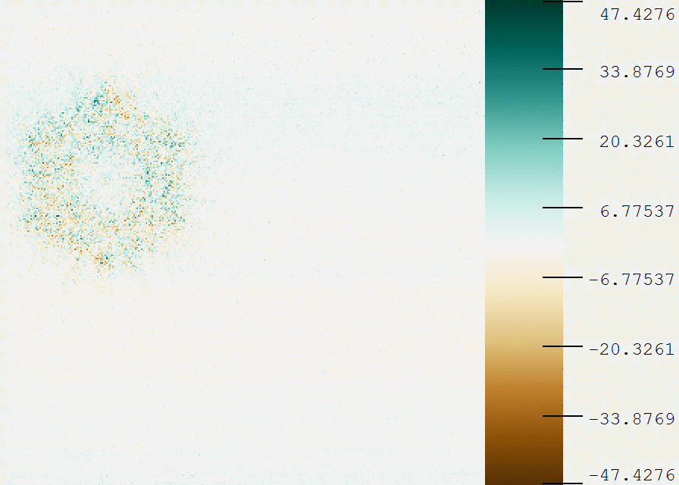
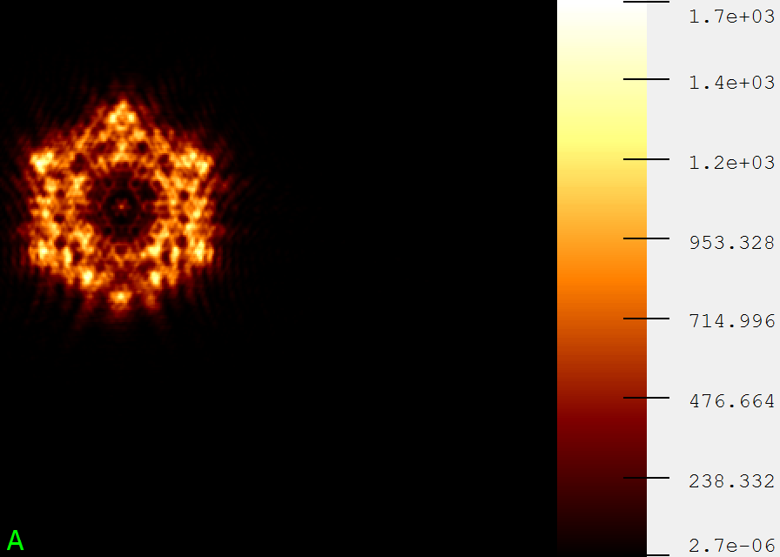
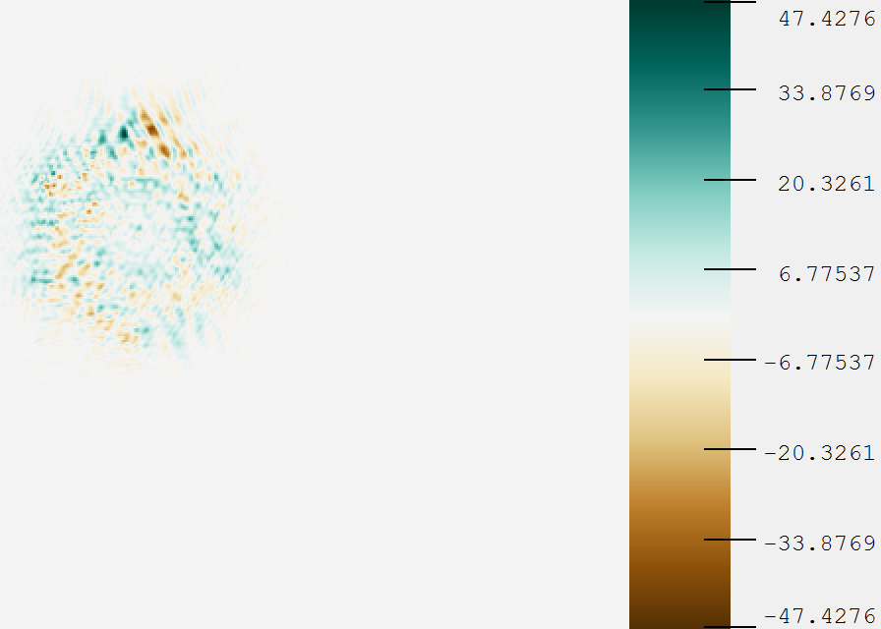
PSF Comparison (3)
A
B-A
B-A Animation
Data
Cropped animation, bigger
PR
Fit

Slide 17
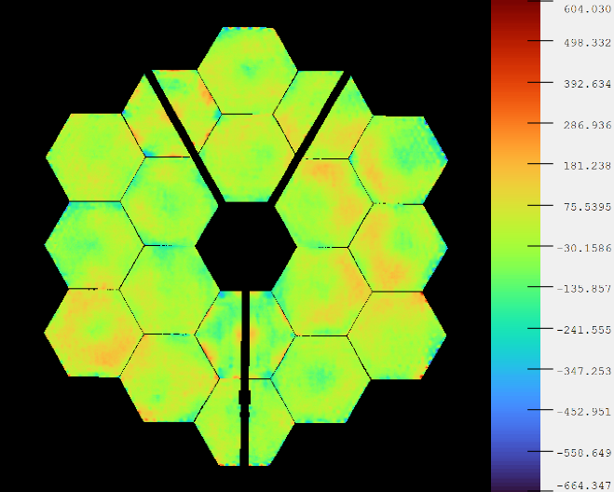
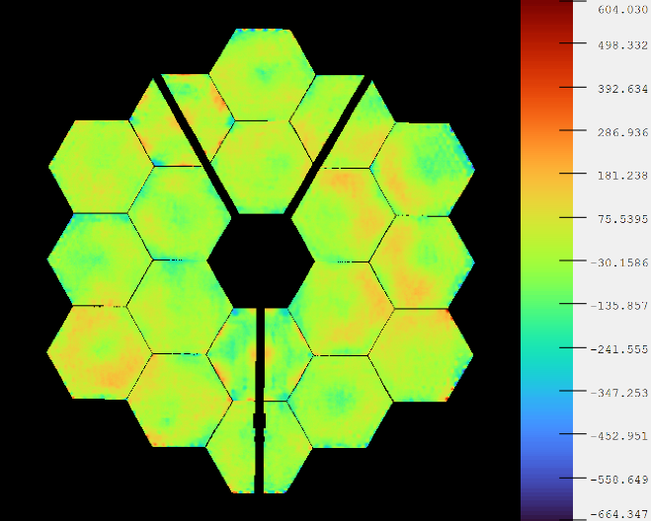
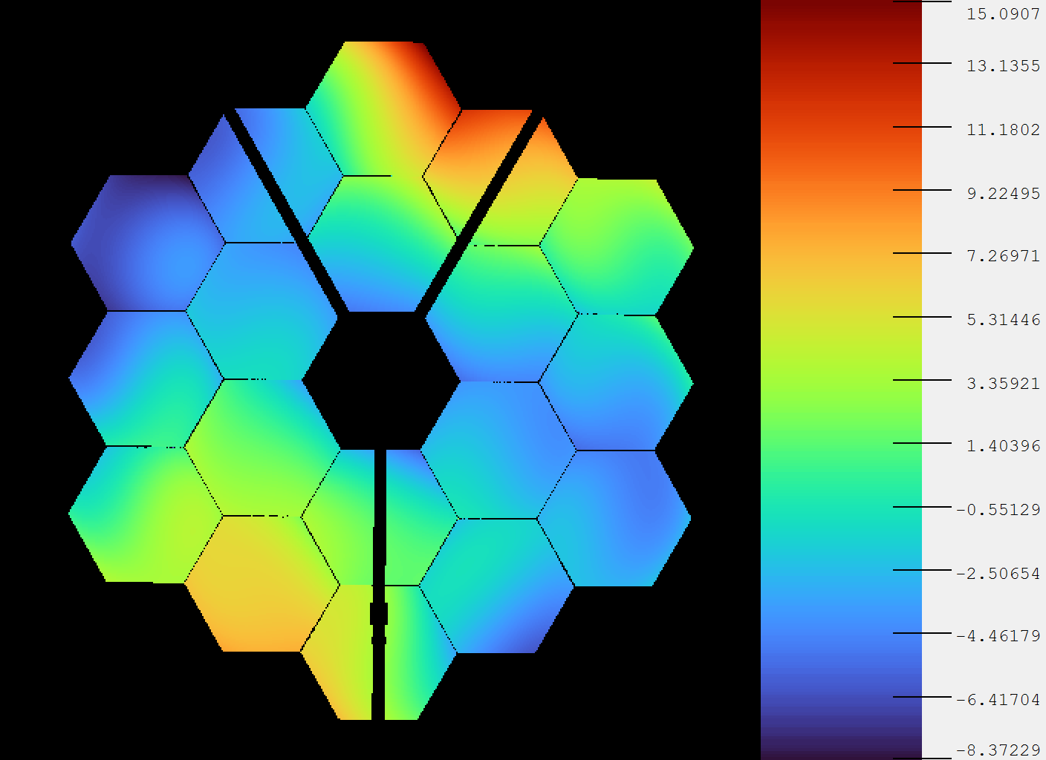
Wavefront Comparison
A
B
B-A
Total wavefronts look identical
  Shown with focus removed
Difference shows clear low order term
  Focus included here
Conceptually difference is due to low order PSF difference shown before

Slide 18
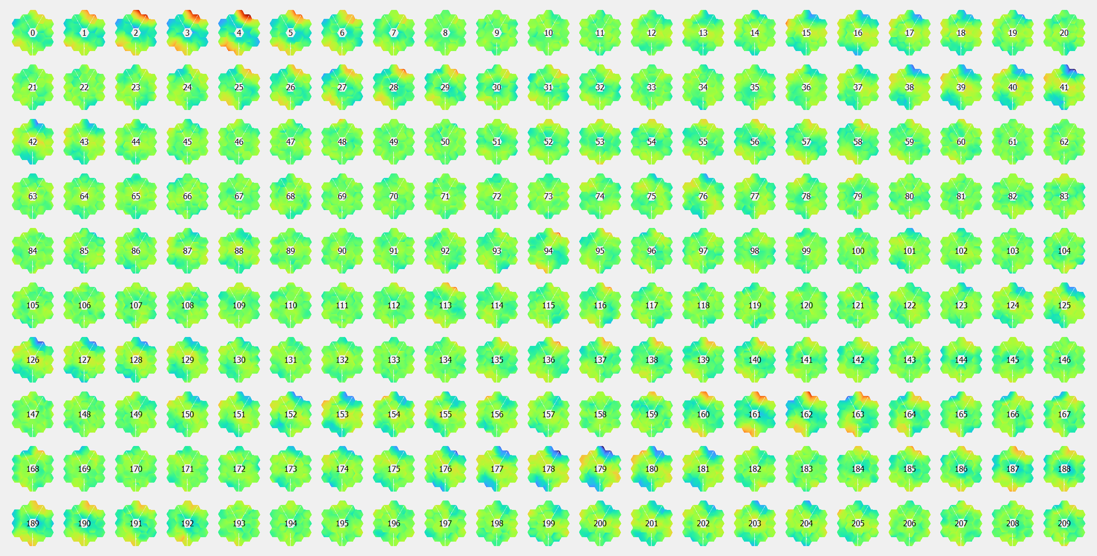
Wavefront time series (average subtracted)
Frame #
A
B

Slide 19
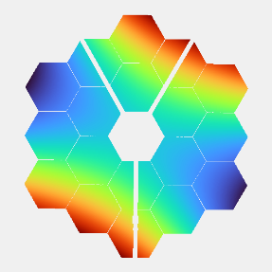
Condensed Intermediate Analysis
Used SVD to extract a coefficient representation of the time dependent part of the wavefront
Got thermal sensor telemetry for this time period
  Identified three time series that correlate with optical measurements
Fit gain and delay parameters to simple signal model to predict optical measurement with thermal data

Slide 20
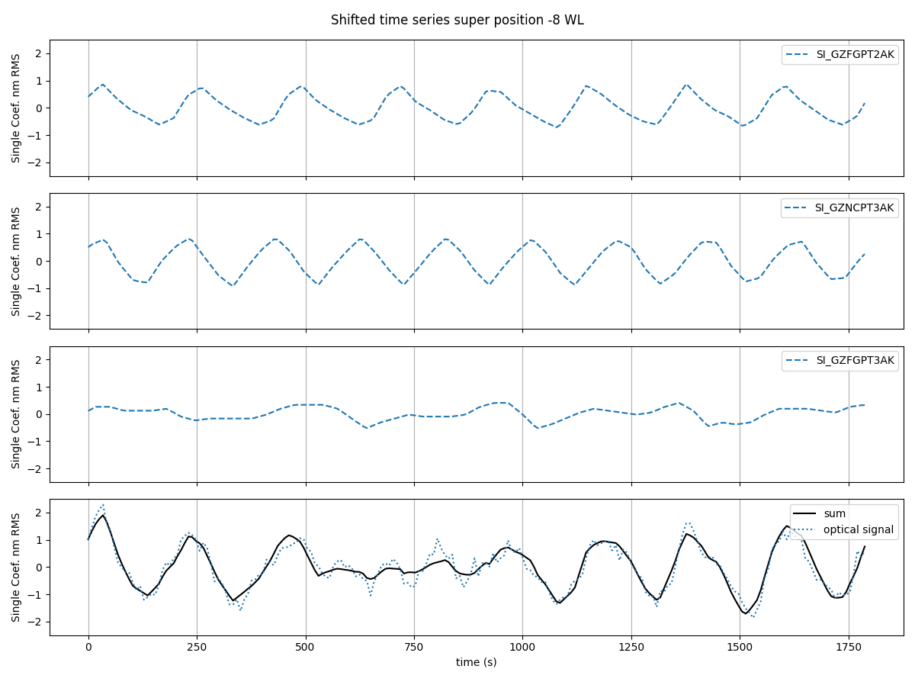
Time Series Superposition
Fit Results
Name | Scale | Delay (s)
SI_GZFGPT2AK | -0.94 | -195
SI_GZNCPT3AK | 0.94 | -69
SI_GZFGPT3AK | -0.6 | -376
+
Note:
Nearly periodic structure makes delay estimation ambiguous at period of dominant frequency
Also ambiguous with half-period shift and sign reversal
+
=

Slide 21
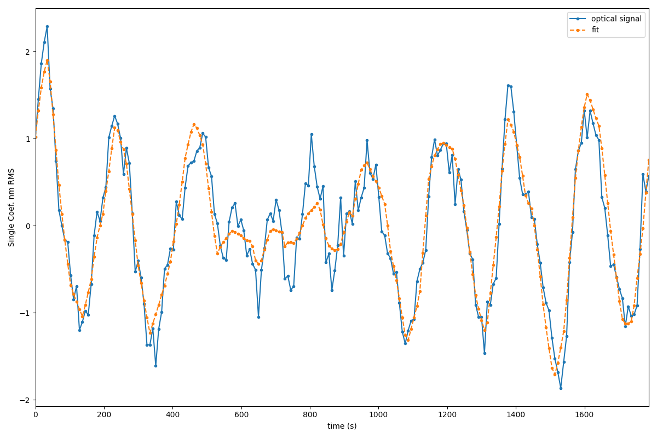
Comparison, -8 WL Time Series
Same as data plot on previous slide, enlarged
Total signal: 0.80 nm RMS
Fitting error 0.25 nm RMS
70% of signal variation explained

Slide 22
Extrapolation
We can use the gain and delays obtained in the -8 wave weak lens to predict the time series in the +8 wave weak lens
The two series are average subtracted separately and have a slight configuration change, which could limit how well this works
No attempt (here) to fix a bias or shift between the two series

Slide 23
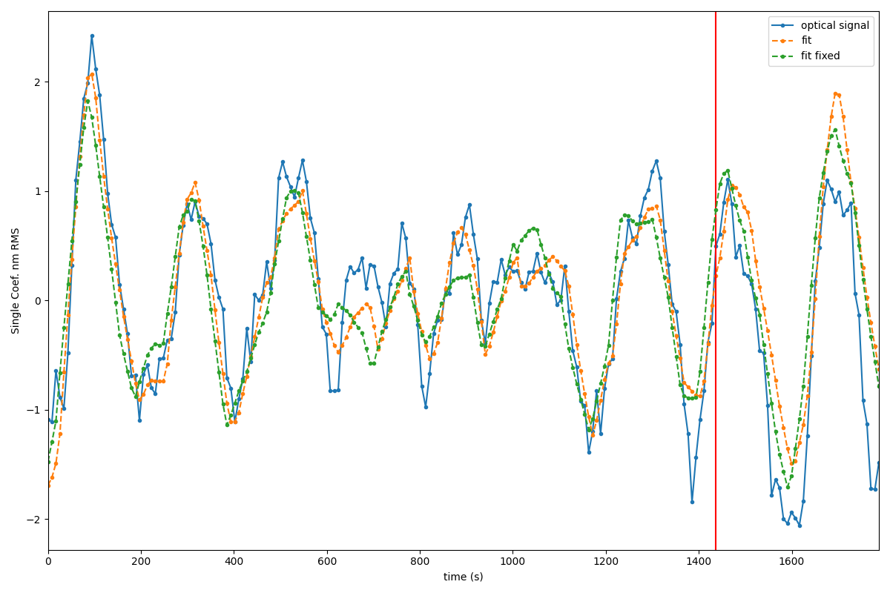
Comparison,+8 WL Time Series
Fit for +8 WL data
Orange curve is refit for these data
Green curve is extrapolated from -8WL data
Data after tilt event (red) is excluded from analysis
Fit Results
Name | Scale | Delay (s)
SI_GZFGPT2AK | -1.3 | -201
SI_GZNCPT3AK | -0.85 | -179
SI_GZFGPT3AK | 0.58 | -160
With fitting:
Total signal: 0.68 nm RMS
Fitting error 0.25 nm RMS
63% of signal variation explained
With only extrapolation from -8:
Extrapolation error: 0.36 nm RMS
47% of signal variation explained

Slide 24
JWST Conclusions
Sub-nm precision phase retrieval data on single defocused image time series data reasonably successful
Wavefront variation can be reasonably well represented by a single term mixing global astigmatism and focus
  True form is probably segment level
Time dependence of wavefront variation can be reasonably well explained using time shifted thermal telemetry
  Supports expectation that short term stability is mostly driven by IEC thermal excitation
Wavefront variation in the second data set (1800s duration) is reasonably well predicted using time shifted telemetry alone with coefficients / time shifts fit from first data set.
Key results
  Successful sub-nm phase retrieval change monitoring
  Reasonably successful extrapolation of sub-nm wavefront perturbation from measured thermal telemetry

Slide 25
Performance Study

Slide 26
How Well Can W Do?
Goal
Find photo limited performance
Find driving design parameters
Series of parametric Monte Carlo studies over different design parameters

Slide 27
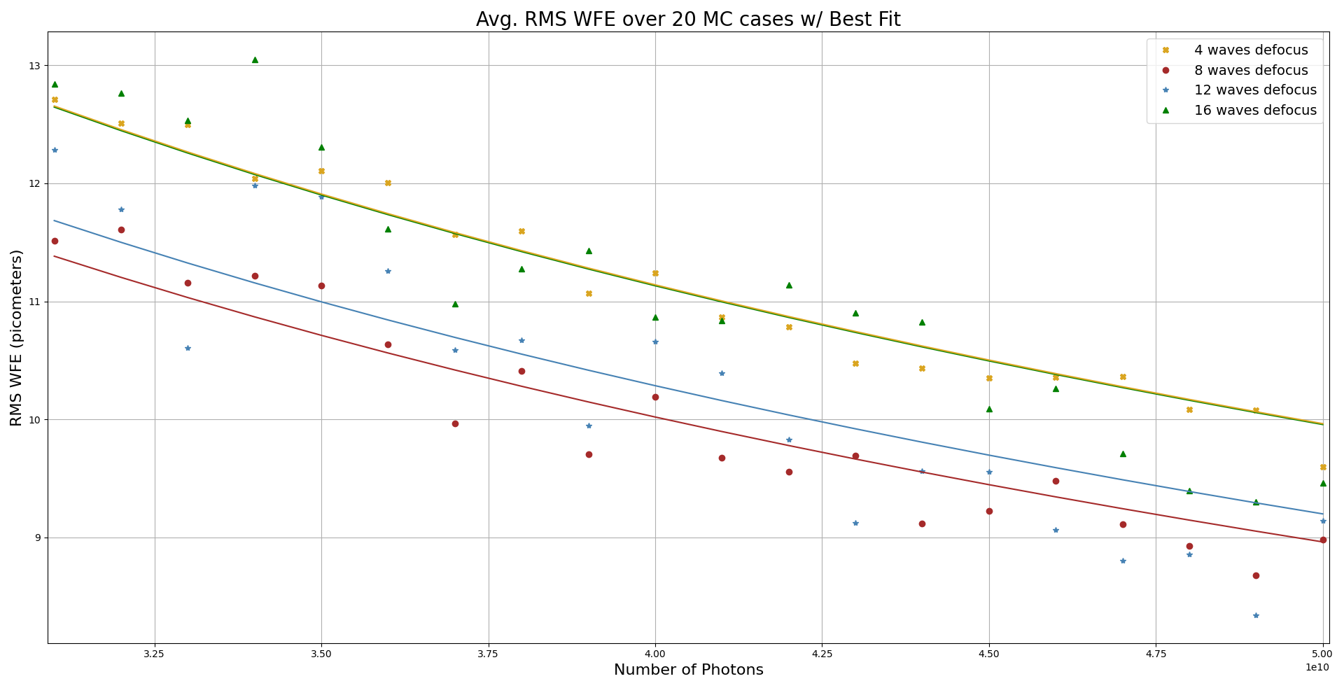
Focus Dependency

Slide 28
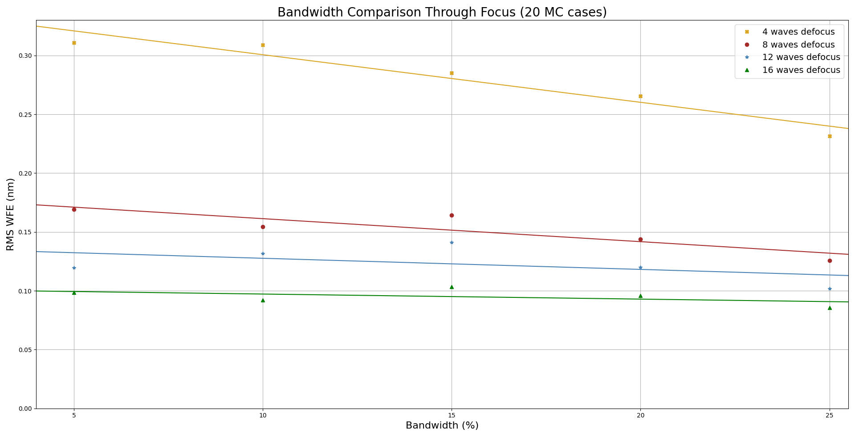
Bandwidth Dependency

Slide 29
Parametric Study Conclusion
You need about 50,000,000,000 photons to achieve 10 pm RMS sensing error at 1 μm wavelength
Example
  50 square meter telescope
  1 μm center wavelength
  100 s integration time
  AB magnitude 7.65 star
Or equivalent combination of dimmer stars
System details do not matter too much
  Defocus, bandwidth,
165 controllable modes (55 segments, piston tiptilt)

Slide 30
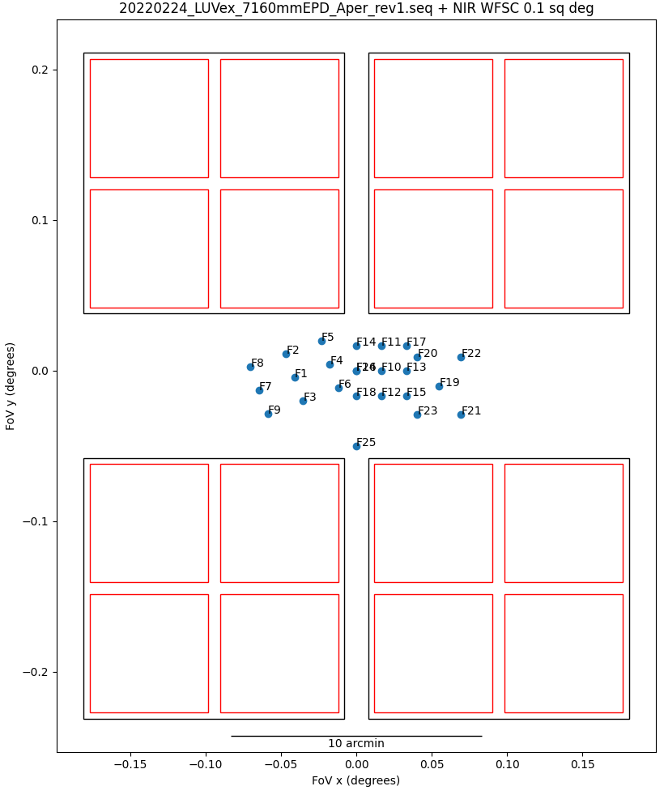
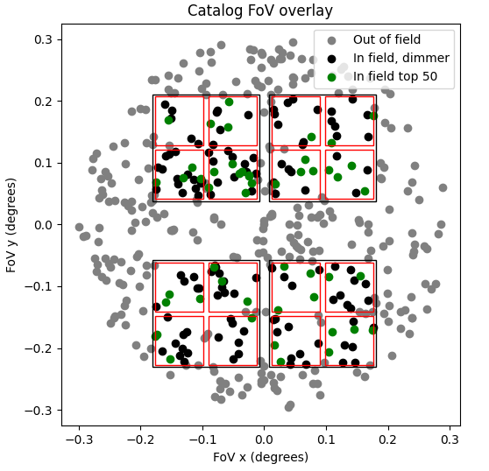
NIR Point Design
Telescope area: 50 m²
Center wavelength: 1 μm, 20% fractional bandwidth
Detector concept:
  Plate scale: 69 mas / pixel
  16 H4RG10 in four 2x2 modules
  0.1 deg² total field of view
Computation assumption: Use 50 brightest sources
Catalog evaluation using 2MASS (example below)

Slide 31
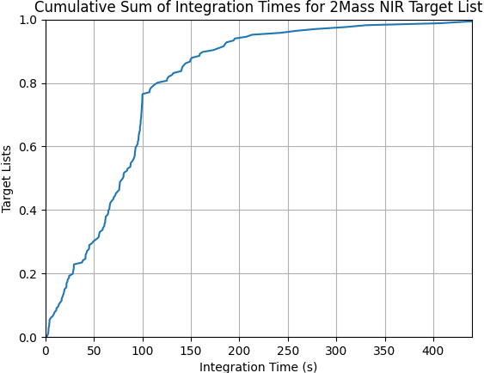
NIR Results
Use LUVOIR target list
Query 2MASS point source catalog around target
Select subset of stars inside detector field of view
Select 50 brightest stars
Calculate total flux
Calculate integration time for 10 pm accuracy
Cumulative distribution to right

Slide 32
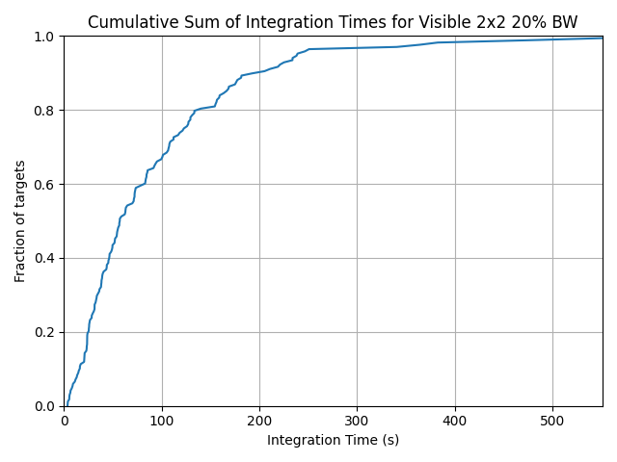
Visible Point Design
Telescope area: 50 m²
Center wavelength:
  500 nm,
  20% fractional bandwidth
Detector concept:
  16 8kx8k visible detectors in four 2x2 modules
    Same layout as NIR system
  0.1 deg² total field of view
Catalog evaluation using GAIA

Slide 33
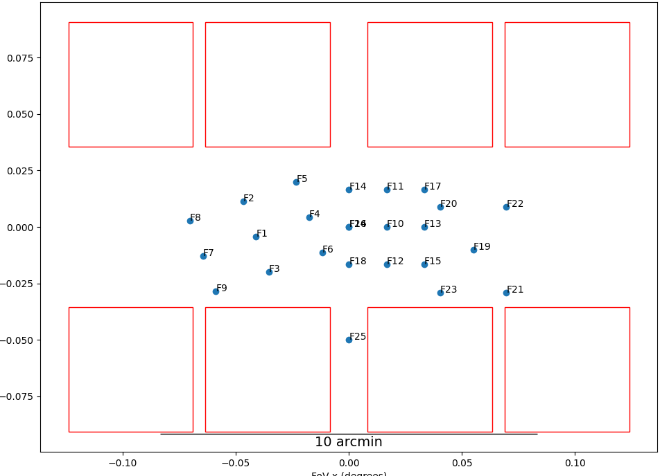
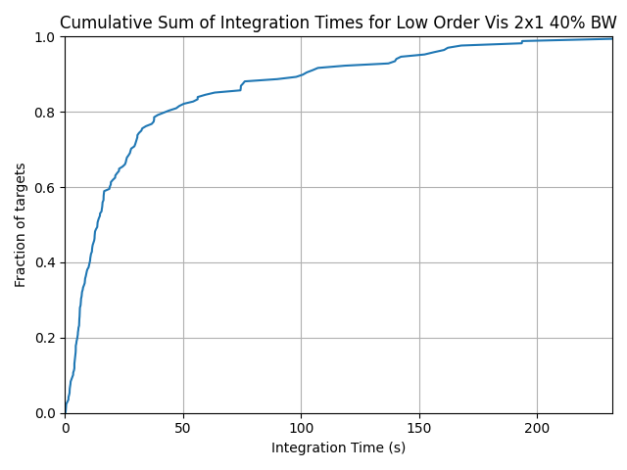
Discussion
These designs have large field of view, making them hard to package
Update rates are slower than we would like
Changes
  Try to control only 4th order global modes (11 vs 165)
    3X better RMS performance, 9X looser flux budget
  Increase bandwidth to 40%: Double flux
  2x1 detector layout: Half FoV
    Half flux

Slide 34
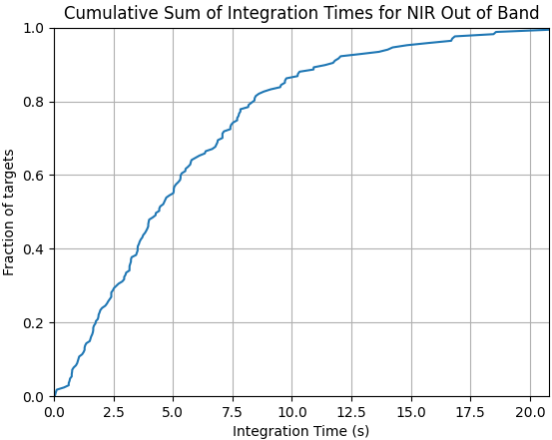
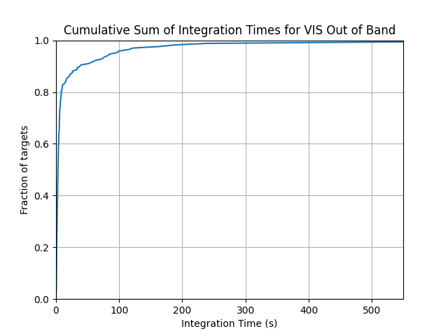
Out of Band Alternative
Instead of using many out of field stars use out of band light from the science target
Two scenarios: (Full 165 controllable modes)
  20% bandwidth J magnitude
  20% bandwidth, V magnitude

Slide 35
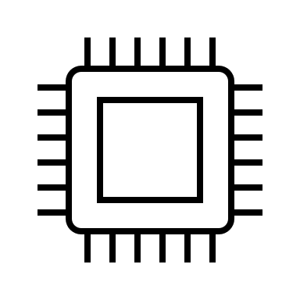
Out of Band Alternative
Instead of using many out of field stars use out of band light from the science target
Two scenarios: (Full 165 controllable modes)
  20% bandwidth J magnitude
  20% bandwidth, V magnitude
Telescope
SM
PM
FSM
BS1
CG1
BS2
CG2
WFS

Slide 36
Comparison
Out of field system
  Large FoV required for good performance
  Requires trade offs with FoV and number of controllable modes
  Independent of science instrument
  Somewhat sky dependent
Out of band system
  Better overall performance
  Requires complicated band sharing with coronagraph
  Easier to package
  Somewhat target dependent

Slide 37
Conclusions
JWST on-sky example demonstrated single image change detection in sub-nm regime
Photon budgets support 10 pm phase retrieval
20-200 second integration times possible
Out-of-band and out-of-field solutions both possible
Plausible for
  Tracking thermal drift
  High fidelity thermal model correlation over most of sky
  Low frequency dynamics model correlation with careful target selection
No silver bullet, but a valuable contributor to a combined system
Future work
  Packaging and optical design trades
  Particularly onboard computing architecture assessment:
    Is parallel phase retrieval on 50 targets in (say) 100 seconds reasonable?
  Closed loop simulations
  Laboratory demonstrations

Slide 38
Acknowledgements
All work was done at NASA GSFC as regular engineering work
Roman Space Telescope
  Phase retrieval software development
  Phase retrieval introduction slides
James Webb Space Telescope
  Phase retrieval software development
  IEC results from commissioning
GSFC IRAD
  Monte Carlo / performance study
  HWO applications

Slide 39
Backup

