Slide 1


TARDIS: Accelerating TVAC Transitions
Seth Abramczyk¹ & Bryan Matonak¹
¹NASA GSFC-545
TFAWS Passive Thermal Paper Session
Presented By
Seth Abramczyk
Thermal & Fluids Analysis Workshop
TFAWS 2023
August 21-25, 2023
NASA Goddard Space Flight Center
Greenbelt, MD

Slide 2
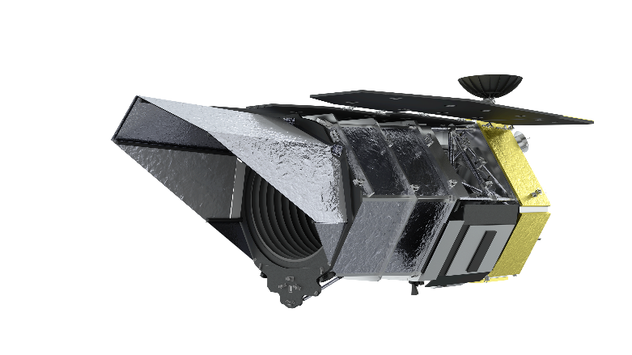

Background
Wide Field Instrument (WFI)
  Cryogenic IR instrument on Roman Space Telescope (RST)
  Undergoing instrument-level TVAC testing at Ball Aerospace in Boulder Colorado
TVAC Transitions
  Significant transition times during TVAC, especially for cryogenic instruments
  Transitions via radiation heat transfer are very slow at cryogenic temperatures due to the T⁴ relationship
WFI
$$Q_{rad}=σεAF_{1−2}\left(T_{2}^{4}−T_{1}^{4}\right)$$
Roman Space Telescope [1]

Slide 3
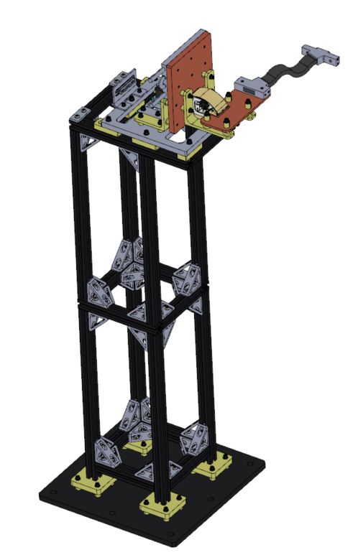
TARDIS Overview (1/2)
TARDIS: Thermal Acceleration Rate Device for Integrated Systems
  TVAC GSE heat switch based off Lucy L’Ralph AZQ (Active Zero-Q) Heat Switch Design
Purpose
  Decrease WFI TVAC transition times during WFI TVAC campaign while also allowing for thermal balances
  Need for high conductance
    Allows TARDIS to drive WFI temperatures cold/hot for transitions
  Need for low conductance
    Reduces TARDIS thermal influence for WFI testing and balances
    Allows for Zero-Q operation
Heat Switch
1.2m
(~4ft)
Stand
TARDIS CAD Model

Slide 4
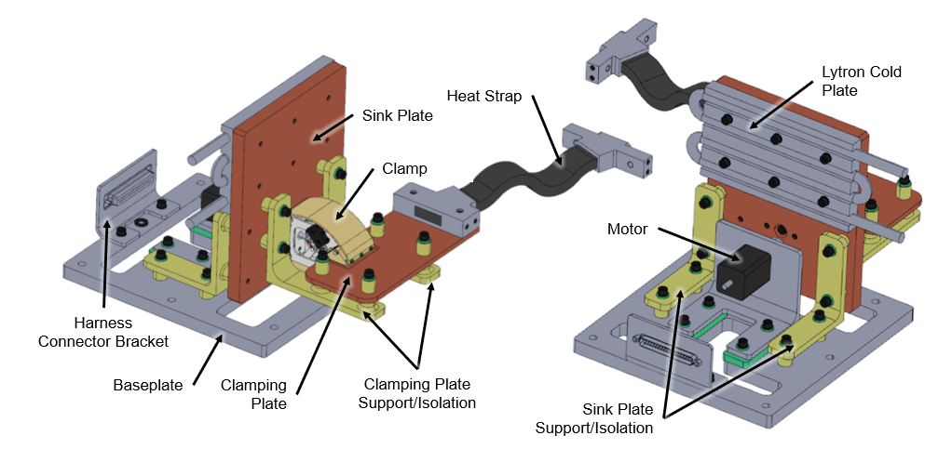
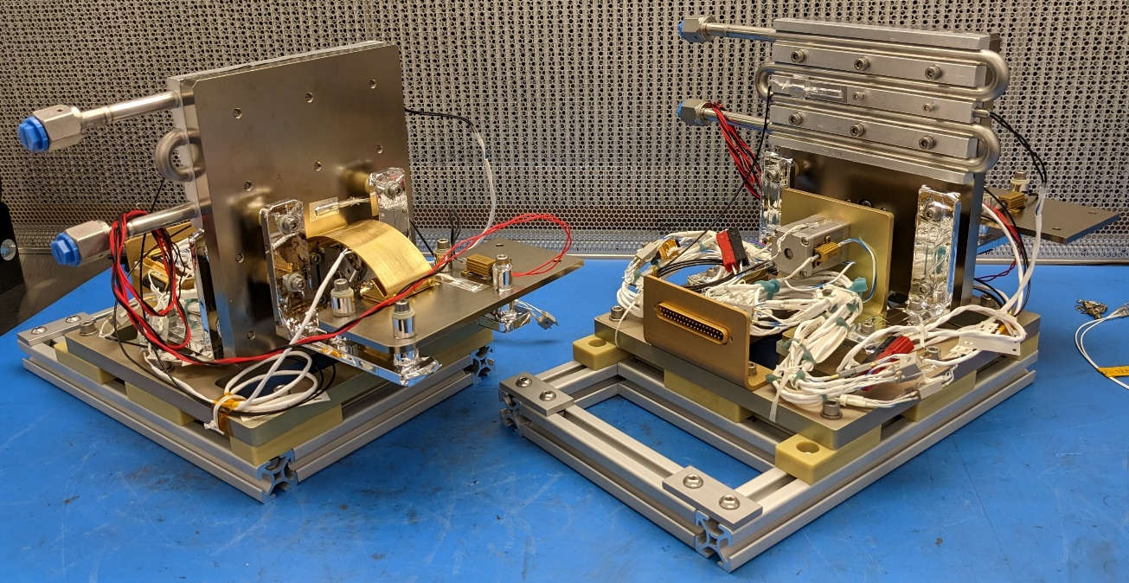
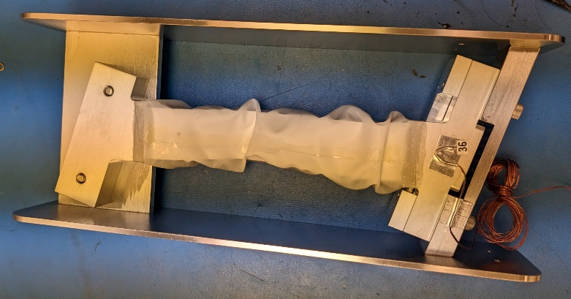
TARDIS Overview (2/2)
Pyrolytic Graphite thermal strap is attached to WFI structure
Thermal strap attached to the clamping plate w/ e-Graf
Clamping plate is thermally isolated from the rest of TARDIS w/ Ultem supports.
When engaged, the clamp thermally connects the clamping plate with the controllable cold plate
Pyrolytic Graphite Heat Strap
TARDIS units during integration

Slide 5
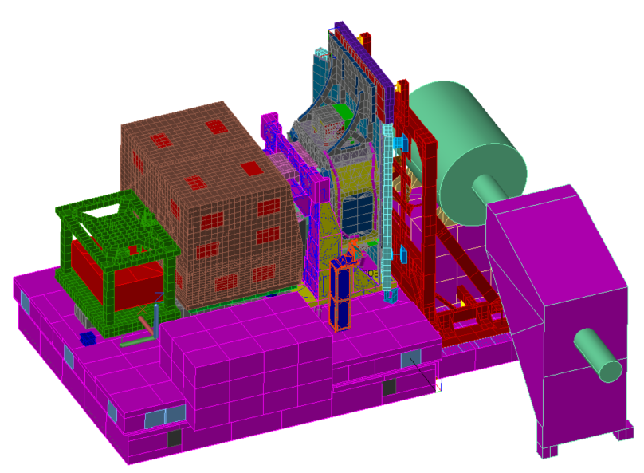
TARDIS in WFI TVAC
TARDIS Position
  TARDIS 1 and TARDIS 2 located on both sides of WFI
  Mounted onto the Trolley Interface Plate (TIF)
WFI
TARDIS 2
TARDIS 1
TIF
WFI TVAC Configuration

Slide 6
TARDIS Operating Modes
 | Engaged | Disengaged | Disengaged Zero-Q
WFI TVAC Stage | WFI Transitions | WFI Testing Plateaus | WFI Balances
Vice Clamp | Engaged | Disengaged
Cold Plate | On: Set hot/cold depending on transition (controlled with LN2/GN2 and/or heater) | Off: Temperature allowed to float | On: Set to measured WFI temperature to maintain Zero-Q
TFAWS 2023 – August 21-25, 2023

Slide 7
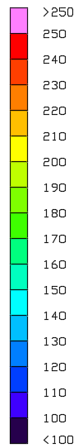
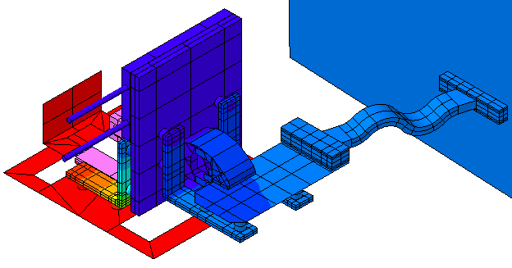
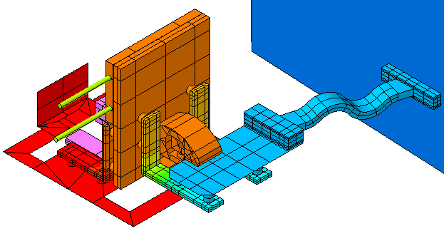
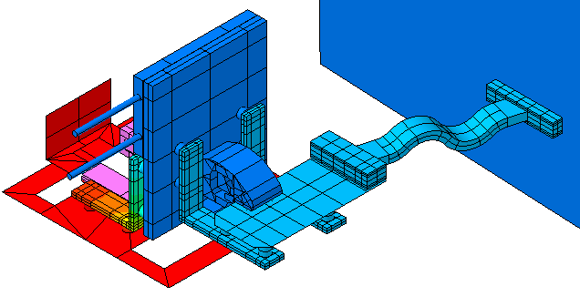
Temperature Profile (1/2)
K
Engaged
Disengaged
WFI
130 K
130 K
Cold Plate
100 K
~220 K
Clamping Plate
~120 K
~235 K
~130 K
~235 K
Disengaged Zero-Q
130 K
130 K
~235 K
~130 K
K
TFAWS 2023 – August 21-25, 2023

Slide 8
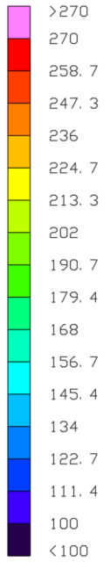
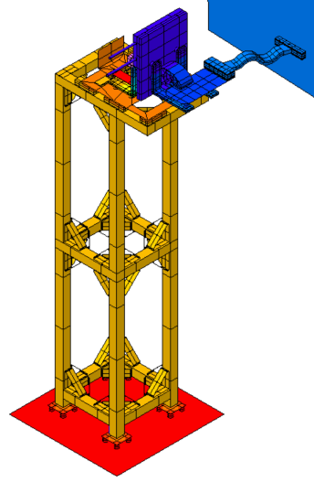
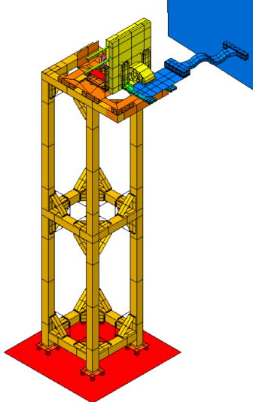
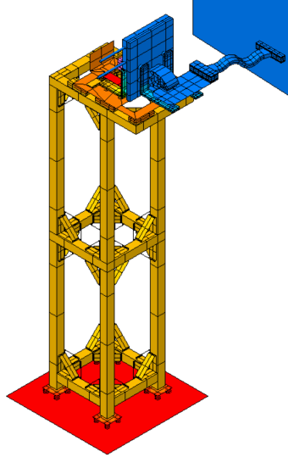
Temperature Profile (2/2)
K
Cold Plate
100 K
WFI
130 K
~220 K
130 K
130 K
130 K
Stand
~230 K
~230 K
~230 K
TIF
270 K
270 K
270 K
Engaged
Disengaged
Disengaged Zero-Q
K
TFAWS 2023 – August 21-25, 2023

Slide 9
Thermal Hardware (per TARDIS)
Temperature Sensors
  5 PRTs
    Read by Lakeshore 336
  18 Thermocouples (only in GSFC TVAC)
    Read by B4 LabVIEW
Heaters
  Cold Plate Heater
    50 W cartridge heater
    PID controlled by Lakeshore 336 from a PRT
  Motor Survival Heater
    10 W Vishay Dale-Ohm heater (two 15 Ω in series)
    PID controlled by Lakeshore 336 from a PRT
  Test Heater on Clamping Plate (only in GSFC TVAC)
    10 W Vishay Dale-Ohm heater (one 5 Ω)
    Controlled by B4 LabVIEW
Cold Plate
  3/8” OD VCR fitted Lytron Cold Plate
  40’ and 60’ flex hoses
  Solenoids controlled from Lakeshores (controlled from B4 LabVIEW during GSFC TVAC)
Control
  Lakeshore 336 (3 total for both TARDIS units)
  Computer & controllers for motors
TFAWS 2023 – August 21-25, 2023

Slide 10
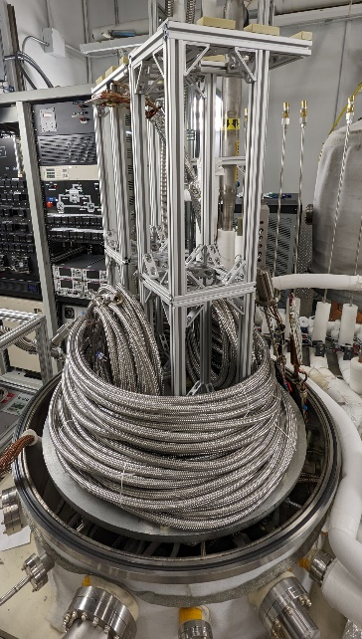
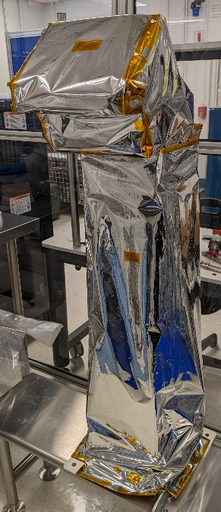
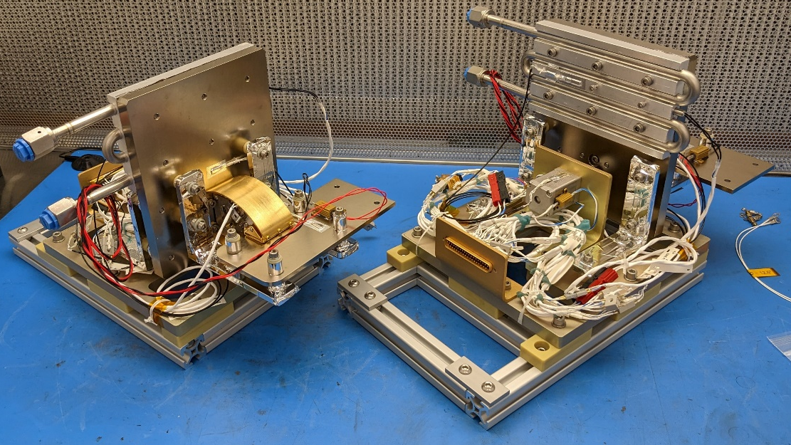
I&T
TARDIS units during I&T on a flow bench
TARDIS and LN2 flex line bakeout
TARDIS with MLI

Slide 11
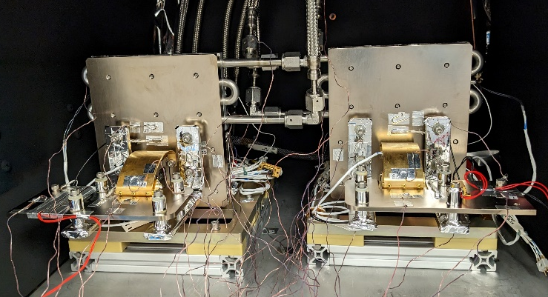
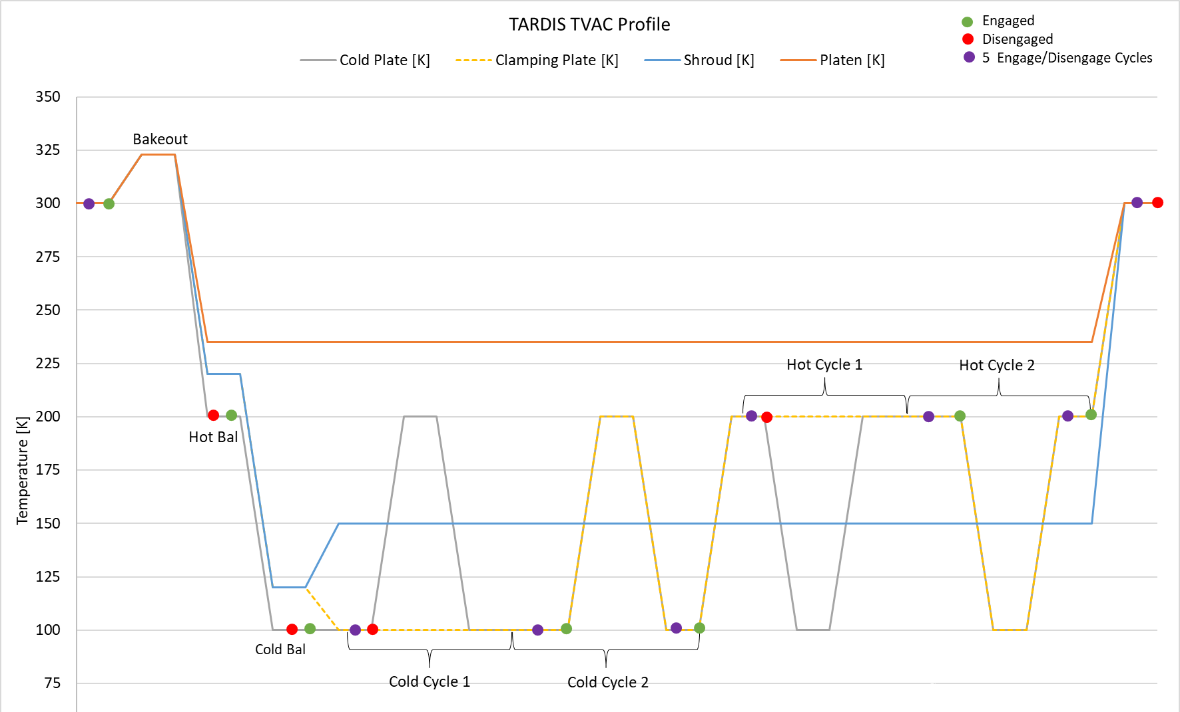
GSFC TVAC
Overview
  Purpose was to checkout TARDIS at GSFC before shipping to Ball
  Bakeouts
    Stand & flex hoses: 4/4– 4/17
    Harnessing: 4/6 – 4/13
    TARDIS: 4/24 – 5/1
  GSFC TVAC
    5/1 – 5/9 in B4 MDC chamber
Setup
  Both TARDIS units tested together
  Stand & PG straps not included
  Dale-Ohm test heater used to simulate heat through strap
Profile
  Hot Balance (engaged & disengaged), Cold Balance (engaged & disengaged), Cold Cycles x2, Hot Cycles x2, Bakeout
  Clamp to undergo at least 30 engage/disengage cycles across operational temperature range
GSFC TVAC Setup
GSFC TVAC Test Profile

Slide 12
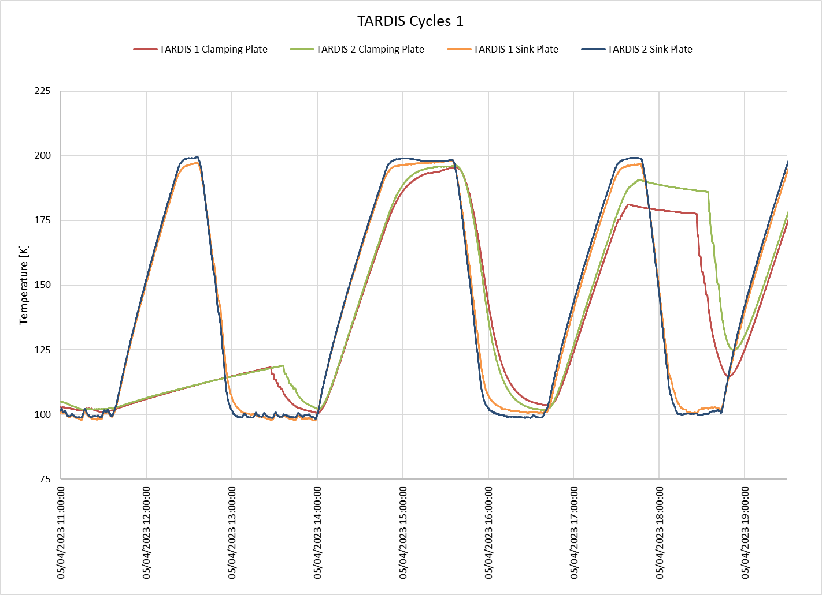
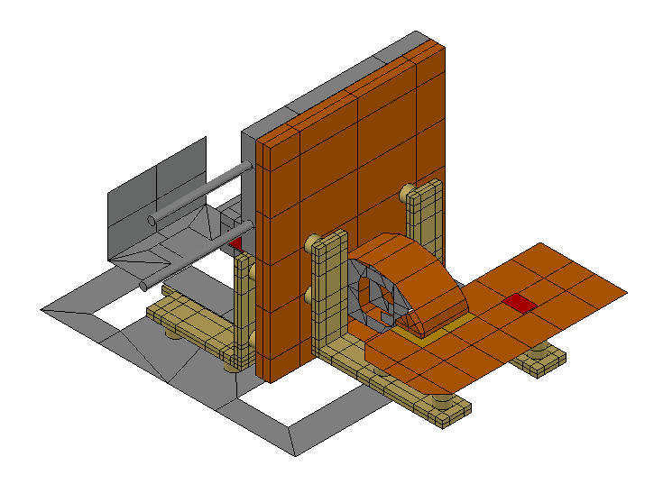
GSFC TVAC – Cycles
Disengaged
  No response on the clamping plate even with ~80K ΔT
  Thermally decoupled
Engaged
  Clamping plate tracks with the sink plate when engaged
  Thermally coupled
Clamp Engaged
Clamp Disengaged
Clamp Disengaged
Clamp Engaged

Slide 13
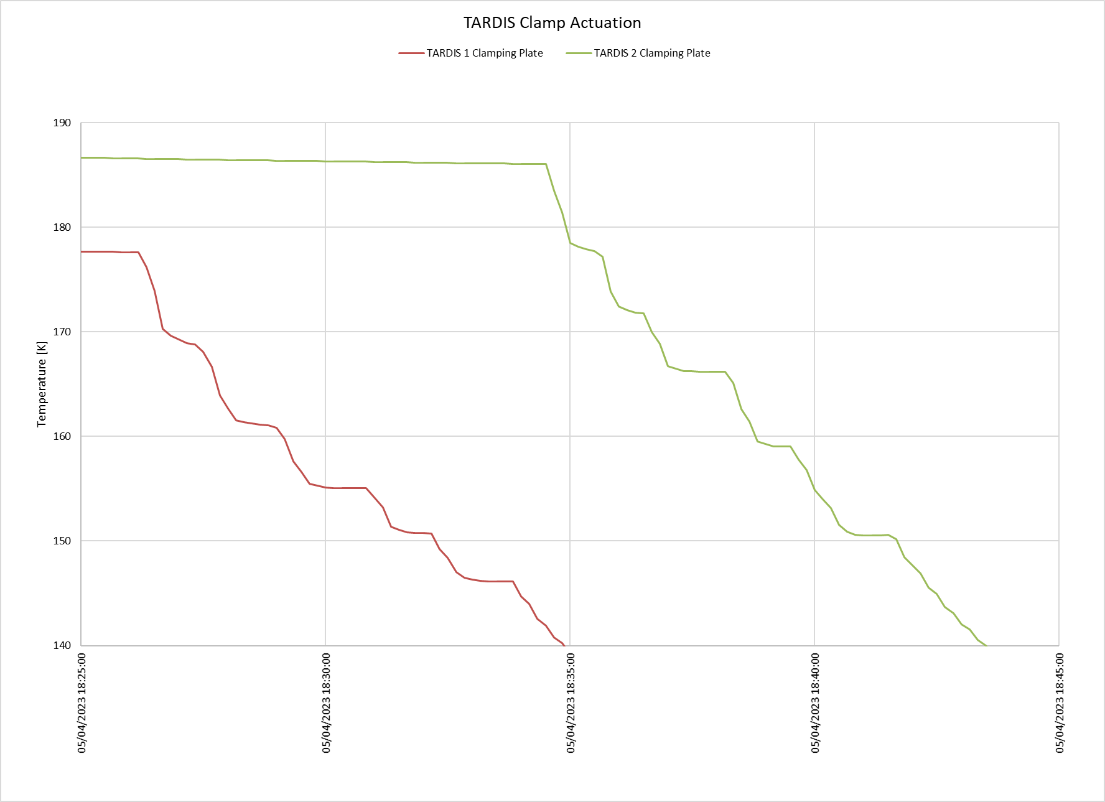
Clamp Actuations at Vacuum
Clamp Actuations
  Sink plate is cooler than clamping plate
  Clamping plate quickly cools when clamp is engaged, temperature stabilizes when disengaged
190K
Clamp Disengaged
Clamp Engaged
Clamp Disengaged
180K
Clamp Engaged
Clamp Disengaged
170K
Clamp Disengaged
Clamp Engaged
160K
Clamp Engaged
Clamp Disengaged
Clamp Engaged
Clamp Disengaged
150K
Clamp Engaged
140K

Slide 14
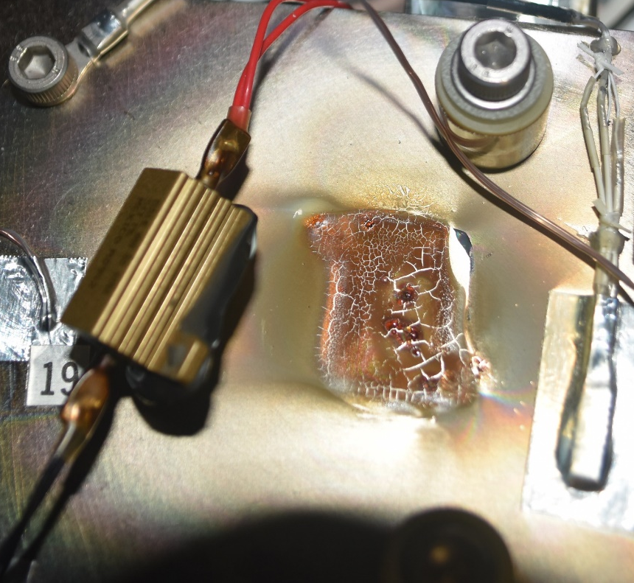
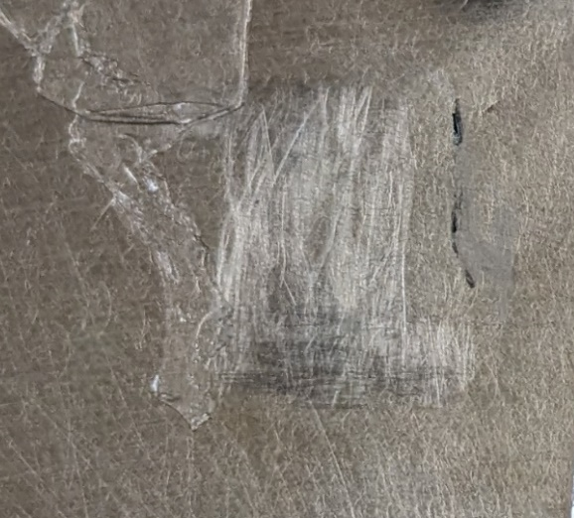
GSFC TVAC Challenges/Issues
Dale RH-10 10W 5Ω test heater de-bonded from the clamping plate on TARDIS 2
  Bonded onto the surface with Stycast but did not have mechanical attachment with bolts
  Broke vacuum and replaced with a Kapton film heater. Does not impact Ball TVAC.
TARDIS 1 clamp intermittently stuck engaged
  TARDIS 1 clamp stayed engaged after commanding it to disengage, twice. Only stuck closed on the first open command. Both times the clamp was able to be disengaged after waiting a few minutes.
  Issue is likely that the clamp & motor shafts are misaligned causing a spot in the motor shaft rotation requiring a higher torque to overcome. To mitigate the risk the clamping torque was reduced to 80% of the motor’s total torque so that we can disengage at 100% torque to unstick the clamp if needed. Benchtop testing confirmed this approach.
  Failure of one (or both) TARDIS units during WFI TVAC will not impact baseline test plan

Slide 15
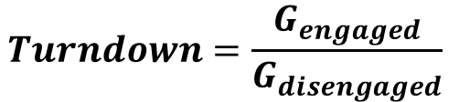
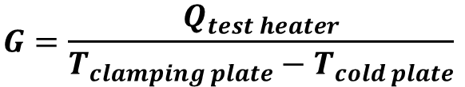
TARDIS Performance
TARDIS 1 and TARDIS 2 Average Calculated Conductance
  Engaged: 0.3068 W/K
  Disengaged: 0.0026 W/K
  Turndown Ratio: 117:1
Performance is as expected, and TARDIS should operate as planned during WFI TVAC Campaign
 |  | Disengaged |  | Engaged
 |  | Cold | Hot | Cold | Hot
TARDIS 1 | Test Heater [W] | 0.10 | 0.10 | 5.00 | 5.00
 | Clamping Plate [K] | 174.20 | 225.07 | 126.17 | 212.30
 | Cold Plate [K] | 108.39 | 199.35 | 107.70 | 197.85
 | Conductance [W/K] | 0.0015 | 0.0039 | 0.2707 | 0.3459
 | Average Conductance [W/K] | 0.0027 |  | 0.3083
 | Turndown Ratio | 114 : 1
TARDIS 2 | Test Heater [W] | 0.10 | 0.10 | 5.00 | 5.00
 | Clamping Plate [K] | 176.68 | 227.27 | 125.12 | 212.39
 | Cold Plate [K] | 108.14 | 199.24 | 107.59 | 197.01
 | Conductance [W/K] | 0.0015 | 0.0036 | 0.2853 | 0.3251
 | Average Conductance [W/K] | 0.0025 |  | 0.3052
 | Turndown Ratio | 121 : 1
$$G=\frac{Q_{test heater}}{T_{clamping plate}−T_{cold plate}}$$
$$Turndown=\frac{G_{engaged}}{G_{disengaged}}$$

Slide 16
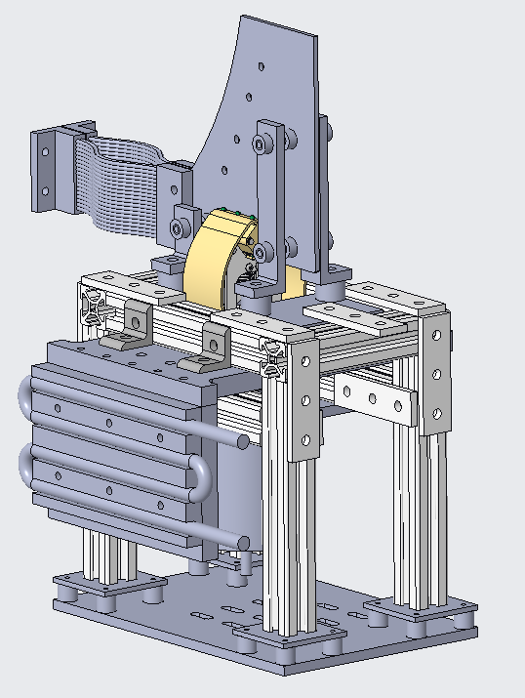
TARDIS vs L’Ralph AZQ Heat Switch
 | TARDIS | L’Ralph AZQ [2]
Approximate Height | 1.2m | 0.4m
QTY in TVAC | 2 | 1
Motor Survival Temp | 253 K | 77 K
TVAC Interface Temperature | > Payload | < Payload
Heat Strap | Pyrolytic Graphite x1 | Braided Copper x2
Clamping Plate Orientation | Horizontal | Vertical
Engaged Conductance | 0.3068 W/K | 0.416 W/K
Disengaged Conductance | 0.0027 W/K | 0.0008 W/K
Turndown Ratio | 117 | 520
TARDIS
L’Ralph AZQ

Slide 17
Conclusion
Summary
  TARDIS is a GSE heat switch designed to speed up transition times for the RST WFI TVAC test campaign
  Design is based off the L’Ralph AZQ Heat Switch
  TARDIS is estimated to save at least 2 days of test time during the WFI TVAC test campaign
  TARDIS can be used for future missions needing faster TVAC transitions
Predicted Savings
  Based on analysis, TARDIS predicted to save at least 2 days of test time in TVAC-1 and TVAC-2 during WFI transitions
Additional Savings
  TARDIS will be useful with nudging the system along to thermal balance

Slide 18
Acknowledgements
TARDIS
  Bryan Matonak
  Ben Abresch
  Allen Lunsford
  Mark Klappenberger
WFI
  John Leanza
  Hume Peabody
Lucy L’Ralph AZQ
  Juan Rodriguez-Ruiz
  Daniel Bae
B4 TVAC
  Frank Robinson
  Colton Cohill
  Elliot Schwartz
  Mike Chapman
Moral Support
  Eric Yee

Slide 19
References
NASA, "Nancy Grace Roman Space Telescope Mission Overview," [Online]. Available: https://roman.gsfc.nasa.gov/about.html.
D. G. Bae and J. E. Rodriguez-Ruiz, "Use of Mechanical Heat Switch to Speed up TVAC Transitions on Flight Hardware Below 200K," in 50th International Conference on Environmental Systems, 2021.
D. G. Gilmore, Spacecraft Thermal Control Handbook Volume 1: Fundamental Technologies, 2 ed., El Segundo, CA: The Aerospace Press, 2002.

Slide 20
Acronyms
AZQ | Active Zero-Q
CSM | Cold Sensing Module
GN2 | Gaseous Nitrogen
GSFC | Goddard Space Flight Center
ICES | International Conference on Environmental Systems
JSC | Johnson Space Center
LN2 | Liquid Nitrogen
PG | Paralytic Graphite
PRT | Platinum Resistance Thermometer
RST | Roman Space Telescope
TARDIS | Thermal Acceleration Rate Device for Integrated Systems
TC | Thermocouple
TFAWS | Thermal & Fluids Analysis Workshop
TVAC | Thermal-Vacuum
WFI | Wide Field Instrument

Slide 21

Backup

Slide 22
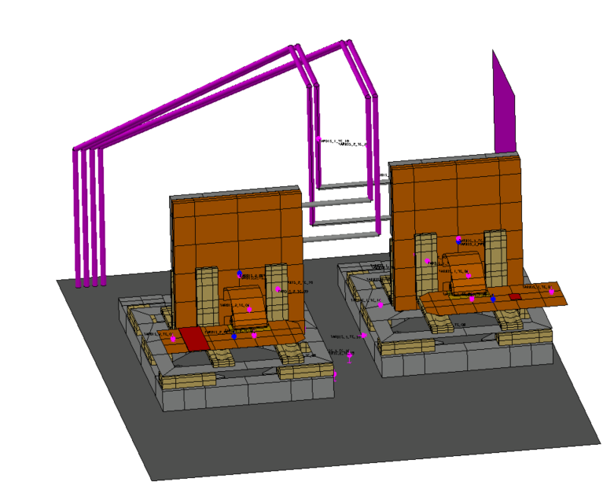
Thermal Model Correlation

Slide 23
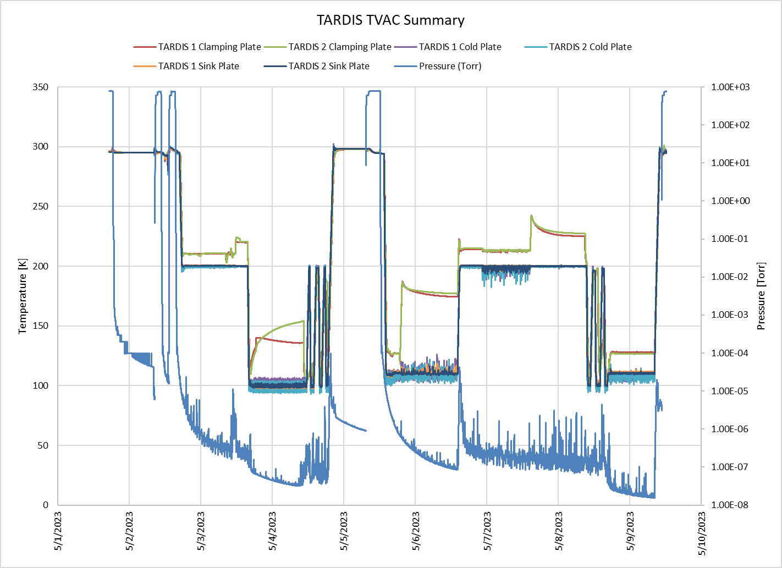
GSFC TVAC – Actual Profile
Initial pump down
Return to ambient to fix leak #1
Return to ambient to fix leak #2
Hot Bal Engaged, Attempt 1
Hot Bal Disengaged, Attempt 1
Cold Bal Disengaged, Attempt 1
Cycles
Return to ambient to replace de-bonded test heater
Cold Bal Engaged, Attempt 1
Cold Bal Disengaged, Attempt 2
Hot Bal Engaged, Attempt 2
Hot Bal Disengaged, Attempt 2
Cycles
Cold Bal Engaged, Attempt 3
Return to ambient & end of test
1
2
3
8
15
5
12
4
11
7
13
10
9
14
6

Slide 24
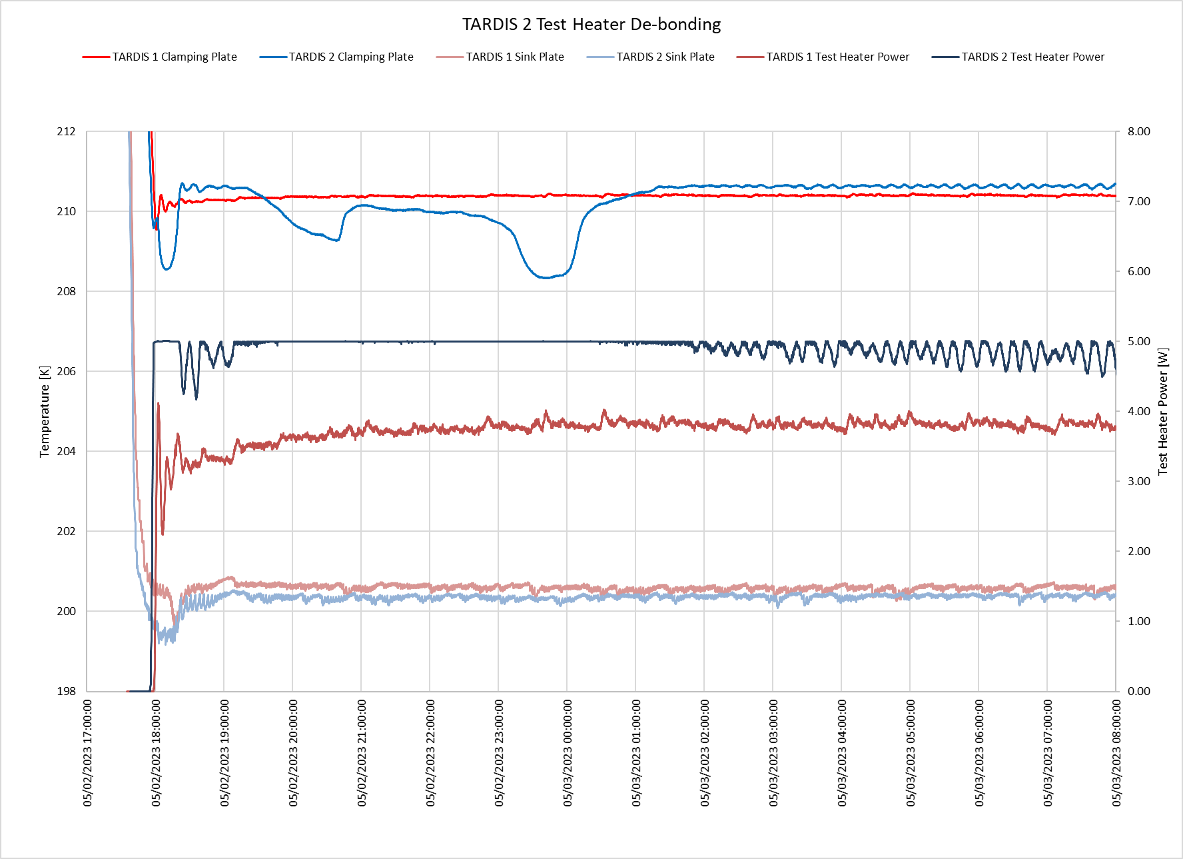
TARDIS 2 Test Heater De-bonding
Test heaters set to PID control, 210K setpoint at clamping plates
Everything appeared to be reaching steady state when we left for the night at 19:00
Overnight, clamping plate #2 cooled to ~208K even with test heater saturated at 5W
Test heater #2 regained control around 1:00
Clamping Plate #1
Clamping Plate #2
Test Heater #2 Saturated at 5W
Test Heater #1 stable at ~4W
Sink Plates

Slide 25
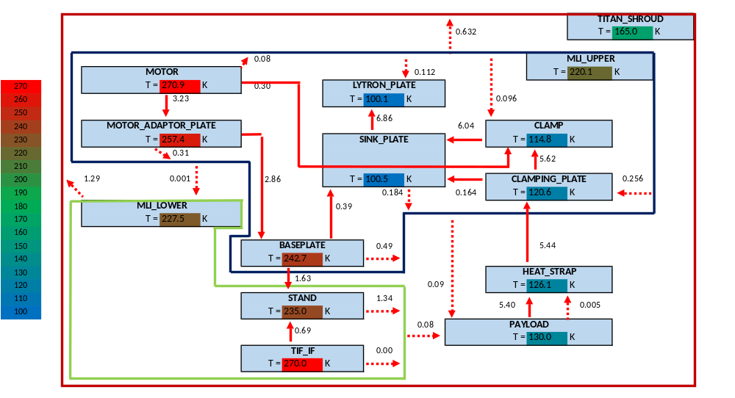
Heat Map: Engaged
Radiation
Conduction

Slide 26
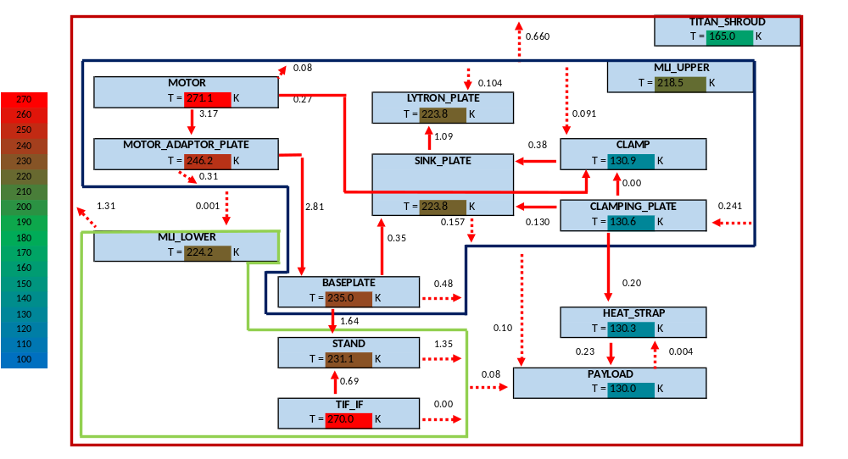
Heat Map: Disengaged
Radiation
Conduction

Slide 27

Heat Map: Disengaged Zero-Q
Radiation
Conduction

