Slide 1
Atmospheric Composition Variable Standard Name Convention (ACVSNC)
Morgan Silverman, Gao Chen, Michael Shook, Megan Buzanowicz, Rebecca Hornbrook, Luke Ziemba, John Nowak

Slide 2
Why do we need it?
The Earth Science Data System (ESDS) ICARTT Refresh Working Group identified the need for ACVSN as a solution to the problem of growing numbers of variables repletely measured in suborbital field campaigns with limited naming guidelines
The ACVSN is a structure with lists of controlled vocabulary used to create standard names used as a tag within the ICARTT V2.0 file format standard to enable data variable search across different field campaigns
The ACVSN provides variable description and enables FAIR principles for discoverability and reusability, especially when handling overlapping variables across different missions
ACVSN was endorsed by an interagency working group MACIE (Measurements of Aerosols, Clouds and their Interactions for ESMs) as one of the steps to enhance data usability and interoperability
ACVSN has been used in FIREX-AQ, CAMP²EX, ACTIVATE, DCOTSS, and ACCLIP, and is being actively used in the NOAA AEROMMA field study by interagency, university, and international partners

Slide 3
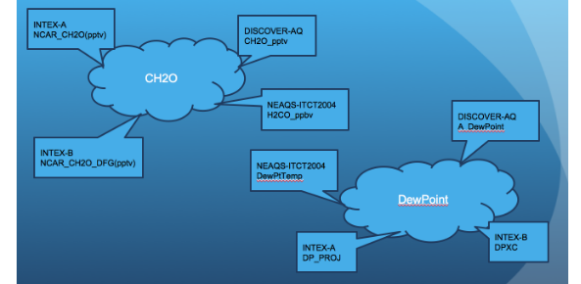
Problem with Atmospheric Composition Variable Naming

Slide 4
Atmospheric Composition Variable Standard Names
ESDS-RFC-043: Atmospheric Composition Variable Standard Name Convention https://www-air.larc.nasa.gov/missions/etc/AtmosphericCompositionVariableStandardNames.pdf
Synergistically developed by instrument scientists, modelers, and data scientists to enhance discoverability, interoperability, and usability
Successful implementation in NASA atmospheric composition field campaigns
Controlled literature-friendly vocabulary with description
Predictable structure
Actively maintained, supported, and updated
Checker under development
Decomposition based on physical /chemical properties and measurement characteristics, similar to ACTRIS
Approach generally consistent with I-ADOPT
Translatable to other variable naming schema, ACTRIS, UMM-Var

Slide 5
Examples
General Structure: MeasurementCategory_CoreName_AcquisitionMethod_DescriptiveAttributes
Trace Gas
Gas_CO2_InSitu_S_DMF: an in-situ measurement of CO2 gas reported in molar fraction with respect to dry air
Gas_NO2_SlantColumn_S_CNDAMB: a remote sensing measurement of slant column NO2 gas reported column number density with respect to ambient air
Aerosol
AerMP_NumSizeDist_InSitu_RHd_Aerodynamic_Coarse_STP: an in-situ measurement of aerosol particle number size distribution reported at reduced relative humidity derived from an aerodynamic sizing technique for coarse-mode aerosols at standard temperature and pressure
AerOpt_Absorption_InSitu_red_RHd_Bulk_AMB: an in-situ measurement of absorption measured at a red wavelength under reduced humidity conditions with a bulk aerosol particle size range reported in ambient conditions

Slide 6
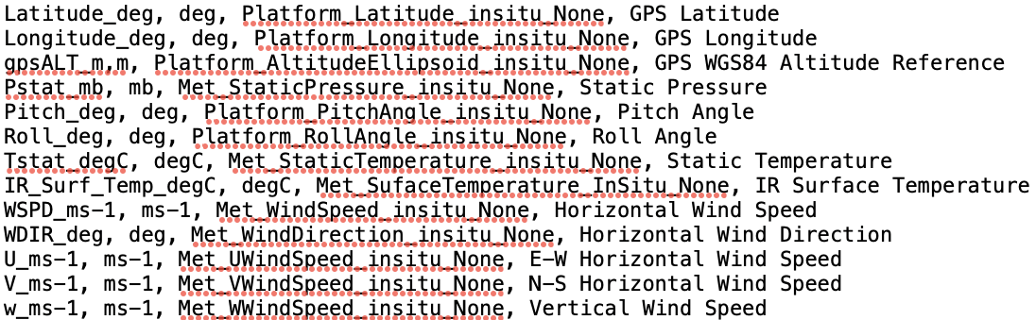
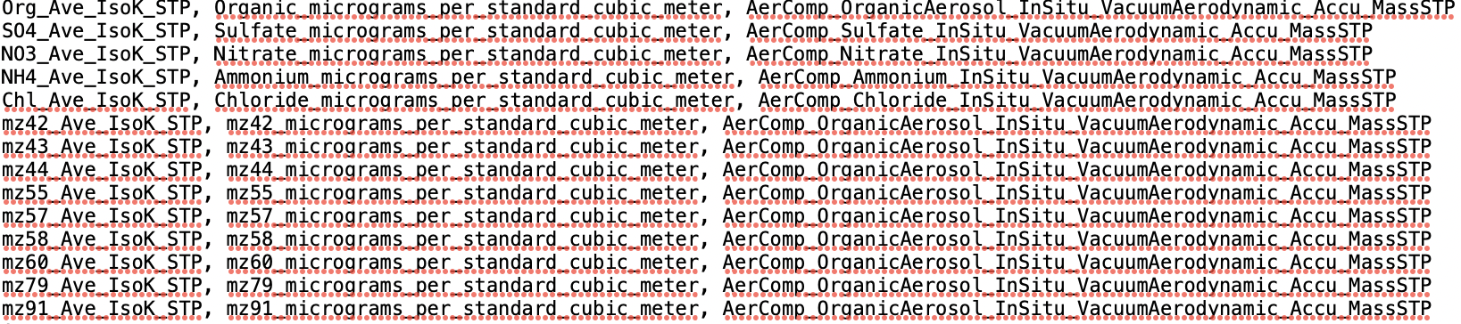
Use of standard names

Slide 7
Shortcomings Identified in the Review Process and Challenges
Atmospheric composition and chemistry focused may not be as user friendly outside of subject area
Governance of controlled vocabulary document is not a formal process
Living document provides flexibility for updates without a formal review process and important for PIs to have input
Ad hoc variable name specification, i.e., different structure across categories
ACVSN designed for discovery and usability, which needs to be accurate and to be tailored to specific measurement
Category dependent construction of CoreNames, i.e., some have object + quantity and others do not
Structure and approach could be applied to other fields of study
Nature of the measurements, ACTRIS has similar issue they’re currently addressing

Slide 8
Applying I-ADOPT to ACVSNC and ACTRIS:
Aerosol Particulate Chloride Mass Concentration
ACVSNC: AerComp_Chloride_Insitu_None_Bulk_MassSTP
ACTRIS: aerosol particle chloride mass concentration
Particulate chloride is one component of the aerosol particle chemical composition
 | Entity ObjectOfInterest | Entity Matrix | Entity ContextObject | Property | Constraint
ACVSNC | Particulate Chloride | AerComp (aerosol particle chemical composition) |  | mass concentration | Insitu, Bulk, STP
ACTRIS | chloride | Aerosol particle phase |  | mass concentration

Slide 9
Applying I-ADOPT to ACVSNC and ACTRIS:
Aerosol Particle Number Concentration
ACVSNC: AerMP_NumConc_Insitu_RHd_Kelvin_NucltoCoarse_STP
ACTRIS: aerosol particle number concentration
Both use conceptual context for matrix; while ACTRIS Matrix broader. Both have repeated information. A significant number of ACTRIS variables do not have ObjectOfInterest and/or Property – a minimum I-ADOPT requirement.
 | Entity ObjectOfInterest | Entity Matrix | Entity ContextObject | Property | Constraint
ACVSNC | AerMP (aerosol particle microphysical properties) or NumConc | Aerosol particle or AerMP (aerosol particle microphysical properties) |  | NumConc | Insitu, RHd, Kelvin, NucltoCoarse, STP
ACTRIS | Particle phase | Aerosol particle phase |  | Number Concentration

Slide 10
Future Direction
Further enable FAIR principles
  Enhance compatibility with existing ontologies including translations to other ontology frameworks, UMM-Var, ACTRIS
  Formalize governance and maintenance for outside organization usage
  URI?
Standard name checker under development
Engage with ESDIS staff, instrument expert, modelers, user outside of the field to address review concerns

