Slide 1
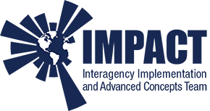

Creating a new Data Governance Framework for Science
Rahul Ramachandran, Kaylin Bugbee, NASA/MSFC
Ge Peng, Shelby Bagwell, Abdelhak Marouane, University of Alabama in Huntsville
Sumant Jha, USRA
Jerika Christman, Barrios Tech, United States
rahul.ramachandran@nasa.gov
www.linkedin.com/in/rramachandran05/

Slide 2
What is a Data Governance Framework?
A Data Governance Framework serves as a template or starting point for enterprises/organizations to define and enforce policies that govern the management of data throughout its lifecycle.
Requirements and implementation procedures captured in this document drive the Open Science Management Plan for Data (i.e., OSDMP) and/or Software (i.e., SMP).

Slide 3
Current Challenges with Scientific Data Governance
Dynamic U.S. Federal mandates and compliance regulations, such as the OSTP 2022 memo, which requires free and Immediate public access to federally funded research; the OPEN Government Data Act (P.L. 115-435, 2019, Title II), which requires data to be in machine-readable format with open licenses; the Geospatial Data Act (P. L. 115-254, 2018, Title F), which mandates the accessibility of geospatial data; the OMB (2013) Open Data Policy; and the Federal Data Strategy 2021 Action Plan focused on mature data governance and data and infrastructure maturity.
Evolving organizational policies and strategies like NASA's Scientific Information Policy (also known as SPD-41a), which emphasizes the free and open availability of scientific information in compliance with FAIR principles.
The abundance of best practices and standards to choose from, Including metadata standards (STAC, UMM-C), controlled vocabularies (GCMD) and guidance such as FAIR, making it challenging to curate all the necessary information.
Data Governance quality drift, also known as "Normalization of deviation," occurs over time due to the absence of systematic Data Management processes.

Slide 4
Vision for a Modern Data Governance Framework (mDGF)
A unified and adaptable science data governance framework that can be customized by each project. This framework:
  Aligns with government mandates and organizational policies, and can be monitored through automation.
  Maps policies to actual requirements, as well as recommended data management procedures/tasks needed to fulfill those requirements.
The framework is "modern" because it:
  Facilitates automation of data management tasks and monitoring of the governance process, whenever possible.
  Is designed for cloud-based data management.
  Ensures that governance processes meet policy requirements, while enabling rather than hindering the scientific process.

Slide 5
Governance Components (1)
Understanding the core entities (or assets) you are managing
Data - any scientific measurement both observation and simulation; includes Earth observation data, scientific images, model outputs
Metadata - structured information about the data, and which can cover structure, discovery and semantics as aspect of the data
Digital content - Information/Digital Documents that pertain to data or the scientific process. This includes documentation, algorithms, technical reports, and any ancillary information or work product related to the data.
Code - a set of instructions used to execute computation i.e. (python programs, notebooks, libraries, run scripts)
Software -TDB (more tools, containers, software service)
Architecture is deemed to be out of scope and should be part of project management plan

Slide 6
Governance Components (2)
Understanding the Resources you have
Resources are your constraints. These constraints are important to consider as they impact governance of the assets and as such have to be managed.
Storage - where data, code, metadata and information are stored i.e Object Store (S3) and Harddrive
People
  Data stewards - responsible for curating metadata, gathering and organizing information, adhering to open science principles, executing against the DMP and Data Governance Plan
  Data engineers - responsible for intaking, checking, reprocessing data, implementing services to make data, metadata, information accessible
Compute - to be added later

Slide 7
Governance Components (2)
Understanding the Resources you have
Resources are your constraints. These constraints are important to consider as they impact governance of the assets and as such have to be managed.
Storage - where data, code, metadata and information are stored i.e Object Store (S3) and Harddrive
People
  Data stewards - responsible for curating metadata, gathering and organizing information, adhering to open science principles, executing against the DMP and Data Governance Plan
  Data engineers - responsible for intaking, checking, reprocessing data, implementing services to make data, metadata, information accessible
Compute - to be added later

Slide 8
Activities that you will have to perform (1)
Foundational : These activities are needed by all projects and impact or inform the data lifecycle
Planning and Design - plan & design what needs to be done for your project at each lifecycle phase
  Determine appropriate lifecycle phases
  Align with requirements and policies
  Must consider external constraints such as architecture and other resources (people, costs, storage)
Monitoring - periodic assessment of the entities being managed as well as the entire governance process
  Metrics
  Quality
  Security (access controls)
  Resources

Slide 9
Activities that you will have to perform (2)
Data LifeCycle : These activities are implemented at different phases of the data lifecycle
Generation/Curation - activities associated with collecting, creating, producing, acquiring, and curating core entities. Activities include: Collection, Creation, Production, Acquisition, Curation, Ingestion, Storage
Sharing - activities associated with making the core entities discoverable and accessible. Activities include:
  Publication of entities to an open, searchable catalog or a repository
  Dissemination/communication of information to stakeholders
  Ensuring access to the core entities
Use/Reuse - activities associated with making core entities usable (reusable) to stakeholders. Activities for interacting with the core entities include:
  Exploration - data, metadata, information, code
  Execution - code
  Analysis - data, metadata
  Visualization - data
Preservation - activities associated with long term care of the core entities. Activities include: Archiving, Maintenance, Disposal

Slide 10
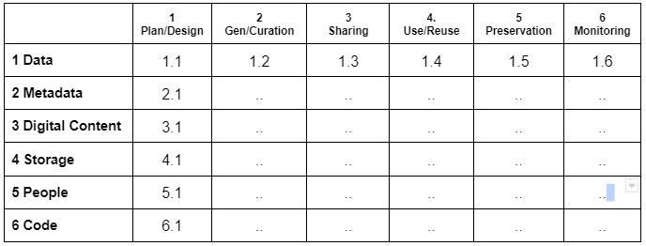
mDGF Structure
The mDGF structure and the numbering system
Each section say 1.1 has three components:
Requirement
Implementation Procedures
Automation (Task or Checks)

Slide 11
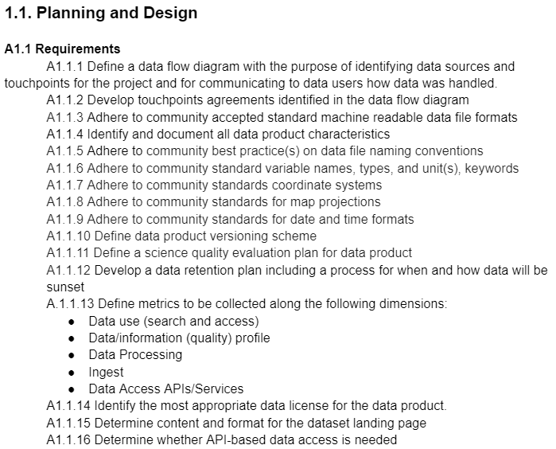
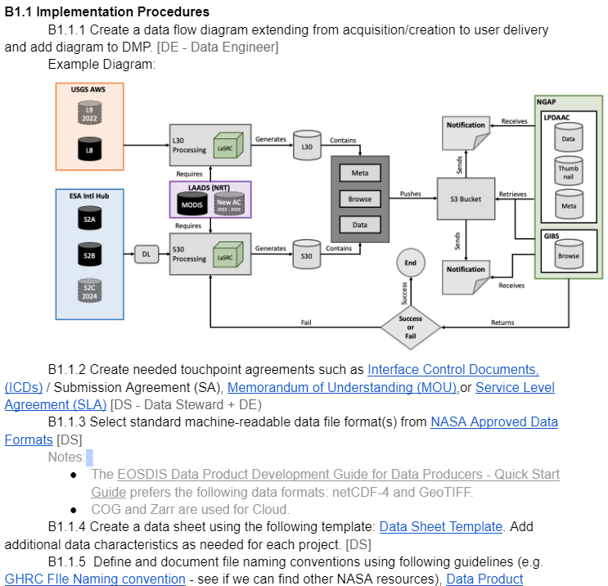
Example: For Data

Slide 12
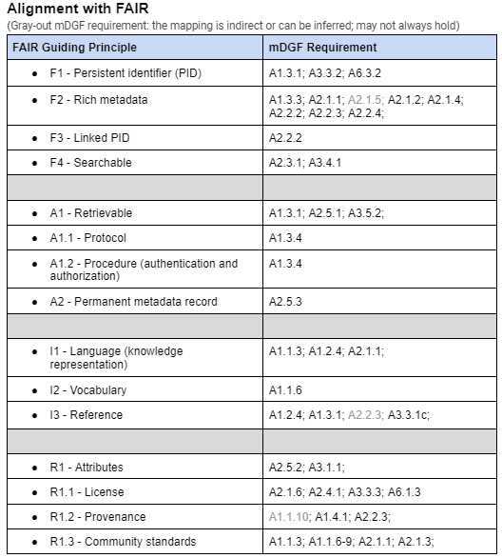
How would one use the mDGF?
Framework will be in an open GitHub to allow others to contribute and improve
Understand the structure and the numbering system for each section
Framework consists of three parts, all mapped to each other
  Requirements
  Procedures (Data Management Tasks)
  Automation recommendations
    Automation of the data management task
    Monitoring of the governance process
Use Github Cookie Cutter to tailor it for your individual project
  Select the entities (and constraints) applicable to your project
  Select the data life cycle phases that apply to your project.
  Performance a quick compliance check against the different policies (SPD-41a, FAIR) etc.
  Export the subset as:
    Document which will serve as your DMP
    Into your project repo as cards

Slide 13
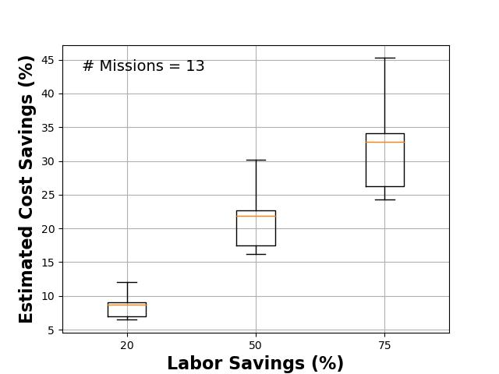
Next Steps
Release the mDGF via GitHub (End of August)
Develop automation and monitoring software (End of December)
  Using heuristics:
    Ex: PyQuARC - https://github.com/NASA-IMPACT/pyQuARC
  Using AI LLM
Box and whisker plot showing estimated savings by using NLP in data ingestion and archiving. Yellow line is mean, boxes are the 1st and 3rd quartiles, and whiskers show the range.
Mean cost savings range from 8%, 22% to 34%

Slide 14
Thank you.
rahul.ramachandran@nasa.gov

