Slide 1

NASA Cryogenic Fluid Management Flight Demonstration Summary: SpaceX 2020 Tipping Point
Sean M. Kenny
NASA Marshall Space Flight Center
CFM Project Sub-Systems Portfolio Lead
July 2023
https://www.nasa.gov
Notes:
NASA Science and Technology Mission Directorate is investing in advancement of on-orbit cryogenic fluid management technologies by partnering with industry through Tipping Point contracts with the primary objective of reducing development costs and schedules for infusion into long duration missions utilizing cryogenic propellant. SpaceX was selected as a partner in 2020 to conduct a demonstration of CFM technologies on a Starship Mission. This presentation provides a summary of the top-level goals and objectives of this contract and how NASA has structured this partnership.

Slide 2
NASA selected 14 companies, including several small businesses, as partners to develop a range of technologies that will help forge a path to sustainable Artemis operations on the Moon by the end of the decade.
U.S. industry submitted the proposals to NASA’s fifth competitive Tipping Point solicitation, and the selections have an expected combined award value of more than $370 million. NASA’s Space Technology Mission Directorate will negotiate with the companies to issue milestone-based firm fixed-price contracts lasting for up to five years.
“NASA's significant investment in innovative technology demonstrations, led by small and large U.S. businesses across nine states, will expand what is possible in space and on the lunar surface,” said NASA Administrator Jim Bridenstine. “Together, NASA and industry are building up an array of mission-ready capabilities to support a sustainable presence on the Moon and future human missions to Mars.”
John Reed is United Launch Alliance’s Chief Rocket Scientist. In this role he manages the Technical Fellows program at ULA and is focused on a wide variety of initiatives from launch vehicle reuse to upper stage enhancements and trajectory planning, from defining our next generation capabilities to creating a culture of innovation and protecting Intellectual Property. He is a strong advocate for partnering with DARPA, NASA and Academia to advance technologies for use and infusion by industry to enhance the services provided. John is a long-time member of the AAS and an Associate Fellow of AIAA, actively engaged on a couple AIAA task force teams, the ASCEND event and AAS GN&C Conference.

Slide 3

Cryogenic Fluid Management Portfolio Project Overview
Primary goal of the Cryogenic Fluid Management Portfolio Project (CFMPP) is to close technology gaps essential to NASA’s future missions in science and exploration
  CFM technologies are essential for chemical and nuclear in-space propulsion, landers, and in-situ resource utilization
The CFMPP is a Technology Demonstration Mission (TDM) portfolio project within NASA’s Space Technology Mission Directorate (STMD) comprised of twenty-four individual CFM technology development activities
  Co-managed between Marshall Space Flight Center and Glenn Research Center
TRL Objectives
  Technology end-state to be at least TRL6 with goal of TRL 7
  Minimum TRL 4 for inclusion as an activity within the CFMP Project
Primary goal of the CFMPP is to close technology gaps leading to a system-level Integrated CFM Flight Demonstration due to gravity dependent-nature of cryogenic fluid behavior
  There is a need to mature CFM technologies and integrated system operations, leading to a system-level integrated Large CFM Flight Demonstration (LCD)
Project portfolio activities include non-flight demo related activities (ex. ISRU liquefaction)
CFM technical goals and objectives are defined in Key Performance Parameters (KPPs) for based on SOA capabilities, captured in project plan.
Notes:
This chart was previously approved for AIAA SciTech by Jason Adam

Slide 4
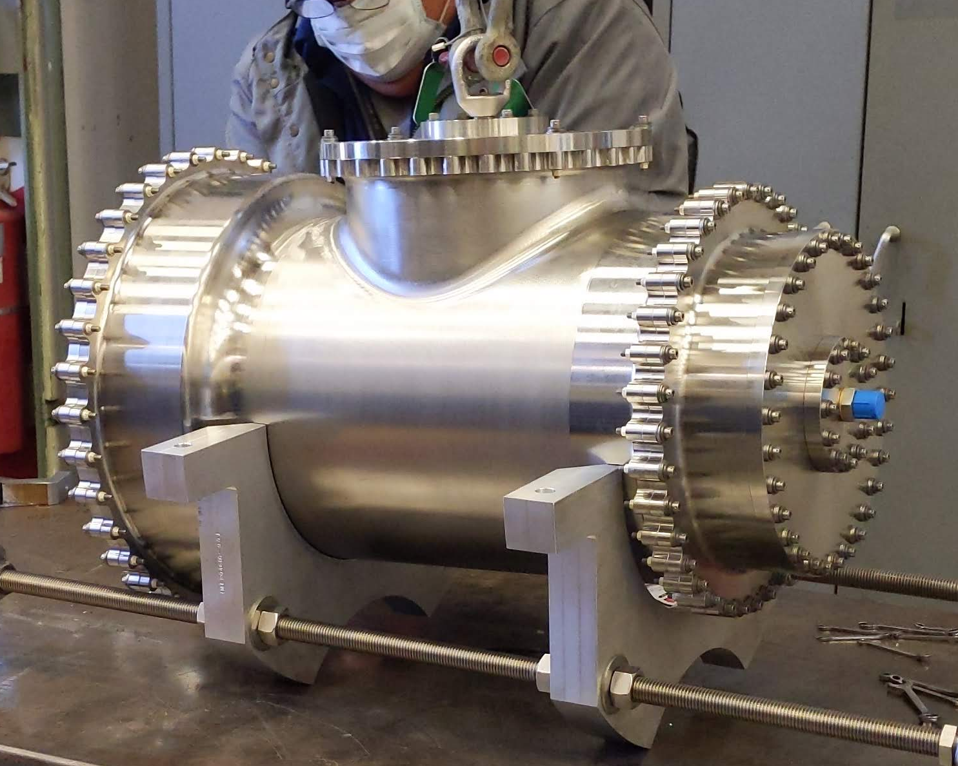
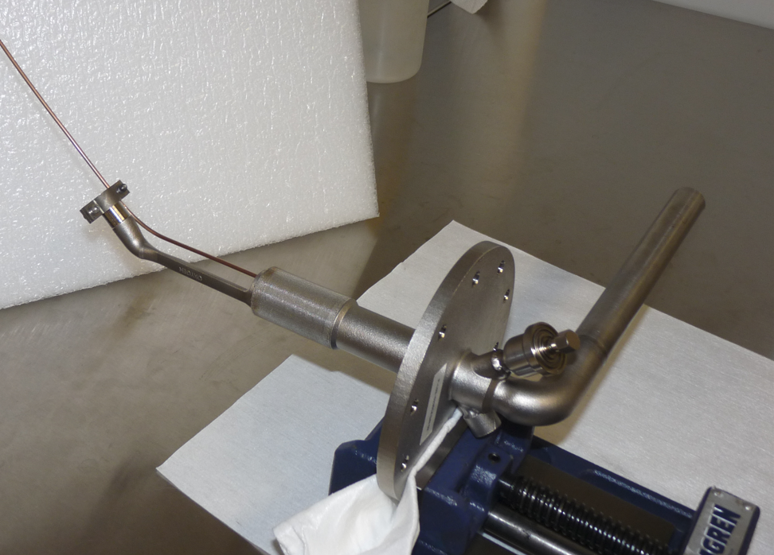
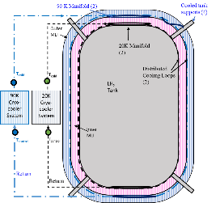
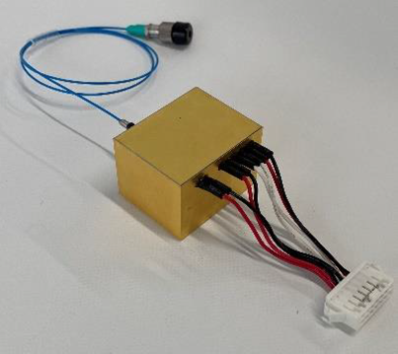
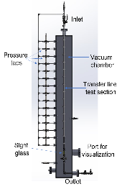
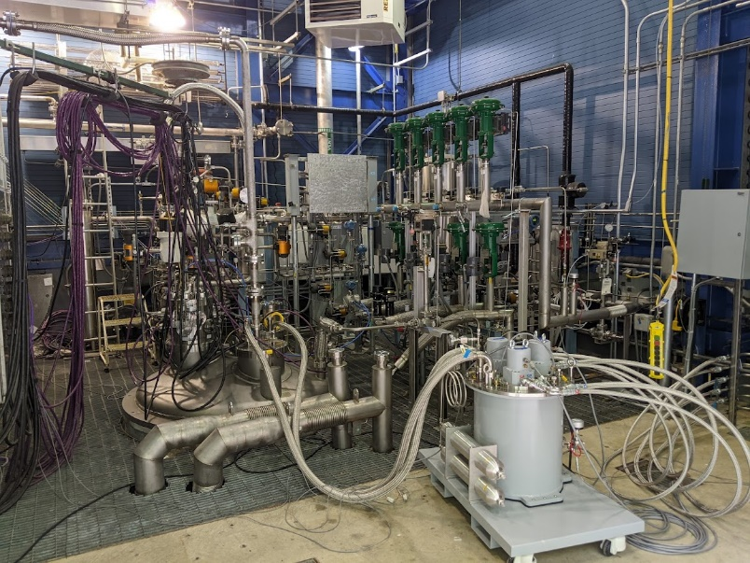
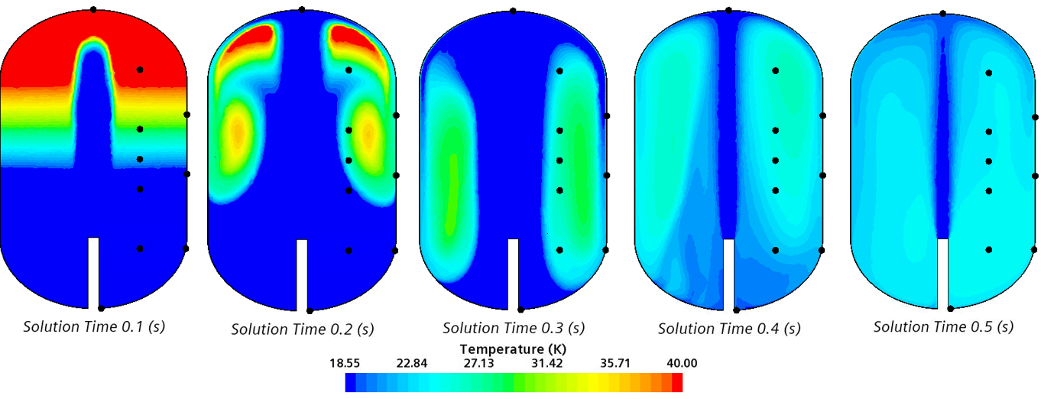
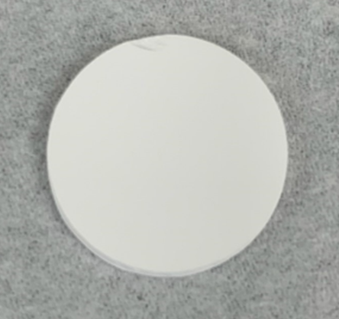
Cryogenic Fluid Management (CFM) Portfolio Project Office
Objective: Mature CFM technologies essential to NASA’s future missions in science and exploration which utilize both chemical and nuclear
in-space propulsion, landers, and in-situ resource utilization
CFMPP was established to consolidate management and integration of TDM CFM technology development activities
NASA MSFC partnering with GRC for management and execution of the portfolio project
CFMP is a TDM portfolio project comprised of twenty-four individual CFM technology development activities, spread across four portfolio areas
Technology entrance minimum of TRL 4, with project end state objective of TRL 7
System Demonstration Complexity
Technologies Portfolio
Subsystems Portfolio
Demonstrations Portfolio
Modeling Portfolio
Scope: Design, development, testing, and evaluation of critical-need cryogenic components enabling long-duration CFM storage and propellant transfer
Major Activities:
Scope: Design, development, and testing of complex systems of technologies to address technical challenges for specific CFM mission needs
Major Activities:
Scope: Design, build, and test integrated flight and ground systems comprised of multiple CFM subsystems, enabling TRL 5 - 7 maturation for many technologies
Major Activities:
Large CFM Demonstration
Concept Planning
Tipping Point Contract Demonstrations
Scope: Develop, enhance, validate, and demonstrate Computational Fluid Dynamics (CFD) and Nodal tools to address capability gaps for predicting cryogenic fluid behavior in 1-G and microgravity environments for use as design tools for future NASA missions
Testing and demo activities across the CFMP portfolio are used within modeling tools to predict CFM behavior at a flight vehicle scale in a relevant environment including microgravity
Hydrogen low-leakage valves and cryo-couplers
20W/20K Cryocooler
90W/150K Cryocooler
Radio Frequency Mass Gauge (RFMG)
Cryocooler Electronics and alternate generic 20W Cryocooler
Two-Stage Cooling Demonstration
Next-generation FOSS (fiber optics sensing system)
Reduced Gravity Cryogenic Transfer (RGCT)
Solar White
thermal coatings
CryoFILL Liquefaction Demonstration
System Validation
Notes:
This chart was previously approved for AIAA SciTech by Jason Adam

Slide 5
CFM Technology prioritization for Flight Demonstrations
Focus on CFM Moon to Mars in-Space Developments
  Current state-of-the-art for Mars in-space transportation CFM storage is limited to NASA Lunar experience (10 days)
Long Term Storage Hardware and Operations
  Primary Focus
    Cryocooler development & Operations
    Tube on Tank / Tube on Shield Hardware and Operations
  Secondary Focus
    Reduced Heat Load Structures
    TVS (Spray)
    Mixing Pump
    Insulation
    Pressurization / Venting Ops
  Enabling
    Mass Gauging
Transfer (0G) Hardware and Operations
  Primary Focus
    Low Leakage Valves
    TVS (Injector)
    Transfer, Chill, Press Ops, Venting (unsettled)
    Liquid Acquisition Devices (LAD)
  Secondary Focus
    Cryocouplers
  Enabling Technologies
    Mass Gauging
Long Term Duration (9 month+ travel time to Mars)
Notes:
This chart was previously approved for AIAA SciTech by Jason Adam

Slide 6
Cryogenic Fluid Management Portfolio Project Office
Blue Origin
2019 Tipping Point (Liquefaction)
NASA Glenn Research Center
Deputy Project Manager
Deputy Chief Engineer
Subject Matter Experts
CFM Test Facilities (SMiRF, etc.)
Creare
90K/150W RTB Cryocooler
20K/20W RTB Cryocooler
Kent
United Launch Alliance
2020 Tipping Point
Smart Prop (CCSC)
Lockheed Martin
2020 Tipping Point
WA
NH
Skyre
2019 Tipping Point (Liquefaction)
Oxeon
2019 Tipping Point (Liquefaction)
ARC
Tipping Point SME (Eta Space)
Spectral Mass Gauging
CA
CT
Salt Lake City
GRC
NASA Langley Research Center
Contracting Officers (2019 Tipping Points)
ARC
Denver
OH
VA
Vandenberg AFB
Potential Launch Site (LM)
UT
CO
LaRC
NASA Marshall Space Flight Center
NASA Project Office
Chief Engineer
CFM Test Facilities (Building 4530, Test Stand 300, etc.)
Subject Matter Experts
VAFB
AFRC
AZ
Hawthorne, CA
SpaceX
2020 Tipping Point
2019 Tipping Point (Cryo-Couplers)
Tucson
TX
MSFC
NASA Kennedy Space Center
Cryogenics Lab
Potential Launch Site (LM)
Launch Operations
AL
Armstrong Flight Research Center
Sensuron ACO
Flight Opportunities Program (RGCT Flight)
Houston, TX
FL
KSC & Merritt Island, FL
Starbase
Potential Starship Launch Site (SpX)
Intuitive Machines
Nova-C Lander (RFMG Demo)
Merritt Island, FL
Eta Space
Paragon
2019 Tipping Point (CELSIUS)
Boca Chica, TX
Notes:
This chart was previously approved for AIAA SciTech by Jason Adam

Slide 7
What is a tipping point contract?
Jim Reuter, associate administrator of NASA’s Space Technology Mission Directorate (STMD):
  “These promising technologies are at a ‘tipping point’ in their development, meaning NASA’s investment is likely the extra push a company needs to significantly mature a capability,”
  “These are important technologies necessary for sustained exploration of the Moon and Mars. As the agency focuses on landing astronauts on the Moon by 2024 with the Artemis program, we continue to prepare for the next phase of lunar exploration that feeds forward to Mars.”
  “We are excited to see our investments and collaborative partnerships bring about new technologies for the Moon and beyond while also benefiting the commercial sector.”
“The majority of the funding will help mature cryogenic fluid management technologies via in-space demonstrations … The ability to store these super-cold liquids, whether they are launched from Earth or produced in space, for an extended period and transfer propellant from one tank to another, is crucial for establishing sustainable operations on the Moon and enabling human missions to Mars.”
These tipping points are truly partnerships with contributions from each company combined with contract award to complete demonstrations.
  Much of the scope is intended to advance a commercial capability
  Most of specifics are understandably proprietary
  Each company had the opportunity to seek expertise within NASA to assist in achieving the tipping point objectives which in the case of SpaceX included advanced modeling and analysis capabilities at MSFC and Glenn.
Notes:
This material is publicly available on the following sites:
https://www.nasa.gov/press-release/nasa-announces-partners-to-advance-tipping-point-technologies-for-the-moon-mars
https://www.nasa.gov/directorates/spacetech/solicitations/tipping_points/2020_selections
NASA Publication: SpaceTech-REDDI-2020_Solicitation_October_1_2019.pdf

Slide 8
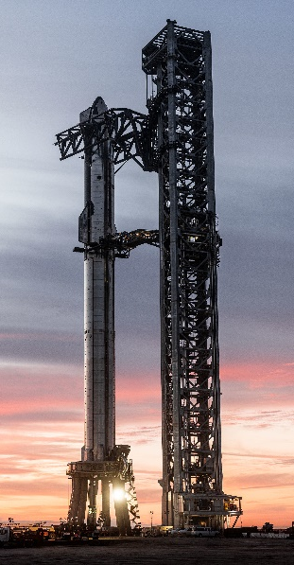
2020 Tipping Points – spacex contract summary
SpaceX of Hawthorne, California, $53.2 million
Large-scale fs on a Starship vehicle. SpaceX will collaborate with Glenn and Marshall.
Contract goals (from contract SOW):
  “…to advance cryogenic fluid transfer and gauging technology through technology risk assessment, design and prototype testing, and on-orbit demonstration.
Tipping Point Objectives will be complemented by a series of ground tests and on-orbit demo.
Primary demonstration objective will be Header-to-Main LOX tank transfer
Approach
  Transfer operations: Transfer 10 mT from the LOX header tank to the LOX main tank
    Instrumentation and onboard video to characterize performance and monitor propellant fill levels
  Tank pressure control and propellant management (settled)
  Transfer line chill-down and flow-control
  Ground testing for comparison between ground and flight test data as well as anchoring thermal/fluid models
Schedule
  Original dates to be updated. Tipping Point Demonstration is dependent on Starship Orbital Launch Success.
Photo Source: Some rights reserved
by Official SpaceX Photos
Notes:
This chart is modified from a previously approved for AIAA SciTech by Jason Adam. The schedule was removed and replaced with the schedule statement.
Photo Link
https://www.flickr.com/photos/spacex/51924607369/sizes/4k/
Rights:
https://creativecommons.org/licenses/by-nc/2.0/
You are free to:
Share — copy and redistribute the material in any medium or format
Adapt — remix, transform, and build upon the material
The licensor cannot revoke these freedoms as long as you follow the license terms.
Under the following terms:
Attribution — You must give appropriate credit, provide a link to the license, and indicate if changes were made. You may do so in any reasonable manner, but not in any way that suggests the licensor endorses you or your use.
NonCommercial — You may not use the material for commercial purposes.

Slide 9
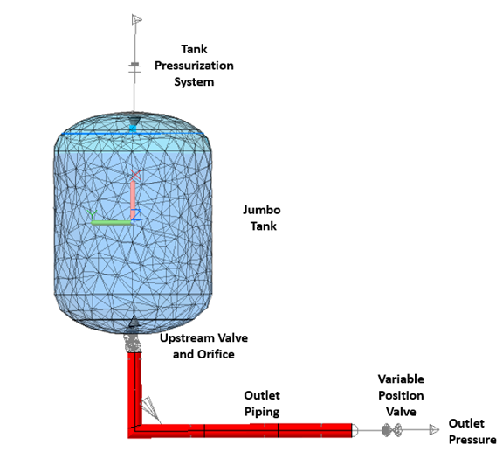
NASA Benefit Example
Use of the data from this CFM Flight Demonstration to validate improved modeling and analysis tools for current and future cryogenic missions
Example: Predicting, Controlling, and Measuring transferred cryogenic propellant
  There is uncertainty in propellant initial thermodynamic state post ascent / pre-transfer
  Temperature and pressure due to:
    Dynamic liquid to gas interactions (Slosh)
    Aero-heating
    Etc.
  There is a possibility of Two-Phase Flow which is a challenge to predict
    Data will improve validation of Dyer’s Model using Thermal Desktop
Just one of many uses for data
Modeling of a Large Scale Liquid Oxygen Propellant Transfer Test,” D. Hauser, B. Wendt, M. Faykus, L. Blackmore, H. Tani, G. Thome, 2023 Space Cryogenics Workshop, Hawaii
Notes:
This chart is based on the publicly approved presentation sited in the footnote.

Slide 10
Mahalo!
Thanks for Attending!

