Slide 1
Data Product Development Guide for Data Producers
H. K. “Rama” Ramapriyan and Peter J. T. Leonard
Presented at
ESIP Summer Meeting – July 18-21, 2023
Burlington, VT

Slide 2
Topics
What?
Where?
Why?
For whom?
Who?
How?
ESCO review and publication
Why DPDG V2.0?
DPDG V2.0 overview and some detail
DPDG’s future maintenance

Slide 3
What and Where?
Data Product Development Guide for Data Producers
  Developed by Data Product Development Guide Working Group, one of NASA’s Earth Science Data System Working Groups
  Ramapriyan, H. K., and P. J. T. Leonard. 2020. Data Product Development Guide (DPDG) for Data Producers version1. NASA Earth Science Data and Information System Standards Office, 21 October 2021. https://doi.org/10.5067/DOC/ESO/RFC-041VERSION1
Quick Start Guide to the Data Product Development Guide for Data Producers
https://www.earthdata.nasa.gov/esdis/esco/standards-and-practices/data-product-development-guide-for-data-producers

Slide 4
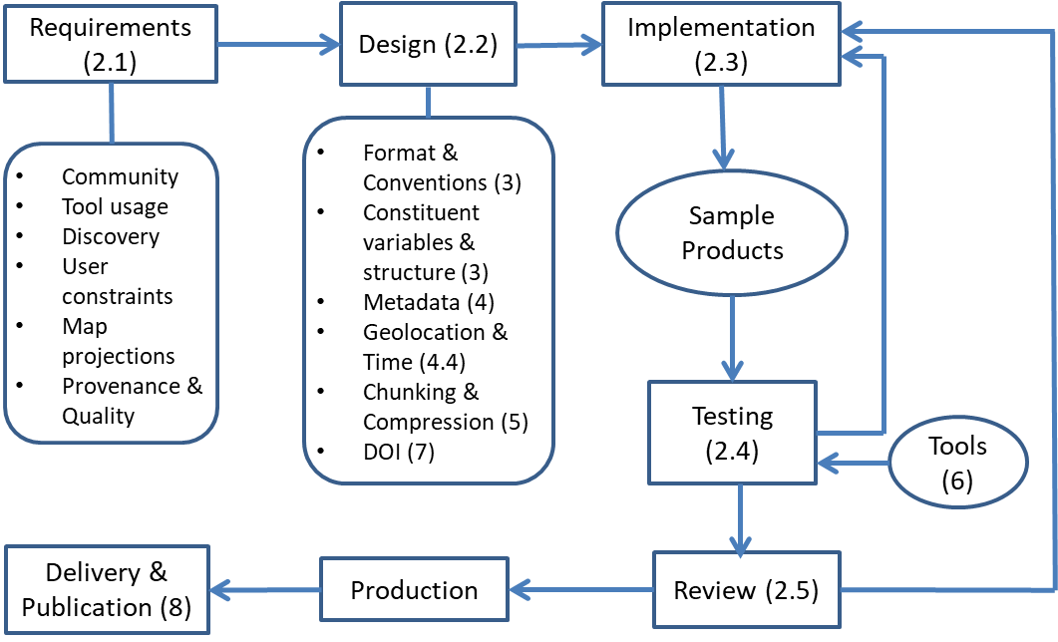
DPDG Organization
Flow of activities for data product development, production, and delivery (the numbers in parentheses in the figure indicate the sections where the individual steps are discussed in the document).

Slide 5
Why?
Large number of data products in EOSDIS
Held at 12 DAACs, each with its rules and guidance for data producers
Need was felt to bring more commonality among them to promote interoperability and greater convenience for end users
Chris Lynnes proposed in 2018 to develop a guide and publish as “suggested practice” following broad community review led by ESDIS Standards Coordination Office (ESCO)

Slide 6
For Whom?
People involved in producing standard Earth observation data products for NASA:
  Science investigators (satellite missions, airborne and field campaign investigators, MEaSUREs projects, etc.)
  Algorithm developers
  Science processing software developers
  Staff at the Distributed Active Archive Centers (DAACs)
  Data tool developers
But – the primary beneficiaries of data product development are the end users.
We make recommendations that serve end users, though they may occasionally levy extra (but manageable) effort on data producers or DAACs.
Producers of other Earth observation data products may find these guidelines useful as well.

Slide 7
Who and How?
DPDG Working Group was formed with “volunteer” representatives from over 20 organizations including data producers, DAACs, ESDIS Project and others
All contributed to discussions, identification of relevant sources of information, and writing sections of the document
A small number of individuals volunteered to form an editing team to integrate all inputs into a readable document
Submitted to ESCO for review and publication

Slide 8
ESCO Review and Publication
Broad community review
  Thorough reviews by stakeholder representatives
DPDG V1.0 had two rounds of review
  Round 1 - ~280 comments
  Round 2 - ~40 comments
Editing team (a subset of authors) dispositioned all and resubmitted after each round
  Intensive process!!
ESCO assigned DOI, created a landing page and made it publicly available
  Landing page includes Strengths, Weaknesses, Applicability, and Limitations (SWAL)
  A Quick Start Guide (condensed version of DPDG) was developed and published after internal review
  An update (DPDG V1.1) with minor changes was also published after internal review

Slide 9
Why DPDG V2.0?
We recognized need for periodic updates even when we started on V1.0
  Technology changes
  Information needs of broader classes of data producers
  Factoring experience from document’s use
In V1.0 and V1.1:
  Airborne and field campaigns not covered
  Cloud technology was not addressed

Slide 10
DPDG V2.0
V2.0 addresses these topics
  Airborne and field campaigns – addressed by adding appropriate terminology and several examples throughout the document
  Cloud technology – developed a new section (Section 3.3)
Status
  Developed final draft and submitted to ESCO – May 6, 2023
  First round of reviews completed – June 23, 2023
  Over 450 comments received (editorial, technical and general)
  Editors reviewing and dispositioning comments

Slide 11
DPDG V2.0 Section 3.3
Cloud-Optimized Formats
  Cloud-Optimized GeoTIFF (COG)
  Zarr
  NetCDF-4 and HDF5 in the Cloud
  Point-cloud formats
  Additional Data Transformation and Access Methods
    Harmony
    Kerchunk
    OPeNDAP in the Cloud

Slide 12
Contact Information
Hampapuram.Ramapriyan@ssaihq.com
pleonard@sesda.com

Slide 13
Back-up Slides
DPDG Table of Contents
Contributors and Editors (DPDG-v1.0 & 1.1)
Contributors and Editors (QSG)
Editors (DPDG-v2.0)

Slide 14
Table of Contents
Introduction - Intended Audience, Purpose, Scope
Data Product Design Process – Requirements, Design, Implementation, Testing, Review
Selecting a Data Format – Recommended Formats, Recognized Formats, Cloud Optimized Formats
Metadata – Overview, Naming Data Products, Versions, Representing Coordinates, Data Quality, Global Attributes, Variable Attributes
Data Compression, Chunking, and Packing
Tools for Data Product Testing – Data Inspection, Compliance Checkers, Internal Metadata Editors, End-User Tools
Data Product Digital Object Identifiers
Product Delivery and Publication
References
Contributors and Editors
Appendix A. Abbreviations and Acronyms
Appendix B. Glossary
Appendix C. Product Testing with Data Tools
Appendix D. Important Global Attributes – Interpretability, Discovery, Geolocation, Temporal Location, Usability, Provenance
Appendix E. Important Variable-Level Attributes

Slide 15
Contributors and Editors (DPDG-v1.0 & 1.1)
Ed Armstrong, JPL/CalTech
Walter E. Baksin, SSAI & NASA/LaRC
Jeanne Beatty, ADNET & NASA/GSFC
Robert R. Downs, SEDAC
George Huffman, NASA/GSFC
Aleksandar Jelenak, The HDF Group
Siri Jodha Khalsa, NSIDC DAAC
Amanda Leon, NSIDC DAAC
Peter J.T. Leonard, ADNET & NASA/GSFC
Wen-Hao Li, JPL/CalTech
Christopher Lynnes, NASA/GSFC
David Moroni, JPL/CalTech
John Moses, NASA/GSFC
Dana Ostrenga, ADNET & NASA/GSFC
Hampapuram K. Ramapriyan, SSAI & NASA/GSFC
Justin Rice, NASA/GSFC
Elliot Sherman, SSAI & NASA/GSFC
Tammy Walker, ORNL DAAC
Lalit Wanchoo, ADNET & NASA/GSFC
Yaxing Wei, ORNL DAAC
Jessica N. Welch, ORNL DAAC
Robert Wolfe, NASA/GSFC
NOTE: Affiliations when DPDG v1.0 was prepared. Editors’ names in bold.

Slide 16
Contributors and Editors (QSG)
Edward M. Armstrong, JPL PO.DAAC/CalTech
Siri Jodha Singh Khalsa, NSIDC DAAC
Peter J.T. Leonard, ADNET & NASA/GSFC
John Moses, NASA/GSFC (Retired)
Hampapuram K. Ramapriyan, SSAI & NASA/GSFC
Tammy Walker, ORNL DAAC

Slide 17
Editors (DPDG-v2.0)
Ed Armstrong, JPL/CalTech
George Huffman, NASA/GSFC
Siri Jodha Khalsa, NSIDC DAAC
Lena Iredell, ADNET & NASA/GSCF
Peter J.T. Leonard, ADNET & NASA/GSFC
Hampapuram K. Ramapriyan, SSAI & NASA/GSFC
Deborah Smith, UAH & NASA IMPACT
Tammy Walker, ORNL DAAC
Daine Wright, ORNL DAAC

