Slide 1
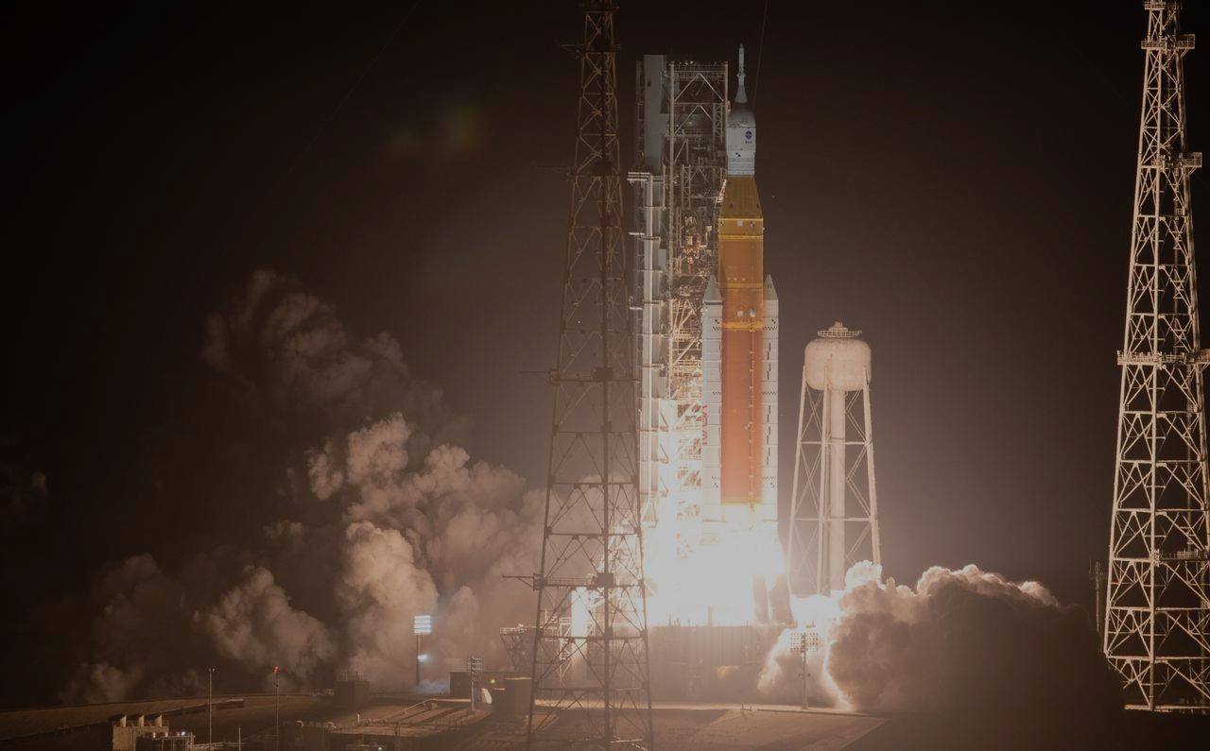
Pathways Showcase Presentation
Ashley Triana
UB-G / Spaceport Technologies Office

Slide 2
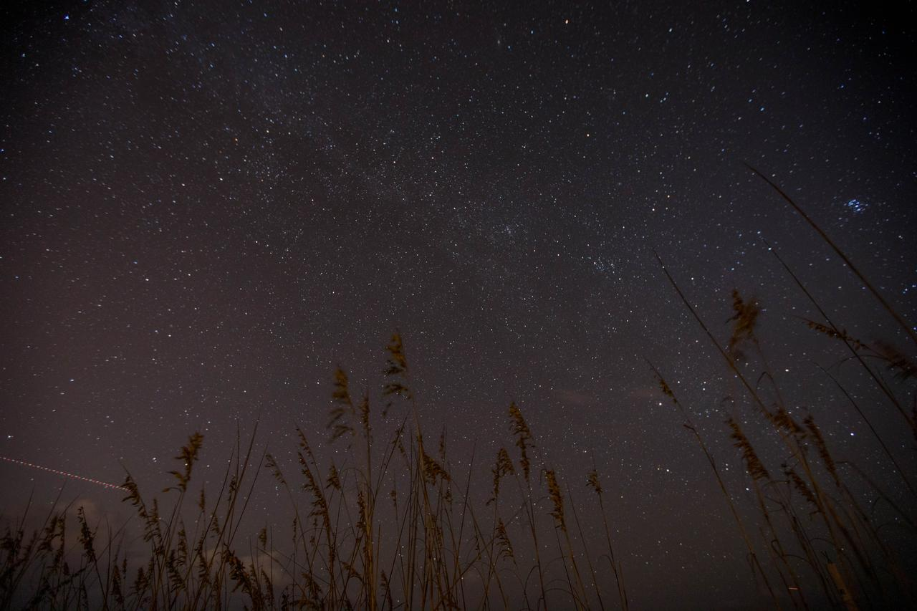
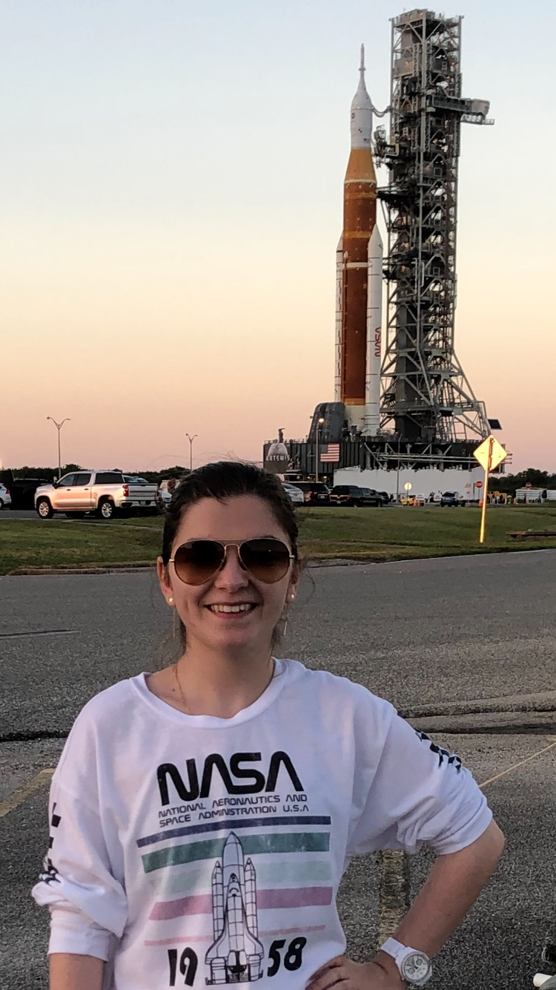
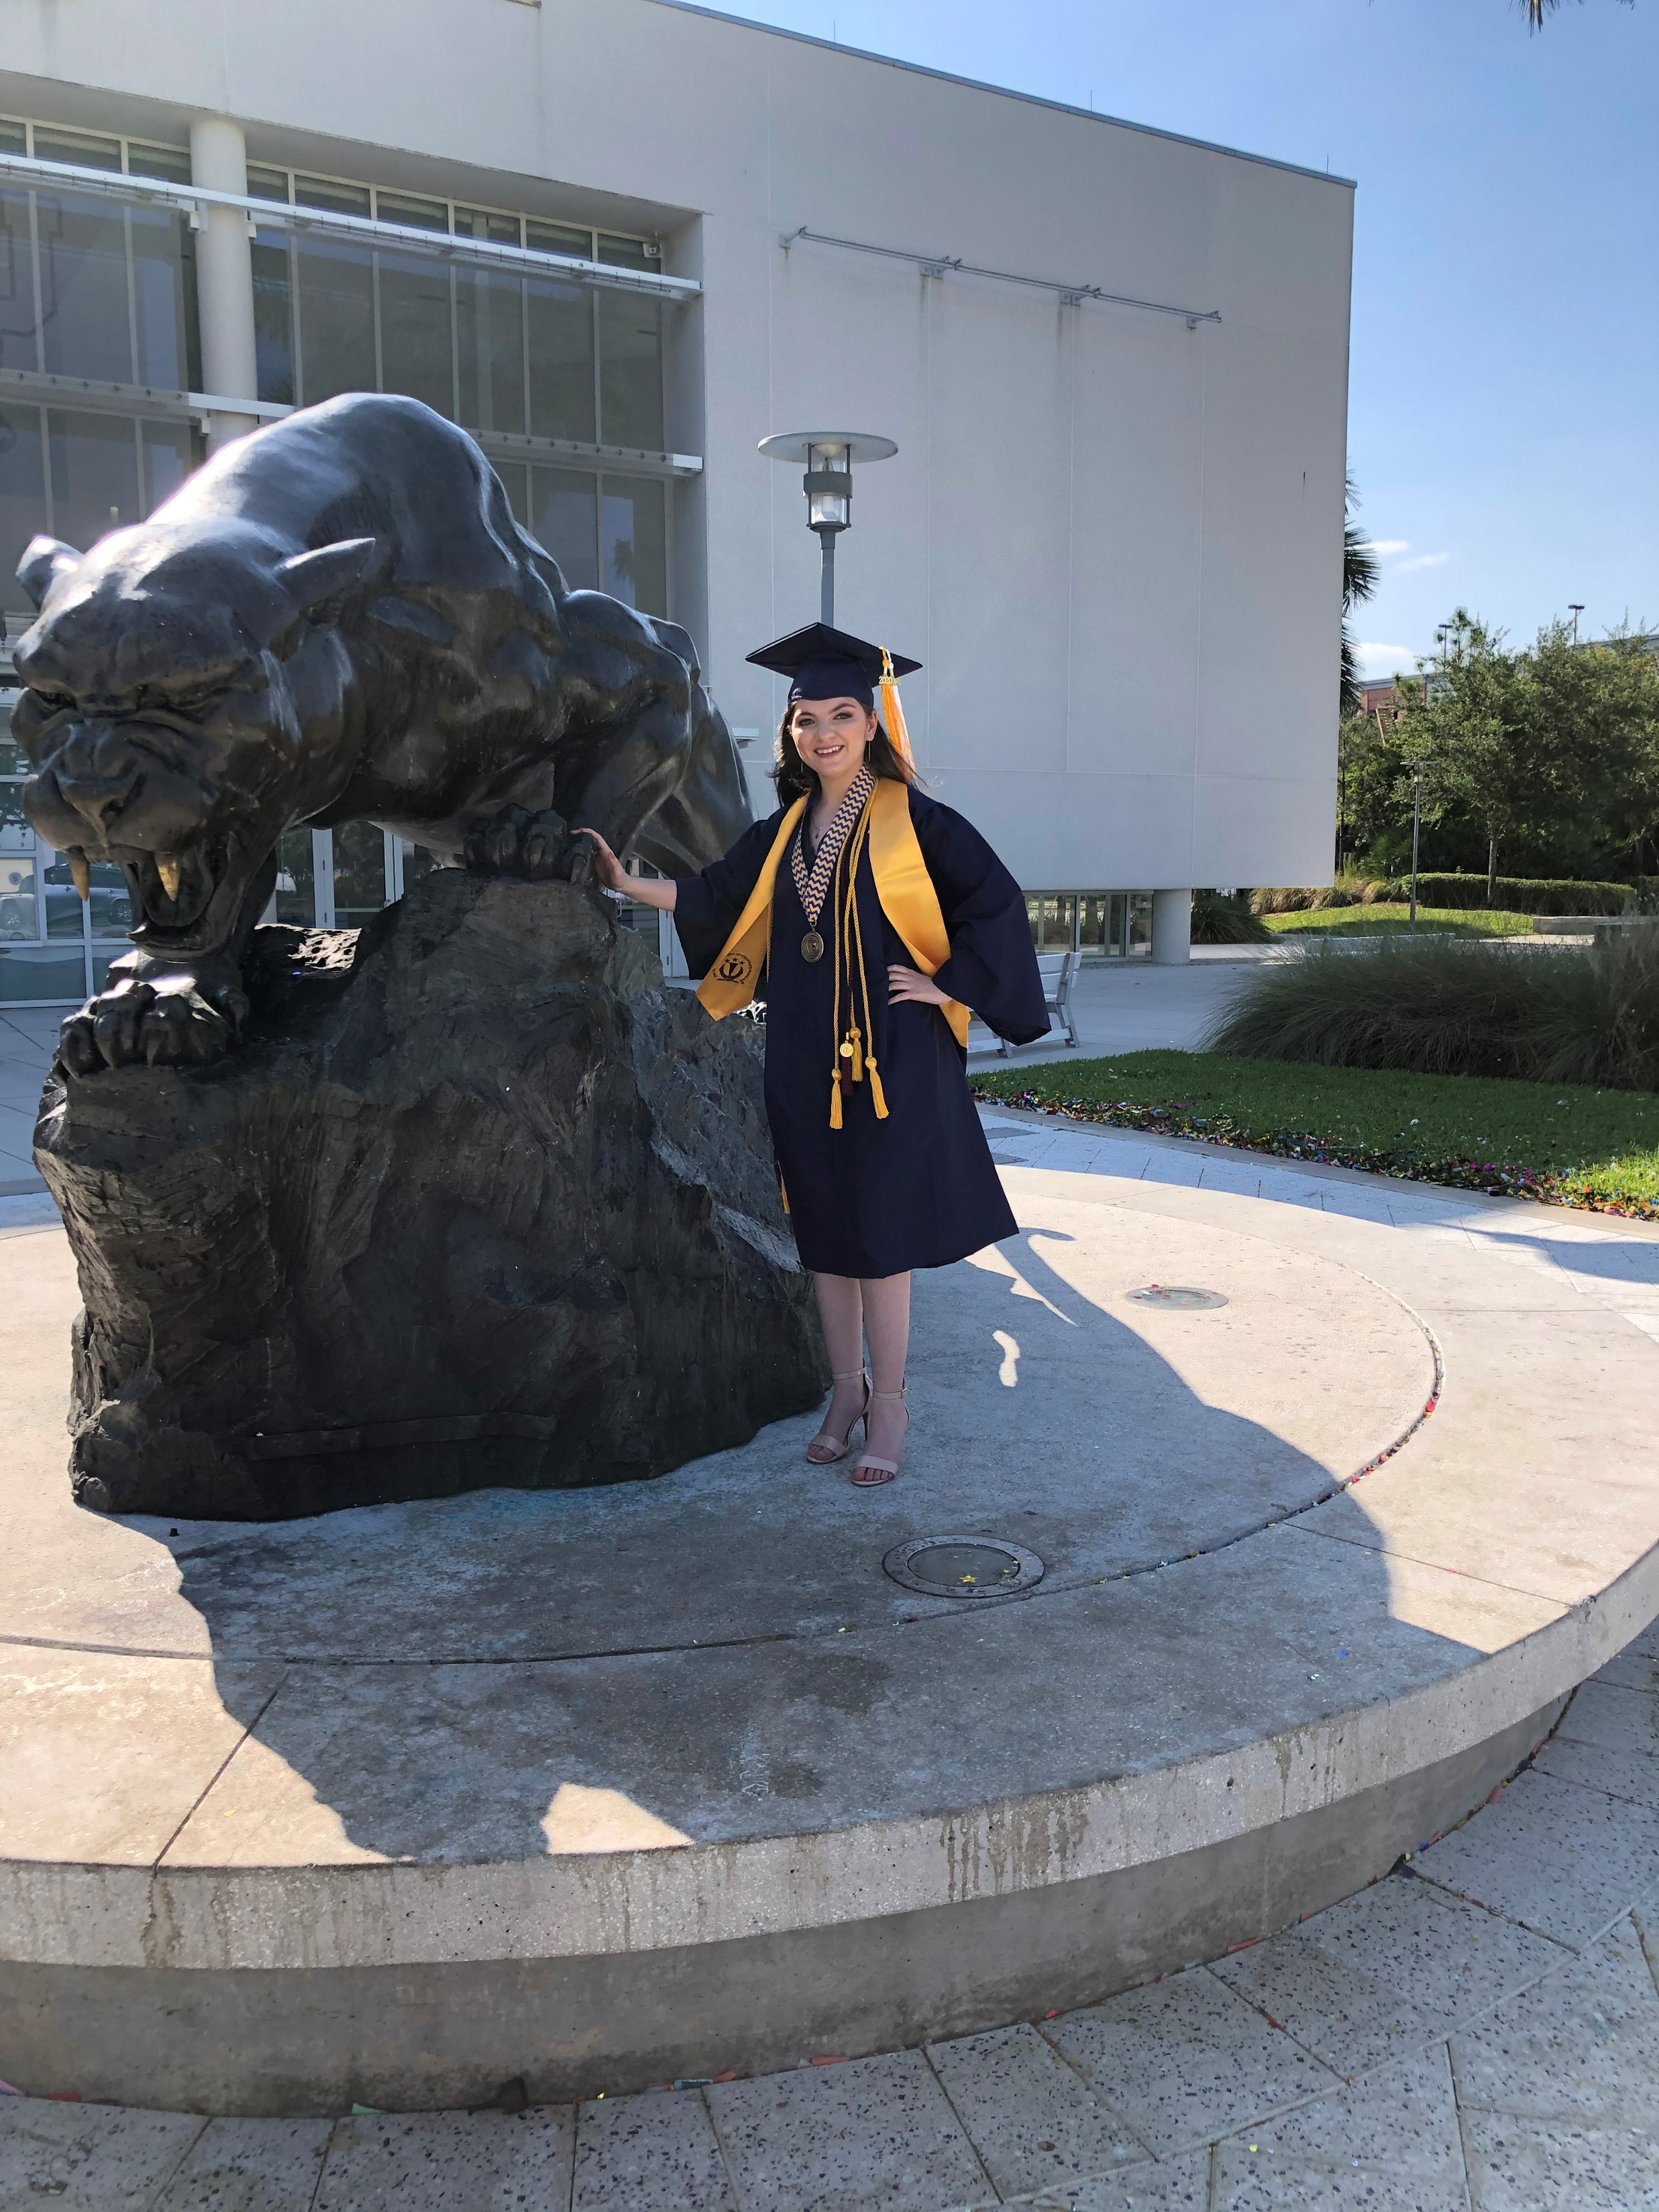
Background Information
Florida International University
  B.S. in Chemistry
  Graduate Student of Materials Science and Engineering
Why NASA?
  Fascinated by STEM and Space Exploration (Sci-Fi).
    Driven by curiosity.
  Visited KSC Visitor Complex & Virtual Internship with JPL.
    Solidified my determination to be a part of the NASA workforce.
  NASA’s Mission & Vision.
    Desire to explore the unknowns of the universe and innovate for all of humanity.

Slide 3
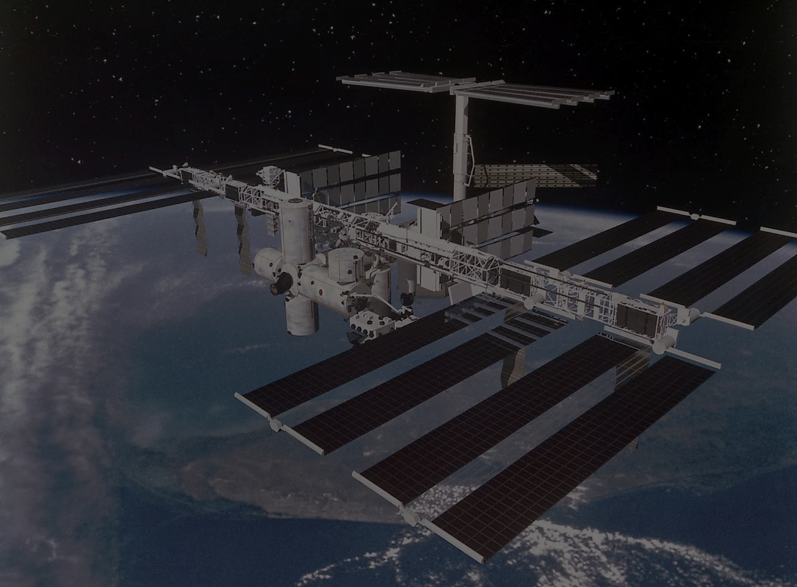
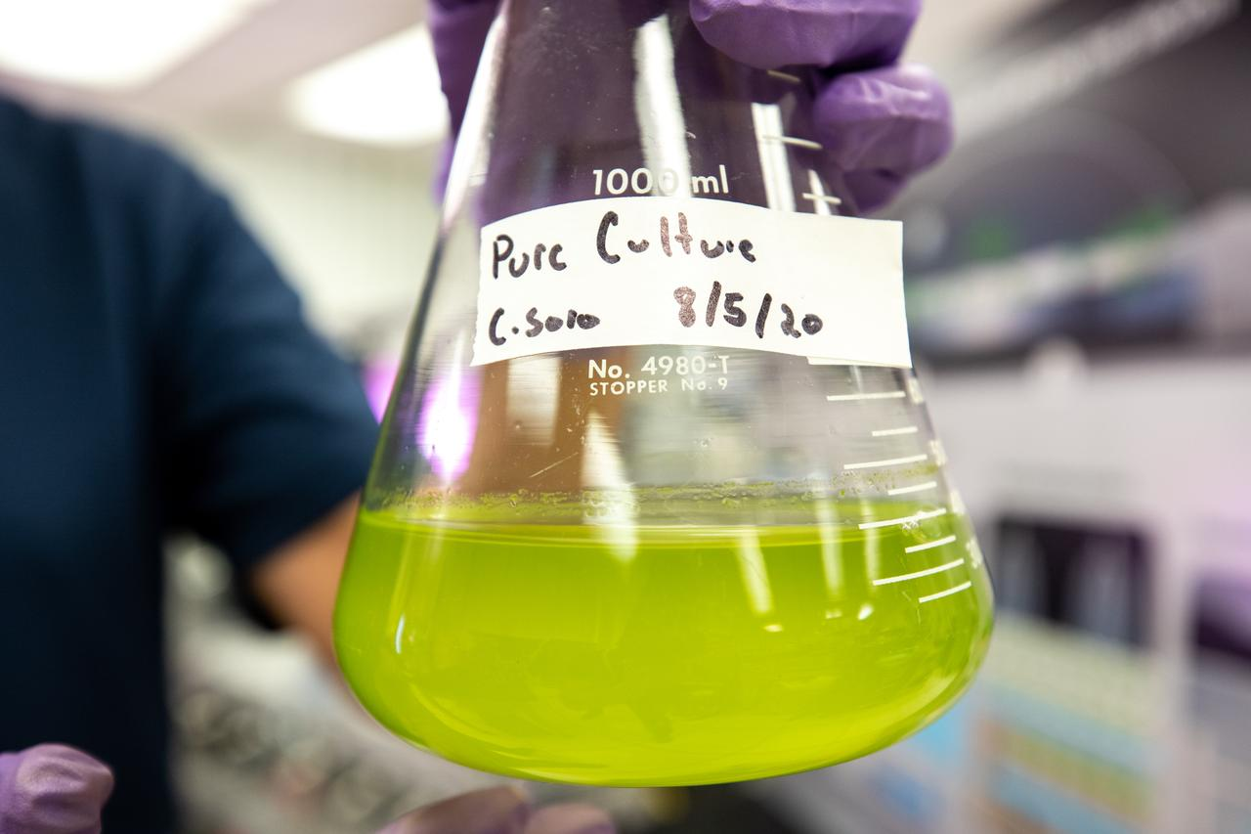
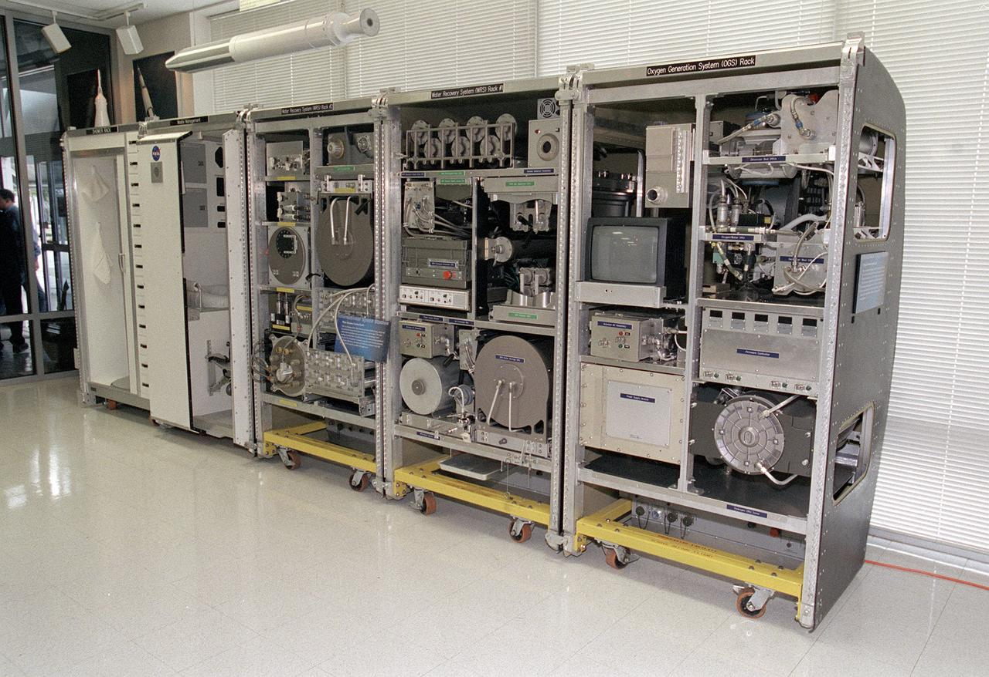
Intro to Water Science Work Area (WSWA)
Water Operations
  Assist with water-related issues on KSC.
  Preparation and certification of chemical pretreatments for ISS.
Bioregenerative Life Support R&D
  Wastewater Purification through Biological means.
  Biomanufacturing in Space.

Slide 4
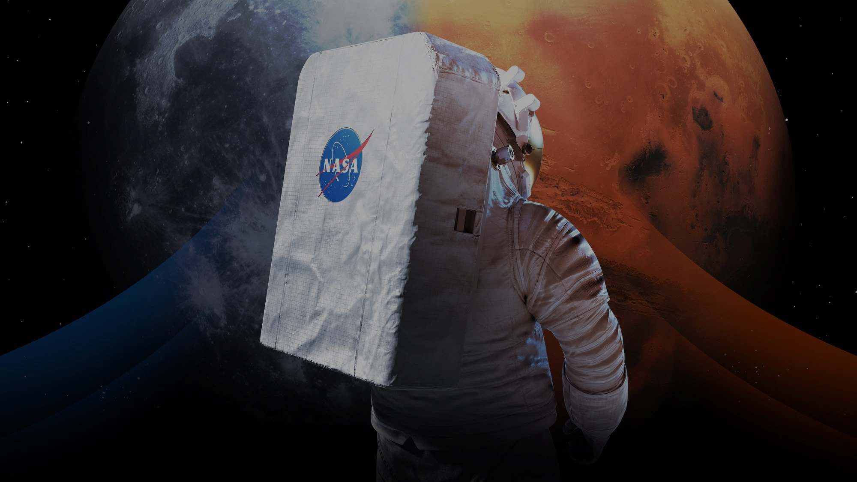
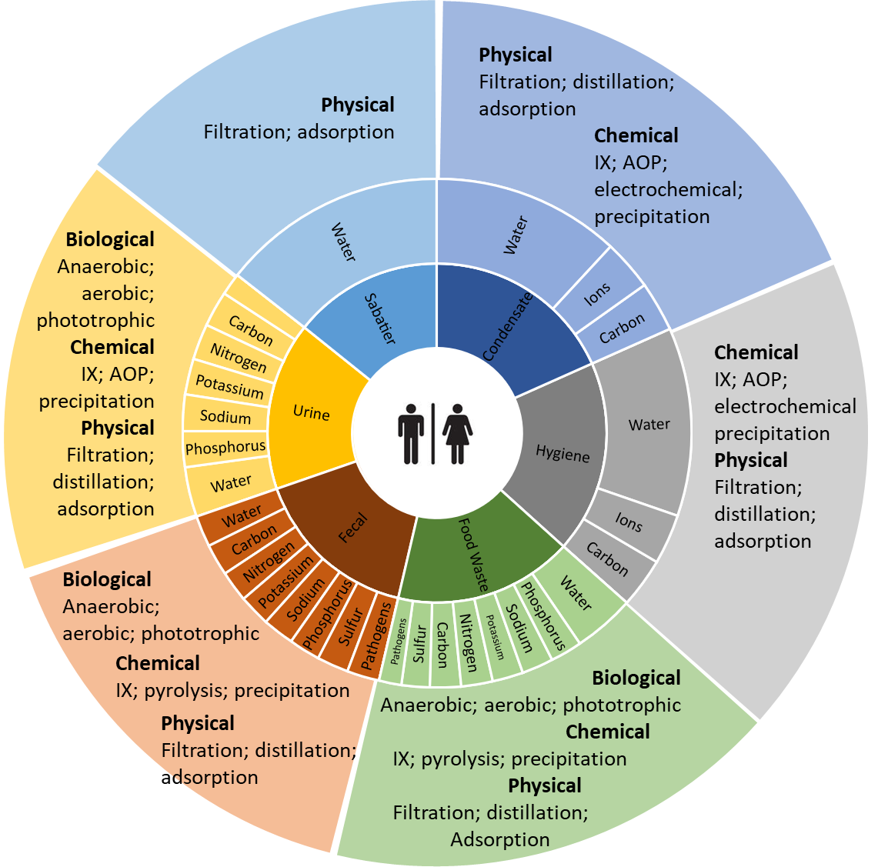

WSWA – Artemis – Moon to Mars
Artemis & Moon to Mars
  An established and viable human presence on Moon & Mars through planetary bases.
    Exploration – New scientific discoveries.
    Resupply is not an expected option – Less dependent of Earth.
    Life Support Systems require recycling of 98% water intake.
    Critical to recycle resources (including waste).
Challenges
  Recovery of water from complex mixture of organic/inorganic sources
  Separation and treatment of liquid and solid metabolic waste
  Sustainable food growth
Scenario – Single Crew Member 30-month mission
  Requires 2250 kg water and 1359 kg food
  Generates 1611.9 kg metabolic waste
How Can We Resolve This?...
Pickett, M. T.; Roberson, L. B.; Calabria, J. L.; Bullard T. J.; Turner, G.; Yeh, D. Regenerative water purification for space applications: Needs, challenges, and technologies towards 'closing the loop'. Life Sciences in Space Research 2020, 24, 64-82. https://doi.org/10.1016/j.lssr.2019.10.002
Notes:
Moon to Mars Overview | NASA
5 Hazards of Human Spaceflight | NASA
Deep Space Habitation Overview (nasa.gov)
Bioreactor for Space PPT (Luke)

Slide 5
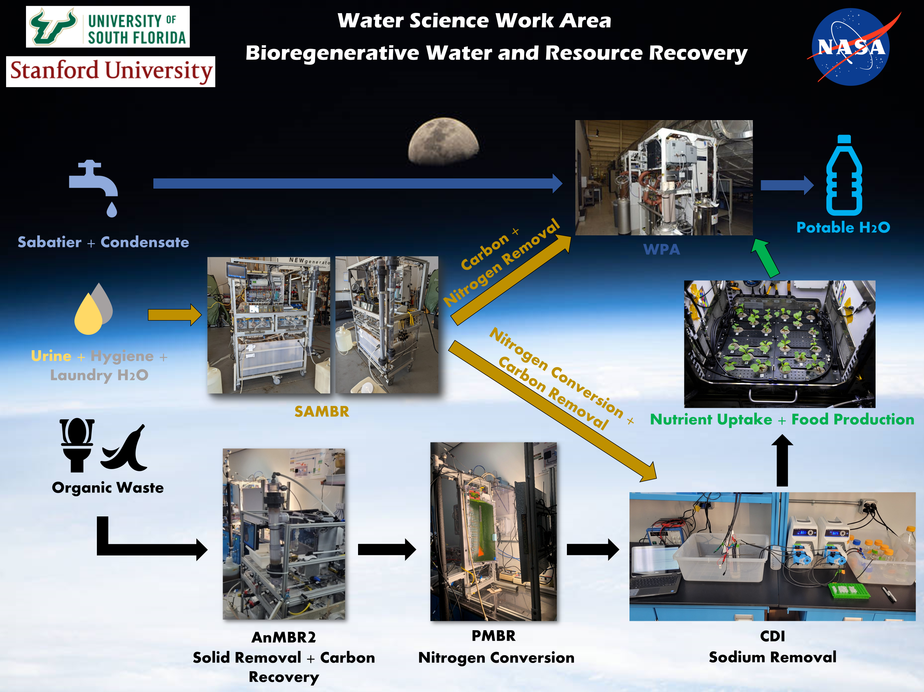
Notes:
Get permission for USF and Stanford logo

Slide 6
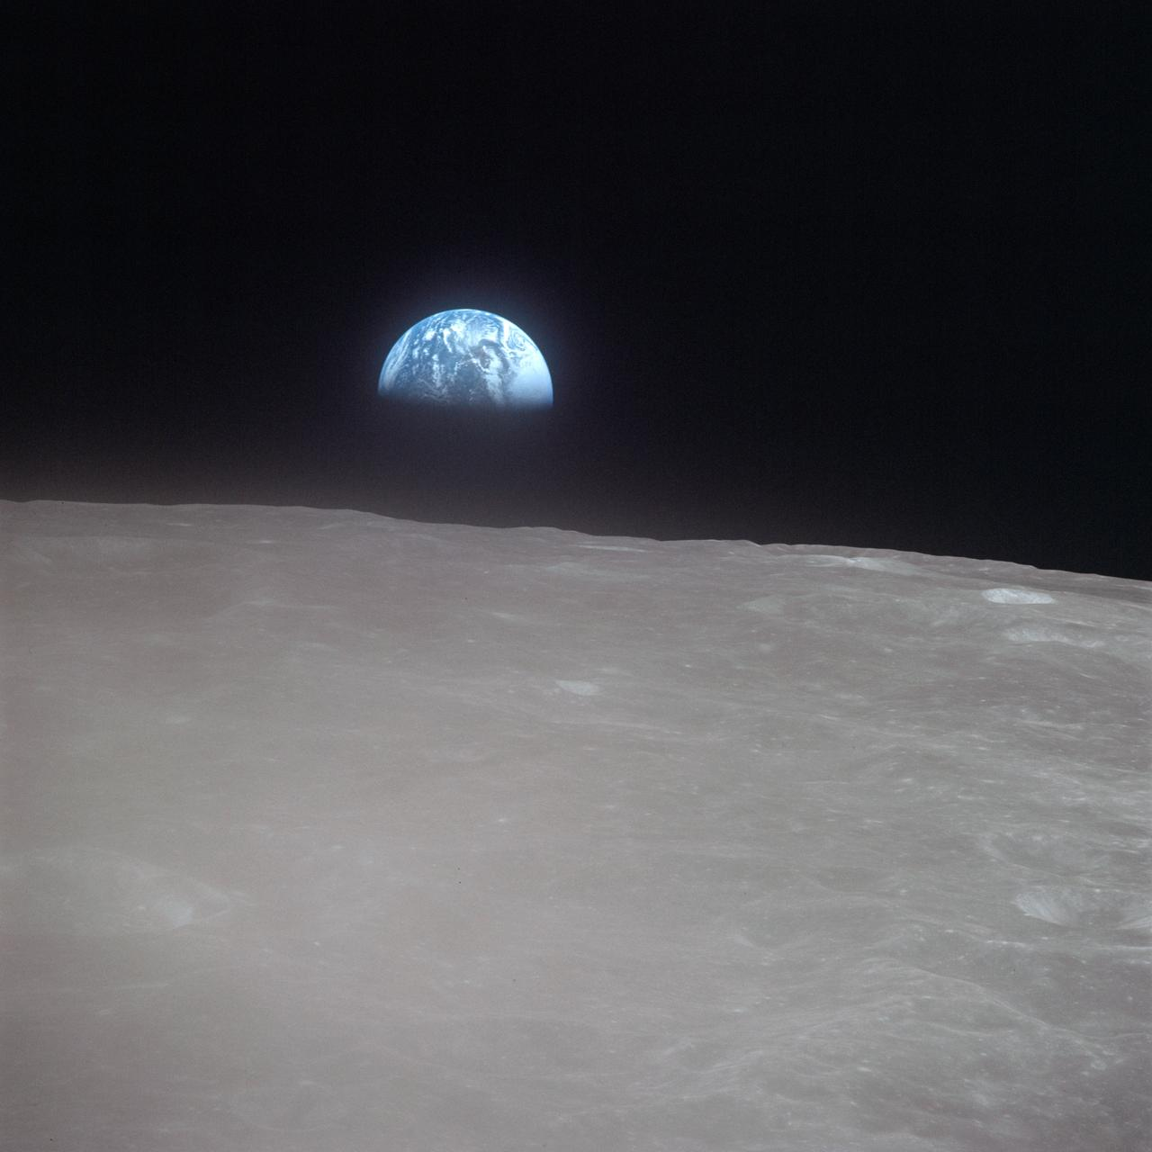
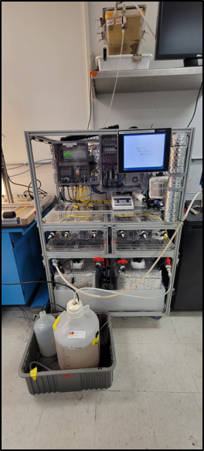
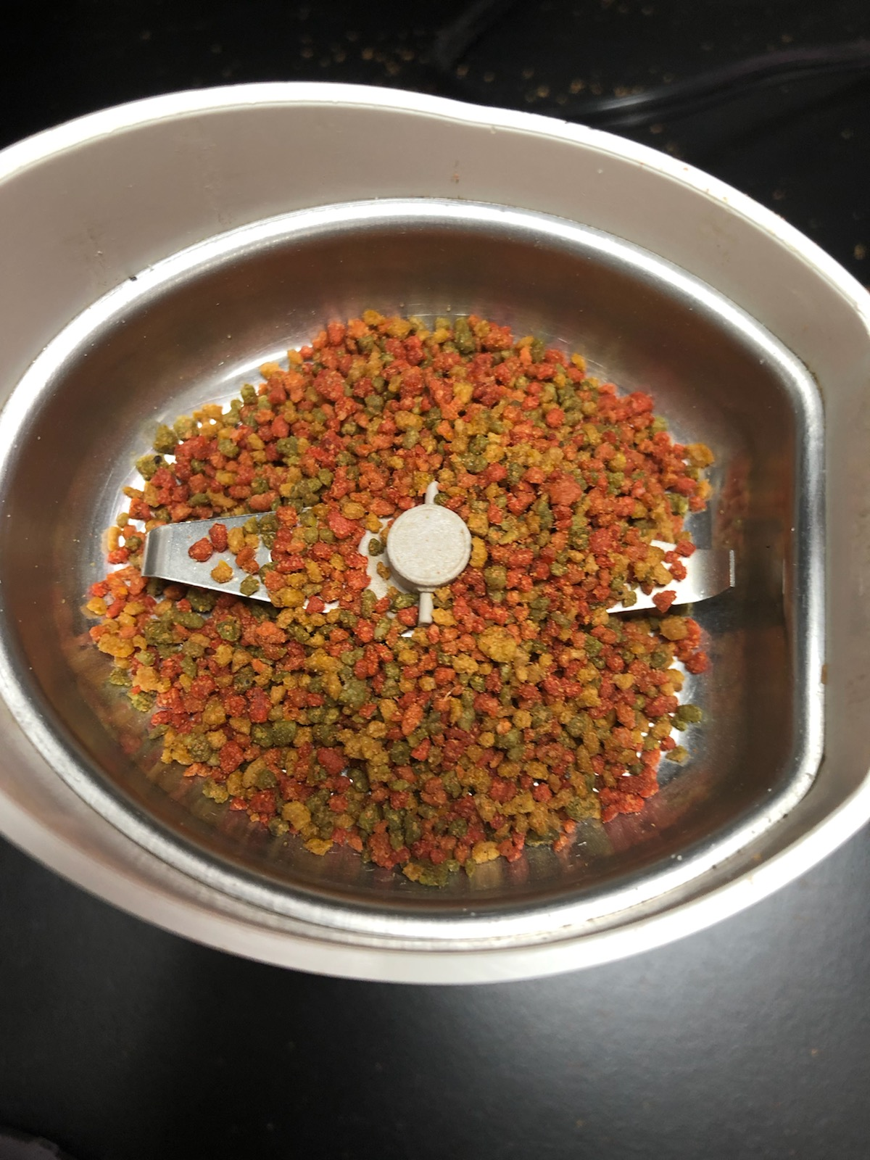
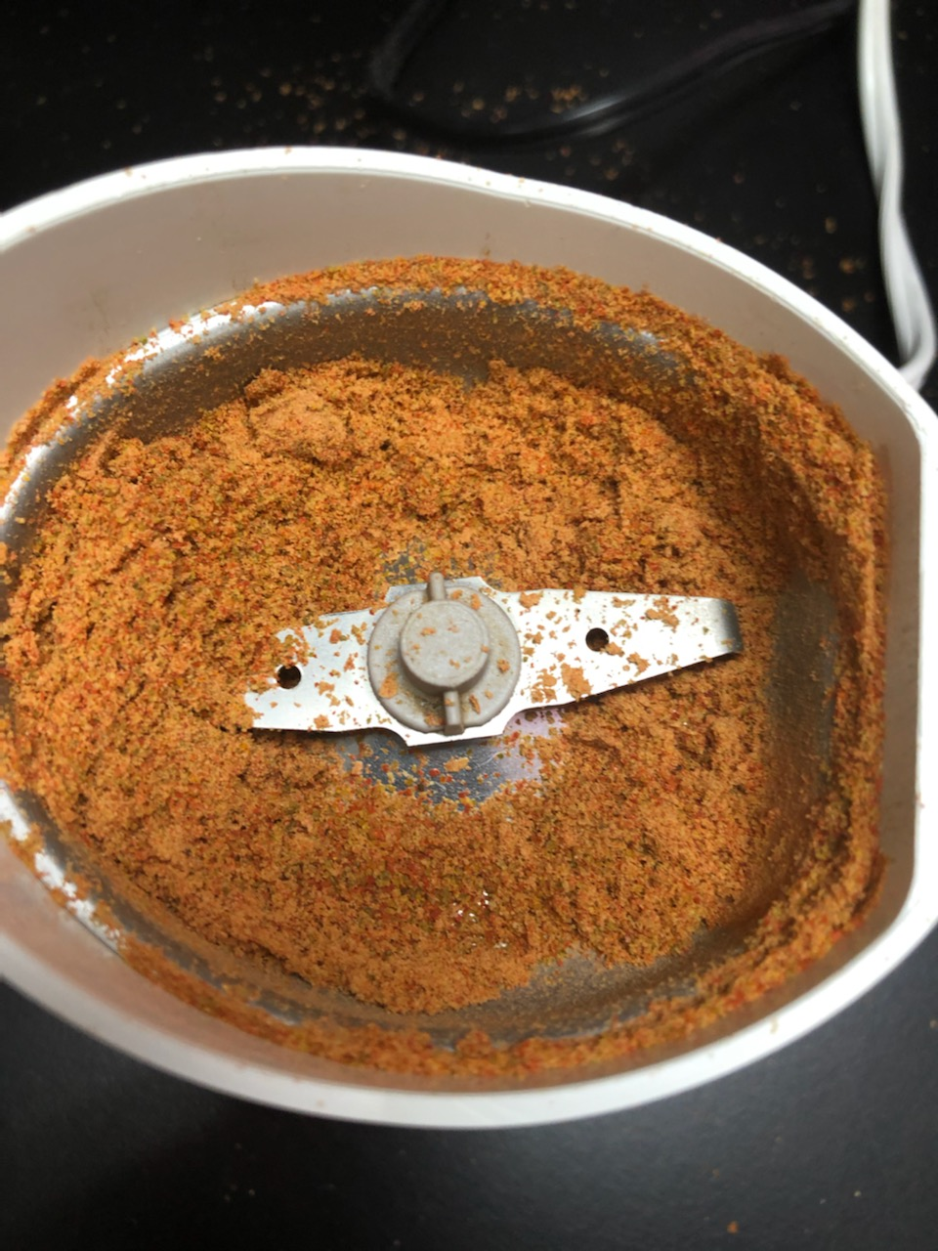
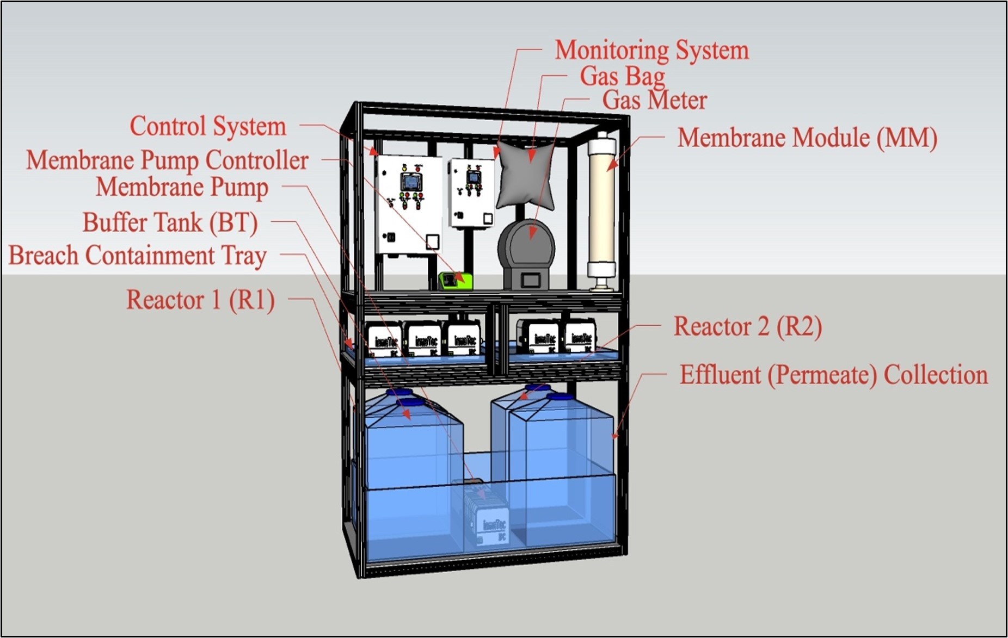
Anaerobic Membrane Bioreactor (AnMBR)
Wastewater Simulant (Cat-Food!) enters AnMBR
  USF’s AnMBR uses Canine Fecal
Anaerobic Digestion
  Hydrolysis
  Acetogenesis
  Acidogenesis
  Methanogenesis
Ultrafiltration Membrane
Responsibilities with Operating/Maintaining AnMBR
  Preparing the simulant
  pH and ORP monitoring
  Hatch kit tests
Notes:
Ask Luke about this slide

Slide 7
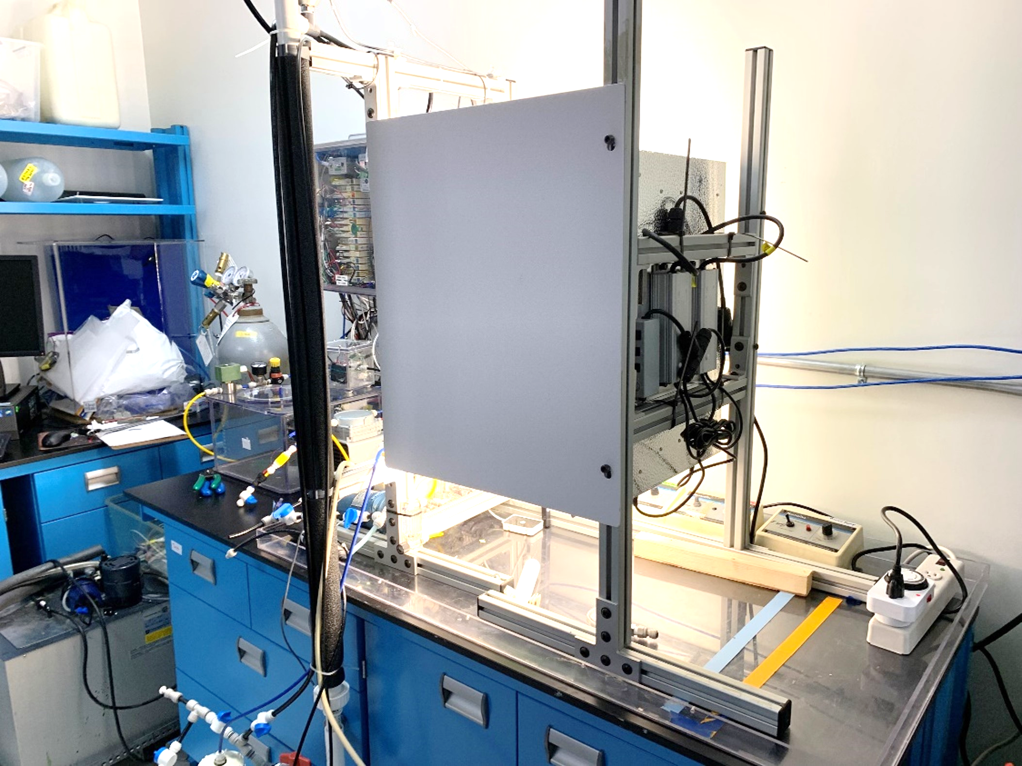
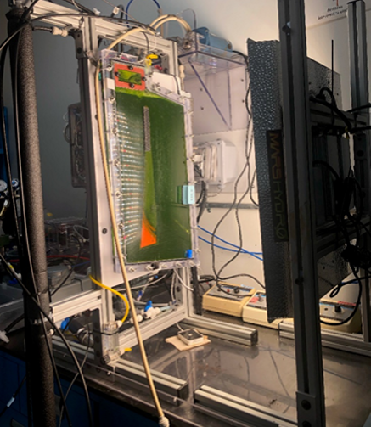
Photomembrane Bioreactor (PMBR)
Effluent from AnMBR flows into PMBR (Algae Reactor)
  AnMBR Effluent – High Concentration of Ammonia
PMBR performs nitrification
  Ammonia (NH3) Nitrate (NO3)
Ultrafiltration Membrane
Responsibilities Related to PMBR
  Weekly Algae Feeding
  Support the Operations of PMBR
  Hatch kit tests

Slide 8
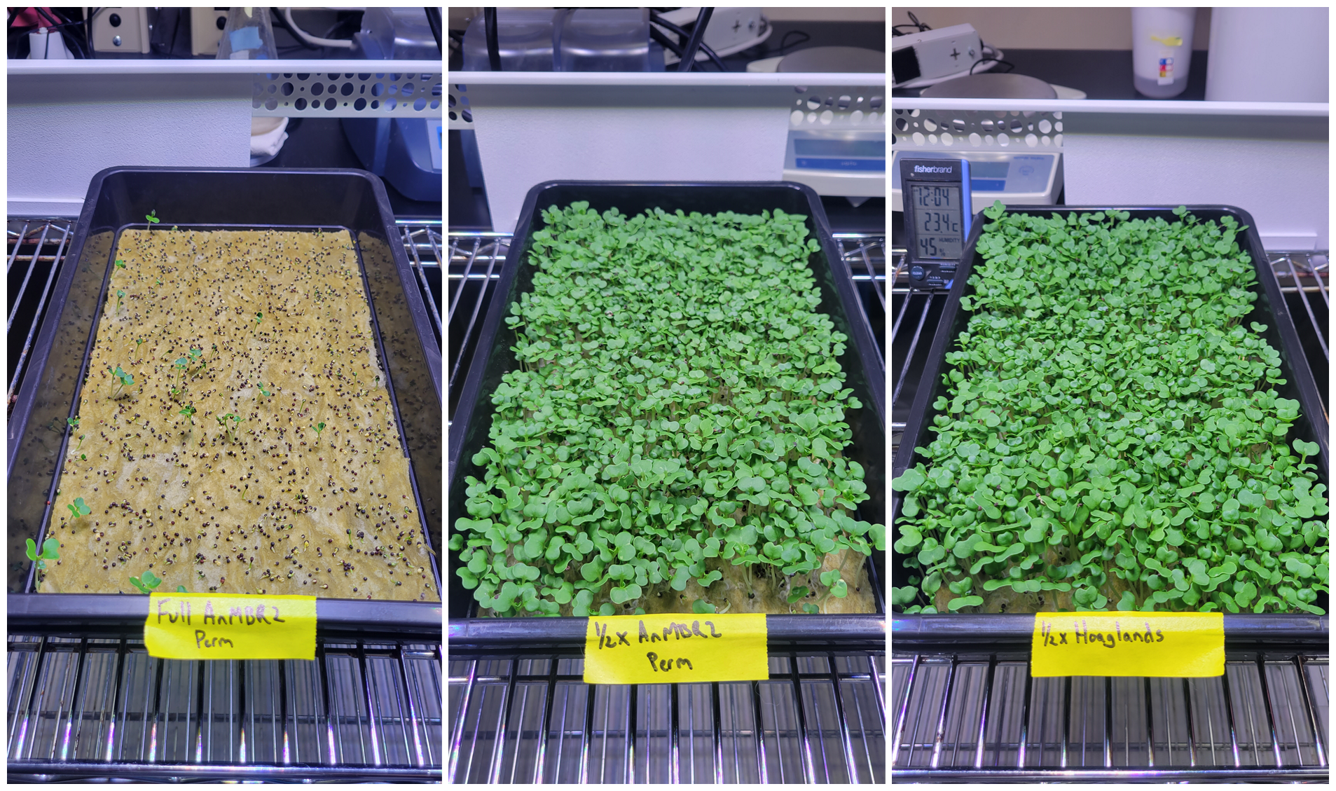
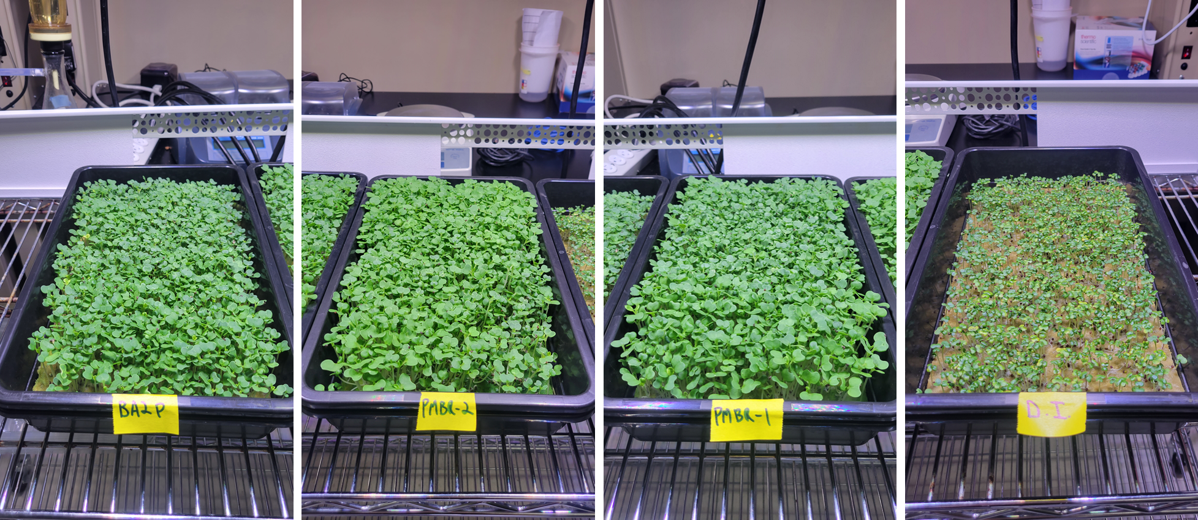
Microgreens Grow-Out Study
AnMBR and PMBR effluent exemplified the ability to grow Pak Choi Microgreens within 10 days!
(Conducted by Principal Members of WSWA Team)
AnMBR (Cat-Food Stream) Effluent
½ AnMBR (Cat-Food Stream) Effluent
½ DI Water
½ Hoaglands
Bubbled AnMBR (Cat-Food Stream) Effluent
PMBR Effluent (From AnMBR Cat-Food Stream)
PMBR Effluent (From AnMBR Canine Fecal Stream)
DI Water

Slide 9
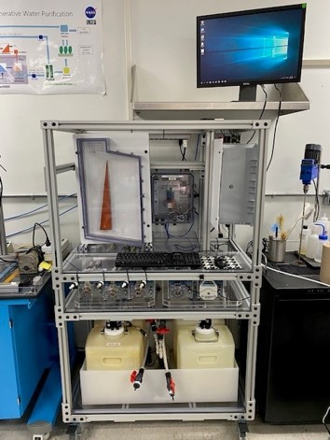
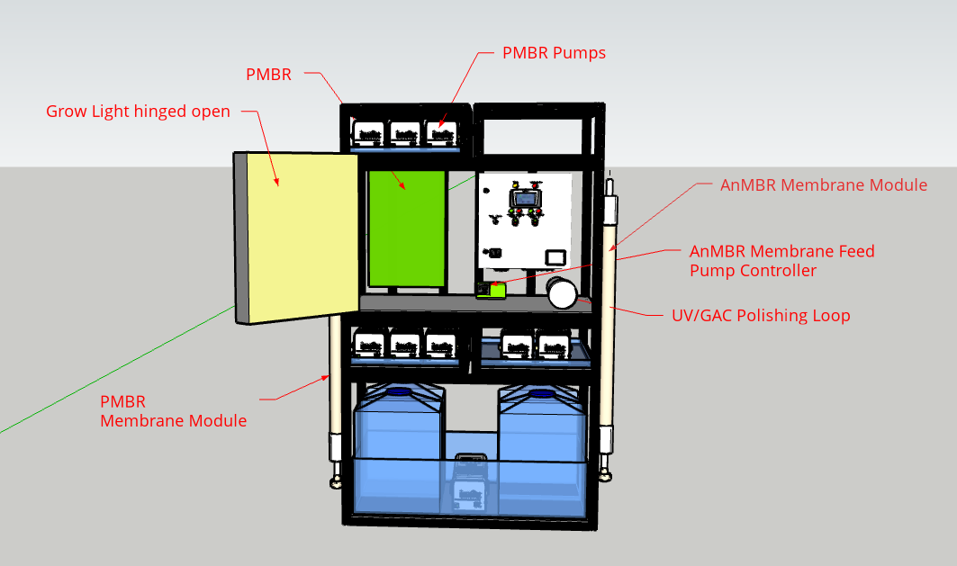
Engineering Design Unit (EDU) – Anaerobic Photomembrane Bioreactor (APMBR)
Combination of both AnMBR and PMBR
  In the process of being set-up and leak testing of PMBR section was completed.

Slide 10
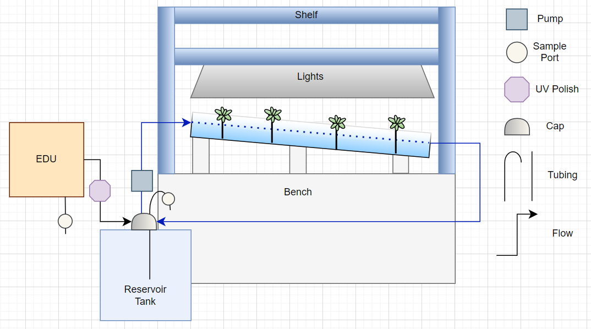
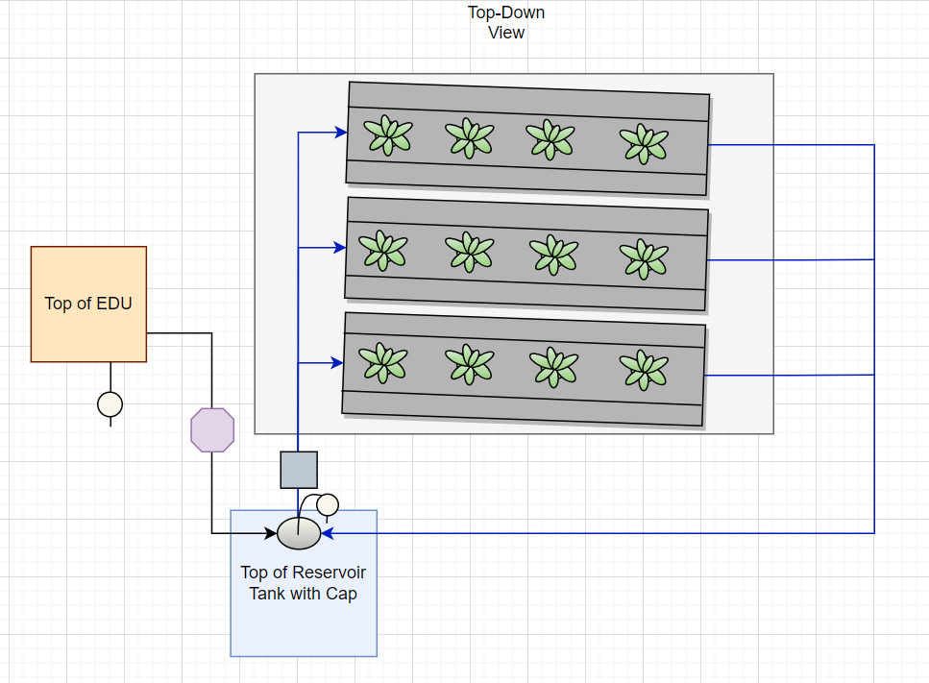
Hydroponics (Dedicated Station)
Design and Build Hydroponics System that will be output of EDU/APMBR.
  Nutrient Film Technique (NFT) was the chosen design model.
Plan for future work
  Building the apparatus
  Hydraulic Testing
  Conduct a Feasibility Study on Plant Growth with EDU/APMBR effluent

Slide 11
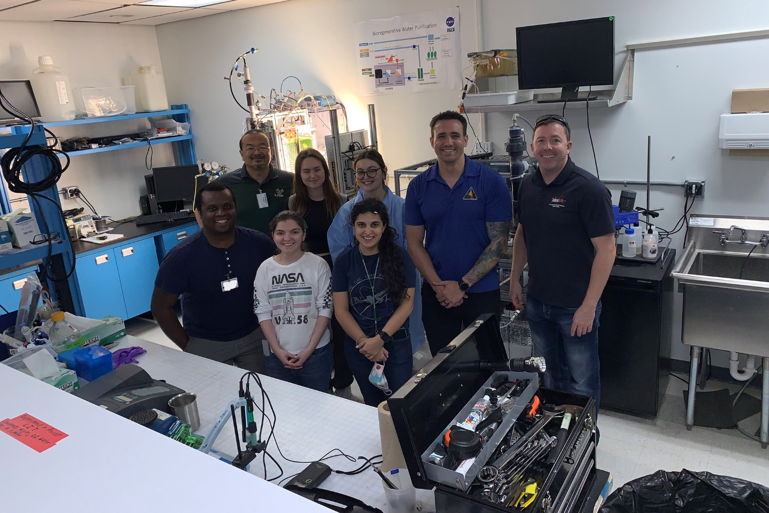
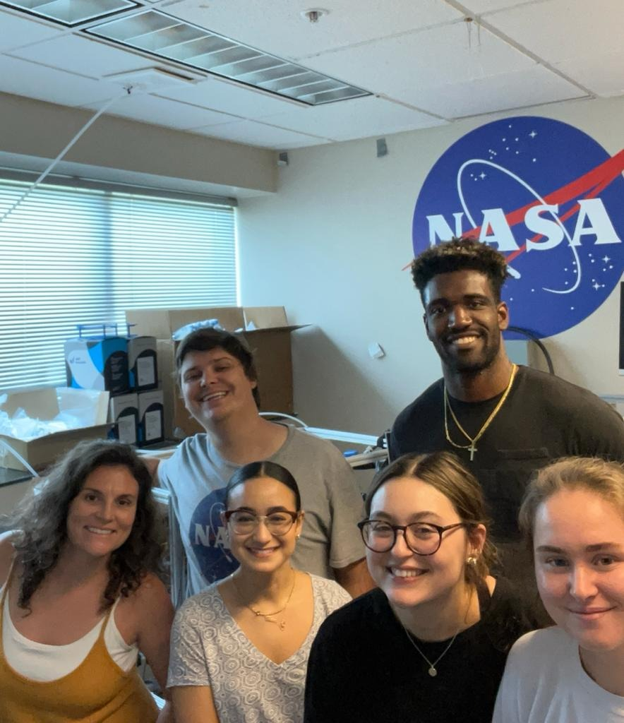
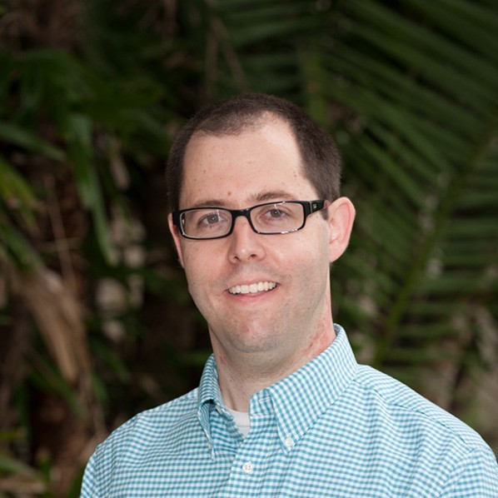
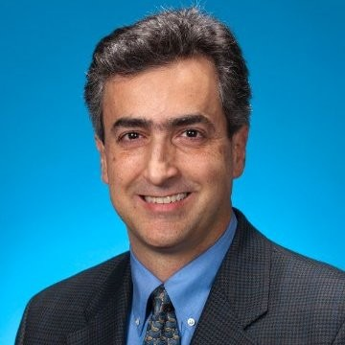
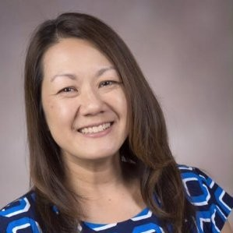

Acknowledgements
Dr. Luke B. Roberson and David J. Miranda.
Dr. Daniella Saetta and Jason A. Fischer.
USF Partners
  Dr. Daniel Yeh, Talon Bullard, Alexandra Smith.
  All students that contributed.
Dr. Jose Nu$\tilde{n}$ez.
The UB-G and UB Organization.
The Pathways Internship Team
  Mai Miller, Rocky Nance, Amy Munch.
All NASA Personnel!

Slide 12
Thank You! Questions?

