Slide 1

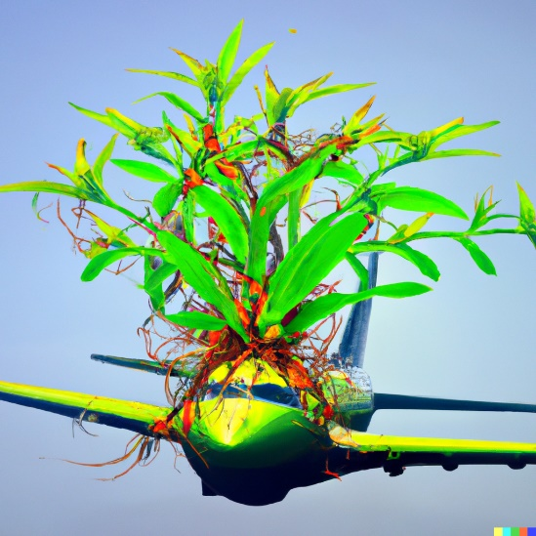
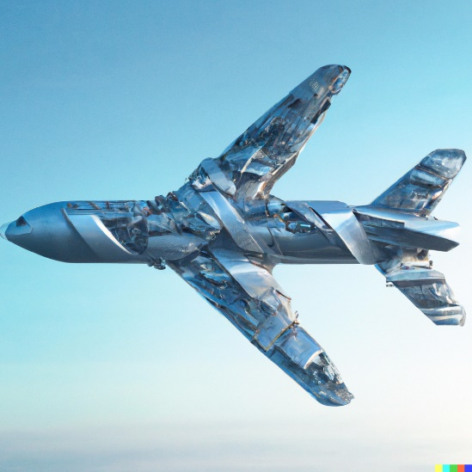





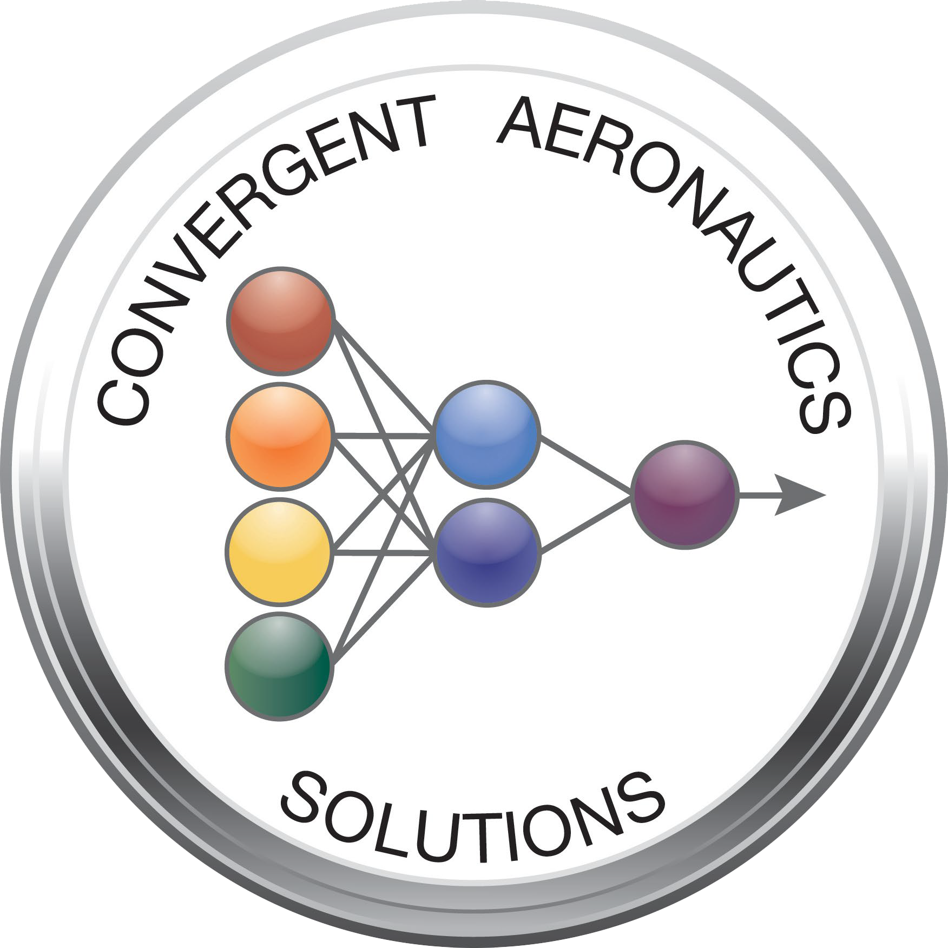


SUstainable Manufacturing of AirCraft (SUMAC)
National Aeronautics and Space Administration
Challenge
  World demand for aerospace alloys exceeds the amount of available scrap by 1/3 at least until 2050
  Sustainably manufacturing aircraft will require:
    Advanced materials technologies
    Sensing capabilities throughout vehicle life cycle
    Scrap and recycling logistics
    Environmental regulations
Exploring a paradigm-shift in materials, manufacturing processes, testing & health monitoring focused on sustainability
Expected Impacts
  Minimize the adverse impact of aviation manufacturing and aircraft life cycle on the environment
  Assess how NASA could potentially contribute to a paradigm-shift in the manufacturing of aircraft with a focus on sustainability
Raw Materials
Exploration Activities
  Conducted internal and external interviews, technical interchange meetings, and workshops to:
    Scope areas to propose for further research activities
    Identify key industry and academic partners
    Illuminate key relevant NASA capabilities
Current Industry Objectives
NASA’s Expertise
Results
  Emerging opportunities identified through the activities:
    Sustainably-derived composite materials
    Dispersion strengthened metals to improve recyclability
    Integrated sensing and vehicle health monitoring
Future of Commercial Aviation
Product Use & End of Life
Manufacturing
For more information, contact:
Chris Wohl - c.j.wohl@nasa.gov
Sang-Hyun Chu - sang-hyon.chu@nasa.gov
www.nasa.gov

