Slide 1
Mechanical Tensile Testing of 3D-Printed Titanium 6Al-4V at Cryogenic Temperature
NASA Goddard Space Flight Center
July 12, 2023
Bryan L. James, Peter W. Barfknecht, Nathan A. Smith, Antonio Moreno, Steven T. Cale, Matthew B. Francom, Richard S. Ottens, Stephen W. Lebair, Olivia L. DeNonno

Slide 2
Agenda
Introduction
Spaceflight Application
Specimen Development
Experimental Setup
Test Results
Conclusions
Future Work
2

Slide 3
Introduction
Titanium 6Al-4V is a highly desired material for use in space cryogenics applications.
Structural applications with good strength-to-weight ratios
Thermal isolation applications
Titanium 6Al-4V components can be fabricated via 3D-Printing which can be very beneficial to cryogenic spaceflight components:
3D-Printing allows parts to be made with geometries and features that are very difficult and sometimes impossible via traditional methods.
Mass savings of components
Increasing structural integrity of components
Increasing thermal isolation and/or conduction of components
Cost savings
Schedule savings
3

Slide 4
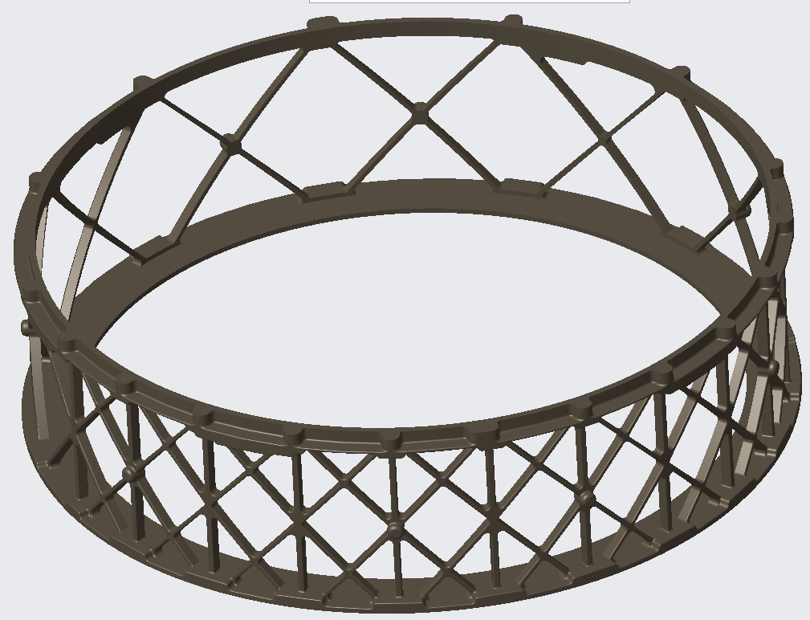
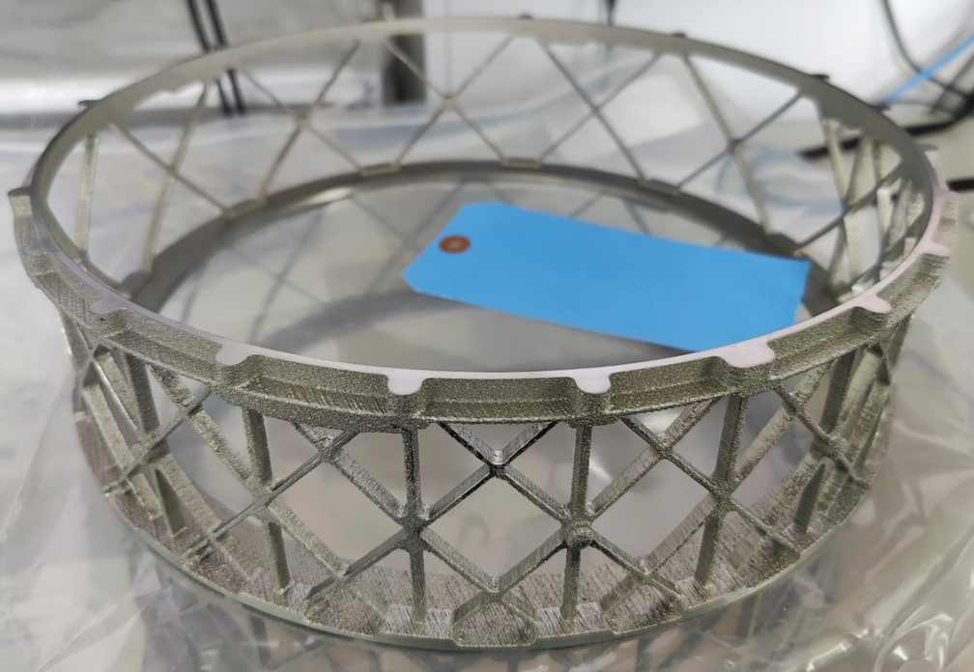
Spaceflight Application
The specific 3D-printing process used in this work is Electron Beam Melting (EBM) where layers of material powder are melted by an electron beam in a vacuum at elevated temperatures to fabricate components.
The cryogenic mechanical properties of EBM printed Ti-6Al-4V components is not known; knowing these properties are required for spaceflight application use.
Figure 2: Hardware photo of the Ti-6Al-4V thermally isolating and structural component from NASA’s DraMS Instrument (from figure 1) fabricated via electron beam melting (EBM).
Figure 1: CAD Model of a Ti-6Al-4V thermally isolating and structural support component from NASA’s DraMS Instrument.
4

Slide 5
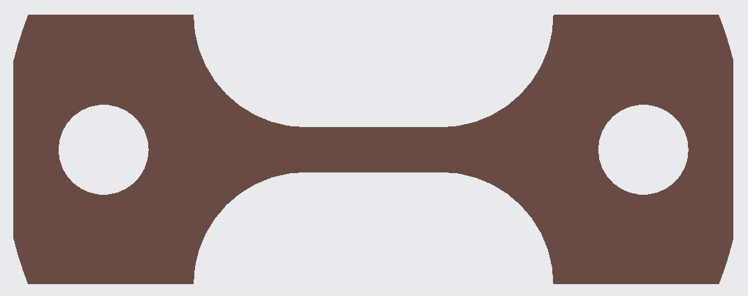
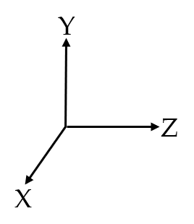
Specimen Development: Design and build direction
Seven EBM printed Ti-6Al-4V tensile test specimens were provided by a company called “Linear AMS” printed with a “GE Arcam EBM Q20plus” printer.
Specimen IDs: X1, X2, Y1, Y2, Z1, Z2, and Z3
The build direction of each specimen is provided in figure 3.
These tensile test specimens were designed and analyzed to break in their gauge length sections (required); the gauge length sections were designed per ASTM Standards E8 and E1450.
Figure 3: CAD Model of the EBM printed Ti-6Al-4V tensile test specimen (left) and build direction coordinate system (right).
5

Slide 6
Specimen Development: Mechanical Properties
The expected room temperature mechanical properties of Arcam Ti-6Al-4V based on the manufacturing standard are provided in Table 1 below.
Table 1: Expected room temperature mechanical properties of Arcam Ti-6Al-4V based on the manufacturing standard.
Tensile Modulus (Msi) (GPa) | Yield Strength (ksi) (MPa) | Elongation to Failure (%) | Ultimate Tensile Strength (ksi) (MPa) | Break Strength (ksi) (MPa)
17.40 120 | 137.79 950 | 14.0 | 147.94 1020
Source: Arcam AB
6

Slide 7
Experimental Setup: Equipment/Instrumentation
Each EBM printed Ti-6Al-4V tensile test specimen was instrumented with the following (see figure 4 on slide 8):
2X HH147U Omega thermocouples; one at the top pin integrating with the specimens and one at the specimen’s gauge length section.
1X HBM P/N 1-LY11-1.5/350 strain gauge with HBM X60 adhesive
Each EBM printed Ti-6Al-4V tensile test specimen was cooled down at 3.6 K/min (to avoid thermal shock) to 77 K by a cooling test chamber (figure 5) and liquid nitrogen.
Cooling Test Chamber: Cooled specimens from 293 K to 150 K
Liquid Nitrogen: Cooled specimens from 150 K to 77 K
Each EBM printed Ti-6Al-4V tensile test specimen was preloaded to 100 lbs (1.6 ksi) while being cooled down and pulled to failure by an Instron 5885 and 4400R.
Each specimen broke in their gauge length sections (required).
7

Slide 8
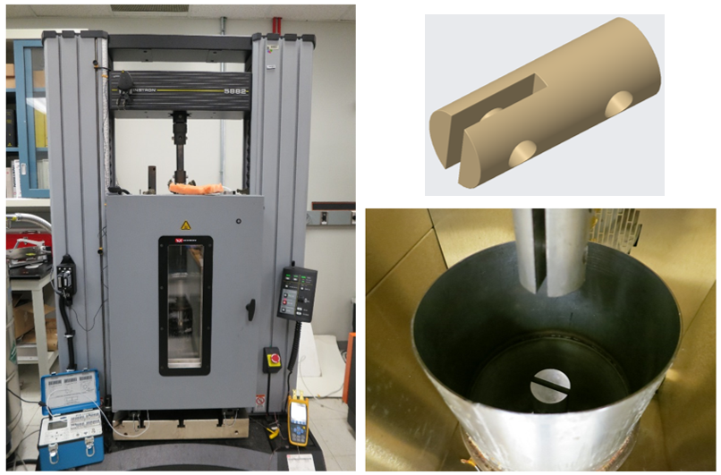
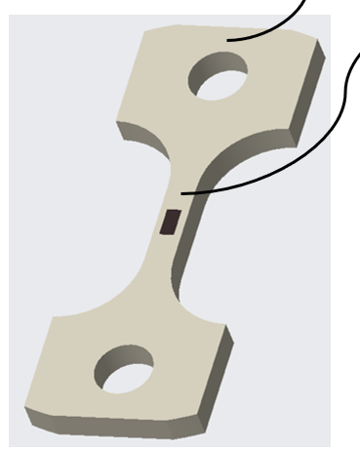
Experimental Setup: Equipment/Instrumentation cont.
Figure 4: EBM printed Ti-6Al-4V tensile test specimen instrumented.
Figure 5: Cooling test chamber integrated with Instron (left); inside cooling chamber (bottom right) with high strength cryo test fixture(top right).
8

Slide 9
Test Results: Cryogenic Mechanical Properties
Table 2: EBM printed Ti-6Al-4V specimen mechanical properties results at 77 K (-321 F)
Specimen ID (-/-) | Test Temperature (F) (K) | Tensile Modulus* (Msi) (GPa) | Yield Strength* (ksi) (MPa) | Elongation to Failure (%) | Ultimate Tensile Strength (ksi) (MPa) | Break Strength (ksi) (MPa)
X1 | -321 77 | TBD | TBD | 19.1 | 228.48 1575.32 | 228.48 1575.32
X2 | -321 77 | TBD | TBD | 19.6 | 227.04 1565.39 | 227.04 1565.39
Y1 | -321 77 | TBD | TBD | 19.1 | 216.96 1495.89 | 216.96 1495.89
Y2 | -321 77 | TBD | TBD | 20.4 | 218.56 1506.92 | 218.56 1506.92
Z1 | -321 77 | TBD | TBD | 19.9 | 214.56 1479.34 | 214.56 1479.34
Z2 | -321 77 | TBD | TBD | 19.8 | 213.12 1469.41 | 213.12 1469.41
Z3 | -321 77 | TBD | TBD | 19.9 | 211.52 1458.37 | 211.52 1458.37
*The tensile modulus and yield strength were NOT obtained because the epoxied cryogenic strain gauges (in their gauge length sections) fell off during cool down from 150 K to 77 K.
9

Slide 10
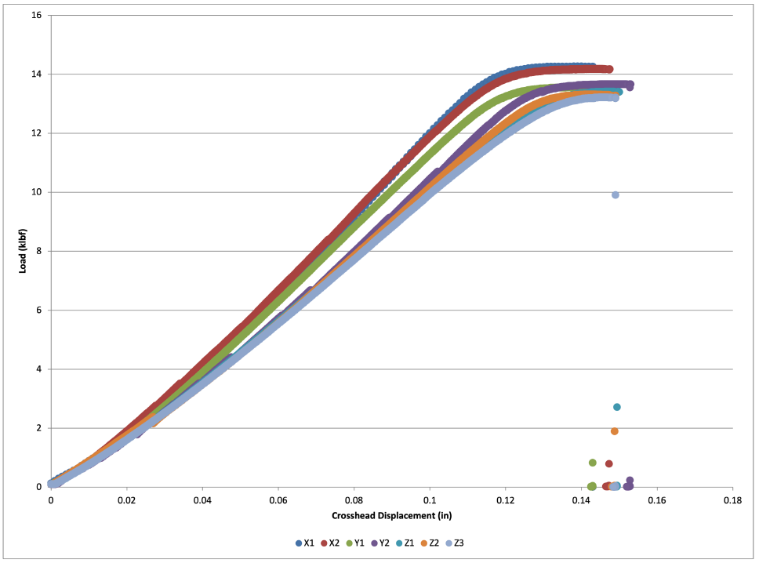
Test Results: Load vs. Crosshead Displacement
Figure 6: Load vs. Crosshead Displacement plots for EBM Printed Ti-6Al-4V specimens.
10

Slide 11
Test Results: Data Comparison
Table 3: EBM Printed Ti-6Al-4V specimen mechanical properties at 77 K (-321 F) compared to their expected mechanical properties at 293 K (68 F) based on the manufacturing standard.
See Table 3 for a comparison of the obtained cryogenic mechanical properties of EBM Printed Ti-6Al-4V to the expected room temperature mechanical properties of Arcam Ti-6Al-4V based on the manufacturing standard.
Future work will include testing specimens at room temperature to make a direct comparison.
Specimen ID (-/-) | Elongation to Failure Percent Increase (%) | Ultimate Tensile Strength Percent Increase (%) | Break Strength Percent Increase (%)
X1 | 36.43 | 54.44 | 54.44
X2 | 40.00 | 53.47 | 53.47
Y1 | 36.43 | 46.65 | 46.65
Y2 | 45.71 | 47.74 | 47.74
Z1 | 42.14 | 45.03 | 45.03
Z2 | 41.43 | 44.06 | 41.43
Z3 | 42.14 | 44.06 | 41.43
11

Slide 12
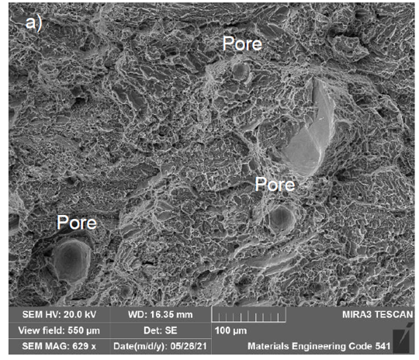
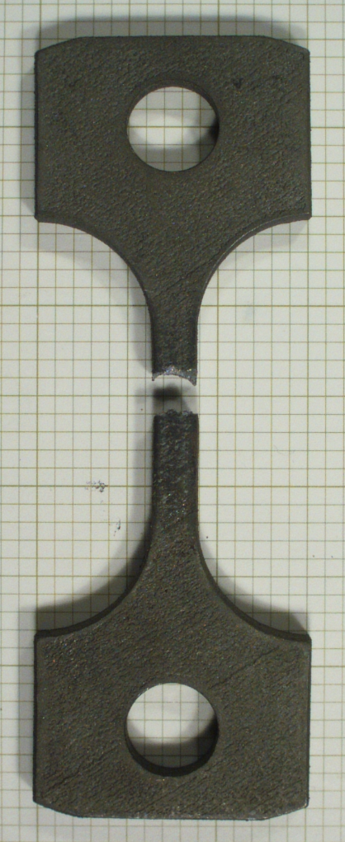
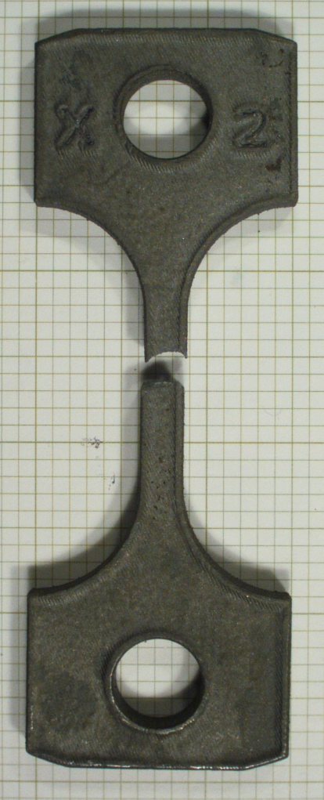

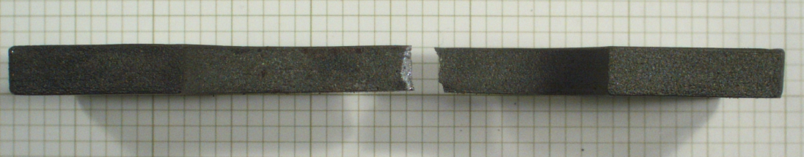
Test Results: Specimens Post Testing X
Figure 8: EBM printed Ti-6Al-4V specimen (X1) fracture surface highlighting pores as a result of gas entrapment during fabrication. These pores contributed to the ductile fracture. Inspected via Scanning Electron Microscope.
Figure 7: EBM printed Ti-6Al-4V specimen (X2) after tensile testing at 77 K (-321 F). Build direction left image.
12

Slide 13
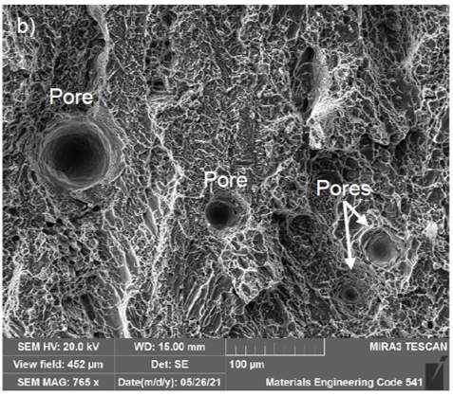
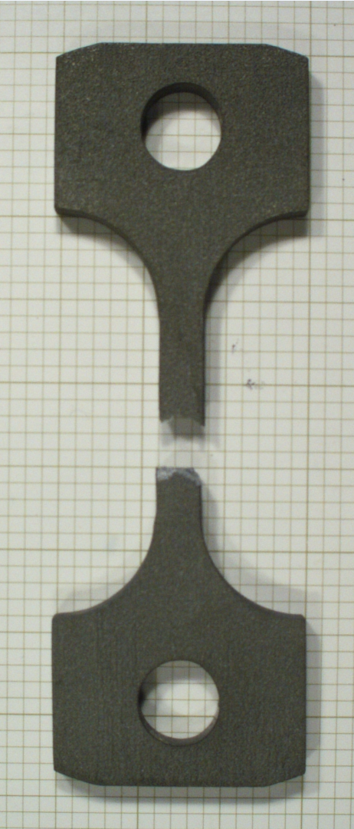
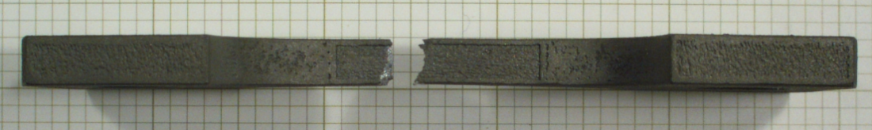
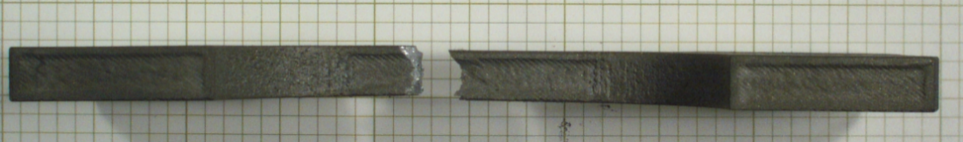
Test Results: Specimens Post Testing Y
Figure 10: EBM printed Ti-6Al-4V specimen (Y2) fracture surface highlighting pores as a result of gas entrapment during fabrication. These pores contributed to the ductile fracture. Inspected via Scanning Electron Microscope.
Figure 9: EBM printed Ti-6Al-4V specimen (Y2) after tensile testing at 77 K (-321 F). Build direction left image.
13

Slide 14
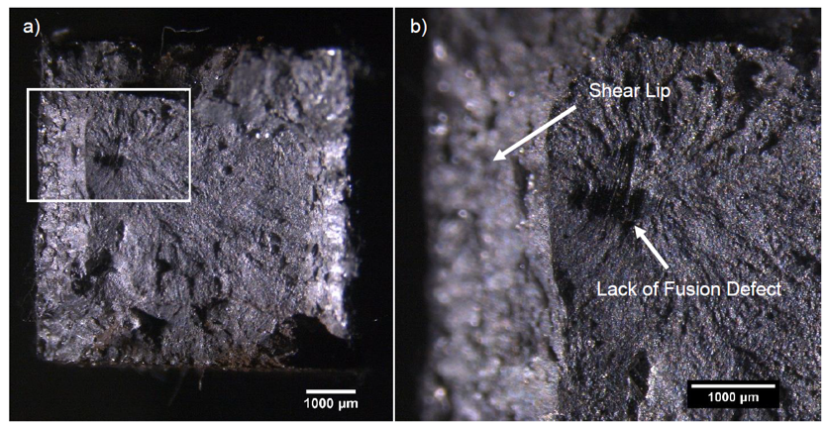
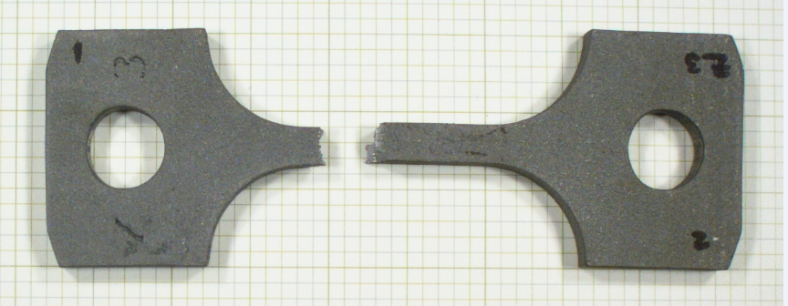
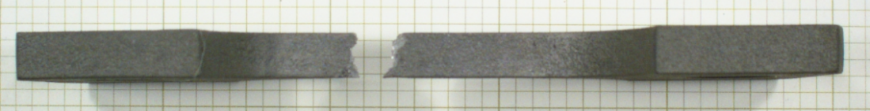
Test Results: Specimens Post Testing Z
Figure 12: EBM printed Ti-6Al-4V specimen (z1) fracture surface highlighting lack of fusion defects that were formed during fabrication. These lack of fusion defects served as the ductile fracture initiation sites. Inspected via Scanning Electron Microscope.
Figure 11: EBM printed Ti-6Al-4V specimen (Z3) after tensile testing at 77 K (-321 F). Build direction left image.
14

Slide 15
Conclusions
EBM printed Ti-6Al-4V components have significantly increased Ultimate Tensile Strength and Break Strength at 77 K as compared to their manufacturing standard expected room temperature values.
EBM printed Ti-6Al-4V components have significantly increased elongation to failure at 77 K as compared to their manufacturing standard expected room temperature values.
EBM printed Ti-6Al-4V has significantly increased Ultimate Tensile Strength, Break Strength and elongation to failure at 77 K as compared to Ti-6Al-4V standard mechanical properties at room temperature.
UTS: 131 ksi
Elongation to failure: 10%
Source: MatWeb Material Property Data
15

Slide 16
Future Work
Mechanical tensile test another batch of EBM printed Ti-6Al-4V specimens at room temperature, 77 K and 4.2 K.
This will provide a direct comparison of the EBM printed Ti-6Al-4V mechanical properties at different temperatures.
Mechanical tensile test another batch of EBM printed Ti-6Al-4V specimens at 77 K with a post-process hot isostatic pressing (HIP) treatment and without a post-process HIP treatment.
This will provide a direct comparison of the EBM printed Ti-6Al-4V cryogenic mechanical properties with and without HIP treatment.
HIP treatment may decrease the porosity in the EBM printed components and in turn may increase yield strength and fracture toughness.
16

