Slide 1
PACE OCI Flight Unit pre-launch spectral characterization
Samuel Kitchen-McKinley¹, Jeff McIntire¹, Hyeungu Choi², Gerhard Meister³, Julia Barsi¹, Brendan McAndrew³, Andrei Sushkov⁴, Barbara Zukowski⁵, William B. Cook³, Ulrik Gliese⁶, Kenneth Squire⁷, Joseph Knuble³
¹Science Systems and Applications, Inc., Lanham, MD 20706, USA
²Global Science & Technology, Greenbelt, MD 20707, USA
³NASA Goddard Space Flight Center, Greenbelt, MD 20771, USA
⁴Genesis Engineering Solutions, Inc., Lanham, MD 20706, USA
⁵Ball Aerospace, Lanham, MD 20706, USA
⁶KBR, 8120 Maple Lawn Blvd, Fulton MD 20759, USA
⁷Space Dynamics Laboratory, North Logan, UT, 84341, USA
July 20th, 2023; IGARSS 2023, Pasadena, CA; Session: NASA PACE Mission

Slide 2
Outline
Introduction
Test setup and measurement description
Analysis methods
System level characterization the of the Flight Unit
  band center, bandwidth, absolute gain,
  relative spectral response (RSR),
  integrated out-of-band response ratio (IOOB)
Conclusions
Acknowledgements
The authors would like to thank the OCI test team, the GLAMR team, and the XINA team for working to provide all the test data. The GLAMR team was especially helpful to properly understand and verify the test data used in this analysis.

Slide 3
OCI Introduction
Rotating telescope
OCI uses a rotating telescope assembly with an Earth view (EV) and dark view (DV) on each scan
A two-sided Half Angle Mirror (HAM) rotates at half the rate of the telescope
Results are calculated separately by HAM side.
  HAM side A results are presented. HAM side B showed similar results.
Light path
Approximate dichroic regions: UV-VIS (340 – 600nm), VIS-NIR (600 – 905nm), SWIR (905 – 2400nm)
Hyperspectral bands
Two slit grating focal plane assembly’s (FPAs)
  Science pixel bands (8x8 aggregation, 5nm bandwidths)
    Used for requirement verification
    Nominal band centers: UV-VIS (340nm-595nm) & VIS-NIR (605nm-885nm)
  Physical pixel bands (8x1 aggregation, 480 bands per FPA. 0.625nm nominal separation)
    8x1 RSRs can be used to form RSR of higher aggregations
    highest spectral resolution results presented here
    Nominal band centers: UV-VIS (307.8125 - 607.1875nm) & VIS-NIR (597.8125 - 897.1875nm)
Multiband filter spectrograph
The SWIR Detector Assembly (SDA) combines 32 detectors into 9 bands
  Nominal band centers: 940, 1038, 1250, 1378, 1615, 2130, & 2260 nm
  1250 & 1615 nm have two separate gain bands. Standard Gain (SG) & High Gain (HG)
Notes:
OCI is the primary sensor on the upcoming PACE mission
It is a rotating telescope based on the SeaWIFS, MODIS and VIRRS heritage
The new part is its two slit grating hyperspectral spectrographs as well as a multiband filter spectrograph
The telescope rotates at approximately 6 Hz with a half angle mirror rotating at half that speed.
Each scan collects an earth view at plus or minus 56 and half deg and an internal dark view
the figure shows a block diagram of the light path
The hyperspectral bands constist of two slit grating focal plane arrays that cover from 340nm to 885nm.
I will refer to them separately as the UV-VIS FPA and the VIS-NIR FPA
the multiband filter spectrograph has 9 SWIR channels from 940nm to 2260nm
The is called the SWIR detector assembly and I refer to it as the SDA
The SDA consists of 32 ingas or mercad detectors that aggregate into 9 bands
There are 7 discrete band centers where 2 of those are dual gain

Slide 4
Test Setup
Absolute calibration source & setup
The Goddard Laser for Absolute Measurement of Radiance (GLAMR) is a monochromatic source
GLAMR is fed to a 20” integrating sphere w. an 8” aperture
Radiance is measured in the sphere near the aperture using NIST traceable calibrated radiometers
OCI nadir view aligned with chamber window in the TVAC chamber at nominal temperature
The integrating sphere aperture is placed 8” from the chamber window and aligned with OCI
GLAMR
Laser
TVAC chamber
Stray light
baffle
20”IS
OCI
GLAMR
Radiometers
Chamber
window

Slide 5
Test Measurements
GLAMR Measurements
Wavelengths
  310 – 2400nm in 1nm steps (in-band) / 10nm steps (out-of-band)
  Four regions 10nm wide centered at 347, 555, 620, and 870 nm in 0.2nm steps (two per CCD)
Radiance
  90% clipping radiance (in-band high gain bands)
  90% expected on-orbit maximum radiance (in-band all other bands)
  Maximum GLAMR radiance (out-of-band)
GLAMR radiance and wavemeter averaged per collect
Data collected Oct 5-15, 2022
GLAMR measurement monitoring and analysis
Measurements were repeated if the GLAMR source was unstable.
Real time monitoring of GLAMR and OCI by test conductors & daily OCI analysis ensured all required data points were recorded stable
Automatic flags and then manual data quality checks made post processing to ensure the best collects were used for each wavelength data point
1386 collects use in this analysis

Slide 6
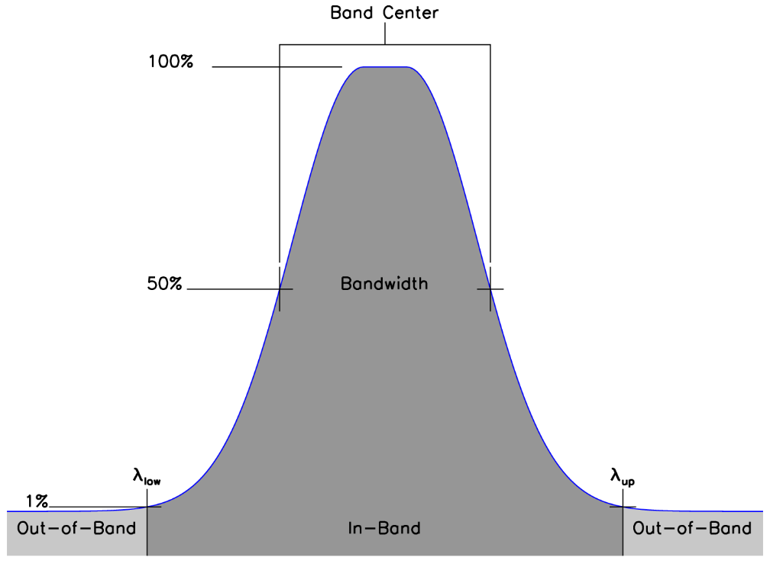
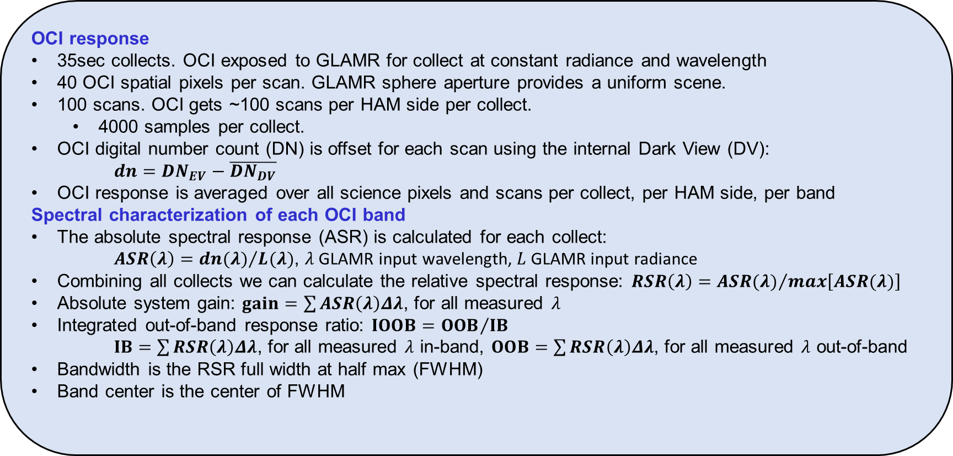
Data Analysis
OCI response
35sec collects. OCI exposed to GLAMR for collect at constant radiance and wavelength
40 OCI spatial pixels per scan. GLAMR sphere aperture provides a uniform scene.
100 scans. OCI gets ~100 scans per HAM side per collect.
  4000 samples per collect.
OCI digital number count (DN) is offset for each scan using the internal Dark View (DV):
  $dn=DN_{EV}−\overline{DN_{DV}}$
OCI response is averaged over all science pixels and scans per collect, per HAM side, per band
Spectral characterization of each OCI band
The absolute spectral response (ASR) is calculated for each collect:
$ASR\left(λ\right)={dn(λ)}/{L(λ)}$, $λ$ GLAMR input wavelength, $L$ GLAMR input radiance
Combining all collects we can calculate the relative spectral response: $RSR\left(λ\right)={ASR(λ)}/{\max\left[ASR(λ)\right]}$
Absolute system gain: $gain=\sum{ASR\left(λ\right)Δλ}$, for all measured $λ$
Integrated out-of-band response ratio: $IOOB={OOB}/{IB}$
$IB=\sum{RSR\left(λ\right)Δλ}$, for all measured $λ$ in-band, $OOB=\sum{RSR\left(λ\right)Δλ}$, for all measured $λ$ out-of-band
Bandwidth is the RSR full width at half max (FWHM)
Band center is the center of FWHM

Slide 7
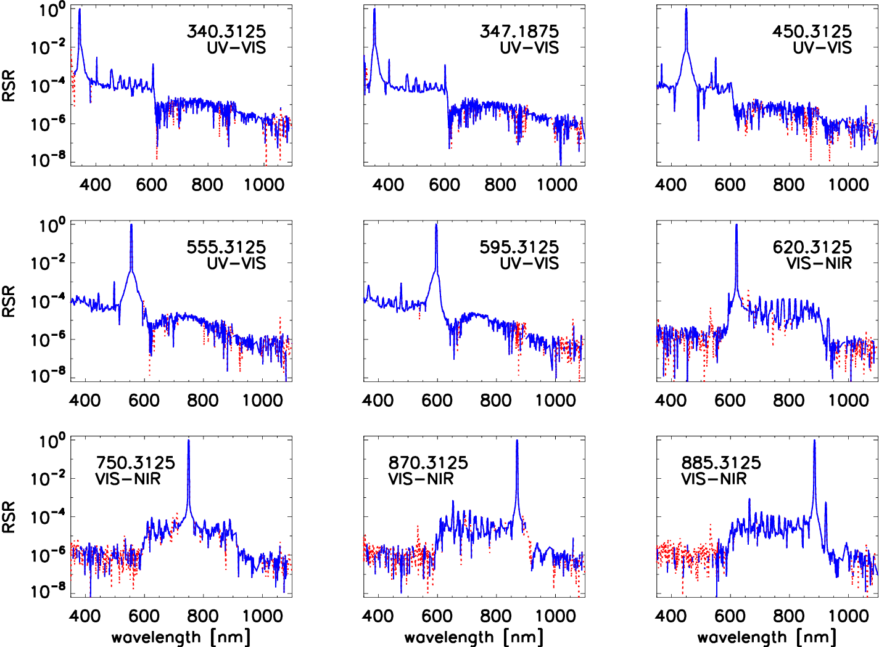
UV-VIS & VIS-NIR RSR results
OOB RSR in log scale
9 select bands from the hyperspectral FPAs
Dotted red lines are absolute values of negative RSR values
Nominal band center (nm) and FPA name shown on each plot
Wavelength range chosen to show more detail in the hyperspectral range
Features
Periodic peaks w/in the band’s FPA spectral region is electrical cross-talk w/ two negative peaks each side of the central peak in most bands
The OOB RSR is based at 10⁻⁵ base & 10⁻⁴ peaks w/in the band’s FPA spectral region 10⁻⁶ outside the band’s FPA spectral region (measurement noise floor)
There is isolated optical cross-talk w/ peaks up to 10⁻³

Slide 8
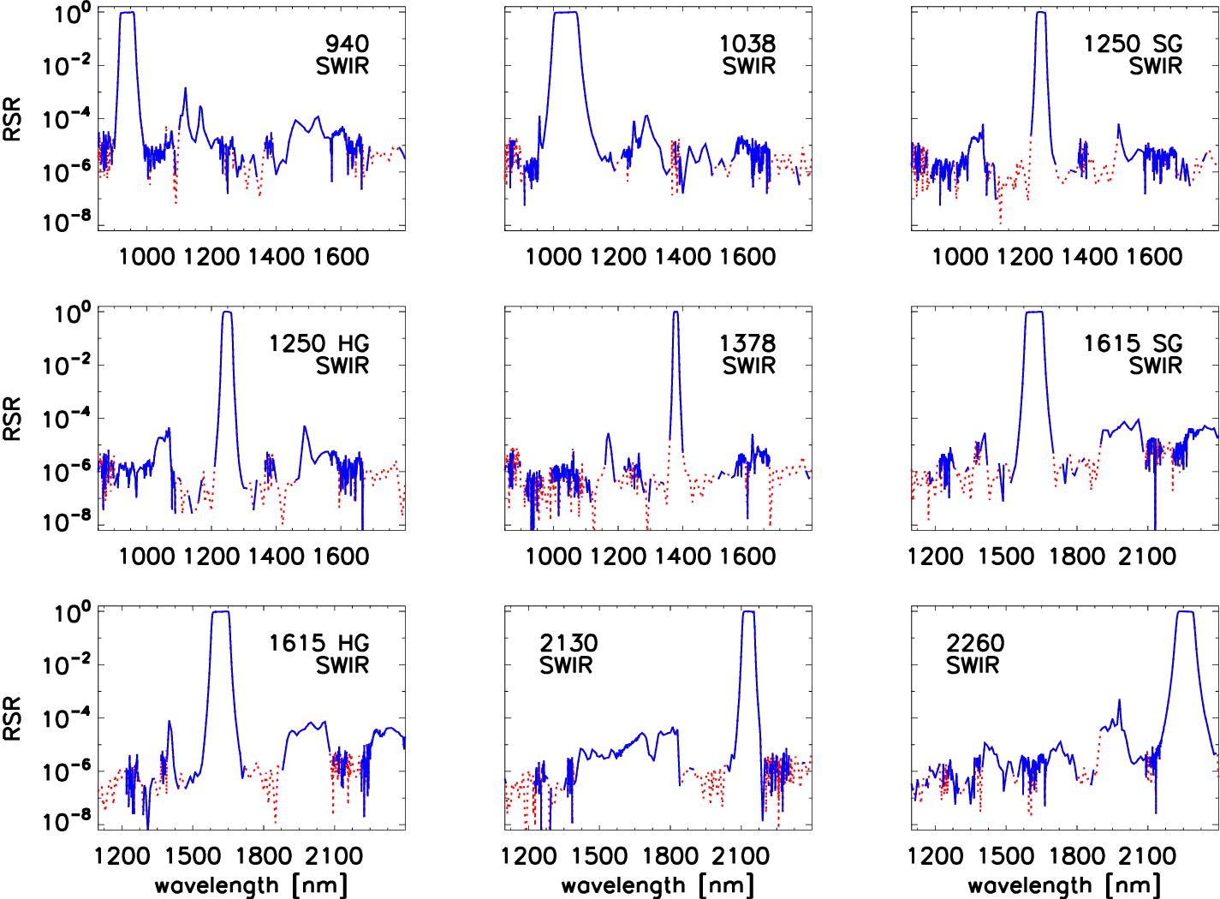
SWIR RSR results
OOB RSR in log scale
All SWIR bands
Nominal band center (nm) shown on each plot
Dotted red lines are absolute values of negative RSR values
Nominal band center (nm) and FPA name shown on each plot
Wavelength range chosen to show more detail in the SWIR range
Features
Most bands show clear OOB features up to 10⁻⁴
OOB measurement noise floor at 10⁻⁶
SWIR OOB lower than OOB for UV-VIS & VIS-NIR

Slide 9
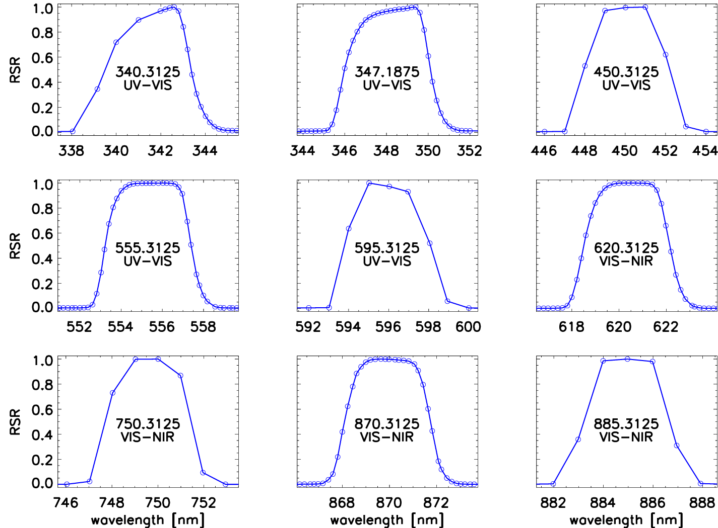
UV-VIS & VIS-NIR RSR results
In-band RSR linear scale
9 select bands from the hyperspectral FPAs
Nominal band center (nm) and FPA name shown on each plot
Circles show measured data points
Examples include the four regions with 0.2nm stepped measurements
Other regions stepped in 1nm steps

Slide 10
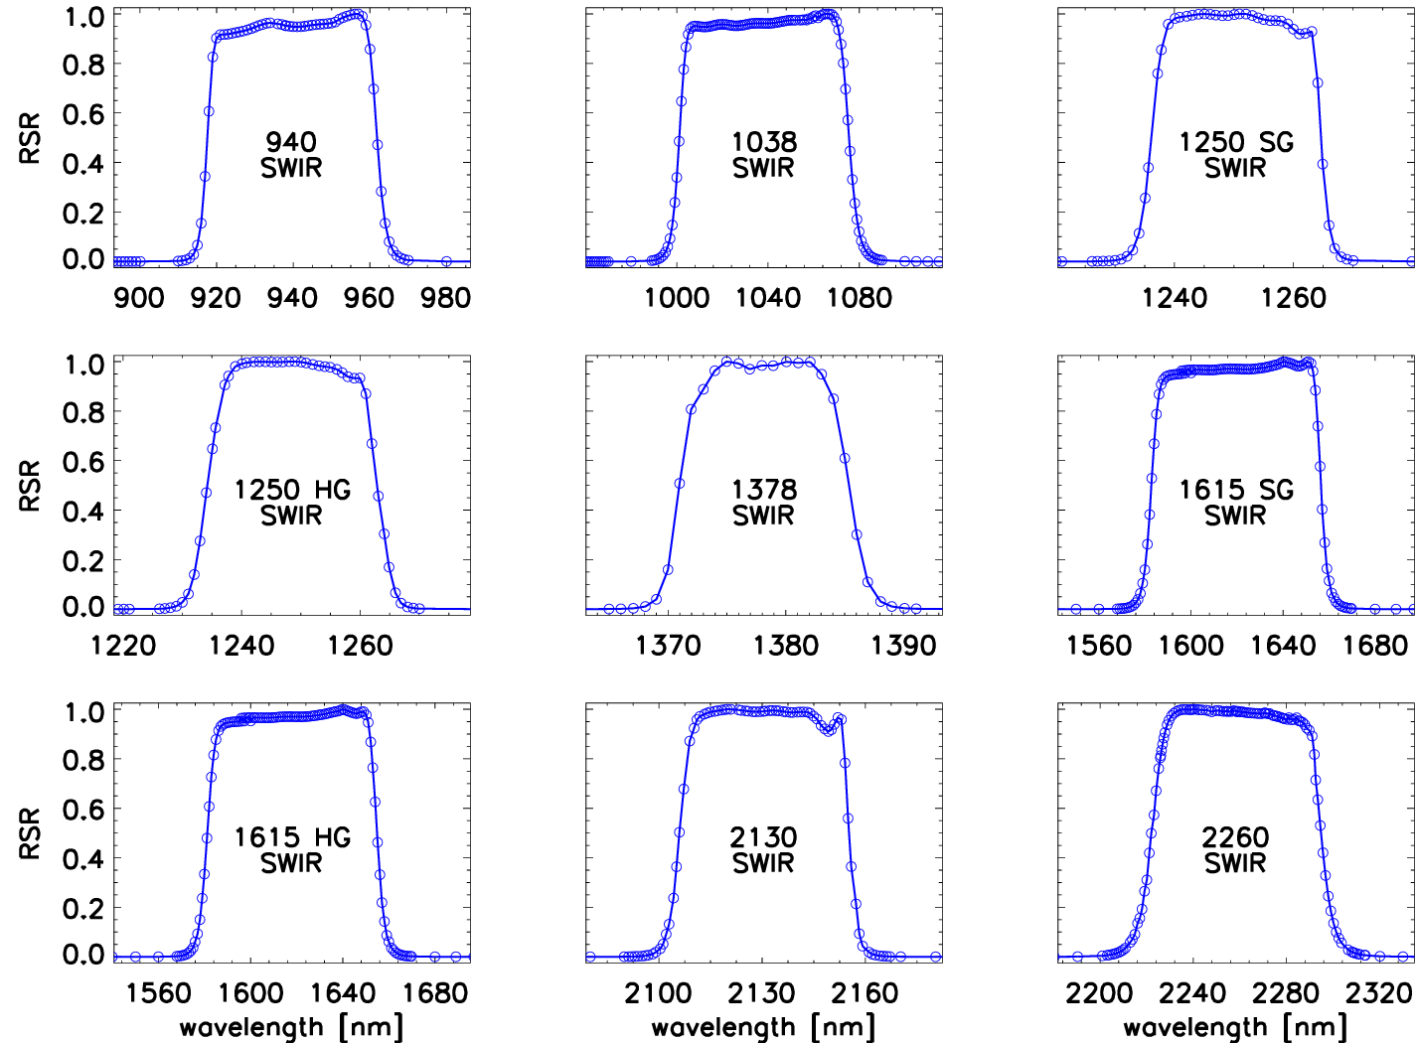
SWIR RSR results
In-band RSR linear scale
All SWIR bands
Nominal band center (nm) shown on each plot
All In-band regions captured with 1nm steps
Circles show measured data points
Features
Most bands show a clear “hump” on the longer wavelength edge of the band

Slide 11
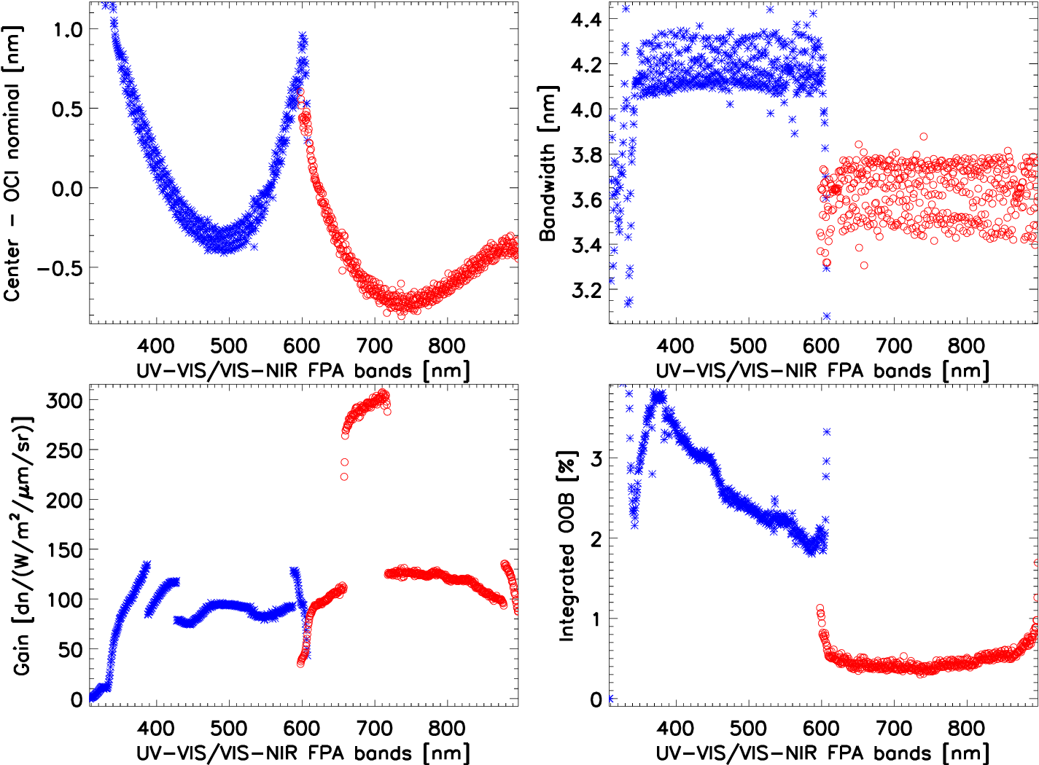
UV-VIS & VIS-NIR Results
UV-VIS (Blue stars) & VIS-NIR (Red circles)
Top Left
Spectral dispersion as the difference from the measured center wavelengths to the nominal center wavelengths of each band.
Measured band centers <1.1nm from nominal band centers.
Spread is because most bands were measured in course 1nm steps
Top Right
Measured bandwidth
UV-VIS: ~4.1nm, VIS-NIR: ~3.6nm.
This is based on the bands measured in fine 0.2nm steps. Spread is because most bands were measured in course 1nm steps
Bottom Left
Measured absolute gain.
Bottom Right
Measured integrated out-of-band response ratio (IOOB).
UV-VIS: 2-4%, VIS-NIR: <1%.

Slide 12
SWIR Results
All measured band centers, bandwidths, and IOOB are within requirements.
Band Name | Specified Center [nm] | Measured Center [nm] | Specified Bandwidth [nm] | Measured Bandwidth [nm] | Specified IOOB requirement [%] | Measured IOOB [%] | System Gain [dn/(W/m²/sr/µm)]
940 SG | 940 ± 4 | 939.7 | 45 ± 4 | 44.3 | ≤ 1.0 | 0.20 | 448
1038 HG | 1038 ± 2 | 1038.3 | 75 ± 4 | 74.4 | ≤ 1.0 | 0.13 | 2028
1250 SG | 1250 ± 4 | 1250.4 | 30 ± 4 | 28.5 | ≤ 1.0 | 0.16 | 684
1250 HG | 1250 ± 4 | 1248.5 | 30 ± 4 | 28.6 | ≤ 1.0 | 0.13 | 5494
1378 SG | 1378 ± 2 | 1378.2 | 15 ± 2 | 14.4 | ≤ 0.7 | 0.19 | 763
1615 SG | 1615 ± 10 | 1619.6 | 75 ± 10 | 73.7 | ≤ 1.0 | 0.11 | 1571
1615 HG | 1615 ± 10 | 1618.0 | 75 ± 10 | 73.6 | ≤ 1.0 | 0.11 | 12186
2130 SG | 2130 ± 5 | 2130.6 | 50 ± 5 | 49.3 | ≤ 1.0 | 0.12 | 4652
2260 SG | 2260 ± 10 | 2258.4 | 75 ± 5 | 72.8 | ≤ 1.0 | 0.18 | 6440

Slide 13
Conclusions
The Flight Unit was tested for spectral characterization in TVAC at nominal temperature using GLAMR as a monochromatic source in October 2022.
All tested OCI bands were found to be within requirements.
The OCI Flight Unit performed as expected based on modeling and the OCI Engineering Test Unit (ETU) that was characterized in 2020 and 2021.
The spectral characterization of the Flight Unit went very well based on lessons learned on the ETU.
  SWIR in-band regions were covered better.
  GLAMR performance was improved to output higher radiance in the UV region from 340nm to 550nm (results below 340nm not shown).
Future work
  Use 0.2nm stepped CCD bands as models to interpolate the 1nm stepped CCD bands, which will improve the band center, bandwidth, and gain accuracy.
  Use SWIR component level RSR measurements to improve OOB accuracy for SWIR bands and use high radiance GLAMR measurements to improve OOB accuracy <340nm.

