Slide 1

Nodal Modeling of Submerged Helium Injection Pressurization of a Cryogenic Propellant Tank
Presented by: Dr. Michael Baldwin, NASA MSFC
Paper co-authors: Dr. Andre LéClair, NASA MSFC
Dr. Alok Majumdar, NASA MSFC

Slide 2
Agenda
Motivation and Background
  Tank pressurization methods
  Generalized Fluid System Simulation Program (GFSSP)
Part 1: Evaporation mass transfer model
  Cho et al. experiments and results
  Centaur test vehicle experiments and results
Part 2: Incorporation of pressurant dissolution mass transfer model
  Cryogenic Propellant Storage and Transfer Engineering Development Unit (CPST EDU) experiments and results
  Cho et al. revisited
Conclusions

Slide 3
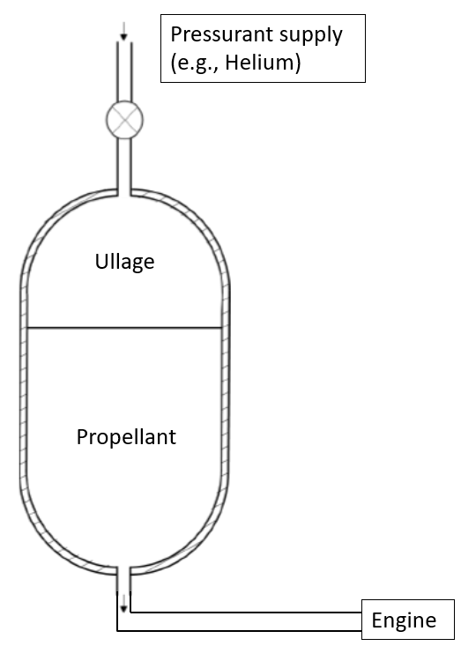
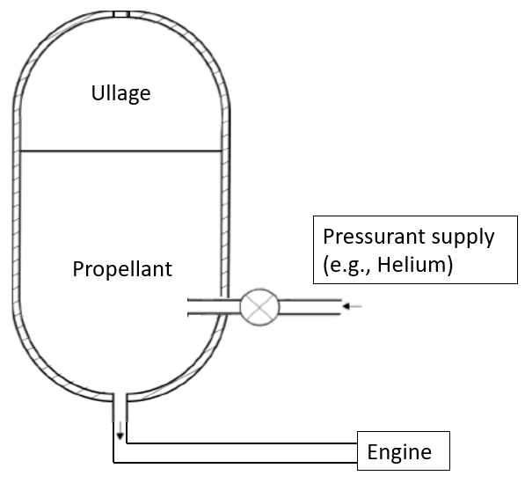
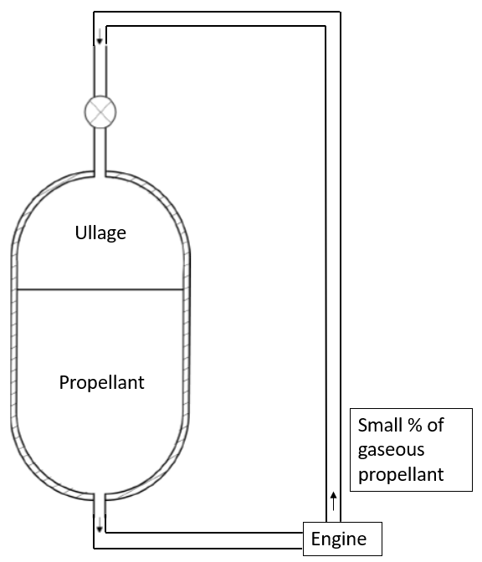
Tank Pressurization Methods
Direct Injection
Submerged (Subsurface) Injection
Autogenous
Straightforward method
Much available data
Propellant subcooling
Reduced pressurant requirements
Reduced risk of ullage collapse
Use propellant to pressurize (second species pressurant not needed)

Slide 4
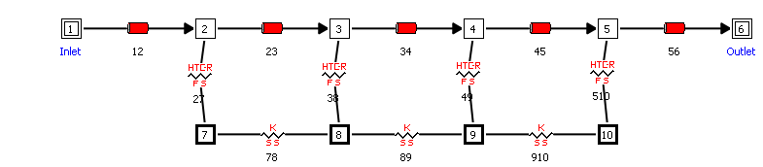
Generalized Fluid System Simulation Program (GFSSP)
System level CFD code developed at NASA in the early 90s
Fluid Nodes: mass and energy equations are solved for pressures and enthalpies
Fluid Branches: momentum equation is solved for flowrates
Fluid network }
Fluid Boundary Nodes
Solid network }
User subroutines are added for advanced physics
Fluid-to-Solid Conductors: conjugate heat transfer
Solid Nodes: solid energy equation is solved for wall temperature
Solid-to-Solid Conductors

Slide 5
Part I: Evaporation Mass Transfer Model

Slide 6
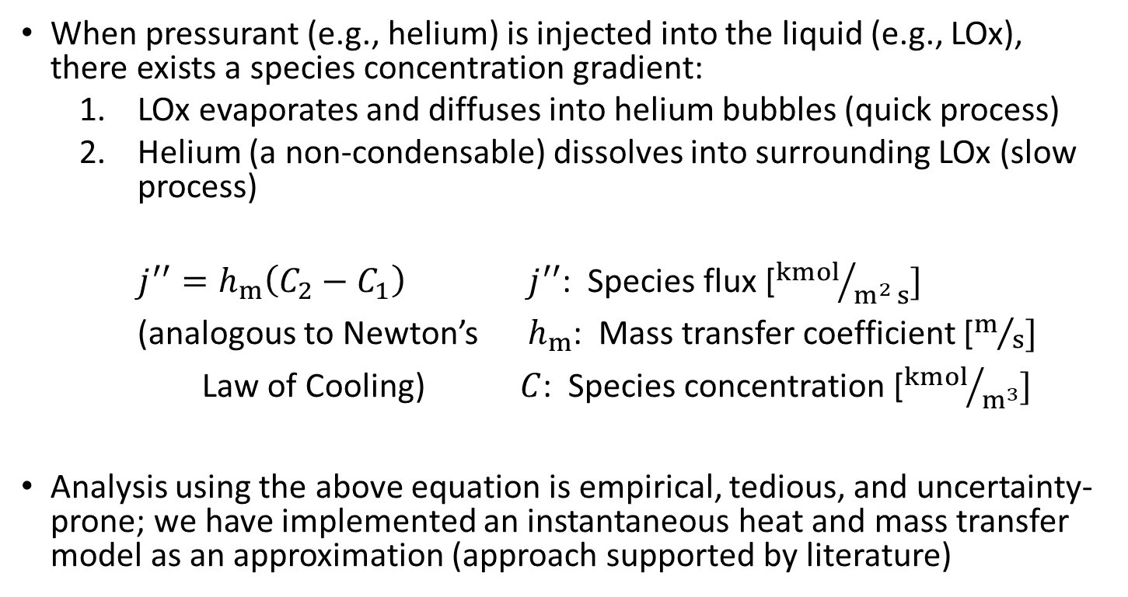
I. Evaporation Mass Transfer Model
When pressurant (e.g., helium) is injected into the liquid (e.g., LOx), there exists a species concentration gradient:
  LOx evaporates and diffuses into helium bubbles (quick process)
  Helium (a non-condensable) dissolves into surrounding LOx (slow process)
$j^{′′}=h_{m}\left(C_{2}−C_{1}\right)$ $j^{′′}$: Species flux [${kmol}/{m^{2} s}]$
(analogous to Newton’s $h_{m}$: Mass transfer coefficient [$m/s]$
Law of Cooling) $C$: Species concentration [${kmol}/{m^{3}}]$
Analysis using the above equation is empirical, tedious, and uncertainty-prone; we have implemented an instantaneous heat and mass transfer model as an approximation (approach supported by literature)
Mass transfer equilibrium time scale on the order of hundredths of seconds
Heat transfer equilibrium time scale on the order of seconds to tens of seconds

Slide 7
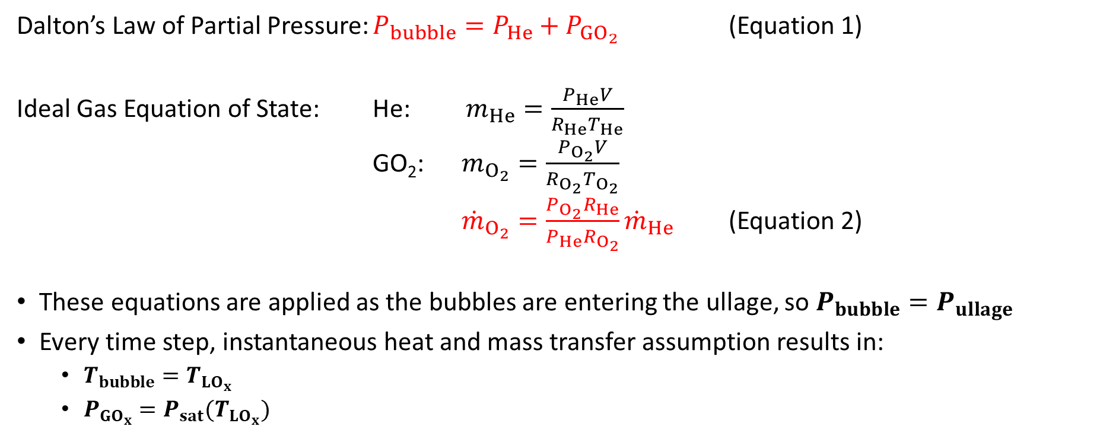
I. Evaporation Mass Transfer Model
Dalton’s Law of Partial Pressure: $P_{bubble}=P_{He}+P_{{GO}_{2}}$ (Equation 1)
Ideal Gas Equation of State: He: $m_{He}=\frac{P_{He}V}{R_{He}T_{He}}$
GO₂: $m_{O_{2}}=\frac{P_{O_{2}}V}{R_{O_{2}}T_{O_{2}}}$
${\dot{m}}_{O_{2}}=\frac{P_{O_{2}}R_{He}}{P_{He}R_{O_{2}}}{\dot{m}}_{He}$ (Equation 2)
These equations are applied as the bubbles are entering the ullage, so $P_{bubble}=P_{ullage}$
Every time step, instantaneous heat and mass transfer assumption results in:
  $T_{bubble}=T_{{LO}_{x}}$
  $P_{{GO}_{x}}=P_{sat}(T_{{LO}_{x}})$

Slide 8
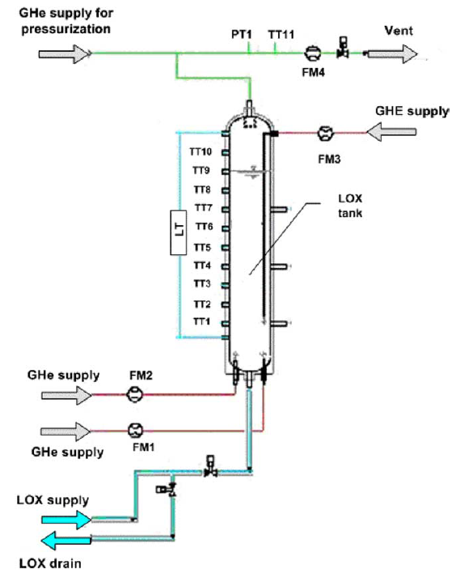
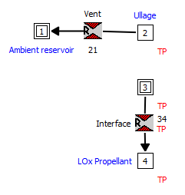
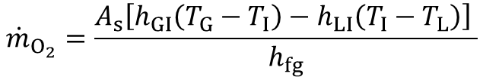

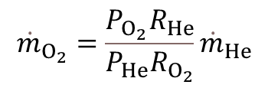
I. Sample Result, Cho et al. [1] experiment (LOx/He)
$${\dot{m}}_{O_{2}}=\frac{A_{s}\left[h_{GI}\left(T_{G}−T_{I}\right)−h_{LI}\left(T_{I}−T_{L}\right)\right] }{h_{fg}}$$
Venting to maintain constant ullage pressure
$${\dot{m}}_{O_{2}}=\frac{P_{O_{2}}R_{He}}{P_{He}R_{O_{2}}}{\dot{m}}_{He}$$
No drain
$$P_{ullage}=P_{O_{2}}+P_{He}$$
Test Case | Initial Fill Volume [L] | Initial Ullage Volume [L] | System Pressure [bar] | Initial LOx temperature [K] | Ambient Heating Rate [W] | Helium Injection Rate [g/s] | Helium Injection Temperature [K]
1 | 65.0 | 25.0 | 1 | 90.8 | 261 | 0.38 | 288
2 | 65.0 | 25.0 | 1 | 90.8 | 261 | 0.25 | 288
3 | 65.1 | 24.9 | 1 | 90.9 | 261 | 0.16 | 288
Test Case | Experimental Time [s] | Experimental Subcooling [K] | Simulated Subcooling [K] | Percent Difference [%]
1 | 1600 | 5.4 | 6.3 | -16.0
2 | 1600 | 4.7 | 5.5 | -18.3
3 | 1600 | 4.3 | 4.5 | -5.2

Slide 9
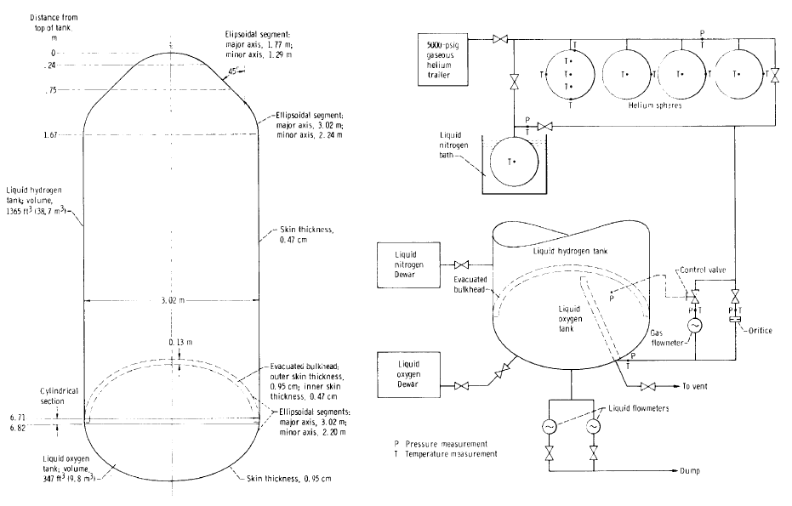
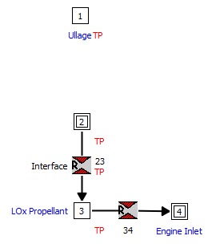
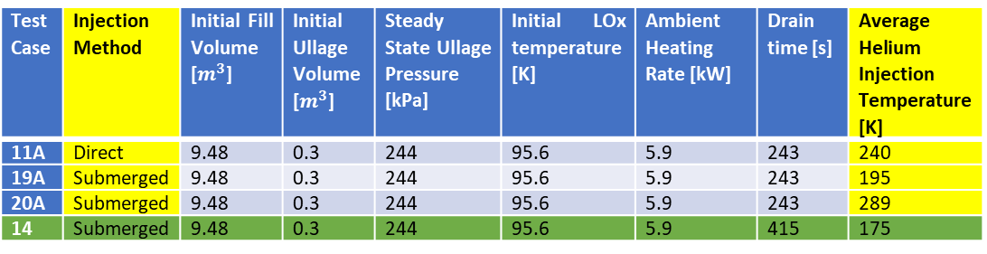
I. Sample Result, Centaur [2] experiments (LOx/He)
Tank draining
Test Case | Injection Method | Initial Fill Volume [$m^{3}$] | Initial Ullage Volume [$m^{3}$] | Steady State Ullage Pressure [kPa] | Initial LOx temperature [K] | Ambient Heating Rate [kW] | Drain time [s] | Average Helium Injection Temperature [K]
11A | Direct | 9.48 | 0.3 | 244 | 95.6 | 5.9 | 243 | 240
19A | Submerged | 9.48 | 0.3 | 244 | 95.6 | 5.9 | 243 | 195
20A | Submerged | 9.48 | 0.3 | 244 | 95.6 | 5.9 | 243 | 289
14 | Submerged | 9.48 | 0.3 | 244 | 95.6 | 5.9 | 415 | 175
Test Case | Exp He Used [kg] | Simulated He Used [kg] | % difference
11A | 4.89 | 4.33 | -13.0
19A | 2.65 | 2.17 | -22.4
20A | 2.55 | 2.15 | -18.7

Slide 10
Part II: Dissolution Mass Transfer Model

Slide 11
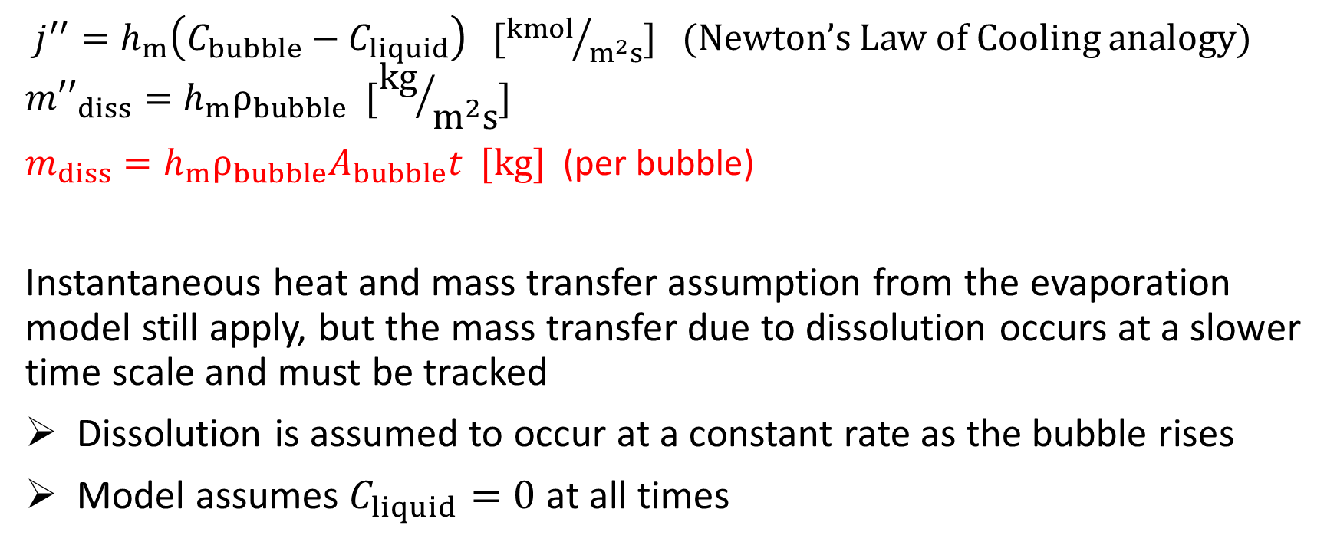
II. Dissolution Mass Transfer Model: physics and assumptions
$j^{′′}=h_{m}\left(C_{bubble}−C_{liquid}\right) [{kmol}/{m^{2}s}]$ (Newton’s Law of Cooling analogy)
$${m′′}_{diss}=h_{m}ρ_{bubble} [{kg}/{m^{2}s}]$$
$m_{diss}=h_{m}ρ_{bubble}A_{bubble}t [kg]$ (per bubble)
Instantaneous heat and mass transfer assumption from the evaporation model still apply, but the mass transfer due to dissolution occurs at a slower time scale and must be tracked
Dissolution is assumed to occur at a constant rate as the bubble rises
Model assumes $C_{liquid}=0$ at all times

Slide 12
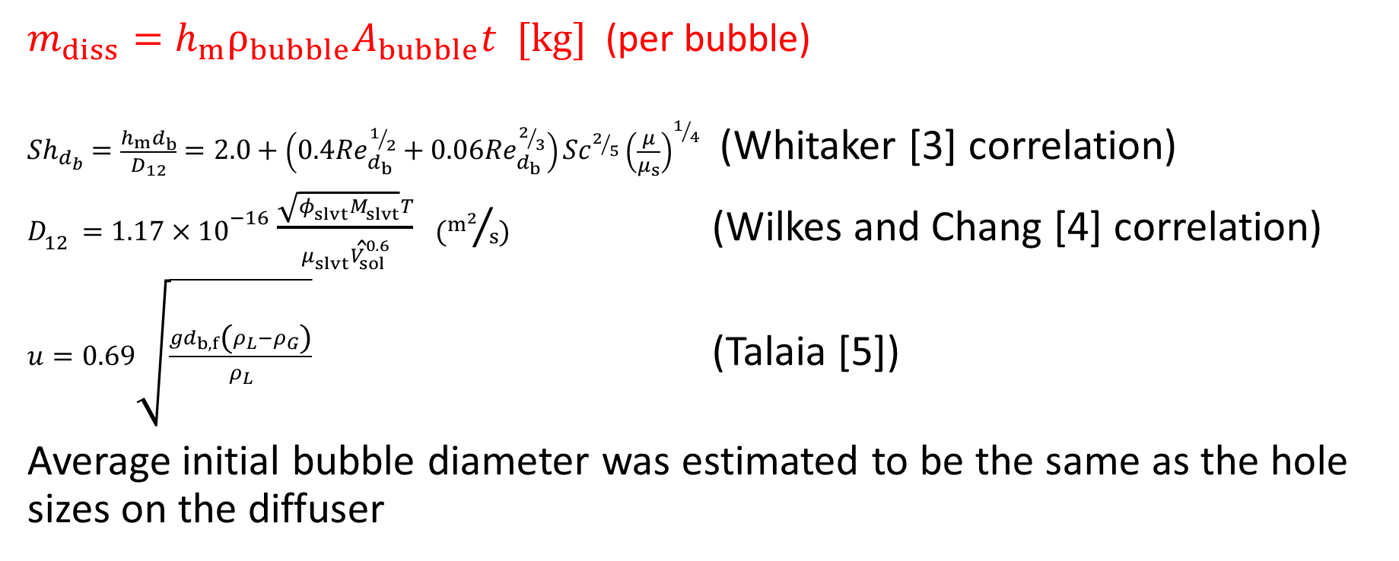
II. Dissolution Mass Transfer Model: unknowns
$m_{diss}=h_{m}ρ_{bubble}A_{bubble}t [kg]$ (per bubble)
${Sh}_{d_{b}}=\frac{h_{m}d_{b}}{D_{12}}=2.0+\left(0.4{Re}_{d_{b}}^{1/2}+0.06{Re}_{d_{b}}^{2/3}\right){Sc}^{2/5}{\left(\frac{μ}{μ_{s}}\right)}^{1/4}$ (Whitaker [3] correlation)
$D_{12}=1.17×{10}^{−16}\frac{\sqrt{φ_{slvt}M_{slvt}}T}{μ_{slvt}{\hat{V}}_{sol}^{0.6}}$ $({m^{2}}/s)$ (Wilkes and Chang [4] correlation)
$u=0.69\sqrt{\frac{gd_{b,f}\left(ρ_{L}−ρ_{G}\right)}{ρ_{L}}}$ (Talaia [5])
Average initial bubble diameter was estimated to be the same as the hole sizes on the diffuser

Slide 13
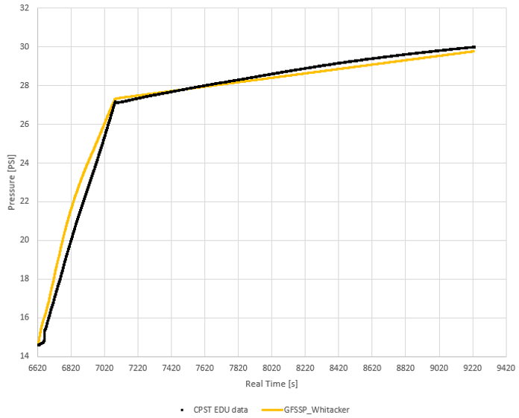
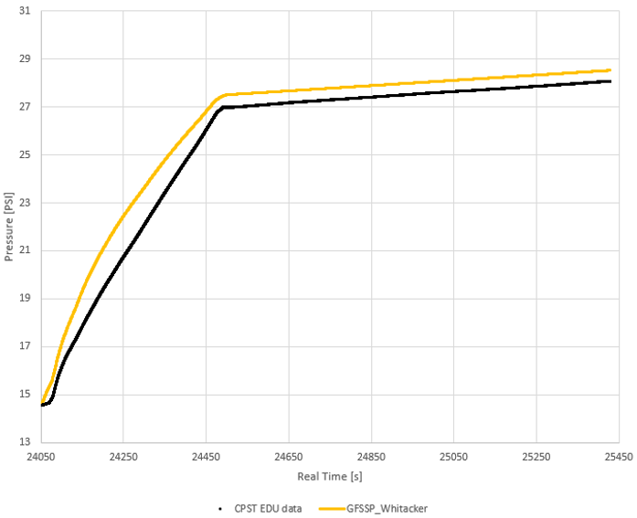
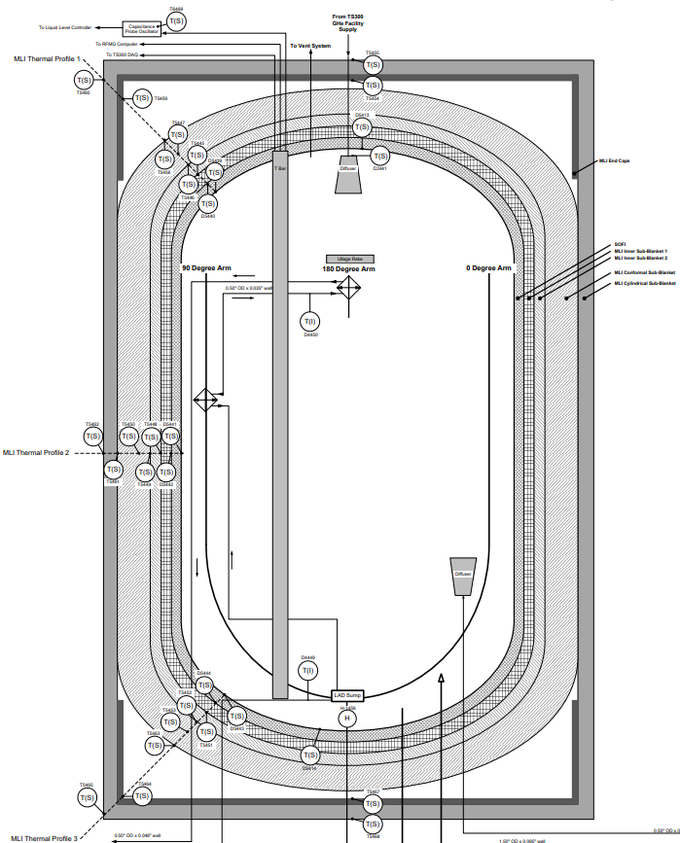
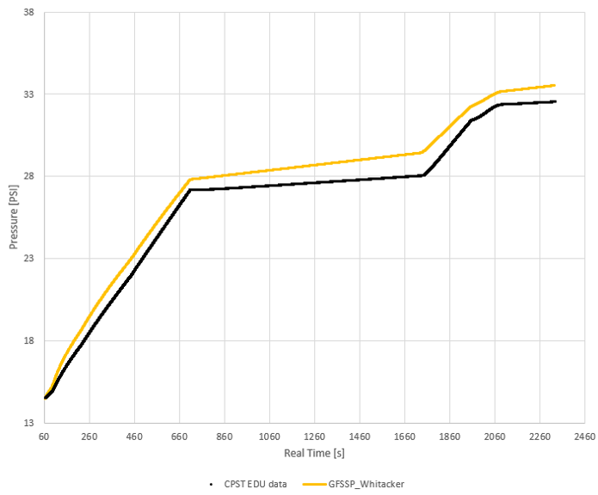
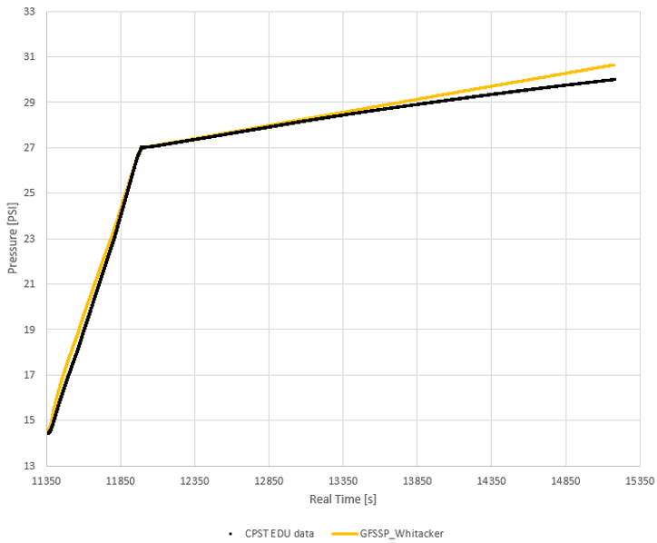
II. Results, CPST EDU tank experiments (H₂/He)

Slide 14
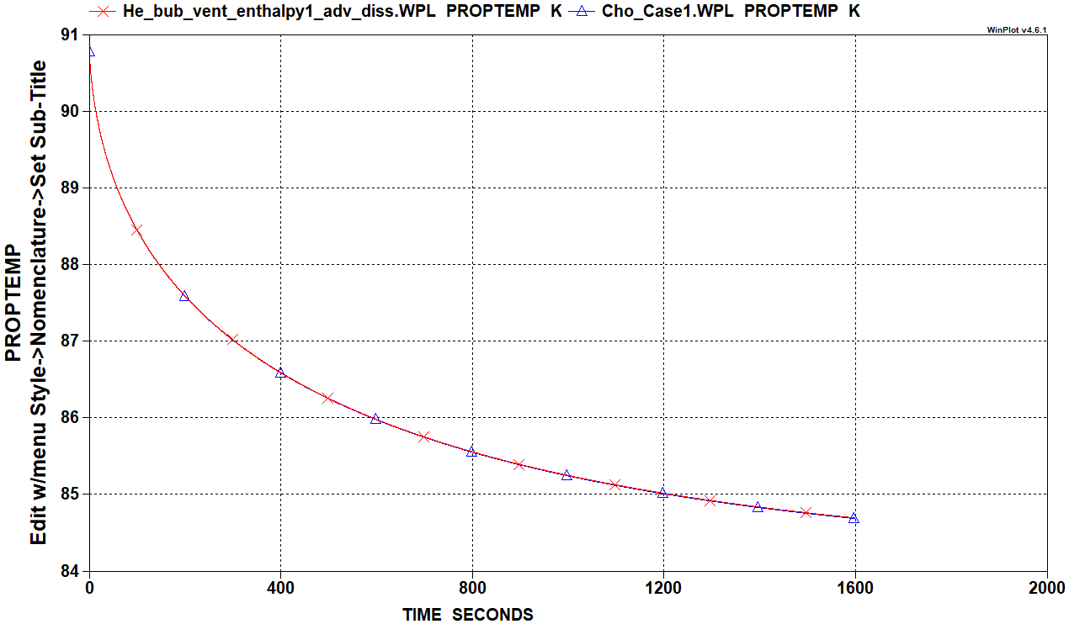
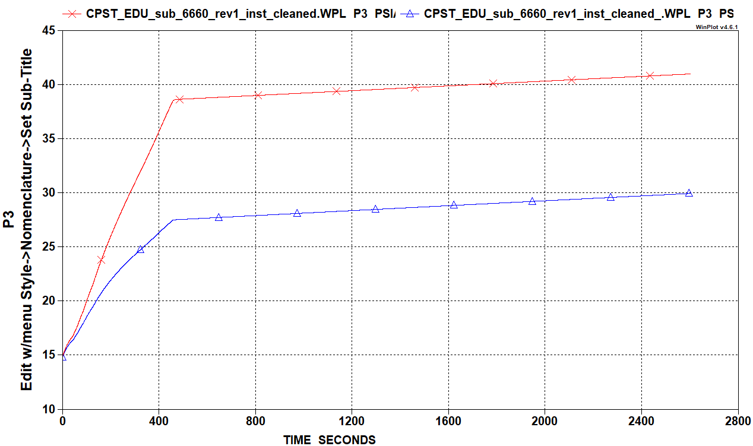
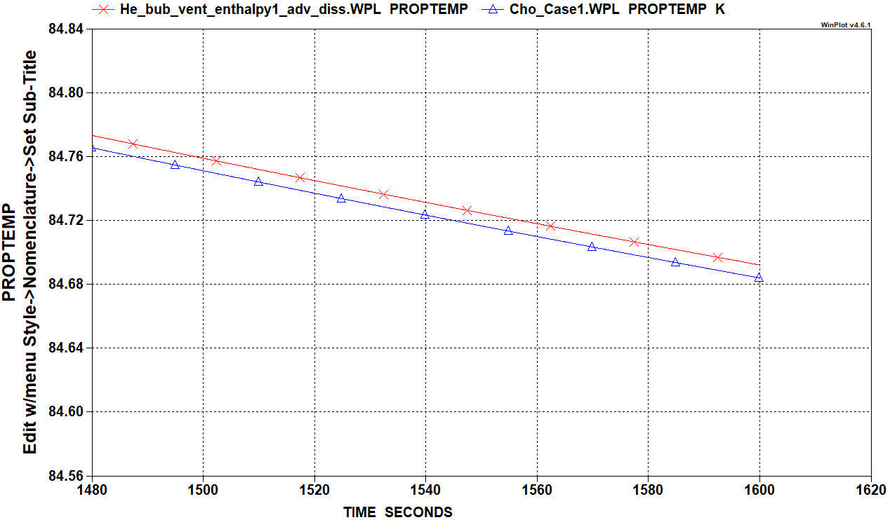
Effect of Dissolution
Cho et al. (LOx)
CPST EDU (H₂)
Red- without dissolution
Blue- with dissolution

Slide 15
Conclusions
LOx/He submerged pressurization systems (w/o dissolution):
  GFSSP can predict liquid subcooling to within 1.5 K for all cases simulated while varying injection flowrate, injection temperature, propellant drain rate, and ullage pressure parameters.
  Helium requirements are predicted to within 20% for all but one case.
H₂/He submerged pressurization systems (w/ dissolution):
  In the four CPST EDU cases simulated, maximum ullage pressure error is less than 10%
  Unknown uncertainty in the two empirical correlations used in model
  Size of injected helium bubbles is unknown and is currently being prescribed
  Without more data, model is insufficient as a predictive tool but is shown to model available data well

Slide 16
References
[1] Cho, Namkyung, et al. "Investigation of helium injection cooling to liquid oxygen propellant chamber." Cryogenics 46.2-3 (2006): 132-142.
[2] Johnson, William R. "Helium pressurant requirements for liquid-hydrogen expulsion using submerged gas injection." (1967).
[3] Whitaker S. Forced convection heat transfer correlations for flow in pipes, past flat plates, single cylinders, single spheres, and flow in packed beds and tube bundles. AIChE J 1972;18.
[4] Wilke, C. R., and Pin Chang. "Correlation of diffusion coefficients in dilute solutions." AIChE journal 1.2 (1955): 264-270.
[5] Talaia, Mário AR. "Terminal velocity of a bubble rise in a liquid column." World Academy of Science, Engineering and Technology 28 (2007): 264-268.

