Slide 1
Managing Uncertainties via Preconditioning Problem Complexity
Natalia M. Alexandrov
NASA Langley Research Center
IEEE/SMC-IT, 19 July 2023
Image credits throughout the talk: NASA, NMA, NMA+AI
Notes:
Shorten examples

Slide 2
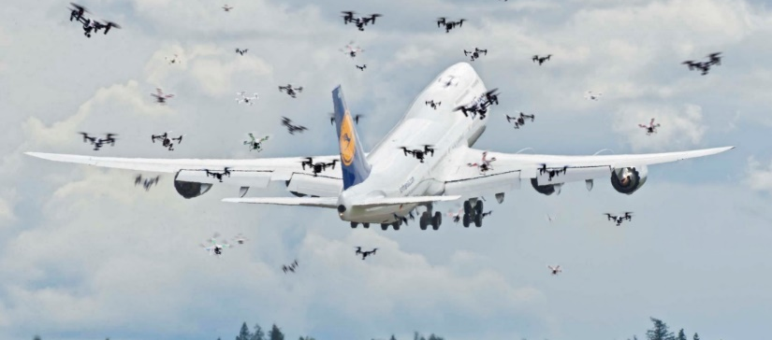




Problem Setting
Unprecedented complexity
Autonomous machine systems and human-machine (HM) teams
Critical aspect of uncertainty in operation of complex systems: the ability of agents to arrive at satisfactory decisions and the attendant actions in time, as a function of problem complexity
HM Teams

Slide 3



Complexity
t
Ɐ action preceded by solution of a decision-making problem
Reducing solvability uncertainty always done via bounding problem complexity; e.g., current airspace
This work:
  Dynamic complexity bound for multiagent systems, both machine and HM
  Additional challenge for machine component: must have explicit problem formulation
  (Beneficial) side effect: an approach to informing decision allocation
Desiderata:
  Represent complexity in computable, actionable form
  Detect approaches to unacceptable complexity
  Reconfigure system to forestall transition to unacceptable complexity & back when resolved

Slide 4
Proposed Measure of Complexity
Here rely on formulating decision-making as optimization; other formulations possible
Complexity
Tractability, with a look ahead, of the problem solution on a time budget, as a function of external and internal parameters
+
The quality of solutions of the decision-making problem measured in terms of constraint satisfaction, optimality, and robustness
+
Other context-dependent criteria

Slide 5
Conceptual Reasoning Framework
Given:
An agent and a goal
Initialize:
Set time t=0
Set initial sampling time interval Δt
Set initial look-ahead time T
Set initial look-ahead sampling time interval Δτ
Select initial problem-solving algorithm P
Select environmental complexity parameters C
Select initial environmental complexity model M
Select transition criteria
Select stopping criteria

Slide 6
Conceptual Framework, cont.
Do until (stopping criteria are satisfied)
Acquire and assess complexity parameters C at time t
Set τ = t
Do while (τ ≤ t + T)
Estimate look-ahead complexity parameters at time τ
τ = τ + Δτ
End do
Input complexity parameters into complexity model M; assess approach to phase transition
If (approach to transition detected) then
Reconfigure operations (“add structure”)
Else
Assess system’s performance slack
If (slack)
Reconfigure operations (“relax structure”)
Else
Continue present operations
End if
End if
Update time
End do

Slide 7
Example: ab initio air traffic control
Problem:
Compute trajectory of an aircraft from point A to point B
No assumption on structure
Complexity parameters:
External:
Internal, e.g.: physical properties of the aircraft and computational properties of decision-making algorithms
Tractability:
Solving trajectory optimization problem on a time budget
Metrics for quality of solutions of the decision-making problem:
Constraint satisfaction
Optimality
Robustness: robust solutions live in the regions of space that allow for many alternative solutions (e.g., flexibility preservation, Idris et al.).
Interaction activation
Density and heterogeneity of the relevant airspace volume

Slide 8
MAGE (Monitor, Anticipate, Guide, Evolve) for Air Traffic
Complexity model construction:
Reconfiguration: change in the decision problem objectives, constraints, and variables
  Directed modification
  Autonomous, distributed modification with emergent outcomes
  Hybrid directed-autonomous
  Example: reduce weight of the delay objective in high-risk, dense environment
Decision-making strategies:
  Solution strategy (e.g., optimization) affects the outcome of actionable complexity prediction
  As new capabilities arise, complexity models must be re-calibrated
Number of aircraft
Aircraft velocities
Decision-making scheme
Machine Learning Model
(or Other Data-Fitting Model)
Estimate of solution time
Estimate of solution quality

Slide 9
Preliminary Computational Results
Operation setup in ATMLG (Air Traffic Monotonic Lagrangian Grid)
  Initialize system
    N = number of aircraft
    System aircraft interaction distance (10 mi)
    Set time t_{i} = start time_{i} (can be 0 or chosen randomly from a set) for i=1,…,N
  Do Ɐ 10 sec until End
    ID all aircraft in conflict (within interaction distance)
    For Ɐ aircraft in conflict, select: {x₁ = Δ heading±45°, x₂= Δ speed±10 kt, x₃= Δ altitude±1000 ft}
    For Ɐ pair of aircraft in conflict, formulate a constraint:
      Compute t of closest approach for 2 aircraft based on current position, heading and speed (regardless of altitude)
      Compute separation distance between the 2 aircraft at t of closest approach
      Compute a projected altitude factor
        $f_{1}$ = $1 − \frac{\left({alt}_{1} −{ alt}_{2}\right)}{{Alt}_{sep}}$ $f_{2}$ = $1 − \frac{\left({alt}_{2} − {alt}_{1}\right)}{{Alt}_{sep}}$ $g= \left(1 − \frac{{distance}_{closest}}{{distance}_{allowed}}\right) ∗ f_{1} ∗ f_{2}$
    Solve minimize$\sum{{\left(\frac{x_{i}}{{scale}_{i}}\right)}^{2}}$, subject to g ≤ 0
  End Do

Slide 10
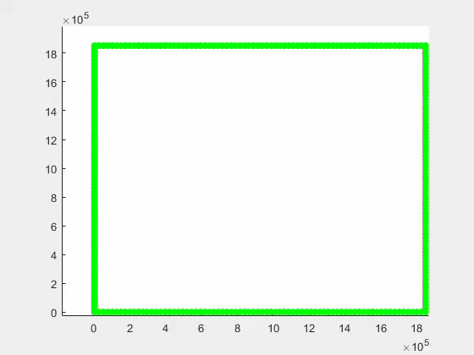
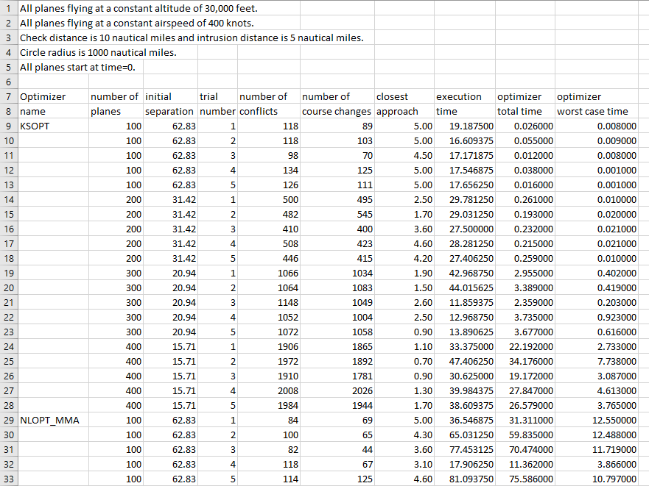
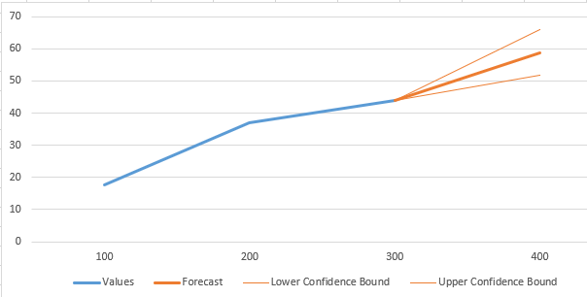
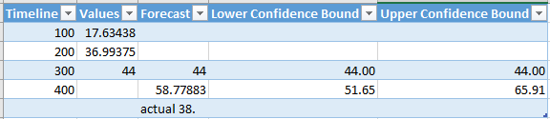
Sample of Outcomes
Training set
Validation set
Different optimizer

Slide 11
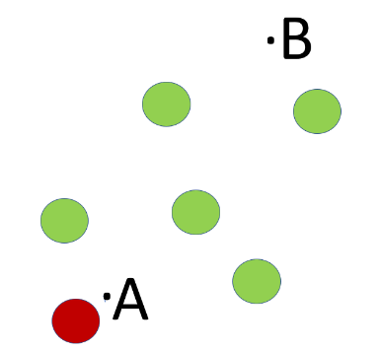
More Numerical Tests of Tractability Prediction
Shortest Path Finding via Visibility Graph
Minimization of Deviation from Optimal Path
# obstacles | # scenarios | Avg. # solutions | Avg. time to solution (sec) | # test scenarios | Avg. # test solutions | Avg. % time prediction Δ
4 | 100 | 97 | 0.86 | 25 | 24 | 0.02
5 | 100 | 89 | 1.31 | 25 | 19 | 0.07
10 | 100 | 34 | 324.33 | 25 | 7 | 2.03
20 | 100 | 2 | 4800.00 | 25 | Not found | N/A
Detect trends in computational tractability of simple decision problem formulations, using examples of two formulations and two decision-making schemes.
Results to date indicate that further development of the planned complexity models is justified.
# obstacles | # scenarios | Avg. # solutions | Avg. time to solution (sec) | # test scenarios | Avg. # test solutions | Avg. % time prediction Δ
4 | 100 | 94 | 0.38 | 25 | 25 | 0.01
5 | 100 | 100 | 0.37 | 25 | 23 | 0.01
10 | 100 | 83 | 11.60 | 25 | 24 | 0.03
20 | 100 | 86 | 64.52 | 25 | 19 | 0.05

Slide 12
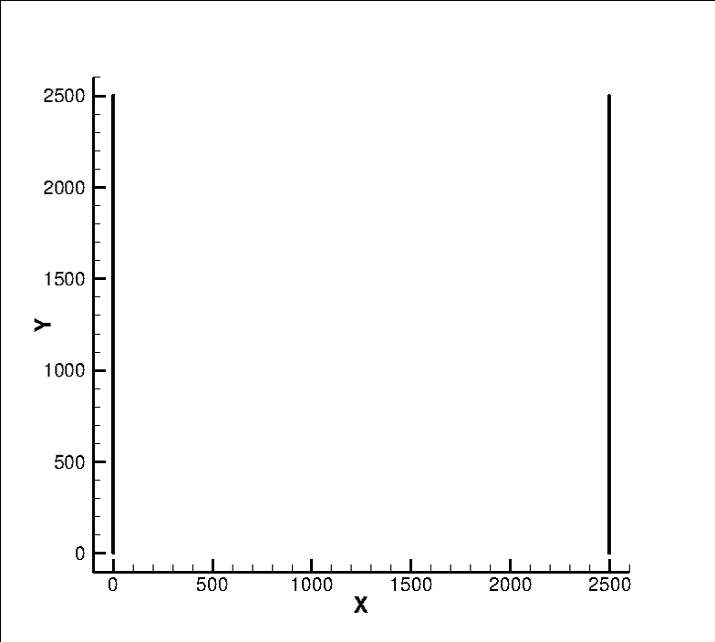
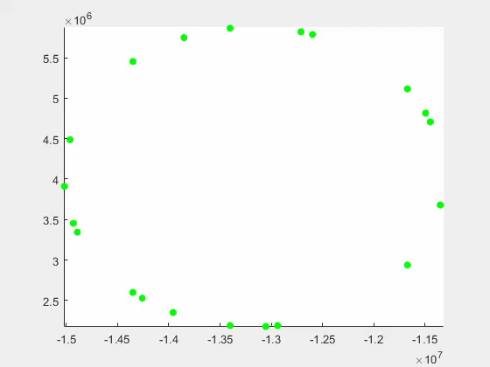
In Progress
Problem
  Suppose perfect information is available to all
  Suppose all participants use the same optimization algorithm
  Satisfactory solutions not guaranteed
Current computational setup: Locally centralized
To do:
  Find the minimum necessary (and sufficient?) commonality in heterogeneous decision-making to ensure viability of any architecture
Information and
decision-making
assumptions

Slide 13
Evaluating Approach
Metrics
Accurate detection of shifts in tractability and quality of solutions from nominal?
Clear ID of dependence of precursors (slowing down of solutions, shrinking of feasible regions) as a function of variables?
Low percentage of false positives?
Note: Comparative metrics are not available because there is no baseline SOA.
Risks
In shared-rules approaches, low risk
In algorithmic decision-making, the risk of not detecting precursors in time is higher.
Mitigation: Lack of detectable precursors will point to the need for different control schemes.
Rewards
Insights into practical sensitivities of a dense, heterogeneous system to control strategies and uncertainties.
A component in a toolbox for monitoring system controllability, efficiency, and safety, regardless of the overall control strategy.

Slide 14

Concluding Remarks
The idea: reduce uncertainty in reaching successful decisions via “conditioning” the system to be simple enough to allow each agent to solve its problem in time.
Cautiously optimistic about proof of concept:
  For a centralized or distributed solution, the onset of complexity is detectable in advance
  Reconfigurability can be controlled automatically
  For practical solution, need a minimum necessary set of information requirements for any viable architecture
  In the case or air traffic, few problem formulations will be used
  Caution: uncertain whether patterns will emerge for general NLP
Authority allocation aspect:
  Reconfiguration may involve transfer of authority to alternative decision-maker
DOE of more realistic scenarios in development for data collection and complexity model construction.
Acknowledgments
The author thanks the NASA LaRC CIF/IRAD Program for supporting this work.

