Slide 1
Advanced Air Mobility

Slide 2
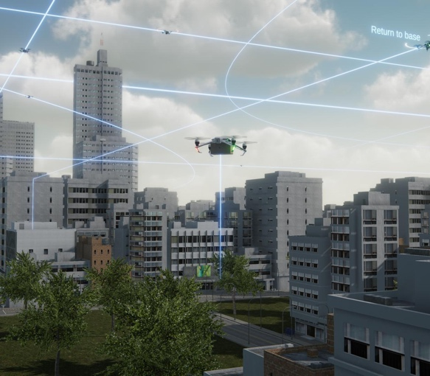
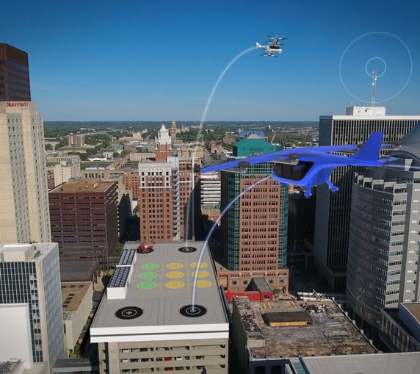
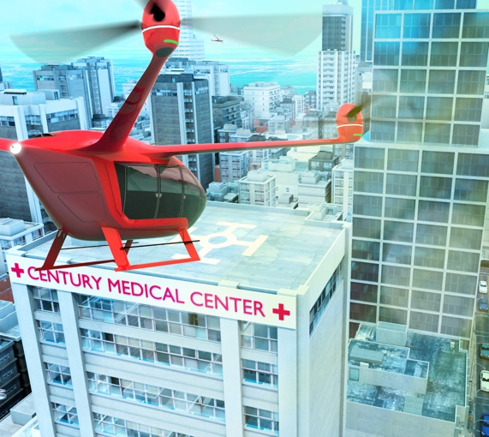
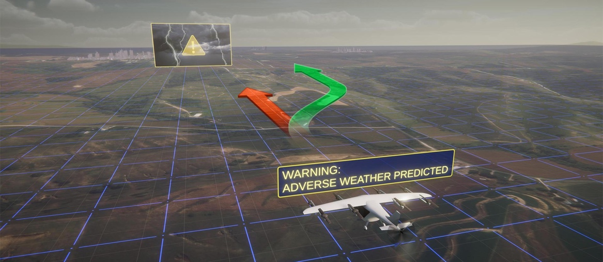
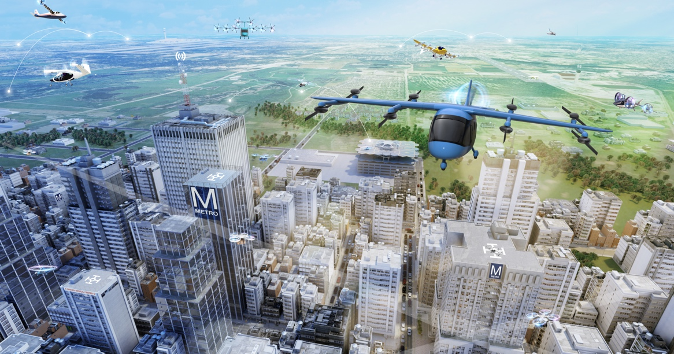
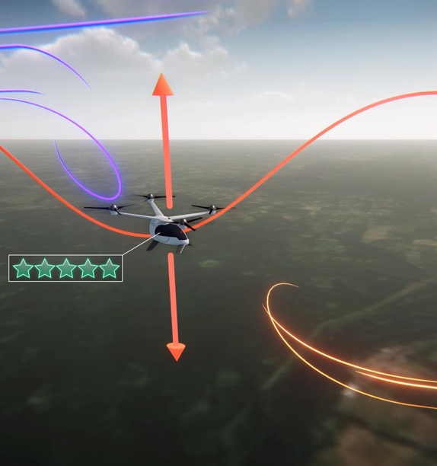
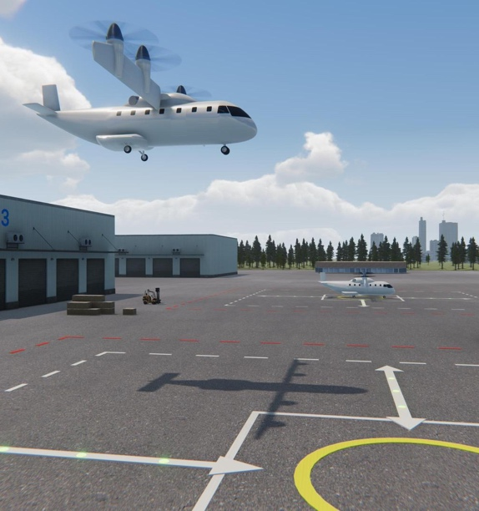
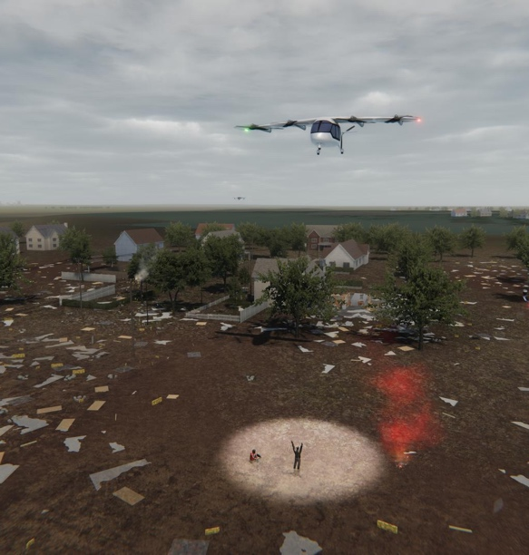
What does Advanced Air Mobility (AAM) look like?
This air transportation system of the future will include low-altitude passenger transport, cargo delivery, and public service capabilities

Slide 3
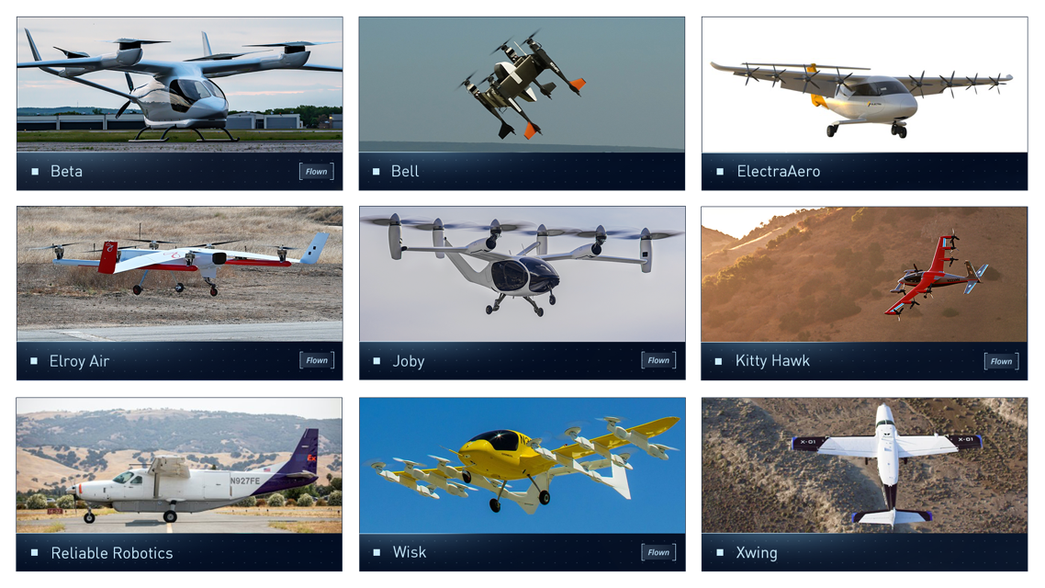
Strong Domestic AAM Industry Base
According to a 2021 Deloitte study the U.S. AAM market could reach $115 billion annually, potentially creating 280,000 jobs

Slide 4




NASA’s Areas of Research
COMMUNITY INTEGRATION
AIRSPACE
INFRASTRUTURE
AIRCRAFT
How these aircraft will fly routinely in cities and rural areas
Integration with already established transportation systems, buildings, and city policy
Communication between aircraft and air traffic control
Location of aircraft in the airspace while flying
Automation of air traffic control systems for unexpected events
Vertiport research, where the aircraft will take off and land
Power research, how the aircraft will be powered
Digital support for aircraft and operators
Safety of the aircraft design materials
Noise of the aircraft, making sure it is quiet
Ride quality for passengers
Aircraft automation – software and hardware for self flying aircraft
Notes:
These are just a few areas of AAM that NASA is researching

Slide 5



Transfer Data to the FAA
As NASA research is ongoing, the data and results are being transferred to the Federal Aviation Administration to help influence future rules and policy.
NASA is answering questions like:
What are the design requirements for safe and quiet vehicles?
What are the pilot training qualifications to fly these aircraft?
What infrastructure would an airport need to include to support these aircraft?

Slide 6
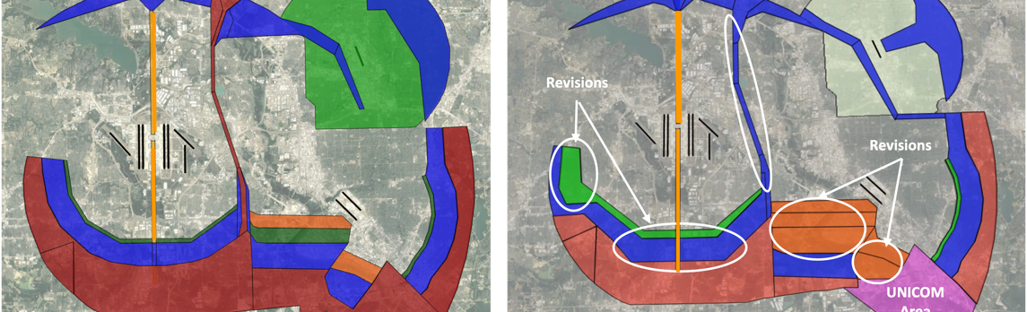
Airspace Integration for Urban Air Mobility
Minimalize disruption of current aviation operations
Avoid excessive noise above neighborhoods
Maintain acceptable Air Traffic Controller workload
Routes that enable economic viability

Slide 7
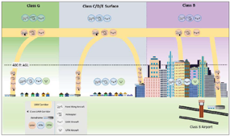
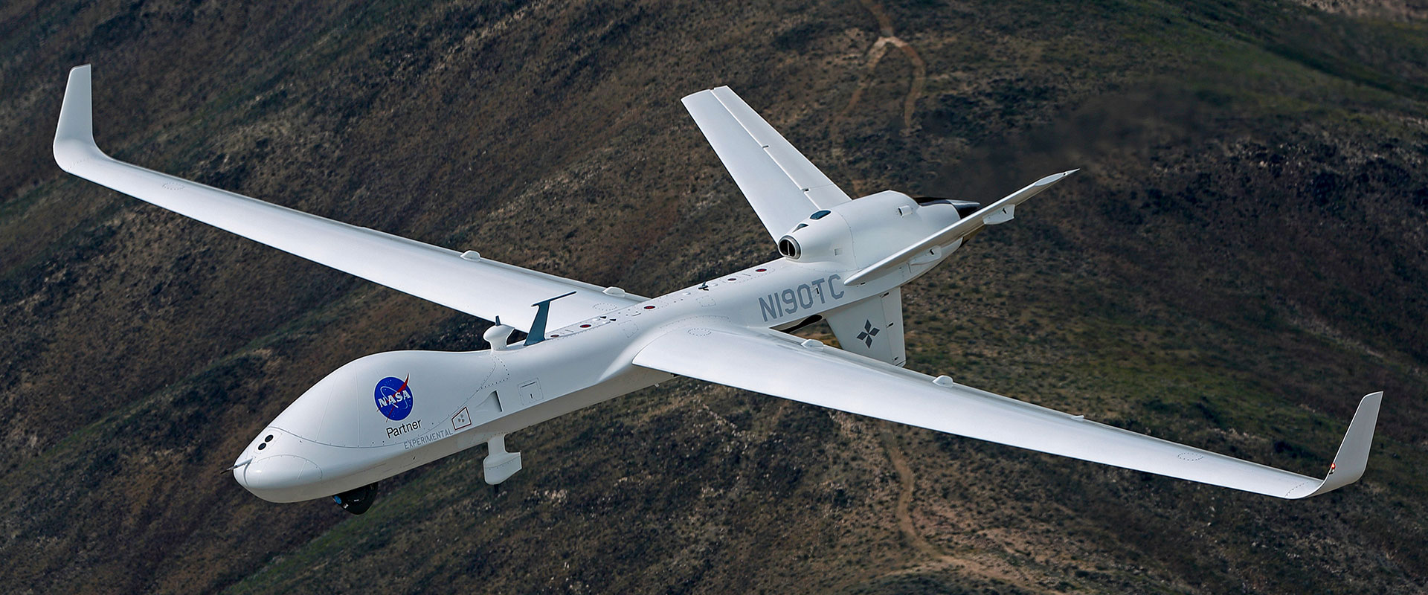
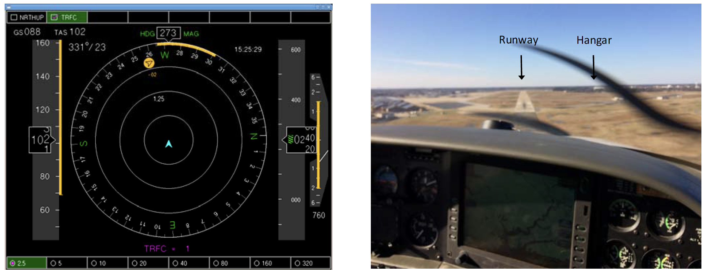
Conflict Management
Strategic Deconfliction
Minimize the need for inefficient deconfliction maneuvers and holding
Shared intent
Demand and capacity balancing
Scheduling
Tactical Conflict Management
Detect and Avoid was developed for Large Uncrewed Aircraft
NASA’s DANTI activity is investigating the use of Detect and Avoid for UAM and general aviation

Slide 8
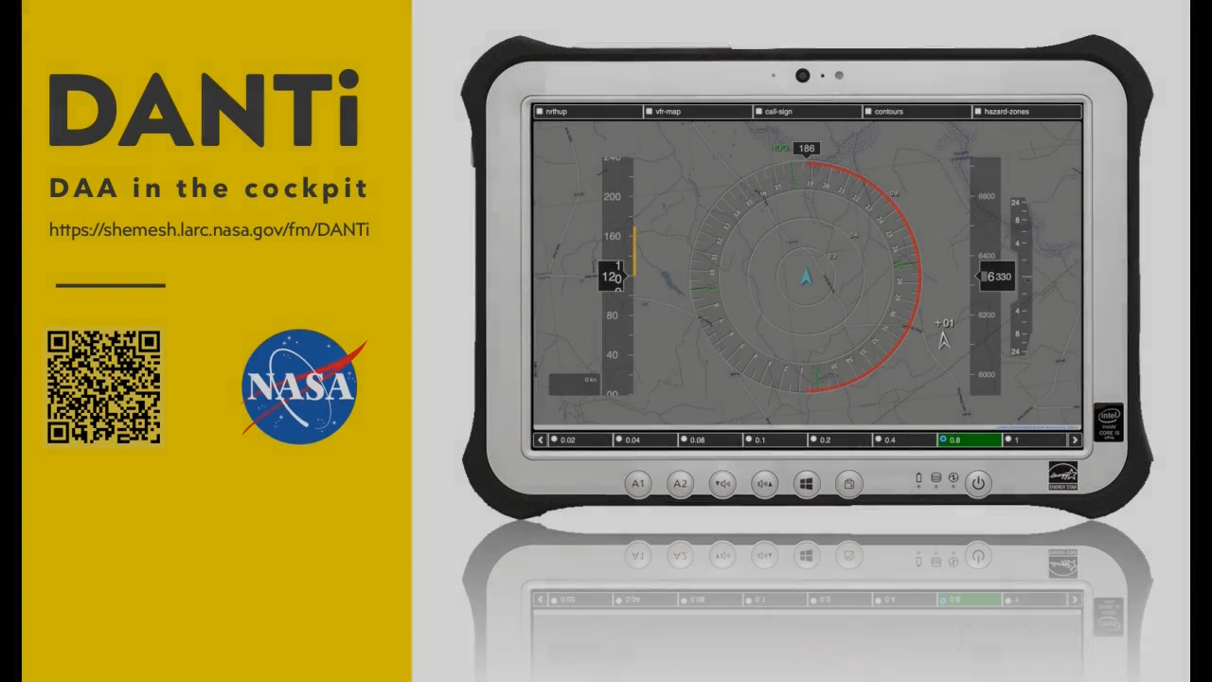

Slide 9
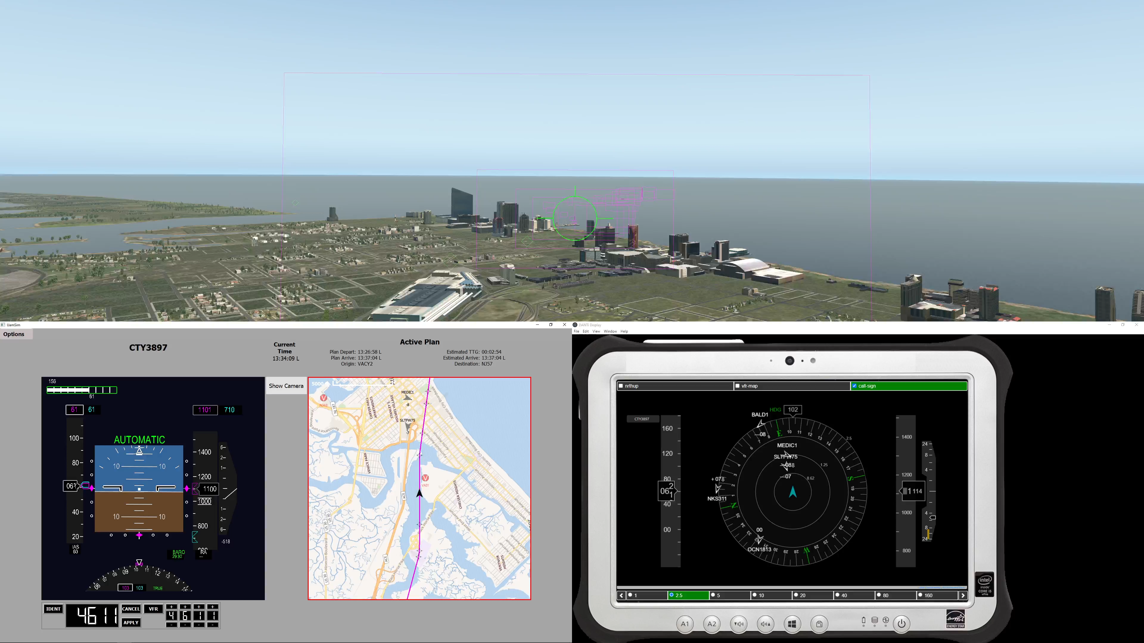

Slide 10
Conclusions
AAM operations will enhance mobility and provide publicly beneficial services
AAM operations are being deigned to share the airspace with existing operations
Technologies developed for AAM can enhance safety of conventional operations

Slide 11
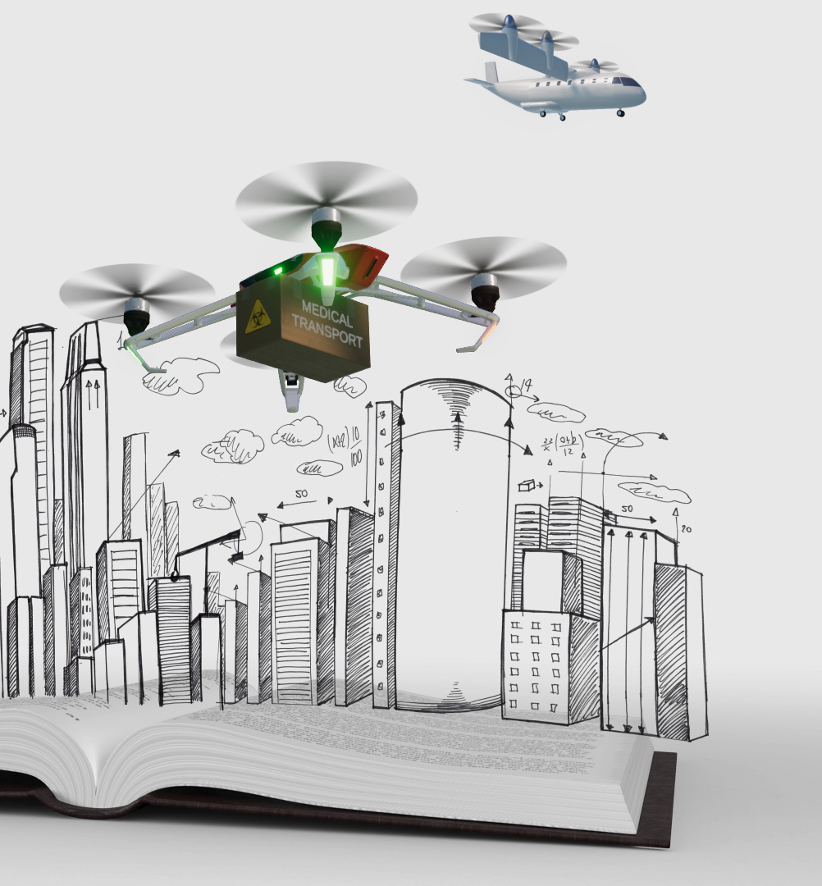
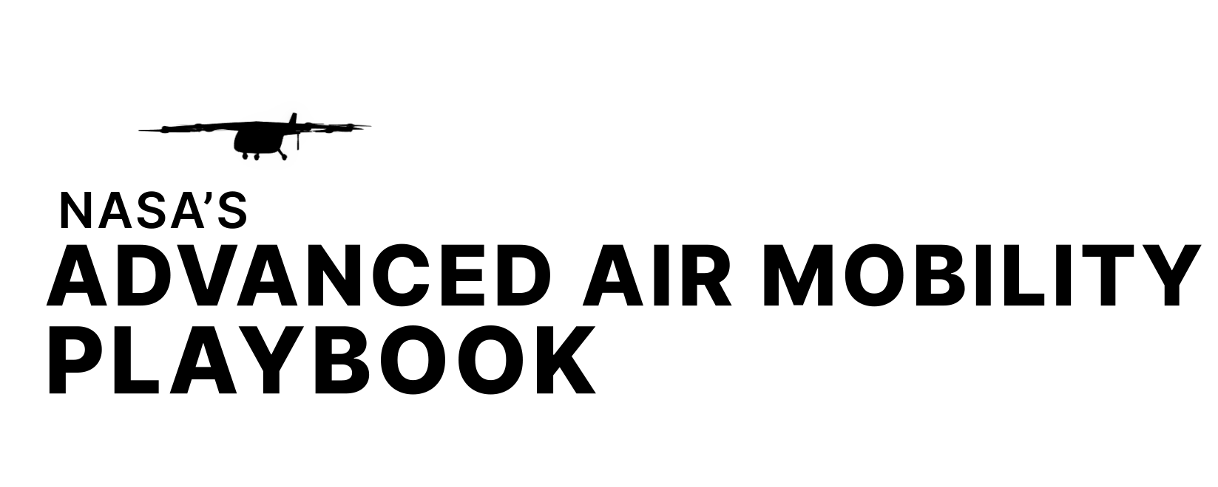
Want to Learn More?
NASA’s AAM website: nasa.gov/aam
NASA’s Advanced Air Mobility Playbook series: in both English and Spanish. Video series and corresponding web articles. Season one in English is live here: https://www.nasa.gov/feature/nasa-is-creating-an-advanced-air-mobility-playbook/
OSTEM content: Students can engage with the principles of AAM in a variety of ways — including hands-on STEM activities, coding activities, math lessons, and more. https://www.nasa.gov/aeroresearch/stem/AAM
Public events: NASA participates in various air shows, conferences, and events each year. Stay tuned to social media to learn more: https://twitter.com/nasaaero

