Slide 1
Conjunction Assessment NASA Best Practices
Lauri K. Newman
NASA Conjunction Assessment Program Officer
HQ Science Mission Directorate
Office of the Deputy Associate Administrator for Programs
Aug 7, 2023

Slide 2
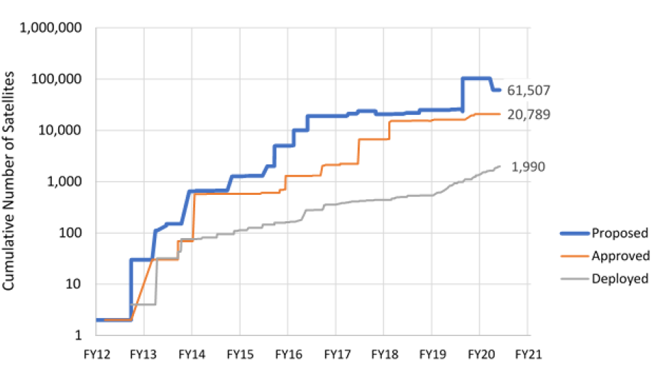
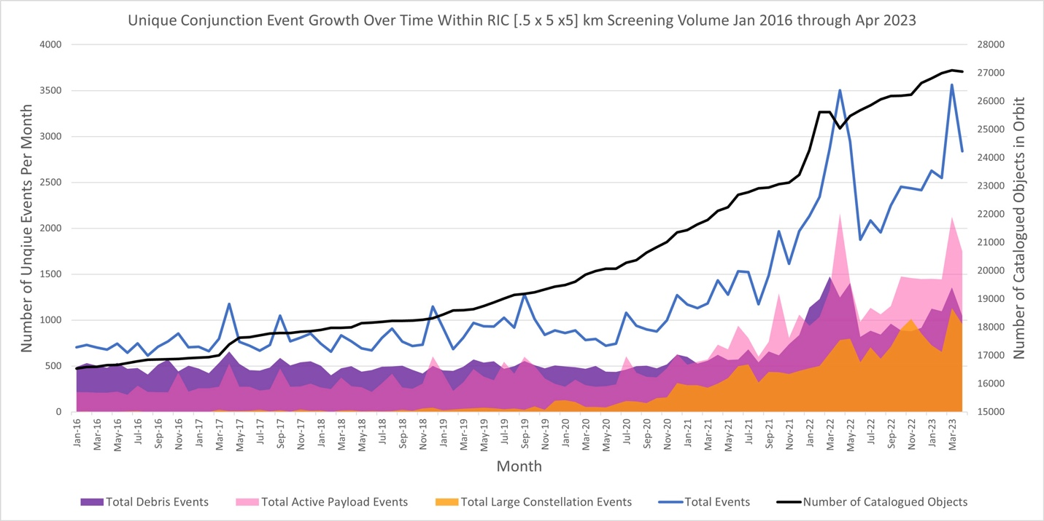
Growth Trends in Earth Orbit
Conjunction events (blue line) have grown significantly, mainly due to:
orbital debris (dark purple area)
[includes effects of anti-satellite weapons demonstrations]
large constellation deployments (orange area)
The number of satellites over time continues to grow, as shown by the graph of spacecraft counts listed in license requests to U.S. regulators.
Several ultra-large constellations (up to 30k space vehicles) have been announced (for Low Earth Orbit), though not yet deployed.
One constellation already has ~4000 space vehicles in orbit.
Peak increasing in total active space vehicles from constellations and orbital debris activity (weapons effect)
The “dip” is for orbital debris (weapons effect) re-entry;
~700 objects as of 2022-04-27 and
~1283 objects as of 2021-10-17
Aggregate increase in total events:
• 125% since Sep. 2020 (~2 years)
• 50% since Sep. 2021 (~1 year)
https://www.nasa.gov/sites/default/files/thumbnails/image/cara-conjunction-events-plot-apr-2023.jpg

Slide 3
Conjunction Assessment:
Basic Definitions and Responsibilities
Catalog Object i+1
Secondary Object
Secondary Object
Catalog Object i+2
Maneuver
∆V
Primary S/C
Primary S/C
Catalog Object i
Primary S/C
Primary S/C
Conjunction Assessment (CA) is the process of identifying close approaches between two orbiting objects; sometimes called conjunction screening.
The 18th Space Defense Squadron (18 SDS) at Vandenberg Space Force Base (VSFB) maintains the high accuracy catalog of space objects. Orbital Safety Analysts (OSAs) at VSFB screen protected assets against the catalog, perform tasking requests, and generate close approach data.
CA Risk Analysis (CARA) is the process of assessing collision risk and assisting satellites in planning maneuvers to mitigate that risk, if warranted.
The NASA CARA program performs risk assessment for all NASA operational non-HSF satellites, and some partner missions.
JSC Flight Operations Directorate (FOD) performs risk assessment for all NASA Human Spaceflight (HSF) program assets and is the O/O for maneuver decisions and execution.
Collision Avoidance is the process of executing mitigative action, typically in the form of an orbital maneuver, to reduce collision risk.
Each satellite Owner/Operator (O/O) – mission management, flight dynamics, and flight operations – is responsible for making maneuver decisions and executing the maneuvers.

Slide 4



Resources
NASA is committed to refining and sharing appropriate best practices
  Best practices document available to the public
  NASA tool sets with test data available to the public
NASA spacecraft are required to follow best practices
  Requirements documented in NID 7120.132/NPR 8079.1
Accompanying FAQ: https://www.nasa.gov/sites/default/files/atoms/files/faq-nid-and-hbk-collision-avoidance.pdf
NASA CA Handbook
CARA Tool Repository
NASA CA website

Slide 5

Questions?

Slide 6
Backup

Slide 7
NID: Project Deliverables During Formulation and Implementation
Orbital Collision Avoidance Plan (OCAP) contents:
  Orbit selection
  Ascent / descent Plan
  Space Surveillance Network trackability and cataloging
  Ephemeris generation
  Conjunction mitigation action resources
  Spacecraft flight control and navigation paradigm
  Autonomous flight control
Lifecycle Integration:
  Baseline plan prior to approval to proceed to the
  Implementation Phase
  NPR 7120.5 missions baseline the plan prior to proceeding into the Implementation Phase
  When updated, provide OCAP for reviews and
  decisions points during the Implementation Phase
Approval:
  Reviewed and concurred by JSC FOD (for HSF) or
  CARA (for non-HSF)
  Approved by Program Manager
Conjunction Assessment Operations Implementation Agreement (CAOIA) contents:
  Ephemeris sharing (post-launch, continuing), for maneuverable spacecraft, specifications for ephemeris sharing
  Maneuver considerations (24-hr advance notice, yield right-of-way to on-station objects, close approaches, mitigations, anomalies)
  Autonomous flight control and navigation (ground awareness, ephemeris planning, abort)
  Deorbit / Descent considerations (coordinate with JSC FOD to avoid ISS)
Lifecycle integration:
  Approved agreement required before proceeding to Operations
  NPR 7120.5 missions provide the agreement at Operational Readiness Review (ORR)
  NPR 7120.8 missions provide the agreement at an appropriate pre-launch review (e.g., continuation assessment, periodic project review), determined in coordination with the program manager
Approval:
  Approved by project and CARA (for non-HSF)
  Implemented and approved within existing procedural requirements for HSF missions (not a separate plan)

Slide 8
Spacecraft Design Considerations
It is important (and efficient) to make plans for conjunction assessment during spacecraft planning and design
  CA process needs can be accommodated more easily prior to spacecraft fabrication
  All processes and tools must be developed and validated well in advance of launch
Key items to consider during design:
  Orbit selection
  Trackability
  Deployment plan
  Ephemeris generation process and tools
Lesson learned example:
  A NASA spacecraft assumed that two-line elements (TLEs) would be available from DOD for use as acquisition data for tracking radars.
  After launch, it was discovered that the orbit was too low an inclination for DOD CA sensors to track and maintain it appropriately, so TLEs were not regularly available
  This situation could have been prevented through pre-launch analysis

Slide 9
Cis-lunar CA
Catalog of non-cooperatively/passively tracked objects used in CA includes only Earth-orbiting objects
Activity at Moon, Mars, and Libration points increasing risk of collision; screening of orbits in these regimes now needed
  NASA MADCAP provides ephem-on-ephem screening for missions
  Relies on sharing of data
  Open to non-NASA entities
DoD developing cis-lunar catalog and screening capability
  Requirements not yet defined
  Implementation is still in early stages of development
NASA continues to work with DoD on beyond GEO SSA capabilities.

