Slide 1
Forward and Inverse Models for Satellite Remote Sensors Using Principal Component Analysis
Xu Liu
NASA Langley Research Center, Hampton, VA, USA
Acknowledgement
Colleagues and collaborators
NASA Sounder SIPS, NOAA NUCAPS Team, NASA NAS and NCCS, NASA DACC, NASA Science of Terra, Aqua, and Suomi NPP, NAST-I, CPF, TEMPO, and SBG programs

Slide 2
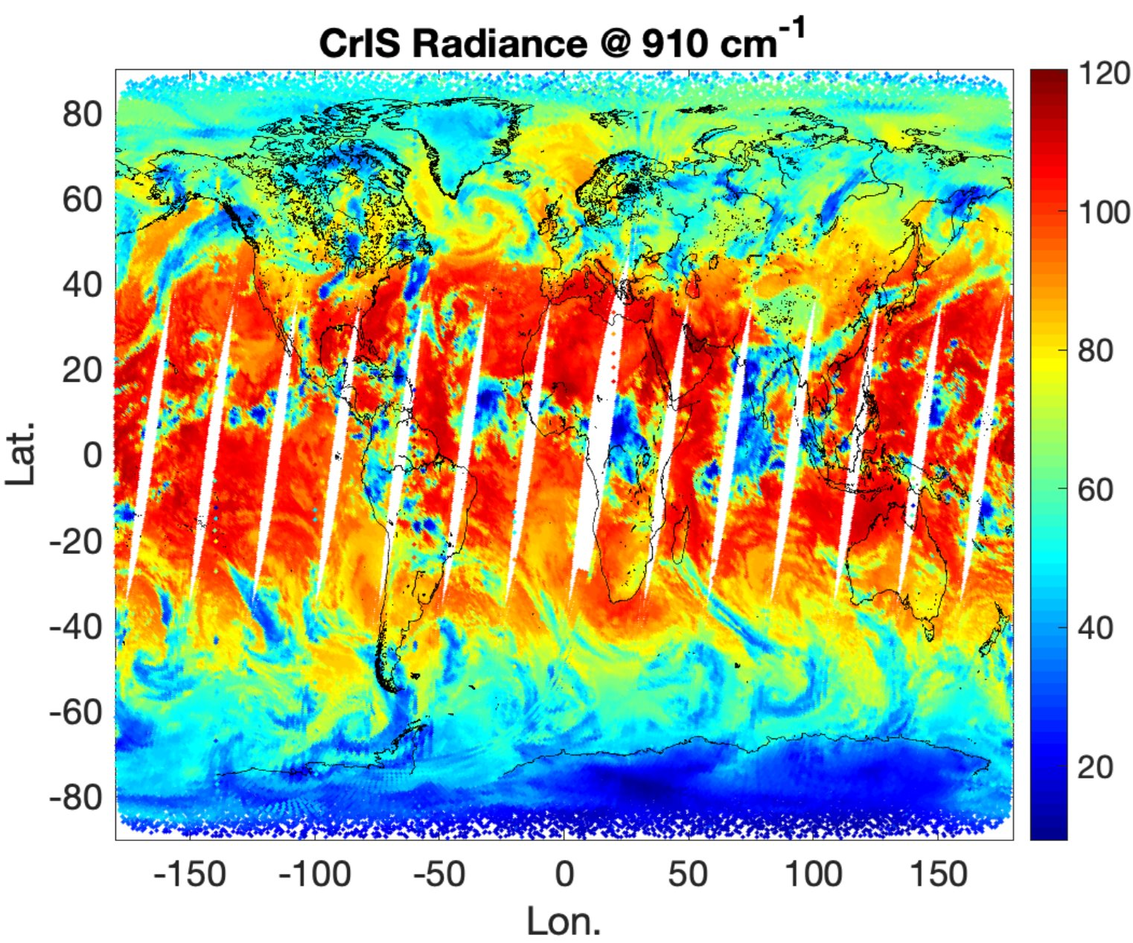
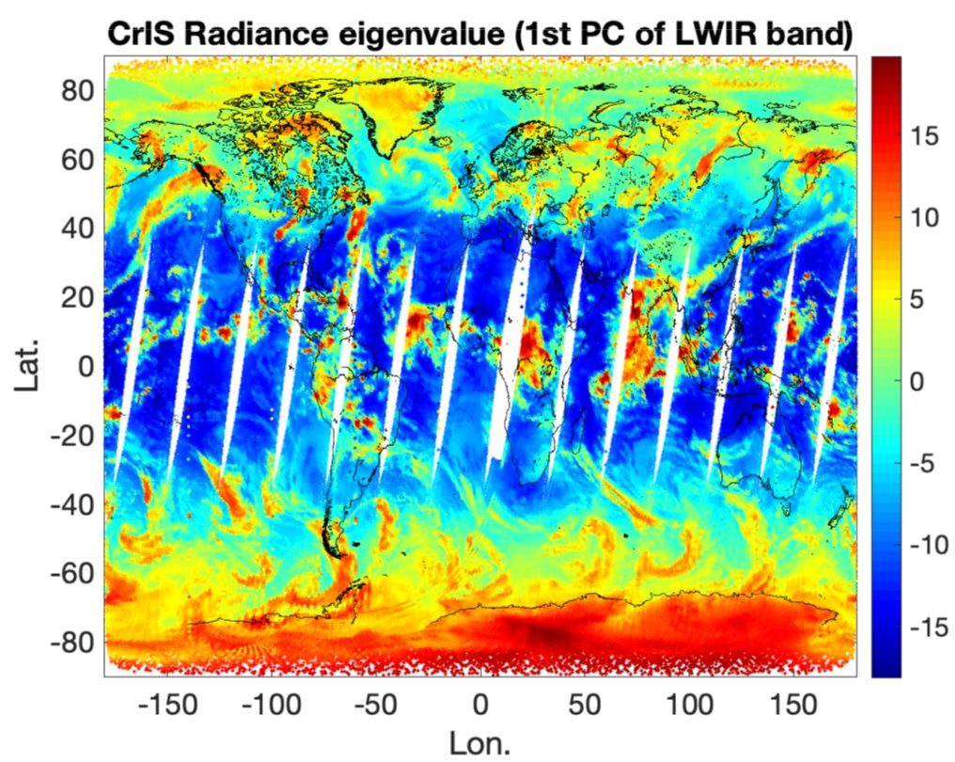
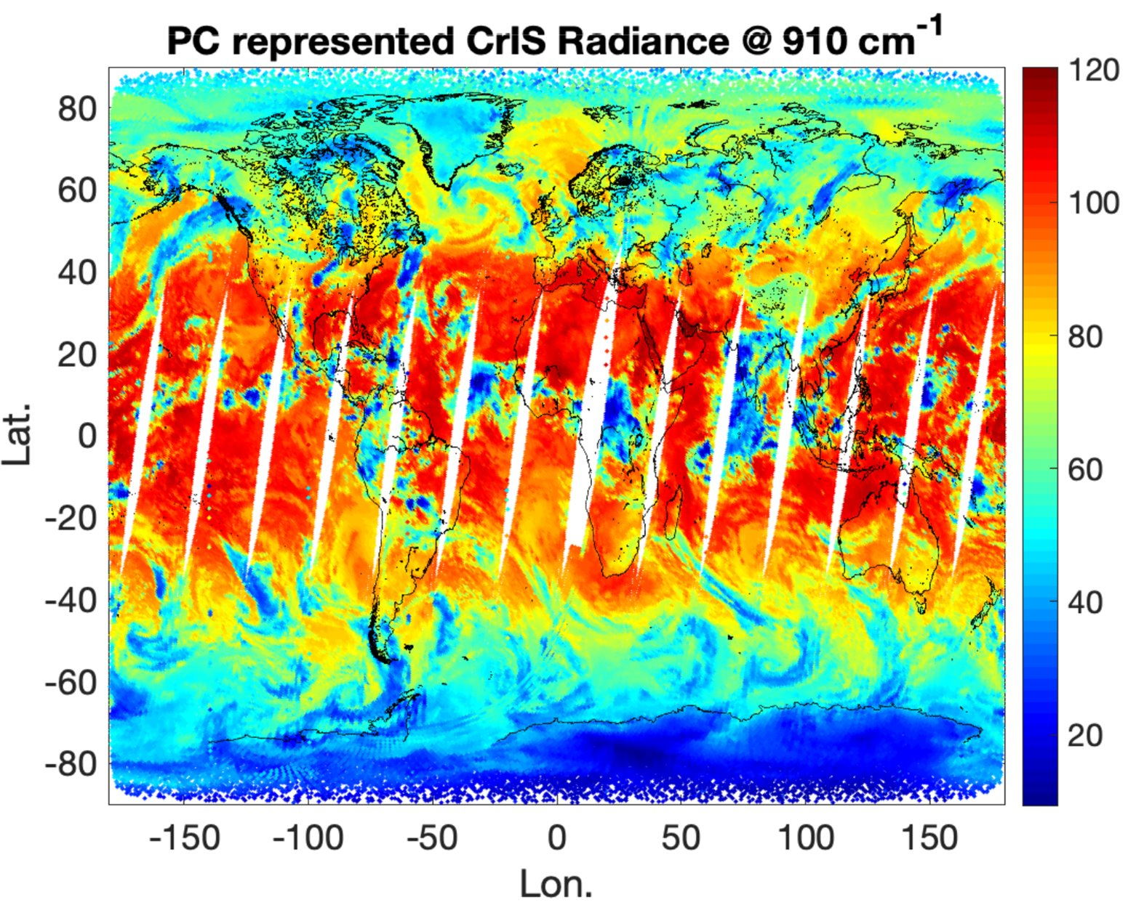
Introduction
Fast and accurate forward models are needed to invert hyperspectral data
  Hundreds to thousands of spectral channels with millions of observations each day
  Line-by-line (LBL) radiative transfer model (RTM) is too slow (needs millions of LBL RT calculations to account for atmospheric gas spectral contributions)
  Traditional channel-based forward models are also too slow (at least one RT calculations needed for each channel
Principal Component Analysis (PCA) converts hyperspectral data into super-channels
  Principal Components (PCs) capture the spectral correlations (remove redundant info)
  Super channels (PC-scores) capture all original spectral information
  Reduced data dimension (super-channel number << than the original channel numbers)
Many future IR hyperspectral sounder data will be delivered as PC-scores
  For efficient data transfer
  Forward model and inversion models in PC-domains are desired

Slide 3
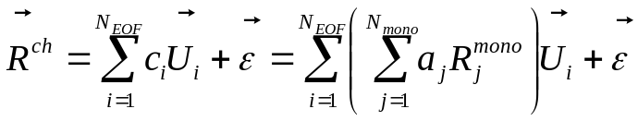
Introduction to a Principal Component-based Transfer Model (PCRTM)
Channel-based fast radiative transfer models may be too slow
  Not taking advantages of spectral correlations across the whole spectral regions
  Reductant RT calculations performed
PCRTM was first developed in 2004 and has been extensively used by many projects
  Compress spectra into Principal Component (PC) domain
  Performs minimum number of monochromatic calculations
  Covers spectral range from far infrared, IR, mid-IR, Near-IR, Visible, UV-Vis spectral regions
Calculates channel radiances (or transmittances ) by linearly combining a set of PCs:
Channel radiance/reflectance/flux can be obtained by a linear combination of PC-scores (c) and corresponding PCs (U)
Selected publication related to PCRTM
  Liu et al. 2004, 2006, 2007, 2009, 2016, 2017, 2018, Yang et al. 2016, 2023, Wu et al 2017,2020, 2022, 2023, Chen et al 2013, Pan et al. 20 Seiji et al 2011, 2014, Huang et. al. 2014. Pan et al. 2015, 2017, 2020, Feldman et al.2013, Bantges et al. 2016, Rose et al. 2013, Sergio et al AMT 2018,Aunman et al. JGR, 2018, 2023, Jang et al, 2023, Xiong et al. 2022, 2023...

Slide 4
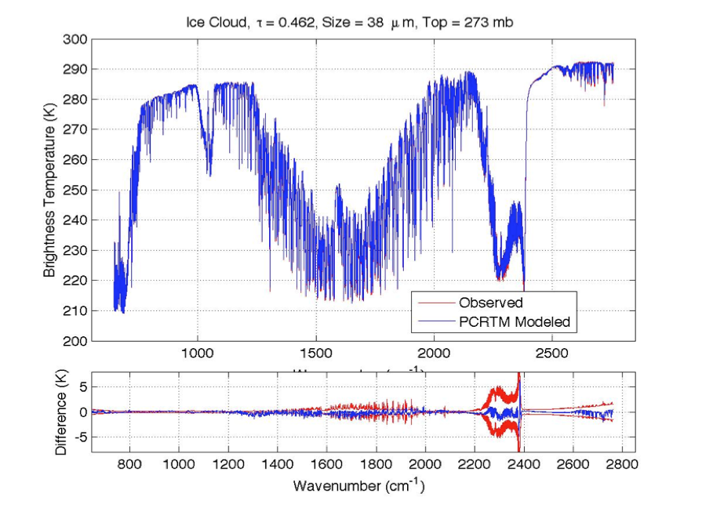
Demonstration of Speed and Accuracy of PCRTM for IR sounders
IASI
CrIS
AIRS
Sensor | Channel Number | PC score (seconds)
CLARREO, 0.1 cm⁻¹ | 19901 | 0.014 s
CLARREO, 0.5 cm⁻¹ | 5421 | 0.011 s
CLARREO, 1.0 cm⁻¹ | 2711 | 0.0096 s
IASI, 0.25 cm⁻¹ | 8461 | 0.011 s
AIRS, 0.5-2.5 cm⁻¹ | 2378 | 0.0060 s
CrIS,0.625-2.5 cm⁻¹ | 1317 | 0.0050 s
NAST-I, 0.25 cm⁻¹ | 8632 | 0.010 s
S-HIS, 0.5 cm⁻¹ | 4316 | 0.008 s
CrIS, 0.625 cm⁻¹ | 2211 | 0.009 s
PCRTM calculated TOA radiance spectra match IASI, CrIS, and AIRS observations very well for both clear and cloudy conditions
PCRTM IR speed: Milliseconds/spectrum
Channel-based IR RTMs: seconds or fractional seconds per spectrum

Slide 5
Recent Results on Simulating AIRS spectra in the using ECMWF cloud fields (Aunman et al, 2018 JGR)
Studies using AIRS Spectra and ECMWF Cloud Fields (Aumann et al., 2018, JGR) show PCRTM (out of 6 fast RTMs) has the best performance for multiple scattering cloud modeling for solar spectral region
bt2616 (AIRS observed –calculated) | day PDF correlation | day bias ± stddev [K] 1437 cases |  | day-night [K]
SARTA_pM1 | 0.8744 | +5.00±14.79 |  | 8.0
SARTA_p999 | 0.8779 | +7.05±15.57 |  | 7.4
PCRTM_ERO | 0.9855 | +1.55±15.90 |  | 1.84
PCRTM_MRO | 0.9846 | +0.73±15.84 |  | 2.61
PCRTM_ERO2 | 0.9804 | +2.52±16.79 |  | 1.94
PCRTM_MRO4 | 0.9766 | +0.91±16.22 |  | 2.1
HT_CMO | 0.6669 | +15.04±20.11 |  | 17.5
HT_CRO | 0.6492 | +15.97±19.76 |  | 17.4
HT_CMRO | 0.6653 | +15.13±20.10 |  | 17.5
HT_SMO | 0.9215 | +3.69±15.86 |  | 5.7
HT_SRO | 0.9628 | +3.87±15.83 |  | 4.7
HT_SMRO | 0.9245 | +3.65±15.88 |  | 5.7
RTTOV_MRO | 0.8948 | +4.81±15.86 |  | 11.3
RTTOV_CMSS | 0.8803 | +8.07±15.26 |  | 10.5
σ-IASI_as | 0.4809 | +20.94±18.94* |  | 15.6
CRTM2_tcc | 0.3991 | +20.55±17.60 |  | 14.1
CRTM_mro | 0.6680 | +13.90±18.74 |  | 16.1
CRTM_2col | 0.6410 | +15.33±18.59 |  | 16.4
(Xu.Liu-1@nasa.gov )

Slide 6
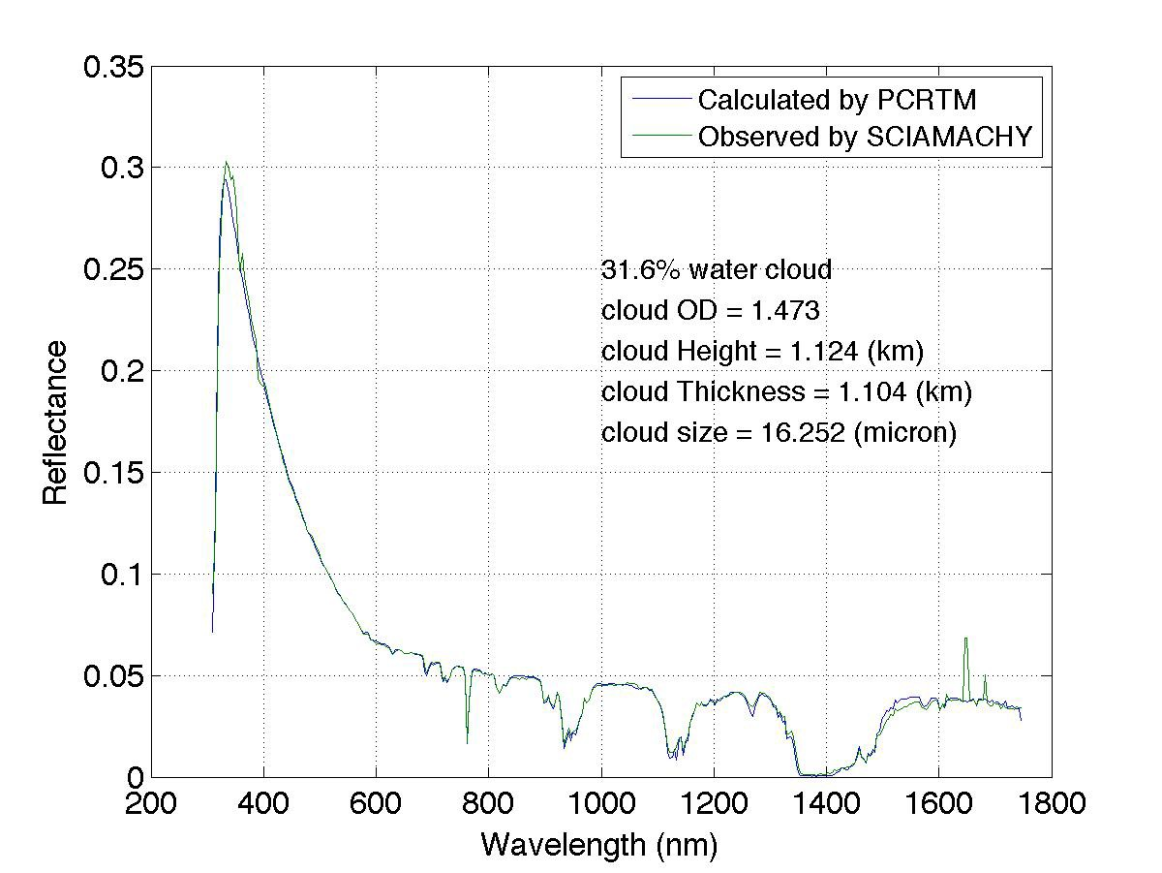
PCRTM for Reflected Solar Region under the CLARREO and CPF Projects
SCIAMACHY
PCRTM Simulated Reflectance @646 nm using MODIS L2 data
MODIS L1 Observed
Reflectance @646 nm
PCRTM calculated reflectances agree well with those observed by SCHIAMACHY and MODIS
PCRTM is 3-4 orders of magnitude faster than MODTRAN
A Climate OSSE, which will take MODTRAN 10 years to run on one CPU, can be accomplished with PCRTM in 10-20 hours using one CPU
PCRTM | M1 | M2 | Speed-up to MODTRAN
CPF spectral resolution | 241 | 23 | 11,262
MODIS L2 + CPF simulator @646nm

Slide 7
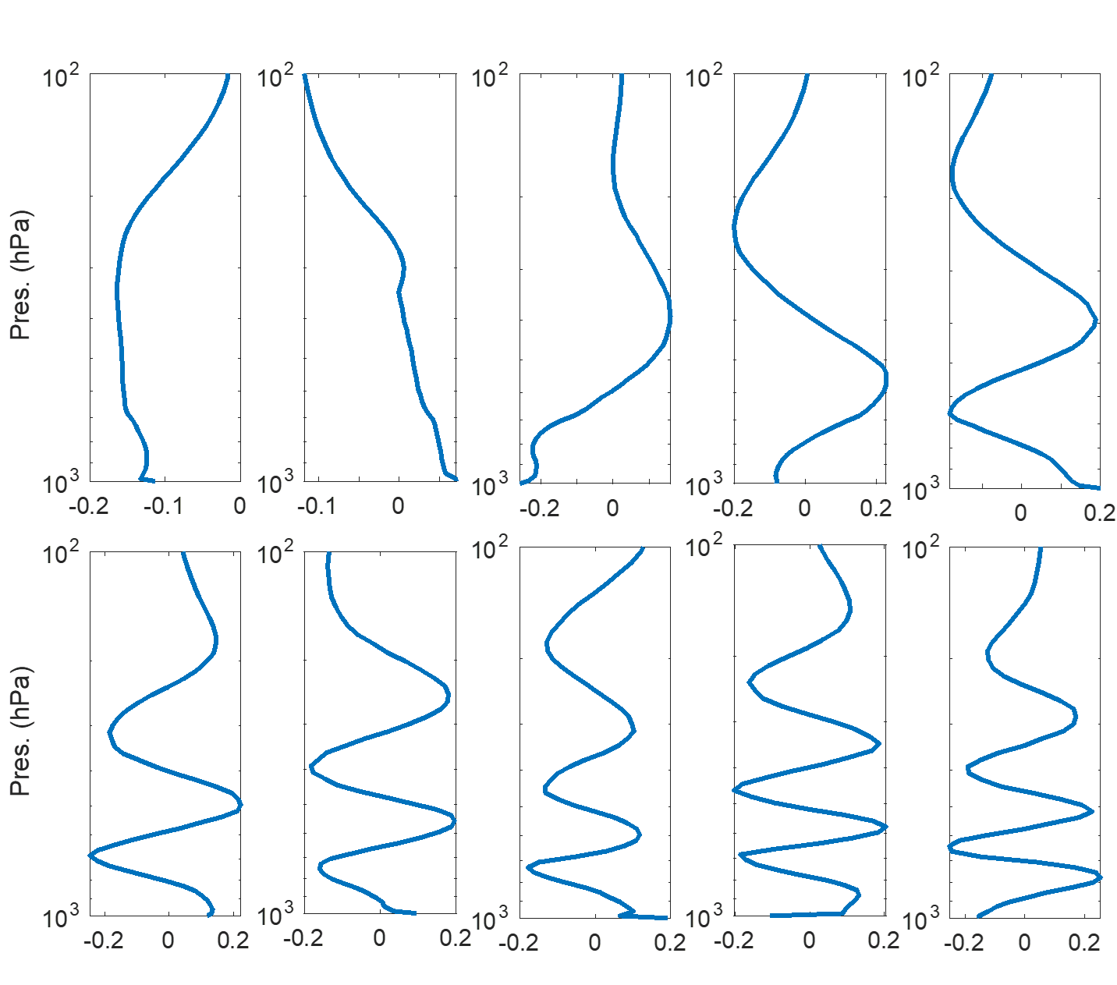
PCA-based Inversion Algorithms
Iterative Optimal Estimation Inversion:
PCRTM compresses R, Se, and K into smaller dimensions
Applying PCA to X will further reduce the dimension of X, K and Sa
Advantages of using PCA
  reduces the ill-condition of the inversion process
  Speed up the inversion
  Easy to store the retrieved parameters with associated error covariance matrix
$$X_{n+1}−X_{n}={\left(K^{T}S_{ε}^{−1}K+S_{a}^{−1}\right)}^{−1}\left(K^{T}S_{ε}^{−1}\left(R−R_{n}\right)−S_{a}^{−1}\left(X−X_{a}\right)\right)$$
Example of PCs representing H2O vertical profiles
Satellite Sensors | Original Dim | PC-compressed Dim
CrIS | 2211 | 124
AIRS | 2378 | 120
IASI | 8461 | 190
Geophysical Parameters | Original Dimension | PC-compressed Dimension
Temperature | 101 | 20
H2O | 101 | 15
CO2 | 101 | 1
O3 | 101 | 10
CO | 101 | 4
CH4 | 101 | 2
N2O | 101 | 2
IR Surface Emissivity | Hundreds -thousands | 8
MW Surface Emissivity | 15-22 | 5
Notes:
Flow diagram shown as applied to NAST-I, but has analogous applicability to all sensors.
Bottom QC is for spot checking in spectral domain, if desired; entire loop stays in PC domain (fast).
Super channels = PCs

Slide 8
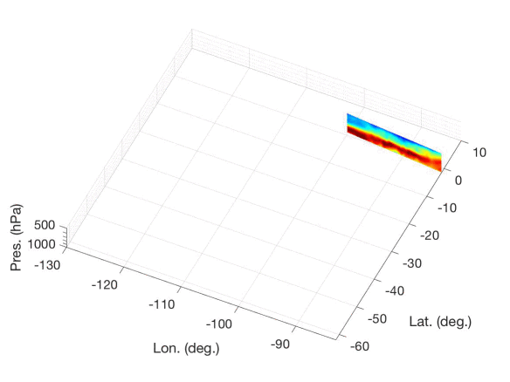
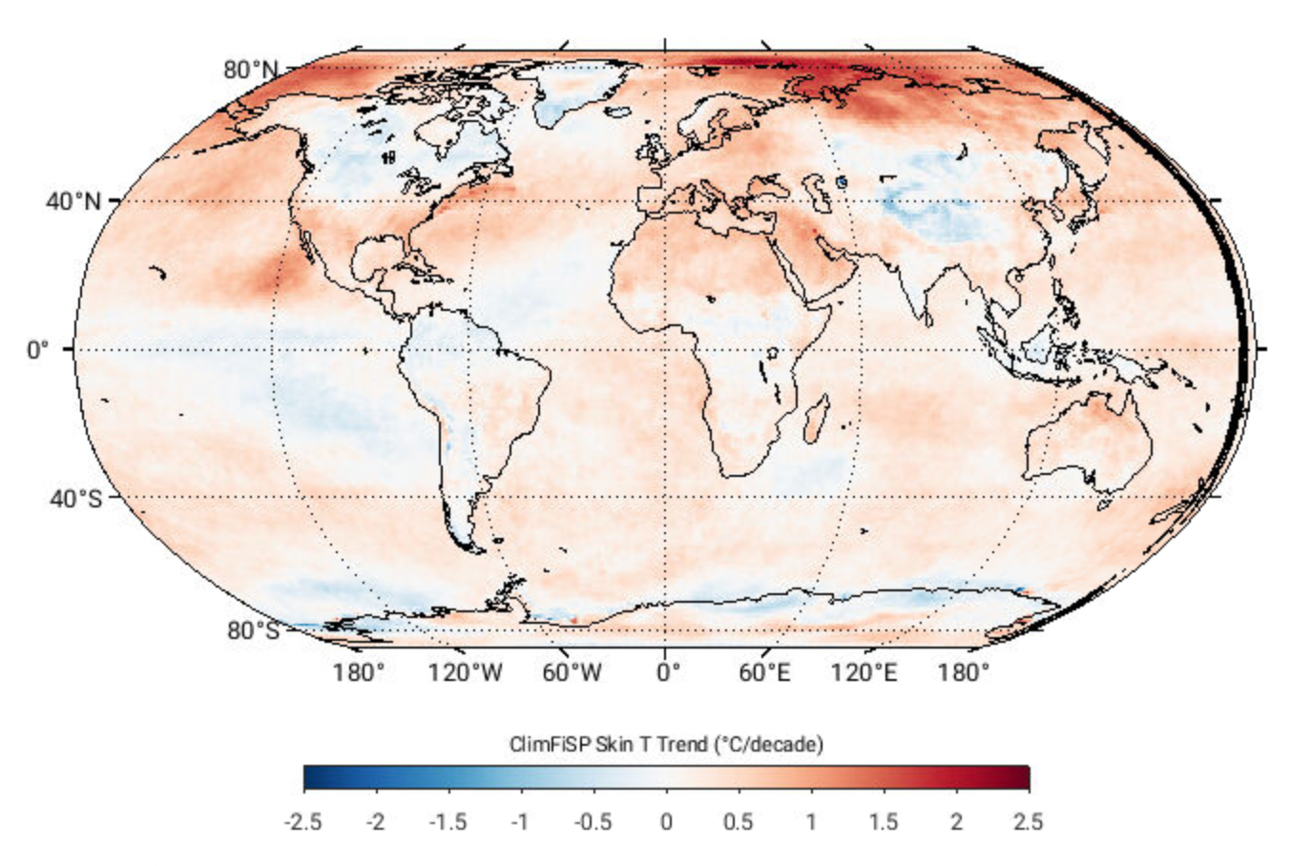
Two PCRTM-based Inversion Algorithms
L2 products: Single Field-of-view Sounder Atmospheric Product (SiFSAP)
  3-times higher spatial resolution
  Uses all spectral channel
  All sky algorithm-retrieves cloud explicitly
  Retrieve temperature, clouds, trace gases, and surface properties simultaneously
L3 Products: Climate Fingerprinting Sounder Products (ClimFiSP)
  Works on spatiotemporally averaged radiance spectra
  High quality climate product from multiple satellite data fusion
    Use consistent radiative kernels
    Ensure radiometric closures
Both products will be available at NASA GES DISC for public access
The PCRTM based algorithm has been extended to solar spectral region
Example of SiFSAP H₂O product
Example of ClimFiSP derived global surface temperature trend

Slide 9
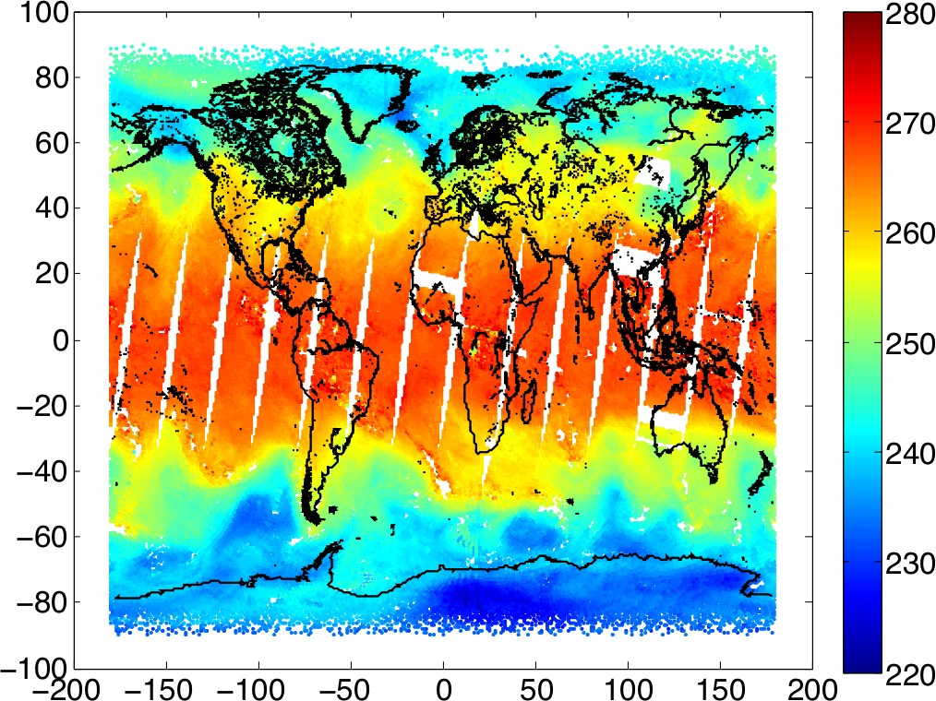
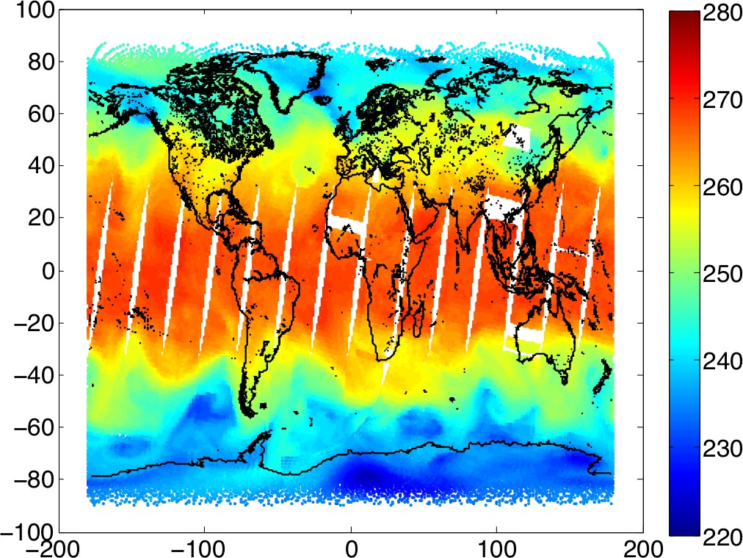
Comparison of PCRTM-RA Retrieved and ECMWF Atmospheric Temperature from focus day CrIS/ATMS data
500 hPa Retrieved from ATMS/CrIS using PCRTM_RA
500 hPa Temperature from ECMWF

Slide 10
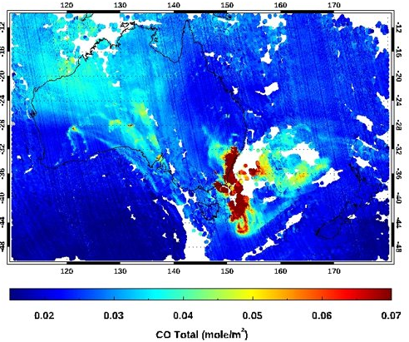
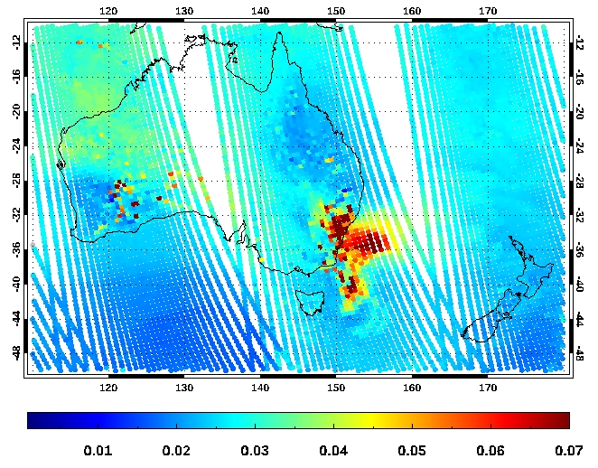
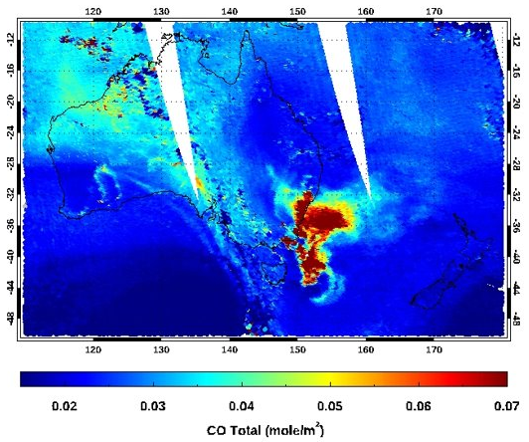
PCRTM-RA Retrieved CO from CrIS and comparison with TROPOMI for Australia Fires on December 30, 2019
CLIMCAPS total CO from CrIS
TROPOMI total CO
Both TROPOMI (4 km resolution) and SiFSAP (14 km) capture fine CO plume spatial distributions
CLIMCAPS cannot capture the fine CO features
  Low resolution retrieval (45 km)
  Less coherent CO due to errors in cloud clearing
SiFSAP is less affected by the fire particular (dust) emission relative to TROPOMI
  SiFSAP retrieves effective cloud optical depth to compensate for fire particular contributions
  TROPOMI has many non-successful retrievals due to clouds and fire dust emissions
SiFSAP total CO from CrIS

Slide 11
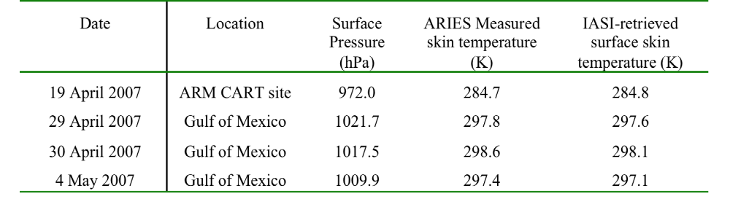
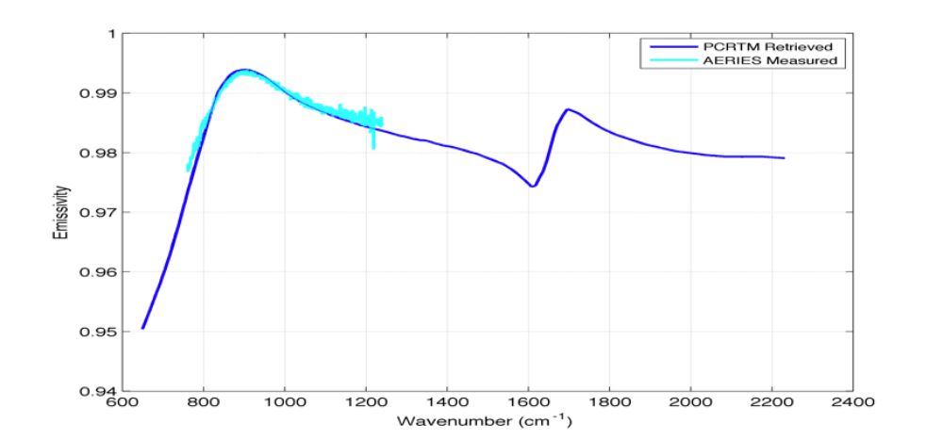
Example of retrieved surface temperature and emssivity and comparison with field validation data
Comparison of PCRTM retrieved surface skin temperature with ARIES measured Tskin
Comparison of retrieved ocean emissivity with ARIES aircraft measurements

Slide 12
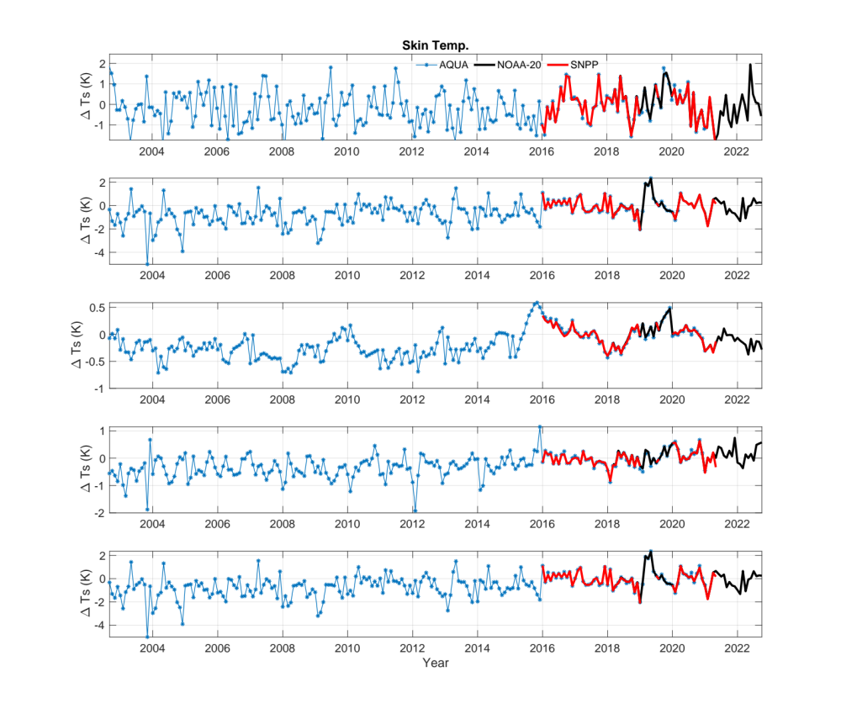
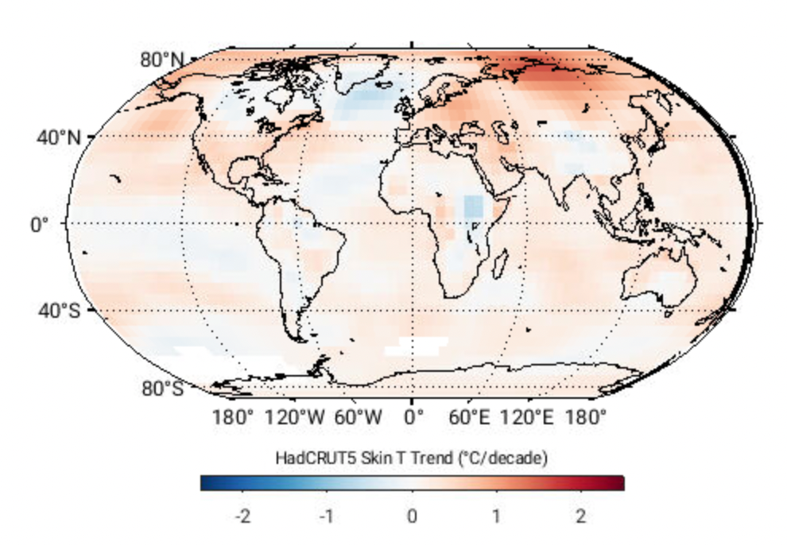
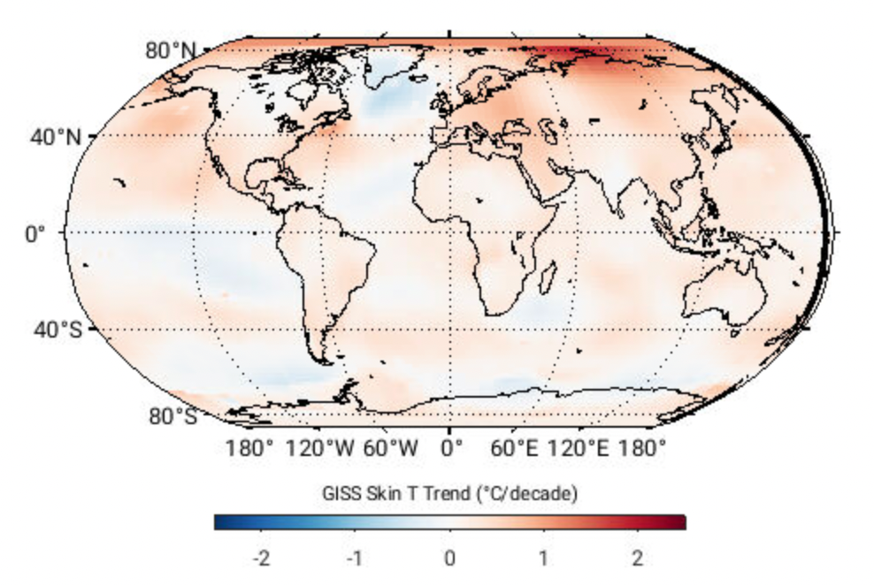
PCRTM-based Climate Products from AIRS and CrIS (SNPP/NOAA20) Sep. 2002 – June 2022
Zonally Surface Temperature Anomalies
Surface Temperature Warming Trend
(-60º – -90º)
(-60º – -30º)
(-30º – 30º)
(30º – 60º)
(-90º – -60º)
PCRTM
HadCRUT5
GISS
PCRTM-based SiFSAP and ClimFiSP sounder products will be generated at NASA GES DISC for public access

Slide 13
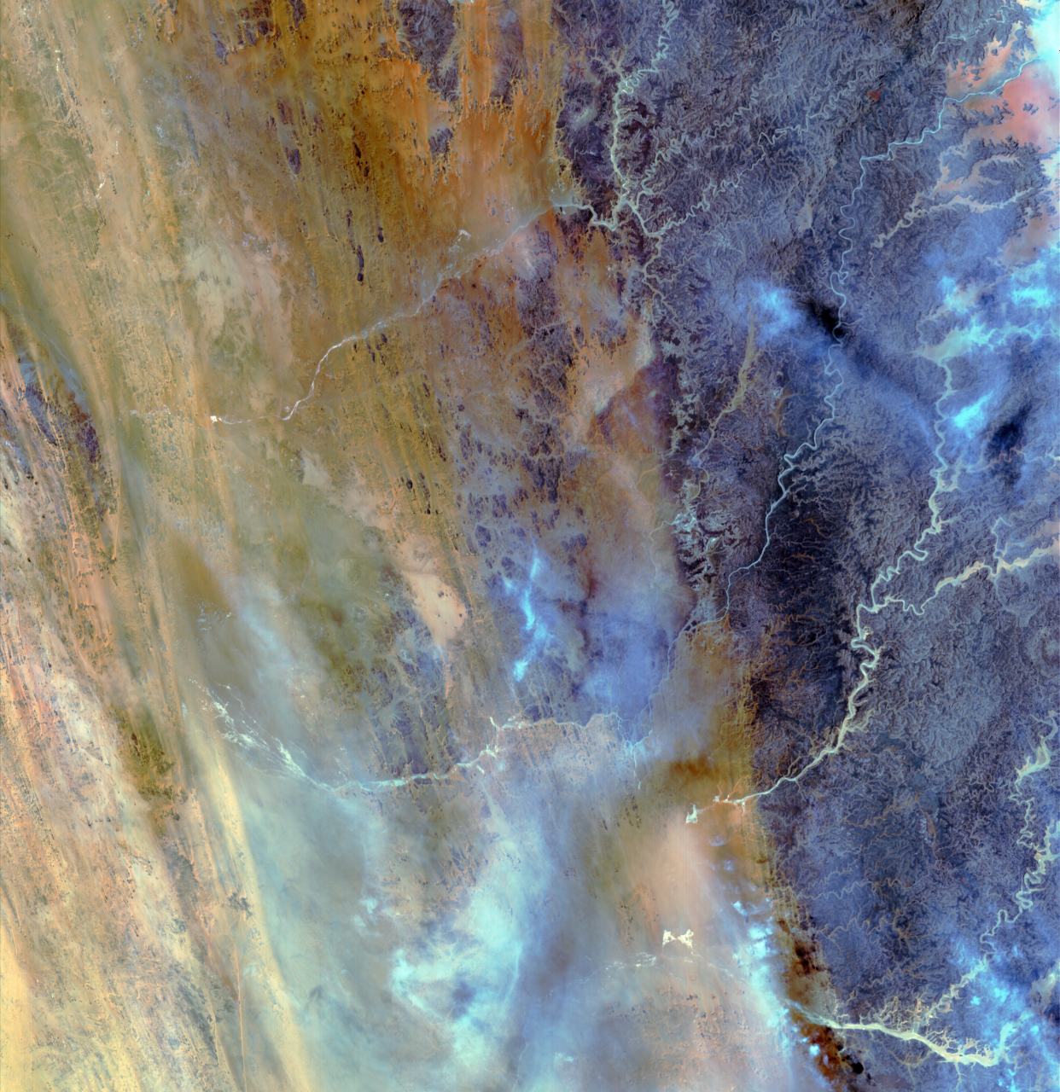
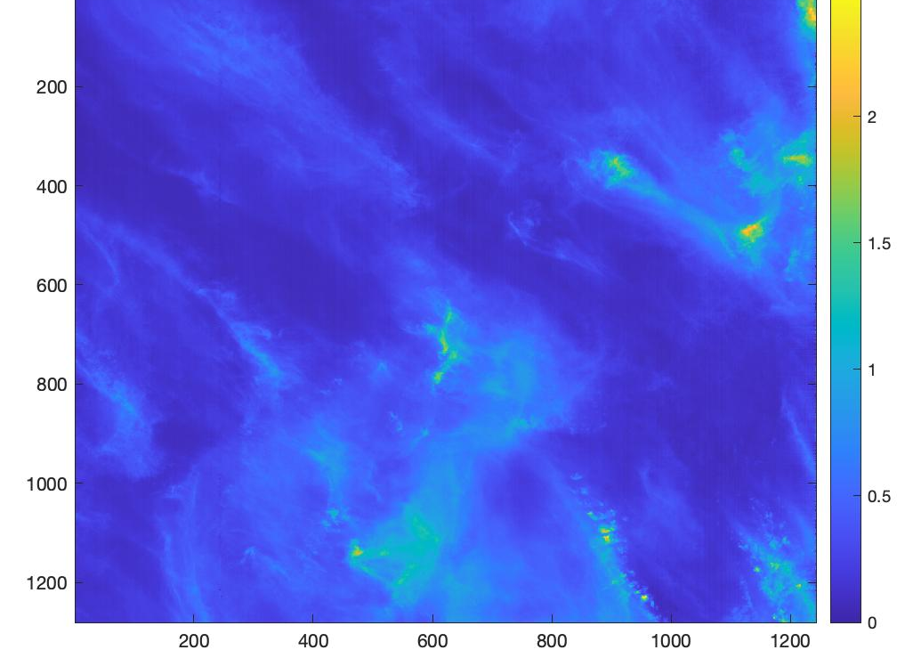
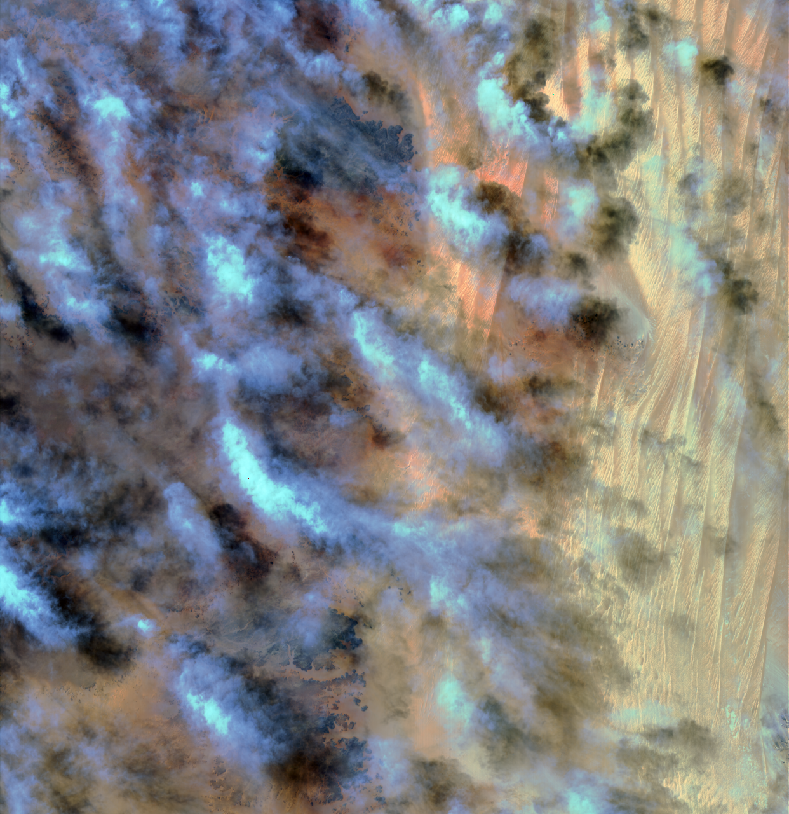
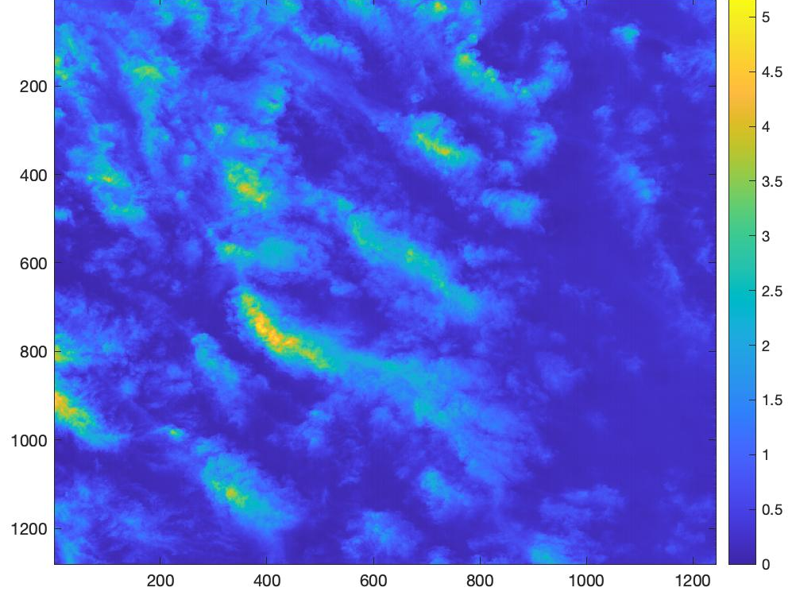
PCRTM-based Cloud Retrieval for EMIT data
RGB EMIT Image
Retr. COD
RGB EMIT Image
Retr. COD

Slide 14
Summary and Conclusions
PCA can be used to compress both the satellite observed data and the state vector in an inversion process
  Stabilize inversion solution by reduce random noise
  Speed up inversion process by reducing the matrix and vector dimensions
PCRTM is a fast and accurate forward model for analyzing satellite data
  Enable all sky retrievals due to accurate cloud calculations
  Uses all spectral channels instead limited selected channels
  Can be used for pre-launch sensor design and post-launch data analysis
PCRTM-based inversion algorithms provide radiometrically consistent products
  High-spatial resolution L2 products for weather, air quality, and atmospheric dynamic studies
  Consistent long-term climate data records (T, Q, cloud …) from multiple satellite IR hyperspectral sounders

