Slide 1
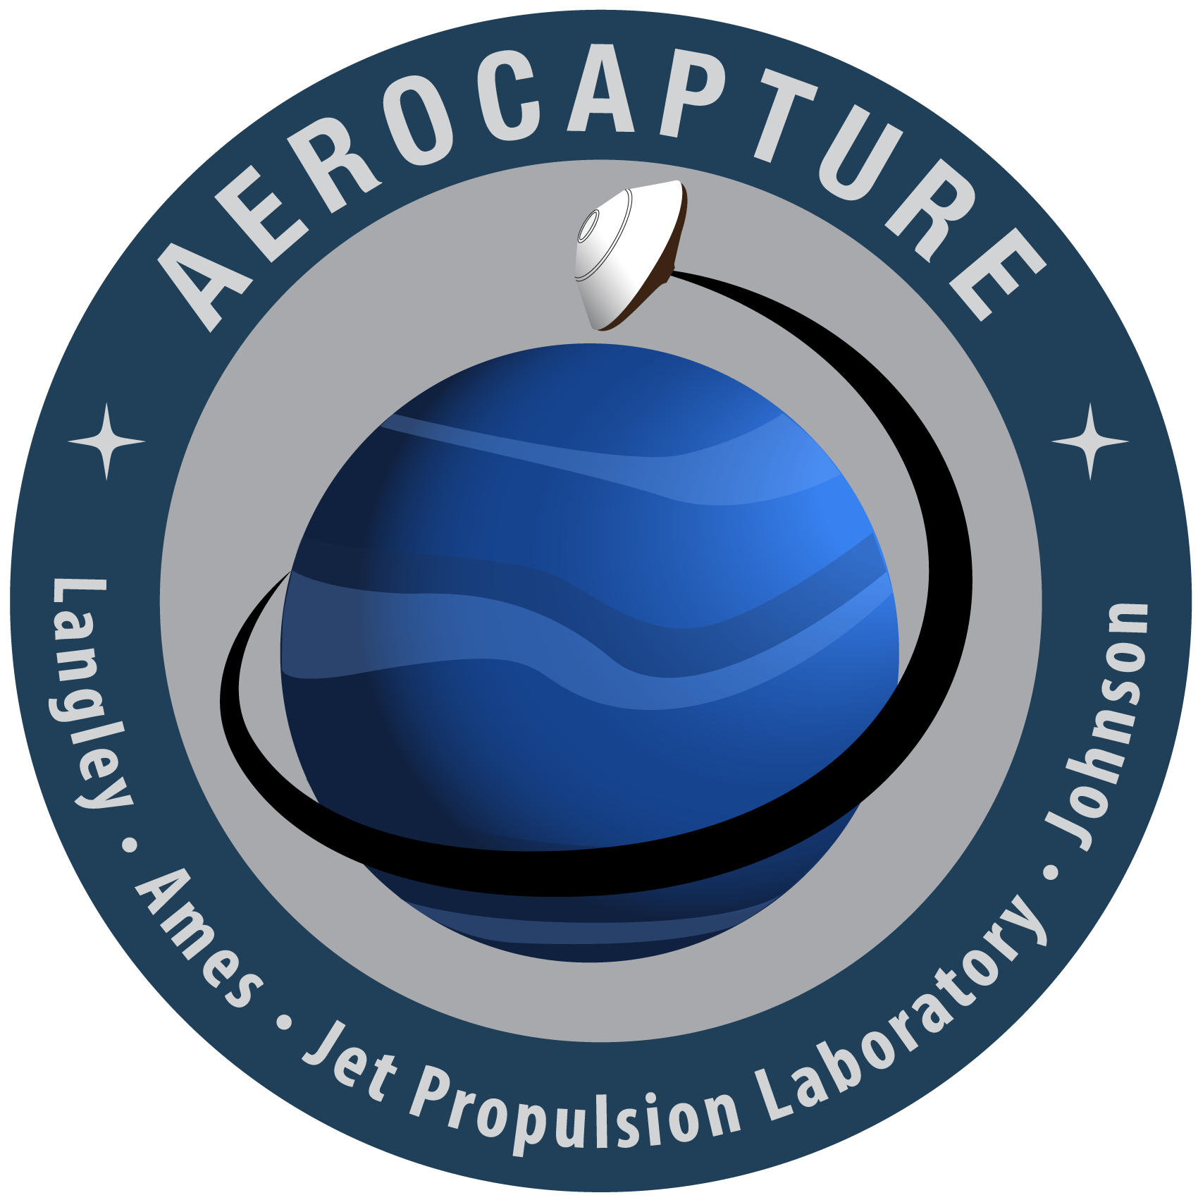
Early Career Initiative (ECI) Project FY23
Thermal Protection Design for Uranus Orbiter Flagship Mission:
Probes and Aerocapture
Joseph Williams
Jonathan Morgan
Uranus Flagship Workshop
07/27/23

Slide 2
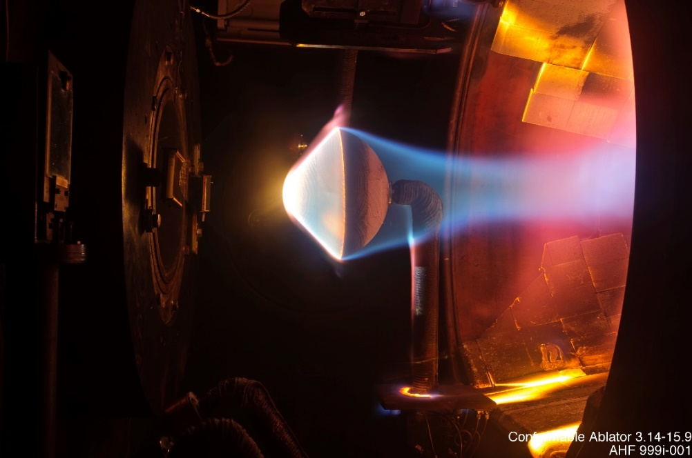
TPS & Applications in a Uranus Flagship Mission
Thermal Project Systems (TPS) are essential when spacecraft engage planetary atmospheres which generates significant heating and thermal soak back to the spacecraft.
Over the last two decades, NASA has developed new ablative TPS solutions that are robust against the extreme environments experienced at the outer planets.
These carbon-phenolic based systems dissipate thermal energy through chemical decomposition while insulating the spacecraft.
For Uranus, a TPS subsystem is relevant to:
  An aerocapture mission phase
  Atmospheric entry probe:
    Probe deployment on hyperbolic approach [UOP Considered]
    Probe deployment on elliptic post-capture [UOP Considered]
    Aerocapture orbit insertion followed by probe deployment [ECI Focus]
Flowfield Analysis of a Small Entry Probe (SPRITE) Tested in an Arc Jet. Dinesh K. Prabhu

Slide 3
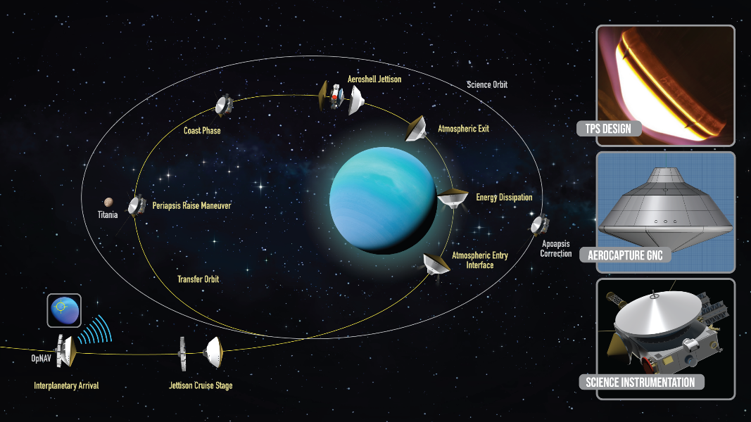
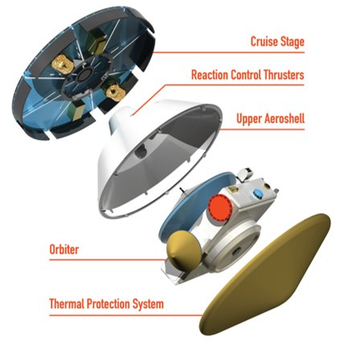
Introduction to Aerocapture
Aerocapture is a method of orbit insertion that does not require significant use of a propellant burn.
  ΔV is achieved by dipping into the planet’s atmosphere, slowing the spacecraft through atmospheric drag before exiting into a target orbit.
  Heritage entry vehicle geometries are enabling at Uranus. ECI design closed with a 5 m diameter, 4000 kg capsule.
Performance Metrics:
  Interplanetary Transit Time: UOP baselined a 13-year trajectory compared to ECI 8-year transit time.
  Mass: despite requiring an aeroshell (structure and TPS), aerocapture eliminates most propellant offering a net mass savings allowing for more science payload.
Rohan Deshmukh has a poster discussing the aerocapture concept and its impact to mission design.

Slide 4
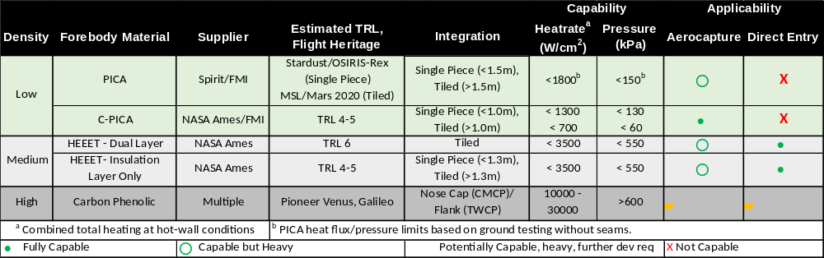
TPS Sub-Families by Application
Aerocapture TPS: vehicle stays higher in the atmosphere leading to:
  Lower heat rates
  Lower peak surface pressures
  Longer durations: emphasizes better insulators
  Larger vehicles to break in atmosphere and insert orbiters
Direct Entry TPS: probes dive into atmosphere to deliver science equipment:
  Higher heat rates: denser materials for ablation performance
  Higher surface pressures
  Shorter duration
  Smaller probes
Loose
Fibers
Woven
Fibers
*Based on White Paper to the NRC Decadal Survey
TPS and Entry Technologies for Future Outer Planet Exploration

Slide 5
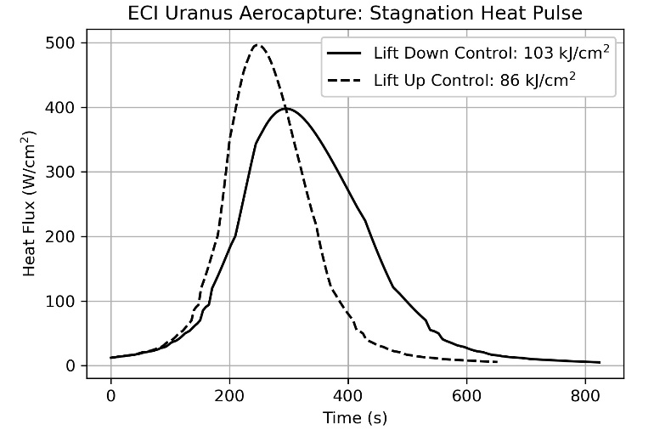
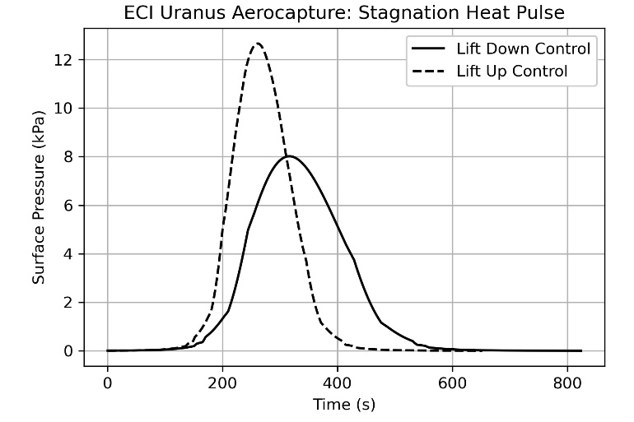
Aerocapture TPS Design
The ECI considered 8-year interplanetary trajectory results in a UOI aerocapture heating pulse that lasts ~10-12 min.
  Bounding forebody conditions from guided trajectories yield peak conditions:
The lowest density TPS options are most mass efficient:
  C-PICA: 14 kg/m² | PICA-D: 21 kg/m² | Woven TPS: 65 kg/m²
Sized C-PICA heatshield is 5.28 cm thick (low mass fraction of 6.5%)
  Aeroshell and UOI Propellant have a total mass fraction of ~33%
TPS Technology is already a high TRL for these environments:
  C-PICA tested in arc-jet ground test facilities to 1300 W/cm² & 132 kPa
  Option for nitrogen test gas to simulate the lack of TPS surface oxidation expected from Uranus’ reducing atmosphere
Heating rates of ~500 W/cm² | Integrated heat load 103 kJ/cm²
Surface pressures of ~12 kPa | Flank shear of 250 Pa
C-PICA is being transferred for commercial LEO & lunar return mission
  VARDA to demonstrate a 1m C-PICA aeroshell recovery from LEO at end of July 2023: ~250 W/cm² & 40 kPa

Slide 6
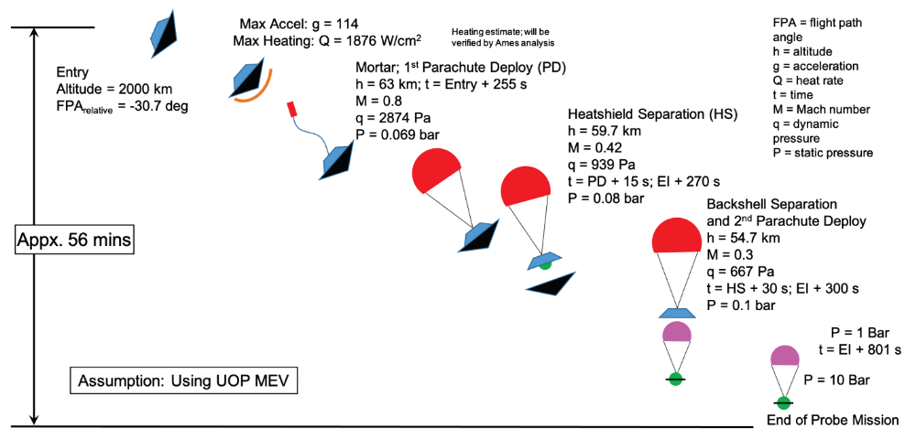
Probe TPS (analysis from Josh Monk & Helen Hwang)
The probe design from the UOP decadal survey study is quite different from the aerocapture problem due to diving much deeper into the atmosphere.
  The time of flight is halved, and the heatshield is separated much sooner
  Peak heating rates are nearly 1900 W/cm2 and peak surface pressure during entry is ~450 kPa
TPS materials are ready for Flagship Uranus Probes
  Woven TPS – up to 3500 W/cm² & 540 kPa
Sized woven TPS heatshield is 1.9 cm thick (mass fraction of 10%)
Significant development in Woven TPS is completed for these environments:
  The Earth Entry System for the Mars Sample Return mission is manufacturing heatshields of relevant dimensions and further characterizing material.
  Venus mission led by Rocket Lab is using woven TPS
Credit: Uranus Orbiter & Probe Planetary Mission Concept Study for the 2023-2032 Decadal Survey

Slide 7
Conclusion
Aerocapture can significantly reduce mission interplanetary transit time while saving mass
TPS materials are ready for a Uranus Flagship Mission and enable:
  Orbit insertion through aerocapture
  Delivery of atmospheric science probes
Today, NASA Ames is actively supporting a broad spectrum of missions that will use the same TPS systems needed for Uranus Flagship.
  Experience working with these materials will only grow
  Commercial involvement is likely to grow
  Manufacturing facilities will be supported bridging to Uranus Flagship

Slide 8

Questions

