Slide 1
Automated Model Tuning for Multifidelity Trajectory Simulation Estimators
James Warner¹, Marten Thompson², Gianluca Geraci³, Geoffrey Bomarito¹,
Michael Eldred³, John Jakeman³, Alex Gorodetsky⁴
NASA Langley Research Center, Hampton, VA
University of Minnesota Twin Cities, Minneapolis, MN
Sandia National Laboratories, Albuquerque, NM
University of Michigan, Ann Arbor, MI
MS418: Data-Enhanced Modeling and Uncertainty Quantification
of Systems with Multiple Fidelities
17th U.S. National Congress on Computational Mechanics
July 26th, 2023

Slide 2
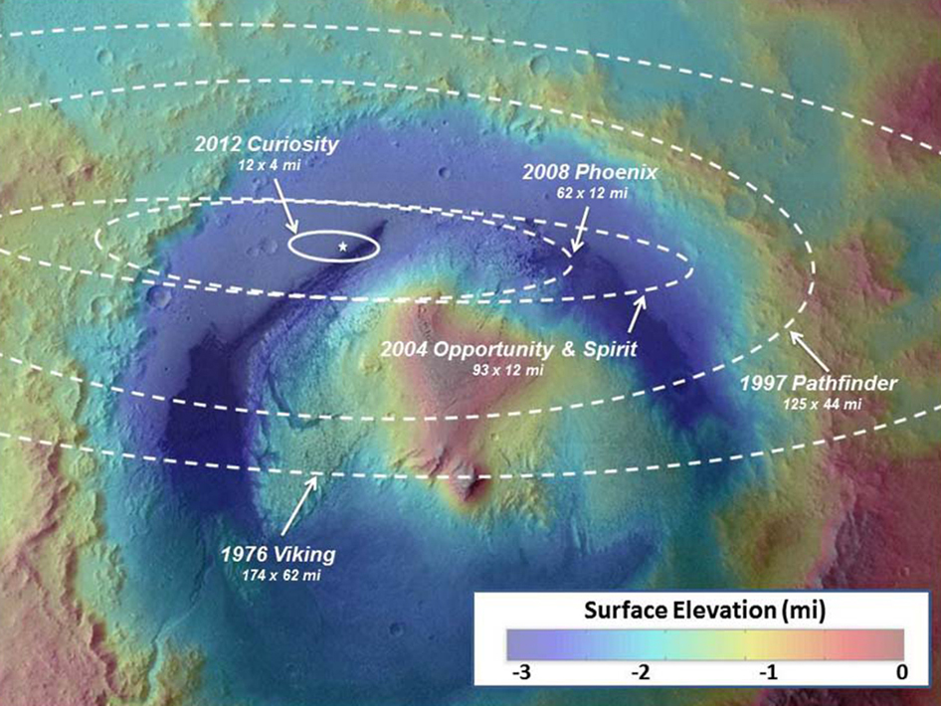
Motivation: Trajectory Guidance
Orders of magnitude improvement in landing precision for entry, descent, and landing (EDL) systems is required to enable human Mars missions
  Long-term goal: robust trajectory optimization with uncertainty quantification (UQ)
Surface Elevation (miles)
Mars landing precision over time
Notes:
Introduce “EDL” somewhere..

Slide 3

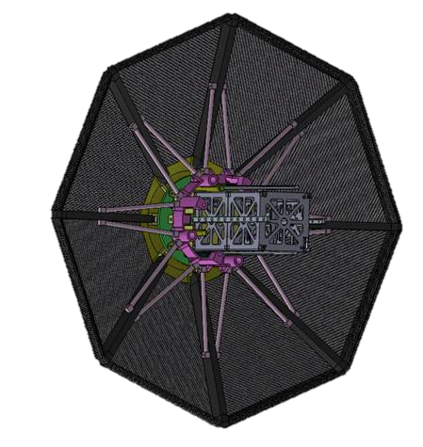
Inner Loop: Trajectory Simulation UQ
The uncertainty propagation problem for trajectory simulation is characterized by:
  High dimensional input – e.g., atmosphere conditions, vehicle state
  Multiple quantities of interest (QoIs) – e.g., landing location, flight time
  High-fidelity model: Program to Optimize Simulated Trajectories II (POST2)
Monte Carlo (MC) simulation
Heatshield
Payload
Notes:
Uncertainty propagation problem & characteristics

Slide 4
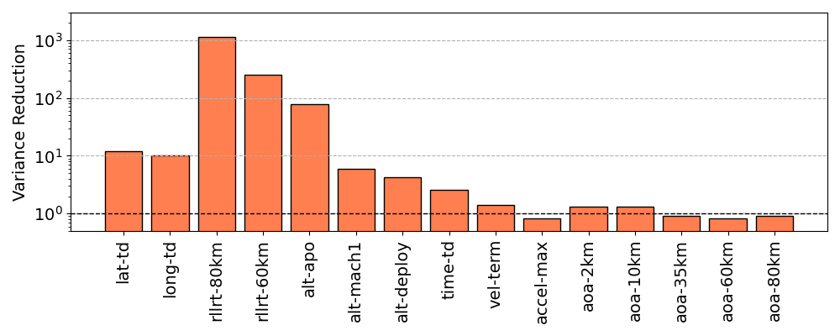
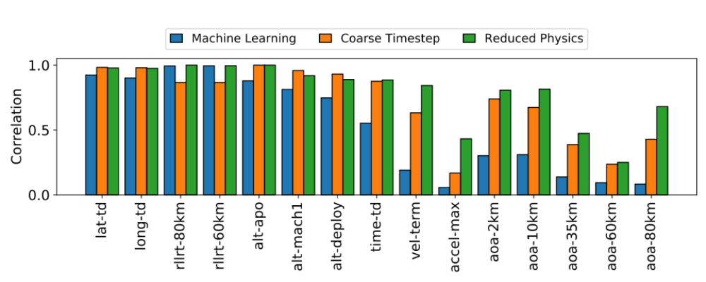

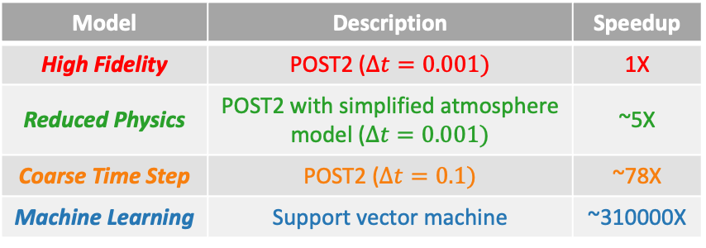
Multifidelity Trajectory Simulation
Original work [1] demonstrated approximate control variates (ACVs) [2, 3] with three hand-selected low-fidelity models
Multifidelity UQ
Variance Reduction for Each Trajectory QoI
Heatshield
Payload
1000X
100X
10X
= MC
Model | Description | Speedup
High Fidelity | POST2 ($∆t=0.001)$ | 1X
Reduced Physics | POST2 with simplified atmosphere model ($∆t=0.001)$ | ~5X
Coarse Time Step | POST2 ($∆t=0.1)$ | ~78X
Machine Learning | Support vector machine | ~310000X
Correlation w.r.t High-Fidelity Model for Each Trajectory QoI
Reduced Physics
Coarse Time Step
Machine Learning
[1] Warner, J. E., et al. AIAA SciTech (2021).
[2] Gorodetsky, A A., et al. Journal of Computational Physics (2020)
[3] Bomarito, G. F., et al. Journal of Computational Physics (2022)
Avenues of research to increase performance for all QoIs:
Multi-output ACVs (MOACVs) with University of Michigan
Model tuning with Sandia National Labs
Notes:
Original approach for EDL/ACVs – SciTech 2021 overview & short comings

Slide 5
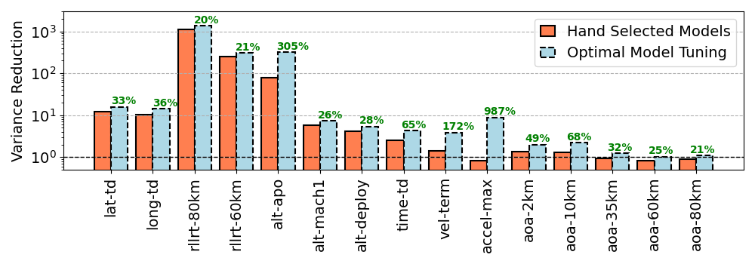
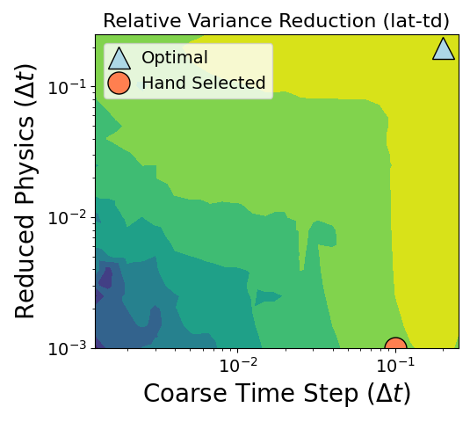
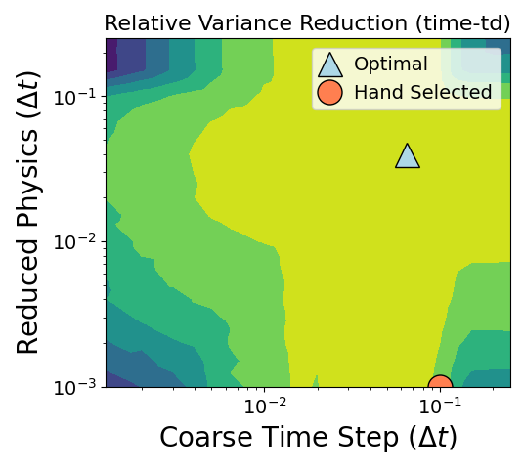
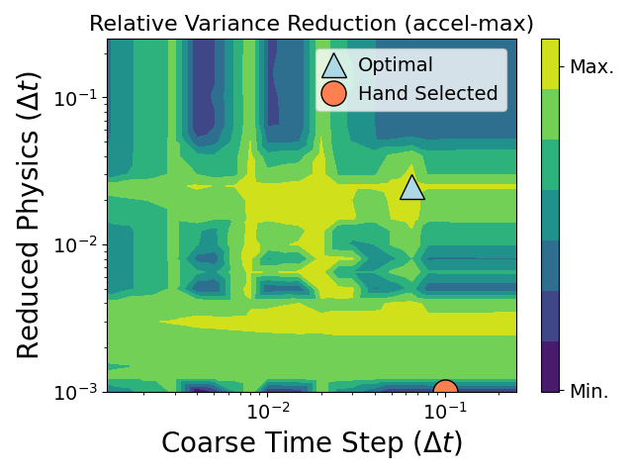
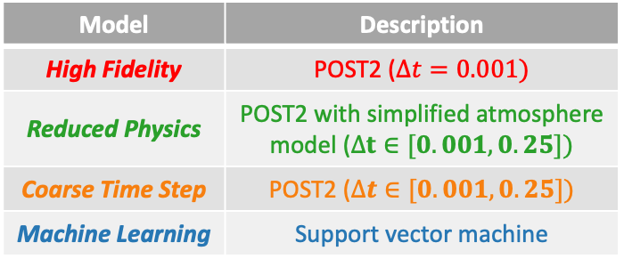
Model Tuning for Trajectory Simulation
Considering low-fidelity model hyperparameters (i.e., time steps) as tunable rather than fixed can yield substantial performance improvement
Multifidelity UQ
Potential Performance Improvement Using Model Tuning
Heatshield
Payload
Max. % Improvement via Model Tuning
Model | Description
High Fidelity | POST2 ($∆t=0.001)$
Reduced Physics | POST2 with simplified atmosphere model ($∆t∈[0.001, 0.25])$
Coarse Time Step | POST2 ($∆t∈[0.001, 0.25])$
Machine Learning | Support vector machine
Fixed
Tunable time step
Fixed
Automated model tuning for trajectory simulation:
  Can we identify near-optimal time step values efficiently enough to realize performance gains?
Notes:
Potential improvement on original work via model tuning

Slide 6
Model Tuning for Trajectory Simulation
The current work explores the practicality and challenges of automated model tuning in a realistic context
  Efficient, online analysis is important for EDL applications
  Optimization landscape for hyperparameters is non-trivial
Uses hand-selected models from original ACV+EDL work as a baseline
Leverages Sandia Dakota UQ software for optimization
Model Tuning Performance:
Best Case vs. In Practice
?
Model Tuning: Actual
Variance Reduction
Model Tuning: Best Case
Hand Selected Models
EDL QoI

Slide 7
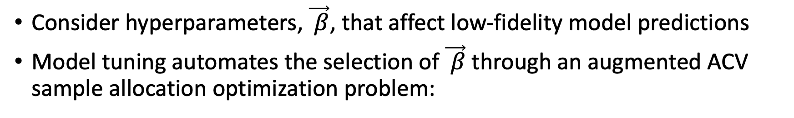
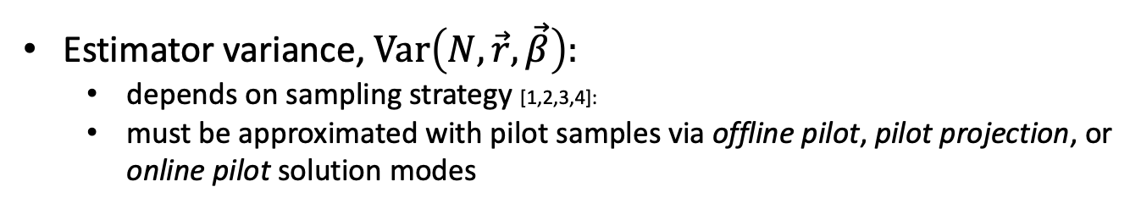
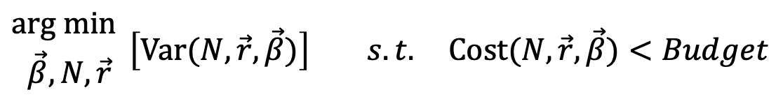
Model Tuning for ACVs
Consider hyperparameters, $\vec{ β}$, that affect low-fidelity model predictions
Model tuning automates the selection of $\vec{ β}$ through an augmented ACV sample allocation optimization problem:
$$\begin{aligned}arg min{ } \\ \vec{β},N,\vec{r}\end{aligned}\left[Var(N,\vec{r},\vec{β})\right] s.t. Cost(N,\vec{r},\vec{β})<Budget$$
# high-fidelity evaluations
Sampling ratios
Estimator variance
Estimator cost
Computational budget
Estimator variance, $Var\left(N,\vec{r},\vec{β}\right):$
  depends on sampling strategy [1,2,3,4]:
  must be approximated with pilot samples via offline pilot, pilot projection, or online pilot solution modes
[1] Multi-level Monte Carlo (MLMC) - Giles, M B. (2008) [3] ACVs - Gorodetsky, A A., et al. (2020)
[2] Multifidelity Monte Carlo (MFMC) - Peherstorfer, B, et al. (2016) [4] Parametrically-defined ACVs - Bomarito, G. F., et al. (2022)
Could introduce solution modes here under first bullet

Slide 8


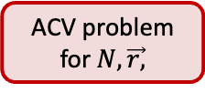

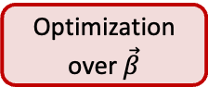
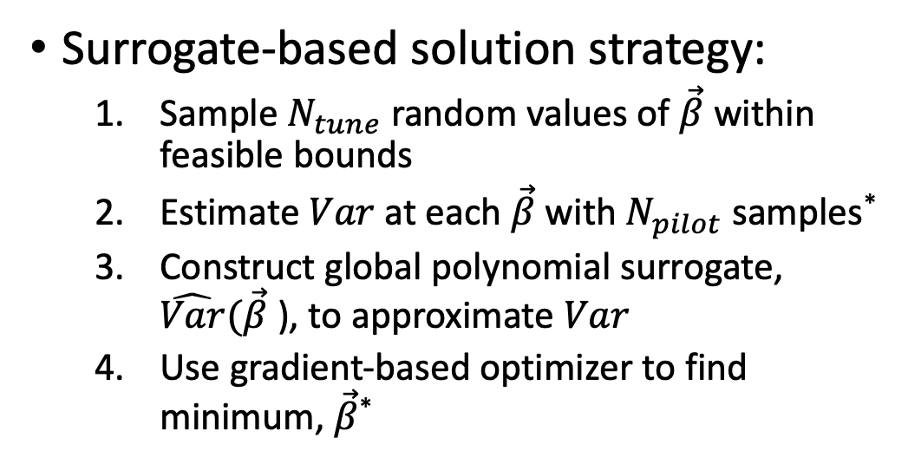



Bi-Level Optimization Approach
Optimization over $\vec{β}$
arg min arg min $Var\left(N,\vec{r,}\vec{β}\right)$ s.t.$Cost(N,\vec{r},\vec{β})<Budget$
Dakota
$$\vec{β}$$
$$N,\vec{r}$$
ACV problem for $N,\vec{r,}$
POST2
Pilot Sampling
Surrogate-based solution strategy:
  Sample $N_{tune}$ random values of $\vec{β}$ within feasible bounds
  Estimate $Var$at each $\vec{β}$ with $N_{pilot}$ samples*
  Construct global polynomial surrogate, $\hat{Var}(\vec{β}$ ), to approximate $Var$
  Use gradient-based optimizer to find minimum, $\vec{β}$*
Estimator Variance
$Var(β$)
$\hat{Var}(β$)
$$β$$
$β$*
*Using pilot projection solution mode

Slide 9
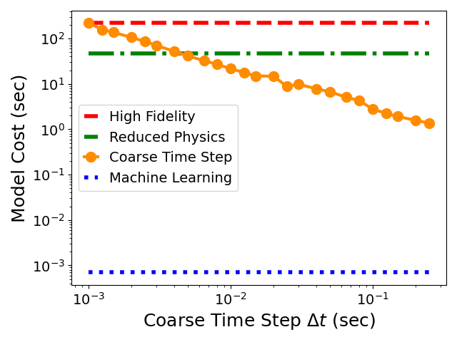
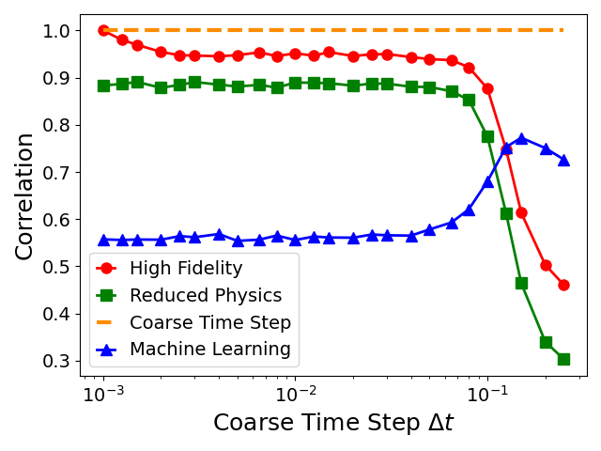
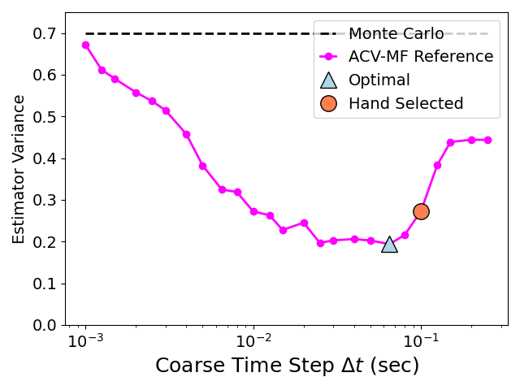
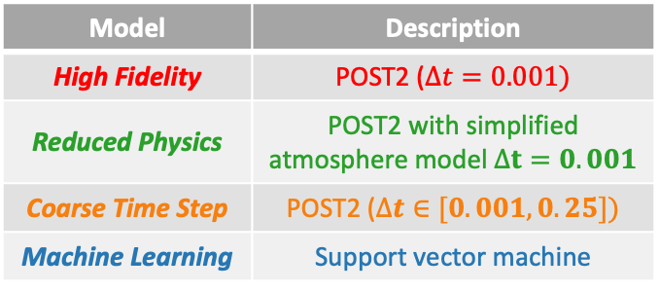
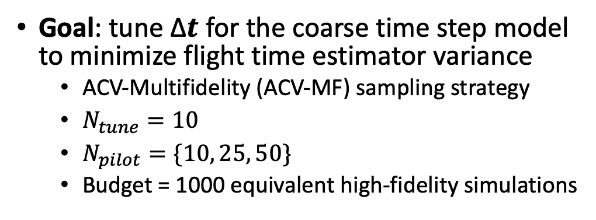
Example 1: Single Tuning Parameter
Goal: tune ∆𝒕 for the coarse time step model to minimize flight time estimator variance
  ACV-Multifidelity (ACV-MF) sampling strategy
  $N_{tune}=10$
  $N_{pilot}=\{10, 25, 50\}$
  Budget = 1000 equivalent high-fidelity simulations
Model | Description
High Fidelity | POST2 ($∆t=0.001)$
Reduced Physics | POST2 with simplified atmosphere model $∆t=0.001$
Coarse Time Step | POST2 ($∆t∈[0.001, 0.25])$
Machine Learning | Support vector machine
Fixed
Fixed
Tunable
Fixed
Model Costs vs. Coarse Time Step ∆𝒕
Correlations w.r.t. Coarse Time Step Model
Estimator Variance vs. Coarse Time Step ∆𝒕

Slide 10
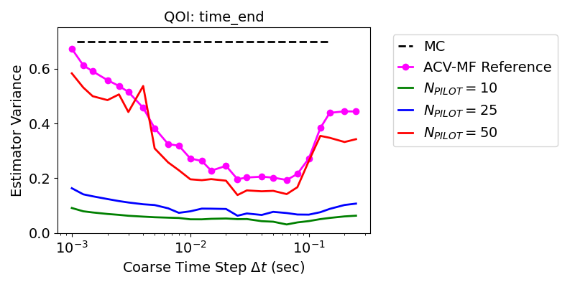
Example 1: Results
Estimates of the optimization objective function (variance vs. time step) using different numbers of pilot samples
ACV-MF Reference uses offline pilot solution mode with 5000 samples
Variance estimated at 25 equally (log) spaced time steps
Notes:
Two interesting/challenging aspects of model tuning optimization problem:
Noisiness of objective function
Cost of objective evaluation depends on design variables

Slide 11
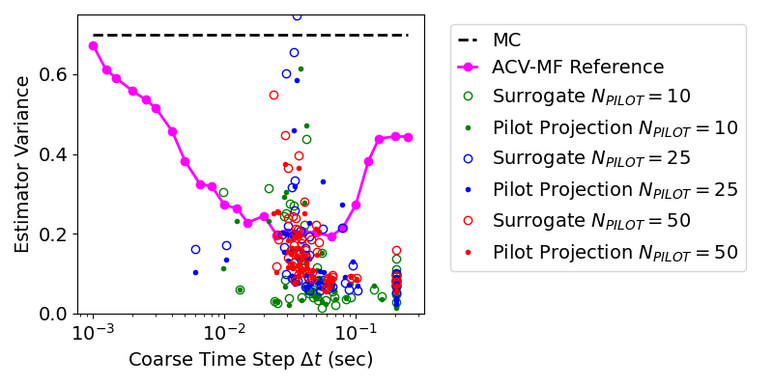
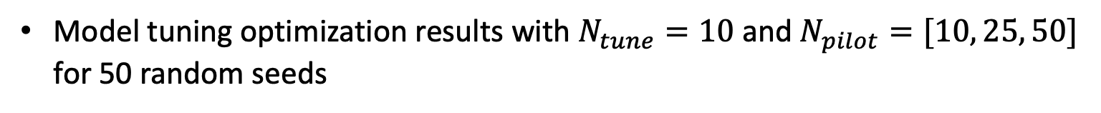
Example 1: Results
Model tuning optimization results with $N_{tune}=10$ and $N_{pilot}=[10, 25, 50]$ for 50 random seeds
Optimization failed

Slide 12
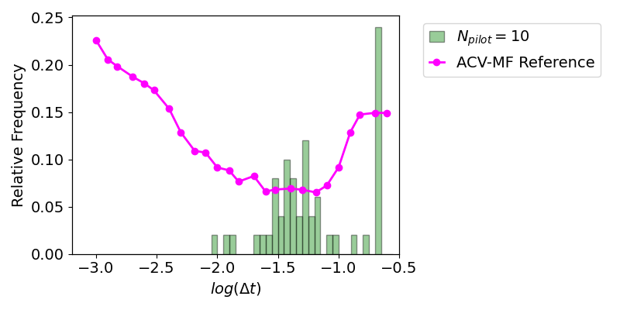
Example 1: Results
Optimized time step values across 50 random trials

Slide 13
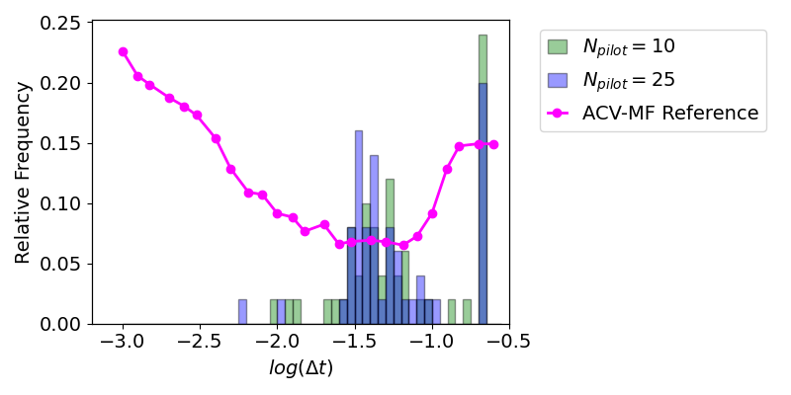
Example 1: Results
Optimized time step values across 50 random trials

Slide 14
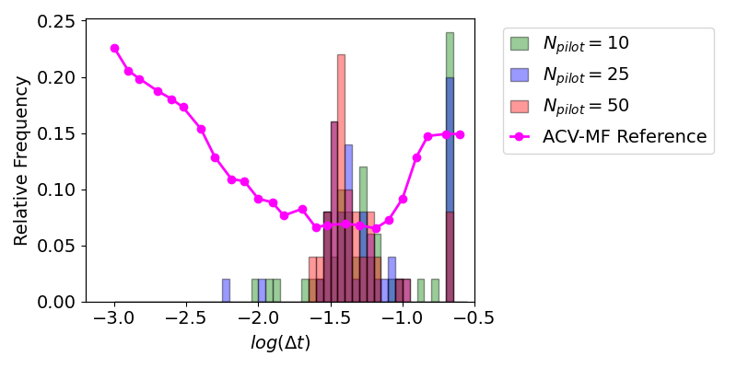
Example 1: Results
Optimized time step values across 50 random trials

Slide 15
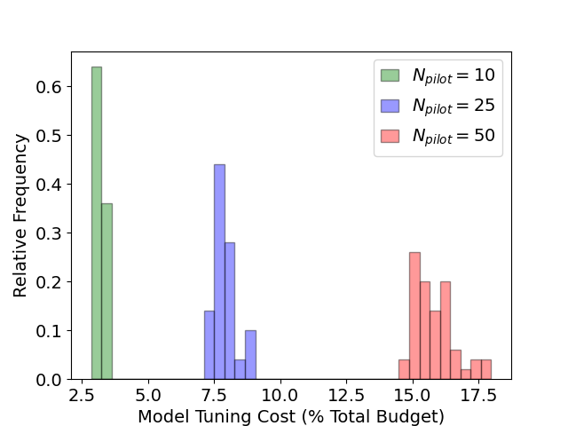
Example 1: Results
Model tuning optimization cost across 50 random trials with a total computational budget of 1000 equivalent high-fidelity simulations

Slide 16
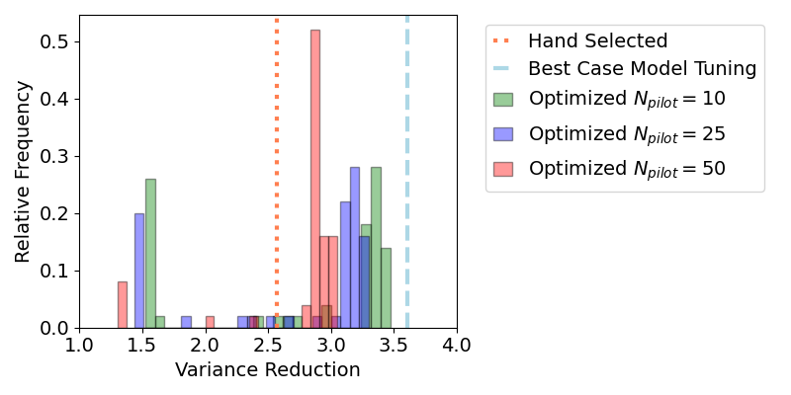
Example 1: Results
Variance reduction from model tuning accounting for upfront optimization cost
  Budget: 1000 equivalent high-fidelity simulations
Optimized Time Step Values
Model Tuning Variance Reductions
Optimization Costs
Note: variance reduction estimates ignore the effects of pilot sampling error (i.e., use offline pilot solutions)

Slide 17
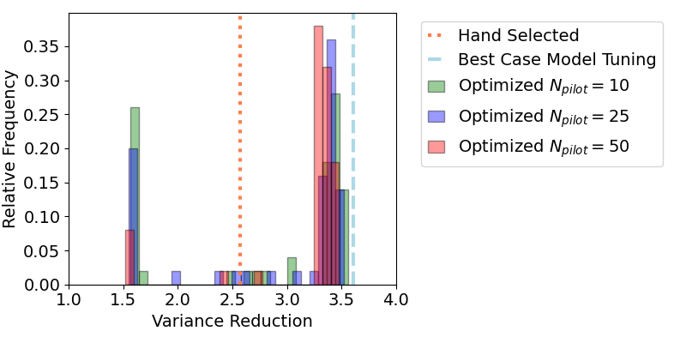
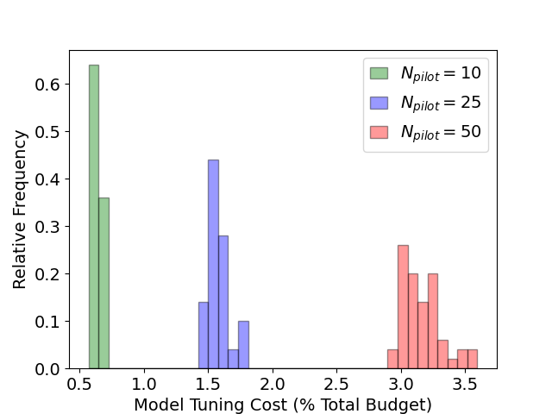
Example 1: Results
Variance reduction from model tuning accounting for upfront optimization cost
  Budget: 5000 equivalent high-fidelity simulations
Optimized Time Step Values
Model Tuning Variance Reductions
Optimization Costs
Note: variance reduction estimates ignore the effects of pilot sampling error (i.e., use offline pilot solutions)

Slide 18
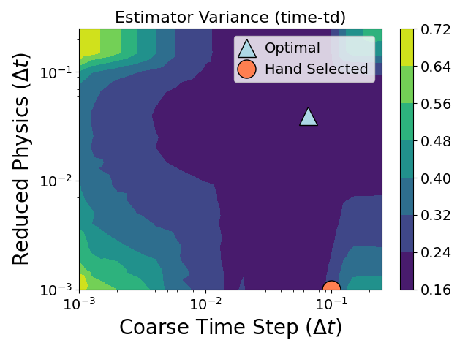
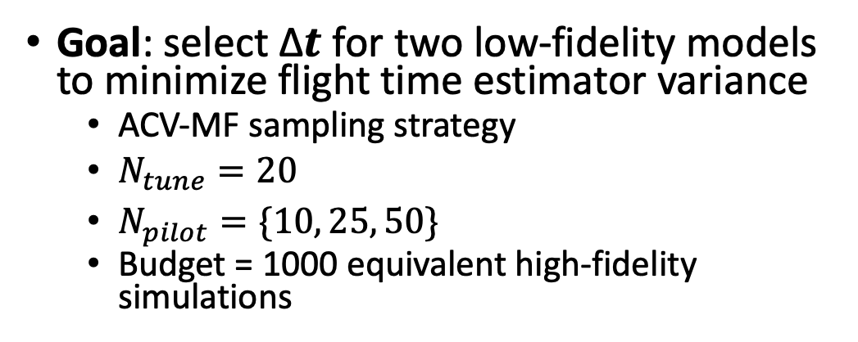
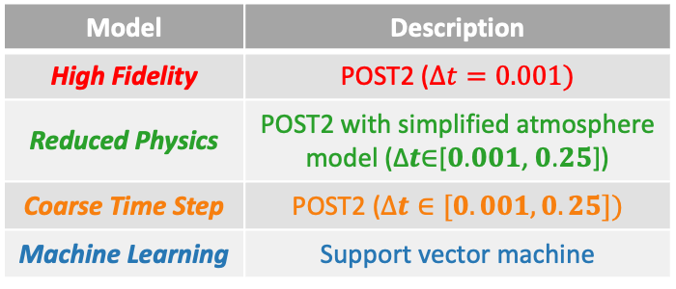
Example 2: Multiple Tuning Parameters
Goal: select ∆𝒕 for two low-fidelity models to minimize flight time estimator variance
  ACV-MF sampling strategy
  $N_{tune}=20$
  $N_{pilot}=\{10, 25, 50\}$
  Budget = 1000 equivalent high-fidelity simulations
Model | Description
High Fidelity | POST2 ($∆t=0.001)$
Reduced Physics | POST2 with simplified atmosphere model (∆𝒕∈[𝟎.𝟎𝟎𝟏, 𝟎.𝟐𝟓])
Coarse Time Step | POST2 ($∆t∈[0.001, 0.25])$
Machine Learning | Support vector machine
Fixed
Tunable
Tunable
Fixed
Notes:
Estimate flight time; remind of models; tuning one;
Show 1d param sweep reference plot; show correlations/cost vs time step (show 2d param sweep as reference?)

Slide 19
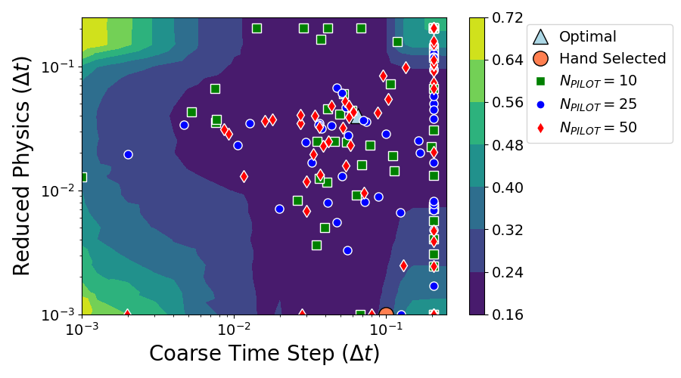
Example 2: Results
25 model tuning optimization trials with $N_{tune}=20$,$N_{pilot}=\left\{10, 25, 50\right\},$ and budget = 1000 equivalent high-fidelity simulations

Slide 20
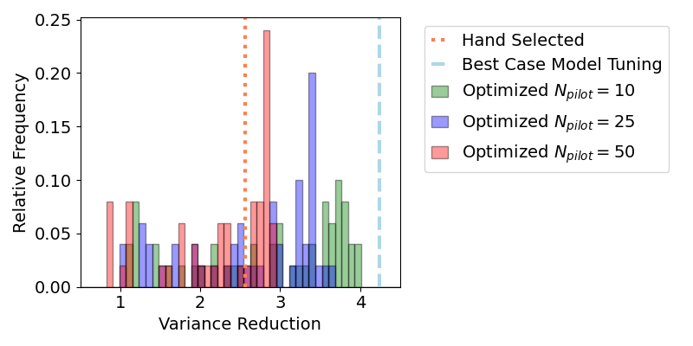
Example 2: Results
25 model tuning optimization trials with $N_{tune}=20$,$N_{pilot}=\left\{10, 25, 50\right\},$ and budget = 1000 equivalent high-fidelity simulations
Model Tuning Variance Reductions
Note: variance reduction estimates ignore the effects of pilot sampling error (i.e., use offline pilot solutions)

Slide 21
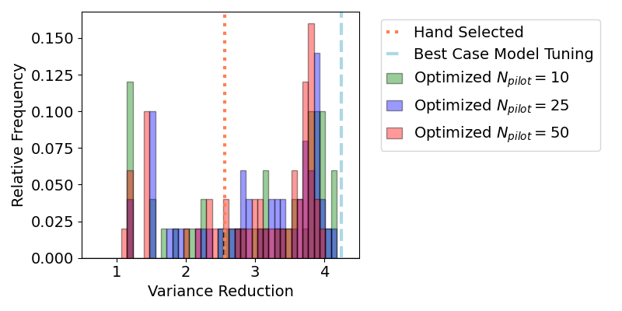
Example 2: Results
25 model tuning optimization trials with $N_{tune}=20$,$N_{pilot}=\left\{10, 25, 50\right\},$ and budget = 5000 equivalent high-fidelity simulations
Model Tuning Variance Reductions
Note: variance reduction estimates ignore the effects of pilot sampling error (i.e., use offline pilot solutions)

Slide 22
Conclusions and Future Work
Model tuning can significantly enhance ACV performance for realistic applications (e.g., trajectory simulation)
In practice, performance improvements are problem-dependent and may require thoughtful optimization strategies
  Feasibility of model tuning problem is affected by overall computational budget, number of tunable models, degree of variability in model statistics, amount of a priori knowledge of low-fidelity model behavior, etc.
Future work
  Account for pilot sampling error in hand-selected vs. model tuned solutions
    Compare variance of online ACV estimators
  Perform model tuning in conjunction with ACV graph search and multi-output ACVs
  Leverage more advanced optimization approaches, e.g., efficient global optimization (EGO), all-at-once optimization (model tuning + sample allocation)

Slide 23
Questions?
Email: james.e.warner@nasa.gov
Reference:
  M. Thompson, G. F. Bomarito, G. Geraci, J. E. Warner, P. E. Leser, W. P. Leser, M. S. Eldred, J. D. Jakeman, A. A. Gorodetsky. Strategies for Automation of Model Tuning in Multi-fidelity Trajectory Uncertainty Propagation. 2023 AIAA Scitech Proceedings.
Acknowledgement:
  NASA researchers supported by the Entry Systems Modeling (ESM) project
  Sandia National Laboratories is a multimission laboratory managed and operated by National Technology and Engineering Solutions of Sandia LLC, a wholly owned subsidiary of Honeywell International Inc. for the U.S. Department of Energy’s National Nuclear Security Administration under contract DE-NA0003525. This paper describes objective technical results and analysis. Any subjective views or opinions that might be expressed in the paper do not necessarily represent the views of the U.S. Department of Energy or the United States Government.

