Slide 1
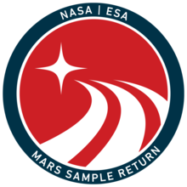
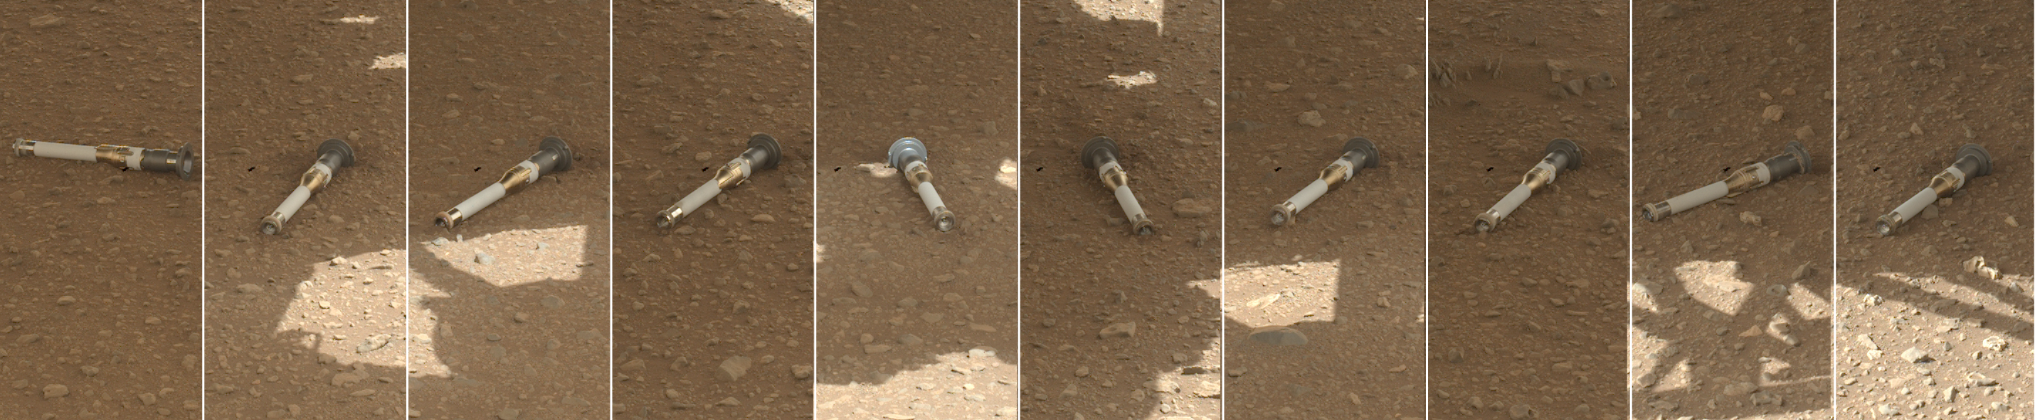
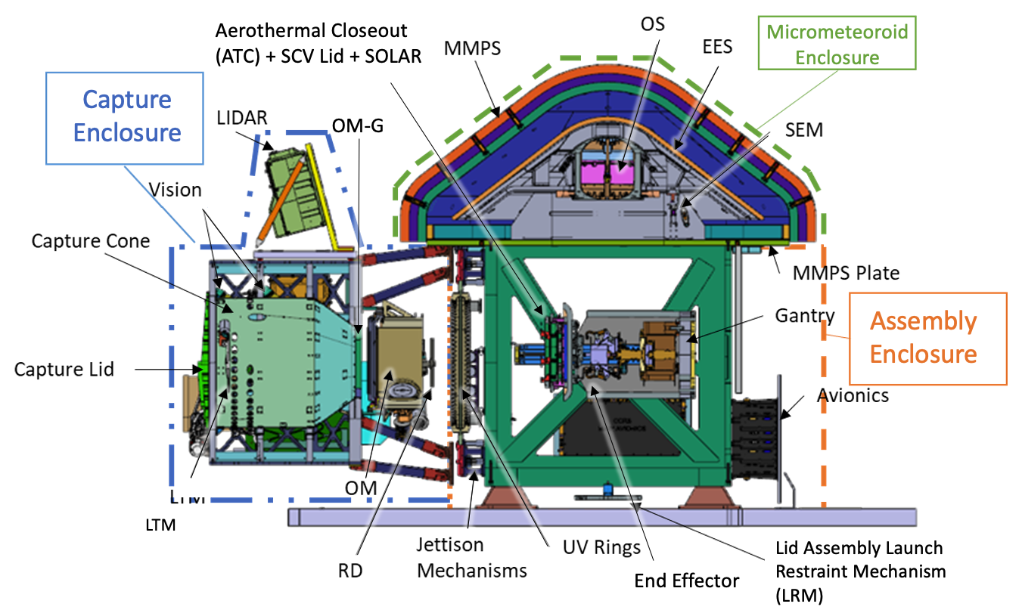
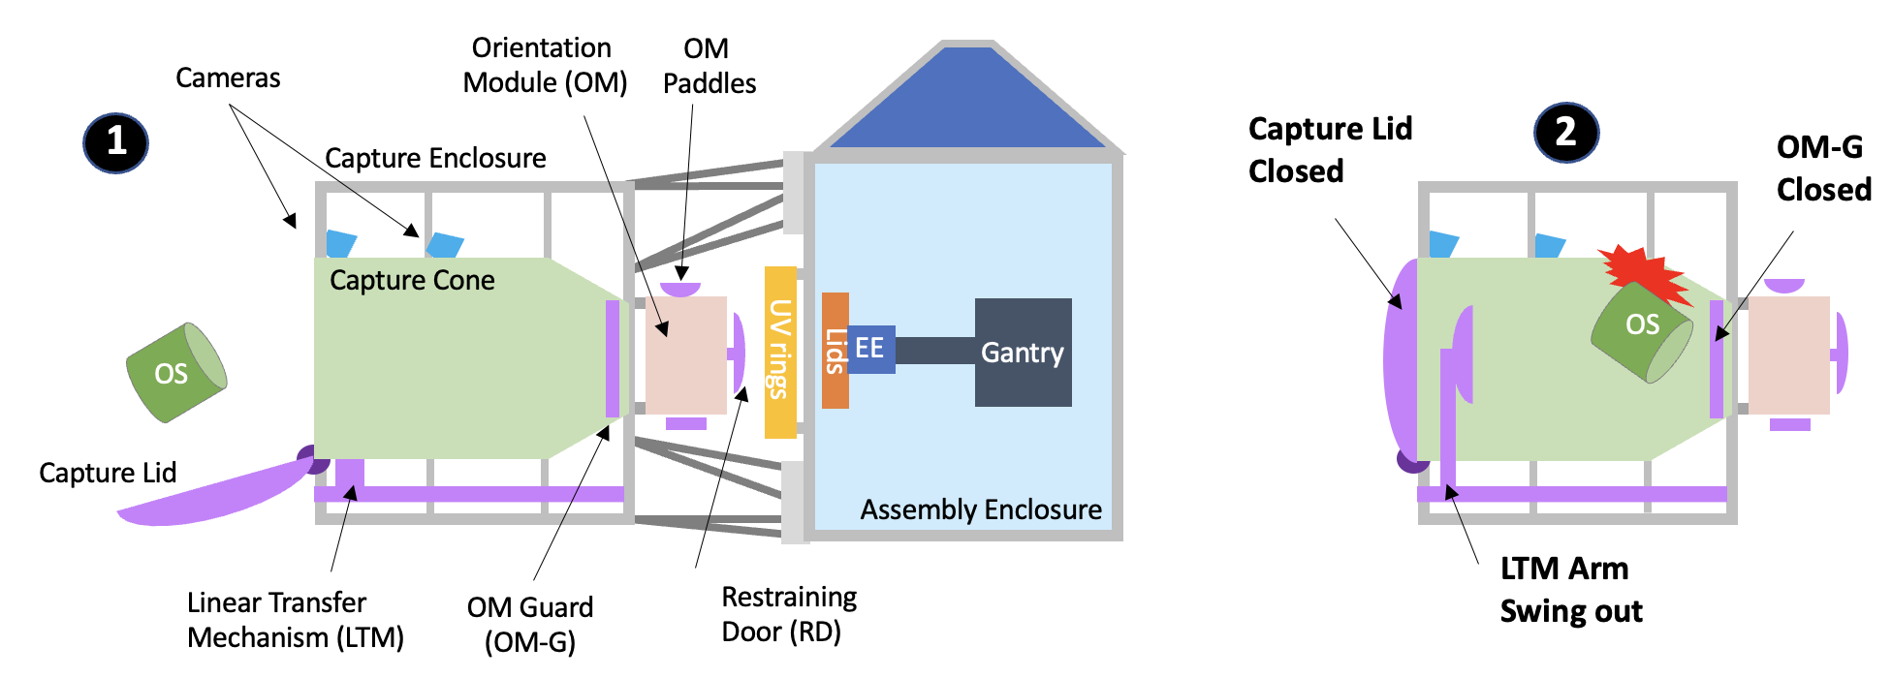
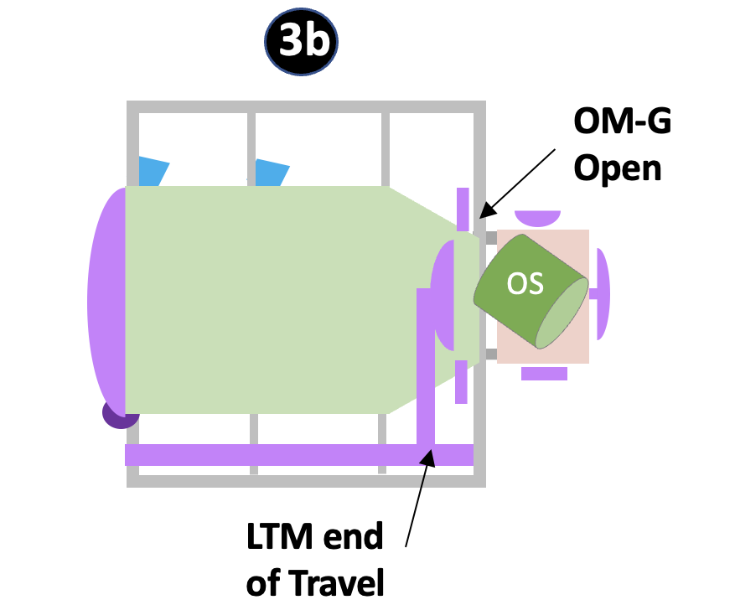
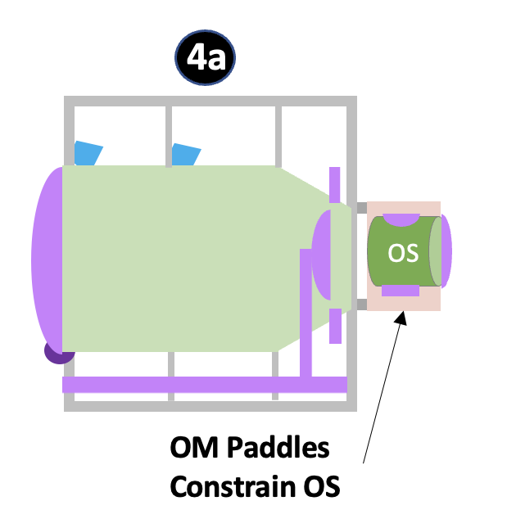
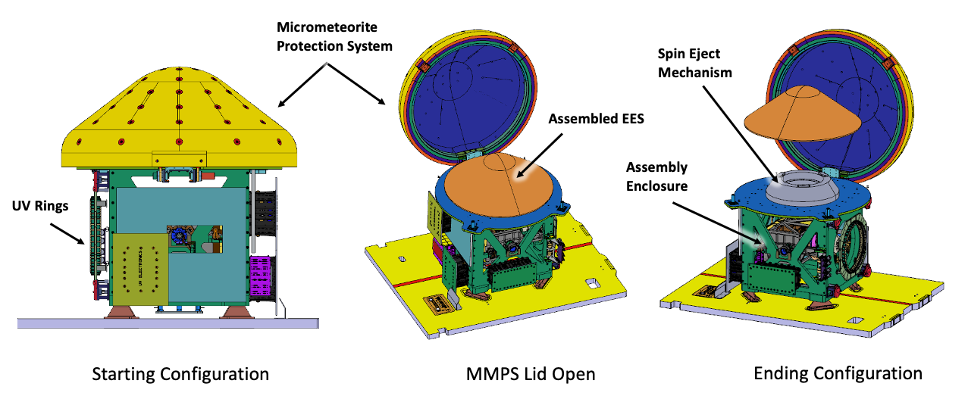
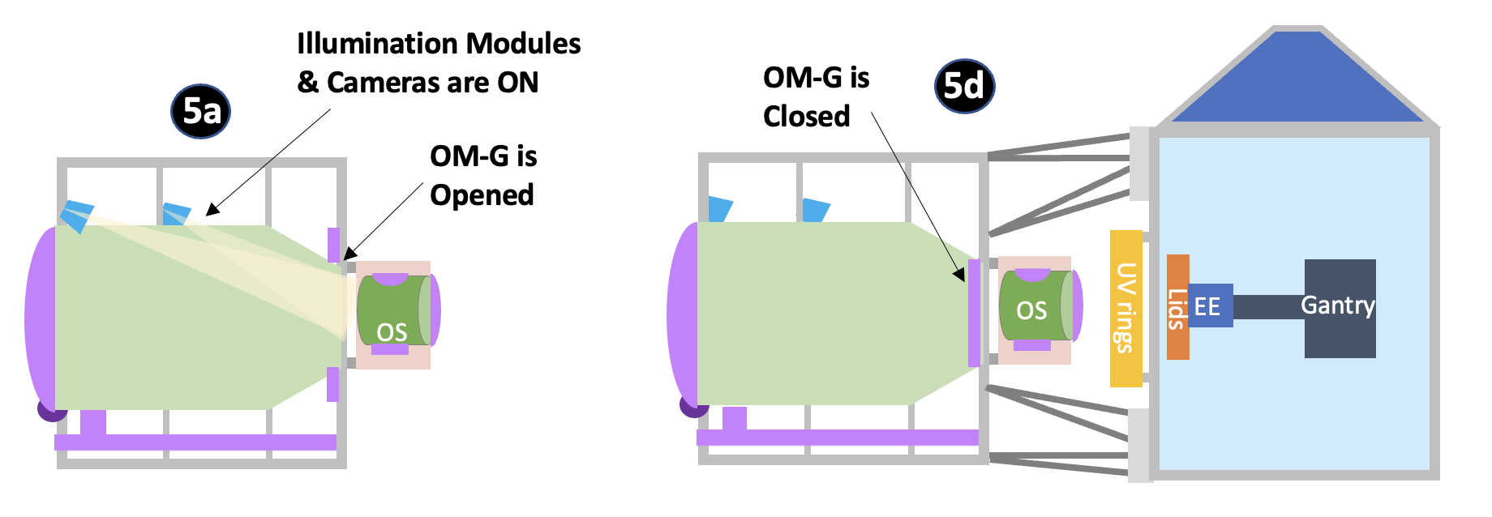
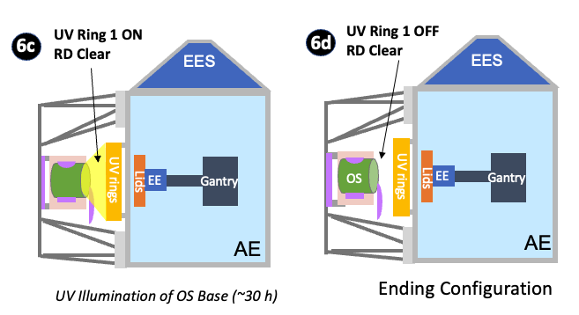
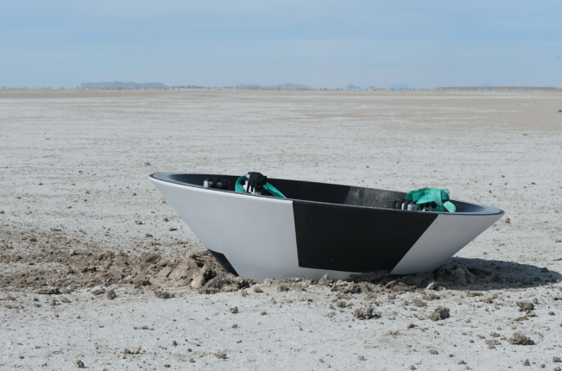
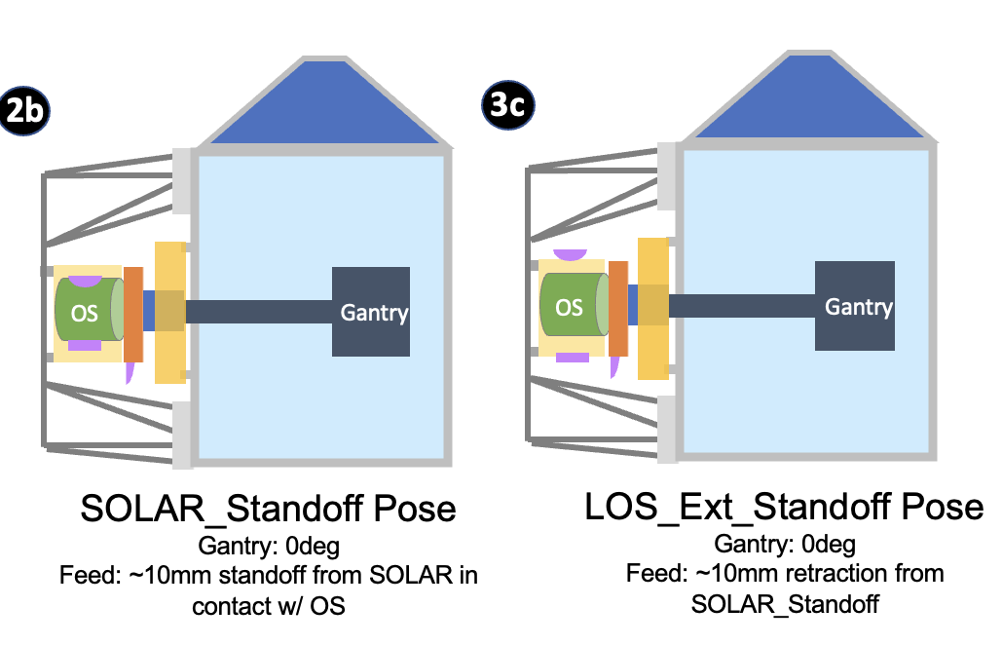
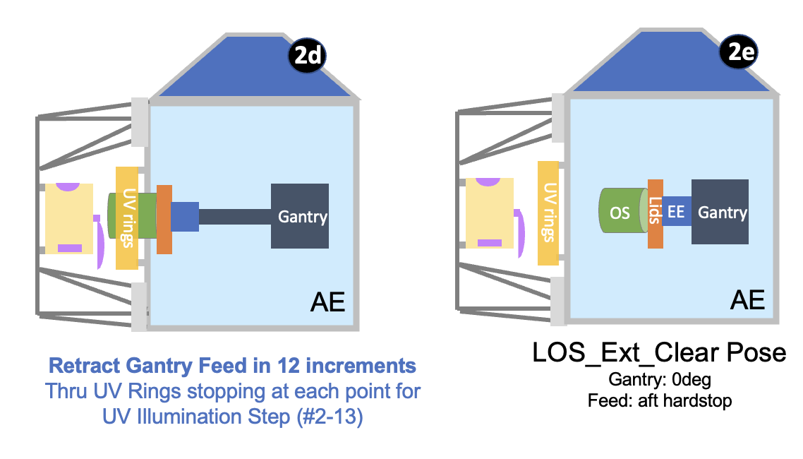
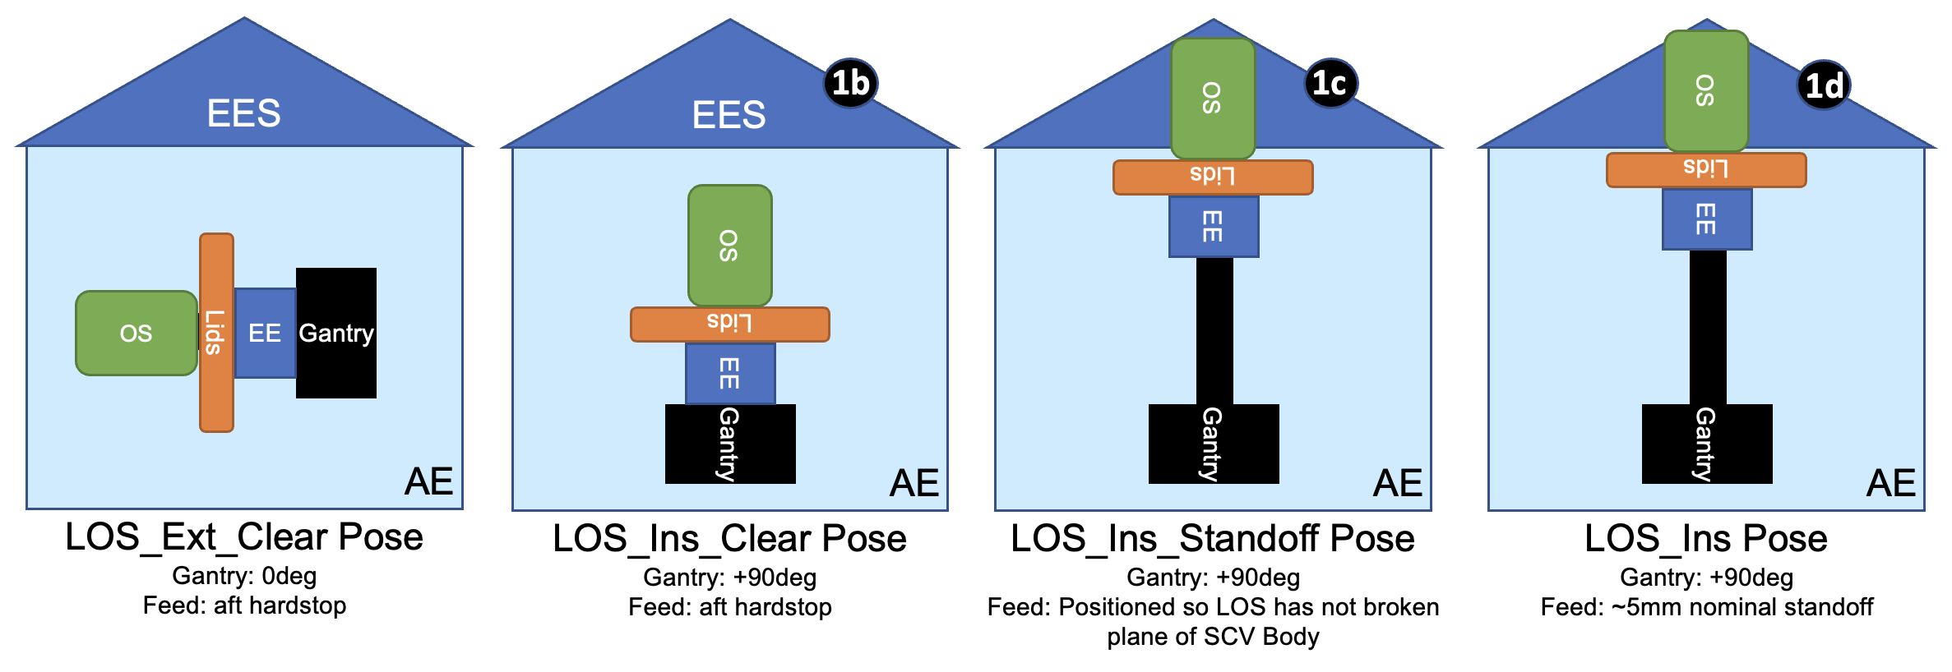
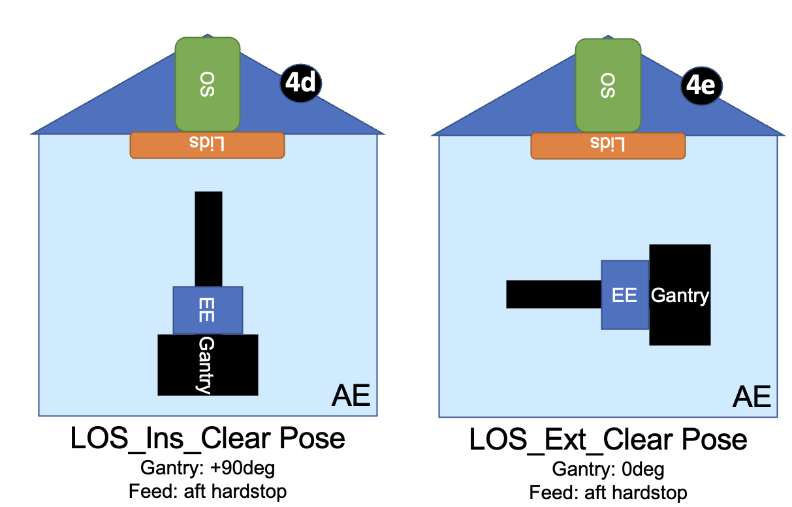
20th International Planetary Probe Workshop
Overview of the Capture, Containment, and Return System (CCRS)
Carlie H. Zumwalt
NASA Langley Research Center
The Capture, Containment and Return System (CCRS) is a Goddard Spaceflight Center managed and operated payload on the European Space Agency’s Earth Return Orbiter (ERO) Mission, which is part of the Mars Sample Return (MSR) program. The objective of the MSR program is to collect samples from the surface of Mars and return those samples to Earth for scientific research.
CCRS is a key element in the final step of the MSR program. The primary mission for CCRS begins with the capture of the Orbiting Sample (OS) in Low Mars Orbit and concludes with the landing of the passive Earth Entry System at the Utah Test and Training Range (UTTR). This poster outlines the journey the OS would take from capture to UTTR.
CCRS applies a set of Planetary Protection measures which affirm the need for protecting solar system bodies from potentially harmful contamination by terrestrial materials. These are important for understanding the CCRS design.
Backward Planetary Protection is concerned with protecting Earth from Mars contamination.
CCRS is classified as “Class V(r) Restricted Return”, which requires the spacecraft to “break the chain of contact” (BTC) with Mars in order to prohibit uncontrolled transmission and release of Mars material into Earth’s biosphere.
BTC is addressed in several elements of the CCRS design, from the use of active UV illumination of the OS, the use of a secondary containment vessel (SCV) around the OS, and passive heat sterilization of the EES during Earth entry.
Forward Planetary Protection is concerned with protecting Mars from Earth contamination.
CCRS is classified as a “Category III Flyby/Orbiter” which is addressed through ERO orbit stability and compatibility with bioburden assessments.
Mars Sample Return Concept of Operations
Sample Depot as of February 2023
CCRS has five mission phases that are outlined in chronological order below. Each phase immediately follows the preceding phase; there is no gap in time between phases.
Phase 1: Launch, Commissioning, and Outbound Transfer (LCOT)
The LCOT phase starts with the arrival of ERO/CCRS at the launch site and ends with ERO’s arrival in low Mars orbit, to begin rendezvous operations with the OS. It is the longest of the CCRS phases.
For the majority of this phase CCRS is powered off, only powering on periodically to perform risk reduction activities and health & safety checks.
Phase 2: Capture and Configuration (C&C)
The Capture and Configuration phase begins prior to rendezvous with the OS and ends the OS base endcap has completed sterilization and the OS is ready for pickup by the robot transfer arm system.
The following is the sequence of events which occur for the C&C phase:
When “Go” for capture is confirmed, ERO begins terminal rendezvous with the OS (1). When capture is confirmed, the Capture Lid closes and the Linear Transfer Mechanism (LTM) is released (2).
The LTM translates the OS down the Capture Cone and pushes it up to the Orientation Mechanism Guard (OM-G). The OM-G opens and the OS enters the Orientation Mechanism (OM) (3b).
The OM paddles grasp the OS and place it into the correct orientation (4a), using cameras confirm the proper orientation has been achieved (5a). The OM-G closes behind the OS (5d).
The UV system is activated to sterilize the base of the OS (6a) and deactivated when sterilization is complete (6d).
Identification of Major CCRS Payload Systems
Phase 4: Protection, Jettison, and Release (PJR)
The PJR phase begins after the assembly of the EES in Mars orbit and ends immediately after EES is released from CCRS.
Two events occur: Capture Enclosure (CE) jettison and EES release.
CE jettison: To bring the mass returned to Earth within the capability of ERO, the Capture Enclosure is jettisoned from CCRS prior to Earth return.
EES release: Nominal release of EES is three days prior to Entry, with a back-up opportunity available. The Spin Eject Mechanism is used for release.
The assembled EES remains protected by the Micrometeorite Protection System (MMPS). The MMPS is opened hours prior to EES release.
Phase 3: EES On-Orbit Assembly Phase (EESOOA)
The EES On-Orbit Assembly phase begins at the completion of UV Illumination of the OS base endcap and ends when the ground confirms successful assembly of the Earth Entry System (EES) into its landing configuration.
The following is the sequence of events which would occur for the EESOOA phase:
The Gantry extends the End Effector (EE) toward the OS and latches the lid assembly, which is attached to the EE, onto the OS (2b). The OM paddles retract (3c).
The UV system is activated. The Gantry slowly retracts the OS + lid assembly (LOS) through the UV rings, sterilizing the assembly as it passes through (2d).
The Gantry rotates to align the LOS with the EES (1b), in order to begin assembly of the EES.
The Gantry extends the LOS for insertion into the Secondary Containment Vessel (SCV) (1d), which is pre-installed on the EES. A torque mechanism rotates the interface to the LOS, in order to engage the SCV rotary latch mechanism.
The Gantry retracts the End Effector (4d) and rotates to a stowed position (4e).
Phase 5: Approach, Entry, Descent, and Landing (AEDL)
The AEDL phase starts immediately following EES release and includes the three-day free-flight through space. It ends with atmospheric entry and landing on Earth.
This phase is entirely passive. There are no active components on the EES.
Immediately after EES release, Navigation determines the final EES free-flight trajectory and the joint ESA/NASA navigation team will provide predictions of the expected EES entry point and time, including dispersions, for ground recovery efforts.
Once EES lands at UTTR, the CCRS mission is complete.

