Slide 1
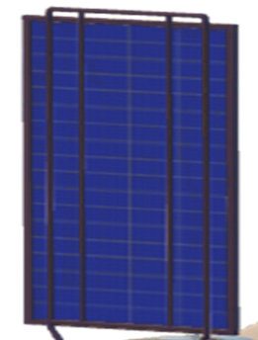
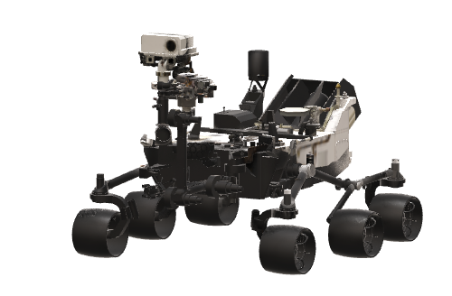
LSIC Surface Power Reliability Workshop
July 27, 2023
Reliable Power Hibernation and Recovery for Solar Powered Lunar Missions
Nicholas R. Uguccini, Presenter nicholas.r.uguccini@nasa.gov
Richard C. Oeftering, richard.c.oeftering@nasa.gov
Thomas B. Miller, thomas.b.miller@nasa.gov
Brian A. Holler, brian.a.holler@nasa.gov
NASA Glenn Research Center
Cleveland, Ohio 44135

Slide 2
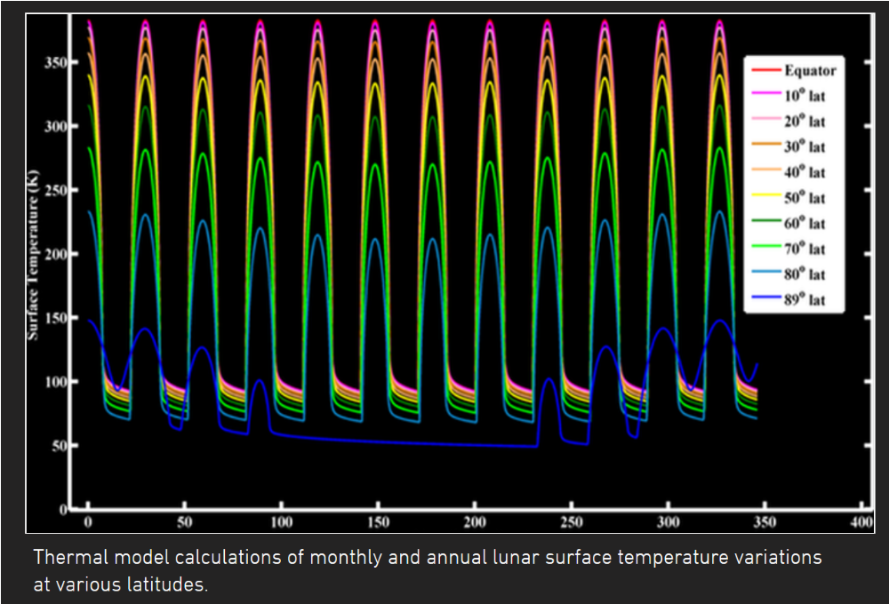
The Extreme Lunar Environment
LRO DIVINER: Lunar Day/Night Temperature Range by Latitude
Day: 150-400 K highs based on latitude
Night: 50-100 K lows at all latitudes
    Duration (non-polar): ~354 hrs (~14.75 Earth days)
Li-ion battery approx. freeze temperature
Range of lunar night low temperatures
Polar winter (4.5 months)
Lunar Polar Winter: Sun is below horizon for ~4.5 months; temps drop to 50 K
Thermal model calculations of monthly & annual lunar surface temperature variations at various latitudes
Image permissions per Dr. N Petro/NASA GSFC, Dr. D Paige/UCLA

Slide 3
Current Lunar Night Survivability Options
Commercial Lunar Payload Services (CLPS): commercially-developed lunar landers to provide a low-cost delivery to the lunar surface
Most likely near-term user of hibernation technology
Currently, all CLPS missions are solar powered and do not require lunar night survival
CLPS program is seeking options for surviving the lunar night
Existing non-nuclear survival options require generating and/or retaining heat throughout the night
  Heaters powered via large mass batteries
  Heavy insulation with heating via consumable chemicals
An alternate option is to disconnect power throughout the night, allow all systems to cool to the lunar environmental temperature, and restore operation at lunar dawn

Slide 4
Example Dawn Start-Up Sequence
Key
Cryo-tolerant
Cryo-operable (“Dawn Mode”)
(#) – Dawn start-up sequence
(1)
Solar Arrays
→ Power
→ Thermal
→ C&DH
(7)
(6)
(2)
Spacecraft Avionics & Payloads
(3)
Battery Management System (BMS)
Main Bus Controller
Power Distribution
Main Bus
Monitoring
Pre-heat control
Pre-charging
(3)
Heater Control
Pre-heat as needed
Battery
Pre-heat
(4)
(5)
Isolation Relay
Closed during nominal ops for battery charge/discharge

Slide 5
Battery Technology for Power Hibernation
Hibernation strategy utilizes widely-available 18650 lithium-ion cells
  Tests at GRC show 18650 cells can passively tolerate a freeze/thaw cycle
  Charge capacity recovers when cells return to operational temperatures
Prior tests at GRC involved a small set of test cells, and raised several questions regarding reliability
  Are there effects that are not evident with simple tests?
  What are potential degradation mechanisms?
  How many freeze/thaw cycles can be tolerated?
  What is the best state of charge for hibernation?
  How does rate of temperature change affect reliability?
  Can we detect and isolate faults while still frozen?
  Are other cell formats capable of survival?

Slide 6
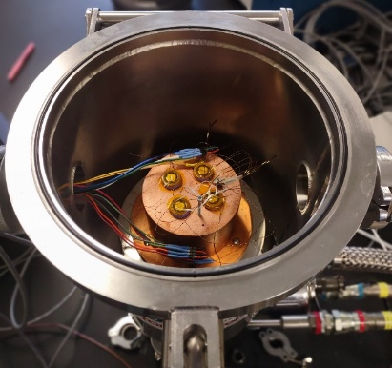
Battery Technology for Power Hibernation
NASA Glenn is testing lithium-ion batteries across multiple freeze/thaw cycles
Tested single cells at 50 K with 0%, 20%, and 40% state-of-charge under multiple lunar hibernation sequences
Acquired high-power and high-energy NASA Strategic Reserve 18650 Li-ion cells
Built and tested series-connected and parallel-connected cell string survivability
Preliminary Results: High-energy cells (LG INR18650-M36 and the Molicel INR18650-M35A) both successfully survived two cryogenic exposures under vacuum at ~50K with 14-day dwell times without degradation
Interior of cryo-cooled chamber with 4 Li-ion cells inserted into a copper cold block

Slide 7
Battery Technology for Power Hibernation
STMD Space Technology Research Grant (Early Career Faculty Program)
Investigators funded under ECF22 Topic 2: Hibernation and Recovery of Solar-Powered Systems for Lunar Missions
Dr. Kelsey Hatzel, Princeton University: Advanced in-situ and operando Characterization of Batteries Under Ultra-Low Temperature Conditions
Dr. Yangying Zho, University of California, Santa Barbara: Characterization of Lithium-ion Battery Cycling Through the Freeze-Thaw Process
  Thorough characterization of the freeze/thaw process in Li-ion cells
  Electrochemical and thermal-mechanical characterization and modelling
  Characterize degradation mechanisms and effect on cell cycle life
  Potential imaging of the electrolyte freeze front in real-time

Slide 8
Power Electronics Technology for Hibernation
Revival from hibernation requires power electronics that survive and operate in cryogenic vacuum conditions
Cryo-tolerance is essential for passive night survival
  Circuit board and device packaging must tolerate repeated exposure to extreme low temperatures (thermal–mechanical stress)
  Conventional circuit boards can tolerate exposure, but we have only found research based on limited thermal cycles
  Physical size of boards and devices can influence reliability
Cryo-operable electronics assures reliable power recovery at lunar dawn
  Cryo-operability requires stable “cold start” operation at 50 K
  Begins operation when solar arrays are first illuminated
    Capable of managing power on solar array output alone
    Preheats batteries and passive avionics for restart
    May perform battery diagnostics and pre-charging

Slide 9
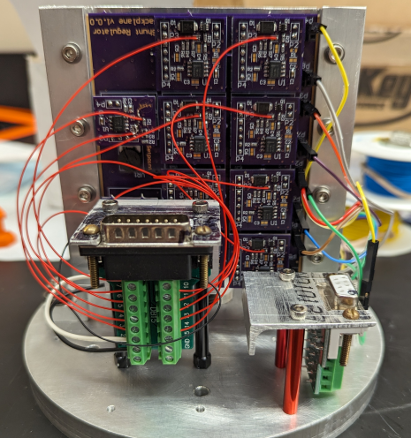
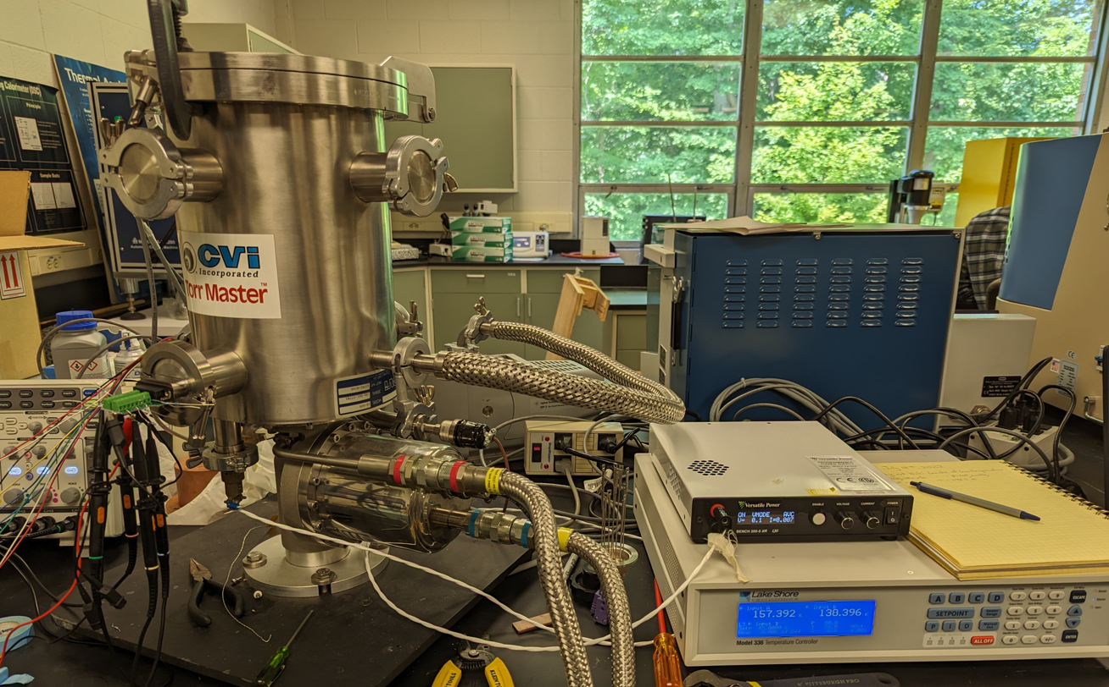
Power Electronics Technology for Hibernation
NASA Glenn is developing a cryo-operable power supply demonstrator
Shunt regulator capable of delivering power to an external load via eight “solar strings”
Designed with component types that have been shown to be operable at low temperatures
  Based on prior analytical assessments of published research
Current accomplishments:
  Stable operation throughout temperature ramp from 300 K down to 50 K
  Cold start capability at 50 K after a 16-hour cold soak
Future work:
  Investigation of microcontroller/FPGA operation at cryogenic temperatures

Slide 10
Power Electronics Technology for Hibernation
STMD Space Technology Research Grant (Early Career Faculty)
ECF22 Topic 2: Hibernation and Recovery of Solar-Powered Systems for Lunar Missions
Dr Zheyu Zhang, Clemson University,
Characterization and Application of Cryogenic Power Semiconductors in Lightweight, Fault-tolerant Systems for Lunar Missions
  Focused on GaN HEMT to exploit its flat response to wide temperature range
  Thorough characterization of Gallium-Nitride devices from 400 K to 50 K
  Identify degradation mechanisms and potential mitigations
  Develop “physics-informed” models of GaN circuits
  Develop GaN based power circuits suited to hibernation and recovery

Slide 11
Power Electronics Technology for Hibernation
Related work:
STMD STRG Program, LuSTR (Lunar Surface Technology Research)
LuSTR21 Topic 3: “Cold-Tolerant Electronics and Packaging for Lunar Surface Exploration”
  Work involves both cryo-tolerance and cryo-operability
  Developing custom devices in silicon, and silicon-germanium
  A silicon-germanium foundry fabricating custom designs
  Investigation also addresses radiation tolerance
  Developing “physics-based” device models
  Seeks to improve circuit and packaging reliability (cryo-tolerance)
  Developing thermo-mechanical package models
We hope to infuse LuSTR work into our hibernation research

Slide 12
Hibernation Technology Infusion
Develop design and operational guidelines for cryo-electronics for spacecraft applications in concert with:
NESC: NASA Engineering & Safety Center
NEPP: NASA Electronics Parts and Packaging Program
Ground-based technology demonstration
Demonstrate CLPS “robotic lander scale” power system capable of operating at cryogenic conditions on photovoltaic output alone, and perform power recovery functions
Potential flight technology demonstration
Flight demonstrator as a CLPS payload
Potentially, embed hibernation technologies in a future CLPS lander

Slide 13
Hibernation Technology Summary
Utilizing cryo-operable and cryo-tolerant electronics to revive frozen Li-ion cells will enable robust, low-cost robotic missions to operate over multiple lunar cycles
Successful hibernation integration will have minimal impact to the design of the existing spacecraft or payload
  Battery capacity/mass is unchanged
  Changes are limited to the spacecraft main bus controls and battery management
  Minimum impact on payload capacity
  Minimum impact on development cost

Slide 14
LSIC Surface Power Reliability Workshop
July 27, 2023
Reliable Power Hibernation and Recovery for Solar Powered Lunar Missions
Nicholas R. Uguccini, nicholas.r.uguccini@nasa.gov
Richard C. Oeftering, richard.c.oeftering@nasa.gov
Thomas B. Miller, thomas.b.miller@nasa.gov
Brian A. Holler, brian.a.holler@nasa.gov
NASA Glenn Research Center
Cleveland, Ohio 44135

