Slide 1
U.S. Women in Nuclear Conference
Power to Explore
July 24, 2023
Kristin Jansen
RPS Stakeholder Engagement Lead
NASA Glenn Research Center

Slide 2
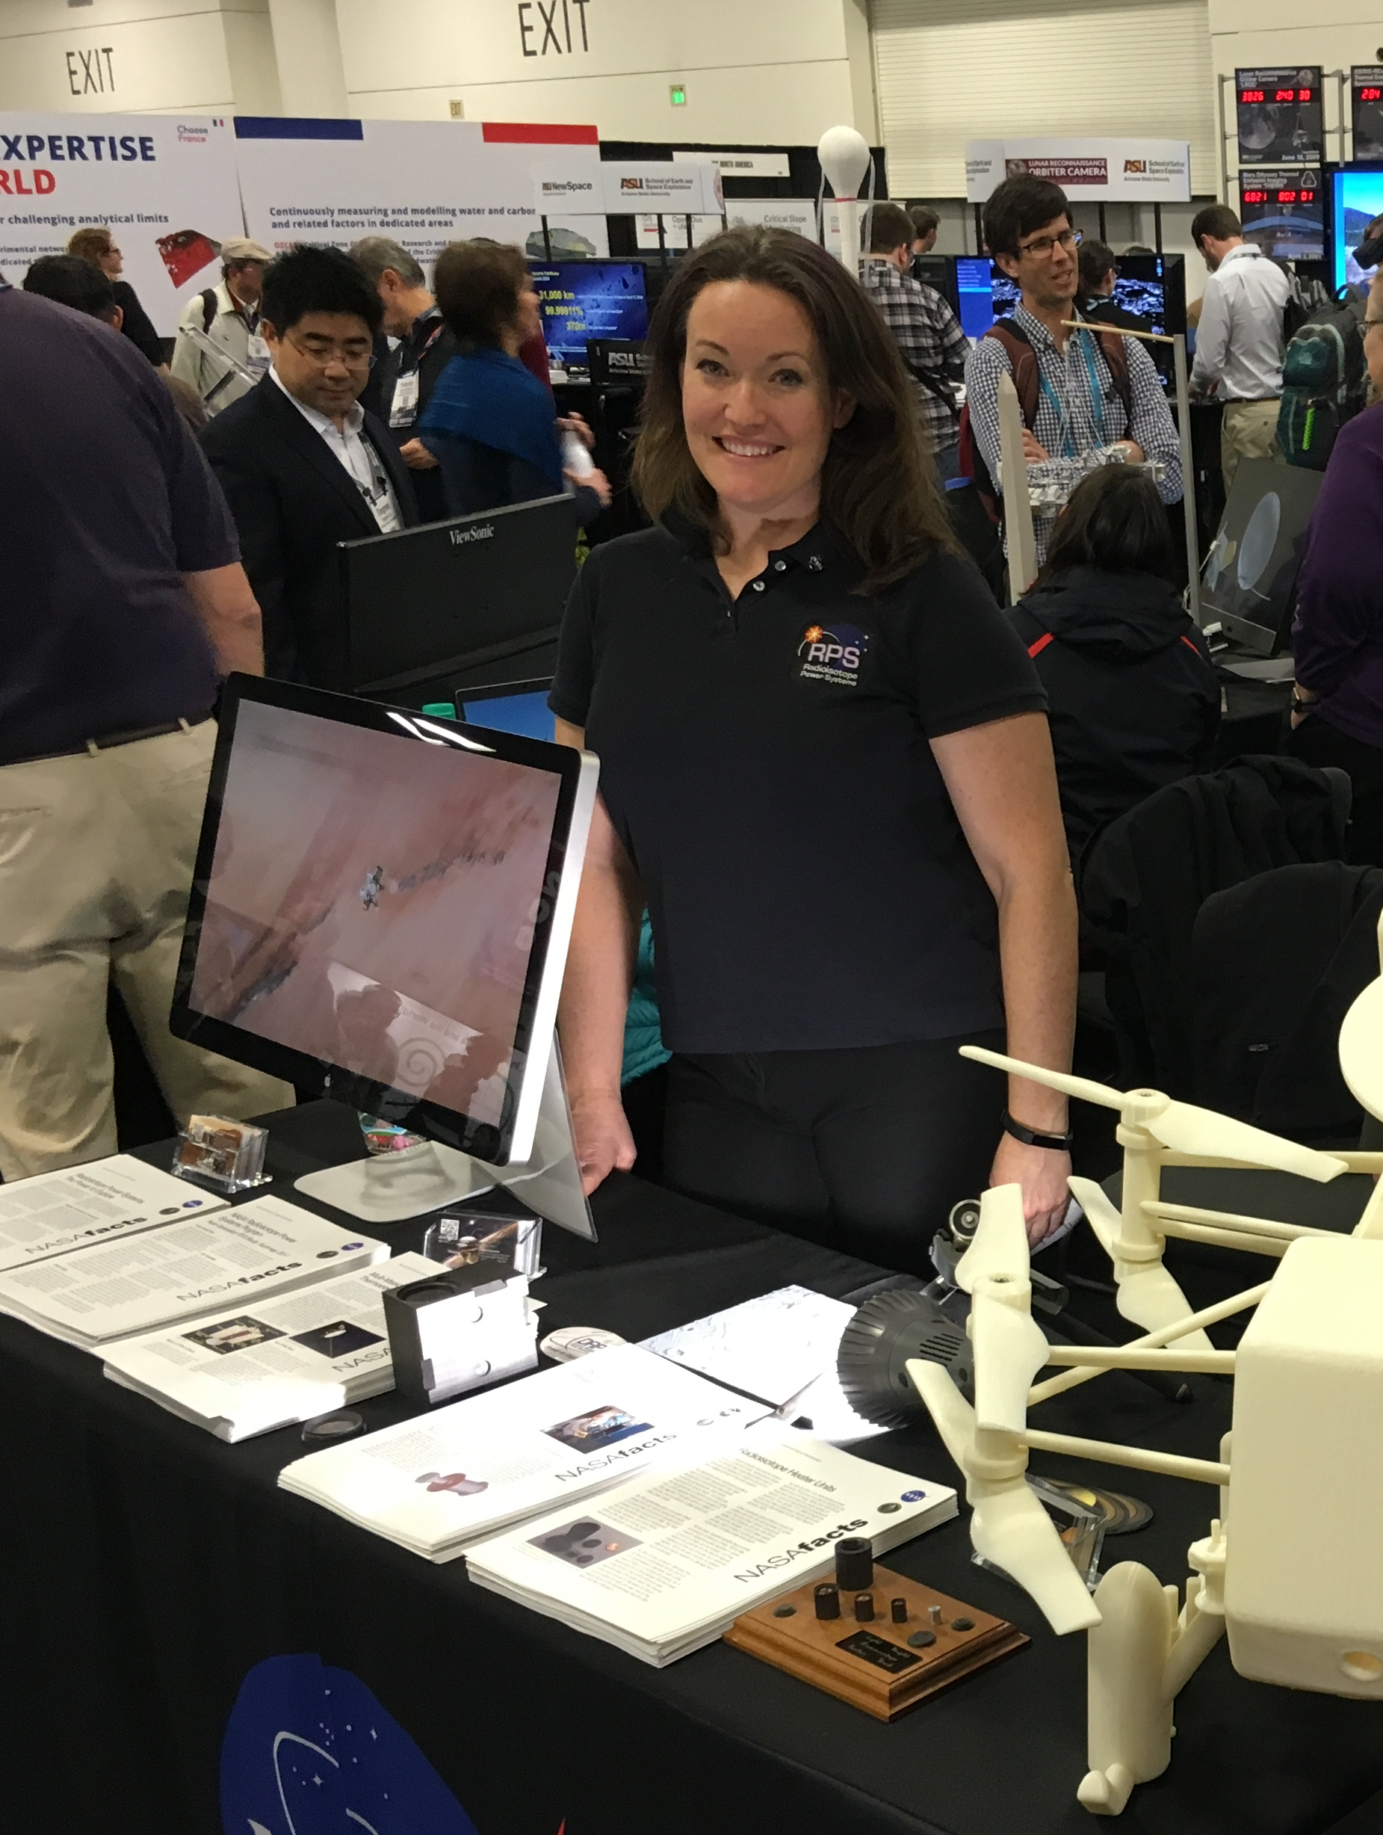
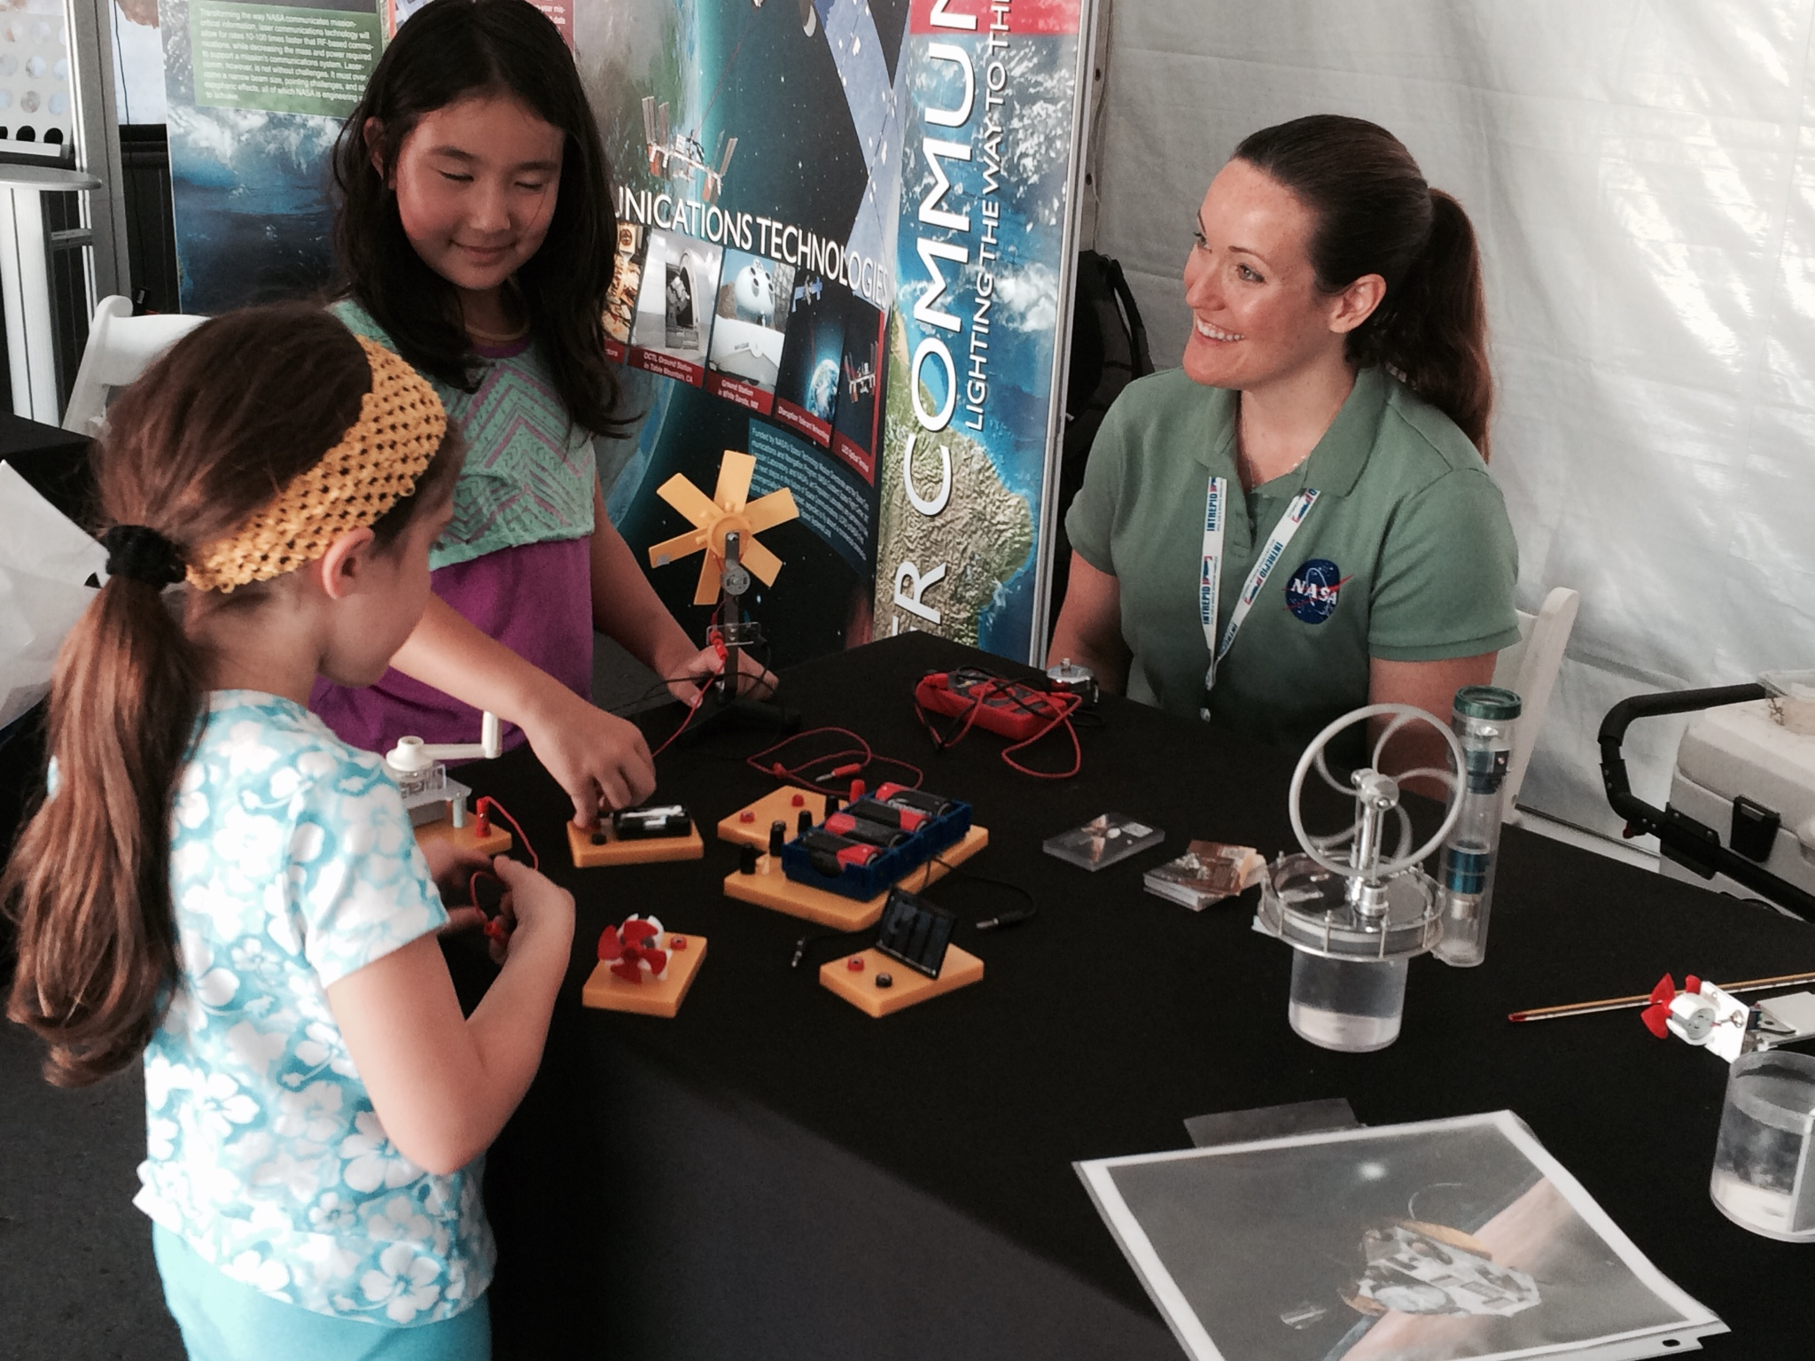

Kristin Jansen | Public Affairs Specialist and Stakeholder Engagement Lead
Bachelor Fine Arts, Bowling Green State University, 1999
Master of Business Administration, Marketing, Walsh University, 2021
NASA Glenn Research Center, 24 years
  Graphic Design, Education and Public Outreach, Stakeholder Engagement, Public Affairs
    Space Transportation Project Office
      Nuclear Thermal Propulsion
      Nuclear Electric Propulsion
      Jupiter Icy Moons Orbiter
    Exploration
    Fission Surface Power
    Thermal Energy Conversion
    Radioisotope Power Systems

Slide 3
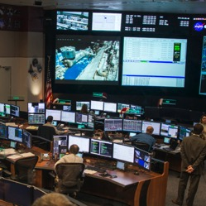
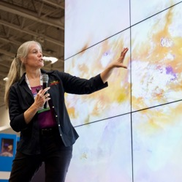

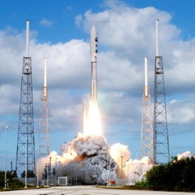
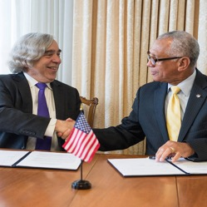
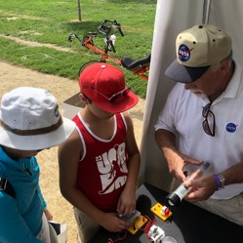
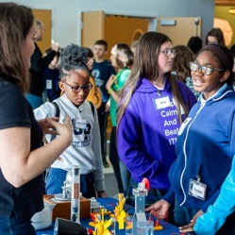
Stakeholders
Missions/ Planners
  Launch Services Program
  Documentation Support
  Planning and Integration
  Decadal Survey
Science & Engineering Community
  Technical Conferences
  Assessment Groups
  International
Policy Makers
  National Research Council
  Office of Science & Technology Policy
  National Environmental Policy Act (NEPA)
Launch Support
Support to Nuclear NEPA Management
  Launch Services Program
  Mission Specific NEPA Teams
  Local Public Populations
  Environmental Impact
Partnerships
  NASA Centers
  NASA Directorates
  Department of Energy
  Academia
  Commercial
  Department of Defense
  DARPA
Public Engagement
  National Events
  Science Festivals
  Local Fairs & Air Shows
  Amusement Parks
  Social Media
  Website
  Museum Consortium
  News Media
STEM
  Classroom visits
  Essay Contests
  Educational Materials
  Scouts, 4-H, etc.
  Distance Learning Network

Slide 4
Power to…
UNDERSTAND
DISCOVER
EXPLORE

Slide 5
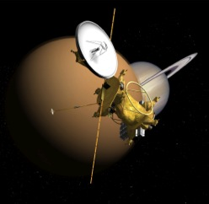
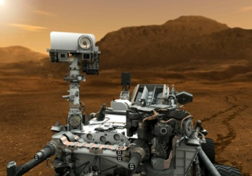
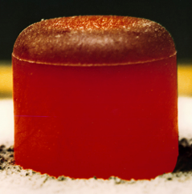
Radioisotope Power Systems
Enable and enhance missions by providing electrical power for to explore remote and challenging environments where solar power is unavailable
  Spacecraft operation
  Instrumentation
Converts heat from a Radioisotope into electricity
  Heat is the product of the natural decay process of the isotope
Notes:
For more than five decades, radioisotope power systems have played a critical role in the exploration of space, enabling missions of scientific discovery to destinations across the solar system. These amazing voyages have helped to reveal the nature of Earth's moon, allowed us to witness icy geysers and sulfur volcanoes on moons of the outer planets, and sustained long journeys to the outer reaches of our sun's influence.

Slide 6
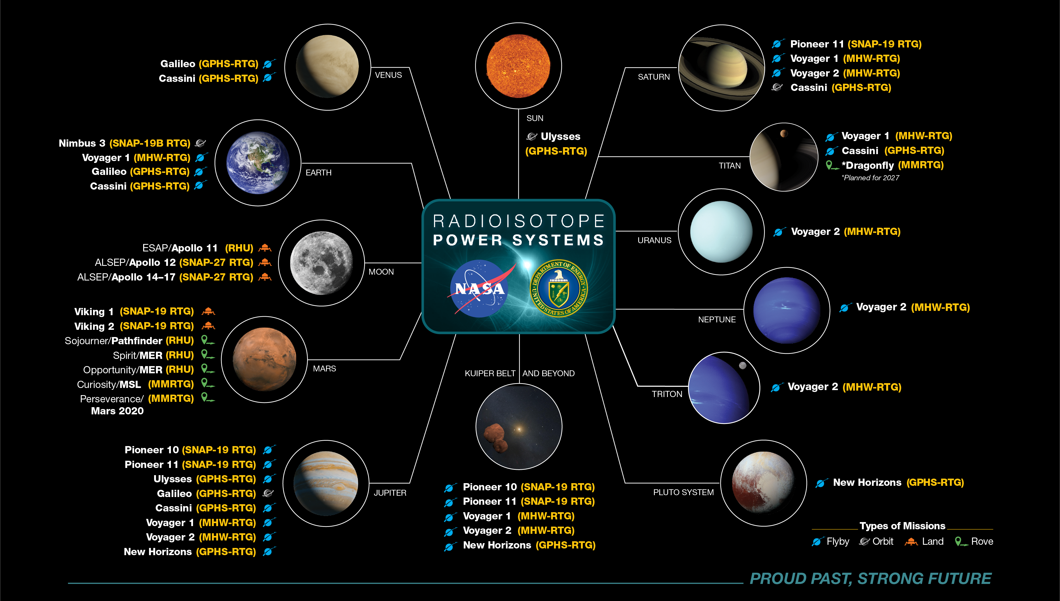

Slide 8
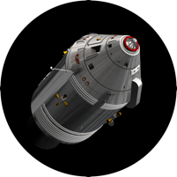
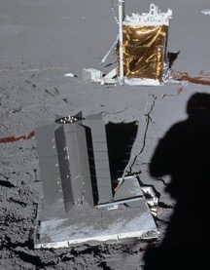
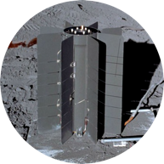
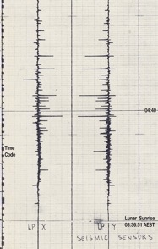
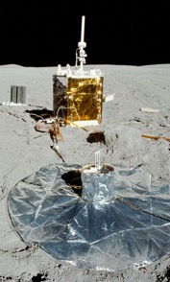
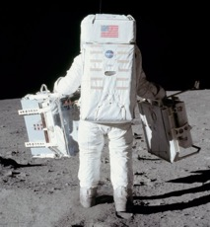
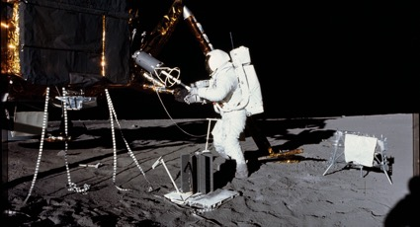
Apollo

Slide 9
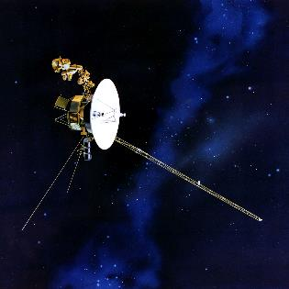
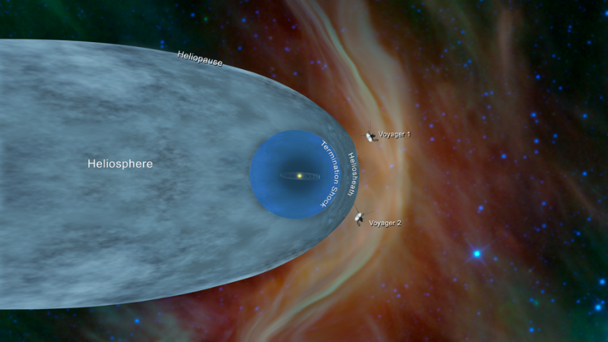
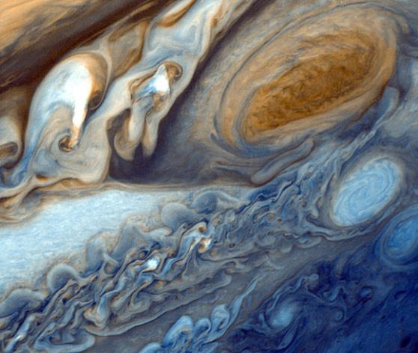
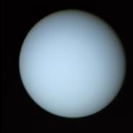
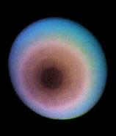
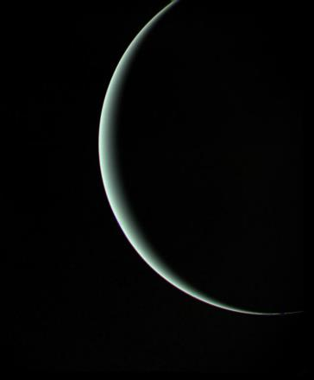
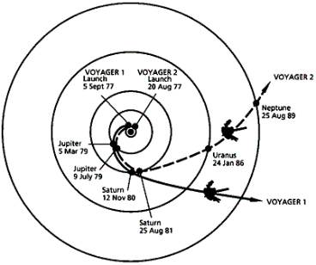
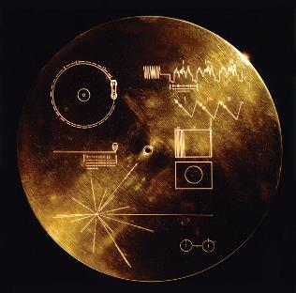
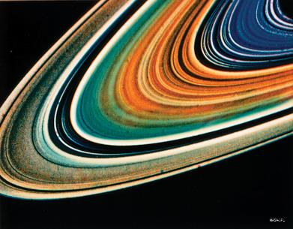
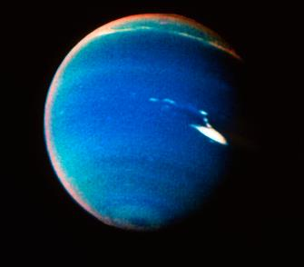
Voyagers 1 & 2

Slide 10
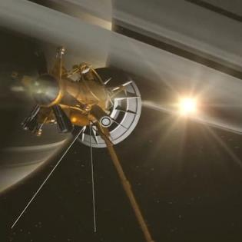
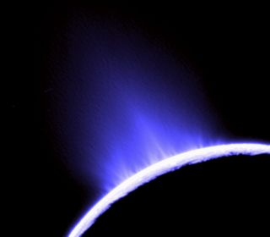
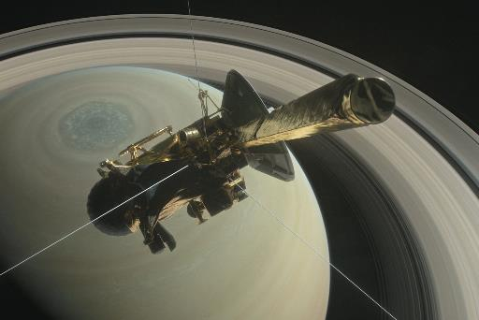
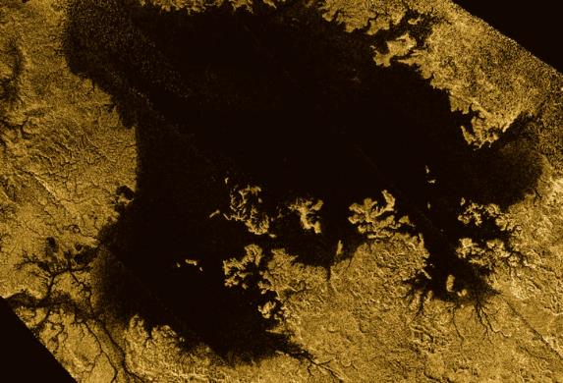
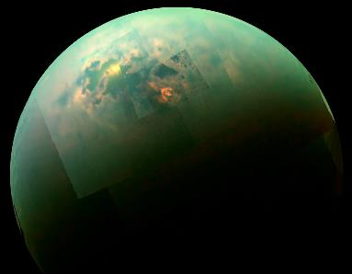
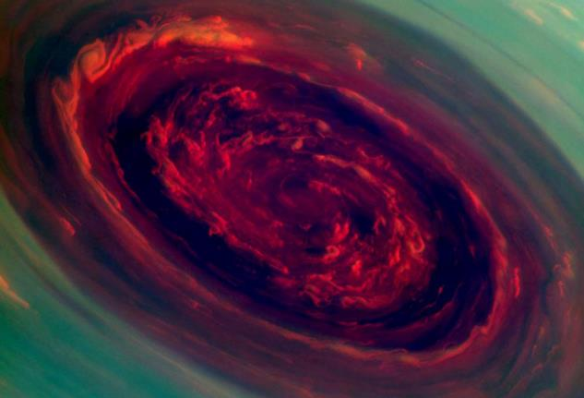
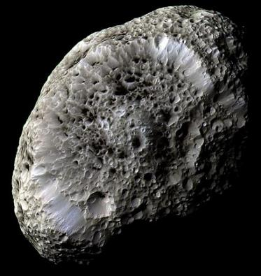
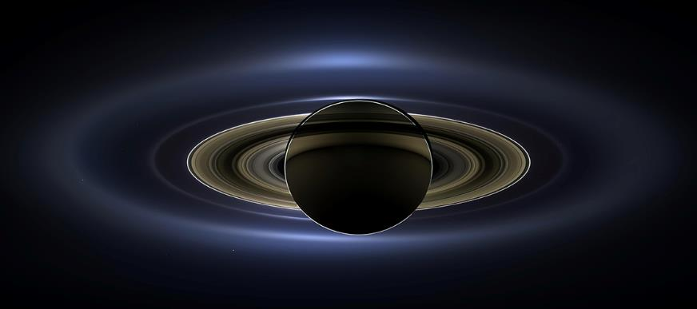
Cassini

Slide 11
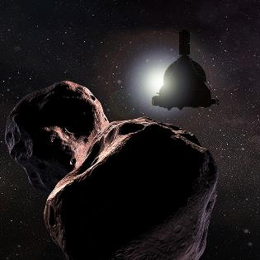
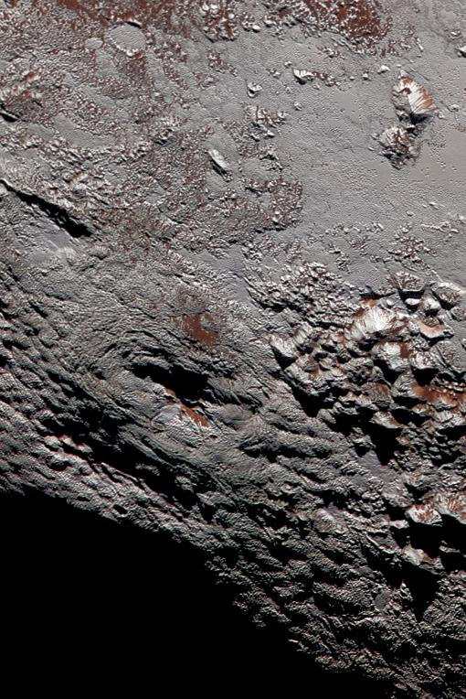
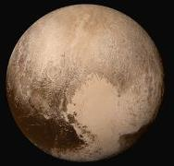
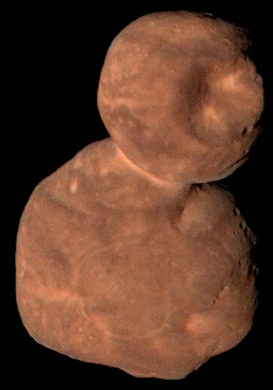

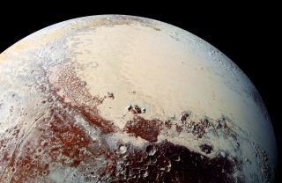
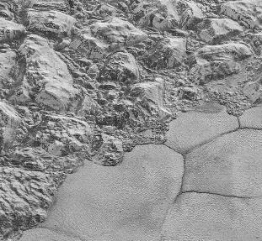
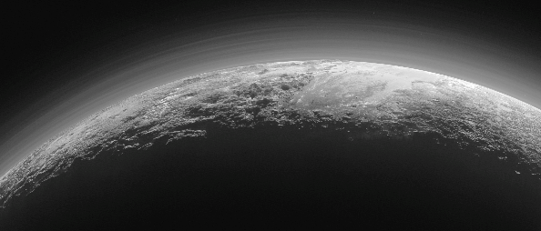
New Horizons

Slide 12
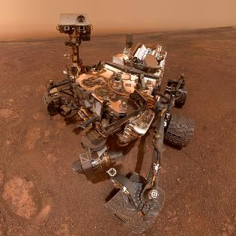
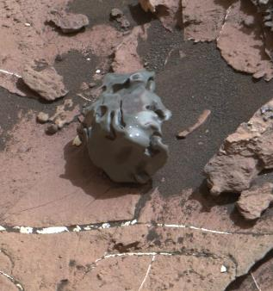

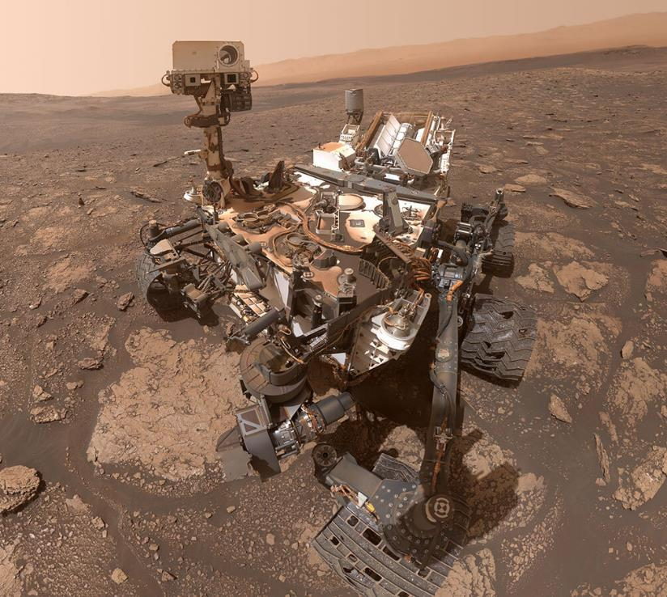
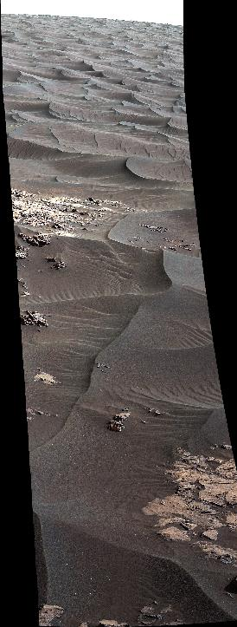
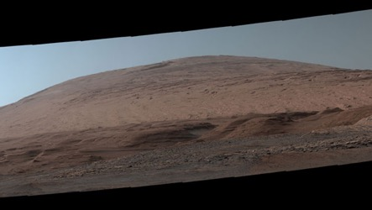
Mars Science Lab | Curiosity

Slide 13
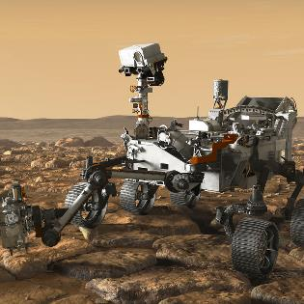







Mars 2020 | Perseverance Rover

Slide 14





Dragonfly

Slide 15








How NASA chooses a power source
Notes:
As you can see by this graph, as a mission travels away from the sun as source of energy, it is essential to use a different source of energy to power discovery.
The same is true of the dark sides of planets or in harsh environments that are too rough on solar technology. NASA works closely with the Department of Energy to develop nuclear power systems for space exploration.
(Radioisotope power is an enabler:
Science and human surface operations in sun starved areas
Near the sun where solar flux is beyond solar energy technology
Outer solar system missions where solar energy or other internal power sources will not meet mission requirements
Solar flux drops as inverse square of distance from Sun (4% of Earth at Jupiter) forcing spacecraft solar arrays to become too large for distant missions.)

Slide 16


Current Radioisotope Power Systems
LWRHU
MMRTG
Light Weight Radioisotope Heater Units
Multi-Mission Radioisotope Power System

Slide 17


Lightweight Radioisotope Heater Units (LWRHU)
Provides heat to ensure optimal operability
300 RHUs have been used on 9 separate missions
Current Cassini-era LWRHUs available (~.8 W_{th})
DOE reconstituting ~ 1 W_{th} LWRHU production capability
  Capability completed at ORNL
  Capability at INL and LANL to be completed by 2026
  Dedicated run is planned for 2027
Notes:
120 on Galileo
117 on Cassini
9 on Voyager

Slide 18



Multi-Mission Radioisotope (MMRTG) Power Systems
F1 on Mars on Curiosity
  Current Power 79.6 W_{e} (fueled 2008)
F2 on Mars on Perseverance
  Current Power 105.6 W_{e} (fueled 2019)
F3 at INL ready for a mission
F4 in fabrication for Dragonfly
Nominal Characteristics
Parameter | Nominal MMRTG
Output Voltage | 22 to 36 Vdc
Electrical Power | 110 W_{e} BOM
Waste Heat | 2000 W_{th} BOM
Mass | 45 kg
Length | 69 cm
Width | 65 cm
* Current as of January 2023

Slide 19



Current RPS Missions
Mission | Launch Date | Type of RPS | Quantity | Current Tot. Avg Power (W_{e}) | Power Reading Date
Perseverance | 7/30/2020 | MMRTG | 1 | 106.0 | 12/2022
Curiosity | 11/26/2011 | MMRTG | 1 | 79.3 | 12/2022
New Horizons | 1/19/2006 | GPHS-RTG | 1 | 178.7 | 6/2022
Voyager 1 | 9/5/1977 | MHW RTG | 3 | 231.9 | 9/2021
Voyager 2 | 8/20/1977 | MHW RTG | 3 | 234.6 | 9/2021

Slide 20


Together, NASA & DOE are Ready to Support Missions
Constant Rate Production in Place
  Plutonium-238 heat source production scaling up
  Fueled clad production meets rate required
  Maintaining essential infrastructure
  Capacity in the system for increased production
Power System
  MMRTG available now for missions, can supply up to two for NF5
  Reestablishing LWRHUs production capability and production run planned
  Next Gen GPHS RTG planned to be available late 2020s for missions
Mission Demand Oriented:
    Decadal Provides the Vision, PSD Decides the Mission
    Congress Provides the Funding
    RPS Program and DOE Provide the Fueled Systems

Slide 21



Slide 22


Slide 23

NASA
NASA
@NASA
NASA
POWER TO EXPLORE
https://rps.nasa.gov
nasa-rps@mail.nasa.gov

