Slide 1
Pacific Northwest Health & Air Quality
Monitoring Trends in Air Quality During a Drought Case Study to Improve Public Health Response to Drought Threats
Abby Sgan • Greta Bolinger • Tallis Monteiro • Cristina Villalobos-Heredia • Taylor West
North Carolina – NCEI | Summer 2023
Notes:
Presenter: Abby
Back up presenter: Taylor
Speaker Notes:
Short title font size: 32pt Long title font size: 22pt Team names font size: 20pt

Slide 2
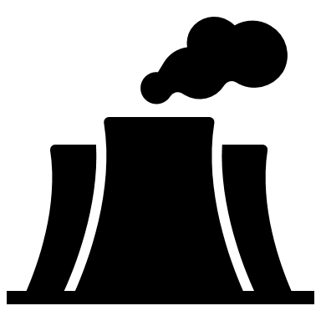
Aerosol Optical Depth
MODIS
stratosphere
troposphere
EPA
natural disasters
anthropogenic sources
Notes:
Presenter:
Back up presenter:
Speaker Notes:
Atmospheric PM concentrations can be monitored both remotely and in situ, or ground based. Remote monitoring of atmospheric PM is achievable via NASA satellite observations of aerosol optical depth (AOD). AOD is not a direct measurement of atmospheric PM but is rather a reflection of the extent to which electromagnetic radiation is blocked by airborne aerosols in the atmosphere. To measure AOD, the team used data processed by MAIAC, an algorithm applied to data collected by NASA’s Moderate Resolution Imaging Spectroradiometer (MODIS) sensor aboard the Terra and Aqua satellites.
In addition to remotely sensed observations of air quality, the team also used in situ data collected by the EPA’s Air Quality System (AQS) ground monitors. AQS ground monitor data were then integrated with satellite observations of AOD to analyze the prevalence of PM in the atmosphere during the study period.
Layout Credit: Adapted from Fall 2021 JPL Oklahoma Health & Air Quality Closeout Presentation

Slide 3
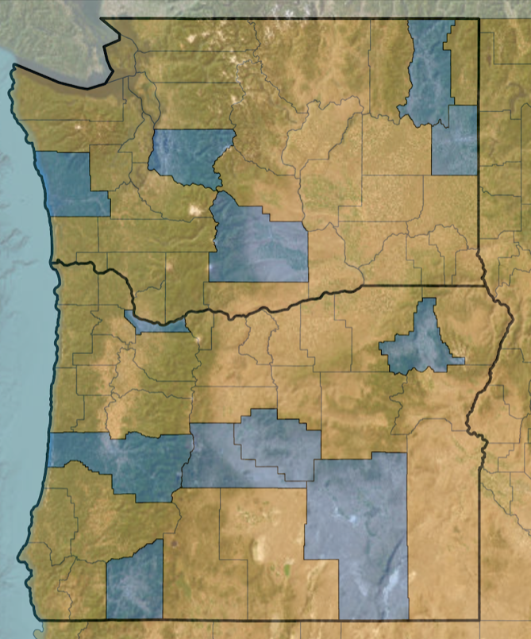
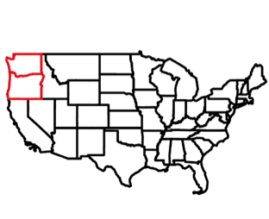
Study Area
Pacific Northwest
Washington + Oregon
Jan. 2015 – Dec. 2022
Population of over 12 million people
Enduring prolonged drought
Basemap credit: Earthstar Geographics
0
100
km
N
Prone to environmental disasters
Counties of Interest
County Boundaries
Washington & Oregon State Boundaries
Notes:
Presenter: Taylor
Back up presenter: Abby
Speaker Notes:
Our study area was broadly the states of Washington and Oregon, defined in this study as the Pacific Northwest. The area is populated with over 12 million people and has endured prolonged drought conditions in the past. The area is especially prone to environmental disasters like wildfires, earthquakes, droughts, and flooding.
The team further condensed the study area to 12 counties of interest based on partner feedback, population, and drought diversity.
Image Credits:
Office 365 PowerPoint Icons
Image Credits:
Earthstar Geographies

Slide 4
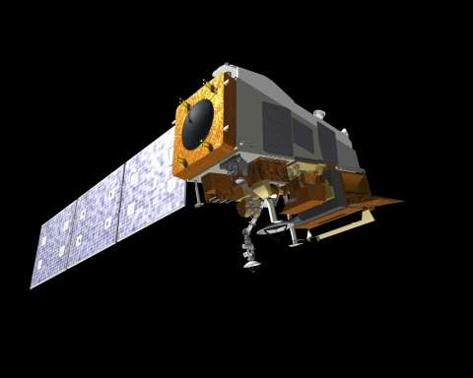
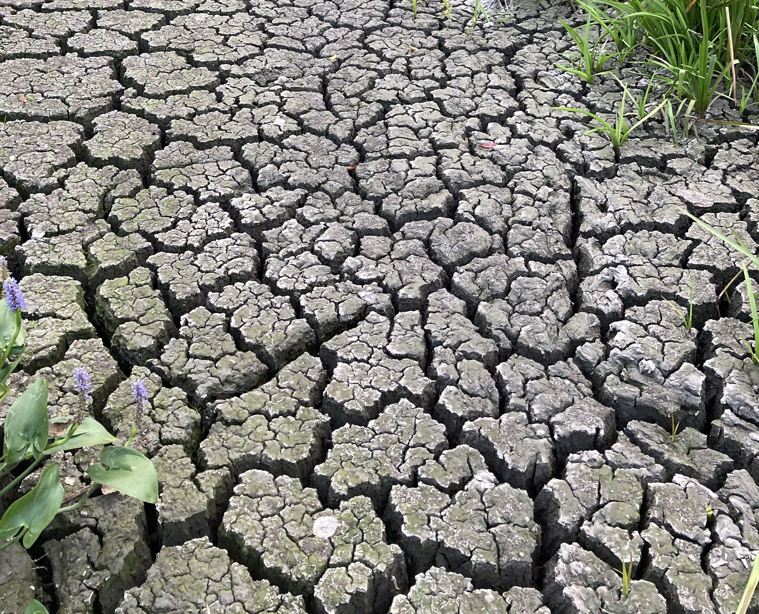
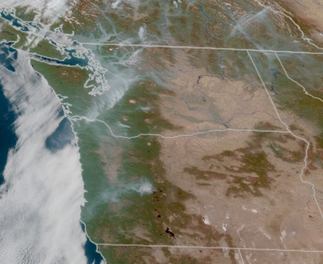
Objectives
Integrate satellite observations with ground-based monitoring
Time series of PNW air quality and drought conditions
Map air quality and drought severity
Image Credit: NOAA / Greta Bolinger / NOAA GOES West
Notes:
Presenter: Tallis
Back up presenter: Taylor
Speaker Notes:
The objectives for this project were to integrate satellites observations with ground-based monitoring to observe changes in air quality. We did this by creating multiple time series that showed our overlapping datasets to get a better idea of the relationships between air quality and drought. Finally, we aimed to express air quality and drought severity using maps that could be handed off to partners at the end of the project.
Image Credits:
1st Image (satellite): NOAA found @ https://www.earthdata.nasa.gov/learn/articles/modis-to-viirs-transition
2nd Image: Greta Bolinger, NASA DEVELOP PNW HAQ team member
3rd Image: NOAA GOES West found @ https://www.accuweather.com/en/weather-forecasts/big-improvements-in-air-quality-expected-for-pacific-northwest/1266756

Slide 5
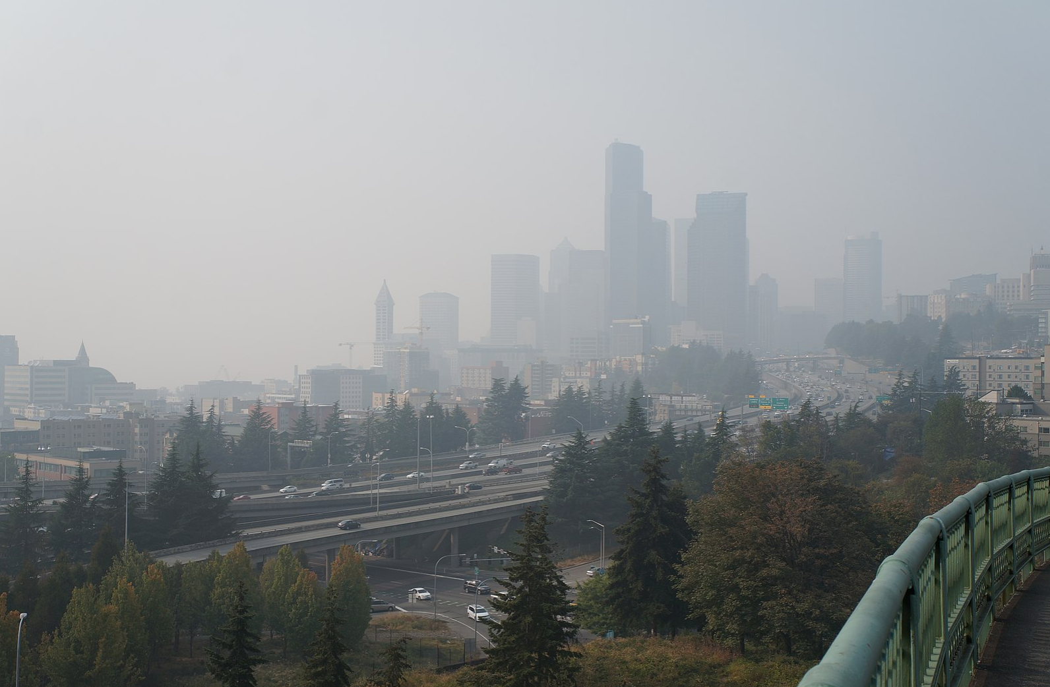
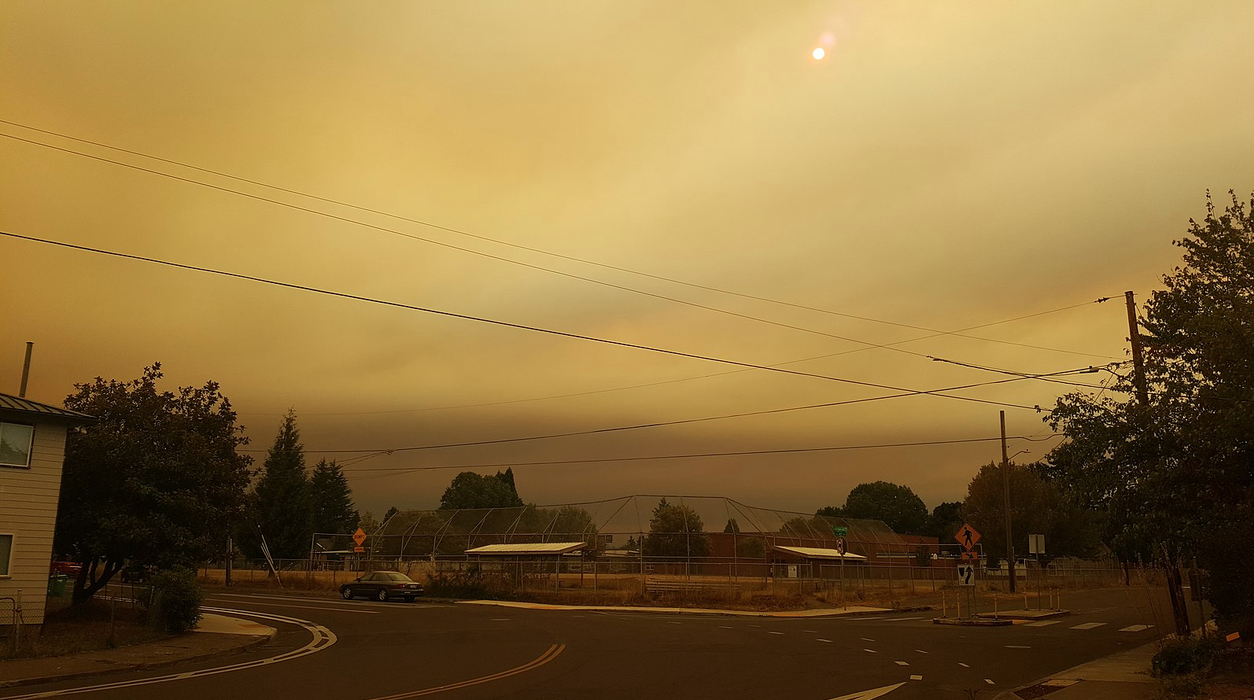
Partners
Project
End Users
Project Collaborators
Oregon Health Authority (OHA)
UNMC Water, Climate, and Health Program
NOAA National Integrated Drought Information System (NIDIS)
Washington State Department of Health (DOH)
Image Credit: Bruce Englehardt / Another Believer – Wikimedia Commons
Notes:
Presenter: Cristina
Back up presenter: Greta
Speaker Notes:
Our project partners fell under two categories: collaborators and end users. Our collaborators were the University of Nebraska Medical Center's Water, Climate, and Health Program and the NOAA National Integrated Drought Information System, or NIDIS. These organizations acted as advising partners who provided guidance on project methodology, development, and end products. Our project end users were the Oregon Health Authority and the Washington State Department of Health. Our end users served as advisors as well but they are different from collaborators in which they will be using our project to support their research examining correlations between drought and health.
•Image Credit: Bruce Englehardt – Wikimedia Commons
•Image Source: https://en.wikipedia.org/wiki/File:Smokey_skyline_view_of_Downtown_Seattle_from_Rizal_Bridge_-_Sept_11,_2020.jpg#file (Wikimedia Commons - Public Domain/Creative Commons)
Image Credit: Another Believer – Wikimedia Commons
Image Source: https://commons.wikimedia.org/wiki/File:Smoke_in_SE_Portland,_Oregon,_September_9,_2020_-_8.jpg (Wikimedia Commons – Public Domain/Creative Commons)

Slide 6
Community Concerns
Exposure to poor air quality is a public health concern
Air quality is correlated with drought severity
Air quality is also driven by secondary impacts of drought
Wildland fires, dust storms
Poor air quality disproportionately impacts certain geographies
Vulnerable populations
Image Credit: U.S. Forest Service – Pacific Northwest Region
Notes:
Presenter: Greta
Back up presenter: Taylor
Speaker Notes:
Exposure to poor air quality is a public health concern in the Pacific Northwest. Acute and chronic exposure to poor quality air are known to impact respiratory, cardiovascular, renal, metabolic, neurologic and reproductive systems. Poor air quality has been shown to be significantly correlated with severe drought, as well as with the secondary impacts of drought, such as wildland fires and dust storms. These secondary events are known to elevate concentrations of airborne particulate matter in the atmosphere, leading to increased health risk for impacted communities. Communities of color, individuals with pre-existing health conditions, the elderly, and children are particularly at risk.
•Image Credit: U.S. Forest Service – Pacific Northwest Region
•Image Source: https://flickr.com/photos/forestservicenw/24498327384/in/photolist-DjQkdU-CYNfPA-2duqRJp-TGLpoH-jkU8qf-8KmDQD-EhFWDM-wuBbb-adv3Cf-zawY4Q-5nsBub-2nUXSnD-DjkPXA-NeeaUn-QVBKmT-8Kji2W-URuU6c-hLmbVm-7C3eJ-fu1795-VQVp6U-8vwcZb-xMY7ha-F6bXEb-ChnJS8-2djxhMQ-AtLy1n-2ci2G6Q-QGuEMm-zJpa9n-2EPMhW-CqGVvV-CsNBwF-2dp1ZQH-2dp1PVH-CZdboB-2aCrCM5-JzhUG2-Rgbqgm-Bu3dBp-2nTYNYt-StQWBf-2aCrCay-2ci2yiA-2djxn1j-kopWH-RgbrjU-Rgbv61-N3YjPo-iz8p8a/ (Federal Agency – Public Domain/Creative Commons)

Slide 7
Earth Observations: Satellites & Sensors
Terra MODIS (MAIAC)
Aqua MODIS (MAIAC)
Image credit: NASA
Notes:
Presenter: Abby
Back up presenter: Cristina
Speaker Notes:
One of our primary datasets, MODIS MAIAC aerosol optical depth (AOD), was measured using the MODIS (Moderate Resolution Imaging Spectrometer) sensor aboard NASA's Terra and Aqua satellites. The data were processed using MAIAC (Multi-Angle Implementation of Atmospheric Correction), an algorithm used to sense aerosols throughout the atmosphere.
Image Credits:
Image credit: NASA
Image Source: DEVELOPedia

Slide 8
Ancillary Datasets
Dataset | Measurement | Spatial & Temporal Resolution | Indicates
Standardized Precipitation-Evapotranspiration Index (SPEI) | Water balance between precipitation & evapotranspiration | 4 km / 270-day 2015 – 2022 | Drought (Ancillary)
Environmental Protection Agency Air Quality System (EPA AQS) | PM2.5 and PM10 | Daily 2015 – 2022 | Air quality (Ground-based)
Notes:
Presenter: Tallis and Greta
Back up presenter: Tallis and Greta
Speaker Notes:
SPEI (Tallis): In addition to our remote observations, we used ancillary datasets to carry out our analysis. The Standardized Precipitation-Evapotranspiration Index (SPEI) served as the drought indicator dataset for this study. It allowed us to observe the water balance between precipitation and evapotranspiration which further allowed us to draw conclusions about drought conditions in our study area.
EPA (Greta): We also used data collected by the Environmental Protection Agency's Air Quality System (AQS) ground-based monitoring stations, equipped with air quality sensors to detect particulate matter concentrations. This measurement was our ground-based indicator of air quality in the region throughout our study period. We specifically chose to include measurements of PM2.5 and PM10 in our analysis, to both maximize data availability and drought-induced aerosol measurement accuracy (PM2.5 had greater spatiotemporal data availability, however PM10 is a more inclusive measurement of drought-sourced aerosols with its larger diameter specification).

Slide 9
Methodology
Data Processing
EPA PM2.5 and PM10
MODIS AOD
GRIDMET SPEI
R-Studio
Google Earth Engine
Filter to study period date and study area site
Cleanup and extract data by counties with available data
Mask clouds
Select SPEI band from gridMET dataset
Average PM10 by each monitoring station in each county
Create timeseries and download as a CSV
Notes:
Presenter: Cristina
Back up presenter: Greta
Speaker Notes:
We began with initiating the processing of our three primary datasets. EPA in-situ data was manipulated in R and cleaned up to extract data by counties with available data. We then averaged PM10 by each monitoring station in the select counties that we used. MODIS AOD and SPEI data were both processed in GOogle Earth Engine. Using code, we filtered the data by study area and study period, applied additional functions to limit the dataset, and downloaded data as CSV filed to combine with in-situ datasets in time series.

Slide 10
Methodology ​
Data Analysis​
Processed EPA PM2.5 & PM10
Statistics
Processed MODIS
Time Series
Processed SPEI
Maps
Notes:
Presenter: Cristina
Back up presenter: Tallis
Speaker Notes:
Finally, we uploaded our processed data to R and ArcGIS in order to visualize the correlations observed between drought and air quality. These visualizations included time series, maps, and simple statistics correlating the datasets to each other.
Image Credits:
Office 365 PowerPoint Icons

Slide 11
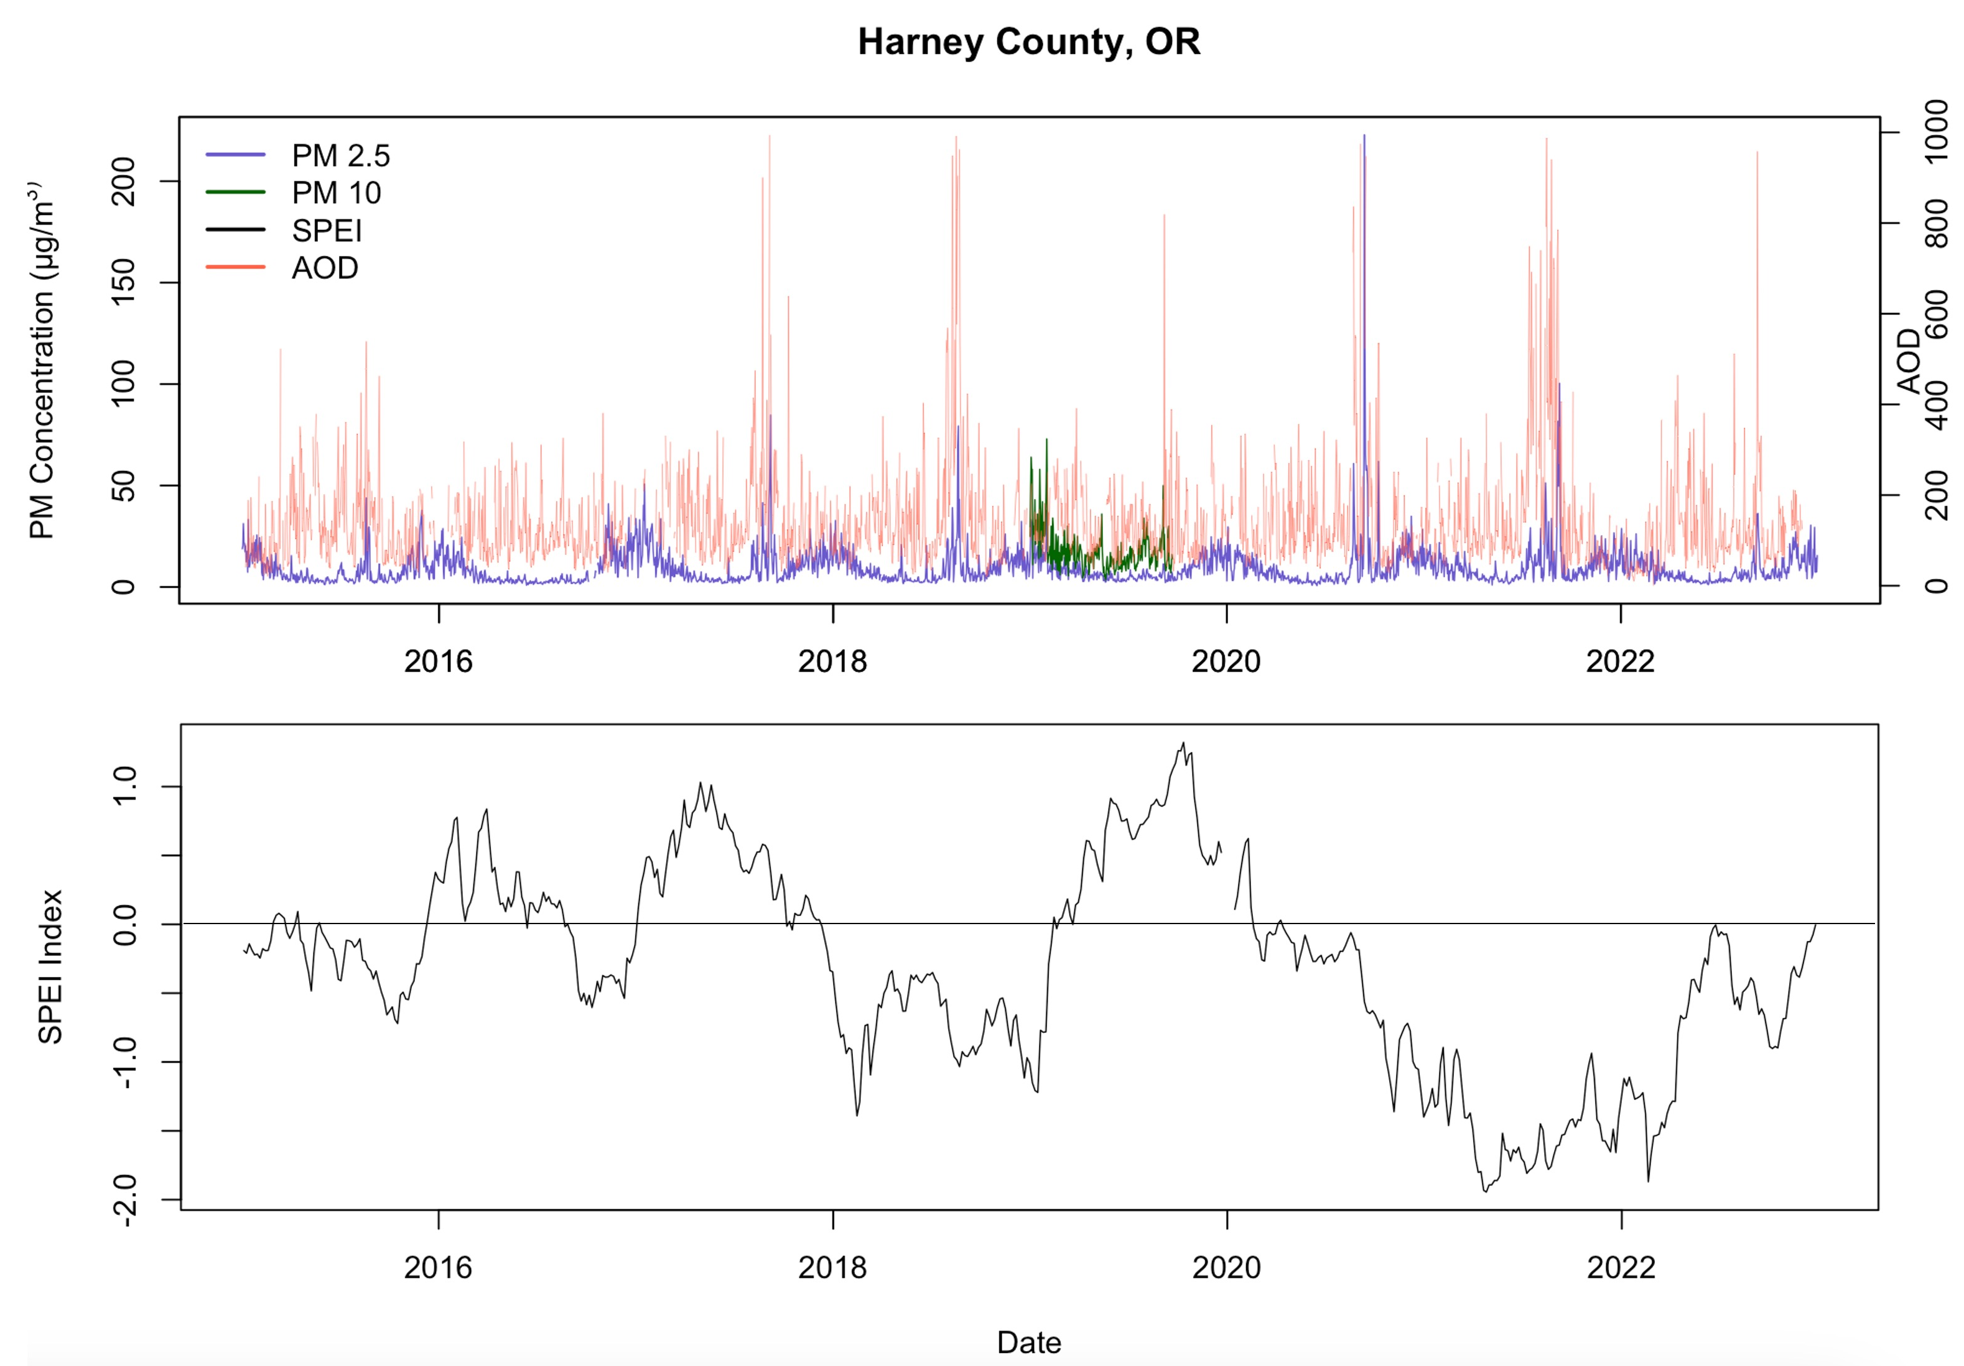
Results
Harney County, OR
1000
200
PM2.5
PM10
800
150
AOD
PM Concentration (microns/m³)
600
AOD
100
400
50
200
0
0
2016
2018
2020
2022
1.0
SPEI
0.0
SPEI Index
-1.0
-2.0
2016
2018
2020
2022
Date
Notes:
Presenter: Greta/Tallis?
Back up presenter:
Speaker Notes:
We processed our datasets into a timeseries for each county of interest. This timeseries is of Harney County in OR, one of the only counties in OR that showed PM10, and is also a quite rural, dry county, home to the Burns Paiute tribe.

Slide 12
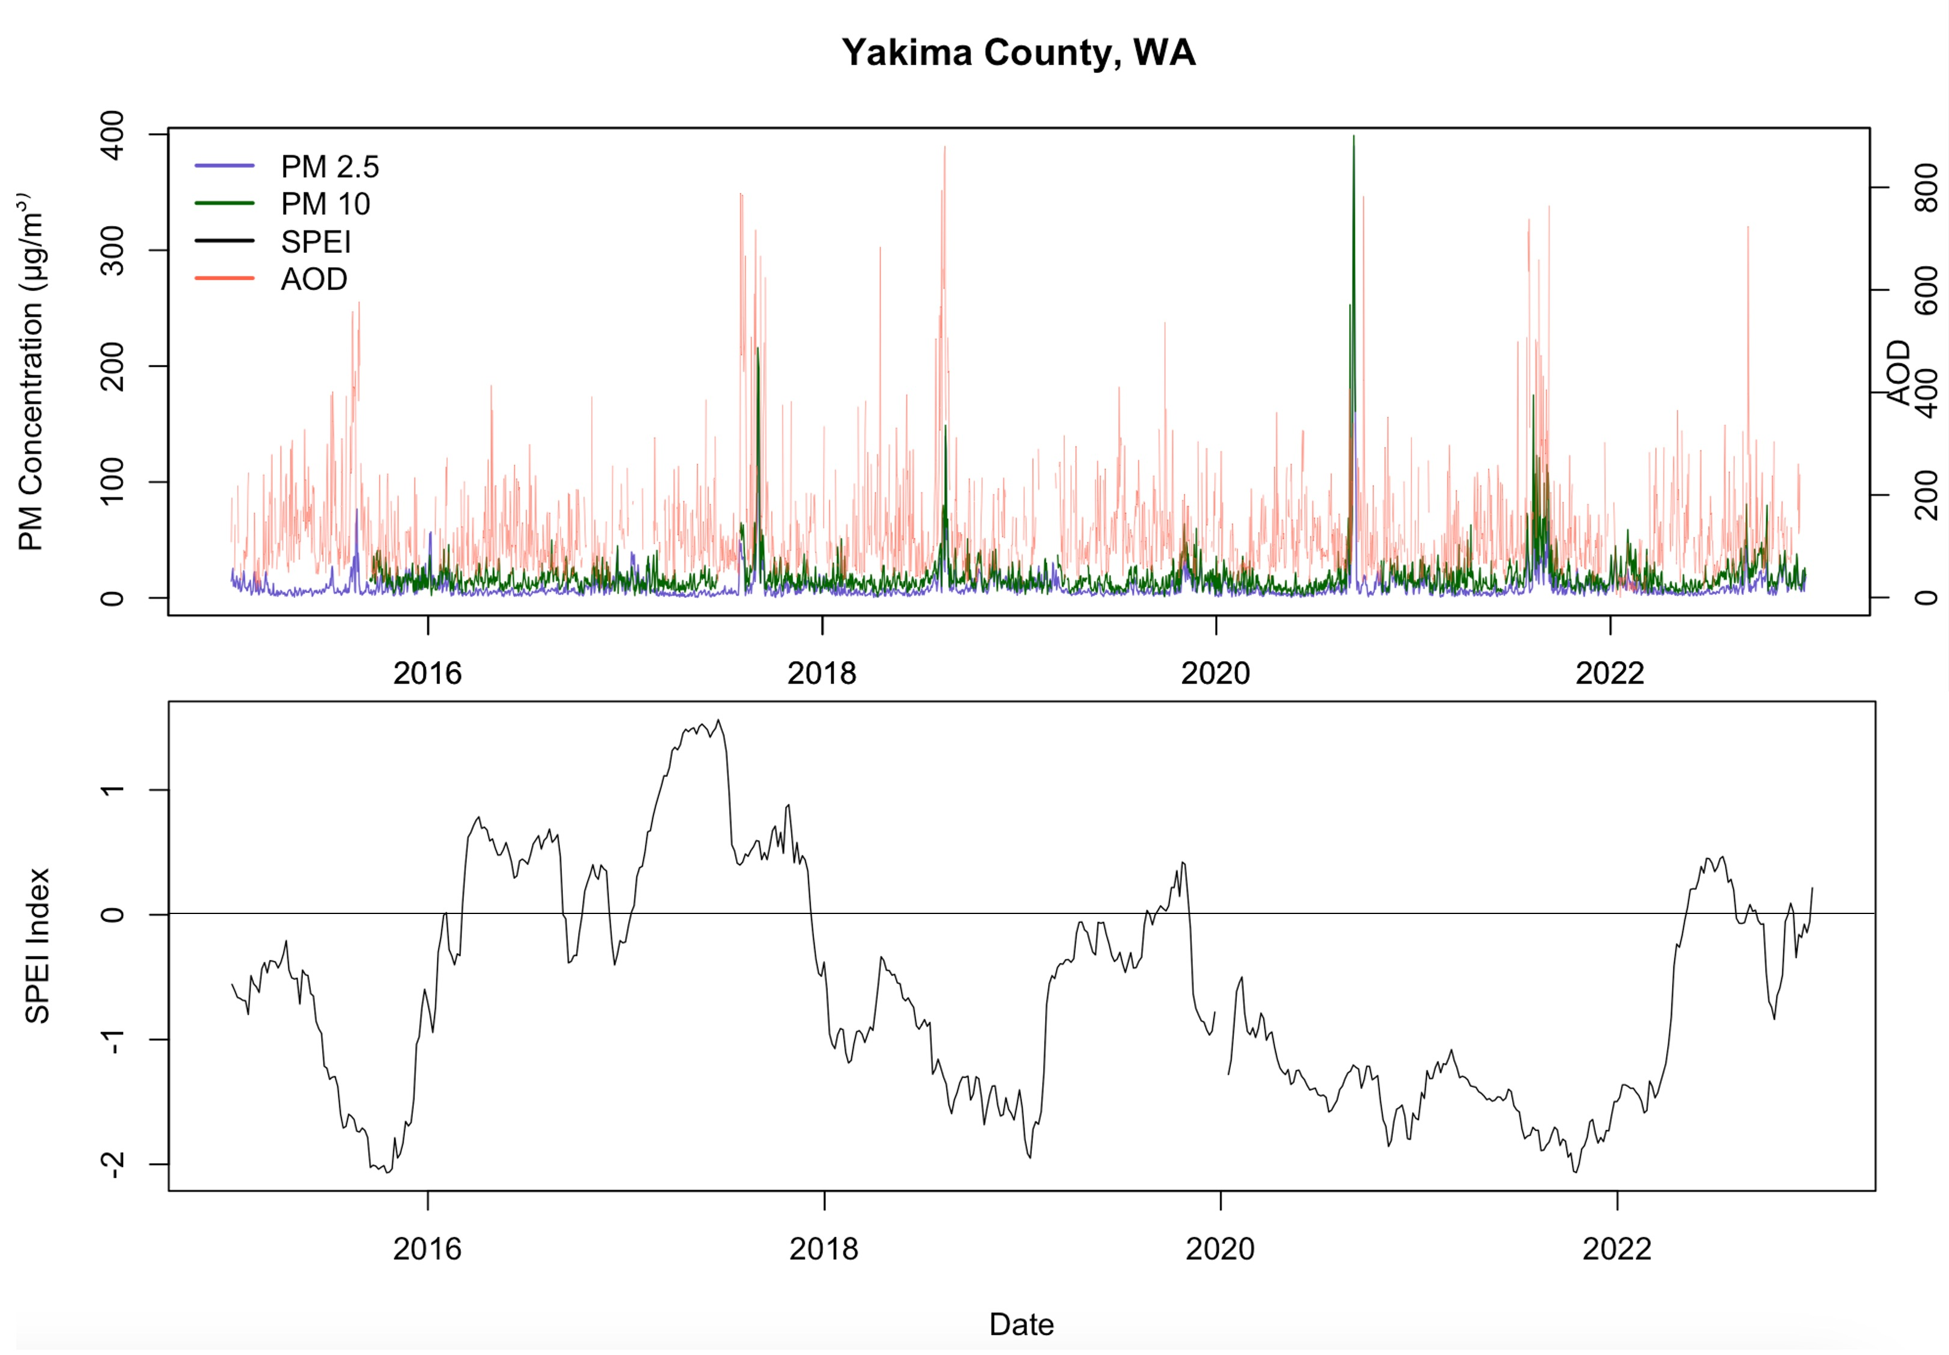
Results
Yakima County, WA
400
PM2.5
800
PM10
300
AOD
600
PM Concentration (microns/m³)
200
400
AOD
100
200
0
0
2016
2018
2020
2022
SPEI
1
0
SPEI Index
-1
-2
2016
2018
2020
2022
Date
Notes:
Presenter: Greta/Tallis?
Back up presenter:
Speaker Notes:
We processed our datasets into a timeseries for each county of interest. This timeseries is of Yakima County in Washington is more populous, and also in the drier part of WA and home to the Yakama Nation.

Slide 13
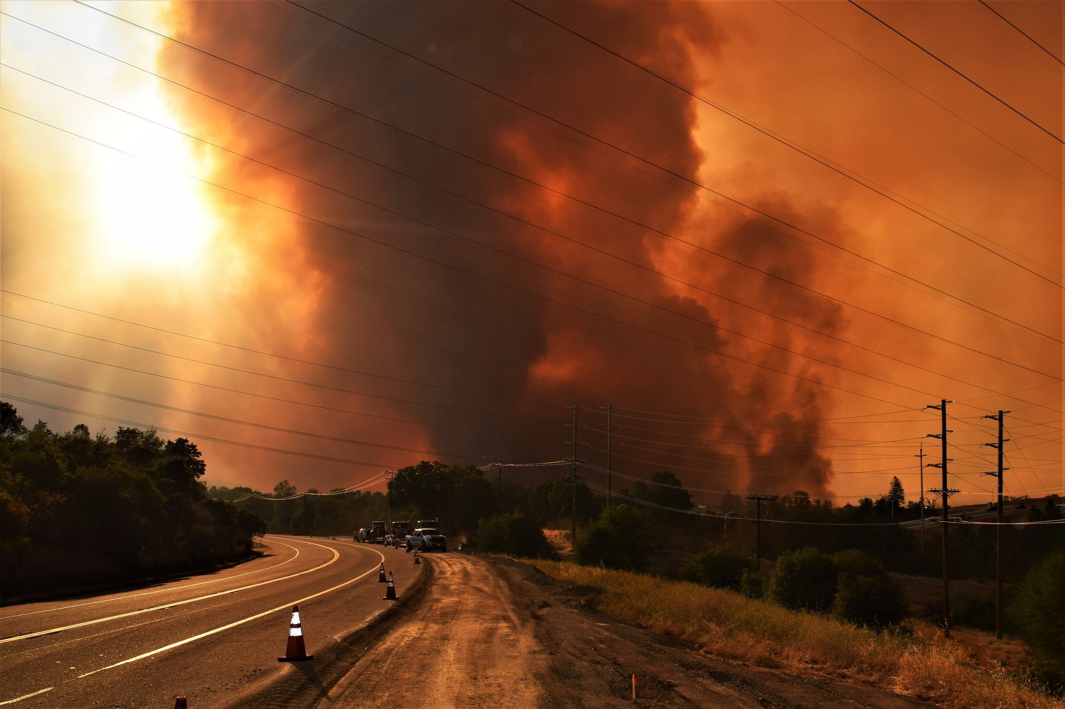
Limitations
Wildfire vs drought influences on air quality
County shapefile size
Missing PM10 monitoring sites
Image Credit: Eric Coulter, BLM
Notes:
Presenter: Cristina
Back up presenter: Taylor
Speaker Notes: Partners were interested in differentiating between wildfires and drought influences on air quality, however given the time constraints of the project we were only able to look at effects of drought on air quality. PM 2.5 is associated with Wildfire debris and smoke as well as particulate matter from various other emissions to the atmosphere. Identifying particulate matter resulting from wildfires would have been difficult given the duration of the project. Additionally, our counties shapefile was too large to be processed by Google Earth Engine. The team had to reduce the scope of our analysis by selecting only a few counties. Lastly, some counties lacked PM 10 monitoring sites which meant we could not create timeseries reflecting comparisons of PM 10 and 2.5 trends.
Image Credit:
https://citizentruth.org/as-customers-lose-electrical-power-bankrupt-utility-continues-to-pay-for-political-power/; Source: Eric Coulter, BLM

Slide 14
Future Work
Incorporate data to health outcomes.
Investigate the relation of wildfire events to air quality and drought.
Extend analysis to all counties in OR and WA.​
Establish continuity between MODIS Climate Data Record (CDR) and VIIRS MAIAC Aerosol Optical Thickness (AOT).​
Analyze atmospheric gases using Sentinel-5P TROPOMI to assess air quality in the region.
Notes:
Presenter: Abby
Back up presenter: Tallis
Speaker Notes: Future work of this project will allow our health department partners to incorporate data to health outcomes.
Based on this project, future develop terms will have the opportunity to expand results by investigating the relation of wildfire events to air quality and drought. The analysis has the potential to extend to all counties in OR and WA with more time.
Another future work could be the incorporation of Sentinel 5-p TROPOMI satellite data to assess air quality in the region.
Finally, given that the VIIRS satellite will eventually replace MODIS for land science, applications and long-term data records, it will become important that this work eventually establish continuity between MODIS Climate Data Record (CDR), and VIIRS CDR.

Slide 15
Project Partners
Amber Blanchard, Victoria Clemons, Curtis Cude, Dr. Carol Trenga, Sarah Worthington, Marnie Boardman, Dr. Anne Doubleday, Dr. Julie Fox, Britt Parker, Dr. Jesse E. Bell, and Rachel Lookadoo.
Science Advisors
Molly Woloszyn, Dr. Jesse Berman, Dr. Babak Fard, Ronald Leeper, and Jared Rennie.
Fellow – Katie Caruso
Special Thanks – Ryan Healey, Britnay Beaudry, Annie Britton, Kristen O'Shea, Steve Ansari, and Dr. Kenton Ross.
Notes:
Presenter: Abby
Back up presenter: Cristina
Speaker Notes:

