Slide 1
Automated Downlink Pipeline for Scientific Data using TReK
1 August 2023
Presented to ISS Research and Development Conference 2023

Slide 2
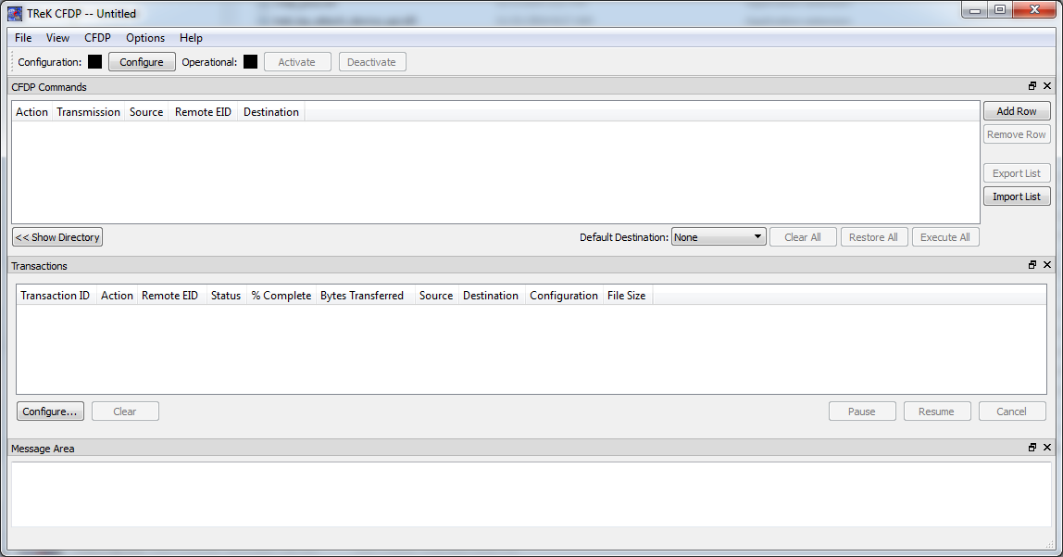
Telescience Resource Kit and Auto CFDP
TReK: Telescience Resource Kit
  Application suite to monitor and control payloads
  Data, commanding, and file transfer
Auto CFDP
  File transfer component using CCSDS* File Delivery Protocol (CFDP)
  Includes space-to-ground transfer capability
*Consultative Committee for Space Data Systems

Slide 3
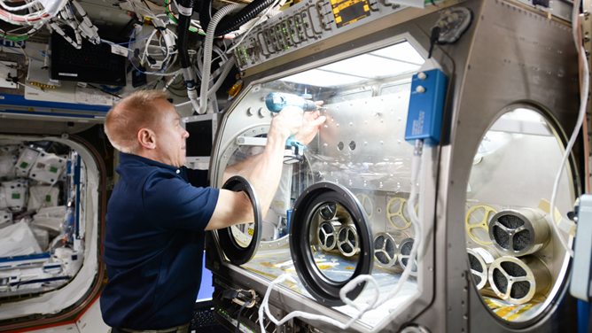
Example of Manual Downlink Process from MSG* Payload
Data files zipped and downlink commanding performed
Data files downlinked to ground system and verified
Data files verified for drop box delivery
Data files placed in user-facing drop box
PD collects scientific data files
Scientific data files generated
PD*
FCT*
(repeat N times)
*Microgravity Science Glovebox
*Payload Developer
*Flight Control Team

Slide 4











ISS Environment from Flight Controller Perspective
MSG Payload
User
MSG Laptop
Ku Comm Unit
File Dropbox
HOSC
MSG Control Room
AEON Portal

Slide 5
Automated Downlink Using TReK
Scientific data files generated
TReK Auto CFDP downlinking
AEON Uploader
PD collects scientific data files
PD
Automation

Slide 6

Desired Lab Environment from PD Perspective
MSG Payload
File Dropbox
(via TReK)
User

Slide 7
Streamlined PD Experience
PD gets files in near-real-time
  Able to adjust next science run of the day based on data received
  During the test phase, the SODI PD expressed that Auto CFDP capability got the files to them much faster, and that this was the best experience in their many years operating the payload.
Accomplished via “in-place” enhancements
  Few onboard changes (no hardware changes, minimal software changes).
  Pipeline that crosses legacy onboard hardware through ground systems to PD dropbox

Slide 8
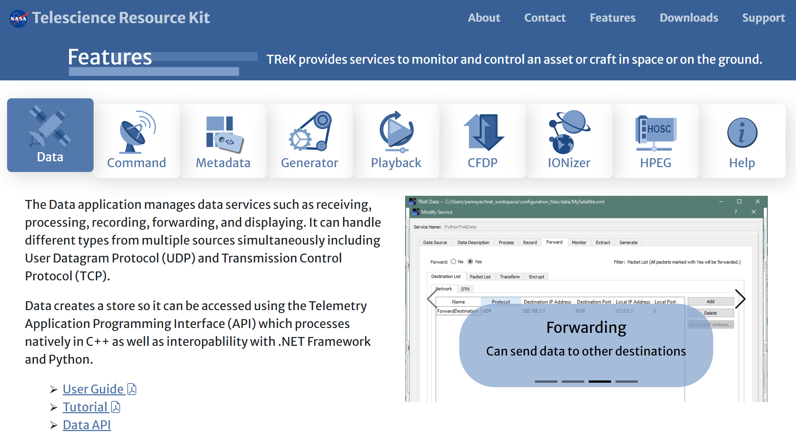
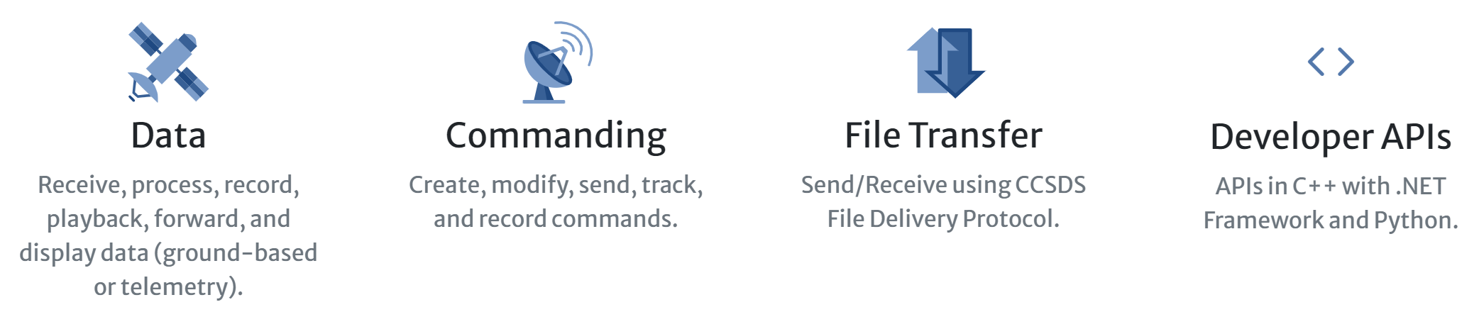
Other TReK Features Available
APIs in ANSI-C, C++, .NET Framework and Python for integration into user developed applications. .NET Core coming soon.
Enables access via IP to payloads. Automated activation for IP services coming soon.
Full telemetry and command support for all ISS packet types.
Onboard APIs and applications available to ease payload integration into ISS.

Slide 9
Next Steps and Future Uses
Streamlining science ops for current and future PDs
Continue to advance automation, especially for routine ops
TReK use on Gateway, small satellite programs, more

Slide 10
Contact Information
Payload and Mission Operations Division (PMOD), NASA Marshall Space Flight Center
Jenna Ruddock
jenna.ruddock@nasa.gov
Jeff Lippincott
jeff.lippincott@nasa.gov
Michael Zekoff
michael.zekoff@nasa.gov
Telescience Resource Kit (TReK)
https://trek.msfc.nasa.gov/

Slide 11
The End

