Slide 1
Mitigating the Impacts of Measurement Error in the Quesst Community Noise Study
Nathan B. Cruze, Kathryn M. Ballard, William J. Doebler, Aaron B. Vaughn
NASA Langley Research Center
August 8, 2023
Joint Statistical Meetings, Toronto, Canada

Slide 2
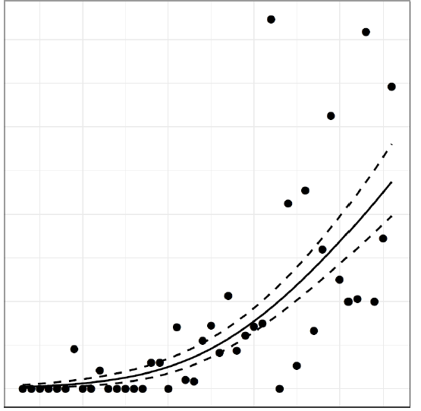
Overview
Motivation: Quesst Community Noise Studies
Application to 2011 Data (WSPR Study)
Example Data Features and GLM(Me)M
Bayesian Hierarchical Models
Data Cloning
Concluding Remarks
Response
(Probability Highly Annoyed)
Dose (Noise Level, dB)

Slide 3
Sonic Boom Moves With The Aircraft

Slide 4
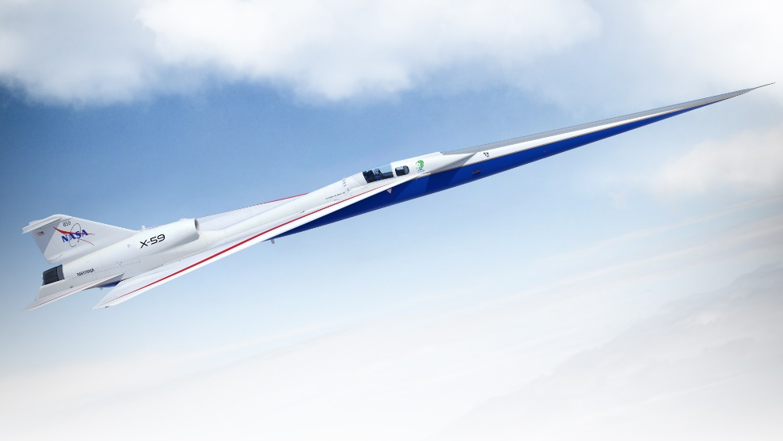
Overland Civil Supersonic Flight Prohibited Since 1973
The NASA Quesst Mission
Image Credit: Lockheed Martin
Build and Test X-59
Acoustic Validation
Community Studies
Data from Quesst mission will inform regulation of civil supersonic flight overland
Federal Aviation Regulations: 14 C.F.R.§91.817 Civil Aircraft Sonic Boom

Slide 5
Covariate Measurement Error in Future Quesst Studies
Potential for measurement error
Estimate doses by Kalman filter (Lympany et al. 2022a,b; Klos 2020)
Predictive performance of physics-based model (Doebler et al. 2023)
Estimate outdoor noise levels (transmission loss; ambient levels)
Potential estimates of dose uncertainty
Acoustic validation phase
Local estimated variances as outputs of Kalman filter
Impacts of measurement error
Nominal 17 dB-wide dose range (Doebler and Loubeau 2023)
Diminished utility of dose-response model for policy making

Slide 6
Waveforms and Sonic Boom Perception and Response
Highly
Annoyed
Test procedures (Page et al. 2014); naïve models (Lee et al. 2019, 2020)

Slide 7
Measurement Error Contributes to Attenuation Bias
Subject-Specific Models
Naïve random intercept logistic model:
$$p\left(X_{ij},u_{i}\right)={logit}^{−1}\left(β_{0}+β_{1}X_{ij}+u_{i}\right)$$
$$u_{i}\sim N(0,σ_{u})$$
(Lee et al. 2019,2020; Vaughn and Cruze 2023)
Error Assumption | ${\hat{β}}_{0}$ (SE) | ${\hat{β}}_{1}$ (SE) | $${\hat{σ}}_{u}$$
No Error Assumed | -19.29 (1.70) | 0.15 (0.02) | 3.34
$$N(0,σ=2 dB)$$ | -18.22 (1.62) | 0.14 (0.01) | 3.27
$$N(0,σ=4 dB)$$ | -16.70 (1.51) | 0.13 (0.01) | 3.22
$$N(0,σ=6 dB)$$ | -14.99 (1.41) | 0.11 (0.01) | 3.19
$$N(0,σ=8 dB)$$ | -13.72 (1.31) | 0.09 (0.01) | 3.15

Slide 8
Measurement Error Contributes to Attenuation Bias
Population Average Models
À la Pavlou et al. (2015):
$$p\left(X\right)=\int_{−∞}^{∞}{\frac{1}{1+exp⁡(−[{\hat{β}}_{0}+{\hat{β}}_{1}X+u])}}\hat{f}\left(u\right)du$$
where $\hat{f}\left(u\right)=N(0,{\hat{σ}}_{u})$
Over/under predict (Stefanski and Carroll 1985)
Quesst studies to have smaller dose range (Doebler and Loubeau 2023)
Case Study: How can we remove or mitigate bias due to the simulated N(0,8 dB) error?

Slide 9
Generalized Linear Mixed Measurement Error Models
Reviews of Simulation Extrapolation (SIMEX), Regression Calibration, other methods
E.g., Fuller (1987); Gustafson (2004); Carroll et al. (2006); Keogh et al. (2020); Shaw et al. (2020)
Bayesian Hierarchical Models
Build joint probability models for data, measurement error processes, and model priors
Doebler et al. (2022); Erciulescu and Opsomer (2023) give applications to NASA QSF18 data
Data Cloning
Uses Bayesian statistical framework to obtain (frequentist) asymptotic MLE and standard errors
Lele et al. (2010); Torabi (2013); Sólymos (2010) and others
Apply Bayesian Hierarchical Models and Data Cloning to WSPR Data Subject to N(0,8 dB) Error

Slide 10
A Bayesian GLMMeM: Classical Measurement Error Model
Data, Process, and Prior Models (E.g., Wikle and Berliner 2007)
$i∈\{1, 2,…, 49\}$ individuals
$j∈\{1, 2,…,n_{i}\}$ booms
$y_{ij}$, indicator, highly annoyed
$p_{ij}$, probability highly annoyed
$u_{i}$, random intercept
$D_{ij}$, actual (“true”) dose, in PL dB
$X_{ij}$, dose as measured, in PL dB
$β_{0}, β_{1}, σ_{u}$, parameters
For now, assume $α_{0}=0, α_{1}=1;σ_{ij}=σ=8 dB$ known
Data | $$y_{ij}|p_{ij} \sim Bernoulli\left(p_{ij}\right)$$ $$p_{ij}|β_{0},β_{1},u_{i}=logit^{−1}\left(β_{0}+β_{1}D_{ij}+u_{i}\right)$$ $$u_{i} \sim N\left(0, σ_{u}\right)$$
Process | $$X_{ij}|D_{ij}\sim N\left(α_{0}+α_{1}D_{ij}, σ_{ij}\right)$$ $$D_{ij}\sim f_{D}$$
Priors | $$β_{0}\sim f_{β_{0}}$$ $$β_{1}\sim f_{β_{1}}$$ $$σ_{u}\sim f_{σ_{u}}$$

Slide 11
Deviance Information Criterion for Six Bayesian Models
Assumed Dose Distribution | $$f_{β_{0}}=N(0,σ=10)$$ $$f_{β_{1}}=N(0,σ=10)$$ $f_{σ_{u}}$ = Uniform(0,1000) | $$f_{β_{0}}=N(0,σ=10)$$ $$f_{β_{1}}=N(0,σ=10)$$ $f_{σ_{u}}$=$Lognorm(0,σ=10)$ | $$f_{β_{0}}=t(0,σ=10,υ=1 df)$$ $$f_{β_{1}}=t(0,σ=2.5,υ=1 df)$$ $f_{σ_{u}}$= $t^{+}$(0, $σ=10,υ=1 df$)
$f_{D}$=$N\left(\begin{aligned}μ=85 dB, \\ σ=10 dB\end{aligned}\right)$ | $\overline{D(θ)}$= 14278 | $\overline{D(θ)}$= 14280 | $\overline{D(θ)}$= 14278
 | $p_{D}$= 1269 | $p_{D}$= 1269 | $p_{D}$= 1270
 | $DIC$= 15547 | $DIC$= 15549 | $DIC$= 15548
$f_{D}$=$t\left(\begin{aligned}μ=85 dB, \\ σ=10 dB, \\ υ=4\end{aligned}\right)$ | $\overline{D(θ)}$= 14189 | $\overline{D(θ)}$= 14190 | $\overline{D(θ)}$= 14184
 | $p_{D}$= 1412 | $p_{D}$= 1412 | $p_{D}$= 1414
 | $DIC$= 15601 | $DIC$= 15602 | $DIC$= 15598
Priors: Browne and Draper (2006), Gelman (2006), Gelman et al. (2008), Polson and Scott (2012)
Erciulescu and Opsomer (2023) applied similar Normal dose structure to QSF18 data
$DIC=\overline{D(θ)}+p_{D}$ (Spiegelhalter et al. 2002); note lower $\overline{D(θ)}$ when t($μ=85,σ=10,υ=4$)

Slide 12
Posterior Summaries: $f_{D}$=$N\left(μ=85 dB, σ=10 dB\right)$
Model |  | Mean | SD | Lower 95% CI | Median | Upper 95% CI | MC Err. (% SD) | ESS | AC 100 | $$\hat{R}$$
$$N(0,σ=10)$$ $$N(0,σ=10)$$ $$Unif(0,1000)$$ | $${\hat{β}}_{0}$$ | -21.26 | 2.67 | -26.59 | -21.08 | -16.24 | 1.9 | 2865 | 0.338 | 1.002
 | $${\hat{β}}_{1}$$ | 0.17 | 0.02 | 0.13 | 0.17 | 0.22 | 1.3 | 5662 | 0.195 | 1.001
 | $${\hat{σ}}_{u}$$ | 3.94 | 0.88 | 2.37 | 3.82 | 5.65 | 2.5 | 1585 | 0.557 | 1.004
$$N(0,σ=10)$$ $$N(0,σ=10)$$ $$LogN(0,σ=10)$$ | $${\hat{β}}_{0}$$ | -20.99 | 2.63 | -26.24 | -20.84 | -16.06 | 1.9 | 2809 | 0.345 | 1.002
 | $${\hat{β}}_{1}$$ | 0.17 | 0.02 | 0.12 | 0.17 | 0.22 | 1.4 | 5195 | 0.206 | 1.001
 | $${\hat{σ}}_{u}$$ | 3.76 | 0.84 | 2.35 | 3.64 | 5.49 | 2.6 | 1504 | 0.558 | 1.003
$$t(0,σ=10,1)$$ $$t(0,σ=2.5,1)$$ $$t^{+}(0,σ=10,1)$$ | $${\hat{β}}_{0}$$ | -22.57 | 3.16 | -28.90 | -22.32 | -16.52 | 6.3 | 255 | 0.900 | 1.011
 | $${\hat{β}}_{1}$$ | 0.18 | 0.03 | 0.13 | 0.18 | 0.24 | 6.2 | 260 | 0.926 | 1.012
 | $${\hat{σ}}_{u}$$ | 4.08 | 0.96 | 2.44 | 3.95 | 5.98 | 1.8 | 3245 | 0.334 | 1.002
Naïve point estimates: ${\hat{β}}_{0}=−13.72$, ${\hat{β}}_{1}=0.09$, ${\hat{σ}}_{u}=3.15$
“Error-free” point estimates: ${\hat{β}}_{0}=−19.29$, ${\hat{β}}_{1}=0.15$, ${\hat{σ}}_{u}=3.34$

Slide 13
Posterior Summaries: $f_{D}$=$t\left(μ=85 dB, σ=10 dB,υ=4\right)$
Model |  | Mean | SD | Lower 95% CI | Median | Upper 95% CI | MC Err. (% SD) | ESS | AC 100 | $$\hat{R}$$
$$N(0,σ=10)$$ $$N(0,σ=10)$$ $$Unif(0,1000)$$ | $${\hat{β}}_{0}$$ | -19.37 | 2.40 | -24.09 | -19.24 | -14.76 | 2.0 | 2446 | 0.374 | 1.002
 | $${\hat{β}}_{1}$$ | 0.15 | 0.02 | 0.11 | 0.15 | 0.19 | 1.4 | 5317 | 0.196 | 1.001
 | $${\hat{σ}}_{u}$$ | 3.99 | 0.92 | 2.41 | 3.87 | 5.85 | 2.7 | 1389 | 0.585 | 1.003
$$N(0,σ=10)$$ $$N(0,σ=10)$$ $$LogN(0,σ=10)$$ | $${\hat{β}}_{0}$$ | -19.06 | 2.31 | -23.69 | -18.91 | -14.77 | 1.9 | 2911 | 0.352 | 1.000
 | $${\hat{β}}_{1}$$ | 0.15 | 0.02 | 0.11 | 0.15 | 0.19 | 1.3 | 5643 | 0.194 | 1.000
 | $${\hat{σ}}_{u}$$ | 3.79 | 0.82 | 2.39 | 3.68 | 5.45 | 2.5 | 1575 | 0.543 | 1.000
$$t(0,σ=10,1)$$ $$t(0,σ=2.5,1)$$ $$t^{+}(0,σ=10,1)$$ | $${\hat{β}}_{0}$$ | -20.05 | 2.69 | -25.46 | -19.90 | -15.09 | 3.3 | 900 | 0.732 | 1.009
 | $${\hat{β}}_{1}$$ | 0.16 | 0.02 | 0.11 | 0.15 | 0.20 | 3.6 | 761 | 0.828 | 1.007
 | $${\hat{σ}}_{u}$$ | 4.09 | 0.95 | 2.44 | 3.96 | 5.99 | 1.1 | 7650 | 0.092 | 1.001
Naïve point estimates: ${\hat{β}}_{0}=−13.72$, ${\hat{β}}_{1}=0.09$, ${\hat{σ}}_{u}=3.15$
“Error-free” point estimates: ${\hat{β}}_{0}=−19.29$, ${\hat{β}}_{1}=0.15$, ${\hat{σ}}_{u}=3.34$

Slide 14
Data Cloning: Main Ideas
Make k duplicates (clones) of data: $y^{(k)}=\left(y,y,…,y\right)$
$L\text{(}{θ;y}^{(k)}\text{)}={\left[L\left(θ;y\right)\right]}^{k}$ and maximizer ${\hat{θ }}_{MLE}$ of $L$($θ;y$) is maximizer of $L$(${θ;y}^{(k)}$)
For large k, when $L\text{(}{θ;y}^{(k)}\text{)}$used in Bayesian model with proper priors:
Mean of posterior distribution converges to ${\hat{θ }}_{MLE}$
Variance is approximately $k^{−1}I^{−1}\left({\hat{θ }}_{MLE}\right)$ (inverse of Fisher Information Matrix)
Diagnostics for required number of clones (Lele et al. 2010; Sólymos 2010)

Slide 15
Data Cloning: Preliminary Results for WSPR Data
Illustrate with $f_{D}$=$t\left(μ=85, σ=10,υ=4\right)$ and Normal, Uniform priors
WSPR data set has 1,891 rows; cloned data have 1891*k rows
Runtime of ~1.6 hours for k=20 clones; four chains (20,000 iterates) in parallel
Multivariate $\hat{R}$, fit (MSE and $r^{2}$) and degeneracy (eigenvalue) diagnostics
Clones, k | Largest Eigenvalue | Mean Squared Error | $$r^{2}$$ | $$\hat{R}$$
2 | 2.880 | 0.225 | 0.018 | 1.077
3 | 1.933 | 0.165 | 0.016 | 1.086
5 | 1.123 | 0.020 | 0.003 | 1.126
10 | 0.706 | 0.009 | 0.001 | 1.086
20 | 0.303 | 0.004 | 0.001 | 1.058

Slide 16
Data Cloning: Preliminary Results for WSPR Data
Results from k=20 clones
“Error-free” point estimates: ${\hat{β}}_{0}=−19.29$, ${\hat{β}}_{1}=0.15$, ${\hat{σ}}_{u}=3.34$
Bayes model, same priors: ${\hat{β}}_{0}=−19.37$, ${\hat{β}}_{1}=0.15$, ${\hat{σ}}_{u}=3.99$
At convergence, results invariant to priors (Lele et al.2010)
 | Mean (MLE) | DC SD (SE) | 2.50% | 25% | 50% | 75% | 97.50% | $$\hat{R}$$
$${\hat{β}}_{0}$$ | -19.549 | 2.426 | -20.58 | -19.93 | -19.56 | -19.18 | -18.47 | 1.056
$${\hat{β}}_{1}$$ | 0.153 | 0.022 | 0.14 | 0.15 | 0.15 | 0.16 | 0.16 | 1.070
$${\hat{σ}}_{u}$$ | 3.632 | 0.778 | 3.31 | 3.51 | 3.63 | 3.75 | 3.98 | 1.003

Slide 17
Conclusions and Future Work
Severe attenuation bias contributes to over- and under prediction of annoyance
Bayesian models sensitive to choice of prior, process model assumptions
Data cloning invariant to choice of prior, but additionally compute intensive
Future work:
Bayesian computing—candidate applications for INLA
Other measurement error process models (e.g., spatial, error as function of dose level)

Slide 18
Thank You!
nasa.gov/quesst
nathan.b.cruze@nasa.gov

Slide 19
References
Baghishani, H., Rue, H., & Mohammadzadeh, M. (2012). On a Hybrid Data Cloning Method and Its Application in Generalized Linear Mixed Models. Statistics and Computing, 22, 597–613. https://doi.org/10.1007/s11222-011-9254-z
Bartlett, J. W. & Keogh, R. H. (2018). Bayesian Correction for Covariate Measurement Error: A Frequentist Evaluation and Comparison with Regression Calibration. Statistical Methods in Medical Research, 27(6), 1695–1708. https://doi.org/10.1177/0962280216667764
Browne, W. J. & Draper, D. (2006). A Comparison of Bayesian and Likelihood-Based Methods for Fitting Multilevel Models. Bayesian Analysis, 1(3), 473 – 514. https://doi.org/10.1214/06-BA117
Carroll, R., Ruppert, D., Stefanski, L., & Crainiceanu, C. (2006). Measurement Error in Nonlinear Models: A Modern Perspective (2nd ed.). Chapman and Hall/CRC. https://doi.org/10.1201/9781420010138
Carroll, R. J., Lin, X., & Wang, N. (1997). Generalized Linear Mixed Measurement Error Models. In Modelling Longitudinal and Spatially Correlated Data, 321–330. https://doi.org/10.1007/978-1-4612-0699-6_28
Cruze, N. B., Ballard, K. M., Vaughn, A. B., Doebler, W. J., Rathsam, J., & Parker, P. A. (2022). Comparison of Likelihood Methods for Generalized Linear Mixed Models with Application to Quiet Supersonic Flights 2018 Data. Technical Memorandum, NASA Langley Research Center. NASA/TM–20220014998. https://ntrs.nasa.gov/citations/20220014998
Denwood, M. J. (2016). runjags: An R Package Providing Interface Utilities, Model Templates, Parallel Computing Methods and Additional Distributions for MCMC Models in JAGS. Journal of Statistical Software, 71(9), 1–25. https://doi.org/10.18637/jss.v071.i09
Doebler, W. J., & Loubeau, A. Estimating the Noise Dose Range of the NASA X-59 Aircraft in Supersonic Cruise Using PCBoom Propagation Simulations. JASA Express Letters. 3(5) p. 053601 https://doi.org/10.1121/10.0019501
Doebler, W. J., Vaughn, A. B., Ballard, K. M., & Rathsam, J. (2022). Simulation and Application of Bayesian Dose Uncertainty Modeling for Low-Boom Community Noise Surveys. Proceedings of Meetings on Acoustics, Volume 45. https://doi.org/10.1121/2.0001592
Doebler, W. J., Wilson, S. R., Loubeau, A., & Sparrow, V. W. (2023). Simulation and Regression Modeling of NASA’s X-59 Low-Boom Carpets Across America. Journal of Aircraft, 60(2), 509–520. https://doi.org/10.2514/1.C036876
Erciulescu, A. L., & Opsomer, J. D. (2023). Accounting for Dose Uncertainty in Dose-Response Curve Estimation Using Hierarchical Bayes Models. 64th World Statistics Congress [Conference Presentation]
Fuller, W. (1987). Measurement Error Models. John Wiley and Sons, Inc. https://doi.org/10.1002/9780470316665

Slide 20
References
Gelman, A. (2006). Prior Distributions for Variance Parameters in Hierarchical Models (comment on article by Browne and Draper). Bayesian Analysis, 1(3), 515 – 534. https://doi.org/10.1214/06-BA117A
Gelman, A., Jakulin, A., Pittau, M. G., & Su, Y.-S. (2008). A Weakly Informative Default Prior Distribution for Logistic and Other Regression Models. The Annals of Applied Statistics, 2(4), 1360 – 1383. https://doi.org/10.1214/08-AOAS191
Gustafson, P. (2004). Measurement Error and Misclassification in Statistics and Epidemiology: Impacts and Bayesian Adjustments. Chapman & Hall/CRC. https://doi.org/10.1201/9780203502761
Keogh, R. H., Shaw, P. A., Gustafson, P., Carroll, R. J., Deffner, V., Dodd, K. W., Kuchenhoff, H., Tooze, J. A., Wallace, M. P., Kipnis, V., & Freedman, L. S. (2020). STRATOS Guidance Document on Measurement Error and Misclassification of Variables in Observational Epidemiology: Part 1—Basic Theory and Simple Methods of Adjustment. Statistics in Medicine, 39(16), 2197–2231. https://doi.org/10.1002/sim.8532
Klos, J. (2020). Recommendations for Using Noise Monitors to Estimate Noise Exposure During X-59 Community Tests. Technical Memorandum, NASA Langley Research Center. NASA/TM–20205007926 Corrected Copy. https://ntrs.nasa.gov/citations/20205007926
Lee, J., Rathsam, J., & Wilson, A. (2019). Statistical Modeling of Quiet Sonic Boom Community Response Survey Data. Technical Memorandum. NASA/TM-2019-220427. https://ntrs.nasa.gov/citations/20190033466
Lee, J., Rathsam, J., & Wilson, A. (2020). Bayesian Statistical Models for Community Annoyance Survey Data. The Journal of the Acoustical Society of America, 147(4), 2222–2234. https://doi.org/10.1121/10.0001021
Lele, S. R., Dennis, B., & Lutscher, F. (2007). Data Cloning: Easy Maximum Likelihood Estimation for Complex Ecological Models Using Bayesian Markov Chain Monte Carlo Methods. Ecology Letters, 10(7), 551–563. https://doi.org/10.1111/j.1461-0248.2007.01047.x
Lele, S. R., Nadeem, K., & Schmuland, B. (2010). Estimability and Likelihood Inference for Generalized Linear Mixed Models Using Data Cloning. Journal of the American Statistical Association, 105(492), 1617–1625. https://doi.org/10.1198/jasa.2010.tm09757
Lympany, S. V. & Page, J. A. (2022a). Estimating Sonic Boom Metrics Across a Community Using a Kalman Filter. The Journal of the Acoustical Society of America, 152(4), A86. [Conference Presentation Abstract]. https://doi.org/10.1121/10.0015632
Lympany, S. V. & Page, J. A. (2022b). Estimating Sonic Boom Metrics Across a Community Using a Kalman Filter. 183rd Meeting of the Acoustical Society of America. [Conference Presentation]. https://ntrs.nasa.gov/citations/20220017380
Muff, S., Riebler, A., Held, L., Rue, H., & Saner, P. (2015). Bayesian Analysis of Measurement Error Models Using Integrated Nested Laplace Approximations. Journal of the Royal Statistical Society. Series C (Applied Statistics), 64(2), 231–252. http://www.jstor.org/stable/24771892

Slide 21
References
Page, J. A., Hodgdon, K. K., Krecker, P., Cowart, R., Hobbs, C., Wilmer, C., Koening, C., Holmes, T., Gaugler, T., Shumway, D. L., Rosenberger, J. L., & Philips, D. (2014). Waveforms and Sonic Boom Perception and Response (WSPR): Low-Boom Community Response Program Pilot Test Design, Execution, and Analysis. Contractor Report, NASA Langley Research Center. NASA/CR-2014-218180. https://ntrs.nasa.gov/citations/20140002785
Pavlou, M., Ambler, G., Seaman, S., & Omar, R. Z. (2015). A Note on Obtaining Correct Marginal Predictions from a Random Intercepts Model for Binary Outcomes. BMC Medical Research Methodology, 15(59). https://doi.org/10.1186/s12874-015-0046-6
Plummer, M. (2003). JAGS: A Program for Analysis of Bayesian Graphical Models Using Gibbs Sampling. Proceedings of the 3rd International Workshop on Distributed Statistical Computing, 1–10. https://www.r-project.org/conferences/DSC-2003/Proceedings/Plummer.pdf
Polson, N. G. & Scott, J. G. (2012). On the Half-Cauchy Prior for a Global Scale Parameter. Bayesian Analysis, 7(4), 887 – 902. https://doi.org/10.1214/12-BA730
Ponciano, J. M., Taper, M. L., Dennis, B., & Lele, S. R. (2009). Hierarchical Models in Ecology: Confidence Intervals, Hypothesis Testing, and Model Selection Using Data Cloning. Ecology, 90(2), 356–362. https://doi.org/10.1890/08-0967.1
Shaw, P. A., Gustafson, P., Carroll, R. J., Deffner, V., Dodd, K. W., Keogh, R. H., Kipnis, V., Tooze, J. A., Wallace, M. P., Kuchenhoff, H., & Freedman, L. S. (2020). STRATOS Guidance Document on Measurement Error and Misclassification of Variables in Observational Epidemiology: Part 2—More Complex Methods of Adjustment and Advanced Topics. Statistics in Medicine, 39(16), 2232–2263. https://doi.org/10.1002/sim.8531
Sólymos, P. (2010). dclone: Data Cloning in R. The R Journal, 2, 29–37. https://doi.org/10.32614/RJ-2010-011
Stefanski, L. A. & Carroll, R. J. (1985). Covariate Measurement Error in Logistic Regression. The Annals of Statistics, 13(4), 1335 – 1351. https://doi.org/10.1214/aos/1176349741
Torabi, M. (2012). Likelihood Inference in Generalized Linear Mixed Models with Two Components of Dispersion Using Data Cloning. Computational Statistics & Data Analysis, 56(12), 4259–4265. https://doi.org/10.1016/j.csda.2012.04.008
Torabi, M. (2013). Likelihood Inference in Generalized Linear Mixed Measurement Error Models. Computational Statistics & Data Analysis, 57(1), 549–557. https://doi.org/10.1016/j.csda.2012.07.018
Vaughn, A.B. & Cruze, N.B. (2023). Multilevel Logistic Regression with Random Slope for Community Annoyance Survey Data. Technical Memorandum, NASA Langley Research Center. NASA/TM-2023-20230008716. https://ntrs.nasa.gov/citations/20230008716
Wikle, C. K. & Berliner, L. M. (2007). A Bayesian Tutorial for Data Assimilation. Physica D: Nonlinear Phenomena, 230(1), 1–16. Data Assimilation. https://doi.org/10.1016/j.physd.2006.09.017

Slide 22
Supplement: NASA is Building the X-59 Research Aircraft
Flights will confirm that a full-scale supersonic aircraft can produce just a gentle sonic “thump”
Key data will be gathered on public perception of quiet supersonic flights in several cities across the nation
Length
99.7 feet long
Width
29.5 feet wingspan
Cruise Speed
Mach 1.4
Cruise Altitude
55,000 feet
Image Credit: Lockheed Martin

Slide 23
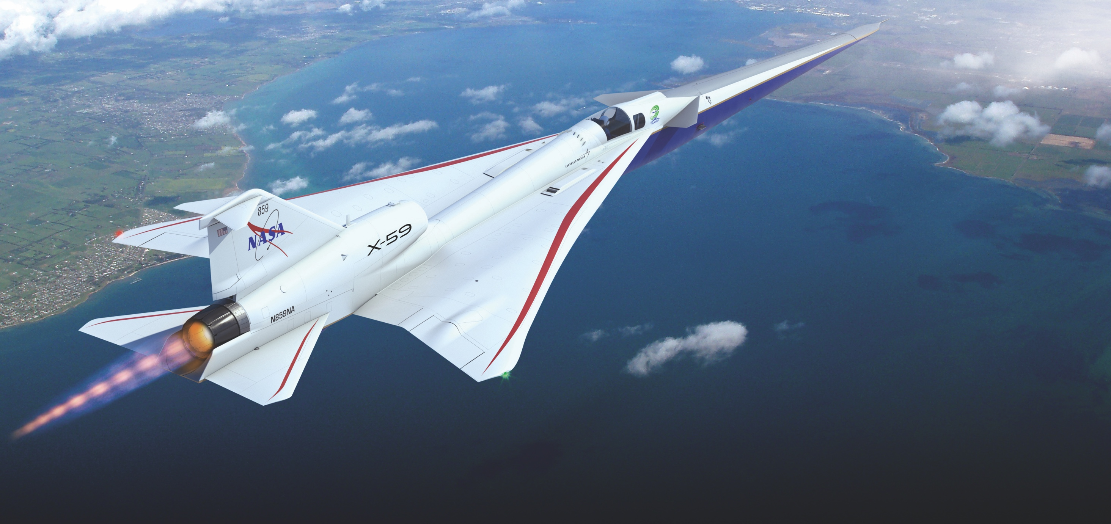
Supplement: X-59 Design Features Quiet design approaches adapted for a unique flight demonstrator
X-plane approach that meets key requirements in a cost-effective design
External and forward vision systems for forward visibility
T-38 aft canopy and ejection seat minimizes qualification cost and schedule
Long nose to shape forward shock
Fixed canard for nose-up trim at low-boom design point
Large, unitized skins reduce parts count and manufacturing cost
T-tail minimizes aft shock
F-16 landing gear and other systems from high performance aircraft minimize qualification cost and schedule
Wing shielding minimizes impact of inlet spillage on sonic boom
Single GE-F414 engine with standard nozzle minimizes cost and schedule
Conventional tail arrangement simplifies stability and control considerations
Image Credit: Lockheed Martin
23

