Slide 1





Conjunction Assessment and Deconfliction Paradigm for Co-located Satellite Constellations with On-Spacecraft “Autonomous” Flight Dynamics Control
M.D. Hejduk
NASA HQ Conjunction Assessment Chief Engineer
S.T. Miller; D.D. Murakami
NASA Ames Research Center
A.B. Probe; G.E. Bryan
Emergent Space Technologies
A.S. Petrov; D.B. Goldstein; E.M. Schwartz; E.P. Babcock
Space Exploration Technologies
AMOS, September 2023

Slide 2
Autonomous Flight Dynamics (AFD)
Definition and Basic Explication
Locution “autonomous satellite constellation” used; but usually this is a misnomer, or at least imprecise
  Question actually centers on data availability to, and machine-executed portions of, flight dynamics process
  For a satellite with near-continuous ground contact, does not matter whether processes executed on board or on ground
Starlink uses a form of autonomous flight dynamics
  When ascending from injection to on-orbit position, satellite follows “master trajectory”
  When in on-orbit position, satellite remains within control box
This autonomous approach includes conjunction assessment
  Large-criteria used for CA screenings—gives snapshot of catalogue in broad vicinity of each Starlink satellite
  CDMs from these screenings made available to autonomous flight dynamics system
    Leverages precise on-board navigation knowledge to update primary state/covariance information
  All maneuvers, whether for orbit maintenance or CA, can be first “screened” against CDM set
    Identifies any high-risk conjunctions and allows replanning

Slide 3
CA CONOPS with Autonomous Flight Dynamics (AFD)
Using Current 18-19 SDS Screening Authority
Fresh screening results received from 18/19 SDS every 8 hours
  Made available to flight dynamics software
For AFD conjunctions with inert secondary objects, no special issues
For AFD conjunctions with active secondaries using traditional flight dynamics, situation is manageable but restricted
  Both O/Os must agree in advance who will bear the maneuver responsibility for all serious conjunctions
  O/O without maneuver responsibility must refrain from quick-turn maneuvers
  Above situation imposes restriction on one of the O/Os
    AFD system bears maneuver responsibility; non-AFD system accepts maneuver restrictions
For conjunctions between different objects that each use autonomous flight dynamics, situation currently irresolvable
  Each has CDMs based only on the other’s latest published ephemeris; may or may not include intended mitigation
  Each could be planning a maneuver that results in the two satellites’ increasing collision risk with each other
    Such maneuvers could be either CA risk mitigation maneuvers or orbit maintenance maneuvers
  This issue recognized as latent problem, but no prompting circumstance to date to force consideration/resolution

Slide 4
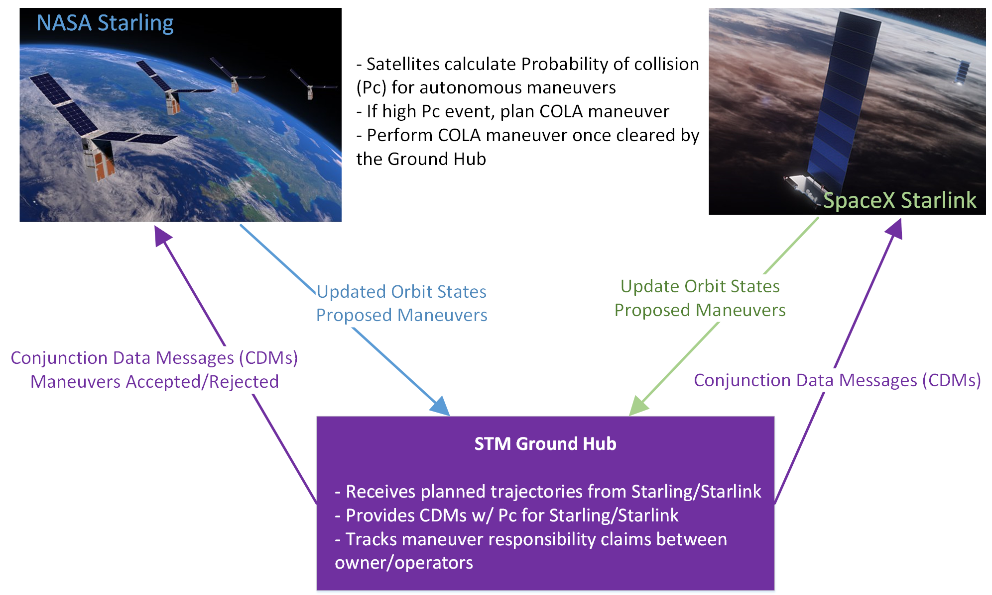
SpaceX Starlink / NASA Starling
Colocated Autonomous Constellations now become Reality
NASA Starling technology demonstration
  Constellation of four, 6U cubesats
  Serendipitously selected rideshare to 550km—collocated with Starlink!
  Actual deployment occurred at upper end of Starlink shell (584 x 565), but conjunctions and maneuvers already required routinely!
Consortium of involved parties formed to develop and test solution with actual operations
  Starling Project: obtained funding for extended mission, development of CONOPS, and needed ground node; and oversaw construction of same
  Starlink: participated in CONOPS development and prepped needed data exchange paradigms
  NASA Conjunction Assessment Risk Analysis Program: participated in CONOPS development and serving as chief technical advisor for experiment
  Department of Commerce: participated in project in observer status
Formal experiment expected to begin January 2024 and run
~9 months
  Starling will be lowered (if necessary) further into the Starlink shell to produce desired density of “yellow” conjunctions
  Mitigation threshold of perhaps 1E-05 for both constellations will produce real events to mitigate, with new CONOPS
    Very high-risk events will be monitored manually and perhaps resolved by traditional methods
  Consortium participants believe proposed CONOPS workable and desirable; experiment will test this hypothesis

Slide 5
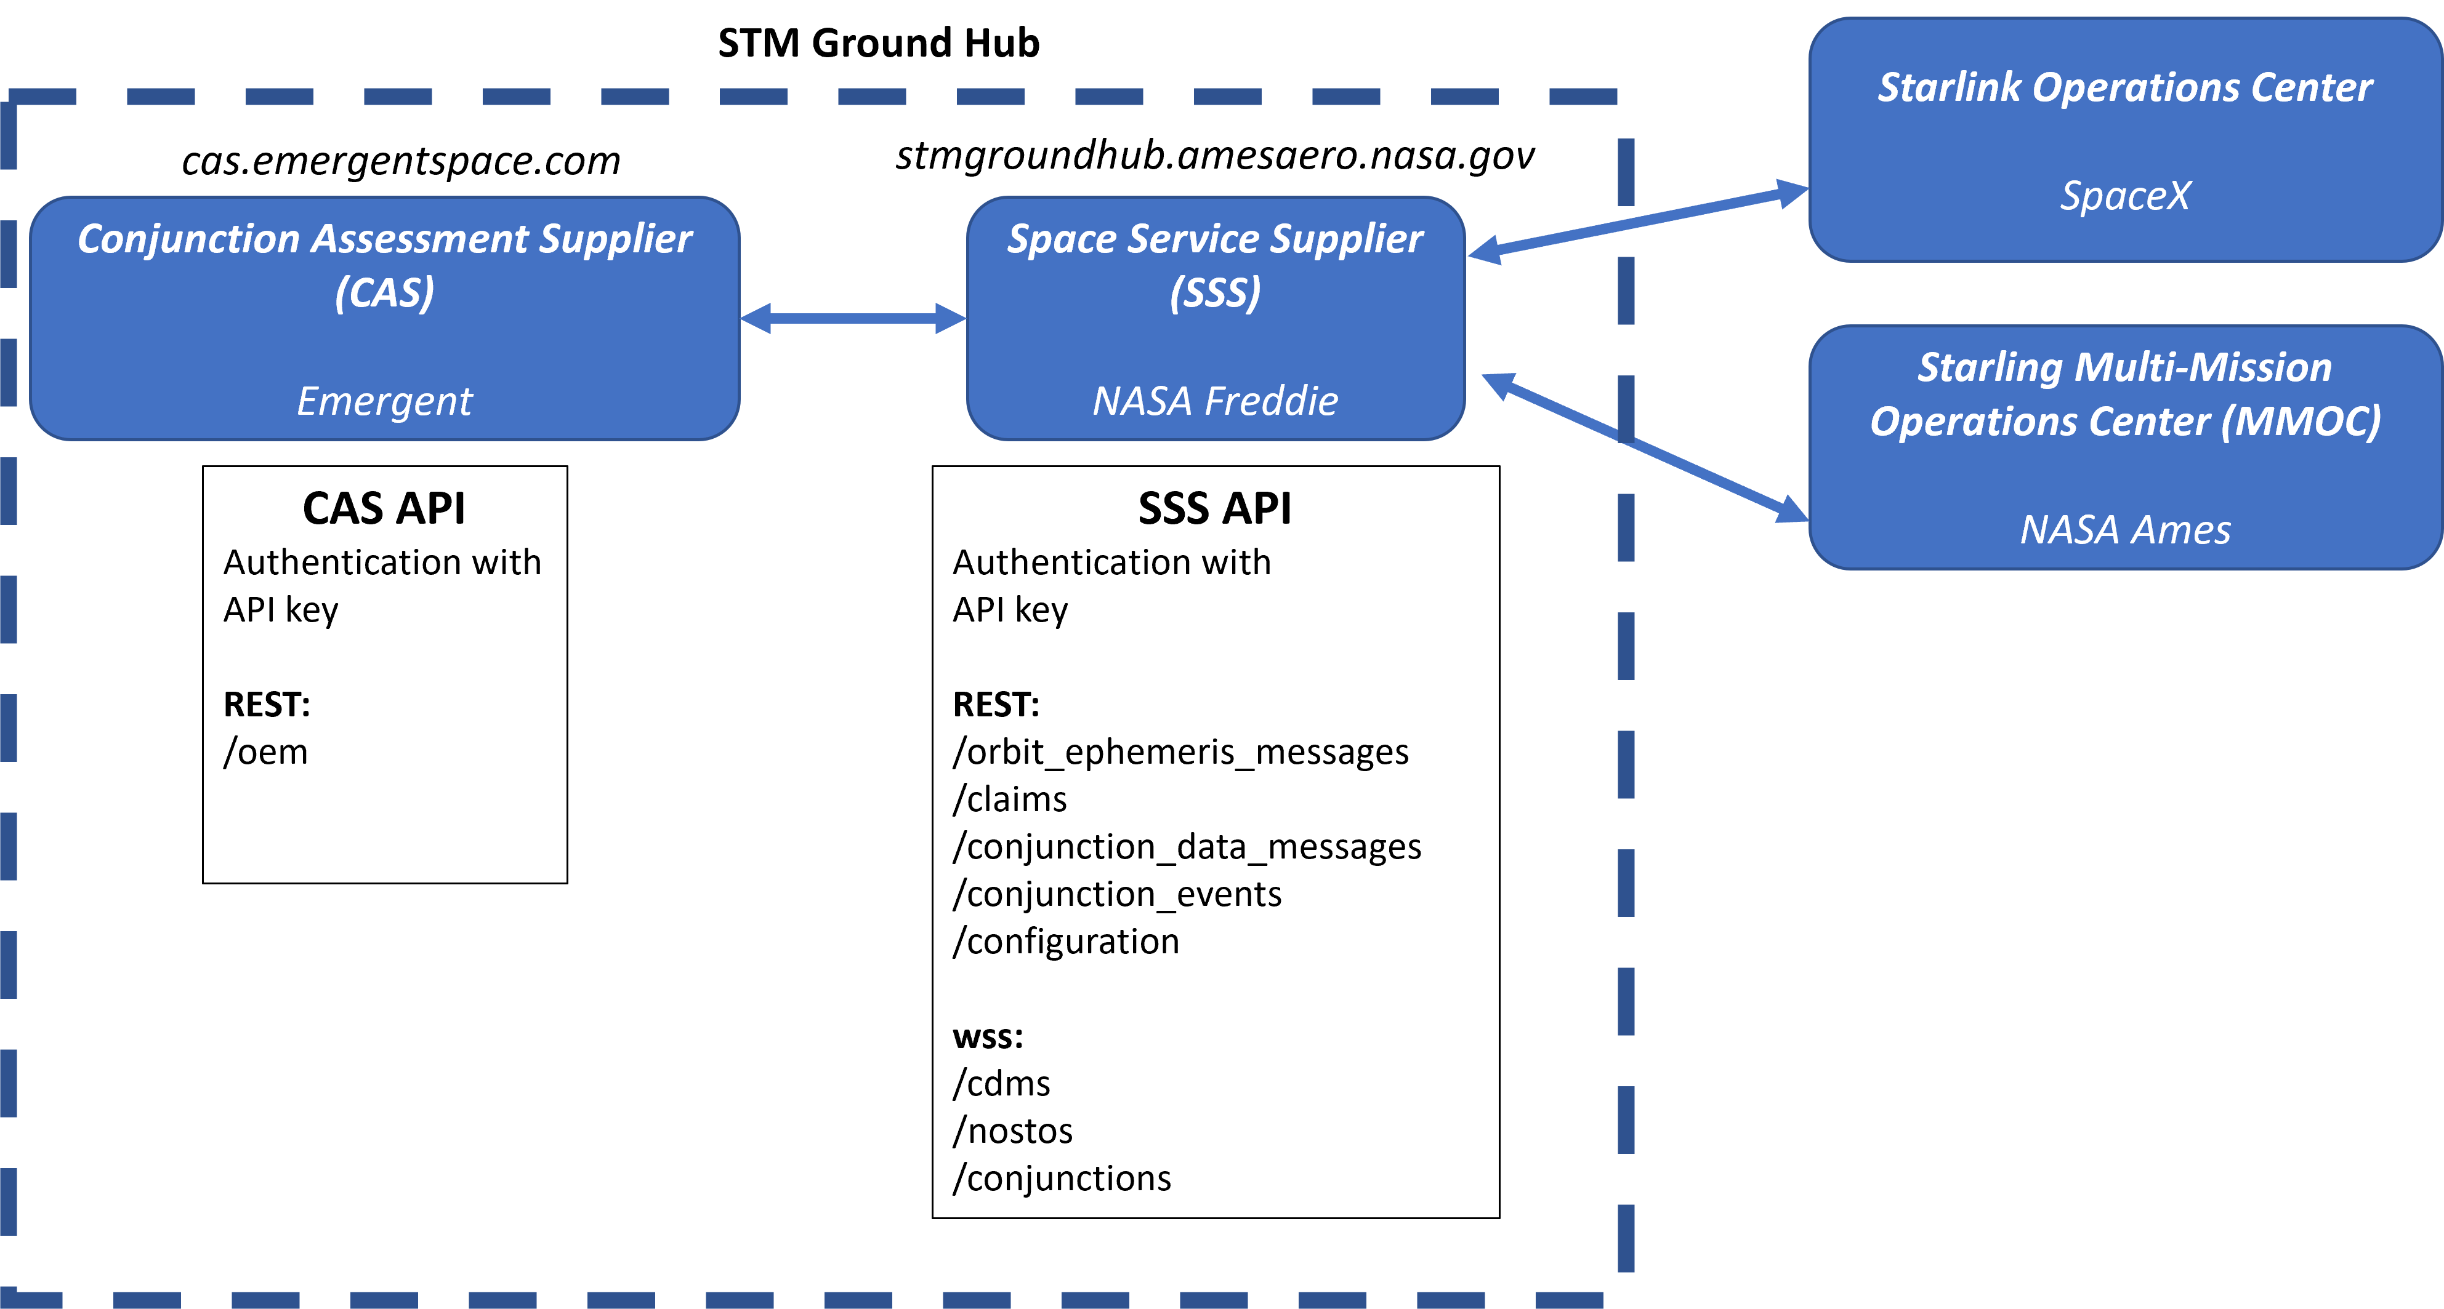
CONOPS Ground Node
Needed for Rapid Posting and Screening of Predicted Ephemerides
Receives each predicted ephemeris update for every satellite in autonomous constellations
Screens each ephemeris against all other ephemerides in its database and returns CDMs
  Extremely low-latency screening—essentially on-demand screenings, with CDMs returned within ~1 min
  Could also screen against remainder of catalogue and provide CDMs for that, if catalogue available to ground node (this functionality will be tested with an open-source prototype catalog)
Updates database with current trajectory for each protected object, according to rules shown on next slide

Slide 6
CONOPS Ground Node
Summary Table of Ephemeris Submission Categories, with Commentary

Slide 7
Centralized Conjunction Adjudication—Issues
Why can’t we have centralized conjunction resolution for everyone?
Centralized: all participants must submit CA maneuvers to a central authority and must receive explicit approval before execution
Optimal assignment of maneuver responsibility is difficult
  Depends on both enduring and specific exigencies of each O/Os situation and the astrodynamics of the encounter
First-in, first-out (FIFO) approach is transparent and formally fair, but is suboptimal and can be gamed
  Whoever can get trajectories in first wins; latecomers’ trajectories rejected until they bend to existing DB
  Grounded ultimately on expectation of strong enforcement of rules; this is what incentivizes an O/O to accept centralized authority’s gatekeeping role
Despite centralized control, ephemeris database will not remain clear of CA conflicts
  Non-maneuvering satellites’ state updates will introduce conjunctions with maneuverable ones; and space weather developments will create unsafe encounters between cleared trajectories
  Maneuverable sats will need to make modifications to accommodate such changes, despite having had their ephemerides “accepted”
Political difficulties with centralized approach
  Hosting organization needs to be given regulatory authority to direct adjudication of conjunctions
  Attendant liability issues need to be resolved
Centralized approach, although prima facie straightforward, presents many difficulties

Slide 8
“Collaborative” Conjunction Adjudication
A centrally-facilitated but bilaterally-resolved approach
Collaborative: participants are free to pursue their own strategies bilaterally; only the state of conjunctions is centrally tracked
When the ground node identifies a conjunction between ephemerides in its DB, alert sent to both O/Os
  CDM accompanies alert to provide basic astrodynamics information and other event details
O/Os can choose from among three categories to indicate their posture toward this collision
Expected that O/Os could embrace general rules for managing the assignment of responsibility, while allowing specific bilateral arrangements between pairs of O/Os

Slide 9
Collaborative Conjunction Adjudication
Further Supporting Arguments
Insulates against outages or other communication breakdowns
  Ruleset could indicate O/O #1 supposed to mitigate, but O/O #1 may not receive message or have other issues
  With current proposal, ground node makes explicit whether O/O #1 actively plans to mitigate conjunction
Allows bilateral modification of standard rules
  Thus enables particular solutions for problems that exist largely between two constellations, such as deorbit of OneWeb satellites through Starlink constellation
  Eliminates need for ground node to take cognizance of bilateral rulesets, which would be both cumbersome and perhaps not possible (if bilateral arrangement would require functionality modifications to ground node)
Promotes paradigm of ex post facto audit rather than ante factum direct enforcement
  Each O/O can follow the licensing rules of its particular governing authority; ground node can make available historical performance data to allow authority to assess compliance
  Much more amenable to multinational collaborative paradigm

Slide 10
CONOPS Development
Past and Future Events vis-à-vis Starlink/Starling Experiment
Discussions among NASA and SpaceX principals over 18-month period
Number of different proposals entertained; present set emerged as most desirable overall
Approach has sustained Starling formal reviews (e.g., Critical Design Assessment in Feb 23), and Starling constellation launched 10 JUL 23
Public event (e.g., workshop) to take place fall 2023 to present approach in more detail and solicit feedback
  Ability to make major changes for upcoming experiment limited, but all feedback helpful in crafting durable proposal for US DOC to consider
Experiment to be conducted Jan-Sep 2024
Results of experiment, and finalized recommended CONOPS, will be broadly circulated once available (probably fall/winter 2024)

Slide 11
Acronym List
AFD: Autonomous Flight Dynamics
API: Application Program Interface
CA: Conjunction Assessment
CDM: Conjunction Data Message
CONOPS: Concept of Operations
DOC: Department of Commerce
DB: Database
O/O: Owner/Operator
Pc: Probability of Collision
RMM: (Collision) Risk Mitigation Manœuvre
SDS: Space Defense Squadron
STM: Space Traffic Management (Coordination)

