Slide 1
Conjunction Assessment NASA Best Practices
Lauri K. Newman
NASA Conjunction Assessment Program Officer
HQ Science Mission Directorate
Office of the Deputy Associate Administrator for Programs
Aug 7, 2023

Slide 2
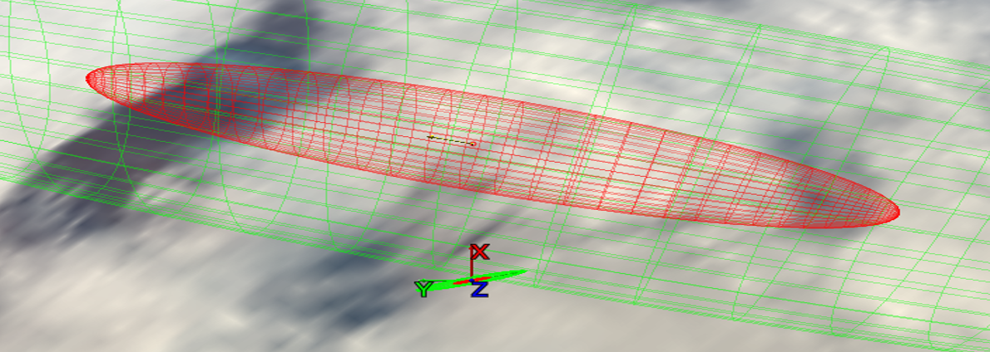
Satellite Conjunction Assessment:
Basics
High-risk satellite conjunction shown below
  NASA satellite well maintained; small 1-σ (red/inner) / 3-σ (green/outer) error ellipses (with axes at bottom)
  Debris object “above” it, with very large error ellipses (3-σ extends beyond image)
Conjunction screening activities find encounters of this nature
Risk assessment determines that actual likelihood/consequence of collision
Mitigation planning helps select maneuver for NASA object to avoid collision

Slide 3
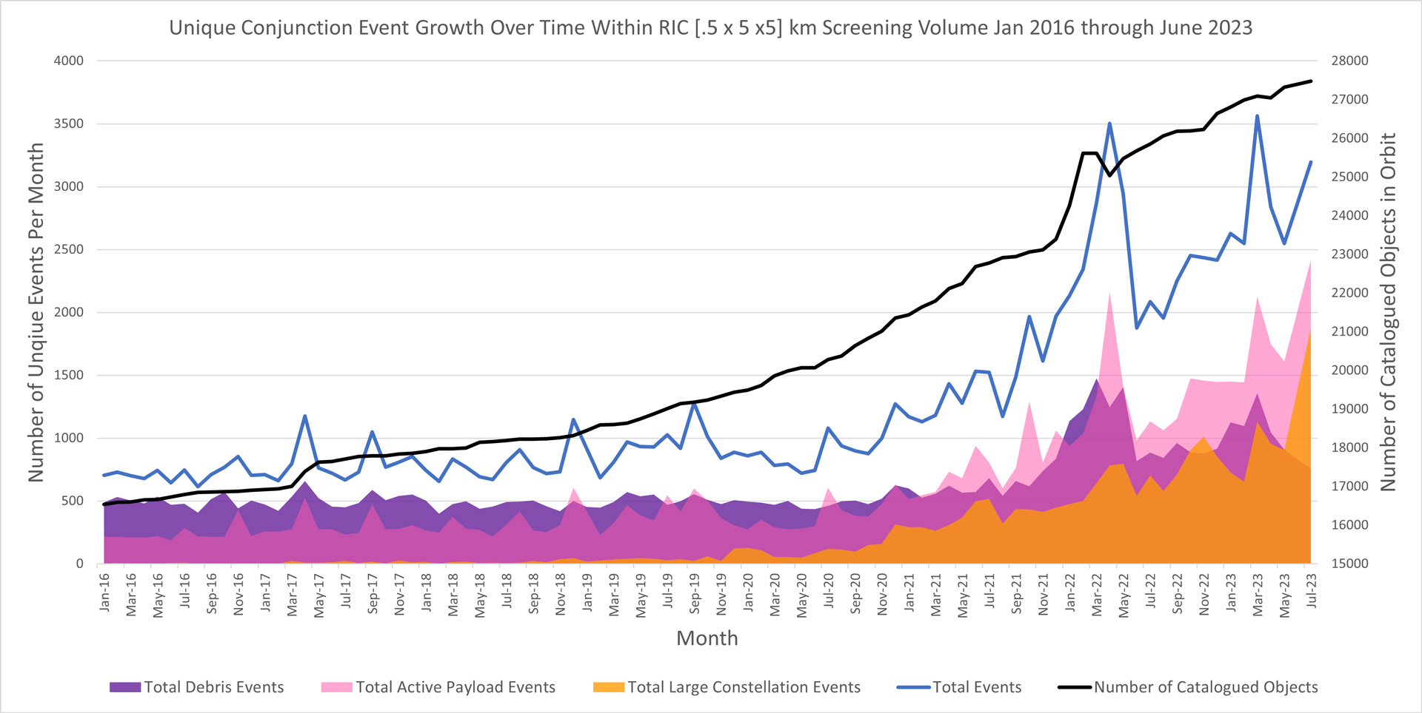
Conjunction Assessment Trends:
Situation is Getting Worse!
Russian ASAT test
15 NOV 2021
1st Starlink launch
23 MAY 2019
https://www.nasa.gov/sites/default/files/thumbnails/image/cara-conjunction-events-plot-jun-2023.jpg
Large constellations will continue to drive the close approach event risk.
Notes:
The number of satellites over time continues to grow.
Number of conjunctions with operational spacecraft now outnumbers conjunctions with debris
Several ultra-large constellations (up to 30k space vehicles) have been announced (for Low Earth Orbit), though not yet deployed.

Slide 4
Conjunction Assessment:
Basic Definitions and Responsibilities
Catalog Object i+1
Secondary Object
Secondary Object
Catalog Object i+2
Maneuver
∆V
Primary S/C
Primary S/C
Catalog Object i
Primary S/C
Primary S/C
Conjunction Assessment (CA) is the process of identifying close approaches between two orbiting objects; sometimes called conjunction screening.
The 18th Space Defense Squadron (18 SDS) at Vandenberg Space Force Base (VSFB) maintains the high accuracy catalog of space objects. Orbital Safety Analysts (OSAs) at VSFB screen protected assets against the catalog, perform tasking requests, and generate close approach data.
CA Risk Analysis (CARA) is the process of assessing collision risk and assisting satellites in planning maneuvers to mitigate that risk, if warranted.
The NASA CARA program performs risk assessment for all NASA operational non-HSF satellites, and some partner missions.
JSC Flight Operations Directorate (FOD) performs risk assessment for all NASA Human Spaceflight (HSF) program assets and is the O/O for maneuver decisions and execution.
Collision Avoidance is the process of executing mitigative action, typically in the form of an orbital maneuver, to reduce collision risk.
Each satellite Owner/Operator (O/O) – mission management, flight dynamics, and flight operations – is responsible for making maneuver decisions and executing the maneuvers.

Slide 5
Spacecraft Design Considerations
It is important (and efficient) to make plans for conjunction assessment during spacecraft planning and design
  CA process needs can be accommodated more easily prior to spacecraft fabrication
  All processes and tools must be developed and validated well in advance of launch
Key items to consider during design:
  Orbit selection
  Trackability
  Deployment plan
  Ephemeris generation process and tools
Lesson learned example:
  A NASA spacecraft assumed that two-line elements (TLEs) would be available from DOD for use as acquisition data for tracking radars.
  After launch, it was discovered that the orbit was too low an inclination for DOD CA sensors to track and maintain it appropriately, so TLEs were not regularly available
  This situation could have been prevented through pre-launch analysis

Slide 6
Cis-lunar CA
Catalog of non-cooperatively/passively tracked objects used in CA includes only Earth-orbiting objects
Activity at Moon, Mars, and Libration points increasing risk of collision; screening of orbits in these regimes now needed
  NASA MADCAP provides ephem-on-ephem screening for missions
  Relies on sharing of data
  Open to non-NASA entities
DoD developing cis-lunar catalog and screening capability
  Requirements not yet defined
  Implementation is still in early stages of development
NASA continues to work with DoD on beyond GEO SSA capabilities.

Slide 7


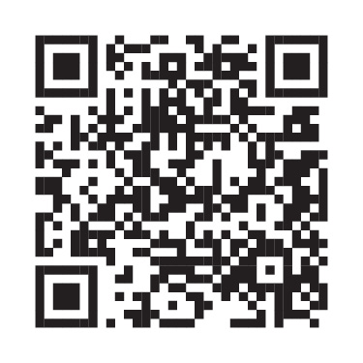
Resources
NASA is committed to refining and sharing appropriate best practices
  Best practices document available to the public
  NASA tool sets with test data available to the public
NASA spacecraft are required to follow best practices
  Requirements documented in NPR 8079.1
Accompanying FAQ: https://www.nasa.gov/sites/default/files/atoms/files/faq-nid-and-hbk-collision-avoidance.pdf
NASA CA Handbook
CARA Tool Repository
NASA CA website

Slide 8

Questions?

