Slide 1

Space Crop Production Challenges
Gioia D. Massa
Exploration Research & Technology Programs
NASA, Kennedy Space Center
Plant SynBio for Space
Engineering Plants and Growth Systems for Space Environments

Slide 2
The Space Crop Production Vision
Ensure Food System Security on Long Duration Missions Beyond LEO
Near-Term Goal
Nutrient Supplementation of Prepackaged Food
Long-Term Goal
Caloric Replacement to Facilitate Earth Independence
Notes:
Ralph
Ensure Food System Security on Long Duration Missions Beyond Low Earth Orbit (LEO)
Food and nutrition are the first line of defense for crew health and performance
Provide safe, nutritious and acceptable fresh food
Add variety to crew diet
Enhance morale
* Food security is the condition in which crew have continuous access to sufficient safe and nutritious food which meets both their dietary needs and food preferences in order to maintain peak health and performance.
Nutrient Supplementation of the Prepackaged Food System - Needed for: Deep Space Transport
Fresh produce supplements vitamins (B₁, K, C) and bioactive compounds that degrade in the stored food system on multi-year exploration missions
“Pick-and-Eat” crops that require no processing and minimal preparation will provide variety, customization, and psychological appeal
Enable testing and demonstration of dependable crop production before reliance on system.
Limiting factors are vehicle resources mass, power, volume, water, air, crew time
Caloric Replacement to Facilitate Earth Independence - Needed for: Long duration Surface missions on the Moon and Mars
Reduce up-mass associated with pre-packaged food
In addition to “pick and eat” crops, include staple crops that require processing and preparation
Bioregenerative capability will be required for long duration surface missions

Slide 3
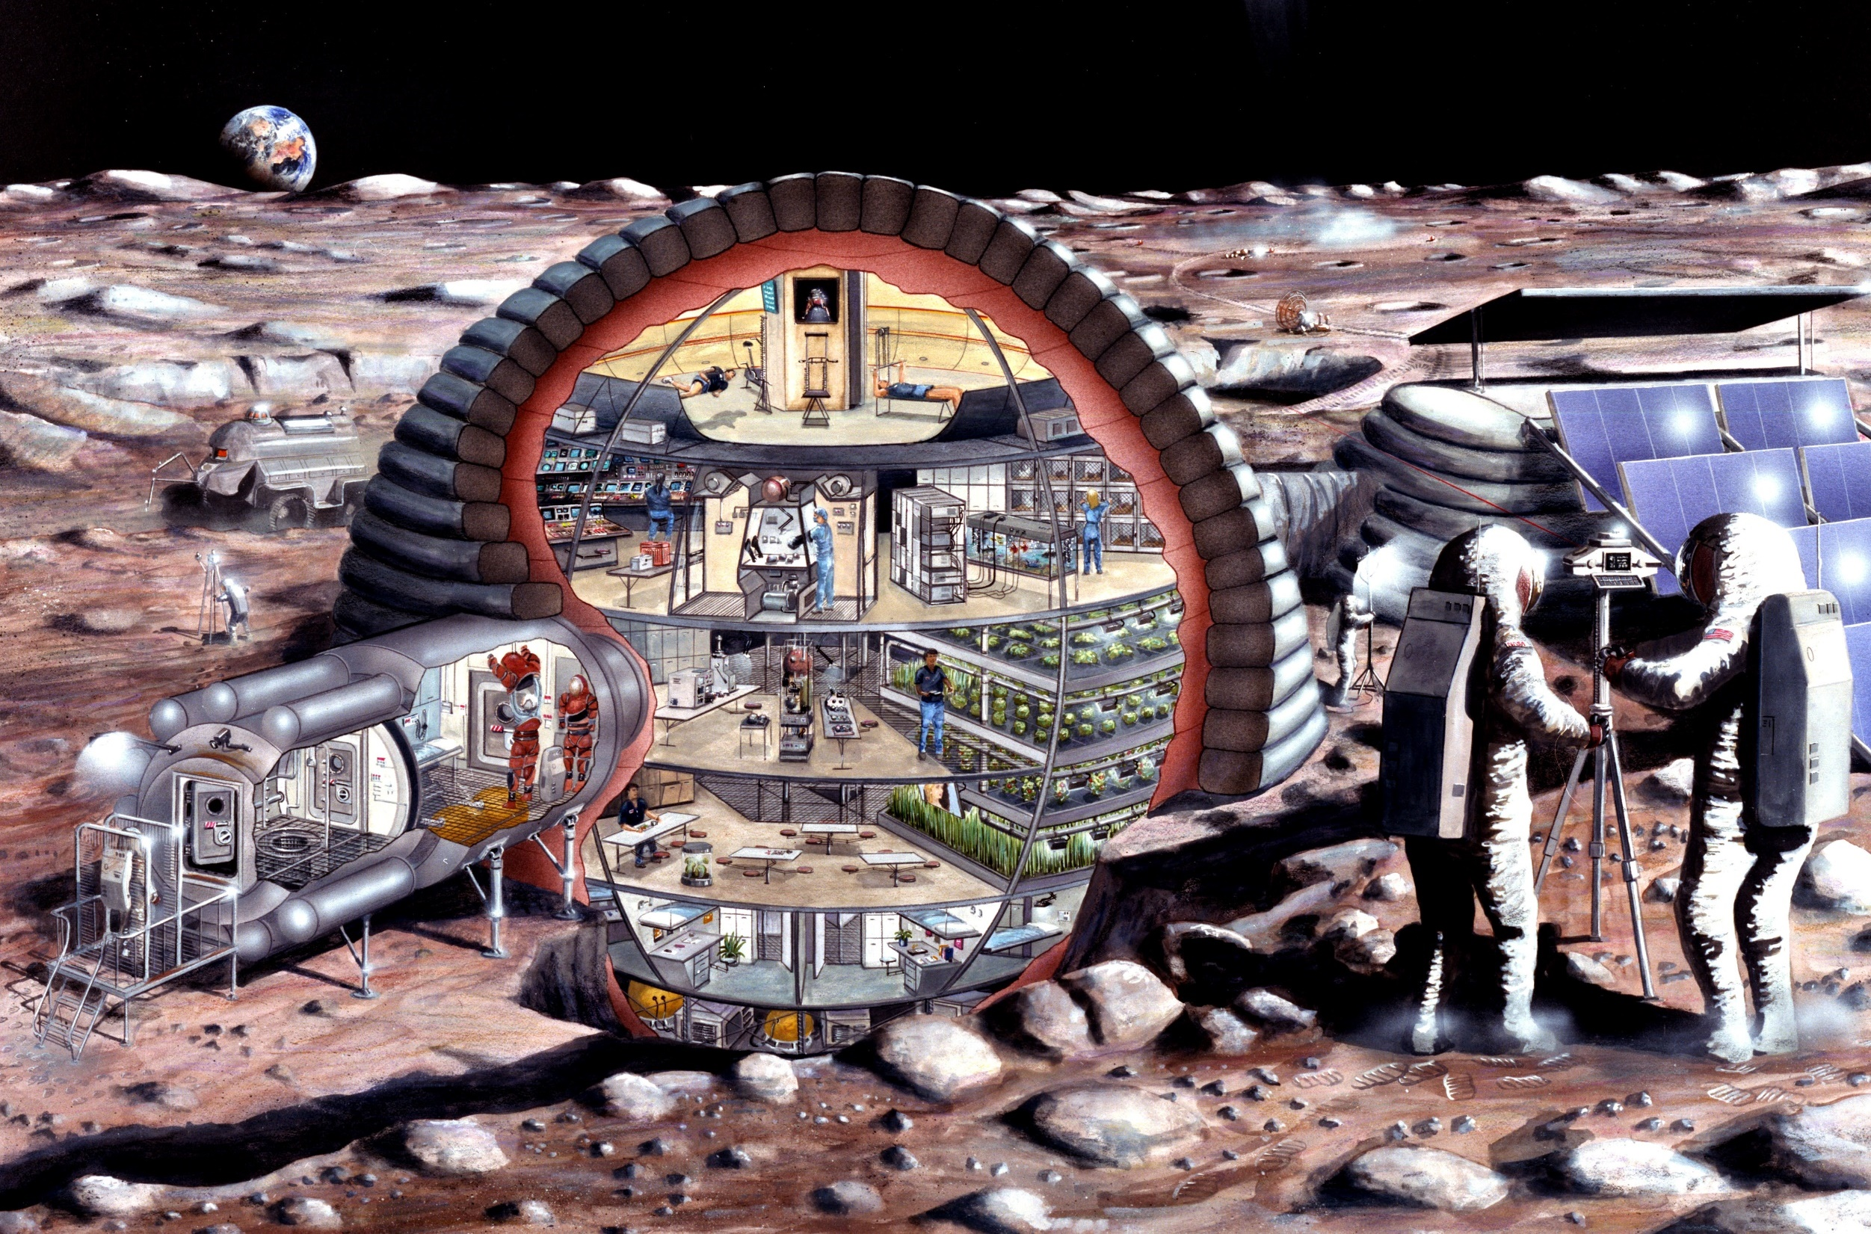

Slide 4
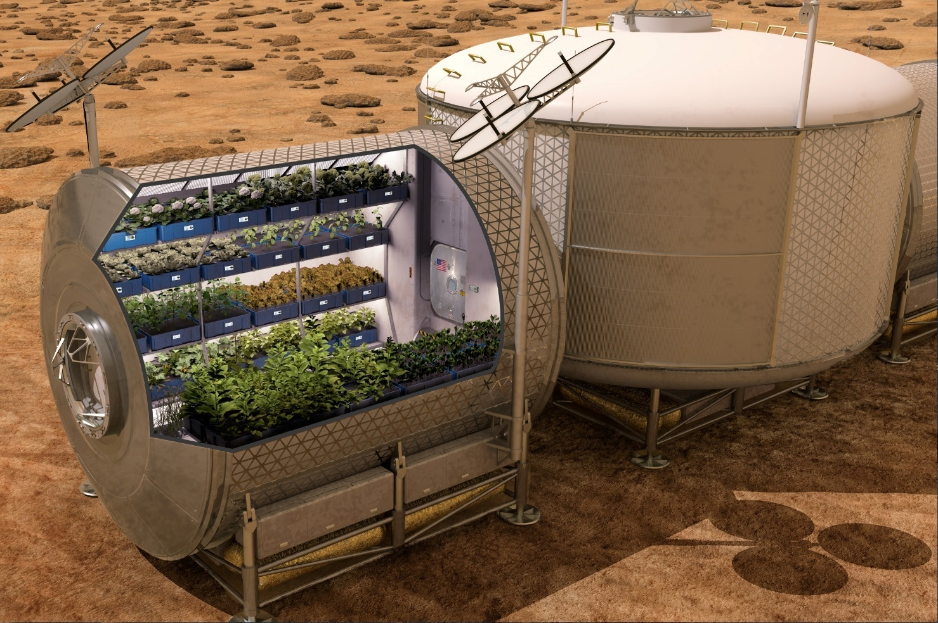

Slide 5
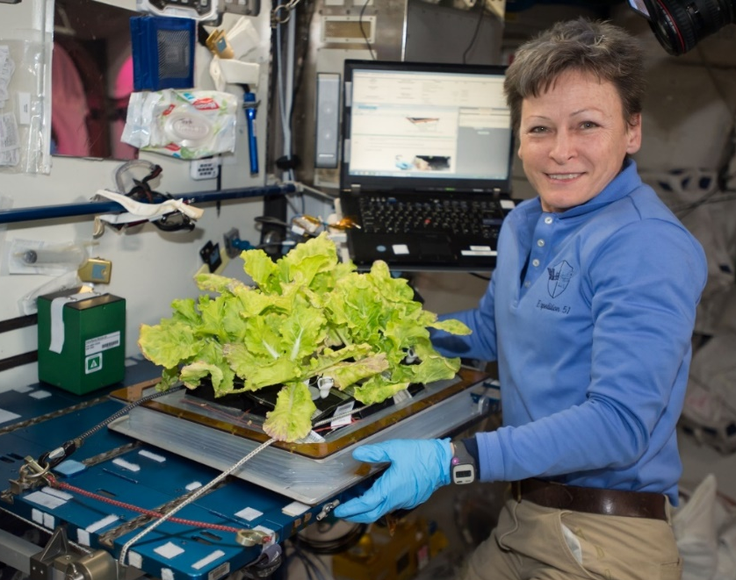
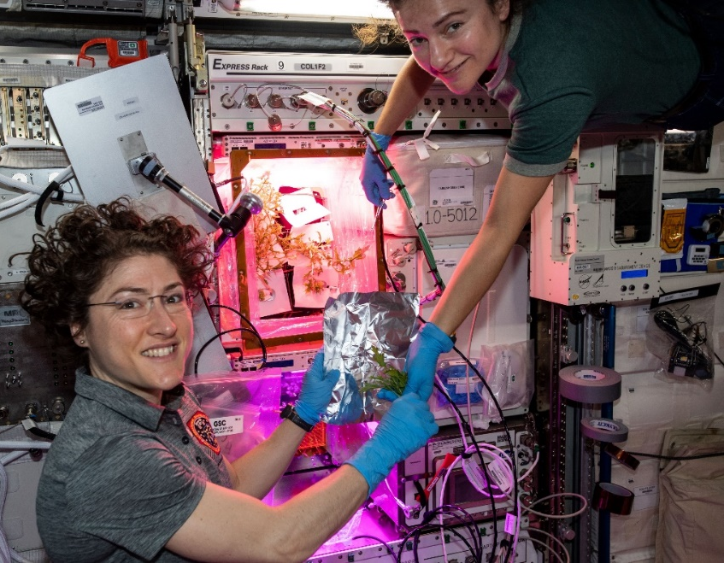
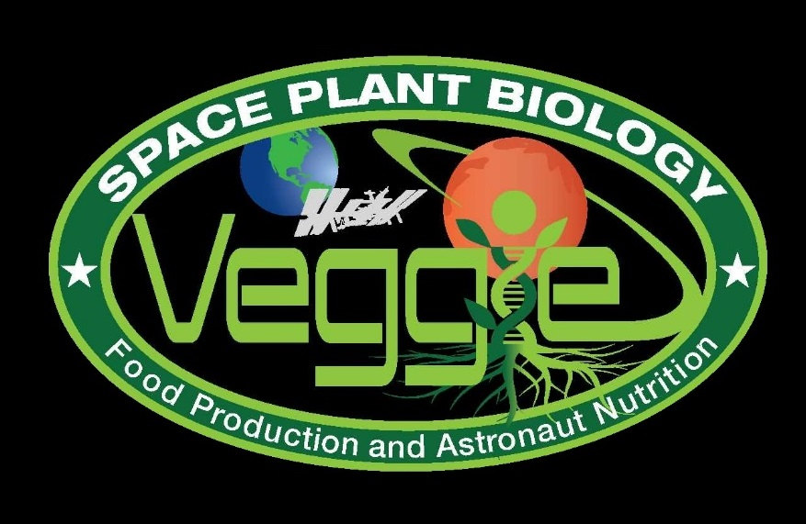
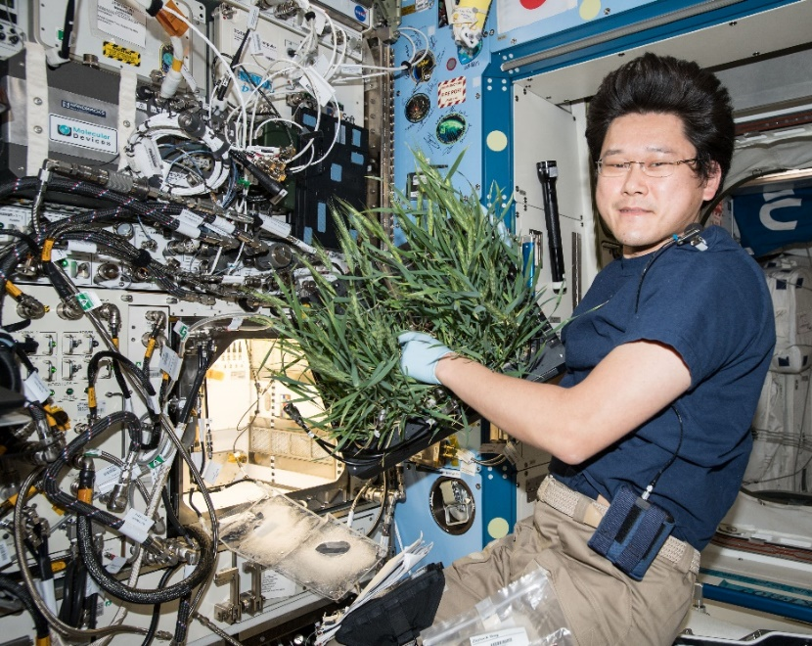
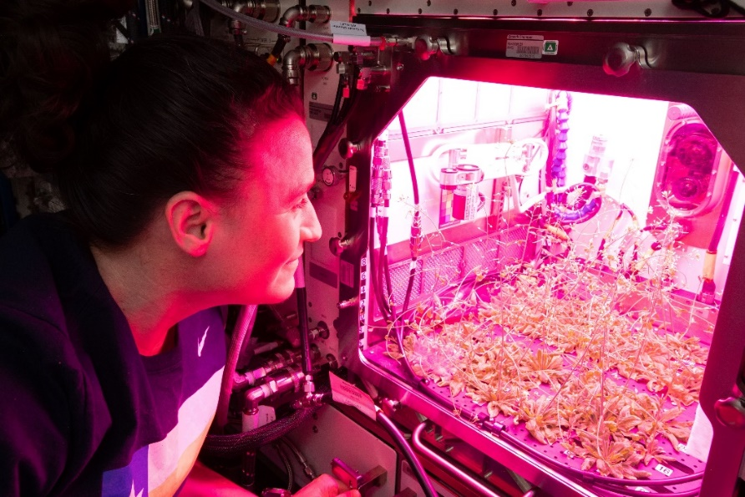

Current NASA Large Plant Research Capabilities On ISS
Notes:
Veggie and the Advanced Plant Habitat

Slide 6


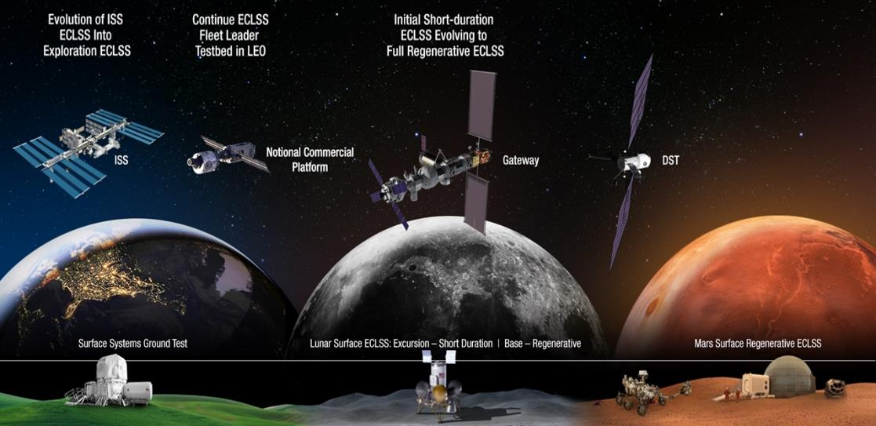


Space Crop Production Roadmap For Exploration
MARS TRANSIT (Crop Production)
GATEWAY (Plant Research)
Operational µg Food Production capability for pick-and-eat crops to supplement crew diet
ISS (Plant Research and H/W Technology)
Proving ground to study the effect of deep space radiation on pick-and-eat crops in µg
Identify challenges and solutions for growing pick-and-eat crops in µg to support crew nutrition
Scale: One to Two EXPRESS Racks (8-16 Lockers)
Scale: Single Locker
Scale: Single Locker to EXPRESS Rack (8 Lockers)
LUNAR SURFACE (Research/Production)
Ground (Plant Research and H/W Technology)
Develop and deploy operational partial gravity systems for both nutritional support and caloric replacement as both a source of food for long duration lunar missions and as a demonstration for Mars
MARTIAN SURFACE (Production)
Develop space crop production concepts and strategies in support of destinations along the exploration roadmap
Leverage Lunar Surface experience in Food Production systems to extend Earth Independence for Mars missions
Scale: Single Locker to Module
Scale: Single Locker to Module
Scale: Single Locker to Module

Slide 7








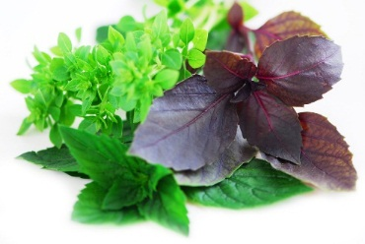


Space Crop Production Candidates
Salad
Leafy Greens
Tomato
Pepper
Radish
Strawberry
Green Onion
Pea
Carrot
Lettuce, Chinese cabbage, Swiss chard, Mizuna, Spinach
Staple Crops
White Potato
Sweet Potato
Rice
Wheat
Dried Bean
Soybean
Peanut
MINIMAL PREPARATION / COOKING
SIGNIFICANT PREPARATION / COOKING
CONSUMED FRESH WITHOUT PROCESSING
Microgreens
Herbs
Basil
Mint
Chives
Dill

Slide 8


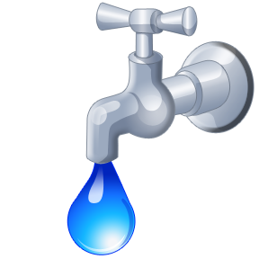

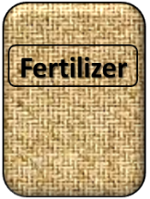

Plant Growth and the Environment
5 Cardinal Factors of Plant Growth…..
O₂

Slide 9

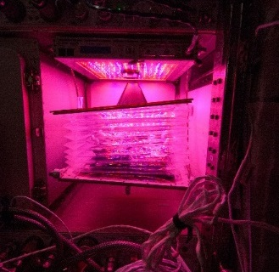
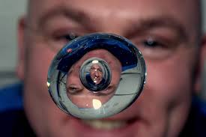

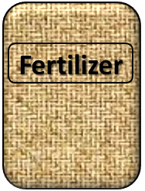
The Space Environment
….and how these work with and without Gravity!
Key plant characteristics may be modified with novel light recipes
No natural convection without gravity so need to mix the air
O₂
Water forms a ball, and water and air don’t mix well, and roots need both!
Fertilizer is heavy to launch so we need to learn how to recycle plant (and other) wastes!

Slide 10
Space Crop Production Challenges
LEO/Deep Space
Water
Recycling
Radiation
Pressure
Micrometeorites
Surface
Microgravity
Fluid movement
No convection
Dust
Regolith
Partial gravity
Plant Size
High CO₂
Food Safety & Microbiome
Nutrient output
Sustainability
Abiotic stresses
Vehicle resources
Crew time
Waste
Productivity
Stress tolerance
Environmental optimization
Crop scheduling
Crop

Slide 11
Space Crop Production Gaps List
67 gaps (currently) in knowledge or technology focusing on:
  Hardware
    Environmental Monitoring, Environmental Control, Food Safety, Sustainability, Systems Architecture
  Crops
    Crop Performance, Plant Environmental Response, Horticultural Practices
  Ecosystems
    Food Security, Food Safety, Human-Plant Interaction, Multi-crop Interaction, Microbiome, Stability
Prioritized

Slide 12
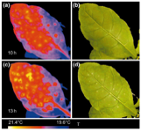
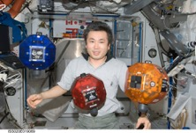
    Hardware and Technology Needs
        Sensor Selection and Development
          Need a suite of non-destructive sensors
        Imaging Systems for Plant Health and Food Safety Monitoring (Hyperspectral, Multispectral, Fluorescence, Thermal)
        Integrated Sensor Control Systems

Slide 13
    Hardware and Technology Needs
    Autonomy and Robotics
    “Smart” Farmer: AI Control Systems and Predictive Algorithms
    Advanced Lighting
    Component Reliability, Maintenance, and Miniaturization
    Sustainable Operations
      e.g. Inedible biomass recycling approaches

Slide 14
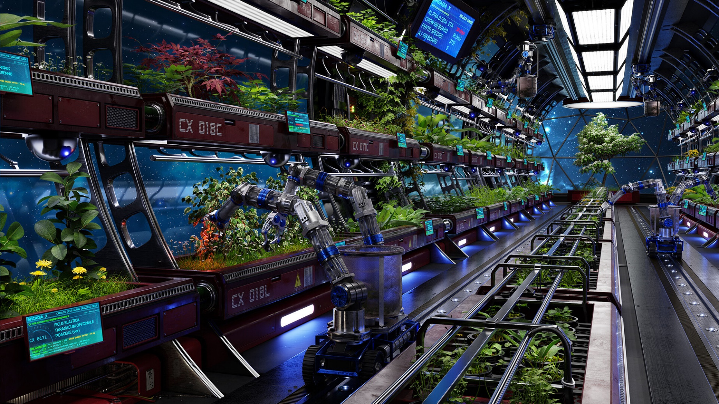
Used with permission from Kenji Aito

Slide 15
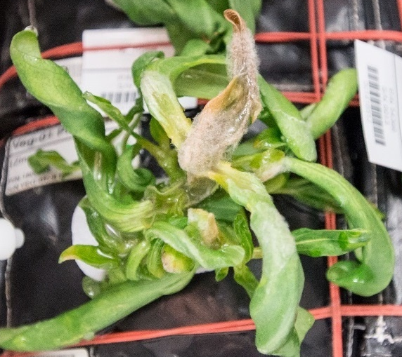
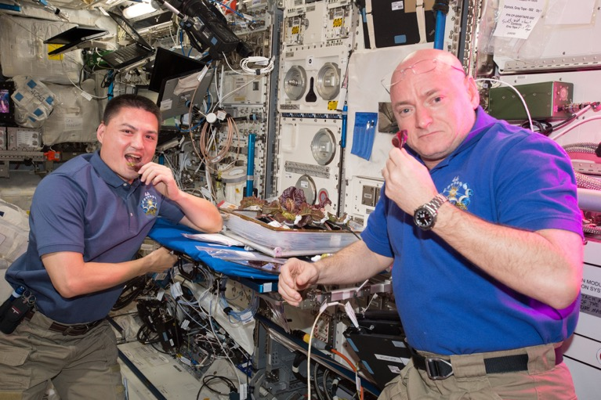
    Horticulture Needs
  Crop selection (Edible Biomass, Yield Verses Volume, Nutrients, Acceptability, Crop Readiness Level)
  Optimized growth recipes
  Microbiome (Plants, Growth System, Vehicle, Crew)
    Food Safety (HACCP)
    Space IPM
  Crop Breeding
  and Engineering

Slide 16
Crop Readiness Levels
CRL | Title | Description
1 | Crop Identification | Identification of candidate crop at cultivar level. Preliminary assessment of morphology, consumable yield, germination, and mission application.
2 | Cultivar Screening | Detailed assessment of plant dimensions at maximal growth, pollination and germination requirements identified, harvest index quantified.
3 | Relevant Environmental Testing | Testing at spaceflight simulated environmental conditions. Currently this is ISS-relevant: ~3000 ppm CO₂, 21-24º C, 38-44% RH, and LED lighting with no UV. Candidates are screened for robust performance or adverse physiological responses.
4 | Chemistry & Organoleptic | Elemental and mission-specific nutritional testing conducted at flight-like conditions Organoleptic and sensory analysis
5 | Baseline Microbiology | Baseline microbiological and food safety characterization conducted under flight-like conditions
6 | Seed / Propagule Sanitization | Identification of acceptable seed surface sterilization or plant propagule sanitization protocols
7 | Flight-like Testing | Testing in flight or flight-analog hardware at flight environmental setpoints
8 | Grown in Space | Crop successfully grown to maturity in space
9 | Consumed in Space | Good growth in space and consumption by crew with acceptability
Modified from Romeyn et al., 2019, Crop Readiness Level (CRL): A Scale to Track Progression of Crop Testing for Space

Slide 17
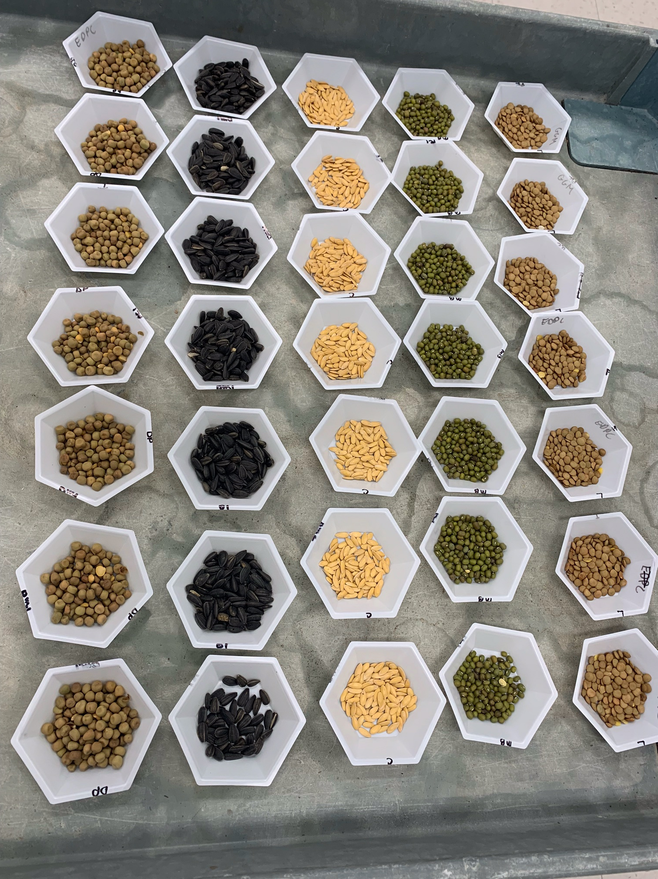
Selection Factors for Space Plants
Targeted breeding areas could fall into several categories:
Plant Growth and Development
Plant Physiology
Produce Nutrition
Produce Organoleptic Acceptability
Postharvest

Slide 18
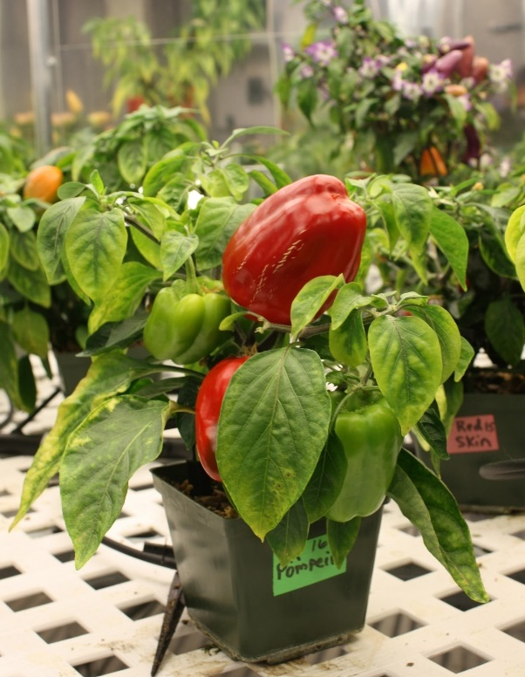
Plant Growth and Development
Compact size (low height and volume)
High yield
High edible/inedible biomass ratio (harvest index)
Reliable germination
Rapid growth to first yield
Uniform growth and development between individuals
Propagules with long shelf stability (seeds, cuttings)
Sustained production capability over long duration (e.g. repetitive fruiting, or cut-and-recut leafy production)
Low debris formation (leaves, flowers, pollen, seeds, etc., remain attached)
Custom microbiome of plant protective and growth promoting microorganisms

Slide 19
Plant Physiology
Stress tolerance (esp. water stress)
Ability to grow well under conditions of:
  Elevated CO₂
  Low relative humidity
  Uniform temperature of 20-23°C
  Narrow spectrum electric lights
  Short photoperiods (to save lighting energy) or long/continuous photoperiods (to speed growth)
  Tolerance of broad environment range
  Tolerance of reduce pressure
No dormancy requirements
Low or pleasing aroma
Low release of volatile organics
High sodium tolerance (e.g. urine recycling)
Preference for ammonia nitrogen sources (e.g. urine recycling)

Slide 20
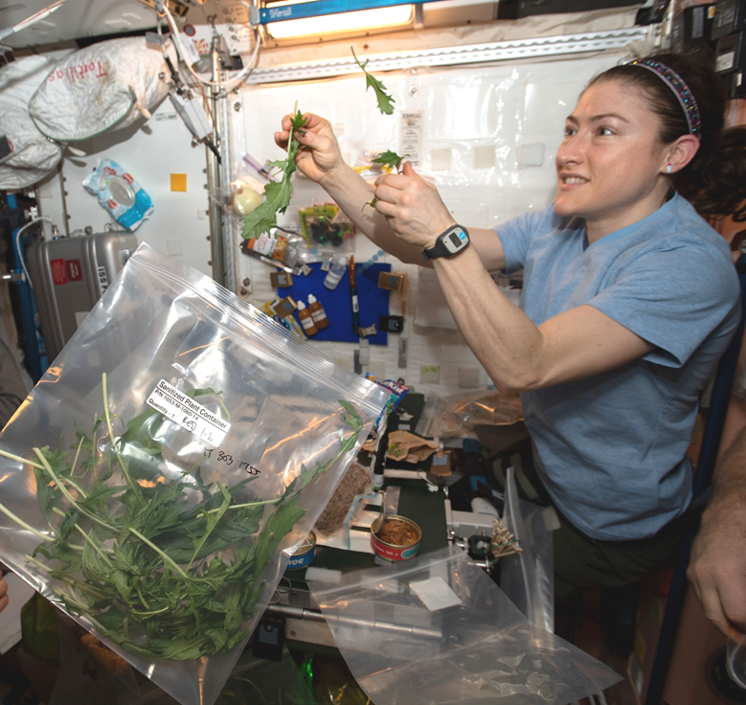
Produce Nutrition
High normal levels of antioxidants
High normal levels of beneficial phytonutrients (e.g. lutein, zeaxanthin, lycopene, phenolics, anthocyanins)
For fresh produce to supplement a packaged diet:
  High normal levels of Potassium and Magnesium
  Low normal levels of Iron
  High normal levels of Vitamins, especially C, B₁, and K
Low levels of antinutrients

Slide 21
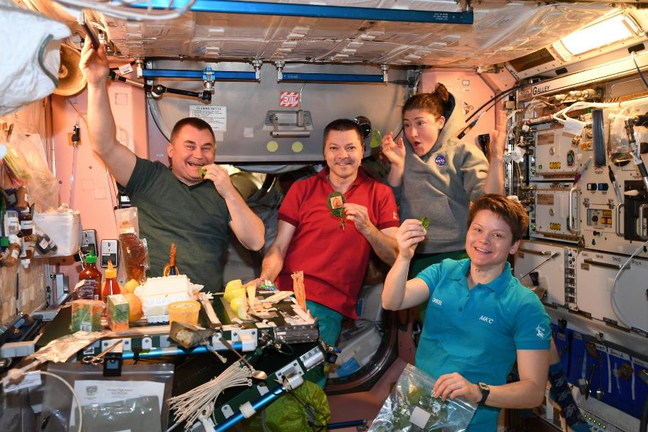
Produce Organoleptic Acceptability
Postharvest
Excellent flavor
Intense flavors
Good texture
Good appearance, color, aroma
Good produce shelf life or storage on the plant
Reduced processing (e.g. seeds easy to remove from seed coats)
Easy composting/digestion of inedible plant material for nutrient reclamation (and possibly less structure in micro/partial g)
Use of waste as resources for other food system components (e.g. fish, edible fungus, cellular ag feedstocks)
Other useful materials produced from waste (e.g. life support, shielding, building, fuel, medicinal compounds & molecular pharming)

Slide 22
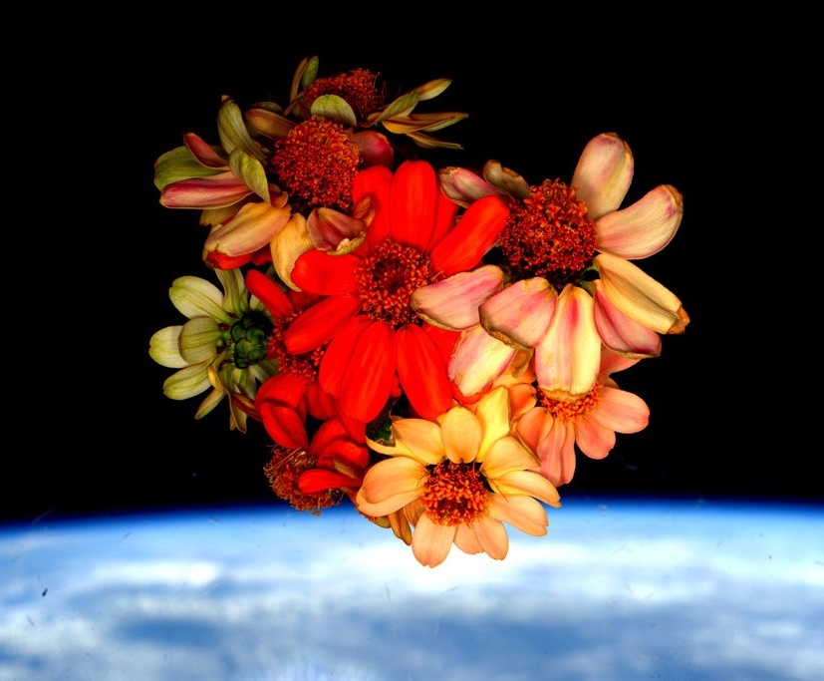
Thank you!
Space Crop Production team
NASA’s Human Research Program, Space Biology Program, ISS Program, Exploration Capabilities Program

